Slide 1
Identifying quark aspects of compact stars in Multimessenger Era
Enping Zhou
May 14th @ DDF2024 in Guizhou
In collaboration with: Y. Ma, C. Xia, A. Li, M. Shibata, K. Kiuchi

Slide 2
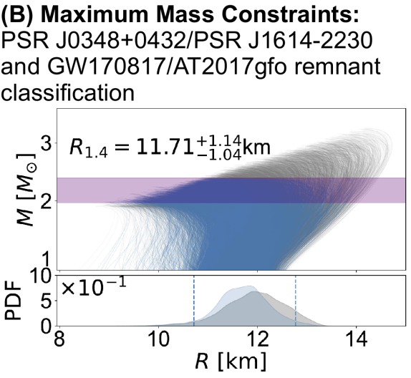
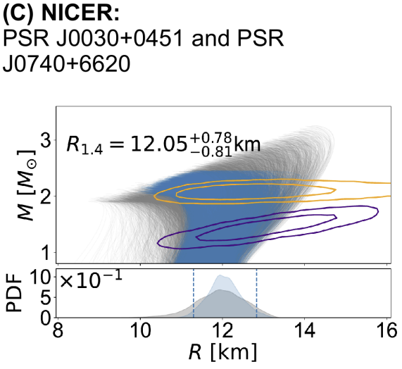
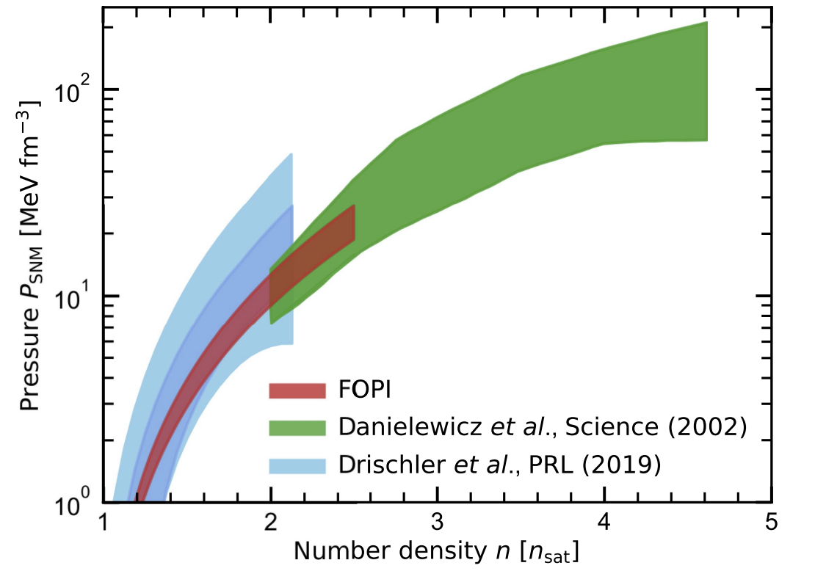
The ultimate dream
Symmetry energy slope
/
Energy gap of paired quarks
/
Why
Be8
unstable?
Huth et al. 2022

Slide 3
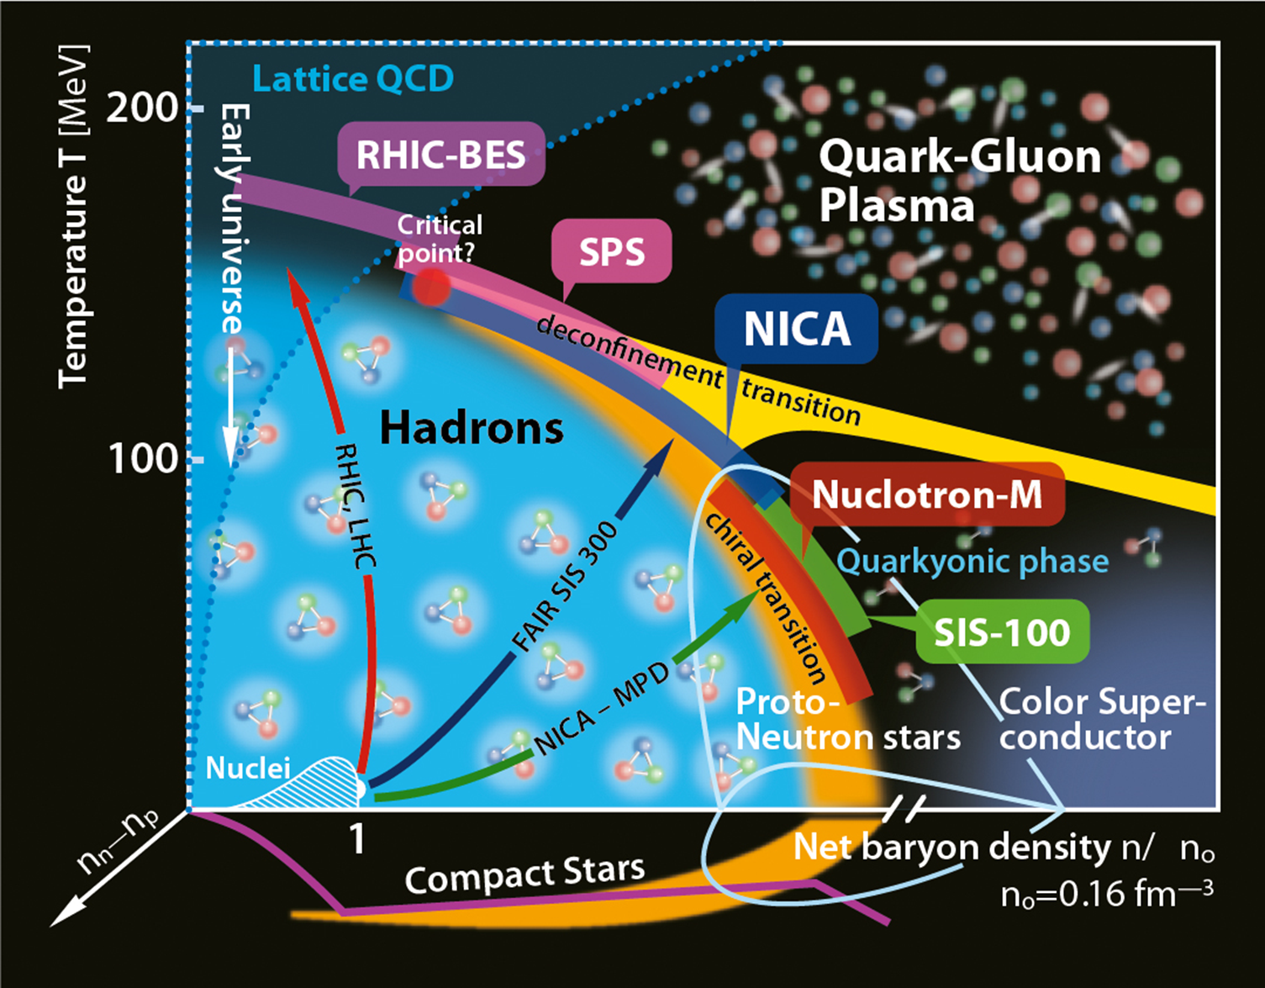
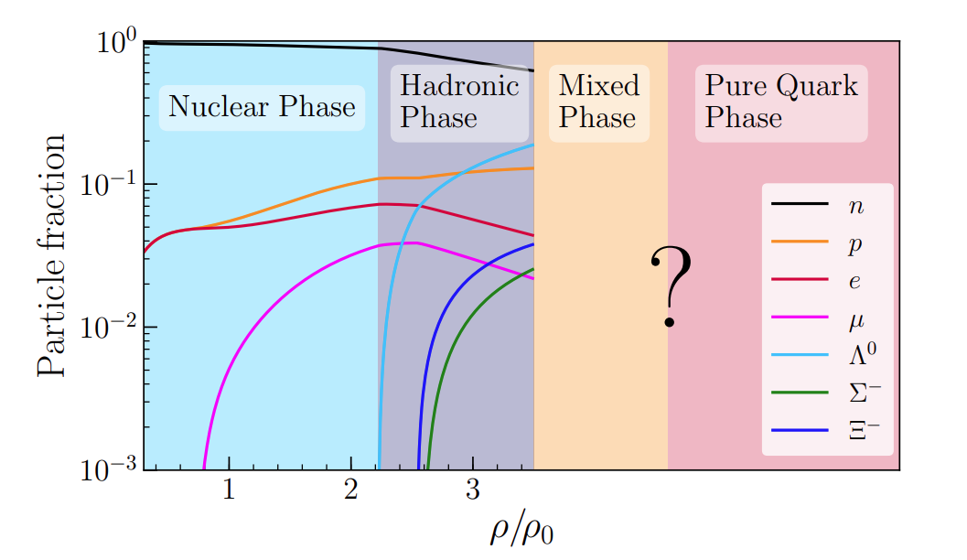
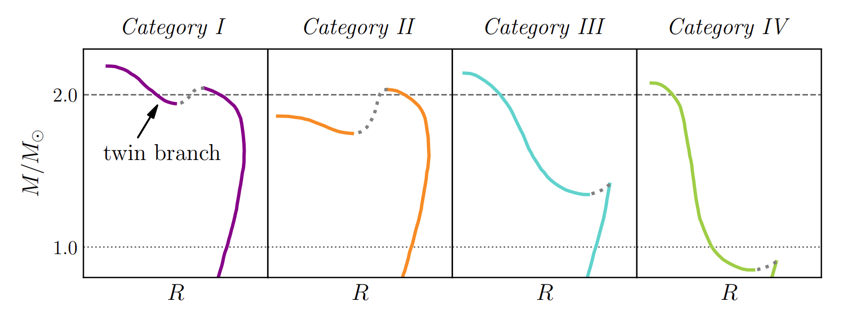
Phase-transition and Compact Star with quarks
If PT happens at the density of NSs
Miao et al. 2021
Motana et al. 2019

Slide 4
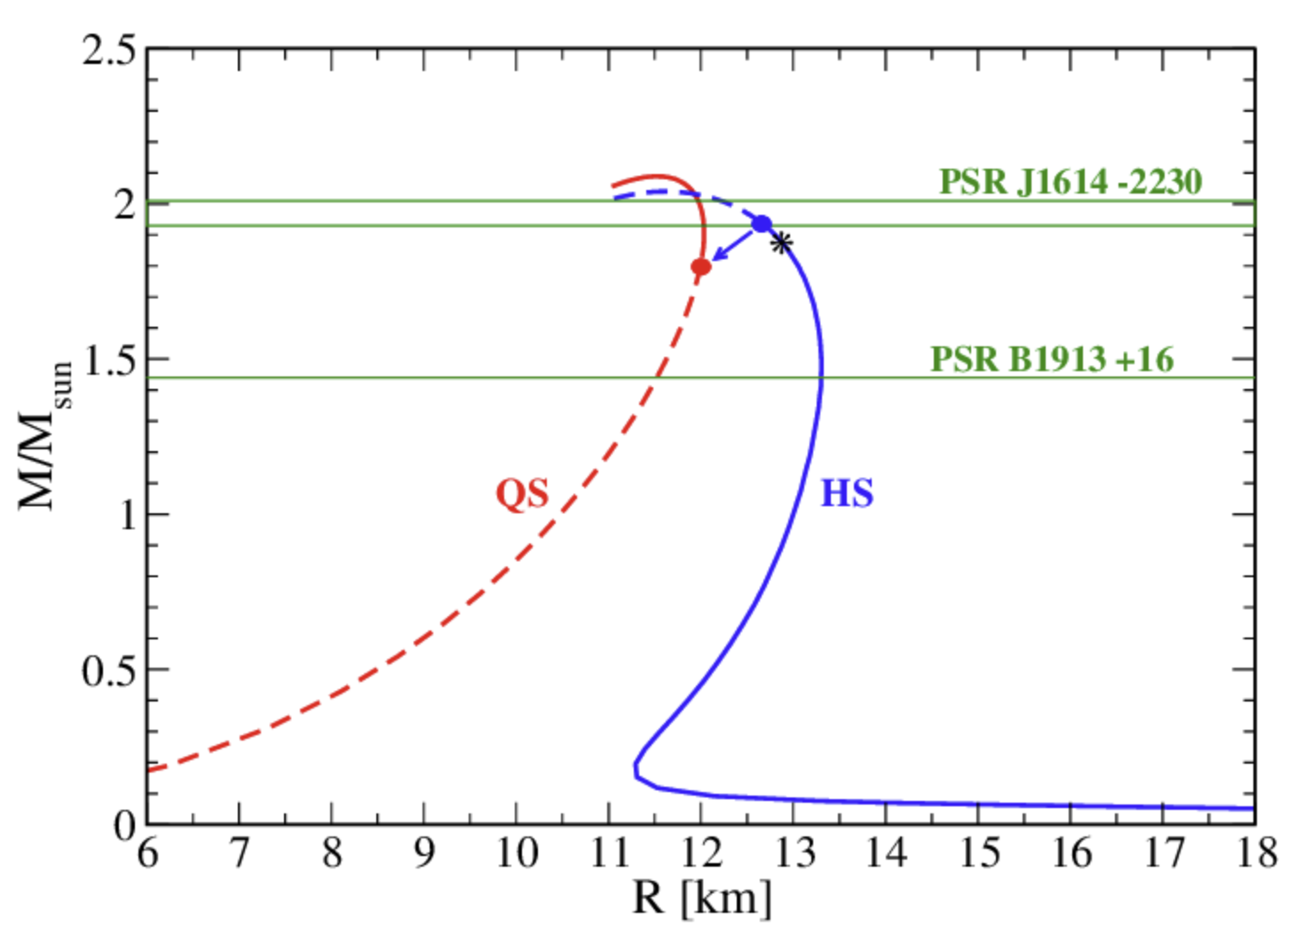
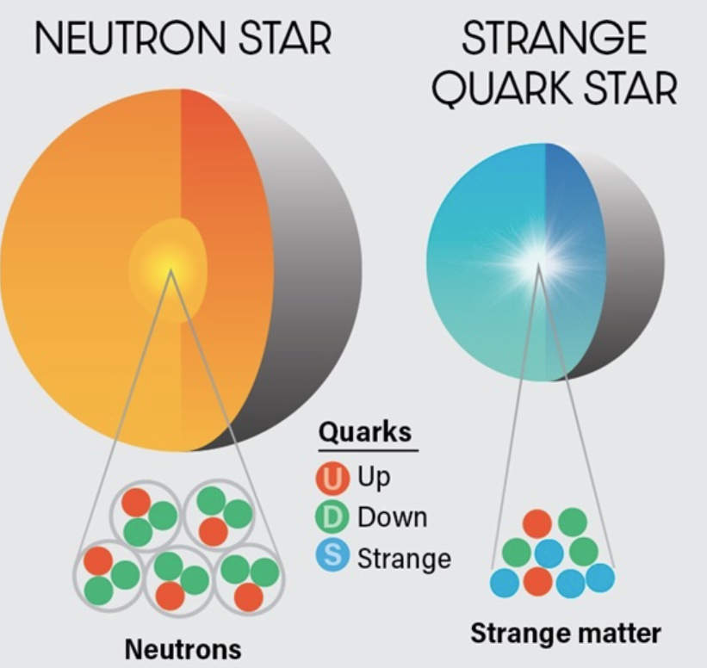
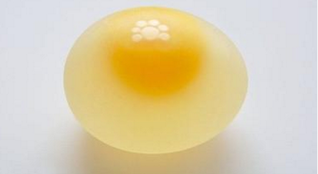
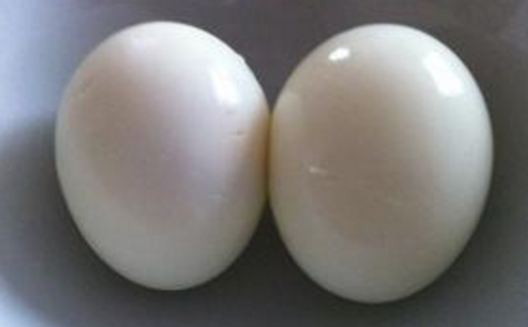
Phase-transition and quark stars
Bombaci 2016

Slide 5
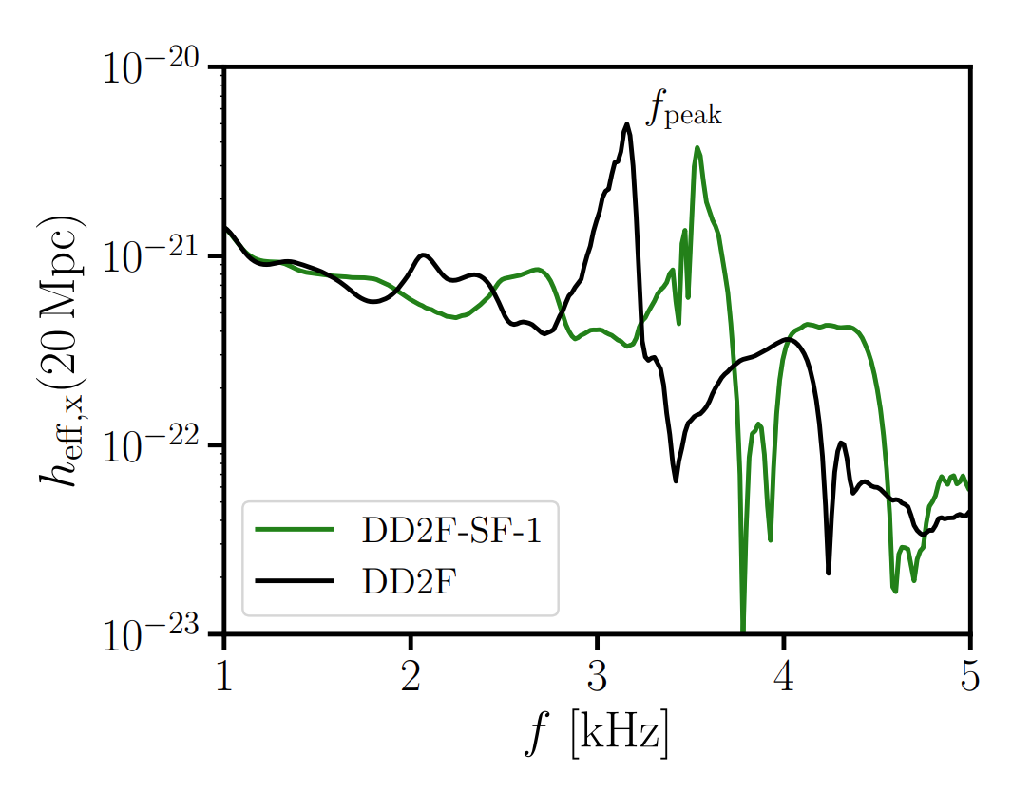
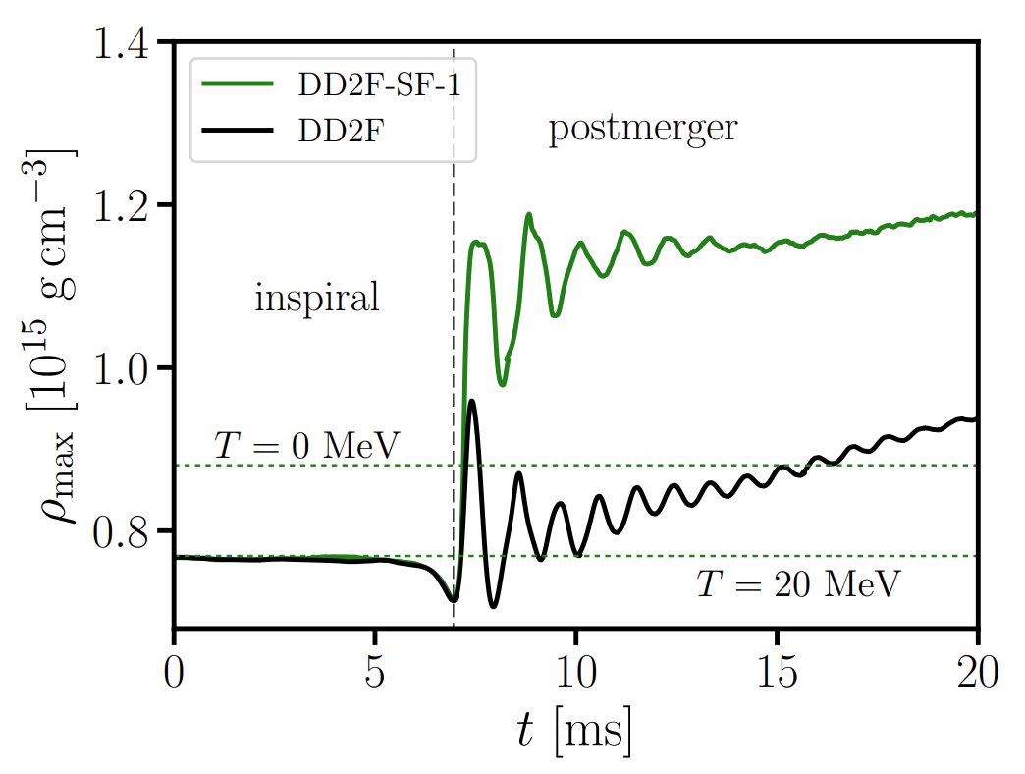
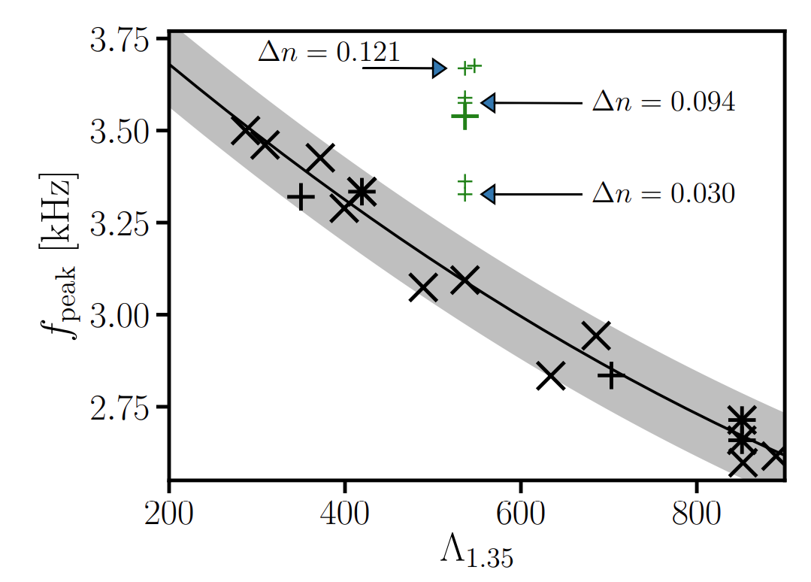
Hybrid Star and Mergers
Bauswein et al. 2018
Requires high sensitivity at very high GW frequencies (~> 3 kHz)
How do the other aspects of BNS mergers affected by a PT?

Slide 6
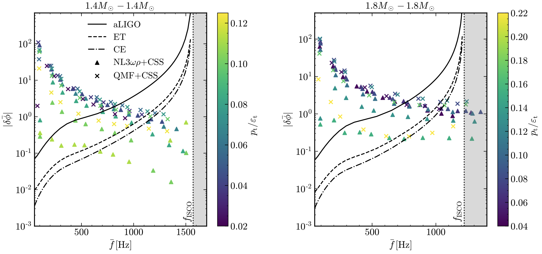
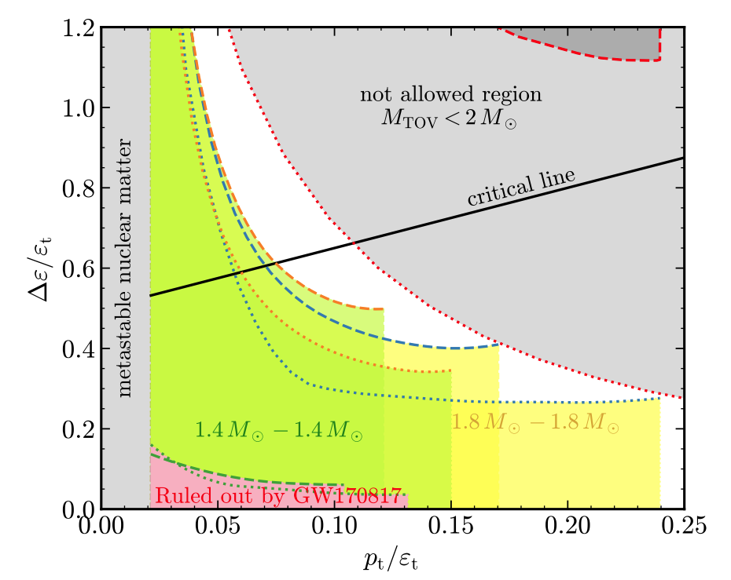
PT and Inspiral
Discontinuity g-mode:
Miao, Zhou, Li 2023
Dynamic tides with discontinuity g-mode

Slide 7
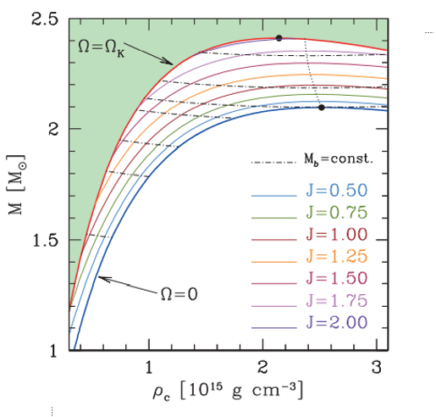
PT and Post-merger: EM aspects
$Δρ$ is larger during the spinning down of the merger remnant, than at the merger.
Any signal could be produced during a PT in the spinning down stage of the remnant?

Slide 8
PT and Post-merger: EM aspects
Phase transition in a much later time may significantly affect the X-ray features of a sGRB.

Slide 9
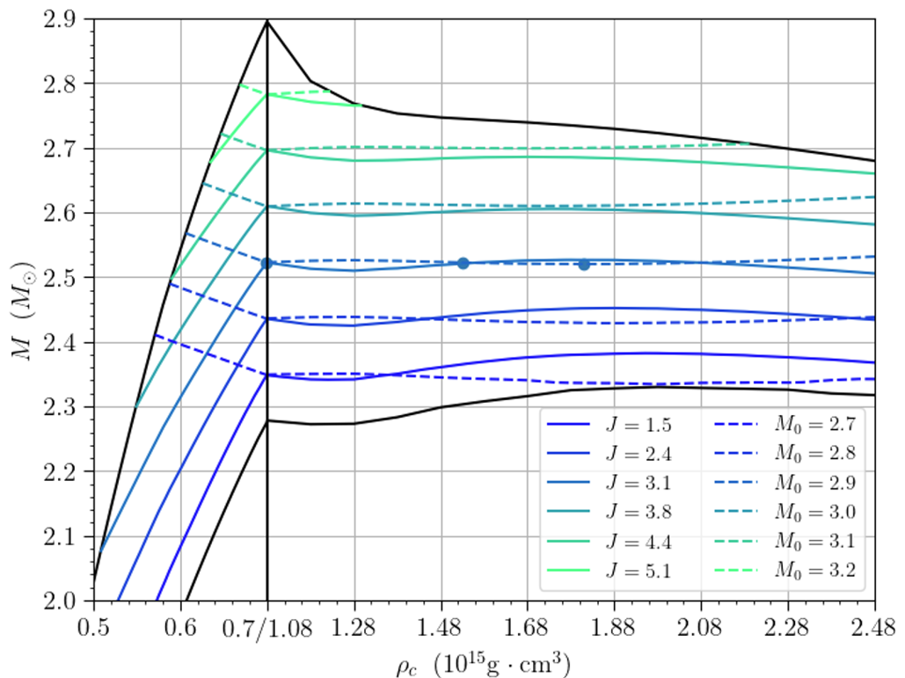
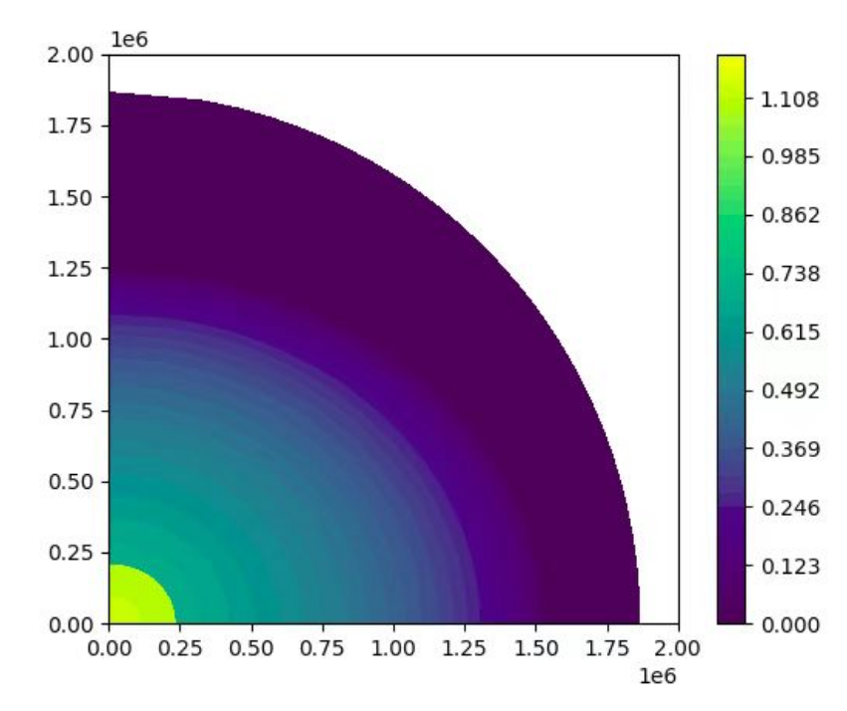
PT and Post-merger: EM aspects
Song & Zhou in prep
Left dot: onset of phase-transition
Middle dot: solution with the same baryonic mass and angular momentum
Right dot: collapse to BH

Slide 10
PT and Post-merger: EM aspects
Song & Zhou in prep
Left dot: onset of phase-transition
Middle dot: solution with the same baryonic mass and angular momentum
Right dot: collapse to BH

Slide 11
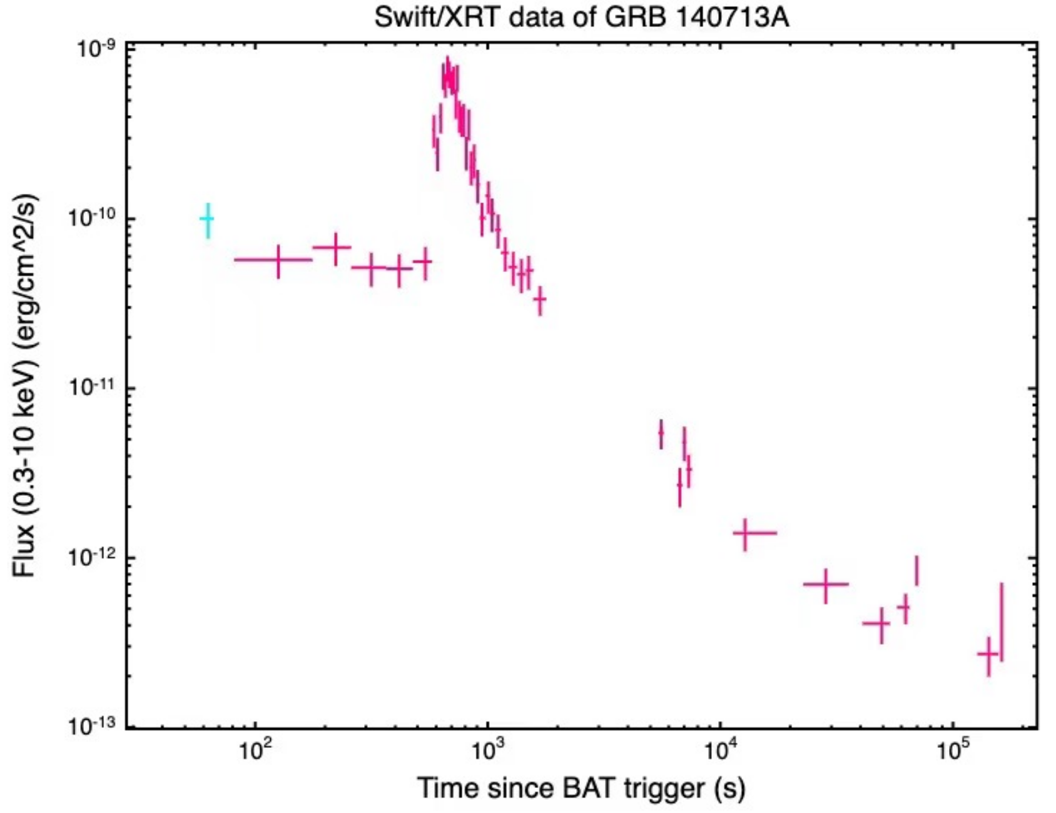
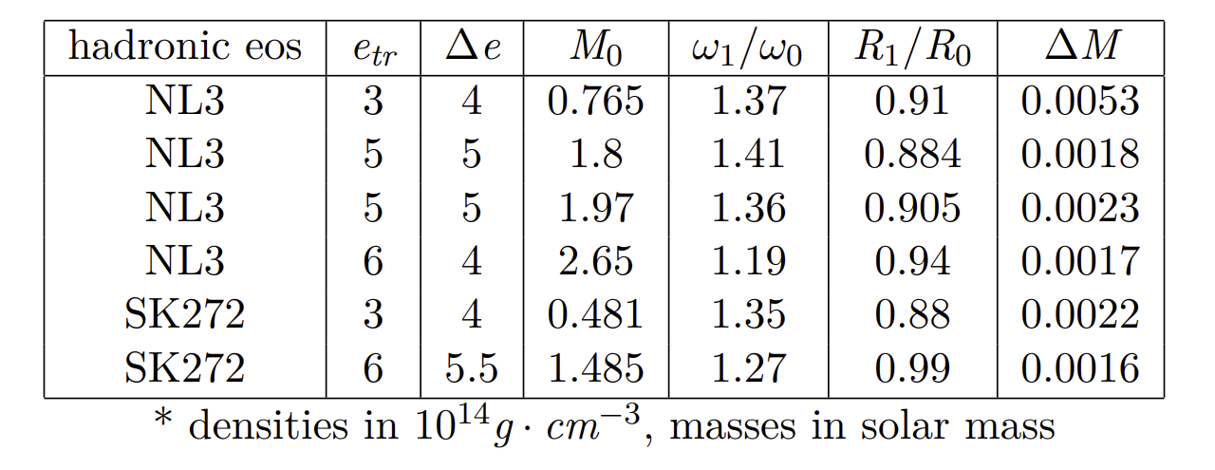
PT and Post-merger: EM aspects
Song & Zhou in prep

Slide 12
Quark stars
Bombaci 2016

Slide 13
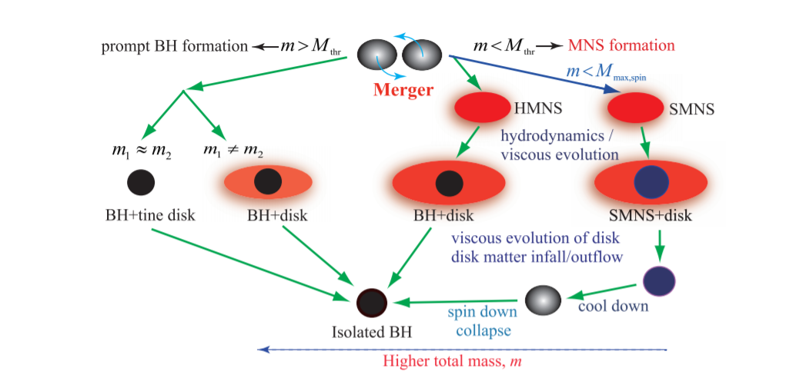
Post-merger evolution channels for QSs
The relation between total mass and several threshold masses determines the evolution channel in the post-merger.
Hotokezaka & Shibata 2019

Slide 14
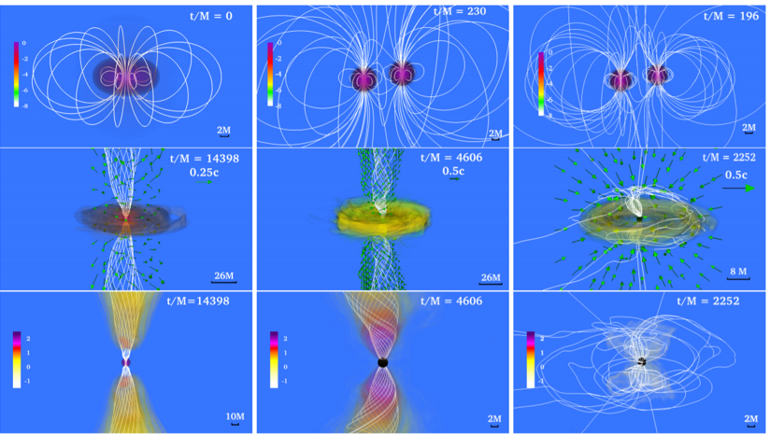
Post-merger signals for QSs
Margalit & Metzger 2017
Ruiz et al. 2018

Slide 15
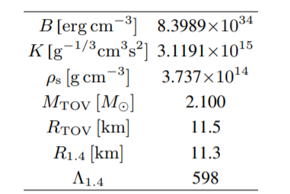
An obvious tension (my talk 2022)
M_max,spin = 3.10 M_sun
M_thr= [2.95,3.15] M_sun
(supposing the same universal relation as BNS cases)
Note: the exact number scales with Bag constant, but the relation holds.

Slide 16
An obvious tension
The relation between total mass and several threshold masses determines the evolution channel in the post-merger.
Hotokezaka & Shibata 2019

Slide 17
An obvious tension
Hotokezaka & Shibata 2019
Either, BQS does not follow the universal relation of BNS case.
Or, this scenario should be different for BQS mergers. Or both?

Slide 18
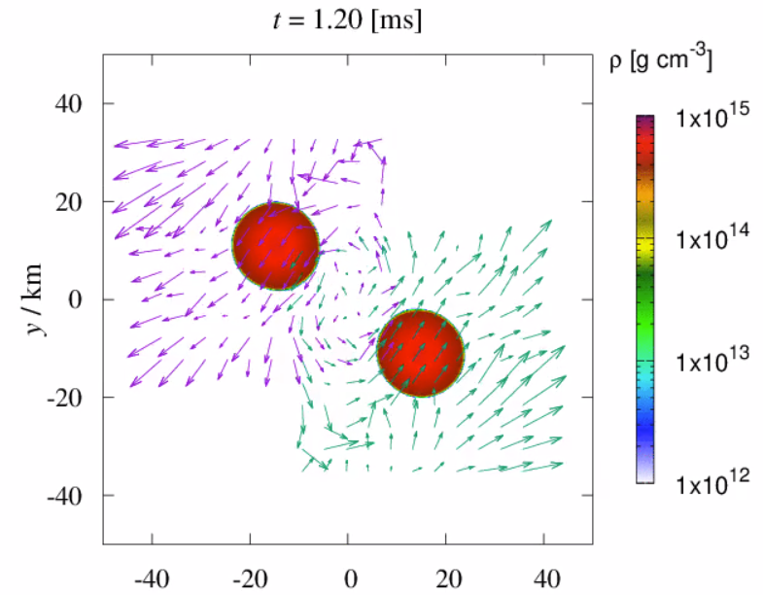
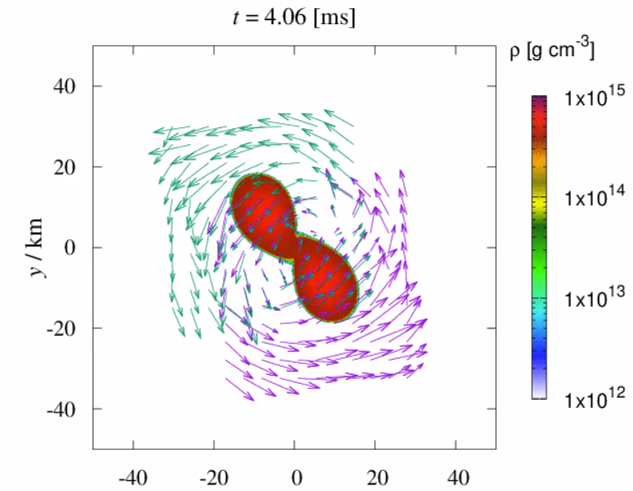
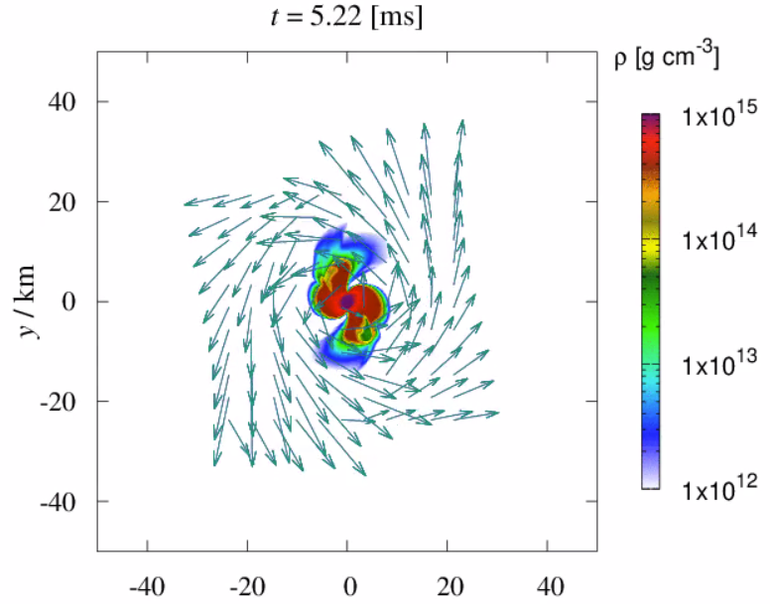
Threshold mass of BQS mergers
Collapse happens ~1 ms after merger, comparable to dynamical timescales.
MIT310 starts at ~ 40 km separation

Slide 19
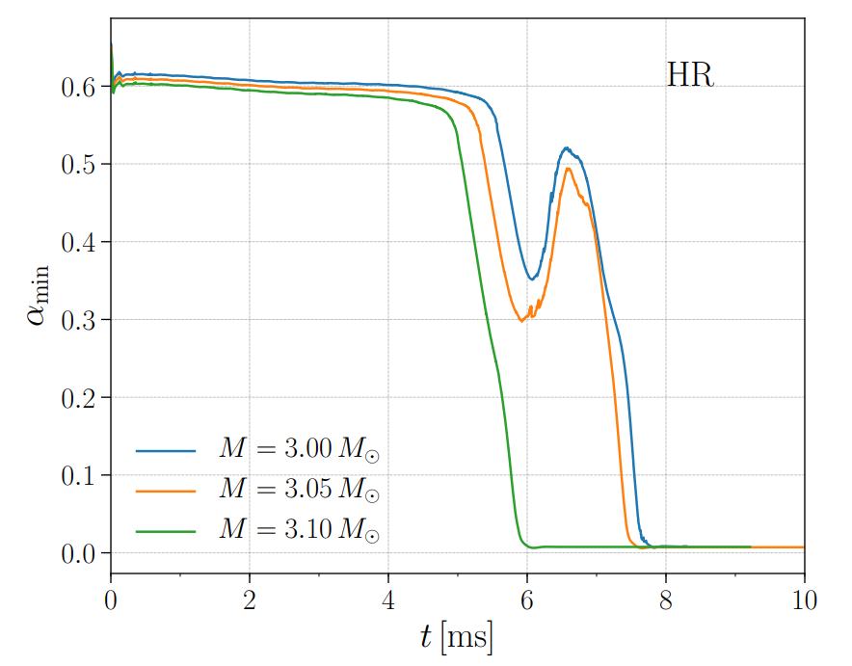
Threshold mass of BQS mergers
Quantitatively, the tt component of the spacetime
metric in the center shows the dynamics of the collapse.
Zhou et al. 2021

Slide 20
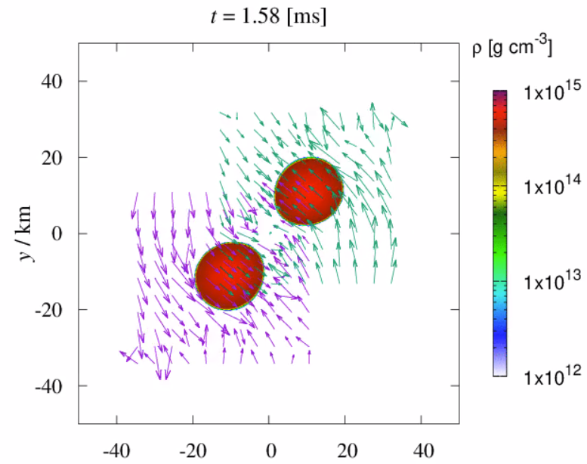
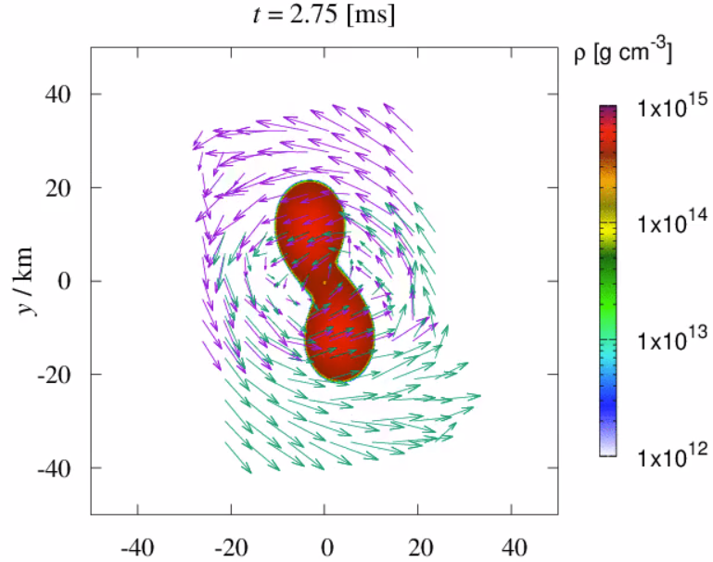
MIT280
Zhou et al. 2023

Slide 21
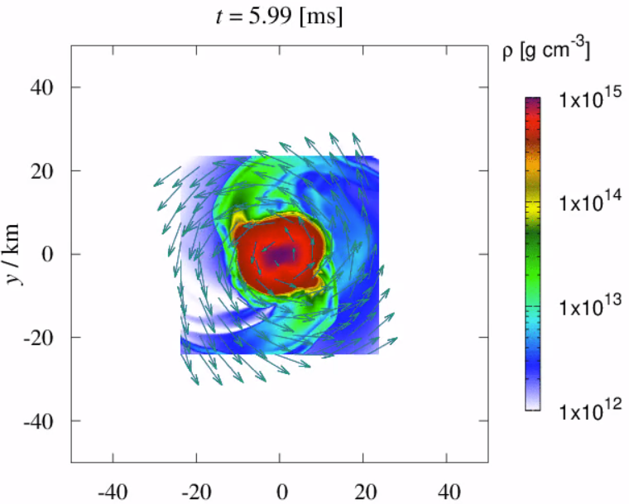
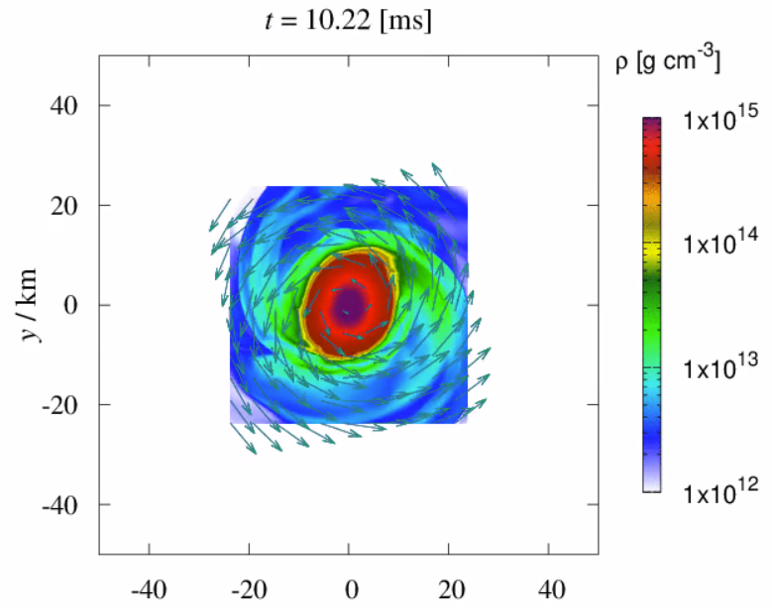
MIT280
GR hydro simulation of BQS reveals high density mass overflow in spiral arm structures.

Slide 22
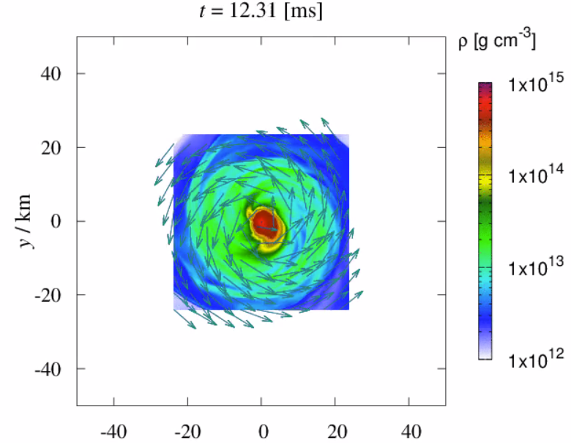
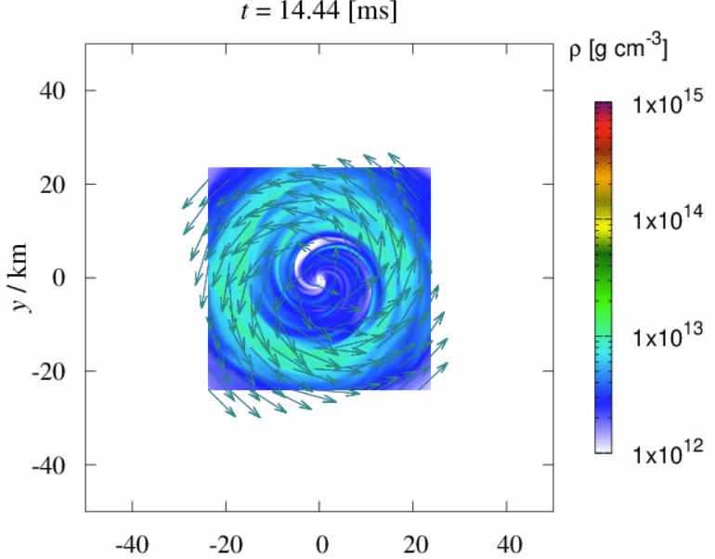
MIT280
Collapse happens for a BQS model with total mass much below its Keplerian limit in ~10 ms. Showing a BQS system in SMQS mass range undergoes HMQS channel.
Exceptionally heavy disc for equal mass binary (>0.2 solar mass, 0.01 solar mass unbound) is left outside the BH even ~30 ms after the collapse. But why?

Slide 23
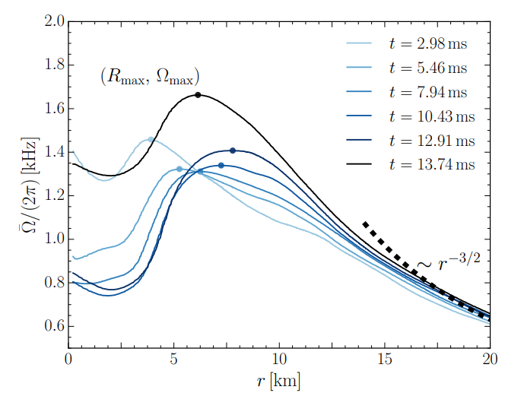
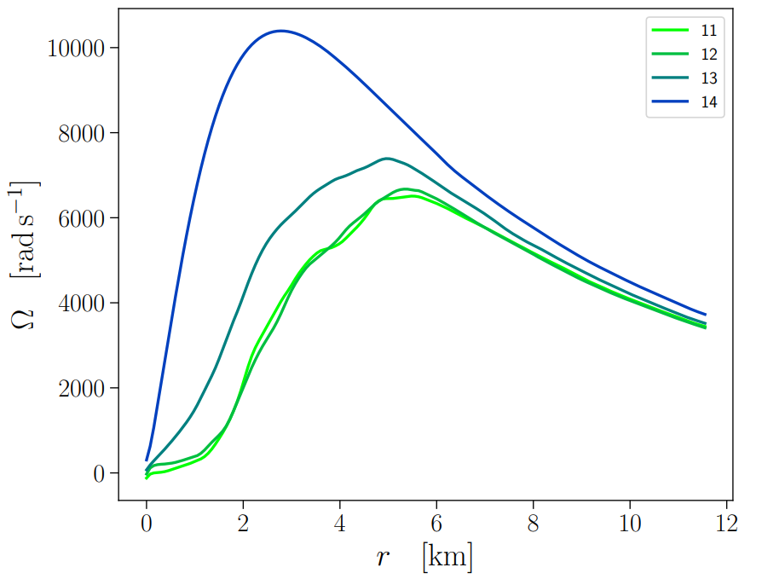
Rotation profile
Hanauske et al. 2016
Zhou et al. 2023
Rotation profile is qualitatively similar for BQS and BNS remnant, but quantitatively, BQS remnant is lacking angular momentum significantly inside the remnant.

Slide 24
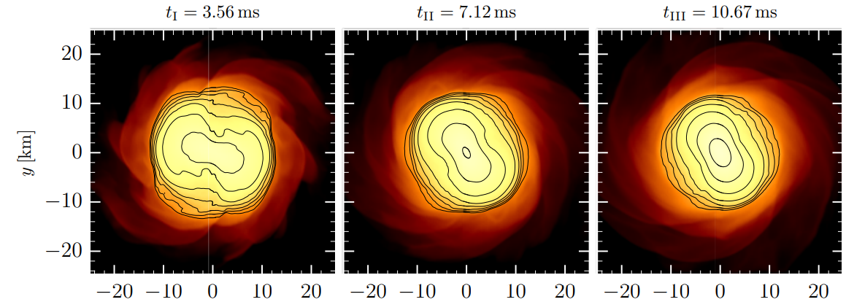
Rotation profile
For BNS, geometric center $≠$ density center. Angular momentum transport toward the inner part of the remnant is easier.

Slide 25
Rotation profile
For BQS, geometric center = density center. Angular momentum transport toward the outside of the remnant is much easier due to squeezing.

Slide 26
Conclusions (for now)
PT results in significant difference in the NS structure.
PT affects asteroseismology of NSs and could be imprinted in GW signals (both inspiral and post-merger).
PT may trigger burst-like events for both EM and GW emissions.
Post-merger evolution channels for BQS are different from BNS, indicating different observational signatures.

Slide 27
ezhou@aei.mpg.de -> ezhou@hust.edu.cn

Slide 28
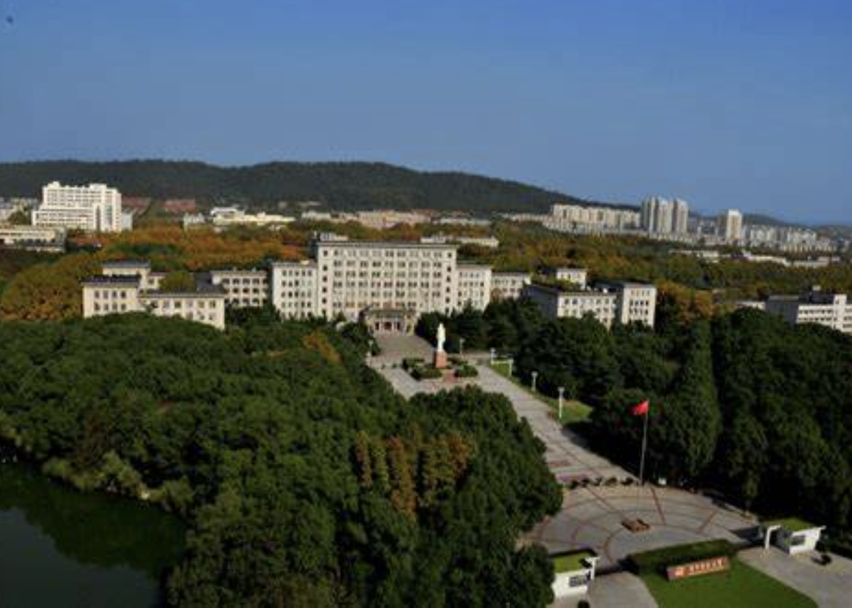
Welcome to visit me again, in HUST, Wuhan!

Slide 29
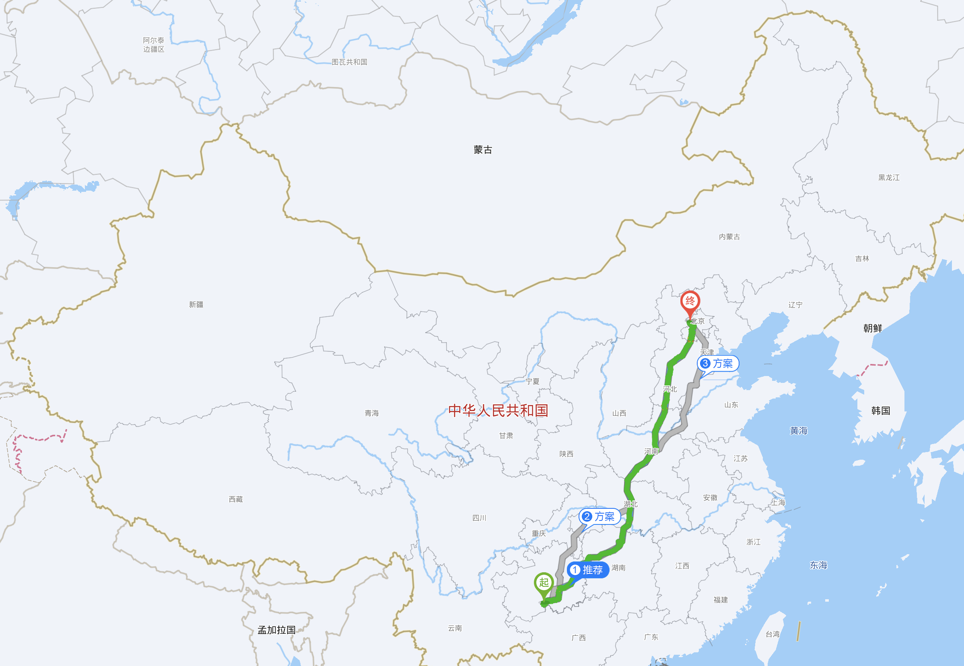
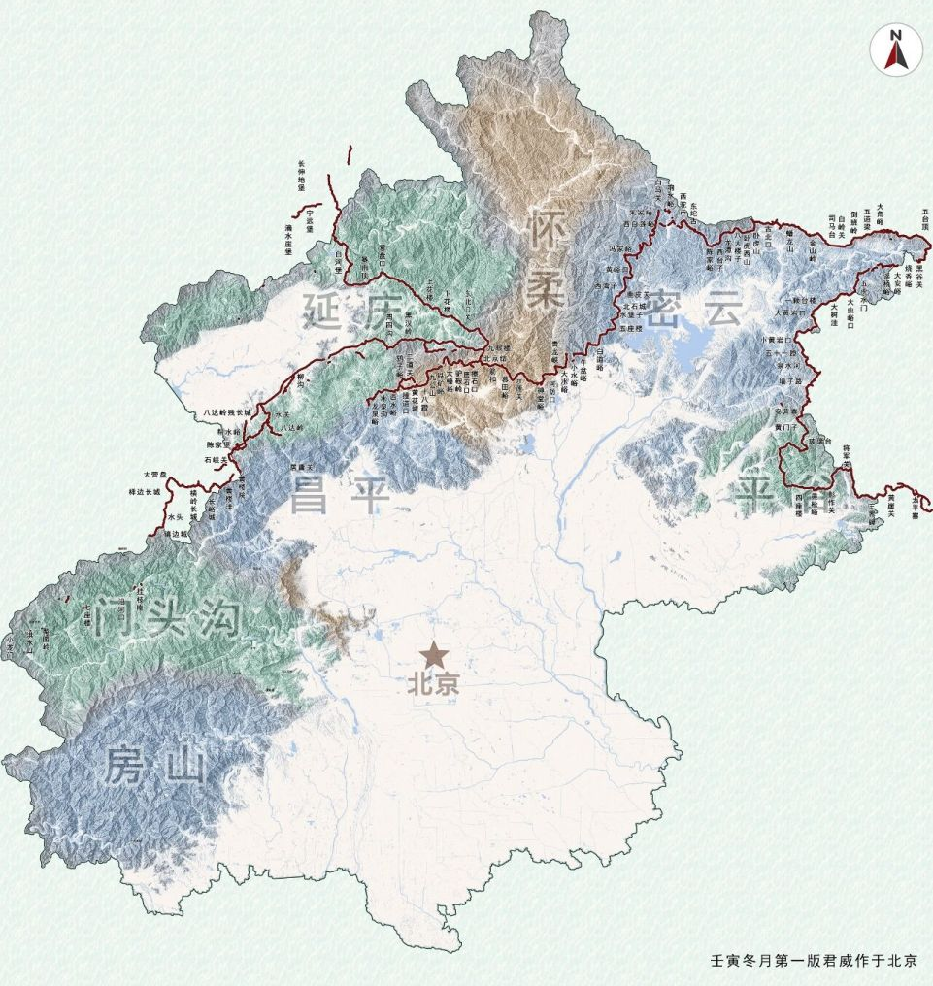
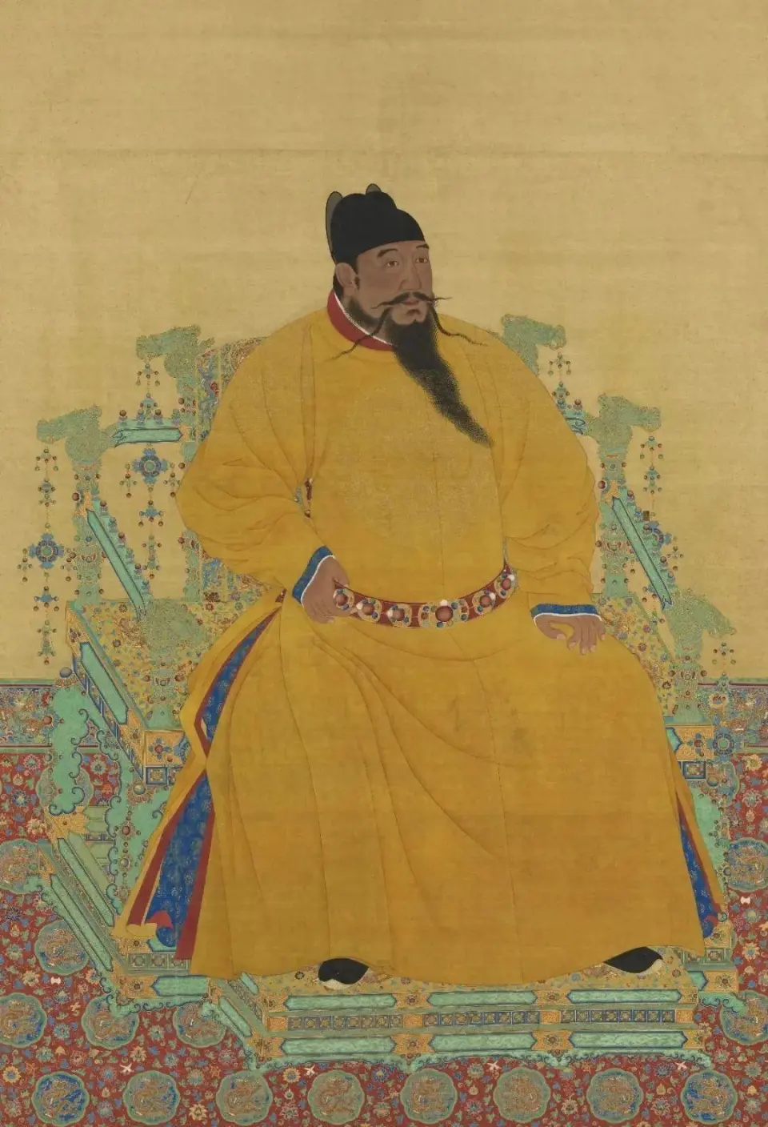
The next DDF (2026)
From Guiyang to Beijing
Weiyang Wang will hold DDF2 in 2026
DDF2
DDF1
The emperor guards the country's gates
明成祖朱棣
Di Zhu, an emperor in Ming Dynasty

Slide 30
The next DDF (2026)
Chinese people often say:
Those who have never been to the Great Wall will never be heroes.
不到长城非好汉

Slide 31
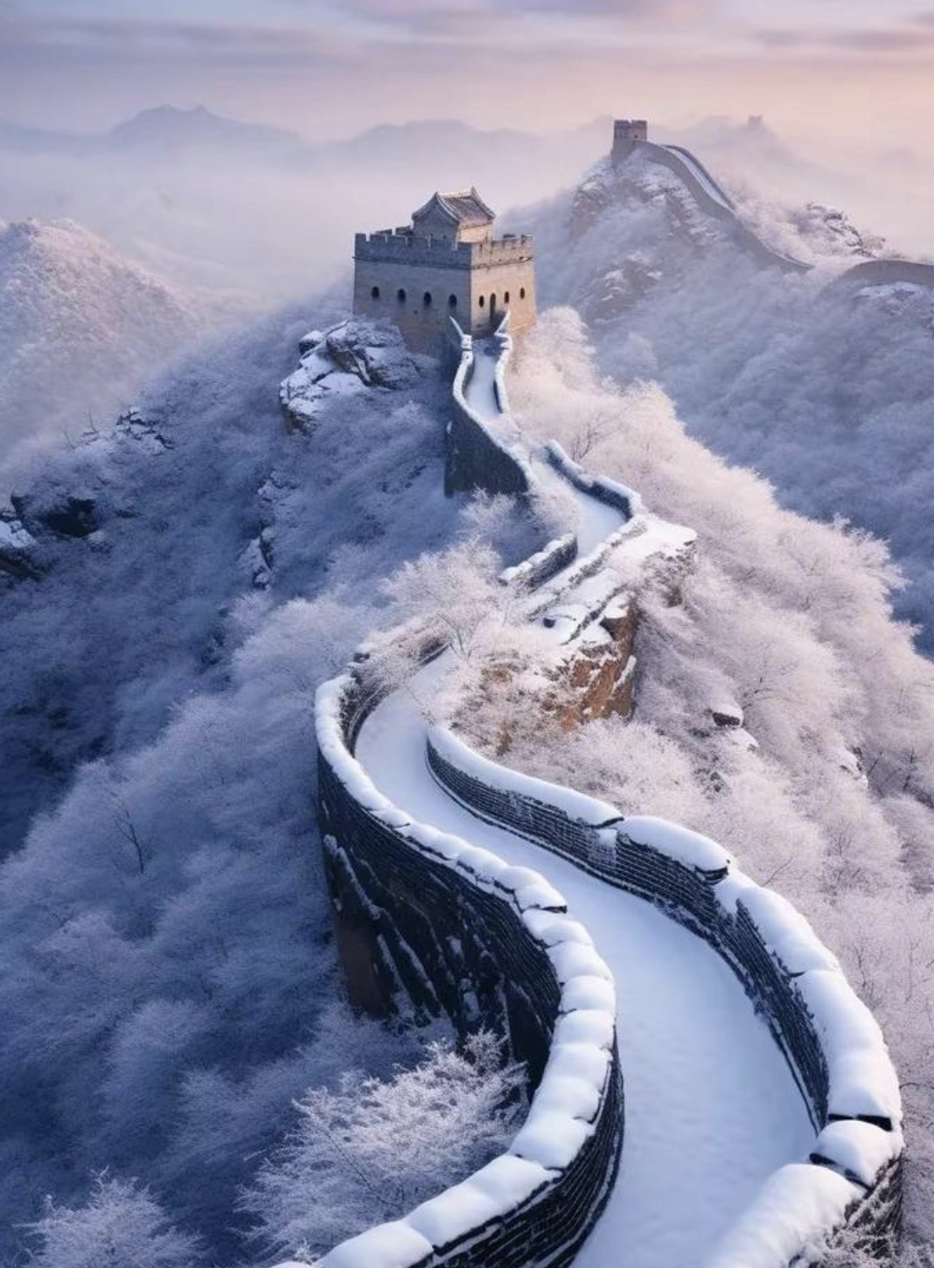
The next DDF (2026)
Beginning of Winter, 2026
The Wall + Hot spring + Snow (maybe) = Dream field!

Slide 32
Afternoon May 14th
13:30: bus for whoever leaves for Guiyang this afternoon
14:30: leave from the reception hall to view FAST and tourism site. Please leave all your digital devices in your room before leaving.
May 15th
7:00 two buses will leave
9:00 one bus for whoever the flight is after 16:00

