Slide 1



Fast Radio Bursts in the Fireball Paradigm
Kunihito Ioka
(YITP, Kyoto U.)
KI 20
Wada & KI 22
Ishizaki & KI 24
Notes:
First of all, I’d like to thank …
Today I’d like to talk about FRBs in the Fireball paradigm.
My name is …
We would like to consider the emission mechanism for FRBs.
But notice that we have not reached the conclusion and just present a step toward the understanding.

Slide 2
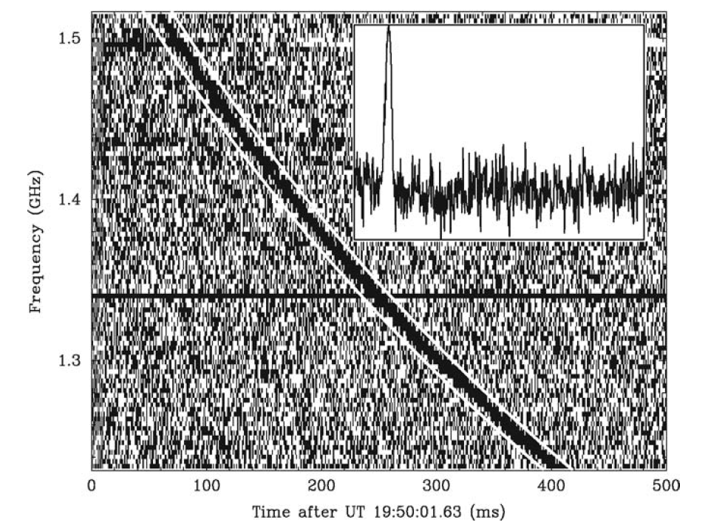
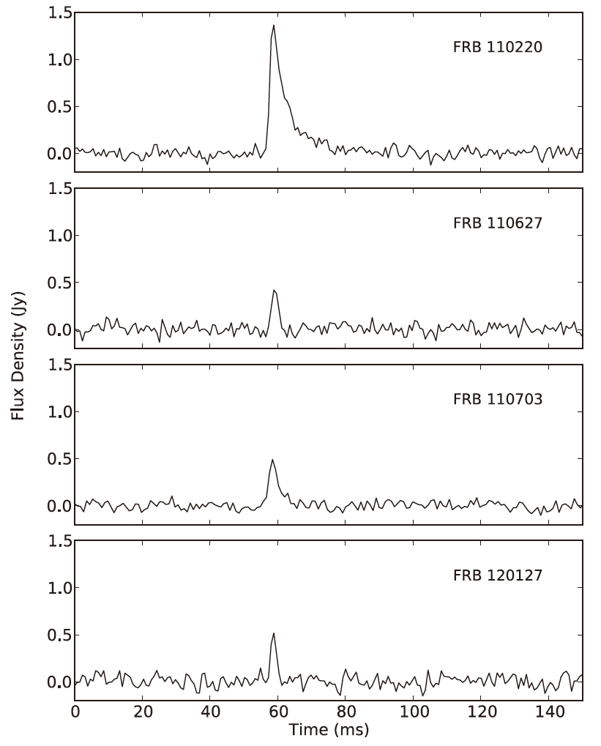
Fast Radio Bursts (FRB)
Lorimer+ 07
Most luminous
radio transients
discovered in 2007
Thornton+ 13
Notes:
FRBs are the most luminous radio transients in the universe, which were discovered in 2007.
FRBs occurs every day or even every second somewhere on the sky.
A radio pulse has a millisecond duration at around GHz.

Slide 3
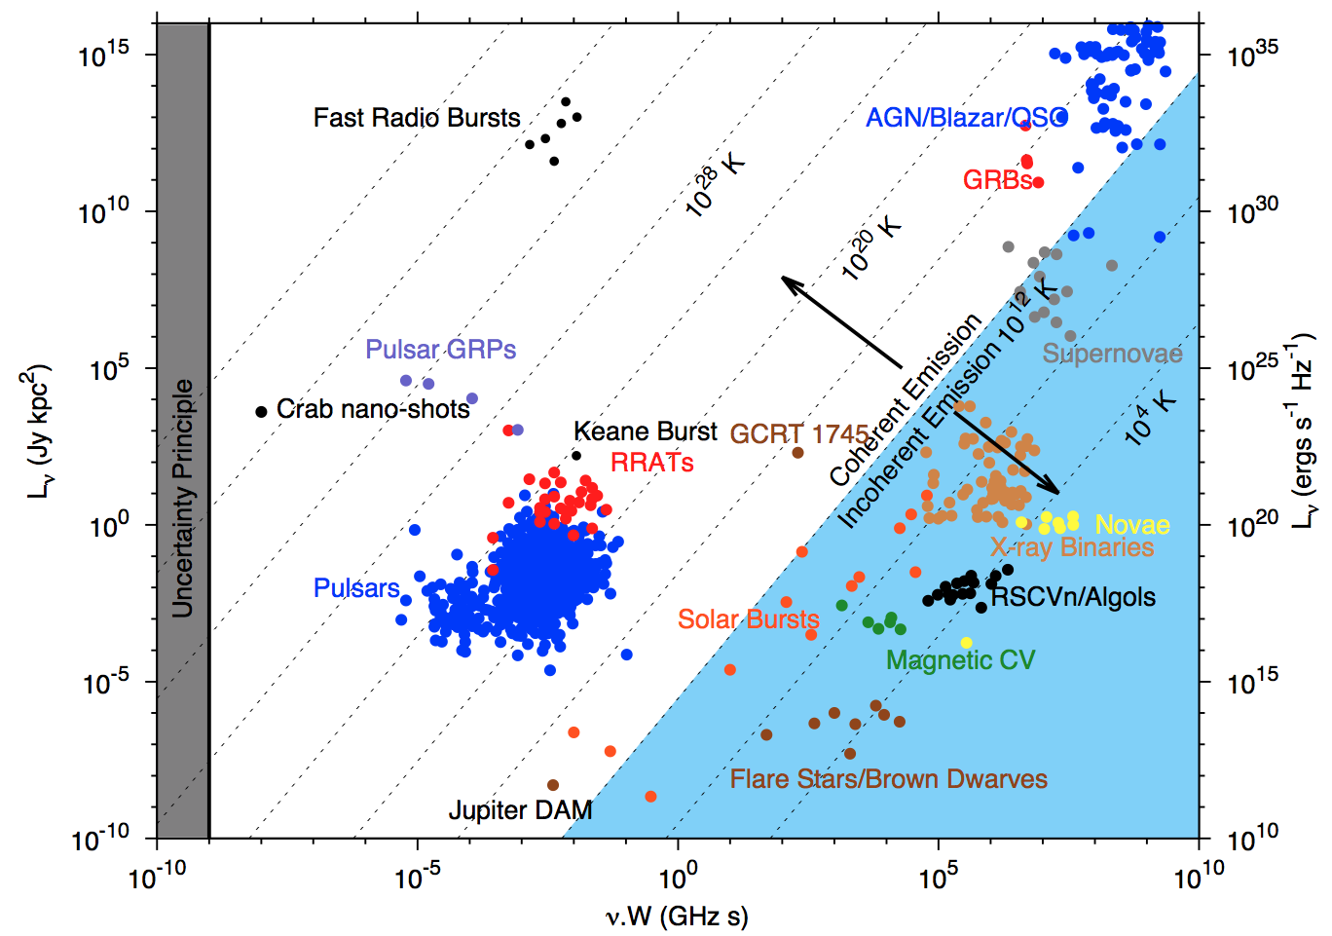
Brightness Temperature
Brightness temperature
Luminosity
Coherent emission
Pietka+ 14
Frequency×Duration
Notes:
People are interested in this phenomena because of the extreme nature.
The brightness temperature is defined by …
can be written by the observables.
The brightness temperature is extreme.
It is believed that the emission is coherent.
The power is the square of the electric field.

Slide 4
Possible Origins
Perytons Burke-Spolaor+ 11; Kulkarni+ 14
Galactic
  Nearby flaring star Loeb+ 13
  RRAT (Rotating Radio Transient; intermittent pulsar)
Extragalactic
  Magnetar giant flare Popov & Postnov 07; Thornton+ 13; Lyubarsky 14; Penn & Conner 15
  NS-NS merger Hansen & Lyutikov 01; Totani 13
  WD-WD merger Kashiyama+ 13
  Collapse of hypermassive NS Falcke & Rezzolla 13; Zhang 13
  Supernova into a nearby star Colgate+ 71,75; Egorov & Postnov 09
  Supergiant pulse Cordes & Wasserman 15
  Pulsar-orbiting bodies Mottez & Zarka 14

Slide 5
Possible Exotics
Evaporation of BH Rees 77; Blandford 77; Kavic+ 08; Keane+ 12
PBH to white hole Barrau+ 14
Superconducting cosmic strings Cai+ 12; Yu+ 14
Axion stars Iwazaki+ 14; Tkachev+ 14
…
http://frbtheorycat.org

Slide 6
Galactic FRB from
Magnetar Bursts
A smoking gun! Magnetar: One of the origins
L_{X}~10⁴¹ erg/s >>
L_{FRB}~10³⁸ erg/s
Mereghetti+ 20,
Bochenek+ 20,
CHIME/FRB+ 20,
Li+ 20,
Ridnaia+ 20,
Tavani+ 20
Notes:
There is one certain source.
This is proved by a discovery of a FRB from Galactic magnetar bursts.
This is the observation:
The important point is that the X-ray burst has more energy, three orders of magnitude larger than the FRB.
So we have to understand the magnetar burst first.
Then on top of that, we should consider the FRB.

Slide 7
Magnetosphere? Outflow?
>10¹³ cm
<10¹⁰ cm
Margalit et al. 20; Yu et al. 20; Yuan et al. 20
Lyubarsky 14; Murase et al. 16; Waxman 17;
Beloborodov 17; Metzger et al. 17
Lu et al. 20; Lyutikov & Popov 20; Katz 20;
Kashiyama et al. 13; Pen & Connor 15;
Cordes & Wasserman 16; Lyutikov et al. 16;
Kumar et al. 17; Zhang 17; Lyubarsky 20;
Kumar & Bošnjak 20; Ioka & Zhang 20
Notes:
There are many discussions on whether the emission site is inside the magnetosphere or far away from it.
There is a big uncertainty over many orders of magnitude.
In other words, with such a large uncertainty, FRBs are the most enigmatic phenomena in the universe.
Today I‘d like to ask a question in a different way.

Slide 8
Kinetic? Magnetic?
FRB
Energy transfer
Totani-san’s talk
Starquake or Reconnection
Magnetar
Energy source is near surface
Notes:
The question is how to transfer the energy from the source to the emission site of FRBs.
In a magnetar model, the energy is most likely generated on the surface of the neutron star.
This is also suggested by recent reports of glitches associated with FRBs.
On the other hand, the emission region is not thought to be on the surface because the FRB waves are attenuated near the surface.
The energy should be transferred from the surface to the emission site.
There are basically two ways of energy transfer: kinetic or magnetic flux.

Slide 9
Poynting Flux
~10kHz-MHz
Alfven wave
Magnetar
Notes:
The magnetic flux or Poynting flux is often discussed.
In particular Alfven waves are thought to be important carrier of energy.

Slide 10
Kinetic Flux
e±p outflow
Expanding
fireball
Magnetar
L_{X}~10³⁸ erg > L_{Edd} ⇒ Baryon may be loaded
Notes:
Kinetic flux is also another possibility.
As shown later, if thermal energy is released at the surface, a fireball is created and the thermal energy can be quickly converted into the kinetic energy of the outflow.
Currently we do not know what kind of energy is released near the surface.
In this talk we first consider the fireball model, and then go to the Alfven wave model.

Slide 11
Trapped Fireball
Thompson & Duncan 95
Notes:
As I mentioned, we have to first understand the magnetar bursts before modeling FRBs.
For the magnetar models, a trapped fireball is traditionally considered.
In this model, the released energy immediately creates electrons and positrons, which are trapped in a closed magnetic field.
The size of the fireball is determined by the luminosity and the temperature of the fireball.
For the Galactic event, the size is about 10^4 cm, much smaller than the neutron star.

Slide 12
High Temperature
Spectrum
N_{E} ∝ E^{α} exp(-E/E_{cut})
Younes+ 20
Notes:
However the trapped fireball does not work for the Galactic FRB, because the temperature is much higher than the typical ones.
Usually the cutoff energy of the spectrum is about 10 keV, while it is about 80 keV for the burst associated with the Galactic FRB.
photon index alpha~1.5

Slide 13
Optical Depth
τ >>1 at the surface
of the trapped fireball
X-ray tails create e±
→ Surrounding field
should be open
→ Expanding fireball
The fireball would
get too big
If B were closed,
KI 20
T~80keV
T<80keV
Notes:
Given the high temperature, the optical depth for photons to create pairs is very large at the surface of the trapped fireball.
The high energy tail of X-rays create e+- pairs outside the initial trapped fireball.
The surrounding magnetic field should be open.
Otherwise, if the field line were closed, the fireball would become too big to explain the temperature.
Therefore we should consider an expanding fireball for the Galactic FRB event.

Slide 14
Expanding Fireball
X-ray
e±p outflow
Expanding
fireball
X-ray
Magnetar
Trapped fireball
KI 20
Wada & KI 23
Notes:
If the fireball can expand along an open magnetic field, the density decreases and eventually photons can escape.
These photons can explain the X-ray emission of the magnetar bursts.
On top of that, we would like to know the kinetic energy of the outflow for FRBs.

Slide 15
Fireball Temperature
Spherical GRB
Dipole flux tube
+ radiation-dominated
Notes:
The released photons basically keep the initial temperature.
Although the comoving temperature decreases as a result of adiabatic cooling,
the Lorentz factor increases, and the blue-shifted temperature is the same as the initial one.
The same thing happens even when the expansion is not spherical but dipole-like along a magnetic flux tube.
Therefore the X-ray temperature can be explained if the initial fireball size is 10^4 cm.

Slide 16
Fireball Evolution
Γ or r/r₀
Paczynski, Goodman
Meszaros & Rees
Shemi & Piran
Matter-
Dominated
Γ*
~10²
Radiation-Dominated
Photon-to-Baryon
η*~10²
η=E/Mc²

Slide 17
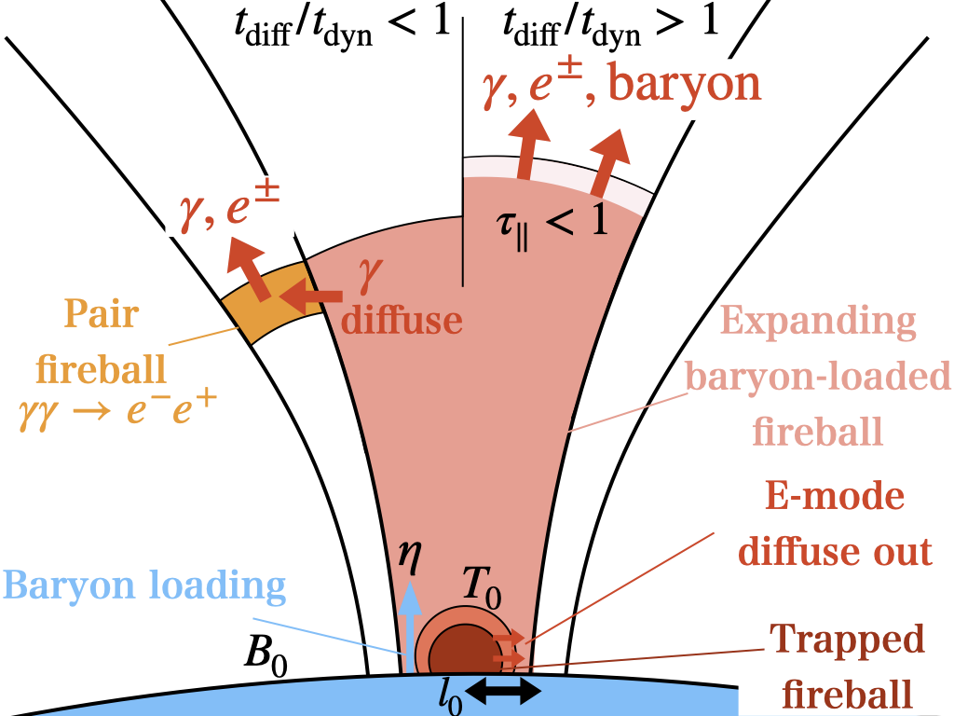
Photon Escape
L>L_{Eddington}
n_{e}∝r^{−9/2}
n±∝exp
Wada
& KI 22
Notes:
At the base of the fireball, baryon may be loaded because the luminosity is higher than the normal Eddington luminosity.
The baryon is important because the electrons associated with the baryon do not decrease exponentially due to pair annihilation and keep the acceleration for a long time.
There are two ways for photons to escape; one is the usual escape from a photosphere, the other is the escape from the lateral side of the flux tube through photon diffusion.

Slide 18
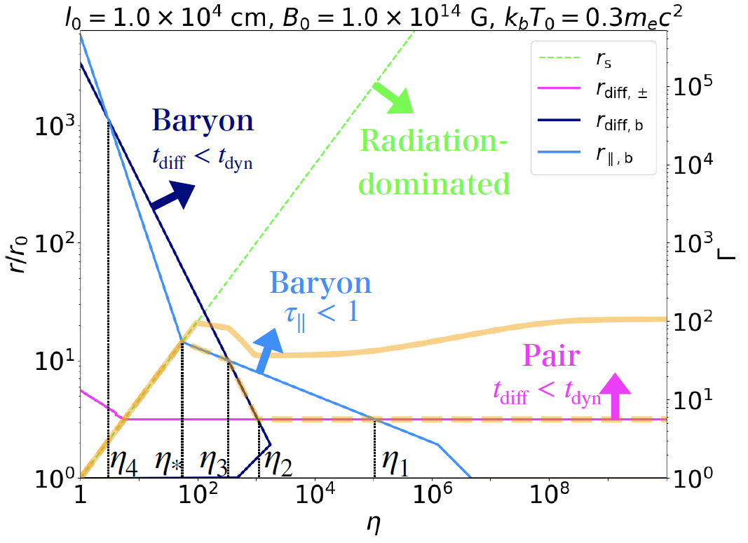
Fireball Evolution
Radius
Lorentz factor
Wada
& KI 22
Baryon rich
= e₀/ρ₀c²
Baryon poor
Notes:
Taking into account of these processes, the fireball evolution is summarized in this figure.
This is the radius and the Lorentz factor as a function of the dimensionless entropy. The right is baryon poor and the left is baryon rich.
For a given eta, a fireball expands and photons escape at the dashed orange line.
At this stage, the Lorentz factor can be accelerated to about 10 for most range of the baryon loading, although the maximum Lorentz factor is about 100 if the baryon loading is the most suitable.
However the Lorentz factor of the outflow can be further accelerated even after the photons are released, up to this thick orange line, namely up to Lorentz factor of 100.

Slide 19
Radiative Acceleration
Even above the photosphere
Work by γ > Rest mass
B
Thomson
scattering
>
τ~1
Resonant
cyclotron
scattering
Mitrofanov
& Pavlov 82
Wada & KI 22
B || n_{radiation} for high Γ

Slide 20
Radiative Deceleration
Plasma
moves
along B
B∝r ⁻³
photon
mildly rela
Magnetar
R~10⁶cm
r_{L}~10¹⁰cm

Slide 21
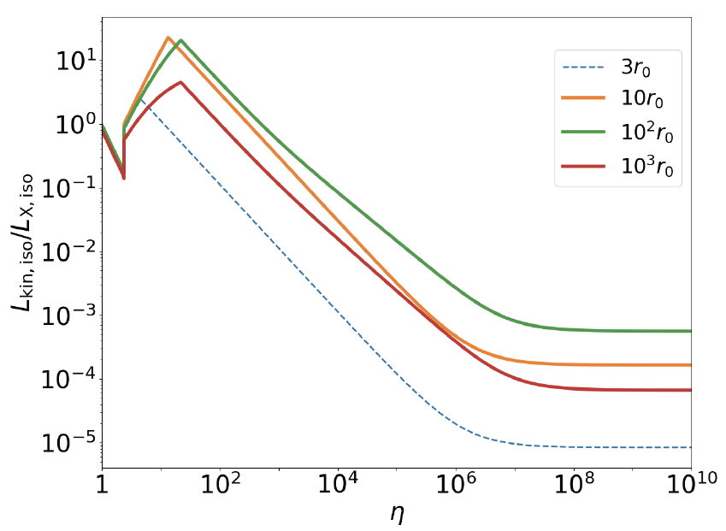
Isotropic Luminosity
Emission radius
Galactic FRB
Isotropic
L_{kin} > L_{FRB}
is possible
θ
Γ
Wada
& KI 22
Baryon rich
Baryon poor
Notes:
The observed luminosity is the isotropic luminosity, which is corrected by the opening angle and the relativistic beaming.
Because theta and Gamma depends on the radius in a different way, the isotropic luminosity goes up and down as the emission radius becomes larger.
In order to explain the Galactic FRB by using the kinetic energy, the isotropic luminosity of the outflow should be larger than this line.
We can see that this is easy by considering baryon rich fireball.
Even without baryon, this may be marginally achieved if the emission radius is appropriate about 100 times the neutron star radius, thanks to the resonant radiative acceleration.

Slide 22
Kinetic Energy
X-ray
e±p outflow
Expanding
fireball
X-ray
Fireball radiation ~ L_{X}
Fireball outflow >~ L_{FRB}
Baryon or Resonant scattering
Magnetar
Notes:
The conclusion of the fist half of the talk is that a fireball that explains the X-ray bursts is also able to produce the kinetic energy larger than the FRBs.
The important ingredient is baryon or resonant scattering.

Slide 23
Poynting Energy
Alfven wave
Magnetar
Notes:
Let‘s consider Poynting flux, in particular Alfven waves next.

Slide 24
Wave Amplitude
Alfven wave
Magnetar
@10⁸cm
Notes:
Let‘s consider Poynting flux, in particular Alfven waves next.

Slide 25
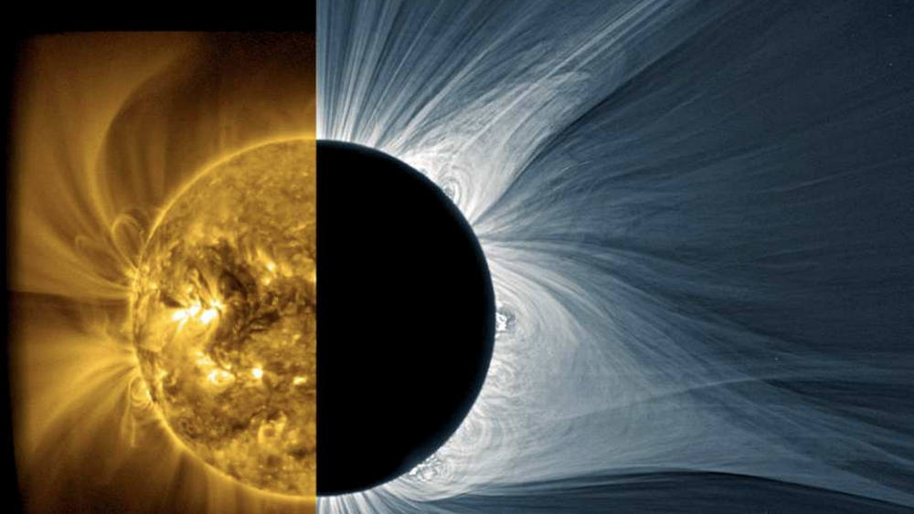
Solar Physics:
Parametric Decay Instability
Alfven → Alfven + Sound
3 wave interactions
Acoustic wave (slow wave)
makes shock and dissipate
Growth rate
Quick decay for δB/B~1
but this eq. is for σ<<1
(v_{A} is non-relativistic)
MHD for ω<<ω_{p,c}
Notes:
Alfven waves are very important in solar physics for the coronal heating and wind acceleration.
Among various instabilities, the decay of Alfven waves into Alfven waves and sound waves through 3 wave interactions is often discussed.
The sound wave or slow wave makes shock and eventually dissipate, leading to the heating of the plasma.
The growth rate is relatively quick, but this equation is derived for the nonrelativistic case of small sigma.

Slide 26
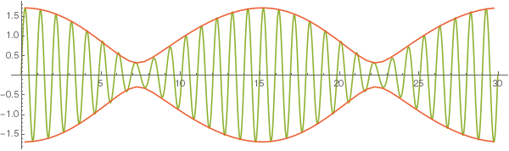
Alfven → Alfven+Sound
Parent Alfven + Daughter Alfven → Beat
© Physics
Slack
Exchange
High & Low EM energy density → Sound wave
Induced Brillouin scattering

Slide 27
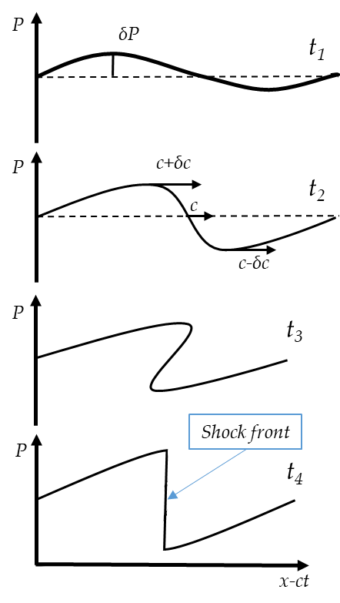
Sound Wave Dissipation
A → A + S
Effectively
E_{Alfven} → E_{thermal}
Yevheniia Chernukha 19

Slide 28
High σ Limit
In the magnetosphere
B energy density >> Matter energy density
Force-free limit: Matter decouples from B
Alfven waves really decay?

Slide 29
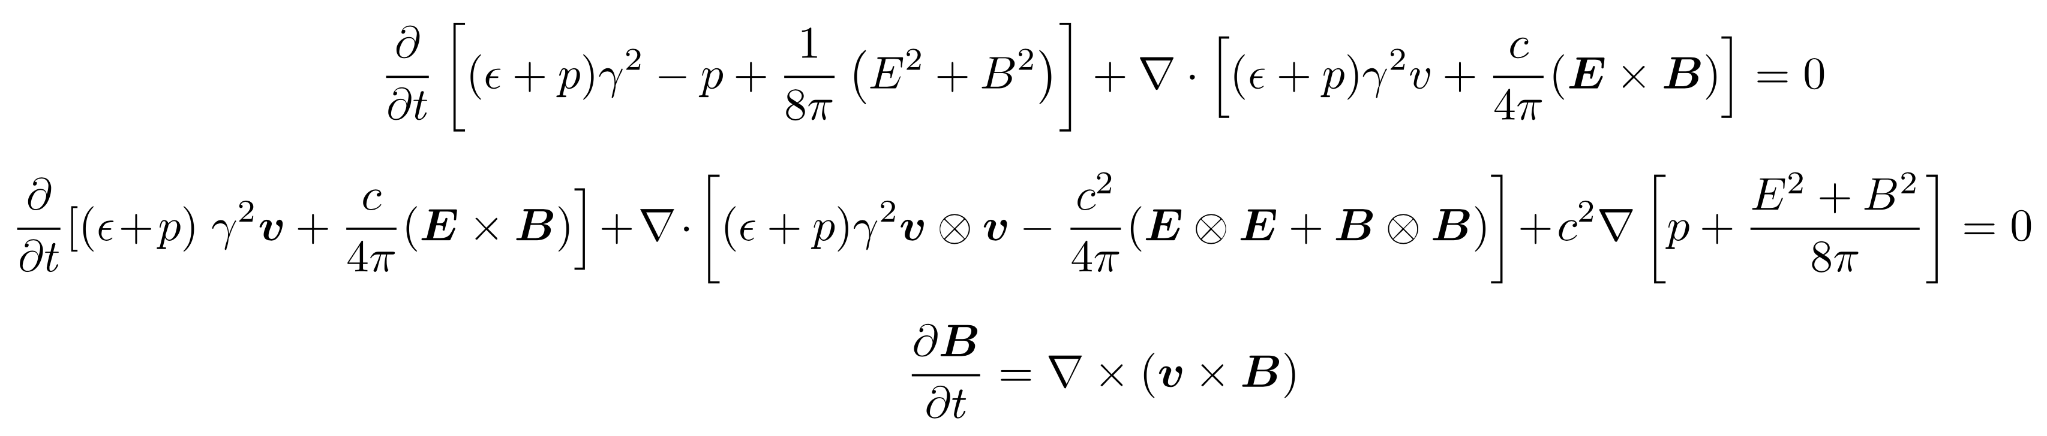
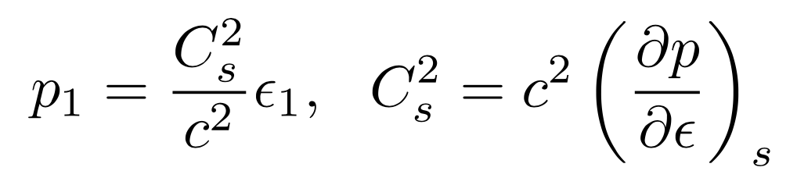
To Relativistic MHD
Energy-momentum conservations & Induction eqs.
EOS
Ideal MHD (ω<<ω_{p,c})
Adiabatic EOS
B₀ || k
Circular polarization
In the fluid comoving frame
(background v_{fluid} ~ 0)
Notes:
So we extend this instability to the relativistic MHD case.
Using the relativistic energy-momentum conservations and induction equations, we consider the simplest problem:
ideal MHD, adiabatic EOS, a constant background magnetic field and a circularly polarized wave propagate along the background B field.
In order to make the problem easy, we consider in the fluid comoving frame so that the background fluid velocity is zero.

Slide 30
Perturbation
Do daughter waves grow?
Ishizaki & KI 24
Notes:
Following the non-relativistic case, we expand the quantities in a perturbative way.
The parent wave is the Alfven wave.
The daughter waves are Alfven wave and sound wave, which are excited by the parent wave.
We neglect the higher orders epsilon^2 and eta^2, but keeping the coupling terms.

Slide 31
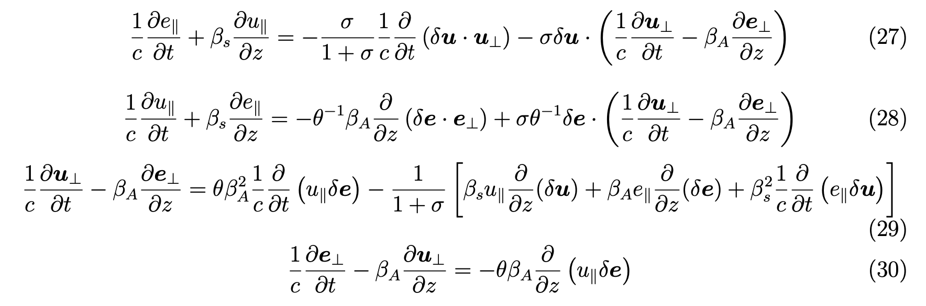
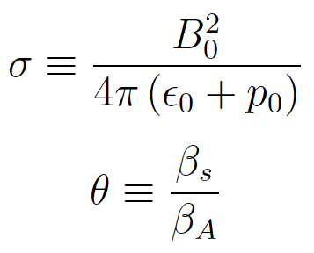
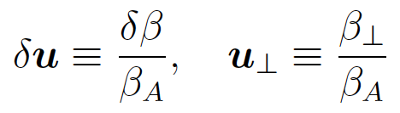
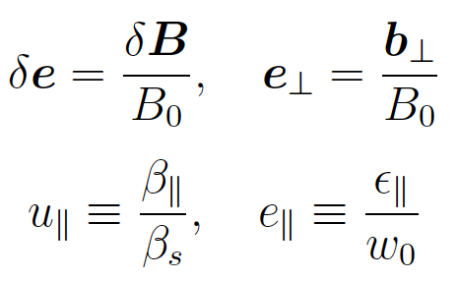


Perturbed Equations
Ishizaki & KI 24
Dimensionless
parameters
For the normalized quantities
Alfven velocity
Enthalpy
Notes:
I should skip the details, but
The important dimensionless parameters are the sigma parameter, namely the ratio of the energy density of magnetic field to matter.
The theta is the ratio of the sound velocity to the Alfven velocity.

Slide 32
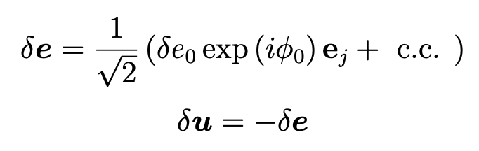
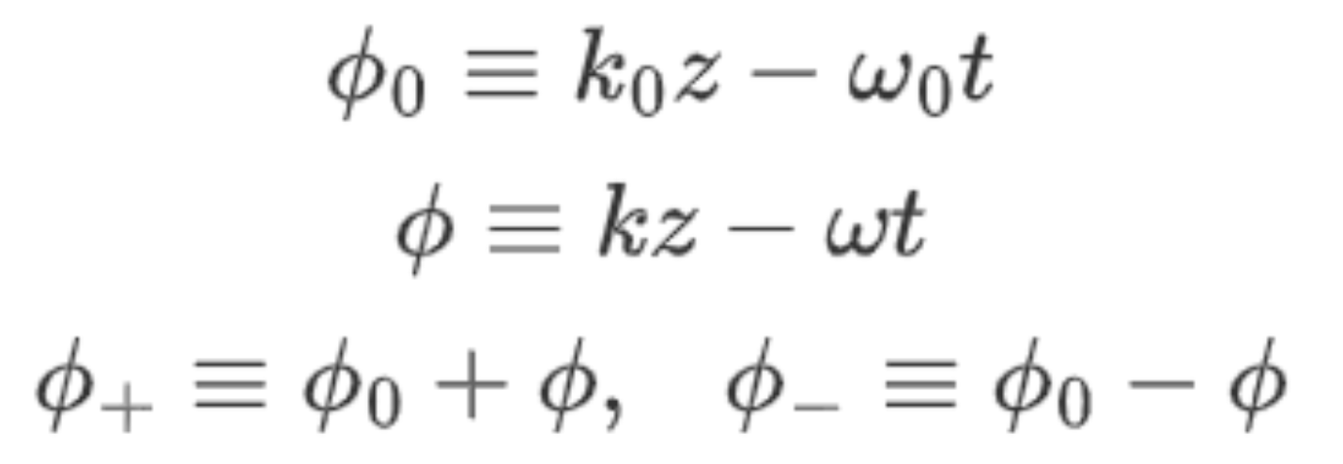
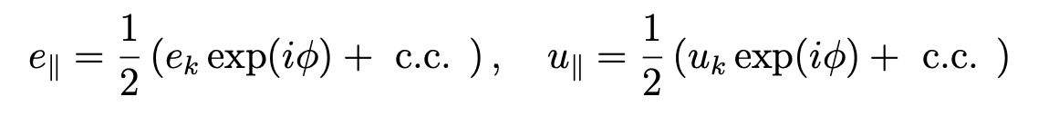
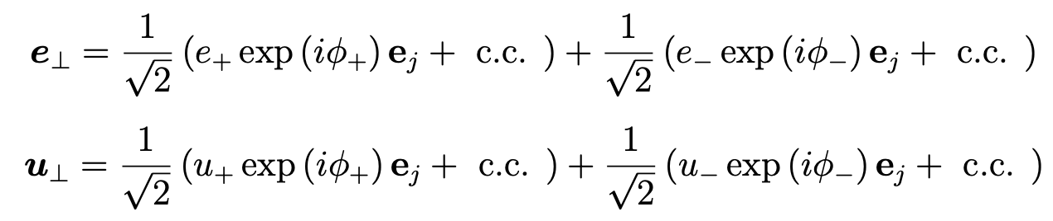
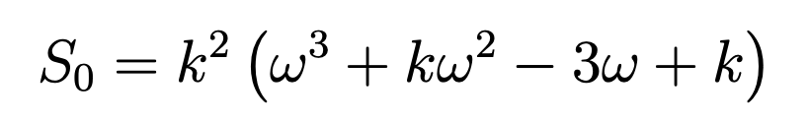
Dispersion Relation
Fourier mode expansion
Ishizaki & KI 24
Parent
Sound
Alfven
(satisfying resonance conditions)
Det (6×6 matrix) = 0 → Dispersion relation
(in the unit of k₀=1, w₀=1)
S₁=…, S₂=…, S₃=…, S₄=…
Notes:
After long calculations including Fourier mode expansion and the determinant of 6x6 matrix, we obtain the dispersion relation like this.
Here S0, S1, etc are functions of omega (wave frequency) and k (wave number).
We do not show all the functions because they are relatively complex.

Slide 33
Decay Rate
Ishizaki & KI 24
Rela
Non-rela
: Wave amplitude of Alfven wave
: Energy density ratio
“sigma” parameter σ >> 1
Alfven wave velocity
~ sound velocity/c
~1

Slide 34
Wave-Heated Fireball?
?
Expanding
fireball
E_{Alfven} → E_{fireball} → E_{FRB}?
in/outside magnetosphere?
Magnetar
Notes:
Then we can speculate the following scenario.
The Alven waves heat the fireball through the parametric decay.
The Alfven wave energy goes to the thermal energy of the fireball, and this is eventually converted into the kinetic energy of outflow.
This may lead to the collision of plasma and 2 stream instability to make FRBs, like the traditional model of pulsars.
This pulsar-like model may be good for explaining 100% linear polarization because the background magnetic field is solid and selects a particular linear polarization.
Or the outflow may escape the fireball to produce FRBs far away.

Slide 35
Fireball reflects Waves?
?
Wave-Wave interactions
Expanding
fireball
A+A ↔︎ F
A+F ↔︎ F
E_{Alfven} → E_{FRB}?
in a fireball?
Magnetar
Notes:
Then we can speculate the following scenario.
The daughter Alven waves go backward. The fireball works as a reflector of Alfven waves.
Then the reflected waves can interact with the forward propagating Alfven waves.
The wave-wave interactions can produce fast magnetosonic waves, which can travel across the magnetic field and may be able to escape from the magnetosphere eventually as an FRB.
Here the wave-wave interactions can produce high frequency waves.

Slide 36
Cyclotron & Plasma Frequency
ω_{c}>ω_{FRB}
ω_{p}~ω_{FRB}

Slide 37
Fireball Ejection opening B
Fireball
Alfven wave
B∝r ⁻³ B∝r ⁻¹
Magnetar
R~10⁶cm
r_{A}~10⁸cm
r_{L}~10¹⁰cm

Slide 38
Fireball Creates FRB Waves?
F
A
A
Fireball
Alfven wave
B∝r ⁻³ B∝r ⁻¹
Magnetar
R~10⁶cm
r_{A}~10⁸cm
r_{L}~10¹⁰cm

Slide 39
Summary
Expanding fireball
  E_{γ} = E_{X} & E_{kin} > E_{FRB}
  Baryon & Resonant cyclotron scattering
Parametric Decay of Alfven waves
  Relativistic MHD: Alfven → Alfven + Sound
  Waves heat fireball? Decay to FRBs?
FRB cosmology
Takahashi+ 21, Shirasaki+ 22
Exciting in the next decade

Slide 40
Thank You

Slide 41
Magnetic Field
Alfven radius
Dipole B∝r⁻³
→ Toroidal B∝r⁻¹
FRB waves are linear
inside the fireball

Slide 42
Nonlinear Interaction
Parent Alfven
Daughter Alfven
Parent Alfven: Circular
BG
Daughter sound wave
Ideal MHD, B₀ || k
Resonant conditions
nonlinear
dominant term
nonlinear
dominant term
→ Im ν
﻿Galeev & Oraevskii 63; Sagdeev & Galeev 69

Slide 43
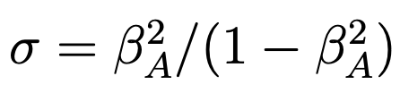
Non-relativistic Limit
Neglecting O(β_{A}²)
is small
the same as Goldstein (1978) & Derby (1978)
In the limit β=c_{s}²/v_{A}²→0, the decay instability is recovered:
forward Alfven → forward acoustic + backward Alfven
Notes:
We can take a non-relativistic limit by neglecting beta_A^2 or sigma.
Then we obtain the same equation as Goldstein and Derby 1978.
This represents the parametric decay instability of forward Alven into forward sound waves and backward Alfven waves.
So this limit is consistent with the previous results.

Slide 44
High σ Limit
σ → ∞
No instability
consistent with force-free
(a single Alfven wave is stable in force-free)
Notes:
We can also take the different limit, namely high sigma limit.
The dispersion relation reduces to this equation,
and this equation has no instability.
This is consistent with the force-free analysis, in which a single Alfven wave is stable.
So this is consistent with the previous results.

Slide 45
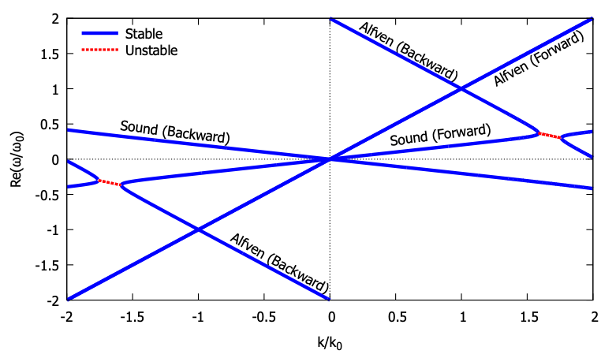
Dispersion Relation
Im ω (instability) arises
at the resonance
Notes:
By plotting the dispersion relation numerically, we can see that the intersection of backward Alfven waves and forward sound waves has an imaginary part.
This means that there is an instability at the resonance point.

Slide 46
Low ω Waves in Strong B
Fast
magnetosonic
wave (X-mode)
Alfven
wave
(O-mode)
Wave frequency ω
e±
F
k
B
k
B
ω_{p}
θ
θ
E
E
A
A+A↔︎F
A+F↔︎F
Wave number k

