Slide 1
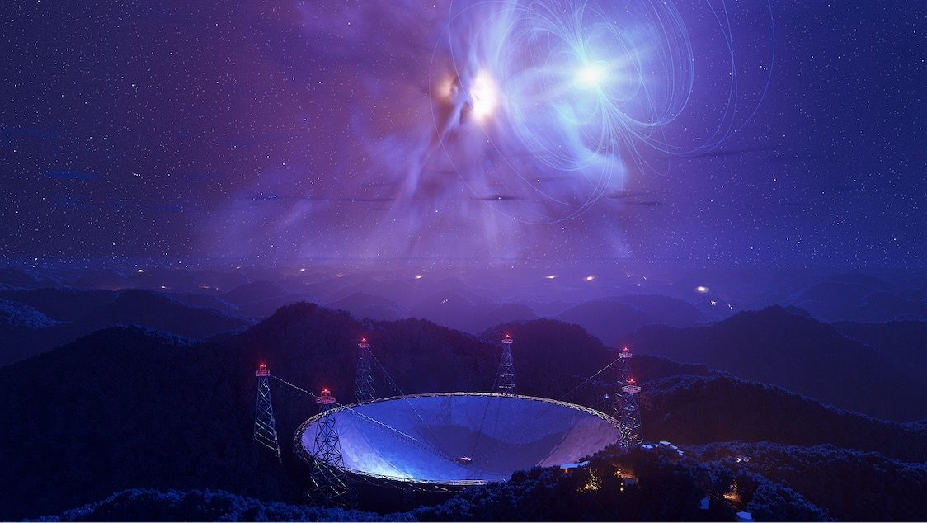

Pulsars in High-Mass X-ray Binaries
Shan-Shan Weng
Nanjing Normal University
wengss@njnu.edu.cn
Dialogue at the Dream Field (DDF2024) @ Guiyang, May 10-15 2024

Slide 2
Outline
Introduction
Gamma-ray binaries – Non-accreting pulsars
Giant outbursts in accreting X-ray pulsars & Pulsating ultraluminous source
Summary

Slide 3
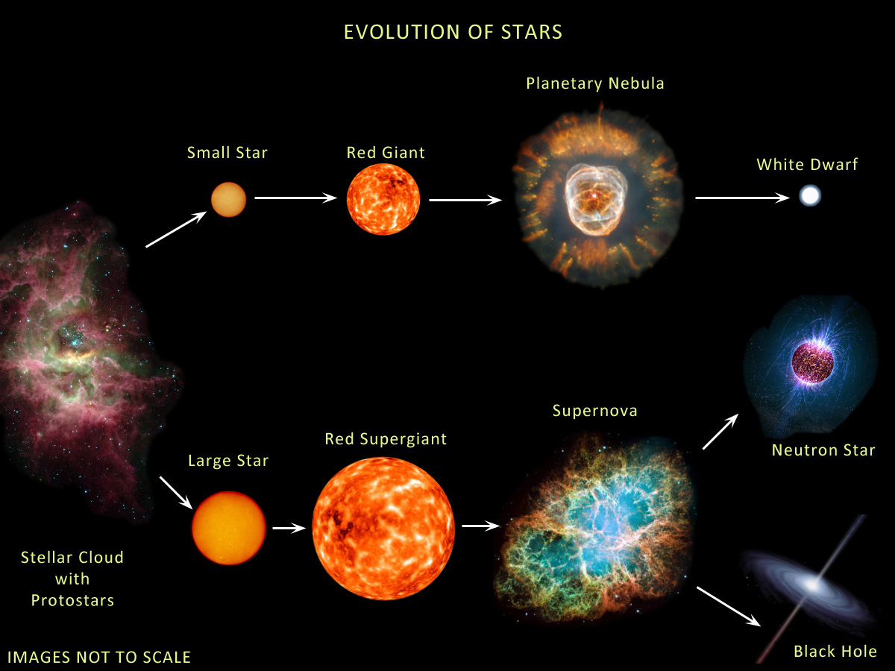
Evolution of massive stars: bright emission & strong wind

Slide 4
Pulsar population
Pulsars
Isolated
Binaries
Old
Young
Old
Young
RPPs
MSPs
…
COOs
XDINs
SGRs/AXPs
RRATs
…
AMXPs
tMSPs
BW/RB
DNSs
…
HMXBs
GRBs
ULXs
…

Slide 5
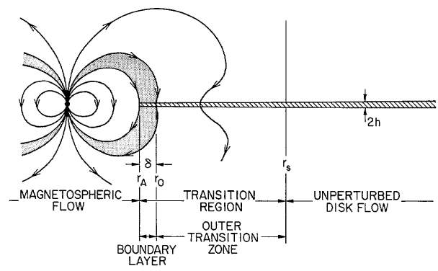

Interaction between magnetosphere and accretion flow
R_{mag}
R_{mag}
Ejector: R_{mag} > R_{LC}
Propeller: R_{LC} > R_{mag} > R_{CO}
Accretor: R_{mag} < R_{CO}
d
Magnetosphere radius is determined by the balance between the ram pressure of accretion flow and the magnetic pressure:
$$R_{mag}∝ B^{4/7}{\dot{M}}^{−2/7}$$

Slide 6
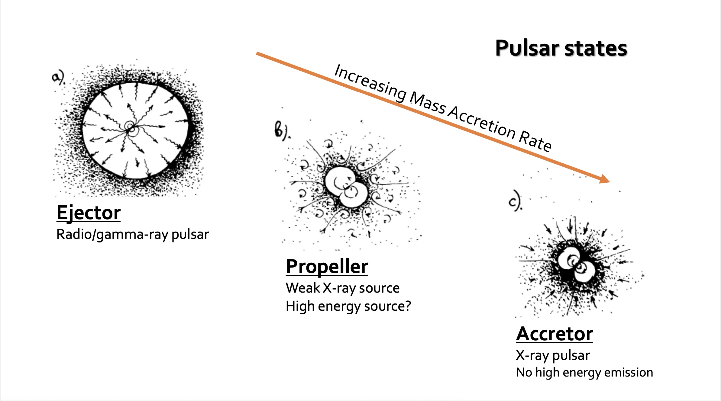
Interaction between pulsars and surrounding material
Slide from Alessandro Papitto
Notes:
Gamma-ray binaries; SFXTs; BeXRBs

Slide 7
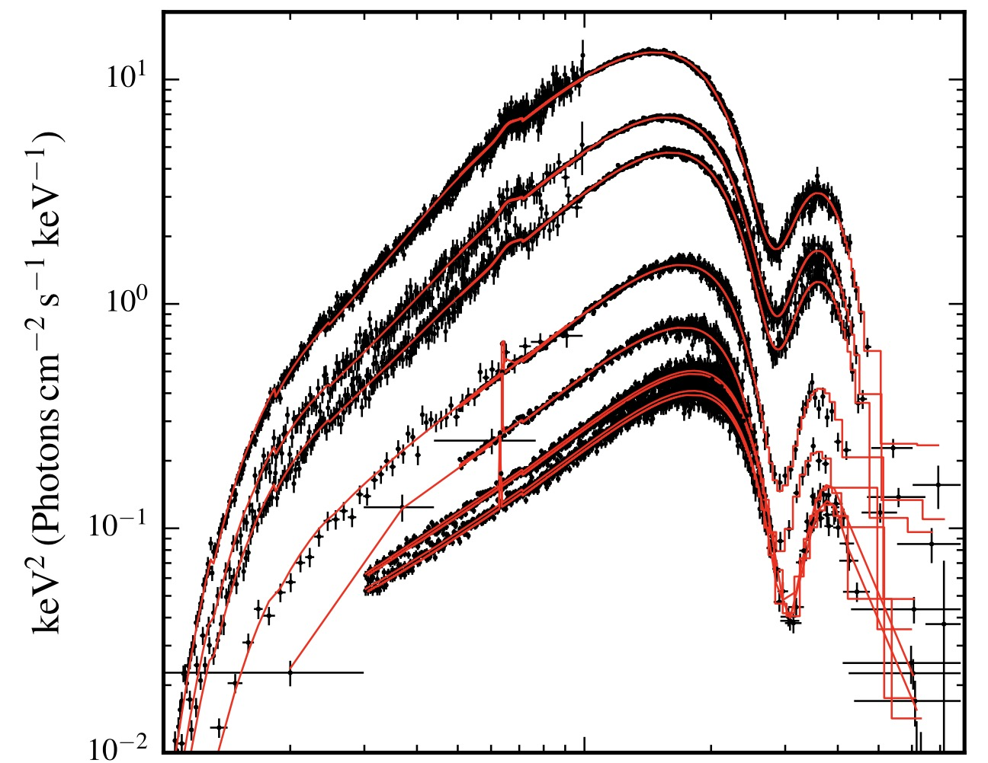
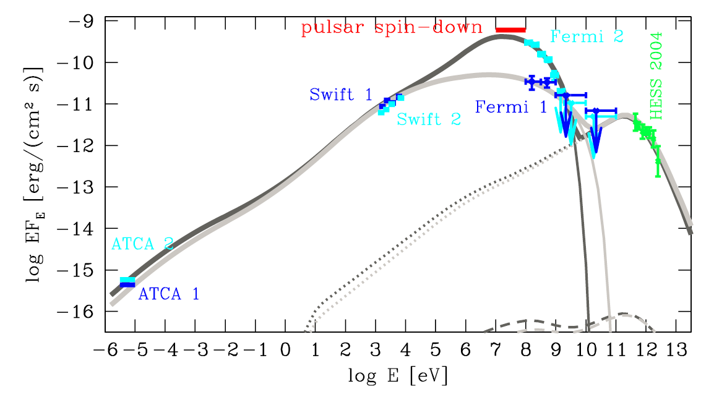
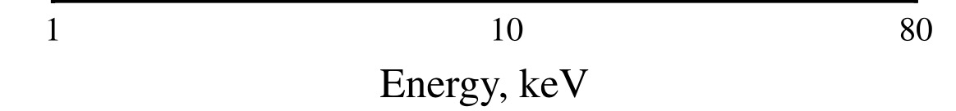
X-ray binaries v.s. Gamma-ray binaries
CRSF~ 28 keV
Peak > 100 MeV
Cyg X-1
Malyshev et al. 2013
PSR B1259-63
V 0332+53
Abdo et al. 2011
Doroshenko et al. 2017

Slide 8
Gamma-Ray Binaries: OB star + BH/NS
Source | Spectral type | Distance | Orbital period | Spin period
PSR B1259-63 | Be | 2.2 kpc | 1236.72 d | 47.74 ms
PSR J2032+4127 | Be | 1.7 kpc | 52.4 y | 143 ms
LS I +61°303 | B0Ve | 2.5 kpc | 26.496 d | 269 ms
HESS J0632+057 | B0Vpe | 1.8 kpc | 315 d
LS 5039 | O6.5V | 1.9 kpc | 3.906 d
1FGL J1018.6-5856 | O6V | 7.6 kpc | 16.58 d
3FGL J1405.4-6119 | O6.5 III | 7.7 kpc | 13.7 d
LMC P3 | O5 III(f) | 50 kpc | 10.301 d
Candidate: HESS J1832-093

Slide 9
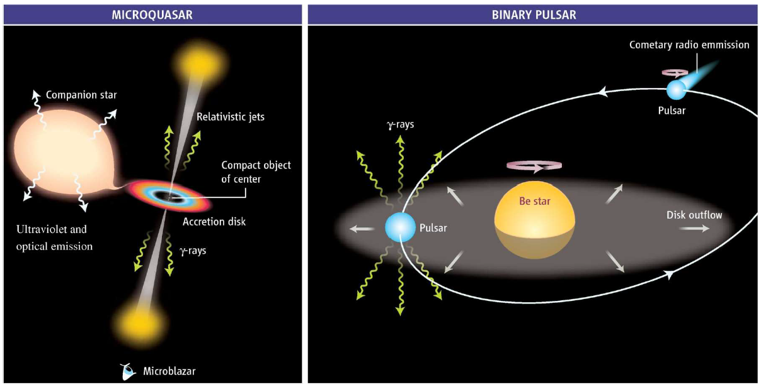
Microquasar v.s. Colliding winds
Mirabel 2006
Notes:
Non-transient gamma-ray binaries
Accretion or colliding wind models

Slide 10
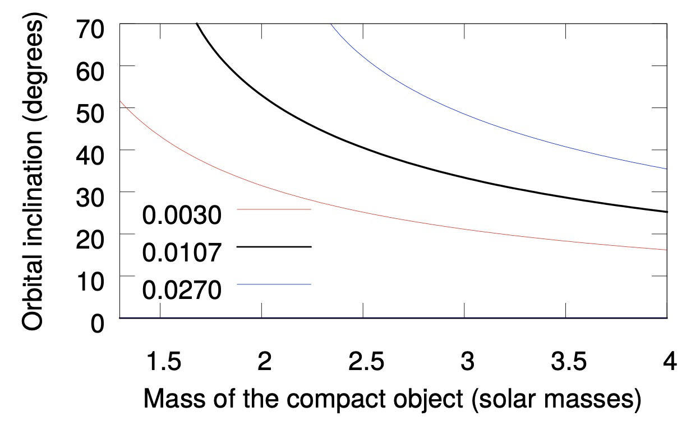
Neutron star or low-mass black-hole
Massi et al. 2017
Notes:
Mass of the compact object in LS I +61◦303 as a function of the inclination angle, for three different values of the mass function (Casares et al. 2005) (see Sec. 2)

Slide 11
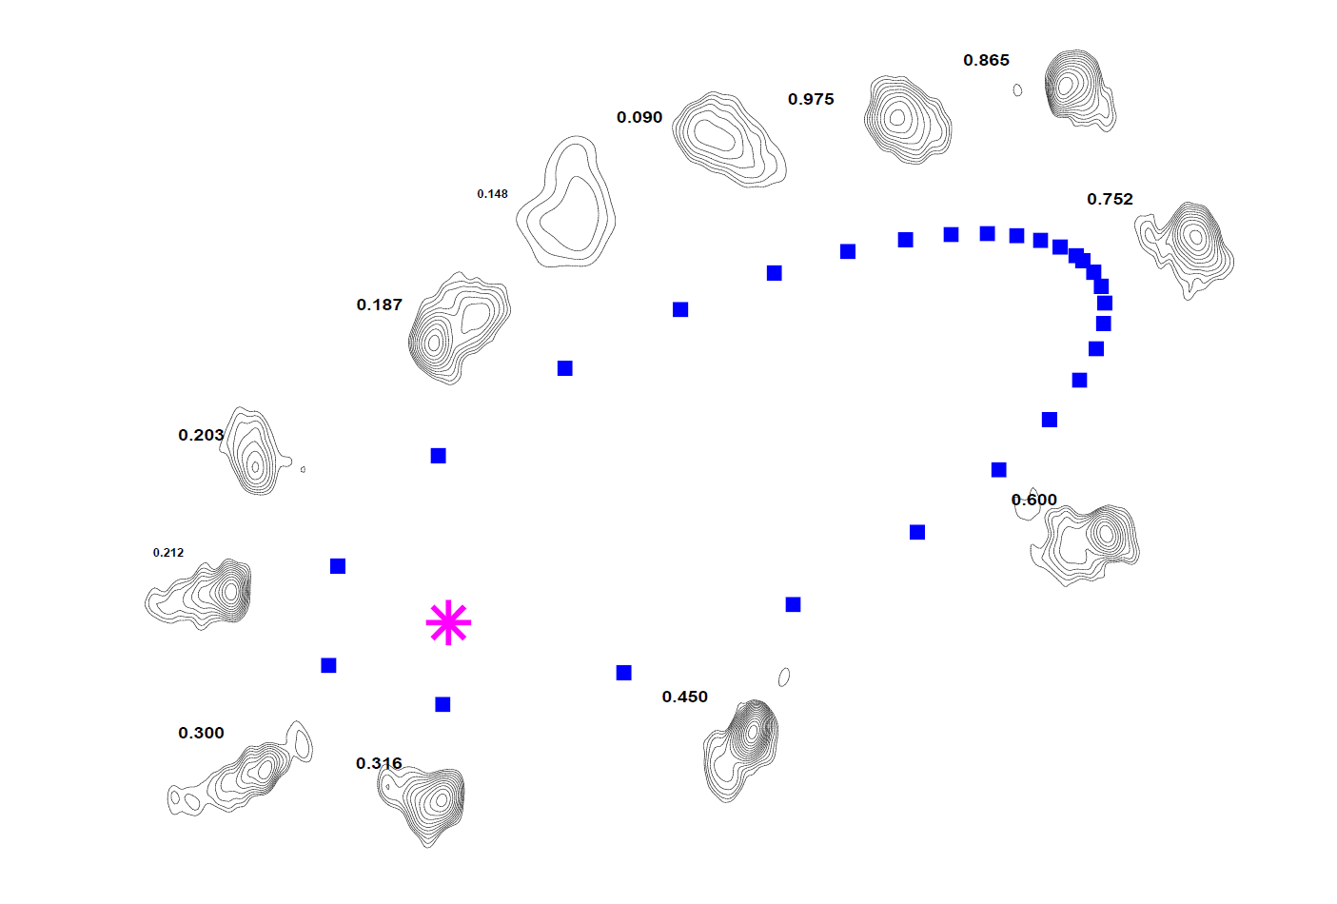
Precessing radio jet or Pulsar wind nebula
VLBA images （at 3.6cm） arranged by orbital phase
Dhawan et al. 2006

Slide 12
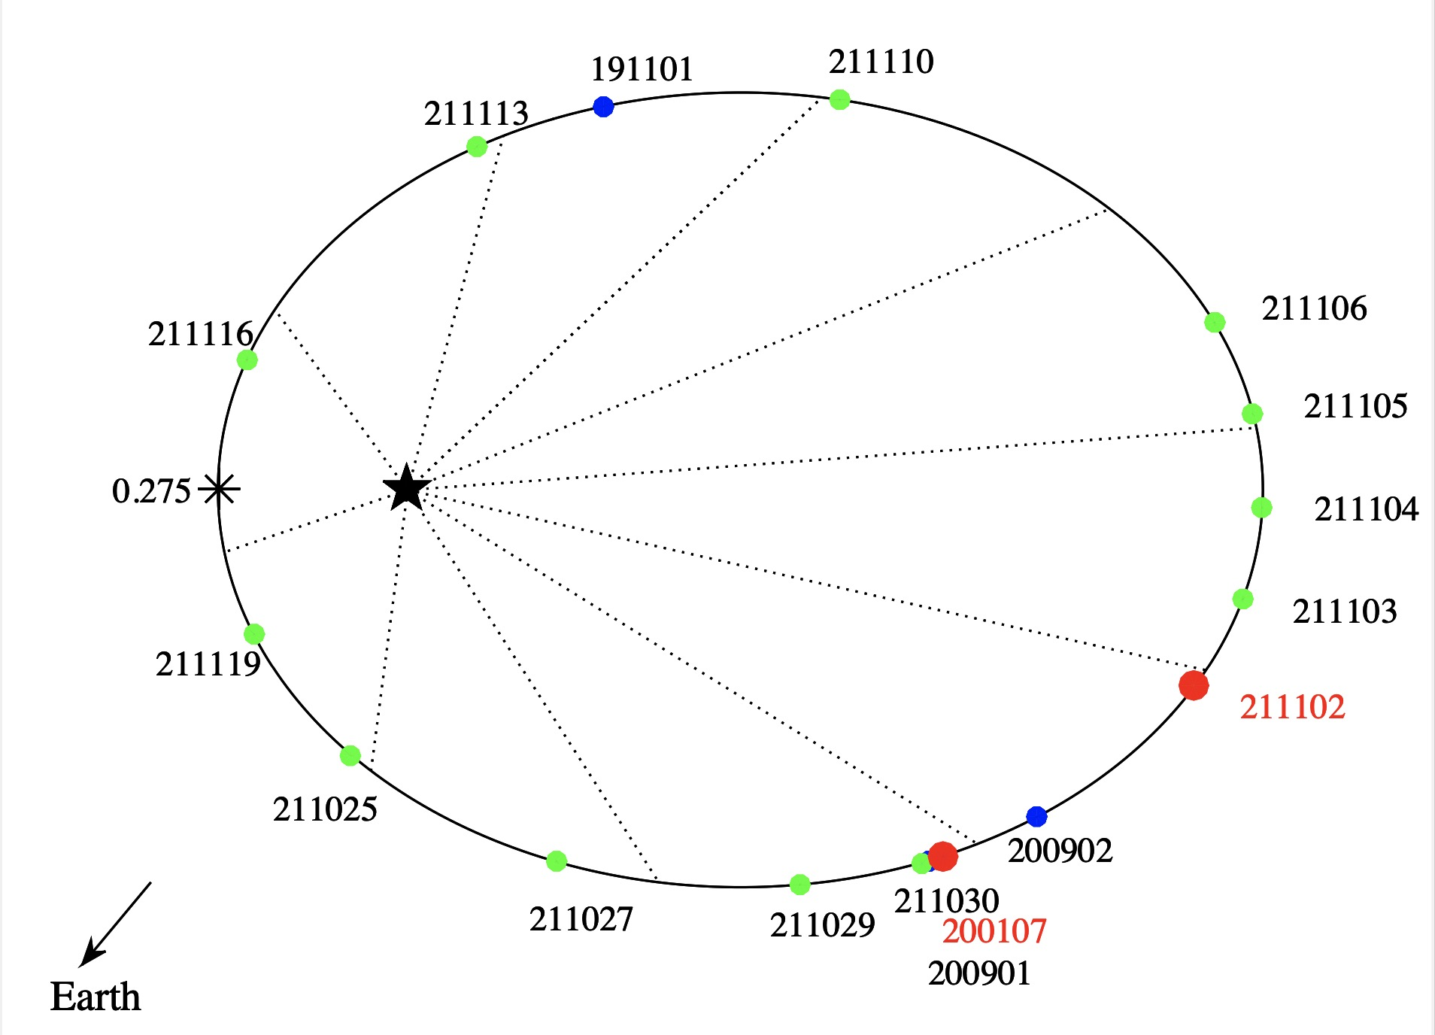
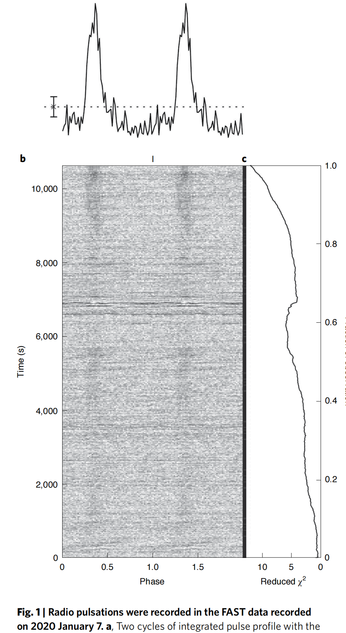
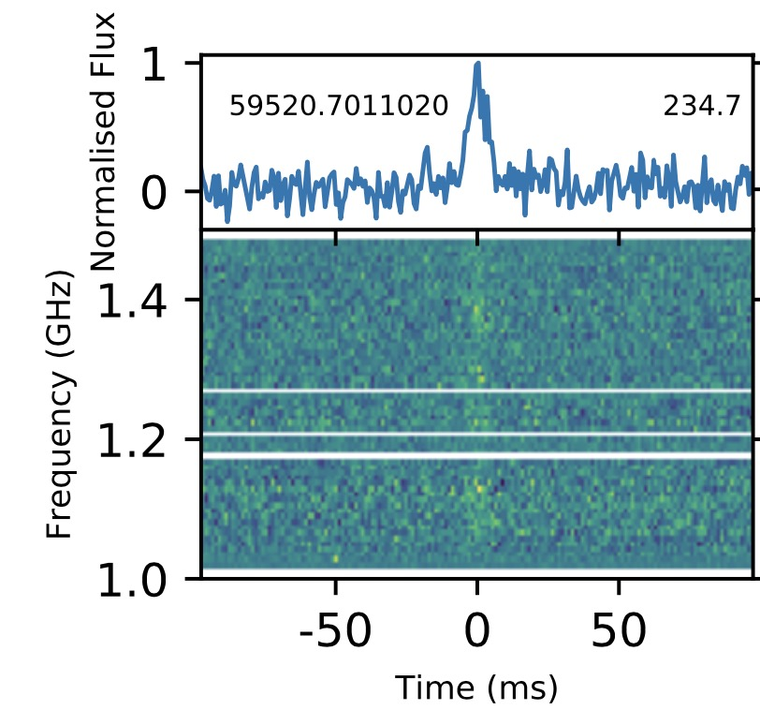
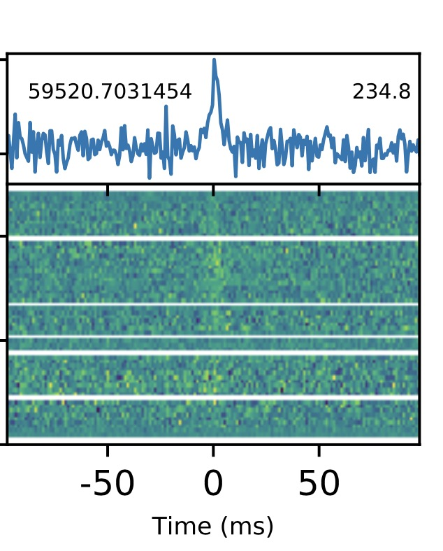
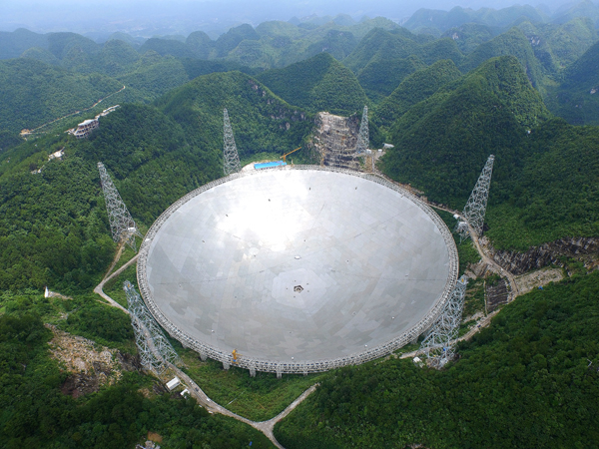
Radio pulsations from a neutron star within the gamma-ray binary LS I +61 303
Weng et al. 2022, Nature Astronomy, 6, 698

Slide 13
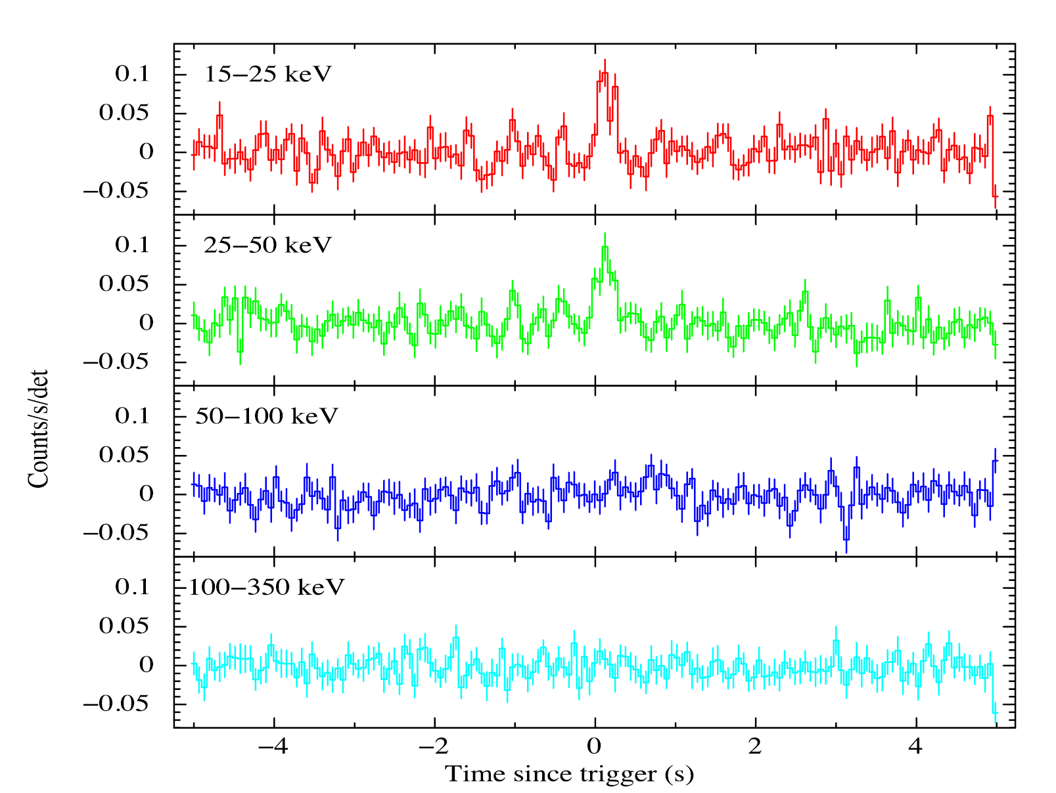
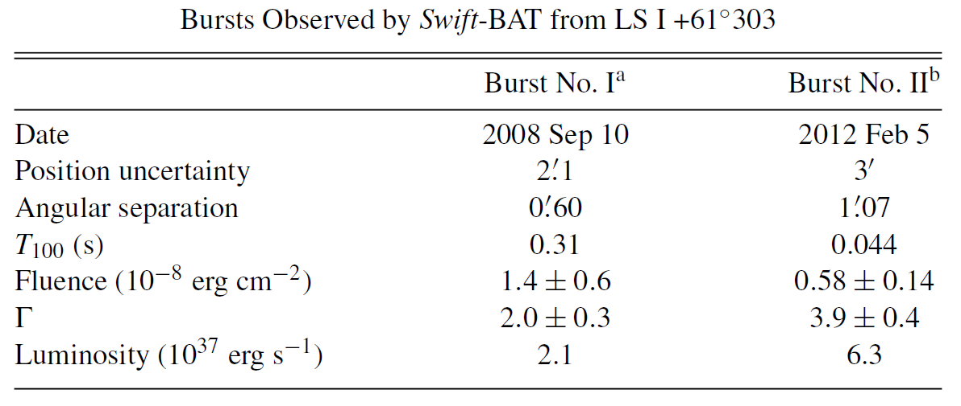
Strongly magnetized neutron star in the gamma-ray binary LS I +61 303
Papitto et al. 2012
Torres et al. 2012

Slide 14
Times of Transient Outburst Detections by Fermi/GBM

Slide 15
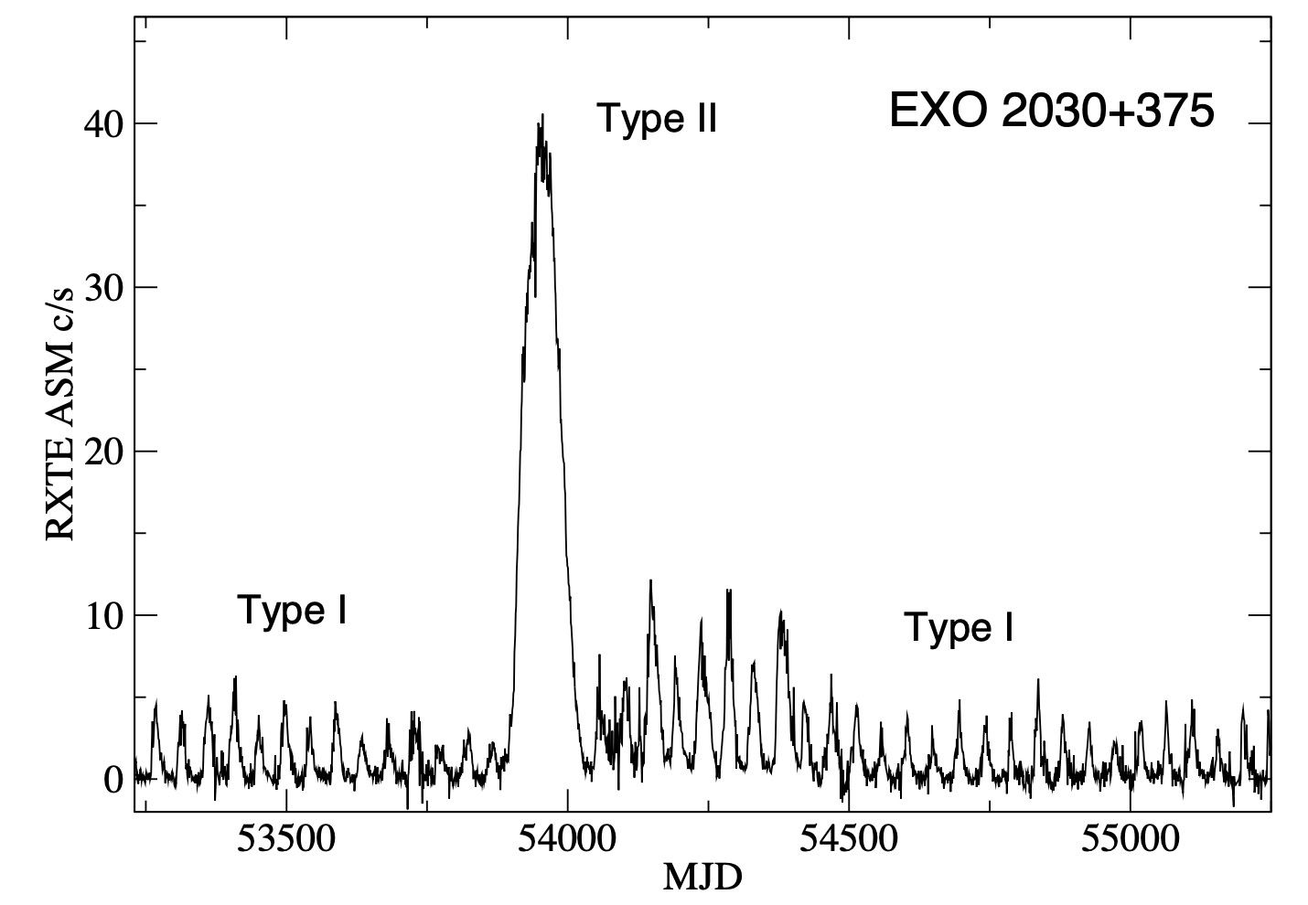
Type I and Type II outbursts in X-ray pulsars
Type I outbursts:
1. locked to periastron
2. quasi-periodic accretion
Type II outbursts:
1. warped Be-disk
2. disk accretion

Slide 16
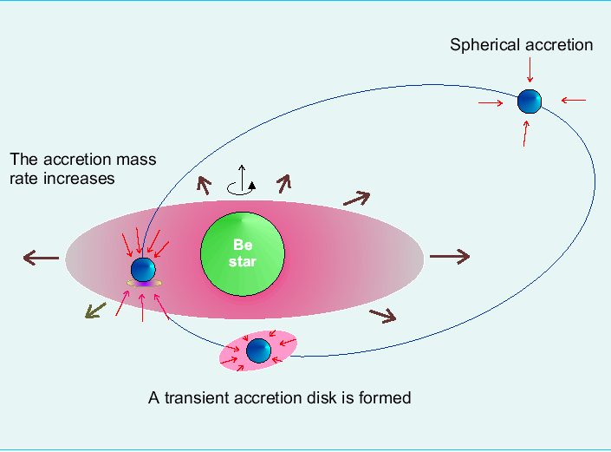
Different accretion flows in Type I and Type II outbursts

Slide 17
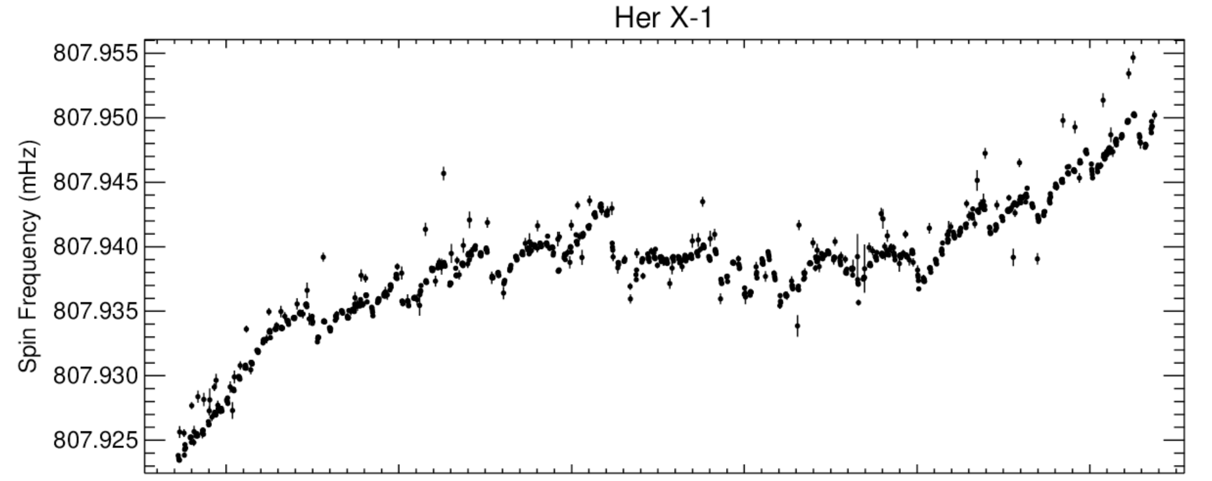
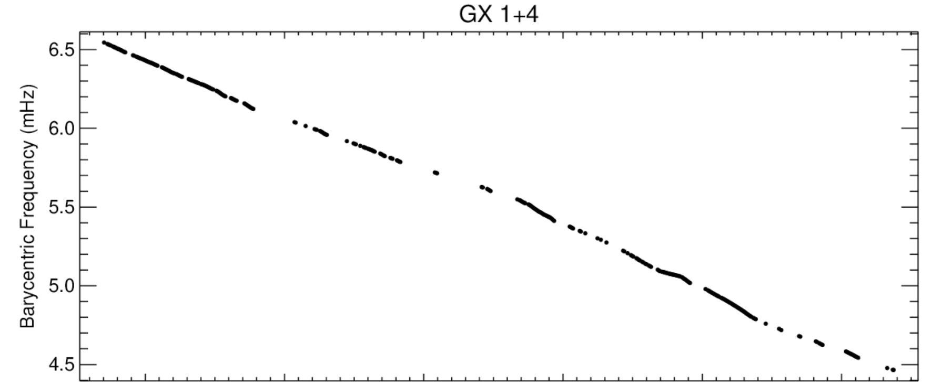
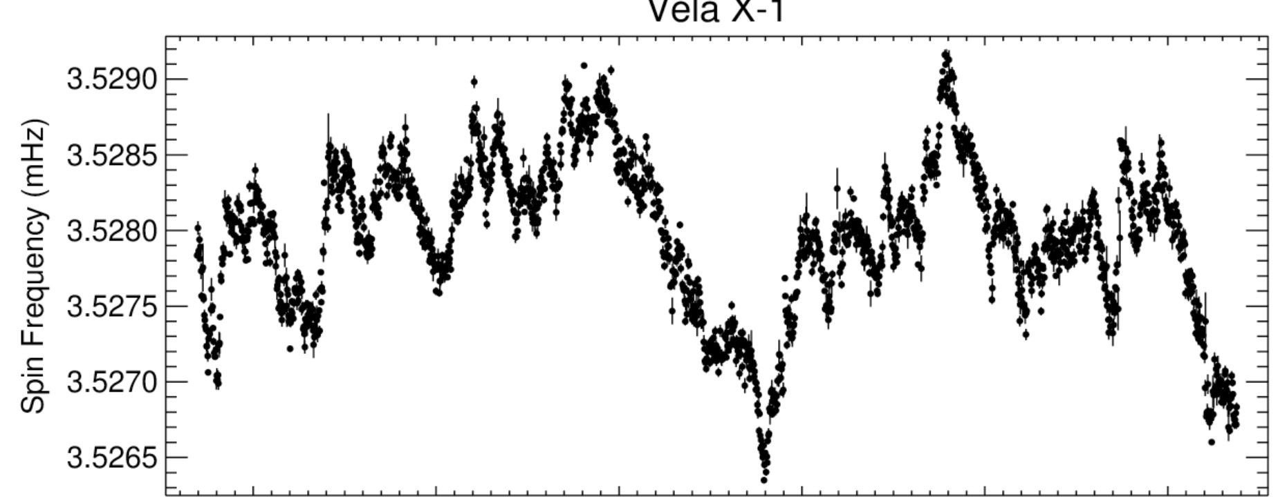

Spin evolution of accreting pulsars：persistent pulsars
Equilibrium period:
$$P_{eq}∝ B^{6/7}{\dot{M}}^{−3/7}$$

Slide 18
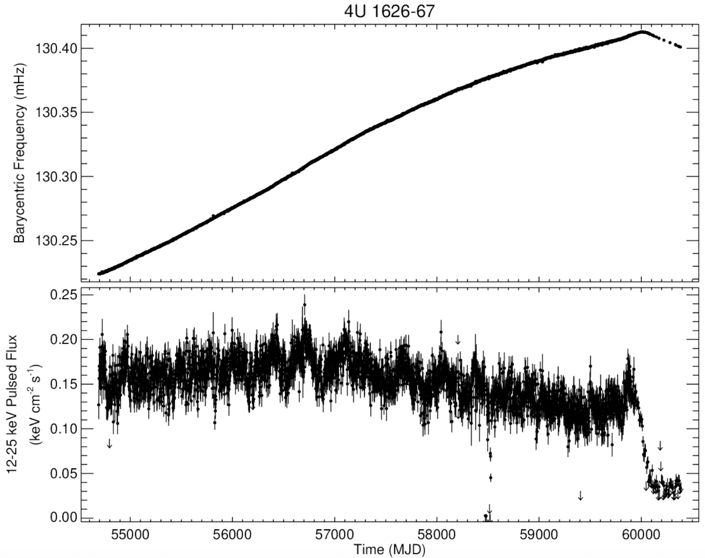
Torque reversal
Notes:
Torque reversal

Slide 19
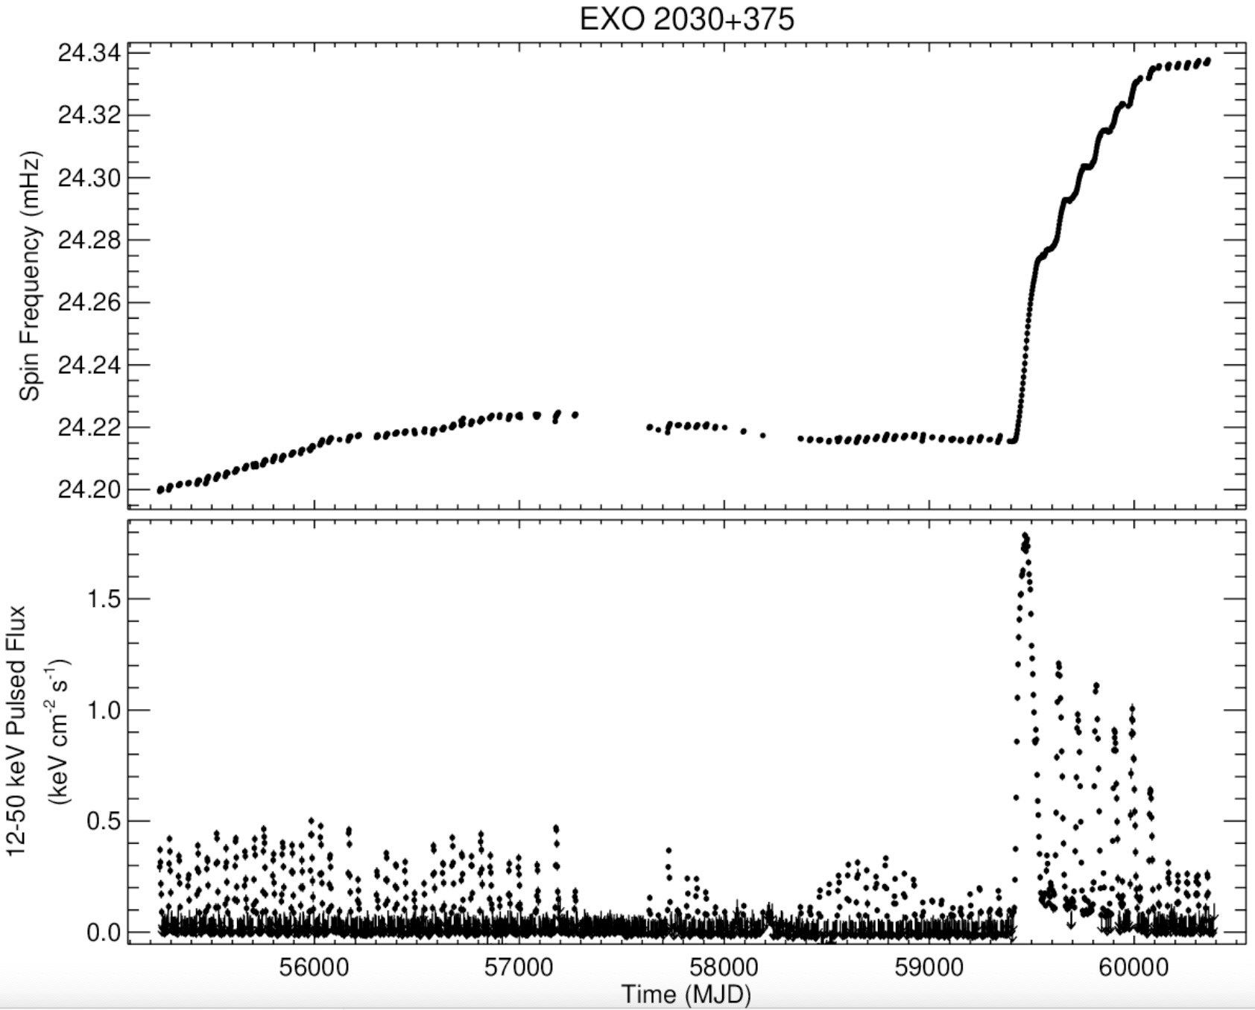
Transient pulsars are spun-up during outbursts
Notes:
XRPs are far from the spin equilibrium

Slide 20
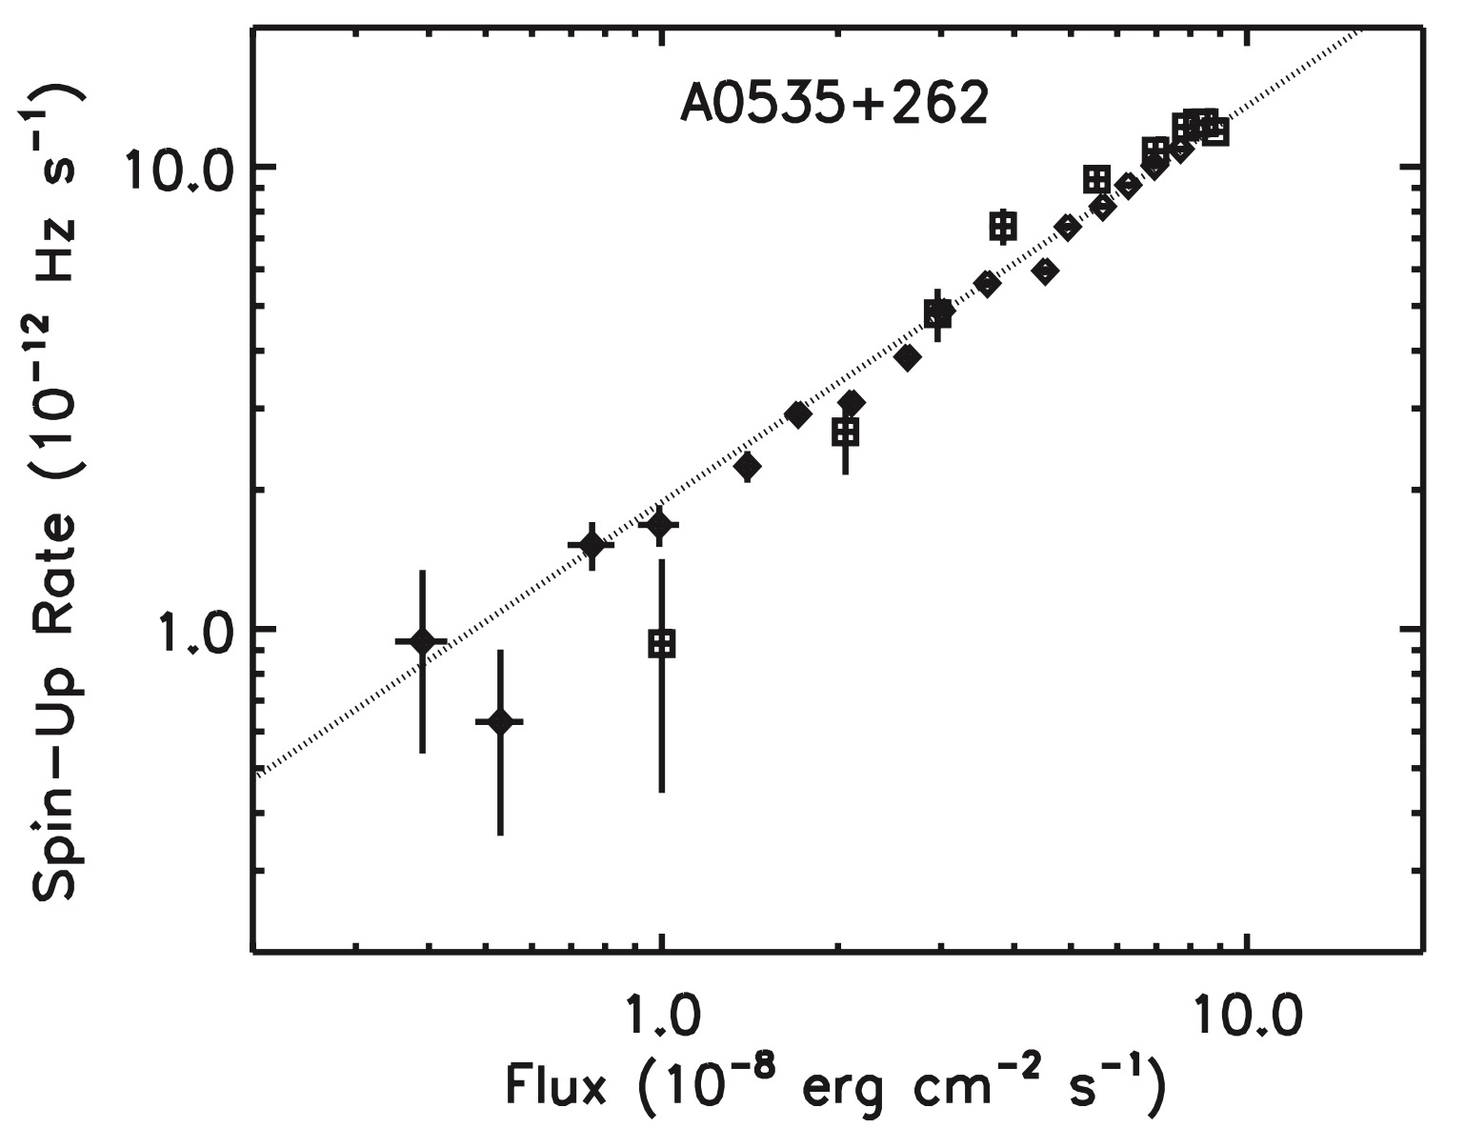
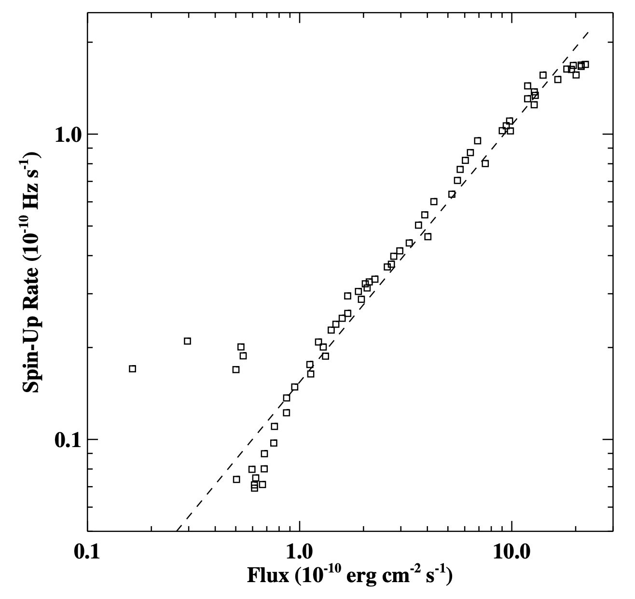
Giant outbursts: Spin-up rate is tightly correlated with X-ray luminosity
Bildsten et al. 1997
Weng et al. 2017

Slide 21
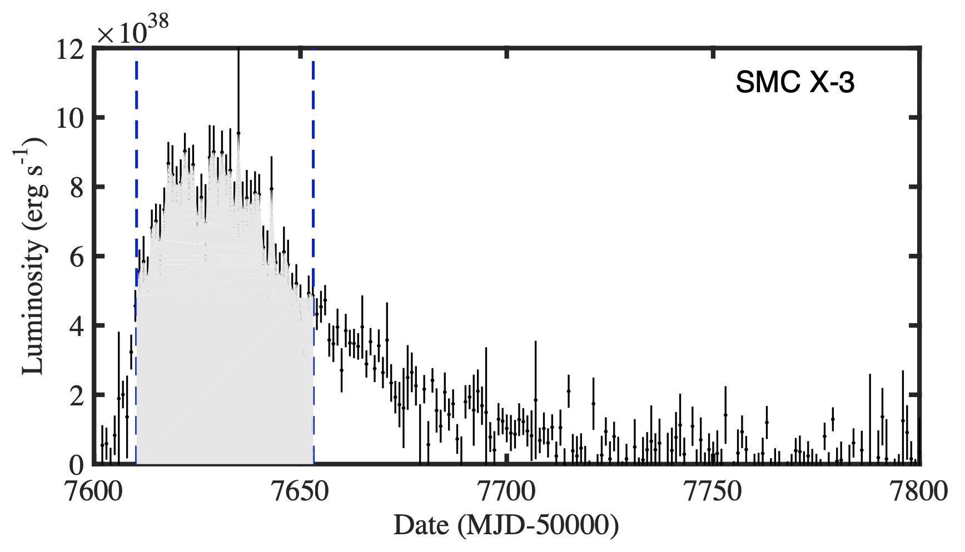
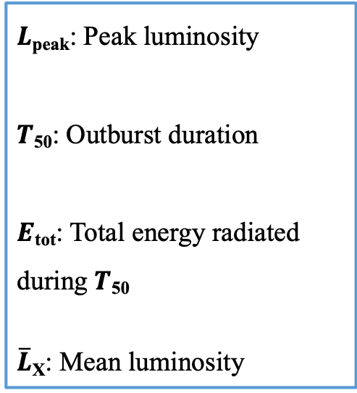
Statistical study with the X-ray monitoring data
$L$_{peak}: Peak luminosity
$T$₅₀: Outburst duration
$E$_{tot}: Total energy radiated during $T$₅₀
$\overline{L}$_{X}: Mean luminosity

Slide 22

Anti-correlations between P_{spin} and outburst parameters
The derived L_{X} – P_{spin} anti-correlation is much flatter than the prediction of spin equilibrium:
$L_{X} ∝$ $P_{eq}^{−7/3}$

Slide 24
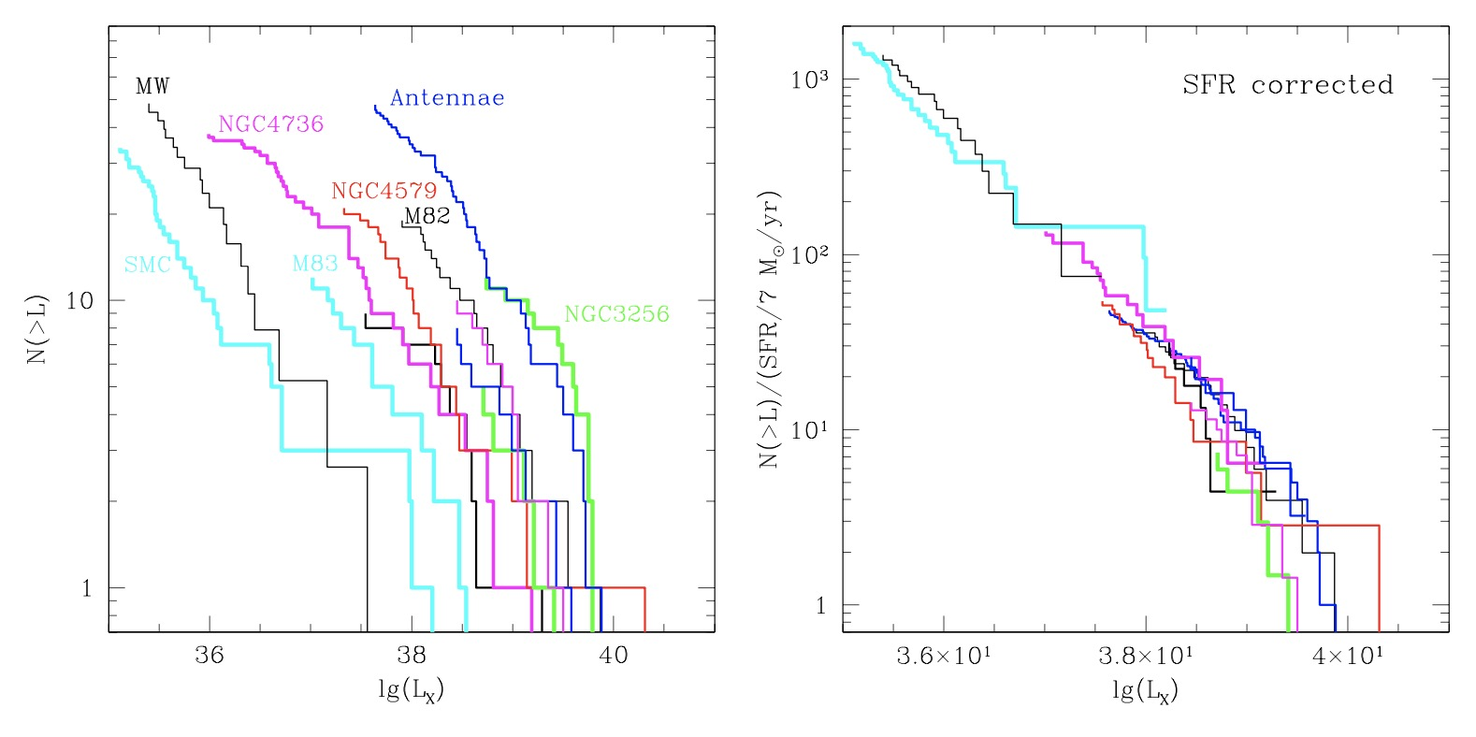
Majority of ULXs are HMXBs
Gilfanov et al. 2003
Notes:
Left: The luminosity functions of compact X-ray sources in nearby galaxies obtained by Chandra. Right: The luminosity functions for the same galaxies scaled by the ratio of their star formation rate to that of Antennae.

Slide 25
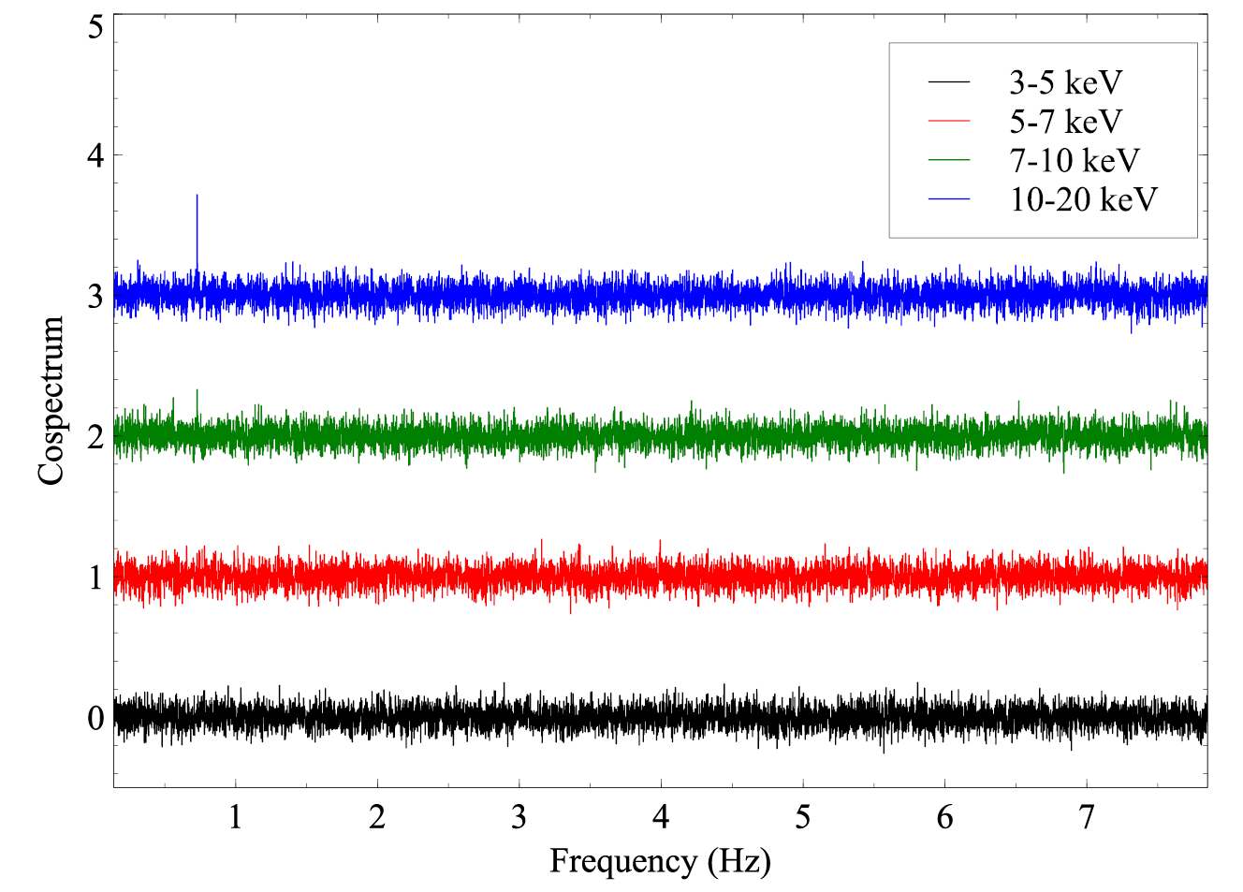
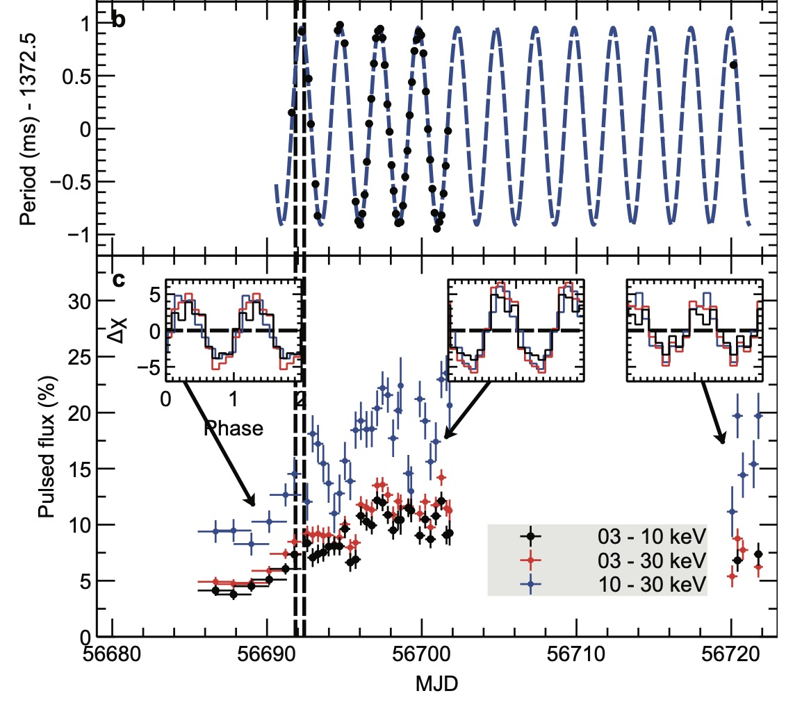
X-ray pulsations detected in ULXs
The first PULX: M82 X-2
L_{X} > 5x10³⁹ erg/s
P_{spin} = 1.37 s
P_{orb} = 2.5 d
Bachetti et al. 2014
Notes:
Panel b: detections of the pulse period (black points) fit using the best sinusoidal ephemeris (grey dashed line). The mean period is 1.37252266(12) seconds, with an orbital modulation period of 2.51784(6) days. The dashed vertical lines delineate the contemporaneous Chandra observation. Panel c shows the pulsed flux as a fraction of the emission from the 70′′ region. The inserts show the pulse profile.

Slide 26
Pulsating ultra-luminous X-ray sources
Source | P_{spin} (s) | L_{peak} (erg s⁻¹)
M82 X-2 | 1.37 | 3.7x10⁴⁰
NGC 7793 P13 | 0.42 | 1 x10⁴⁰
NGC 5907 ULX1 | 1.13 | 2.2x10⁴¹
NGC 300 ULX1 | 31.6 | 4.7x10³⁹
NGC 1313 X-2 | 1.5 | 2 x10⁴⁰
M51 ULX-7 | 2.8 | 1 x10⁴⁰

Slide 27
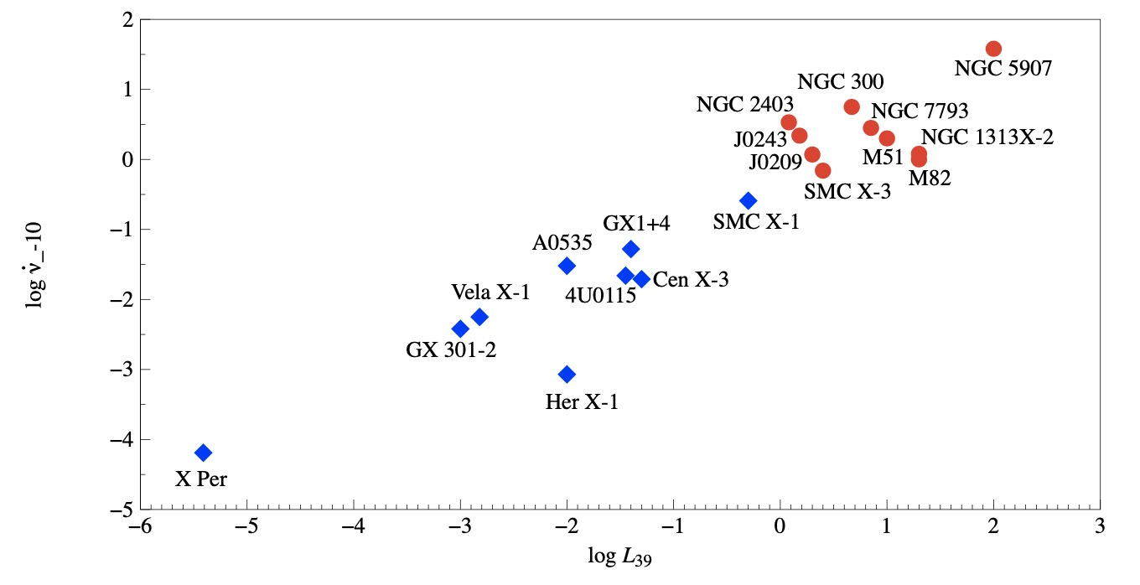
Lasota & King 2023

Slide 28
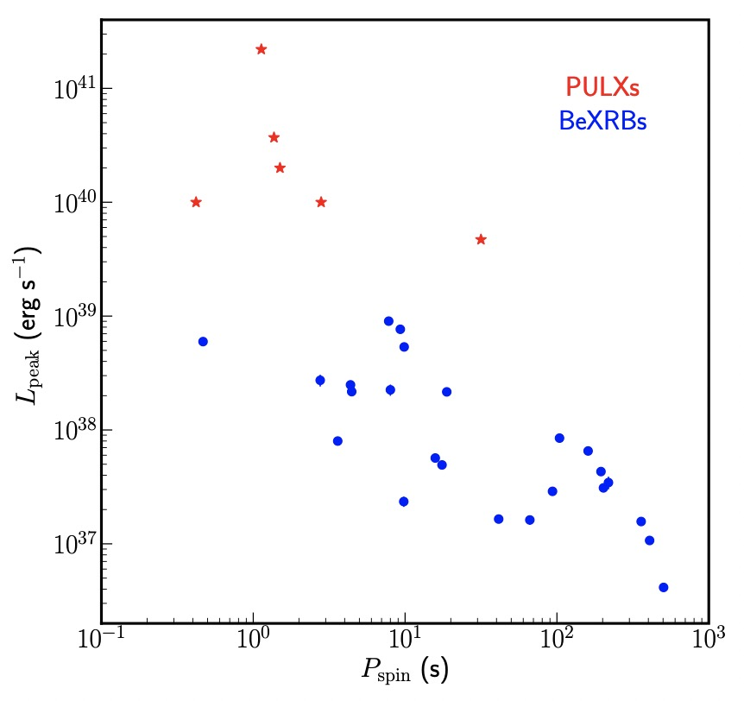
Anti-correlation between P_{spin} and L_{peak} for XRPs and PULXs

Slide 29
Summary
We detected the radio pulsation from a neutron star within the gamma-ray binary, LS I +61 303 with FAST for the first time.
We found the strong the anti-correlations between the spin periods and the outburst parameters, in particular the peak luminosity, for the disk-fed X-ray pulsars.
Thanks!

