Slide 1


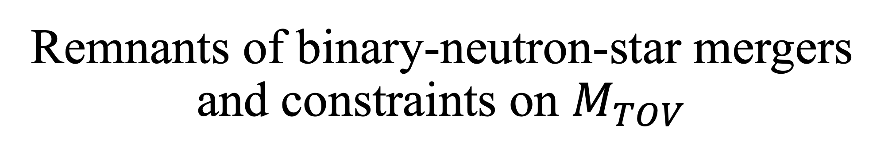
Remnants of binary-neutron-star mergers and constraints on $M_{TOV}$
Shunke Ai
Wuhan University
Collaborators:
Yikang Chen, He Gao, Bing Zhang, Lin Lan, Zong-Hong Zhu …
Dialogue at the Dream Field 2024 @ Guizhou, May 14

Slide 2
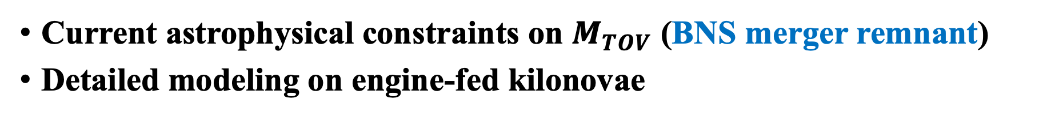
Outline
Current astrophysical constraints on $M_{TOV}$ (BNS merger remnant)
Detailed modeling on engine-fed kilonovae
Notes:
My talk has two parts. First of all, I will discuss the current astrophysical constraints on $M_{TOV}$, mainly focuses on the BNS merger remnant. Then, I could quickly introduce my recent progress on modeling the engine-fed kilonova, which is one of the crucial features related to a long-lived magnetar.

Slide 3
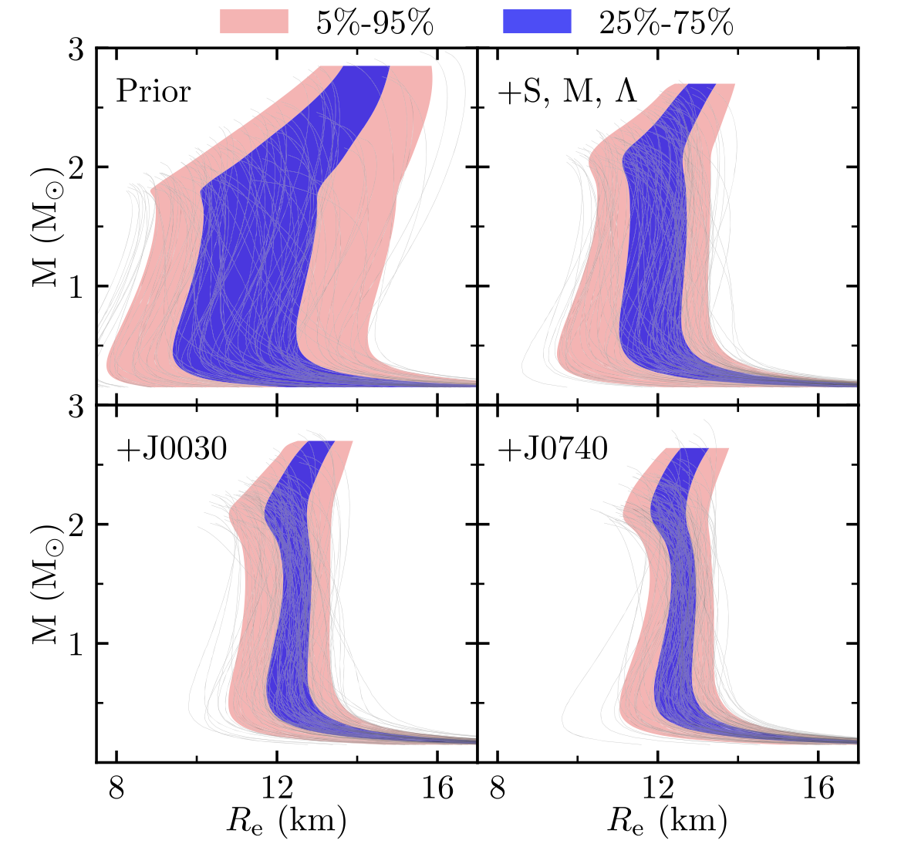
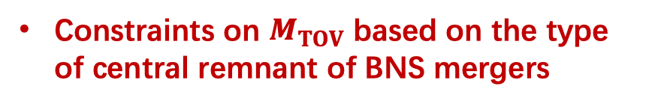
Existing constraints on NS EoS
Most massive pulsars (e.g. J0952-0607)
Radius measurement of massive pulsars
tidal deformability measurements through BNS mergers with GWs (GW170817, GW190425)
Constraints on $M_{TOV}$ based on the type of central remnant of BNS mergers
Miller et al. 2021,APJL,918,28
Li et al. 2021, APJ, 913,27
Notes:
The existing constraints on NS EOS comes from mass and radius measurement of massive pulsars, and the tidal deformability information obtained through GW detection of BNS mergers. These have been discussed for many times these days. People has included all of these observational evidence together into Bayesian inference framework. This is results from Miller 2021, I know Prof. Li ang has another similar work for the NSs with a Quark core.
Here I just want to show that, with more and more information, the constraints on compactness of getting better. However, the constraints on maximum mass was not improved. If one can have the total mass of BNS merger system from GW data and can also determine the remnant type, a constraint on the maximum mass of NSs can be directly posed.

Slide 4
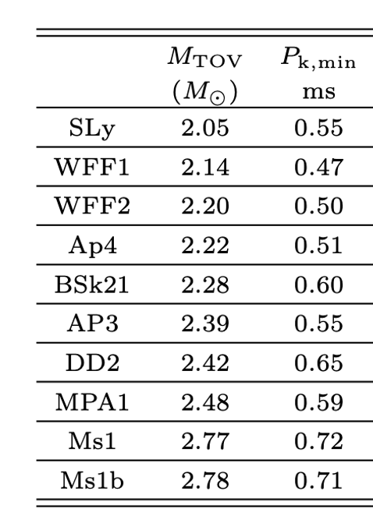
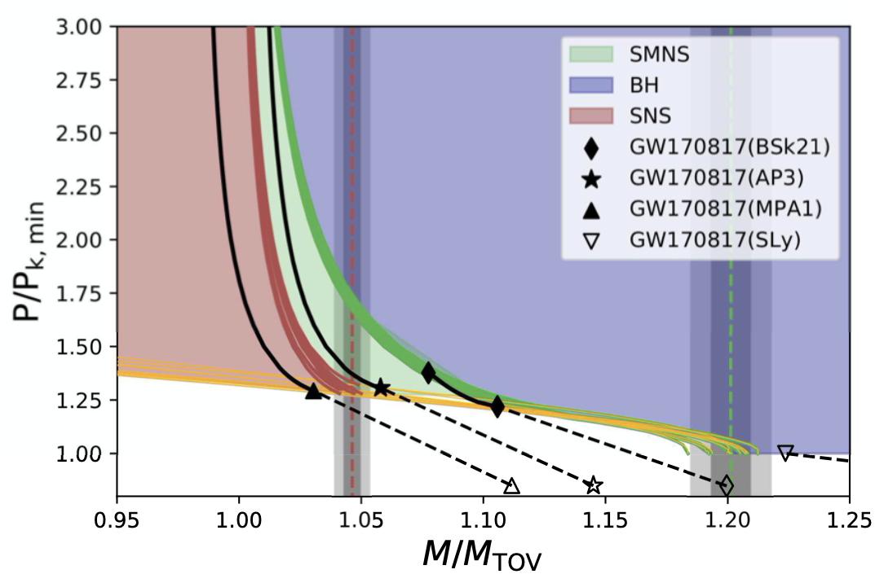
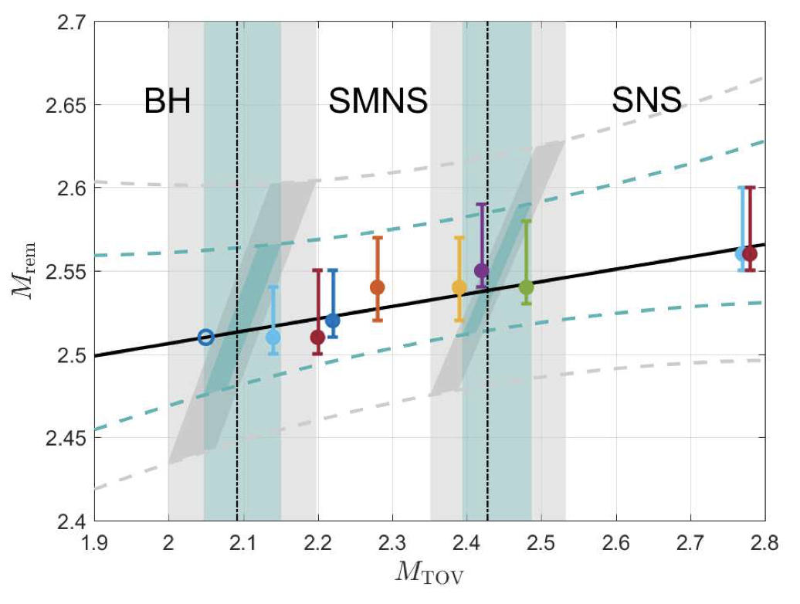


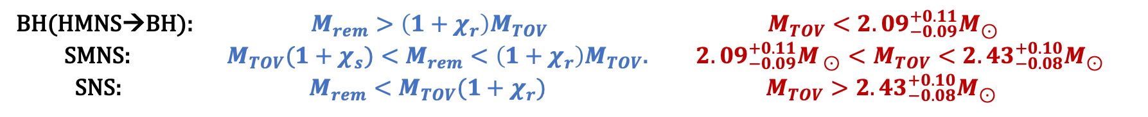

Remnant of GW170817
$M_{TOV}<\sim 2.3M_{⊙}$ (Shibata et al. 2019)
Universal relations for rigidly rotating NSs
(Ai, Gao & Zhang 2020, APJ, 893,146)
$$χ_{r}\sim 0.2, χ_{s}\sim 0.05$$
GW → $M_{tot}$→ $M_{rem}$
BH(HMNS→BH): $M_{rem}>\left(1+χ_{r}\right)M_{TOV}$ $M_{TOV}<{2.09}_{−0.09}^{+0.11}M_{⊙}$
SMNS: $M_{TOV}(1+χ_{s})<M_{rem}<\left(1+χ_{r}\right)M_{TOV}$. ${{2.09}_{−0.09}^{+0.11}M_{ ⊙}<M}_{TOV}<{2.43}_{−0.08}^{+0.10}M_{⊙}$
SNS: $M_{rem}<M_{TOV}(1+χ_{r})$ $M_{TOV}>{2.43}_{−0.08}^{+0.10}M_{⊙}$
Notes:
What was produced after GW170817 is still unclear. So we can

Slide 5
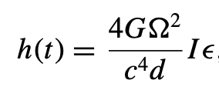
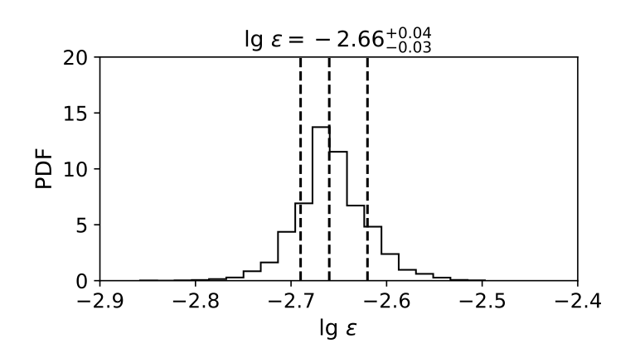
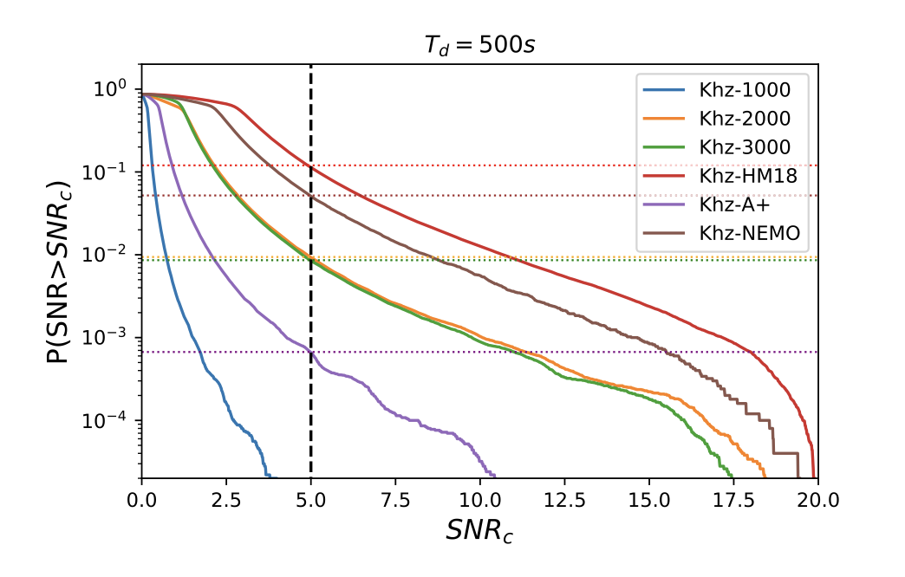
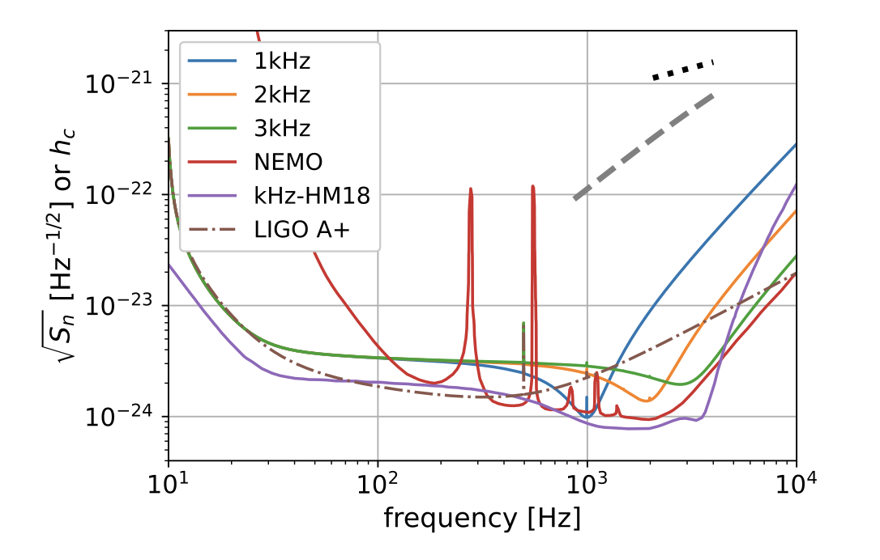
Can we pin our hope on post-merger GWs detection?
Secular GW signal from a long-lived post-merger NS
$1\%\sim 10\%$ of BNS mergers detected by LIGO A+ will have a detectable secular GW signal
Very advanced kilohertz GW detector is required
(Chen, Liu, Ai et al. 2023,MNRAS)

Slide 6
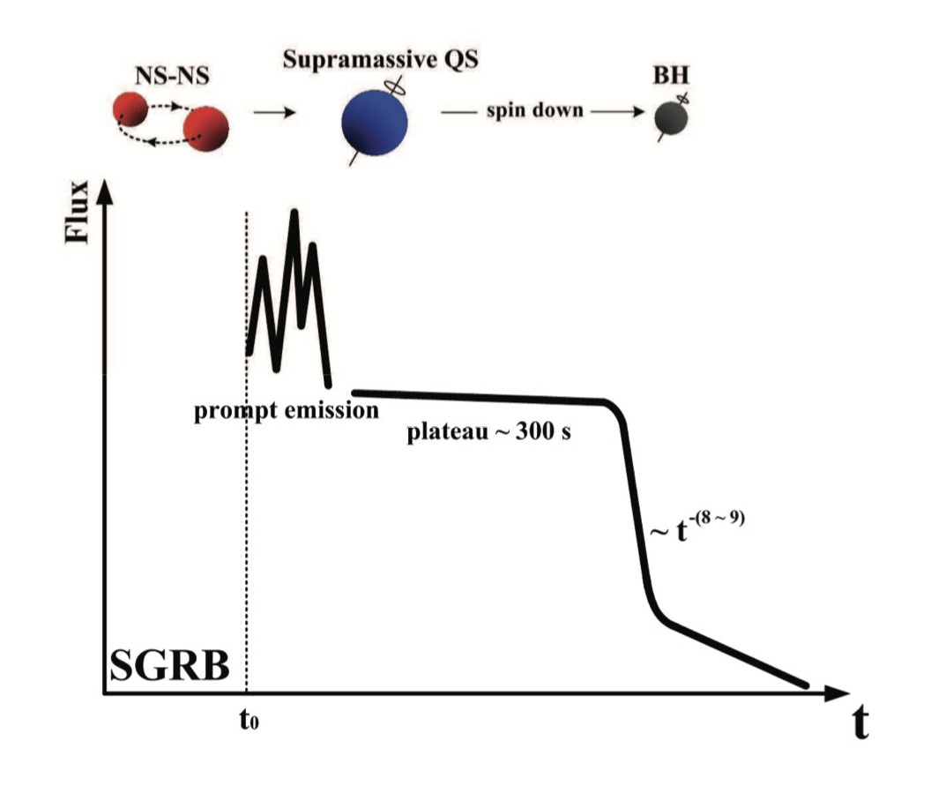
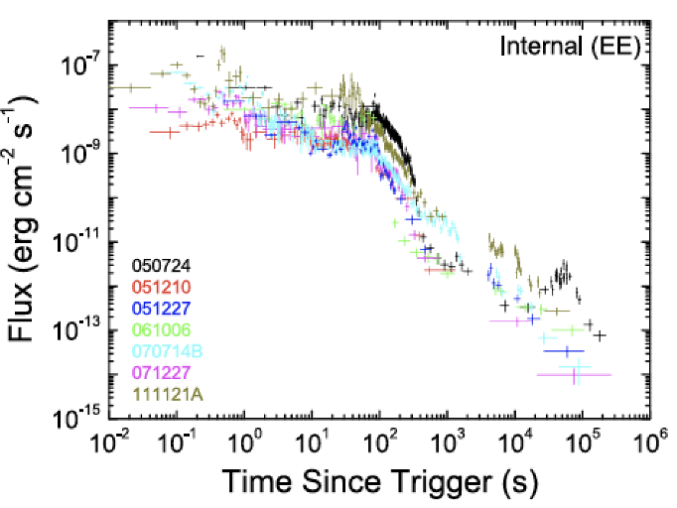
EM features associated with a SMNS
X-ray Internal plateau: SMNS → BH (Bing’s talk)
CDF-S-XT1
(Bauer et al. 2017, MNRAS)
CDF-S-XT2
(Xue et al. 2019, Nature)
XRT240423
(Ai & Zhang 2023, APJL)
GRB230307A
(Sun et al. 2023)
…….
See Sun et al. 2017, 2019
for a unified model
(Li et al. 2016)
(Lü et al. 2015)

Slide 7
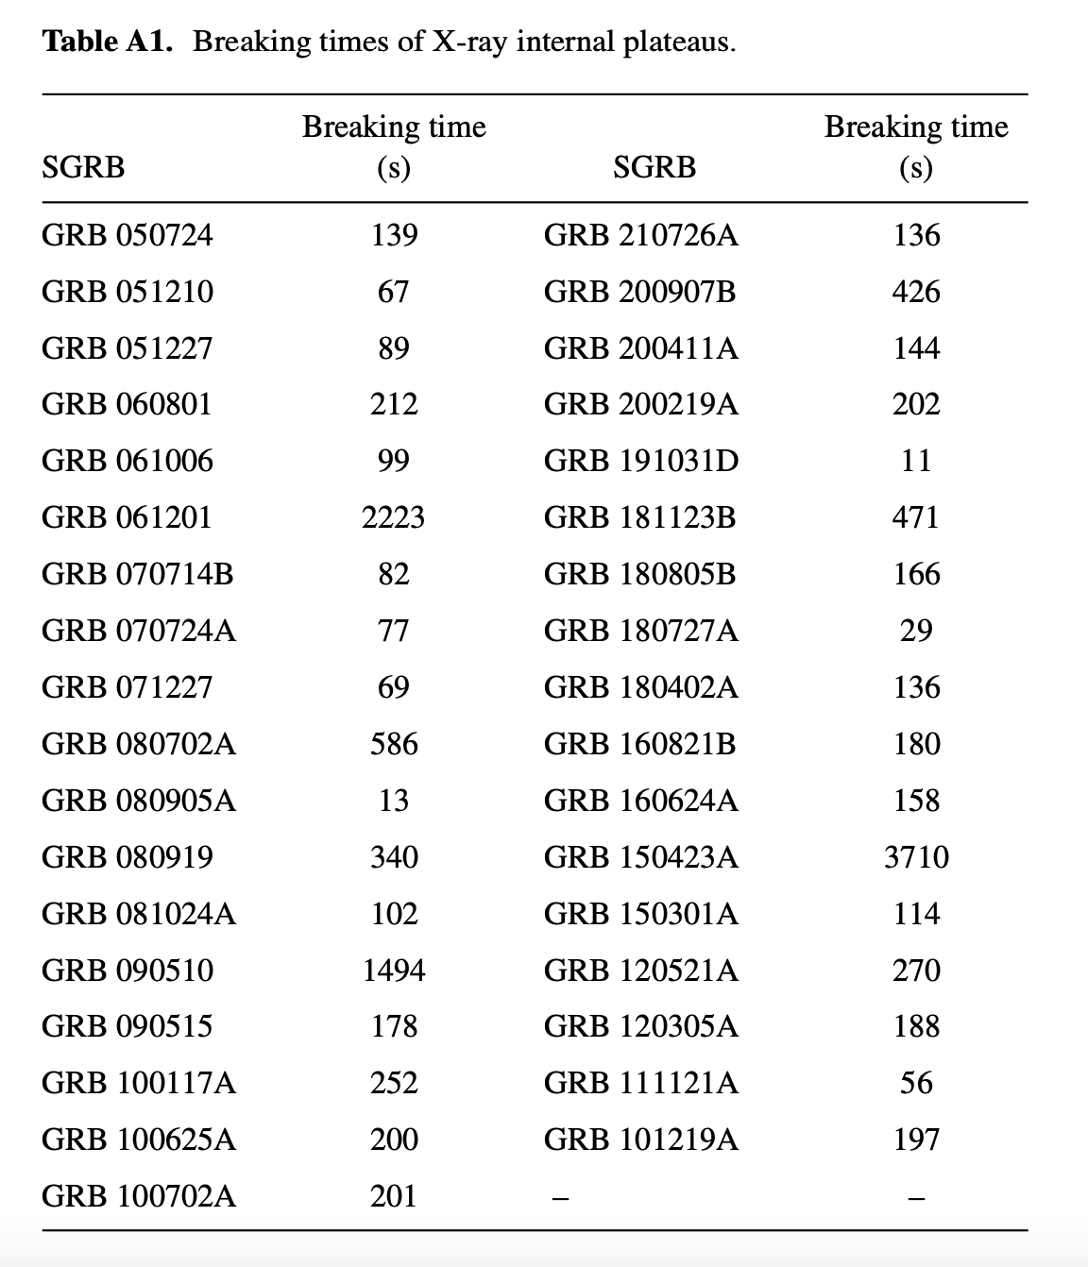

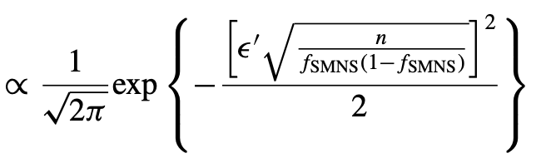

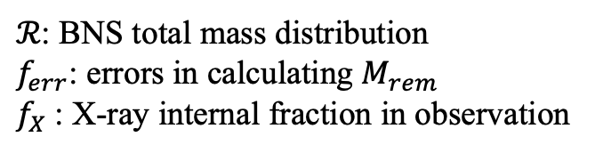
Only EM observation
$ℛ$: BNS total mass distribution
$f_{err}$: errors in calculating $M_{rem}$
$f_{X}$: X-ray internal fraction in observation
(Gao et al. 2016,PRD; Ai et al. 2023,MNRAS)
144 short GRBs with X-ray afterglows detected by Swift
35 has X-ray internal plateau
~22%
Notes:
De Moivre-Laplace central limit theorem

Slide 8
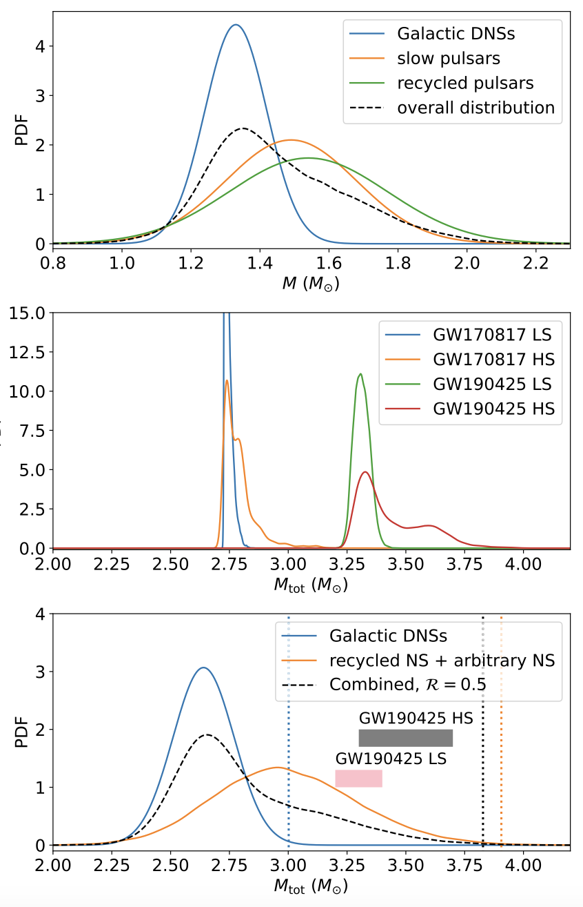
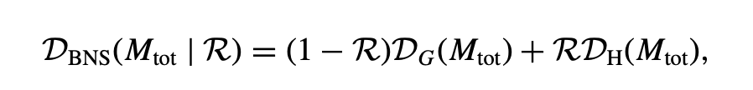
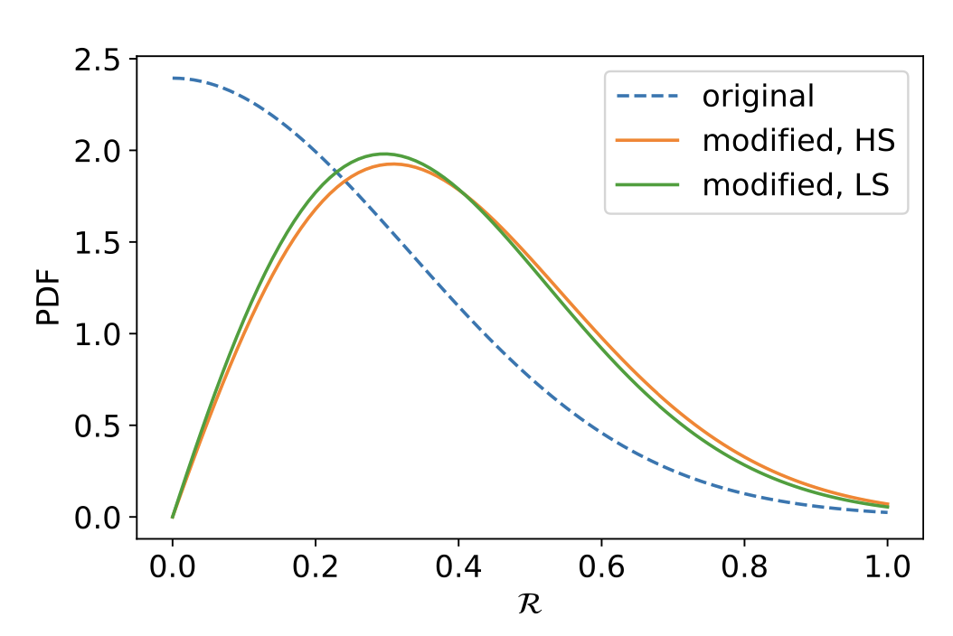
Mass distribution of BNS mergers
Two components:
Galactic BNS mass distribution
BNS systems containing at least one recycled pulsar
(Ai et al. 2023, MNRAS)

Slide 9
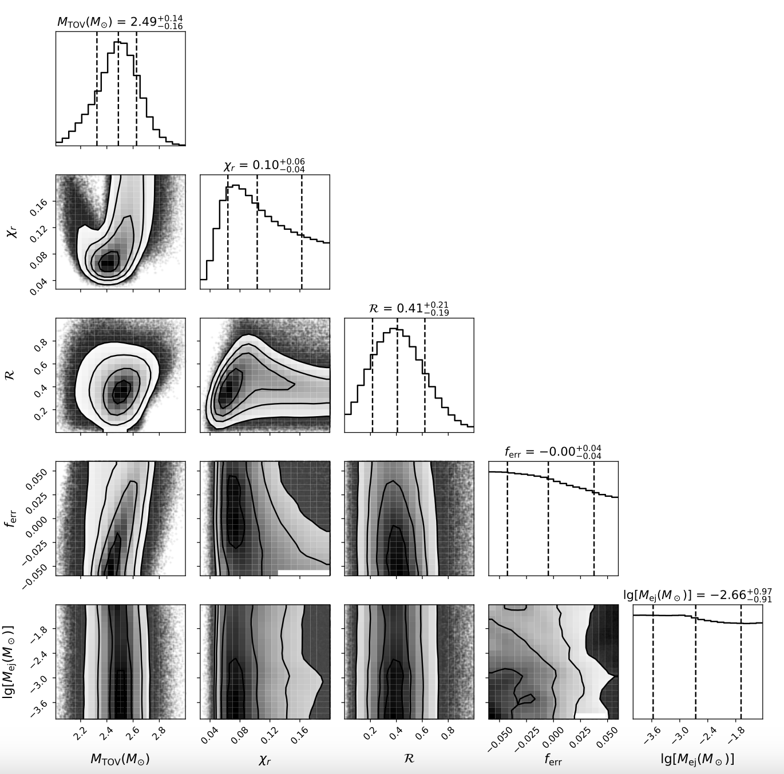
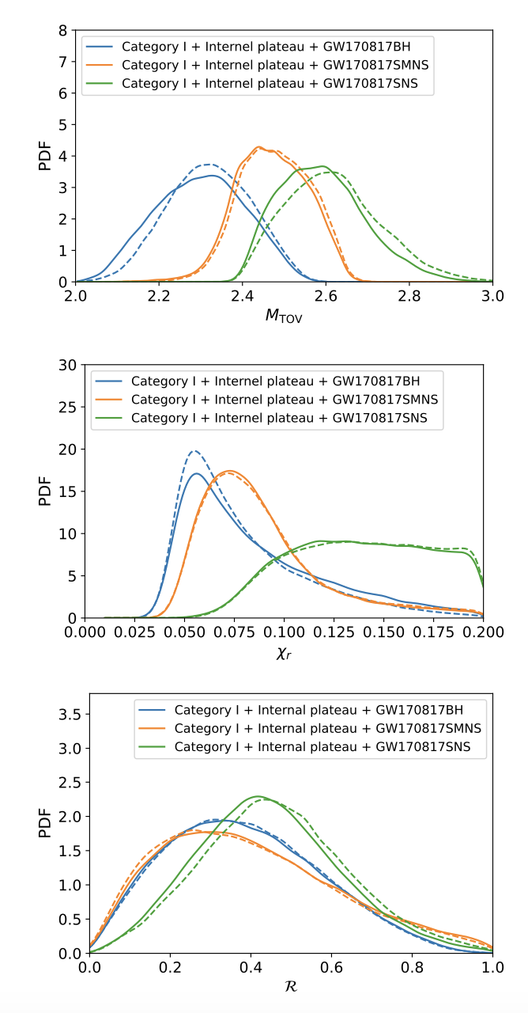

All previous constraints + X-ray internal plateau fraction
$$M_{TOV}\sim 2.5±0.15M_{⊙}$$
(Ai et al. 2023, MNRAS)

Slide 10
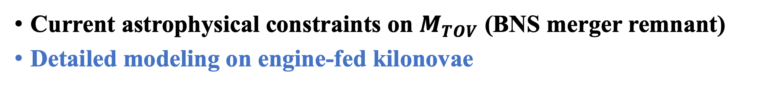
Outline
Current astrophysical constraints on $M_{TOV}$ (BNS merger remnant)
Detailed modeling on engine-fed kilonovae

Slide 11
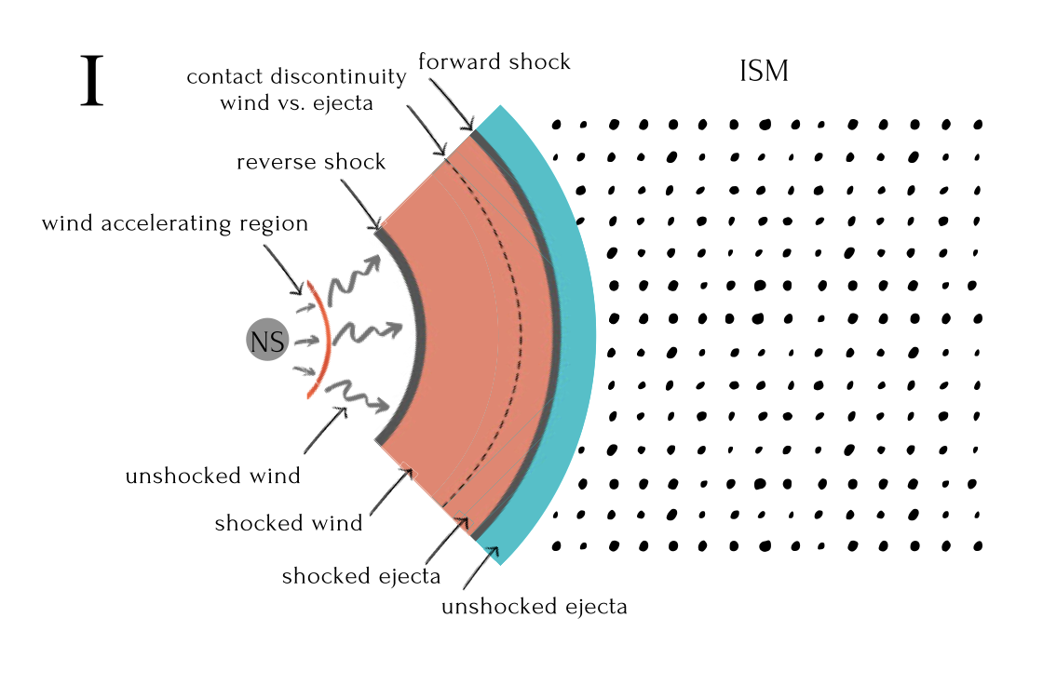
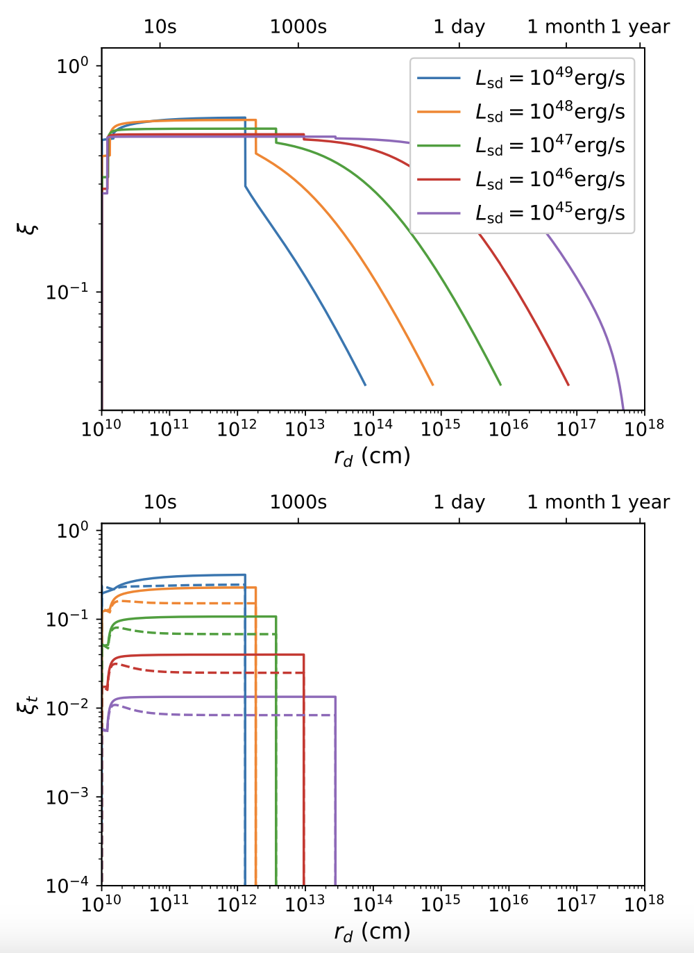
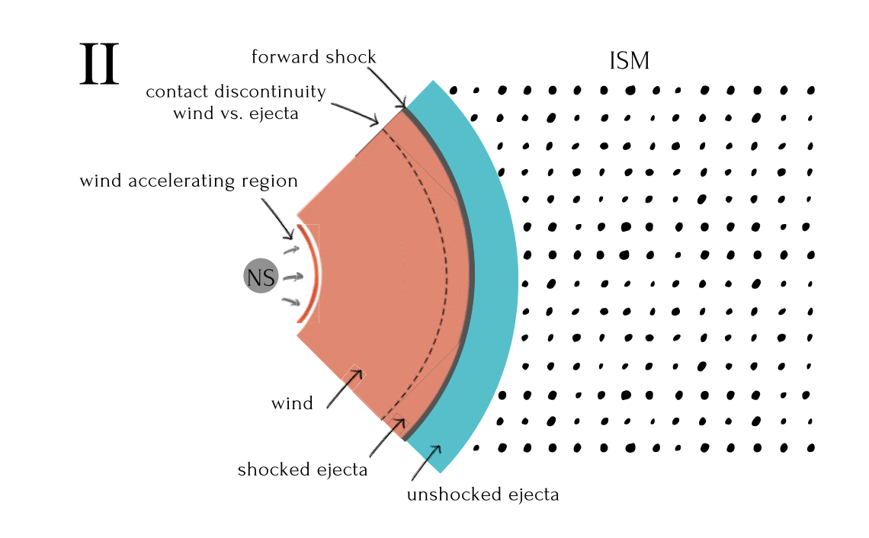


Engine-fed kilonovae (dynamics & heating efficiency)
$$ξ≈0.3\sim 0.6$$
$$ξ_{t}≈0.01\sim 0.3$$
(Ai, Zhang & Zhu, 2022, MNRAS)

Slide 12
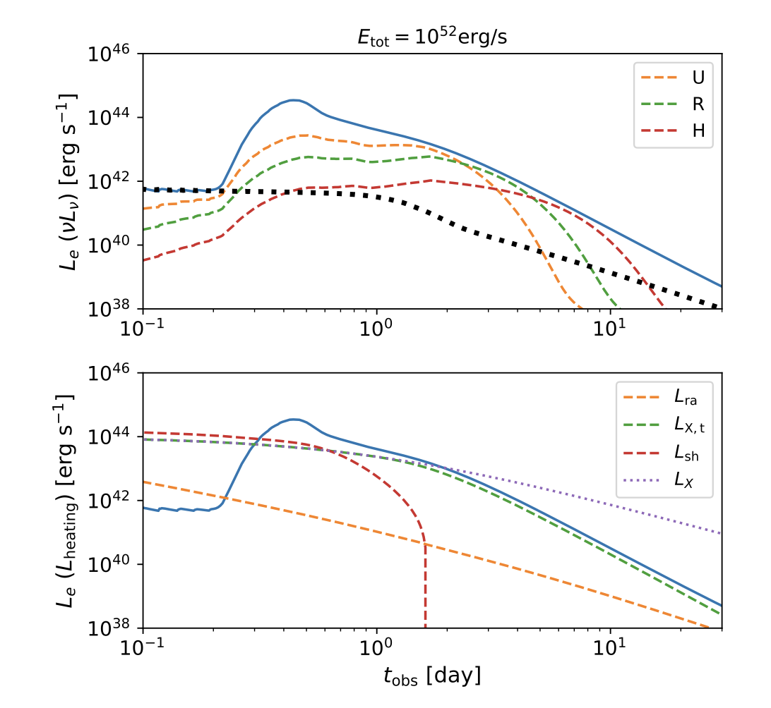
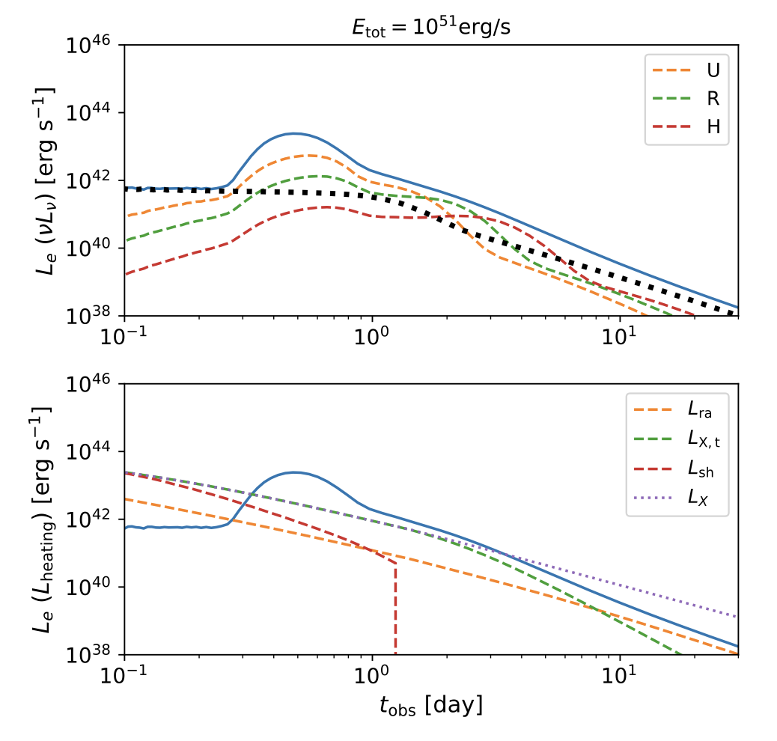
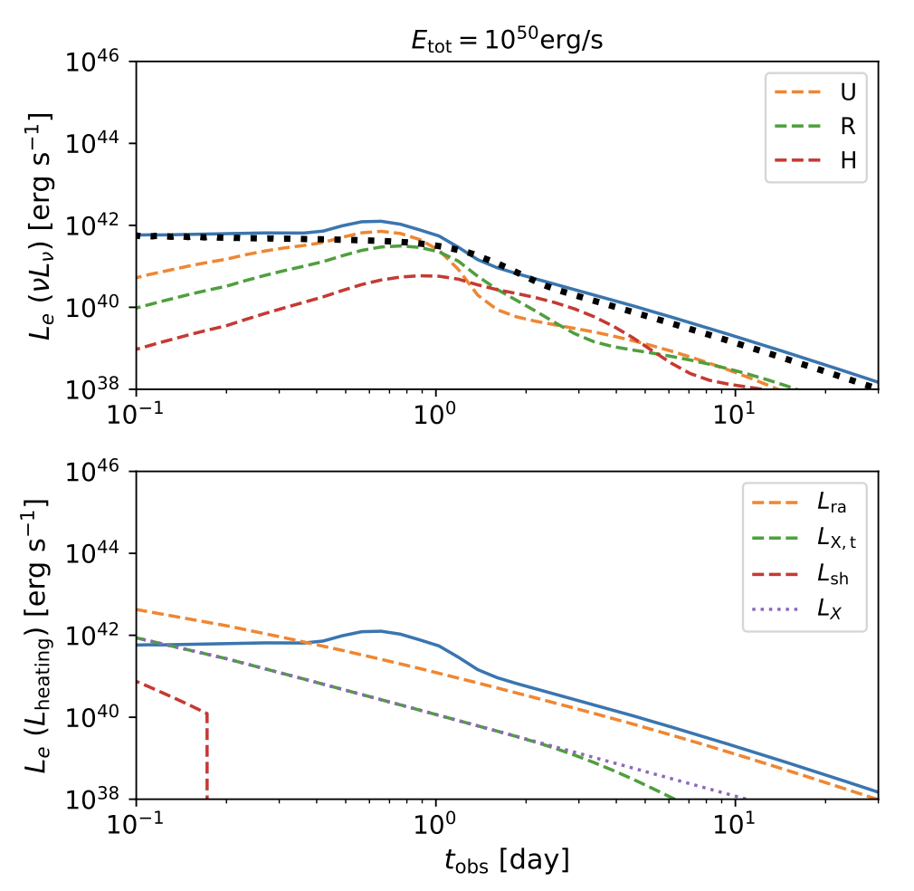
Case I: high spin-down luminosity ($L_{sd}={10}^{47}$erg/s)
(Ai, Gao & Zhang, 2024, arXiv: 2405.00638)
Early blue bump
Late-time luminosity depends on the total energy budget and the fraction of wind dissipating into X-rays

Slide 13
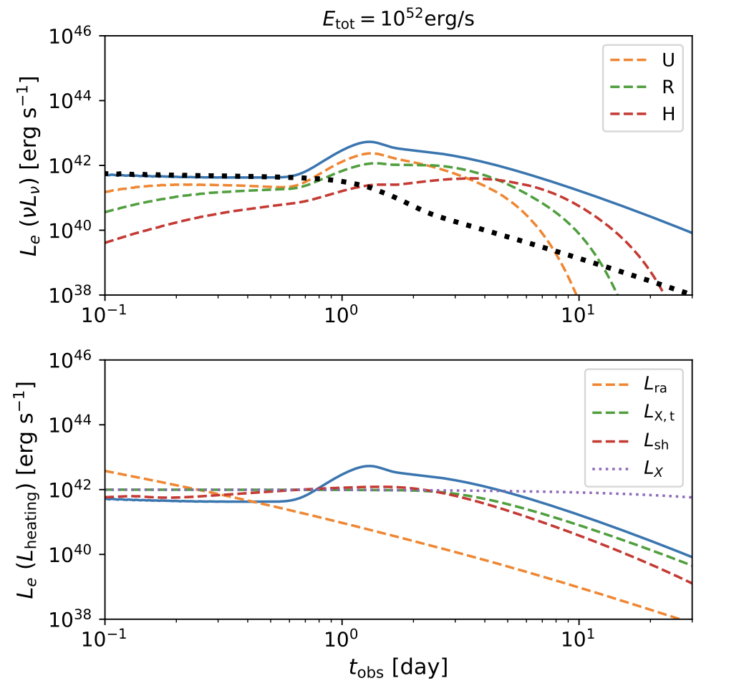
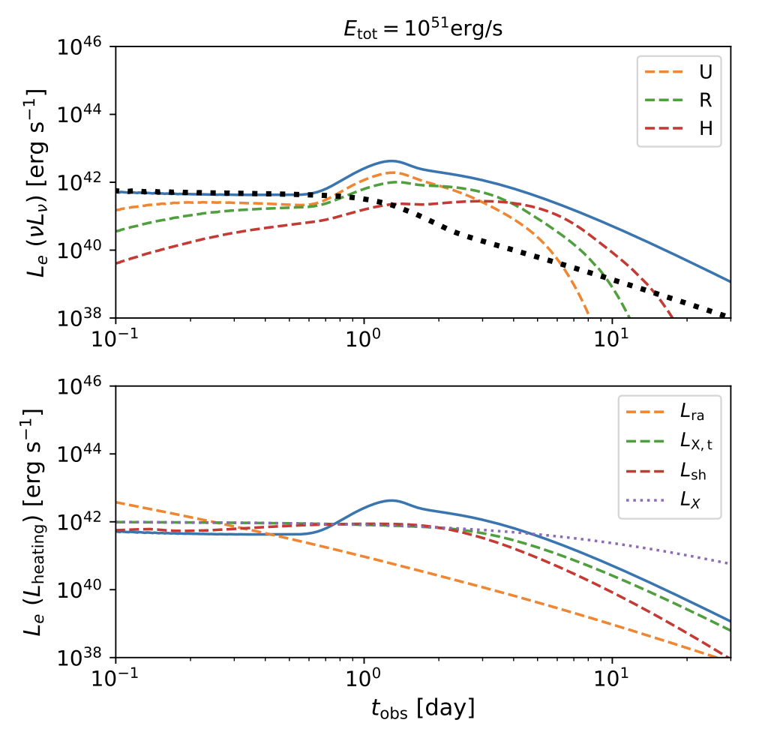
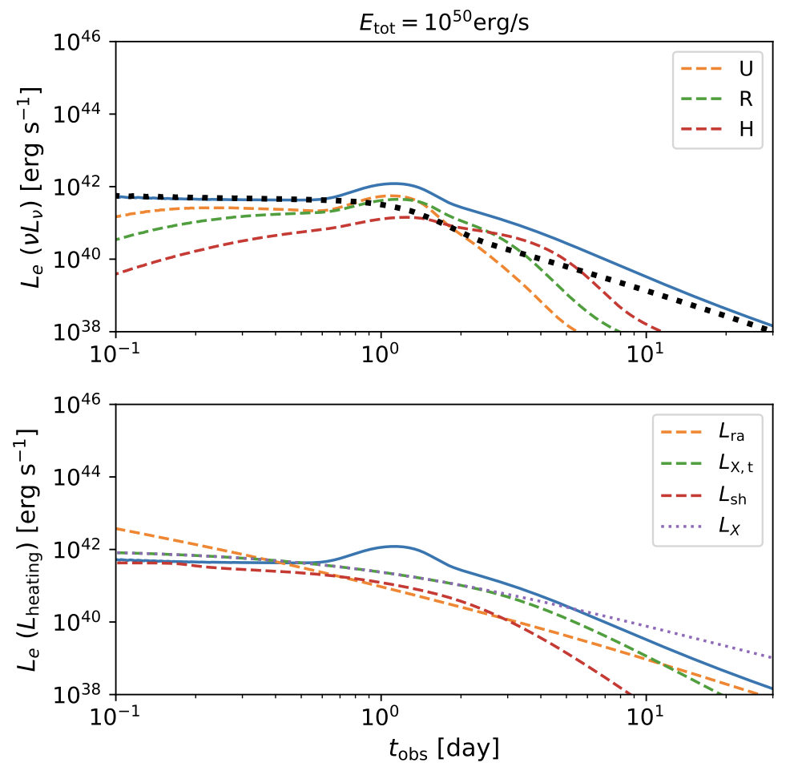
Case II: high spin-down luminosity ($L_{sd}={10}^{45}$erg/s)
(Ai, Gao & Zhang, 2024, arXiv: 2405.00638)
Early blue bump is not clear
A substantial brightening in the relatively late stage

Slide 14
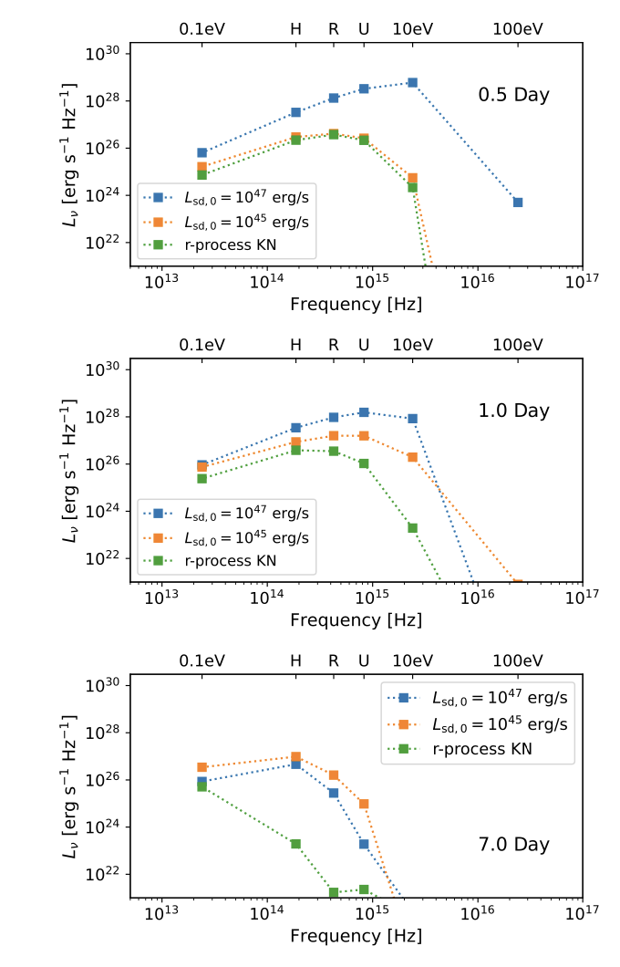
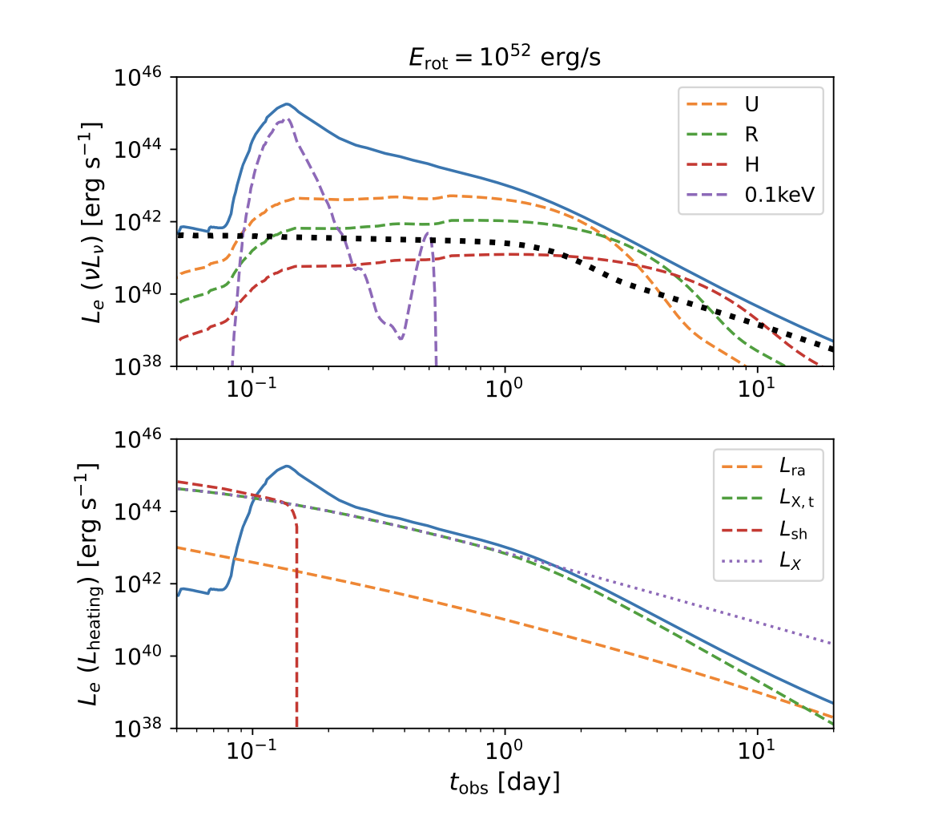
Engine-fed kilonova is relatively blue

Slide 15
Energy injection to interpret the blue component?
Correction: blue and red components are backwards

Slide 16
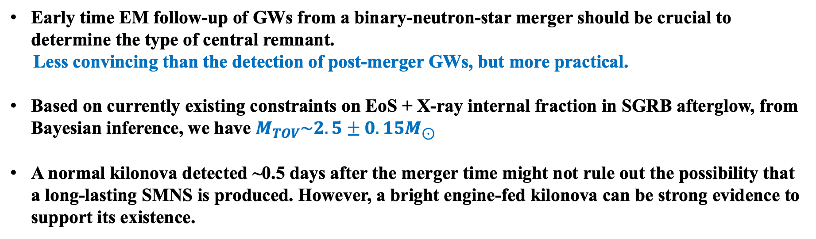
Summary:
Early time EM follow-up of GWs from a binary-neutron-star merger should be crucial to determine the type of central remnant.
Less convincing than the detection of post-merger GWs, but more practical.
Based on currently existing constraints on EoS + X-ray internal fraction in SGRB afterglow, from Bayesian inference, we have $M_{TOV}\sim 2.5±0.15M_{⊙}$
A normal kilonova detected ~0.5 days after the merger time might not rule out the possibility that a long-lasting SMNS is produced. However, a bright engine-fed kilonova can be strong evidence to support its existence.

