Slide 1
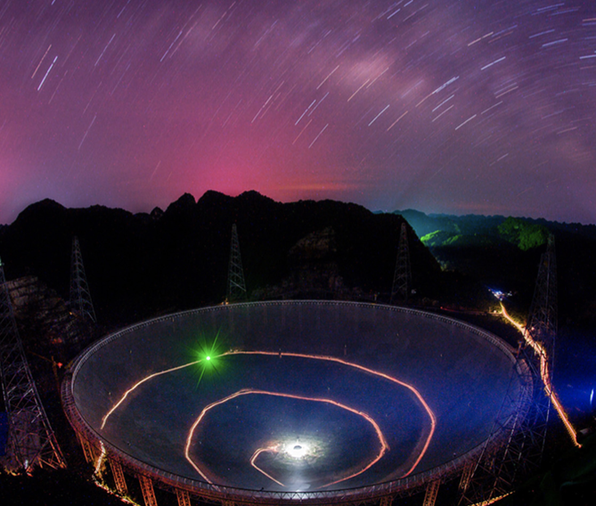
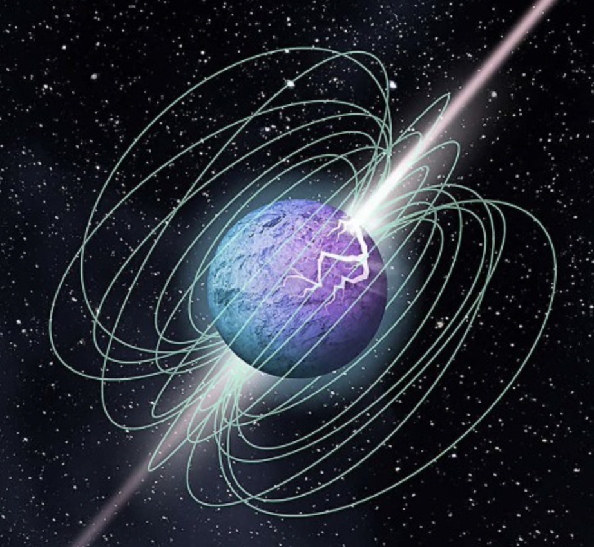
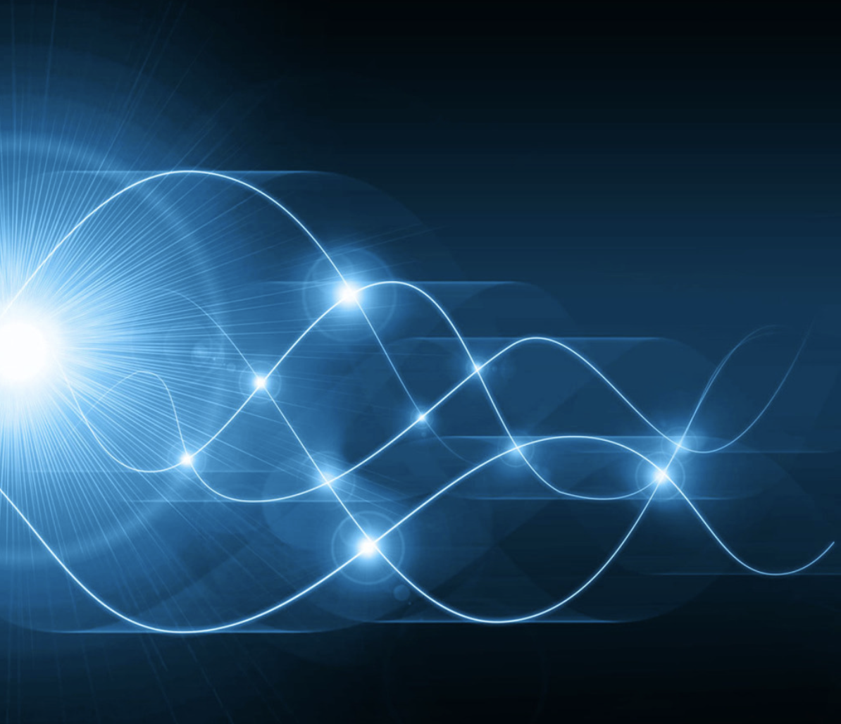
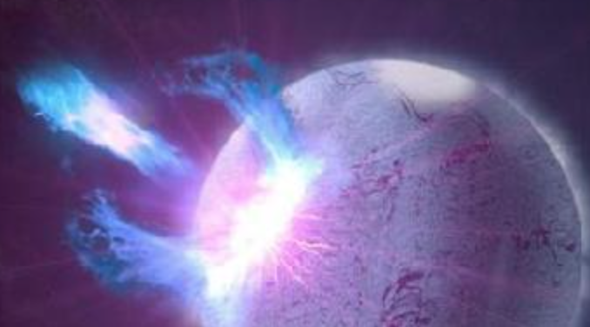




Magnetospheric origin of repeating
Fast Radio Burst
Weiyang Wang（王维扬）
University of Chinese Academy of Sciences
School of Astronomy and Space Science
2024.5.14 @DDF conference

Slide 2
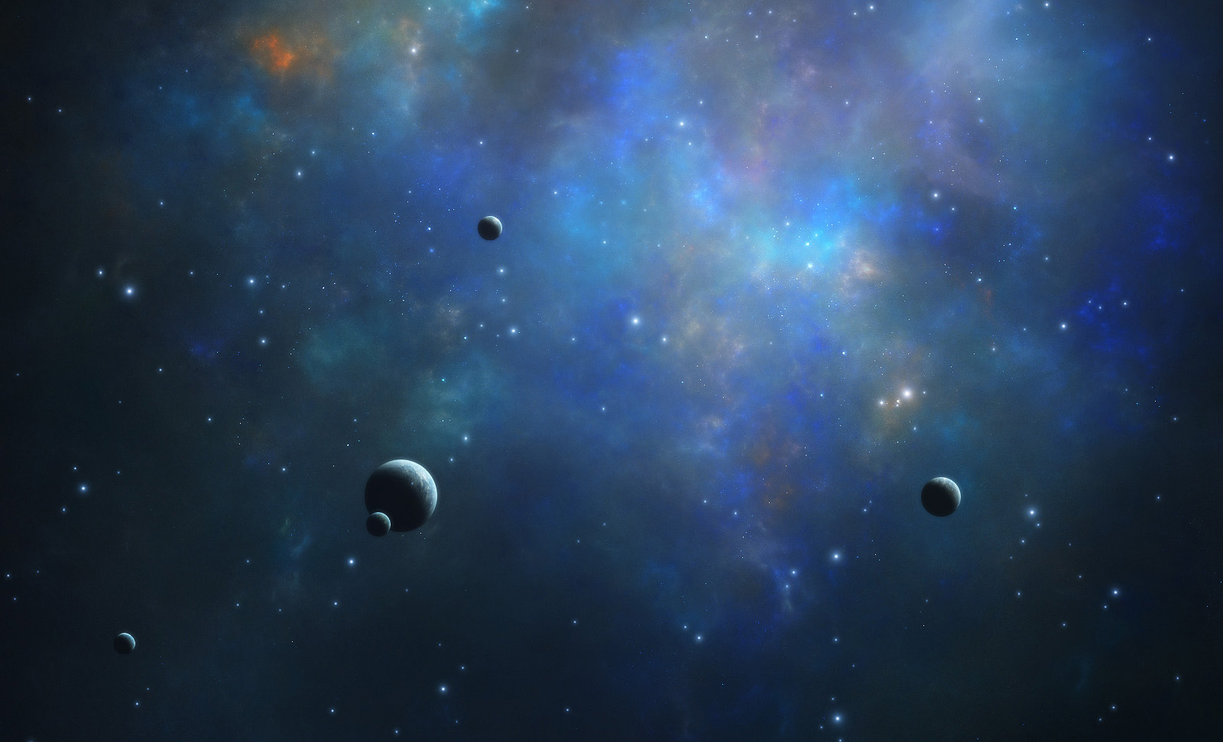
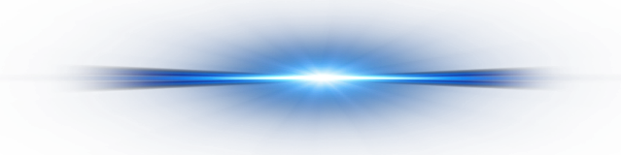

OUTLINES
Background
Origin and Radiation
Discussion
Summary

Slide 3
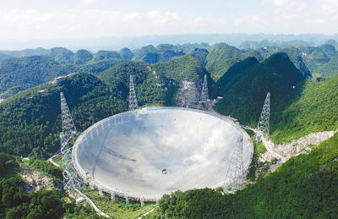
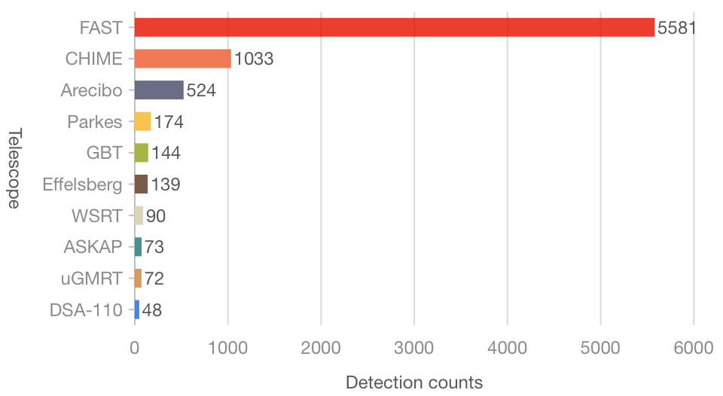
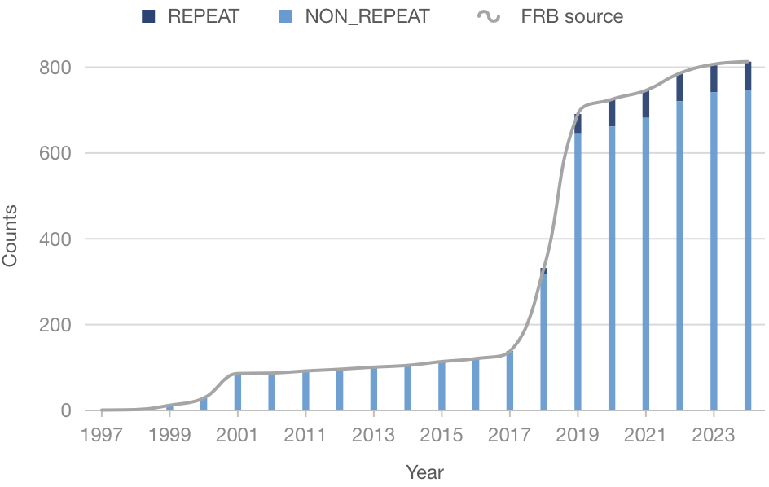
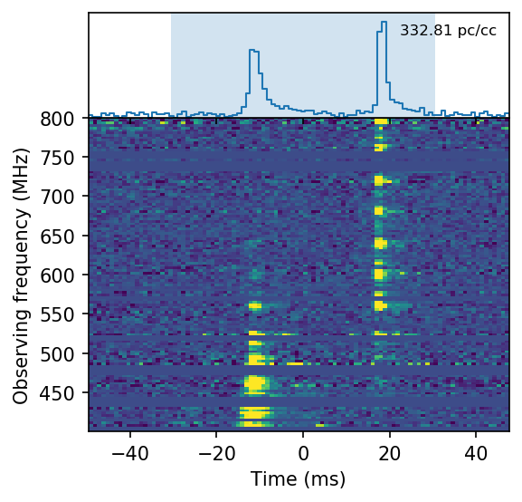
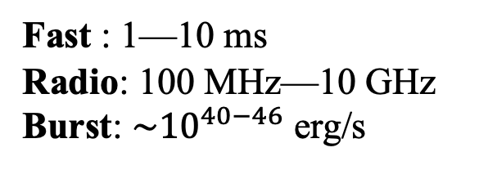
Discovery
Fast : 1—10 ms
Radio: 100 MHz—10 GHz
Burst: ${\sim 10}^{40−46}$ erg/s
800+ FRB sources
60+ repeaters
One is Galactic magnetar
CHIME et al. 2020, Nature
Key questions:
How to trigger FRB?
What is the radiation mechanism?
FRB-like Burst from SGR J1935+2154

Slide 4
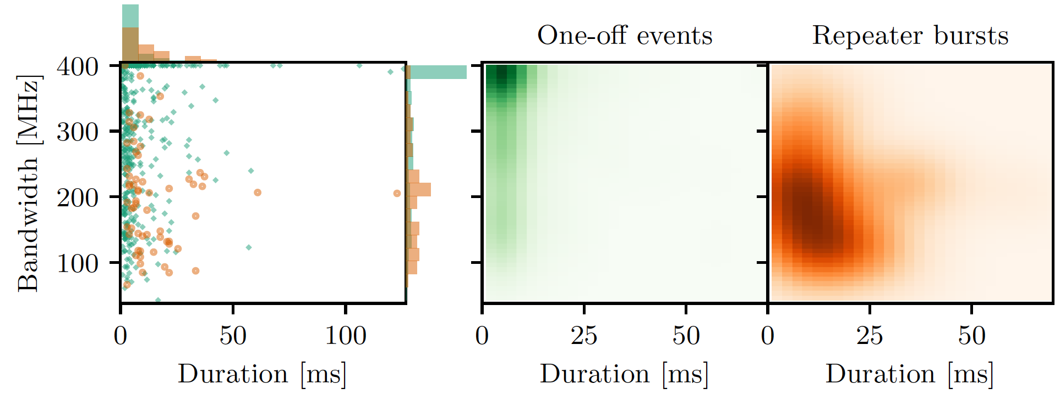
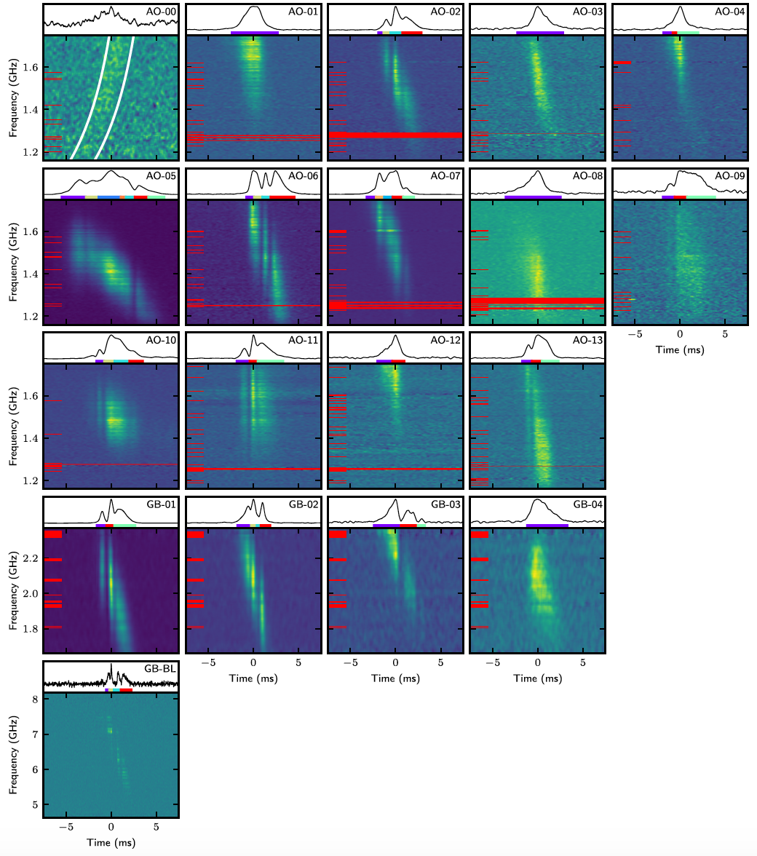
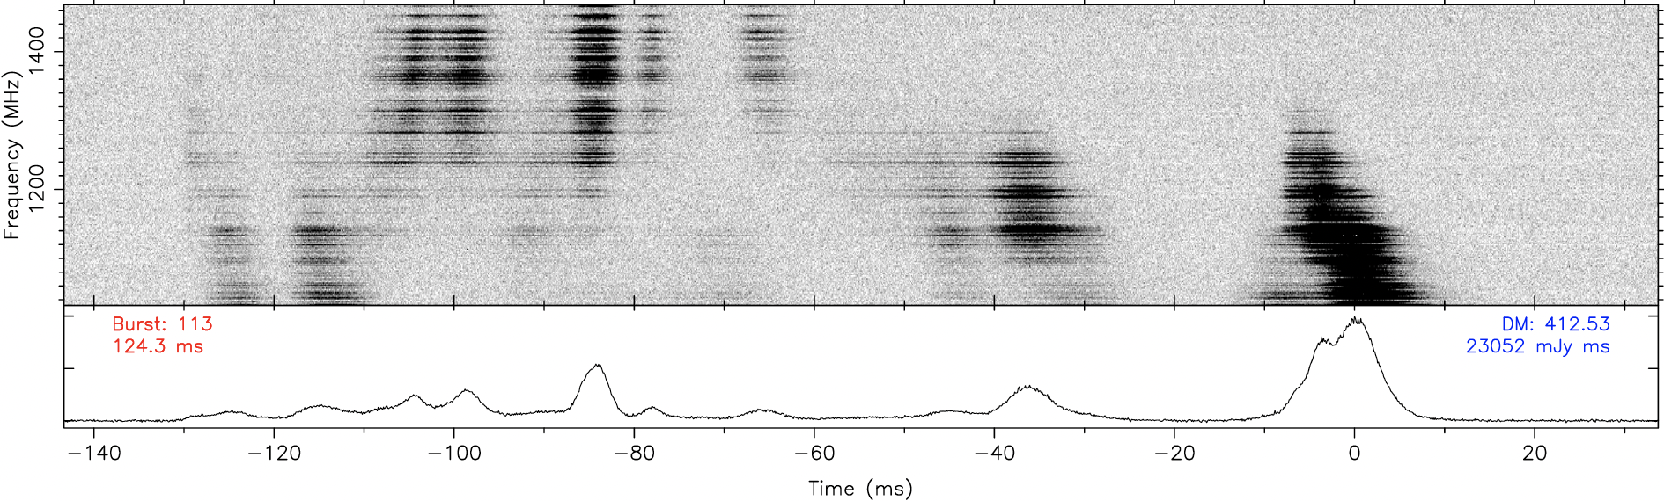
Narrow band drift
Repeaters prefer to narrow spectra
Plenuis et al. 2021, ApJ
Zhou et al. 2022, RAA
Structures: Downward/upward drifting, complex structure, and no drifting pattern
Hessels et al. 2019, ApJ

Slide 5
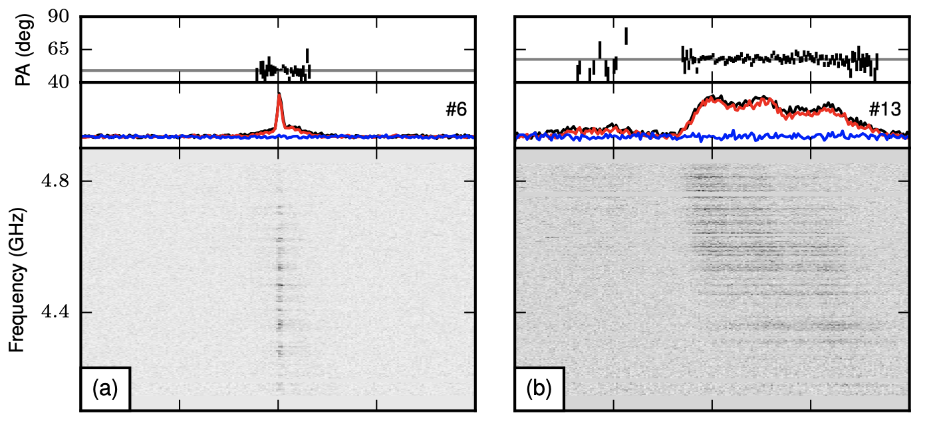
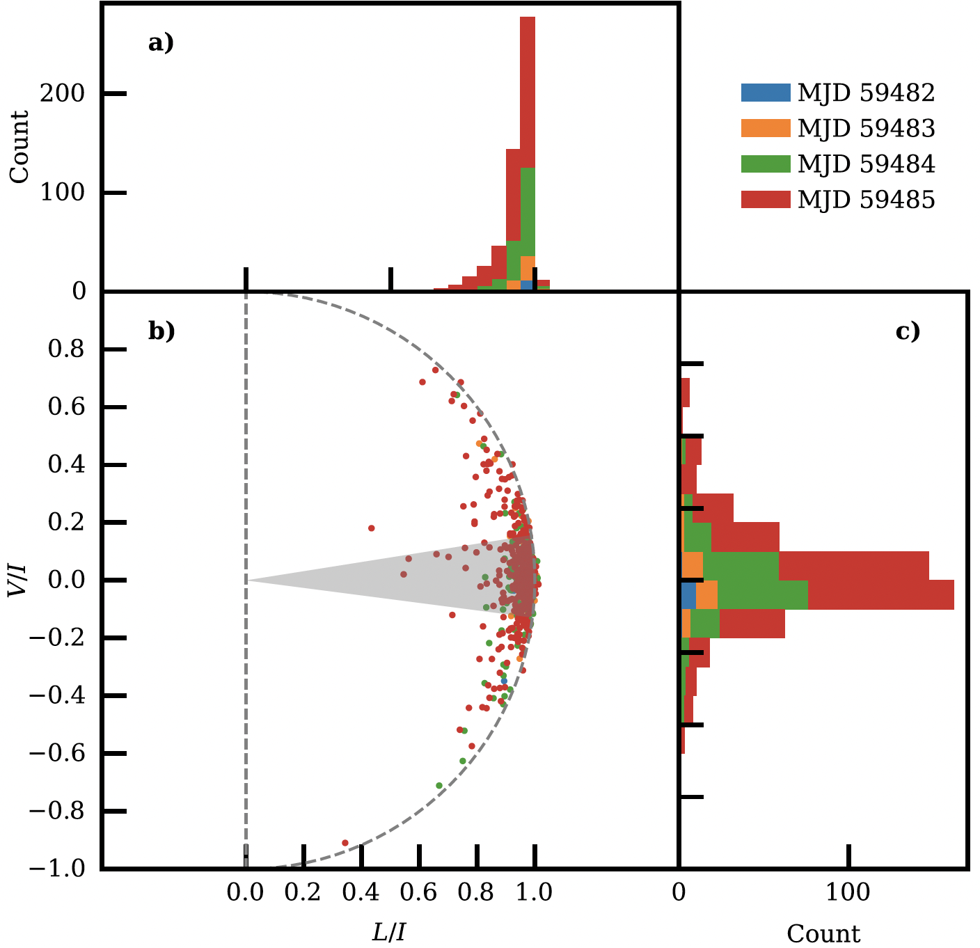
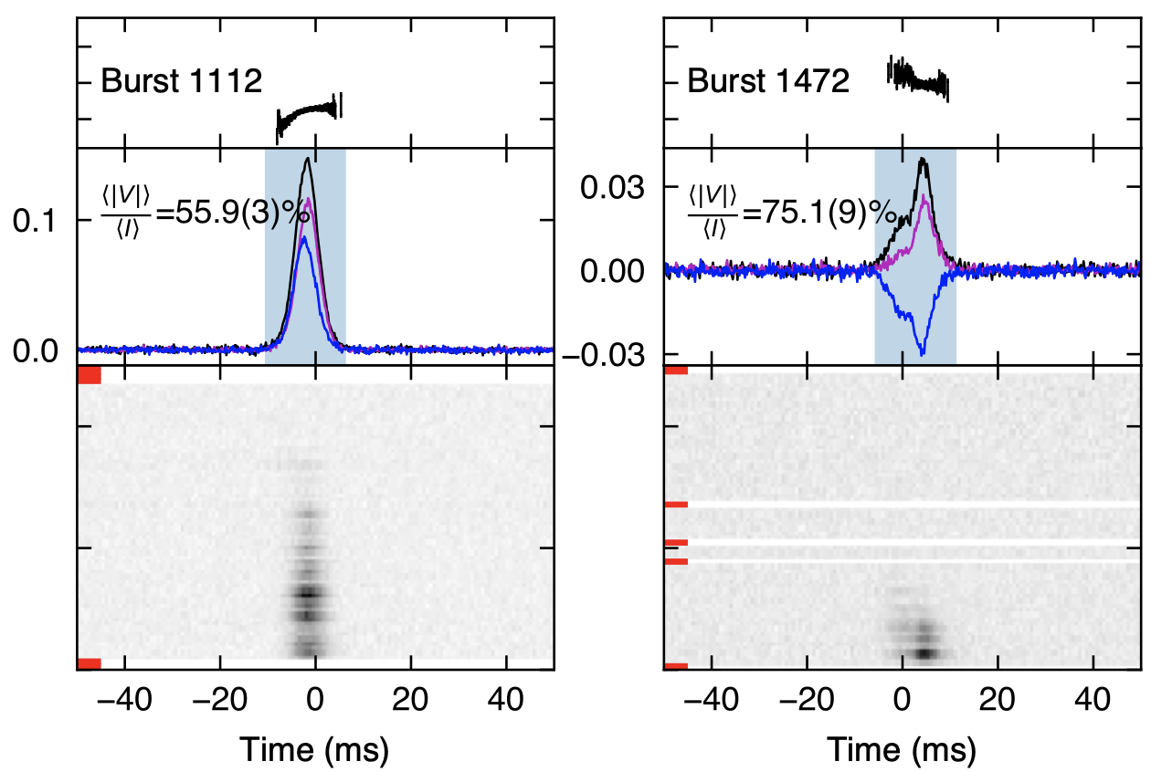
Polarization of FRB
Linear polarization (LP)
Circular polarization (CP)
Most FRBs are dominated by LP, but there are some of them dominated by CP.
Jiang et al. 2022, RAA
FRB 20121102A
Michilli et al. 2018, Nature
FRB 20201124A
Xu et al. 2022, Nature

Slide 6
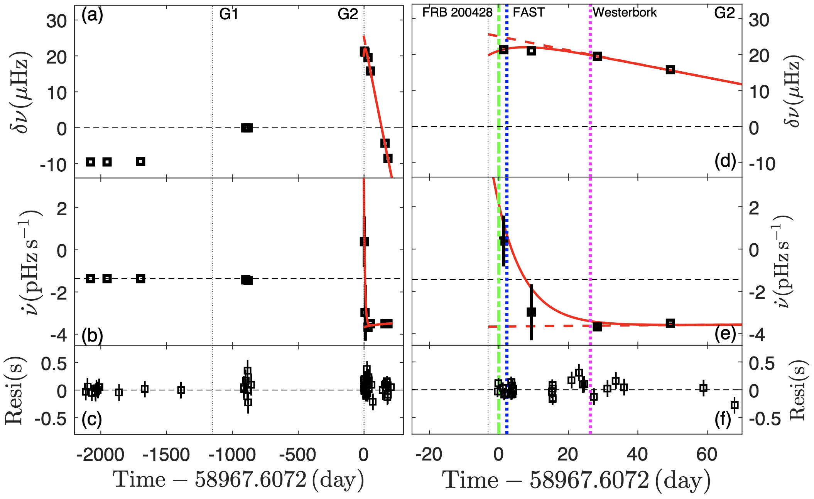
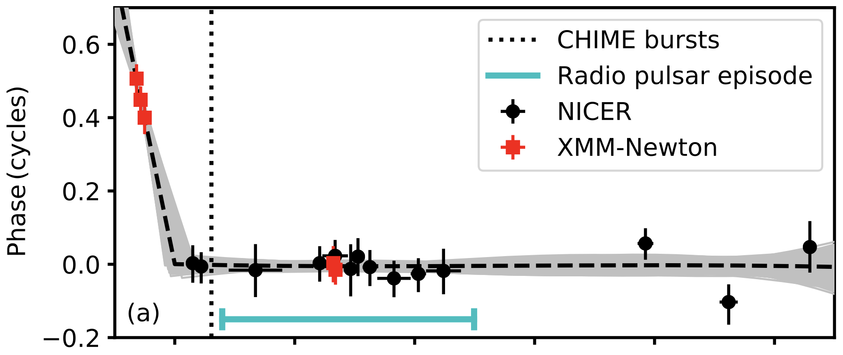
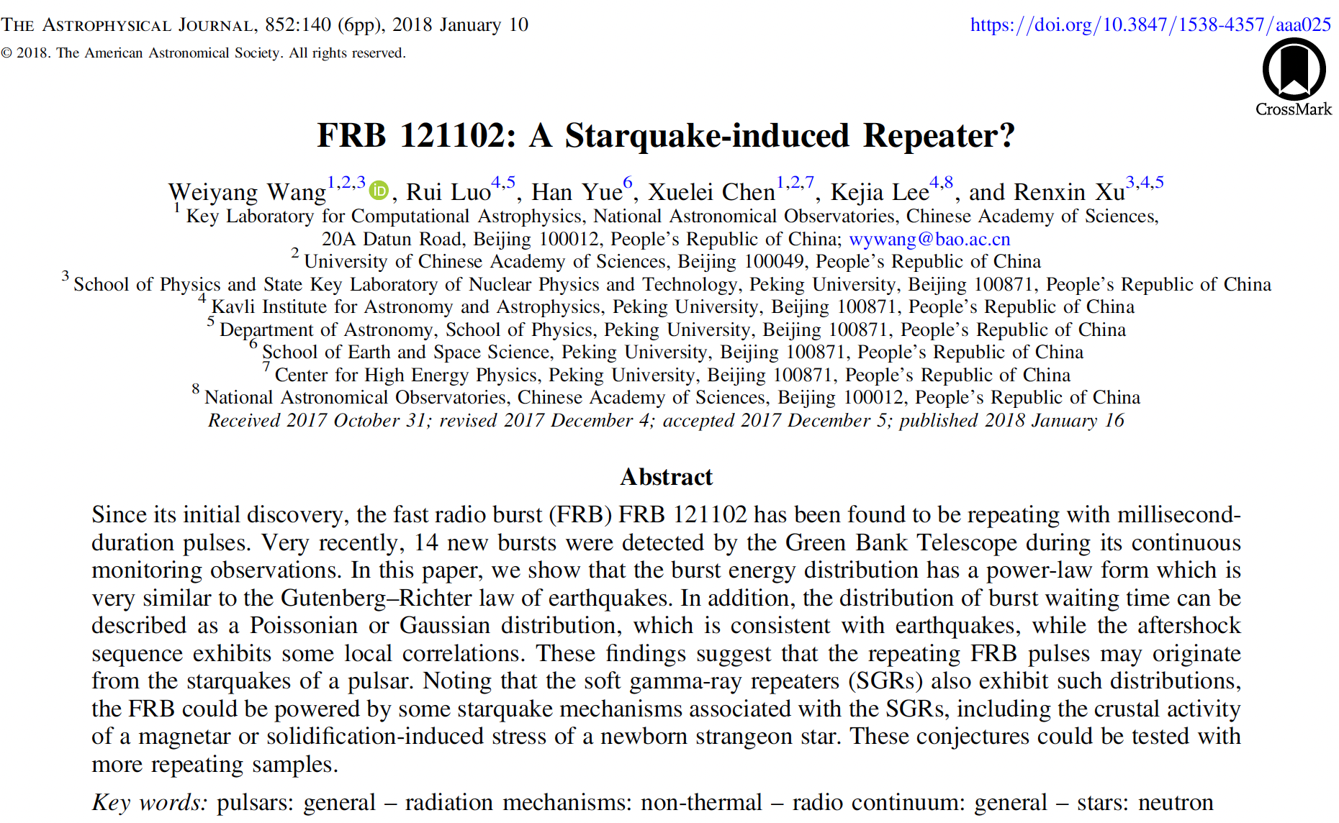
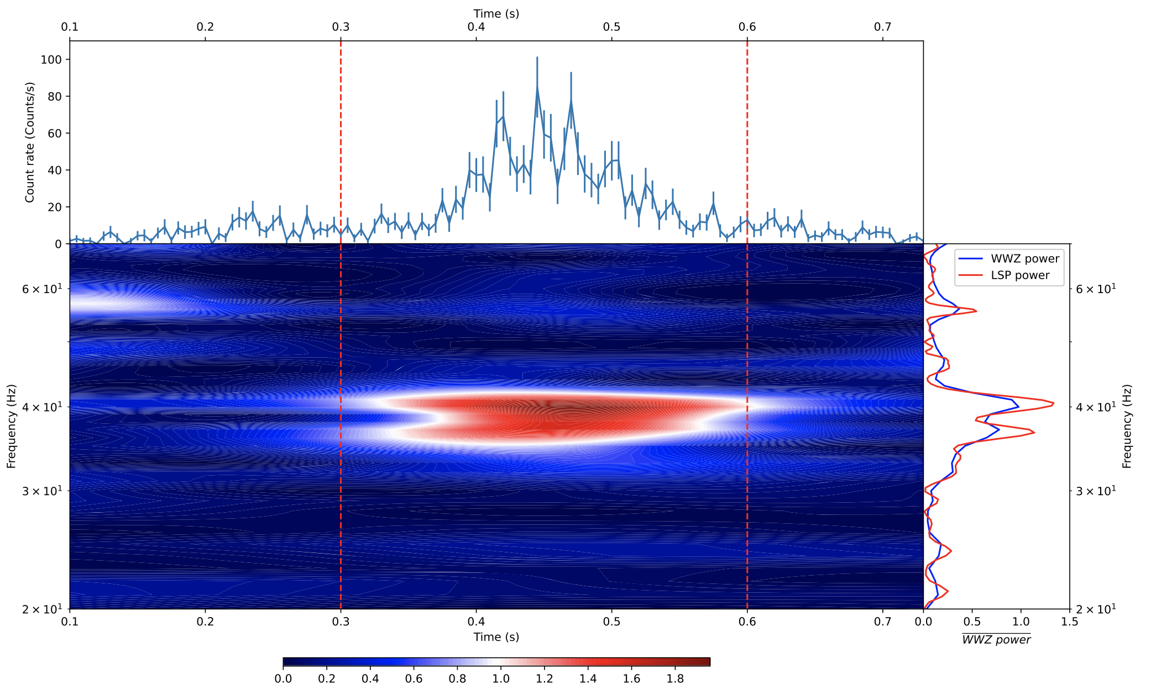
Starquake in SGR J1935+2154
Glitches before FRBs
Younes et al. 2022, NA
Ge et al. 2022, arXiv:2211.03246
QPO of SGR J1935+2154
Li et al. 2022, ApJ
Wang et al. 2018, ApJ
Notes:
Only downward drift…
The propagation effect is challenged by why such structures are favored in repeaters.

Slide 7
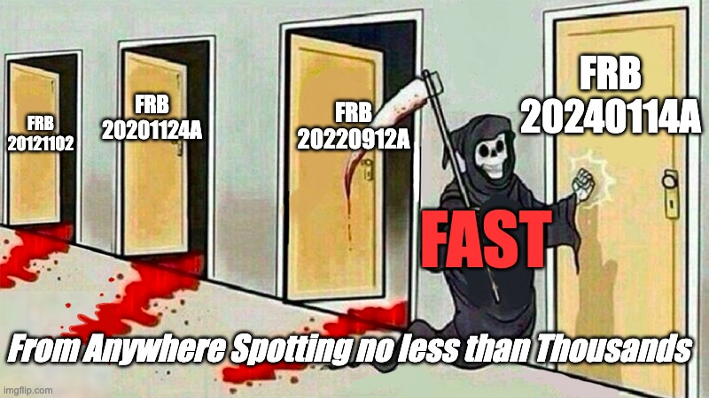
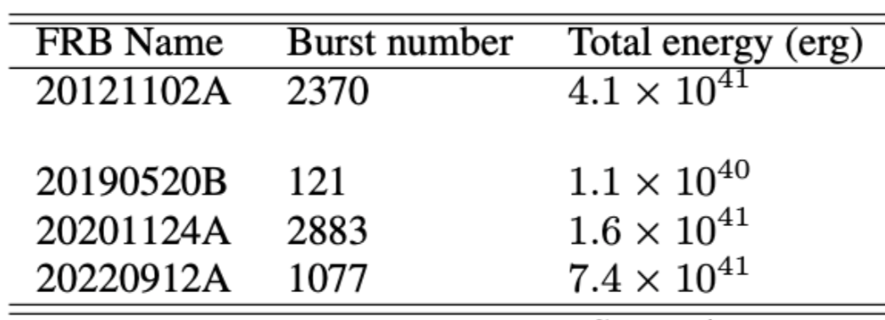
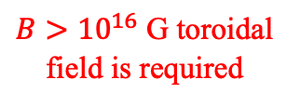
Energy budget and conversion
Rotational energy
Needs a long waiting time
Spindown power
Bulk variable before glitch
A massive star with stiff EOS
Magnetic energy
Strain energy
Gravitational energy
Kinetic energy of oscillation
Internal energy
Magnetic reconnection
Alfvén wave ejecta
$B>{10}^{16}$ G toroidal field is required
Kinetic energy of charges
Considering the beam factor, duty cycle, and efficiency, the total energy budget is at least 10⁴⁶ erg.
FRB Radiation
Wang et al. 2024, today’s arXiv

Slide 8
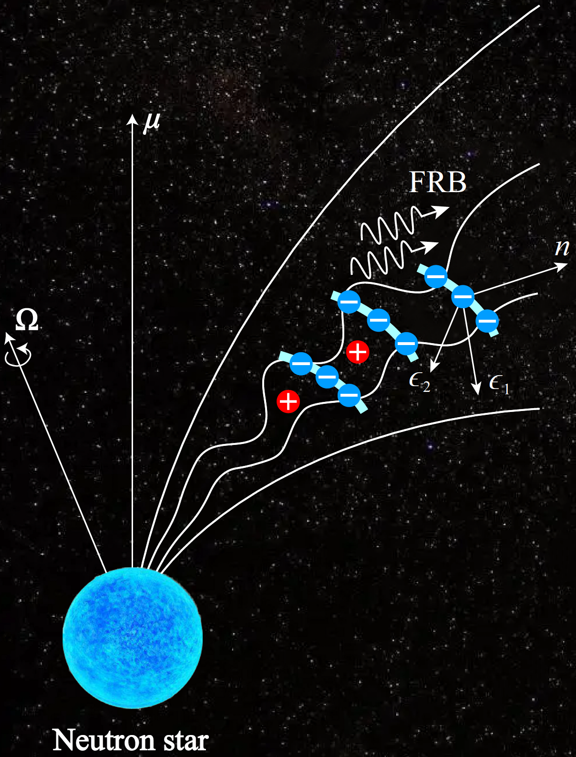
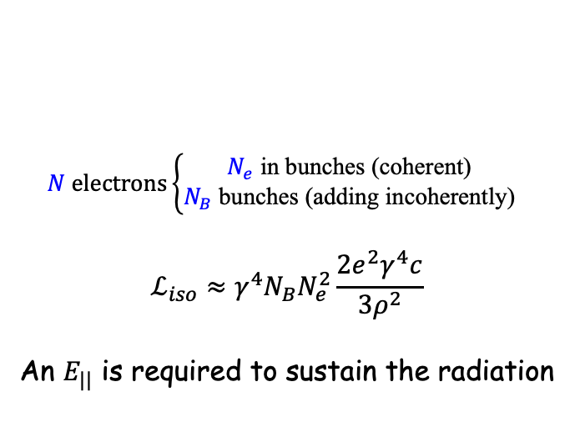
Relativistic charge radiation
Relativistic charges’ emission prefers:
High luminosities
2. Polarization
$$N electrons\left\{\begin{aligned}N_{e} \text{in} \text{bunches}\text{ (}\text{coherent}\text{) } \\ N_{B} \text{bun}\text{ch}\text{es}\text{ (}\text{adding} \text{incoherently}\text{) }\end{aligned}\right.$$
$$ℒ_{iso}≈γ^{4}N_{B}N_{e}^{2}\frac{2e^{2}γ^{4}c}{3ρ^{2}}$$
An $E_{||}$ is required to sustain the radiation
Charged Bunches
Off-beam
On-beam
Off-beam

Slide 9
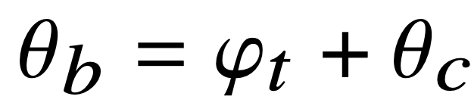




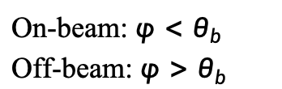
Polarization for charged bunches
On-beam: $φ<θ_{b}$
Off-beam: $φ>θ_{b}$
“thin” bulk
Whole beam
Part beam
“thick” bulk
$$φ_{t}=0.1/γ$$
$$φ_{t}=1/γ$$
$$φ_{t}=10/γ$$
<V/I> = 54%
<V/I> = 38%
<V/I> = 0%
Off-beam:
High CP fraction
Flux are smaller
We calculated circular polarization before discovery
Wang et al. 2022, MNRAS
Notes:
No CP was detecting in repeating FRBs before our paper submitted.

Slide 10
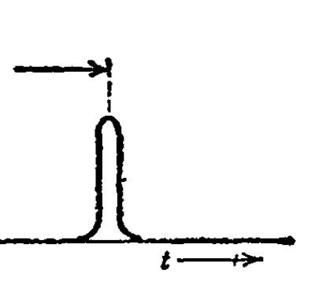
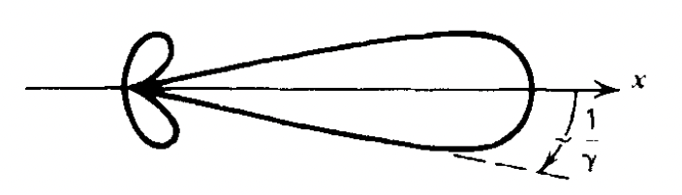
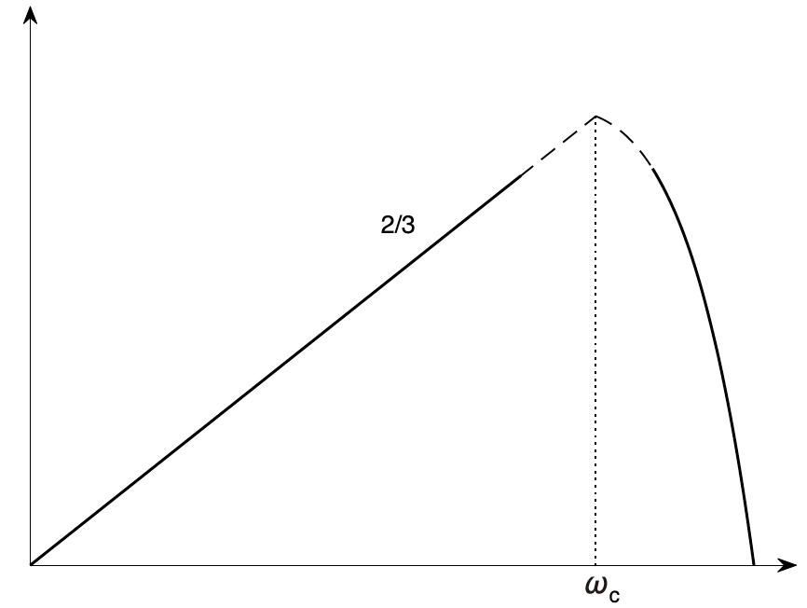
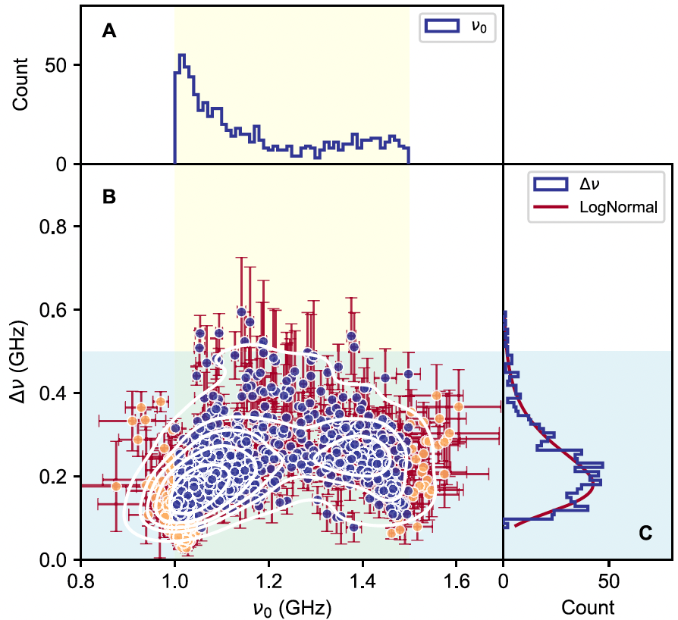
Temporal and spectral properties
Fourier transform
Beamed radiation
A wide-band emission
Wideband in log-log plot
The observed narrow band is 181 MHz for 1—1.5 GHz bands.
Zhang et al. 2023, ApJ

Slide 11
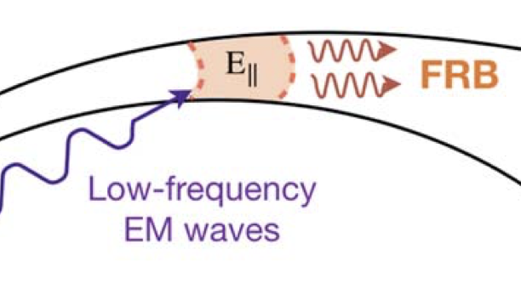
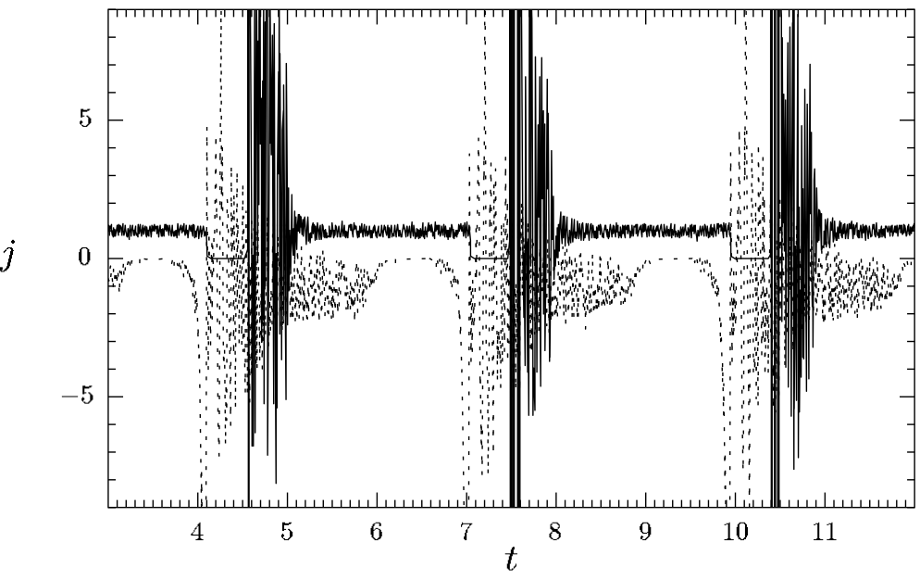
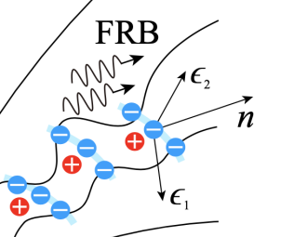
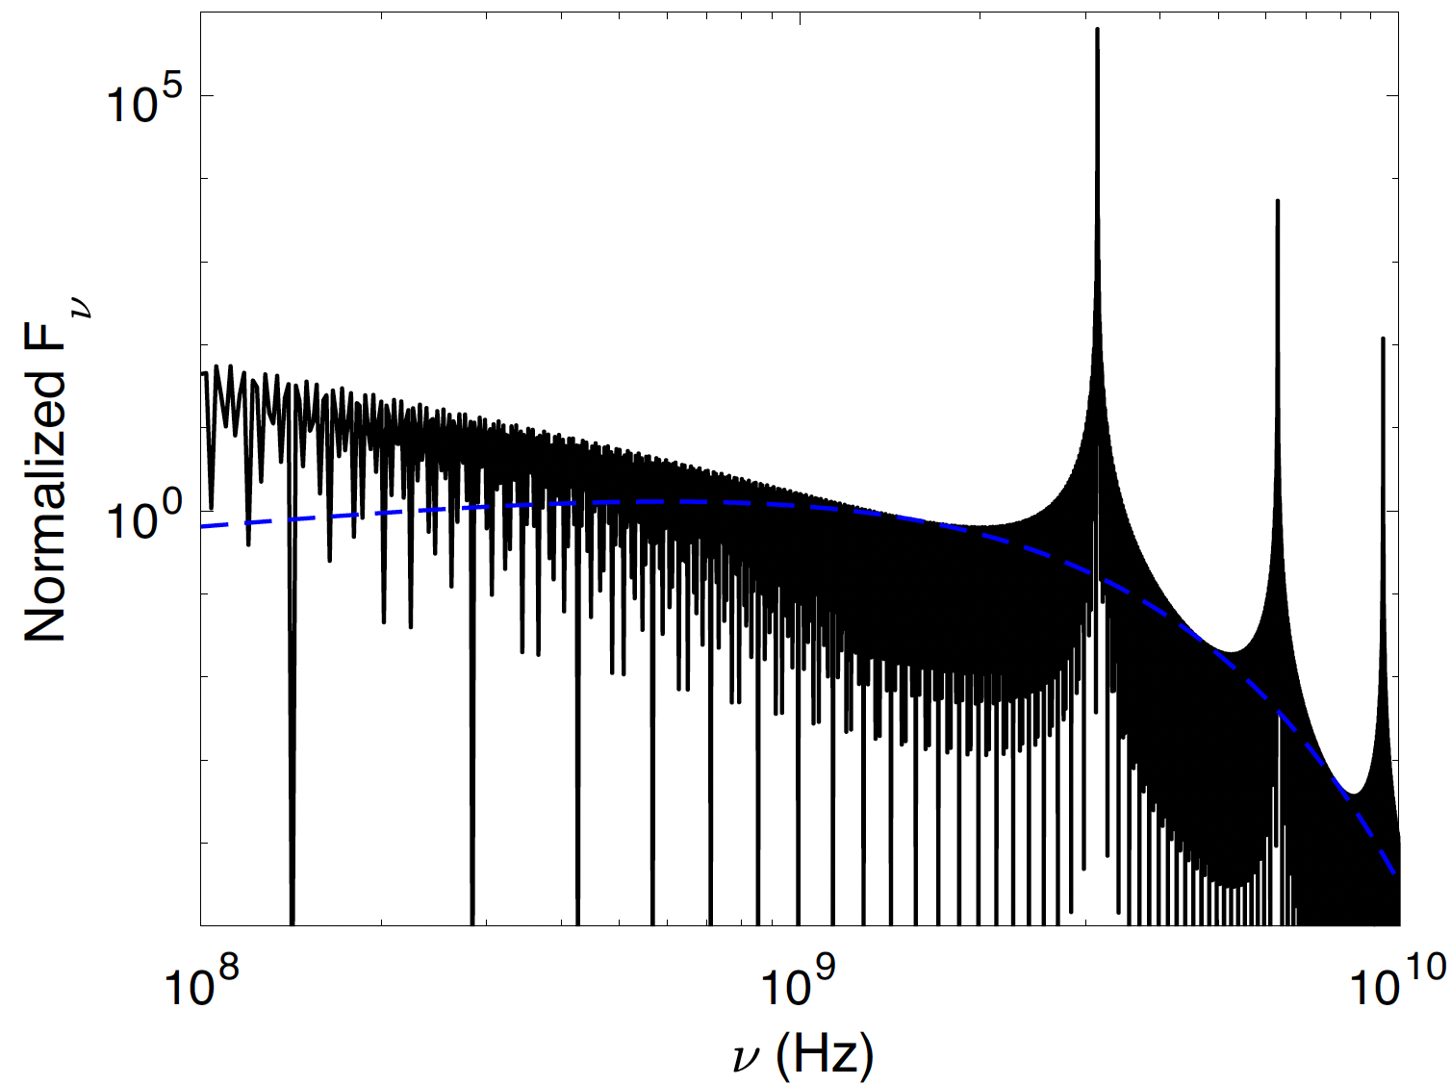
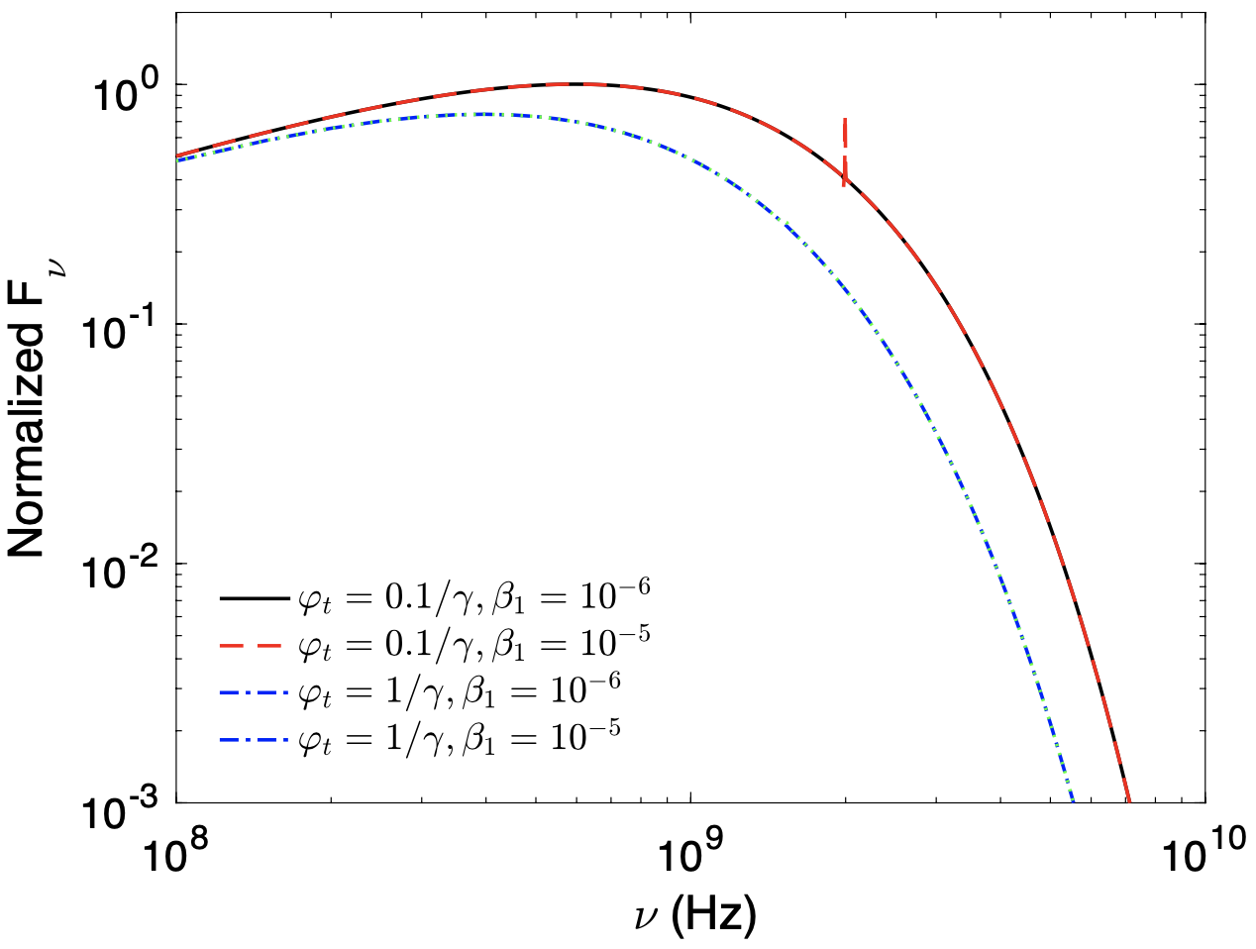

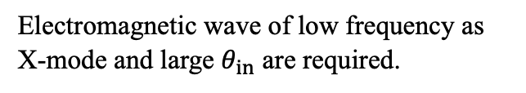
Intrinsic mechanism for narrow spectra
Wang et al. 2024, A&A
Monochrome perturbation
ICS?
Charges are quasi-periodically distributed from “gap”.
Zhang 2022, ApJ
$$ω=\frac{ω_{a}(1−β\cos{θ_{in}})}{1−βcosθ }～\frac{2ω_{a}}{\frac{1}{γ^{2}}+θ^{2}}(1−β\cos{θ_{in}})$$
Electromagnetic wave of low frequency as X-mode and large $θ_{in}$ are required.
Timokhin 2010, MNRAS
Alfvén wave can not generate a narrow spectrum at 100 MHz-10 GHz.
The height of “gap” is ~ 1 m

Slide 12
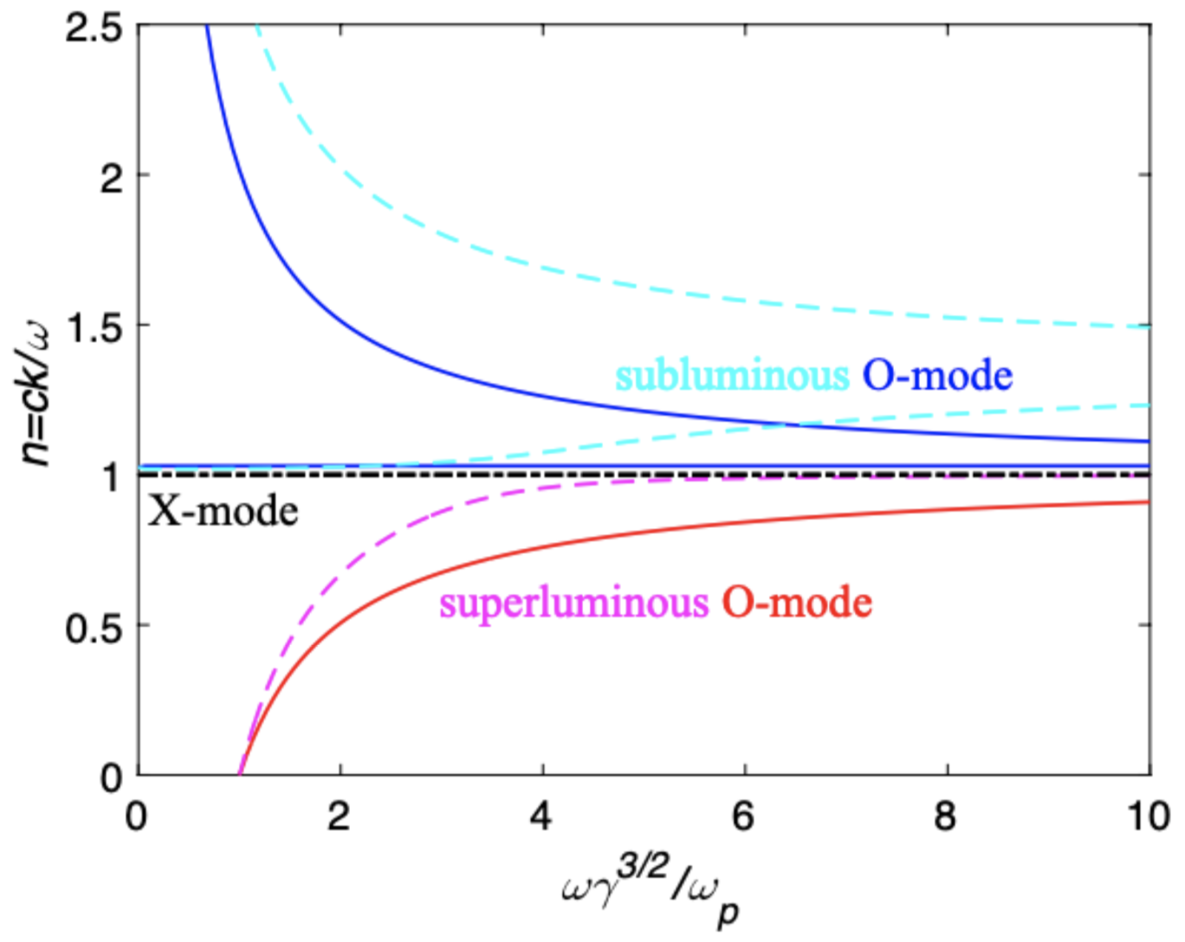
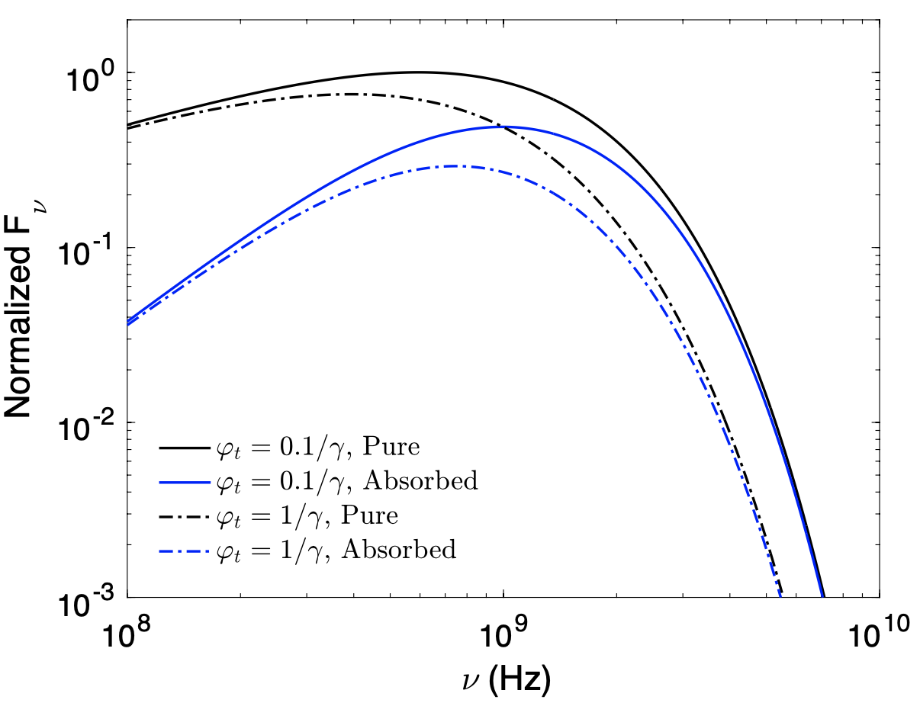
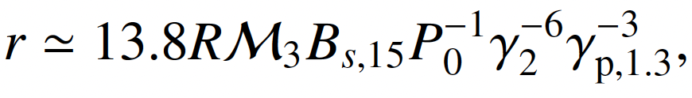
Absorption in magnetosphere
Low frequency waves are absorbed significantly.
Spectra can become narrower.
Landau damping only for subluminous O-mode
Curvature self-absorption
Spectral index is 5/3 at lower band
Superluminous O-mode has a low frequency cut-off, which depends on number density.
Wang et al. 2024, A&A

Slide 13
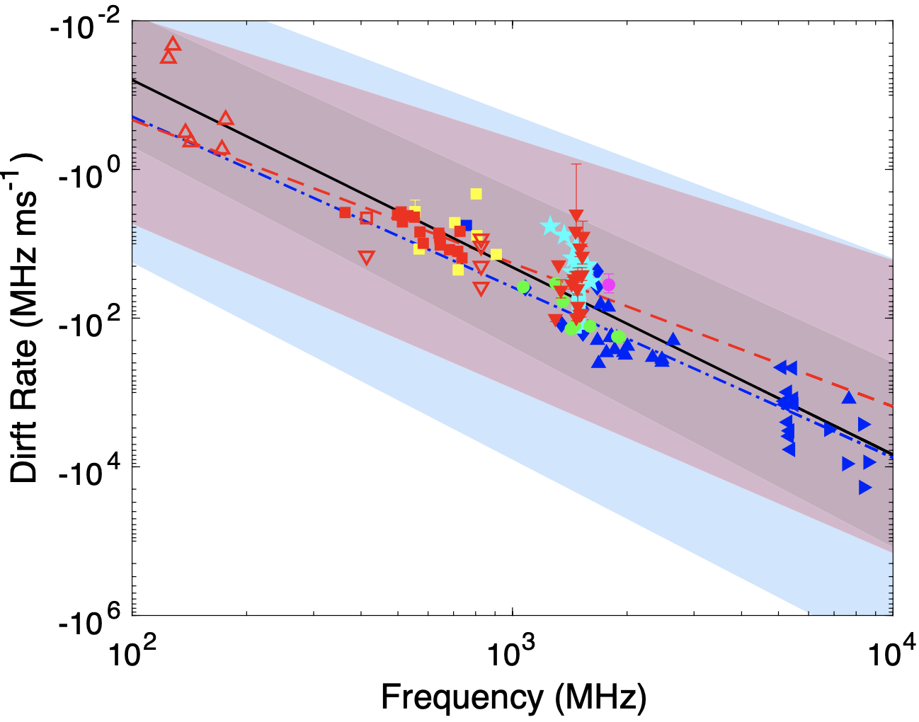
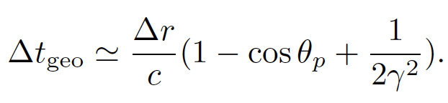
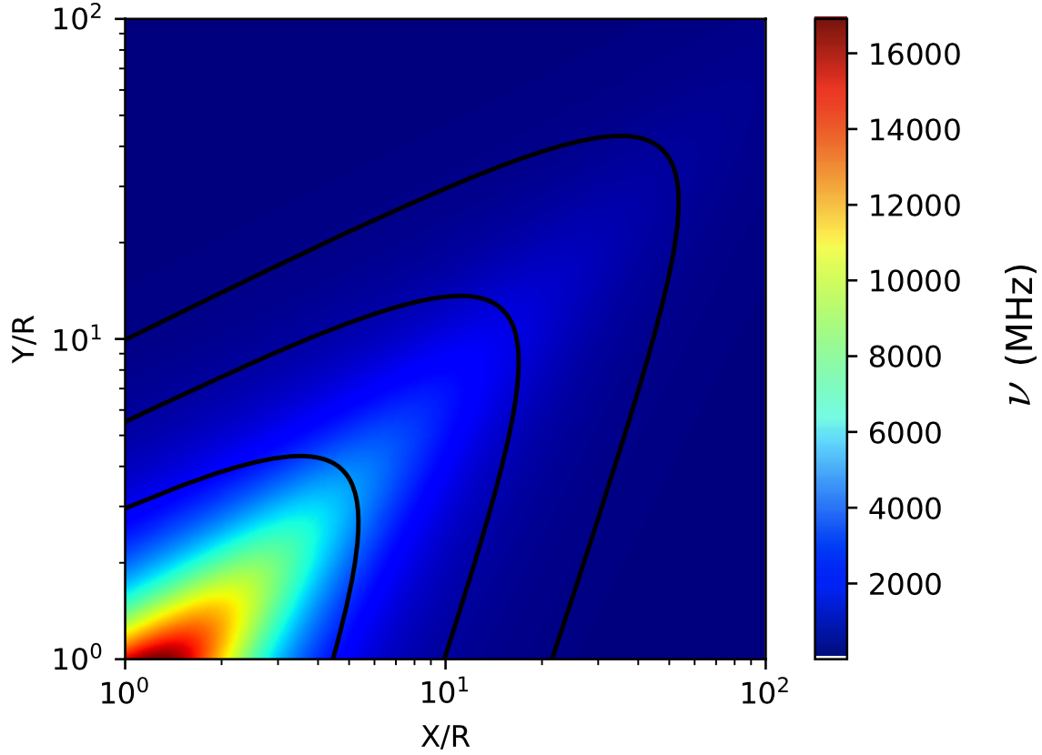
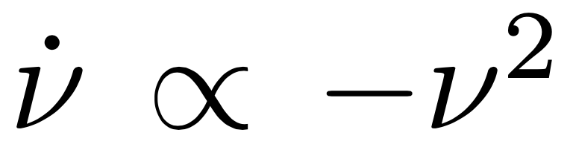
Pulse to pulse drift structure
Bulk 1 and 2 are created at the same time
0 <
Best fitting index: 2.29
For a constant Lorentz factor
Radius to frequency mapping for a quadrupole
Wang et al. 2019, ApJL
Wang et al. 2022, ApJ

Slide 14
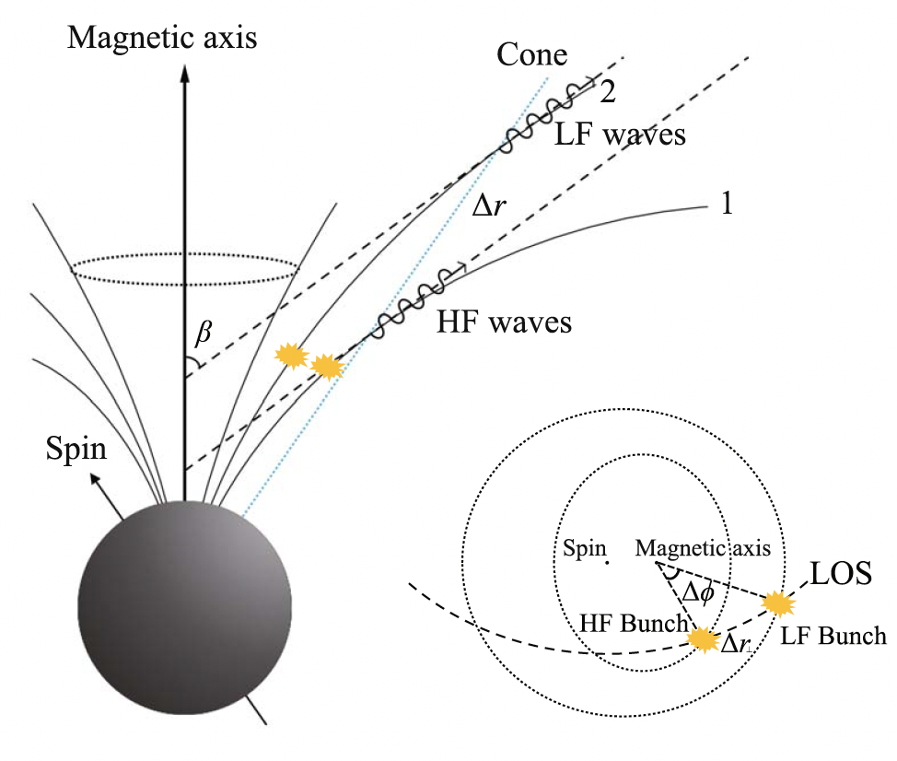
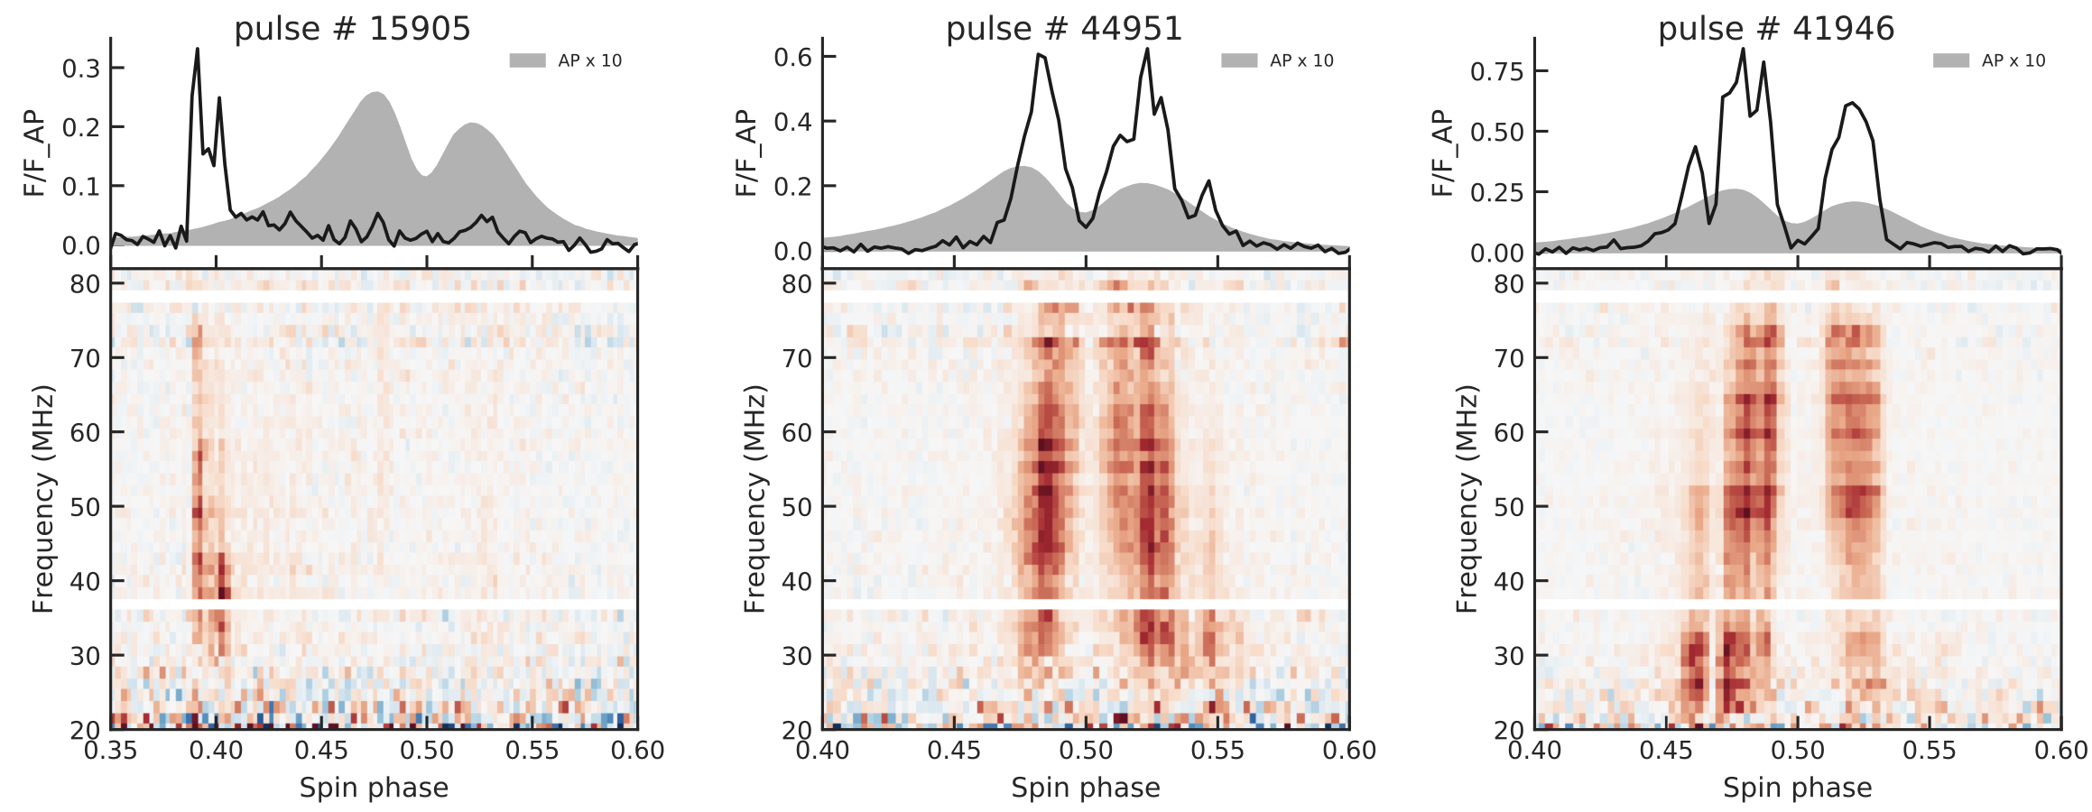
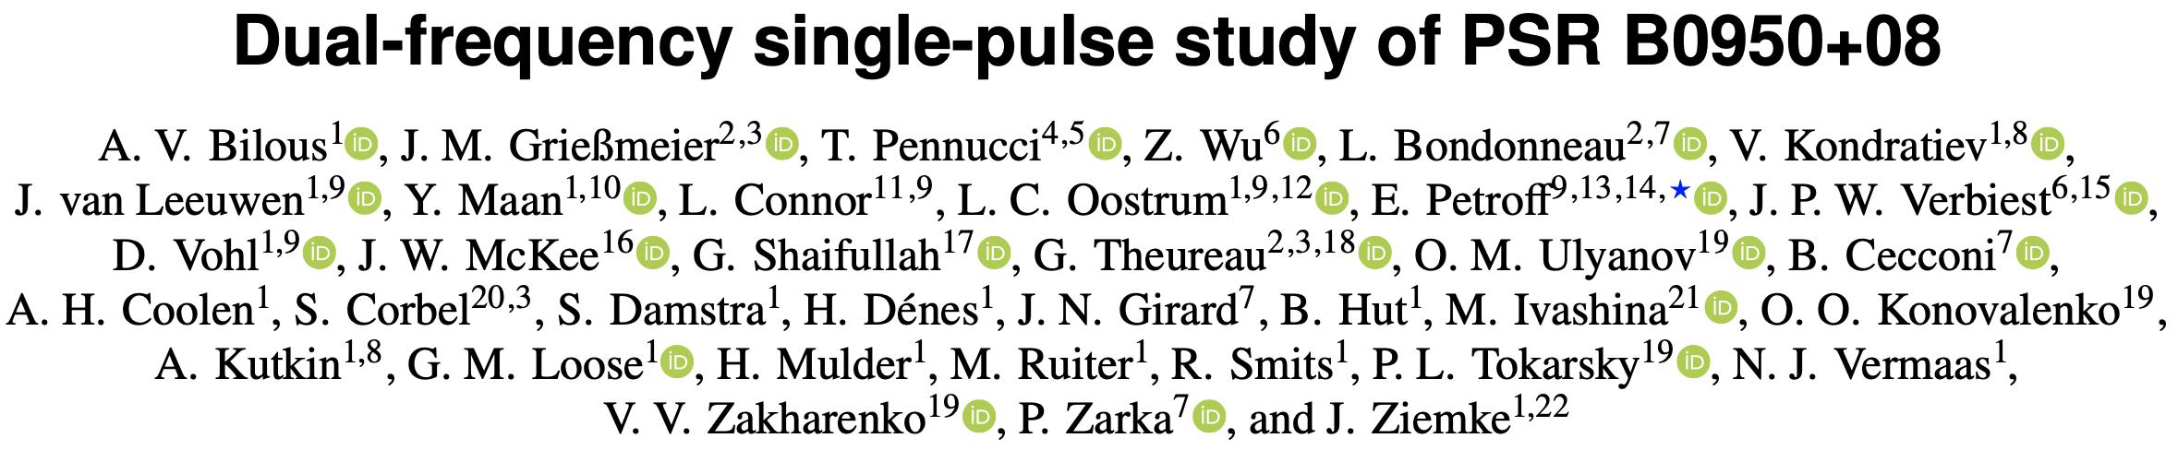
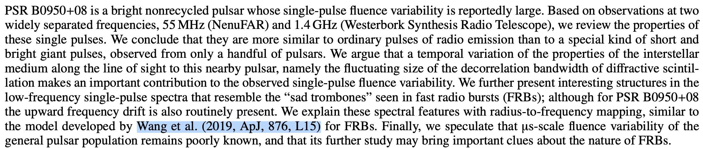
Pulse to pulse drift structure
PSR B0950+08
Wang et al. 2019, ApJL
Consecutive trigger:
FRB ❌
Pulsar ✅
Bilous et al. 2022, A&A

Slide 15
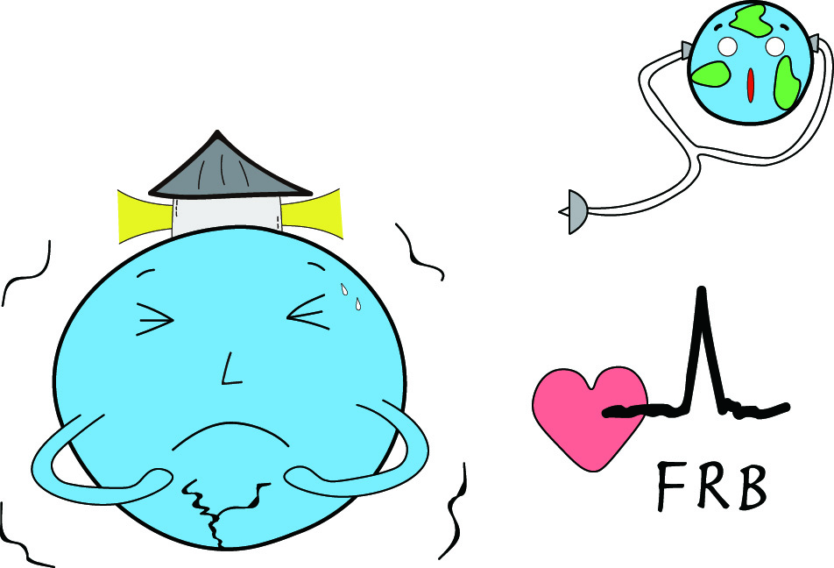
Summary
Thanks!
Magnetic and gravitational energy can match the required budget
Starquake is the trigger
Narrow spectrum: quasi-periodic bunch distribution?
Variety polarization:
On-beam (Linear); Off-beam (Circular)
Drift pattern: Natural consequence of multi-bulks
Radius to frequency mapping

Slide 16


Backup slides
“thin” bulk
VS
“thick” bulk
Only part radiation beam can be seen
FRBs prefer “thin” bulk because there is no significant trend between CP and width
VS
What I see in the frame of beam
Wang et al. 2022, MNRAS
Notes:
The “thickness” here is determined by radial and transverse observing time rather than the true spatial size for the two dimensions. So the“thick” and “thin” cases here are of the visual effects from an observer, not representing the intrinsic geometry of the bulk itself. If the angle \rad is almost constant, a “thick” bulk would be observed for a rapidly spinning object, while a “thin” bulk would be observed for a slowly spinning one.

Slide 17




Backup slides
Detailed calculation can be seen in
Wang et al. 2022, ApJ
Several equations easy to get

Slide 18



The next DDF (2026)
From Guiyang to Beijing
Weiyang Wang will hold DDF2 in 2026
DDF2
DDF1
The emperor guards the country's gates
明成祖朱棣
Di Zhu, an emperor in Ming Dynasty

Slide 19

The next DDF (2026)
Chinese people often say:
Those who have never been to the Great Wall will never be heroes.
不到长城非好汉

Slide 20



The next DDF (2026)
Beginning of Winter, 2026
The Wall + Hot spring + Snow (maybe) = Dream field!

