Slide 1

Understanding various optical transient phenomena wiht the magnetar engine model
Yun-Wei YU
Central China Normal University (CCNU)
Collaborators: Aming Chen, Zi-Gao Dai, Shao-Ze Li, Liang-Duan Liu, Guang-Lei Wu, Zhen-Dong Zhang, Bing Zhang, Jin-Ping Zhu

Slide 2
Formation of rapidly rotating magnetars and different transients
Supernova Emission
Neutron Star
Collapse of Massive Stars

Slide 3
Formation of rapidly rotating magnetars and different transients
Superluminous Supernova Emission
Rapidly rotating magentar
t_{sd} ~ t_{diff}
SN emission is powered by
the Spin-down + decays of ⁵⁶Ni
Collapse of Massive Stars
B~10¹⁴G, P~(1-10)ms
Kasen & Bildsten (2010);
Yu et al. (2017)

Slide 4
Formation of rapidly rotating magnetars and different transients
SLSN
B~10¹⁴G, P~(1-10)ms
Kasen & Bildsten (2010);
Yu et al. (2017)
Long Gamma-Ray Bursts + Supernova
Rapidly rotating magentar
t_{sd} << t_{diff}
SN emission is powered by
the Spin-down + decays of ⁵⁶Ni
Collapse of Massive Stars
Usov (1992); Dai & Lu (1998a,b)
Zhang, Yu, Liu (2022)

Slide 5
Formation of rapidly rotating magnetars and different transients
SLSN
B~10¹⁴G, P~(1-10)ms
Kasen & Bildsten (2010);
Yu et al. (2017)
Fast Blue Optical Transients
LGRB + SN
B~10¹⁵G, P~(1-10)ms
Usov (1992); Dai & Lu (1998a,b)
Zhang, Yu, Liu (2022)
Rapidly rotating magentar
M_{ej}~0.1 M_{sun}
SN emission is powered by
the Spin-down + decays of ⁵⁶Ni
Collapse of Massive Stars
B~(10¹⁴-10¹⁵)G, P>10 ms
Yu et al. (2015, 2019a,b)；Liu+2022

Slide 6
Formation of rapidly rotating magnetars and different transients
SLSN
B~10¹⁴G, P~(1-10)ms
Kasen & Bildsten (2010);
Yu et al. (2017)
LGRB + SN
B~10¹⁵G, P~(1-10)ms
Usov (1992); Dai & Lu (1998a,b)
Zhang, Yu, Liu (2022)
A sequence of unusual SNe
FBOT
B~(10¹⁴-10¹⁵)G, P>10 ms
Yu et al. (2015, 2019a,b)
Ultra-stripped Star
Collapse of Massive Stars

Slide 7
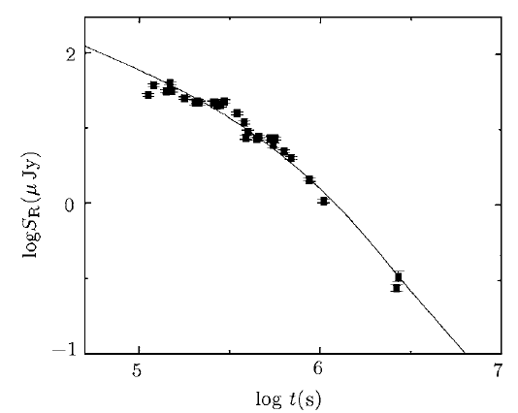
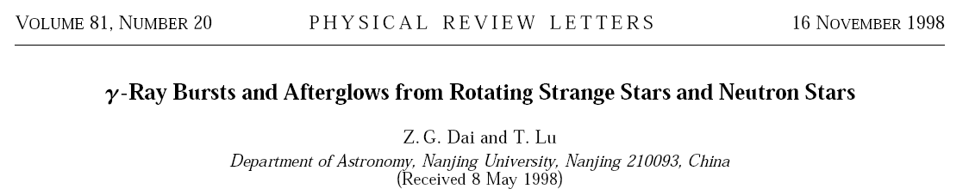
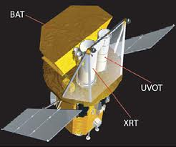
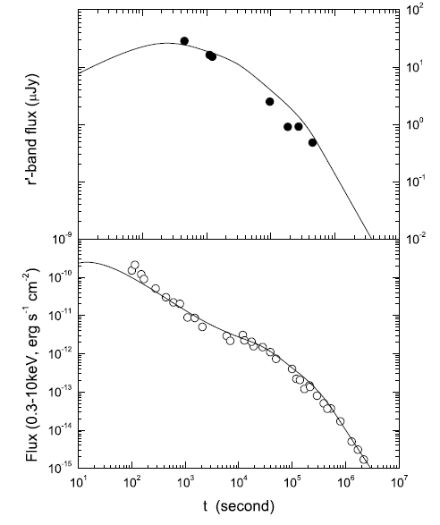
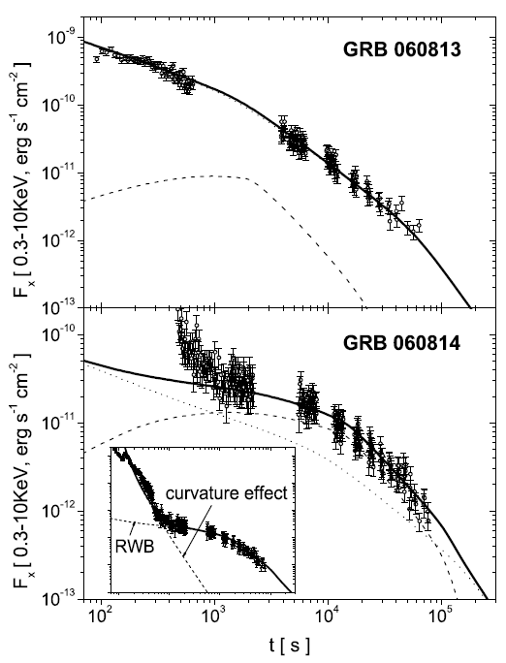
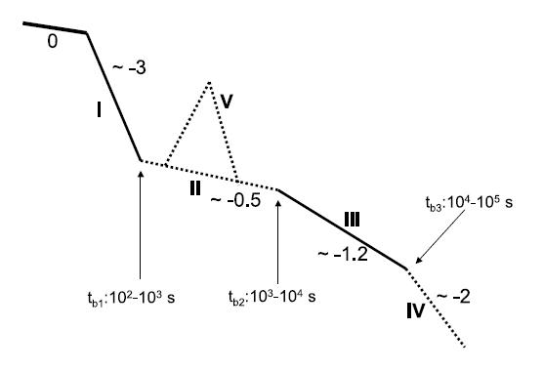
Do such rapidly rotating magnetars exist?
Implication from GRB afterglows
Wang & Dai 2001
GRB 000301C
GRB 051221A
Yu & Dai 2007
Fan & Xu 2006
Zhang et al. 2006

Slide 8
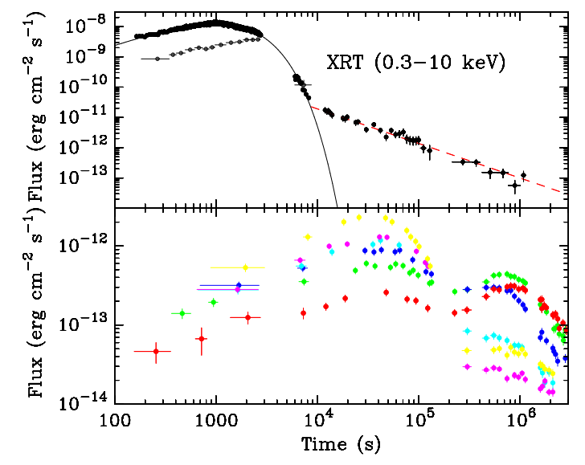
How does the spin-down energy affect the SN emission?
The interaction between the magnetar wind and the SN ejecta
Forward shock
Shock breakout emission (SBO)
Unshocked SN ejecta
Termination shock
Shocked SN ejecta
Shocked Wind
(magnetar wind nebula)
Magnetar Wind
Magnetar

Slide 9
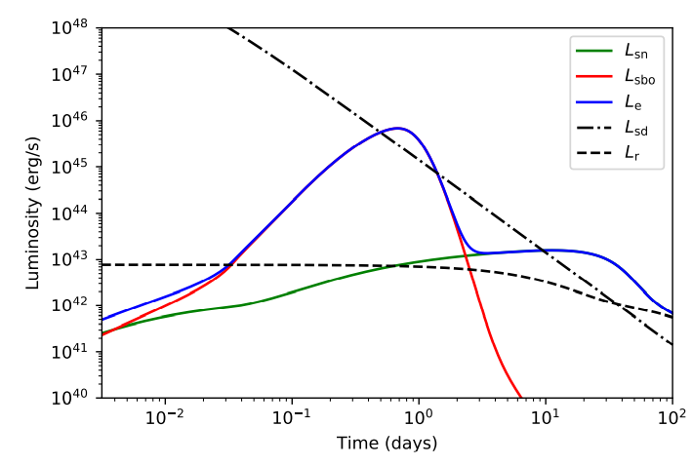
How does the spin-down energy affect the SN emission?
The interaction between the magnetar wind and the SN ejecta
Forward shock
Shock breakout emission (SBO)
Unshocked SN ejecta
Termination shock
Shocked SN ejecta
Shocked Wind
(magnetar wind nebula)
Magnetar Wind
Zhang et al. 2022, ApJ, 936, 54
Magnetar

Slide 10
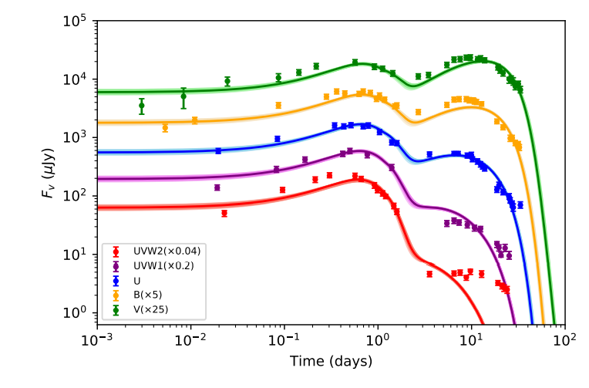
How does the spin-down energy affect the SN emission?
The interaction between the magnetar wind and the SN ejecta
Forward shock
Shock breakout emission (SBO)
Unshocked SN ejecta
Termination shock
Shocked SN ejecta
Shocked Wind
(magnetar wind nebula)
Magnetar Wind
Zhang et al. 2022, ApJ, 936, 54
Magnetar

Slide 11
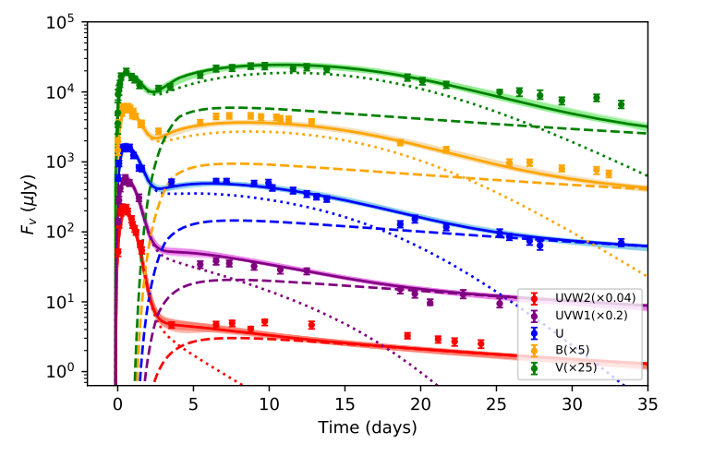
How does the spin-down energy affect the SN emission?
The interaction between the magnetar wind and the SN ejecta
Leakage of the magnetar wind emission
Termination shock
Shocked SN ejecta
Shocked Wind
(magnetar wind nebula)
Magnetar Wind
Zhang et al. 2022, ApJ, 936, 54
Magnetar

Slide 12
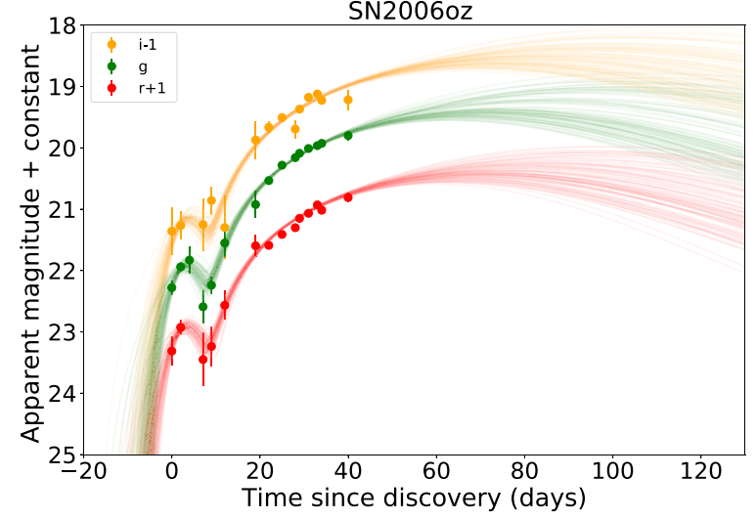
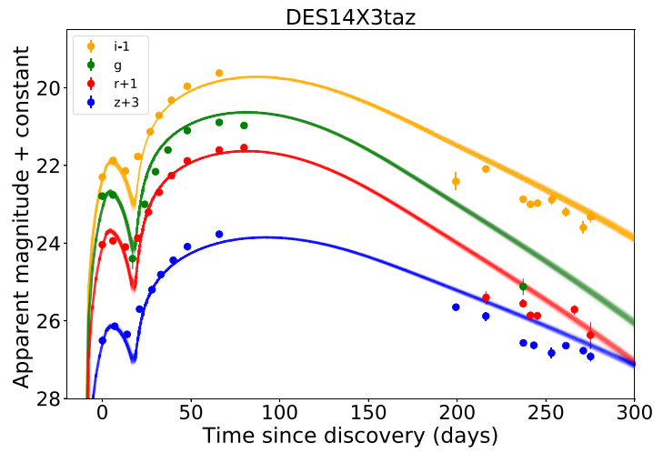
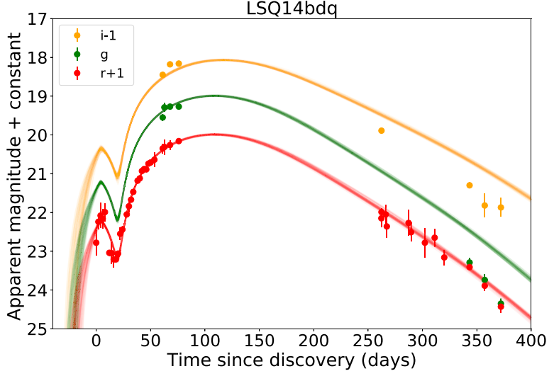
Magnetar wind-driven SBO in SLSNe
Liu et al 2021, ApJ, 911, 142

Slide 13
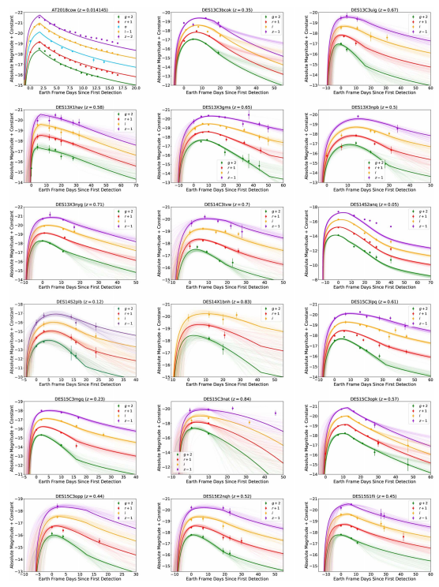
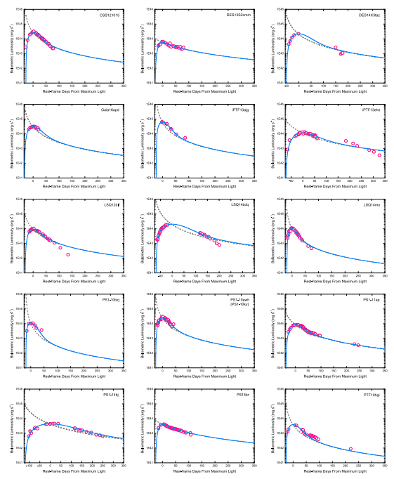
Lightcurve Fittings
YWY, Zhu, Li et al. ApJ840(2017)12
Liu, Zhu, Liu, YWY et al. 2022, ApJL, 935, L34

Slide 14
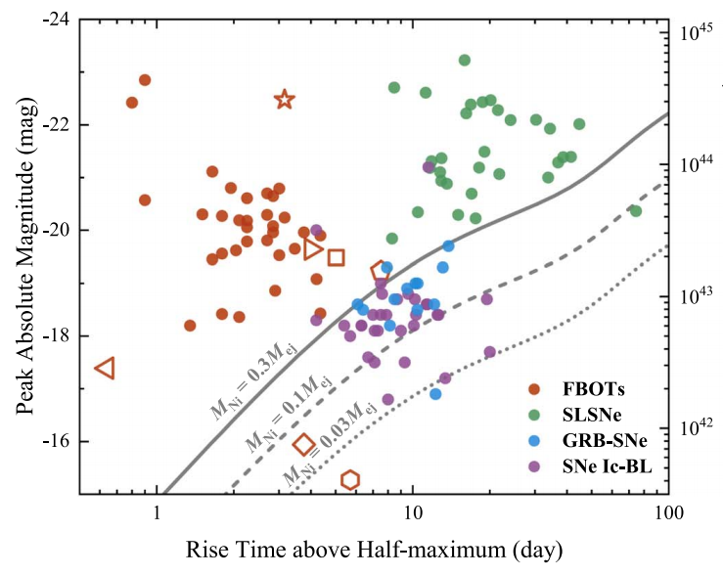
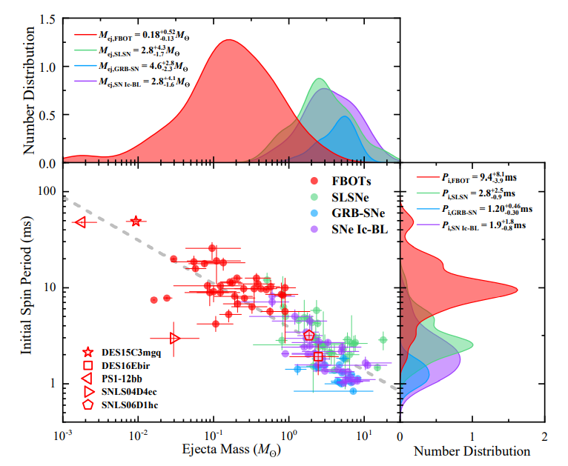

E_{rot}-M_{ej} relationship
Ultra-Stripped Supernova in Close Binary
Liu, Zhu, Liu, YWY et al. 2022, ApJL, 935, L34

Slide 15


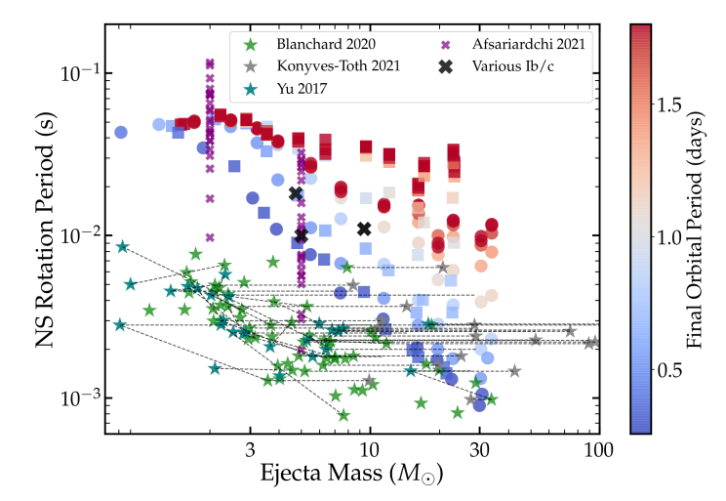
E_{rot}-M_{ej} relationship
Fuller & Lu, 2022, MNRAS, 511, 3951

Slide 16
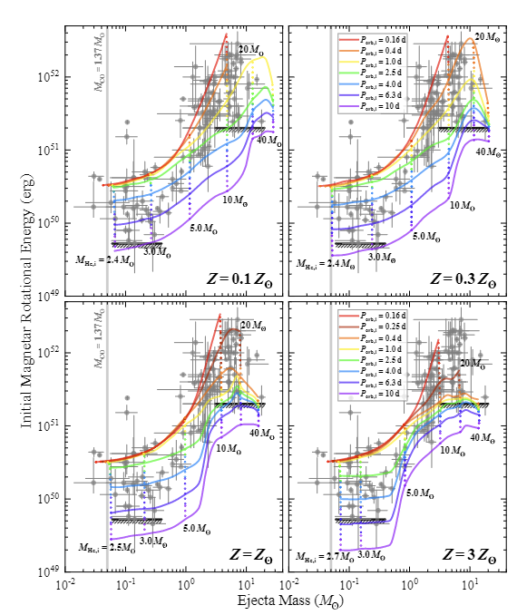
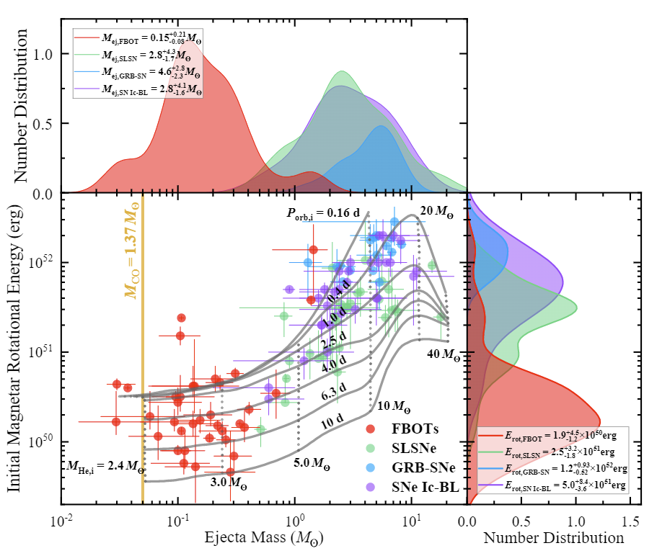
E_{rot}-M_{ej} relationship
preliminary
Hu et al. 2023, arXiv: 2301.06402

Slide 17
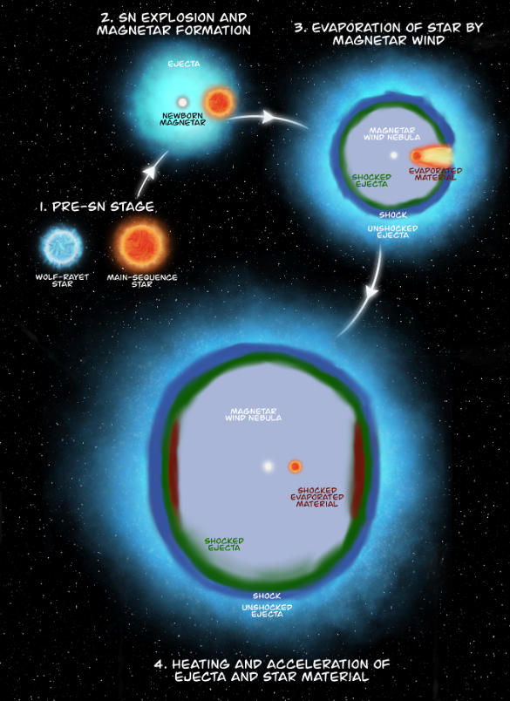
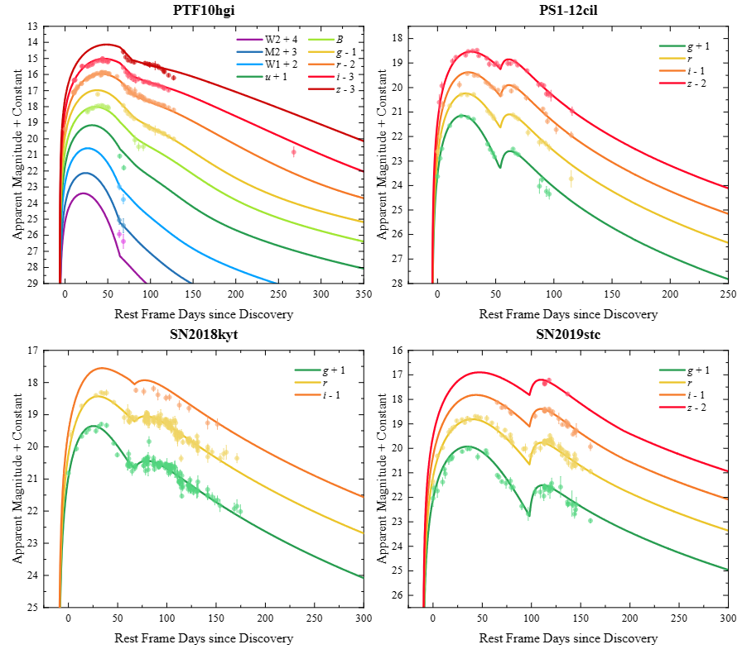
Magentar binary engine
Zhu+2024arXiv2405.01224

Slide 18
Formation of rapidly rotating magnetars and different transients
A sequence of different GRBs
SLSN
B~10¹⁴G, P~(1-10)ms
Kasen & Bildsten (2010);
Yu et al. (2017)
LGRB + faint OT
B~10¹⁵G, P~(1-10)ms
Wang, Yu, Zhang et al. (2023)
SGRB + mergernova
B~10¹⁵G, P~(1-10)ms
Yu et al. (2013)
LGRB + SN
B~10¹⁵G, P~(1-10)ms
Usov (1992); Dai & Lu (1998a,b)
Zhang, Yu, Liu (2022)
A sequence of unusual SNe
FBOT
B~(10¹⁴-10¹⁵)G, P>10 ms
Yu et al. (2015, 2019a,b)
NS+NS
NS+WD
Ultra-stripped Star
WD+WD
WD AIC
Compact Binary Merger
Collapse of Massive Stars
(in binary with a compact star?)

Slide 19
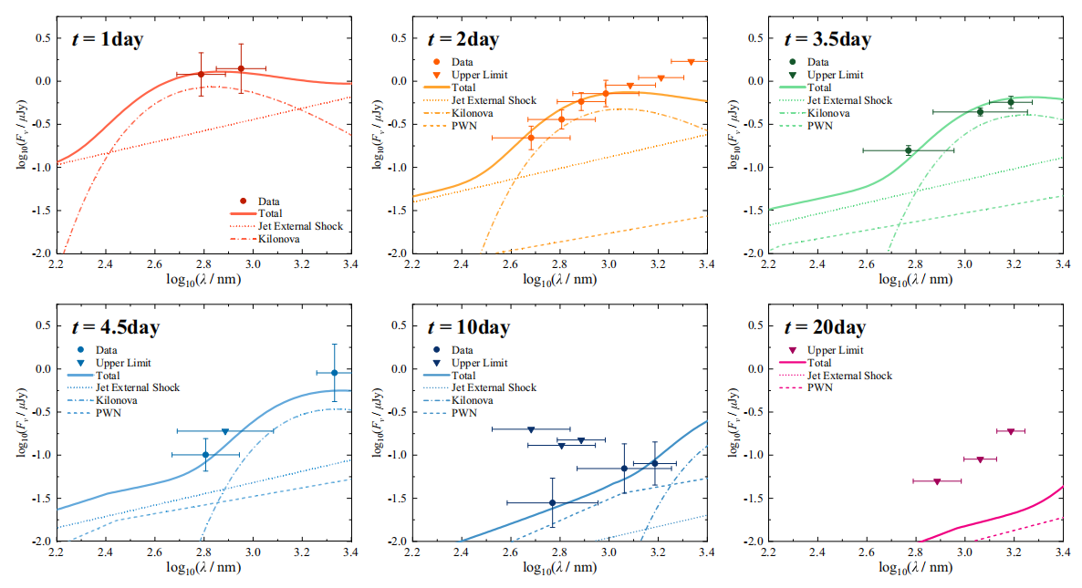
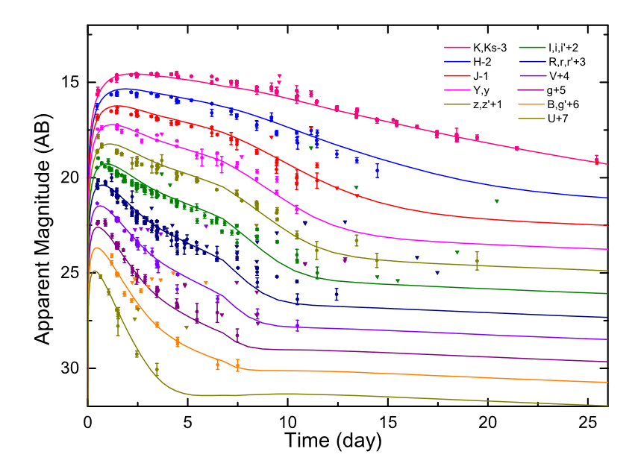
Non-thermal component in mergernvoa emission
AT2017gfo emission after GRB 170817A
Optical excess in the afterglow of GRB 160821B
YWY, Liu, Dai, 2018, ApJ, 861, 114
Ren et al. 2019, ApJ, 885, 60
Wu, YWY, Zhu_AA654(2021)A124

Slide 20
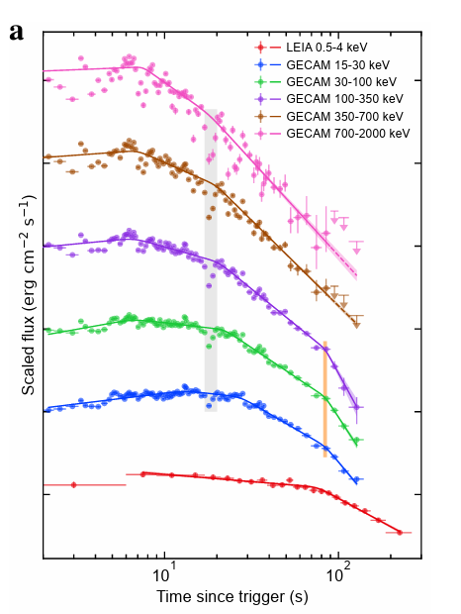
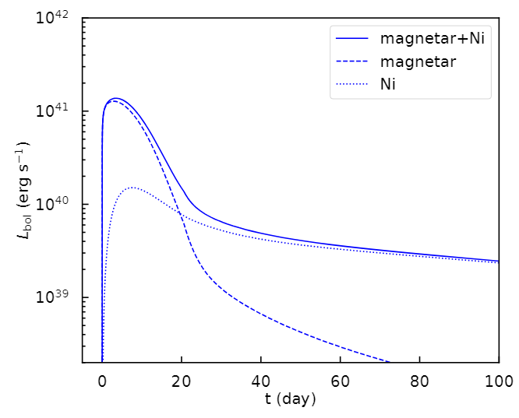
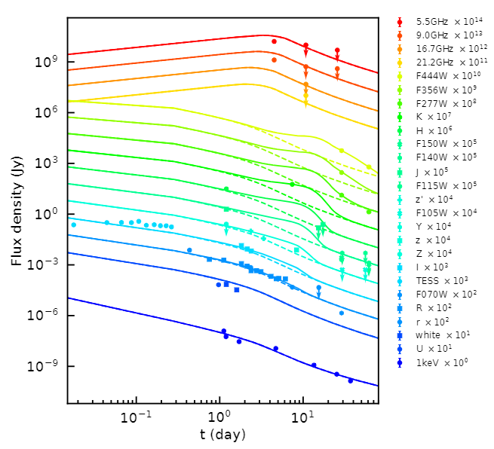
Kilonova-Like Emission After GRB 230307A
Wang, YWY, et al. 2024, ApJL, 964, L9
Sun, Het al. 2023, arXiv:2307.05689

Slide 21
Formation of rapidly rotating magnetars and different transients
Superluminous supernovae
magnetar engine-driven transients
Gamma-ray bursts
Fast blue optical transients

Slide 22
Summary
Formation of a rapidly rotating magnetar can substantially influence the optical transient emission from the ejecta material during the explosion/merger event.
The magnetar engine can provide an explanation for a remarkable fraction of GRBs and associated SNe/mergernovae(kilonovae), SLSNe, and FBOTs. The interaction between the magnetar wind and the ejecta needs to be investigated in more detail.
In the magnetar engine model, the different GRB, SLSN, and FBOT phenomena could have an united origin and explosion mechanism, the progenitors of which may be in a binary with a close companion star.

