Slide 1
What can GRB internal plateaus tell us?
Du Shuang (杜双)
Peking University

Slide 2
Outline
What is a gamma-ray burst (GRB)
Observations and models of GRB
GRB afterglows
Correlation between GRB afterglows and magnetars

Slide 3
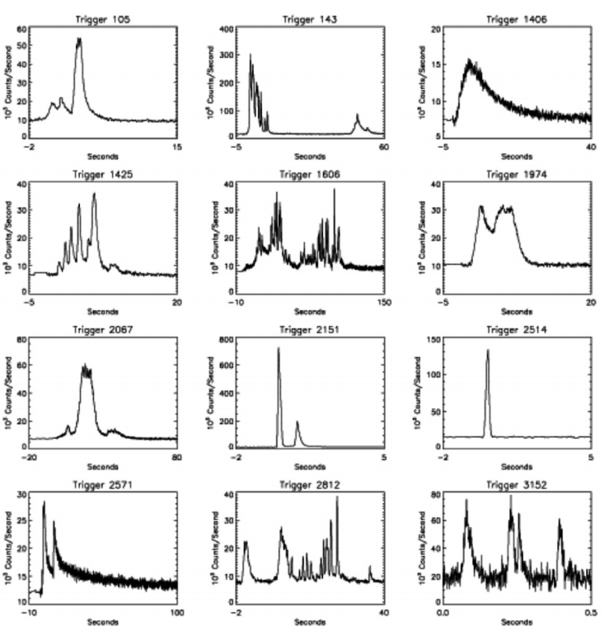
GRB prompt emission
Fishman G. J., Meegan C. A., 1995, Ann. Rev. of Astron. and Astrophys., 33, 415
Kumar P., Zhang B., 2015, Physics Reports, 561, 1

Slide 4
Kouveliotou C., et al., 1993, Astrophys. J., 413, L101

Slide 5
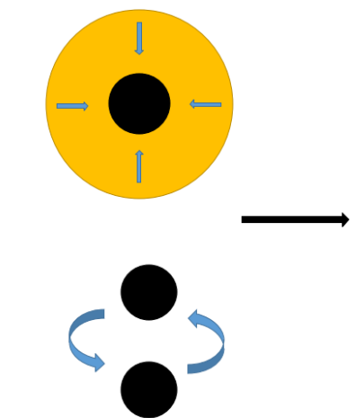
GRB model
Isotropic energy of GRBs is 10⁵¹-10⁵⁴ erg (indicates catastrophes).
external shock
internal shock
medium

Slide 6
Known and unknown
Known:
• Long GRBs originate from massive star collapses
( MacFadyen A. I., Woosley S. E., 1999, Astrophys. J., 524, 262)
• Short GRBs at least originate from NS-NS mergers
( Abbott B. P., et al., 2017, Astrophys. J., 848, L13 )
Unkown:
• Remnant is a BH or an NS?
• Launch mechanism of relativistic jet, Blanford-Znajek
mechanism or neutrino annihilation? Something else?
• Matter-dominated jet or magnetic-energy-dominated jet?
• How jet energy dissipates?
Amphibolously, the answer to the first problem can be:
the central compact objects of part GRBs are NSs.

Slide 7
Why NSs/magnetars
(i) Some long GRBs are associated with supernove
association. An NS can be born in a supernova.
(ii) The upper limit on rest mass of NSs may be larger
than 2.2 M_{⊙(}Cromartie H. T., et al.,arXiv:1904.06759₎,such
that the maximum mass of a uniform rotating NS can
support should be larger than 2.6 M⊙. Total masses
of binary NS systems in the Milky Way is 2.5-2.9 M⊙.
Can we determine the central compact star of a certain GRB?
GRB X-ray afterglows may do.

Slide 8
GRB X-ray afterglow
Zhang B., 2006, Astrophys. J., 642, 354

Slide 9
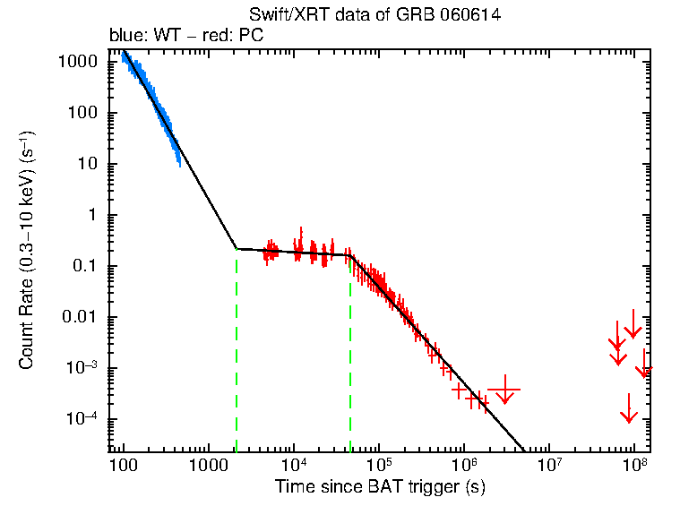
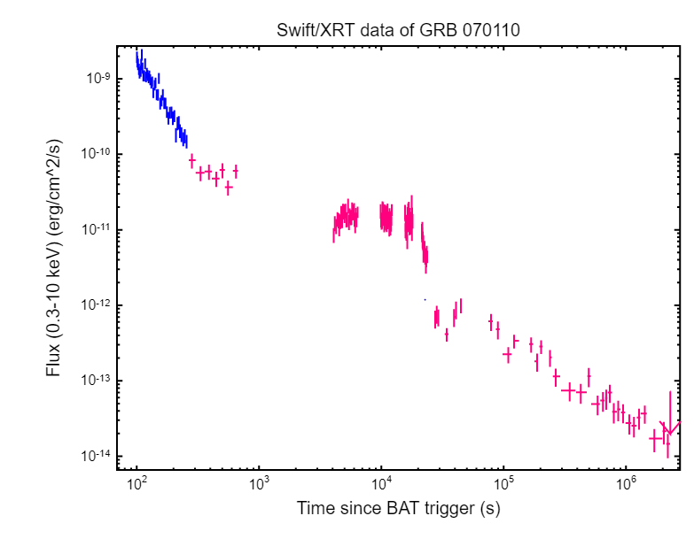
Complements
internal plateau
Evans P. A., et al., 2009, MNRAS, 397, 1177

Slide 10
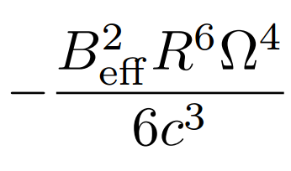
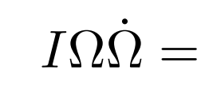
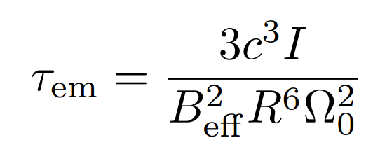
Spin down of stable magnetars due to magnetic dipole radiation

Slide 11
How to explain the internal plateau under magnetar scenarios?
(i) Spin-down wind dissipates independently of external shock;
(ii) the spin-down wind should be highly magnetized;
(iii) the magnetic-energy dissipation rate of the spin-down wind is approximatively the spin-down power;
(iv) electrons/positrons are fast cooling.

Slide 12
How the spin-down wind dissipates
large amplitude electromagnetic waves (LAEWs)

Slide 13
Can LAMWs be generated while satisfying the first three conditions？
Yes, if I haven't miscalculated 😂.

Slide 14
The story doesn't end here

Slide 15
Spin-down wind catches up the jet
GRB 070110
Du S., et al., 2016, MNRAS, 462, 2990
To be continued...

Slide 16
Known and unknown
Known:
• Long GRBs originate from massive star collapses
( MacFadyen A. I., Woosley S. E., 1999, Astrophys. J., 524, 262)
• Short GRBs at least originate from NS-NS mergers
( Abbott B. P., et al., 2017, Astrophys. J., 848, L13 )
Unkown:
• Remnant is a BH or an NS?
• Launch mechanism of relativistic jet, Blanford-Znajek
mechanism or neutrino annihilation? Something else?
• Matter-dominated jet or magnetic-energy-dominated jet?
• How jet energy dissipates?
Amphibolously, the answer to the first problem can be:
the central compact objects of part GRBs are NSs.

Slide 17
Liu T, Gu W M, Zhang B., NewAR, 2017, 79: 1

Slide 18
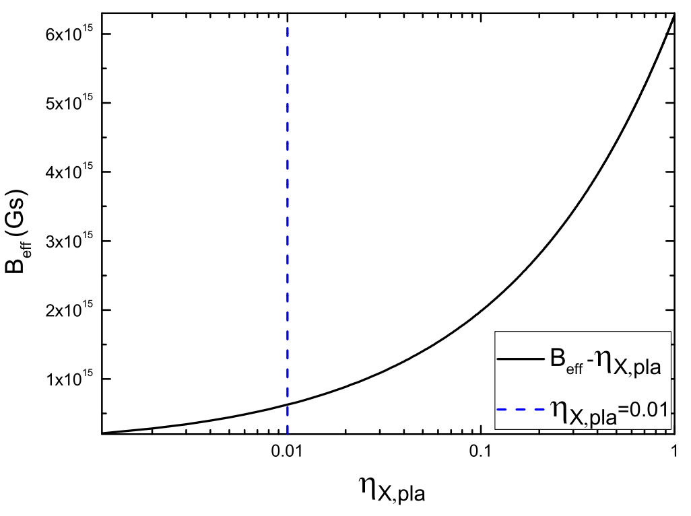
Magnetar in GRB 070110
Du S., et al., 2019, MNRAS, 482, 2973

Slide 19
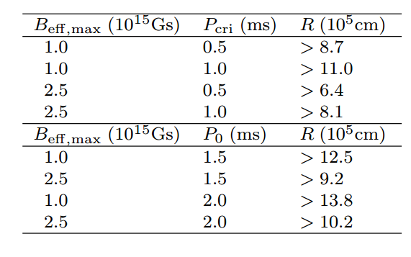
Similar method can be used to constrain the equation of state of NSs
through GRB 170714A
through GRB 080607
Du S., Zhou E. P., Xu R. X., 2019, ApJ accepted

Slide 20
Known and unknown
Known:
• Long GRBs originate from massive star collapses
( MacFadyen A. I., Woosley S. E., 1999, Astrophys. J., 524, 262)
• Short GRBs at least originate from NS-NS mergers
( Abbott B. P., et al., 2017, Astrophys. J., 848, L13 )
Unkown:
• Remnant is a BH or an NS?
• Launch mechanism of relativistic jet, Blanford-Znajek
mechanism or neutrino annihilation? Something else?
• Matter-dominated jet or magnetic-energy-dominated jet?
• How jet energy dissipates?
Amphibolously, the answer to the first problem can be:
the central compact objects of part GRBs are NSs.

Slide 21
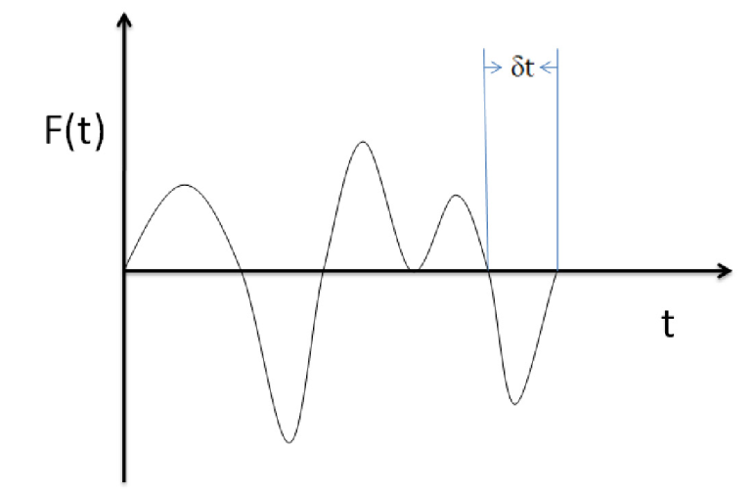
(intermittent) Gravitational waves induced by asymmetric jets
Du S., et al., 2018, MNRAS, 480, 420

Slide 22
Summary
The central compact stars of GRBs can be NSs.
X-ray plateau followed by a power-law decay with index ∼ -2 may be powered by a stable magnetar.
X-ray plateau followed by a steep decay with index < -3 can be explained under the unstable magnetar scenario.
The correlation between GRB X-ray plateaus and the property of corresponding magnetars can be used to constrain the equation of state of NSs.
Thanks

