Slide 1
Delayed spin ups of the Crab pulsar as a possible signature of superfluid PBF
Weihua Wang(汪卫华)@Postdoc,
Department of Astronomy In Peking Uni.
Cooperator: Prof. R. X. Xu（徐仁新教授）

Slide 2
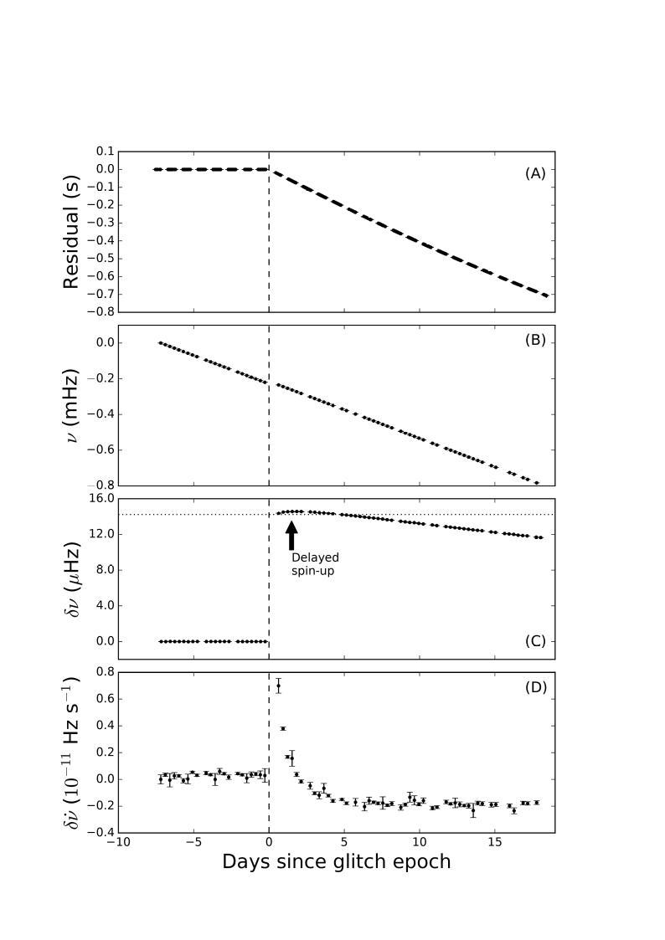
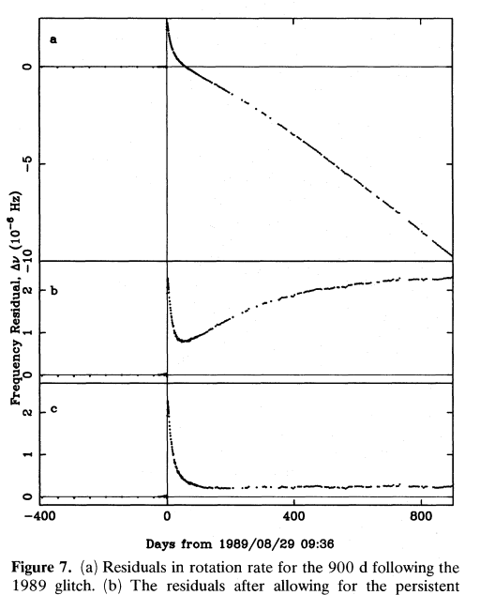
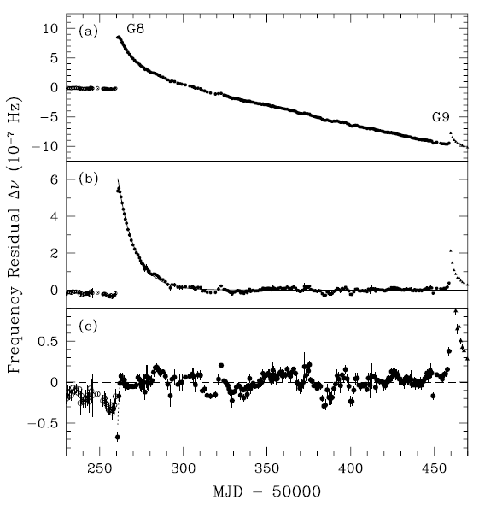
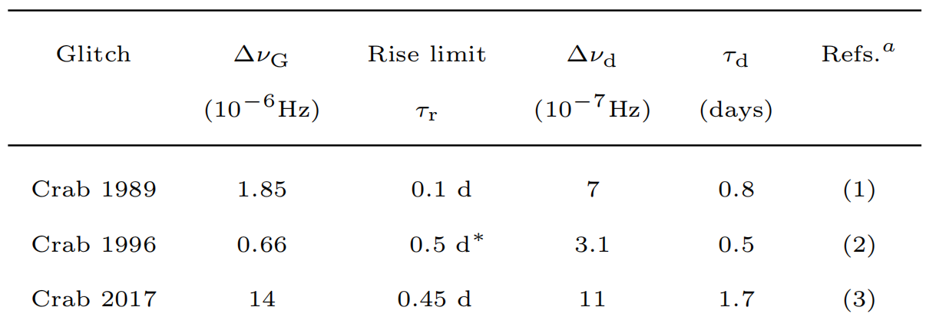
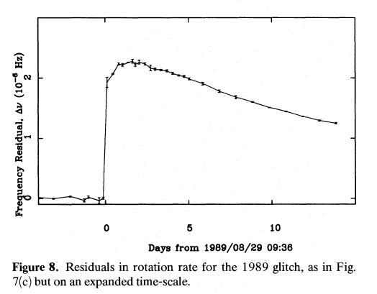
The Crab pulsar glitches and recovery of the spin down rate
Long timescale persistent shift phenomenon
Day-long short timescale delayed spin-up
(1989, glitch MJD 47767.504
Lyne, 1993, MNRAS, 265, 1003)
(1996, glitch 50260.031
Wong, 2001, ApJ, 548, 447)
(2017, glitch 58064.555
Shaw, 2018, MNRAS, 478, 3832)

Slide 3
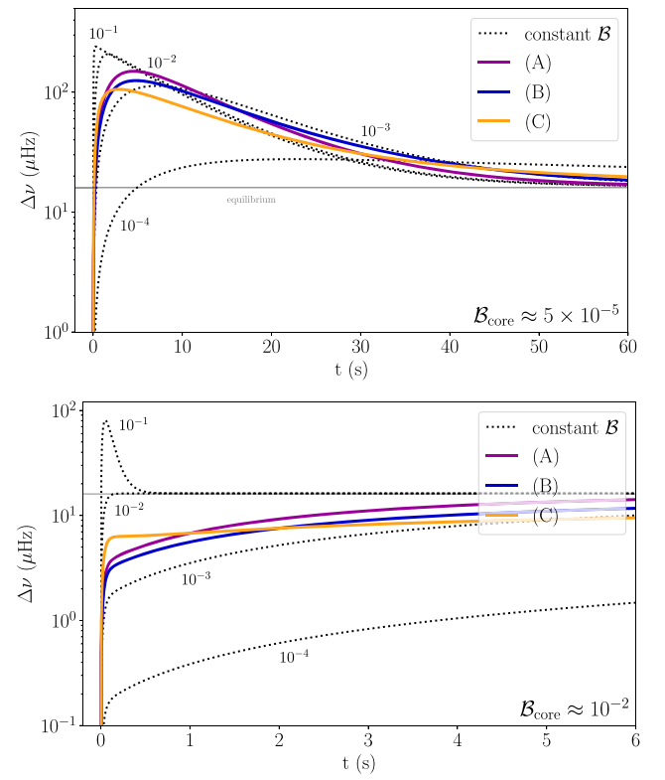
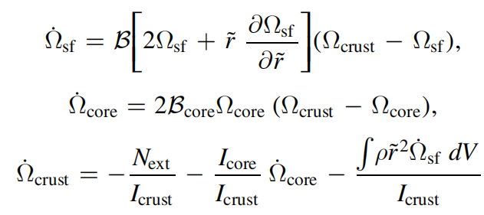
Understand the slow rise from the motion of vortices, previous model
Overshoot
Friction mechanisms and friction parameters:
(1) in the crust, phonon excitations (collsions with the lattice), 10^(-8)-10^(-1);
(2) between the crust and core, Kelvin wave excitations, 10^(-5)-10^(-3);
(3)in the outer core, scattering off electrons, 10^(-5)-10^(-3).
Slow rise will appear at a reasonable core friction parameter (sensitive to the core).
(Graber, 2018, ApJ, 865, 23)

Slide 4
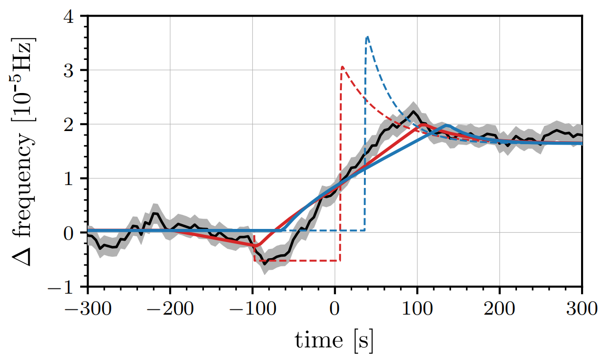
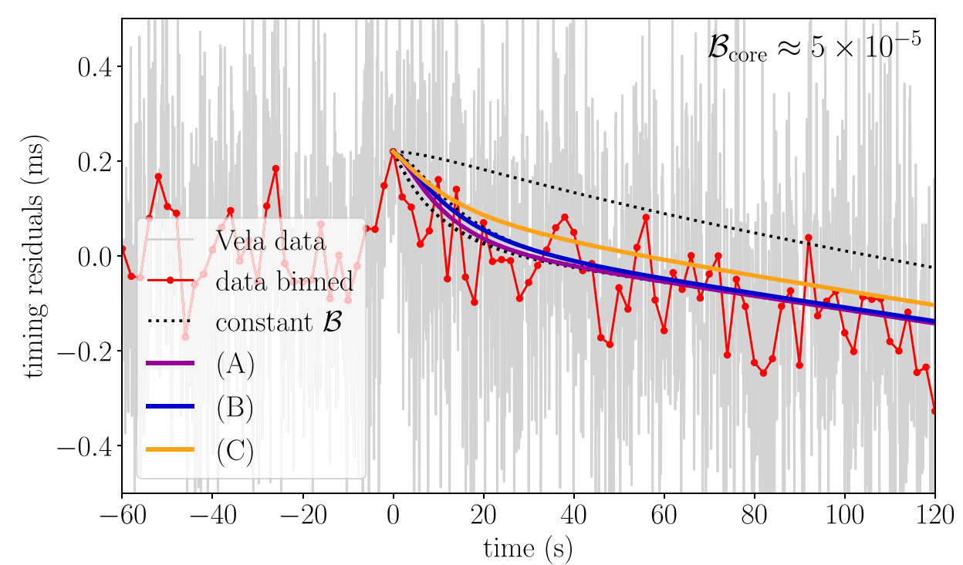
The Vela pulsar observation support the overshoot picture.
(G. Ashton, 2019, Nature Astronomy)
(Graber, 2018, ApJ, 865, 23)

Slide 5
If we reasonably assume the core friction parameter of the Crab pulsar is similar/close to that of the Vela pulsar, the discenpancy between day-long radio observation of the Crab pulsar and the Vela pulsar indicates that, the vortex motion can't explain the delayed spin up phenomenon (timescale).

Slide 6
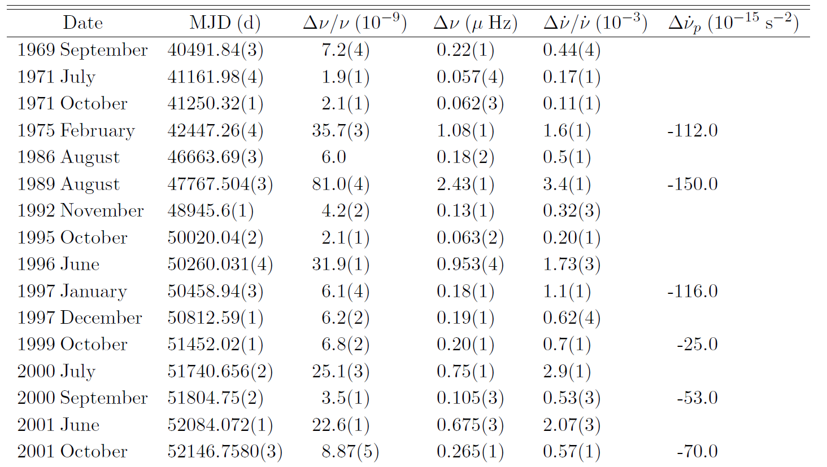
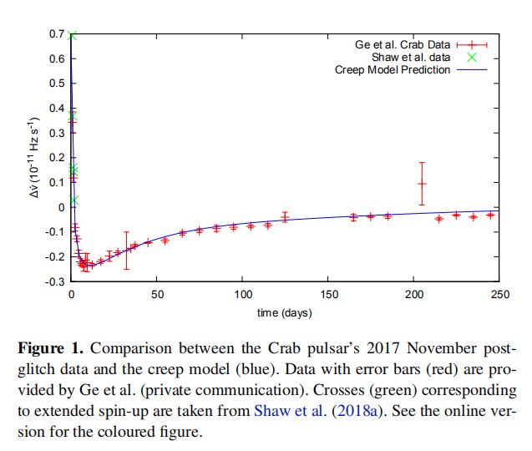
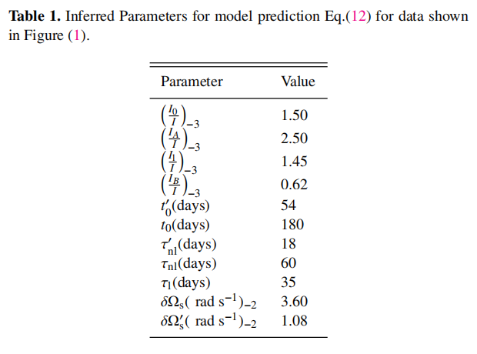
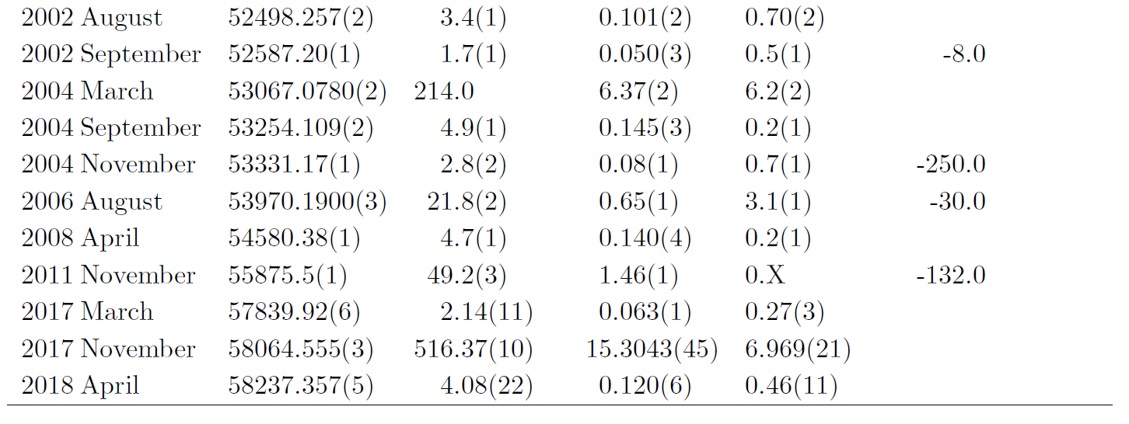
Day-long timescale inward motion of vortices which go into the so-called depletion region, providing the extra positive torque.
(Alpar, 2019, arXiv: 1905.08180)

Slide 7
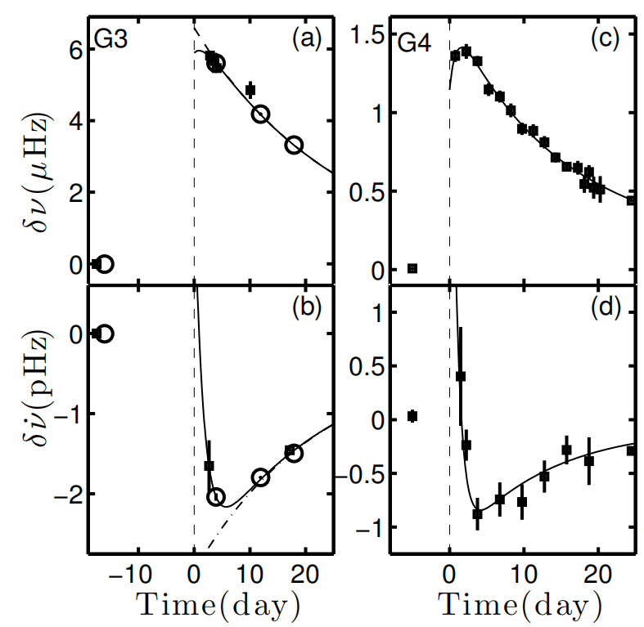
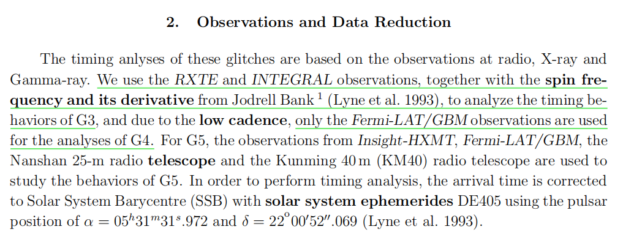
Another two Crab pulsar delayed spin ups found in X-ray/Gamma-ray data
Glitch MJD 53067.0780 data:
RXTE and INTRGRAL X-ray observations;
Glitch MJD 55875.5 data:
Fermi-LAT and GBM X-ray and gamma ray observations.
Spin frequency evolution of glitch MJD 53067.0780 (in 2004) and MJD 55875.5 (in 2011). Provided by M. Y. Ge.

Slide 8
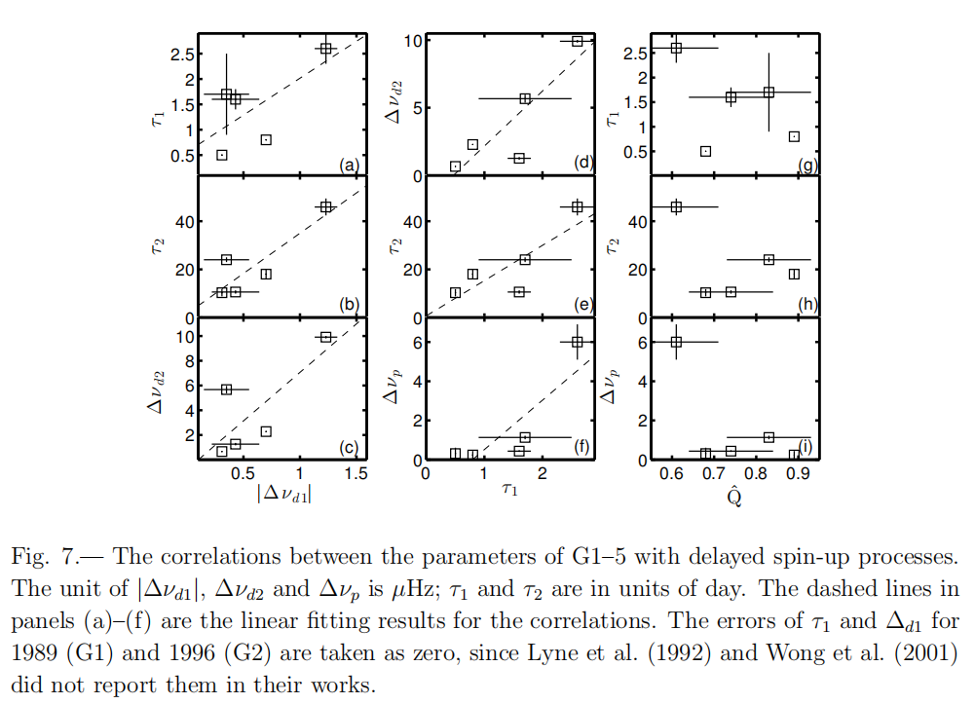
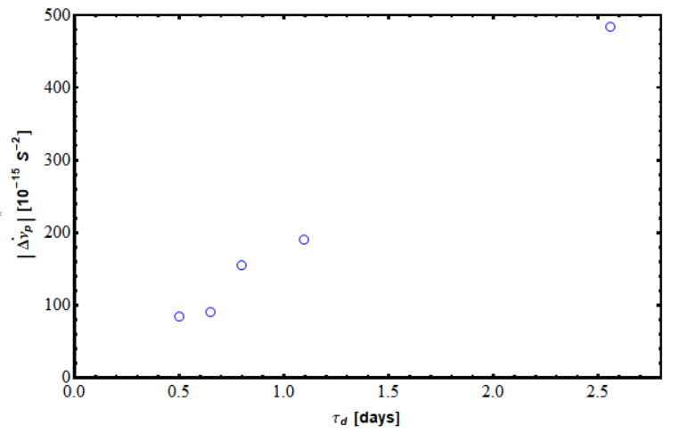
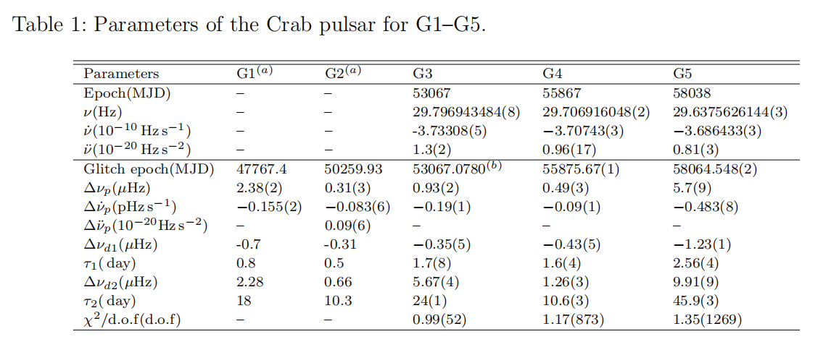
Indicating a strong correlation between the delayed spin ups and the persistent shift values.

Slide 9
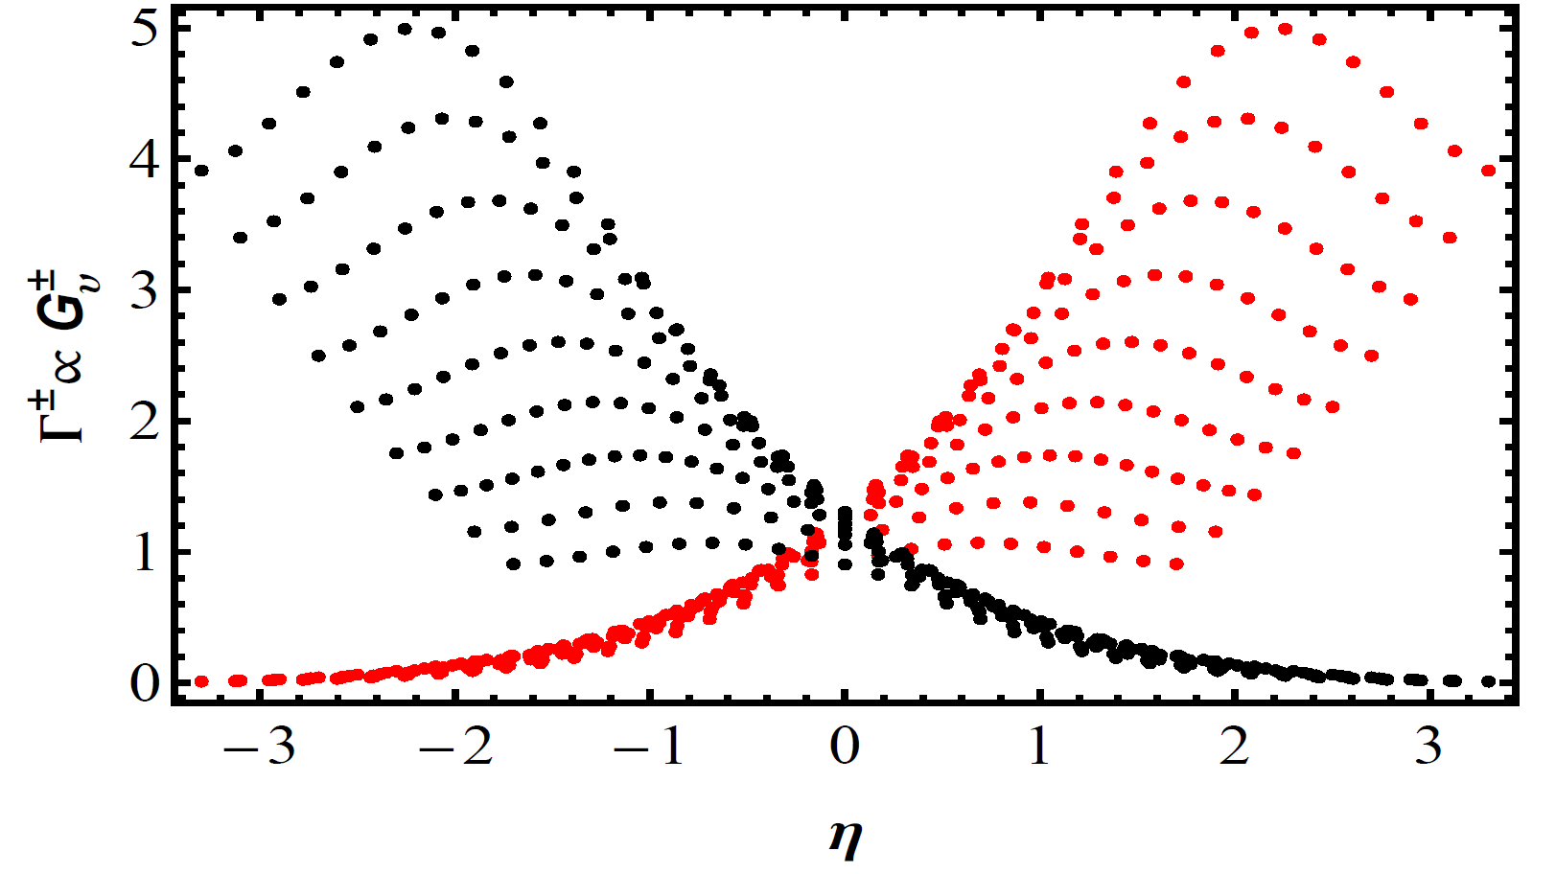
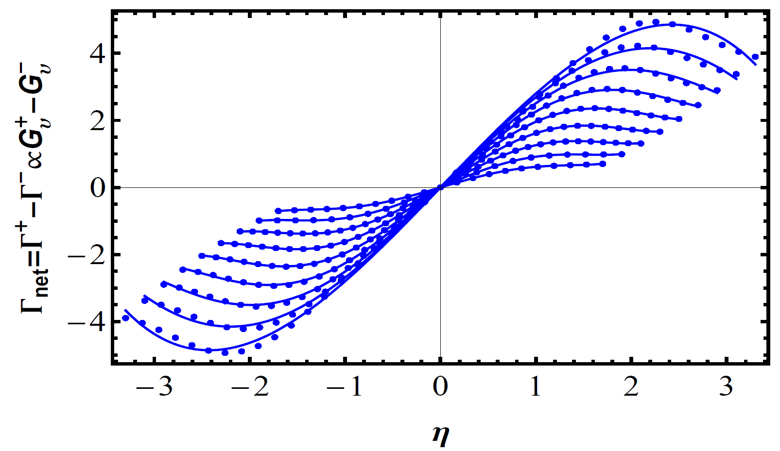
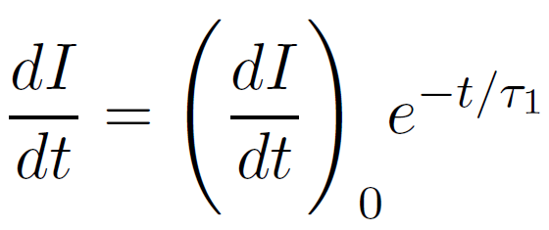
Our Cooper pair breaking picture
Fitting function for singlet state superfluidity (istropic)：
Fitting function for triplet state superfluidity (anisotropy)：
Red dots for Cooper pair breaking rate and black for Cooper pair forming, these series of points correspond to different superfluid energy gaps.
Odd functions of chemical departure
Relation between net reaction rate and chemical departure.

Slide 10
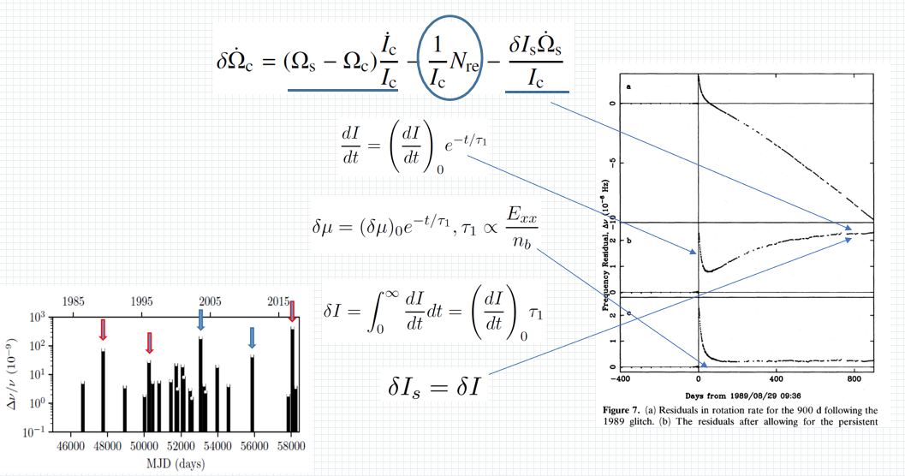

Slide 11
Implications:
1.Constrain the polytropic index of Eos in outer core to be around 1.37 through fitting to the delayed spin-up timescale.
2.Constrain the relative spin-lag between the superfluid and normal components through the linear relation between the delayed spin-up timescale and the measured persistent shift value to be 3.9*10^(-5), for Vela-like middle-aged pulsars, about 10^(-4).
3.Set constraint on the superfluid energy gap.
4.Set constraint on the critical temperature of triplet state superfluid according to the inner temperature of the Crab pulsar.

Slide 12
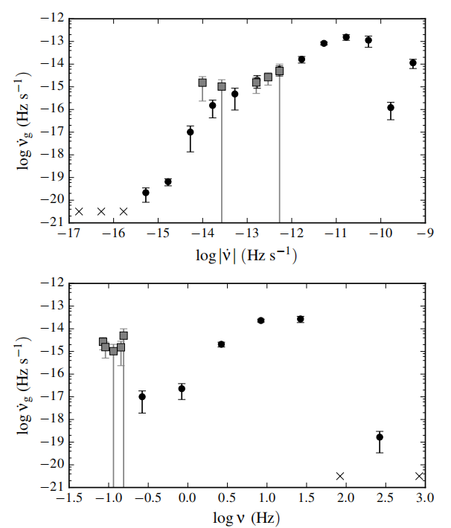
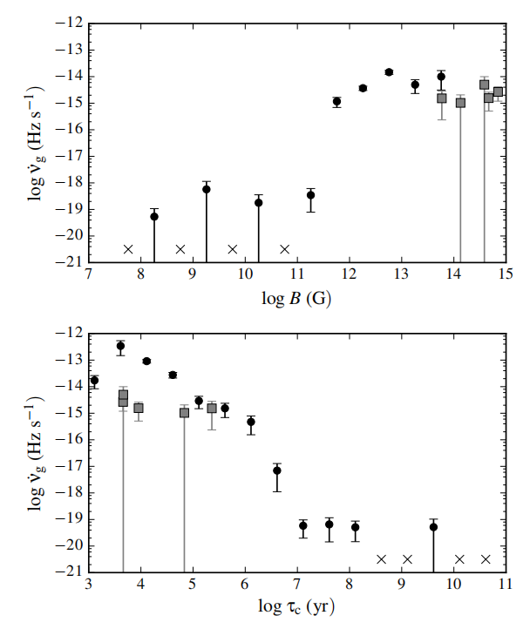
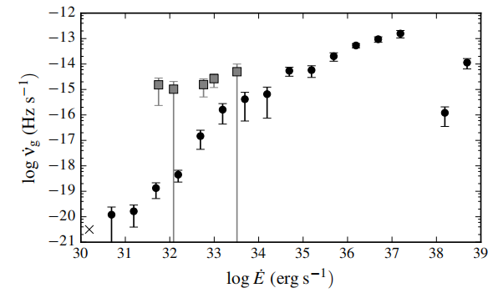
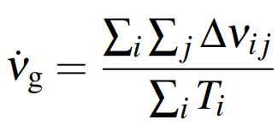
Why may the Crab pulsar be so special?
magnetars
glitch activity:
glitch activity as a function of various pulsar parameters
(Fuentes et al., 2017, A&A, 608, A131)

Slide 13
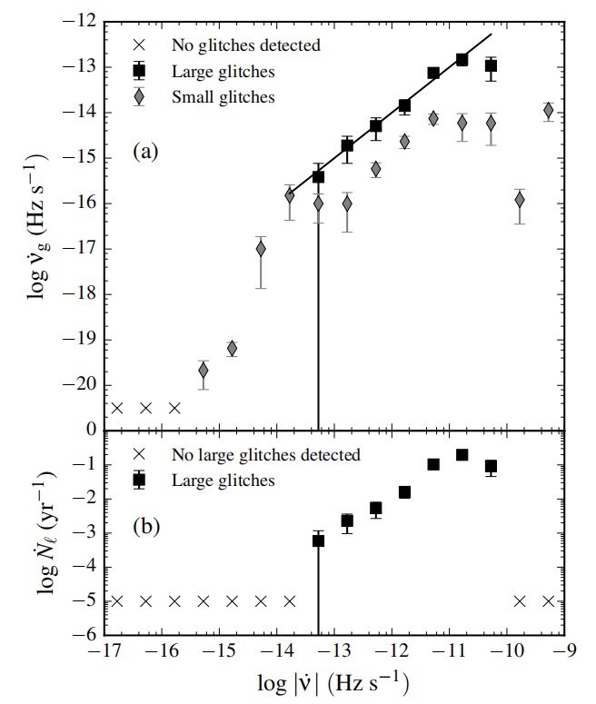
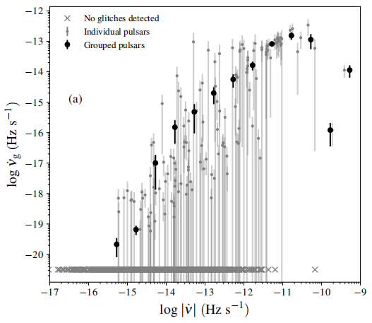
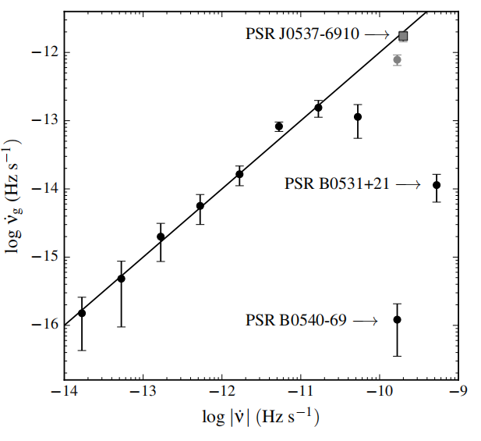
Very young pulsars are special.
linear relation between glitch activity and spin down rate
(Fuentes et al., 2017, A&A, 608, A131)

Slide 14
(1). The linear relation indicating a similar amount of angular momentum resevior for all pulsars.
(2). All these three anamolous pulsars have high spin down rate, very young.
(3). All pulsars with relatively low spin down rates (aged) follow the linear relation, indicating the evolution from young pulsars to aged pulsars.
(4). What have changed most significently when they become aged? Interior physical conditions, such as temperature and interior composition, which are mass dependent.
I propose my explaination as, in these three anomolous young pulsars, superfluid forming is still ongoing, thus superfluid component is not enough compared with middle-aged pulsars. This idea will reconcile linear relation of glitch activities of MSPs, magnetars, normal radio pulsars and very young pulsars.

Slide 15
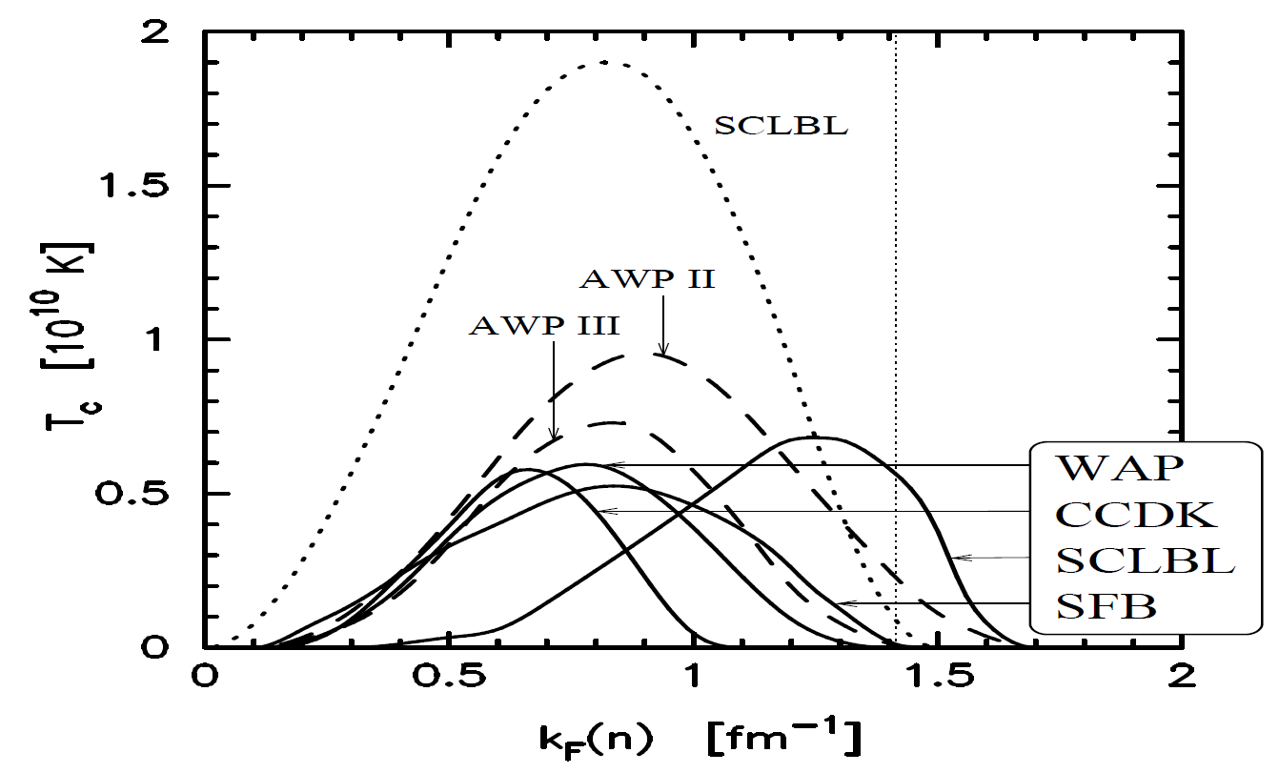
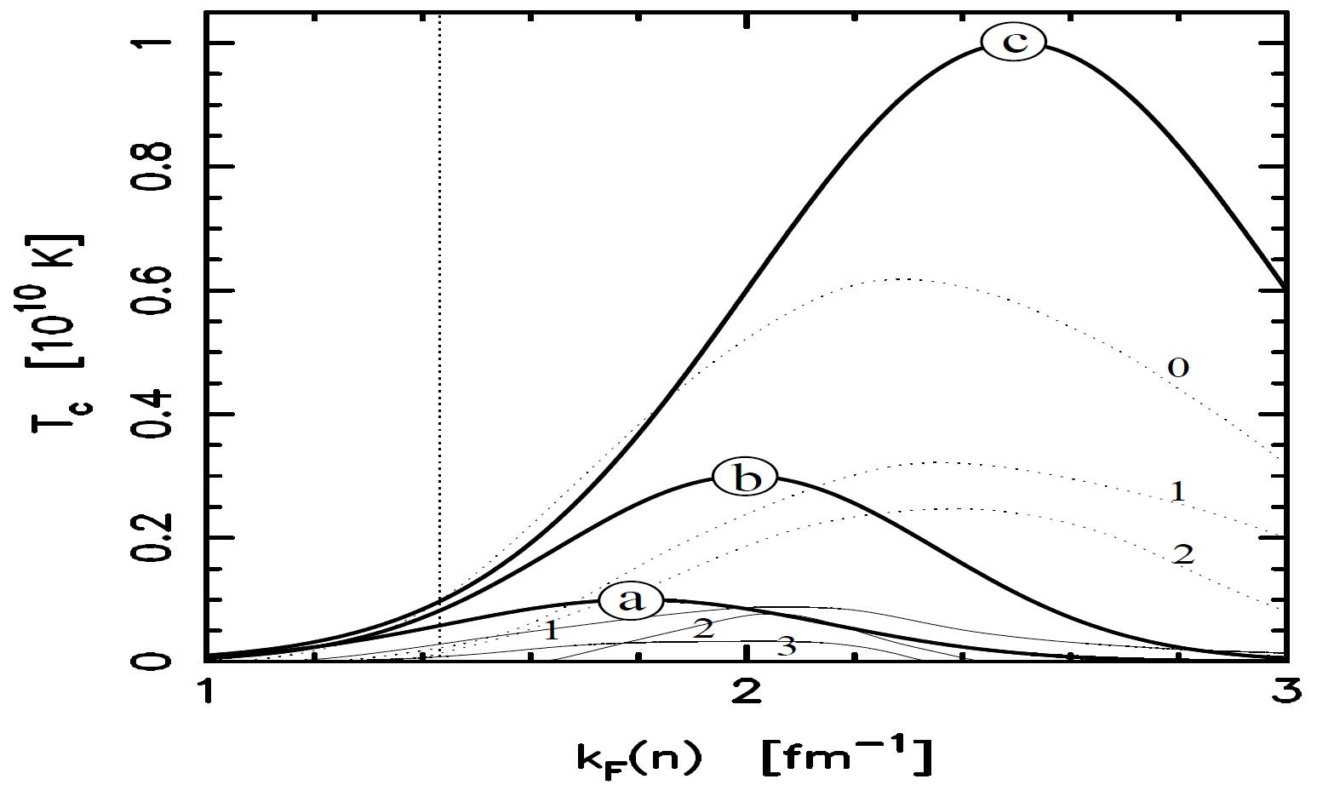
Is this idea possible?
(1).The crust amounts to at most 10% of total moment of inertia, in the crust, singlet state superfluidity has high critical temperature (about 10^10 K), thus the crust become superfluid in a short time after pulsar birth.
(2).The core amounts to at least 90% of total moment of inertia, however, triplet state has low critical temperature, the interior could be normal matter if the temperature is above the critical temperature. The superfluid forming rate depends on the cooling rate, thus on the mass of neutron stars (pulsars).
Density dependence for singet state
Density dependence for triplet state

Slide 16
Could starquake be responsible for the low glitch activity?
Two most important points:
(1). Starquake arises from stress accumulation and deformation of stellar shape, young pulsars suffer high spin down rates, in principle, young pulsars should expericence mainly large glitches and have high glitch activity, inconsistent with observations.
(2). Gravitational energy release accompanied by midium glitch in the Crab pulsar has never been detected, inconsistent with theoretical estimation.

Slide 17
Summary
(1) The comparsion between post-glitch processes the Crab and the Vela pulsars suggests that, delayed spin up is not a part of glitch rise.
(2)The strong correlation between delayed spin up timescale and persistent shift value indicates their same physical origin.
(3)Delayed spin up may be a signature of superfluid PBF(pair breaking and forming).
(4)It is meaningless to talk about physics regardless of the specified environments, if pulsars turn out to be strangeon stars, new glitch mechanism is needed.

Slide 18
Thank you.

