Slide 1

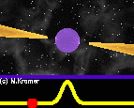
Some thoughts on pulsar radiation studies with TMRT at FAST times
Speaker：Zhen Yan*
Shanghai Astronomical Observatory, CAS
*On behalf of the Shanghai TianMa Radio Telescope Team

Slide 2
Outline
Introduction to Shanghai TianMa Radio Telescope
  The history of TRMT
  Receivers of TMRT
  The pulsar backend of TMRT
  Some pulsar observation results on pulsar radiation
    2.3GHz, 5GHz, 8.6GHz
  What can we do next step
    Restrict RFI
    Make full use of C-band receiver
    New wideband backend
Conclusion

Slide 3
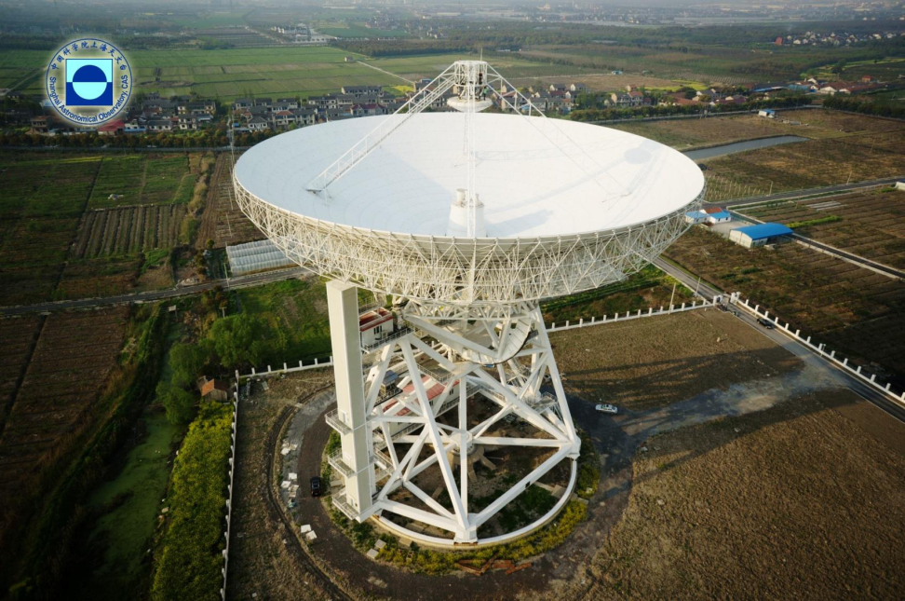
Introduction to Shanghai TianMa radio telescope
  Newly built 65-m in diameter fully steerable radio telescope located in Song-Jiang district of Shanghai city;
  It is called Tianma Radio Telescope (TMRT),because it is near the small mountain named TianMa;
Phase of the SH-65m project
  Funded in 2008;
  Started manufacturing in 2009;
  1st phase was finished in July 2013, four low frequency receivers (L,S,C,X) have been installed.
  Have been expanded to Q-band (43GHz) in 2017 using active surface system to make sure its efficiency

Slide 4
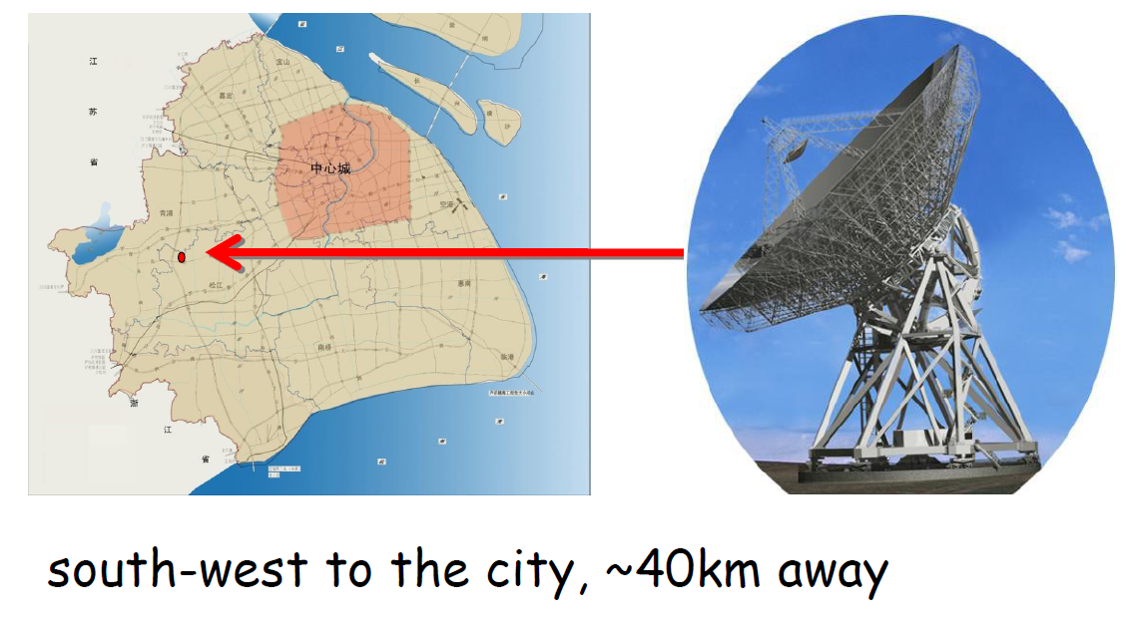
The location of SH65
Yellow
Brown
Red

Slide 5
Comparison TMRT with others of the same architecture
Frequency: 1.25-50.0 GHz, eight receivers; four low frequency receivers which are suitable for normal pulsar observations.
 |  | GBT | Effelsberg | Parkes | Lovell | Tianma
L | Freq-R | 1.15-1.73 | 1.27-1.45, 1.59-1.73 | 1.2-1.8 | 1.25-1.50, 1.55-1.73 | 1.25-1.75
 | SEFD | 10 | 20,19 | 31 | 36,65 | 31
S | Freq-R | 1.73-2.6 | 2.20-2.30 | 2.2-2.5 | ----- | 2.2-2.4
 | SEFD | 12 | 300 | 25 | ----- | ≥31
C | Freq-R | 3.95-5.85 | 5.75-6.75 | 4.5-5.1 | 6.0-7.0 | 4.0-8.0
 | SEFD | 10 | 25 | 61 | 80 | 28
X | Freq-R | 8.00-10.1 | 7.9-9.0 | 8,1-8.7 | ----- | 8.2-9.0
 | SEFD | 15 | 18 | 170 | ----- | ≥38
Note: System Equivalent Flux Density (SEFD):

Slide 6
DIBAS-The Digital Backend System for Tianma
Combination of GUPPI (pulsar system ) and Vegas (spectra line system ) of NRAO
In comparison with GUPPI, DIBAS is an updated system. Maximum bandwidth that GUPPI can support is 800MHz (both coherent & incoherent de-dispersion).
Coherent:
Both the inter- and intra-channel dispersion effects can be eliminated.
Dense computation
Accomplished with 8 GPU computers
Maximum bandwidth supported : 800MHz
DIBAS for TM
Coherent de-dispersion online folding
Incoherent de-dispersion online folding
Coherent de-dispersion search
Incoherent de-dispersion search
As DIBAS is an updated system from NRAO, we have to spent a lot of time on testing!
Incoherent:
Dispersion effect in sub-band can not be eliminated;
Maximum sub-channel number: 8192
Maximum bandwidth supported : 6000MHz (2000MHz/Roach)

Slide 7
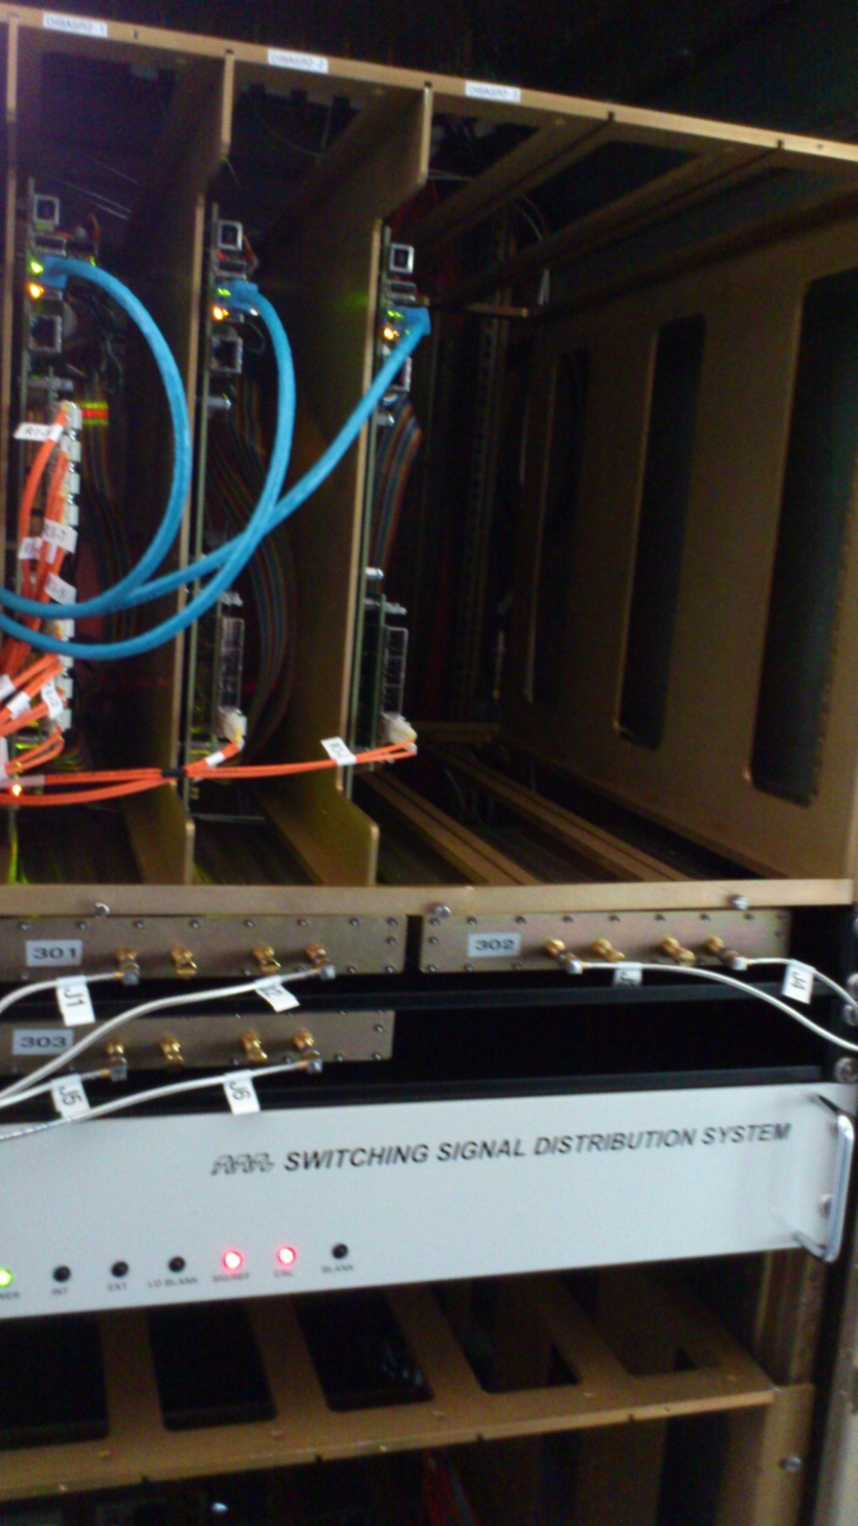
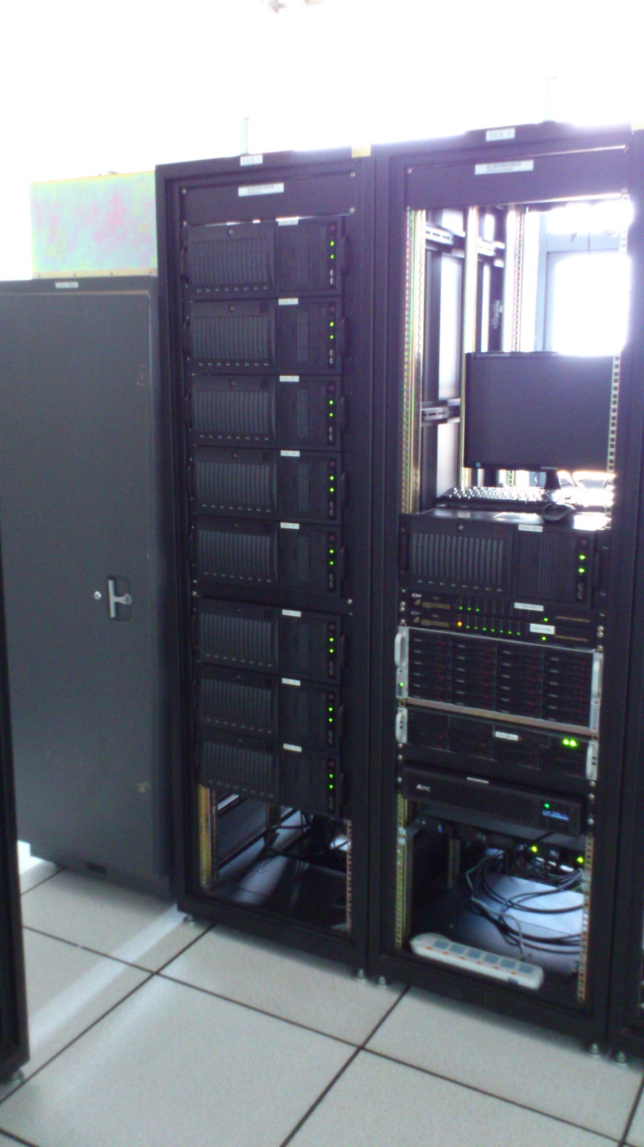
(GTX-580 GPU)

Slide 8
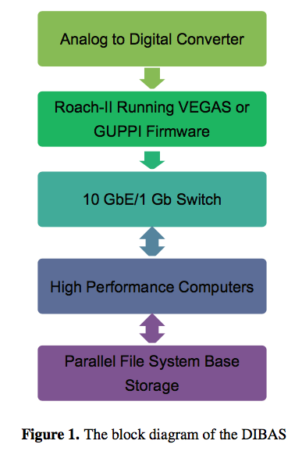
Fig.Lustre File System
Maximum data recording speed: 300MB/s (per thread)
Highest time resolution: 40.96μs

Slide 9

Automatic pulsar observation with TMRT
对库函数进行封装
设计标准化观测纲要文件
解决终端和天线控制联动
从而实现标准化、智能化

Slide 10
Pulsar radiation mechanism

Slide 11
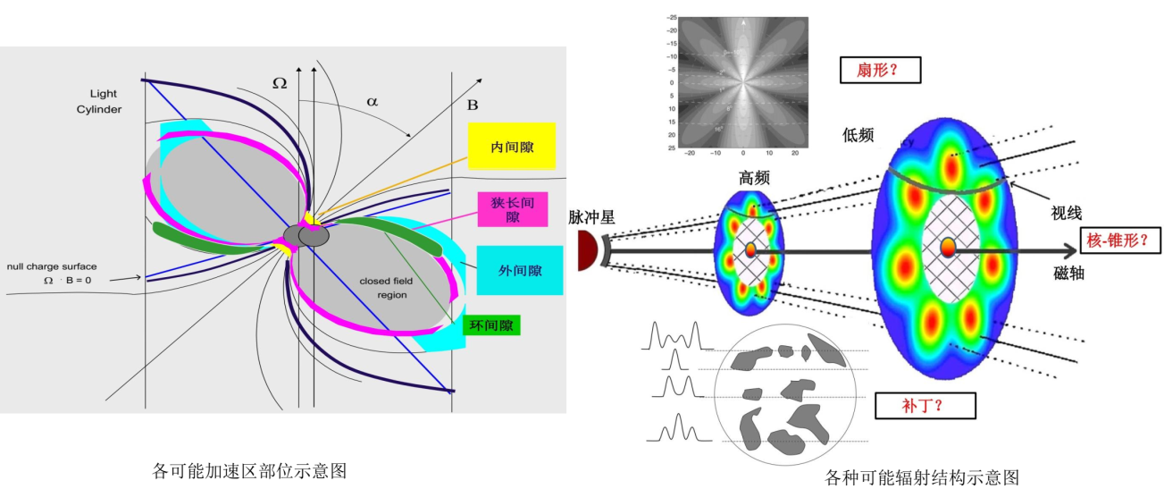
Pulsar radiation mechanism
Still to be an open field
  Shape？
  Position？
  Process？

Slide 12
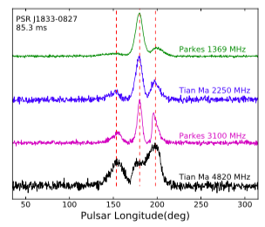
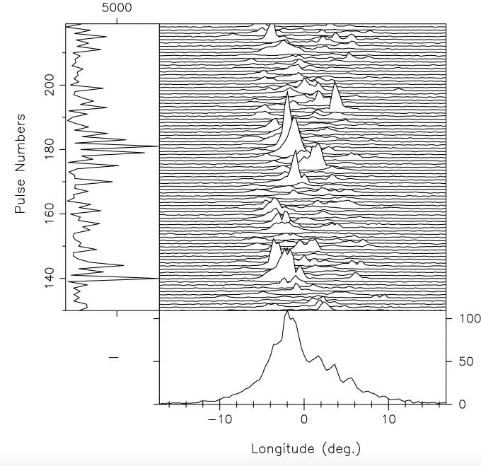
Integrated profile
Single pulse
Multi-frequency
Little high frequency data

Slide 13
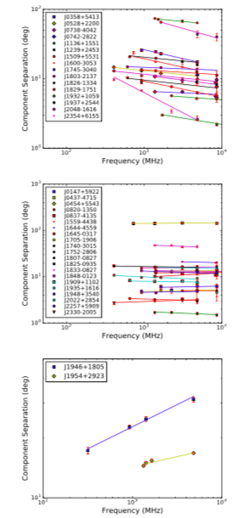
26 integrated pulse Profiles
  The quality of 26 profiles are comparable with the previous from Effelsberg or Parkes.
  Mean flux densities of these pulsars are estimated and the calibrated pulse profiles are provided.
  11 profiles of this sample are obtained for the first time at 8.6 GHz.
5 GHz TMRT observations of 71 pulsars
  For 19 normal pulsars and one MSP, these are the first detections at 5~GHz
  For a further 19, including five MPSs, the profiles have a better signal-to-noise ratio than previous observations
  Mean flux density spectra between 400~MHz and 9~GHz are presented for 27 pulsars
16
21
2
Ru-Shuang Zhao, Xin-Ji Wu, Zhen Yan, et al., ApJ, 2017
Ru-Shuang Zhao, Zhen Yan, Xin-Ji Wu, et al., ApJ, 2019

Slide 14
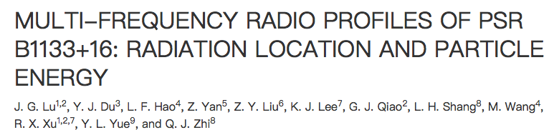
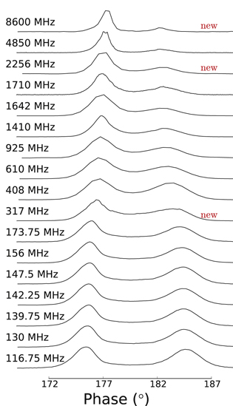
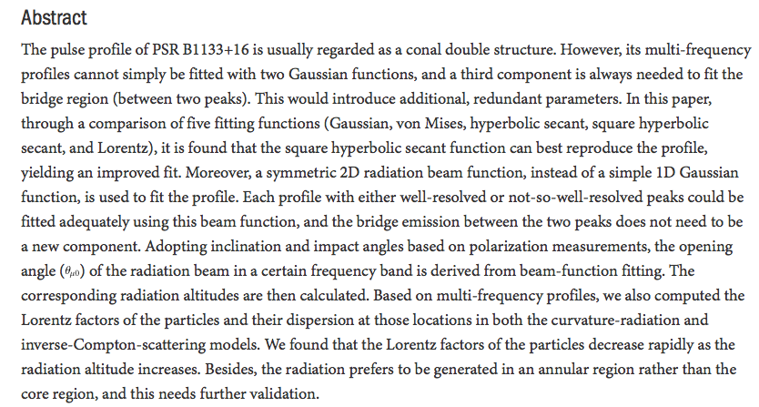

Slide 15
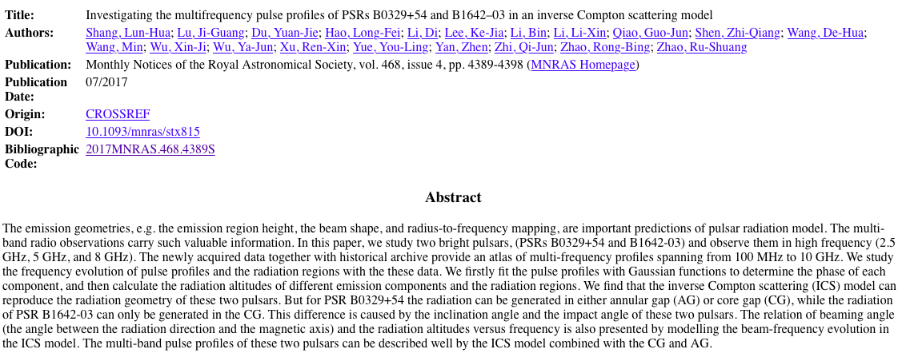

Slide 16
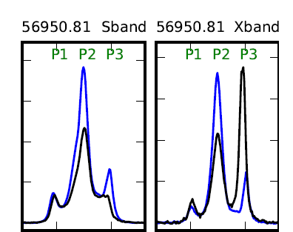
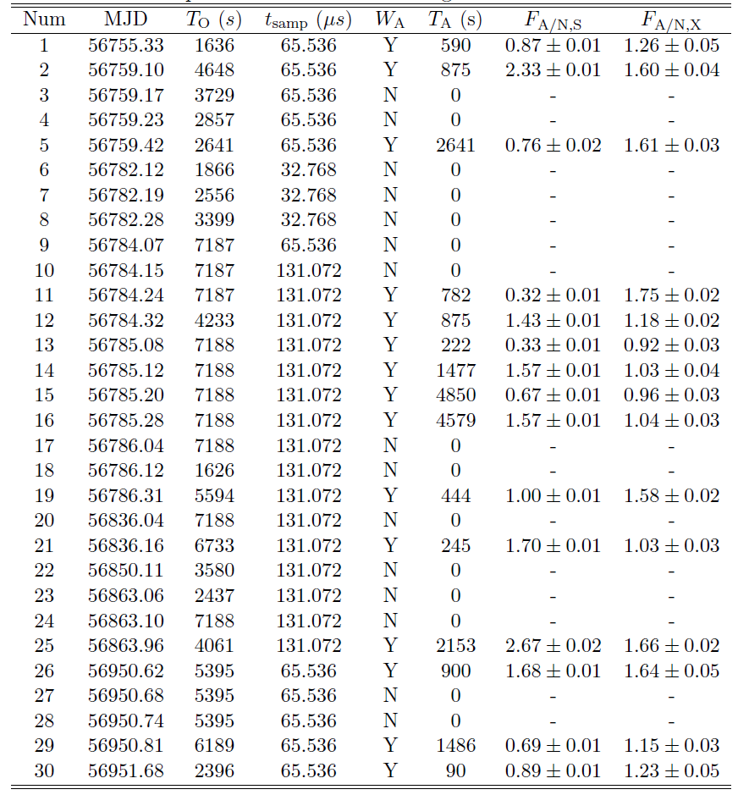
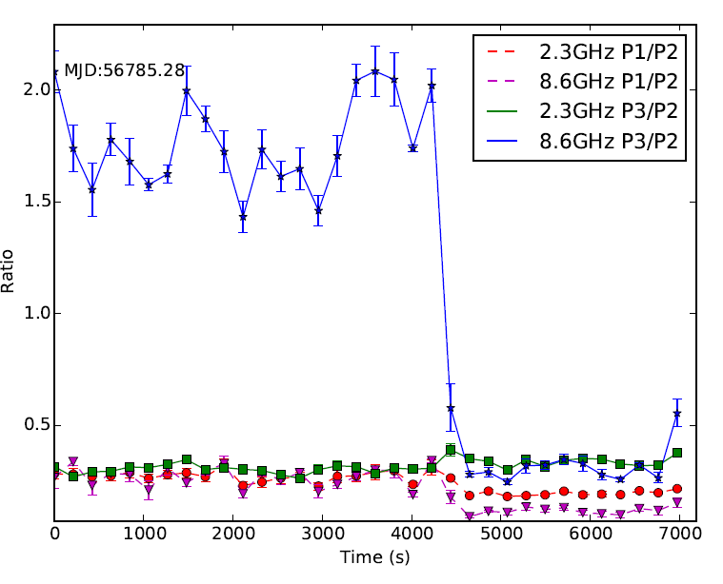
Mode change of PSR B0329+54

Slide 17
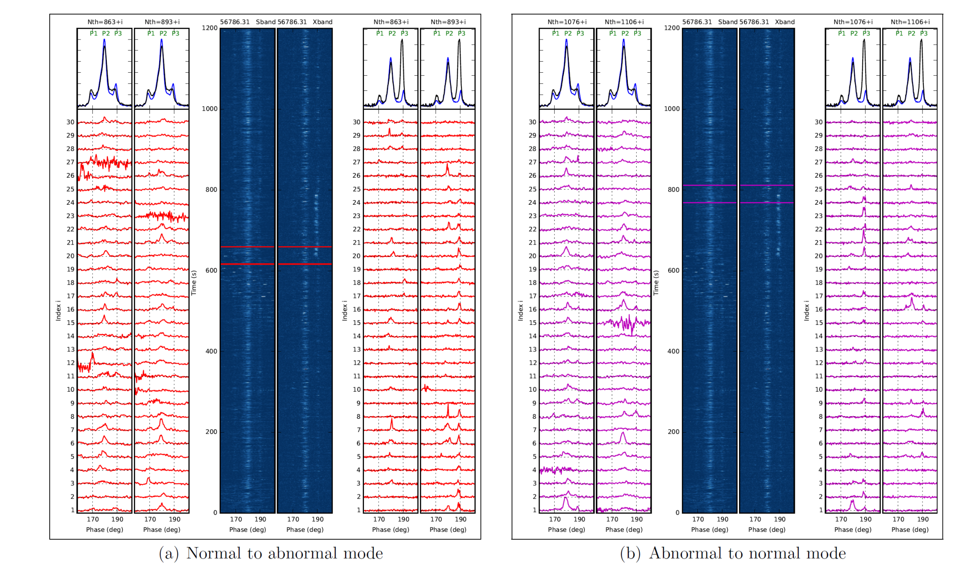
Dual-frequency mode change studies at single-pulse level
S/X-band

Slide 18
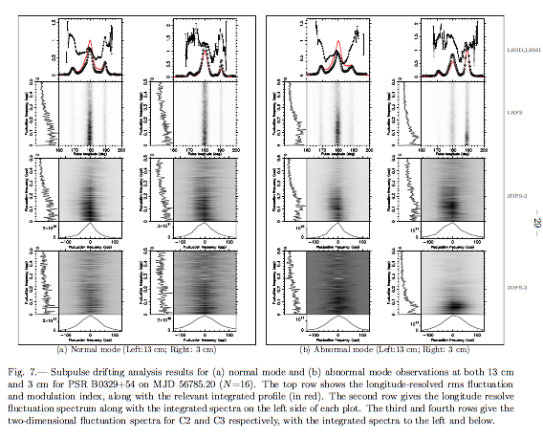
Subpulse drifting properties change with the mode and frequency!
Zhen Yan, Zhi-Qiang Shen, R.N. Manchester et al., ApJ, 2018

Slide 19
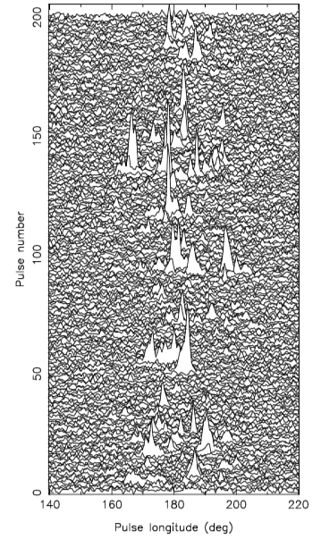
B0329+54 also have spiky pulse；
X band burst rate：0.66% （normal mode）；0.27% （abnormal mode）
S band burst rate：0.007%
Burst rate at S band is only 1% of that at X band.
We infer that the spiky pulse is not a special phenomena. The burst rate is much at lower frequency.
Spiky pulse discovered in 2006 on PSR B0656+14

Slide 20
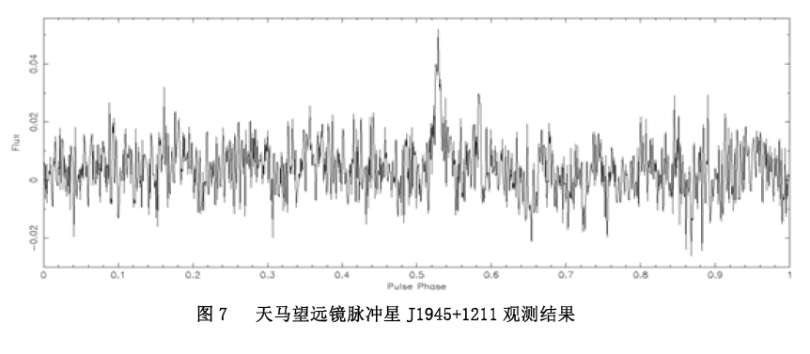
New pulsar discovered with FAST detected with TMRT
PSR J1945+1211 discovered by the FAST, TMRT detected this pulsar at 2.3 GHz, S_{2.3GHz}~0.2 mJy

Slide 21
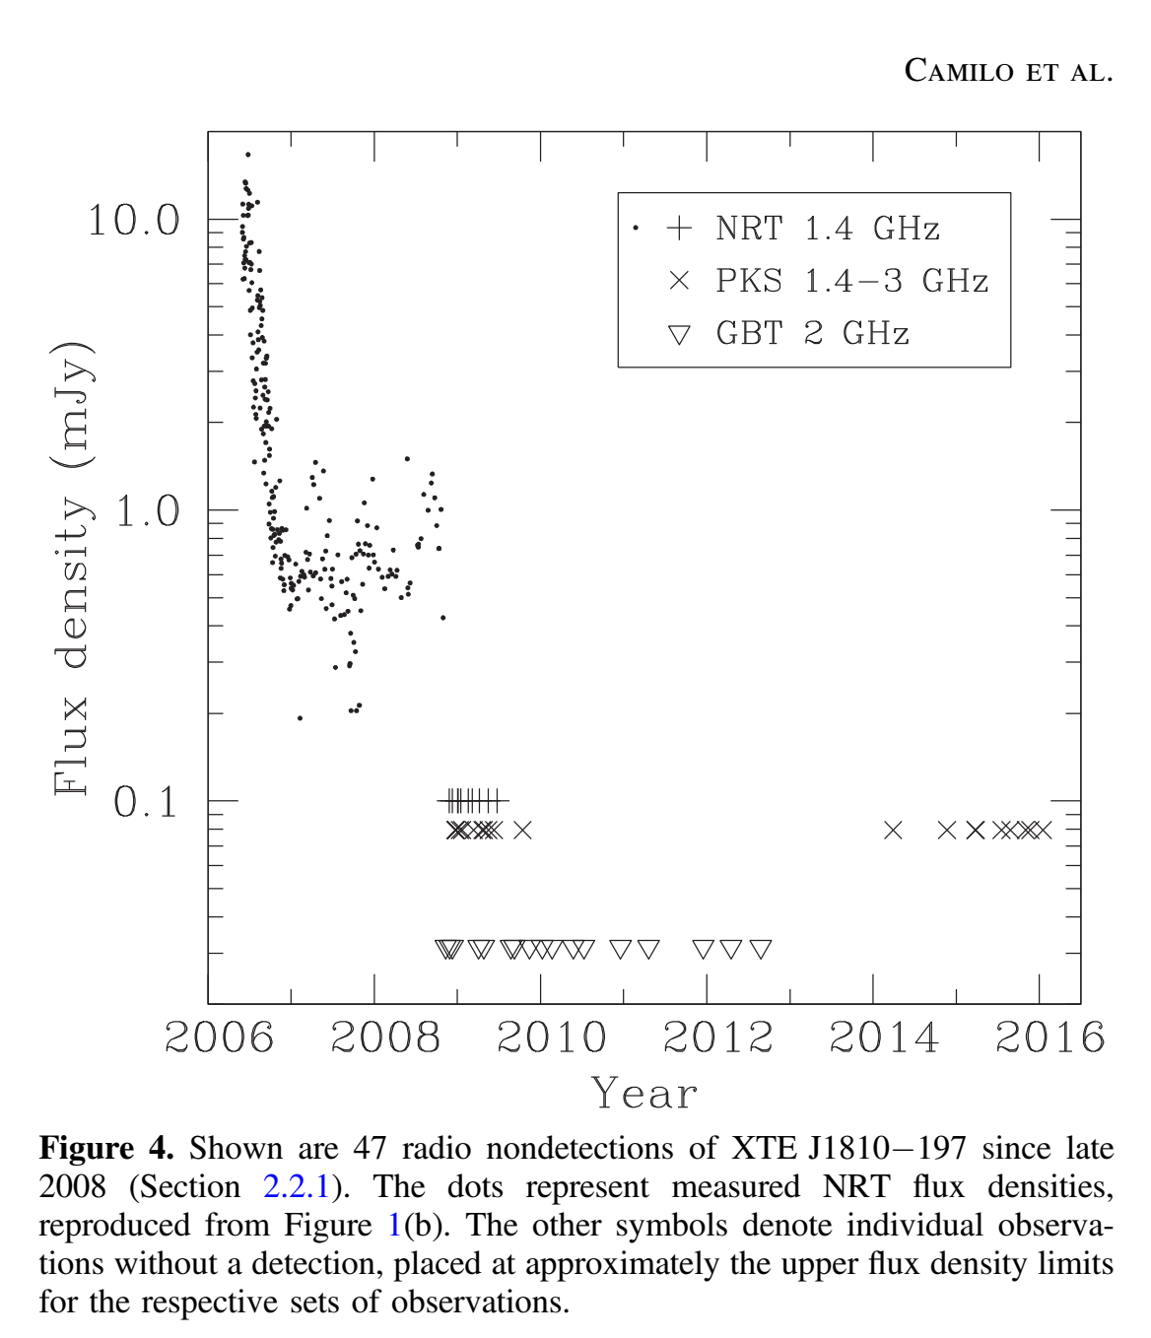
Magnetar： XTE J1810-197
discovered in early 2003
first recognized transient AXP
Period： 5:54 s
surface magnetic dipole field strength 2 *10¹⁴ G
Show obvious profile change with time
Since late 2008, XTE J1810-197 went into decade-long period of quiescence, especially at radio band.

Slide 22
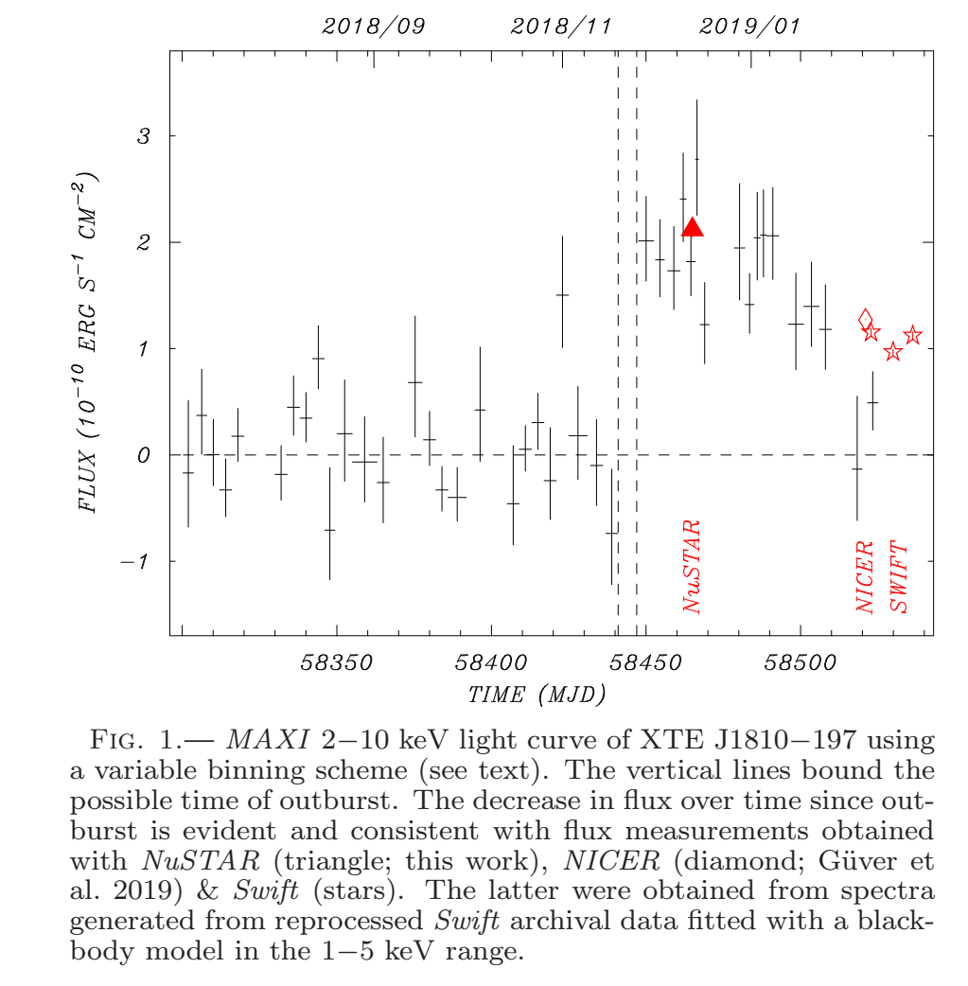
On December 8, 2018, the scientists detected a bright pulsed radio signal at 1.52 GHz from this source, which marked the end of a nearly decade of its radio-quietness.

Slide 23
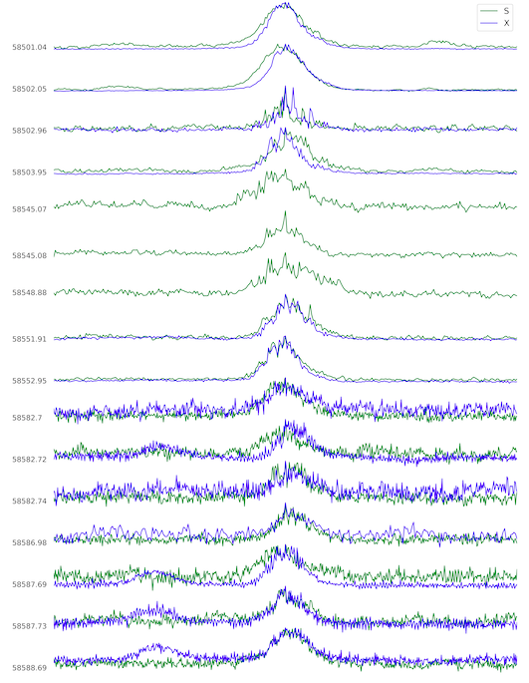
Simultaneous 13 cm/3 cm observations
Very important as the profiles change with time
Long term changes
Some times the its profiles change in less than one hour, some times it is comparative stable.
More analysis and works will be done with our data.

Slide 24
What can we do next step to make TMRT can further studies on pulsar magnetosphere？

Slide 25
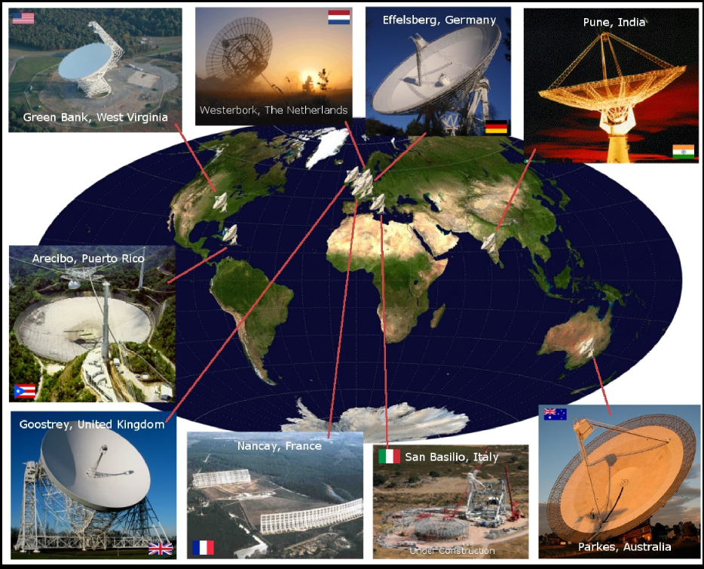
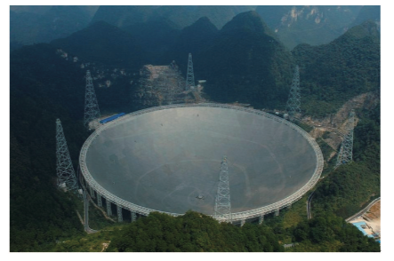

Slide 26
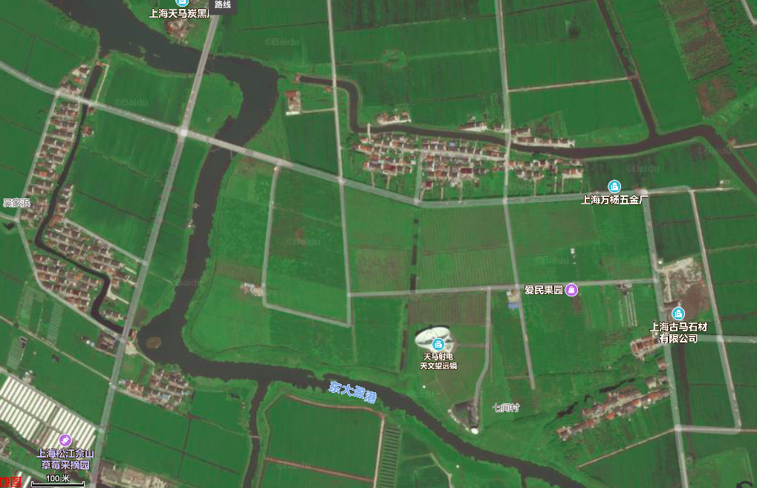

Slide 27
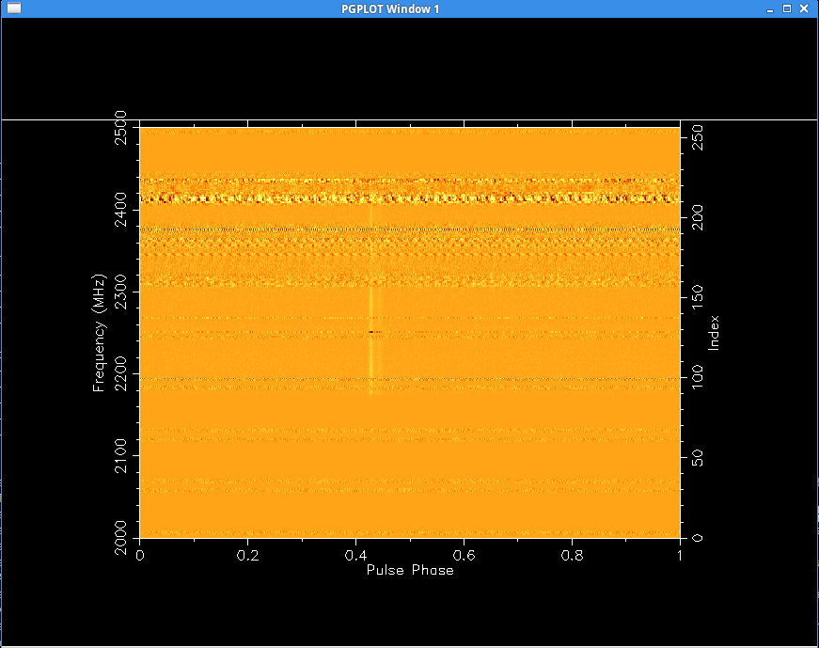
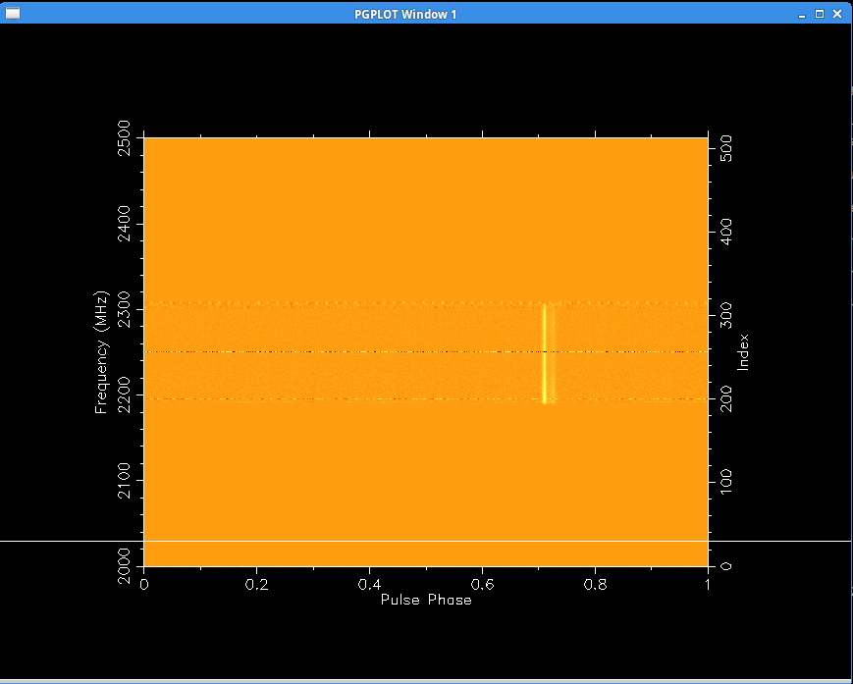
RFI state: take S-band for example
Previous
Now
🤔️
😊
😢
>500 pulsars next?
350 pulsars, now
Better receiver system
~100 pulsars, previous

Slide 28
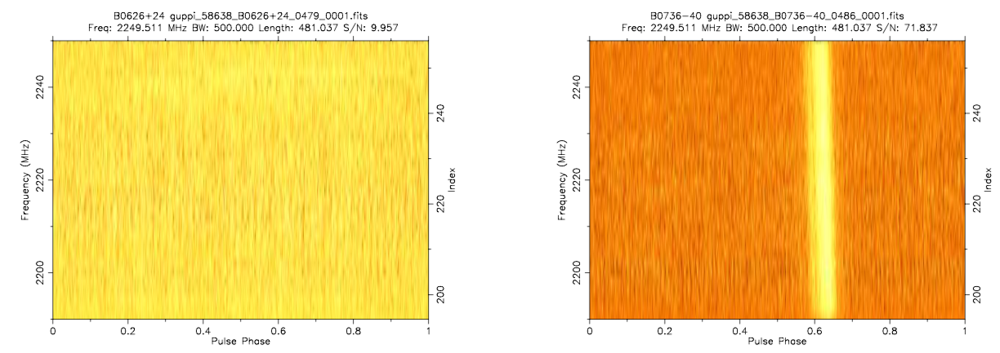
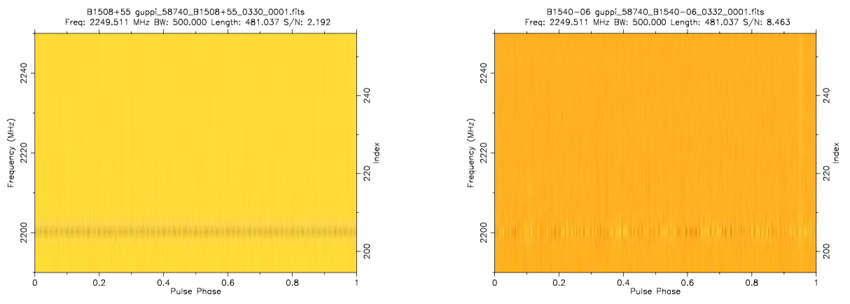
Restrict RFI
06-2019
08&09-2019

Slide 29
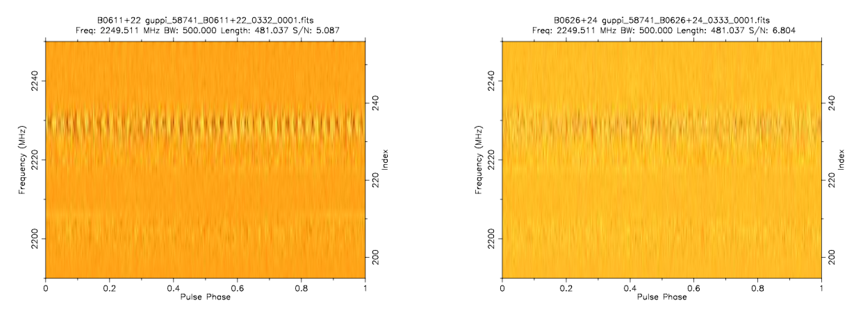
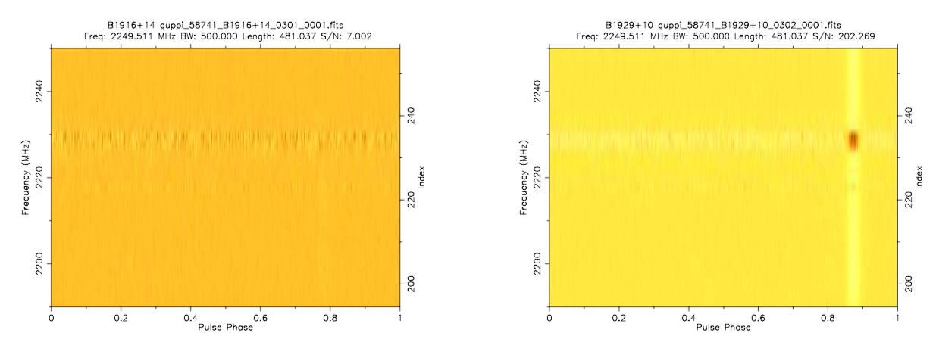
09-2019，turn off camera around
09-2019， turn off all camera
Where is from？

Slide 30
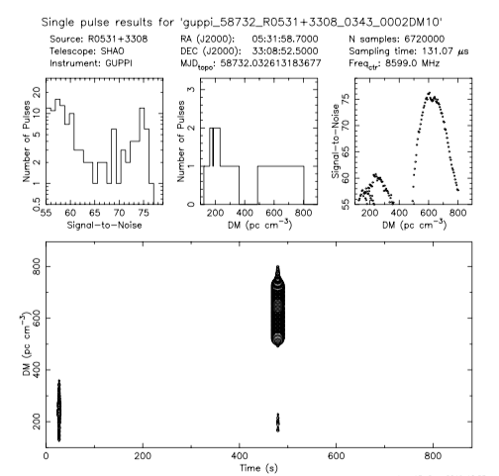
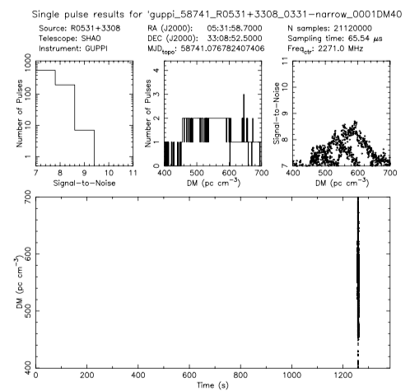

Slide 31
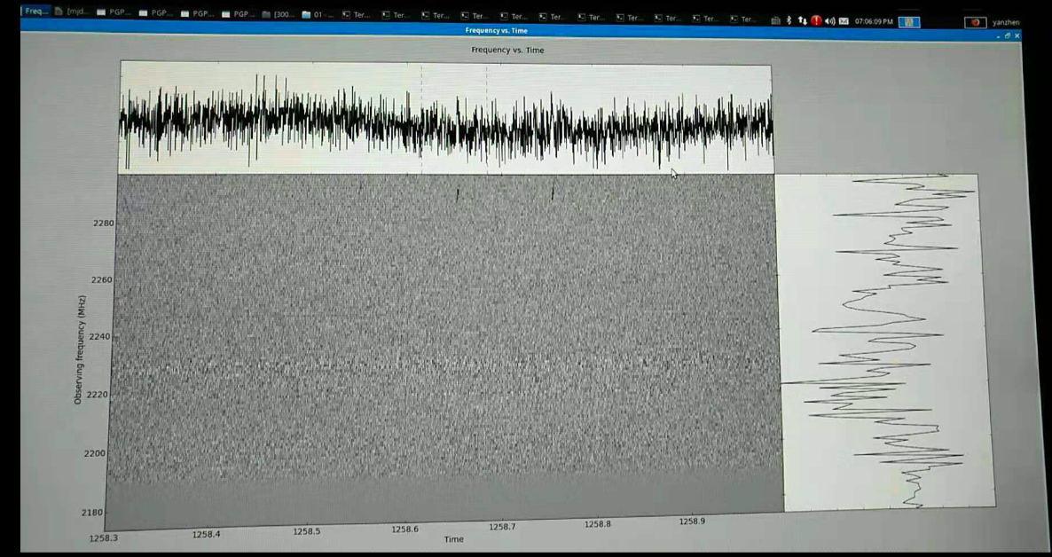

Slide 32
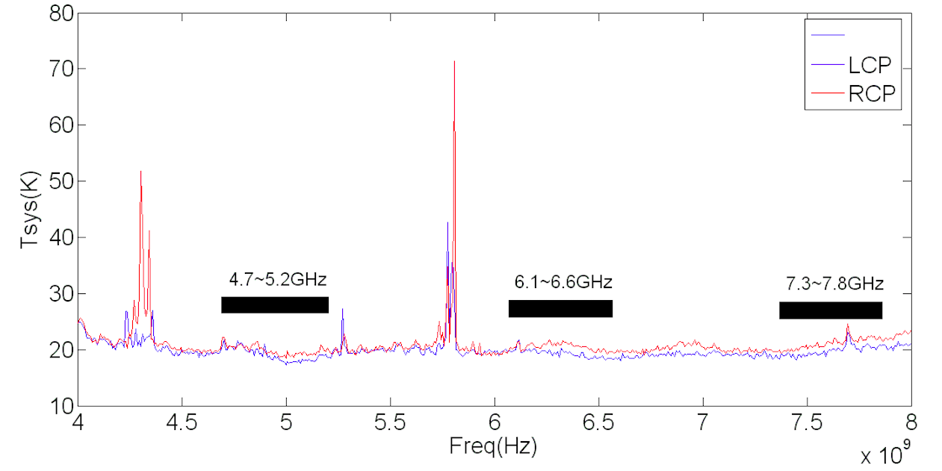
Make full use of C-band
DIBAS: 2GHz, but RFI
So, we need a new wide bandwidth backend can remove RFI

Slide 33
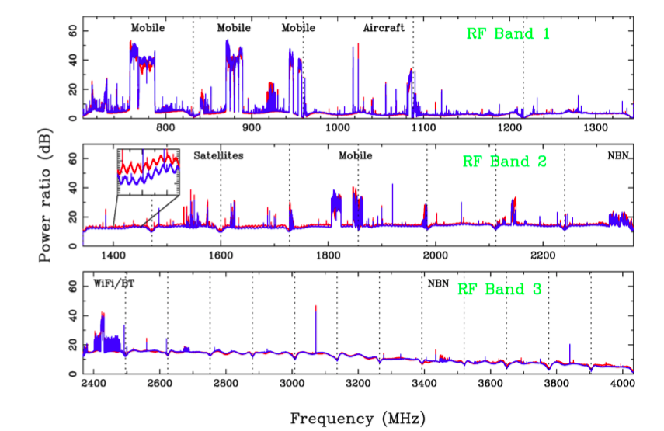

Slide 34
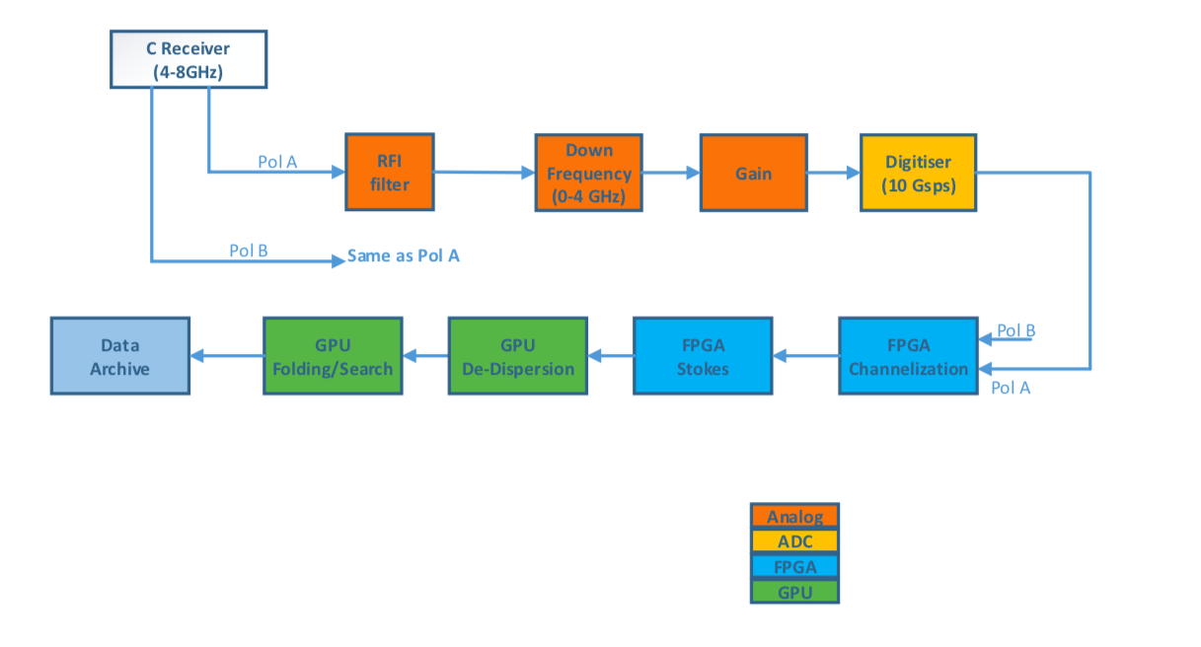
New Backend Structure

Slide 35
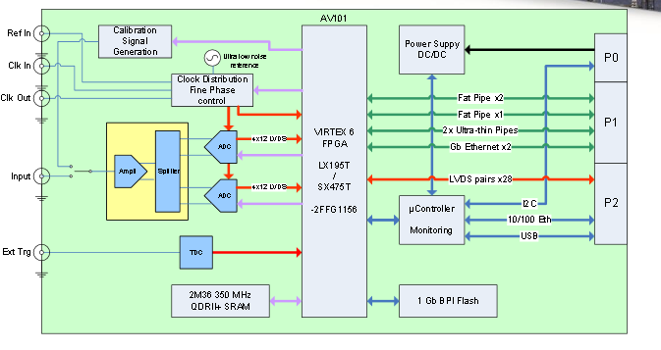

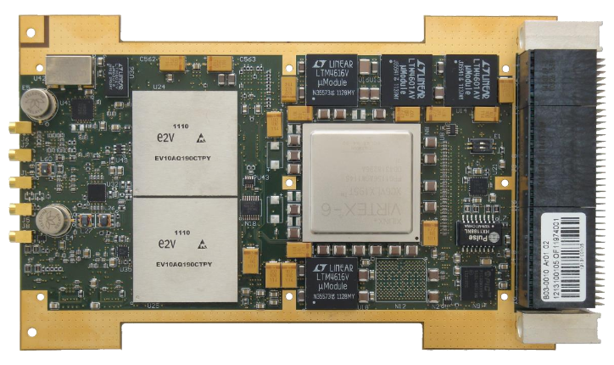
ADC+FPGA Board
1 channel 10-bit, 10Gsps ADC

Slide 36
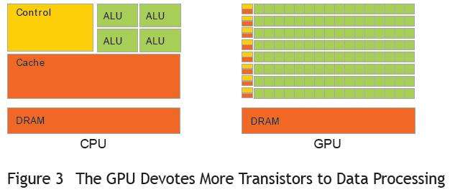
Mode supported by new backend
Mode: incoherent de-dispersion
on-line folding
pulsar search
real time FRB

Slide 37
Conclusions
Pulsar will be one of important scientific targets of TMRT
Some pulsar observations with TMRT have been done. And good results have been obtained.
To make further deep study on pulsar magnetosphere, it is needed to make it more sensitive .
Looking forward your cooperation!

Slide 38
Thank you!

