Slide 1
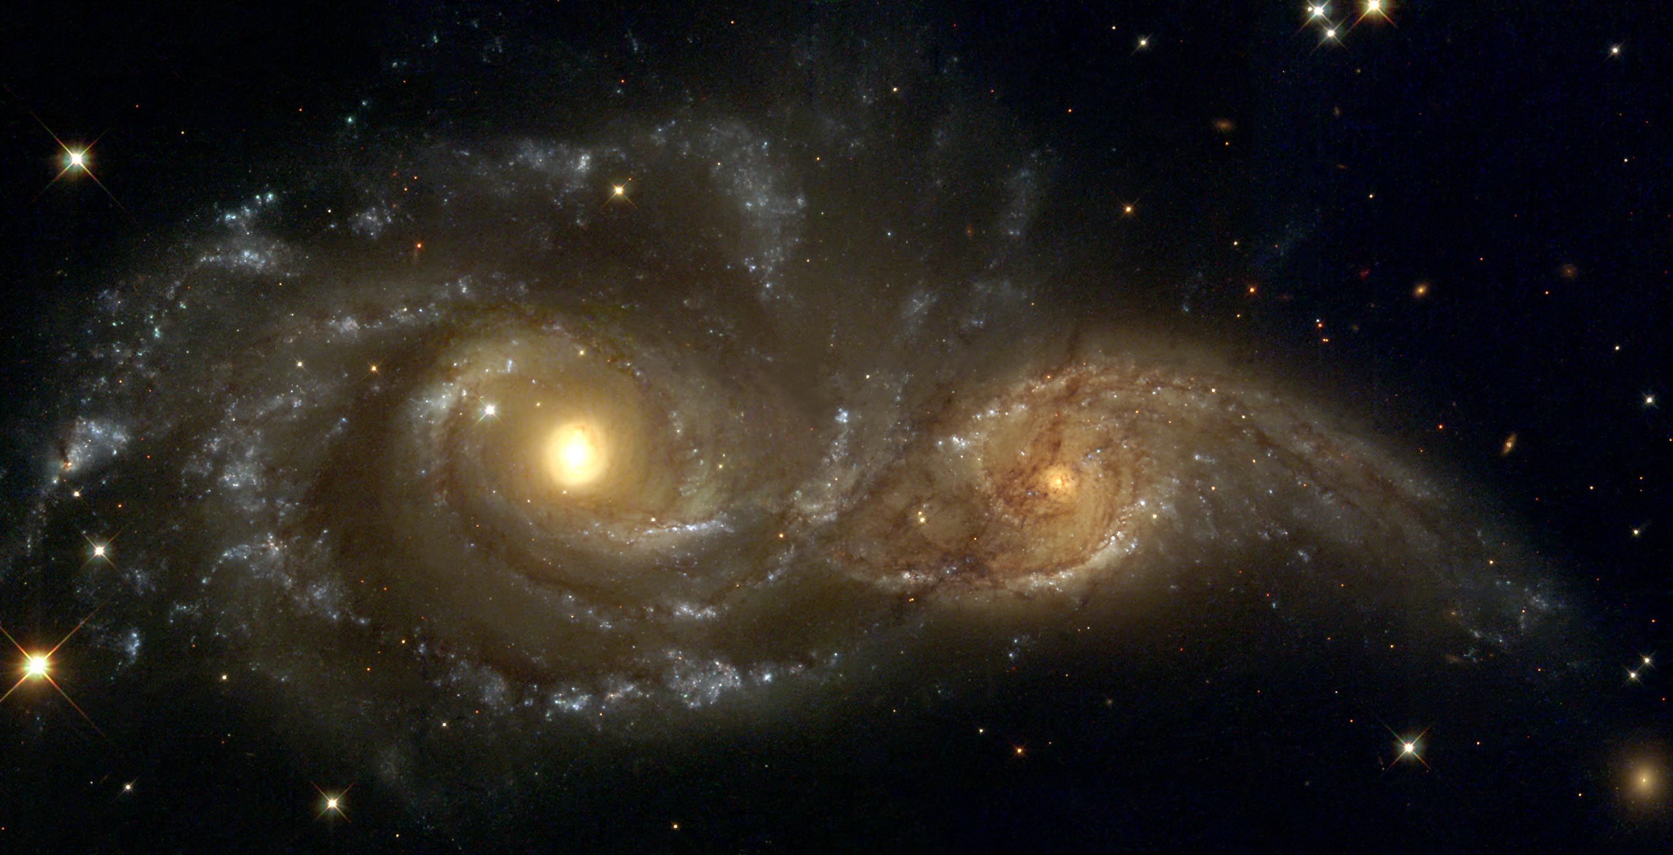
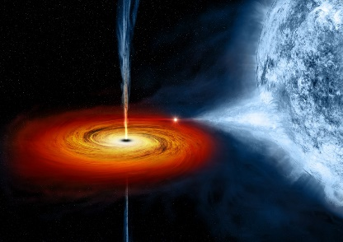
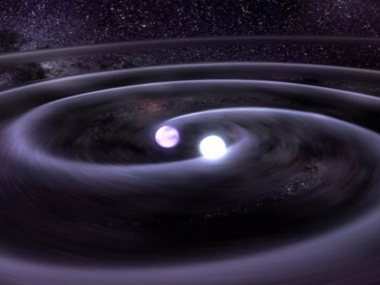
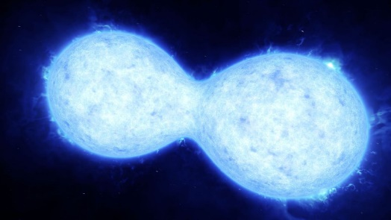
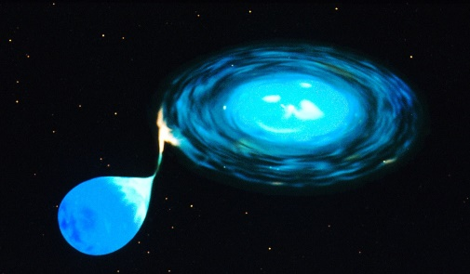
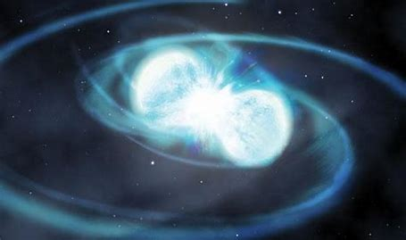
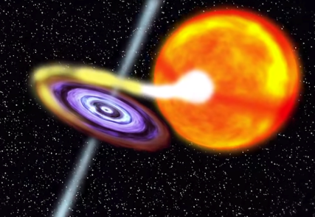




The fundamental problems in
binary star evolution
Hongwei Ge （葛宏伟）
Collaborators: Zhenwei Li, Xuefei Chen, Christohper Tout, Ronald Webbink, Zhanwen Han
The Era When Pulsars Meet FRBs, Guizhou, 2025.05.14

Slide 2
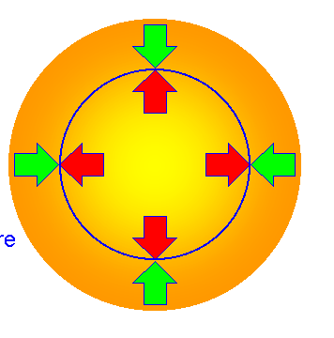
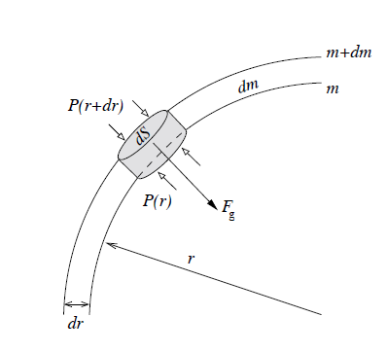
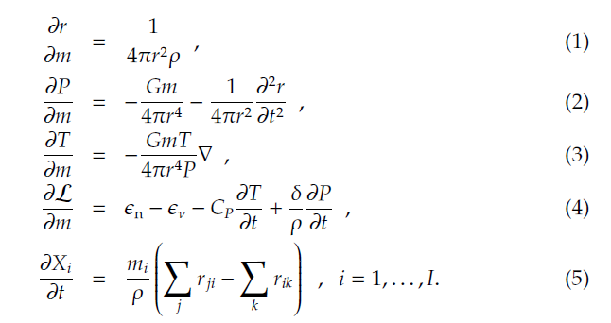
1.1 Stellar Structure and Evolution
One of two foundational theories in astrophysics
Stellar Structure Equations
Mass
Momentum
Energy transport
Energy production
Chemical
hydrostatic
thermal
Nuclear+
mixing
Nobel Prizes, 1967, 1983

Slide 3
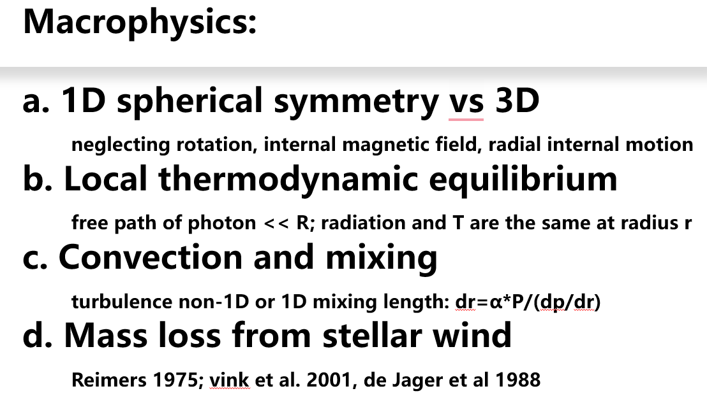
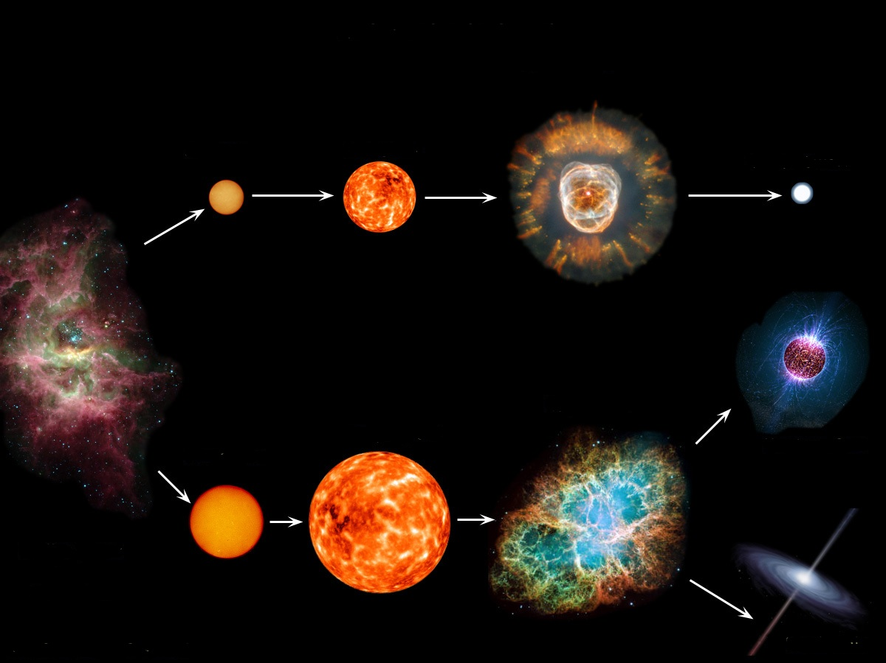
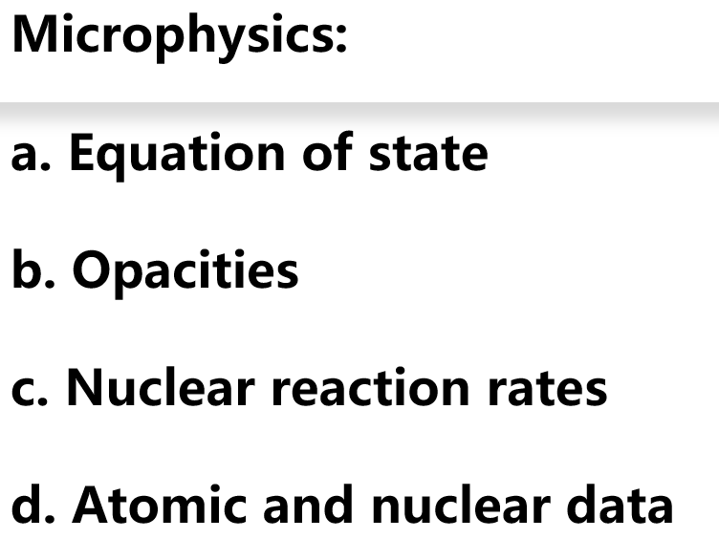
1.2 The Life of a Single Star
Stellar Structure Equations + Macrophysics + Microphysics
The life of a star
White Dwarf
Low Mass
Neutron Star
High Mass
Black Hole

Slide 4
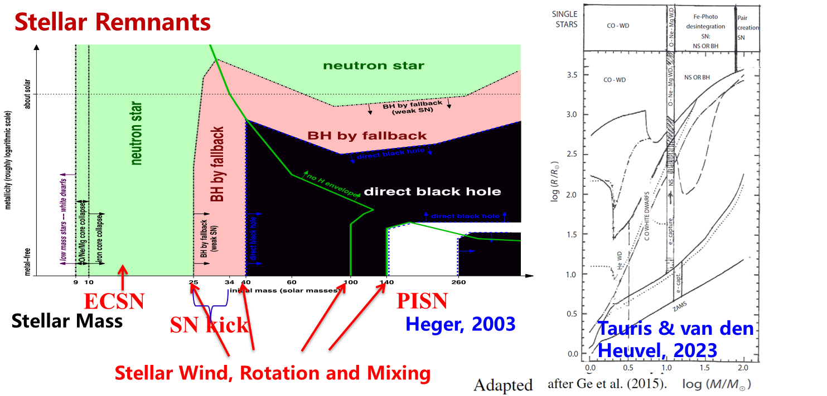
1.3 Stellar Mass vs. Stellar Remnants
Webbink Diagram
: as functions of Mass and Metallicity
Radius
Metallicity
Mass

Slide 5
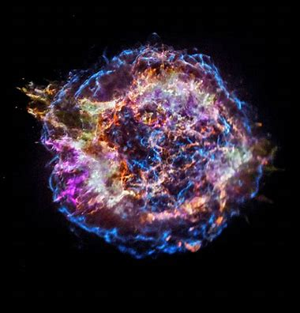
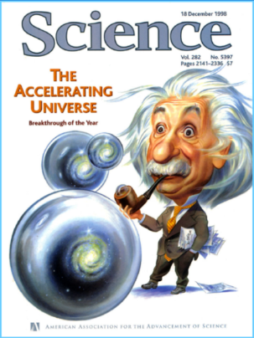
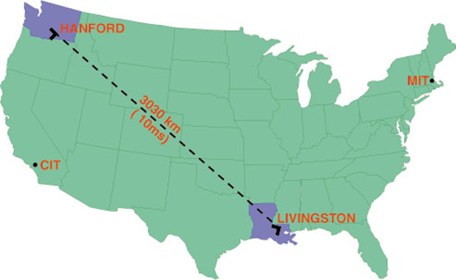
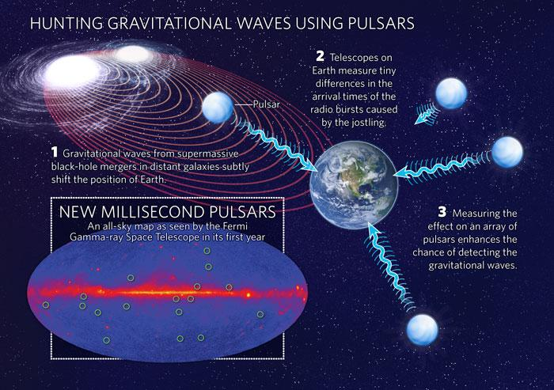
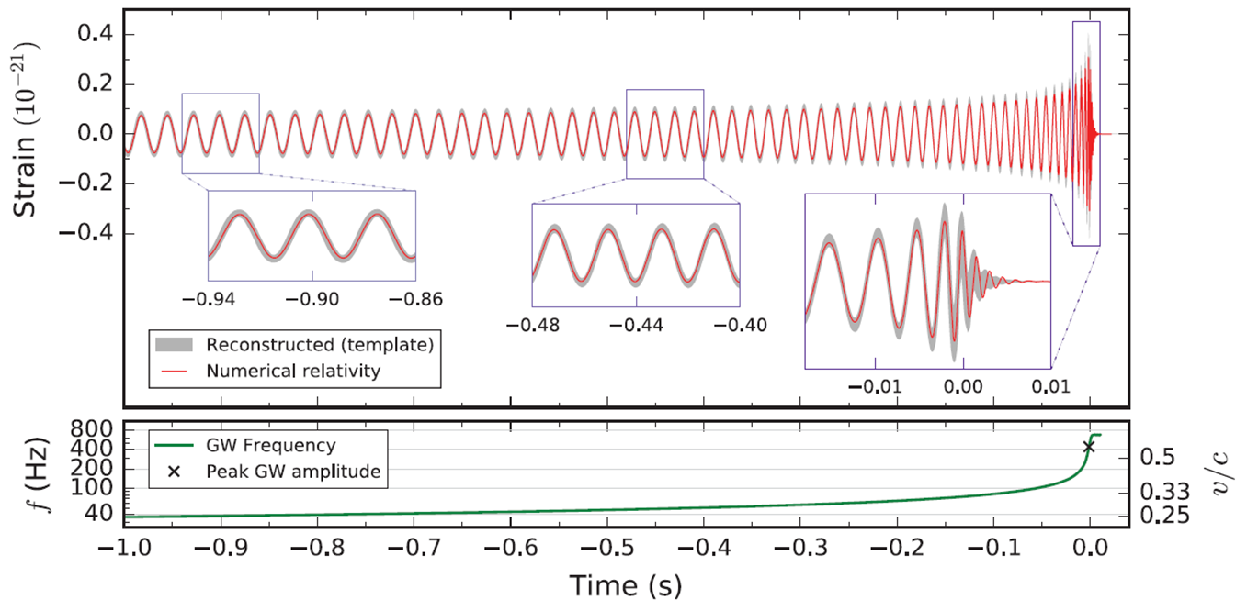
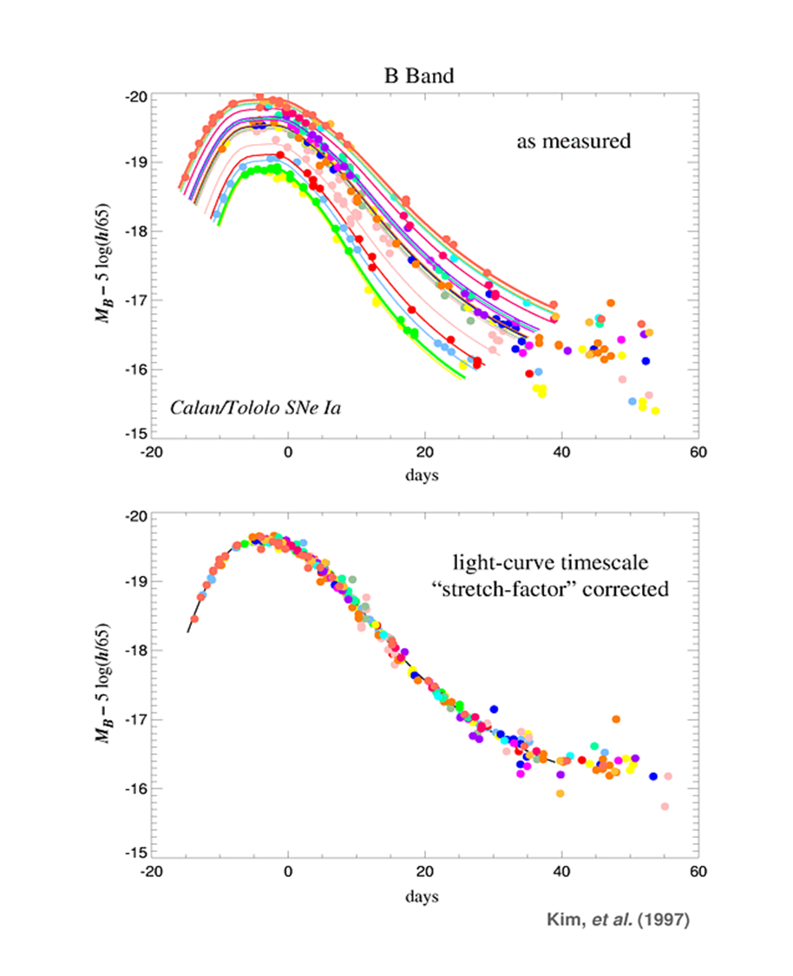
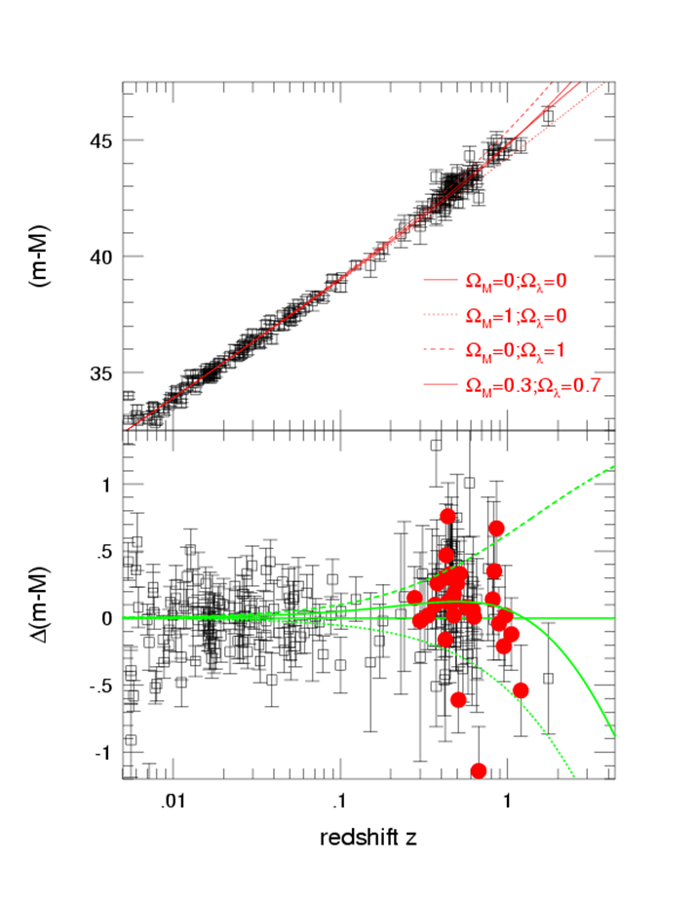
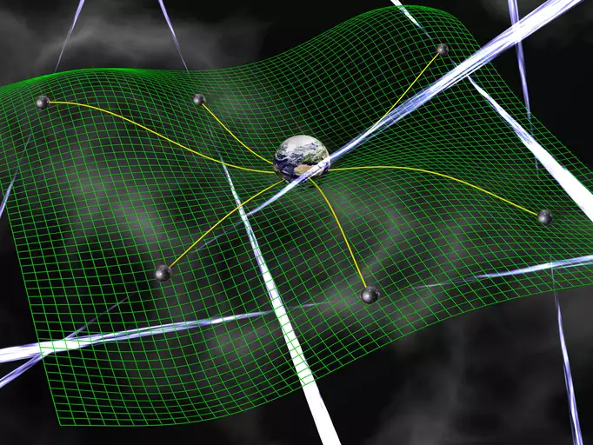
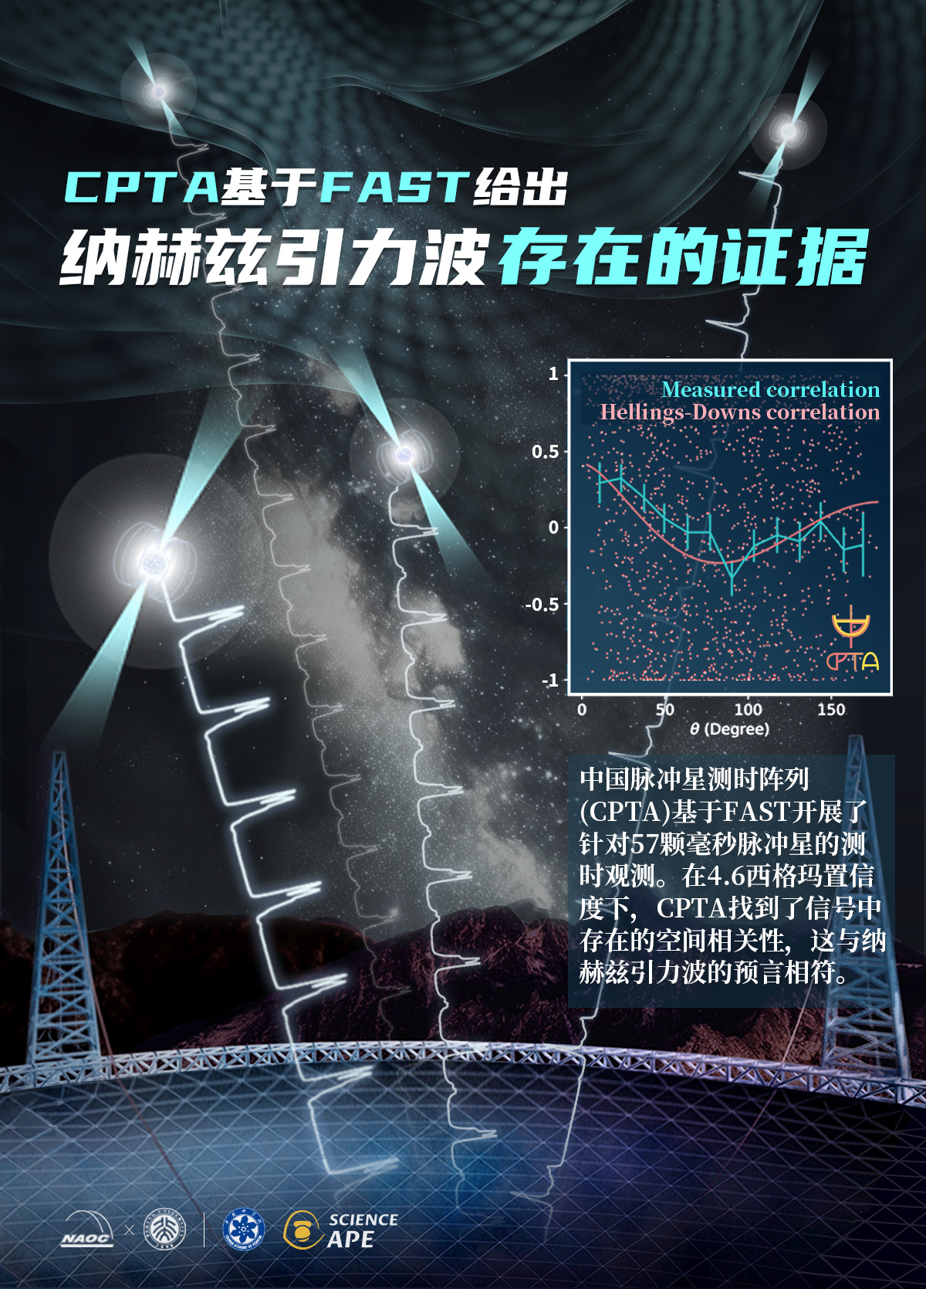
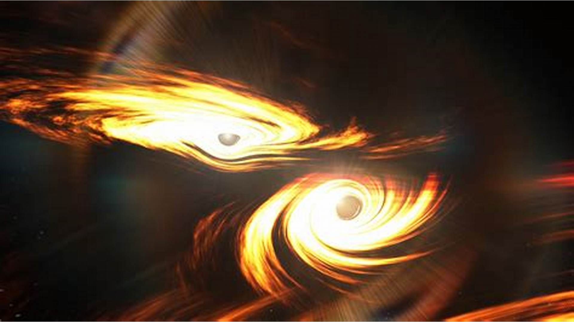
1.4 Growing Insights Over Decades
Type Ia Supernova
Expansion Accelerating
Dark Matter
LIGO-Virgo-Kagra Collaborations:
2015 DBH; 2017 DNS
2020a,b ~150M⊙; large q
Stellar mass BHs/NSs ...
Pulsar Timing Array Collaborations：
2023
CPTA、IPTA
CPTA
EPTA
NanoGrav
PPTA
Riess et al., 1998, 2004
Perlmutter et al., 1999
Tonry et al., 2003
Abbott + 2016; 2017
Abbott + 2020a,b
Abbott + 2023, 2025
Credit: NASA、China Daily
Xu H. et al. 2023
EPTA Collaboration 2023

Slide 6
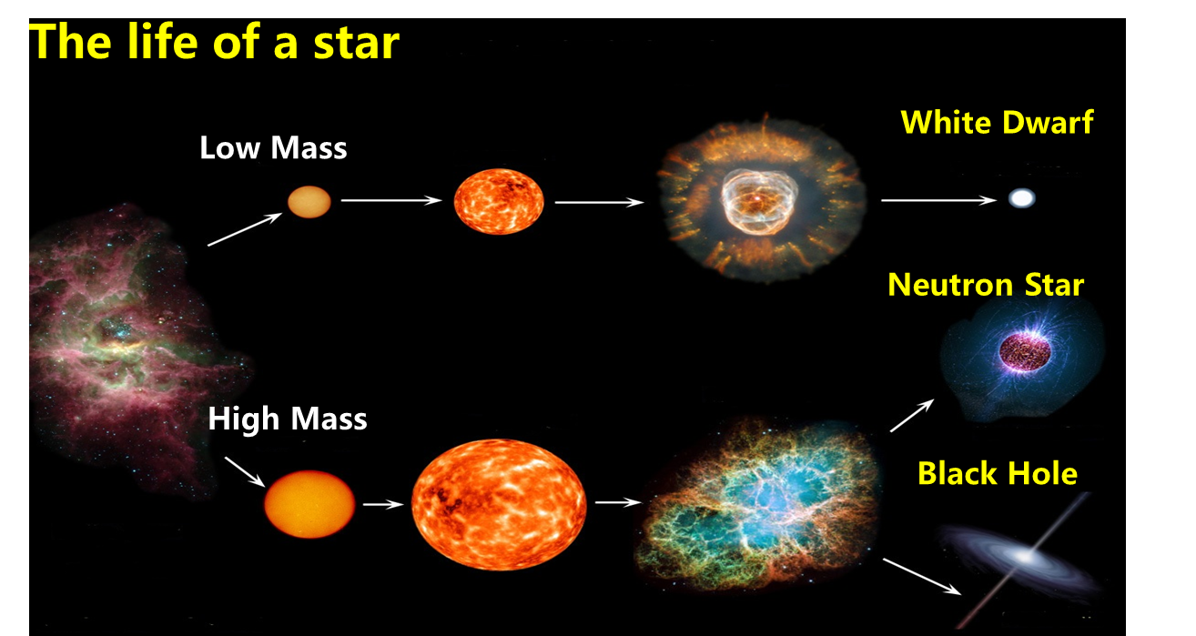
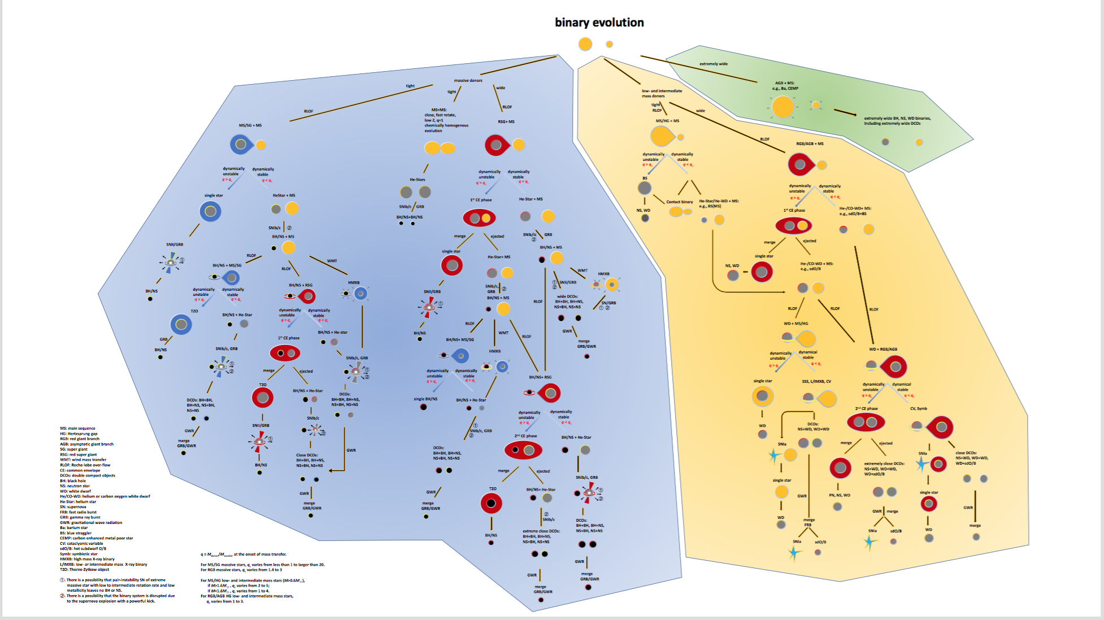
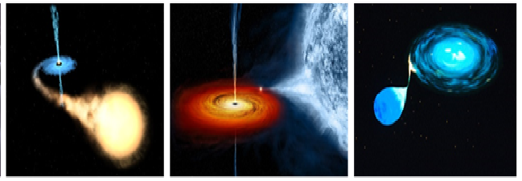

1.5 Binary Evolution Tree: formation and evolution of exotic sources
Han Z et al. 2020 RAA
Change the Fate of Stellar Evolution
M, Z, P_{orb}, q (M₁/M₂)
BH-BH,BH-NS,NS-NS
Double white dwarfs
Type Ia Supernovae
HM/LMXBs、CVs、Pulsars
LIGO/Virgo sources
Low-frequency GW sources
standard candles

Slide 7
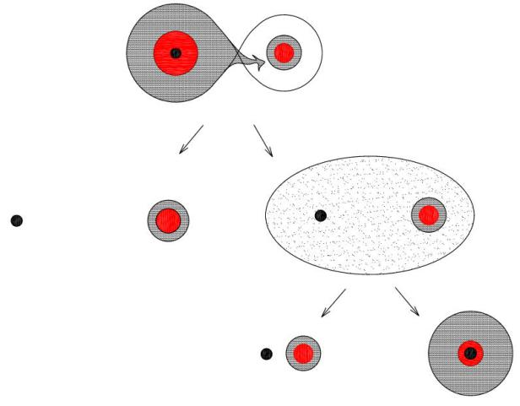

1.6 Basic Questions in Binary Evolution:
Q1：
Mass Transfer Stability
BH-NS: Abbott et al. 2023;
GW190814,191219, 200210, 3 samples q=M₁/M₂ ~ 10
Q2：CE
Common Envelope
Q3: Nonconserved Mass Transfer
DNS：Belczynski et al. 2002
Merging Rate/Myr
E1 E2 E3
2.7 23.5 109.0
Credit: Han 2003
These basic questions determines the evolution fate

Slide 8
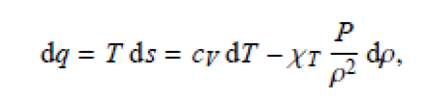
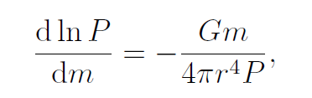

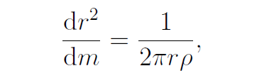

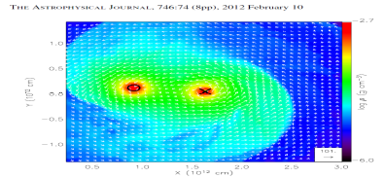
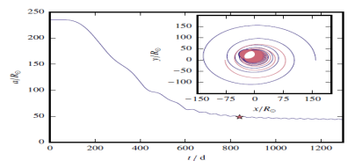
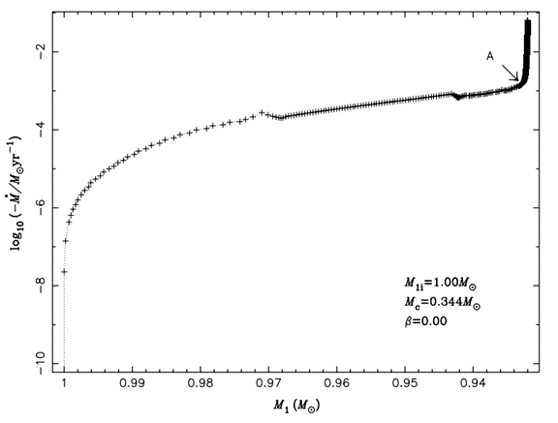
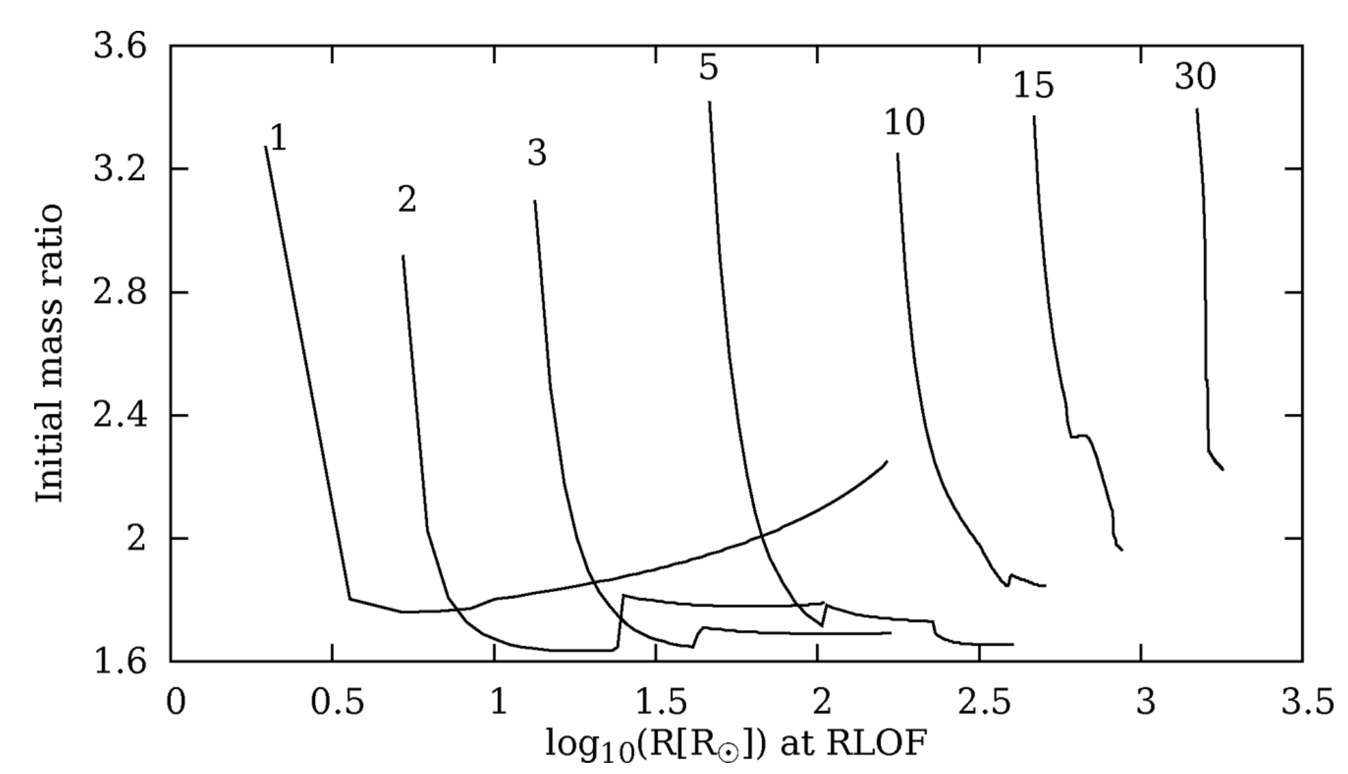
2.1 Three different approaches: Mass Transfer Stability/CE
3. Adiabatic
Mass Loss
Physical model
Rewrite the Stellar Structure and Evolution Equations
抓住物理本质、与双星轨道演化、物质交换边界条件分离
Ge et al.
2010, 2015, 2020, 2023
~dynamical timescale
3
1.Time dependent calculations
Chen & Han 2003, 2008
Shao & Li 2014
Pavlovskii & Ivanova 2015
Sensitive to mass transfer boundary
Ricker & Taam 2012
Sand et al. 2020
2.Hydro-Simul
Simplify Physical process：
Radiative Radiation、Non ideal gas …
Numerical Challenges：
Size、Parameter magnitudes…
Density：10⁻¹⁰-10¹¹gcm⁻³ T：10³-10¹¹K
Mesh：2048³~8 Billion points
2
1

Slide 9
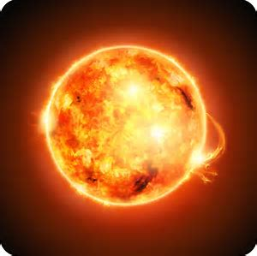
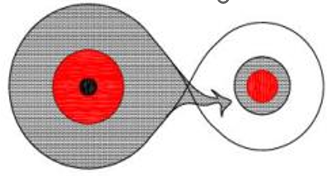
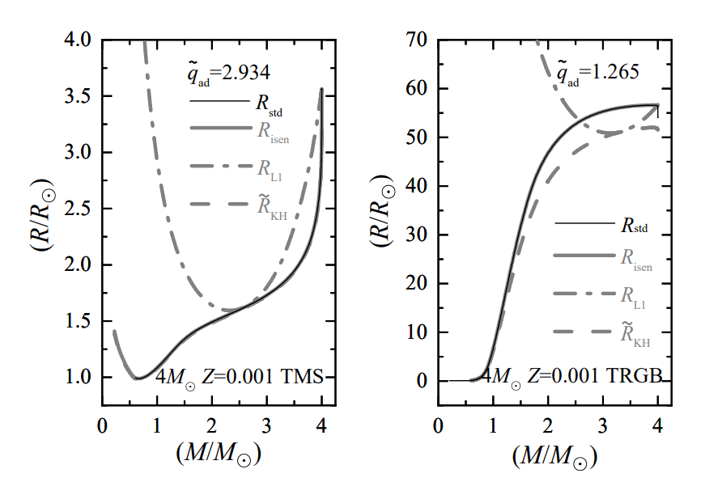
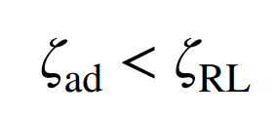
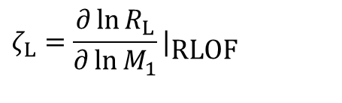
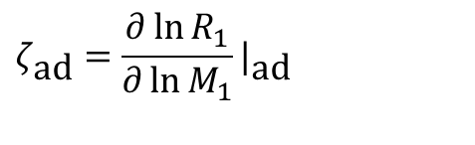
2.2 Criteria for Unstable Mass Transfer:
Donor
Accretor
Radiative
Convective
L₁
Compare R vs R_{L1}
Remnant R
$$ζ_{\text{ad}}=\frac{∂\ln{R_{1}}}{∂\ln{M_{1}}}|_{\text{ad}}$$
$$ζ_{L}=\frac{∂\ln{R_{L}}}{∂\ln{M_{1}}}|_{\text{RLOF}}$$
Dynamical unstable
Remnant M
Remnant M
Solid R；dash-dotted R_{L1}
Webbink 1985
Ge et al. 2023 ApJ

Slide 10

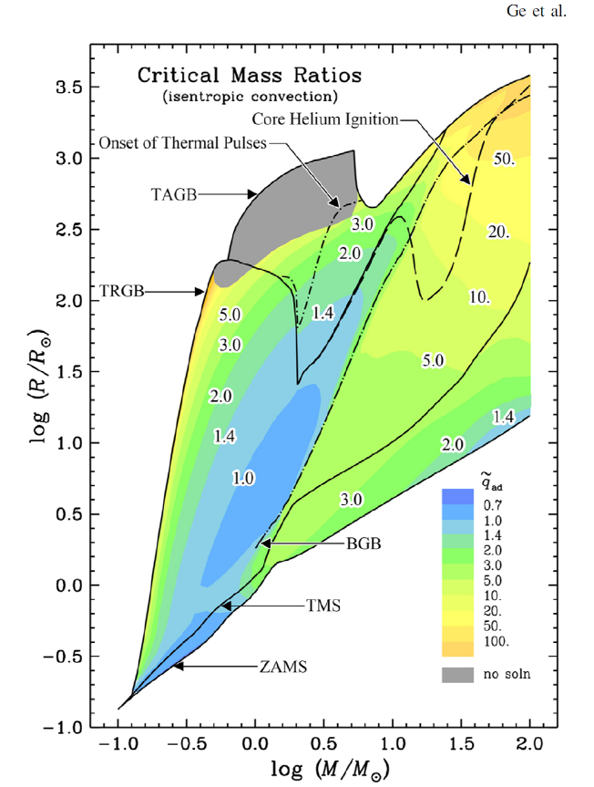
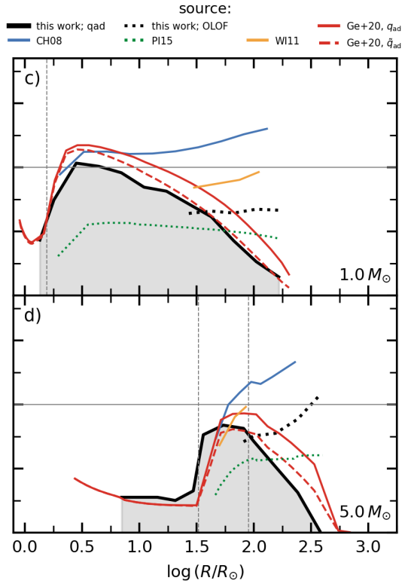
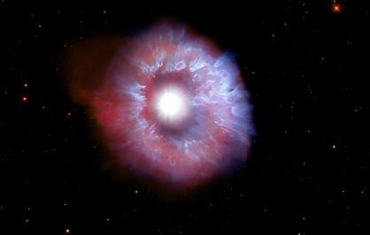
3. Critical mass ratio for unstable mass transfer
Webbink diagram
M~0.1-100M⊙Full stages
Comparison with MESA
1. Massive Stars: more stable
Poly. M₁/M₂ ~ constant 3-4
Now M₁/M₂ ~ evolution stages
AGB
Donor Radius
q_{crit}
HG
2. RGB/AGB stars：more stable
Polytropic M₁/M₂ ~f(Mc)<1
Now M₁/M₂ ~ 1 – 3
3. Ge+2020b, ApJS L_{2/3}
Ge+23/24b, ApJ Z=0.001
Zhang, Ge+2024, ApJS He stars
RGB
MS
Donor Mass
Temmink+, 2023
Ge+, 2020a, ApJ

Slide 11

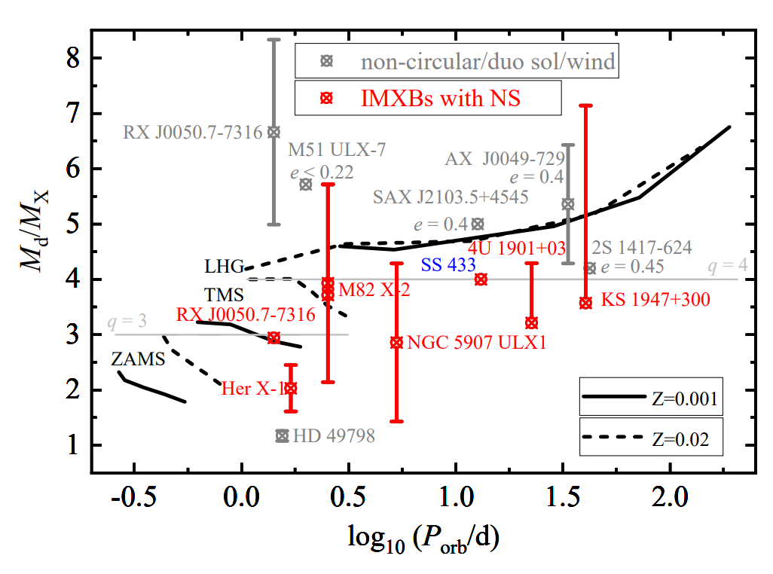
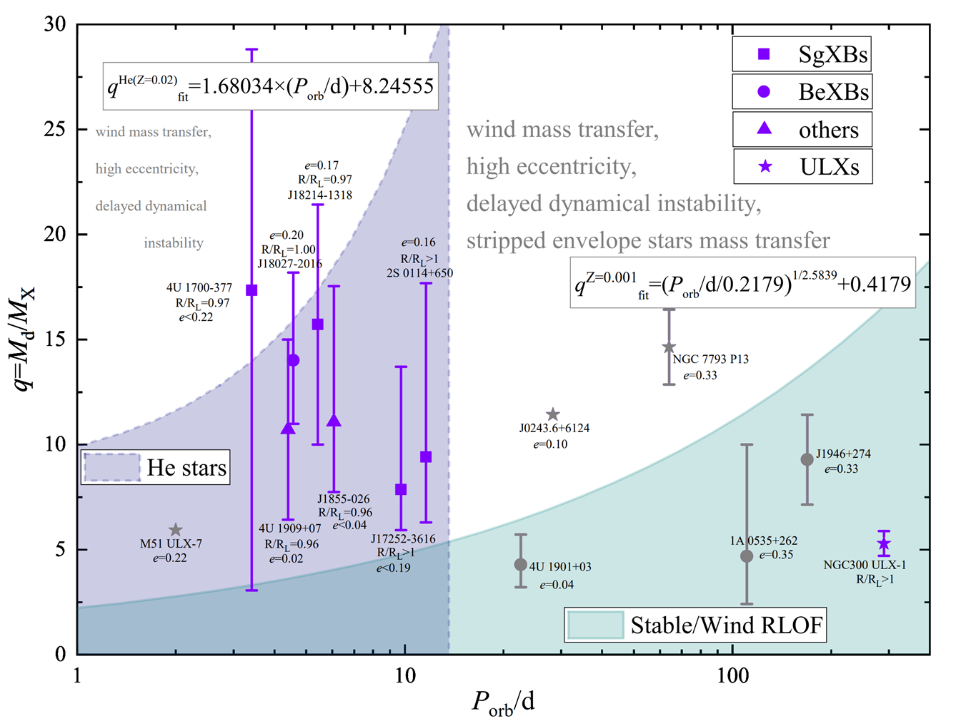
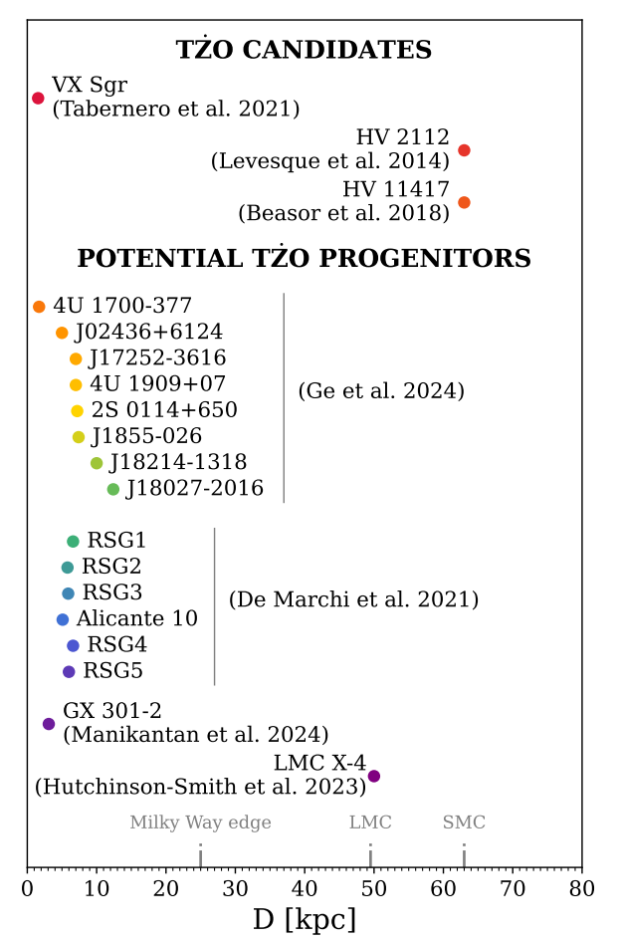
4.1 Applies to IMXBs/HMXBs
Mass Ratio
Orbital Period
Martinez-Mirave et al. 2025, TZO progenitors
Orbital Period
Ge et al. 2023, ApJ
Ge et al. 2024b, ApJ, 975

Slide 12
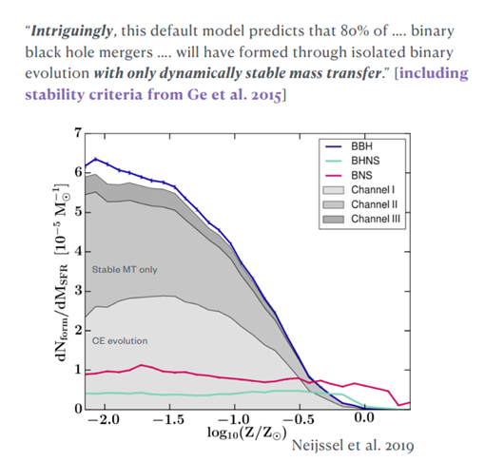
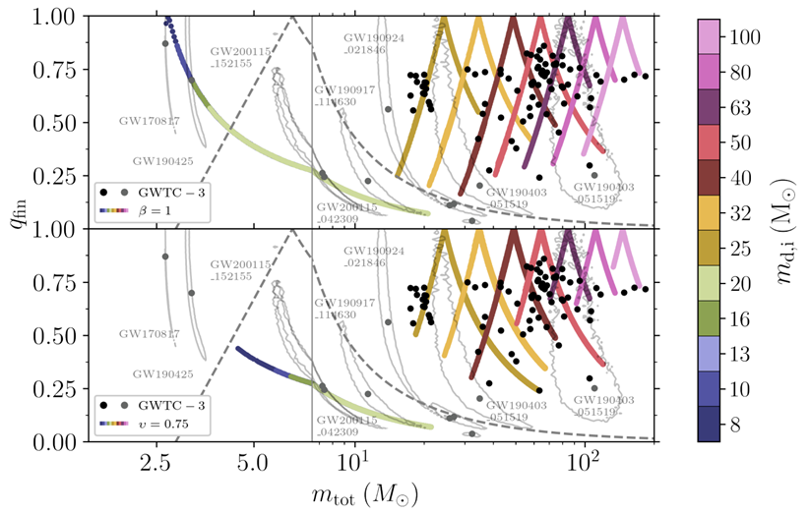
4.2 Applies to DBHs/DNSs:
（1）Common Envelope Evolution Channel:
Belczynski et al. 2002, 2016;
Postnov & Yungelson 2014
Vigna Gómez et al. 2018
（2）Stable Mass Transfer Channel:
Neijssel et al. 2019
Gallegos-Garcia et al. 2021
Broekgaarden et al. 2021
Olejak et al. 2021
van Son et al. 2022
Briel et al. 2023
Picco et al. 2024

Slide 13
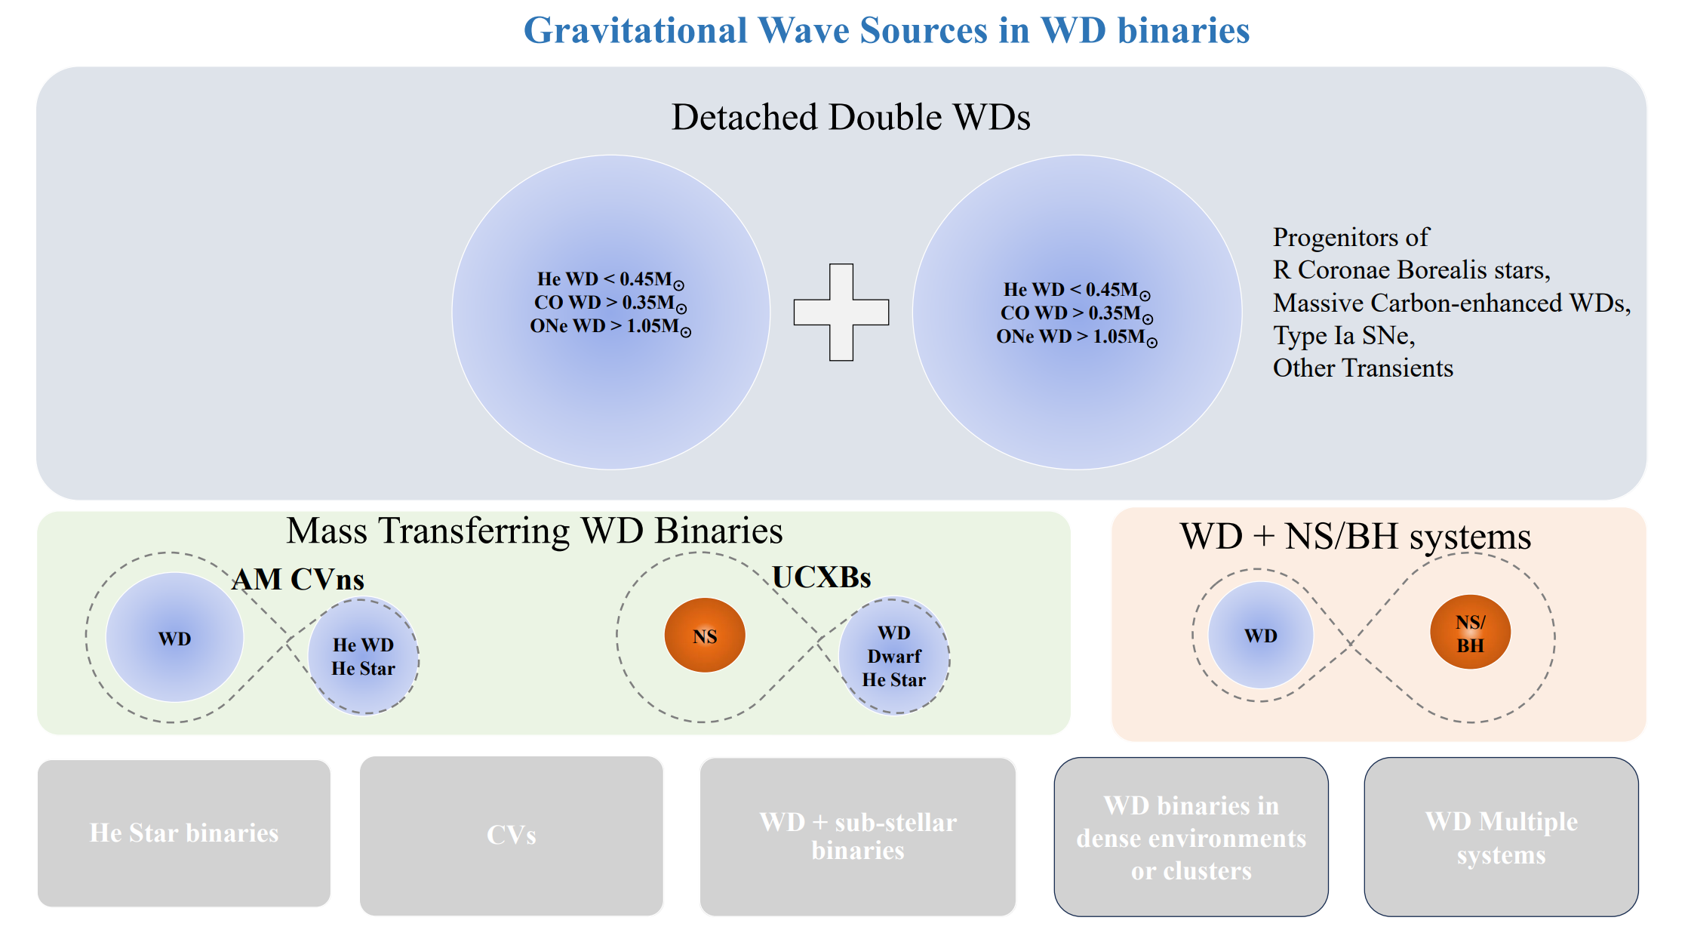
4.3 Applies to DWDs:
From Tianqin White Paper (Li et al. 2025 ROPP)
Credit: Hongwei Ge

Slide 14




4.3 Applies to DWDs:
Polytropic
Now
Polytropic
Now
Tight orbit
Wideorbit
Tight orbit
Wideorbit
Li, Chen, Ge, Chen, Han 2023, A&A

Slide 15



4.3 Applies to DWDs:
Merge Rate/dM
Total Mass
Total Mass
Li, Chen, Ge, Chen, Han 2023, A&A

Slide 16









4.4 Applies to post-common-envelope stars
A pulsar-helium star compact binary system that formed by common envelope evolution
PSR J1928+1815
Pspin=10.55ms; Porb=3.6 hr
Old
Now

Slide 17


5. Summary
4. Applications
HMXBs, DBHs, DWDs, NS+Helium star...
GW and EM sources
2/3. Method/Results
Mass 0.1-100M⊙
Whole stages
q_{ad}
1. Physical Model
Adiabatic Mass-loss Model
Criteria for
Unstable Mass Transfer

Slide 18

Thanks for your attention
Questions/Comments
gehw@ynao.ac.cn

Slide 19






Log Beta
Ge et al. 2024, ApJ
Short P_{orb} sdB+WD binaries
Precise binding energy Ebind，
Constrain Mass and states of sdB Progenitor using P-M_{WD} relation,
Knowledge of common envelope ejection efficiencies.
Log Mass Ratio

Slide 20

White Dwarfs (WDs) binaries:
Yamaguchi 2024

Slide 21

IMXBs/HMXBs
Observation vs. theoretical prediction:
Mass Ratio
Mass Ratio
Orbital Period
Orbital Period
Ge et al. 2023, ApJ
Ge et al. 2024, ApJ

Slide 22

Theoretical Motivation to build adiabatic mass-loss model
Ge et al. 2010, ApJ

Slide 23






DWDs
Li et al. 2023, A&A

Slide 24


Applies to DWDs: Formation Channels
Li, Chen, Ge, Chen, Han 2023, A&A

Slide 25




Critical mass ratios for Helium (stripped) binaries
Zhang et al. 2024 ApJS
He-MS: 1.0 < q_{crit} < 2.6
After early He-HG: q_{crit} > 10
Polytropic model MS: q_{crit} = 3
GB: q_{crit} = 4)

