Slide 1
Memory Effects in Repeating FRBs: Revealing Hidden Patterns in Burst Sequences
Ping Wang
IHEP
May 11 – 16, 2025
FAST – Light Years Away

Slide 2
Memory Effects in Repeating FRBs: Revealing Hidden Patterns in Burst Sequences
Outline:
Why waiting time is important?
Scale invariance
Universality
Cluster
Dual analogue
Memory in repeating FRBs burst sequences
Conditional waiting time distribution
Residual waiting time
One-off is a patient repeater?

Slide 3
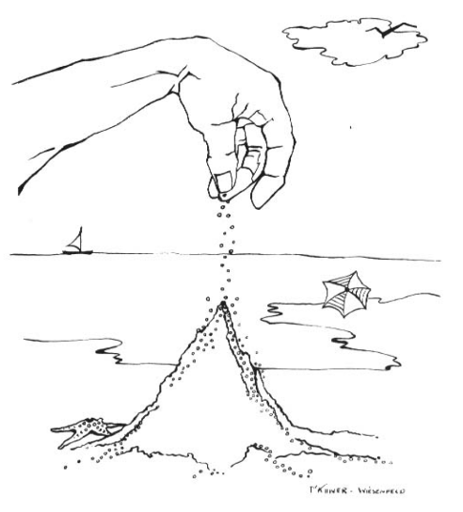
1–Why waiting time?
Are there other indications of criticality?
Energy distribution is usually described by power-law
The power-law response emerged as a result of attraction of dynamics toward a critical state
Sandpile paradigm (Bak et al. PRL, 1987)
FRB，some cases exhibit bimodal form
Solar flare
SGR
Earthquake
SOC mechanism make the slope fluctuates around the fixed value
Notes:
This critical behavior can be vividly illustrated by Bak’s sandpile model, here the power law response …
However, the energy is insufficient to describe the dynamics of frbs

Slide 4
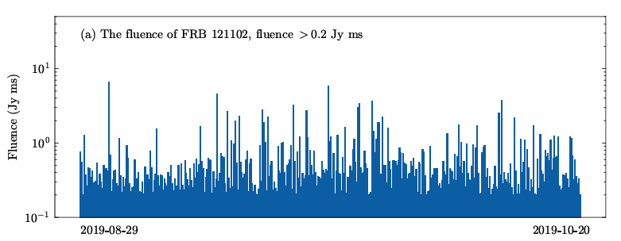
1–Why waiting time?
Are there other indications of criticality?
Waiting time distribution may provide more information
Definition of waiting time
Waiting time distribution:
1,Random or non-random
2,If non-random, any pattern exists?
2，Compared with other familiar natural burst phenomena, such as solar flares, EQ
FRB with fluence larger than a threshold
Waiting time as interval between two continuous bursts
For different thresholds, waiting time is different
λ_i
λ_i+1
More important
contrasting with the distribution of burst energy, waiting time statistics may have the potential to uncover key dynamics of the burst mechanism (P. Kumar, Scientific Reports, 10, 626, 2020)
τ_i
τ _i+1
Notes:
1,
2,for different state, despite they have similar power law energy distribution, but the waiting time is apparently different

Slide 5
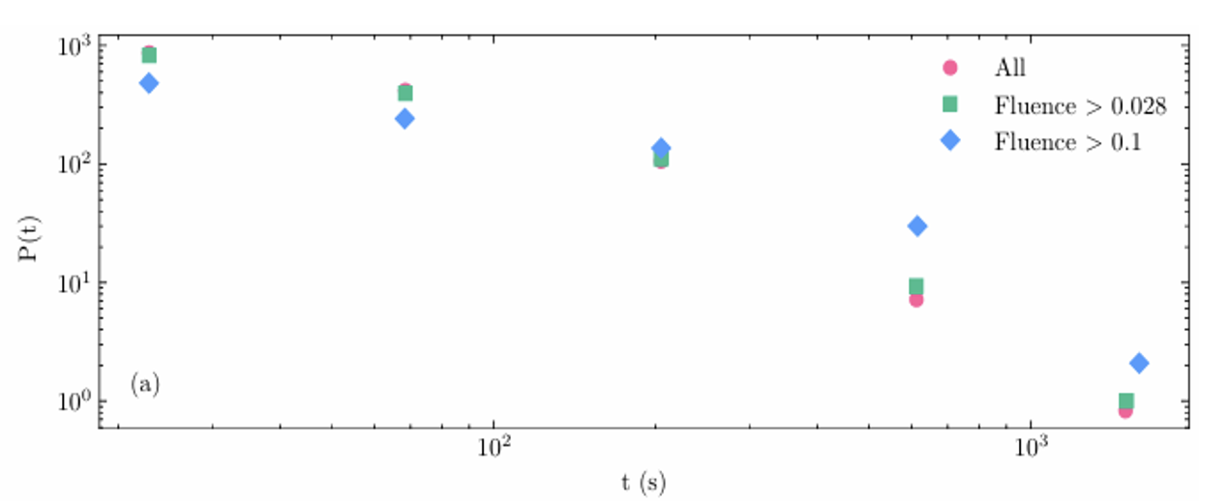
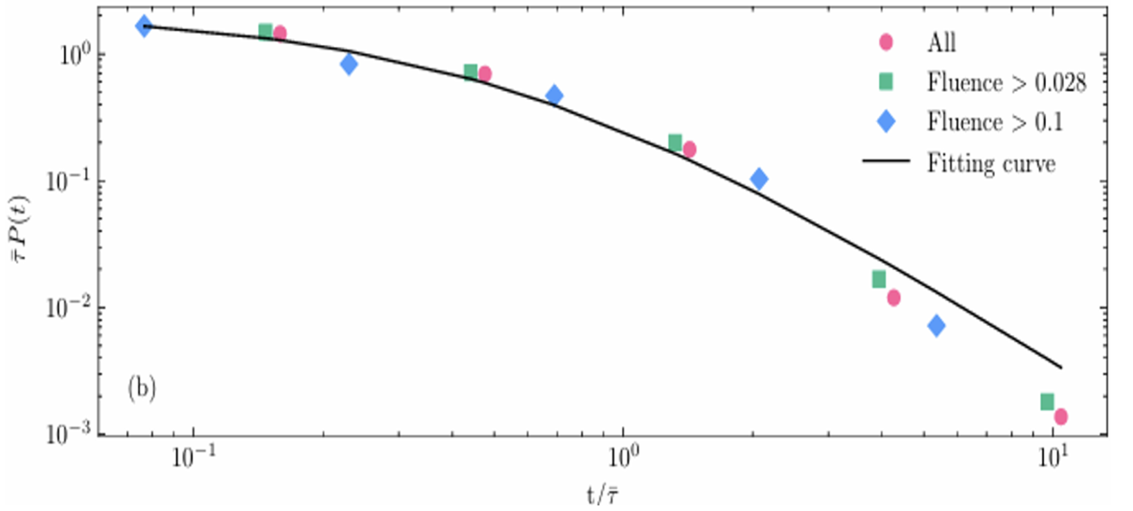
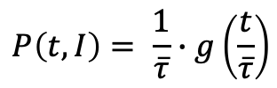

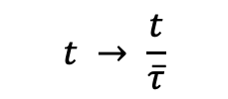

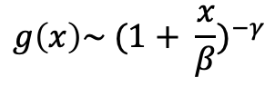
1–Waiting time
A unified scale invariant waiting time distribution is needed
Scale transformation of t and P (Corral, PRL, 92, 2004)
$$t → \frac{t}{\overline{τ}}$$
$Here, \overline{τ}$ is the average waiting time with the threshold I, and t > 1 s.
$$\overline{τ}∙P\left(t,I\right)=g(t/\overline{τ})$$
$$P\left(t,I\right)= \frac{1}{\overline{τ}}∙g\left(\frac{t}{\overline{τ}}\right)$$
$$g\left(x\right)\sim {(1+ \frac{x}{β})}^{−γ}$$
Scaling law:
$$, β and γ are parameters$$
FRB 121102
FRB 121102
Du et al., MNRASL, 531, 2024

Slide 6
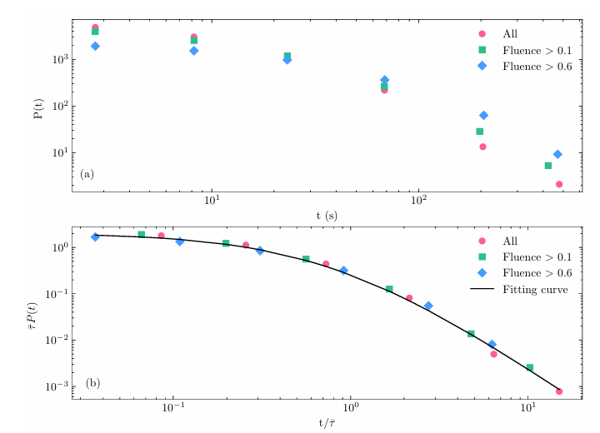
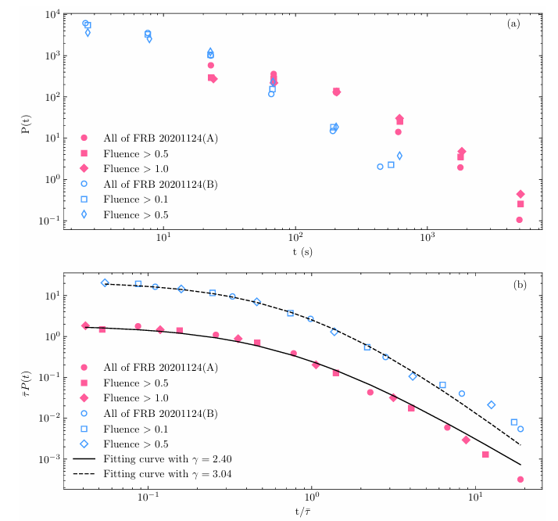
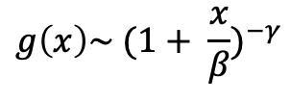

1 – Waiting time
Three main properties:
Scale invariance
Du et al., MNRASL, 531, 2024
$$P\left(t,I\right)= \frac{1}{\overline{τ}}∙g\left(\frac{t}{\overline{τ}}\right)$$
Note: this hints that there is maybe no characteristic time scale, such as no hidden periodicity—just scale-free dynamics.
FRB 20220912A
FRB 20201124A
Universality
Scaling behavior emerges across three different sources, and four datasets
Cluster
$$g\left(x\right)\sim {(1+ \frac{x}{β})}^{−γ}$$
Non-random, fat tail distribution imply possible many extreme bursts clustering
Notes:
A slow decay in the probability of long waiting times is characteristic of clustered events. If the
bursts were happening totally independently and randomly, what scientists call a Poisson process, the
probability would drop off much faster

Slide 7


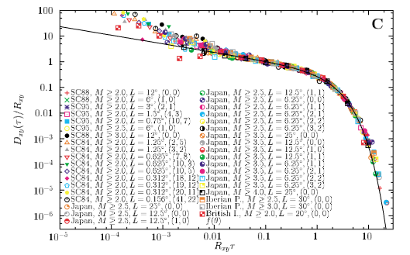
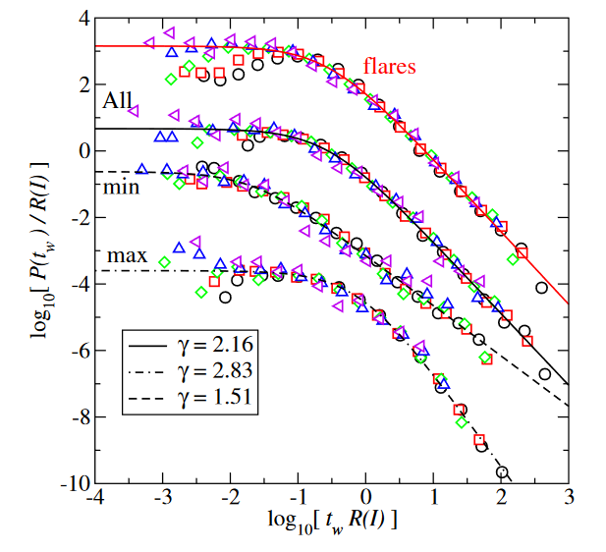
1 – Waiting time
-- The results compared with solar flares and EQs
Scale invariance make the comparison for different energy scale systems possible, such as solar flares, EQs et al.
Possible dual analogy for underlying mechanism
EQs
Solar flares
Gamma distribution, Corral, PRL, 92, 2004
Pareto distribution, the same with FRB, Baiesi, PRL, 96, 2006
Longer than about 1 second, analogous to solar flares
Short than about 1 second, analogous to EQs (Totani, MNRAS, 2023)
This 1-second threshold may reflect the dynamic timescale of magnetar crusts

Slide 8
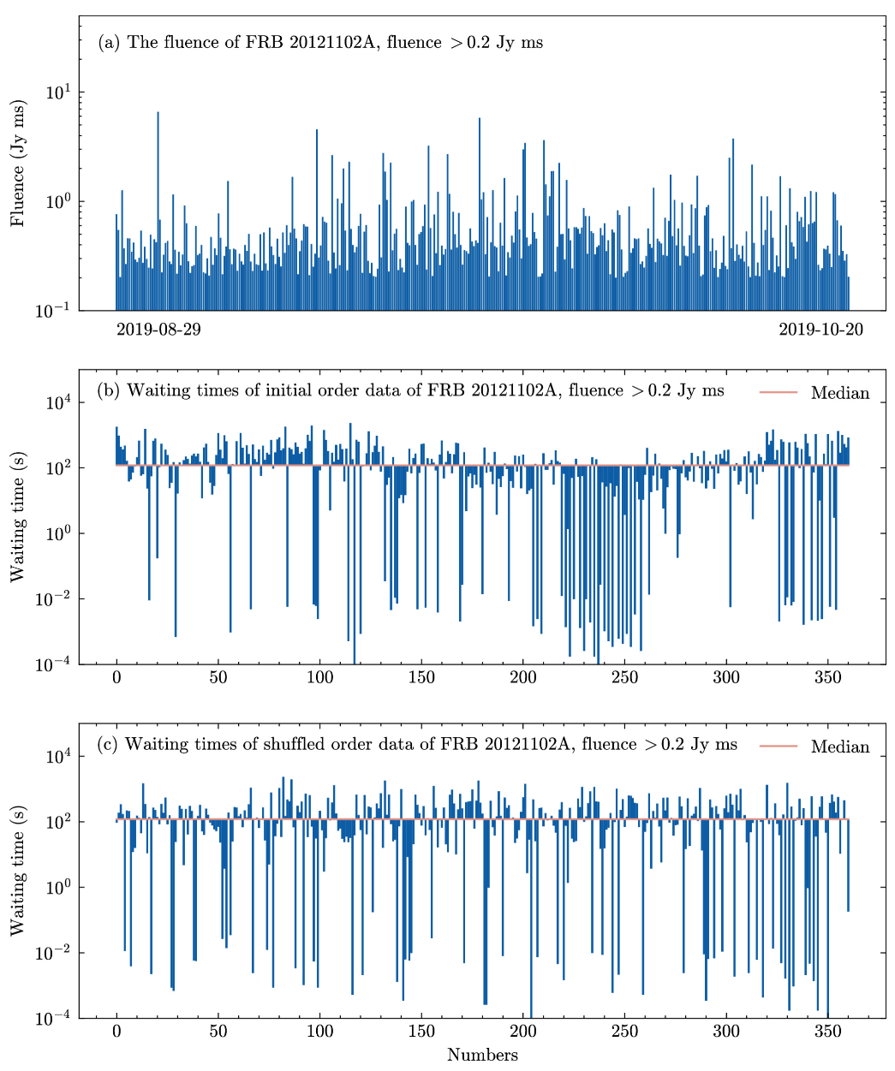
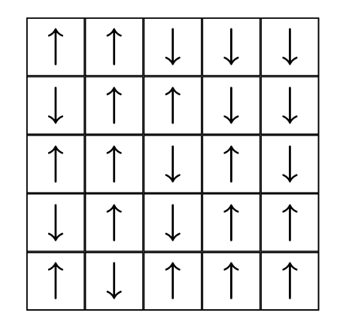
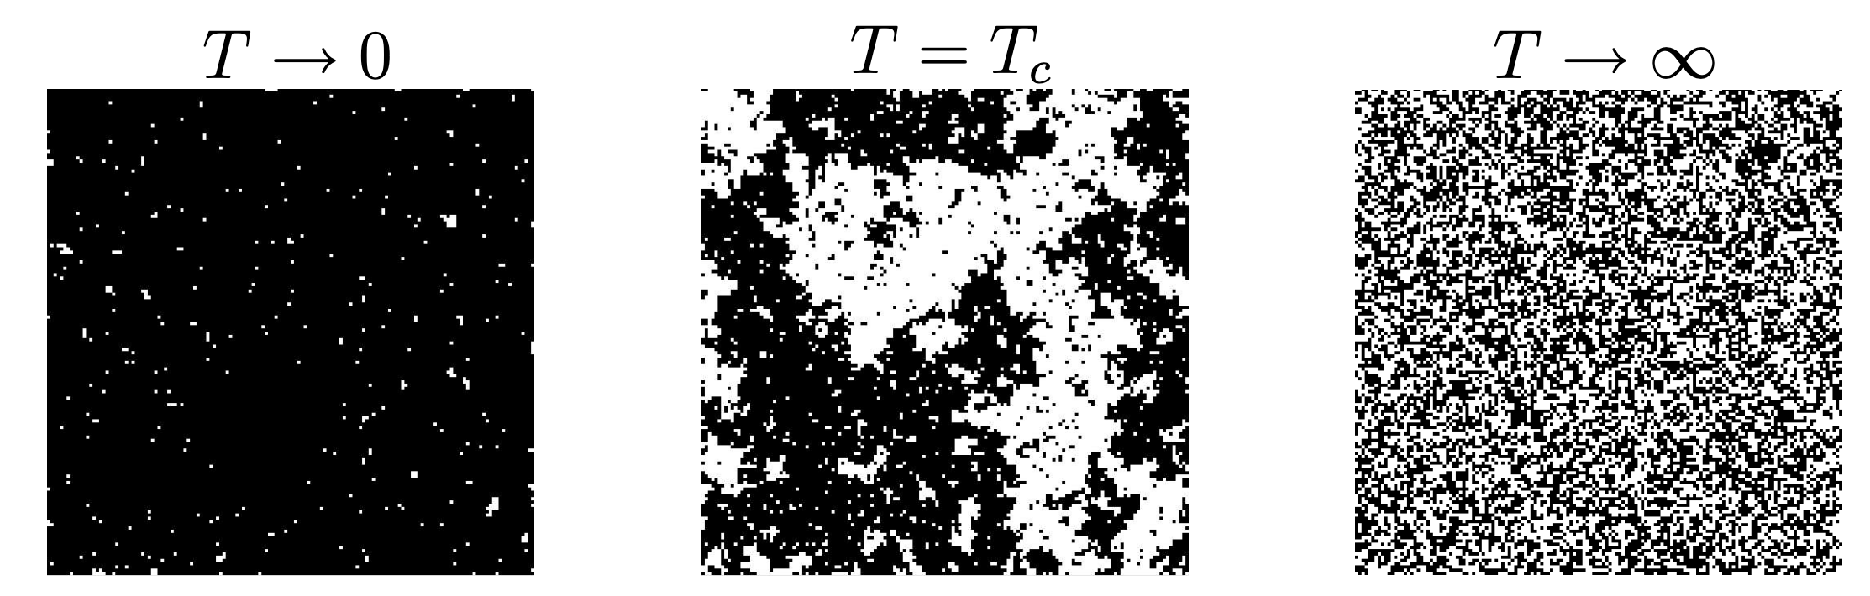
2 - Memory in Repeating FRBs
Cluster emerge from waiting time sequences
For critical behavior, clusters emerge with all size
Waiting time clustering
Size distributions: another example of critical behavior
Ising model: site = spin with 2 states
There exists a critical temperature T_c
Above T_c : No magnetization, random distributed
Below T_c: Magnetization, one very large cluster
At the precise value T_c: Clusters of all sizes
T = T_c ⇒ clusters of all size ⇒ power law!
Analogous to spin up and down
Notes:
In order to understand how cluster happend, we introduce ising model to explain it
1，Clusters in time series analogous to Ising model space cluster

Slide 9
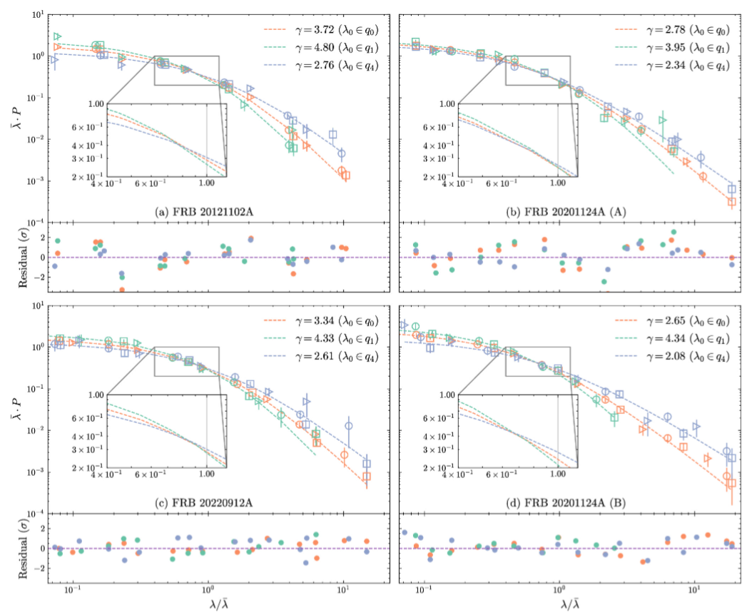
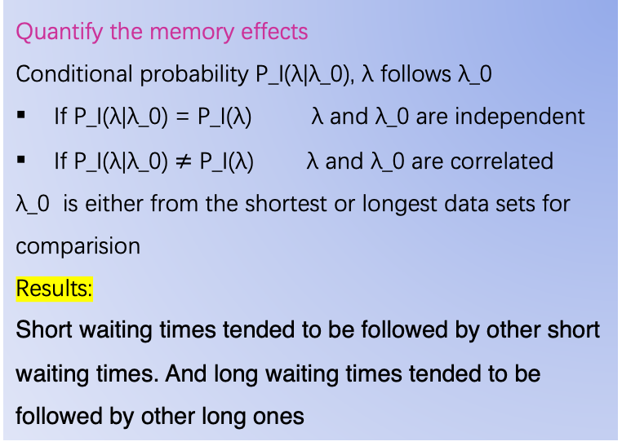
2 - Memory in Repeating FRBs
-- Conditional distribution
Does the time interval between the last two bursts influence how long you have to wait for the next one
Quantify the memory effects
Conditional probability P_I(λ|λ_0), λ follows λ_0
If P_I(λ|λ_0) = P_I(λ) λ and λ_0 are independent
If P_I(λ|λ_0) $≠$ P_I(λ) λ and λ_0 are correlated
λ_0 is either from the shortest or longest data sets for comparision
Results:
Short waiting times tended to be followed by other short waiting times. And long waiting times tended to be followed by other long ones
Wang et al., ApJ, 975, 2024
Notes:
Cluster means nearested event tend to have similar state, this is the results of memory.
How to quantify this effect
If there's no memory, like in a simple Poisson process, knowing the last waiting time tells you nothing
about the next one.

Slide 10
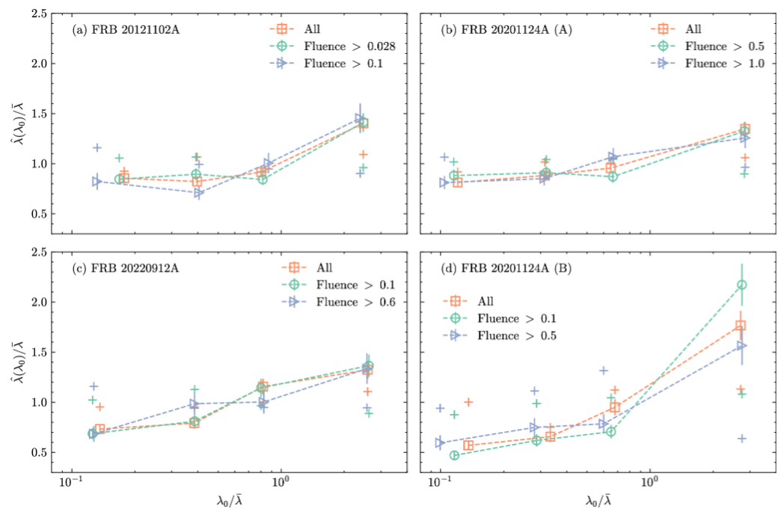
2 - Memory in Repeating FRBs
-- conditional mean waiting time
If the previous waiting time was shorter than average, the next average waiting time was also shorter than average and vice versa, for long previous waiting times

Slide 11
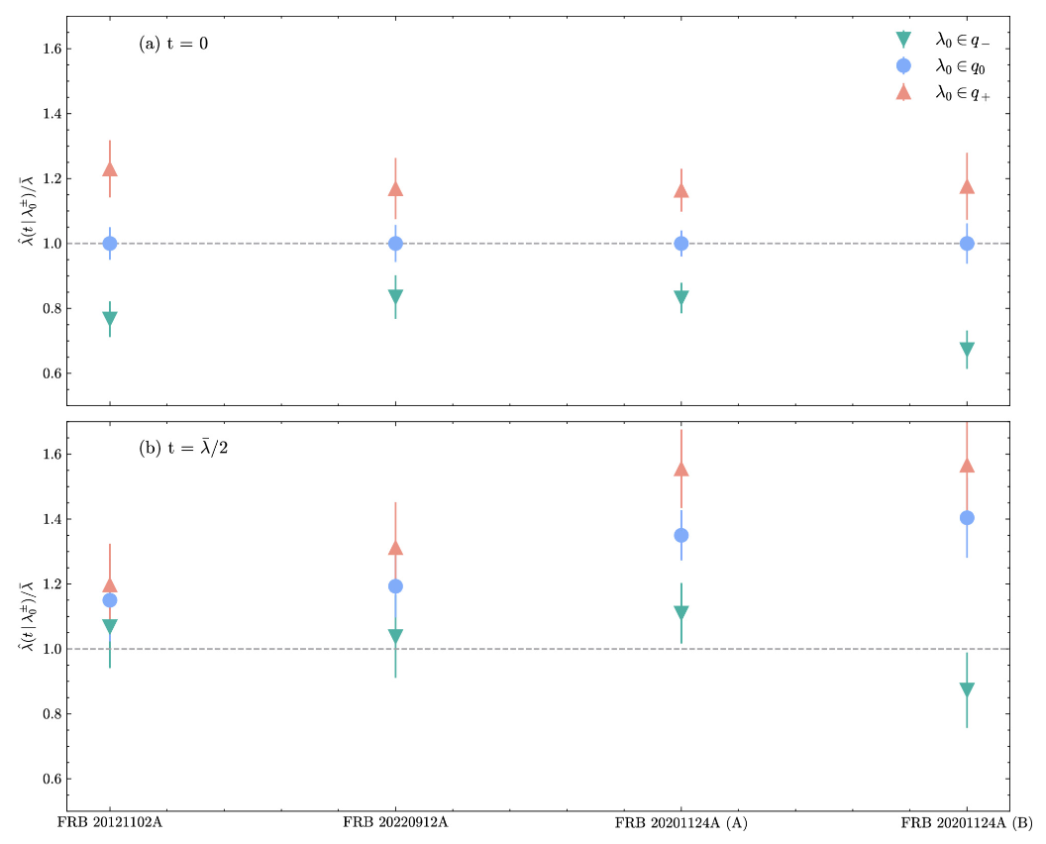
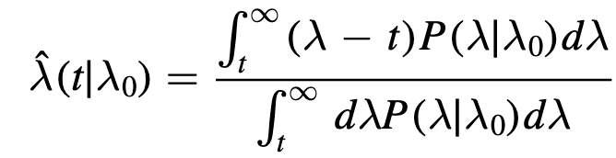
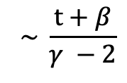
2 – Memory in Repeating FRBs
-- Residual waiting time
From the viewpoint of observation, one - off corresponds the residual time tends to be infinity
From average waiting time to residual waiting time
Let's say sometimes t has passed since the last burst. The conditional residual time is the average additional time you expect to wait from now until the next burst.
$$\sim \frac{t+β}{γ −2}$$
It‘s another signature of this temporal clustering, but the most important thing is that one-off possibility perhaps hidden behind repeating FRBs waiting time distribution.
Notes:
Residual waiting time is an observable quantity, it can be analytically integrated, from the result we can see …
If its truth, we maybe don’t need two completely different underlying mechnism

Slide 12
Summary
The dynamics of repeating FRBs exhibit temporal clustering and memory effect, described by a universal scaling law
Short waiting times tend to be followed by short ones, and long by long, recurrence times depend on history
Even if some non-repeating FRBs may be repeating FRBs, it may take longer to observe their repeated bursts that occurred earlier
For newly discovered non-repeating bursts, it is more likely to observe their repeated bursts in a shorter period
So an apparently non repeating FRB might just be a very patient repeater

