Slide 1
The radiative subpulse modulation and spectral features of PSR B1929+10 with the whole pulse phase emission
Zhengli Wang (GXU)
Wang et al. 2025 submitted

Slide 2
Outline
Radio emission behaviors
Three-dimensional pulsar magnetosphere
Emission physics
Conclusion

Slide 3
Radio emission behaviors
Three-dimensional pulsar magnetosphere
Emission physics
Conclusion

Slide 4
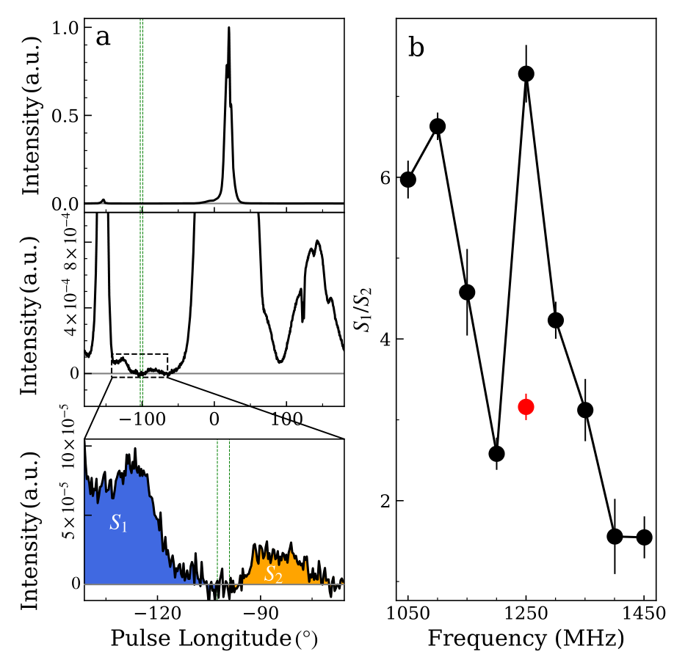
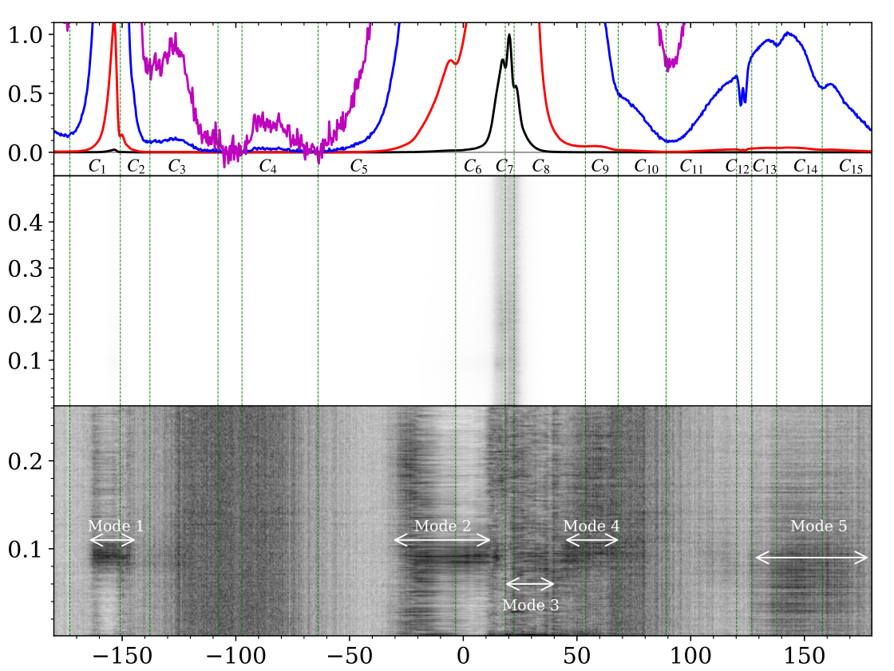
Radio emission behaviors
Two weak pulse windows are first identified that demonstrate the whole pulse phase emission.
Extremely complicated pulse profile that has at least 15 pulse components.
There are 5 subpulse modulations.

Slide 5
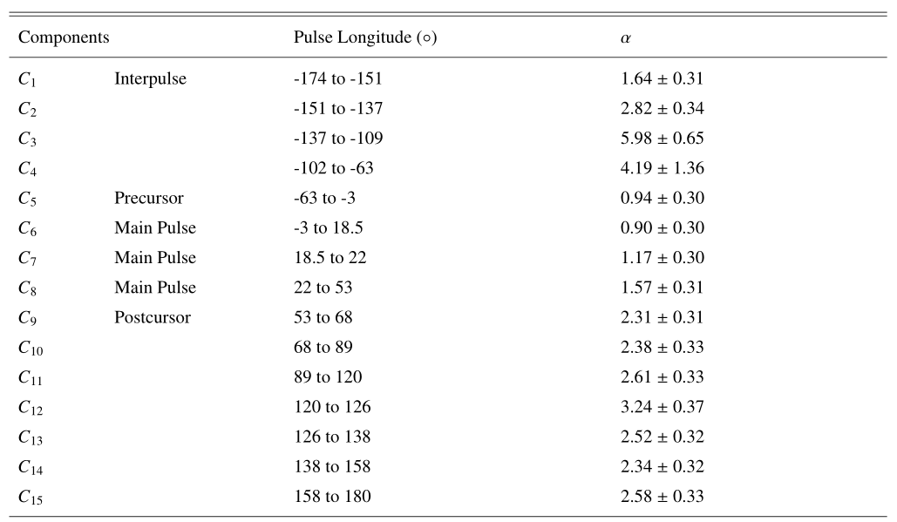
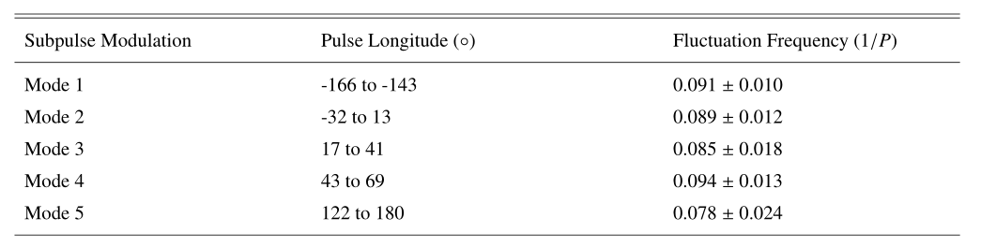
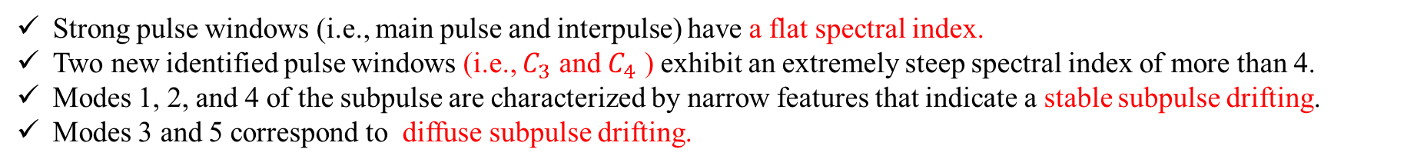
Radio emission behaviors
Strong pulse windows (i.e., main pulse and interpulse) have a flat spectral index.
Two new identified pulse windows (i.e., $C_{3}$ and $C_{4}$ ) exhibit an extremely steep spectral index of more than 4.
Modes 1, 2, and 4 of the subpulse are characterized by narrow features that indicate a stable subpulse drifting.
Modes 3 and 5 correspond to diffuse subpulse drifting.

Slide 6
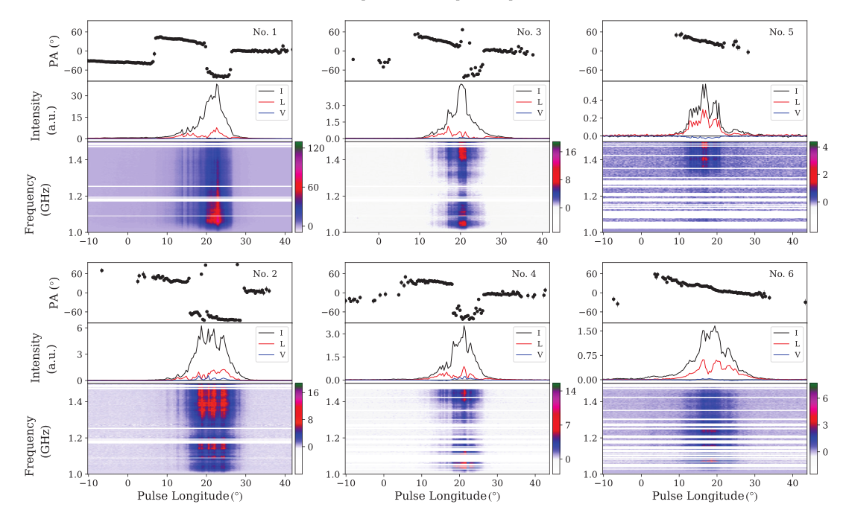
Radio emission behaviors
Narrow band emission
Only high frequency characterizes
emission (Period No.5)
Quasi-periodic emission (Period No. 2)
Frequent jumps in polarization position
angle (PPA) (Periods No.1 and 4).

Slide 7
Radio emission behaviors
Three-dimensional pulsar magnetosphere
Emission physics
Conclusion

Slide 8
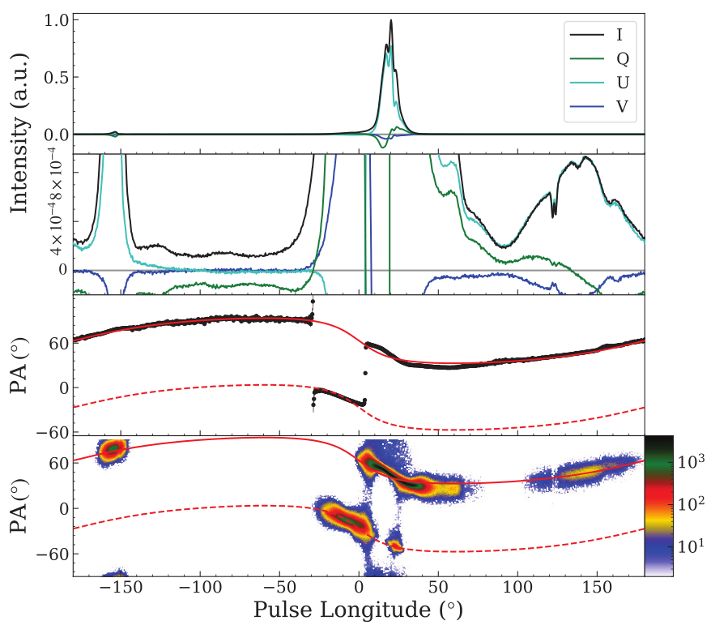
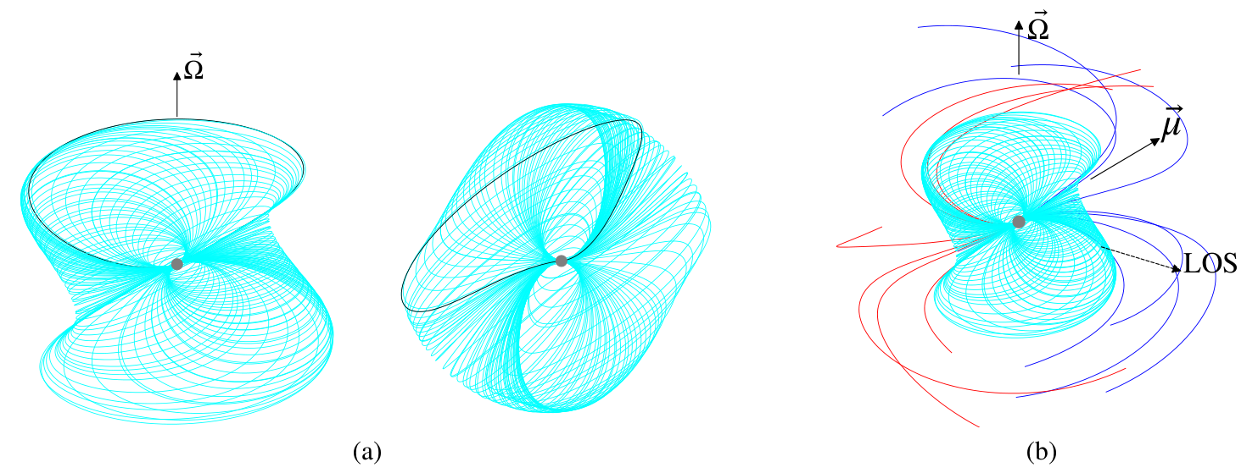
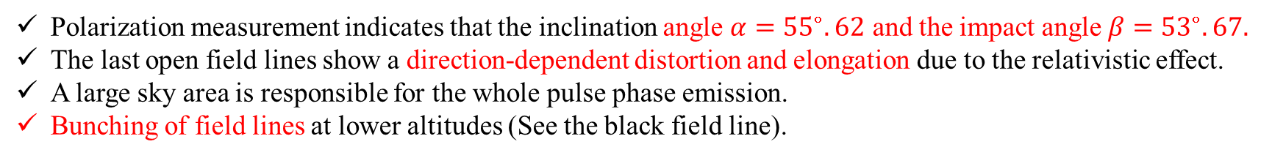
Pulsar magnetosphere
Polarization measurement indicates that the inclination angle $α={55}^{∘}.62$ and the impact angle $β={53}^{∘}.67.$
The last open field lines show a direction-dependent distortion and elongation due to the relativistic effect.
A large sky area is responsible for the whole pulse phase emission.
Bunching of field lines at lower altitudes (See the black field line).

Slide 9
Radio emission behaviors
Three-dimensional pulsar magnetosphere
Emission physics
Conclusion

Slide 10
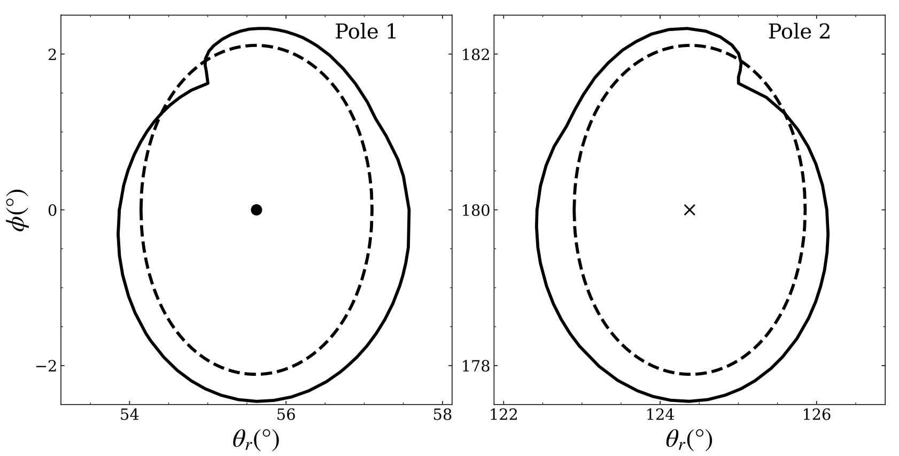
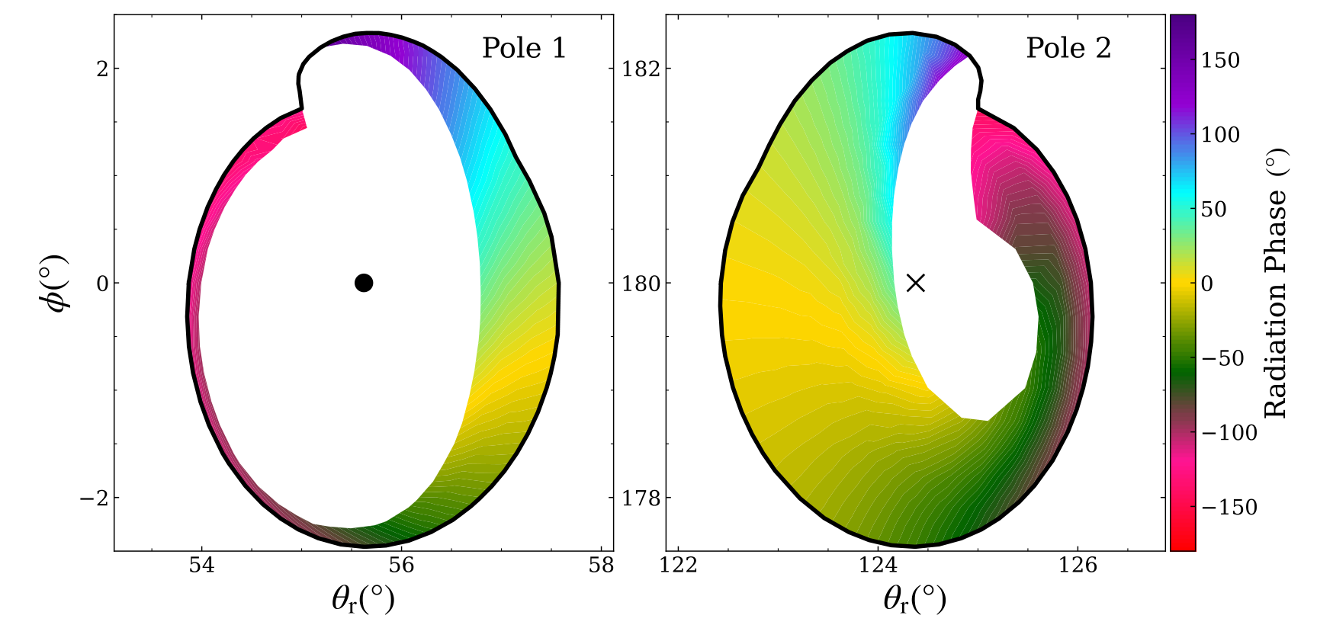
Emission physics
The polar cap of the rotating magnetosphere is larger and complicated than that of a static one.
A notch or discontuity structure is seen in the polar cap due to the phenomenon of bunching of field lines.
Two-pole models are responsible for the radio emission behaviors
The narrow polar cap surface contributes to the weak emission.

Slide 11
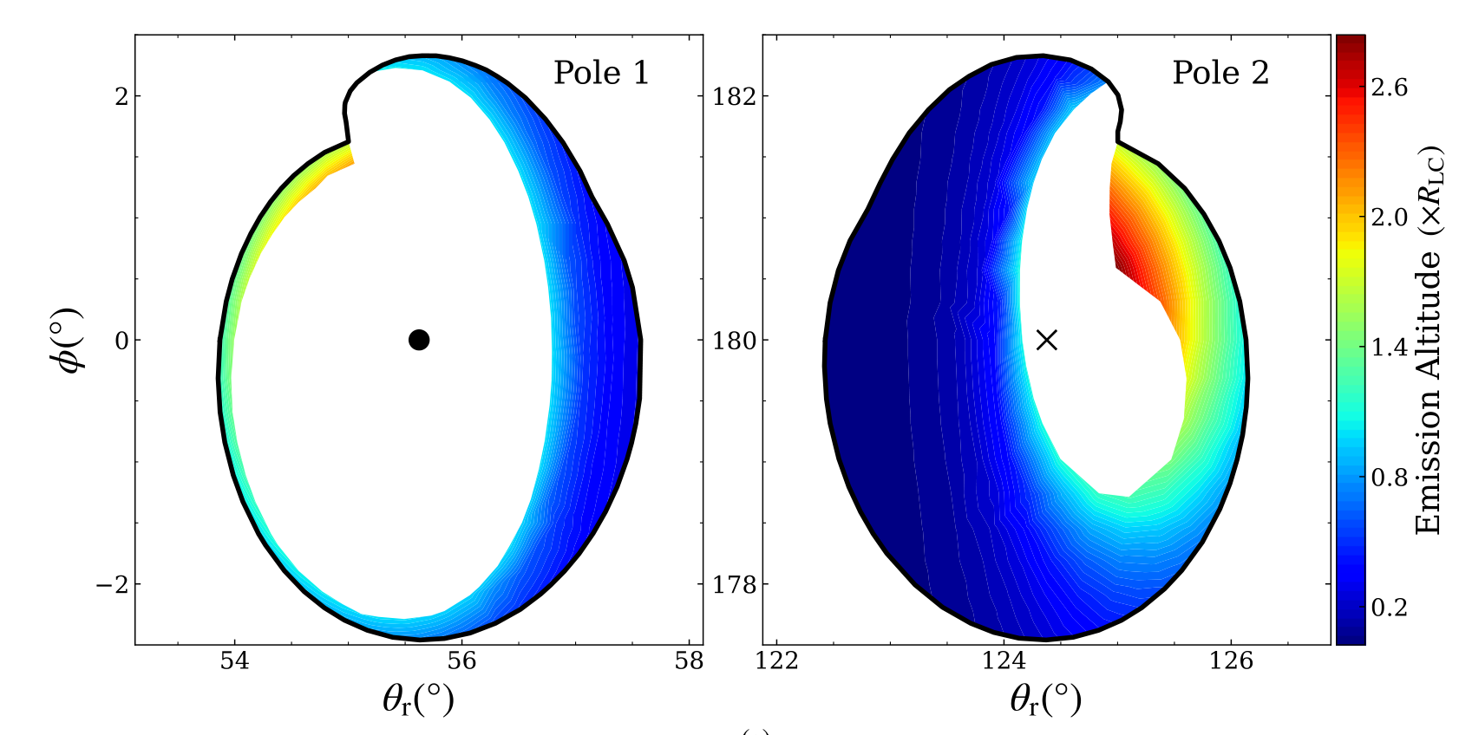
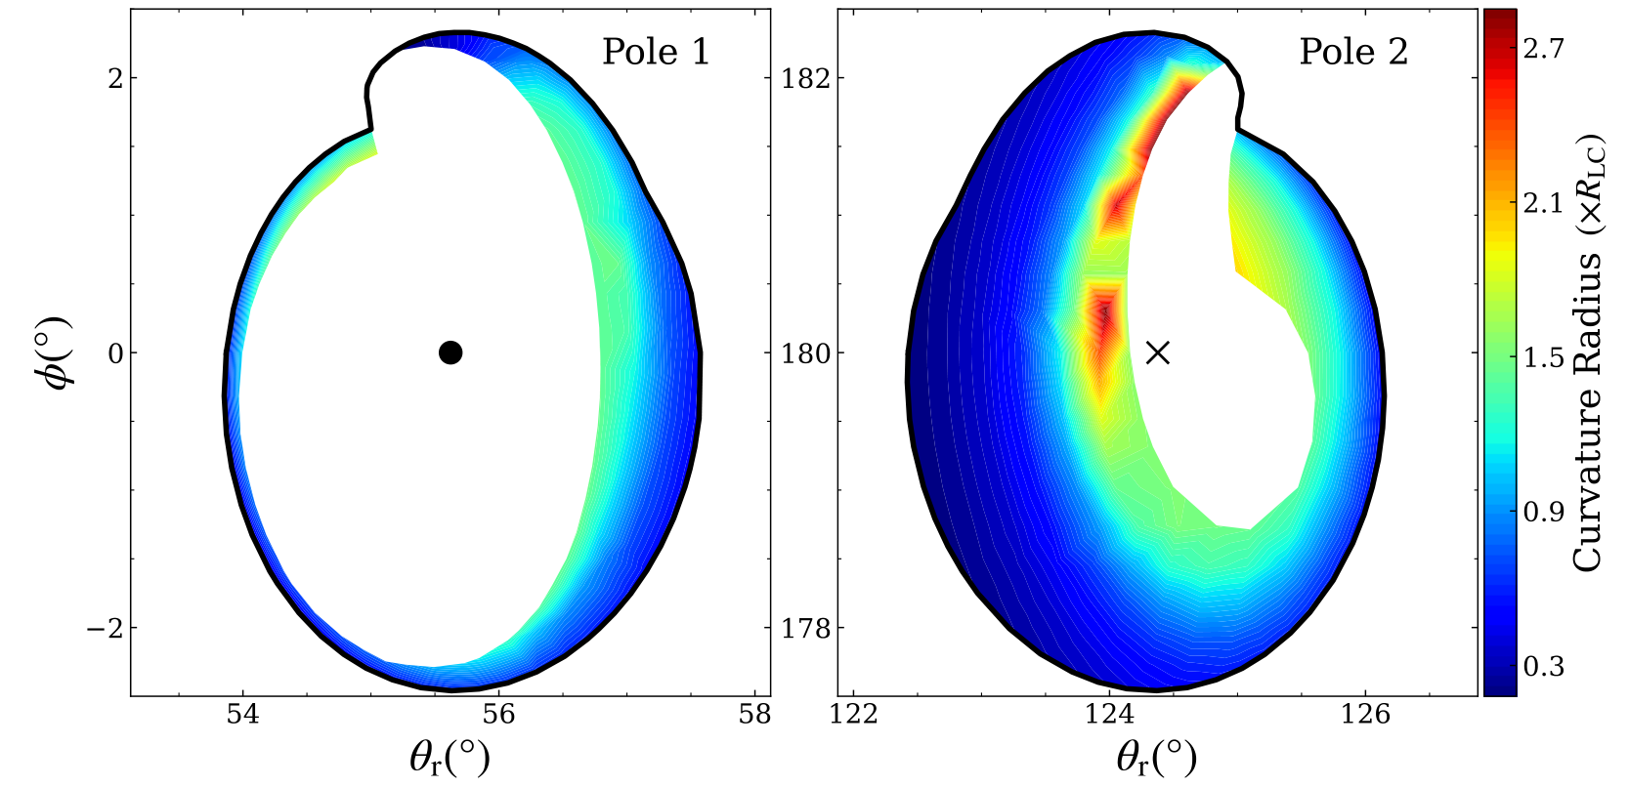
Emission physics
High-altitude magnetospheric radio emission.
The weak radio emission comes from the high-altitude magnetosphere.
Strong pulse emission window emits from a low altitude of less than 1000 km. This is consistent with the works of
Cordes 1978, BCW 1991, Phillips 1992, and Kramer 1997.
An extremely distorted phenomenon characterized by a large curvature radius in field lines in certain regions.

Slide 12
Radio emission behaviors
Three-dimensional pulsar magnetosphere
Emission physics
Conclusion

Slide 13
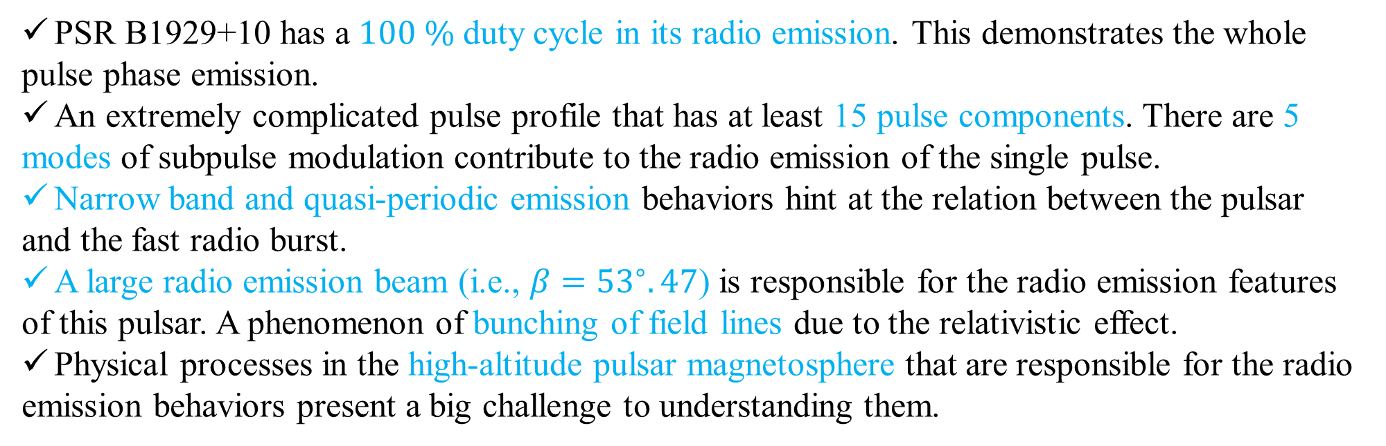
Conclusion
PSR B1929+10 has a $100 \%$ duty cycle in its radio emission. This demonstrates the whole
pulse phase emission.
An extremely complicated pulse profile that has at least 15 pulse components. There are 5
modes of subpulse modulation contribute to the radio emission of the single pulse.
Narrow band and quasi-periodic emission behaviors hint at the relation between the pulsar
and the fast radio burst.
A large radio emission beam (i.e., $β={53}^{∘}.47$) is responsible for the radio emission features
of this pulsar. A phenomenon of bunching of field lines due to the relativistic effect.
Physical processes in the high-altitude pulsar magnetosphere that are responsible for the radio
emission behaviors present a big challenge to understanding them.

