Slide 1
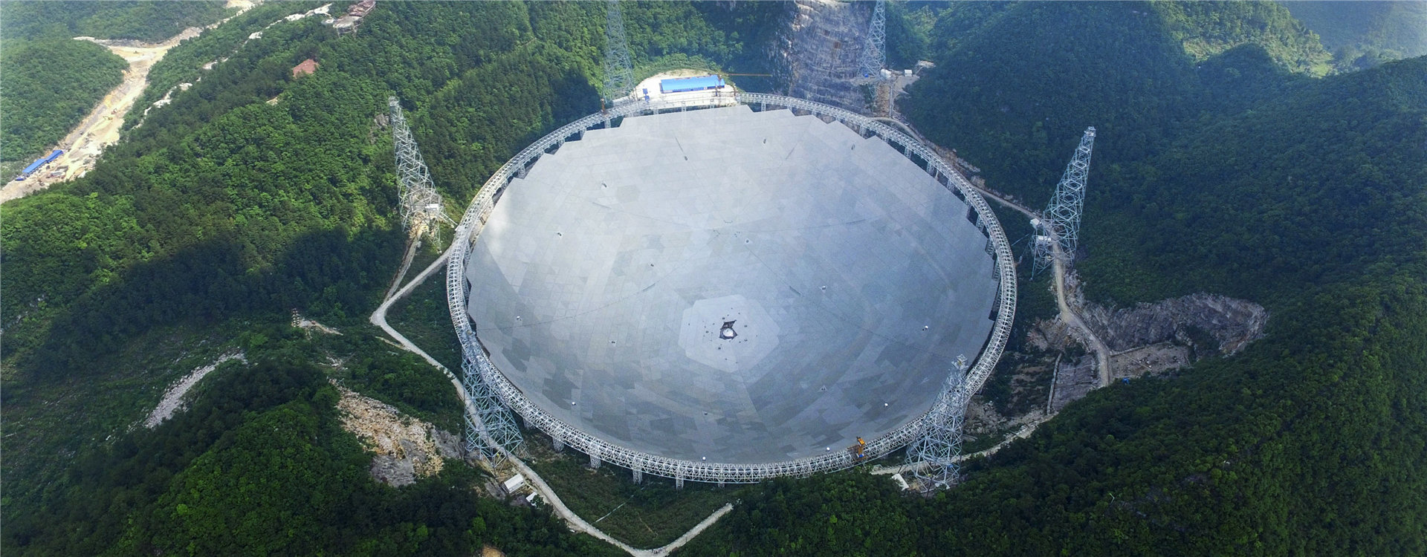
High Galactic Latitude FAST Pulsar Search and Pulsar Radiation Studies
Xin Xu
Guizhou Normal University
2025.05.13

Slide 2


1. Introduction
Contents
2. Resuls and disscussion
3. Summary

Slide 3
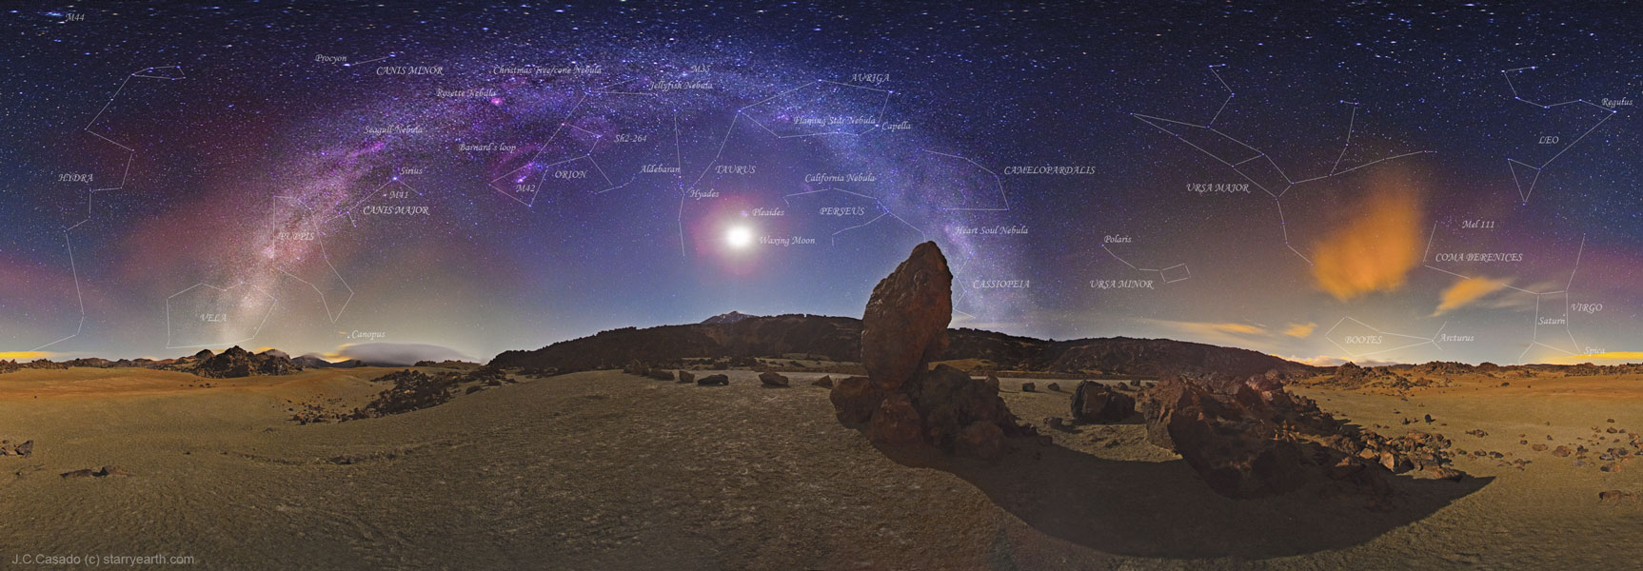
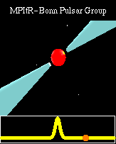
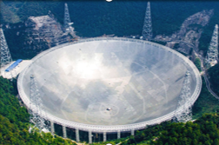
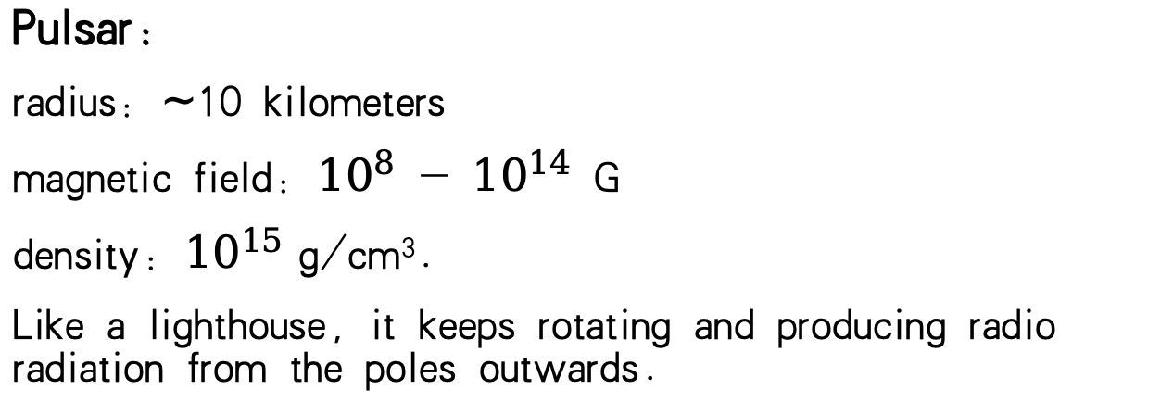
MilkyWay in Sky
Pulsar:
radius：$\sim$10 kilometers
magnetic field：${10}^{8}$ - ${10}^{14}$ G
density：${10}^{15}$ g/cm³.
Like a lighthouse, it keeps rotating and producing radio radiation from the poles outwards.

Slide 4
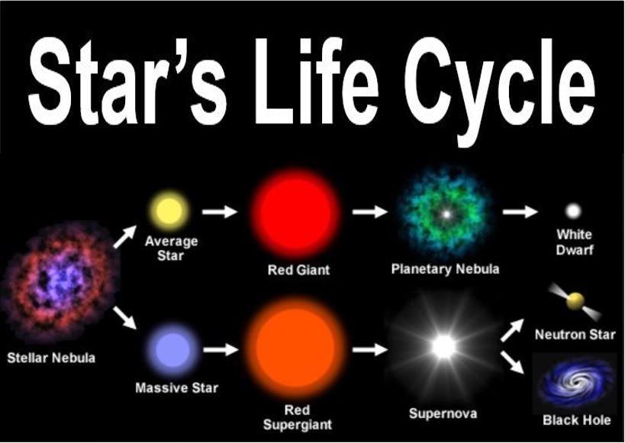
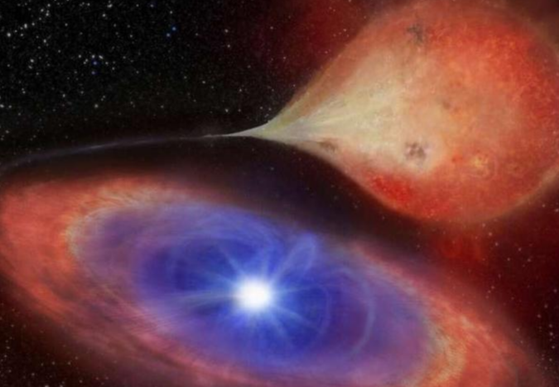
Production of pulsars/neutron stars
White dwarf through accretion-induced collapse (AIC)
Star occurs during the late stages of the evolution of a massive star

Slide 5
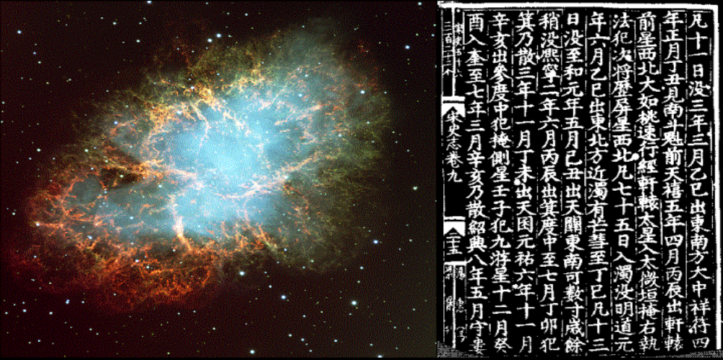
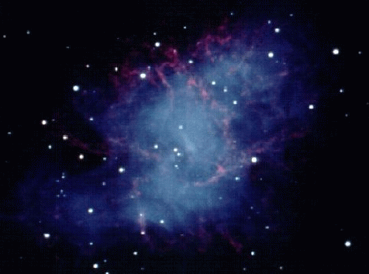
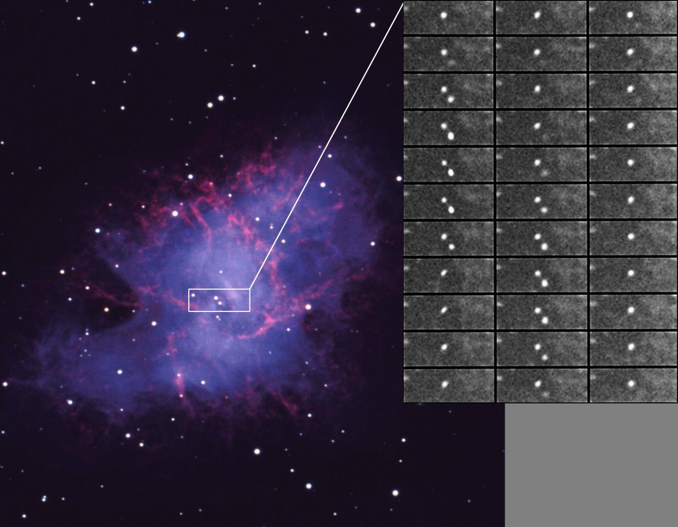
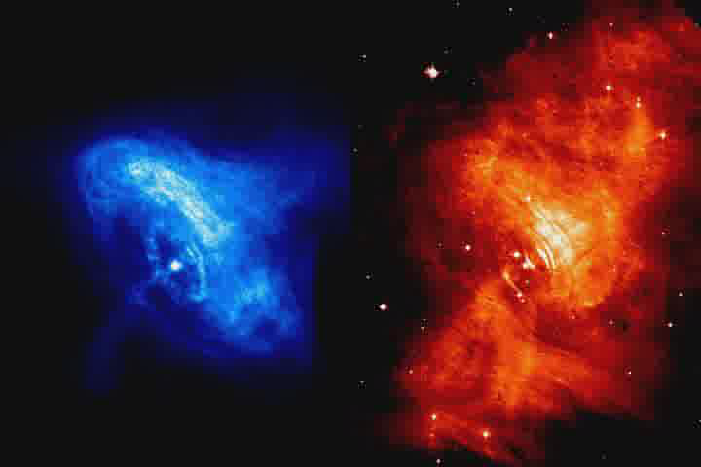
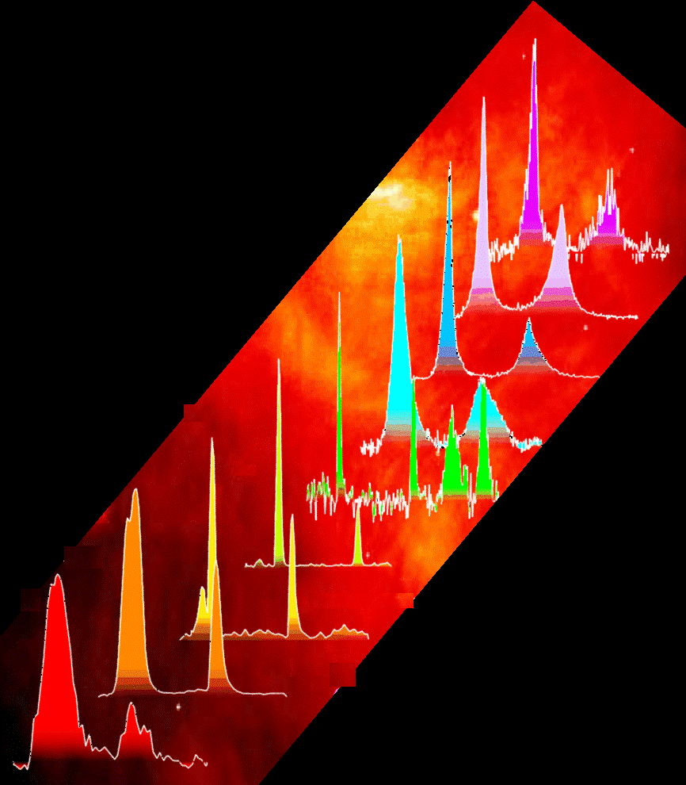
The Crab Nebula and its Pulsar.
1054AD Explosion, Chinese history records complete, age reliable.
rotation period：33ms.
Possessing full-spectrum radiation across optical, radio, and high energy bands.
X-Ray
Radio

Slide 6
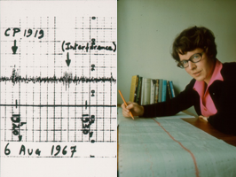
Introduction
In 1967, Hewish and Bell discovered pulsars.
So far, an extremely rich research result has been achieved in terms of both observational and theoretical studies.
Many interesting phenomena were found.
Pulsar Physics:
Origin and Evolution?
Radiation mechanism?
Spatial surroundings?
Equation of States?
More pulsars
High-sensitivity observations

Slide 7
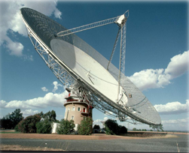
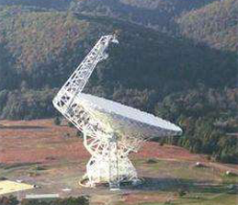
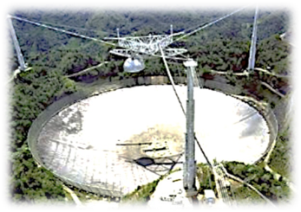
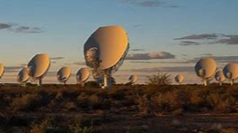
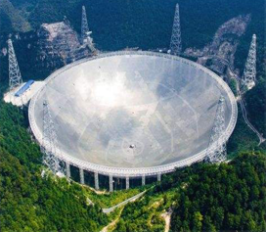
Introduction
Pulsar survey：
Parkes
GBT
Arecibo
MeerKAT
Observational studies related to pulsar searches are being conducted by major telescopes around the world.
More than 3,000 pulsars have been discovered so far.
FAST

Slide 8

Introduction

Slide 9
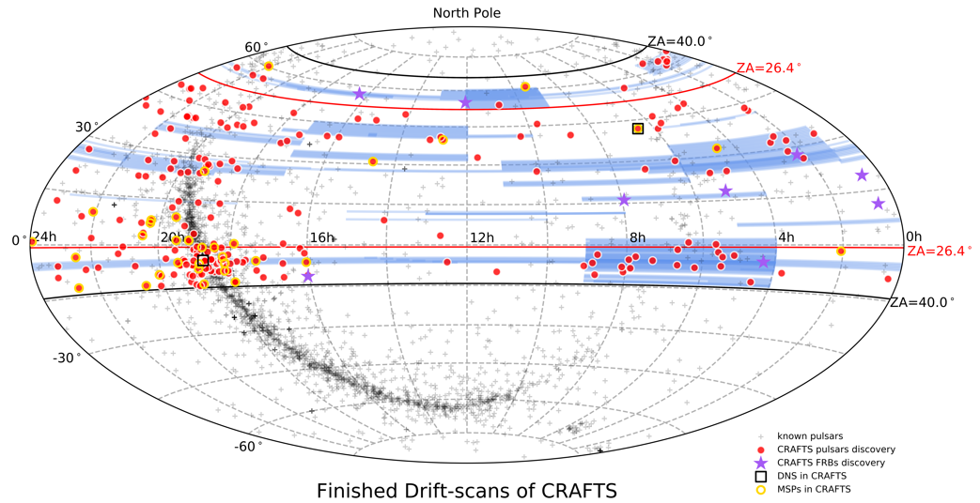
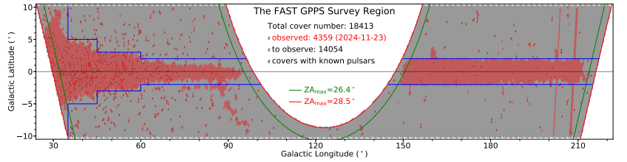
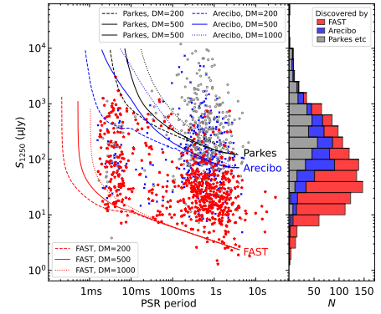
Introduction
(Jinlin Han. GPPS)
(Di Li. CRAFTS)
More than 90% of these one thousand new pulsars were discovered by these two surveys:
GPPS：751 （Han et al.）
CRAFTS：208 (Li et al.)
Particularly, many pulsars with weak radiation have been discovered, which other telescopes could not achieve.
(Han et al. 2025)

Slide 10
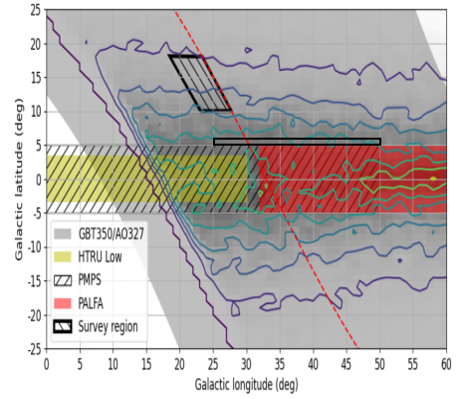
Introduction
There may be some pulsars at high Galactic latitudes, especially millisecond pulsars (MSPs) waiting to be discovered.
Why?
Lower Scattering: lower scattering of signals due to the shorter path through ISM.
Reduced Dispersion Effects：easier to detect some weaker pulsars
Found many MSP: It has a preference for high latitudes.
The sky map of discovery rate of MSPs in Galactic coordinates. Contours with lighter colors represent a higher discovery rate.

Slide 11
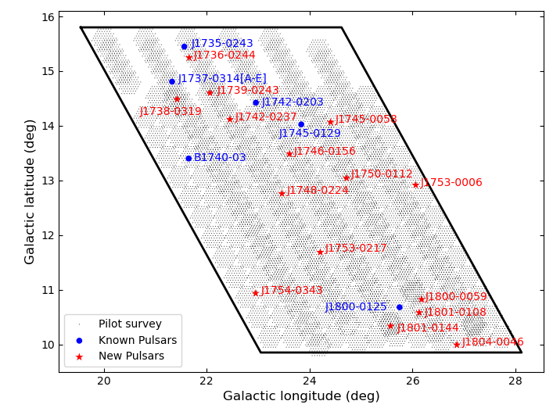
Results and discussions
High Galactic Latitudes pulsar survey
A plot of the sky coverage map of this survey：
A total of 15 pulsars have been discovered, including 11 normal pulsars and 4 MSPs.
NGC 6402
This globular cluster hosts six MSPs, but due to our limited sensitivity (with a 5 minutes integration time per pointing), we could not detect the remaining five pulsars.
XinXu, Shi Dai, Qijun Zhi, Juntai Bai et al. 2025, ApJ, 982, 117

Slide 12
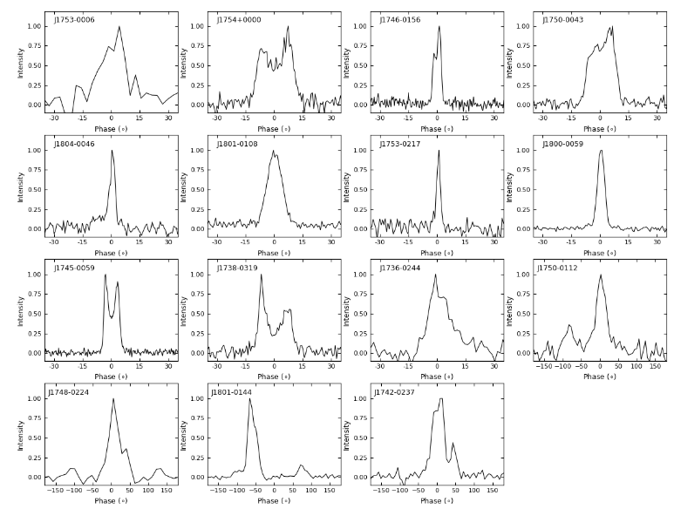
Results and discussions
The first 11 panels: the 5 minutes integrated pulse profiles of the 11 normal pulsars
The next 4 panels: the 20 minutes integrated pulse profiles of the four MSPs.
J1801-0144: The intermediate pulse was observed, but no bridge radiation was seen.

Slide 13
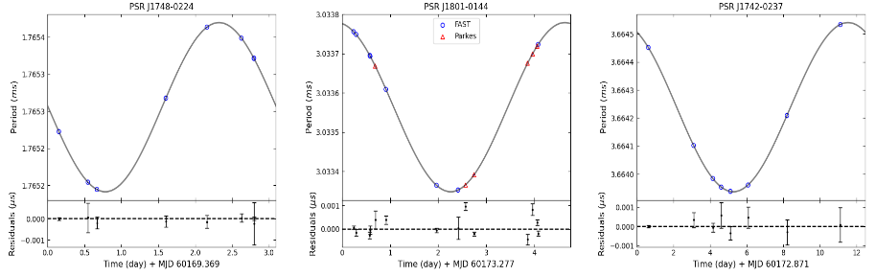
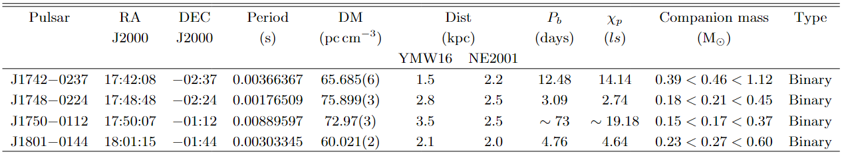
Results and discussions
For the four new MSPs:
Previously, three pulsars were identified as being in binary systems through at least eight observations.
Approximate binary star parameters for them:

Slide 14
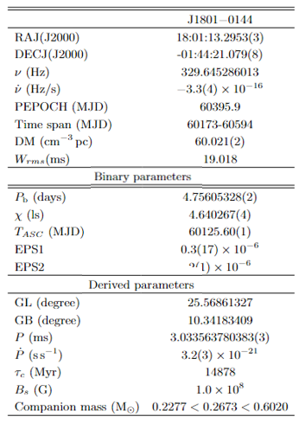
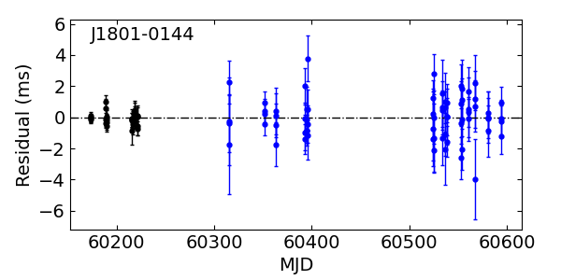
Results and discussions
More than 400 days of observations obtained a timing solution for J1801−0144
Black indicates observations made with FAST and blue with Parkes.
Follow-up observations of the remaining two MSPs continue ......

Slide 15
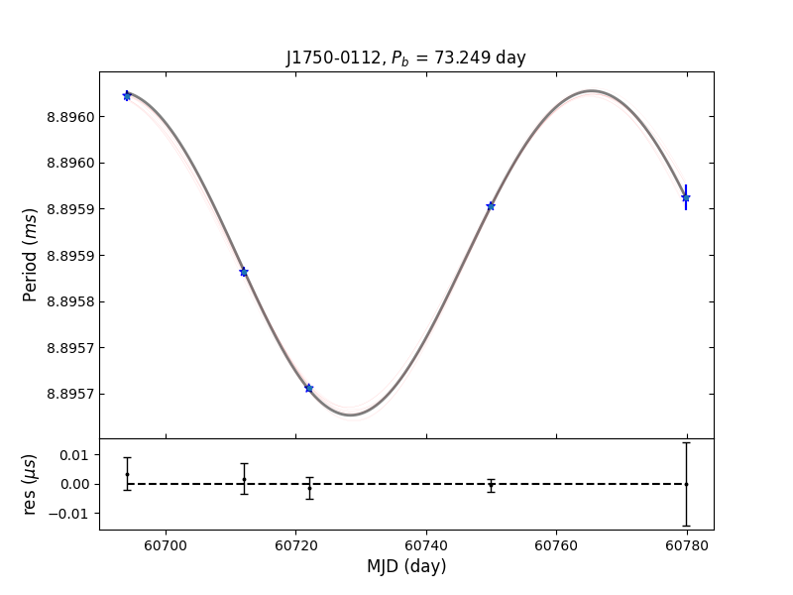
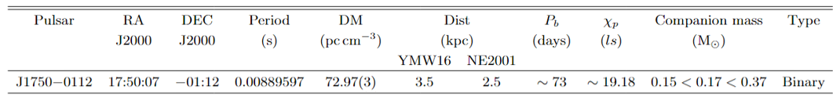
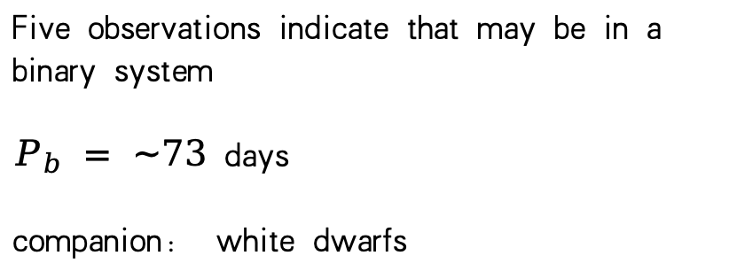
Results and discussions
Previously, three observations with FAST showed negligible changes in its observed period, within the limits of uncertainty.
It was therefore considered likely to be an isolated millisecond pulsar.
Five observations indicate that may be in a binary system
$P_{b} = \sim 73$ days
companion: white dwarfs

Slide 16
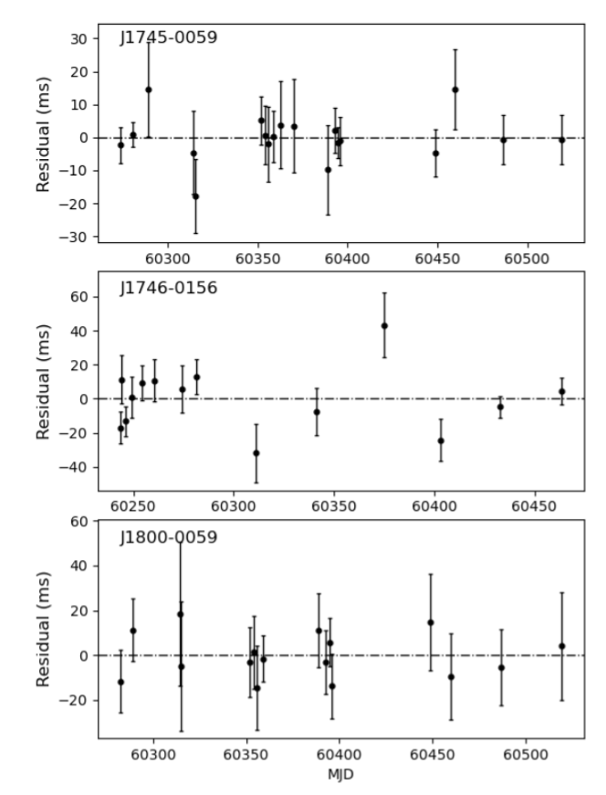
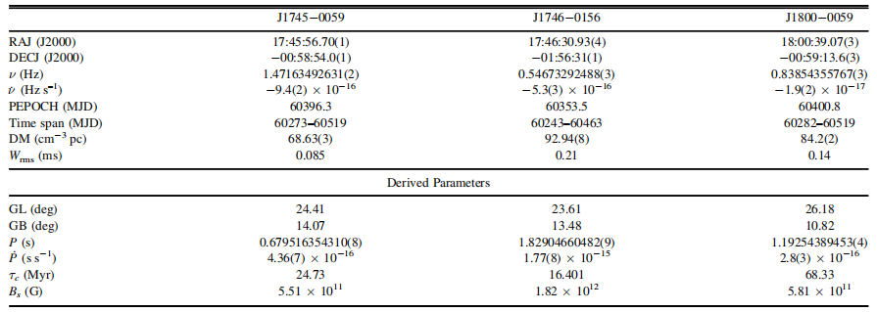
Results and discussions
For normal pulsars:
Timing solutions for three of these normal pulsars were obtained with FAST and Parkes.
The timing of J1746−0156 was carried out with FAST, while J1745−0059 and J1800−0059 were observed with Murriyang.

Slide 17
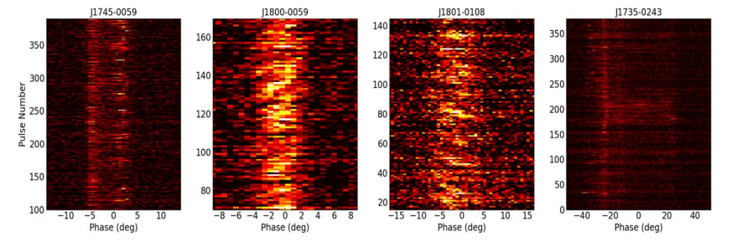
Results and discussions
J1745−0059: mode changing pulsar
A distinct intensity modulation is observed in its second component, which is not evident in the first component.
J1800−0059 and J1801−0108: subpulse drifting pulsars
both exhibit subpulse drifting behavior with the distinction that their subpulse drift trajectories are in opposite directions.

Slide 18
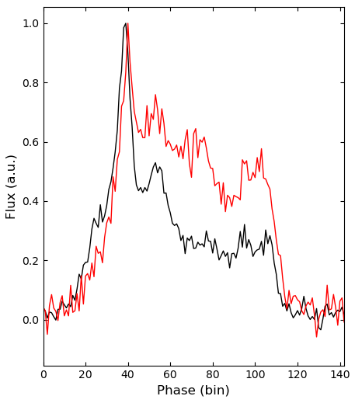
Results and discussions
J1735−0243: Mode changing pulsar
the normal mode: the first component is more intense relative to the others
The anomalous mode: the intensity of each component is comparable.
In our observations, abnormal modes account for only about one-tenth of the total observation time.
Black line: Normal mode
Red line: Abnormal mode

Slide 19
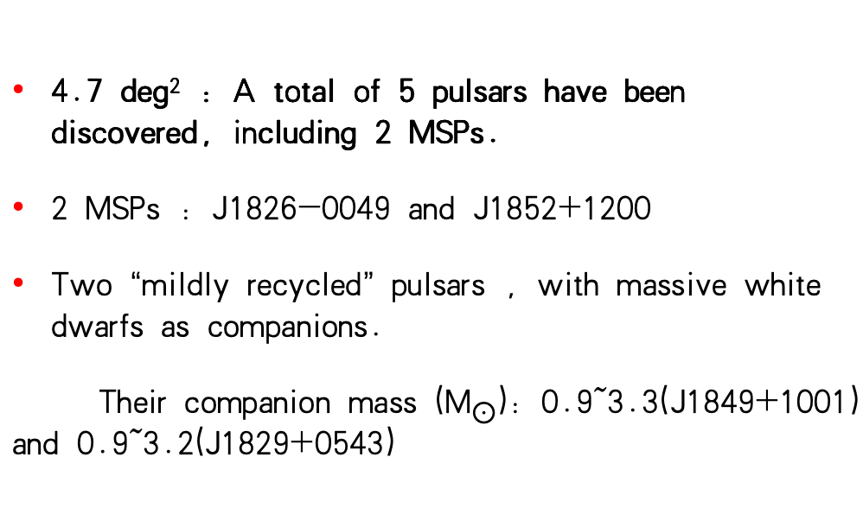
Results and discussions
2、Intermediate Galactic Latitudes：5<GL<5.8
4.7 deg² : A total of 5 pulsars have been discovered, including 2 MSPs.
2 MSPs : J1826-0049 and J1852+1200
Two “mildly recycled” pulsars , with massive white dwarfs as companions.
Their companion mass (M$⨀$): 0.9~3.3(J1849+1001) and 0.9~3.2(J1829+0543)
Intermediate Galactic Latitudes have great potential for discovering more new pulsars.

Slide 20
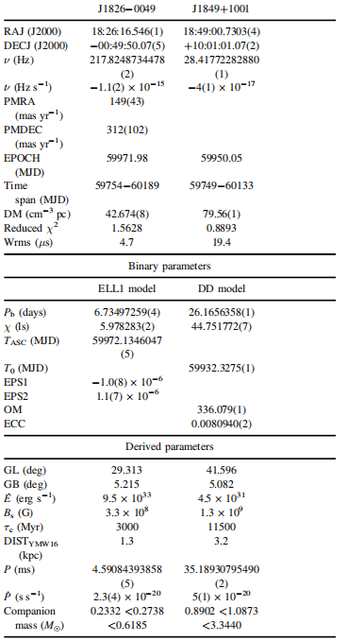
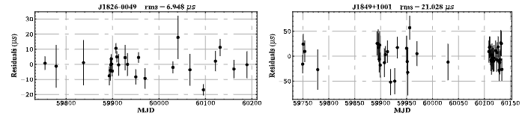
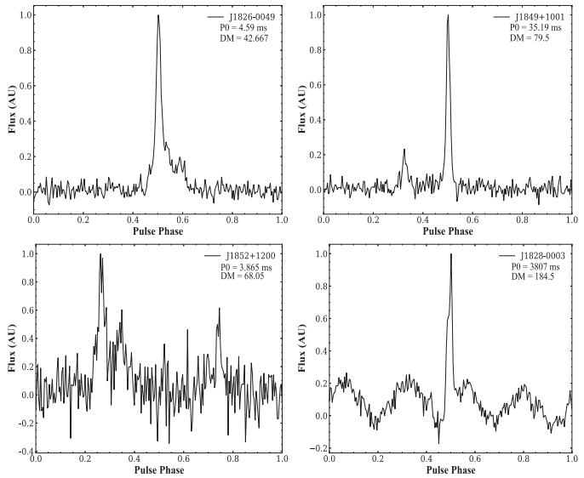
Results and discussions
Qijun Zhi, Juntao Bai, Shi Dai et al. , 2024, APJ

Slide 21
Summary
At high Galactic latitudes, a total of 15 pulsars were discovered. The newly discovered pulsars consist of 11 normal pulsars and four millisecond pulsars (MSPs);
In these MSPs are certified in binary systems with orbital periods of ∼3.1, 4.6, 12.5 and ∼73 days, respectively;
Successfully obtained coherent timing solutions for three of the normal pulsars. Furthermore, In addition, four pulsars (three new and one known) were found to show mode changing and/or subpulse drifting phenomena.
At intermediate Galactic latitudes, 5 new pulsars were discovered, including 2 millisecond pulsars (MSPs). Among them, 2 pulsars have massive white dwarfs as companions.

Slide 22
Thanks

