Slide 1



Binary origin of fast radio burst
Zhenyin Zhao
School of Astronomy and Space Science, Nanjing University
Collaborators: W. J. Lu, R. N. Li, Q. Wu, G. Q. Zhang,
F. Y. Wang and Z. G. Dai
The Era When Pulsars Meet FRBs, May 11-16th, GuiYang
Notes:
Hello everyone, my name is Zhenyin Zhao, and I am from Nanjing University. Today, I am honored to present my talk titled Binary origin of fast radio bursts.

Slide 2


Outline
1. Background
2. Rotation measure variations
3. RM scatters & Depolarization
4. Structure function
5. Summary
2

Slide 3
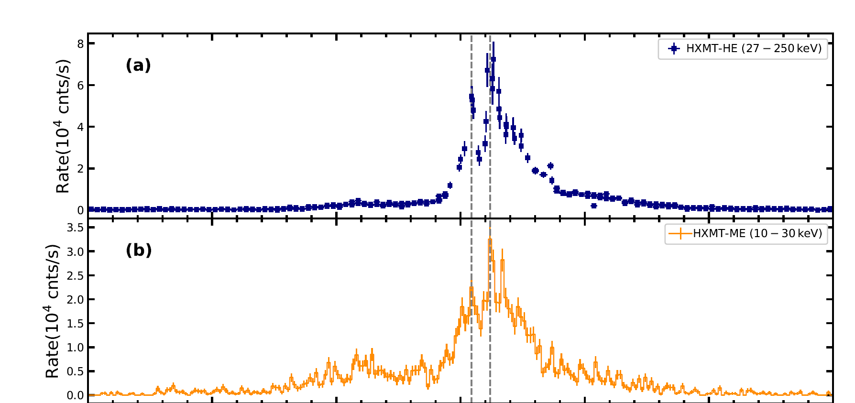
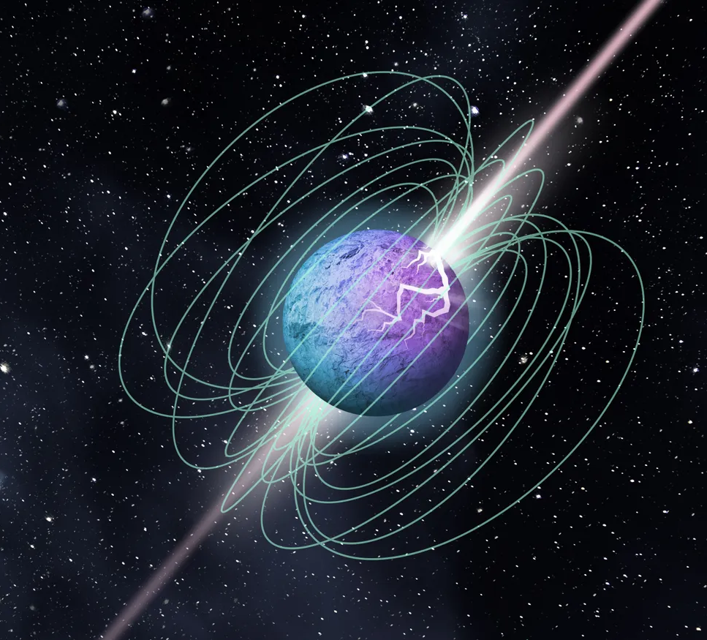
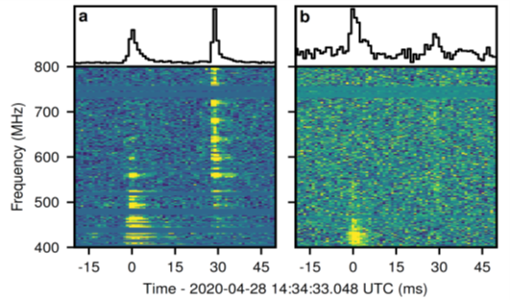
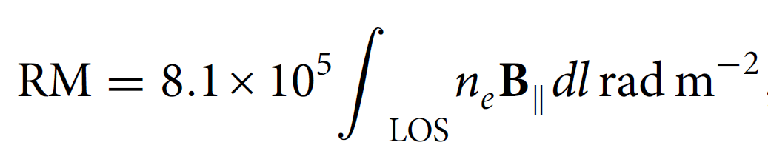
Environments of FRBs
Local and nearby FRBs
Detailed observations
2. Cosmological FRBs
Dispersion measure (DM),
Faraday rotation measure (RM)
Scattering
…
Bochenek et al., (2020); The Chime/Frb Collaboration et al., (2020)
FRB 200428
Notes:
For local and nearby FRBs, we can make detailed observations of their surrounding medium, such as FRB 200428 from the Galactic magnetar. For cosmological FRBs, we can only obtain information about their local environment indirectly through their dispersion measure (DM), Faraday rotation measure (RM), and scattering. Today, I will focus on RMs, which depends on both electron density and the parallel magnetic field along the line of sight.

Slide 4
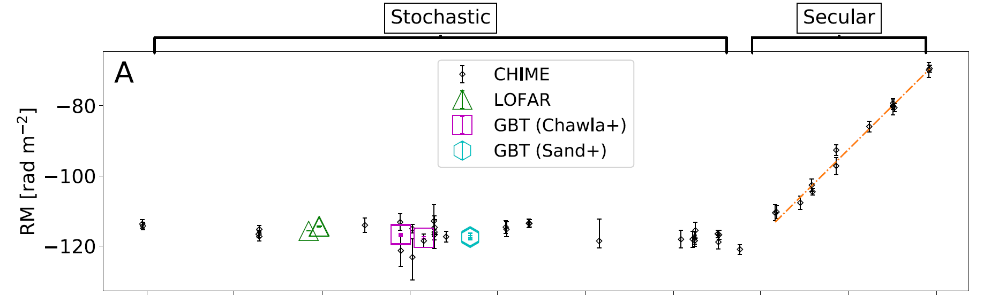
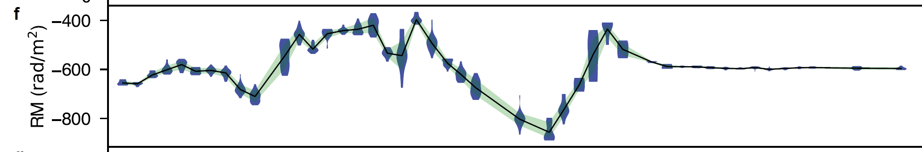
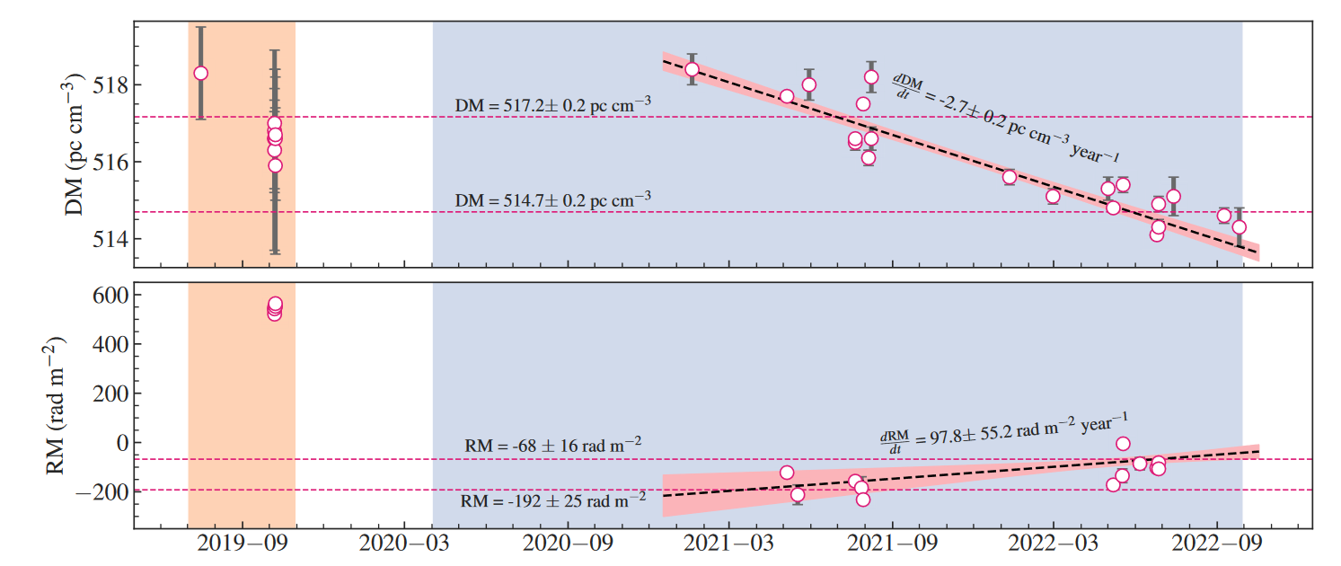
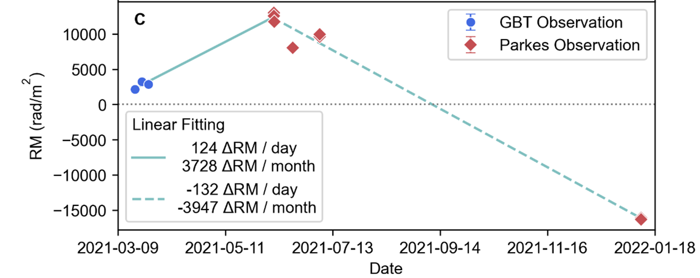
Rotation measure variations
FRB 20180916B
FRB 20201124A
Xu+ 2022
Mckinven+ 2023
FRB 20190520B
FRB 20180301A
Anna-Thomas + (2023)
Kumar + (2023)
4
Notes:
Some active repeating FRBs show complicated variations and reversals of rotation measures (RMs), indicating that the sources are embedded in a dynamically magnetized environment.

Slide 5
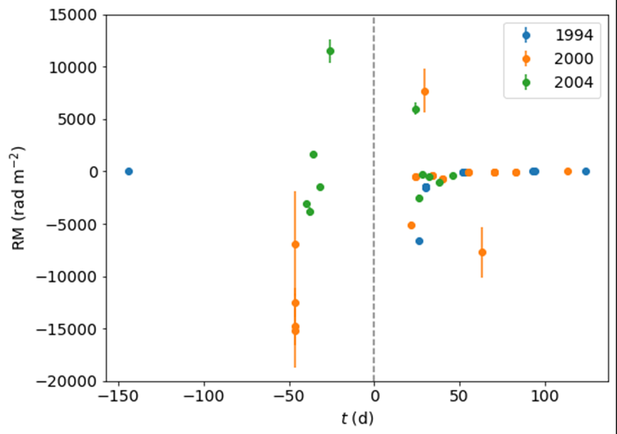
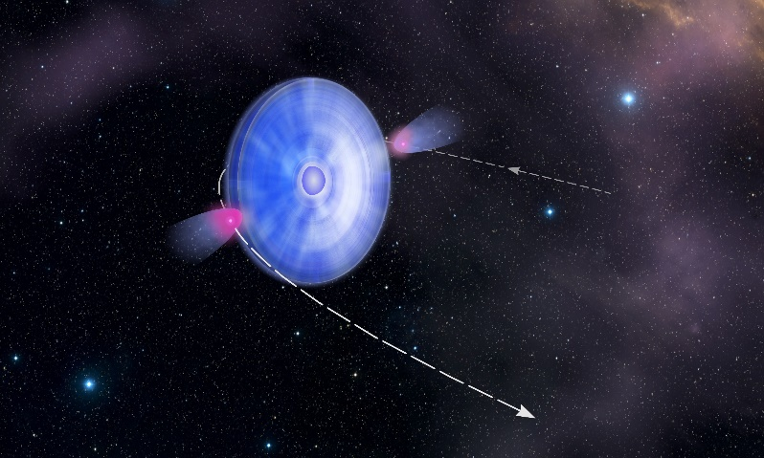
RM from HMXBs
PSR B1259−63/LS 2883
High-mass X-ray binary (HMXB)
NASA
Pulsar + Massive star with strong stellar wind (disk)
Johnston+ (1996,2005)
Notes:
A similar RM evolution (large variations & reversals) has been found in the Galactic high-mass X-ray binary system containing a pulsar and a massive star with strong stellar wind and a possible stellar disk. As this figure shown, the RM evolution of the famous Galactic Be X-ray binary PSR B1259−63.

Slide 6
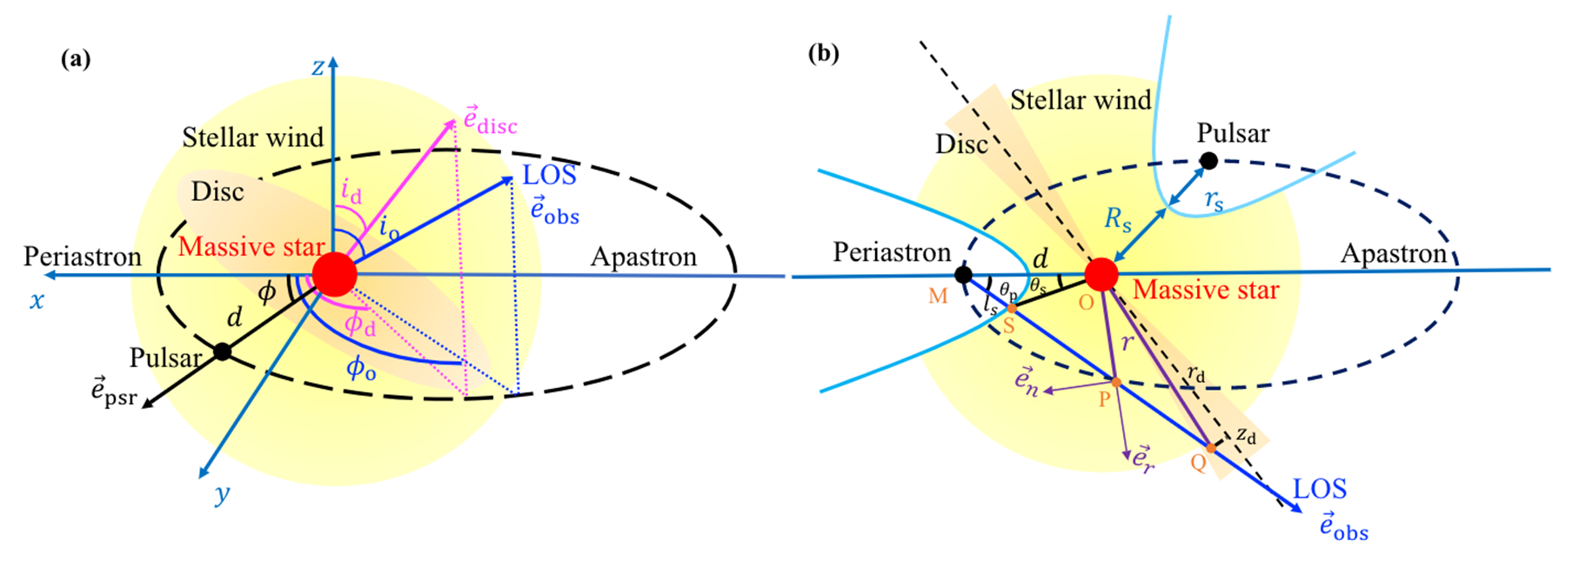
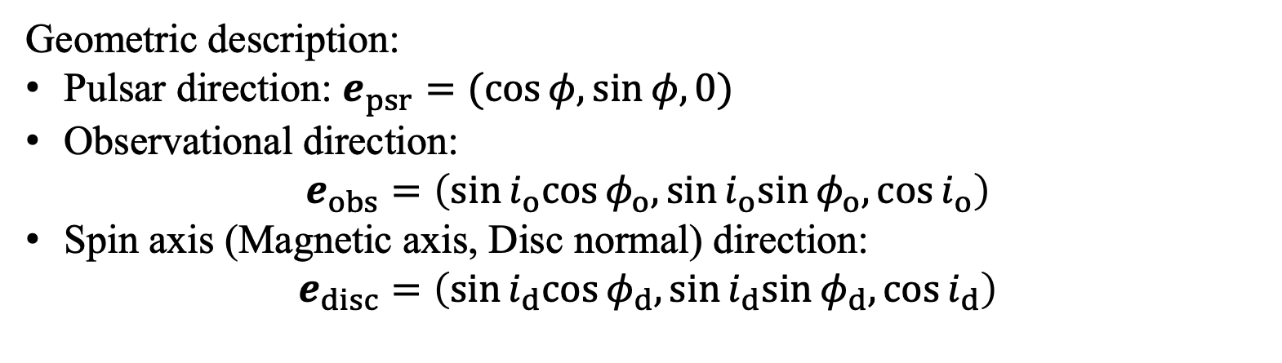
Zhao et al., 2023, ApJ;
Geometric description:
Pulsar direction: $e_{psr}=(cos⁡φ,sin⁡φ,0)$
Observational direction:
$$e_{obs}=\left(sin⁡i_{o}cos⁡φ_{o},sin⁡i_{o}sin⁡φ_{o},cos⁡i_{o}\right)$$
Spin axis (Magnetic axis, Disc normal) direction:
$$e_{disc}=\left(sin⁡i_{d}cos⁡φ_{d},sin⁡i_{d}sin⁡φ_{d},cos⁡i_{d}\right)$$

Slide 7
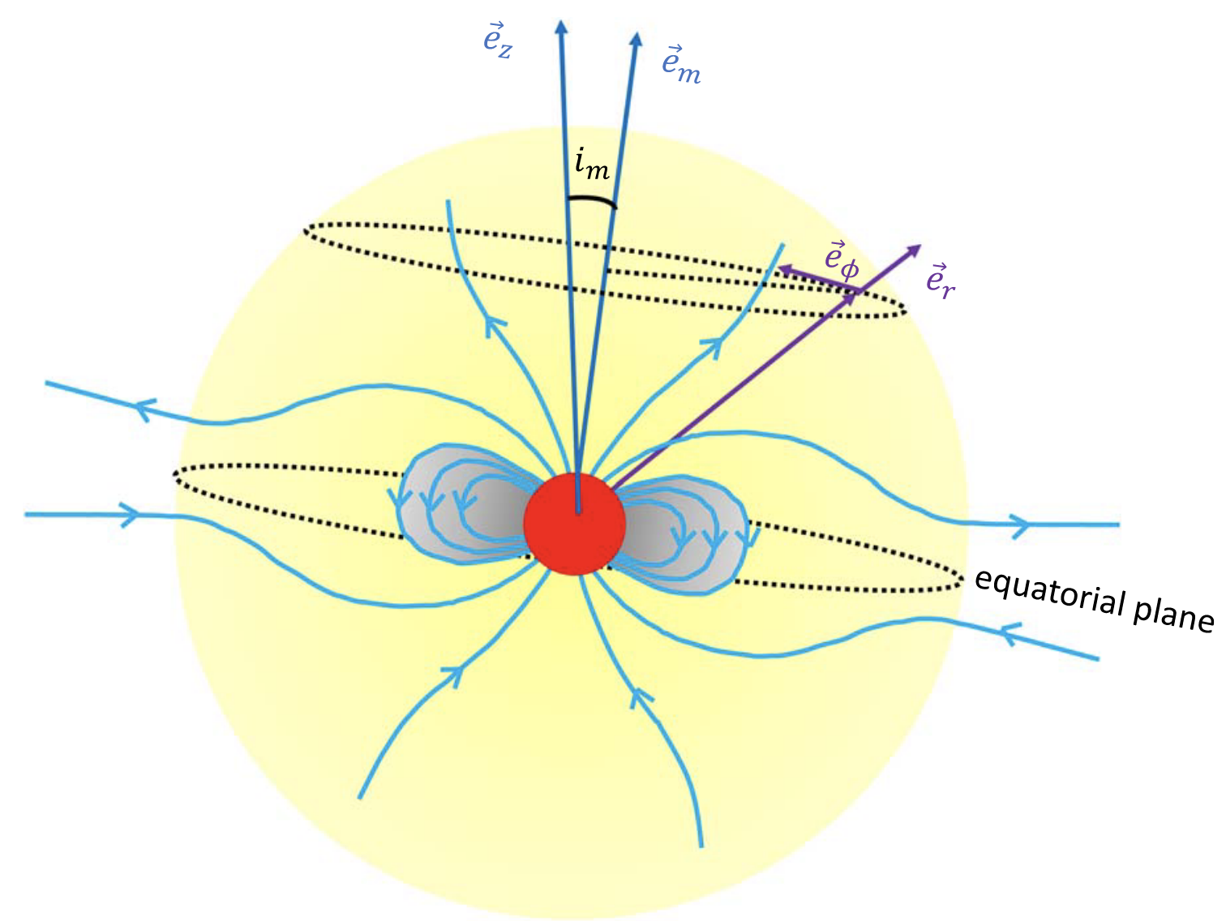
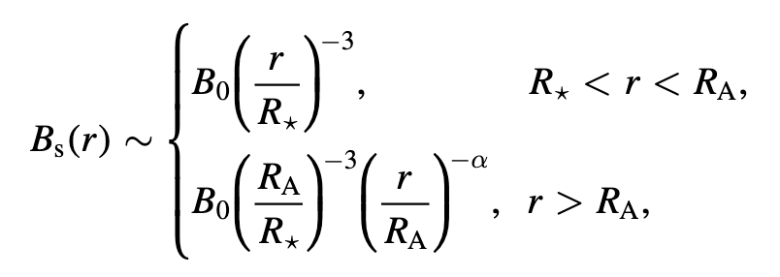
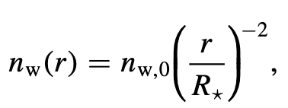
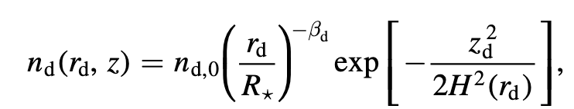
Large-scale magnetic field
Stellar wind: radial or toroidal field
Stellar disk: toroidal field
Be star
Zhao et al., 2023
Wang et al., 2022
Notes:
To obtain the RM, we should know the large-scale electron number density and magnetic field. Here is the density distribution in the stellar wind and the disk. The large-scale magnetic field of the stellar wind is radial or toroidal, and the magnetic field in disk is usually toroidal.

Slide 8
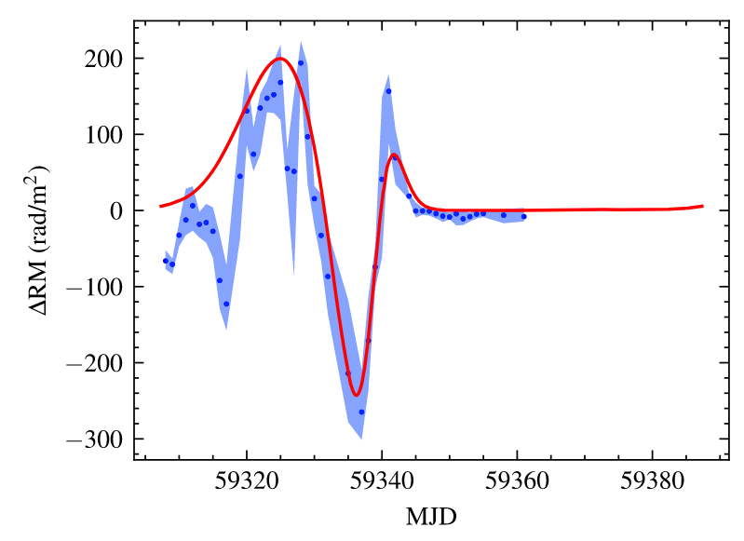
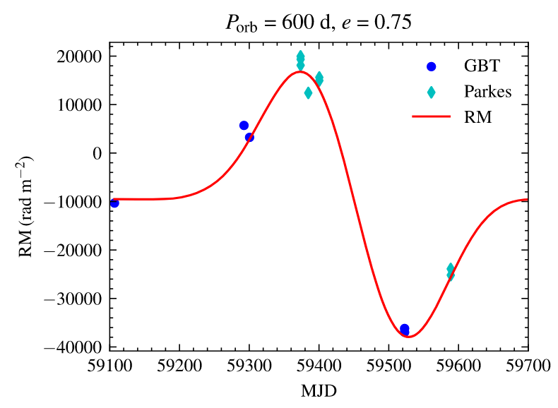
Stellar disk model
FRB 20190520B
FRB 20201124A
RM Variations and Reversals: orbital motion
Wang et al., 2022,
Notes:
The RM variations and reversals may come from the orbital motion of binary systems. We have successfully applied this model to explain the RM evolution of repeating FRBs.

Slide 9
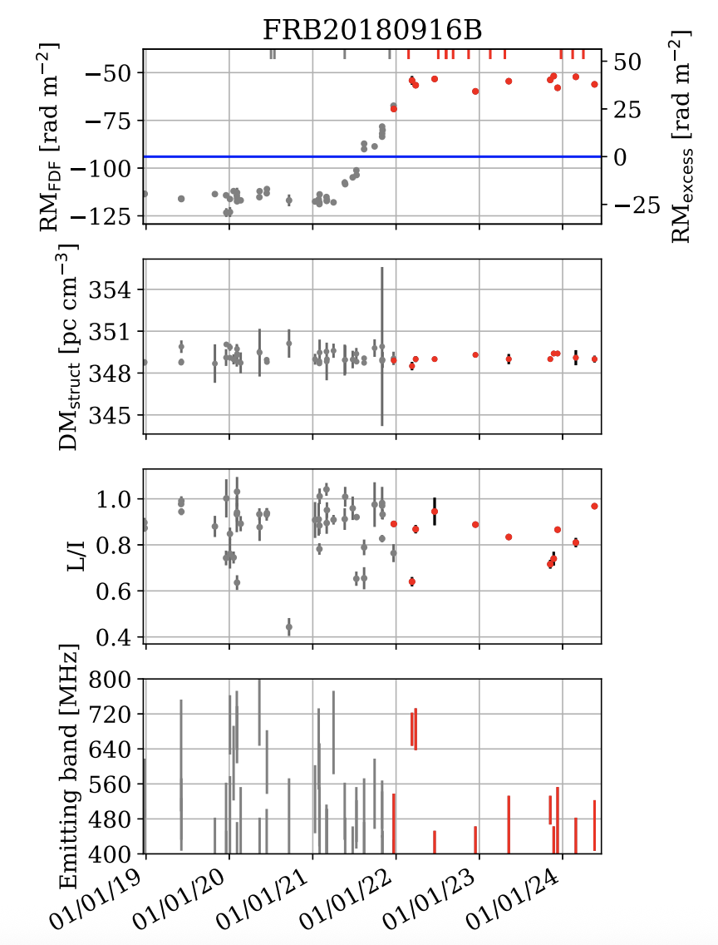
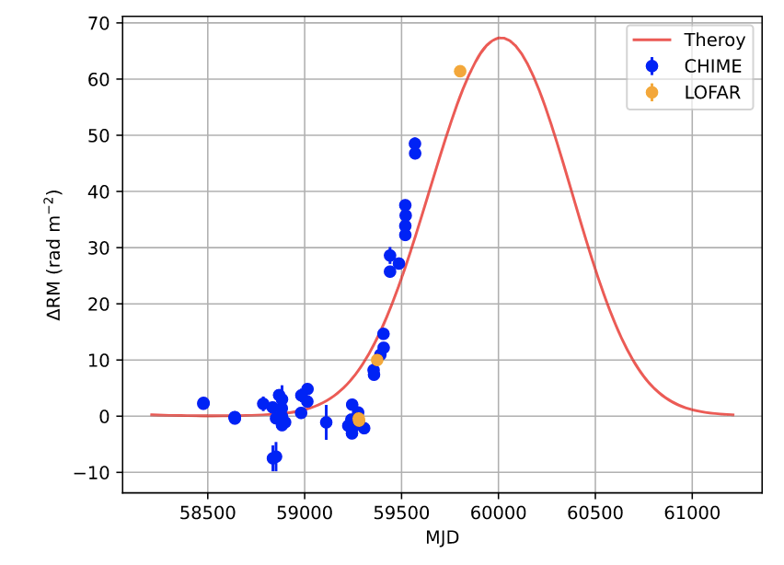
Ng et al. (2025)
FRB 20180916B
Zhao et al., 2023, ApJ;
Lan, Zhao, Wei, Wang, 2024, ApJL
Notes:
We also attempted to model the RM evolution of FRB 20180916B. Here are the fitting results based on the earlier data. Our model predicts the RM should either turn over or reverse. But here’s the latest data of CHIME: after rising for about a year, the RM is now become stable. If upcoming observations of other telescope show no turnover or reversal, the binary scenario might be ruled out for this FRB

Slide 10
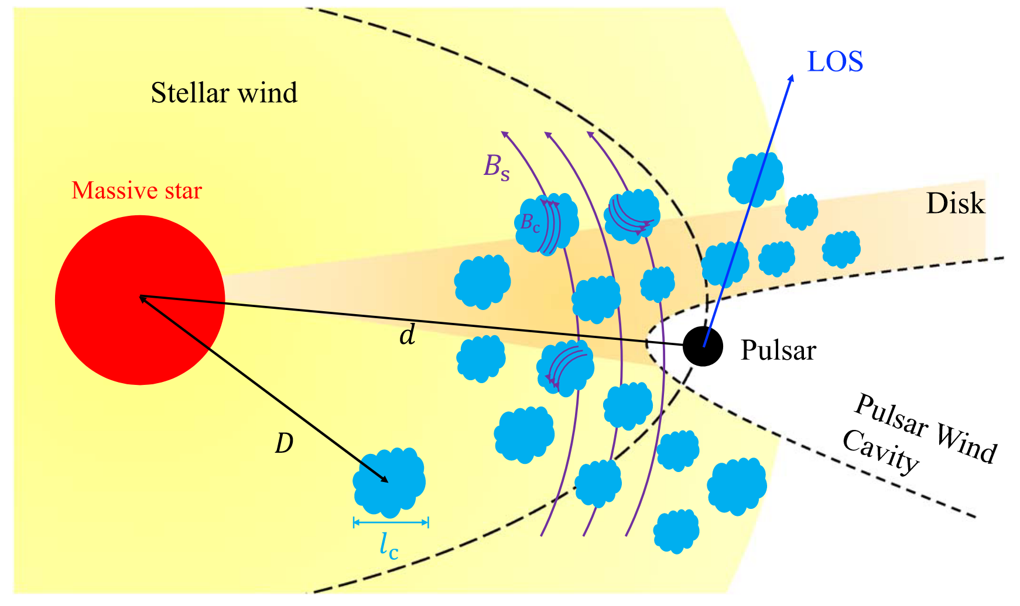
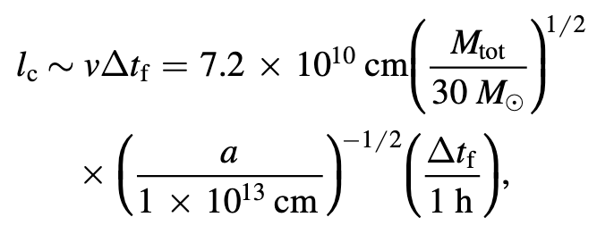
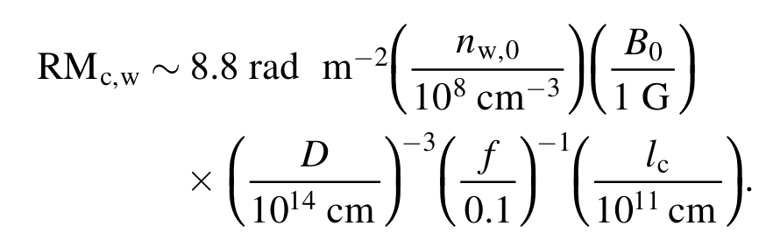
Clumps
The size of the clumps can be estimated from the duration of X-ray flares
Random RM change
Zhao et al., 2023, ApJ;
filling factor f ∼ 0.1 (Puls et al. 2006)
10
Notes:
the stellar wind or disk are found to be clumpy from observations. The size of the clumps can be estimated from the duration of X-ray flares of the Be star binary system. For the several hours’ duration X-ray flares, the size is about ten to the eleventh cm. The random RM variations caused by the clumps in the stellar wind is about 8 rad m-2. The clumps enhance the density by a factor of 1/f compared to the smooth stellar outflows, with f being the filling factor. From observations, the filling factor of the stellar wind is f ∼ 0.1.

Slide 11
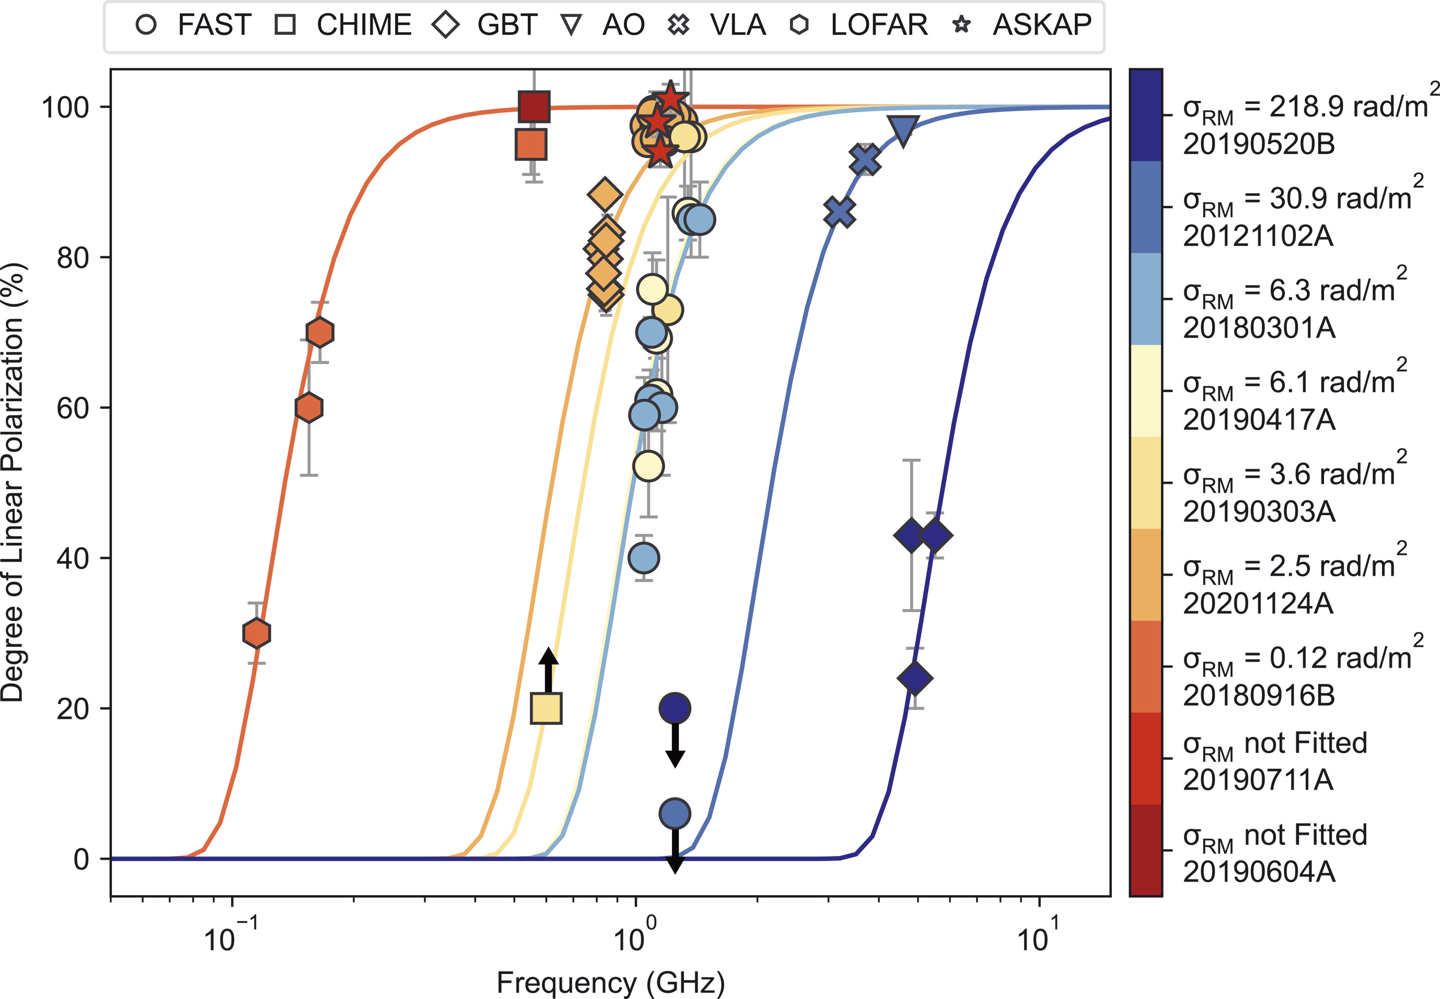
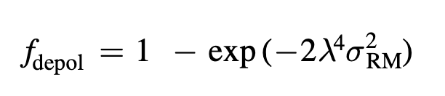
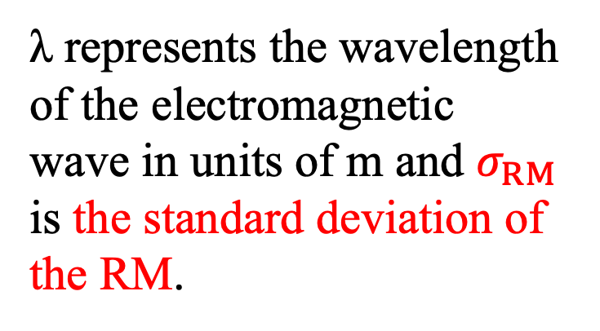
Depolarization
RM scatters
λ represents the wavelength of the electromagnetic wave in units of m and $σ_{RM}$ is the standard deviation of the RM.
Feng et al. (2022)
11
Notes:
RM scatters will also cause depolarization. λ is the wavelength of the electromagnetic wave in units of meter and σ_RM is the standard deviation of the RM. This is the depolarization fitting results for some repeating frbs.

Slide 12
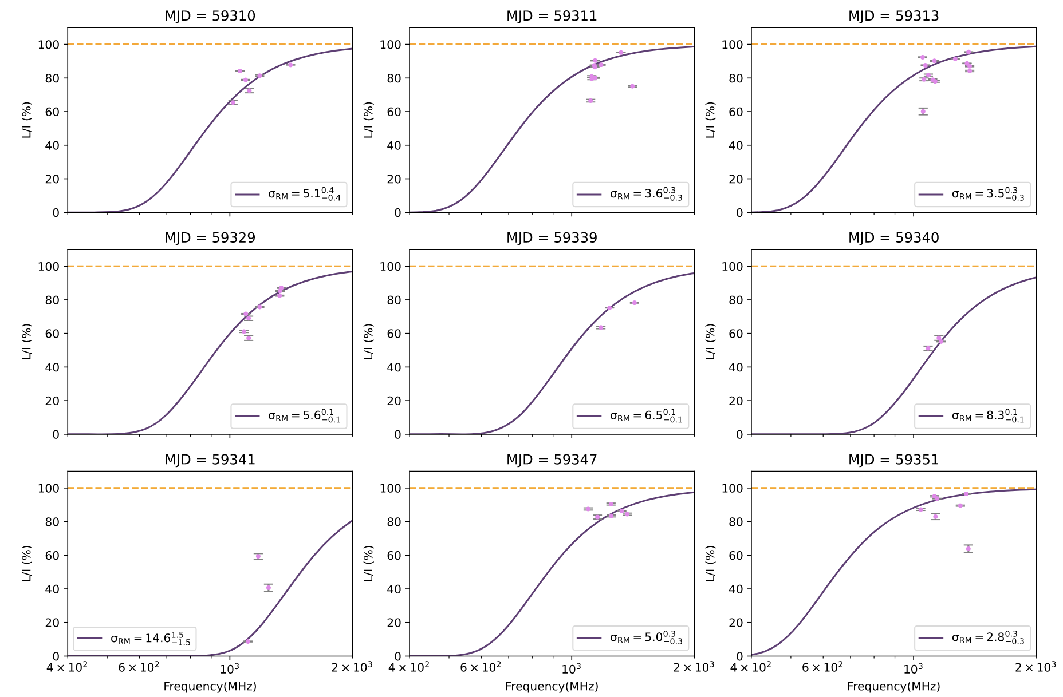
FRB 20201124A
Filtering the narrow-banded bursts (～700 bursts) in Xu et al. (2022, 1863 bursts)
Depolarization fitting day-by-day
Temporal evolution
Lu et al. (2023)
12
Notes:
We studied the temporal evolution of sigma_RM for the repeating FRB 20201124A. First, we selected about 700 narrow-banded bursts from the original sample of 1,863 bursts in Xu and others (2022). Then, we did depolarization fitting for each day’s data to track how sigma_RM evolves over time.

Slide 13
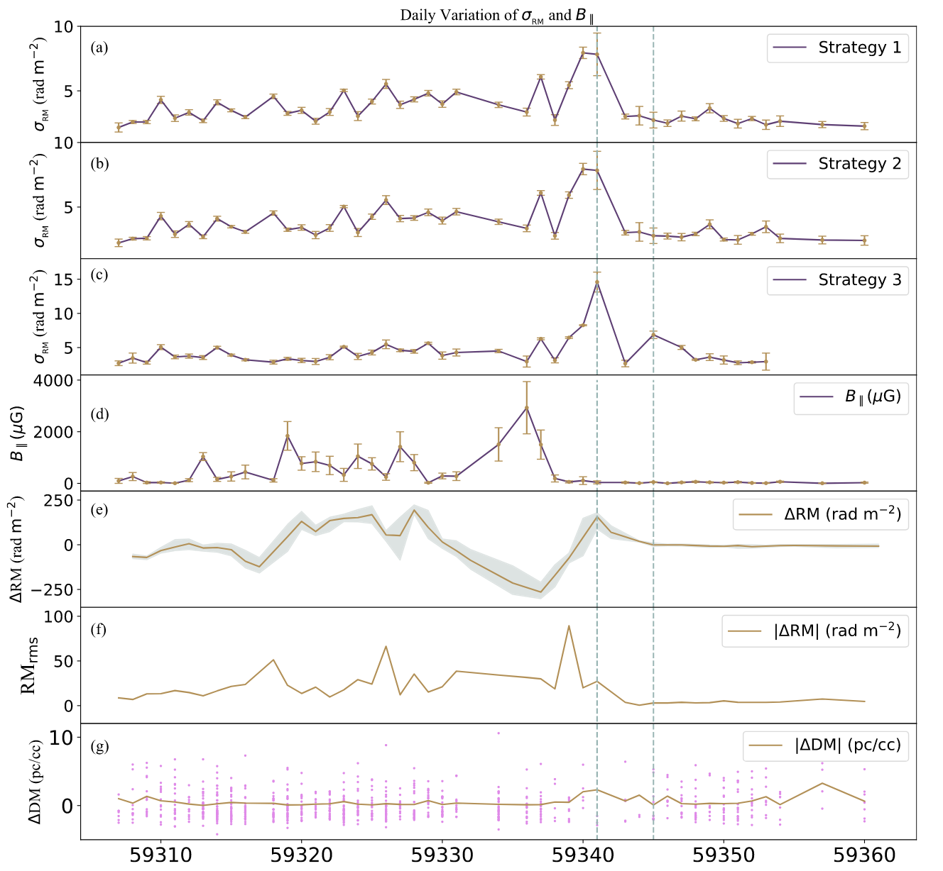
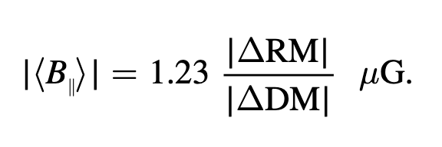
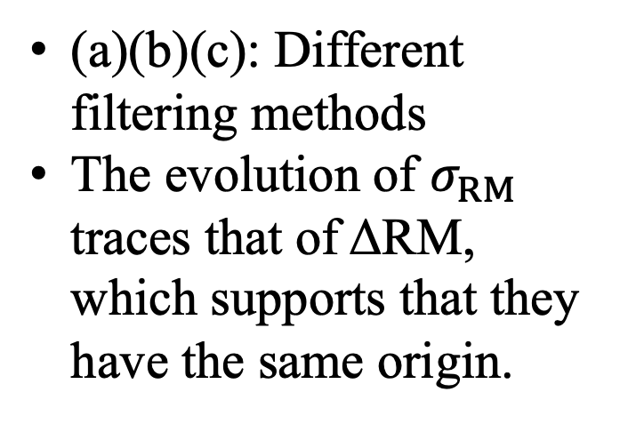
Temporal evolution
Evolution of B-field line-of-sight
(a)(b)(c): Different filtering methods
The evolution of $σ_{RM}$ traces that of ΔRM, which supports that they have the same origin.
Lu et al. (2023)
13
Notes:
This figure shows temporal evolution of the parallel magnetic field and sigma_RM. The panel (a), (b), and (c) compare three different filtering methods we used. The evolution of σ_RM traces that of ΔRM, which supports that they have the same origin.

Slide 14
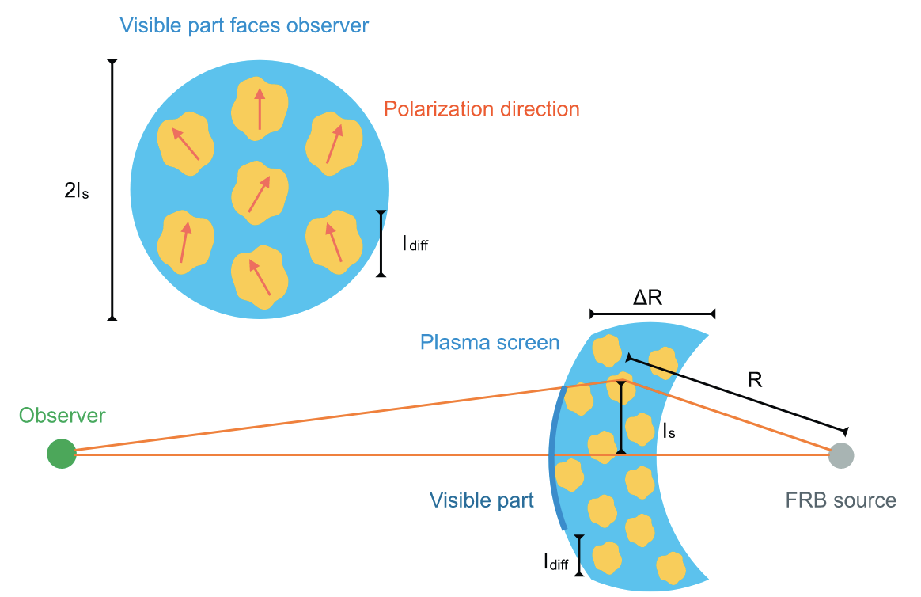
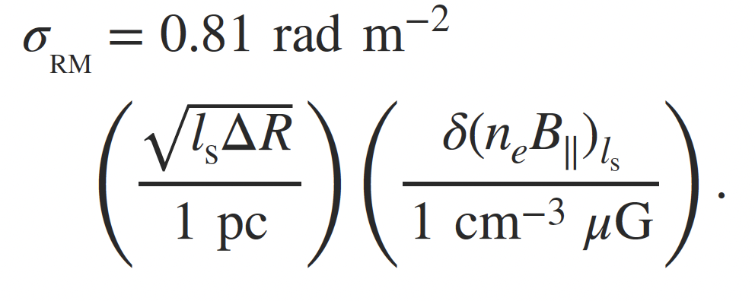

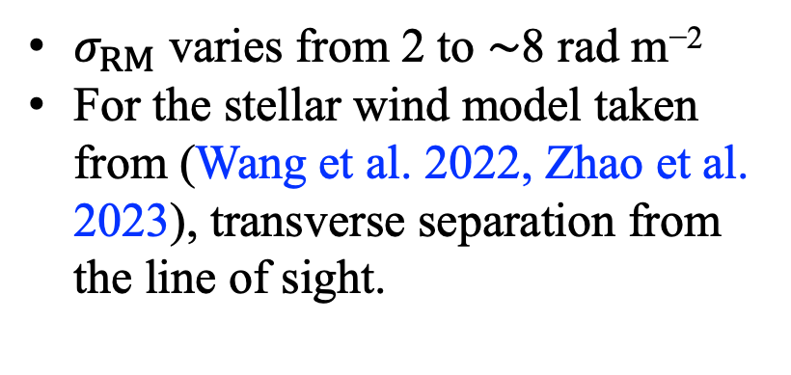
Depolarization
$σ_{RM}$ varies from 2 to ∼8 rad m⁻²
For the stellar wind model taken from (Wang et al. 2022, Zhao et al. 2023), transverse separation from the line of sight.
$$ls\sim 1.2×{10}^{10}−1.9×{10}^{11} cm$$
Yang et al. (2022)
14
Notes:
Yang and others (twenty twenty-two) estimated the value of sigma_RM contributed by the screen as, delta R is the thickness of the screen, ls is transverse separation from the line of sight. Our fitting sigma_RM varies from 2 to ∼8 rad m⁻² . For the stellar wind model taken from our previous work，ls is about ten to the tenth to ten to the eleventh cm. The result is also comparable with the size of the clumps in the stellar wind.

Slide 15
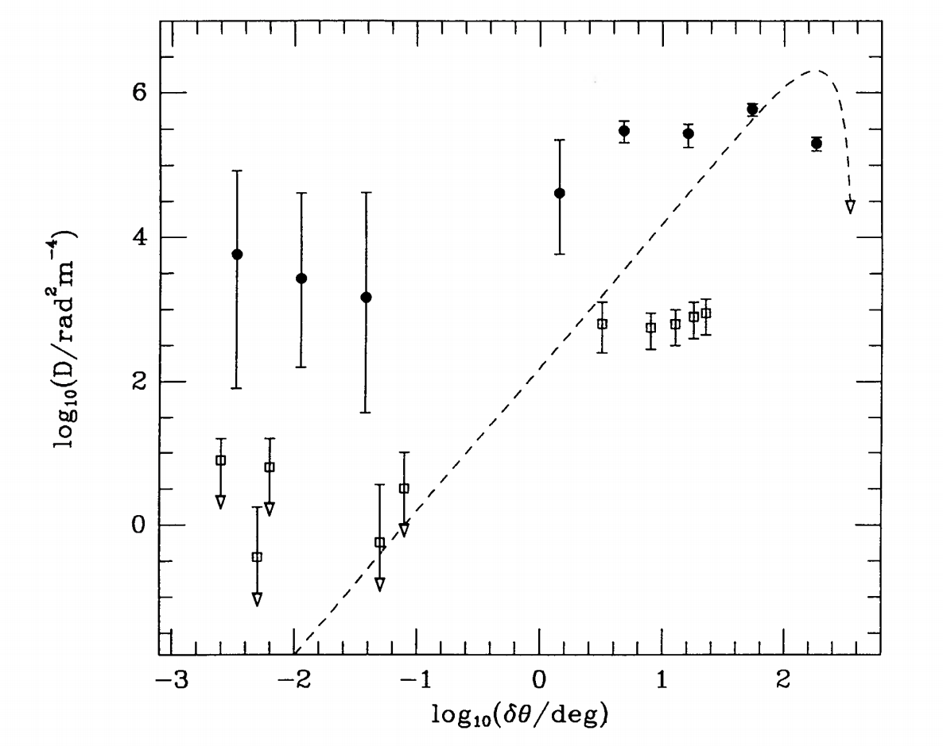
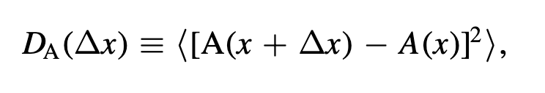
Structure function
SF (Structure function)
Statistical component D_{s}: The stochastic fluctuations in free electron density and magnetic field
Geometrical component D_{g} : At large spatial separations, the SF of a source traveling in an extended homogeneous medium with an ordered magnetic field
Clegg et al. (1992)
15
Notes:
The next section is about SF. Here is the SF’s definition of an observational quantity A(x). The right figure is the spatial structure function diagram of 56 extragalactic radio sources. We can see that within a small spatial distance, the structure function tends to a constant value, and within a large spatial distance, there will be a significant increase. The author believe that the random fluctuations of the electron density and the magnetic field contribute to the statistical term Ds. For a large spatial distance, the structure function ​​at different angles are contributed by the geometric term.

Slide 16
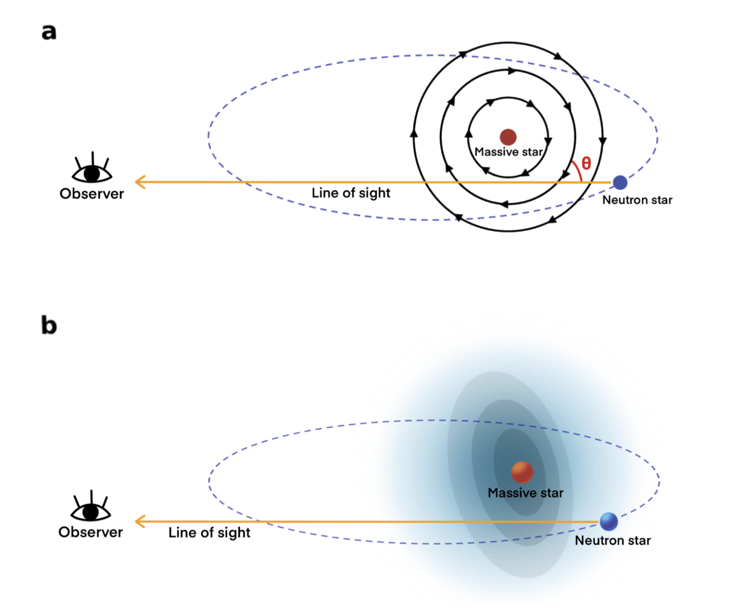
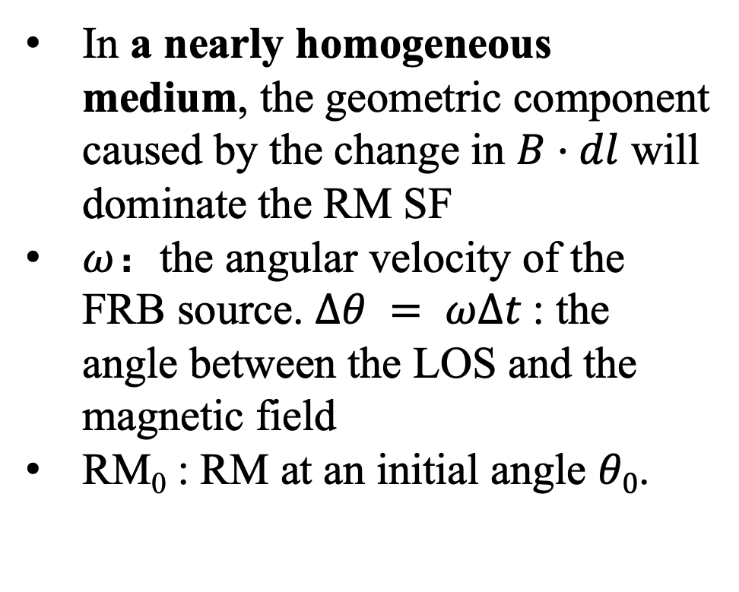
D_{g} in binary system
Li et al., (2025)
In a nearly homogeneous medium, the geometric component caused by the change in $B·dl$ will dominate the RM SF
$ω$：the angular velocity of the FRB source. $∆θ = ω∆t$: the angle between the LOS and the magnetic field
RM₀ : RM at an initial angle $θ0$.
16
Notes:
Next we will give the geometric term in the binary system. In a nearly homogeneous medium, the geometric component caused by the change in B along LOS will dominate the RM SF. We assume ω is the angular velocity of the FRB source, and ∆θ = ω∆t is the angle between the LOS and the magnetic field. RM0 is RM at an initial angle θ₀.

Slide 17
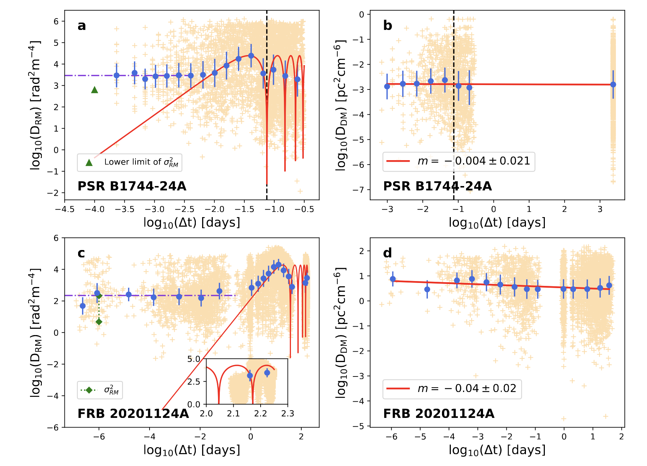
Results
Li et al., (2025)
Orbital period P ~1.8 h
Statistical component Ds = 2927.14 rad² m⁻⁴
Power-law index: −0.004 ± 0.021
Orbital period P = 37 ± 1 d
Statistical component Ds = 221.88 rad² m⁻⁴
Power-law index: −0.04 ± 0.02
17
Notes:
This figure shows the structure function results of Rotation Measure and Dispersion Measure for the binary system PSR B1744 and FRB 20201124A. At small time lags, the geometric term contributes weakly, and the SF is dominated by a time-independent statistic term, whose value closely matches sigma_RM. At larger time lags, the geometric term dominates the RM structure function. The red curve represents the fitting result based on the geometric term discussed earlier. For Binary pulsar B1744, the orbital period derived from the geometric term fitting is very close to its known orbital period of 1.8 hours.

Slide 18
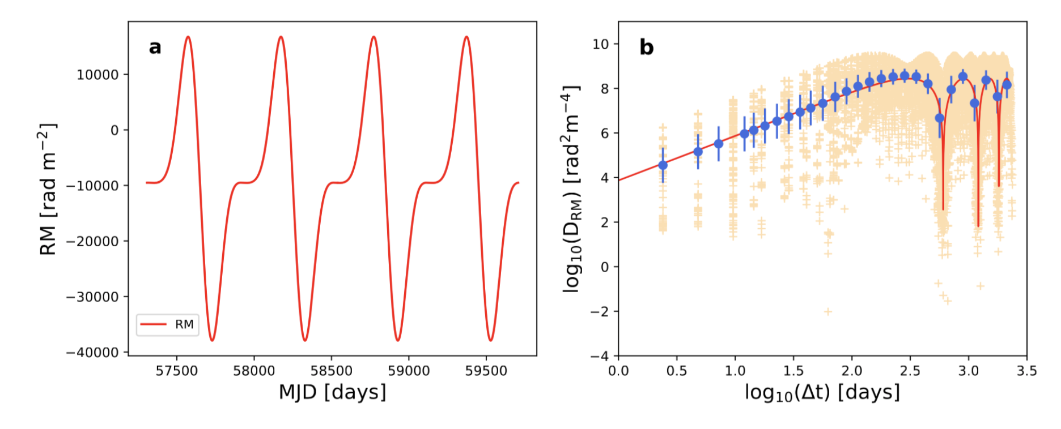
P = 600 days
P = 605 ± 3 days
Li et al., (2025)
Test the geometric component using simulations
18
Notes:
To check if the RM evolution of FRB in binary systems follows our geometric model’s predictions, we ran simulations over four orbital cycles using the binary RM evolution model described earlier. The parameters are the same as the RM fitting results of FRB 20190520B, and the period is about 600 days. The resulting SF shows geometric term perfectly and clear oscillations. The period obtained from the fitting results of SF is also around 600 days. Since we didn’t add any random noise in the simulation, the SF has no statistic term, which is exactly what we expected.

Slide 19
FRBs in Binary system
RM scatters ($σ_{RM}$)
SF: Statistical component D_{s}
RM scatters (𝜎_RM)
SF: Statistical component D_{s}
RM: Long-term evolution
SF: Geometrical component D_{g}
RM: periodic
SF: periodic oscillations
$$t\sim P$$
Timescale
$$t≪P$$
$$t\sim N∙P$$
can be tested by future observations
References: Wang et al., 2022, Nature Communications; Zhao et al., 2023, ApJ; Lu, Zhao, et al., 2023 ApJL; Lan, Zhao et al., 2024, ApJL; Li, Zhao et al., 2025, ApJL

