Slide 1

Neutron Stars, Quark Stars and the High-Density Symmetry Energy in the Multi-Messenger Era
Lie-Wen Chen (陈列文)
School of Physics and Astronomy, Shanghai Jiao Tong University, China
The Symmetry Energy (Esym) – Nuclear Matter EOS
Neutron Star verses Quark Star – Multi-Messenger Data + Nuclear Physics
High Density Behavior of Esym
Conclusions
The 4th workshop on quarks and compact stars (QCS2023)
Yangzhou University, Yangzhou, China, September 24, 2023

Slide 2
Outline
The Symmetry Energy (Esym) – Nuclear Matter EOS
Neutron Star verses Quark Star – Multi-Messenger Data + Nuclear Physics
High Density Behavior of Esym
Conclusions

Slide 3
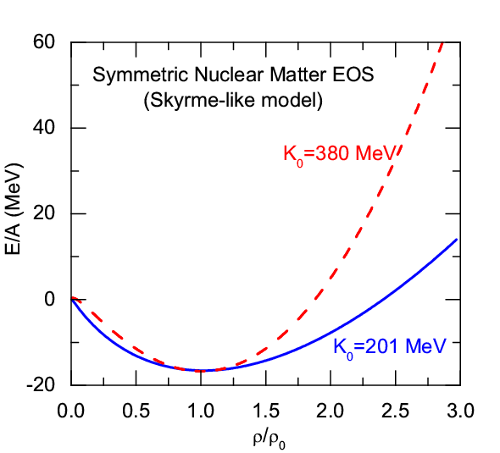
The Symmetry Energy of Nuclear Matter
EOS of Isospin Asymmetric Nuclear Matter
(Parabolic law)
Symmetric Nuclear Matter
(relatively well-determined)
Isospin asymmetry
Symmetry energy term (largely uncertain)
Nuclear Matter Symmetry Energy
LWC, EPJ Web of Conf. 88, 00017 (2015)
While the EOS of symmetric nuclear matter is relatively well determined, the density dependence of the symmetry energy is still largely uncertain!
Determining the density dependence of the symmetry energy has been one of the main scientific goals in large-scale scientific facilities, e.g., CSR/HIAF in China、RIBF/RIKEN in Japan、FRIB/MSU in USA, FAIR/GSI in Germany, RAON in South Korea, …
p. 1

Slide 4
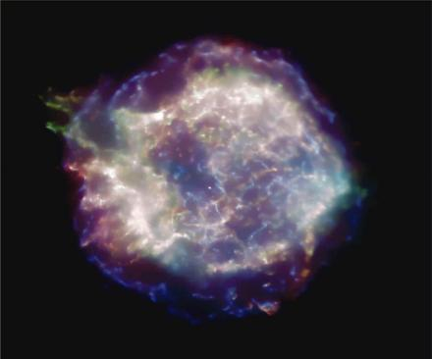
The Symmetry Energy of Nuclear Matter
Where does the symmetry energy play an important role?
Nucleus
HIC
Supernova
NStar
NStar Merger
p. 2

Slide 5
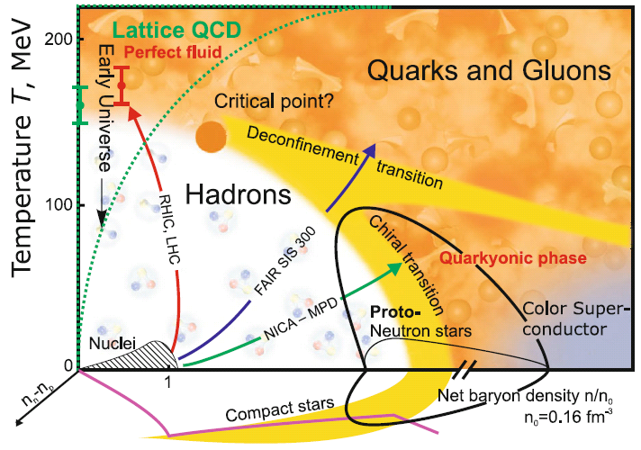

QCD Phase Diagram
V.E. Fortov, Extreme States of Matter – on Earth and in the Cosmos, Springer-Verlag, 2011
Probing QCD phase diagram in Nuclei and Heavy Ion Collisions in terrestrial labs
and in SN, Nstar and NS Merger in heaven?
Nuclei
HIC
SN
NStar
NS Merger
NS Mergers/NStar/CCSNe:
Ideal and unique site to probe QCD phase diagram at low T and high densities (and large isospin )!
Quark Matter Symmetry Energy?
Small baryon chemical potential:
Smooth Crossover Transition
Large baryon chemical potential:
First-order Phase Transition
QCD Critical Endpoint (CEP):
where the first-order phase transition ends
M. Di Toro et al., NPA775 (2006); P.C. Chu (初鹏程)/LWC, ApJ780 (2014); LWC, Nuclear Physics Review 34, 20 (2017) [arXiv:1708.04433]
p. 3

Slide 6
EOS of Symmetric Nuclear Matter
Current status of the EOS of SNM:
W.G. Lynch et al.,
PPNP 62, 427 (2009)
S. Huth et al.,
Nature 606, 276 (2022)
Around ρ_{0:} K₀=240±20 MeV from GMR [U. Garg and G. Colo, PPNP101, 55 (2018)]
1ρ₀< ρ < 3ρ₀ from K⁺ production in HIC’s. An educated guess [C. Fuchs, PPNP 56, 1 (2006)]
1ρ₀< ρ < 2.5ρ₀ from elliptic flow data in HIC’s from FOPI. [A. Le Fevre, NPA 945, 112 (2016)]
2ρ₀< ρ < 5ρ₀ using flow data from BEVALAC, SIS/GSI and AGS [P. Danielewicz et al., Science 298, 1592 (2002)]
N2LO
N3LO
68% C.L.
The EOS of Symmetric NM has been relatively well constrained!
(~Soft EOS of SNM at high densities)
p. 4

Slide 7
Esym: Many-Body Approaches
The nuclear matter EOS cannot be measured experimentally, its determination thus depends on theoretical approaches
Microscopic Many-Body Approaches
Non-relativistic Brueckner-Bethe-Goldstone (BBG) Theory
Relativistic Dirac-Brueckner-Hartree-Fock (DBHF) approach
Self-Consistent Green’s Function (SCGF) Theory
Variational Many-Body (VMB) approach
Green’s Function Monte Carlo Calculation
V_{lowk} + Renormalization Group
Nuclear Lattice Approach
Effective Field Theory
Density Functional Theory (DFT)
Chiral Perturbation Theory (ChPT)
QCD-based theory
Phenomenological Approaches
Relativistic mean-field (RMF) theory
Quark Meson Coupling (QMC) Model
Relativistic Hartree-Fock (RHF)
Non-relativistic Hartree-Fock (Skyrme-Hartree-Fock)
Thomas-Fermi (TF) approximations
p. 5

Slide 8
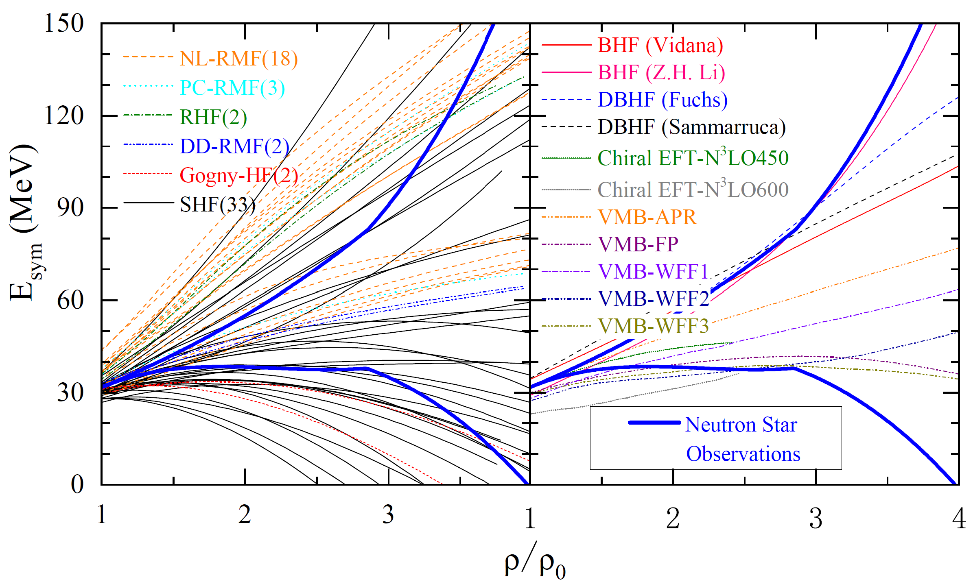
Esym: Many-Body Approaches
L.W. Chen,
Nucl. Phys. Rev. (原子核物理评论) 34, 20 (2017)
[arXiv:1708.04433]
B.A. Li, B.J. Cai, W.J. Xie, and N.B. Zhang,
Universe 7, 182 (2021)
[arXiv:2105.04629]
p. 6
Notes:
8

Slide 9
Esym: Experimental Probes
Promising Probes of the E_{sym}(ρ)
(an incomplete list !)
RHIC-STAR isobaric collisions provide a unique way to determine nuclear neutron skin thickness and thus constrain Esym!
Pigmy/Giant resonances
Nucleon optical potential
B.A. Li, L.W. Chen, C.M. Ko
Phys. Rep. 464, 113(2008)
[arXiv:0804.3580] (Citations: 1187+)
p. 7

Slide 10

E_{sym}: Around saturation density
LWC et al., Invited Review/PPNP
58 analyses of terrestrial nuclear experiments and astrophysical observations
E_{sym}(ρ₀) = 31.7±3.1
L = 57.5±24.5 MeV
Similar conclusion has been obtained in:
B. A. Li and X. Han, Phys. Lett. B727, 276 (2013);
M. Oertel, M. Hempel, T. Klahn, and S. Typel, Rev. Mod. Phys. 89, 015007 (2017).
Assuming all the constraints are equally reliable !!!
Very recent PREX-II/CREX data suggest stiff/soft Esym around saturation density，
and strong tension is observed!
p. 8

Slide 11
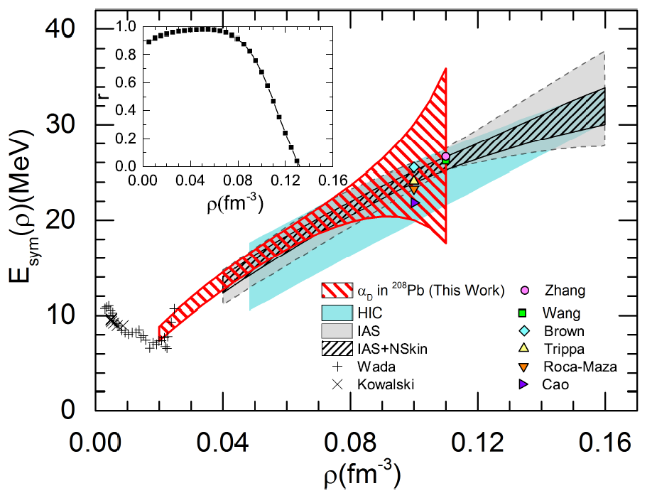
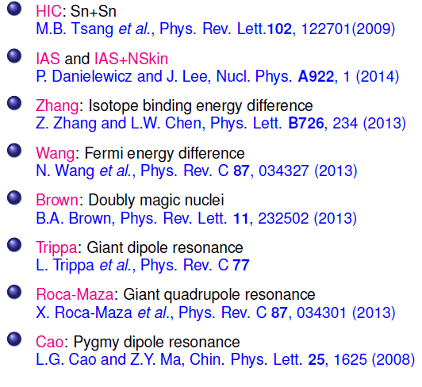

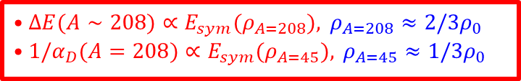
E_{sym}: Subsaturation densities
Z. Zhang (张振) and LWC, PRC92, 031301(R) (2015)
$$•ΔE(A∼208)∝E_{sym}(ρ_{A=208}),​ ρ_{A=208}≈2/3ρ_{0} \\ •1/α_{D}(A=208)∝E_{sym}(ρ_{A=45}),​ ρ_{A=45}≈1/3ρ_{0}$$
$$∼ρ_{0}/3$$
Wada and Kowalski: experimental results of the symmetry energies at densities below 0.2$ρ_{0}$ and temperatures in the range 3 ~11 MeV from the analysis of cluster formation in heavy ion collisions.
Wada et al., Phys. Rev. C85, (2012) 064618; Kowlski et al., Phys. Rev. C75, (2007) 014601. Natowitz et al., Phys. Rev. Lett. 104, (2010) 202501.
p. 9

Slide 12
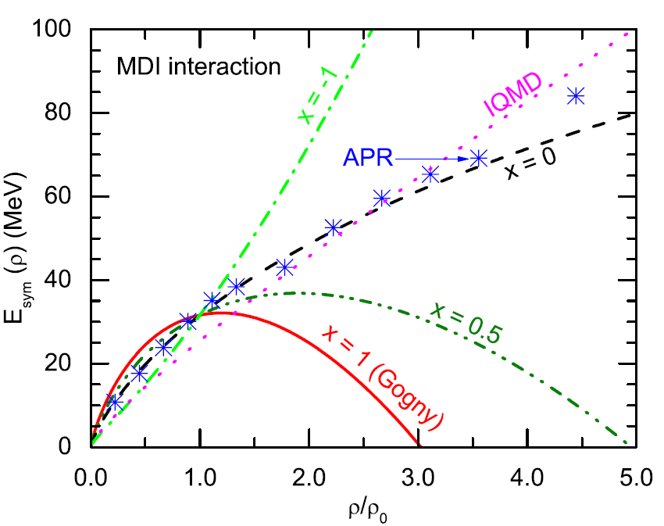
E_{sym}：Supra-saturation density
A Soft or Stiff Esym at supra-saturation densities ???
pion ratio (FOPI): ImIQMD, Feng/Jin, PLB683, 140(2010)
Tong-Gang Yue (岳侗钢)， LWC, Z. Zhang (张振), and Y. Zhou (周颖), PRReseach 4, L022054(22)
Stiffer
n/p v2 (FOPI):
Russotto/Trauntmann/Li et al.,
PLB697, 471(2011) (UrQMD)
PRC94, 034608 (2016)
PREX-II
Cozma/Trauntmann/Li et al.,
PRC88, 044912 (2013) (Tubingen QMD - MDI)
Softer
pion ratio (FOPI):
IBUU04, Xiao/Li/Chen/Yong/Zhang, PRL102,062502(2009)
ImIBLE, Xie/Su/Zhu/Zhang, PLB718,1510(2013)
B.A.Li, B.J. Cai, W.J. Xie, and N.B. Zhang, Universe 7, 187 (2021)
p. 10

Slide 13
Outline
The Symmetry Energy (Esym) – Nuclear Matter EOS
Neutron Star verses Quark Star – Multi-Messenger Data + Nuclear Physics
High Density Behavior of Esym
Conclusions

Slide 14
Multimessenger era: GW170817
arXiv:1710.05832
Citations: 7252+
On August 17, 2017, the merger of two neutron stars was observed with gravitational waves (GW) by the LIGO and Virgo detectors.
The Fermi and Integral spacecrafts independently detected a short gamma ray burst.
Extensive follow up observations detected this event at X-ray, ultra-violet, visible, infrared, and radio wavelengths.
No ultra-high-energy gamma-rays and no neutrino candidates consistent with the source were found in follow-up searches. These observations support the hypothesis that GW170817 was produced by the merger of two neutron stars in NGC 4993 followed by a short gamma-ray burst (GRB 170817A) and a kilonova/macronova powered by the radioactive decay of r-process nuclei synthesized in the ejecta
LIGO/Virgo/KAGRA:
2023(O4)，Binary NStar Merger events：2~20 pere year [A. Colombo et al., ApJ937, 79 (2022)]
p. 11

Slide 15
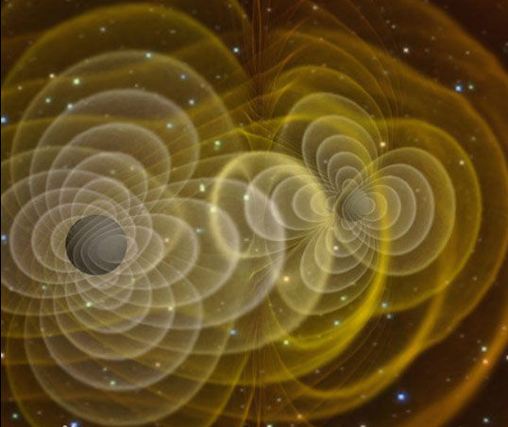
Tidal Deformability
Tidal Deformability (Polarizability)
(oscillation response coefficient λ )
Q_{ij}: Quadrupole moment
ε_{ij}: Tidal field of companion
k₂: Love number
R: Radius
M: Mass
Éanna É. Flanagan and Tanja Hinderer, Phys.Rev.D 77, 021502(R) (2008)
p. 12

Slide 16
Tidal Deformability
Merging neutron stars
Two inspiralling neutron stars
Single mass
Tidal deformation
Inspiral Chirp signal
NS oscillation/BH formation
LIGO is sensitive to increase in orbital frequency as system loses energy to both gravitational waves and internal excitation of neutron stars. GW170817 data place limits on polarizability (deformability) Λ of NS and hence limits on NS radius.
p. 13

Slide 17
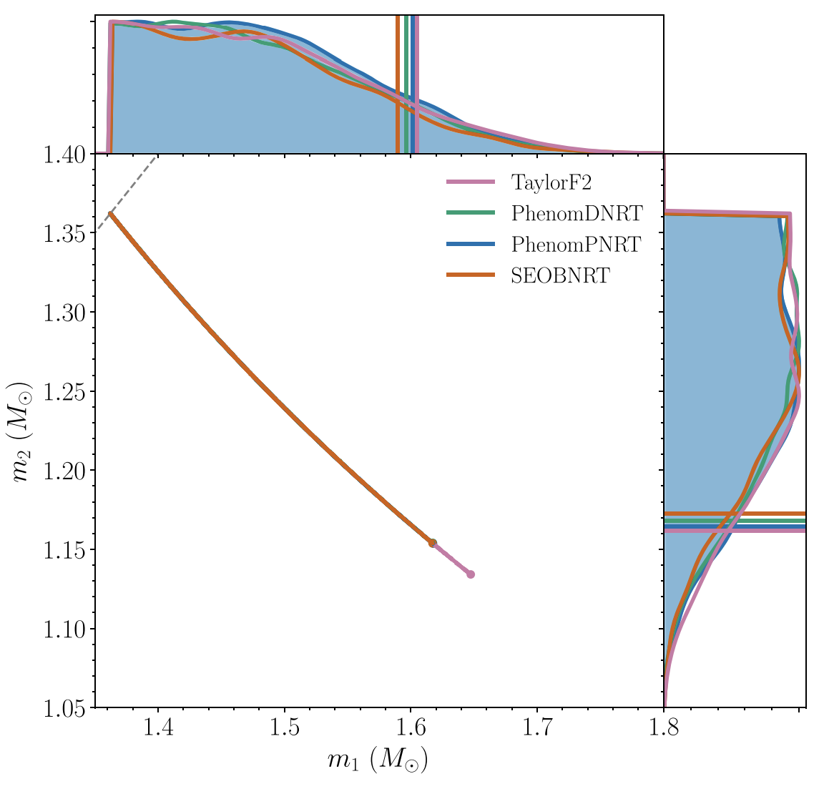
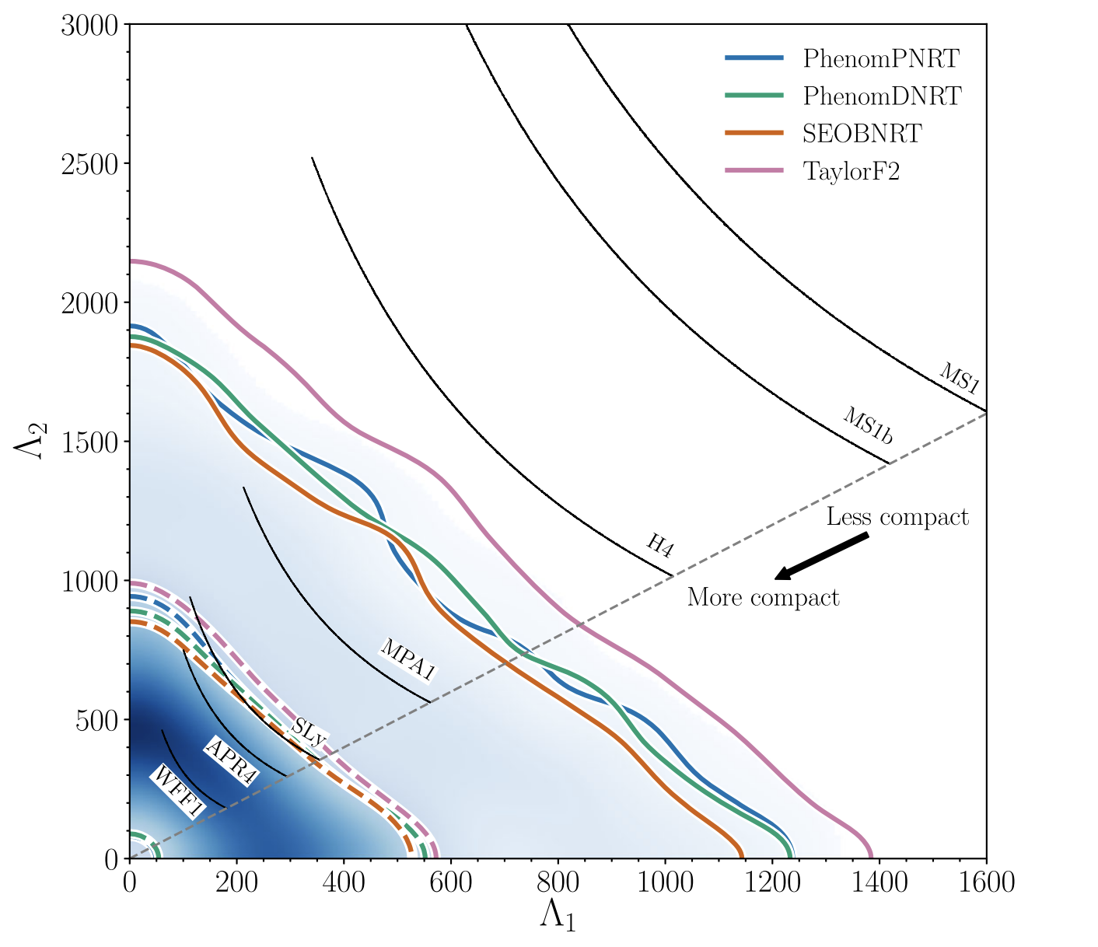


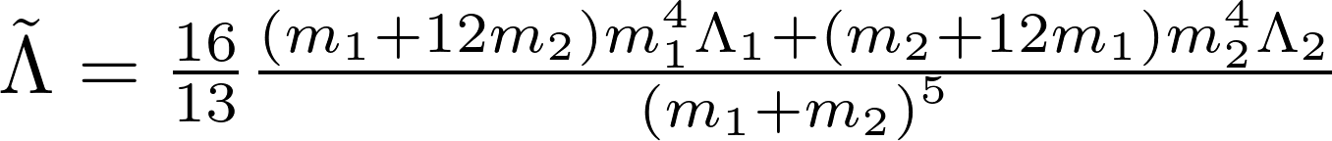
Tidal deformability from GW events
GW170817
GW170817:
GW190425:
B. P. Abbott et al., PRX, 2019
p. 14

Slide 18
Heavy NStars with M~2M_{ʘ}
solar mass
p. 15

Slide 19
Heavy NStars with M~2M_{ʘ}
Heaviest Nstar observed so far with
precise mass from radio-timing observation
p. 16

Slide 20
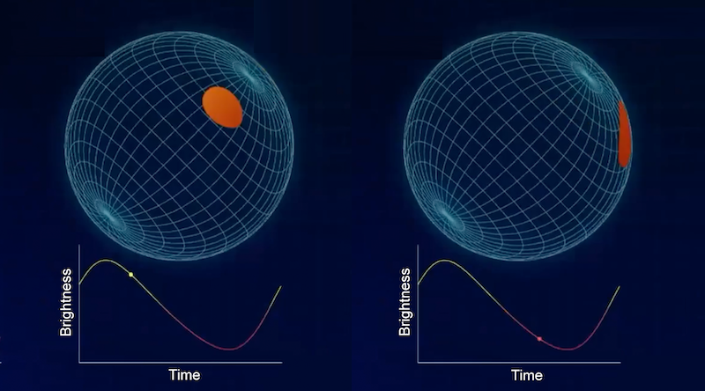
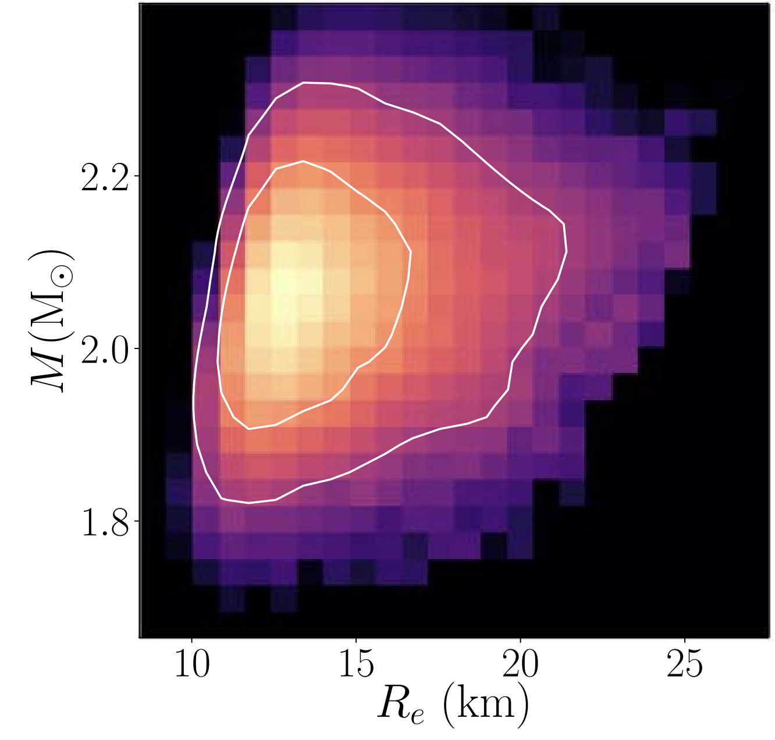
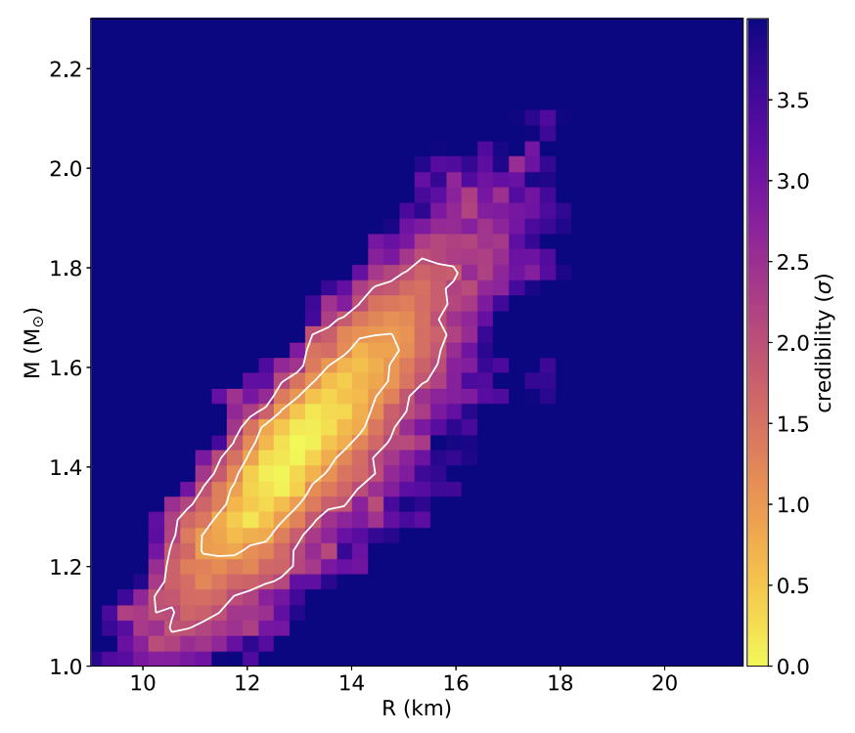
NICER: Mass-Radius Measurement
https://physics.aps.org/articles/v14/64
Miller et al., ApJL, 2021
Miller et al., ApJL, 2019
NICER:
Neutron star Interior Composition ExploreR
tracking the x-ray emission from “hot spots”
Posterior samples are publicly available!
Likelihood of
mass-radius measurements
p. 17

Slide 21
Pulsars: Neutron Stars? Quark Stars? Others?
Composition of Neutron Star Matter
Neutron Stars
F. Weber, PPNP54, 193 (2005)
V.E. Fortov, Extreme States of Matter – on Earth and
in the Cosmos, Springer-Verlag Berlin Heidelberg 2011
Quark Stars
Strangeon Stars
Mass: ~ 1.4 M⊙, Radius: ~ 10 km
Extremely neutron-rich matter
Density at the center: ~ 6ρ₀
Average density: ~ 2.5ρ₀
R. X. Xu and Y.J Gao, arXiv:1601.05607
Bodmer-Witten-Terazawa Conjecture:
the deconfined strange quark matter could be the true ground state of QCD
p. 18

Slide 22
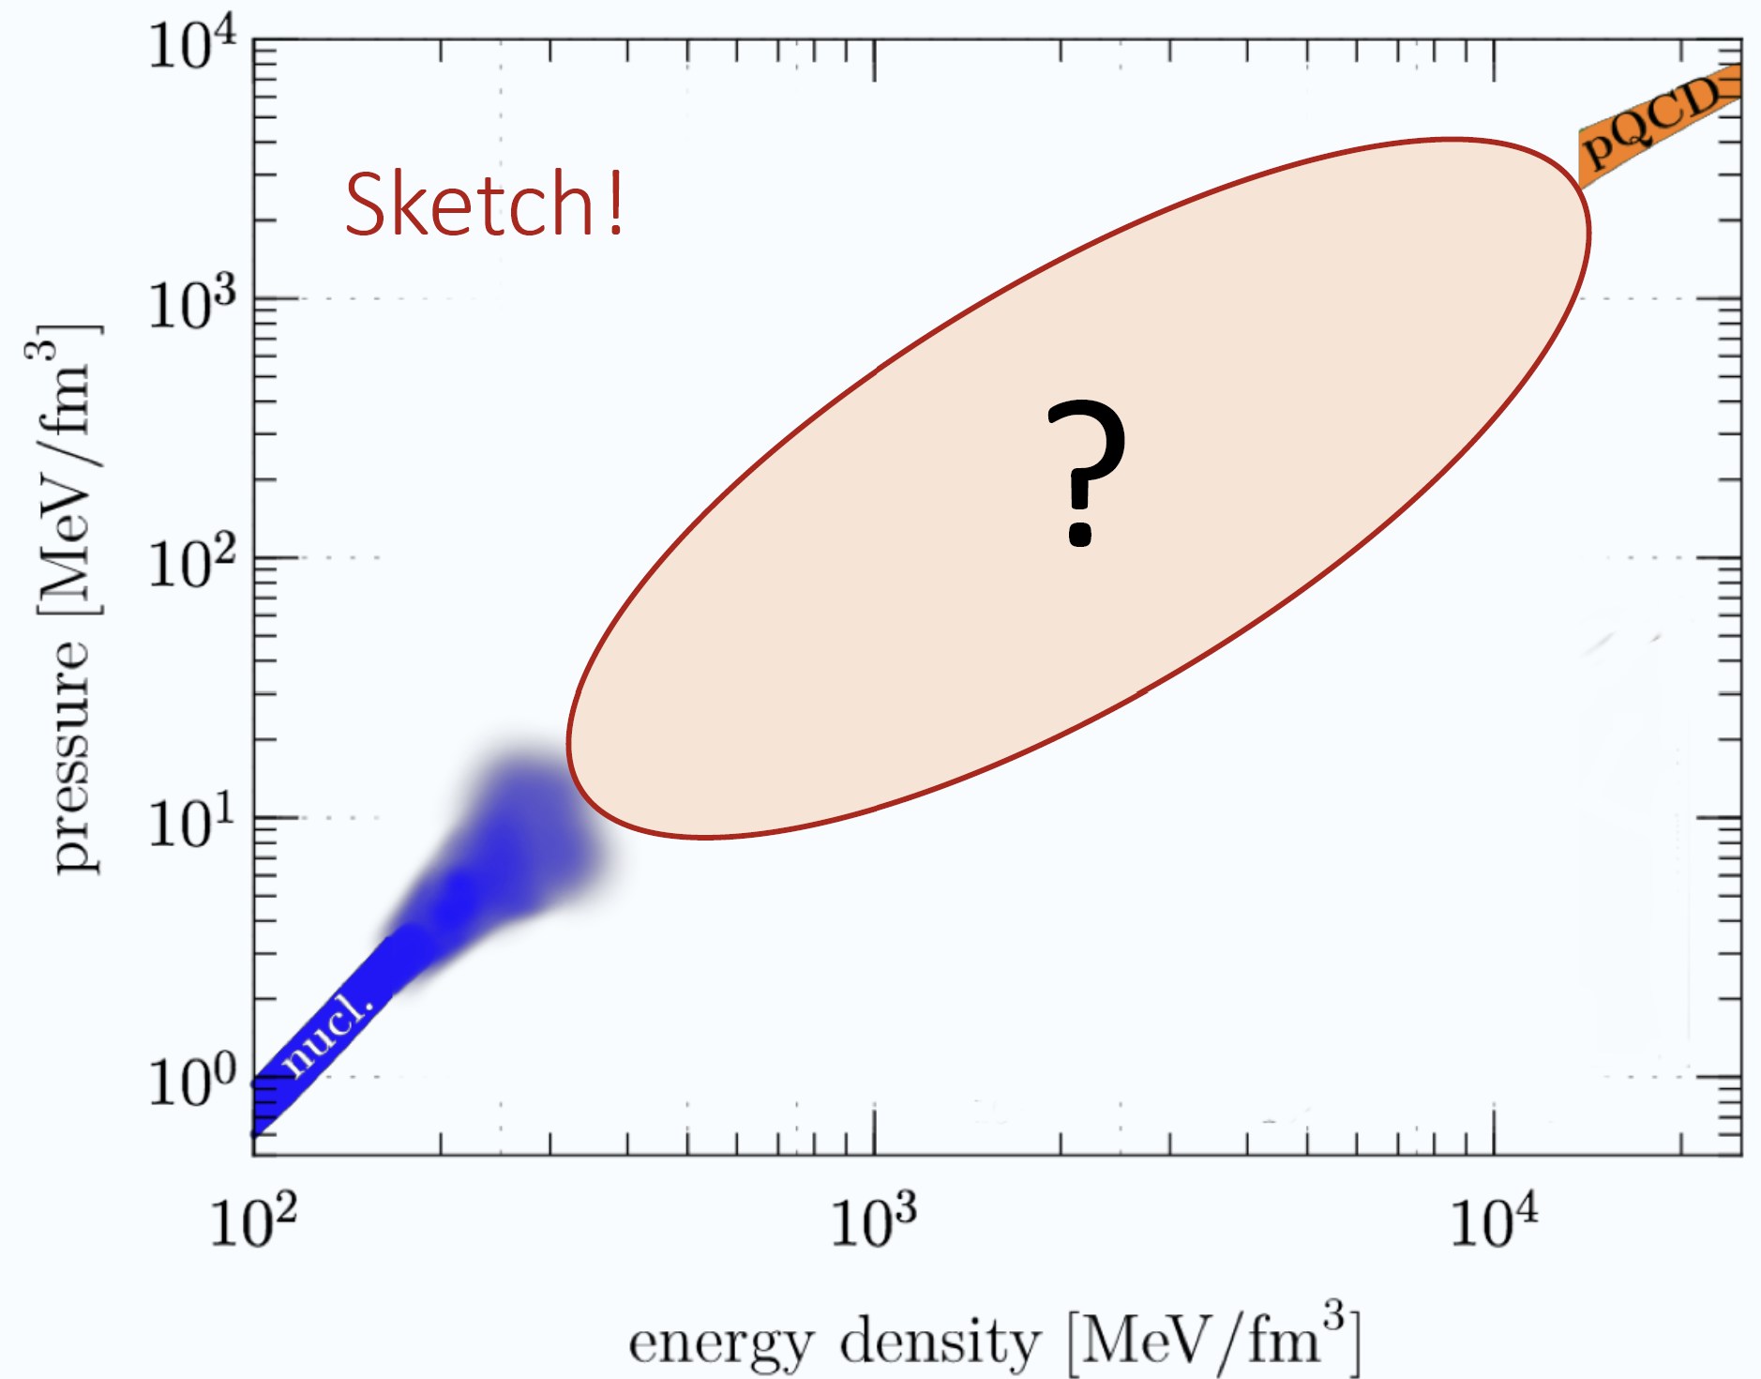


EOS: Bayesian Model-Agnostic Inference？
Zheng Cao (曹政)/LWC,
arXiv:2308.16783
Sound speed extension
to high density to match
pQCD
Ingo Tews
~40n₀
Quark stars (with sharp surface)
(it is self-bound and could contain uds, ud, even strangeons, and has a sharp surface – zero-pressure point at which the E/A < 930 MeV)
<~1n₀
Compact star: <10n₀
I. Tews et al., ApJ860, 149 (2018);
T. Gorda et al., PRL127, 162003(2021)
E. Annala et al., PRX12, 011058(2022)
Neutron stars (with crust)
(its core could contain Hyperons, Condensates, Quark Matter, …)
p. 19

Slide 23

EOS: Bayesian Model-Agnostic Inference？
Neutron Star verses Quark Star
Zheng Cao (曹政)/LWC,
arXiv:2308.16783
Bayesian analyses combining
ChEFT: n<1.1n₀
pQCD: High Densities
Nstar Mmax: ~2M⊙
Nstar MR: NICER
GW: GW170817, GW190425
Annala et al., Nature Phys., 2020
Constraints:
Properties of Neutron star (Quark star) at 90% C.L.:
QSs would have a significantly larger Mmax but smaller canonical radius than the NSs.
For NSs, our result is in nice agreement with the value estimated recently by taking advantage of the various structures sampling by a single layer feed-forward neural network model embedded in the Bayesian nonparametric inference (Han/Huang/Tang/Fan, Sci. Bull. 68, 913 (2023) ), and also many other works
Our conclusions are independent of the detailed realization of the model-agnostic EOSs.
p. 20

Slide 24
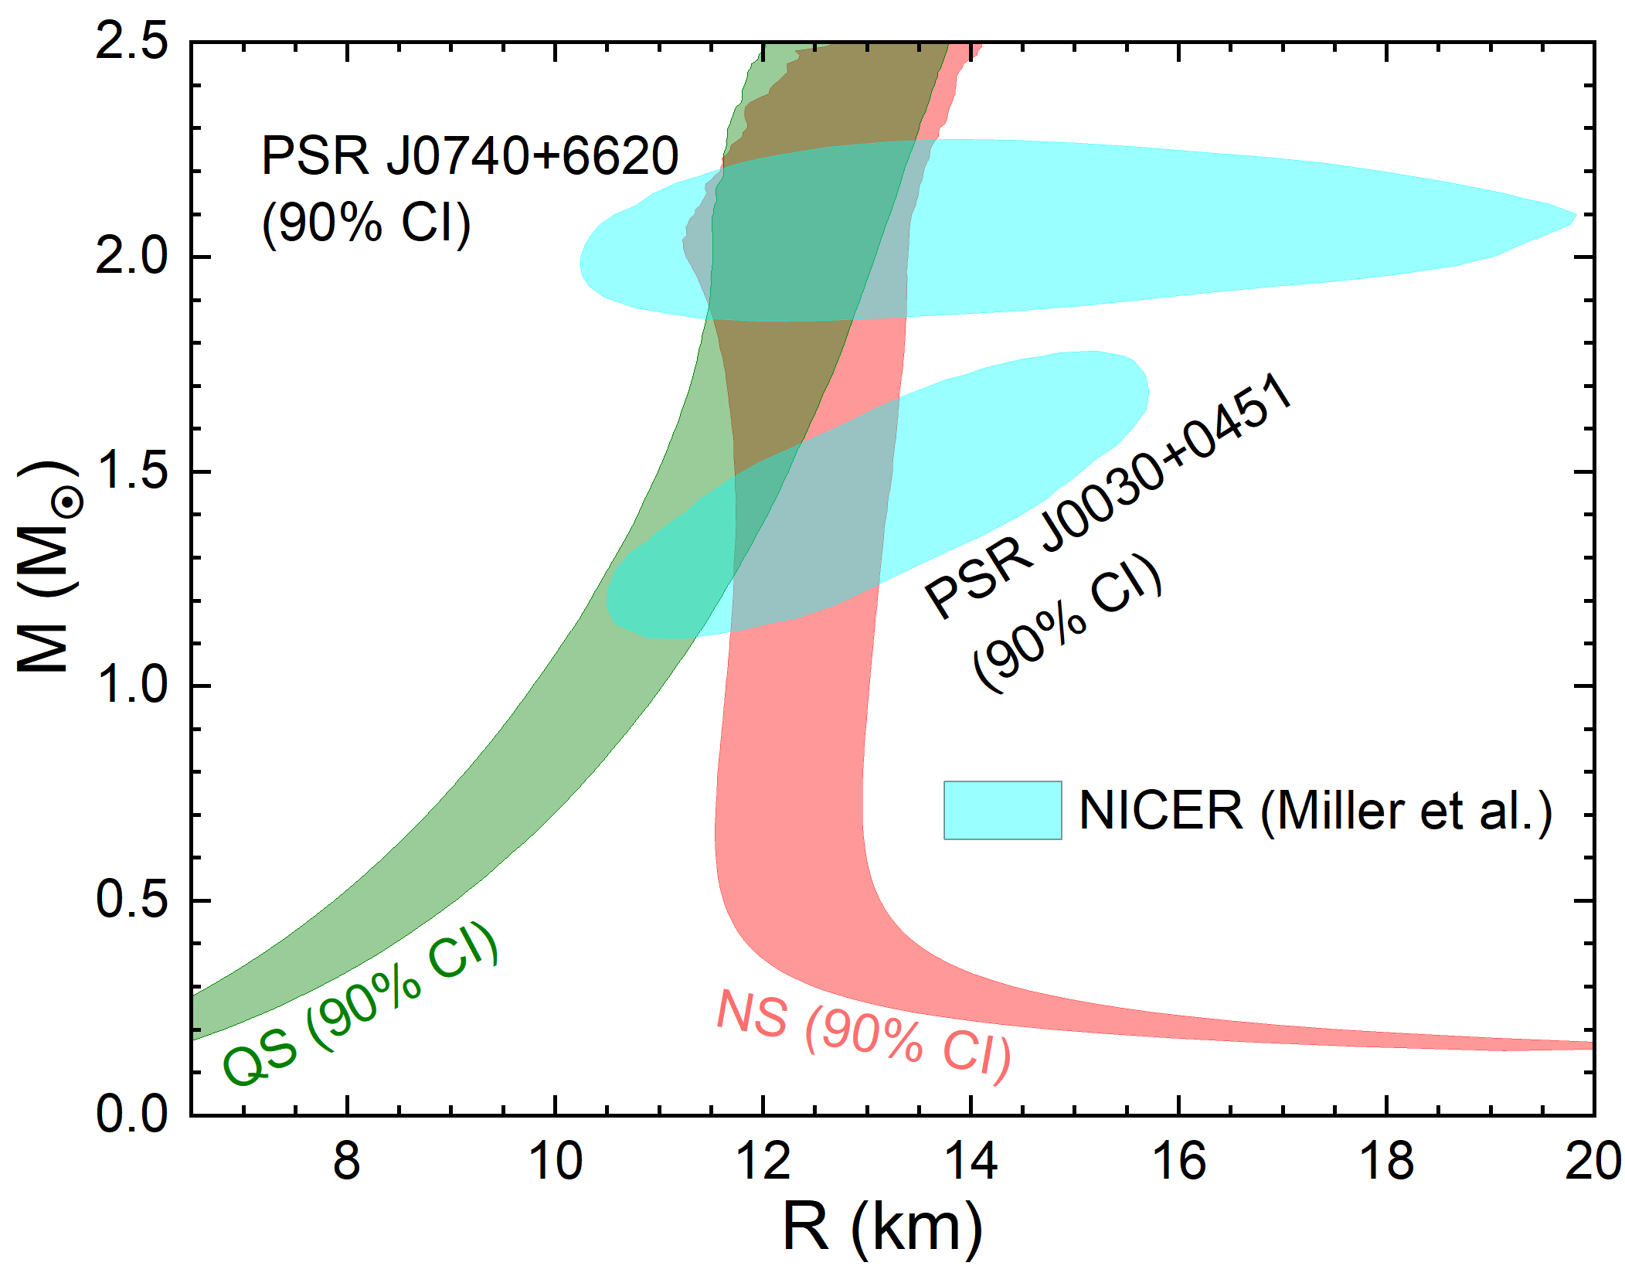

EOS: Bayesian Model-Agnostic Inference？
Zheng Cao (曹政)/LWC,
arXiv:2308.16783
Bayesian analyses combining
ChEFT: n<1.1n₀
pQCD: High Densities
Nstar Mmax: ~2M⊙
Nstar MR: NICER
GW: GW170817, GW190425
Annala et al., Nature Phys., 2020
Bayes Factor
Lee/Wagenmakers, Bayesian Cognitive Modeling (Cambridge University Press, 2014).
Bayesian analyses combining ChEFT + pQCD + Nstar Mmax + GW+ Nstar MR suggests that the NS hypothesis is strongly favored against QS hypothesis!
Bodmer-Witten-Terazawa Conjecture is disfavored! Natural explanation on the fact that there is so far no definite evidence for the existence of strangelet-like exotic objects.
p. 21

Slide 25

EOS: Bayesian Model-Agnostic Inference？
Position of Maximum c_{s}²
in Neutron Star Matter: ~3.5n₀
Central density inside Neutron Star at Maximum mass : ~6n₀
Zheng Cao (曹政)/LWC,
arXiv:2308.16783
Bayesian analyses combining
ChEFT: n<1.1n₀
pQCD: High Densities
Nstar Mmax: ~2M⊙
Nstar MR: NICER
GW: GW170817, GW190425
Annala et al., Nature Phys., 2020
A clear peak appeared in NS matter around 3-4 n₀, disappears in the QS case (Quarkyonic matter? McLerran/Reddy PRL (2019); Skymion matter? Y.L. Ma/Rho; Esym? N.B. Zhang/B.A. Li; … )
Peak structure depends on pQCD, ~2M_{ʘ} and the input low density EOS (Crust/Surface)
NS matter approach to its conformal limit in the core of heavy NS, but NOT in QS, suggesting that QM may appear in the center of heavy NSs, consistent with the conclusion obtained recently from other groups, see, e.g., Annala et al., Nature Phys. 16, 907 (2020); Fujimoto et al., PRL129, 252702 (2022); Marczenko et al., PRC 107, 025802 (2023); Annala et al., arXiv:2303.11356
Trace anomaly:
A new measure of conformality:
Fujimoto/Fukushima/McLerran
/Praszalowicz, PRL129, 252702 (2022)
p. 22

Slide 26
Recently Observed Light NStar
Unusually low mass of M ~ 0.77M⊙ and
a small radius of R ~ 10.4 km !
p. 23

Slide 27
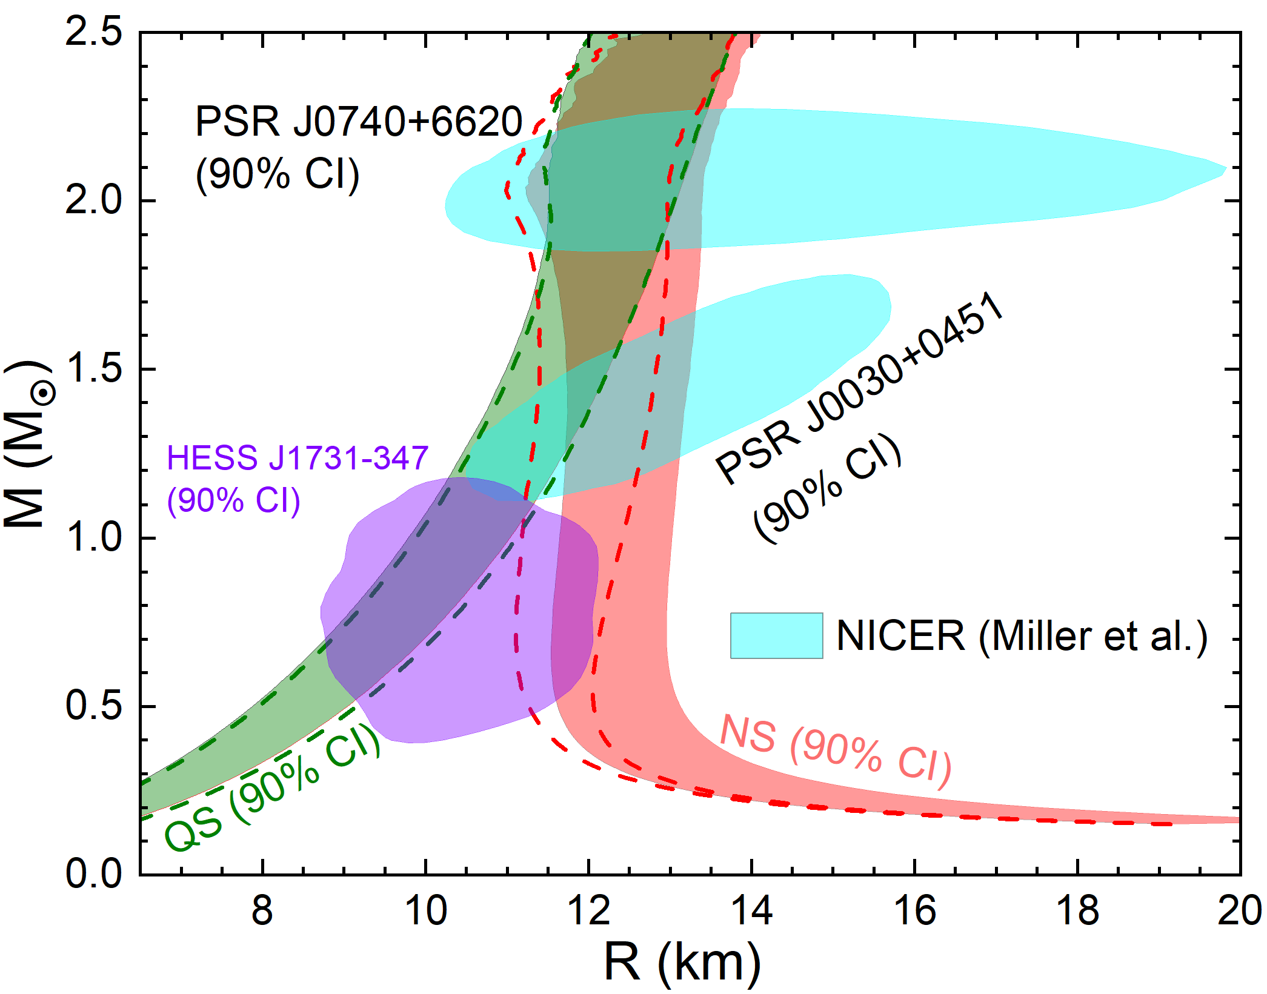
EOS: Bayesian Model-Agnostic Inference？
Zheng Cao (曹政)/LWC,
arXiv:2308.16783
Bayesian analyses combining
ChEFT: n<1.1n₀
pQCD: High Densities
Nstar Mmax: ~2M⊙
Nstar MR: NICER
GW: GW170817, GW190425
Nstar MR: HESS J1731-347
Bayes Factor
Lee/Wagenmakers, Bayesian Cognitive Modeling (Cambridge University Press, 2014).
Bayes Factor (NS/QS) of 4 !
Bayesian analyses combining ChEFT + pQCD + Nstar Mmax + GW+ Nstar MR + HESS J1731-347 suggests that the NS hypothesis is still favored against QS hypothesis!
p. 24

Slide 28
Outline
The Symmetry Energy (Esym) – Nuclear Matter EOS
Neutron Star verses Quark Star – Multi-Messenger Data + Nuclear Physics
High Density Behavior of Esym
Conclusions

Slide 29
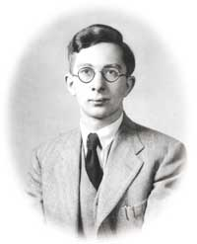
Esym: Bayesian Model-Agnostic Inference？
The extended SHF (eSHF) Energy Density Functional
N. Chamel, S. Goriely, and J.M. Pearson, PRC80, 065804 (2009)
T.H.R Skyrme,
Nucl. Phys. 9, 615 (1959)
Z. Zhang/LWC, PRC94, 064326 (2016)
Momentum-dependence
of many-body forces
LWC/Ko/Li/Xu, PRC82, 024321(2010)
13 Skyrme parameters:
13 macroscopic nuclear properties:
p. 25

Slide 30
Esym: Bayesian Model-Agnostic Inference？
The eSHF can describe simultaneously nuclear matter, finite nuclei, and neutron stars!
The eSHF EDF is very flexible to mimic various density behaviors for EOS (13 parameters)
To constrain the high density Esym in the Bayesian Model-Agnostic Inference, the eSHF is used to describe Finite Nuclei and Nuclear Matter at densities below 2n₀
p. 26

Slide 31
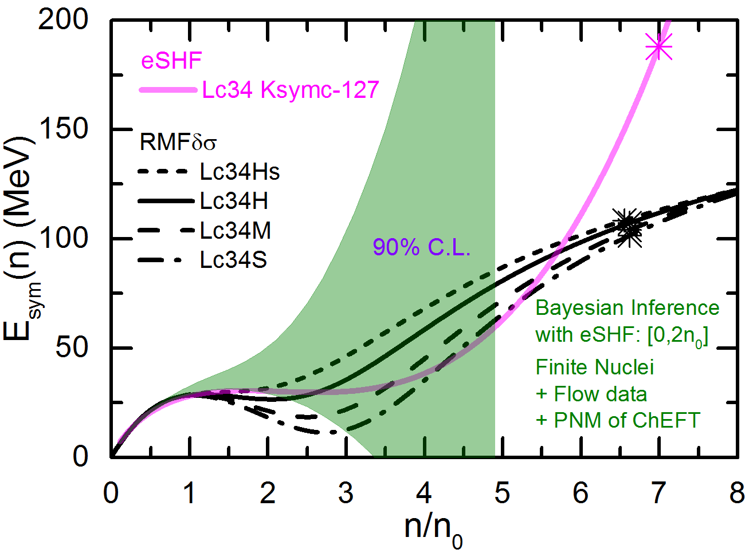
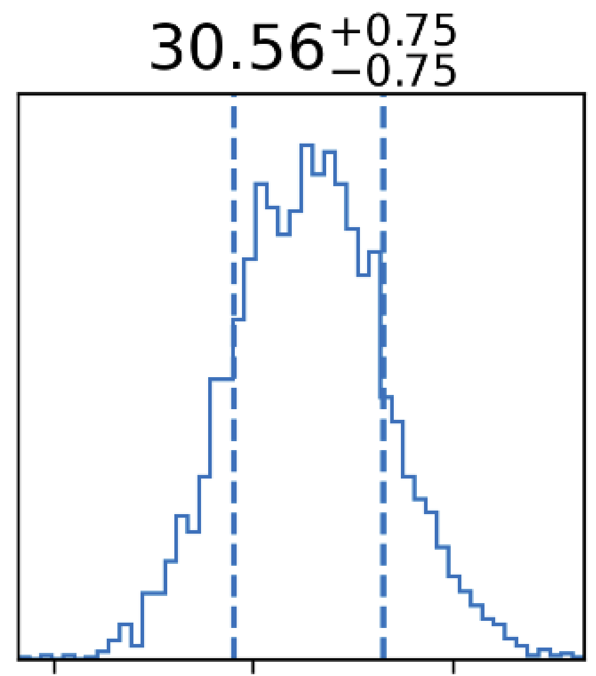
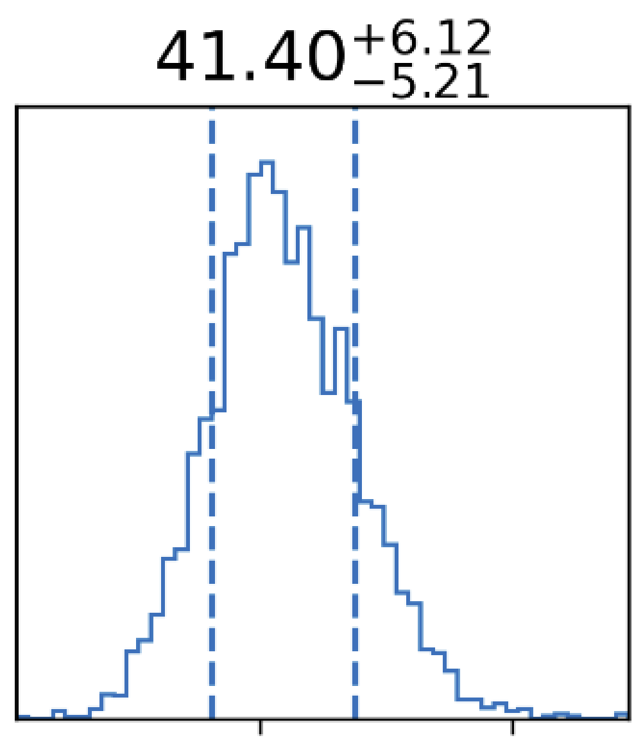
Esym: Bayesian Model-Agnostic Inference？
Zheng Cao (曹政) et al.,
Preliminary results
Bayesian analyses combining
ChEFT: PNM
pQCD: High Densities
Nstar Mmax: ~2M⊙
Nstar MR: NICER+HESS J1731-347
GW: GW170817, GW190425
Nstar MR: HESS J1731-347
Nuclei: mass, charge radius, GMR, Spin-Orbit energy level splitting +Flow data (eSHF)
E_{sym}(n₀)
MeV
L
MeV
Bayesian analyses combining ChEFT + pQCD + Nstar Mmax + Nstar MR + GW+ Nuclei suggests a soft Esym around intermediate densities!
p. 27

Slide 32
Outline
The Symmetry Energy (Esym) – Nuclear Matter EOS
Neutron Star verses Quark Star – Multi-Messenger Data + Nuclear Physics
High Density Behavior of Esym
Conclusions

Slide 33
Conclusions
Based on the analyses on data of nuclear masses, charge radii, neutron skin,
giant resonances, nucleon optical potential et al., we may conclude：
    Esym in subsaturation density is relatively well constrained
    Esym at saturation:
World Average: E_{sym}(ρ₀) =31.7±3.1 MeV and L=57.5±24.5 MeV
(But PREX-II/CREX data make the situation quite elusive!!!)
Bayesian model-agnostic analyses on the multimessenger data together with
ab initio calculations from ChEFT and pQCD favor the compact stars as
neutron stars against quark stars
Bayesian model-agnostic analyses on the multimessenger data together with
ab initio calculations from ChEFT and pQCD suggest the symmetry energy
at intermediate densities (around 2~3n₀) is soft!
p. 28

Slide 34
谢 谢！
Thanks!

Slide 35
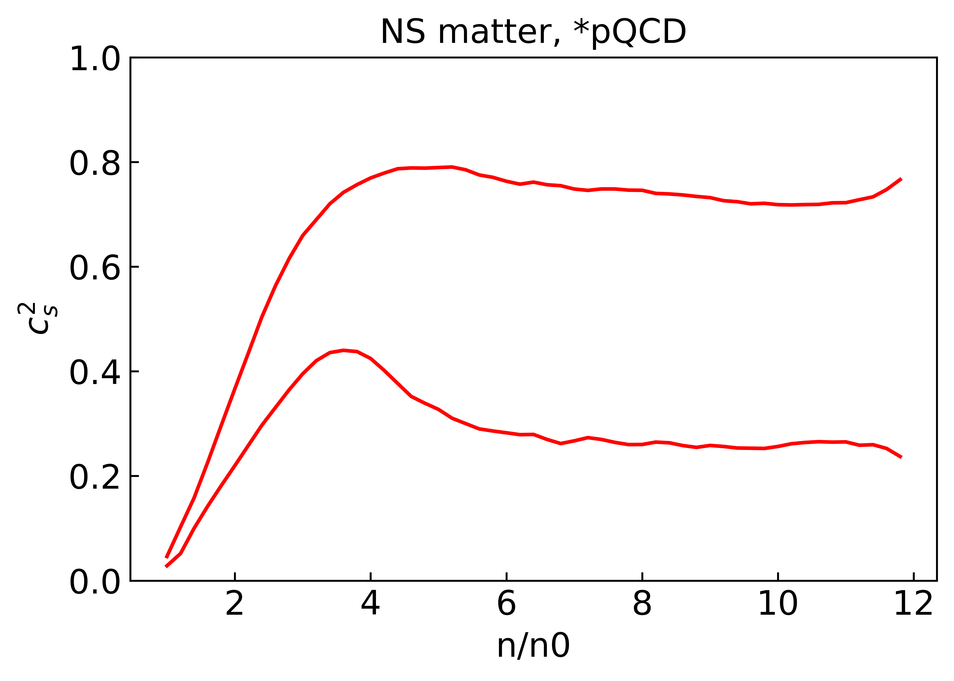
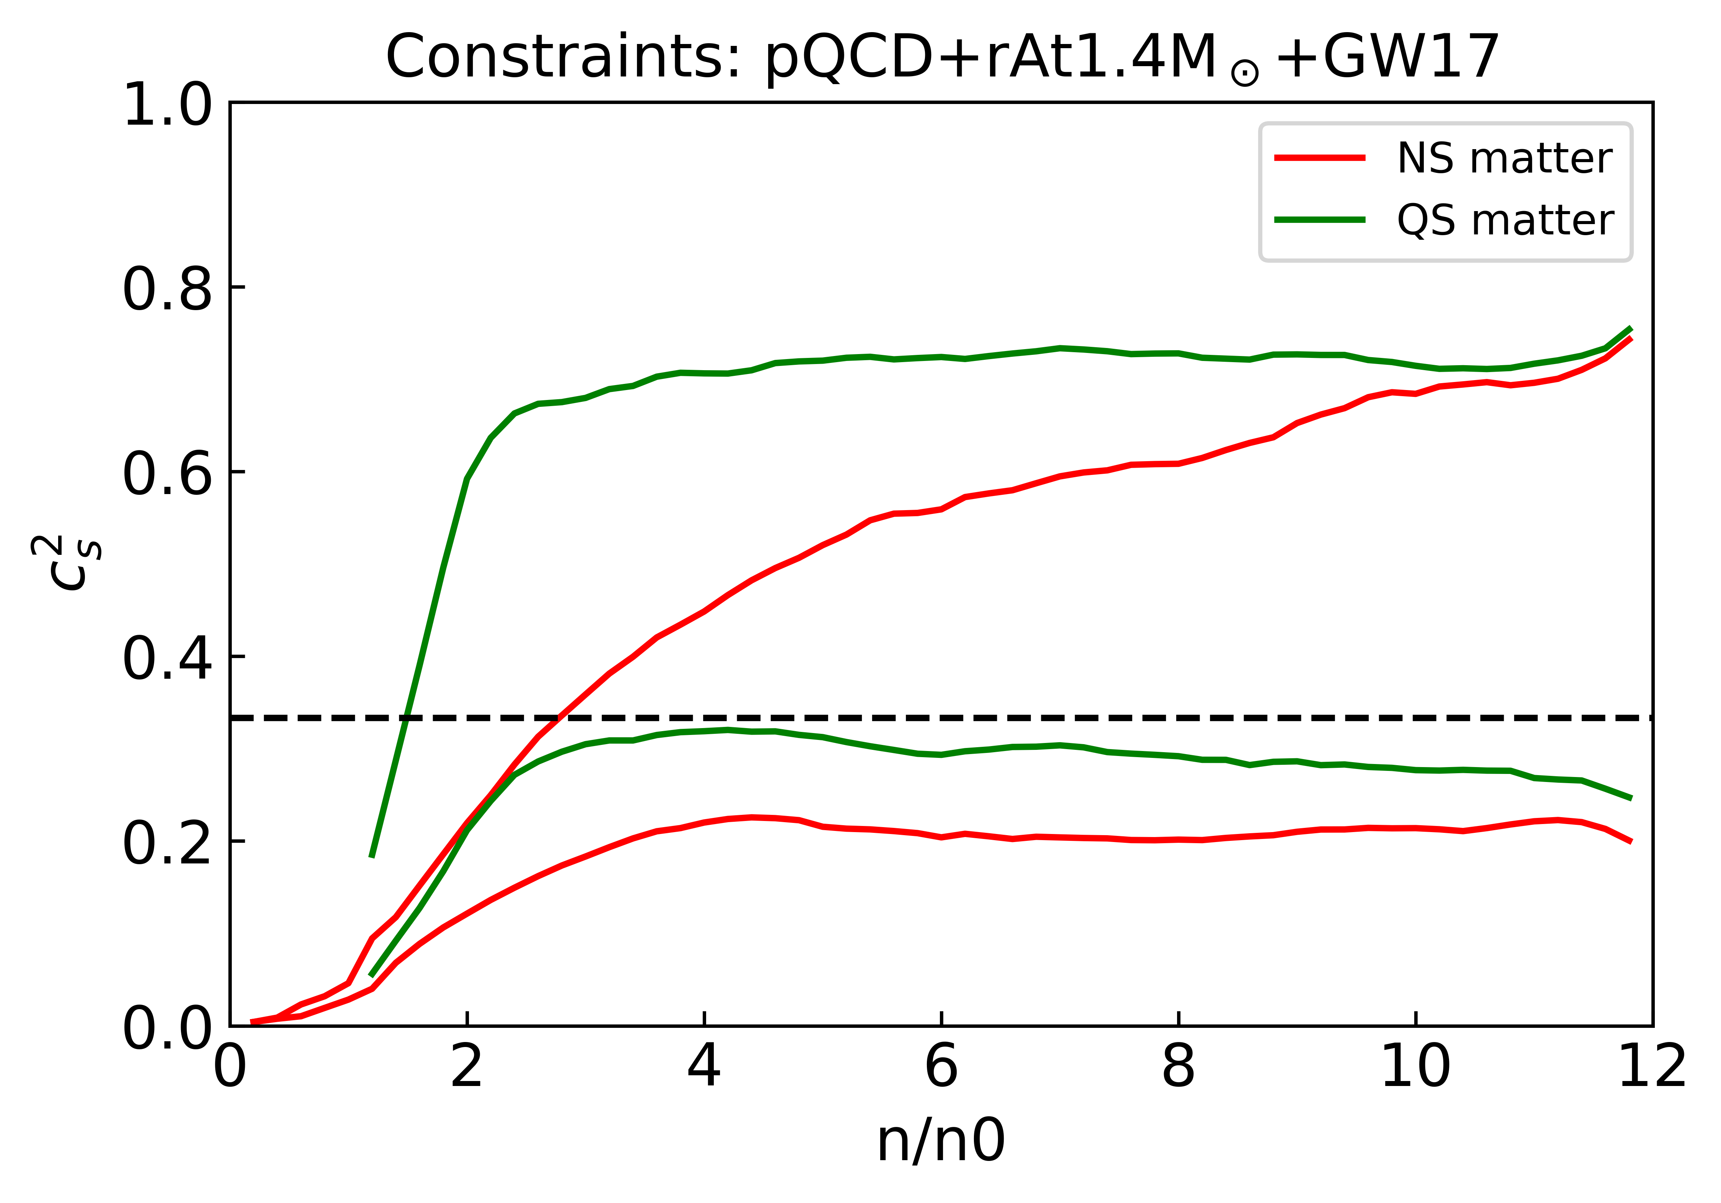
Peak in speed of sound of NS matter
pQCD constraint is removed
massive compact stars
are removed
Peak disappear!
p. 44

Slide 36
Nskin in ²⁰⁸Pb : PREX-II
PREX:
The Lead (Pb) Radius EXperiment
PREX-II: Rskin = [0.212, 0.354] fm for Pb208
Huge Nskin!
In PREX, the neutron density distribution in 208Pb is determined by measuring the parity-violating electroweak asymmetry in the elastic scattering of polarized electrons off 208Pb and thus is free from the strong interaction uncertainties
RMF: Inconsistent with GW170817: Λ_{1.4} <580 !!!
δ meson may be important in the RMF model !!!
Fan Li (李帆)/Cai/Zhou/Jiang/LWC, ApJ 929, 183 (2022)
p. 39

Slide 37
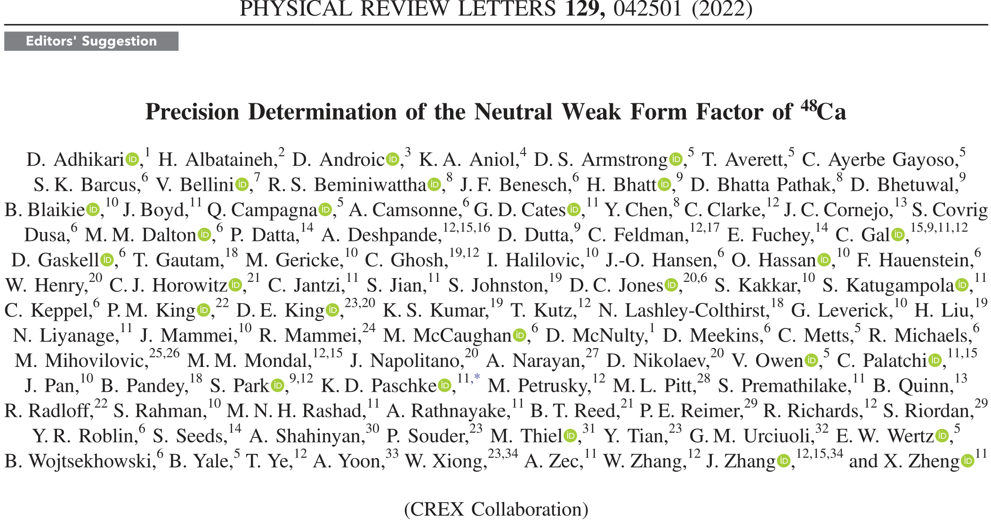
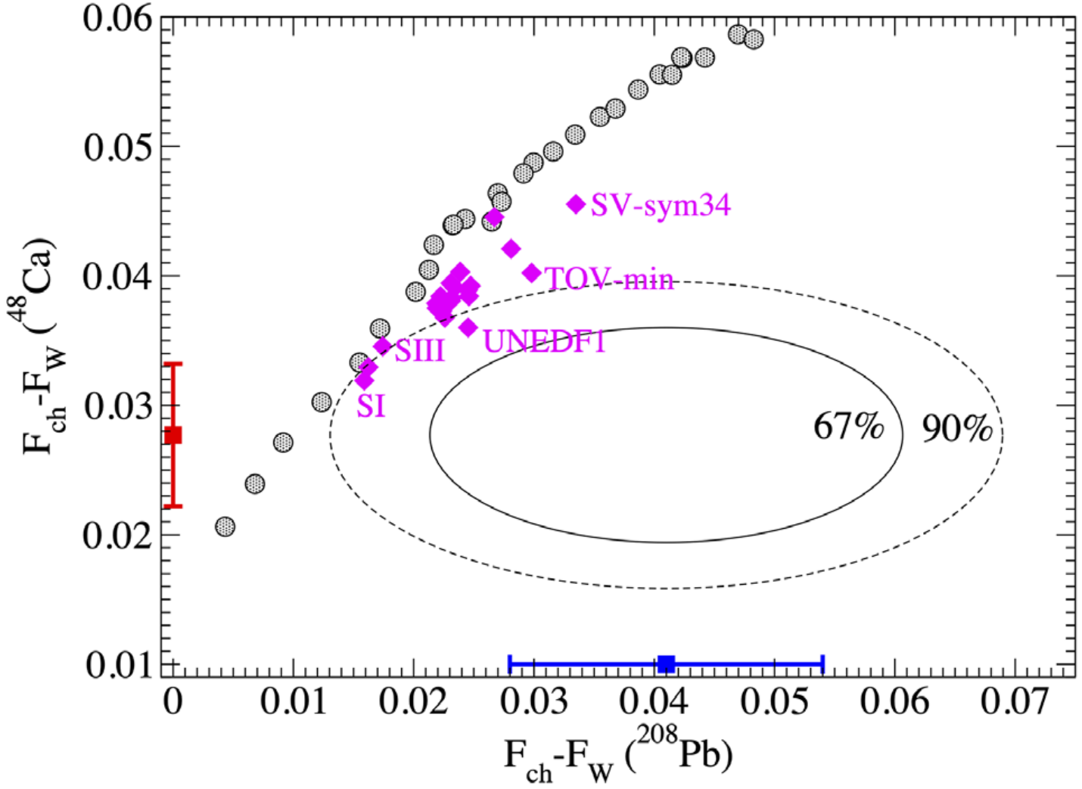
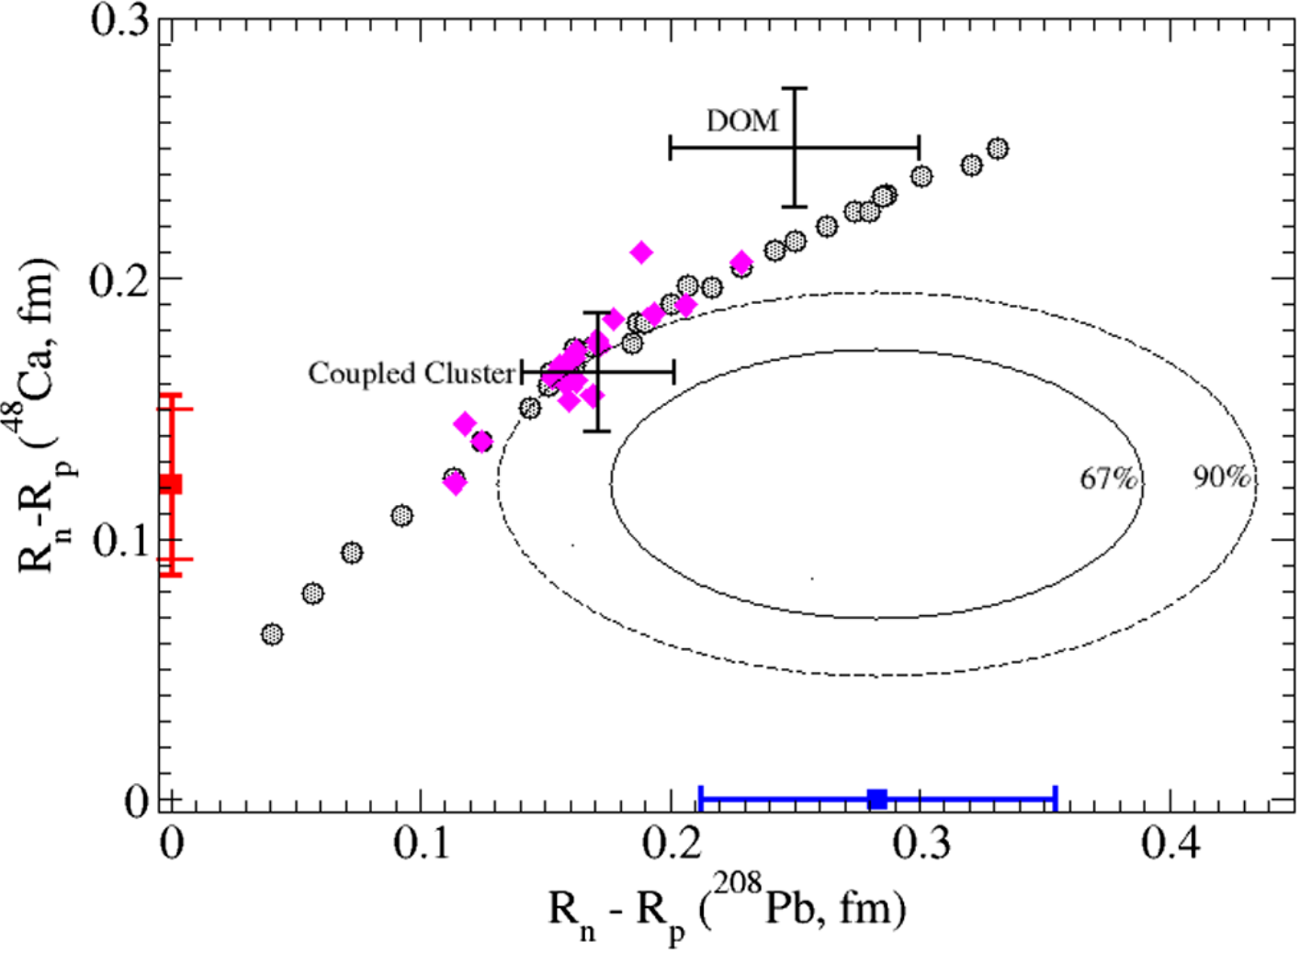
Nskin in ⁴⁸Ca : CREX
CREX, PRL129, 042501 (2022)
Strong tension between CREX and PREX?
With too small Nskin of ⁴⁸Ca or too large Nskin of ²⁰⁸Pb
p. 44

Slide 38
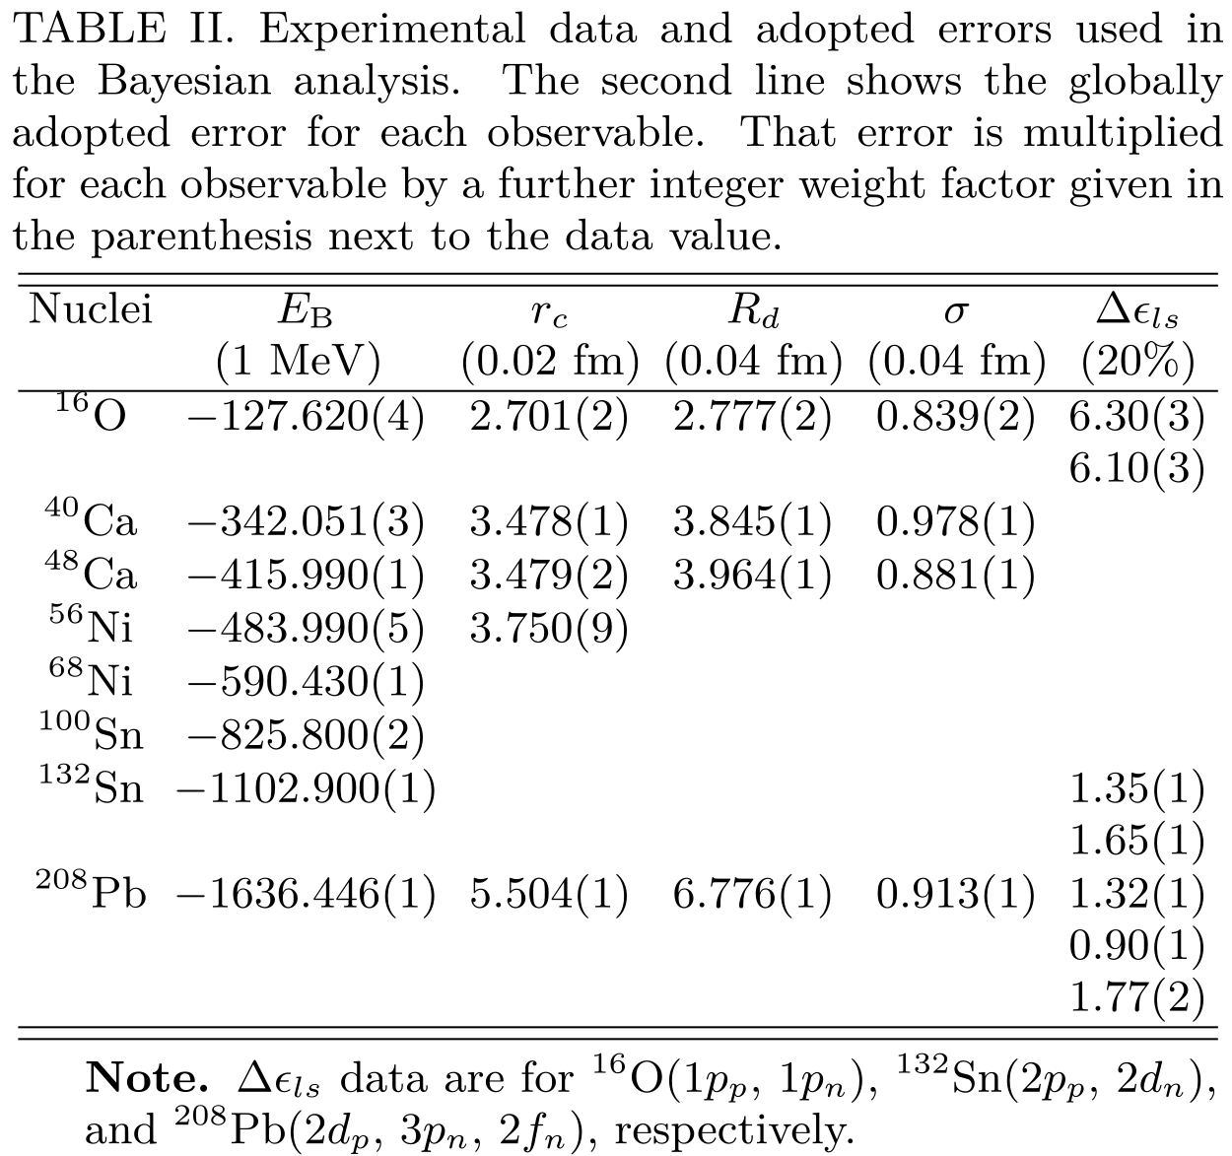
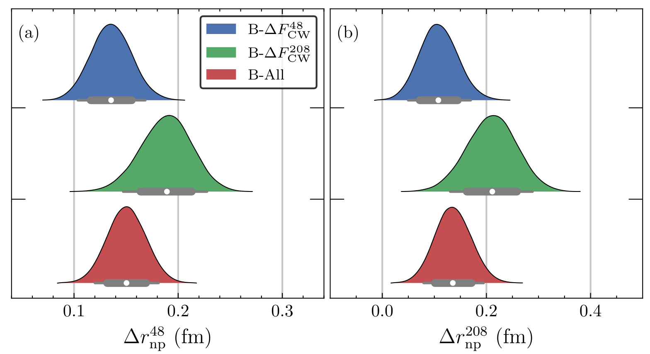
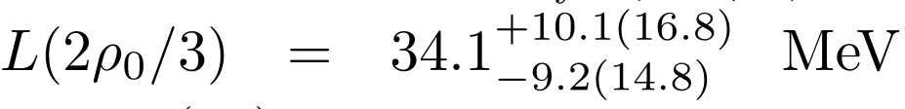
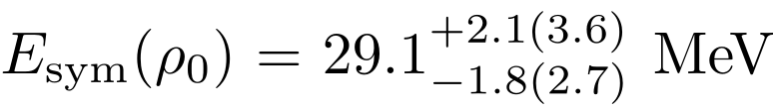

PREX and CREX: A Bayesian analysis
Zhang/Chen, arXiv: 2207.03328
SHF
base data of nuclei
Also n-p Fermi energy difference of ¹⁶O, ^{40,48}Ca, ⁵⁶Ni, ¹³²Sn, ²⁰⁸Pb and GMR of ²⁰⁸Pb
CREX and PREX are compatible in 90% C.L.
PREX is less effective to constrain Esym due to its lower precision compared to CREX
Combining CREX+PREX favor mildly soft Esym around saturation density!
p. 45

Slide 39
Recently Observed Light NStar
RMFδσ - RMF with δ-σ mixing
Fan Li (李帆), Z. Zhang and LWC,
To be submitted
RMFδσ with Lc = L(2/3ρ₀)=34 MeV is also in good agreement with the ChEFT prediction on EOS of pure neutron matter
RMFδσ can successfully describe the unusually small M&R of HESS J1731-347 with soft Esym around intermediate densities!
p. 24

Slide 40
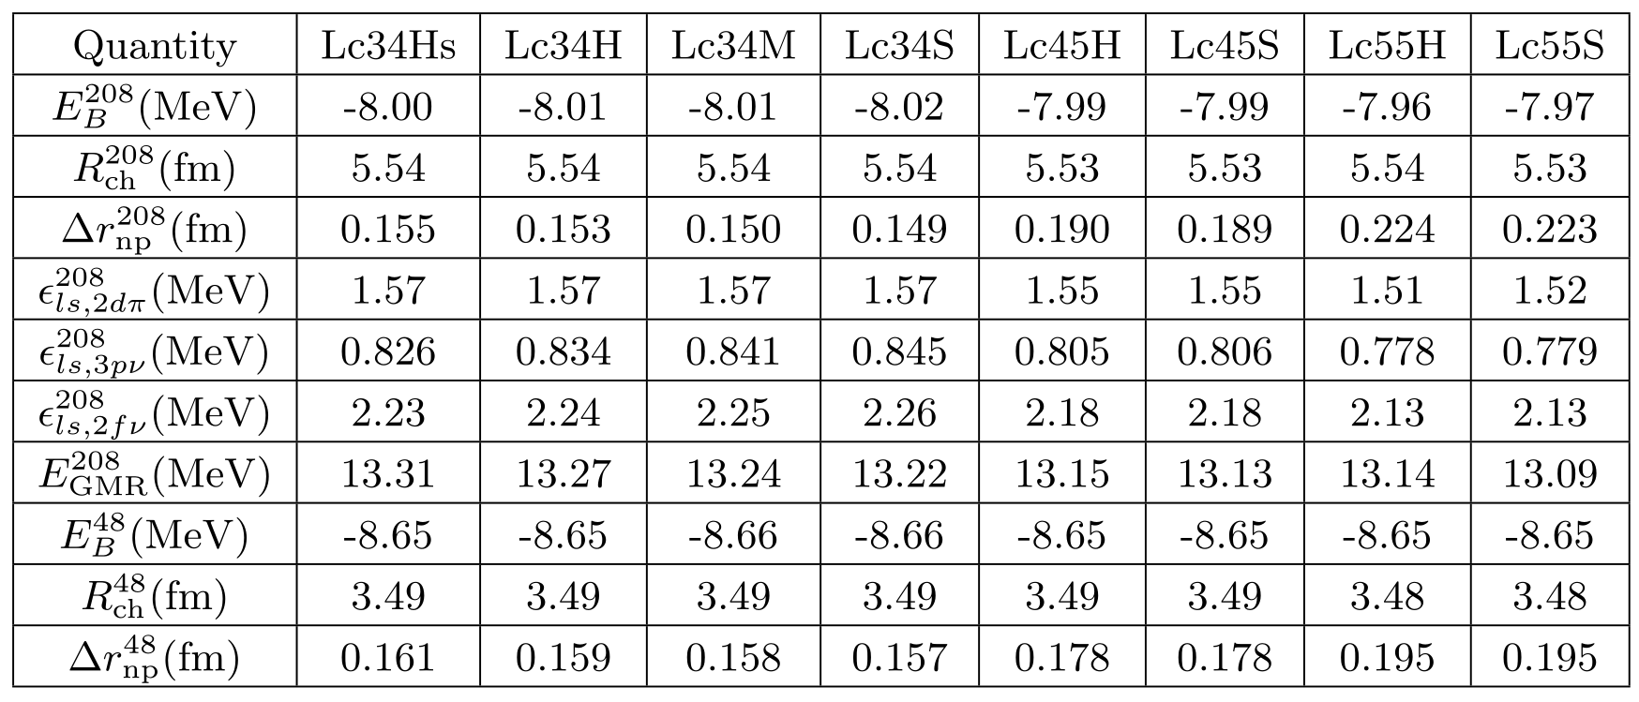
Recently Observed Light NStar
RMFδσ - RMF with δ-σ mixing
Fan Li (李帆), Z. Zhang and LWC,
To be submitted
Exp. Data:
-7.87 MeV
5.50 fm
≈ 1.32 MeV
≈ 0.89 MeV
≈ 1.77 MeV
≈ 13.6 MeV
-8.67 MeV
3.48 fm
The neutron skin of ⁴⁸Ca and ²⁰⁸Pb - Zhang/Chen, PRC (in press) [arXiv: 2207.03328]
RMFδσ can also successfully describe the ground state properties of ⁴⁸Ca and ²⁰⁸Pb with Lc = L(2/3ρ₀)=34 MeV.
p. 25

Slide 41
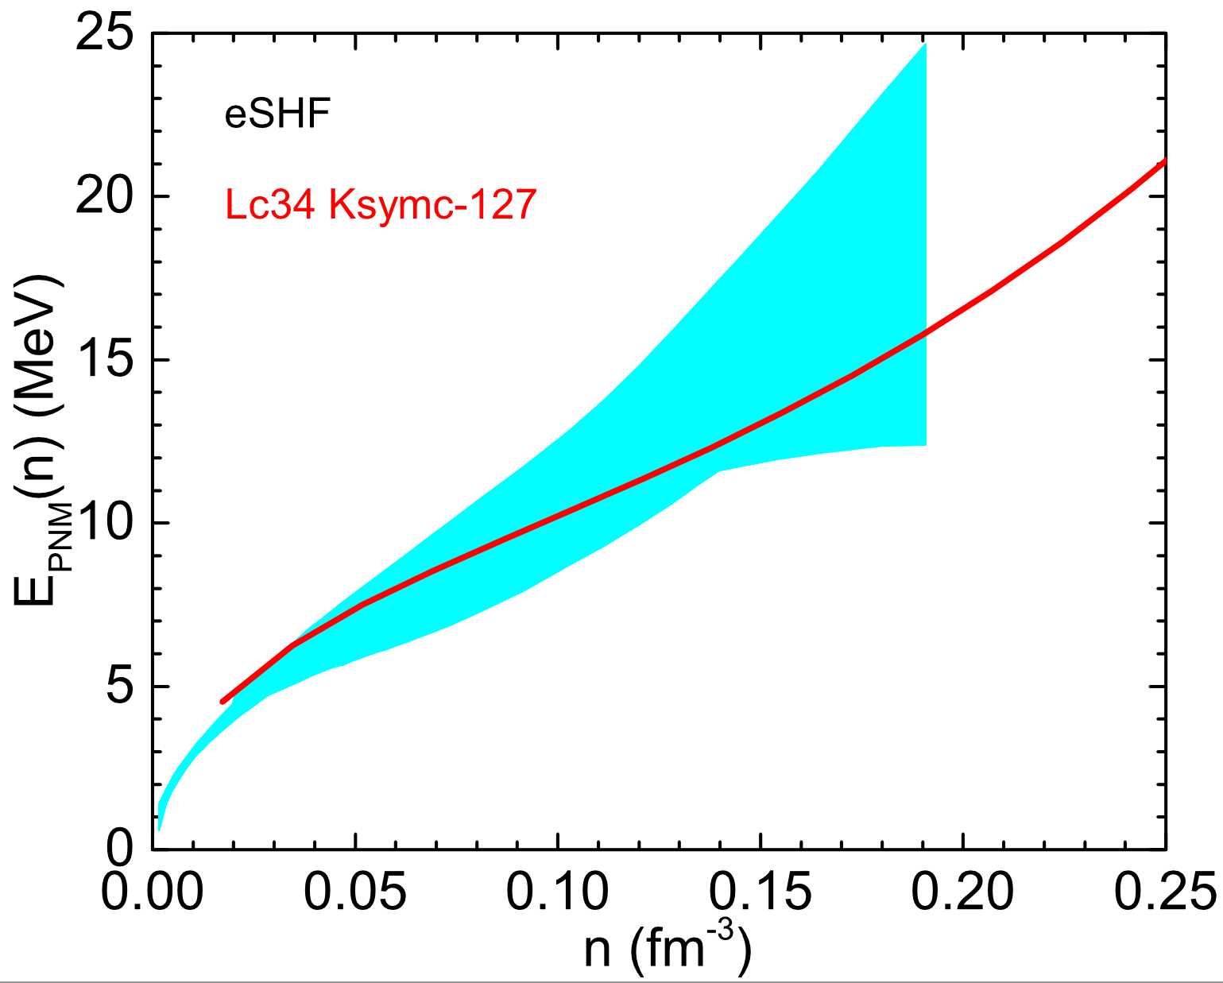
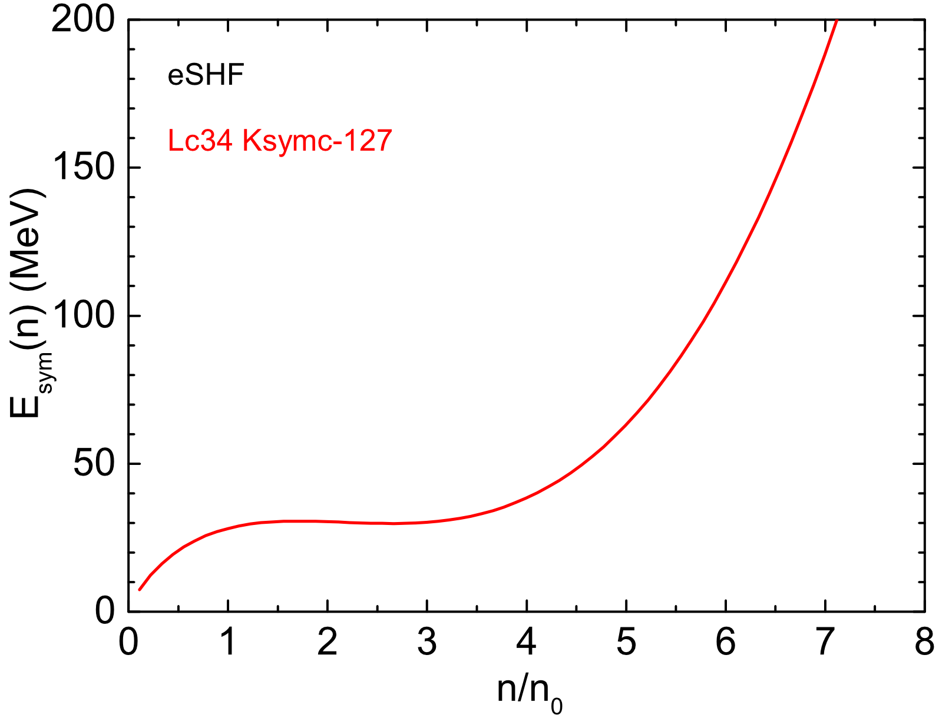
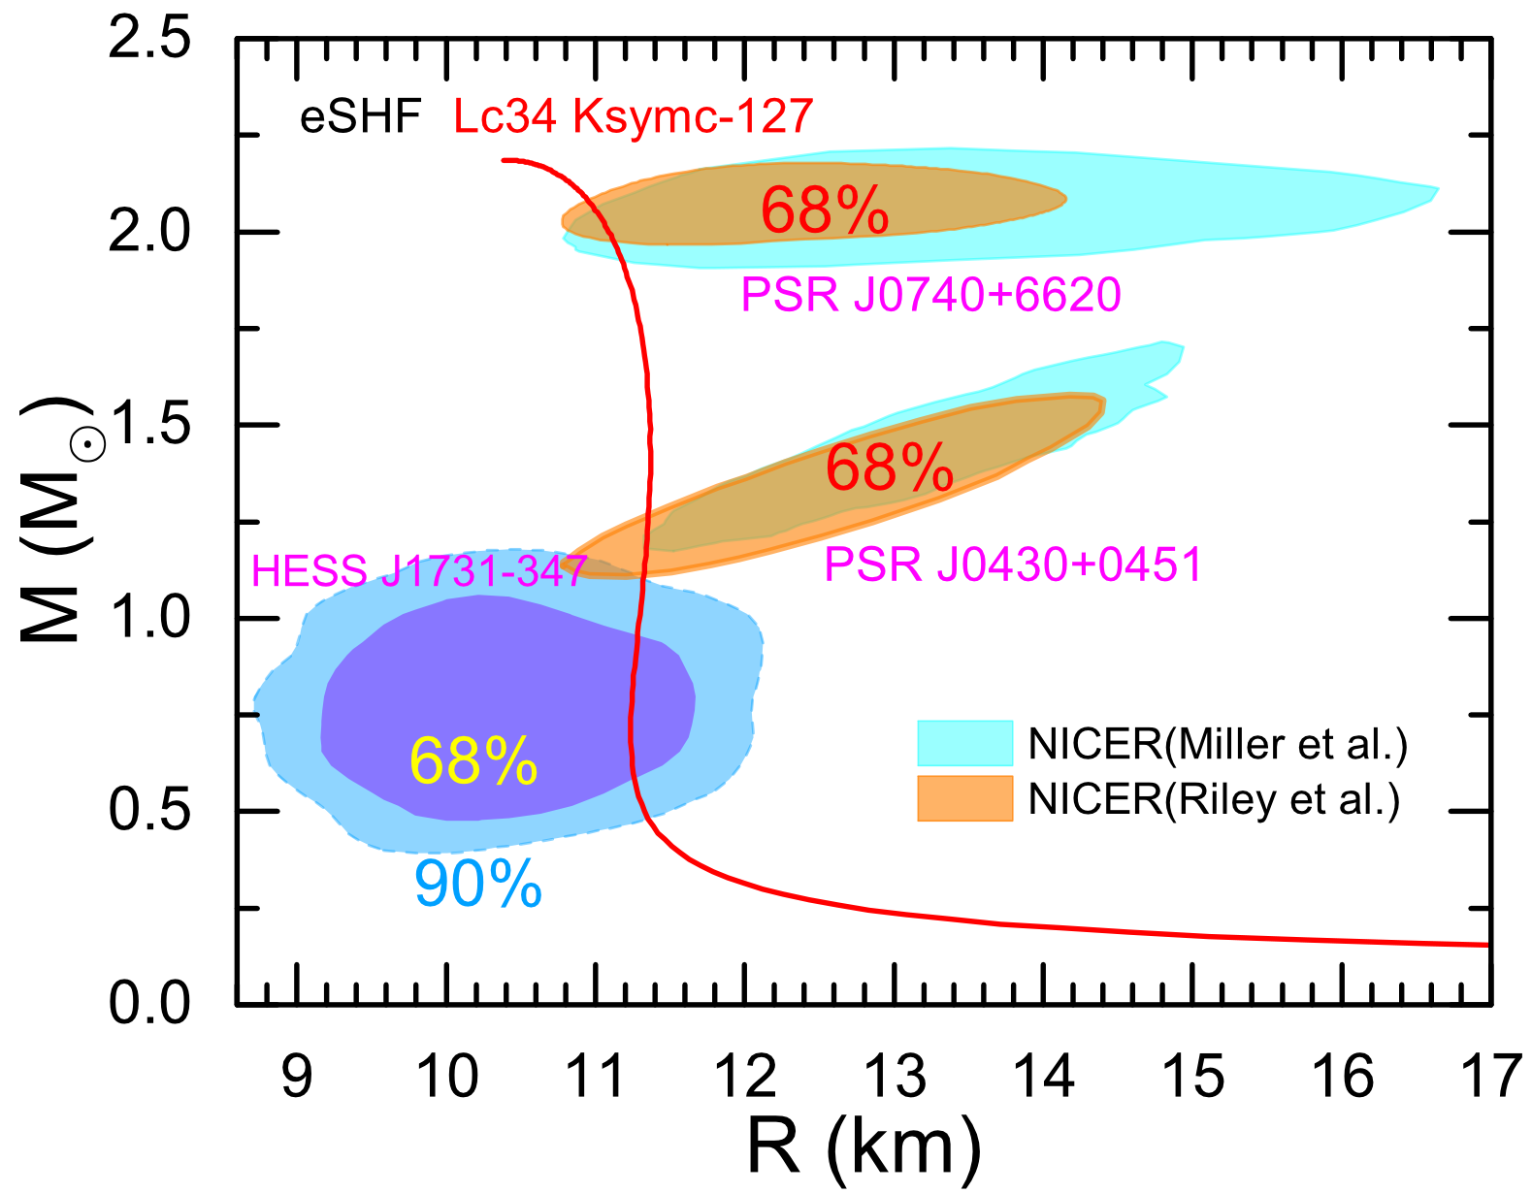
Recently Observed Light NStar
eSHF – extended Skyrme-HF
Tong-Gang Yue(岳侗钢), Z. Zhang and LWC (Preliminary)
ChEFT
eSHF can successfully describe the unusually small M&R of HESS J1731-347 with soft Esym around intermediate densities!
p. 26

Slide 42
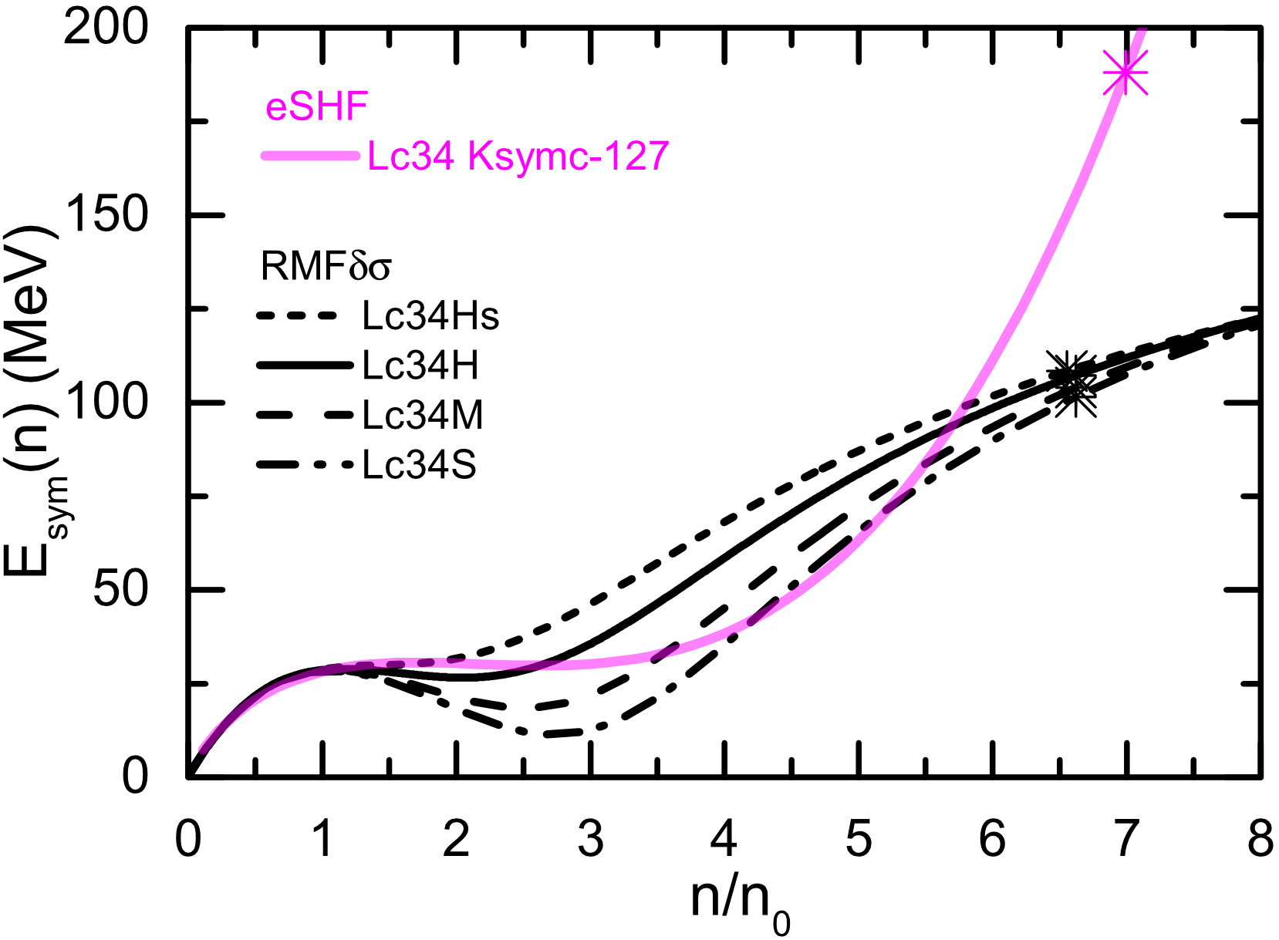
Esym: RMFδσ vs eSHF
B.A.Li, B.J. Cai, W.J. Xie, and N.B. Zhang, Universe 7, 187 (2021)
Both RMFδσ and eSHF suggest a soft Esym around intermediate densities!
p. 27

