Slide 1

Quarks and Compact Stars
The magnetic field, inclination angle and spin-down evolutions
of young and strongly magnetized neutron stars
^{Gao Zhifu}
Xinjiang Ostranomical Observatory, CAS
^{2023/09/24}
^{Yangzhou, China}
。

Slide 2
Outline
Magetic field origin and EoS
Inclination angle evolution
Spin-down evolution
Recent work and summary

Slide 3
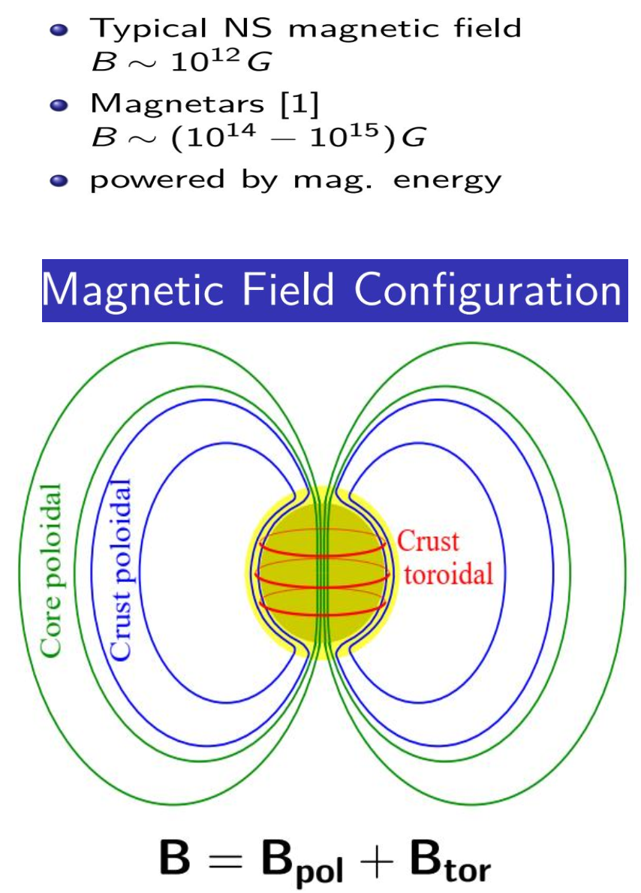
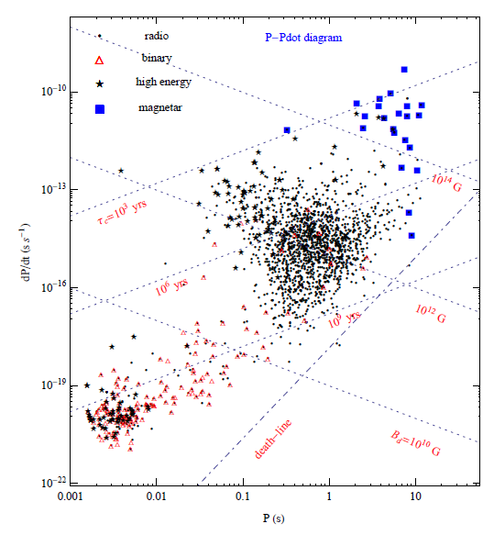
Pulsar magnetic fields
Notes:
The line from the upper left to the lower right indicates the magnetic field strength

Slide 4
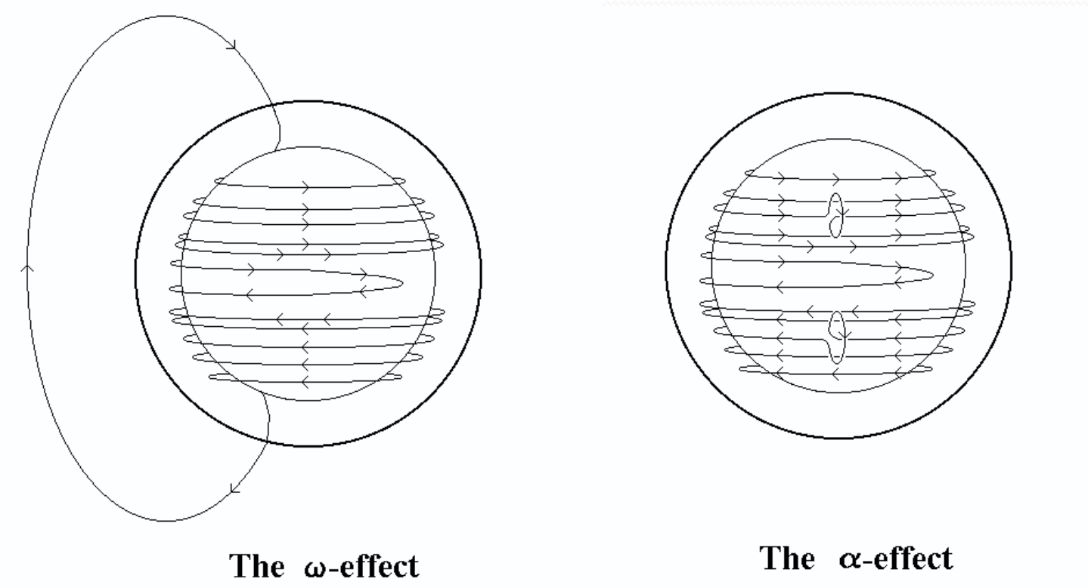
The supposed origin of magnetic field
Fossil origin: Originated from molecular current, gravitational collapse, magnetic flux constant, so the magnetic field amplification；
α-Ω effects: If the magnetic field line is straightened, the magnetic field is amplified, calledOmega effect, due t differential rotation, the magnetic field line is distorted, the magnetic field is amplified, called the alpaca effect,the turbulent kinetic energy,and gravitationa energy is converted into magnetic field energy.
Notes:
For a rotating star, if the magnetic field line is straightened, the magnetic field is amplified, j is called the Omega effect, due to the existence of differential rotation, the magnetic field line is distorted, the magnetic field is amplified, called the alpaca effect, so that the turbulent kinetic energy nuclear gravitational potential energy is converted into magnetic field energy.

Slide 5
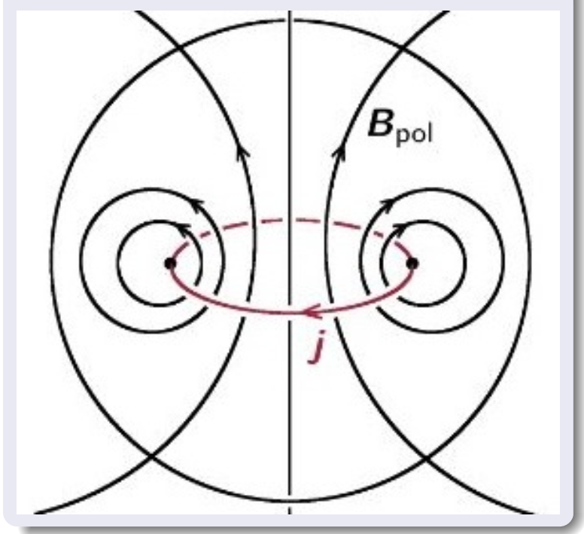
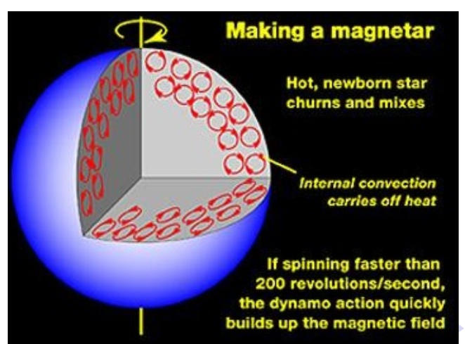
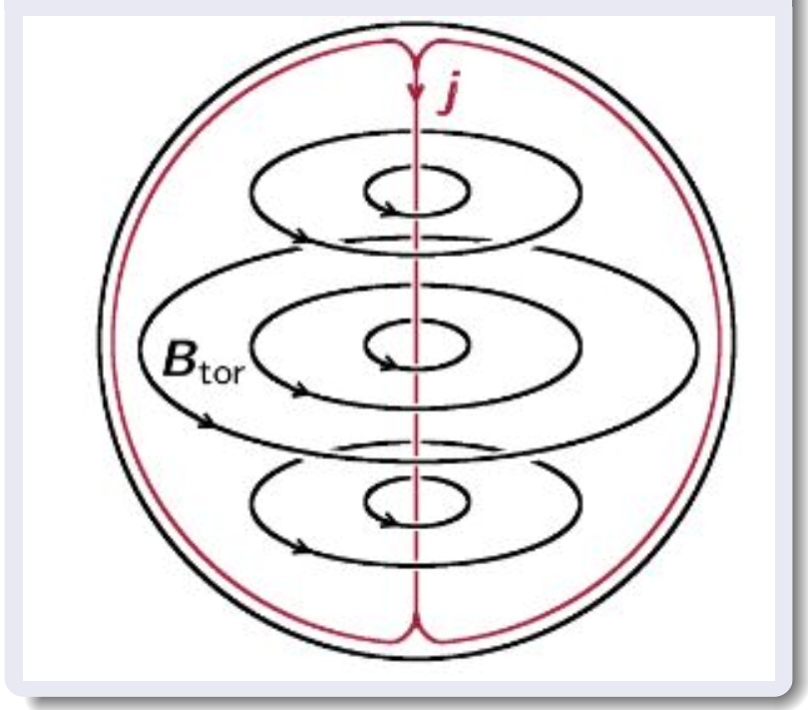
The supposed origin of magnetic field
The amplification of stellar magnetic fields through the combination of rapid rotation and convective processes in plasma during the proto–NS phase
Notes:
If there is only a polar or toroidal magnetic field, then the structure of the star is unstable
If there is only a polar or toroidal magnetic field, then the structure of the star is unstable;

Slide 6

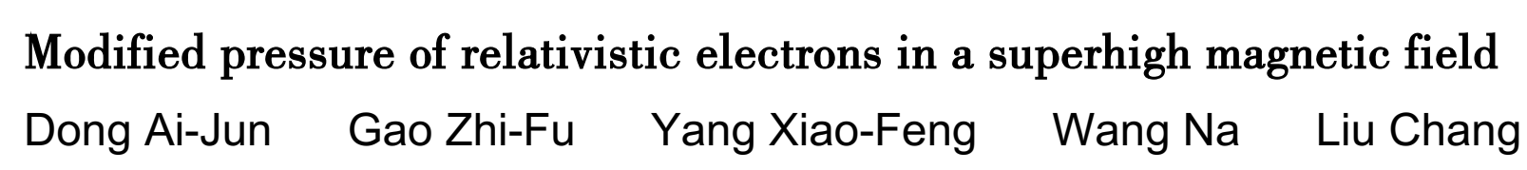
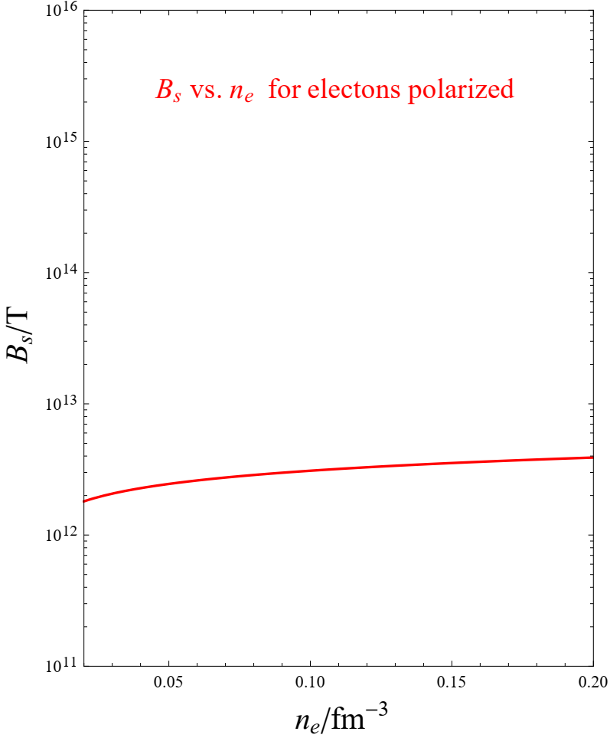
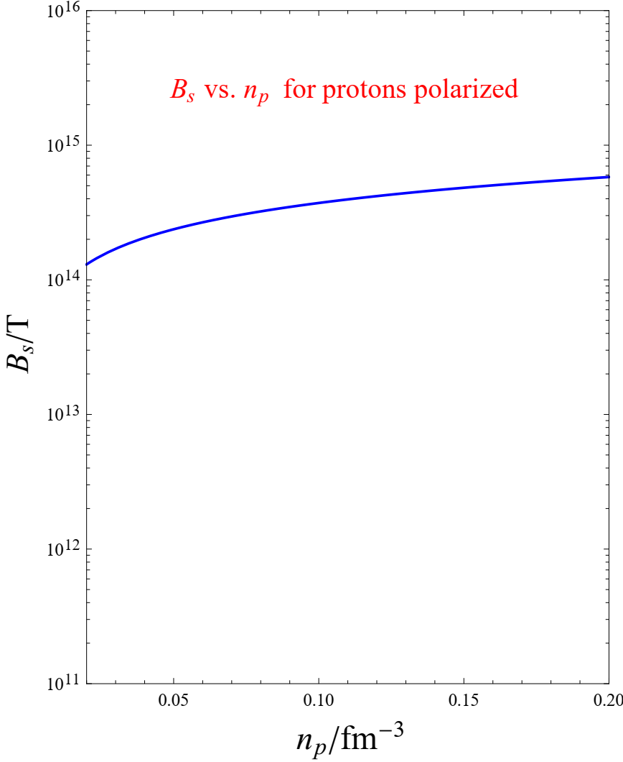
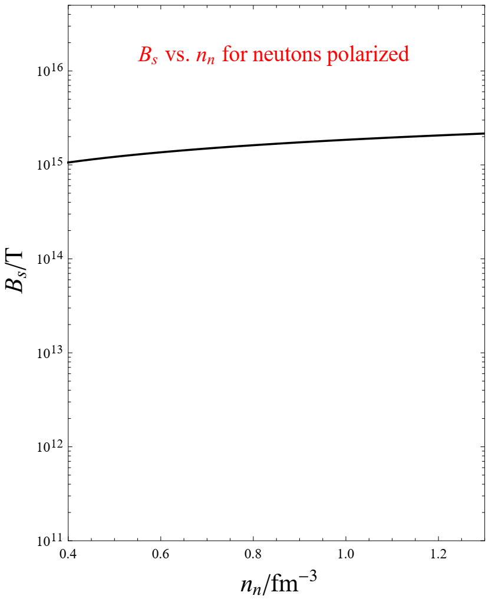
(a)
(b)
(c)
It is found that when the electron spin is completely polarized, the maximum value of the magnetic field inside the magnetar is (1.5-3.1)*10^16 G.

Slide 7


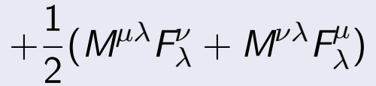
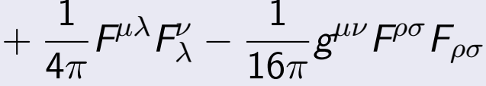
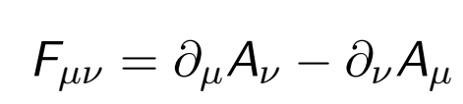
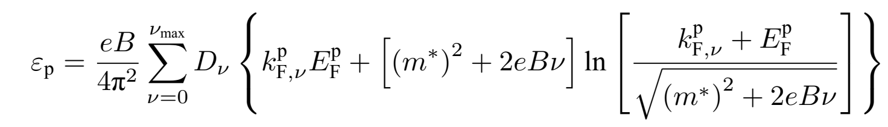
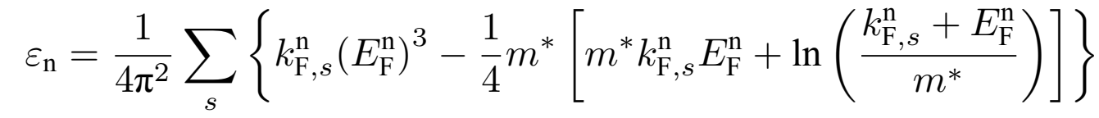
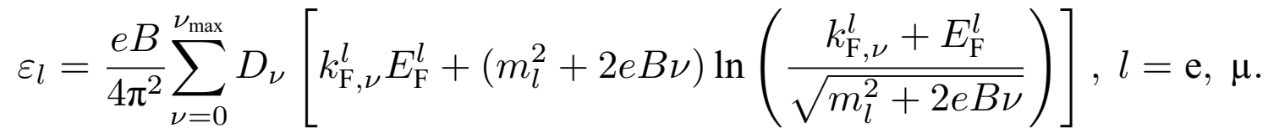
Anisotropy in presure of magnetars
Notes:
If there is only a polar or toroidal magnetic field, then the structure of the star is unstable
If there is only a polar or toroidal magnetic field, then the structure of the star is unstable;

Slide 8
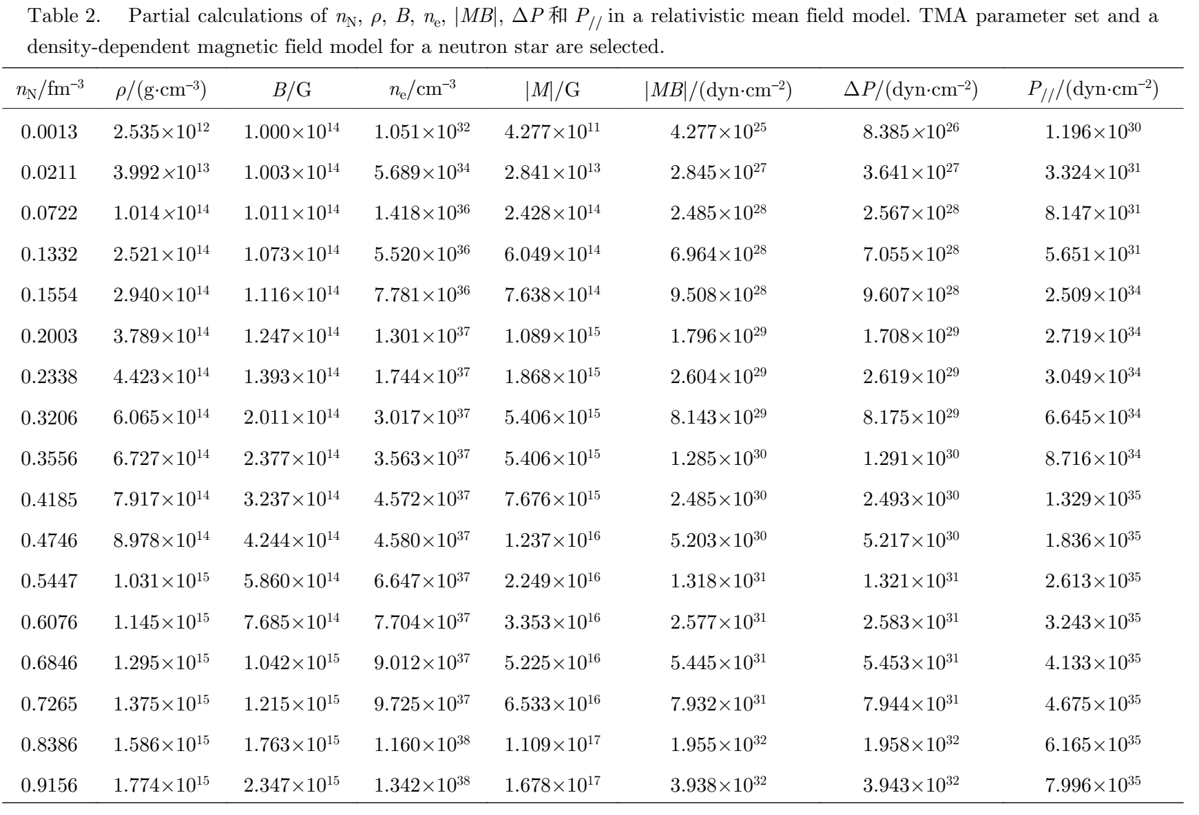


≈

Slide 9
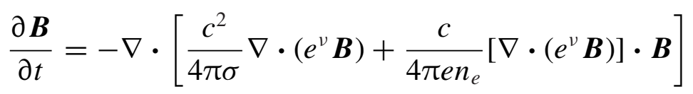


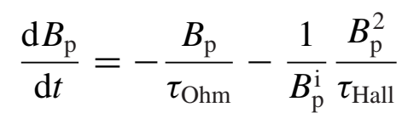

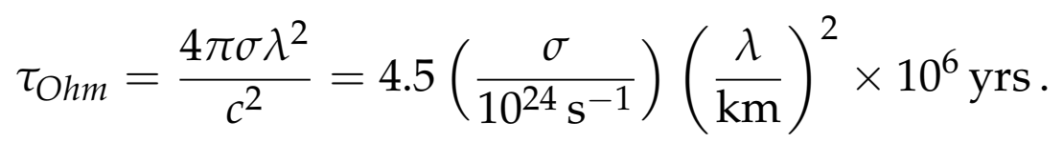
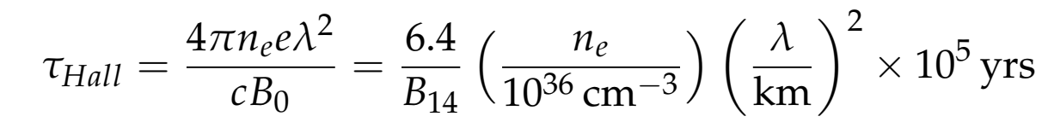
Magnetic induction equation
Considering the general relativistic effect, the magnetic induction equation of the neutron star crustal magnetic field：
A simple analytical solution
Two field decay time scales

Slide 10
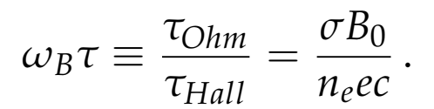


Heat conductivity
Magnetization parameters
The strong magnetic field not only affects the rate of heat conduction, but also causes the anisotropy of heat flow. Main contribution to heat conductivity comes from electrons moving in the direction of magnetic field.
Heat conductivity in a strong magnetic field
Select possible ranges of thre magnetic field B, temperature T and promiscuity Q, and then calculate the conductivity of the inner shell of the neutron star, and obtain the range of magnetization parameters
where m* is the effective elctron mass，and v is the effective collision rate.
For a non-degenerate gas α = 3/2, for a strongly degenerate particle α = (π2)/3.
（Wang Gao et al. 2020,PASP)
Notes:
The retention of the thermal conductivity component along magnetic field line is the same as κ0 in the weak magnetic field approximation, while the electron thermal conductivity perpendicular to the magnetic field is

Slide 11
The expressions of the poloidal and toroidal magnetic fields are:
The change rates of the poloidal and toroidal magnetic fields are:
The dissipation rates of magnetc energies for poloidal and toroidal
magnetic field are:：
Notes:
Here, we show the expressions of the relationship between the poloidal and toroidal magnetic fields of neutron stars with time.

Slide 12
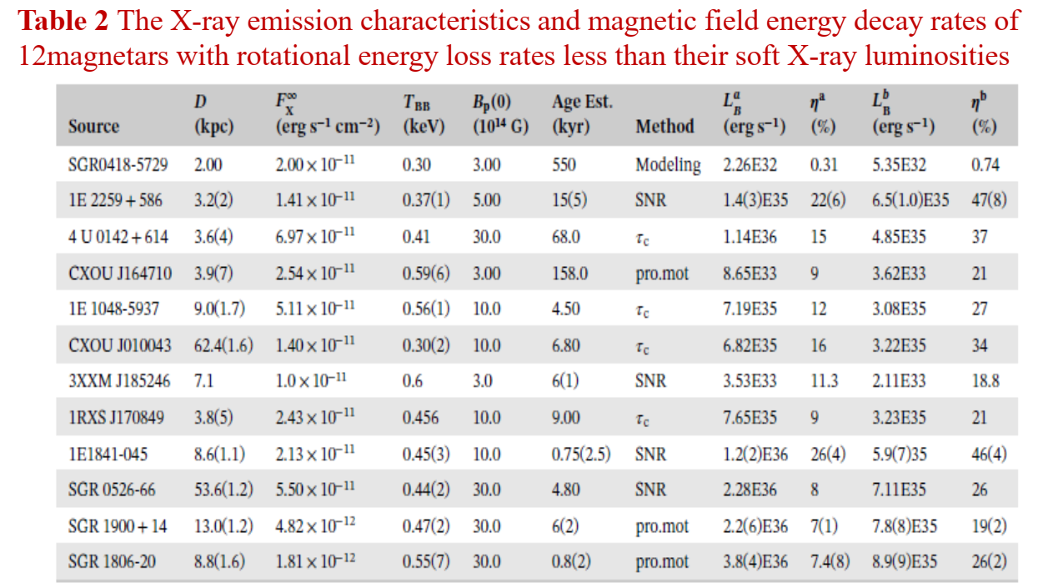
(Gao et al. 2019)

Slide 13
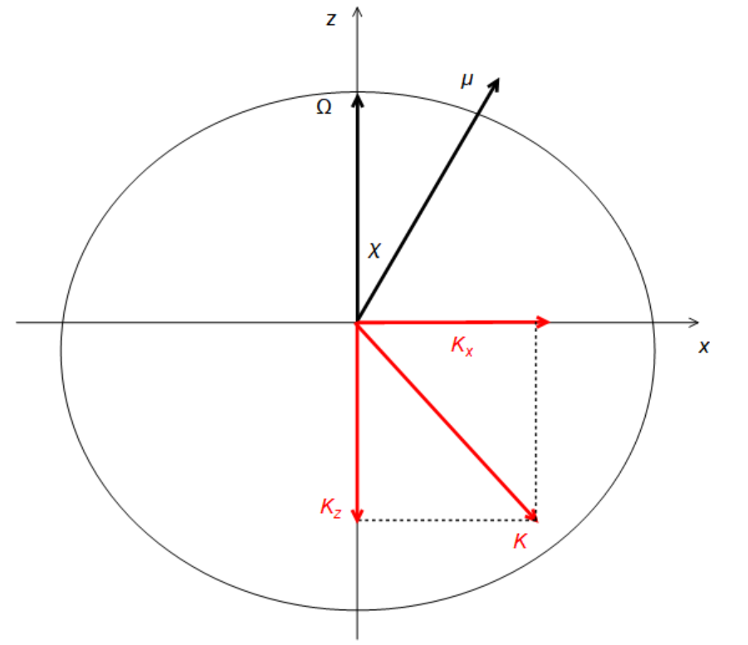
Inclination angle evolution
External origin
  Vocum model：
  MHD model：
  magnetospheric
  current model：
  Composed model, eg. magnetic dipole
  radiation + magnetospheric current model
Radiation moment diagram

Slide 14
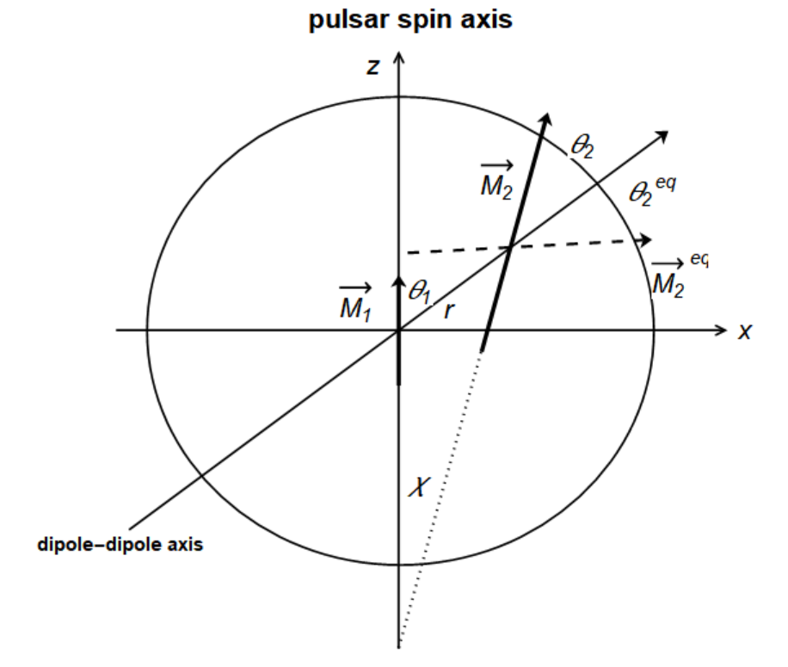
Inclination angle evolution
Internal origin
  Free precession: non-spherical, no dissipation; The spin axis also precesses around symmetry axis, and the precession process will affect the evolution of magnetic inclination, including the magnitude and direction of magnetic inclination change. The magnetic inclination increases and decreases alternately.
  Internal dissipation: early evolution；
  Inclination angle evolution of young pulsars is effected
  by neutrino cooling, external electromagnetic forque and internal dissipation.
  Double magnetic dipole model:：
  Fossil magnetic field generated by rotation effect
  of charged sphere;
  Induced field generated by paramagnetic magnetization.
Double magnetic dipole model

Slide 15
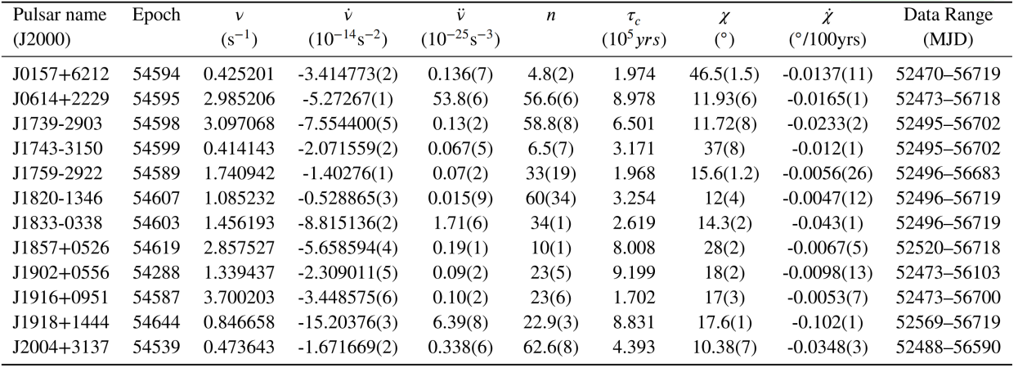
Rotation and inclination angle evolution parameters of 12 pulsars without glitch. Columns 1-6 and 10 are data from Dang et al. (2020). Column 7 lists the calculated values of characteristic ages; Columns 8-9 show the magnetic inclination angles and their change rates calculated using the vacuum model.
(Gao et al. 2023 RAA)

Slide 16


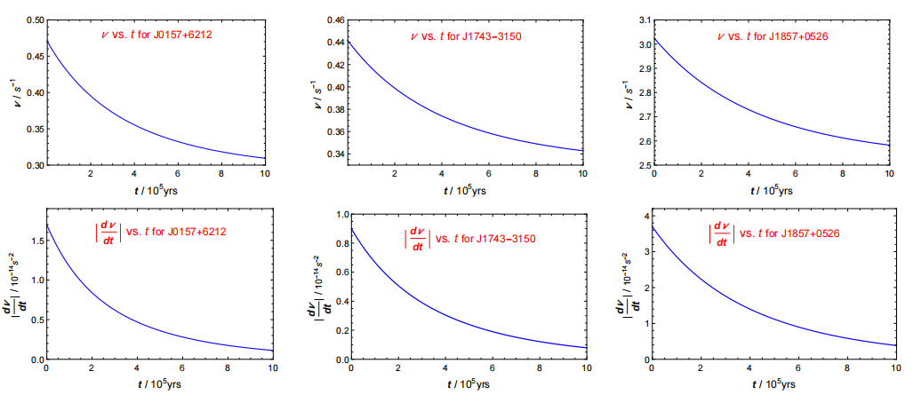
Evolutions of rotation frequencies and their first derivatives with time for pulsars J0157+6212, J1743-3150, J1857+0526. The time scale for inclination angle is

Slide 17
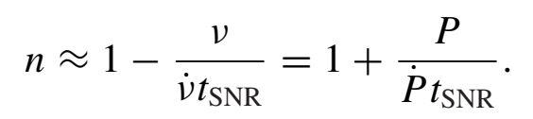
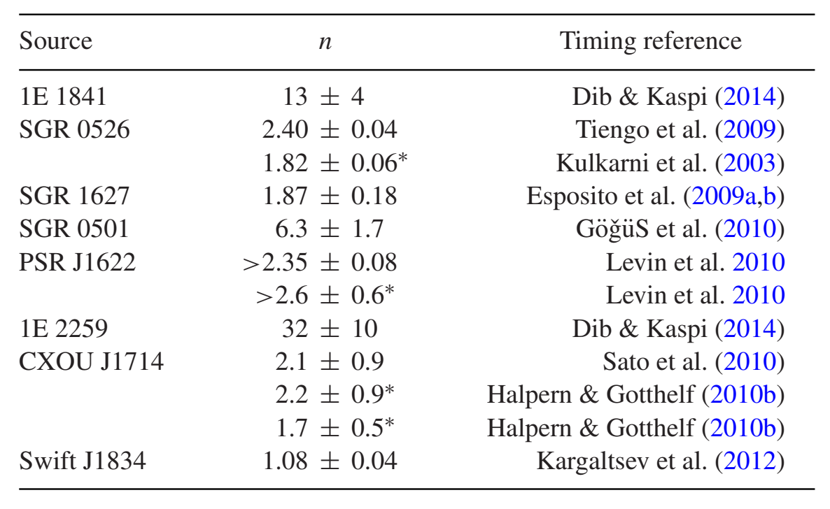
Constraining the braking indice of magnetars
磁星自转演化的研究
(Gao et al. 2016,MNRAS)

Slide 18
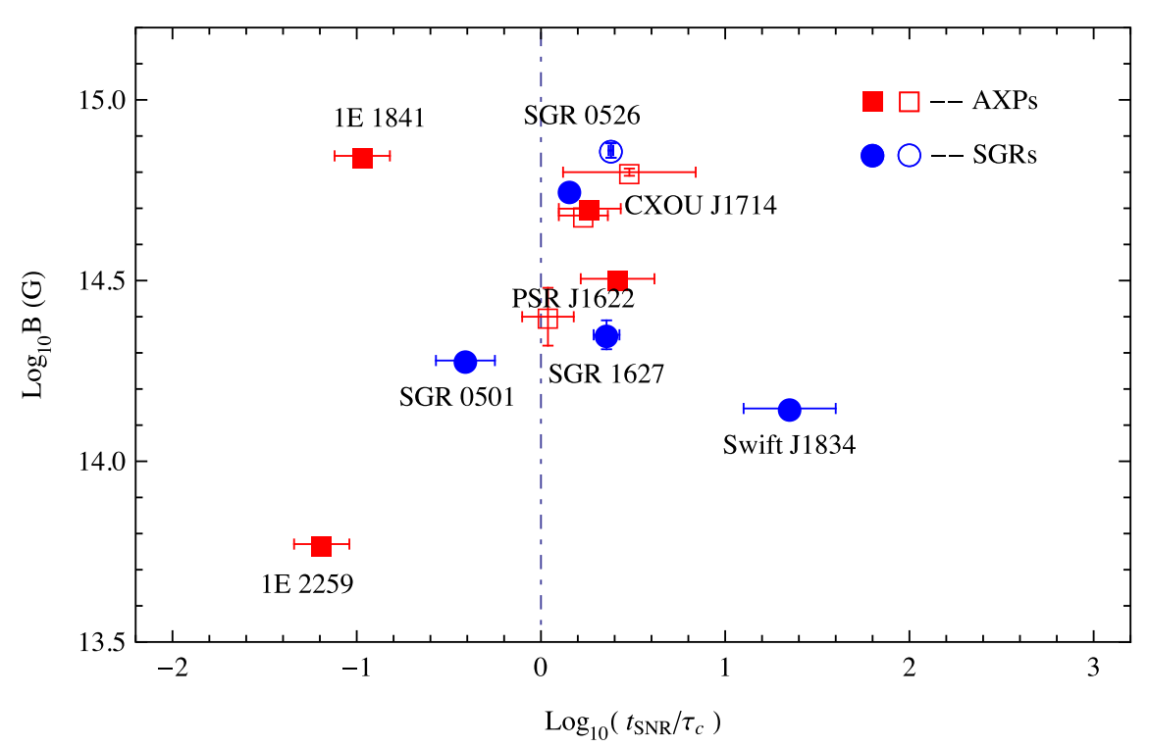





Relation between characteristc age and real age
磁星自转演化的研究

Slide 19
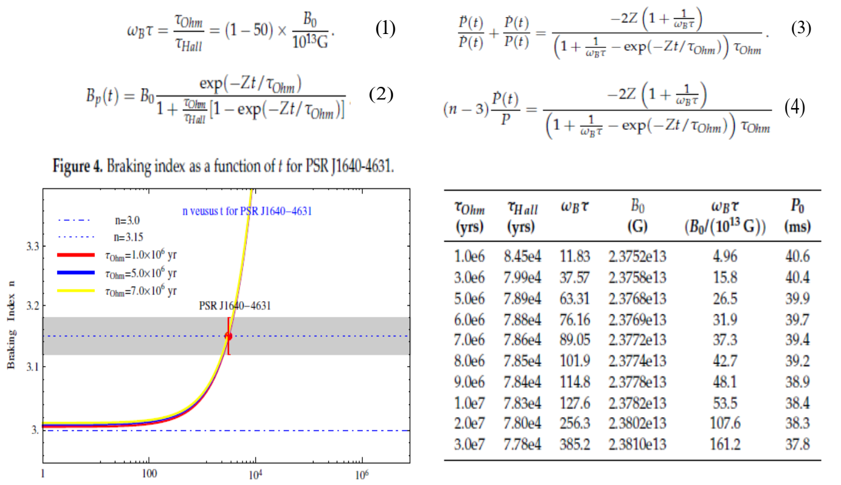
Spin-down evolution for high-braking pulsar
Notes:
Here I derive fourm important expressions for magnatization parameter, dipole magnetic field, period,amd its firsm dirivative and second derivaves and braking index.

Slide 20
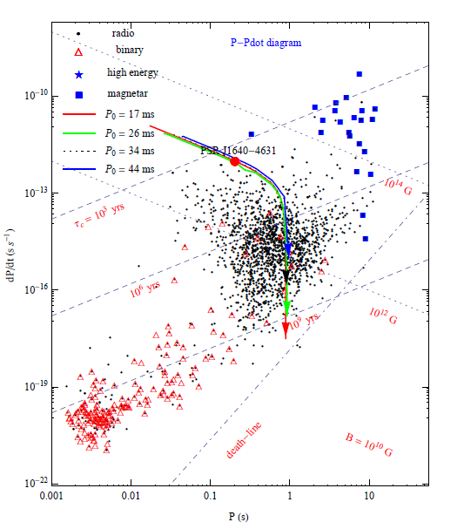
(Gao et al. 2017，ApJ）
Notes:
This schem depicts the spin-down evolution for high braking pulsar in the p_Pdot , different lines correspond to different initial spin periods.

Slide 21
The model of magnetar crustal mageto-thermal evolution
Magnetars have higher surface thermal temperatures than those of NSs.
The X-ray luminosities of ome magnetars are much larger than their spin-down luminosities,
Theory of NS minimal cooling was developed after the first discovery of X-
ray radiation on the NS surface.
1 Basic heat evolution equation is given as
H =H_{B}+H_{EC},
High surface thermal radiation from magnetar may be attributed to heating caused by the decay of crustal magnetic field or/and electron capture.
where L_{v} is the total neutrino luminosity.
L_{γ} is thermal luminosity
(Gao et al. 2023，in preparion）

Slide 22

2. Magnetic field decay
Then H_{B} can be estimated by
The crustal magnetic field evolution can be divided into two stages: the initial stage with rapid non-exponential decay and the later slow exponential decay.
where dV = 4πr²dr and r/R- 0.98, magnetic
to-thermal conversion coefficient ξ ∼10^-2-
10^-1.
3. Electron capture in the crust
When the magnetic field decays, the crust loses its magnetic pressure support and must be compensated by increasing the electron degeneracy pressure, the increase in the electron Fermi energy induces EC reactions , implies complex heating mechanism .
Taking the first derivative of the dipole field with respect to time, we obtain

Slide 23
The total thermal energyb release rates via EC is obtained as
where Γ is electron capture rate h_{EC} is the total magnetic energy contained in a crust of scale height, μ_{e} is the mean molecular weight per electron, E_{F} is an electron capture threshold energy with super-strong magnetic field.
In general, a nucleus will undergo several electron captures in the outer crust as the field decays, but for most reactions of heat per nucleus is estimated q < 0.1 MeV.
F_{X} = 1.41(3) × 10¹¹ erg cm⁻² s⁻¹
To find the total EC rate per proton, we integrate over all initial electron states and over dE_{ν}
In the interior of a NS, for neutrinos (antineutrinos), (1 – f_{ν})= 1; for electrons, when E_{e} < E_{F} (e), f_{e} = 1, and when E_{e} > E_{F} (e), f_{e} = 0. The average kinetic energy of the outgoing neutrinos <L_{ν}> can be calculated by

Slide 24
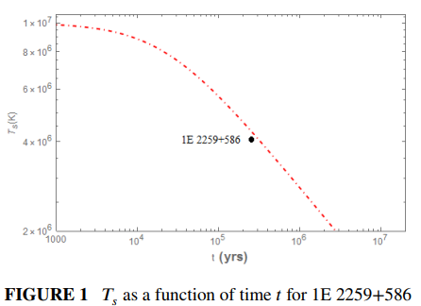
4. Applied to AXP 1E 2259 + 586
Assuming B₀ = 5.0 × 10¹⁴ G, when σ₁ = 8.75 × 10²⁴ s⁻¹, H_{B} = 5.35(3.0) × 10³⁵ erg s⁻¹, and C_{v} ∼ 10¹⁷ erg cm⁻³ K⁻¹, T (0) = 1×10⁷ K.
Notes:
We applied this model to a typical magnetar AXP 1E 2259+586, and compare the fit results with
observations of persistent thermal radiation from this source.. Continuing to monitor
1E 2259+586 and the other bright magnetars is critical to better understand the long-term evolution of the X-ray emission
properties of magnetars.

Slide 25
Summary
The observation and theoretical study of magnetar are one of hot topics in the field of pulsar research. The persistent thermal emissions and bursts of magnetars indicates the presence of some internal heat sources in their outer crusts. In this work, we have formulated the energy balance equation and used in investigating the thermal evolution in the magnetar crust by considering the heating mechanism, whcih inculde the Ohmic dissipation and the electron capture processes. This model was compared with persistent X-ray observations for several canonical magnetars.

Slide 26
Thank you
for your attention!

