Slide 1
Investigations on the equation of state of neutron star with density-dependent relativistic mean-field model
Kaixuan Huang (黄开轩)
School of Physics, Nankai University, China
huangkaixuan@mail.nankai.edu.cn
Quarks and Compact Stars
Sept. 23-26, 2023 @Yangzhou, China
Notes:
Hello everyone, I’m HuangKaixuan, I am a PhD student from NanKai university.
I am so glad to be here to share my work. Totay I want to talk about the equation of states and properties of neutron stars with the density-dependent relativistic mean-field model. I”ll call it the DDRMF model for short.

Slide 2
Outline
Introduction
Density-dependent relativistic mean-field model
Massive neutron star from DDRMF model
Hyperonic star from RMF model
Light neutron star from DDRMF model
Summary
Notes:
Here is my outline today, firstly, I’ll give a brief introduction to nuclear matter and neutron stars. and then introduce our works about using DDRMF model to study different neutron stars. Finally I"ll give a conclusion.

Slide 3
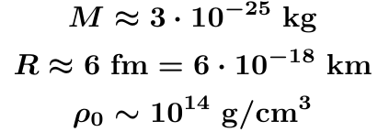
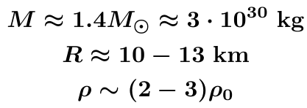
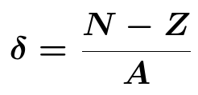
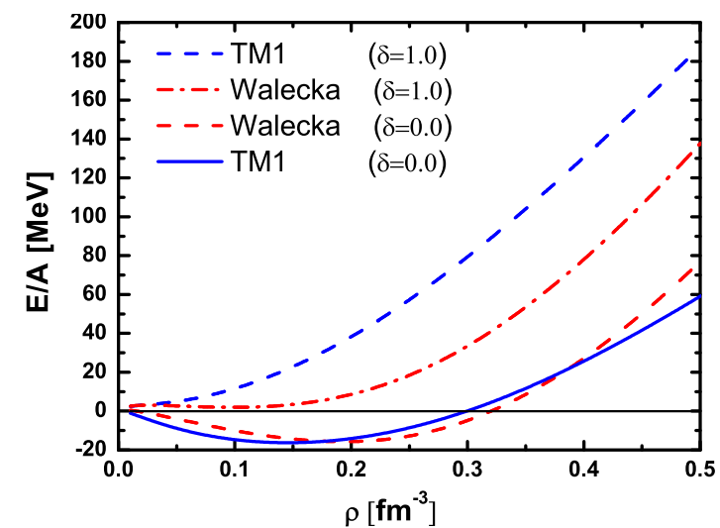
1
Introduction: Nuclear Matter
An infinite uniform system of nucleons, where the Coulomb interaction is switched off.
Atomic nucleus, e.g.
Neutron Star
Strongly connected
Nuclear saturation density
Equation of state (EOS) of Nuclear Matter
Semi-empirical mass formula:
asymmetry factor
Equation of state:
Symmetric Nuclear Matter (SNM):
PNM
Symmetry Energy
Symmetry Energy:
SNM
Neutron star matter: high isospin-asymmetry
Notes:
I’ll start with nuclear matter, we know that it’s an infinite uniform system of nucleons. This kind of system can be found in the core region of a heavy nucleus or the core of neutron Stars. If we compare a neutron star with an atomic nucleus, for instance, the lead208, we can calculate the average densities with the masses and radii, then we can find the density in both systems is pretty similar, that is, several times nuclear saturation density.
Although the scales are so different, the properties of neutron stars and nuclei are strongly connected because they explore similar nuclear densities where strong interactions become very important. So if we observe one, it will constrain the other.

Slide 4
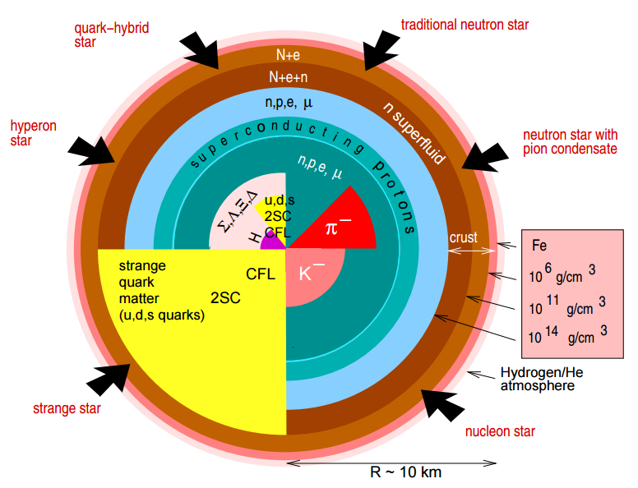
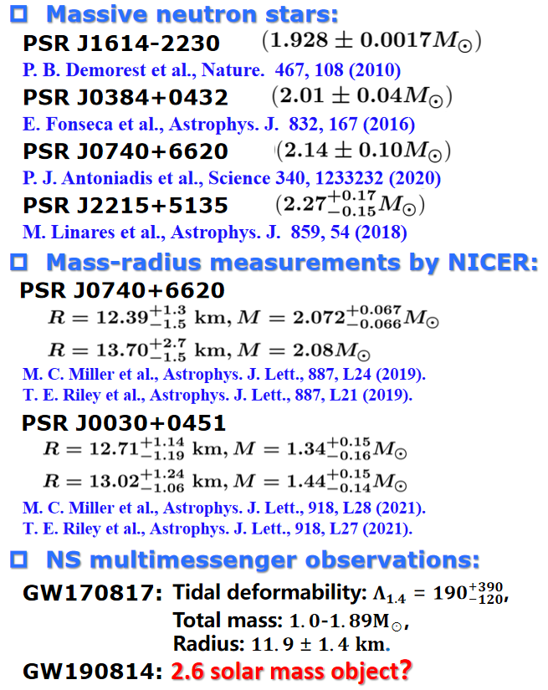
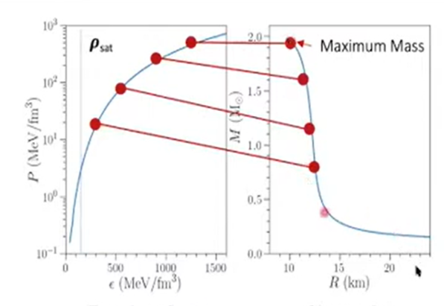
1
Introduction: Neutron Star
Observations and Constraints:
F. Weber, Progress in Particle and Nuclear Physics, 54, 1 (2005)
Tolman-Oppenheimer-Volkov (TOV) equation:
Notes:
We have known that neutron stars have this onion-like structure. What we care about most is the CORE, it’s really interesting because the core is determined by the interactions in strongly interacting matter. The outer core consists mainly of neutrons and protons, but then if we go to the inner core, there may be exotic degrees of freedom, such as hyperons, meson condensates, or quarks.
Up to now, there have been many observations of neutron stars, including three massive neutron stars, the simultaneous mass-radius measurement of the two pulsars, and the first observation of a binary neutron star merger event GW170817, the merger was described in different wavelengths. So we got many information, like the total mass, the tidal deformability, and the radius at 1.4solar mass. Moreover, the secondary object of GW190814 has also attracted a lot of attention, since it may be the heaviest neutron star or the lightest black hole ever seen.
The neutron star structure is determined by solving the TOV equation with the EOS of neutron star matter as an input, which is the pressure and energy density relation. Therefore, We need a good nuclear many-body method that not only describes finite nuclei well but also constructs a good EOS of neutron star matter to satisfy the constraints of the observations.

Slide 5
Outline
Introduction
Density-dependent relativistic mean-field model
Massive neutron star from DDRMF model
Hyperonic star from RMF model
Light neutron star from DDRMF model
Summary
Notes:
So the relativistic mean field (RMF) model is a great success both in nuclear physics and astrophysics.

Slide 6
2
Density-dependent relativistic mean-field (DDRMF) model
NLRMF Lagrangian density:
$$σ, ω,ρ$$
Hartree
DDRMF Lagrangian density:
density-dependent
Couplings for $σ$ and $ω$ mesons:
Couplings for $ρ$ and $δ$ mesons:
Constraints reduce the number of free parameters in rational functions:
Mean-field approximation:
Notes:
In this model, nucleons interact with each other through exchanging mesons, and coupling can be determined by fitting properties of nuclear matter or finite nuclei. $σ$ and $ω$ mesons are introduced to produce attractive scalar fields and short-range repulsion, respectively. and $ρ$ meson is used to describe the isospin. Then nonlinear (NL) self-interactions and other mesons, like delta meson, are subsequently introduced.
After that, someone proposed the density-dependent RMF models with reference to the Dirac-Bruckner theory of nuclear matter. At this point, the parameters of those nonlinear terms are contracted into density-dependent coupling constants.
The most common form for the $σ$ and $ω$ couplings is a rational function. For the $ρ$ meson, we choose a simple exponential form. These conditions are used to reduce the number of free parameters in the rational function.
In the mean-field approximation, the meson and nucleon field operators are replaced by their expectation values.

Slide 7
2
2
DDRMF Model
Equations of motion of DDRMF:
Self-consistently
The energy density, and pressure of infinite nuclear matter:
$β$-equilibrium and charge neutrality in neutron star matter:
Notes:
Then the equations of motion can be greatly simplified, this is for the nucleons and these are for the mesons. These equations can be solved self-consistently. Finally, we can have the EOS of nuclear matter, which is the relation between pressure and energy density.
The formalism can be applied to neutron-star matter, we assume that neutron-star matter consists of neutrons, protons, electrons, and muons which are undergoing β decay until the particles reach β equilibrium. So the neutron star matter should satisfy the beta equilibrium condition. Moreover, the charge neutrality of the system is another condition.

Slide 8
Outline
Introduction
Density-dependent relativistic mean-field model
Massive neutron star from DDRMF model
Hyperonic star from RMF model
Light neutron star from DDRMF model
Summary
Notes:
Then we use the DDRMF theory to study the properties of nuclear matter and neutron stars.

Slide 9
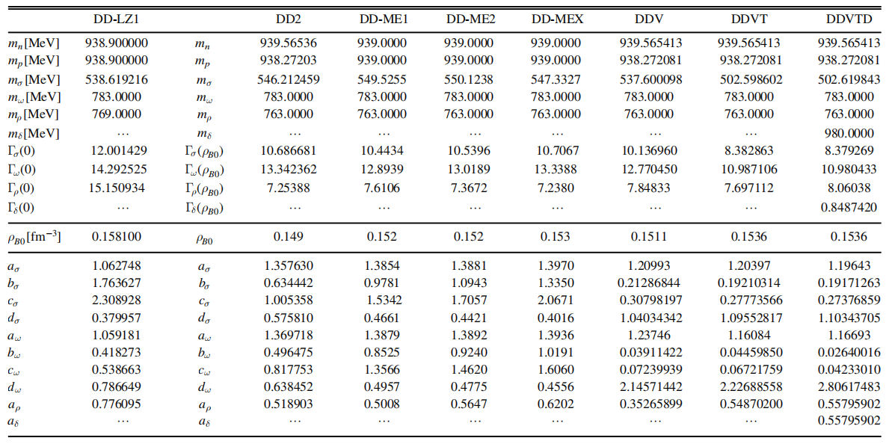
3
Massive neutron star from DDRMF model
Parameters of different DDRMF models:
K. X. Huang, J. N. Hu, Y. Zhang & H. Shen, Astrophys. J. 904, 39 (2020)
DD2
DD-ME1
DD-ME2
DD-MEX
DD-LZ1
DDV
DDVT
DDVTD
The density-dependent behaviors of the meson-nucleon couplings:
Stronger
Stronger
Softer
In DDVT and DDVTD, the tensor couplings between vector mesons and nucleons were considered.
Notes:
We choose 8 different DDRMF parameter sets.
1、This picture shows the density-dependent behaviors of these coupling constants. 2、These five parameter sets can produce stronger sigma and omega couplings. But they are very small in DDVT and DDVTD sets, the tensor couplings between vector mesons and nucleons were considered when fitting the properties of finite nuclei. The ρ meson coupling vanishes at very high density because of the exponential form couplings.

Slide 10
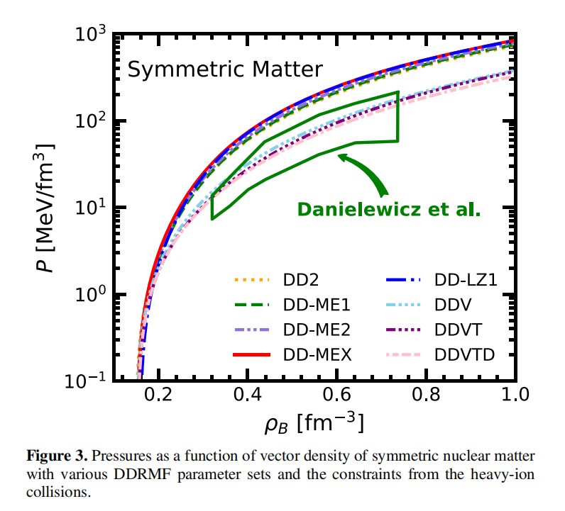
3
Massive neutron star from DDRMF model
Saturation properties of SNM:
K. X. Huang, J. N. Hu, Y. Zhang & H. Shen, Astrophys. J. 904, 39 (2020)
DD2
DD-ME1
DD-ME2
DD-MEX
DD-LZ1
DDV
DDVT
DDVTD
EOSs of nuclear matter:
Stiffer group
heavy-ion collision
Softer group
The vector coupling strengths in the stiffer group are obviously stronger than those in the softer group sets.
Notes:
(SNM表)This will lead to 1. the effective nucleon masses in DDVT and DDVTD are relatively larger according to the definition of effective mass. (E/A图)2.1 These equations of state (EOSs) at low density are similar because all the parameters were determined by properties of finite nuclei, where central density is around nuclear saturation density. 2.2 But at higher density, the EOSs can be separated into two groups, the stiffer one and a softer one, because the vector coupling strengths in the stiffer group are obviously stronger than those in the softer group sets. (P-nb图)3. The constraints from heavy-ion collisions support the softer group sets.

Slide 11
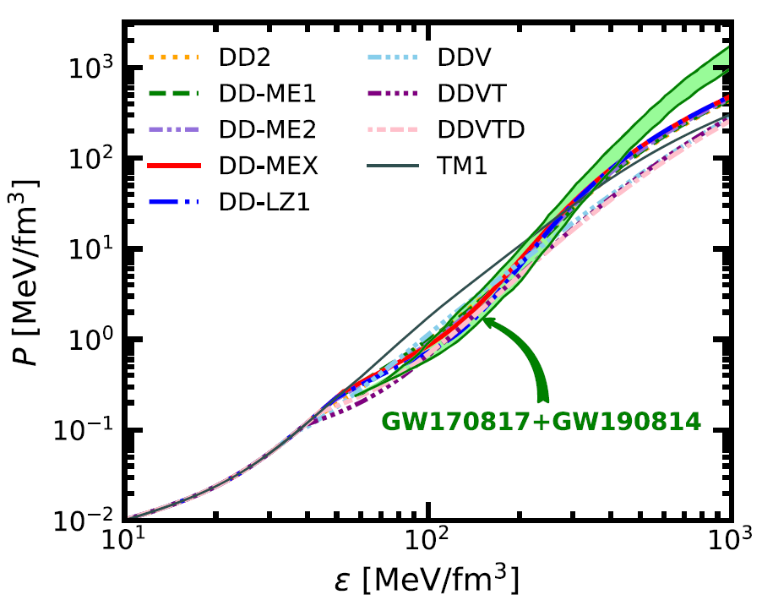
3
Massive neutron star from DDRMF model
K. X. Huang, J. N. Hu, Y. Zhang & H. Shen, Astrophys. J. 904, 39 (2020)
EOSs of neutron star matter (pressure vs. energy density):
The EOSs from stiffer group can satisfy the constraints from the gravitational wave detection, while those from softer group sets start to become lower than the constraint band from $ε=300 MeV⋅fm^{−3}.$
Notes:
Together with the conditions of beta equilibrium and charge neutrality, we can have the EOSs of neutron star matter

Slide 12
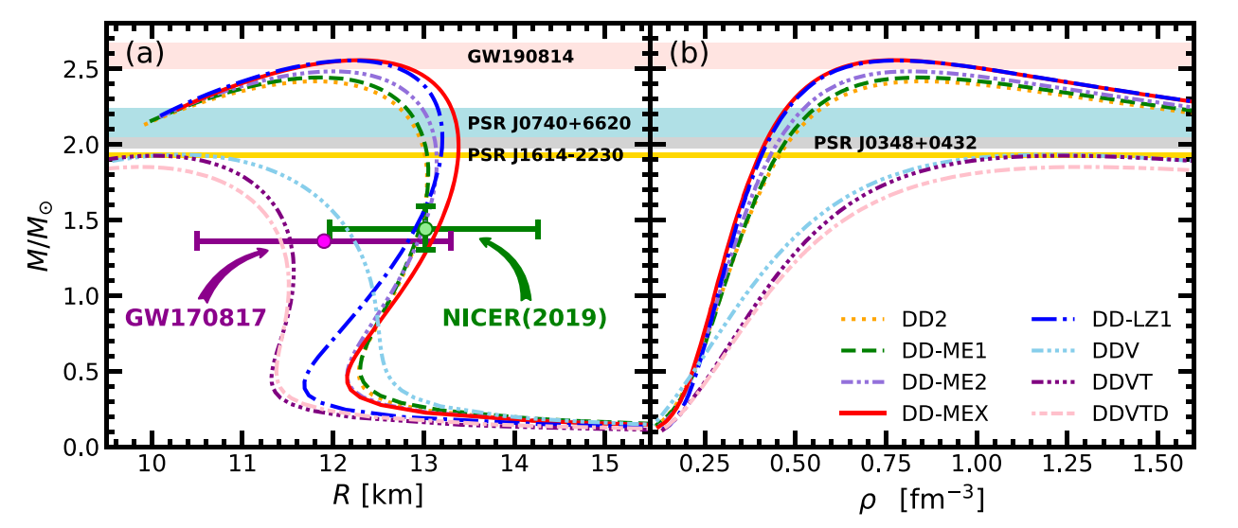
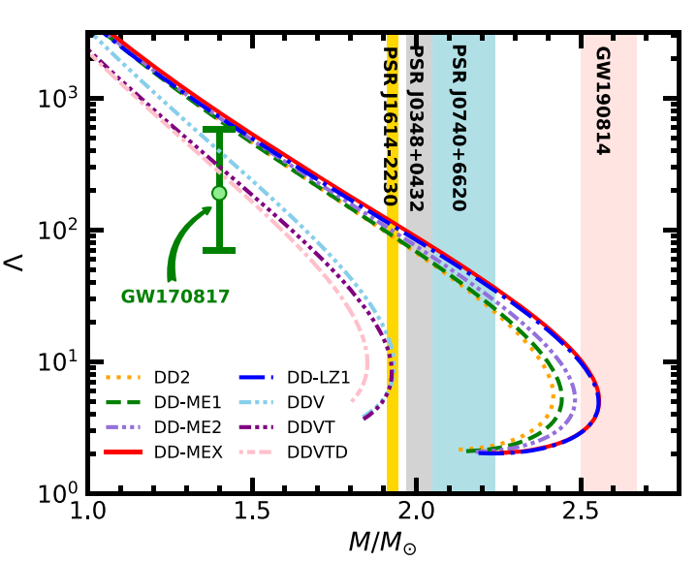
3
Massive neutron star from DDRMF model
Neutron Star Properties:
GW190814:
Mass-radius relation:
Tidal deformabilities:
DD-MEX and DD-LZ1 sets can support the neutron star above 2.5$M_{⊙}$ because of their strong repulsive contributions from $ω$ meson, which are in accord with the observed mass of the secondary object in GW190814.
K. X. Huang, J. N. Hu, Y. Zhang & H. Shen, Astrophys. J. 904, 39 (2020)
Notes:
, and then the mass-radius relation of a static neutron star can be solved by TOV equation with the EOSs. (M-R图)1. We can find that DD-MEX and DD-LZ1 sets can support the neutron star above 2.5 solar mass because of their strongest repulsive contributions from the ω meson. Their maximum masses can approach 2.56 solar mass, which can be in accord with the observed mass of the secondary compact object in GW190814, with a mass of 2.50–2.67 solar mass. 3. At the same time, the stiffer group can satisfy almost all the mass-radius constraints. (Lambda图)4. We also calculate the tidal deformability. In fact, none of the stiffer EOSs, whose tidal deformability can satisfy constraints from GW170817, while the softer group can.

Slide 13
Outline
Introduction
Density-dependent relativistic mean-field model
Massive neutron star from DDRMF model
Hyperonic star from RMF model
Light neutron star from DDRMF model
Summary
Notes:
In the introduction, I mentioned that in the inner core of the neutron star, strange degrees of freedom, such as the hyperons will appear.These neutron stars that contain hyperons are called hyperonic star.

Slide 14
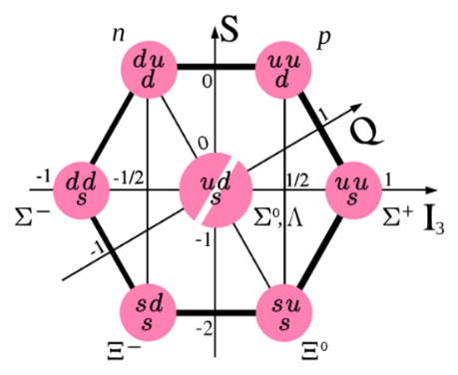
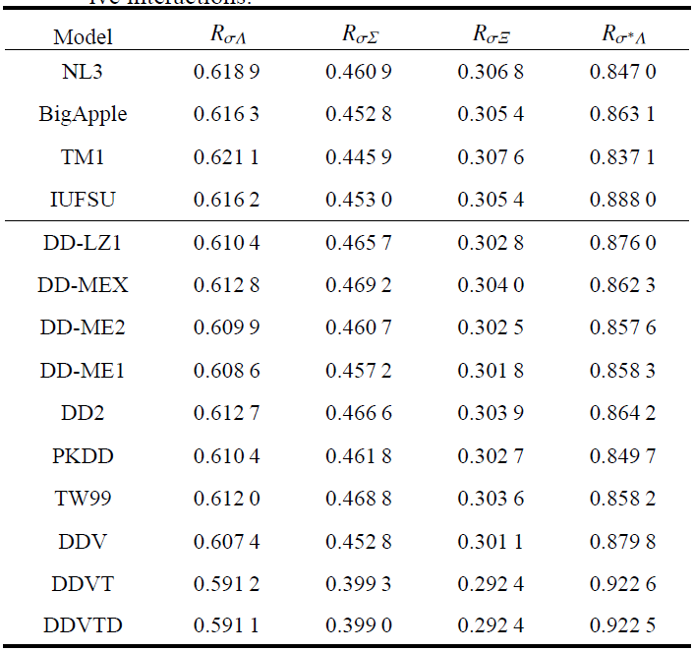
4
Hyperonic star from RMF model
Mesons:$σ, σ^{∗},ω,φ, ρ, δ$
NLRMF Lagrangian density:
Baryons:
DDRMF Lagrangian density:
The meson-hyperon coupling constants:
For $ω, φ, ρ, δ$ mesons:
For $σ$meson: （$ρ_{B0}$: saturation density）
For $σ^{∗}$ meson:
K. X. Huang, J. N. Hu, Y. Zhang & H. Shen, Nucl. Phys. Rev. 39, 2 (2022)
Notes:
We also systematically studied the hyperonic star with the NL and DDRMF model. In our RMF model, we also added $φ$ mesons to increase the repulsion to make the EOS stiffer because the inclusion of the hyperons will reduce the maximum mass of neutron stars. And here the sigma* meson is also included.
(Couplings)For these mesons, the hyperon-meson coupling constants are from the simple quark model. But for igma and sigma* meson, the meson-hyperon coupling constants are obtained by fitting empirical hyperon-nucleon potential or Double-Λ hypernuclei potentials in symmetric nuclear matter from the hypernuclei experimental observables. These are the calculation result of the coupling constant.

Slide 15
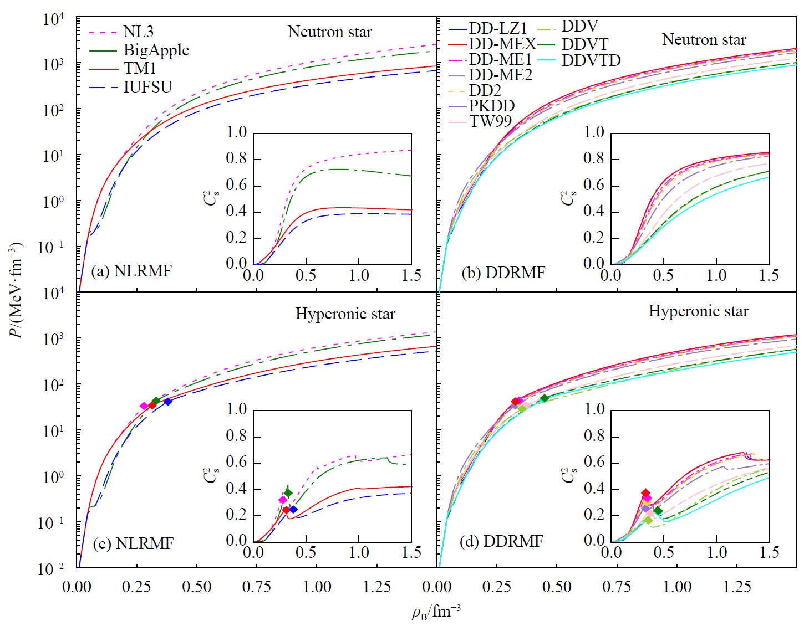
3
4
Hyperonic star from RMF model
EOSs of hyperonic star matter (pressure vs. baryon density):
Apparently, the inclusion of the hyperons can soften the EOS and can also reduce the speed of sound.
K. X. Huang, J. N. Hu, Y. Zhang & H. Shen, Nucl. Phys. Rev. 39, 2 (2022)
Notes:
These are the EoSs of hyperonic star matter from the NLRMF and DDRMF models. The EOSs without hyperons are also shown for comparison. Apparently, the inclusion of the hyperons can soften the EOSs. The sound speed of hyperonic star matter is not smooth anymore because the appearance of hyperon can sharply reduce the speed of sound, especially at first onset density.

Slide 16
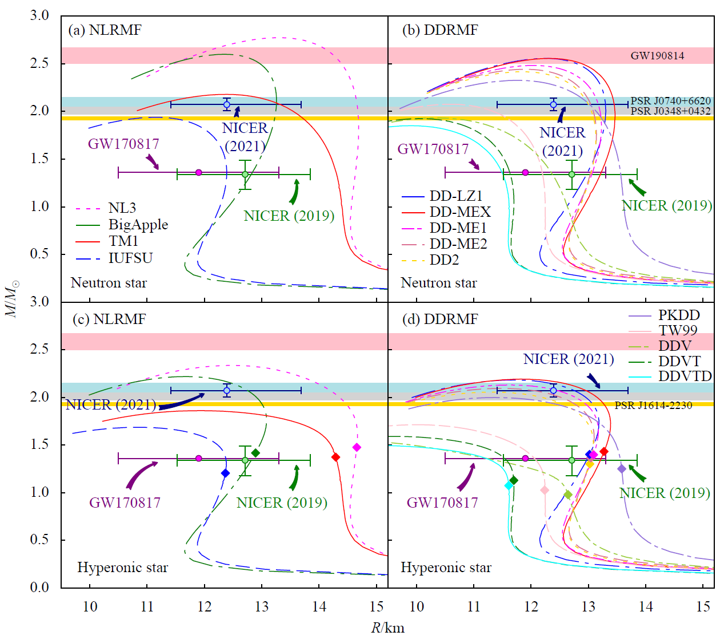
3
4
Hyperonic star from RMF model
Mass-radius relation:
K. X. Huang, J. N. Hu, Y. Zhang & H. Shen, Nucl. Phys. Rev. 39, 2 (2022)
Similarly, after considering the hyperons, the maximum masses of the hyperonic star are reduced by about 15%-20%, but some of the parameter sets can still produce a mass of $2M_{⊙}$.
Notes:
After considering the hyperons, the maximum masses of the hyperonic star are reduced by about 15%-20%, but some of the parameter sets can still produce a mass of 2 times the solar mass.

Slide 17
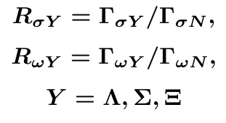
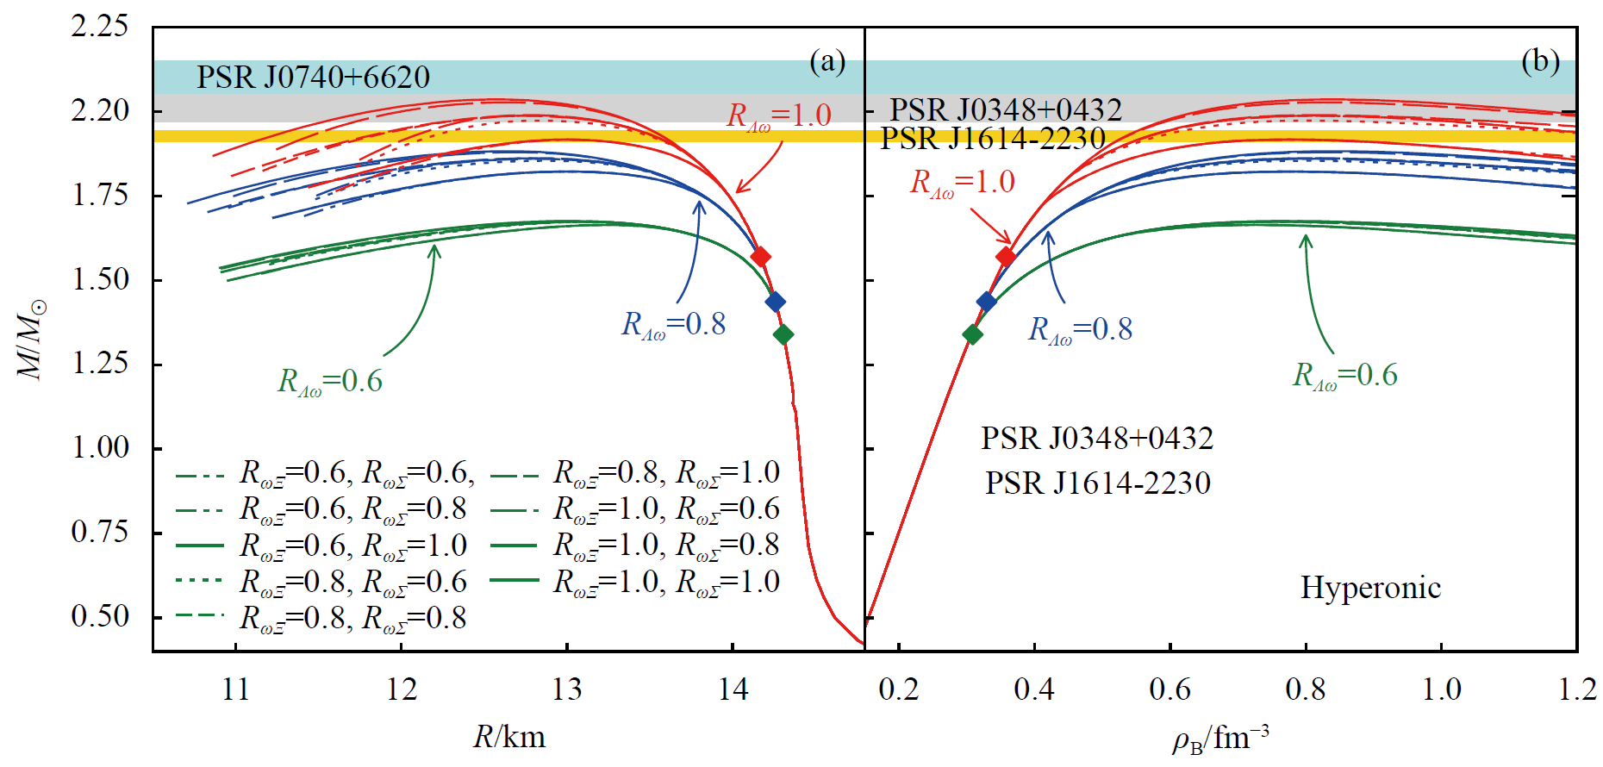
4
Hyperonic star from RMF model
The correlations of hyperon coupling constants:
From the definition of $U_{Y}^{N}$ above, we can find that $R_{σY}$ and $R_{ωY}$ have a linear correlation:
Coupling ratio:
TM1
If the $ω$ meson-hyperon coupling constants are large enough, we can also get massive neutron stars up to $2M_{⊙}$.
K. X. Huang, J. N. Hu, Y. Zhang & H. Shen, Nucl. Phys. Rev. 39, 2 (2022)
Notes:
Before, we mentioned that the omega meson-hyperon couplings are determined by the simple quark model, but actually, there’s no experimental data can give these couplings, so the omega-hyperon couplings can be adjusted. From the definition of the hyperon-nucleon potential, we can find that the coupling ratio between the omega meson and sigma meson is almost linear. So the sigma meson-hyperon couplings can also changed with the omega couplings. Based on that, we studied the effect of the omega-hyperon coupling constant on the properties of neutron stars using the TM1 model. We find that if the omega-hyperon coupling constant is large enough, we can also get massive neutron stars.

Slide 18
Outline
Introduction
Density-dependent relativistic mean-field model
Massive neutron star from DDRMF model
Hyperonic star from RMF model
Light neutron star from DDRMF model
Summary

Slide 19
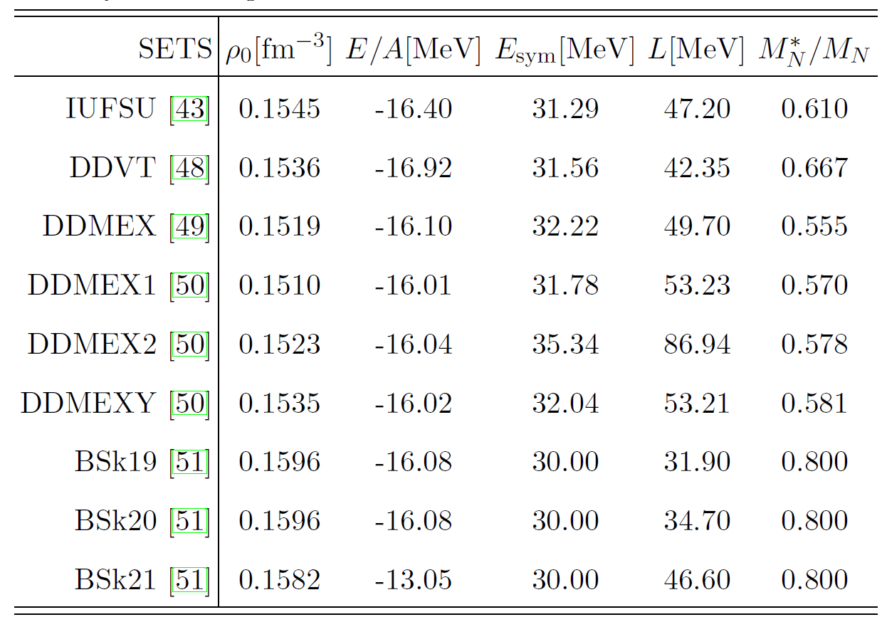
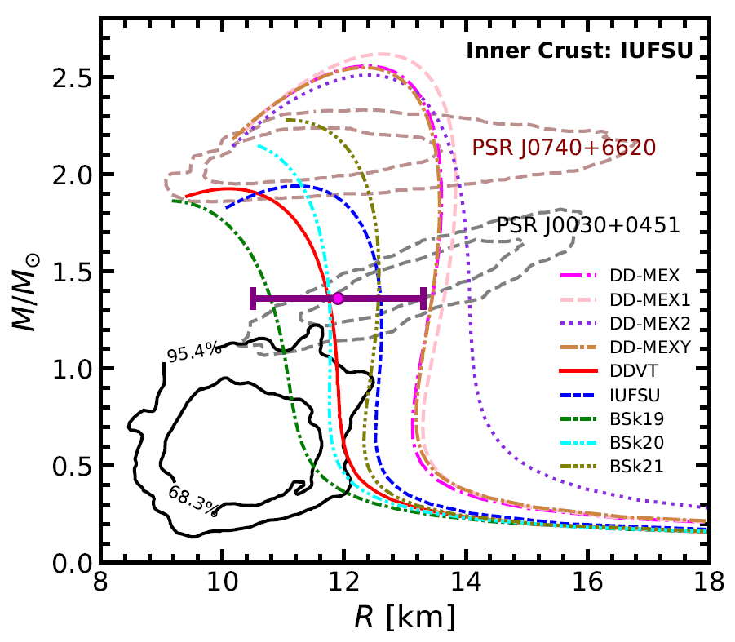
5
Light neutron star from DDRMF model
A recent report has identified a central compact object (CCO) within the supernova remnant HESS J1731-347, with a mass and radius with
A quark star? Hybrid Star? or a neutron star?
EOS of HESS J1731-347 from the DDVT model with tensor coupling
DDVT can produce a relatively small radius at the low-mass region.
DDVT:
S. Typel, D. A. Terrer, Eur. Phys. J. A 56, 160 (2020)
Saturation properties:
Mass-Radius relation:
DDVT and BSk series with large $M_{N}^{∗}$ are capable of generating smaller radii in the lower mass region, which all fall within the 95 % confidence region of HESS J1731-347.
K. X. Huang, J. N. Hu, Y. Zhang & H. Shen, arXiv:2306.04992
Notes:
Recently a light compact object was reported, the mass is about 0.77M⊙ and corresponding radius is about R = 10.4 km. So we tried to construct an EOS to describe NS that can satisfy the constraint. In previous studies, we calculated the properties of neutron stars with different DDRMF parameter sets, and we find that DDVT can produce a relatively small radius.

Slide 20
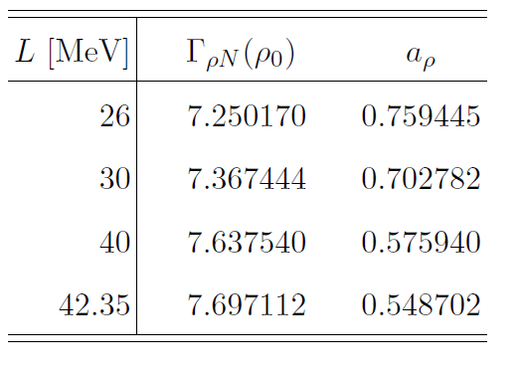
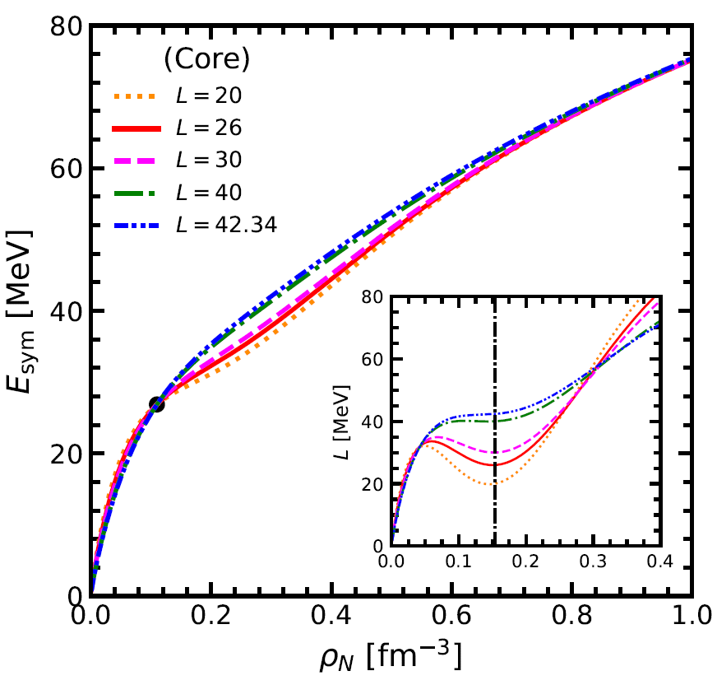
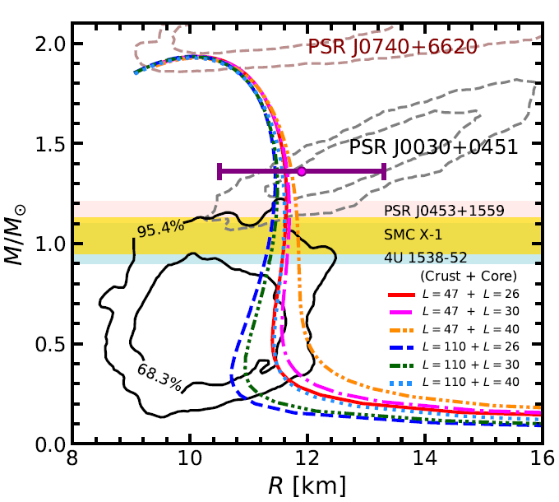
5
Light neutron star from DDRMF model
Impact of the symmetry energy
Core EOS: Parameter $Γ_{ρN} (ρ_{0} )$and $a_{ρ}$are generated from the DDVT model for different 𝑳 at the saturation point with $E_{sym}$fixed at $ρ_{B} = 0.11 fm^{−3}:$
A smaller $L$ for the core EOS could provide a smaller radius above the intermediate-mass region.
Behavior of the symmetry energy:
Mass-Radius relation:
$$c_{s}^{2}=\frac{∂P}{∂ε}<0$$
The constructing EOSs with larger $L$ for the crust EOS and smaller $L$ for the core EOS will produce smaller radius at the low-mass region.
K. X. Huang, J. N. Hu, Y. Zhang & H. Shen, arXiv:2306.04992

Slide 21
Outline
Introduction
Density-dependent relativistic mean-field model
Massive neutron star from DDRMF model
Hyperonic star from RMF model
Light neutron star from DDRMF model
Summary

Slide 22
6
Summary
We use DDRMF models, which are determined by fitting the properties of finite nuclei, to study the properties of neutron stars.
The secondary object in GW190814 may be the heaviest neutron star with the stiffer EOS from DDRMF models.
The mass of hyperonic stars can satisfy recent massive neutron star measurements if the EOS was hard enough.
The radius can be small at low-mass regions if the tensor coupling between vector meson and nucleon is considered in the DDRMF model, which can increase the effective nucleon mass. Therefore, the CCO in HESS J1731-347 may be the lightest neutron star.
There are still large uncertainties for dense nuclear matter due to the lack of related experimental data.

Slide 23
Thank you ！

