Slide 1
Revisiting effects of hyperonization and core-crust transition on tidal deformability of neutron stars
蒋维洲 (W. Z. Jiang)
东南大学物理学院 (Southeast Univ.)
Contributors to content of this talk: Niu Li, Jing Ye, Sina Wei, W.Z.Shangguan, R.Y. Yang, B.A. Li, L.W. Chen et al.

Slide 2
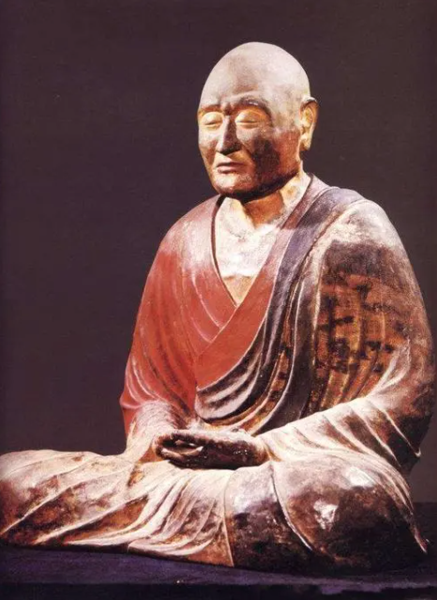
Yangzhou is a special city
鉴真(がんじん)（688-763) , born in Yangzhou, is Envoy of culture, peace and friendship.
He preached Vinaya (precepts) of Buddhism in Yangzhou and was invited and prepared on the trip to Nihon for 5th times before succeeded.

Slide 3
Content
1
Crust and core of neutron stars
2
Density dependent hyperon-nucleon interaction
Tidal deformability with core-crust interfaces
and core hyperonziation
3
4
Summary

Slide 4
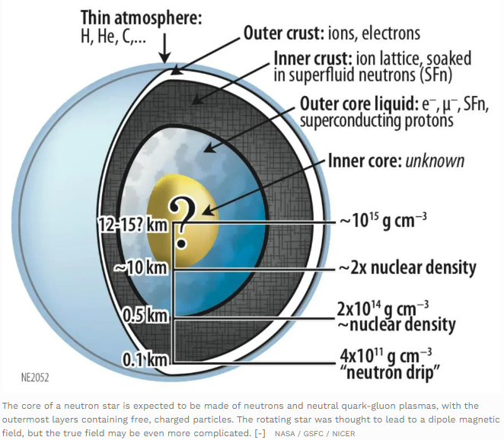
https://astrobites.org/2014/08/11/peeling-apart-a-neutron-star/

Slide 5
core-crust transition: Homogeneous to inhomogeneous matter
neutron star radius
pulsar glitches
crust meltdown in inspiraling binary neutron stars
asteroseismology from giant magnetar flares
crust relaxation in cooling and accreting neutron stars

Slide 6
Method for obtaining transition density
Hydrodynamic method: Vlasov equation, Master equation
Chomaz et al PR389,263(04), Ducoin, et al.NPA 789, 403 (07), Zheng & Chen, PRD 85, 043013(12)
Thermodynamic method: P&μ instability condition
Douchin & Haensel, PLB 485, 107 (00), Li, et al, NPA 699, 493 (02), Kubis, PRC 76, 025801 (07).
Relativistic RPA: Dyson equation
Lim &Horowitz, NPA 501, 729(89), Carriere, Horowitz, et al, ApJ 593, 463 (03); Ma, et al, NPA 686, 173 (01)

Slide 7
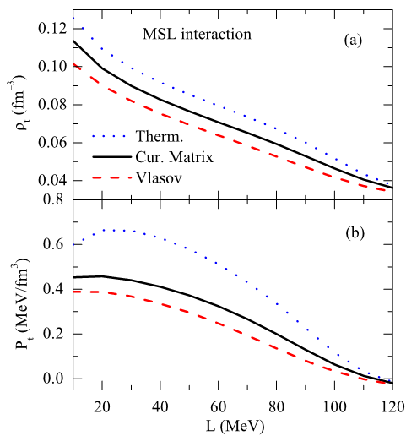
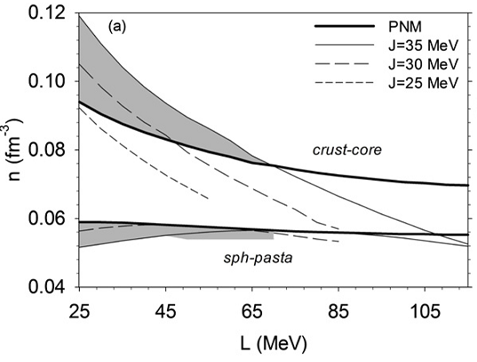
Core-crust transition density $ρ_{t}$
Zheng et al PRD85, 043013 (12)
Xu et al ApJ697:1549(09)
Newton et al ApJss204:9(13)

Slide 8
Discrepency of $ρ_{t}$with various methods
Models | RRPA | Thermodynamic
NL3 | 0.0519 | 0.0856
TM1 | 0.0582 | 0.0870
IU-FSU | 0.0870 | 0.0919
SLC | 0.1432 | 0.0904
SLCd | 0.1443 | 0.0915

Slide 9
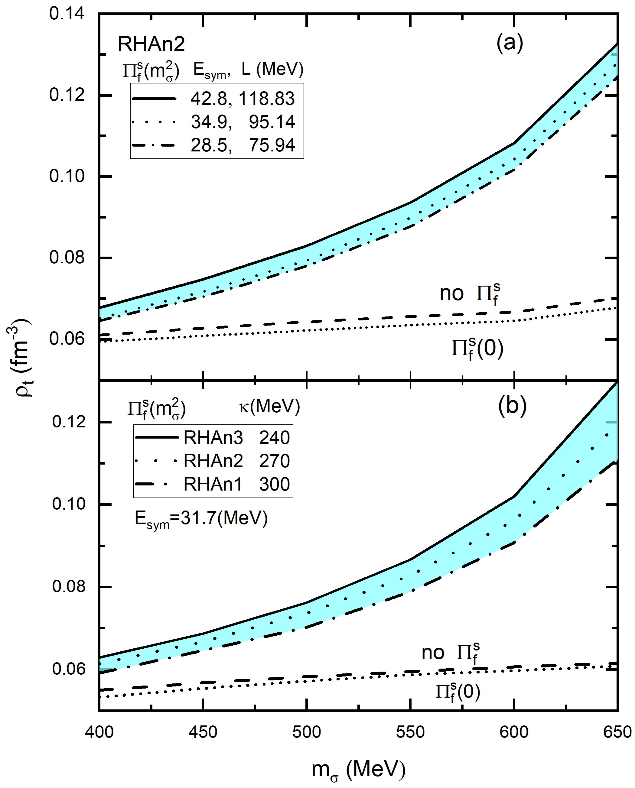
Vacuum polarization shifts $ρ_{t}$
Li, et al PLB 839 137765(23)

Slide 10
Observations of large-mass neutron stars
T. Guver, et al, Astrophys. J. 712, 964 (2010): 1.74$M_{⊙}$
P. B. Demorest, et.al. Nature 467, 1081 (2010): 2.0$M_{⊙}$ of PSR J1614-2230 using Sharpilo delay.
J. Antoniadis, et al., Science 340, 448 (2013): $2.01±0.04 M_{⊙}$: Radio-timing observations of the pulsar J0348+0432 and the white-dwarf companion with 0.165-0.185$M_{⊙}$
Cromartie, et al. 2020, Nat Astron. 4, 72(2020): $2.08±0.07 M_{⊙}$of PSR J0740+6620
Difficulty to obtain $2M_{⊙}$NS with hyperons using standard nuclear EOS: eg. see Schulze et al. PRC 73, 058801(06); 84, 035801(11)
.

Slide 11
Efforts to accommodate hyperons
Additional repulsive boson (U-boson), see Krivoruchenko et al. PRD79, 125023(09)
New parameter from SU(6) symmetry: See Weissenborn et al. arXiv:1112.0234v1, PRC 85, 065802(12)
Large onset density of hyperon see Takatsuka et al. Prog. Theor. Phys. Suppl., 146, 279(02)
In-medium hyperon-meson interaction see Jiang, Li, Chen, ApJ756, 56(12)
Three-body force, see Yamamoto et al. PRC90, 045805 (14)

Slide 12
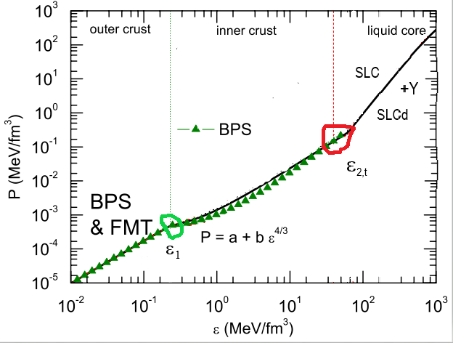

Slide 13
Our models with density dependent hyperon-nucleon interaction
RMF models with density dependent hyperon interactions
Jiang, Li, Chen, PLB653, 184 (07) which has the chiral limit in terms of vector manifestation of the local hidden symmetry
For hadron masses $Φ\left(ρ\right)=1−yρ/ρ_{0}$ in light of the work Brown,Rho, PRL66, 2720(91):

Slide 14
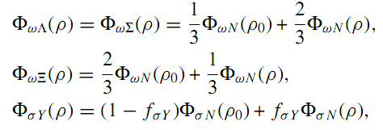
----Separable case
The special density dependence of hyperon-meson interaction is preferred to retain 2$M_{⊙} constraint$ & monotonous pressure with increasing the density.

Slide 15
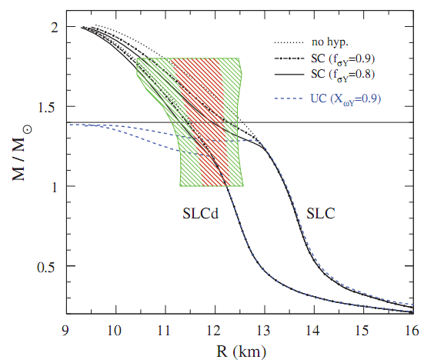
Our models with density dependent hyperon-nucleon interaction
Usual case can’t reach $2M_{⊙}$ constraint
Jiang, Li, Chen, APJ756,56（12）

Slide 16
Particle fractions vs UC/SC interactions
Changing $f_{σΛ}$

Slide 17
Additional parameter $α$ to readjust in-medium hyperon potential
$α$ can shift the fraction and onset density of hyperons in NS

Slide 18
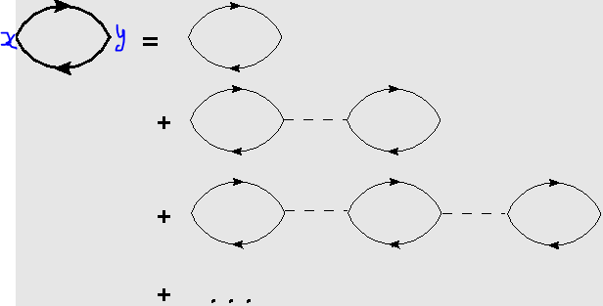
RRPA
Relativistic RPA: Dyson equation
Lim &Horowitz, NPA 501, 729(89), Ma, et al, NPA 686, 173 (01)，Carriere, Horowitz, et al, ApJ 593, 463 (03)
相对论无规相位近似：给定初点与终点，包含各种可能的随机行走，幅度固定，相位随机

Slide 19
Dyson equation
${\tilde{Π}}_{L}=Π_{L}+{\tilde{Π}}_{L}D_{L}Π_{L}$ $vertex:γ_{μ},γ_{ν}$
$${\tilde{D}}_{L}=D_{L}^{}+D_{L}^{}Π_{L}{\tilde{D}}_{L}$$
${\tilde{Π}}_{L}={\left(1−D_{L}^{}Π_{L}\right)}^{−1}Π_{L}$; $D_{L}={\left(1−D_{L}^{}Π_{L}\right)}^{−1}D_{L}^{}$
Dielectric function: $ε_{L}=det(1−D_{L}^{}Π_{L})$
$ρ_{t}$ is the largest density that $ε_{L}≤$0 holds for any momentum.

Slide 20
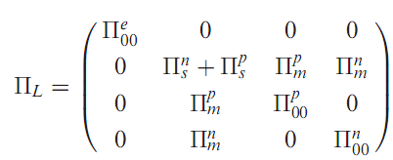
RRPA method in simple RMF model
Polarization matrix in nuclear matter, neutron star matter
Usually, the polarization just includes the density-dependent part, and the vacuum effect can have special effect on matter stability
Here $D^{0},d^{0}$ just means no meson Self-interactions
see Carriere et al, ApJ 593,463(03).

Slide 21
介子传播子in the presence of meson couplings？

Slide 22
Inclusion of the meson-meson couplings
Coupling terms between different mesons such as ω&ρ, $σ\&ω$ ➔modification to propagator matrix $D_{L}\left(q\right)$
树图近似下
$$Γ_{2}^{0}\left(x,y\right)=\frac{δ^{2}Γ^{0}}{δφ\left(x\right)δφ\left(y\right)}$$
The two-point canonical vertex is first evaluated, then obtain the inverse of the matrix→$D$

Slide 23
The crossing term ${d_{σω},d}_{ωρ}$included
ω&ρ coupling is used to simulate the density dependence of the symmetry energy

Slide 24
Tidal deformability
Perturbation to the spacetime metric, H:
$Λ_{g}=\frac{2}{3}k_{2}β^{−5}, β=\frac{M}{R}, k_{2} the Love number$
Discontinuity of $\frac{dε}{dp}$ may exist at interfaces of core-crust and hadron-quark transitions.

Slide 25
Interface discontinuity
Effect of first-order hadron-quark transition, see Postnikov et al. PRD82,024016(10)
Our focus on the core-crust interface$ρ_{t}, ρ_{2}$
Thermodynamic consistency: $p=μρ−ε$; $ρ=\frac{∂p}{∂μ}⇒ρ\left(ε\right)=ρ_{1}exp⁡(∫_{ε_{1}}^{ε} \frac{dε}{p+ε})$
Generally, $ρ\left(ε_{t}\right)≠ρ_{t}, Δρ⇒Δε$
$y=\frac{H^{′}}{H}$, at the interface, $y^{+}=y^{−}−\frac{Δε}{ρ\left(r_{t}\right)+3ρ_{Mt}}$
$ρ_{Mt}=M(r_{t})/V\left(r_{t}\right)$ , V is the volume

Slide 26
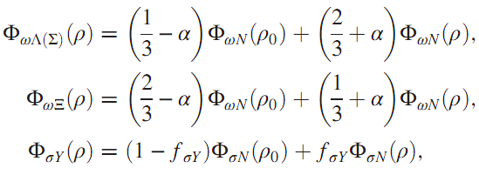
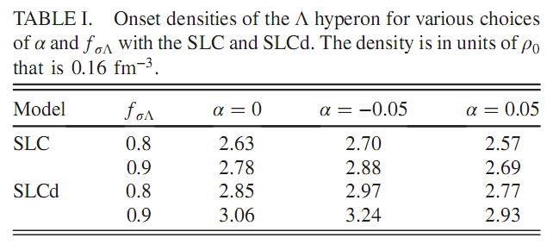
Some results
Models | RRPA $ρ_{t} (Δρ_{t})$ | Thermodyn.
SLC | 0.1432 (0.0067) | 0.0904 (0.0014)
SLCd | 0.1443 (0.004) | 0.0915 (0.00065)

Slide 27
Total hyperon number ratio

Slide 28
Love number vs mass & compactness $β$

Slide 29
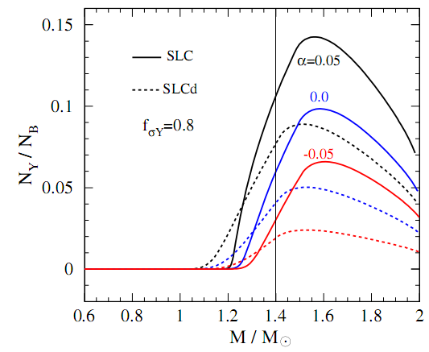
Above are the results with core-crust transition density obtained from thermodynamic instability
Shangguan et al. PRD104, 063035 (21)

Slide 30
Tidal deformability $Λ_{g}$ of 1.4$M_{⊙} NS$ with core-crust interfaces
DC: Direct connecting
Models | RRPA $Δε / DC$ | Therm. $Δε / DC$
SLCd $(L=61 MeV)$
$$f_{σΛ}=0.8,α=0.5$$ | 165.77 / 168.54 | 161.15 / 163.52
$$f_{σΛ}=0.8,α=0$$ | 197.04 / 200.47 | 191.02 / 193.91
$$f_{σΛ}=0.8,α=−0.5$$ | 218.54 / 222.45 | 211.62 / 214.97
SLC $(L=92 MeV)$
$$f_{σΛ}=0.8,α=0.5$$ | 226.01 / 229.28 | 217.03 / 220.30
$$f_{σΛ}=0.8,α=0$$ | 285.81 / 290.16 | 251.24 / 255.19
$$f_{σΛ}=0.8,α=−0.5$$ | 401.17 / 407.68 | 345.65 / 351.52
Core-crust discontinuity brings down $Λ_{g}$ by at most 2%.
Difference in transition density affects $Λ_{g}$ significantly in the model with stiff symmetry energy (SLC) with smaller hyperon.

Slide 31
Tidal deformability $Λ_{g}$ & Radius R of 1.4$M_{⊙} NS$
Models | RRPA $Λ_{g}$ ($Δε$) / Radius R | Therm. ${ Λ}_{g}$ ($Δε$) / R
SLCd
$$f_{σΛ}=0.8,α=0.5$$ | 165.77 / 12.11 | 161.15 / 11.28
$$f_{σΛ}=0.8,α=0$$ | 197.04 / 12.40 | 191.02 / 11.52
$$f_{σΛ}=0.8,α=−0.5$$ | 218.54 / 12.57 | 211.62 / 11.66
SLC
$$f_{σΛ}=0.8,α=0.5$$ | 226.01 / 13.79 | 217.03 / 12.14
$$f_{σΛ}=0.8,α=0$$ | 285.81 / 14.34 | 251.24 / 12.46
$$f_{σΛ}=0.8,α=−0.5$$ | 401.17 / 15.07 | 345.65 / 12.99
Difference in core-crust transition density has a big effect on Radius.
The limited effects on $Λ_{g}$ is due to the opposing contributions to R and Love number $k_{2}$.

Slide 32
Summary
2$M_{⊙}$ neutron star can accommodate hyperons with appropriate in-medium hyperon potential.
More hyperon accommodation agrees better with the extracted tidal deformability.
Sites of core-crust interface affect star radius significantly.
Sufficient hyperons immersed in the core favorably diminish the difference in tidal deformability arising from the core-crust transition.
Thank you for your attention！

