Slide 1
EOS vs. Modified Gravity in Compact Star
September 26, 2023
Quark Matter and Compact Stars 2023, Yangzhou
Taishi Katsuragawa (桂川 大志)
Institute of Astrophysics, Central China Normal U. (华中师范大学，天体物理研究所)
K. Numajiri, TK, S. Nojiri, PLB 826, (2022); arXiv: 2111.02660
K. Numajiri, Y. Cui, TK, S. Nojiri, PRD107, no.10 (2023); arXiv: 2302.03951
In collaboration with Kota Numajiri (Nagoya), Shin’ichi Nojiri (Nagoya, KMI), Yongxiang Cui (CCNU), Zu Yan(CCNU), Ruifeng Huang (CCNU)

Slide 2
Introduction
Compact star and gravitational theory
Compact stars can provide a multi-disciplinary research field in high-energy physics, involving astrophysics, particle physics, and gravitational physics:
Astrophysics
Neutron star, Pulsar, FRB, GRB etc.
Particle physics
Hadron/QCD physics, DM capture etc.
Gravitational physics (today’s topic)
Strong-gravity regime: Test of GR
--> Constraints on modified gravity
cf.) BH shadow, GWs etc.

Slide 3
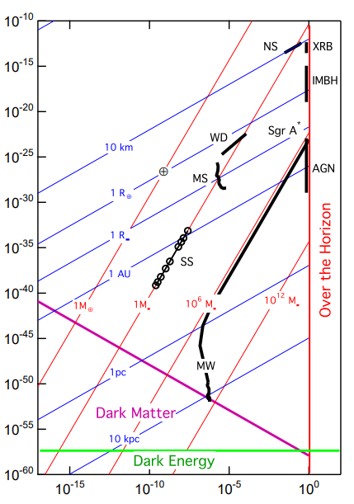
Introduction
Why modified gravity?
Despite various success of GR, there are still mysteries...
At high-energy scale
BH singularity
Quantum corrections
At low-energy scale
DE & DM
Small-scale crisis
$H_{0}$ & $S_{8}$ ($σ_{8}$) tension
Modified gravity (beyond GR) can be a solution to the above
[Psaltis (2008)]
Curvature $GM/r^{3}c^{2}\left[{cm}^{−2}\right]$
Potential $GM/rc^{−2}$

Slide 4
Introduction
Compact star in GR
Hydrostatic equilibrium
Static and Spherically Symmetric spacetime
With Equation of State (EOS) $P=P\left(ρ\right)$
Tolman-Oppenheimer-Volkov (TOV) equation
Attractive force by gravity
Star
Repulsive force by matter

Slide 5
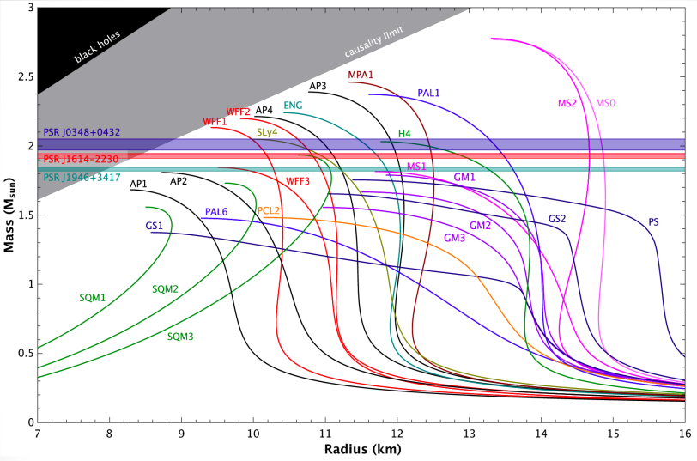
Introduction
Compact star in GR
Continuity to Schwarzschild metric (boundary condition)
For specific EOS, Mass-Radius (M-R) relation is given
Then, observation of M-R relation determines EOS.
[Lattimer & Prakash, Astrophys. J. 550 (2001)]
Really?

Slide 6
Research Purpose
Modified TOV equation
If gravitational theory is modified, TOV equation is also modified, which predicts different M-R relation.
--> Testing gravitational theory with compact star
Questions
We have two ambiguities: EOS and gravitational theory
How do we distinguish constraint on EOS from that on gravitational theory?
How can we extract signals of modified gravity from astrophysical observation?
Cf.) Hyperon puzzle “Hard to explain massive NS in GR ?”
--> “Don’t worry, modified gravity may explain it (!?) ”
有名人

Slide 7
TOV Equation in F(R) Gravity
F(R) gravity theory
EOM with matter field
Here, $F_{R}=∂_{R}F\left(R\right)$
F(R) gravity includes fourth-order derivative of metric
Trace of the EOM
Ricci scalar is dynamical: scalar mode $φ=F_{R}\left(R\right)$
Action of F(R) gravity
cf.) EH-action
[Buchdahl (1970)]
Replace:

Slide 8
TOV Equation in F(R) Gravity
Rudiments
Three non-vanishing components of EOM
Conservation law implies
Due to Bianchi id., 3 EOMs reproduce conservation law (1 of 4 eqs. is redundant)

Slide 9
Reconstruction of F(R) Function
“To solve” TOV equation
We assume density profile $ρ=ρ\left(r\right)$ and EOS $p=p\left(ρ\right)$
→ $p=p\left(r\right)$
Note) M-R relation is given by integration of density profile $ρ=ρ\left(r\right)$
TOV equation
$$ν=ν\left(r\right)$$

Slide 10
Reconstruction of F(R) Function
“To solve” TOV equation
Defining $N\left(r\right)≡e^{−2ν−2λ}$ and rewriting two eqs.
We find differential eq. for $F_{R}\left(r\right)$
From $N\left(r\right)≡e^{−2ν−2λ}$, we find $λ=λ\left(r\right)$
Ricci scalar $R=R\left(ν^{′′},v^{′},ν,λ^{′},λ,r\right)$ gives $r=r\left(R\right)$
Finally, we obtain $F_{R}=F_{R}\left(r\right)→F=F\left(R\right)$
$$N=N\left(F_{R},r\right)$$
known
$$F_{R}=F_{R}\left(r\right)$$
known

Slide 11
Reconstruction of F(R) Function
Degeneracy Problem [Numajiri et al, PLB 826, (2022)]
If M-R relation (= density profile) and EOS are given, we can solve TOV eq. w.r.t. F(R) function.
In other words, we can construct a model of F(R) gravity which explains observed M-R relation for arbitrary EOS.
--> M-R relation is not conclusive enough.
$F\left(R\right)$ func.
$F(R)$
EOS
M-R relation
Pressure $p\left(ρ\right)$
Mass $M\left(r_{s}\right)$
Curvature $R$
Degenerated
Energy density $ρ$
Radius $r_{s}$

Slide 12
Next Step…
Measurements other than M-R relation
M-R relation alone cannot rule out modified gravity.
--> We need more measurements (= constraints) to dissolve the degeneracy
Point) M-R relation is bkg. solution of TOV eq.
Other measurements
Tidal deformation (perturbed TOV eq.)
Scalar-mode of perturbation ~ scalar GW
Thermal evolution (cooling)
Decay of scalar “particle” ~ DM capture and heating
Steller oscillations (asteroseismology)
Relation to Quasi-Period Oscillation (QPO) etc.

Slide 13
Scalarization in Compact Star
Non-Integer power correction [Numajiri et al, PLB 826, (2022)]
Assuming F(R) function describes corrections to GR as
Imposing Schwarzschild spacetime outside compact star, $R$ behaves like
Demanding continuity at surface for polytrope EOS, we find
$F\left(R\right)=R+αR^{1+β}$ ($0<β<1$) is known as DE or Inflation model. [Artymowski & Lalak, JCAP 09 (2014)] etc.
Non-integer power shows up

Slide 14
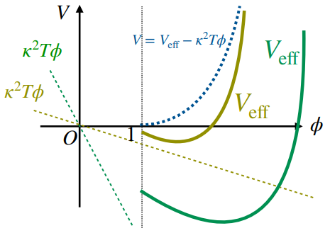
Scalarization in Compact Star
Screening scalar field [Numajiri et al, PLB 826, (2022)]
Scalar mode $φ=F_{R}\left(R\right)$ obeys KG eq.
For larger $\left|T\right|=ρ$, $φ$ is more massive and suppressed.
--> Chameleon mechanism
[Khoury & Weltman, PRL 93 (2004)]
Chameleon mechanism screens $φ$
--> To guarantee the Schwarzschild spacetime as external sol.
--- No Birkhoff theorem in F(R) gravity.

Slide 15
Scalarization in Compact Star
Scalar field in $R^{2}$ gravity [K. Numajiri et al, PRD107, no.10 (2023)]
$R^{2}$ model [Starobinsky PLB (1980)]
Trace part of EOM = Scalar-field EOM
Asymp. flatness and GR limit ($Φ→1$) suggests asymp. Schwarzschild sol. at $r→∞$ (not at surface).
$α$ is parameter
BCs @center
BCs @away from $r_{s}$

Slide 16
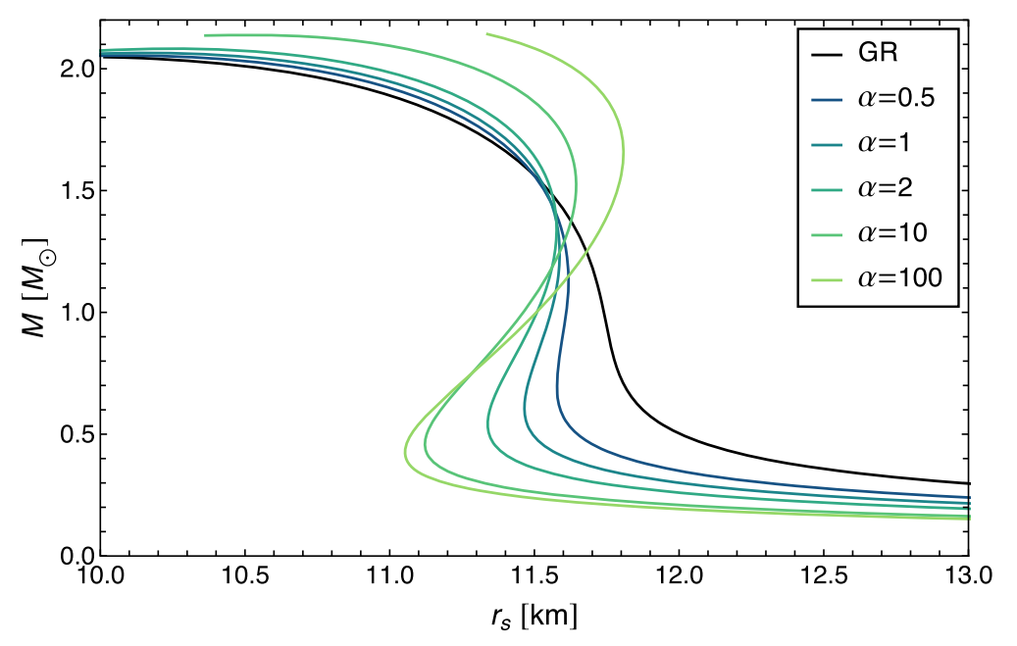
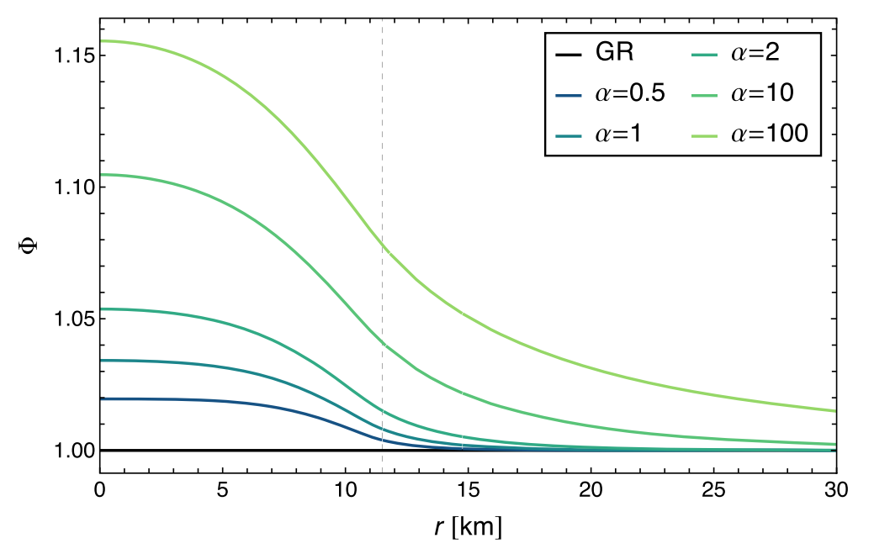
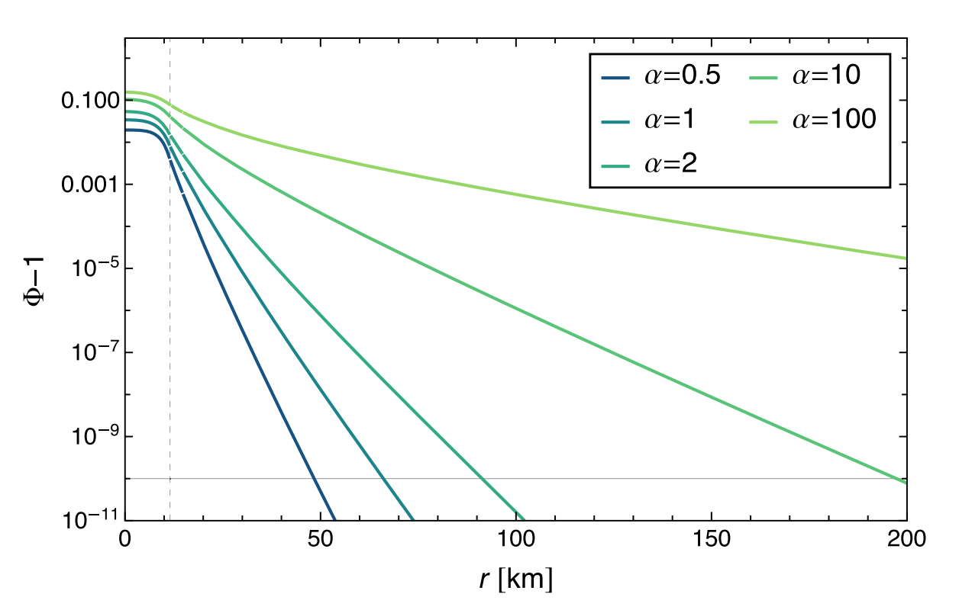
Scalarization in Compact Star
Scalar field in $R^{2}$ gravity [K. Numajiri et al, PRD107, no.10 (2023)]
$R^{2}$ model [Starobinsky PLB (1980)]
Scalar field affects external and internal structure of compact stars as well as M-R relation.
($α$ is normalized by $r_{g}^{2}$)
M-R relation for SLy
Scalar-field distribution
Scalarization radius
Nonvanishing scalar

Slide 17
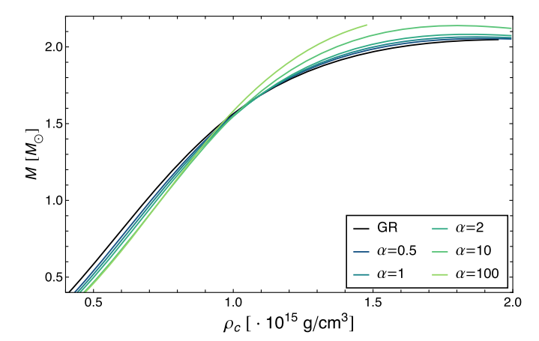
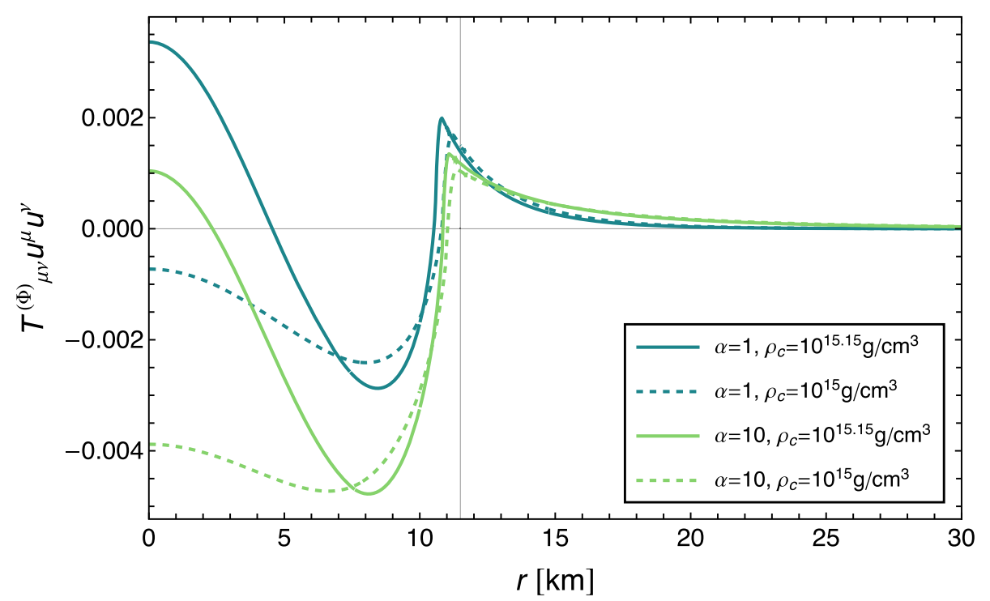
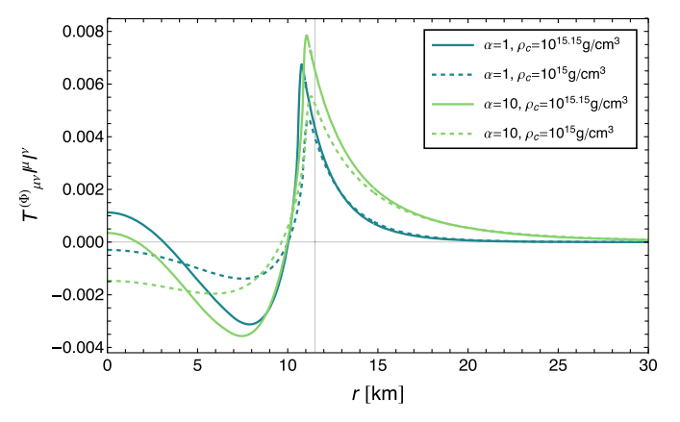
Scalarization in Compact Star
Scalar field in $R^{2}$ gravity [K. Numajiri et al, PRD107, no.10 (2023)]
$R^{2}$ model [Starobinsky PLB (1980)]
Scalar field affects external and internal structure of compact stars as well as M-R relation.
($α$ is normalized by $r_{g}^{2}$)
M-$ρ_{c}$ relation for SLy
Energy condition $T_{μν}^{(Φ)}u^{μ}u^{ν}$
Energy condition $T_{μν}^{(Φ)}l^{μ}l^{ν}$
Quintessence-like behavior

Slide 18
Conclusion
Degeneracy problem
F(R) function, M-R relation (=density profile), EOS
Only with M-R relation, we cannot constrain F(R) gravity and EOS separately.
Reconstruction technique in Cosmology
Cf.) Sound speed $c_{s}^{2}>1$ is forbidden by causality
--> At least, distinguishable from GR
In-progress and future works
Demonstration of parameter degeneracy
EOS: ($L,K_{0}$,…) vs. Gravity: $α$ in $R^{2}$ model
[Special thanks to Dr. Tomoya Naito in Riken]
Theoretical predictions
Tidal deformation and scalar mode GW
Decay of scalar particle and NS heating etc.
Phenomenology induced by new scalar field

Slide 19
Thank you!

Slide 20
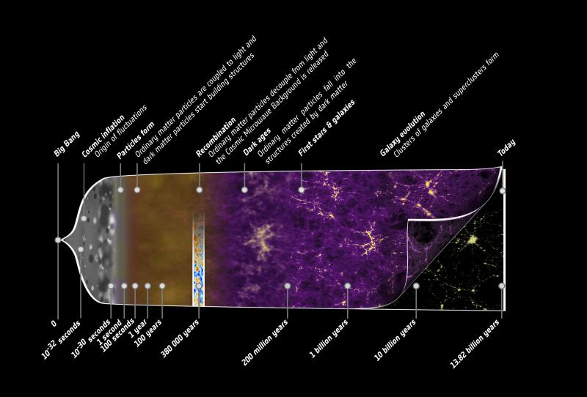
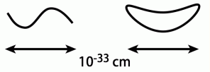
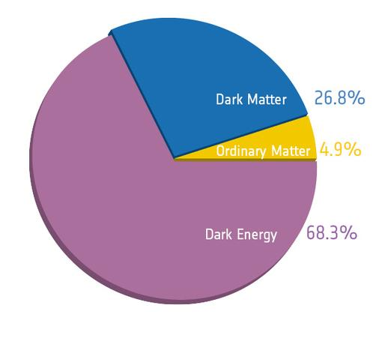
Why Modified Gravity?
Motivations for modified gravity
1. UV (high energy) physics
Quantum theory of gravitation
BH singularities etc.
2. IR (low energy) physics
Dark Energy (Late-time cosmic acceleration)
Dark Matter (cf. Modified Newtonian Dynamics)
3. Theoretical interests
To understand GR better
Why modified gravity = Why GR?
GR
The others

Slide 21
Constraint from Boundary Condition
Near surface of compact star
One can reconstruct F(R) function to lead to a given M-R relation.
But, boundary condition can constrain F(R) function.
Let’s consider following setup
Outside:
Schwarzschild sol.
Vacuum ($T_{μν}=0,R=0$)
Inside:
TOV eq.
Energy-Polytrope
$$p=Kρ^{1+\frac{1}{n}}$$
$0.5<n<1$ for NS
$$r$$
Surface $r=R_{s}$: $p(R_{s})=0$

Slide 22
Constraint from Boundary Condition
Non-Integer power correction [Numajiri et al, PLB 826, (2022)]
Assuming F(R) function describes corrections to GR as
Near the surface, $R$ behaves like
From EOM
To balance both-hand sides, we find
$$∼{\left(1−\frac{r}{R_{s}}\right)}^{N_{0}−2}$$
$$∼{\left(1−\frac{r}{R_{s}}\right)}^{αβ−2}$$
$$∼{\left(1−\frac{r}{R_{s}}\right)}^{n}$$
Non-integer power shows up

Slide 23
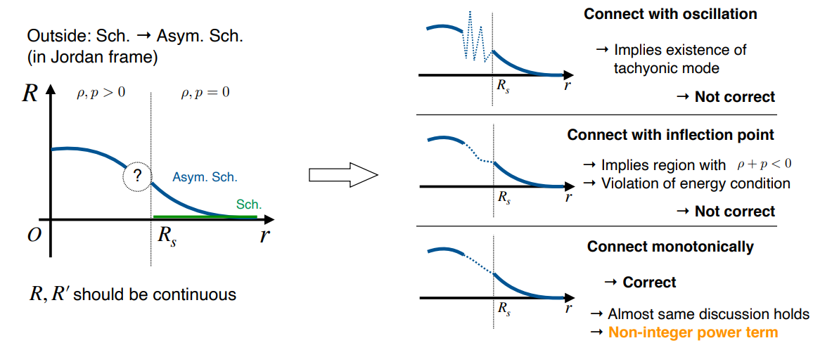
Continuity at Boundary
Taken from Kota Numajiri (Nagoya U.)’s slide

Slide 24
TOV Equation in F(R) Gravity
Rudiments
EOM
Generalized Bianchi identity
Static and Spherically Symmetric metric
Perfect fluid as internal matter
$ρ$ and $p$ are total energy density and pressure.

