Slide 1

Quarks and Compact Stars @YZU Sep. 2023
Study of hybrid stars and quark stars with the NJL model
Speaker：Cheng-Ming Li (李程明)
Collaborators：Yan Yan (严妍), Yong-Feng Huang (黄永锋), Hong-Shi Zong (宗红石), and et al.
Email: licm@zzu.edu.cn
Phys. Rev. D 98, 083013 (2018), Phys. Rev. D 101, 063023 (2020), Phys. Rev. D 106. 116009 (2022).

Slide 2
Quarks and Compact Stars @YZU Sep. 2023
Contents
Backgrounds
EOS of QCD based on the NJL model
Hybrid stars, quark stars, and astro-measurements
Summary and Outlook
1
2
3
4
1

Slide 3
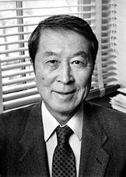
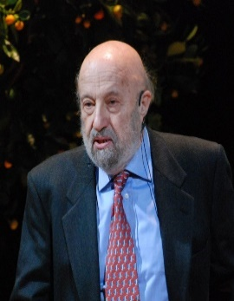
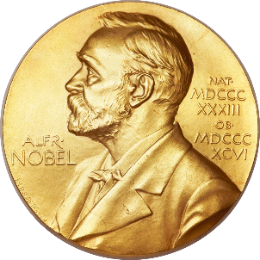
Quarks and Compact Stars @YZU Sep. 2023
Backgrounds
The Nambu–Jona-Lasinio (NJL) Model:
invented by Yoichiro Nambu and Giovanni Jona-Lasinio in 1961 at The University of Chicago
inspired by the BCS theory of superconductivity, is originally a theory of elementary nucleons, and rediscovered as an effective quark theory in the 1980s
“for the discovery of the mechanism of spontaneous broken symmetry in subatomic physics” —— Nobel Committee (2008)
It is a relativistic quantum field theory, and is relatively easy to work with. Furthermore, it is very successful in the description of hadrons, nuclear matter, etc
[Rev. Mod. Phys. 64, 649 (1992), Phys. Rep. 407, 205 (2005), Phys. Rev. 122, 345 (1961), Phys. Rev. 124, 246 (1961)]
2

Slide 4
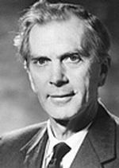
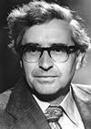
Quarks and Compact Stars @YZU Sep. 2023
Backgrounds
Neutron stars:
first discovered by Jocelyn Bell and Antony Hewish in the 1960s:
PSR 1919+21
as the densest stars except black holes, was listed as one of the major exciting discoveries of the 20th century, and was named one of the four major discoveries in astronomy in the 1960s
“for their pioneering research in radio astrophysics: Ryle for his observations and inventions, in particular of the aperture synthesis technique, and Hewish for his decisive role in the discovery of pulsars” —— Nobel Committee (1974)
3

Slide 5
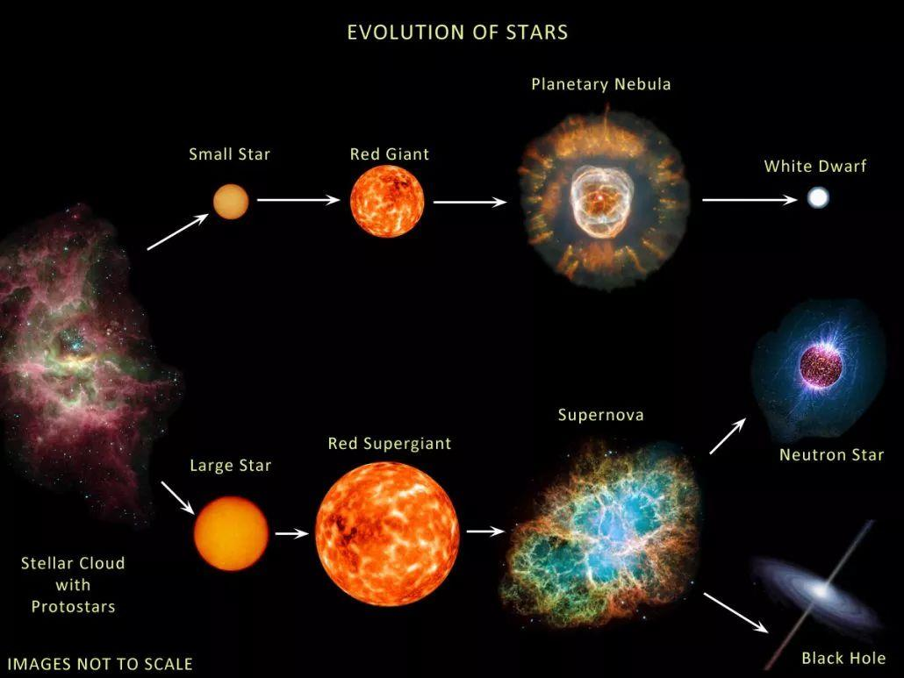
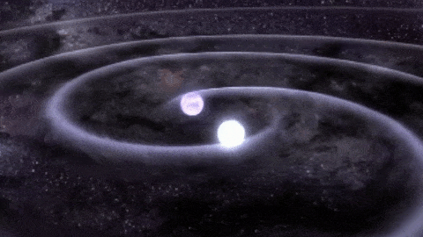
Quarks and Compact Stars @YZU Sep. 2023
Backgrounds
Neutron stars:
4

Slide 6
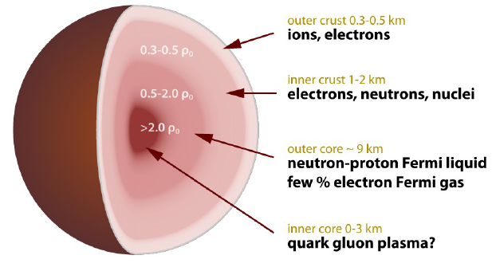

Quarks and Compact Stars @YZU Sep. 2023
Backgrounds
Neutron stars:
At present, there are roughly four theoretical models portraying the wreckage left after a supernova explosion:
Hadron star
Hybrid star (HS, a neutron star with an extremely dense core containing quark matter that looks like an egg with a yolk)
Quark star (QS)
Strangeon star (formerly known as the star of strange quark-cluster, where quarks are not completely free, but instead there are six quarks or more that form a small collective, which in turn form a large strangeon star)
[X.-Y. Lai and R.-X. Xu, J. Phys.: Conf. Series 861, 012027 (2017)]
5

Slide 7
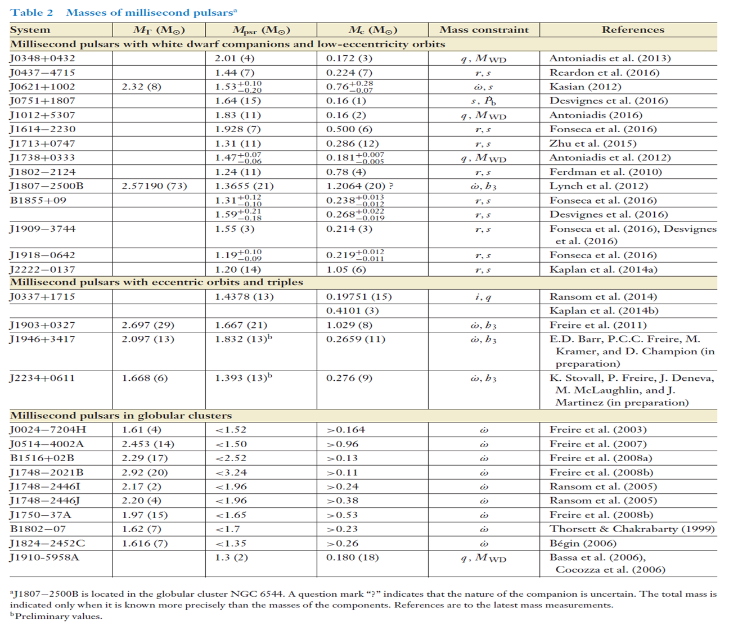
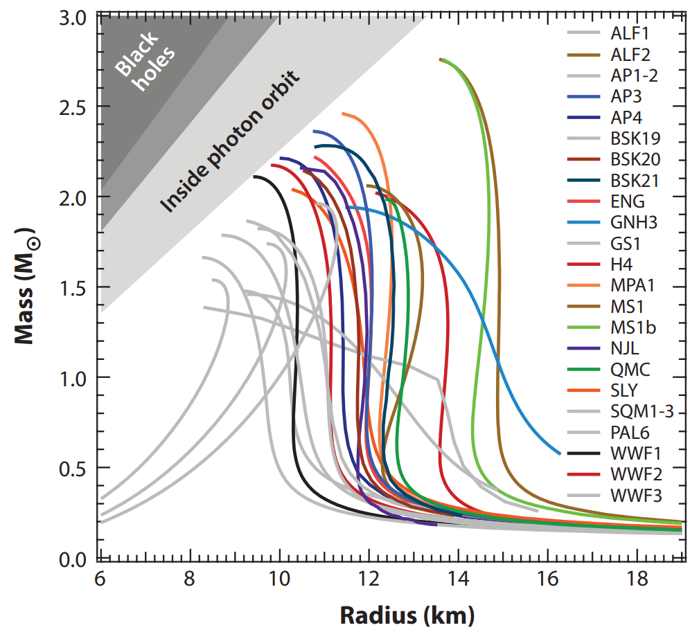
Quarks and Compact Stars @YZU Sep. 2023
Backgrounds
Neutron stars:
[F. Ozel and P. Freire, ARAA 54, 1: 401–440, 2016]
6

Slide 8
Quarks and Compact Stars @YZU Sep. 2023
Contents
Backgrounds
EOS of QCD based on the NJL model
Hybrid stars, quark stars, and astro-measurements
Summary and Outlook
1
2
3
4
7

Slide 9
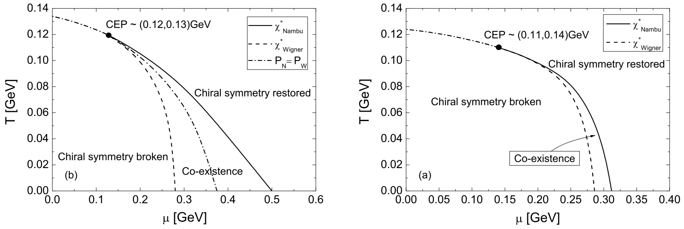
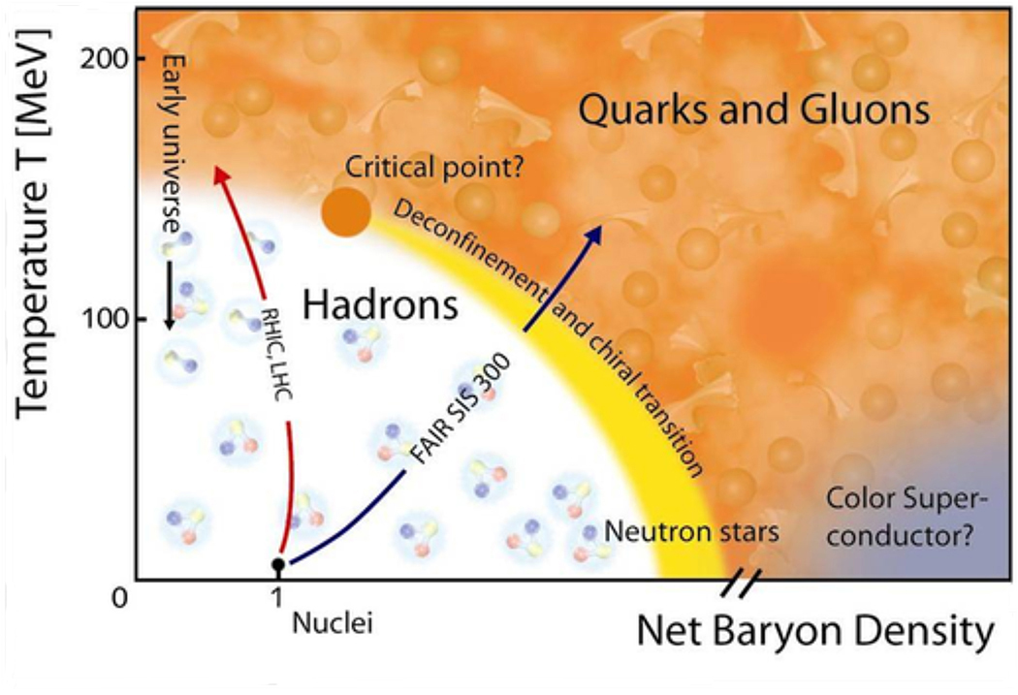
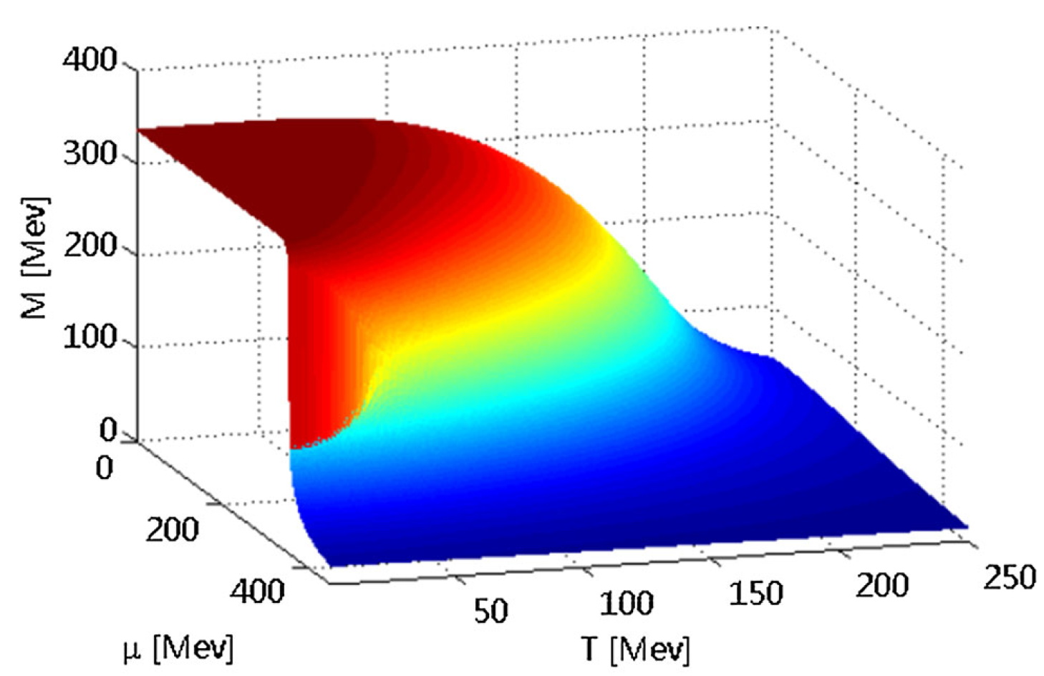

QCD phase diagram
Quarks and Compact Stars @YZU Sep. 2023
A sketch of the QCD phase diagram
DSEs with bare and BC vertex [Y.-X. Liu, and et al., 2011]
[CBM Progress Report]
What is the EOS at T=0, and how to get it?
NJL with 3D cutoff [Y Lu, and et al., 2015]
8

Slide 10
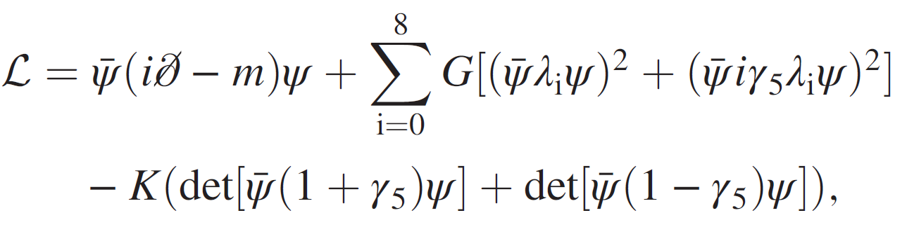
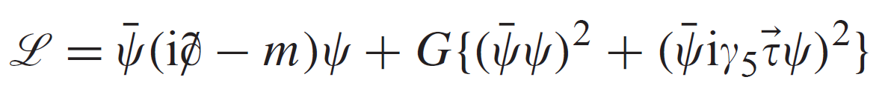
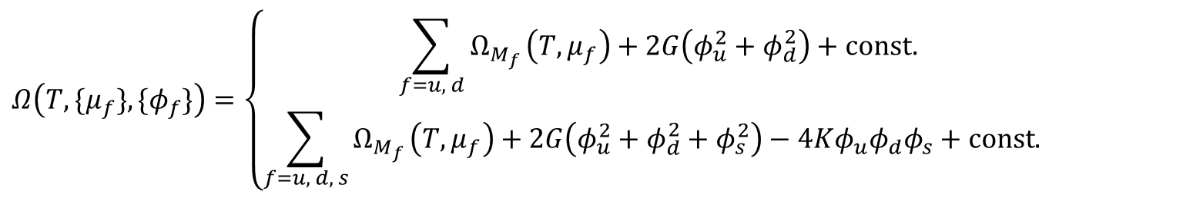
NJL model
Quarks and Compact Stars @YZU Sep. 2023
Lagrangian
Two flavor:
Three flavor:
scalar-isoscalar
pseudoscalar-isovector
Thermodynamic potential
KMT interaction
(with Mean Field approximation)
$$Ω\left(T, {\{μ}_{f}\}, {\{φ}_{f}\}\right)=\left\{\begin{matrix}\sum_{f=u, d}{Ω_{M_{f}}}\left(T,μ_{f}\right)+2G\left(φ_{u}^{2}+φ_{d}^{2}\right)+const. \\ \sum_{f=u, d, s}{Ω_{M_{f}}}\left(T,μ_{f}\right)+2G\left(φ_{u}^{2}+φ_{d}^{2}+φ_{s}^{2}\right)−4Kφ_{u}φ_{d}φ_{s}+const. \end{matrix}\right.$$
2-flavor,
3-flavor,
where${ Ω}_{M_{f}}\left(T,μ_{f}\right)$: contribution of a gas of quasi-particles, $φ_{f}$: quark condensate of flavor f. See Ref. [M. Buballa, Phys. Rep. 407, 205 (2005)] for the details.
9

Slide 11
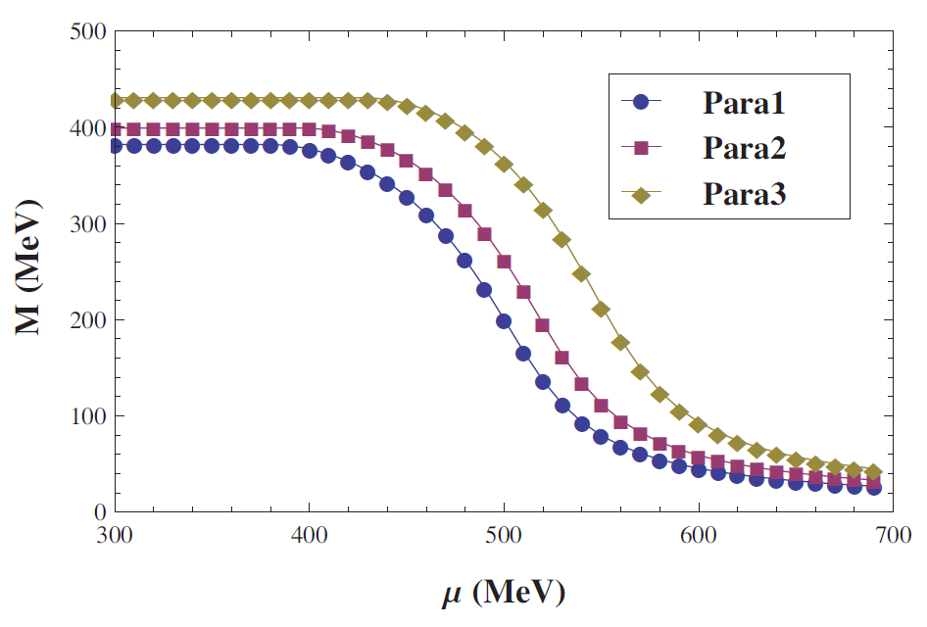
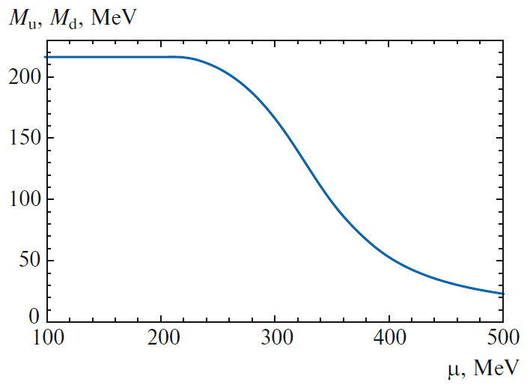
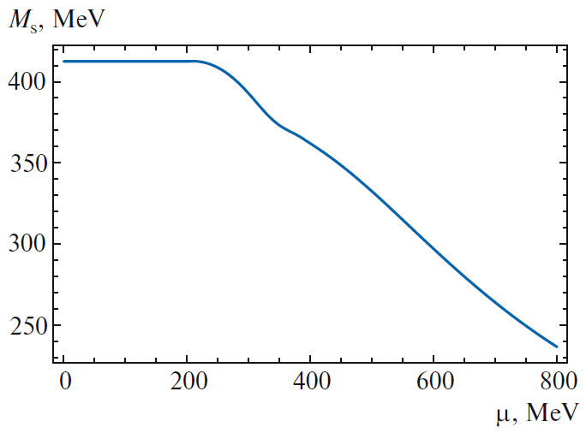
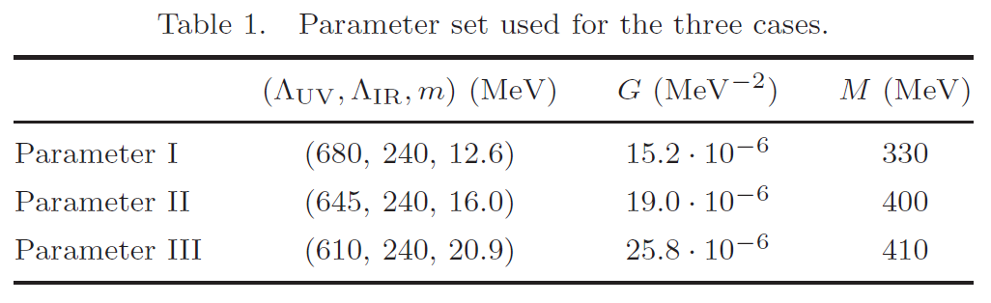
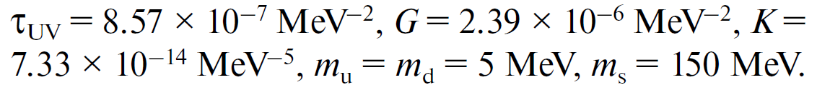
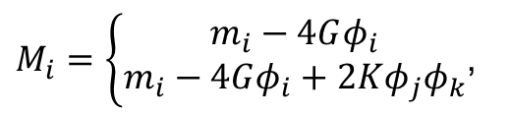
NJL model
Quarks and Compact Stars @YZU Sep. 2023
Gap equations
(with Mean Field approximation)
$M_{i}=\left\{\begin{aligned}m_{i}−4Gφ_{i} \\ m_{i}−4Gφ_{i}+2Kφ_{j}φ_{k}\end{aligned}\right.$,
2-flavor,
3-flavor,
3-flavor:
2-flavor:
[Y.-P. Zhao, and et al., 2018]
[J.-L. Zhang, and et al., 2016]
10

Slide 12
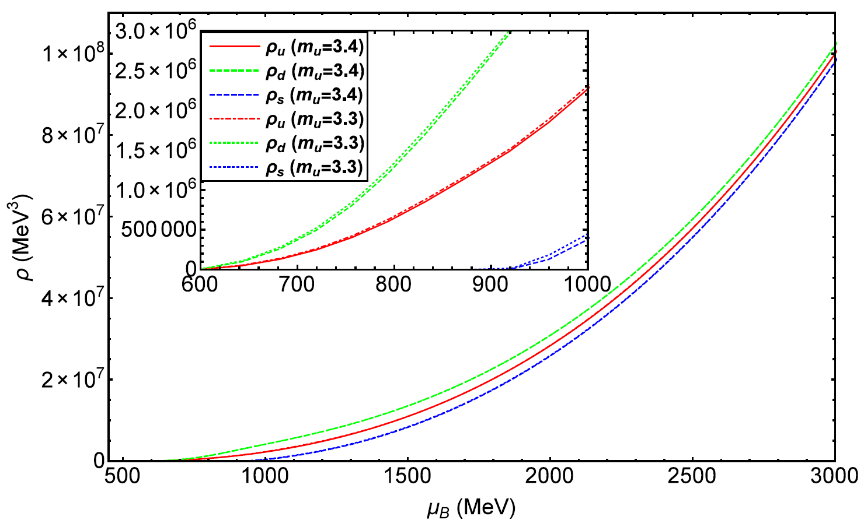
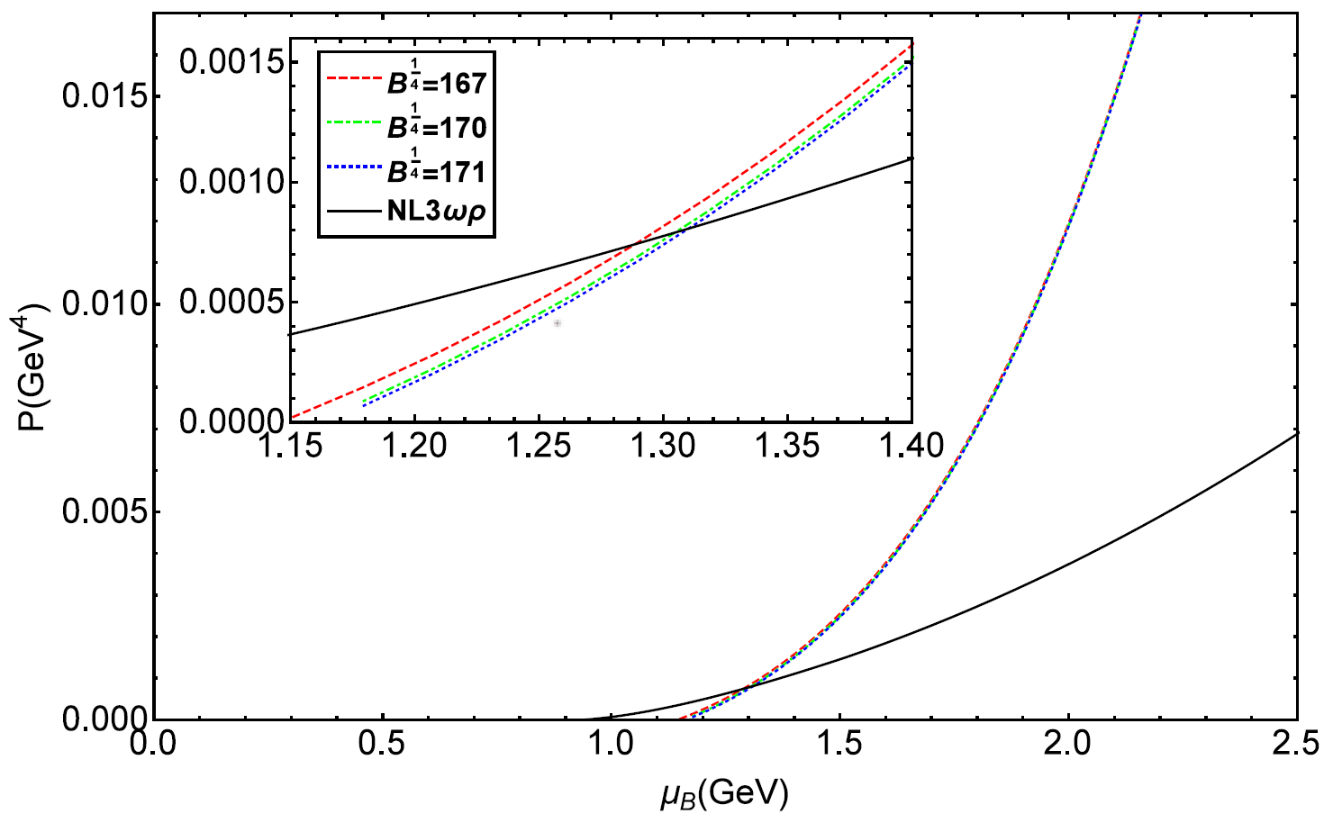
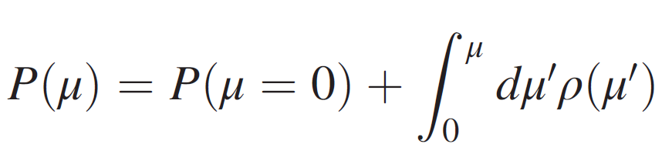
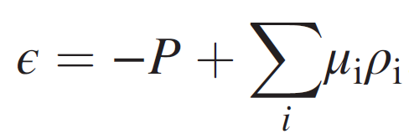
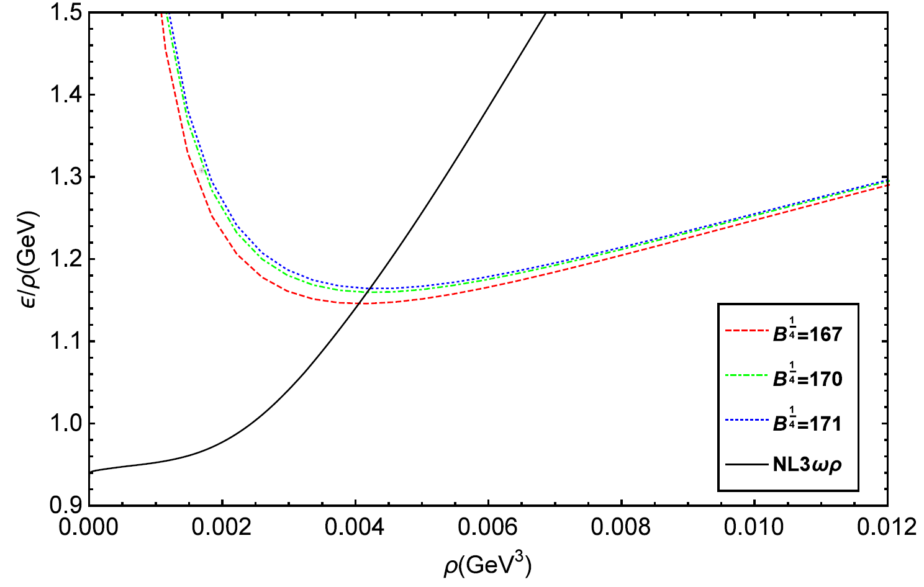
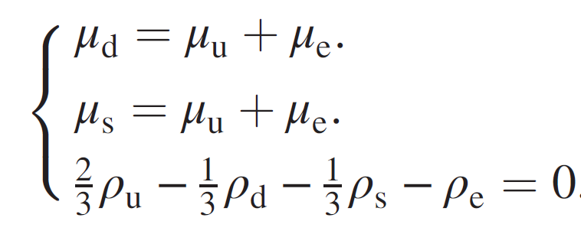
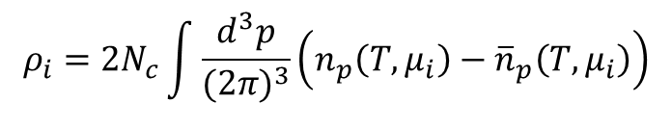
Equation of state
Quarks and Compact Stars @YZU Sep. 2023
Quark densities
PhysRevD.98.083013
3-flavor:
$$ρ_{i}=2N_{c}\int{\frac{d^{3}p}{{(2π)}^{3}}}\left(n_{p}\left(T, μ_{i}\right)−{\overline{n}}_{p}\left(T, μ_{i}\right)\right)$$
Equation of state
vacuum bag constant, -B
$β$-equilibrium, electric charge neutrality
11

Slide 13

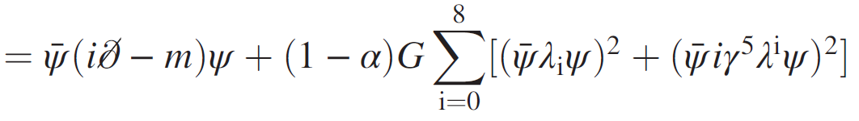
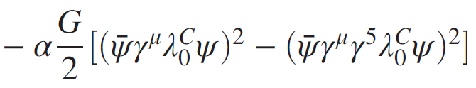

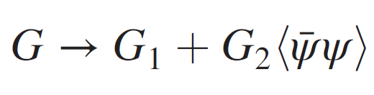
Modified NJL model
Quarks and Compact Stars @YZU Sep. 2023
Case I:
modified Lagrangian
Phys. Rev. D 101, 063023 (2020)
(3-flavor)
Case II:
modified coupling strength
Phys. Rev. D 106. 116009 (2022)
Incorporating the quark condensate into the gluon propagator, thus making it naturally
change with the temperature and chemical potential
2) Making the effective gluon propagator different in Nambu and Wigner phase
12

Slide 14
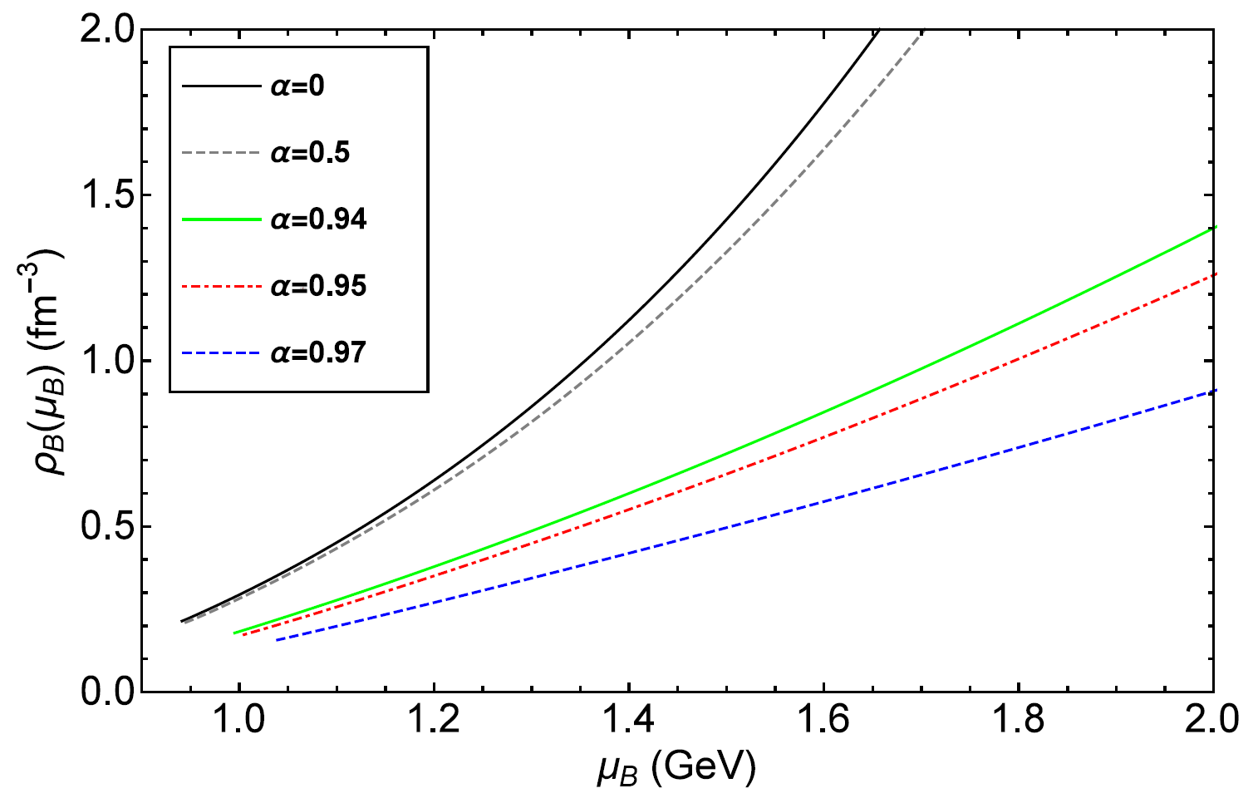
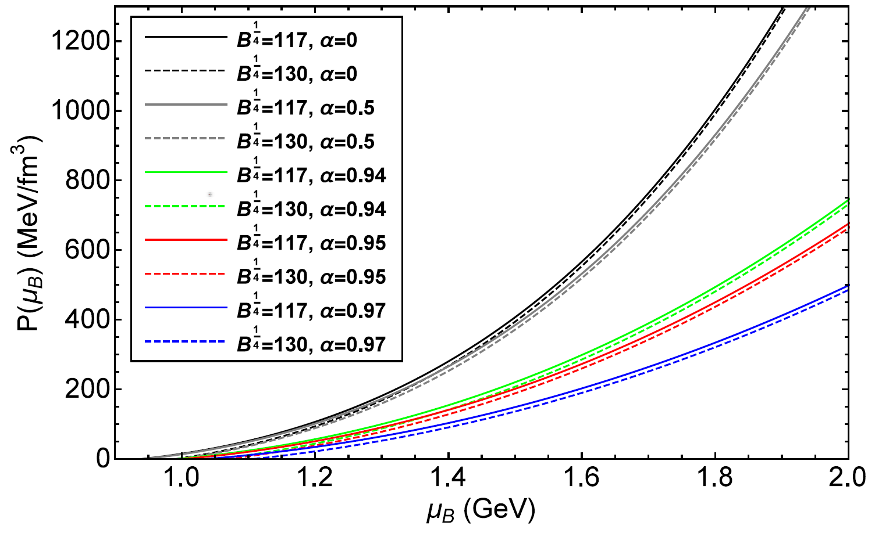
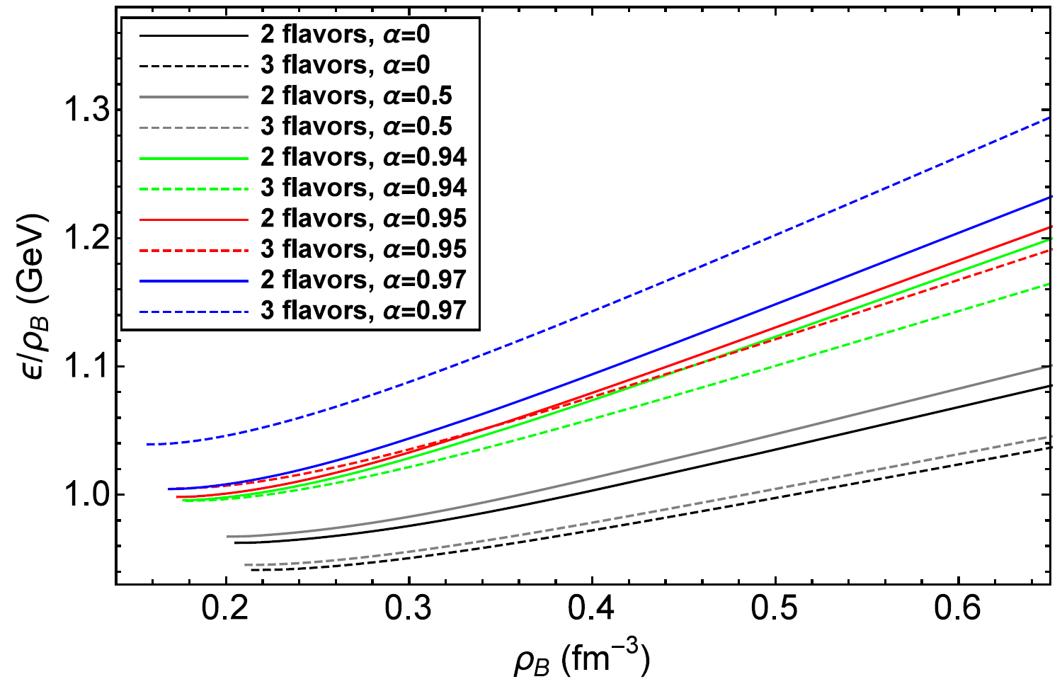
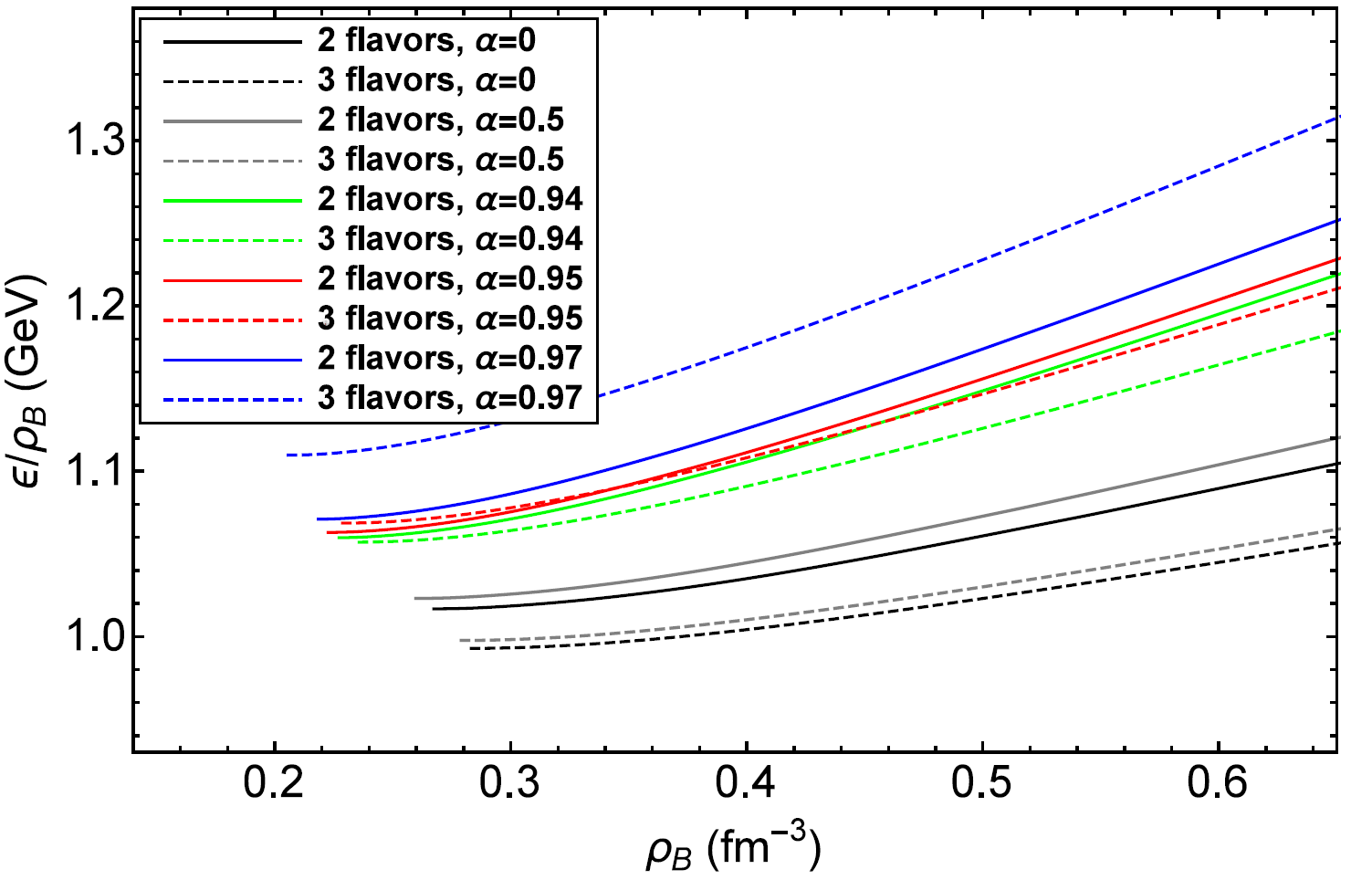
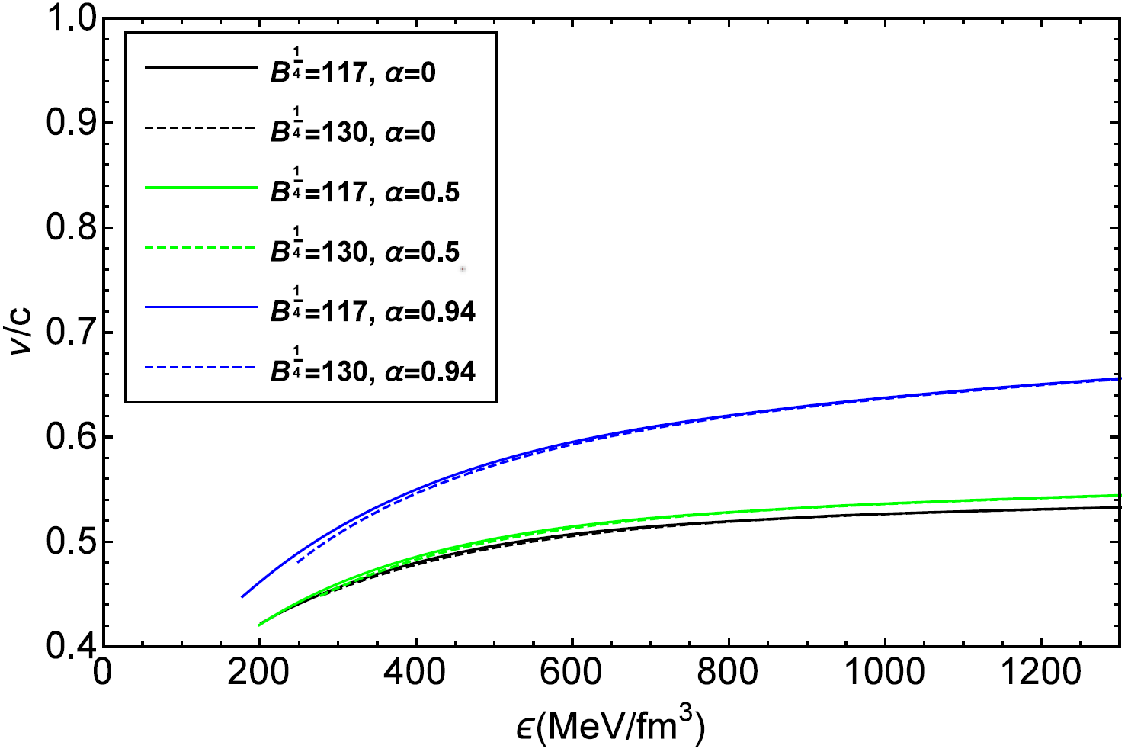
EOS of the modified NJL model
Quarks and Compact Stars @YZU Sep. 2023
PhysRevD.101.063023
Case I:
13

Slide 15
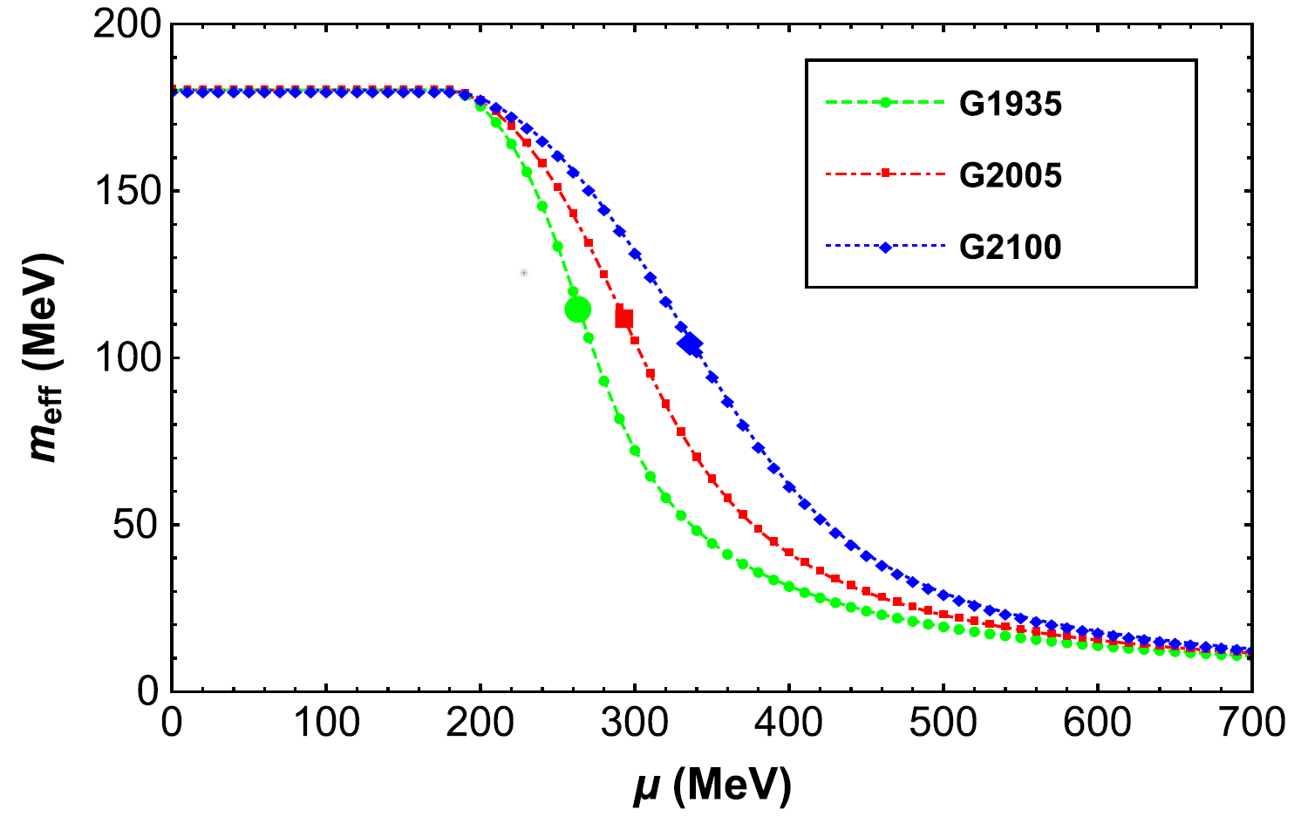
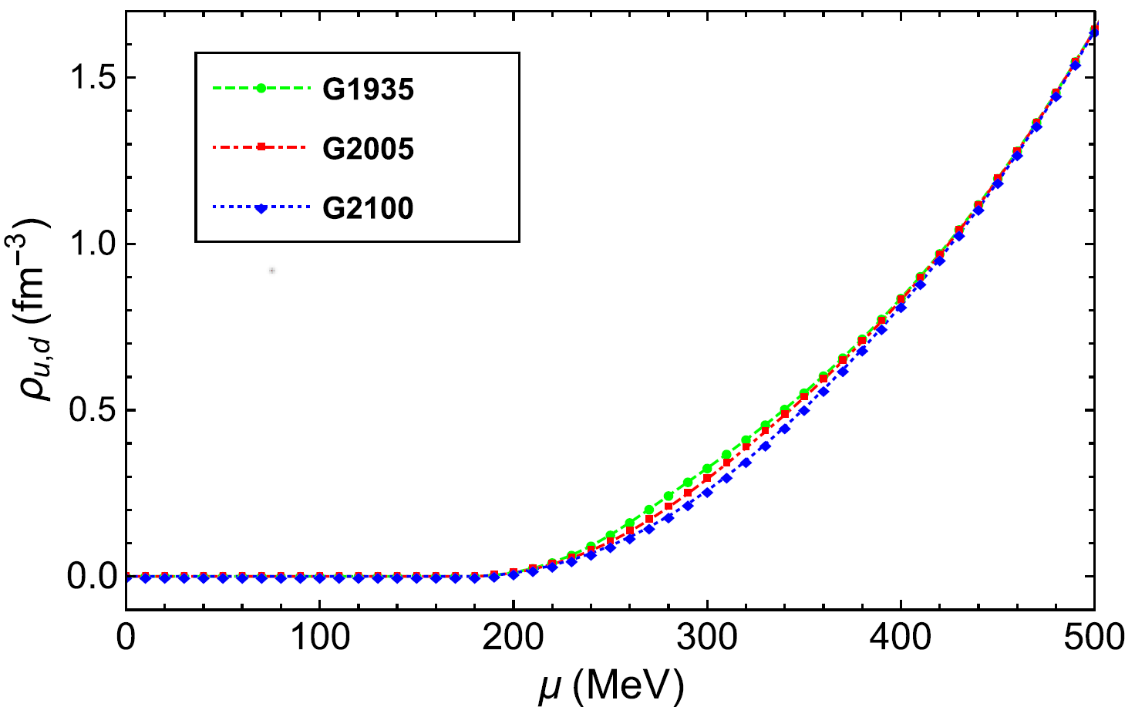
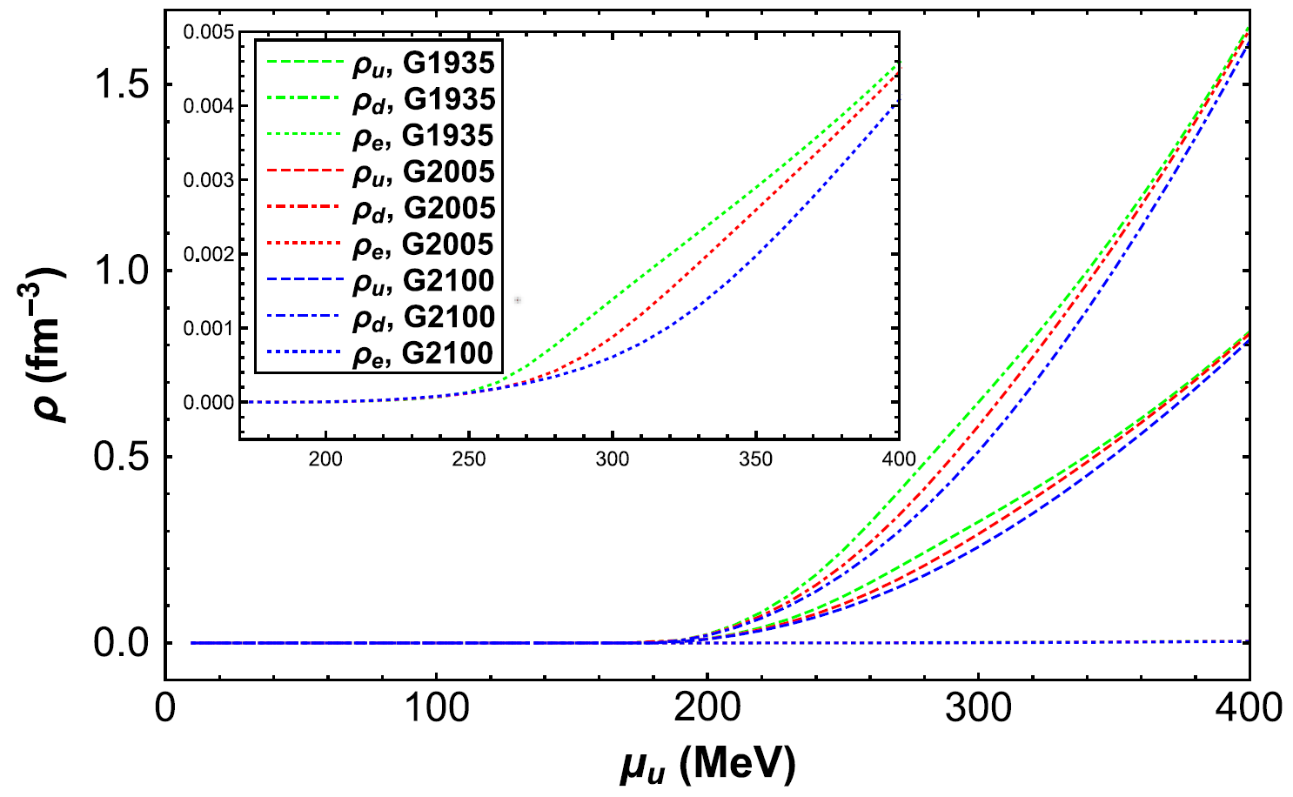
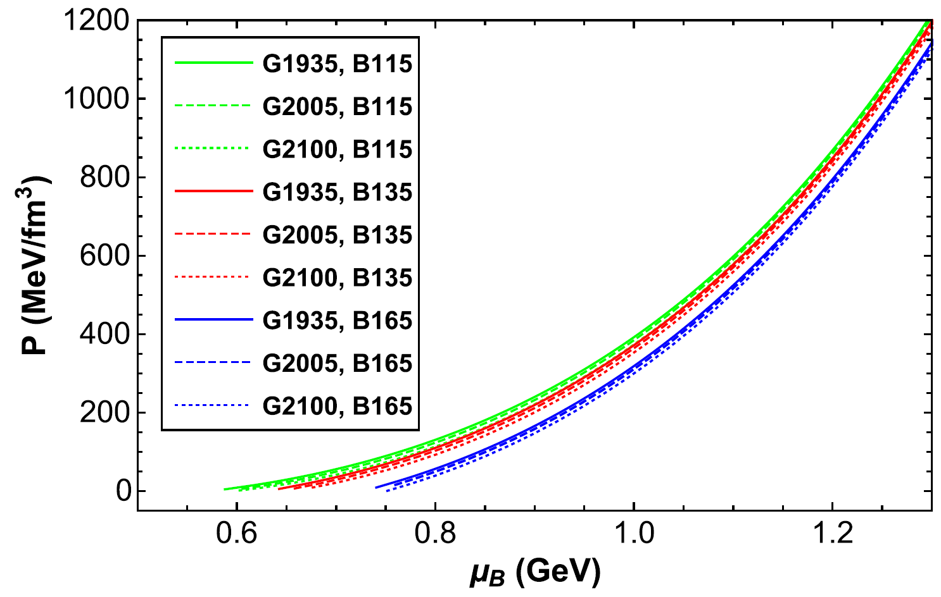
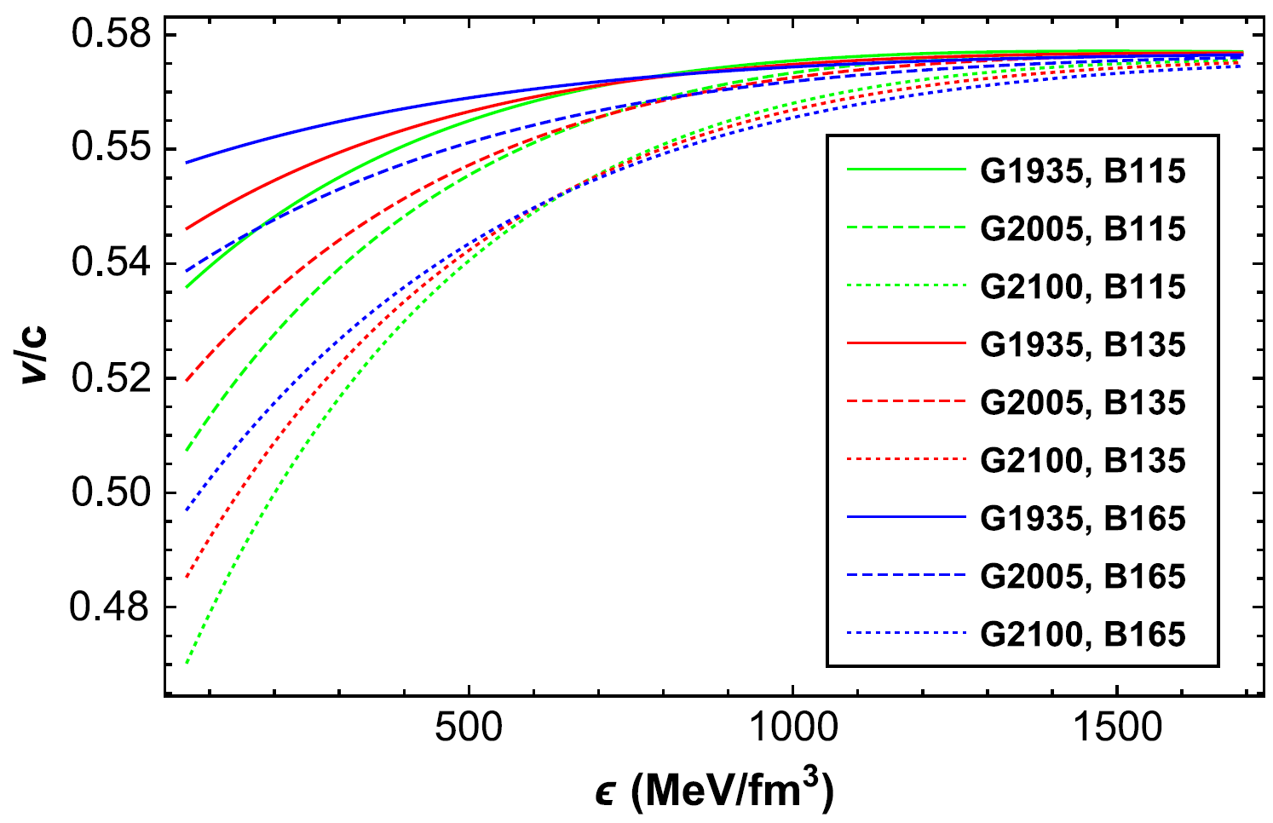
EOS of the modified NJL model
Quarks and Compact Stars @YZU Sep. 2023
PhysRevD.106.116009
Case II:
14

Slide 16
Quarks and Compact Stars @YZU Sep. 2023
Contents
Backgrounds
EOS of QCD based on the NJL model
Hybrid stars, quark stars, and astro-measurements
Summary and Outlook
1
2
3
4
15

Slide 17
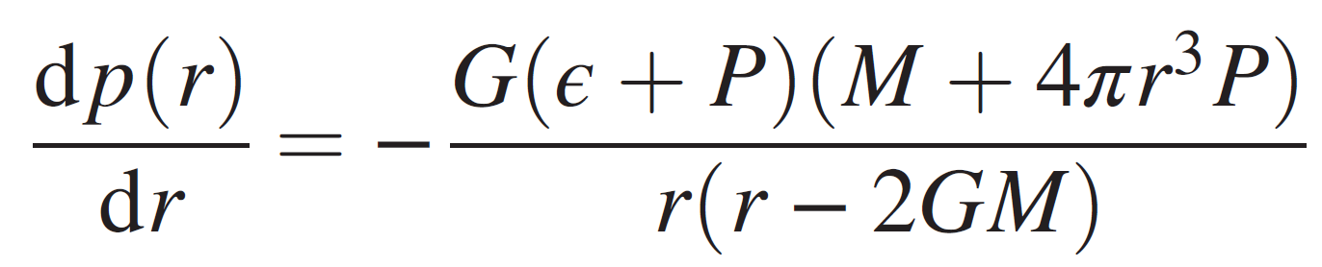
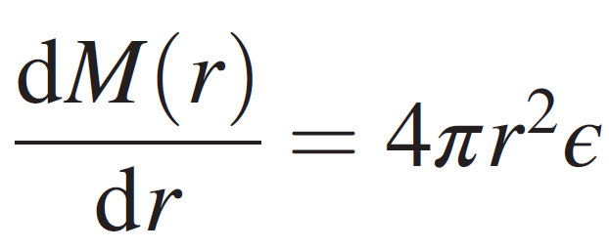
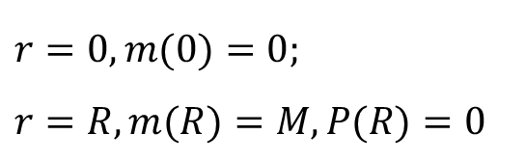
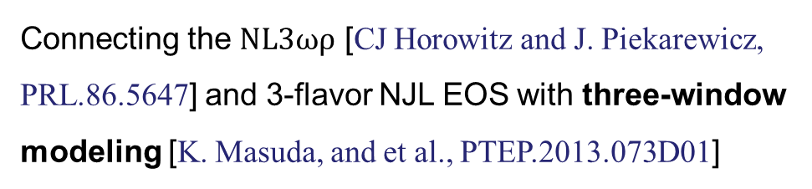
Quarks and Compact Stars @YZU Sep. 2023
M-R relations
[PRD.30.272 (1984)]: Witten hyperthesis, strange quark matter may be the true ground state of baryonic matter
TOV equations:
EOS of quark matter:
(1) 3-flavor NJL model with PTR: PhysRevD.95.056018
(2) Modified 3-flavor NJL model in the light of Fierz
transformation: PhysRevD.101.063023
Modified 2-flavor NJL model with the modification
of coupling strength G: PhysRevD.106.116009
Boundary conditions
$$r=0, m(0)=0;$$
$$r=R, m(R)=M, P(R)=0$$
[B. Holdom, and et al., PRL.120.222001 (2018)]: ud quark matter could be more table than the uds
Hybrid EOS:
PhysRevD.98.083013
Equation of state
Connecting the $NL3ωρ$ [CJ Horowitz and J. Piekarewicz, PRL.86.5647] and 3-flavor NJL EOS with three-window modeling [K. Masuda, and et al., PTEP.2013.073D01]
nucleon？quark？Or hybrid?
16

Slide 18
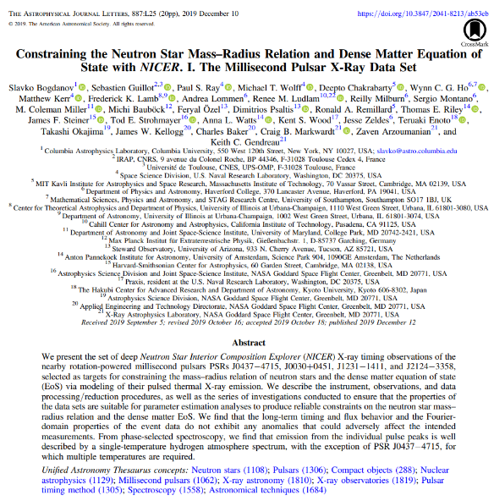
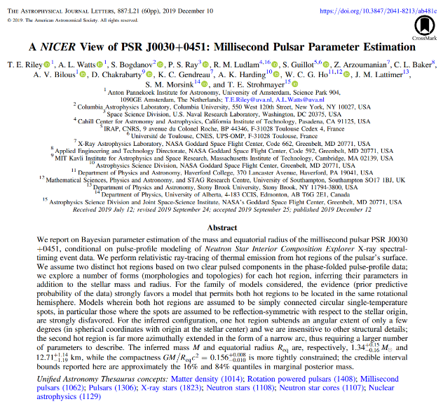
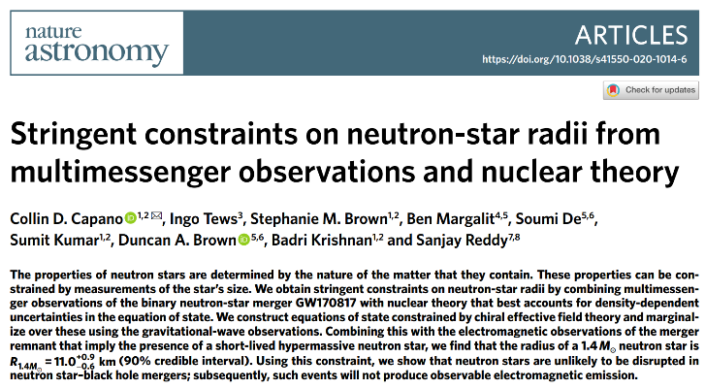
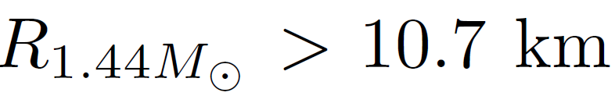



Quarks and Compact Stars @YZU Sep. 2023
M-R relations
Recent astro-observations:
Mass
$\text{PSR} \text{J}\text{0348+0432}:2.01±0.04 M_{⊙}$ [J. Antoniadis, and et al., Science 340, 1233232 (2013)]
PSR J0740+6620: $2.14±0.1 M_{⊙}$ [HT Cromartie, and et al., Nat. Astron. 4, 72 (2020)]
Radius: NICER x-ray timing observations
1)
[S. Bogdanov, and et al., ApJL 887, 25 (2019)]
2)
[CD Capano, and et al., Nat. Astron. 4, 625 (2020)]
3) PSR J0030+0451:
[TE Riley, and et al., ApJL 887, 21 (2019)]
17

Slide 19







Quarks and Compact Stars @YZU Sep. 2023
M-R relations
Strange quark stars with EOS (2):
Hybrid stars:
$$M_{max}=2.06 M_{⨀}$$
$$R=11.2 km$$
Nonstrange quark stars with EOS (3):
$$M_{max}=2.10 M_{⨀}$$
$$R=11.7 km$$
$$M_{max}=2.19 M_{⨀}$$
$$R=12.0 km$$
18

Slide 20





Quarks and Compact Stars @YZU Sep. 2023
Tidal deformability
00
[BP Abbott, and et al., PRL 119, 161101 (2017)]
19

Slide 21




Quarks and Compact Stars @YZU Sep. 2023
Tidal deformability
Strange quark stars with EOS (2):
Nonstrange quark stars with EOS (3):
20

Slide 22


Quarks and Compact Stars @YZU Sep. 2023
Tidal deformability
Hybrid stars:
PhysRevD.98.083013
21

Slide 23






Quarks and Compact Stars @YZU Sep. 2023
Constraining the EOS of HSs
Constraints:
Mass constraint from PSR J0348+0432: $M_{max}≥1.97 M_{⨀}$
[J. Antoniadis, and et al., Science 340, 1233232 (2013)]
4) Sound velocity:
$$0<υ/c<1$$
2) Deconfinement point: ${ μ}_{deconfinement}≿μ_{ChiralRestoration}∼1 GeV$
$[K. Fukushima, PRD 77, 114028 \left(2008\right), K. Fukushima and T. Hatsuda, RPP 74, 014001 (2011)$]
5) Stability of the hybrid star:
$μ_{C}>μ_{BE}$,
3) Tidal deformability from GW170817:
$μ_{C}$: baryon chemical potential
in the center of the star
$μ_{BE}$: baryon chemical potential
of the intersection between
quark binding energy and
hadronic binding energy
00
[BP Abbott, and et al., PRX 9, 011001 (2019)]
22

Slide 24






Quarks and Compact Stars @YZU Sep. 2023
Constraining the EOS of HSs
Hybrid stars:
PhysRevD.98.083013
1) Parameter space of the bag constant.
2) Parameter space of interpolating window with $B^{1/4}=167, 170, 171 MeV$, respectively.
23

Slide 25
Quarks and Compact Stars @YZU Sep. 2023
Contents
Backgrounds
EOS of QCD based on the NJL model
Hybrid stars, quark stars, and astro-measurements
Summary and Outlook
1
2
3
4
24

Slide 26

Quarks and Compact Stars @YZU Sep. 2023
Summary
Study of hybrid stars and quark stars with the NJL model
The EOS of quark matter with proper-time regularized NJL model can lead to the crossover at $T=0$, and the hybrid EOSs we construct with it and the three-window modeling approach are consistent the recent astro-observations of neutron stars.
The two modified NJL model with a) the Fierz transformation and b) the modification $G→G_{1}+$ $G_{2}<\overline{ψ}ψ>$ both support the hyperthesis that the quark stars can exist in the universe in the light of the astro-observations of neutron stars at present.
Calculations of the hybrid EOS are still model dependent. We constrain the hybrid EOS with five theoretical and observable constraints, and obtain the parameter space for the stable existence of hybrid stars, e.g. $B^{1/4}$ is well constrained to a range of (166.16, 171.06) MeV.
The NL3ωρ model to construct the pure neutron star has already been excluded by the observation of tidal deformability from GW170817, but this model is still suggested to be effective to describe the hadronic phase in HSs, which do not have a pure quark core but a mixed-phase in center.
25

Slide 27

Quarks and Compact Stars @YZU Sep. 2023
Outlook
The mass measurement of the compact object in GW190814 implies the possibility of a neutron star, providing a more strict constraint on the EOS of QCD.
There might be more and more NICER results, and gravitational wave events of BNS mergers, which would give more constraints on the radius and tidal deformability of neutron stars.
The EOS will be more theoretically accurate and include more physical meanings, if we consider the color superconductivity and calculate the EOS beyond the MFA approach.
26

Slide 28

Quarks and Compact Stars @YZU Sep. 2023
27

Slide 29
Backup

Slide 30




Proper-time regularization
PhysRevD.95.056018
Parameters fixed with PTR
B.1

Slide 31


Modification of coupling constant G
PhysRevD.106.116009
According to the plane wave method in QCD sum rule approach [L. Reinders, and et al., Phys. Rep. 127, 1 (1985)], the full Green’s function (which is unknown) can be divided into two parts: the nonperturbative part and the perturbative part. the most general form of the “nonperturbative” gluon propagator is:
where second term is about the gluon condensate, $c_1$and $c_2$are coefficients that can be calculated with the QCD sum rule approach, and the ellipsis refers to the contributions from other condensates (e.g., the mixed quark-gluon condensate).
Among all the condensates, the quark condensate has the lowest dimension, and a nonzero value of this quantity, in the chiral limit, just signals the dynamical chiral symmetry breaking. Thus we will treat its contribution separately, while the contribution of other condensates is included in the perturbative part of the gluon propagator, which is
B.1

Slide 32







Hybrid EOS
Three-window modeling
In $P−μ$ plane:
where the interpolating function:
$P_{H}$, $P_{Q}$: pressure in hadronic phase and quark phase
[PTEP.2013.073D01]
Schematic picture of the QCD $P−ρ$ relation under the assumption of the hadron–quark crossover
$\overline{μ}−Γ≤μ≤\overline{μ}+Γ$: characterizing the range of the crossover region
B.2

Slide 33






Hybrid EOS
PhysRevD.95.056018
APR [PhysRevC.58.1804] + NJL + three-window modeling:
EOS and M-R relation
B.3

Slide 34






Quarks and Compact Stars @YZU Sep. 2023
Tidal deformability
$H\left(r\right):$the metric function
$p$: pressure
$y$:
See Ref. [Phys. Rev. D 81, 123016] for the details.
Dimensionless tidal deformability for $l=2:$
Dimensionless tidal Love number for $l=2:$
Dimensionless combined tidal deformability$:$
B.4

