Slide 1
EOS-dependent millihertz quasi-periodic oscillation in low-mass X-ray binary
Helei Liu (刘荷蕾)
Xinjiang University
In collaboration with
Renxin Xu (Peking Univ.), Zhaosheng Li(Xiangtan Univ.), Akira Dohi (RIKEN)
2023.9.24

Slide 2
Contents
Introduction
  LMXBs and X-ray burst
  mHz QPOs
One-zone model
Marginally stable burning from accreting neutron star and strange star
  Oscillation frequency
  The impact of metallicity on the properties of mHz QPOs
Summary and future work plan

Slide 3
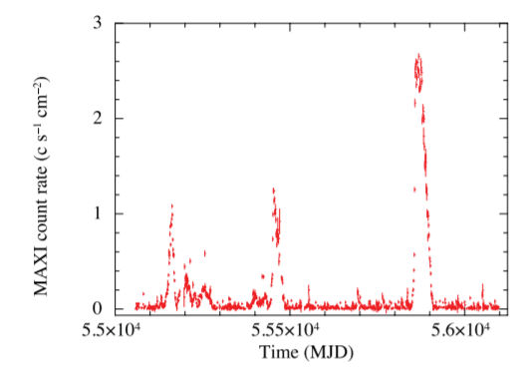
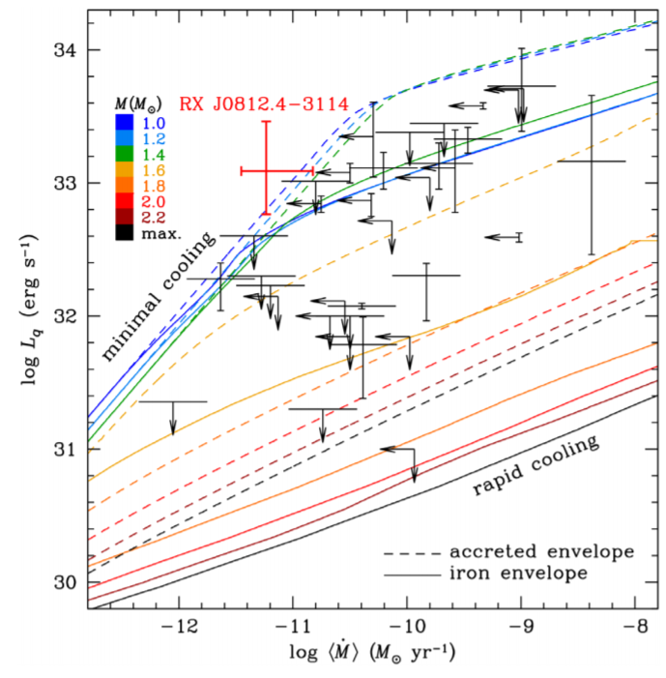
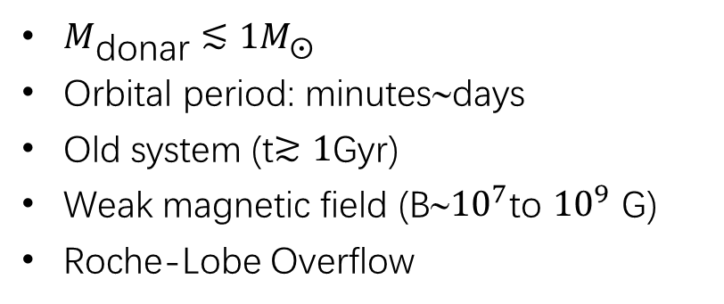

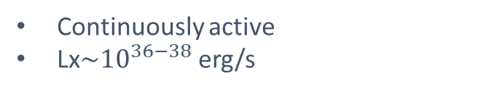
Low-Mass X-ray Binary (LMXB)
Persistent sources
$M_{\text{donar}}≲1M_{⨀}$
Orbital period: minutes∼days
Old system (t$≳1$Gyr)
Weak magnetic field (B∼${10}^{7}$to ${10}^{9}$ G)
Roche-Lobe Overflow
Continuously active
Lx$\sim {10}^{36−38}$ erg/s
Transient sources
  Switched on
    accretion induced outburst
    Lx∼10³⁴⁻³⁹ erg/s
  Switch off
    Quiescence
    Lx∼10³¹⁻³⁴ erg/s
Aql X-1
(NASA website)
Campana, et al. 2013
Zhao, et al. 2019

Slide 4
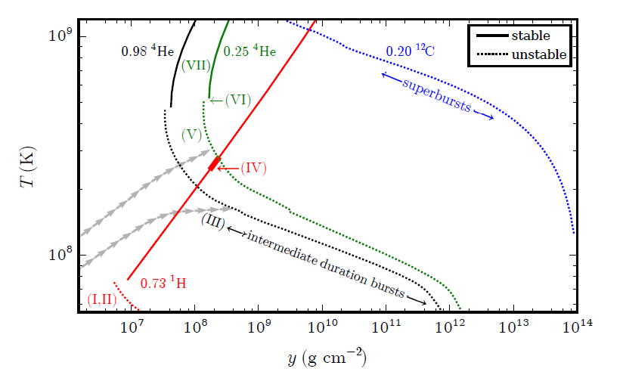
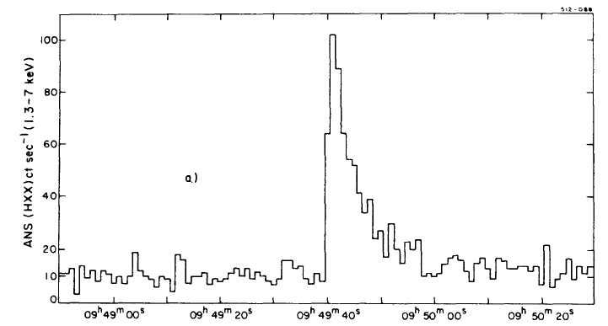
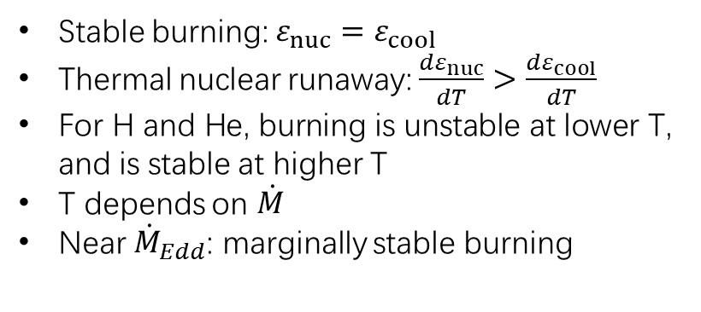
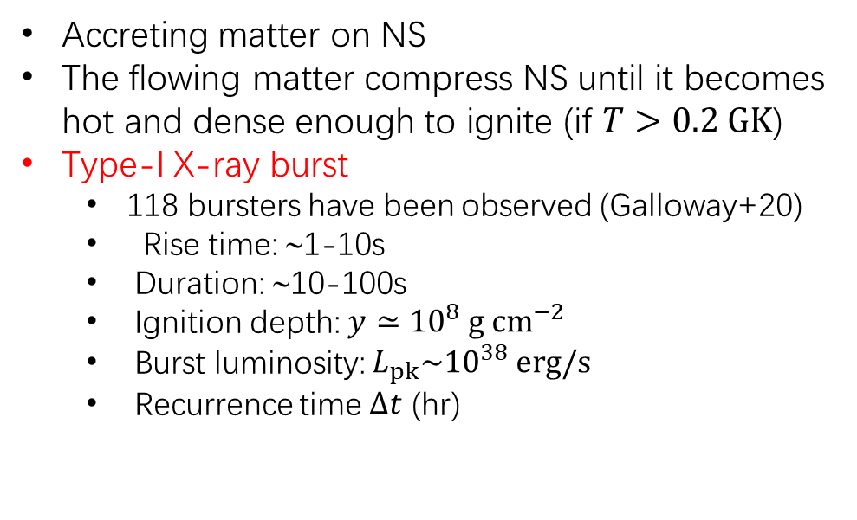
Thermonuclear X-ray burst
Accreting matter on NS
The flowing matter compress NS until it becomes hot and dense enough to ignite (if $T>0.2 GK$)
Type-I X-ray burst
  118 bursters have been observed (Galloway+20)
  Rise time: ∼1-10s
  Duration: ∼10-100s
  Ignition depth: $y≃{10}^{8} g {cm}^{−2}$
  Burst luminosity: $L_{pk}\sim {10}^{38} erg/s$
  Recurrence time $∆t$ (hr)
Galloway, et al. 2017
3A 1820-30
Stable burning: $ε_{nuc}=ε_{cool}$
Thermal nuclear runaway: $\frac{dε_{nuc}}{dT}>\frac{dε_{cool}}{dT}$
For H and He, burning is unstable at lower T, and is stable at higher T
T depends on $\dot{M}$
Near ${\dot{M}}_{Edd}$: marginally stable burning
Grindlay, 1976, ApJ

Slide 5
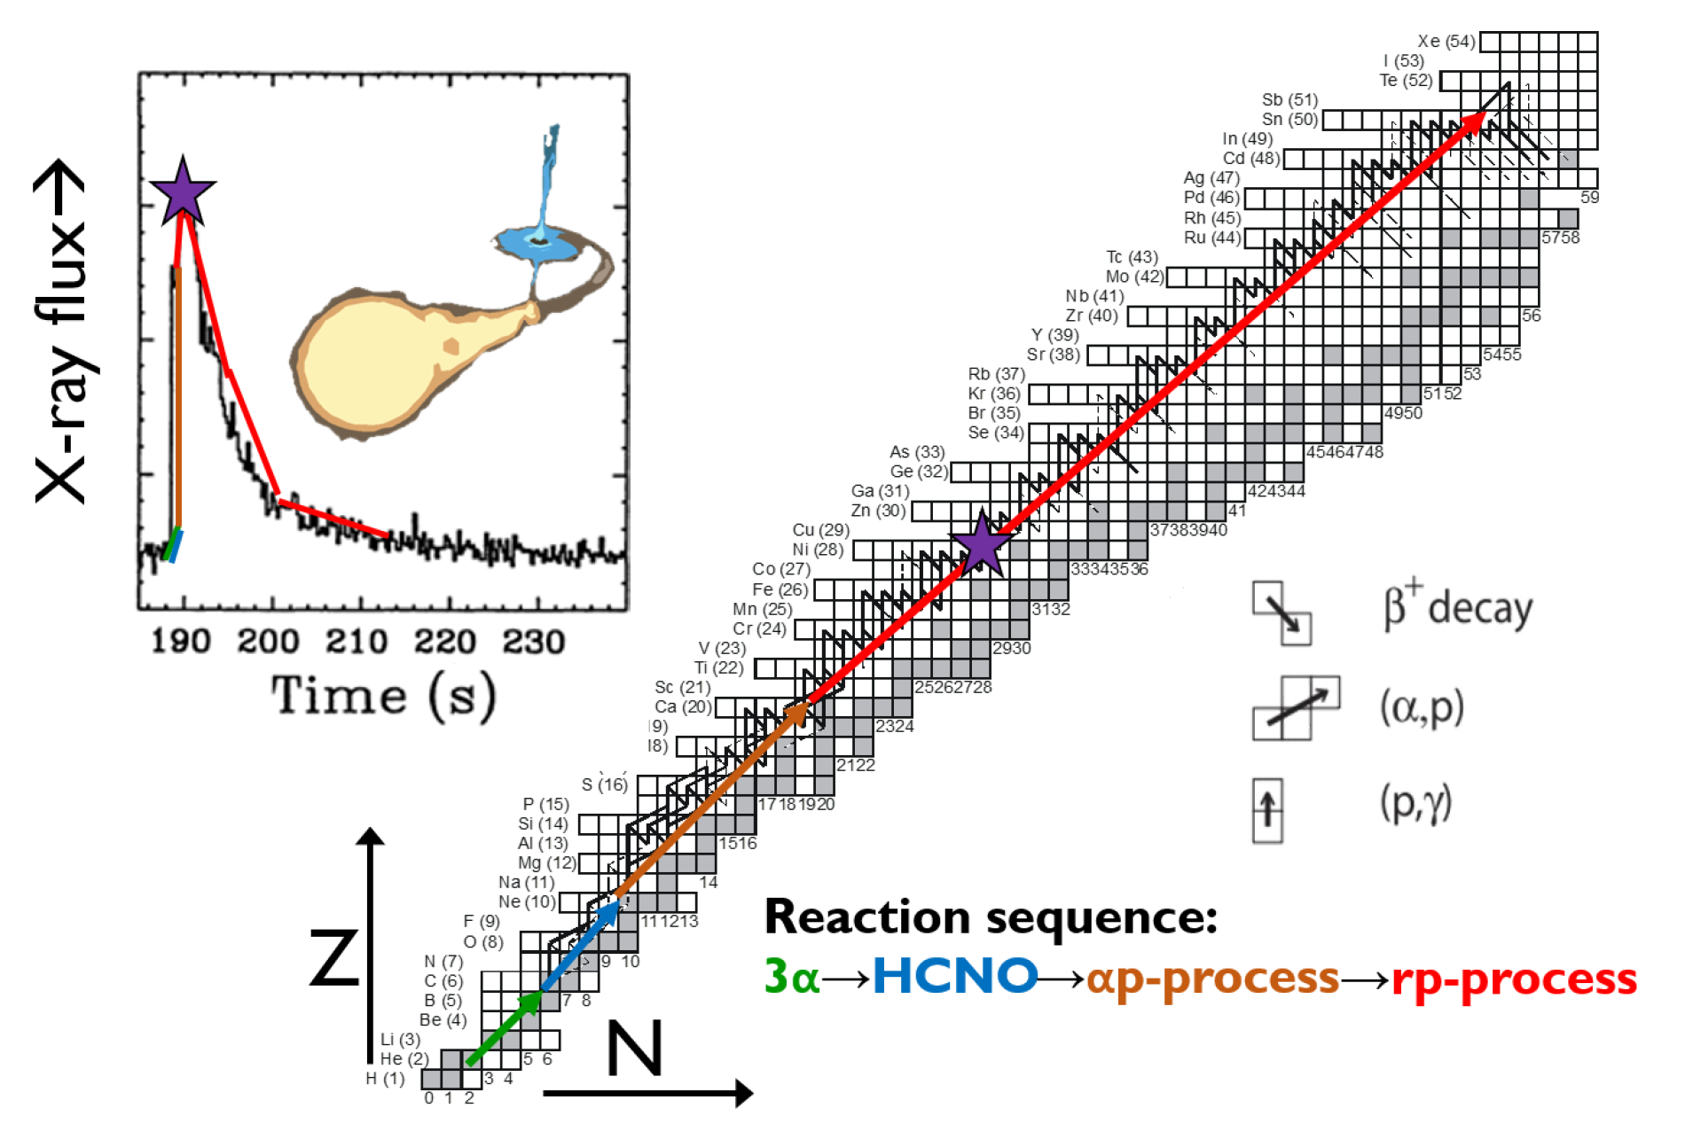
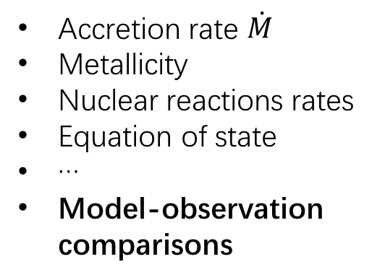
Nucleosynthesis in X-ray Burst
Accretion rate $\dot{M}$
Metallicity
Nuclear reactions rates
Equation of state
…
Model-observation comparisons
Meisel, 2018

Slide 6
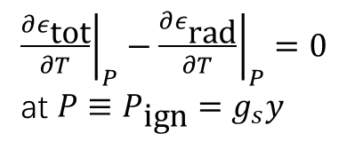


Energy Sources in Accreting NS
Ignition condition:
Outer physics of NS
  Release of gravitation
  Nuclear burning
Inner physics of NS
  Crust heating (Haensel & Zdnick 90,03,08)
  Shallow heating (Deibel, 2016)
  ν emission (slow+Fast cooling)
  EOS properties
${\left.\frac{∂ε_{\text{tot}}}{∂T}\right|}_{P}−{\left.\frac{∂ε_{\text{rad}}}{∂T}\right|}_{P}=0$
at $P≡P_{\text{ign}}=g_{s}y$
3α reaction→HCNO cycle
（Wallance & Woosley 1981）
→αp process→rp process
(Woosley & Weaver 1981,84)
→SnSbTe cycle (Schatz+2001)
what’s the origin of $ε_{\text{tot}}$?
$$Q_{b}$$
⇒
burst phenomenon is related to not only outside but also inside physics of NS

Slide 7
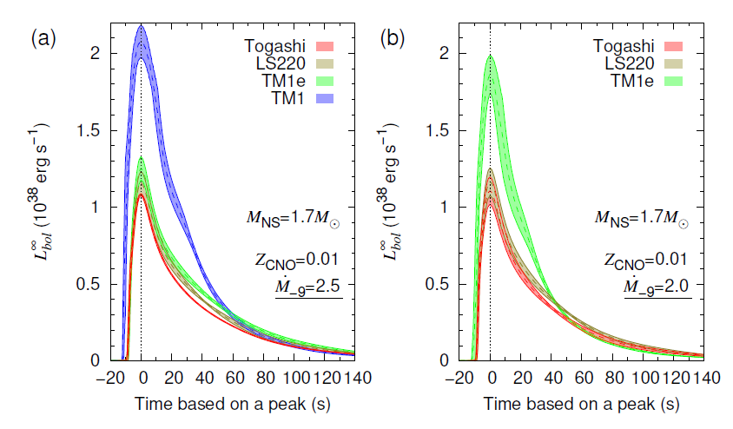
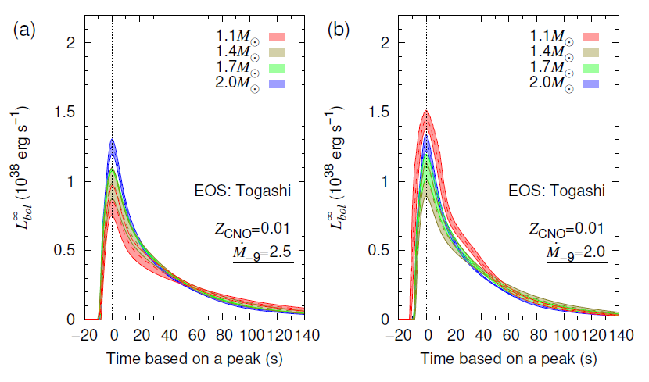
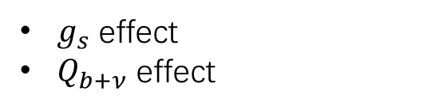
Equation of state dependence of X-ray bursts
Dohi, et al. 2021
$g_{s}$ effect
$Q_{b+ν}$ effect

Slide 8
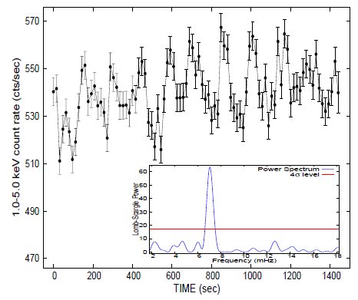
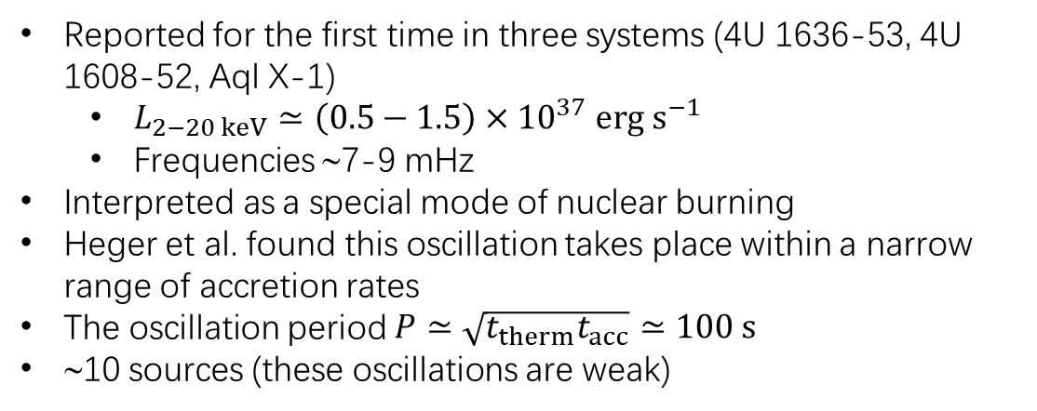
mHz quasi-periodic oscillations in the low-mass X-ray binary
Quasi-periodic oscillation (QPO)
Aperiodic X-ray variability in their light curves during outbursts (s to ms)
Sharp and narrow peaks in Fourier power density spectra
mHz QPO
4U 1730-22
Reported for the first time in three systems (4U 1636-53, 4U 1608-52, Aql X-1)
  $L_{2−20 keV}≃\left(0.5−1.5\right)×{10}^{37} erg s^{−1}$
  Frequencies ∼7-9 mHz
Interpreted as a special mode of nuclear burning
Heger et al. found this oscillation takes place within a narrow range of accretion rates
The oscillation period $P≃\sqrt{{t_{therm}t}_{acc}}≃100 s$
∼10 sources (these oscillations are weak)
Revnivtsev et al. 2001
Heger et al.(2007)
Mancuso et al, 2023

Slide 9
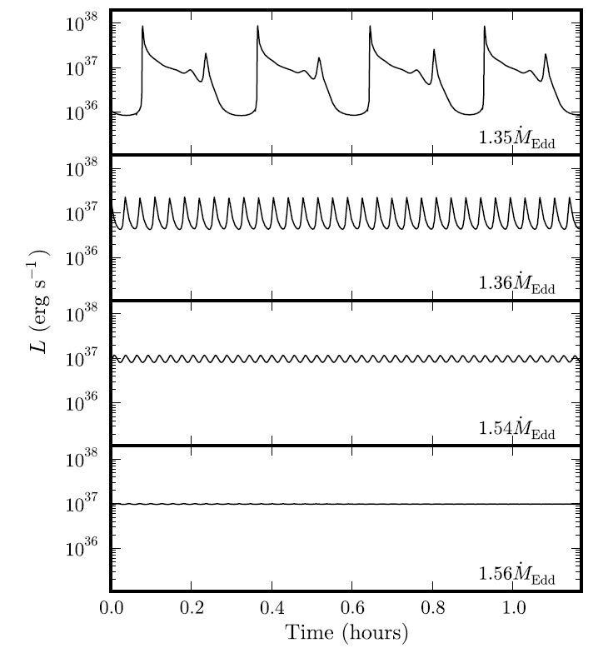
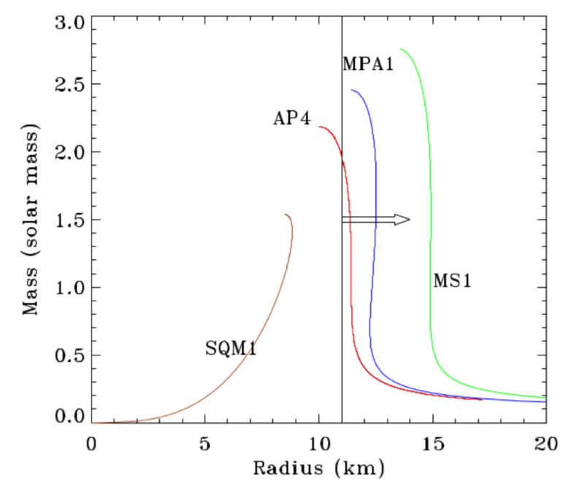
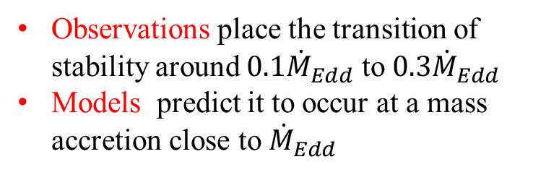
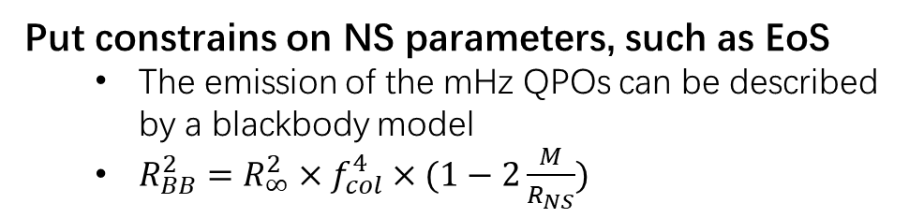
Marginally stable nuclear burning
Keek et al, 2014
bursts
Observations place the transition of stability around $0.1{\dot{M}}_{Edd}$ to $0.3{\dot{M}}_{Edd}$
Models predict it to occur at a mass accretion close to ${\dot{M}}_{Edd}$
marginally stable burning
The discrepancy is close to an order of magnitude!!
Stable burning
Possible solutions
Rotation and rotationally induced magnetic fields
Composition of the burning layer and reaction rates
Need additional samples to enhance our understanding of the marginally stable burning
4U 1636-536
Put constrains on NS parameters, such as EoS
  The emission of the mHz QPOs can be described by a blackbody model
  $R_{BB}^{2}=R_{∞}^{2}×f_{col}^{4}×(1−2\frac{M}{R_{NS}})$
Stiele, Yu & Kong 2016

Slide 10
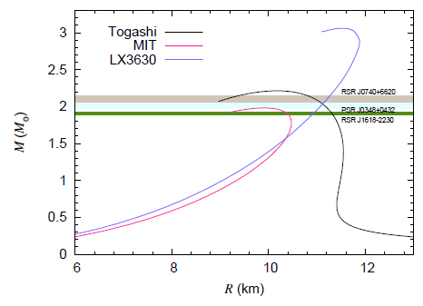
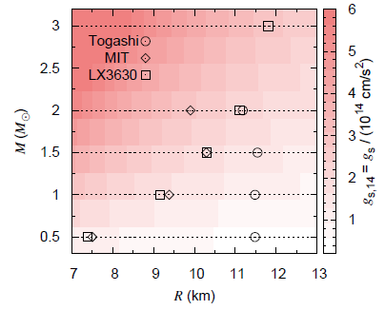
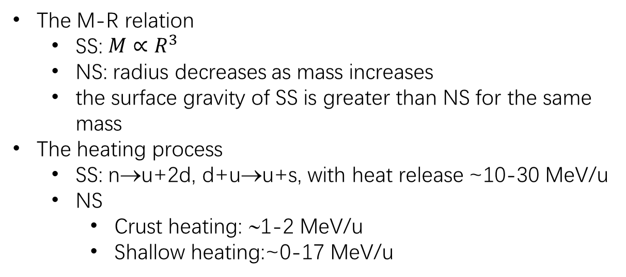
The differences between NS and SS
X-ray burst phenomena on the surface of accreting strange star has rarely been explored
The M-R relation
  SS: $M∝R^{3}$
  NS: radius decreases as mass increases
  the surface gravity of SS is greater than NS for the same mass
The heating process
  SS: n→u+2d, d+u→u+s, with heat release ~10-30 MeV/u
  NS
    Crust heating: ∼1-2 MeV/u
    Shallow heating:~0-17 MeV/u

Slide 11
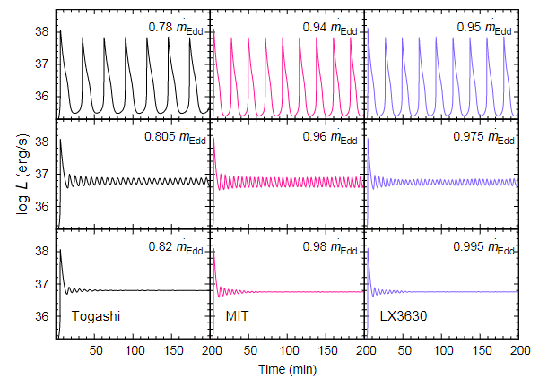
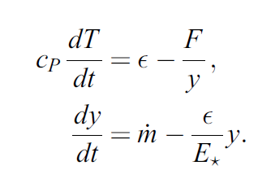
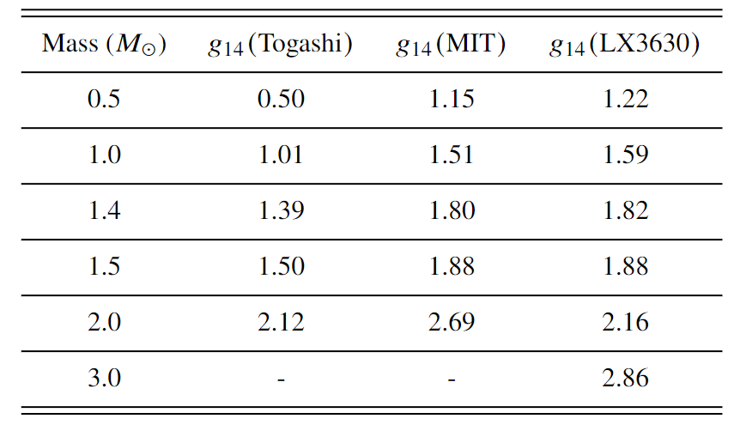


One-zone model
The entire NS/SS envelope is reduced to a single zone
$M=1.4M_{⨀}$, $Q_{b}=0.15$ MeV/u, $X_{0}=0.7$
$P=g_{s}y$ （1）
（2）
（3）
Surface gravity
The more compact the star, the greater the transition mass accretion rate.
Base flux

Slide 12
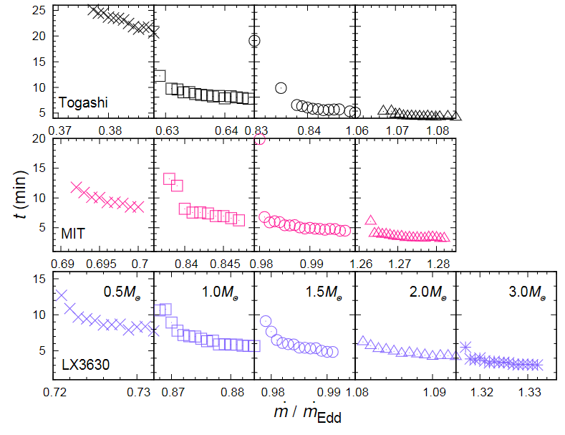


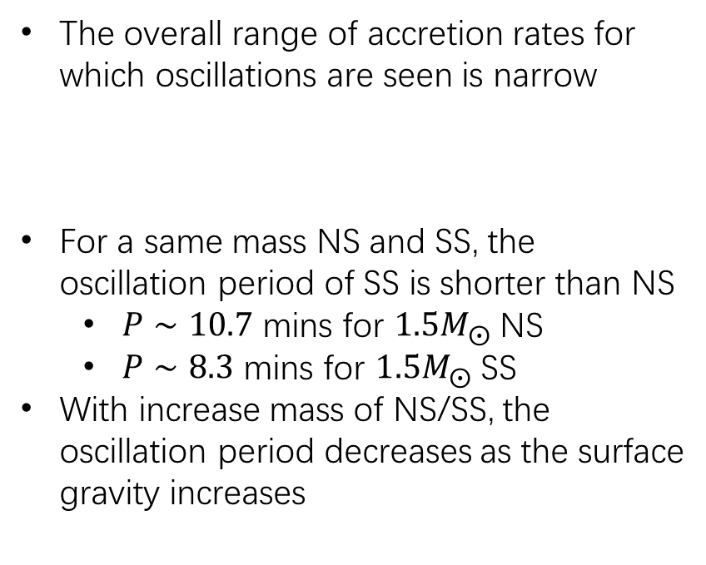
Oscillation period
$X_{0}=0.7$, $Q_{b}=0.15$ MeV/u
The overall range of accretion rates for which oscillations are seen is narrow
For a same mass NS and SS, the oscillation period of SS is shorter than NS
  $P∼10.7$ mins for $1.5M_{⨀}$ NS
  $P∼8.3$ mins for $1.5M_{⨀}$ SS
With increase mass of NS/SS, the oscillation period decreases as the surface gravity increases
$$\frac{Δ\dot{m}}{\dot{m}}≈1\%$$
Liu et al, 2023, MNRAS

Slide 13
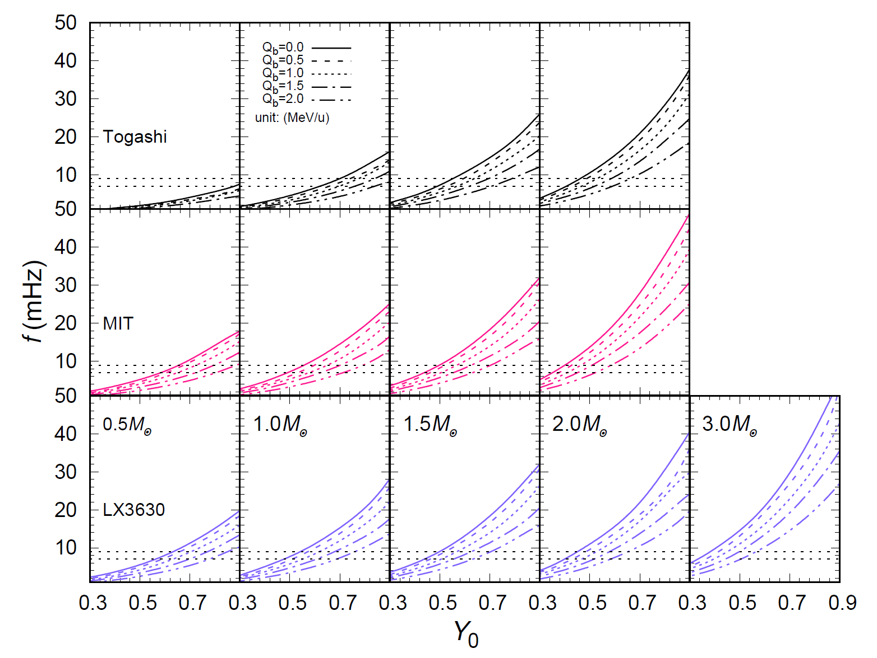
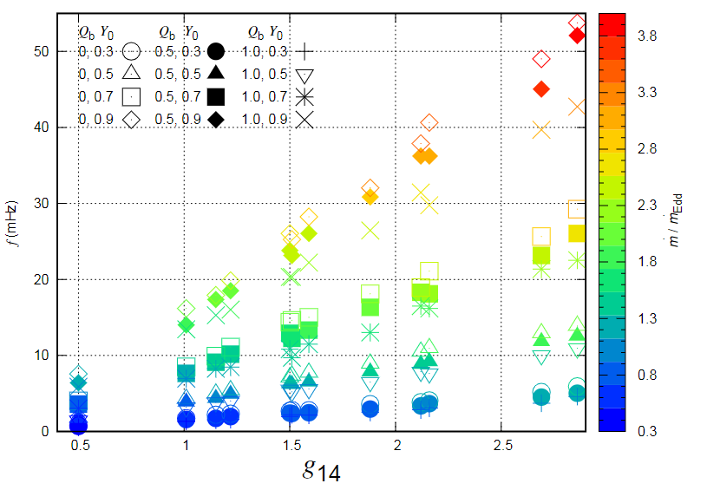
Oscillation frequency from NS/SS
Liu et al, 2023, MNRAS
A possible constraint of surface gravity (EOS) by the observation from mHz QPO

Slide 14
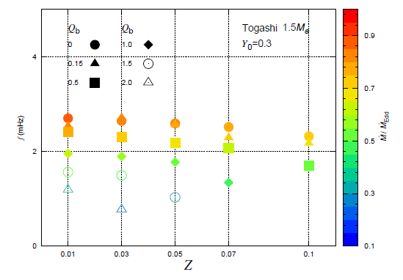

The impact of metallicity on mHz QPOs
Z ↑, f ↓, ${\dot{m}}_{crit}$ ↓
High metallicity, high base heating, low helium mass fraction, low surface gravity are the conditions for low critical mass accretion rate

Slide 15
Summary of My Talk
We calculated the EoS-dependent mHz QPO in LMXBs using a simple one-zone model
  Surface gravity ↑, oscillation frequency ↑, critical mass accretion rate ↑
  Base heating ↑, oscillation frequency ↓, critical mass accretion rate ↓
  Helium mass fraction ↑, oscillation frequency ↑, critical mass accretion rate ↑
  Metallicity ↑, oscillation frequency ↓, critical mass accretion rate ↓
High metallicity, high base heating, low helium mass fraction, low surface gravity are the conditions for low critical mass accretion rate
Infer the surface gravity from observations of the mHz QPO
**In future work**
Investigate the effects of interior physics such as neutrino cooling and superfluidity on the oscillation frequency
Understanding the mHz QPOs by using the observations such as NICER and Insight-HXMT
THANKS!

