Slide 1


Bubble nucleation in the two-flavor quark-meson model
BEST
Hong MAO
School of Physics, Hangzhou Normal University
With: Junrong Wang, Ziwan Yu
2023.09.23 QCS2023

Slide 2

Outline
01
The Motivation
02
Phase diagram in the quark-meson model
03
Homogeneous thermal nucleation
04
Summary and outlook

Slide 3
01
The Motivation
A. Pandav, D. Mallick, B. Mohanty, Progress in Particle and Nuclear Physics 125 (2022) 103960
A conjectured QCD phase diagram

Slide 4
(1) Due to the “fermion sign” problem, an ab initio approach, Lattice Field Theory, is severely hampered by the failure of importance sampling if a chemical potential is involved
(2) After the discovery of gravitational waves by LIGO Collaboration, the subject of cosmological first-order phase transition has gathered increasingly interest, most of works focus on Electroweak phase transition relevant to Baryogensis, Gravitational waves et al.
(3) It is a multimessenger era, to understand the dynamics of the first-order quark-hadron phase transition is also crucial and important.
(4) The dynamics of first-order phase transition in the early universe and heavy-ion collisions at ultrarelativistic energies can be applied through the homogeneous nucleation theory, previous studies most adopted the thin-wall approximation, we believe the precise and exact numerical solution is also essential, especially when the temperature is far from the critical one.

Slide 5
Junrong Wang, Ziwan Yu, and HM, in submitting
02
Phase diagram in the quark-meson model
2.1 The Lagrangian density of the quark meson model has the global SU(2)_{L} × SU(2)_{R} chiral symmetry
With the classical potential
2.2 In a mean field approximaiton, the temperature-dependent effective potential with the vacuum fluctuations
where

Slide 6
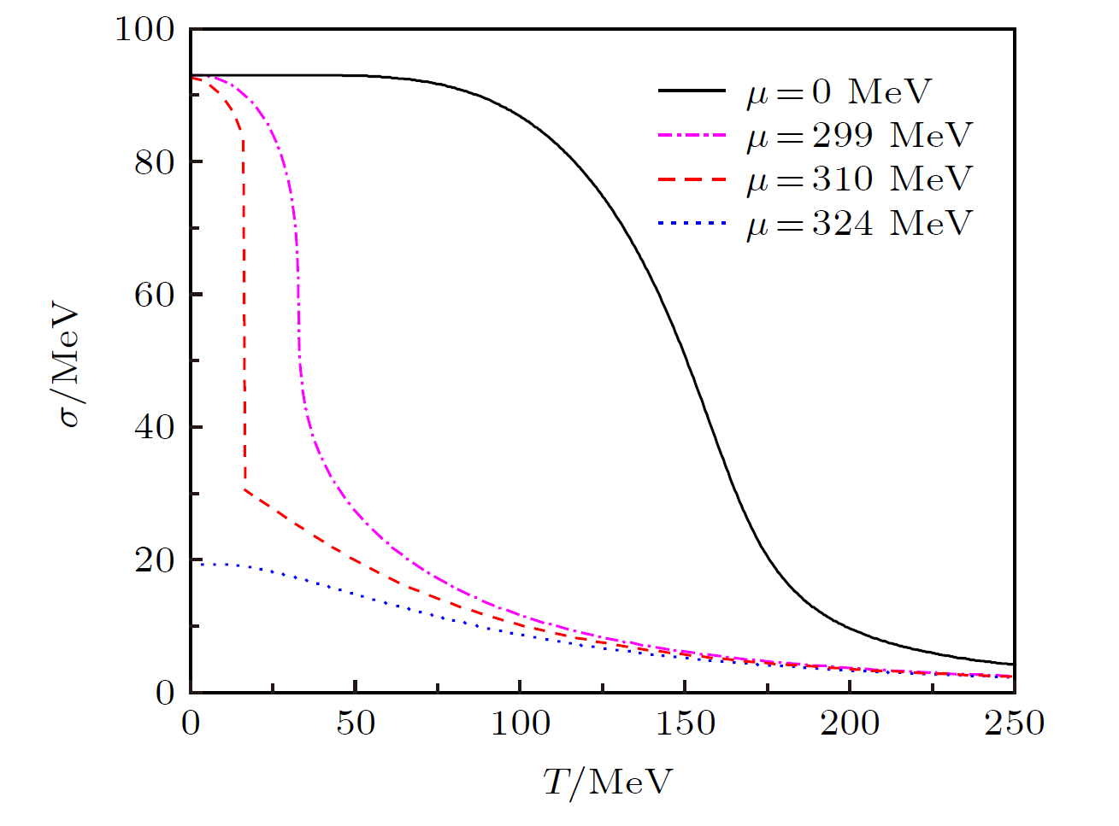
by using the dimensional regularization scheme, the renormalized fermion vacuum one-loop contribution reads
Λ is an arbitrary renormalization scale parameter, which can be neatly cancelled out after the rearrangement of parameters in the model
The phase diagram of the model at finite temperature and density by minimizing the thermodynamical potential (the gap equation!)
Chiral condensate σ as a function of temperature at various chemical potentials

Slide 7
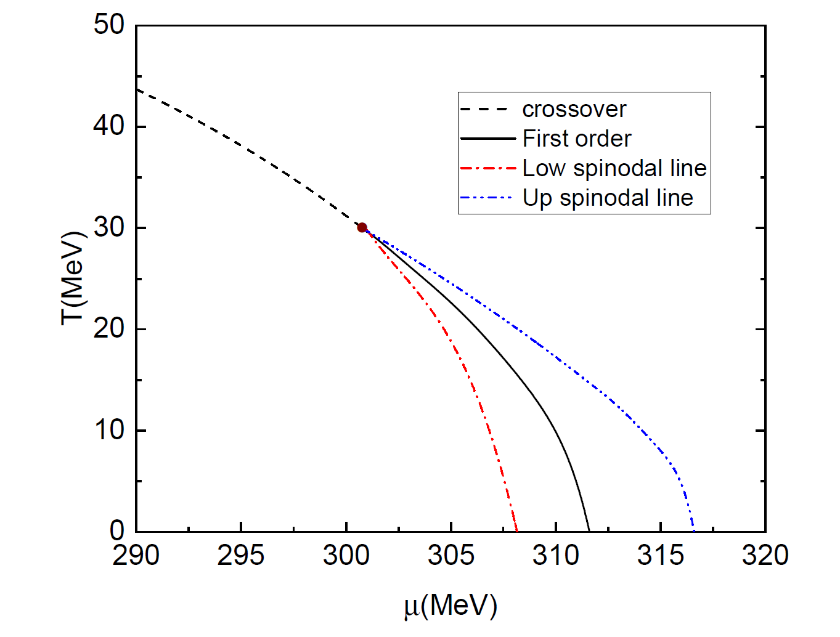
2.3 Phase diagram
The corresponding CEP is located at (T_{E}, μ_{E}) ≃ (30, 301) MeV.

Slide 8
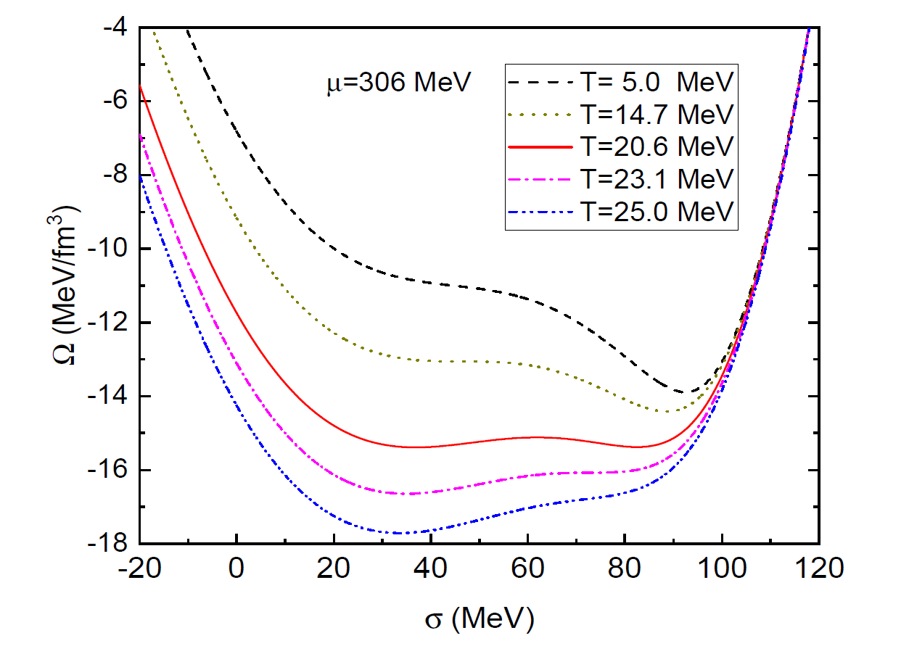
2.4 The Effective potential in the region of the first-order phase transition
(1) A weak first-order phase transition
Spinodal T_{c1}
Coexistence T_{c}
Spinodal T_{c2}

Slide 9
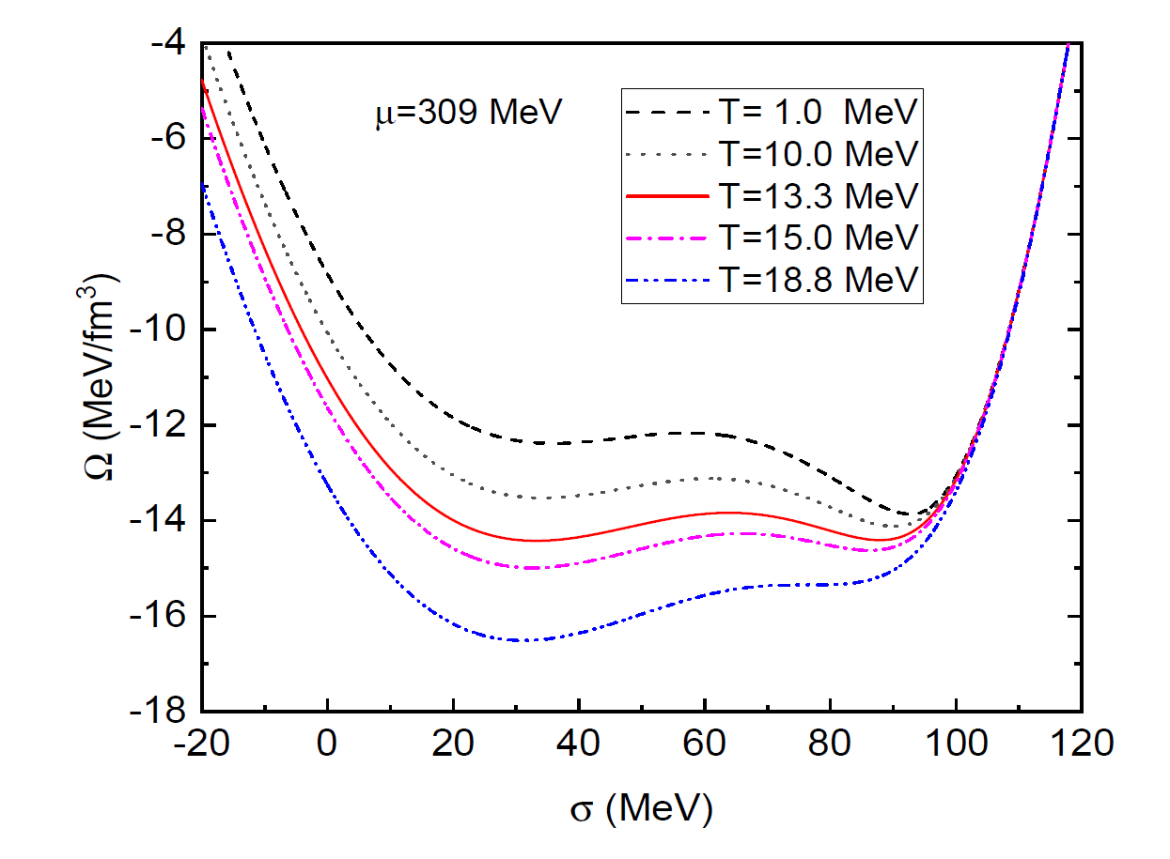
(2) A strong first-order phase transition
No Spinodal T_{c1}
Coexistence T_{c}
Spinodal T_{c2}

Slide 10
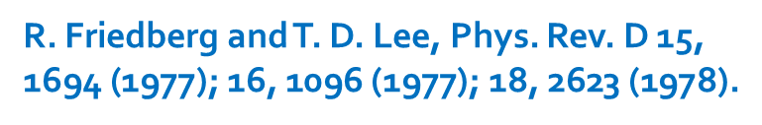
03
Homogeneous thermal nucleation
3.1 The Friedberg-Lee as a toy model
With
The potential has a a local minimum at , and the global minimum at , with
添加标题
3.2 Based on thermal field theory, the one-loop finite temperature effective potential (without the vacuum fluctuations )

Slide 11
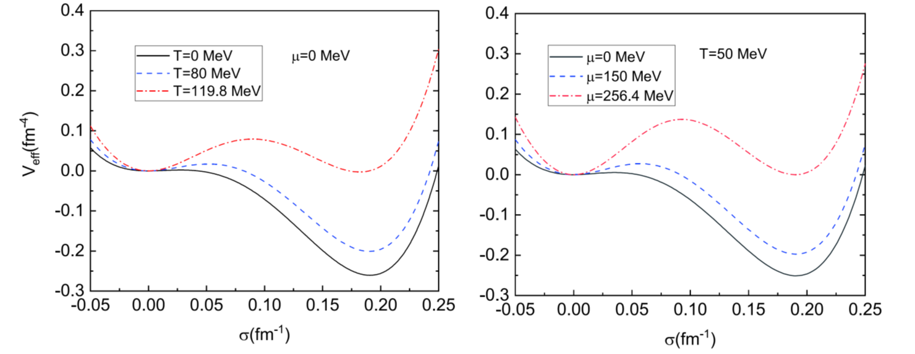
with

Slide 12
3.3 Bubble nucleation
HM, Minjie Yao and Wei-Qin Zhao, PhysRevC.77.065205
Shuying Zhou, Song Shu and HM, Chinese Physics C 45 (2021) 043104
the false vacuum
the true vacuum

Slide 13
an interface
the energy cost from the creation
of an interface
R
the false vacuum
the true vacuum
the free energy gain from the phase conversion of the bulk
(1) If a droplet is too small, the free energy gain from the phase transition of the bulk is less than the energy cost in the creation of an interface, the total free energy is positive, the droplet will shrink and evaporate
(2) if the droplet is large, a bulk free energy gain is relatively large and the surface energy cost is negligible, the droplet will tend to grow and eventually occupy the whole system, completing the phase conversion

Slide 14
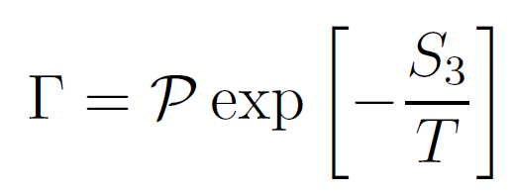
3.4 Bubble nucleation in thermal field theory
(1) The nucleation rate per unit time per unit volume
S. R. Coleman, Phys. Rev. D 15, 2929-2936 (1977) [erratum: Phys. Rev. D 16, 1248 (1977)]
C. G. Callan, Jr. and S. R. Coleman, Phys. Rev. D 16, 1762-1768 (1977)
With the prefactor
A. D. Linde, Nucl. Phys. B 216, 421 (1983) [erratum: Nucl. Phys. B 223, 544 (1983)]
Note:
ω₋ is the eigenvalue of the negative mode.
the terms Ω′′_{FV} and Ω′′_{B} are abbreviations for Ω′′ evaluated in the false vacuum and the critical bubble.
the prime in the determinant signifies that the zero eigenvalues associated with the translation symmetry of the bubble are omitted.
Ω′′ is the second derivative of the effective potential Ω(T, μ) with respect to the order parameter σ.
S₃ is the three-dimensional saddle point action associated with the O(3)-symmetric critical bubble or droplet.

Slide 15
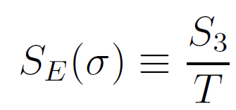
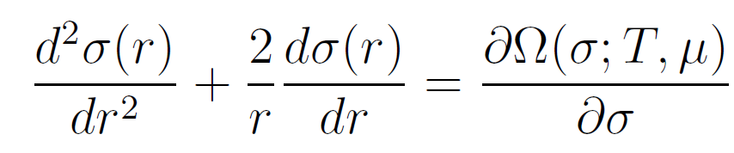
(2) The bounce
By taking the scalar field σ as the order parameter, at finite temperature, a Euclidean action
For sufficiently high temperature
The bounce is an O(3) symmetric solution to the classical equation of motion that extremizes the Euclidean action S₃
with boundary conditions

Slide 16
Once the solution σ_{b} is obtained, the S₃ exponent in the present of the bounce is given by
The surface tension of the nucleation bubble interface between the false vacuum and the true vacuum
What is the false vacuum in boundary conditions? As μ=309 MeV as an example
There are two minima separated by the barrier.
Quark phase is at σ_{l}, hadron phase is at σ_{h}.
For T<Tc, the false vacuum is σ_{l}, but for T>Tc, the false vacuum is σ_{h}.
σ_{l}
σ_{h}

Slide 17
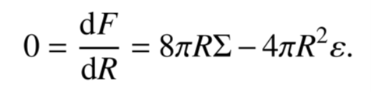
3.5 Why the thin-wall approximation?
When the system is very close to the critical coexistence line, the typical radius of the bubbles becomes much greater than the wall thickness, and the second term in the equation of motion can be neglected.
The critical radius
01

Slide 18
A. D. Linde, Nucl. Phys. B 216, 421 (1983).
02
The surface tension
03
The saddle-point action
Here is the energy difference between
the effective potential at the false vacuum and at the true vacuum

Slide 19
3.6 Results and discussion
(1) The top-down scenario (T<Tc)
At , the false vacuum is treated as quark phase, and the specific boundary conditions as σ → σ_{l} as r → ∞ and dσ(0)/dr = 0.
(a) The critical bubble profile

Slide 20
(b) Surface tension
(c) The saddle-point action

Slide 21
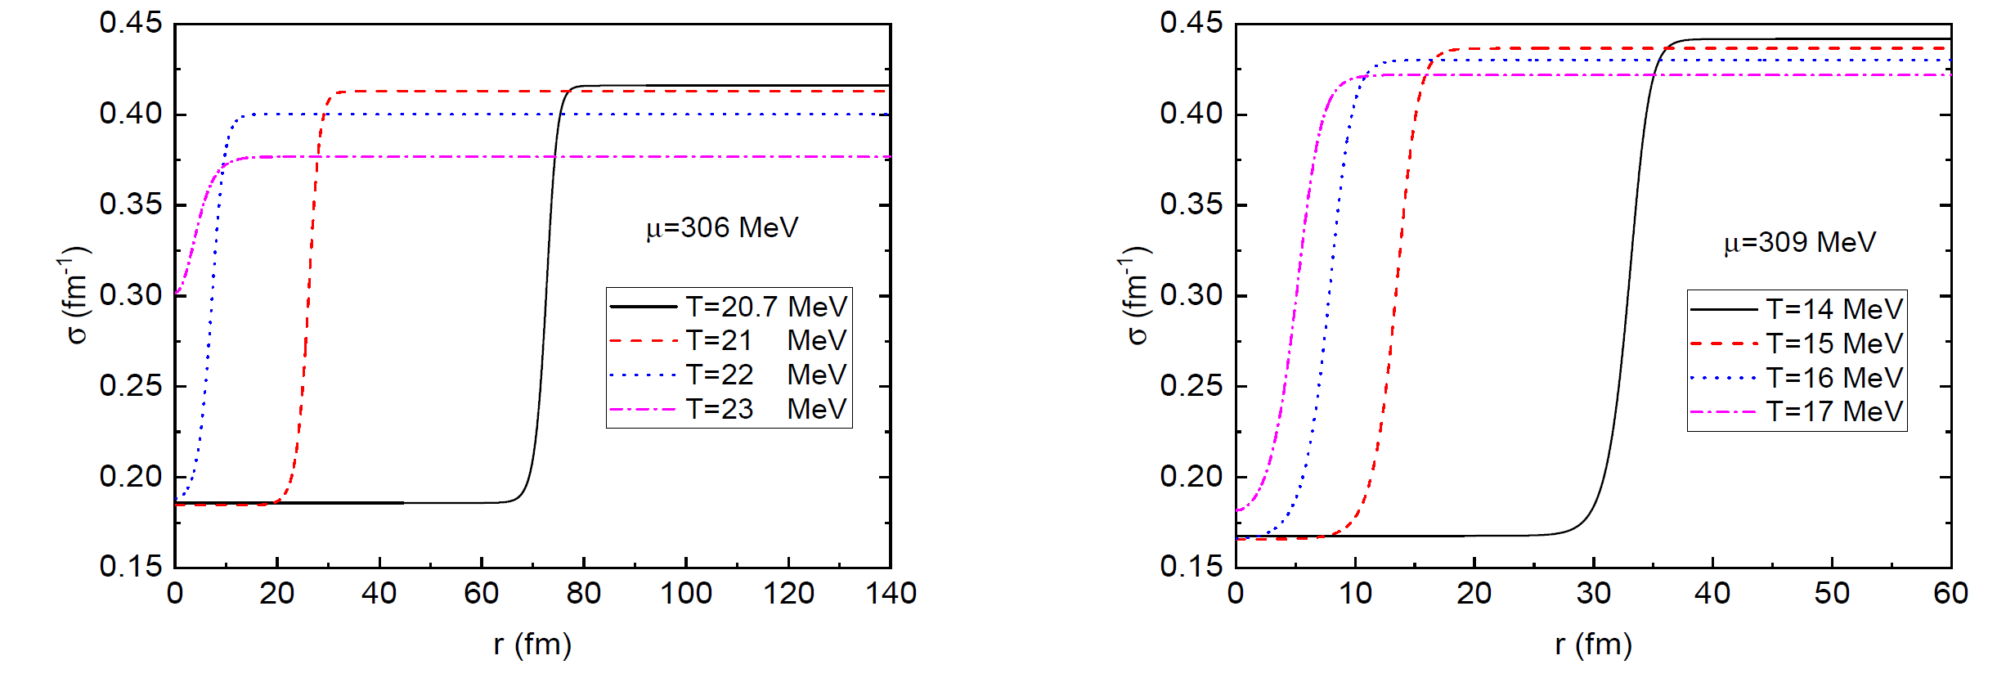
(2) The bottom-up scenario (T>Tc)
At , the false vacuum is treated as hadron phase, and the specific boundary conditions as σ → σ_{h} as r → ∞ and dσ(0)/dr = 0.
(a) The critical bubble profile

Slide 22
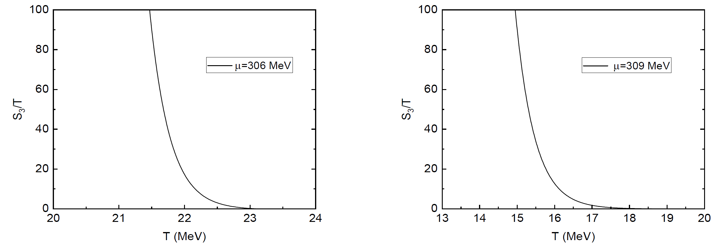
(b) Surface tension
(c) The saddle-point action

Slide 23
(3) In summary
Hadron phase
Quark phase
(a)“Actual” phase diagram for the first-order phase transition.
(b) Surface tension as a function of a quark chemical potential when T ≃ Tc. The solid line is for the “top-down” scenario and the dashed line is for the “bottom-up” scenario.

Slide 24
4
Summary and Outlook
We investigate the dynamics of a first-order quark-hadron transition via homogeneous thermal nucleation in the quark-meson model.
By taking the temperature as the variables, the critical bubble profiles, the evolutions of the surface tension and the three-dimensional saddle-point action S₃/T in the presence of a nucleation bubble are calculated in detail.
For a realistic quark meson model, the false vacuum could survive and exist as a metastable state as long as the temperature lies between the up and low spinodal lines.
The quark meson model predicts a surface tension of Σ ∼ 0−4 MeV/fm², such a small value of the surface tension would favor a mixed phase in the cores of compact stars.

Slide 25
Future studies:
To extend our works to the quark meson model with the Polyakov loop, moreover, to the 3-flavor quark-meson model with and without the Polyakov loop by included the strange quark.
For the physics we are interested in this work, we can give an estimate of the prefactor by T⁴ based on dimensional analysis. However, when the temperature is close to the spinodal critical lines in phase diagram, S₃/T<1, the nucleation rate will be primarily determined by the prefactor. So calculations of functional determinates are under consideration.
The possible Gravitational waves from the QCD first-order phase transitions in compact stars and cosmology.

Slide 26

BEST
Thanks!

