Slide 1
Molecular Dynamics for Spin Systems
Toshiki MARUYAMA (JAEA)
Nobutoshi YASUTAKE (Chiba Inst. Tech.)
We have developed “Color Moleculuar Dunamics” for quark systems and applied it to the EOS of matter.
Spin of quarks are fixed. Only each color is time-dependent.
But spin of quarks is important for baryon mass spectra, etc.
There is no reason to leave spin of quarks time-independent.
So, we should consider time-dependent spins together with colors of quarks.
But let’s first consider only the system of time-dependent spins.

Slide 2
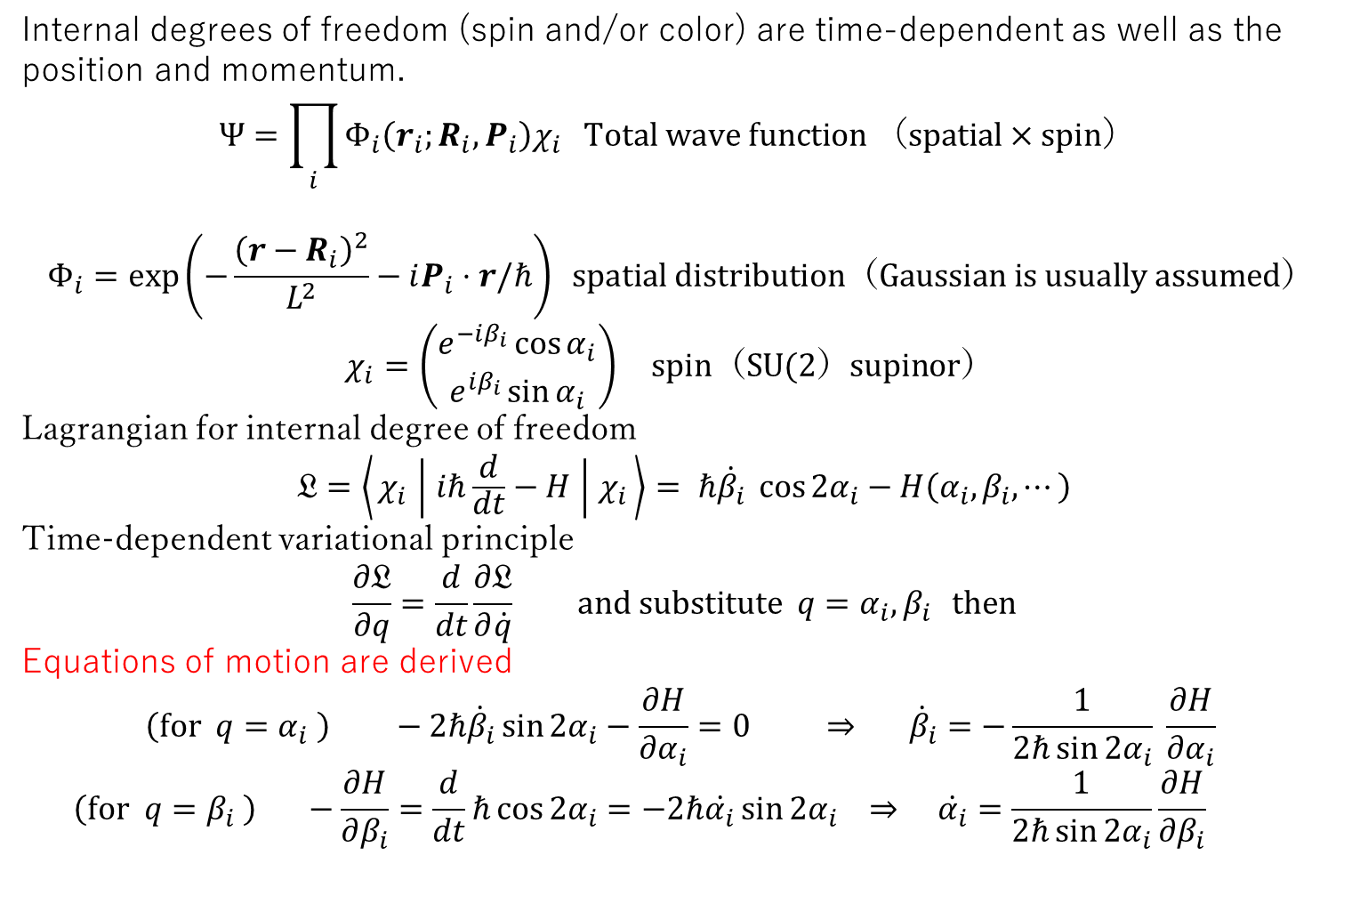
Molecular Dynamics for Spin Systems
Internal degrees of freedom (spin and/or color) are time-dependent as well as the position and momentum.
$$Ψ=\prod_{i}{Φ_{i}\left(r_{i};R_{i},P_{i}\right)χ_{i} Total wave function （spatial×spin） }$$
$$Φ_{i}=\exp\left(−\frac{{\left(r−R_{i}\right)}^{2}}{L^{2}}−iP_{i}⋅r/ℏ\right) spatial distribution（Gaussian is usually assumed）$$
$$χ_{i}=\left(\begin{aligned}e^{−iβ_{i}}\cos{α_{i}} \\ e^{iβ_{i}}\sin{α_{i}}\end{aligned}\right) spin（SU(2）supinor）$$
Lagrangian for internal degree of freedom
$$𝔏=\left\langle χ_{i} ∣ iℏ\frac{d}{dt}−H ∣ χ_{i}\right\rangle = ℏ\dot{β_{i}} \cos{2α_{i}}−H\left(α_{i},β_{i},⋯\right)$$
Time-dependent variational principle
$$\frac{∂𝔏}{∂q}=\frac{d}{dt}\frac{∂𝔏}{∂\dot{q}} and substitute q=α_{i},β_{i } then$$
Equations of motion are derived
$$\left(for q=α_{i} \right) −2ℏ{\dot{β}}_{i}\sin{2α_{i}}−\frac{∂H}{∂α_{i}}=0 ⇒ {\dot{β}}_{i}=−\frac{1}{2ℏ\sin{2α_{i}}} \frac{∂H}{∂α_{i}}$$
$$\left(for q=β_{i} \right) −\frac{∂H}{∂β_{i}}=\frac{d}{dt}ℏ\cos{2α_{i}}=−2ℏ\dot{α_{i}}\sin{2α_{i}} ⇒ \dot{α_{i}}=\frac{1}{2ℏ\sin{2α_{i}}}\frac{∂H}{∂β_{i}}$$

Slide 3

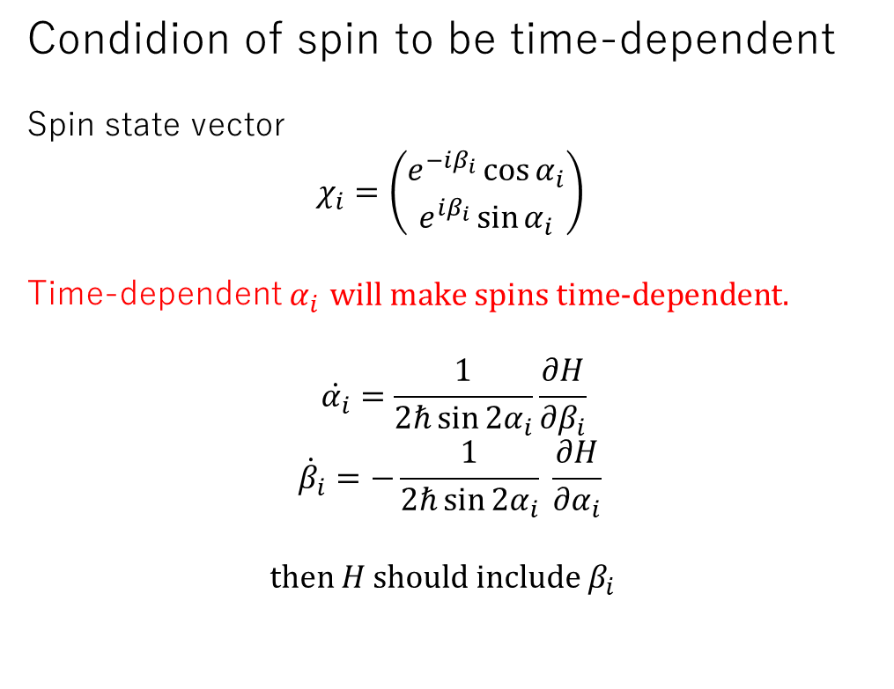
Condidion of spin to be time-dependent
Spin state vector
$$χ_{i}=\left(\begin{aligned}e^{−iβ_{i}}\cos{α_{i}} \\ e^{iβ_{i}}\sin{α_{i}}\end{aligned}\right)$$
Time-dependent $α_{i}$ $\text{will} \text{make} \text{spins} \text{time}\text{-}\text{dependent}\text{.}$
$$\dot{α_{i}}=\frac{1}{2ℏ\sin{2α_{i}}}\frac{∂H}{∂β_{i}}$$
$${\dot{β}}_{i}=−\frac{1}{2ℏ\sin{2α_{i}}} \frac{∂H}{∂α_{i}}$$
$$\text{then} H \text{should} \text{include} β_{i}$$
$$\left.\begin{aligned} \\ \\ \\ \end{aligned}\right\}EOM$$

Slide 4
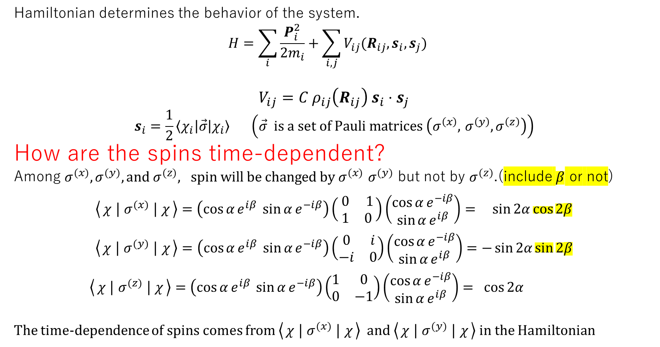
Hamiltonian determines the behavior of the system.
$$H=\sum_{i}{\frac{P_{i}^{2}}{2m_{i}}+\sum_{i, j}{V_{ij}(R_{ij}, s_{i},s_{j})} }$$
$$V_{ij}={C ρ}_{ij}\left(R_{ij}\right) s_{i}{⋅s}_{j}$$
$$s_{i}=\frac{1}{2}\left\langle χ_{i}\left|\vec{σ}\right|χ_{i}\right\rangle \left(\vec{σ} is a set of Pauli matrices \left(σ^{\left(x\right)}\text{,} σ^{\left(y\right)}, σ^{\left(z\right)}\right)\right)$$
How are the spins time-dependent?
Among $σ^{(x)}, σ^{(y)}, and σ^{(z)}, spin will be changed by σ^{(x)} σ^{(y)}$ but not by $σ^{(z)}$.(include $β$ or not)
$$\left\langle χ ∣ σ^{(x)} ∣ χ\right\rangle =\left(\cos{α}e^{iβ} \sin{α}e^{−iβ}\right)\left( \begin{matrix}0 & 1 \\ 1 & 0 \end{matrix}\right)\left(\begin{aligned}\cos{α}e^{−iβ} \\ \sin{α}e^{iβ}\end{aligned}\right)=\sin{2α}\cos{2β}$$
$$\left\langle χ ∣ σ^{(y)} ∣ χ\right\rangle =\left(\cos{α}e^{iβ} \sin{α}e^{−iβ}\right)\left(\begin{matrix}0 & i \\ −i & 0\end{matrix}\right)\left(\begin{aligned}\cos{α}e^{−iβ} \\ \sin{α}e^{iβ}\end{aligned}\right)=−\sin{2α}\sin{2β}$$
$$\left\langle χ ∣ σ^{(z)} ∣ χ\right\rangle =\left(\cos{α}e^{iβ} \sin{α}e^{−iβ}\right)\left(\begin{matrix}1 & 0 \\ 0 & −1\end{matrix}\right)\left(\begin{aligned}\cos{α}e^{−iβ} \\ \sin{α}e^{iβ}\end{aligned}\right)= \cos{2α}$$
The time-dependence of spins comes from $\left\langle χ ∣ σ^{(x)} ∣ χ\right\rangle and \left\langle χ ∣ σ^{(y)} ∣ χ\right\rangle$ in the Hamiltonian

Slide 5



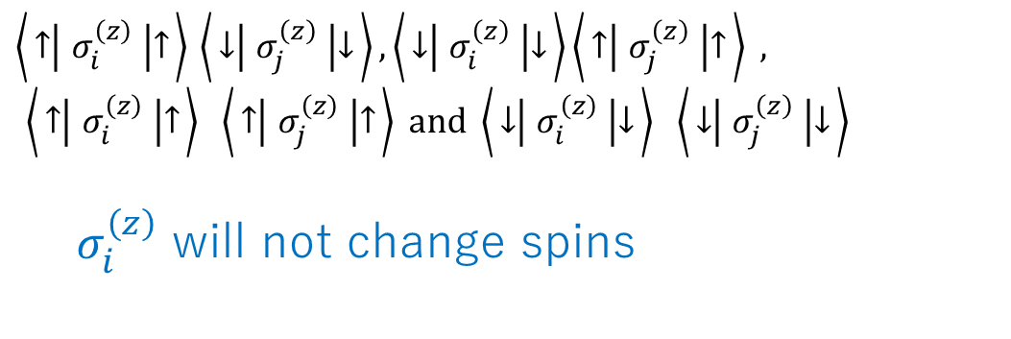



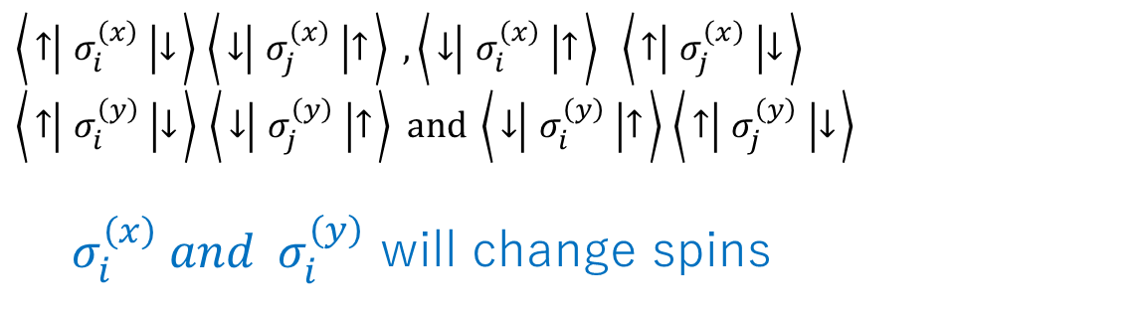









This fact is consistent with the diagrams below.
$$↓$$
$$↑$$
$\left\langle ↑ ∣ σ_{i}^{\left(x\right)} ∣ ↓\right\rangle$ $\left\langle ↓ ∣ σ_{j}^{\left(x\right)} ∣ ↑\right\rangle ,\left\langle ↓ ∣ σ_{i}^{\left(x\right)} ∣ ↑\right\rangle \left\langle ↑ ∣ σ_{j}^{\left(x\right)} ∣ ↓\right\rangle$
$\left\langle ↑ ∣ σ_{i}^{\left(y\right)} ∣ ↓\right\rangle$ $\left\langle ↓ ∣ σ_{j}^{\left(y\right)} ∣ ↑\right\rangle and \left\langle ↓ ∣ σ_{i}^{\left(y\right)} ∣ ↑\right\rangle$ $\left\langle ↑ ∣ σ_{j}^{\left(y\right)} ∣ ↓\right\rangle$
$σ_{i}^{\left(x\right)} and σ_{i}^{\left(y\right)}$ will change spins
$$↑$$
$$↓$$
$$i$$
$$j$$
$$j$$
$\left\langle ↑ ∣ σ_{i}^{\left(z\right)} ∣ ↑\right\rangle$ $\left\langle ↓ ∣ σ_{j}^{\left(z\right)} ∣ ↓\right\rangle ,\left\langle ↓ ∣ σ_{i}^{\left(z\right)} ∣ ↓\right\rangle \left\langle ↑ ∣ σ_{j}^{\left(z\right)} ∣ ↑\right\rangle ,$
$$\left\langle ↑ ∣ σ_{i}^{\left(z\right)} ∣ ↑\right\rangle \left\langle ↑ ∣ σ_{j}^{\left(z\right)} ∣ ↑\right\rangle and \left\langle ↓ ∣ σ_{i}^{\left(z\right)} ∣ ↓\right\rangle \left\langle ↓ ∣ σ_{j}^{\left(z\right)} ∣ ↓\right\rangle$$
$σ_{i}^{\left(z\right)}$ will not change spins
$$i$$
$$j$$
$$i$$
$$j$$
$$i$$
$$j$$
$$i$$
$$j$$

Slide 6
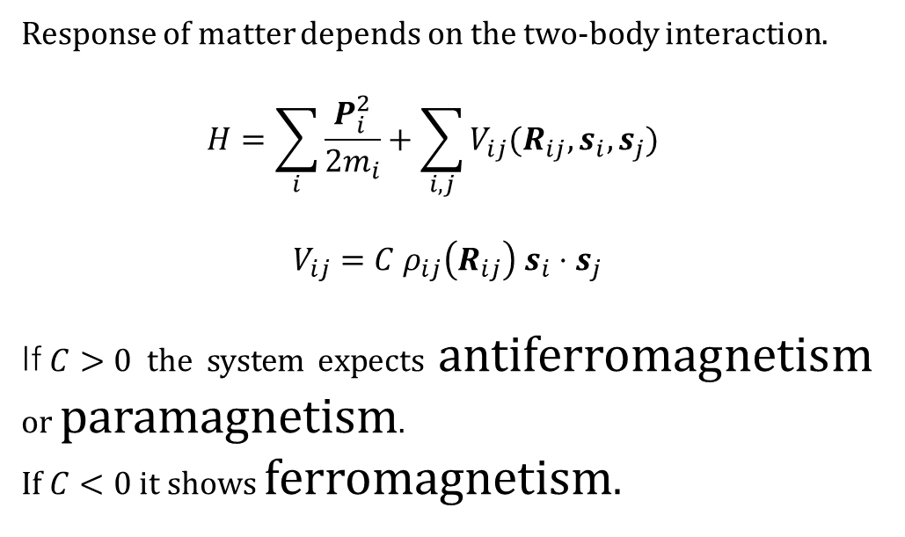
Response of matter depends on the two-body interaction.
$$H=\sum_{i}{\frac{P_{i}^{2}}{2m_{i}}+\sum_{i, j}{V_{ij}(R_{ij}, s_{i},s_{j})} }$$
$$V_{ij}={C ρ}_{ij}\left(R_{ij}\right) s_{i}{⋅s}_{j}$$
If$C>0$the system expects antiferromagnetism or paramagnetism.
If $C<0$ it shows ferromagnetism.

Slide 7
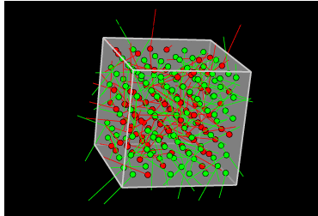

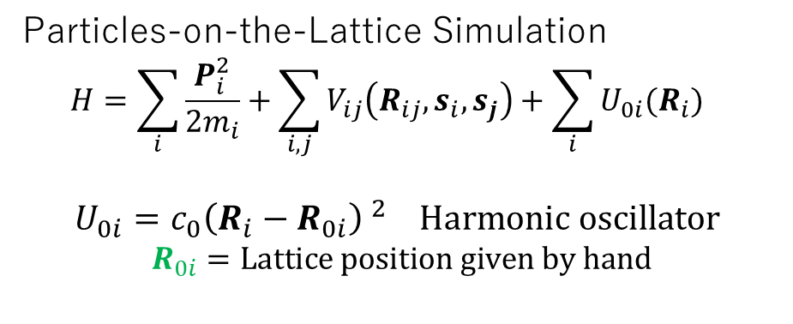

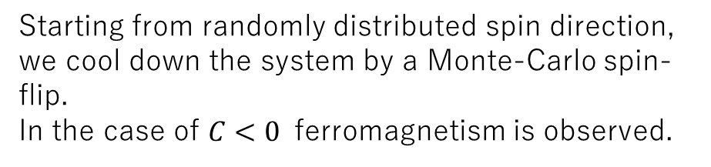
Starting from randomly distributed spin direction, we cool down the system by a Monte-Carlo spin-flip.
In the case of $C<0$ ferromagnetism is observed.
Particles-on-the-Lattice Simulation
$$H=\sum_{i}{\frac{P_{i}^{2}}{2m_{i}}+\sum_{i, j}{V_{ij}\left(R_{ij}, s_{i},s_{j}\right)+\sum_{i}{U_{0i}(R_{i})}} }$$
$$U_{0i}=c_{0}{\left(R_{i}−R_{0i}\right) }^{2} Harmonic oscillator$$
$$R_{0i}=Lattice position given by hand$$
$$R_{0i}$$
$$R_{i}$$
Due to attraction among particles in the magnetic site and repulsion between magnetic sites, clusters are formed.

Slide 8
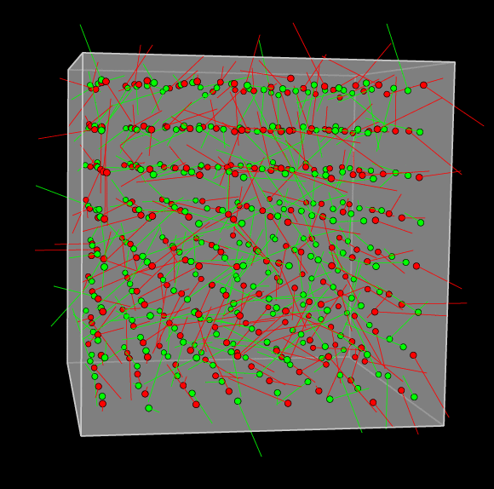
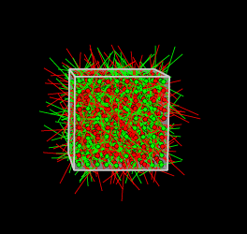
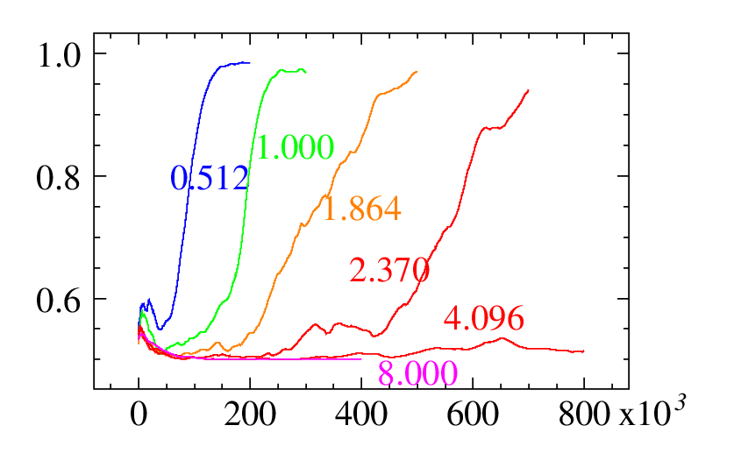
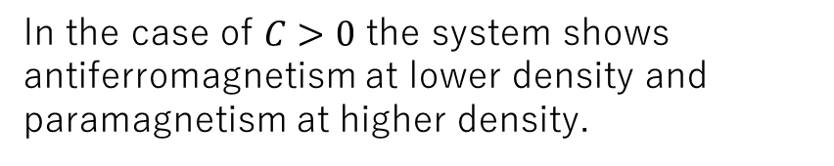
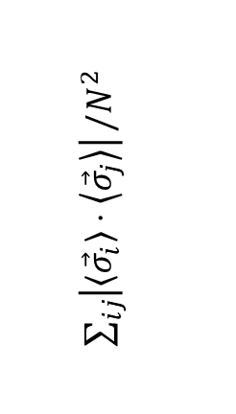
In the case of $C>0$ the system shows antiferromagnetism at lower density and paramagnetism at higher density.
Density-dependence of antiferromagnetism and paramagnetism
Density=0.512 antiferromagnetism
Density=8.000 paramagnetism
Monotonity of spin direction
antiferro
$\sum_{ij}{\left|\left\langle {\vec{σ}}_{i}\right\rangle ⋅\left\langle {\vec{σ}}_{j}\right\rangle \right|}/N^{2}$
para
Time step

Slide 9
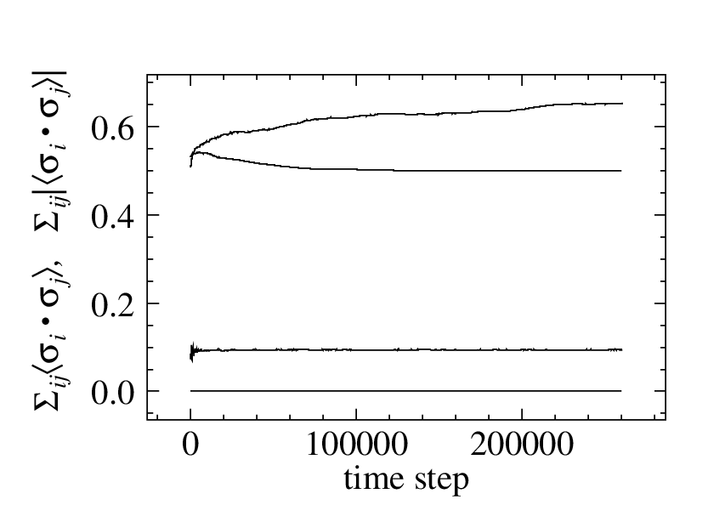
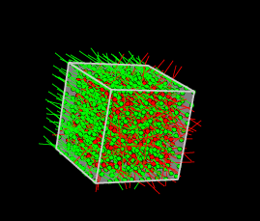
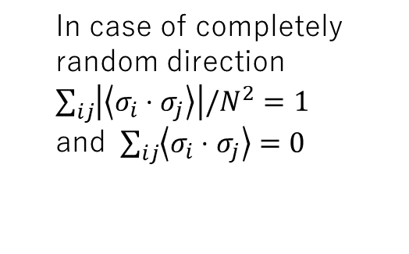
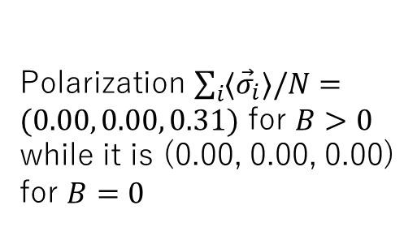

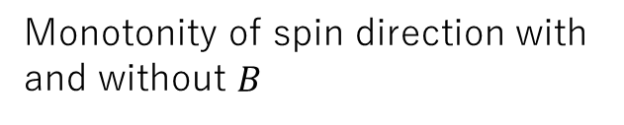

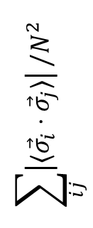

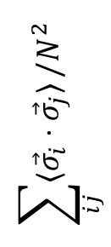


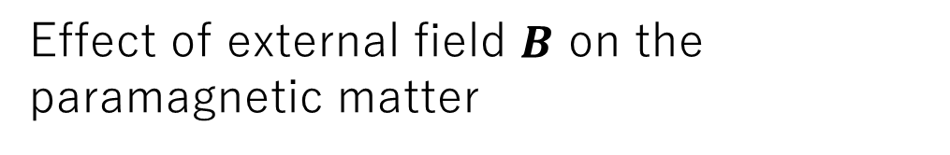
Effect of external field $B$ on the paramagnetic matter
Monotonity of spin direction with and without $B$
$$B>0$$
$$\sum_{ij}{\left|⟨{\vec{σ}}_{i}⋅{\vec{σ}}_{j}⟩\right|}/N^{2}$$
In case of completely random direction $\sum_{ij}{\left|\left\langle σ_{i}⋅σ_{j}\right\rangle \right|/N^{2}=1}$
and $\sum_{ij}{\left\langle σ_{i}⋅σ_{j}\right\rangle =0}$
$$B=0$$
$$/N^{2}$$
$$\sum_{ij}{⟨{\vec{σ}}_{i}⋅{\vec{σ}}_{j}⟩}/N^{2}$$
$$B>0$$
$$B=0$$
Polarization $\sum_{i}{{⟨\vec{σ}}_{i}⟩/N}=(0.00, 0.00, 0.31)$ for $B>0$
while it is (0.00, 0.00, 0.00) for $B=0$

Slide 10
Summary -- Molecular Dynamics for Spin Systems
Molecular dynamics of particles with time-dependent spin.
Ferromagnetism and antiferromagnetism or paramagnetism are observed for different spin-spin interaction parameters and different densities.
For ferromagnetism, clusterization of particles due to the ferromagnetic attraction was observed.
EOS should be modified by magnetic feature of matter.➔ Future work!
In the quark system, strong spin pair correlation may cause color interaction among three pairs as well as spin interaction between two baryons.

