Slide 1
Thermal evolution of neutron stars and The nature of hess j1731-347
Rodrigo Negreiros – UFF – RJ/Brazil

Slide 2
Reference

Slide 3
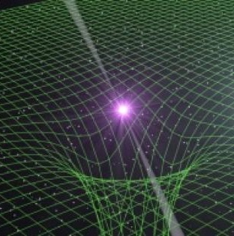
Structure Equations
Einstein’s equation
Hydro. equilibriu,m
Boundary conditions

Slide 4
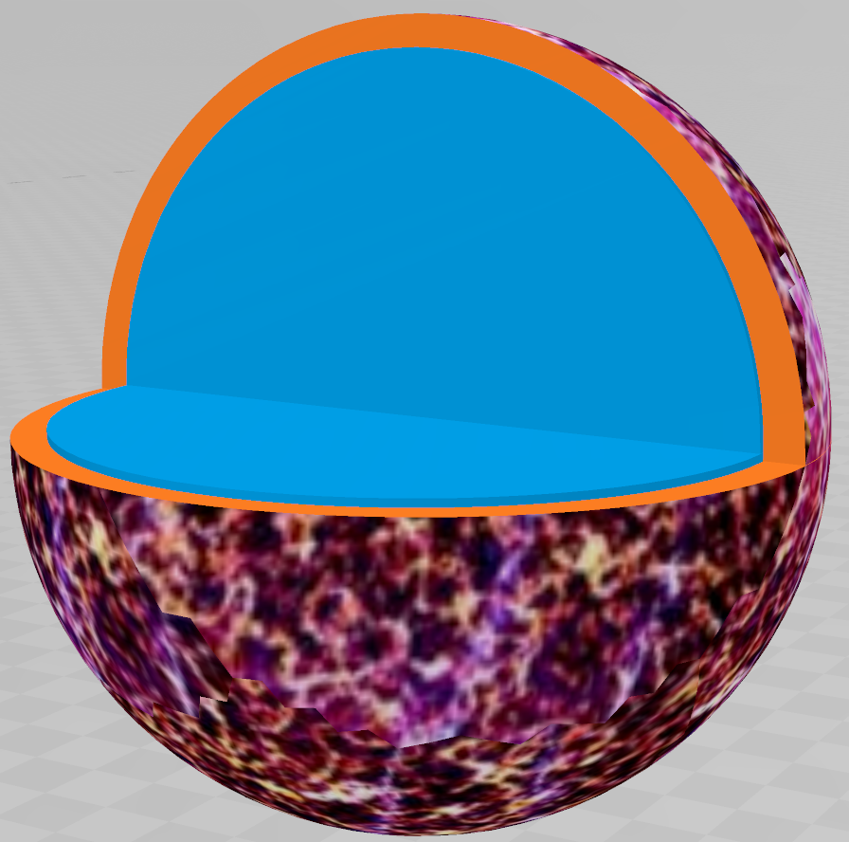
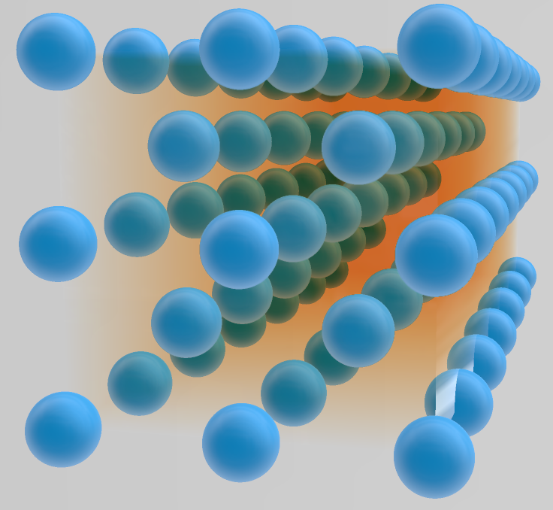
Microscopic Composition
Crust
Core:
Quantum fluid:neutrons, protons, e- + hyps

Slide 5
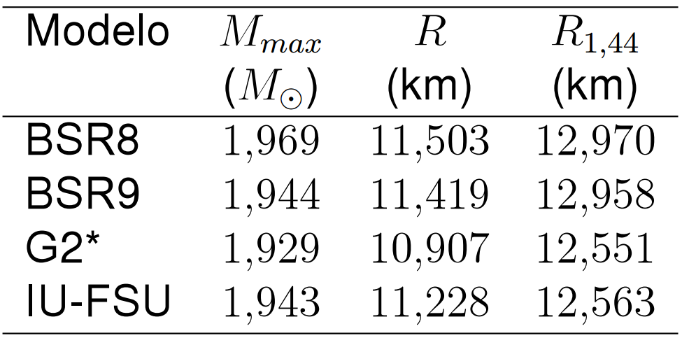
Adopted models
Saturation properties
Macroscopic properties
(Dutra; Lourenço; e Menezes, 2016)

Slide 6
Cooling
Energy conservation
Energy transport
(Thorne, 1977; Riper, 1991; Weber, 1999)

Slide 7
Neutrino Emissivity
Crust
Bremsstrahlung
e- e+ anihhilation
Plasmon decay:

Slide 8
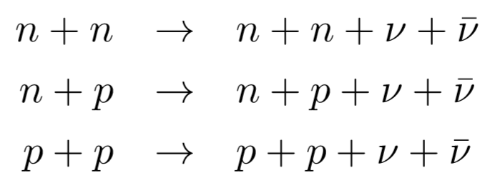
Neutrino Emissivity
Core
Direct Urca:
Modified Urca:
Bremsstrahlung:

Slide 9
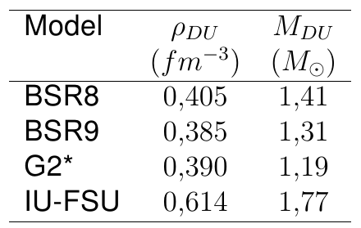
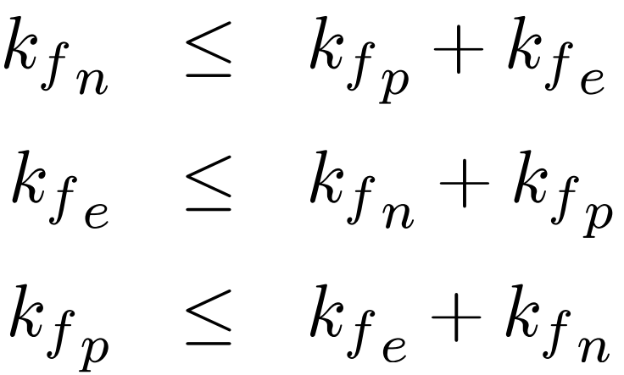
Direct Urca Threshold
(Dutra; Lourenço; e Menezes, 2016)
DU emissivity
MU emissivity

Slide 10
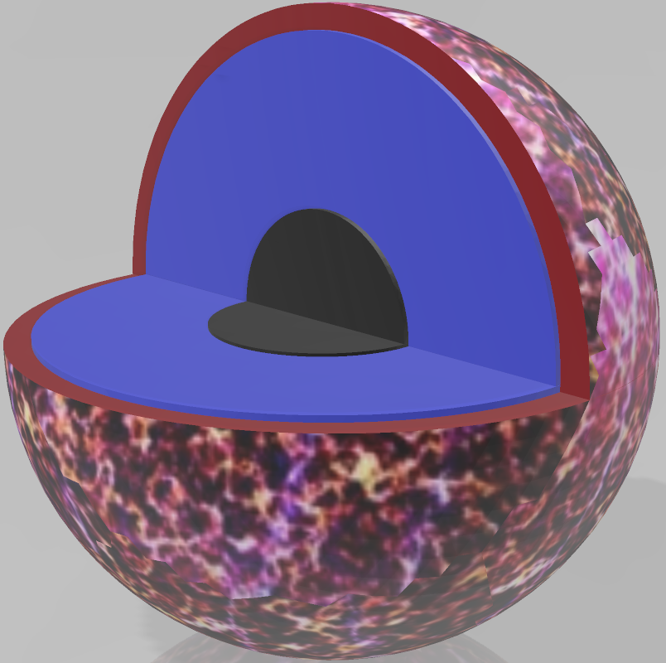
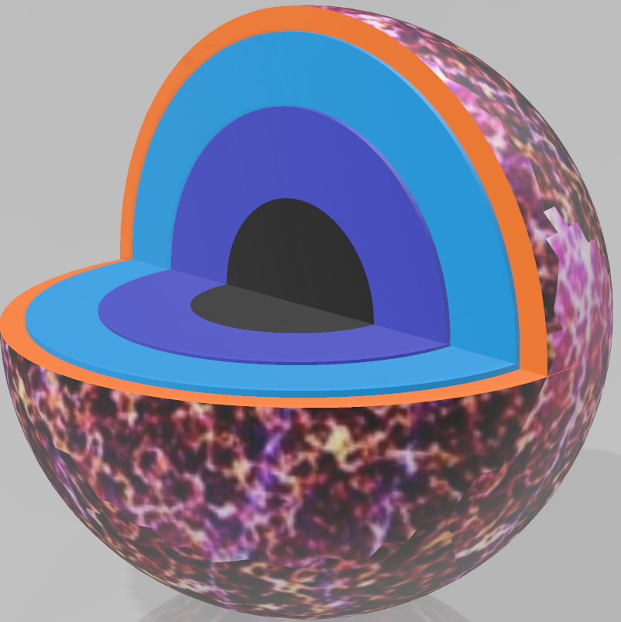
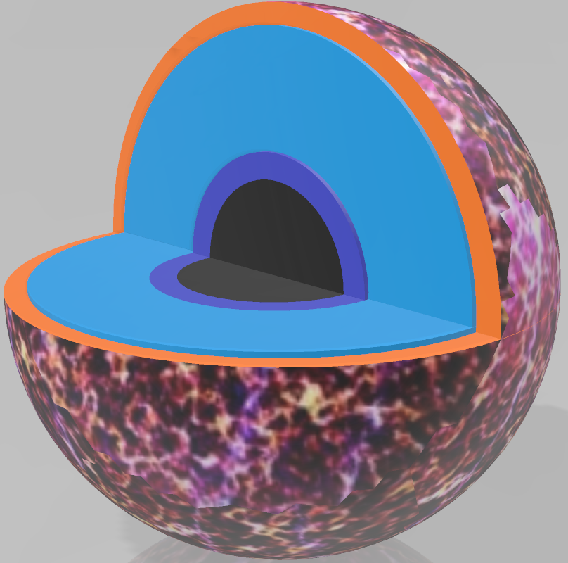
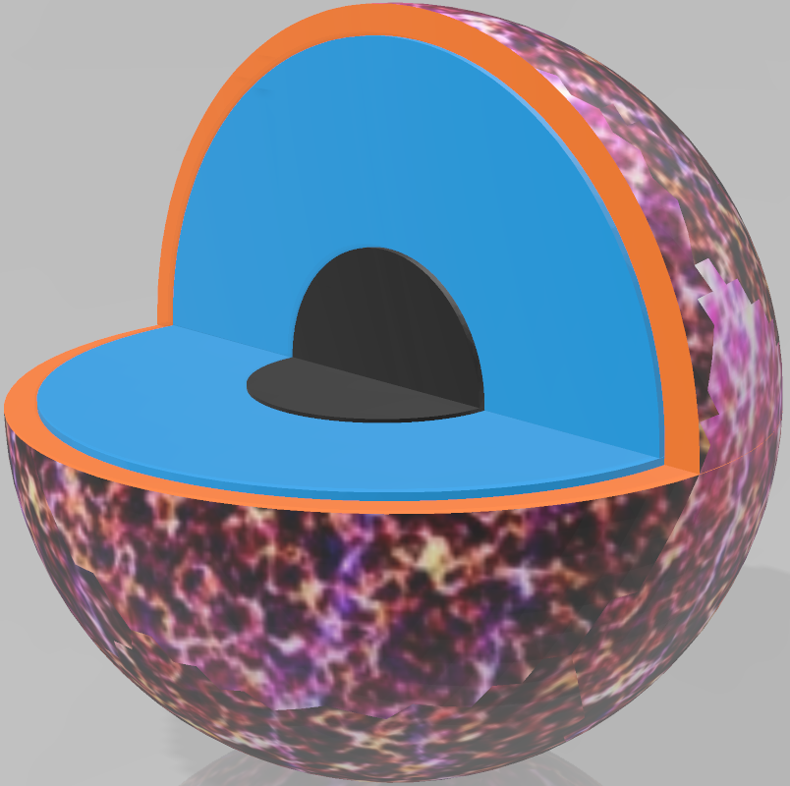
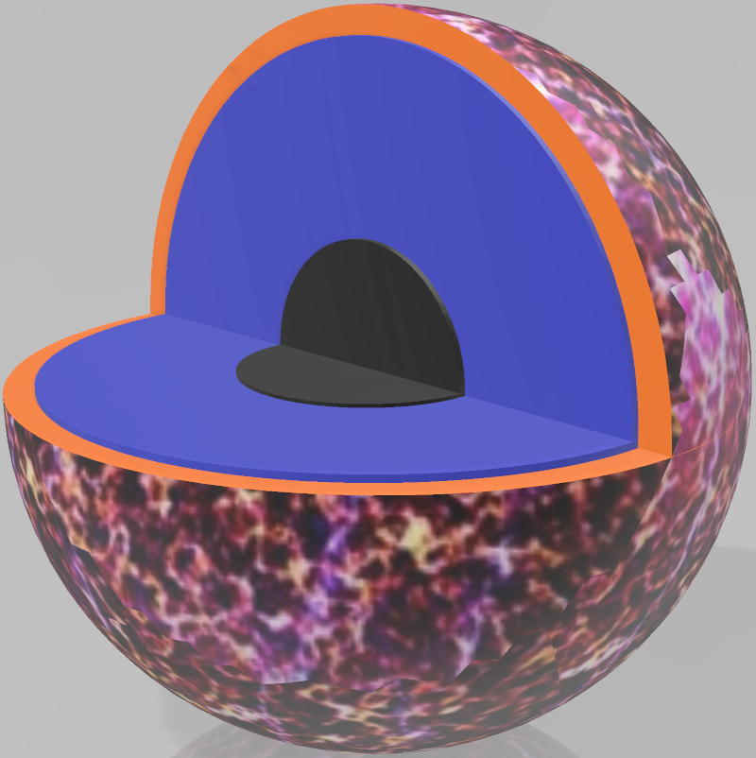
Thermal Relaxation
Crust
Thermally decoupled
NO DU core
DU Core

Slide 11
Negreiros, Schramm and Weber, Phys.Rev. D85 (2012) 104019

Slide 12
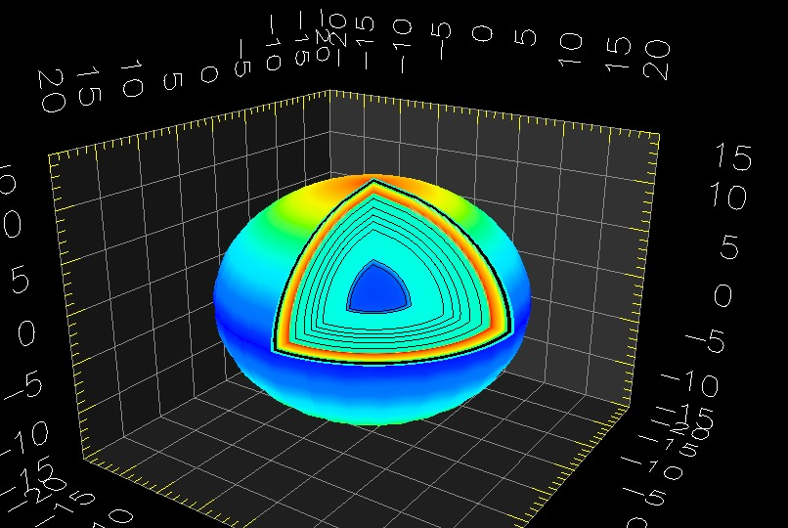
1
1

Slide 13
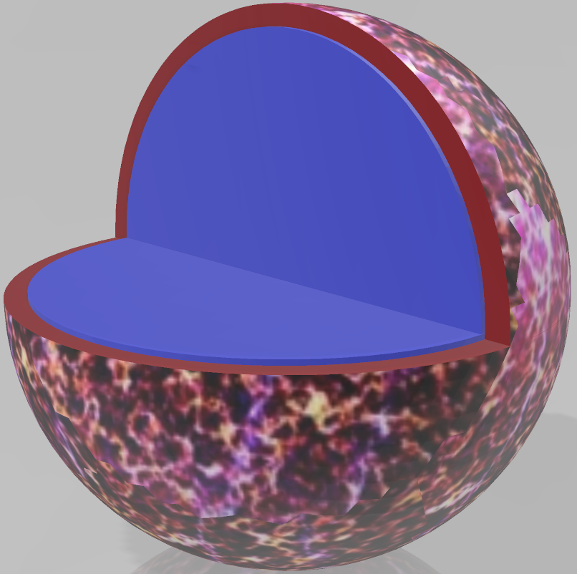
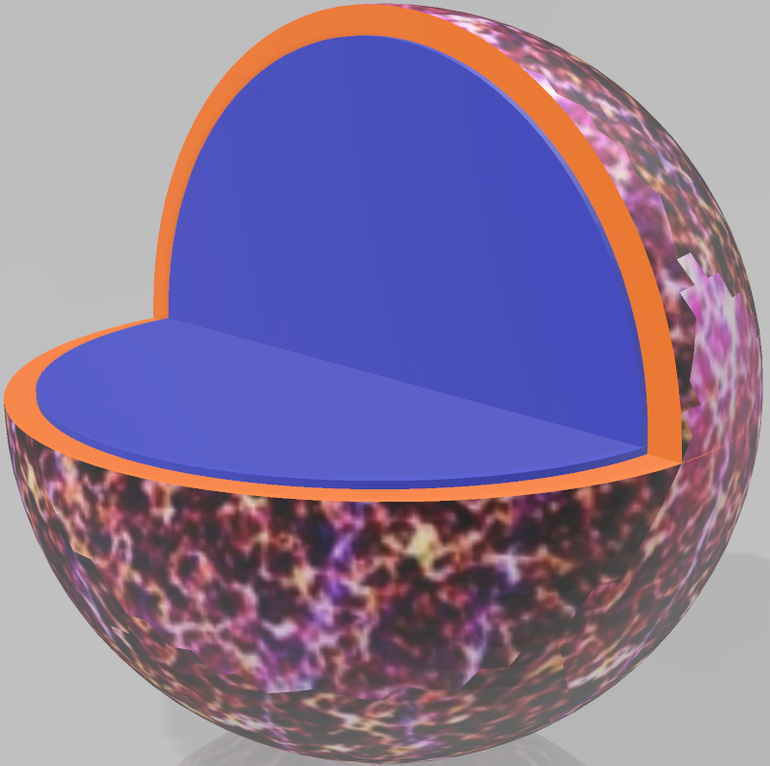
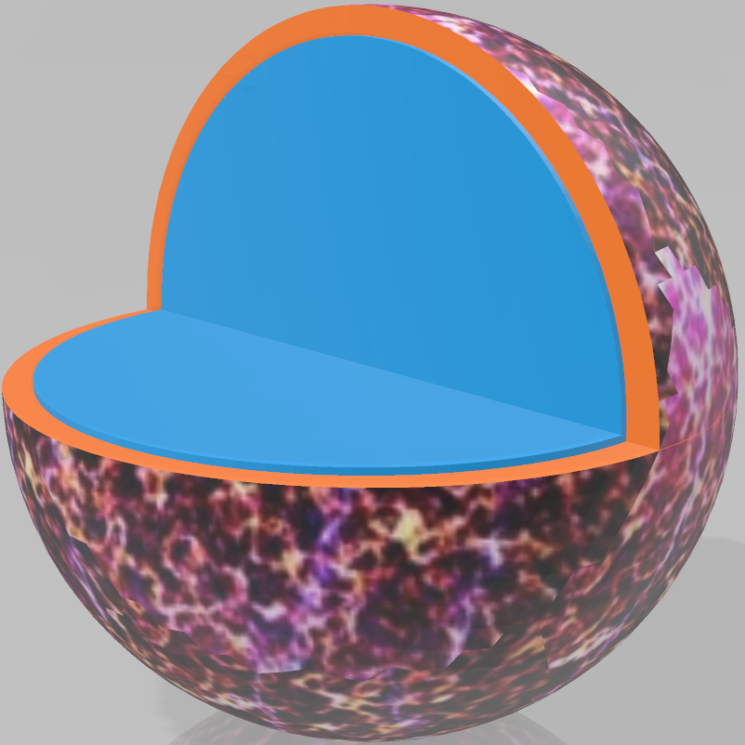
Thermal Relaxation
Crust
Thermally decoupled
NO DU core

Slide 14
Thermal Relaxation
Fast cooling
Slow cooling

Slide 15
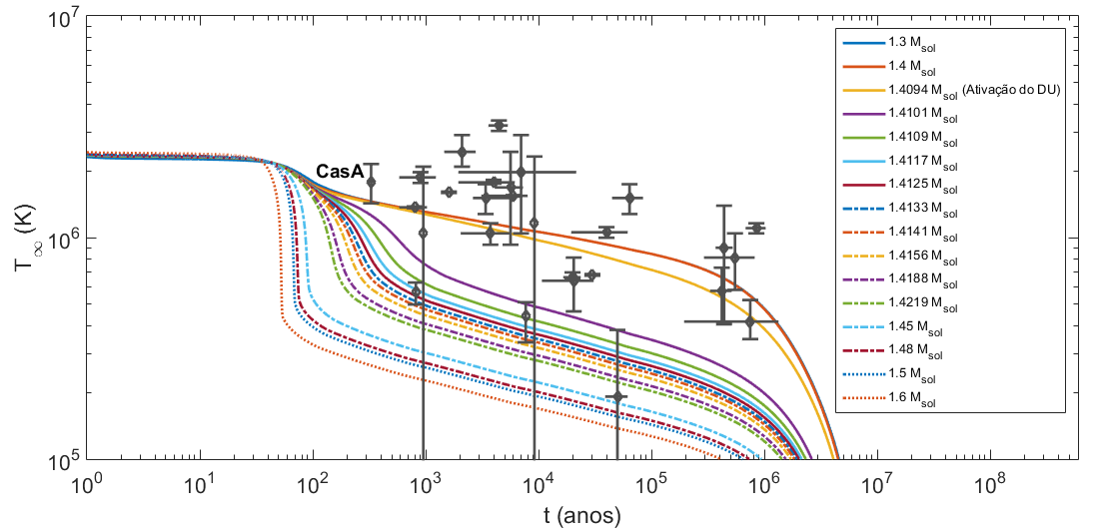
BSR8

Slide 16
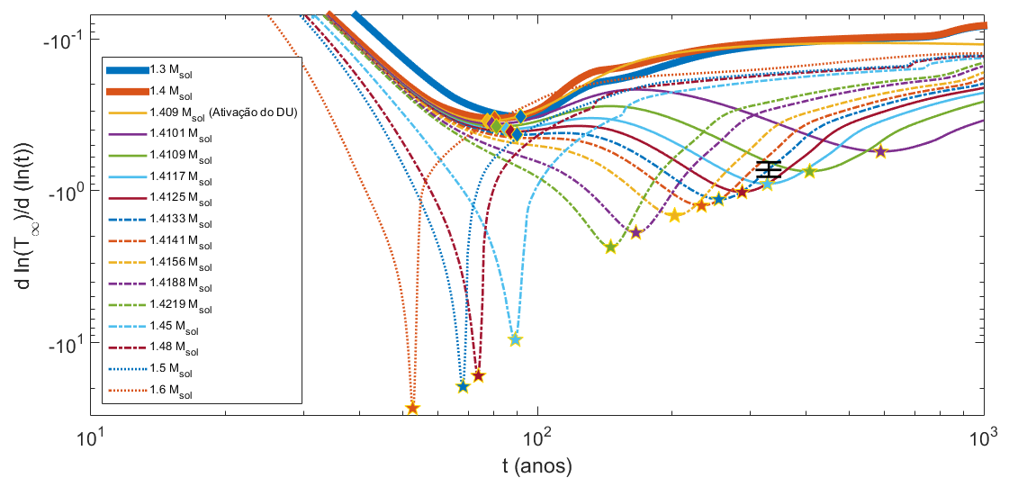
BSR8

Slide 17
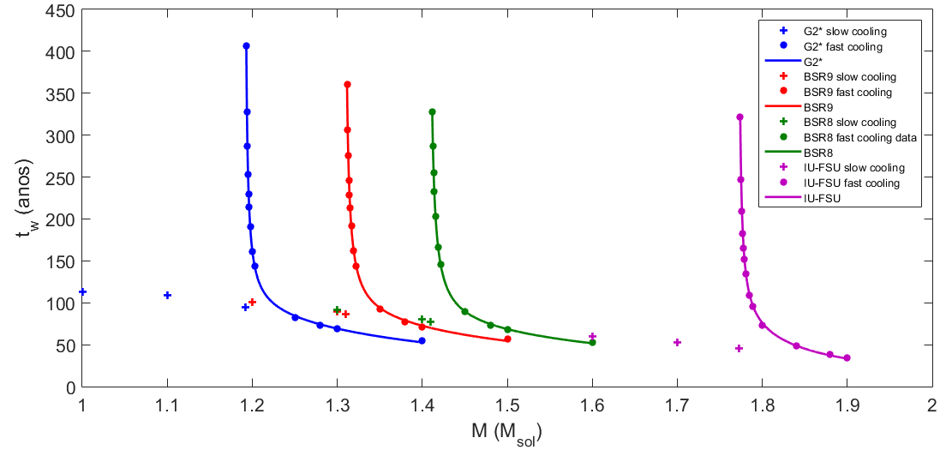
Mass dependency of relaxation time

Slide 18
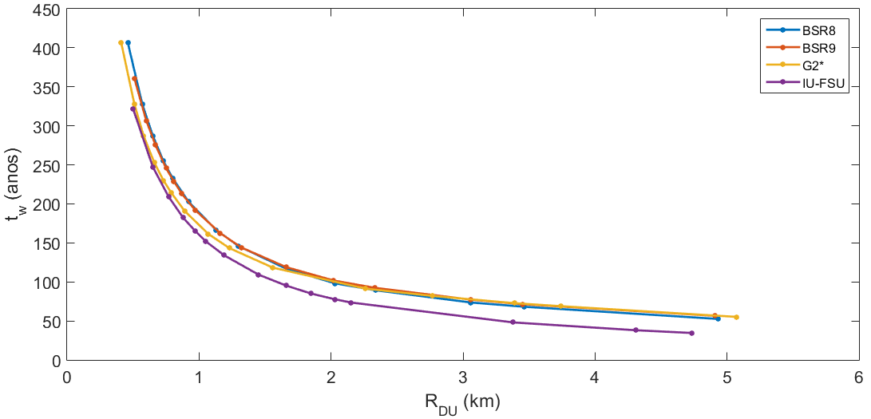
Relaxation time x R_DU

Slide 19
Core relaxation is not so simple....
Unseen behavior.
Stars on the onset of fast neutrino emission may have significantly larger relaxation times.
Could possibly take place in other transition/transiente scenarios, such as in hybrid stars, axions, etc.

Slide 20
hess j1731-347
ACCEPTED FOR PUBLICATION IN THE ASTROPHYSICAL JOURNAL (AJP)
[2306.12326] What is the nature of the HESS J1731-347 compact object? (arxiv.org)

Slide 21
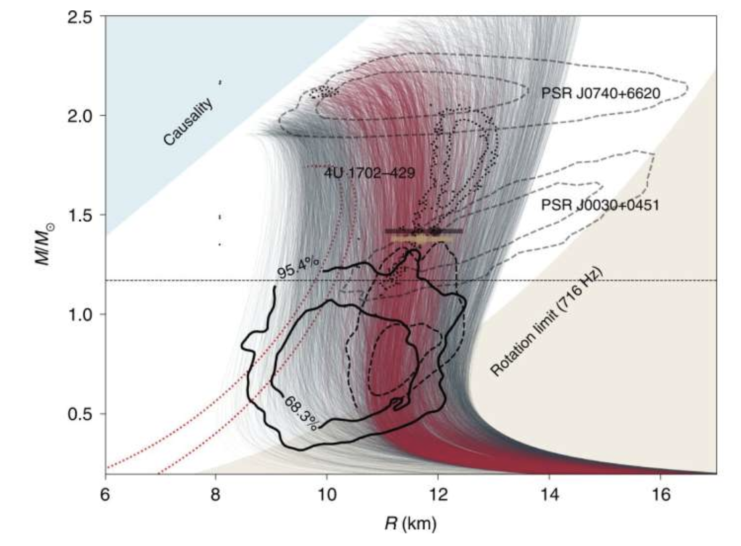

Slide 22
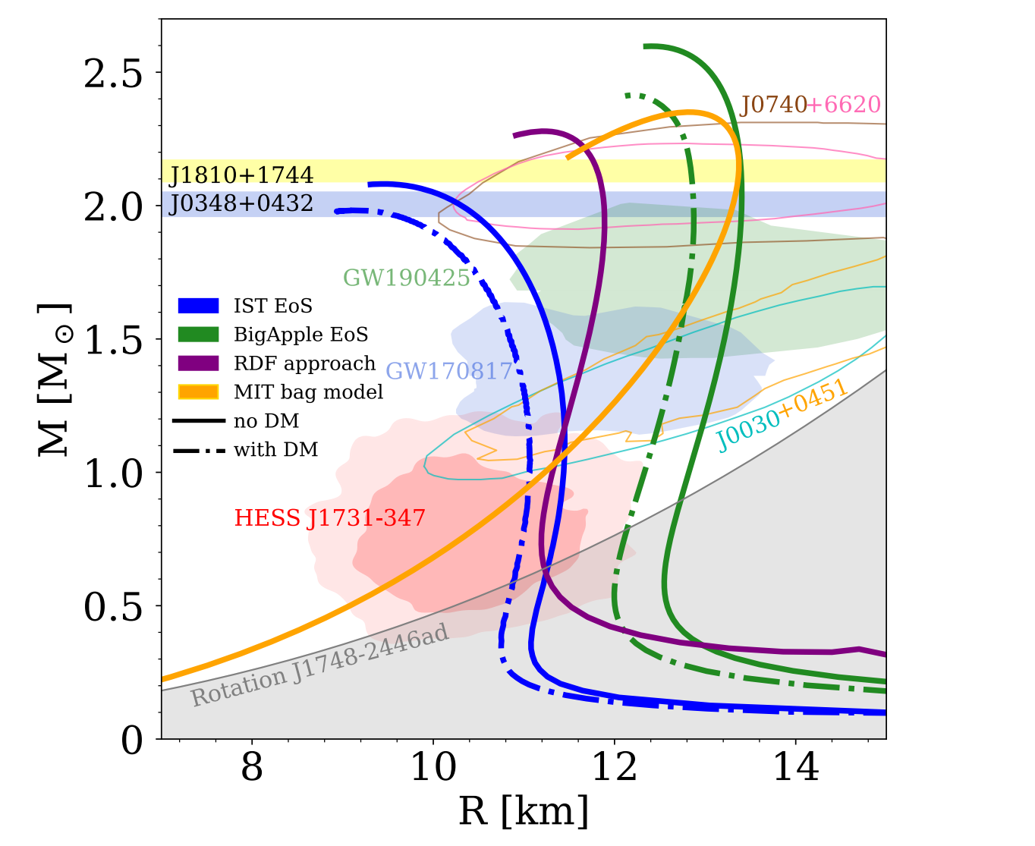
Modelling the hess compact object

Slide 23
Modelling the neutron star
IST (B) EoS
RDF Model
MIT Bag Model
Neutron Star
Hybrid Star
Quark Star

Slide 24
Thermal evolution of neutron stars

Slide 25
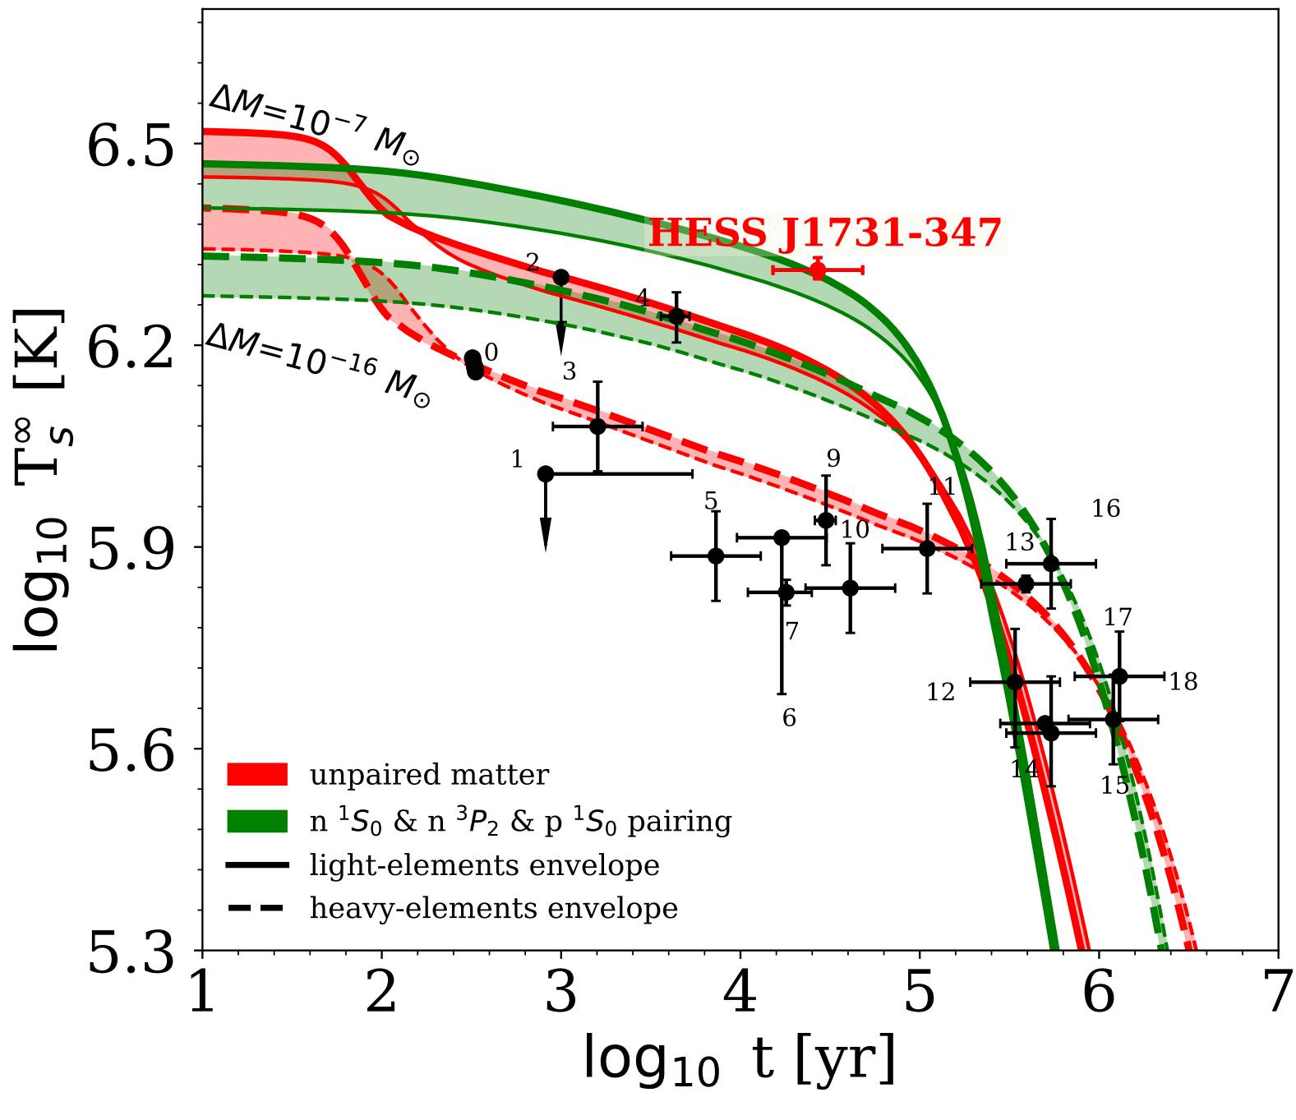
Thermal behavior – Neutron STARS -

Slide 26
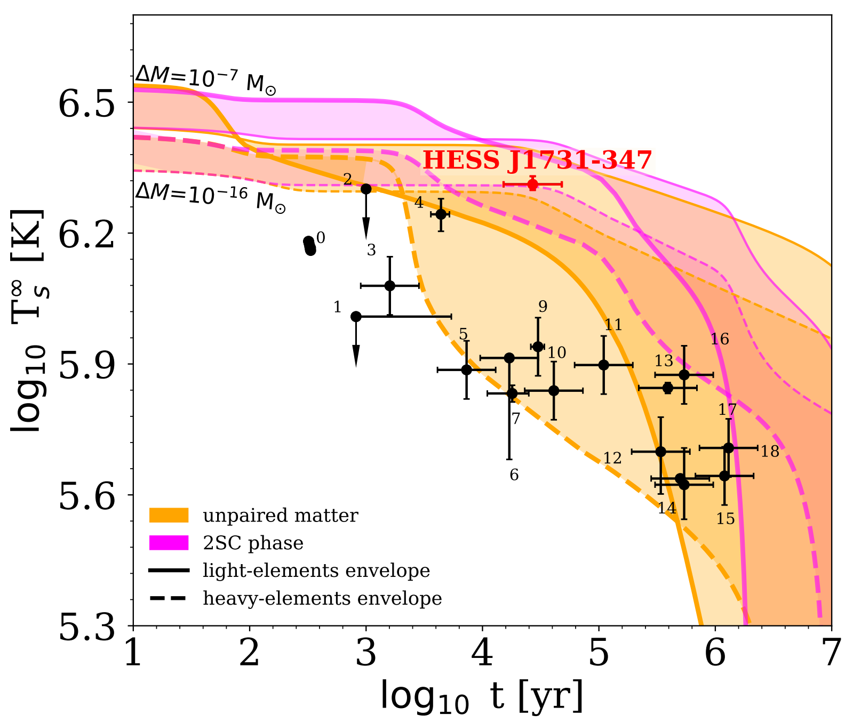
Thermal behavior – HYBRID STARS -

Slide 27
OUTLOOK
We analyzed four different scenarios of the possible internal composition of a central compact object within the supernova remnant HESS J1731-347 in light of the recent measurement presented by Doroshenko et al. (2022).
We found that the soft nucleonic EoS is able to simultaneously reproduce the mass and radius measurements within the 1σ CI, and give a good description of the surface temperature.
This scenario also includes the possibility of the soft hadronic EoS at 1-2n0, while at n ≥ 2n0 the EoS could attain an extra stiffening due to, e.g. density dependent repulsion between the constituents.
From the analysis of various models of pairing gaps, we conclude that a combination of n and p singlet pairing with n triplet pairing described within the SFB, CCDK models, and phenomenological gap obtained from the fit of Cas A, respectively, light-elements envelope provide the best fit of the data.

