Slide 1
厦门大学物理科学与技术学院
College of Physical Science and Technology, Xiamen University
The Hyperon Superfluidity and the Hyperon Couplings in Neutron Stars within the Relativistic Mean Field Model
tuzhonghao@xmu.edu.cn
Speaker: Zhong-Hao Tu (涂中豪)
Supervisor: Prof. Ang Li (李昂 教授)
Collaborator: Prof. Shan-Gui Zhou (周善贵 研究员)
CGC, Yangzhou University, Yangzhou, China; Sept 23, 2023

Slide 2
Contents
Background
Theoretical Framework
Results
hyperon potentials
SU(3) symmetry
Summary and Perspective

Slide 3
Contents
Background
Theoretical Framework
Results
hyperon potentials
SU(3) symmetry
Summary and Perspective

Slide 4
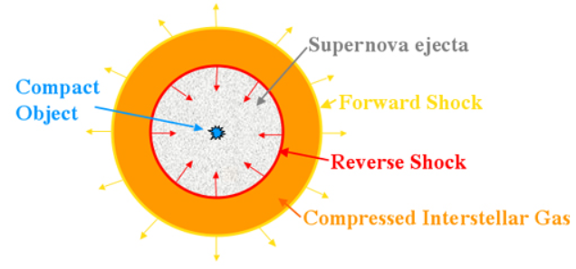
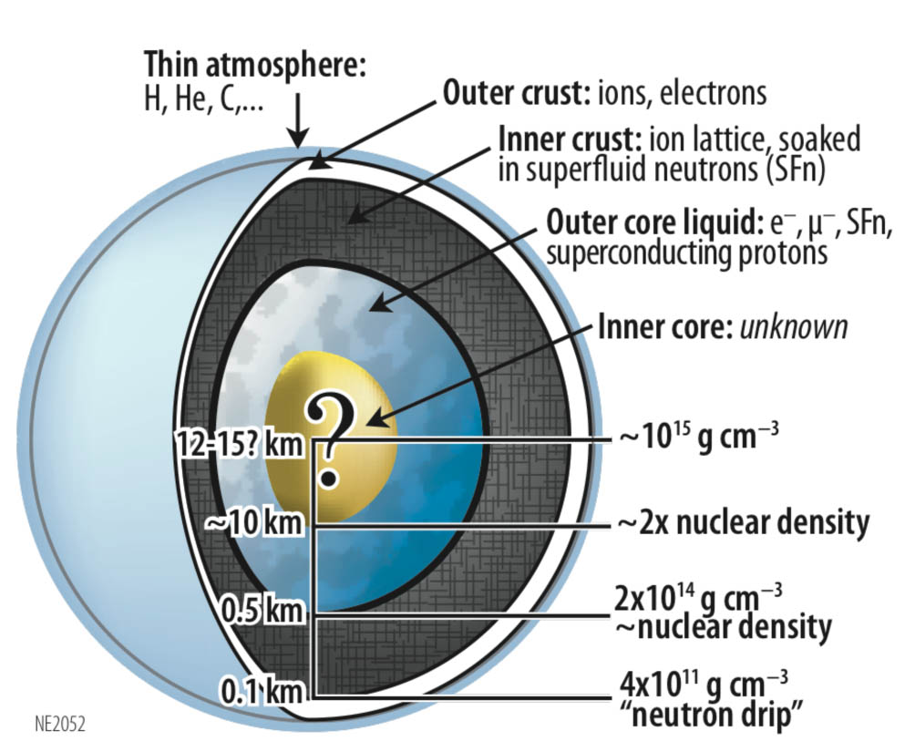
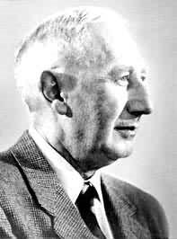
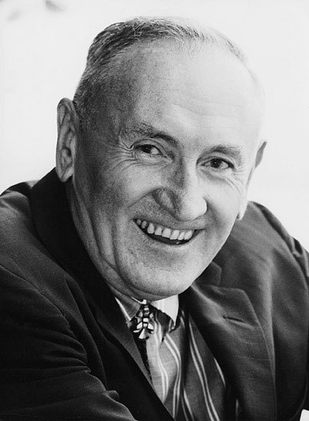
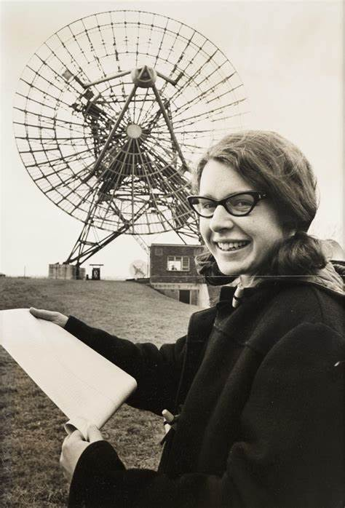
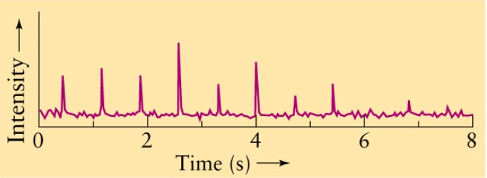
Neutron Stars
Walter Baade
Fritz Zwicky
1930’s，the possible existence of neutron stars
Jocelyn Bell
Lecture 19: Neutron Stars (ualberta.ca)
Index of /Images/nicer (nasa.gov)
1967，the first observation of pulsar

Slide 5
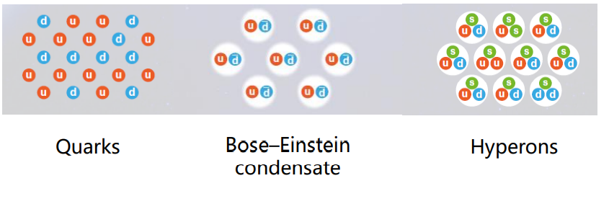
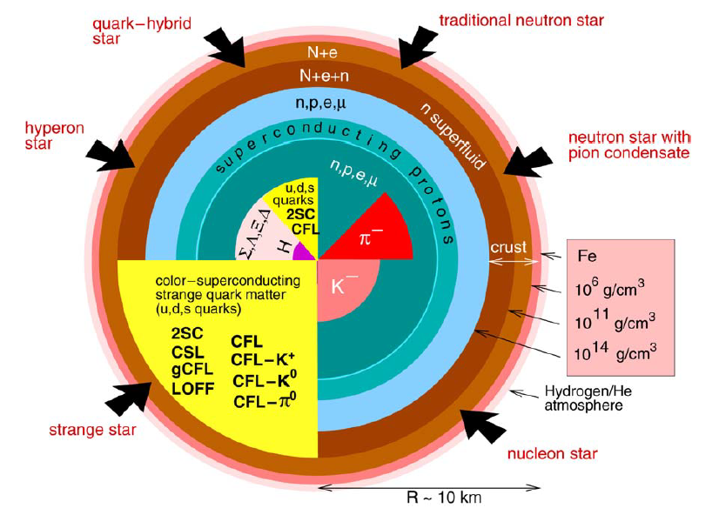
Neutron Star Compositions
Other possible compositions:
excited nucleon $Δ$
dark matter
……
F. Weber, PPNP 54 (2005) 193

Slide 6
Neutron Star Compositions
Other possible compositions:
excited nucleon $Δ$
dark matter
……
Core-based classification of neutron stars:
nucleon star
hyperon star
quark star
hybrid star
dark matter mixed star
……
F. Weber, PPNP 54 (2005) 193

Slide 7
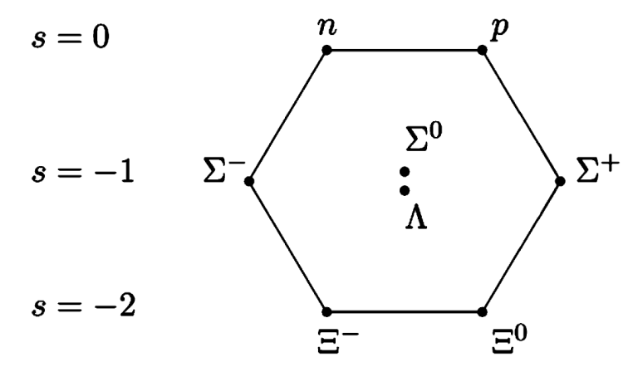
Neutron Star Compositions
Other possible compositions:
excited nucleon $Δ$
dark matter
……
Core-based classification of neutron stars:
nucleon star
hyperon star
quark satr
hybrid star
dark matter mixed star
……
$J^{P}={(1/2)}^{+}$ octet
F. Weber, PPNP 54 (2005) 193
C. Alexandrou et al., PRD 80 (2009) 114503

Slide 8
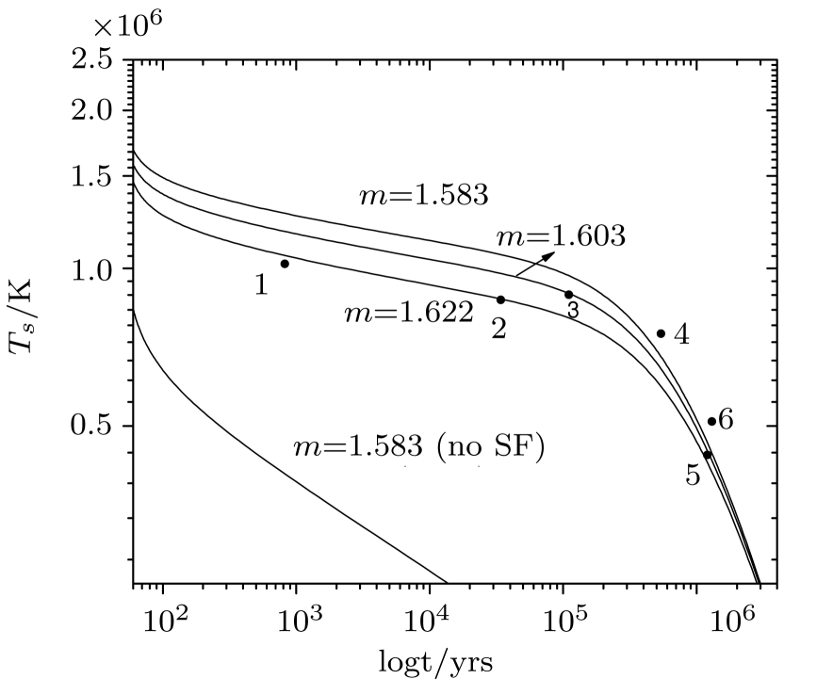
Hyperon and Neutron Star Cooling
Neutron star cooling + hyperon pairing
The direct Urca (dUrca) processes involving hyperons significantly enhance the neutrino luminosity and rapidly cool NSs
The paired hyperons exponentially suppress the neutrino emissivity of hyperon dUrca processes far below the critical temperature
with $ΛΛ$ pairing
M. Prakash et al., ApJ 390 (1992) L77
P. Haensel, O.Y. Gnedin, A&A 290 (1994) 458
D. Yakovlev et al., PR 354 (2001) 1
D. Page, S. Reddy, ARNPS 56 (2006) 327
without $ΛΛ$ pairing
Hyperon superfluidity is essential to the hyperon star cooling
Y. Xu et al., CTP 56 (2011) 521

Slide 9
Hyperon and Neutron Star Cooling
The magnitude of the hyperon superfluidity in NSs is characterized by the hyperon-hyperon (YY) pairing gap
In the BCS approximation, the pairing gap depends on the equation of state(EoS) and the pairing force
Pairing force
状态方程
EoS
nuclear interactions
Hyperon superfluidity have much uncertainty

Slide 10
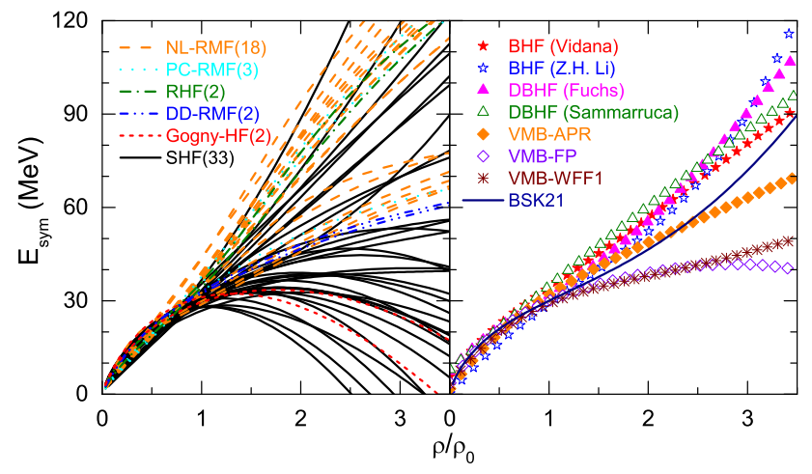
Uncertainties of Nuclear Interactions
Nucleon-nucleon (NN) interaction
Why?
Nuclear matter is well constrained at the saturation density
Extrapolation to high density is highly uncertain
L.W. Chen et al., NPR 34 (2017) 20

Slide 11
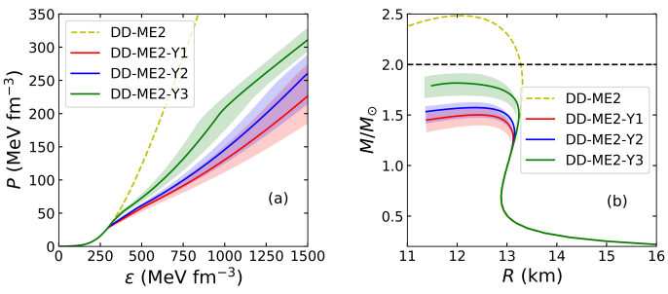
Uncertainties of Nuclear Interactions
Nucleon-hyperon (NY) and YY interactions
Why?
Lack of scatter experimental data
Few single-$Λ$ hypernuclei
Fewer multi-$Λ$ hypernuclei
only 1%
Y.T. Rong et al., PRC 104 (2022) 054321

Slide 12
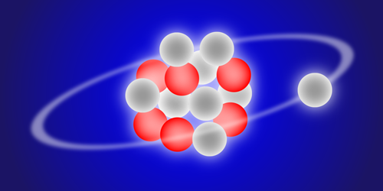
What do we want to do?
predict
constrain
How do the uncertainties of nuclear interactions affect the hyperon superfluidity?
How do the uncertainties of nuclear interactions affect the NS cooling?
Can we constrain the nuclear interactions by the observations of NS cooling?
Notes:
利用上述相互作用的不确定性，我们可以去预言中子星宏观可观测性质的改变；反过来，我们也可以通过已有的天文观约束，减少相互作用的不确定性。这就构成了我们工作的出发点。首先……其次……，最后，超子超流不仅取决于对力，也取决于由超子耦合确定的 NY 和 YY 有效相互作用，因此超子超流可以在中子星冷却和超子耦合之间建立联系，我们希望通过讨论…….

Slide 13
Contents
Background
Theoretical Framework
Results
hyperon potentials
SU(3) symmetry
Summary and Perspective

Slide 14
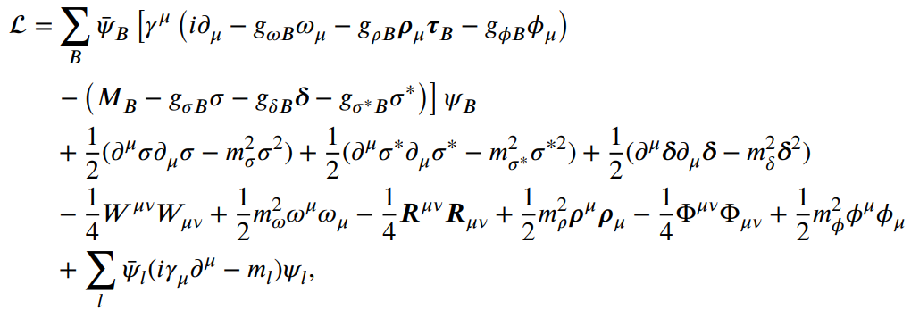
EoS of NSs
The effective Lagrangian density for the relativistic mean field (RMF) model
baryon octet + ($σωρσ^{∗}φ$)
Density dependent meson exchange RMF model:

Slide 15
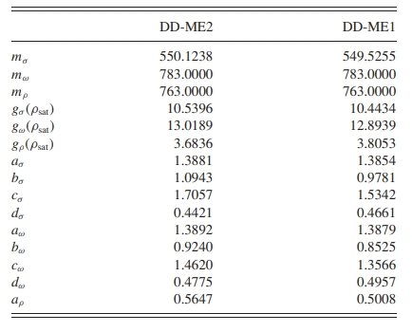
NN interaction
The characteristic coefficients of nuclear matter:
$R_{mY}=g_{mΛ}/g_{mN}$
Based on DD-ME2, the effective NN interactions with different $L_{sym}$ are obtained by adjusting $g_{ρN}$ and $a_{ρ}$ but fix $E_{sym}$=27.09 MeV at $ρ_{B}=0.11 {fm}^{−3}$
G.A. Lalazissis et al., PRC 71 (2005) 024312
From Prof. Jia-Jie Li of Southwest University
$L_{sym}$ (MeV) | $$g_{ρN}$$ | $a_{ρ}$
30 | 3.0314 | 0.8889
51.26 | 3.6836 | 0.5647
80 | 3.8892 | 0.2576
100 | 4.1544 | 0.0905
H.R. Fu et al., PLB 834 (2022) 137470
J.J. Li and A. Sedrakian, PRC 100 (2019) 015809

Slide 16
NY and YY interactions
Fitting the hyperon potential at the saturation density ($\text{scalar} \text{mesons} σσ^{∗}$)
empirical hyperon potentials in symmetric nuclear matter： $U_{Λ}^{(N)}$, $U_{Σ}^{(N)}$, $U_{Ξ}^{(N)}$
$R_{mY}=g_{mΛ}/g_{mN}$
$R_{mY}=g_{mY}/g_{mN}$

Slide 17
NY and YY interactions
Fitting the hyperon potential at the saturation density (scalar mesons $σσ^{∗}$)
empirical hyperon potentials in symmetric nuclear matter： $U_{Λ}^{(N)}$, $U_{Σ}^{(N)}$, $U_{Ξ}^{(N)}$
$R_{mY}=g_{mΛ}/g_{mN}$
$R_{mY}=g_{mY}/g_{mN}$
The uncertain range of hyperon potentials
$$U_{Λ}^{(N)}≃−30 MeV$$
$U_{Σ}^{(N)}=−10$-$30 MeV$
$U_{Ξ}^{(N)}=−(11$-$23) MeV$
free parameters：($U_{Σ}^{(N)}$, $U_{Ξ}^{(N)}$)
A. Bouyssy et al., PLB 64 (1976) 276
C. Providencia et al., 2019 FASS 6 (2019) 13
T. Harada et al., RRC 103 (2021) 024605
J.N. Hu et al., JPG 49 (2022) 025104
Notes:
我们可以去拟合饱和密度处的超子势场深度，首先拟合对称核物质中的超子势场深度，一个有三个，这个式子是……，只要我们给定一个势场深度，就会得到……，但是势场深度存在不确定度，……。

Slide 18
NY and YY interactions
Fitting the hyperon potential at the saturation density (scalar mesons $σσ^{∗}$)
empirical hyperon potentials in symmetric nuclear matter： $U_{Λ}^{(N)}$, $U_{Σ}^{(N)}$, $U_{Ξ}^{(N)}$
hyperon potentials in symmetric hypernuclear matter: $U_{Y}^{(Y)}$
$R_{mY}=g_{mΛ}/g_{mN}$
$R_{mY}=g_{mY}/g_{mN}$
The uncertain range of hyperon potentials
$$U_{Λ}^{(N)}≃−30 MeV$$
$U_{Σ}^{(N)}=−10$-$30 MeV$
$U_{Ξ}^{(N)}=−(11$-$23) MeV$
free parameters：($U_{Σ}^{(N)}$, $U_{Ξ}^{(N)}$)
A. Bouyssy et al., PLB 64 (1976) 276
C. Providencia et al., 2019 FASS 6 (2019) 13
T. Harada et al., RRC 103 (2021) 024605
J.N. Hu et al., JPG 49 (2022) 025104
J. Schaffner et al., AoP 235 (1994) 35.
Fixed $U_{Y}^{(Y)}$

Slide 19
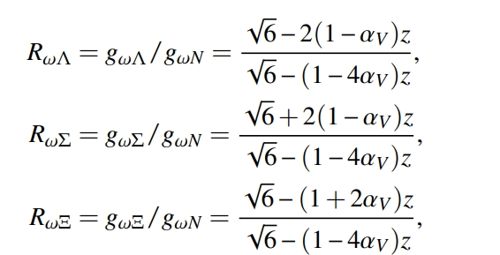
NY and YY interactions
SU(3) symmetry (vector mesons $ωρφ$)
$R_{mY}=g_{mY}/g_{mN}$
J.J. de Swart, RMP 35 (1963) 916
Y. Lim et al., PRD 97 (2018) 023010
$$z=g_{8}/g_{1}$$
Example：

Slide 20
NY and YY interactions
SU(3) symmetry (vector mesons $ωρφ$)
$R_{mY}=g_{mY}/g_{mN}$
J.J. de Swart, RMP 35 (1963) 916
Y. Lim et al., PRD 97 (2018) 023010
$z: ω$ exchange to be repulsive for all baryons
$α_{V}:$weight factor for the contributions of symmetric and the antisymmetric couplings
$$z=g_{8}/g_{1}$$
Example：
The uncertain range within SU(3) symmetry
$z=0$-$2/\sqrt{6}$
$α_{V}=0$-$1$
free parameters ：($z$, $α_{V}$)

Slide 21
Uncertainties of Nuclear Interactions
symmetry energy slope $L_{sym}$
NY and YY interactions are determined by two groups parameters
Vector mesons ($ω+φ+ρ$)
Scalar mesons ($σ+σ^{∗}$)
($z$, $α_{V}$)
($U_{Σ}^{(N)}$, $U_{Ξ}^{(N)}$)
$$R_{δY}=R_{ρY}$$
Pairing force
Pairing force in this talk:
Z.H. Tu, PRC 106 (2022) 025806

Slide 22
Contents
Background
Theoretical Framework
Results
hyperon potentials
SU(3) symmetry
Summary and Perspective

Slide 23
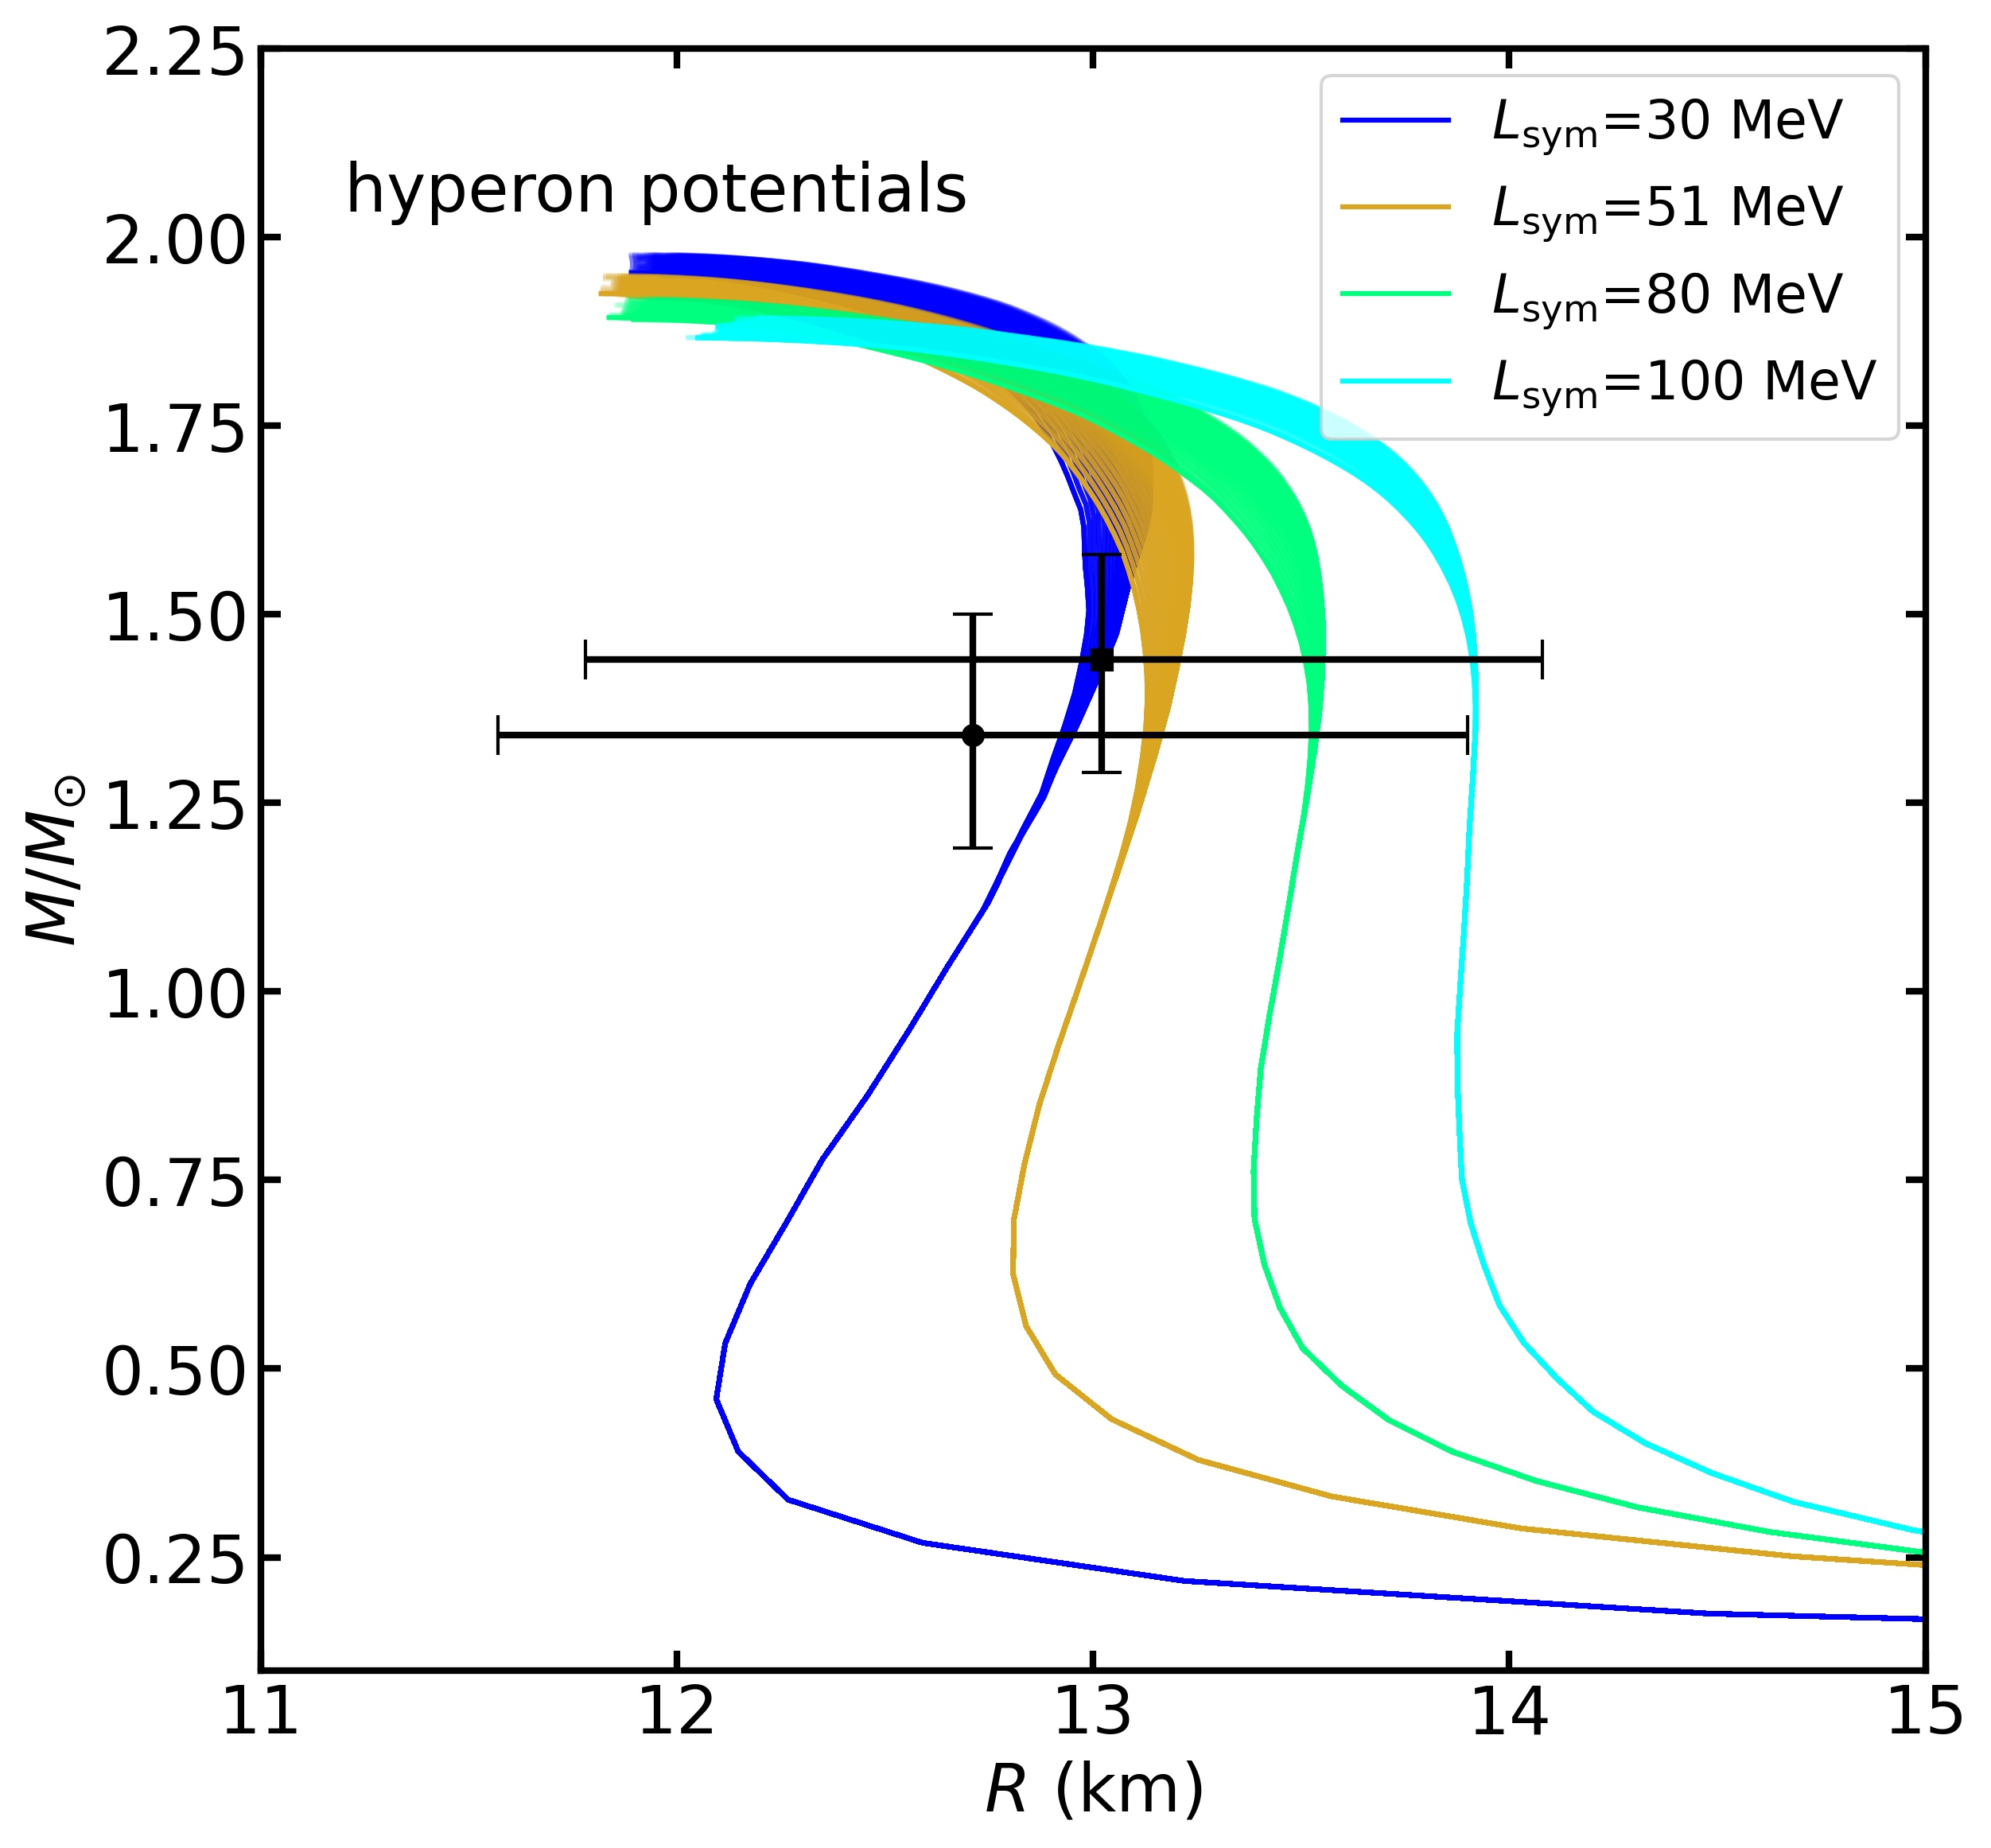
Results: hyperon potentials
Hyperon potentials and M-R relations
SU(6) symmetry is applied
The variations of maximum mass induced by $L_{sym}$ and hyperon potentials are less than $0.1 M_{⨀}$ and $0.03 M_{⨀}$, respectively
It is hard to distinguish the hyperon potential by global properties (mass and radius, etc.)
NICER
T.E. Riley et al., ApJL 887 (2019) L21
M.C. Miller et al., ApJL 887 (2019) L24

Slide 24
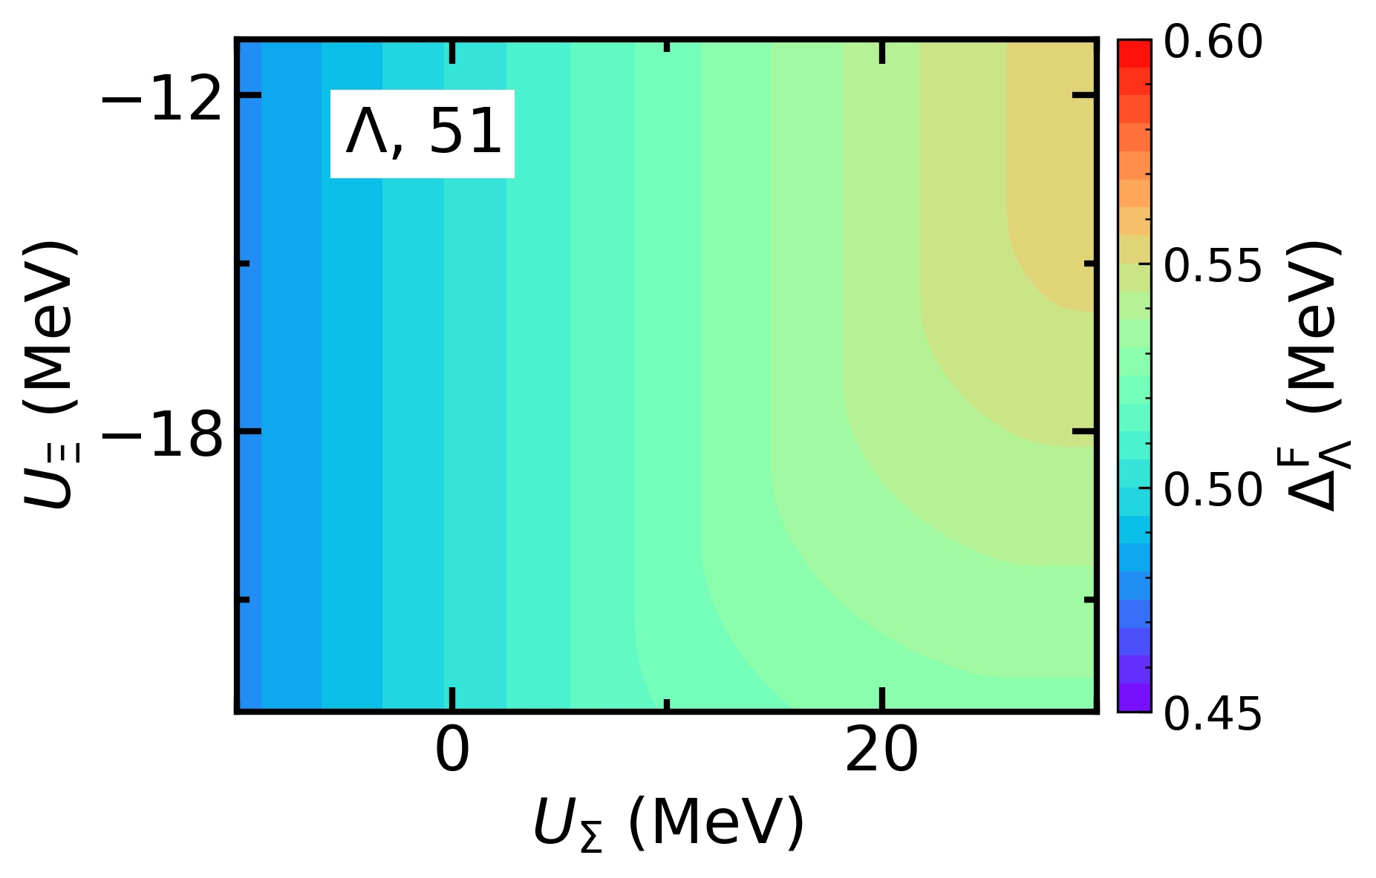
Results: hyperon potentials
$ΛΛ$ pairing: the maximum pairing gap $Δ_{Λ}^{F}$ inside NSs
The variation of the maximum pairing gap in ($U_{Σ}^{(N)}$, $U_{Ξ}^{(N)}$) parameter space is less than 0.08 MeV (~15%)
The maximum pairing gap is slightly sensitive to $U_{Σ}^{(N)}$ but is insensitive to $U_{Ξ}^{(N)}$ at smaller $U_{Σ}^{(N)}$
$U_{Σ}^{(N)}$ has a greater impact on $ΛΛ$ pairing

Slide 25
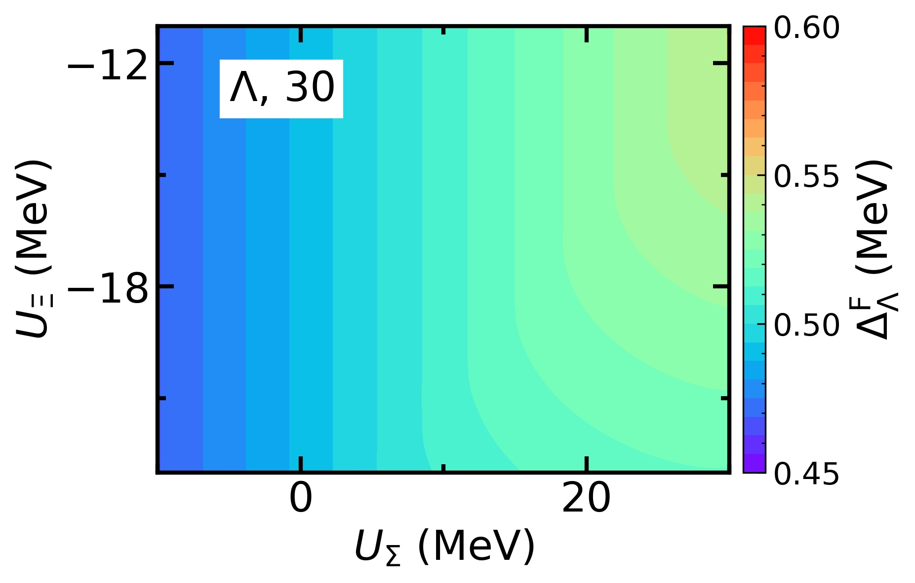
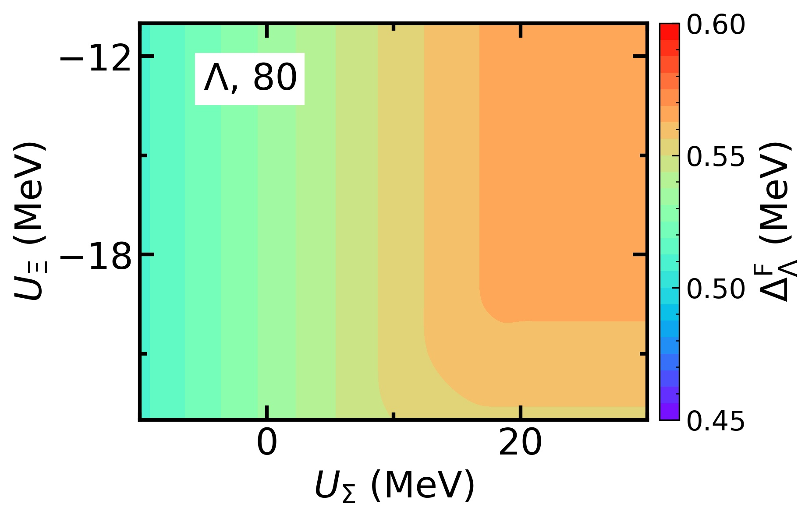
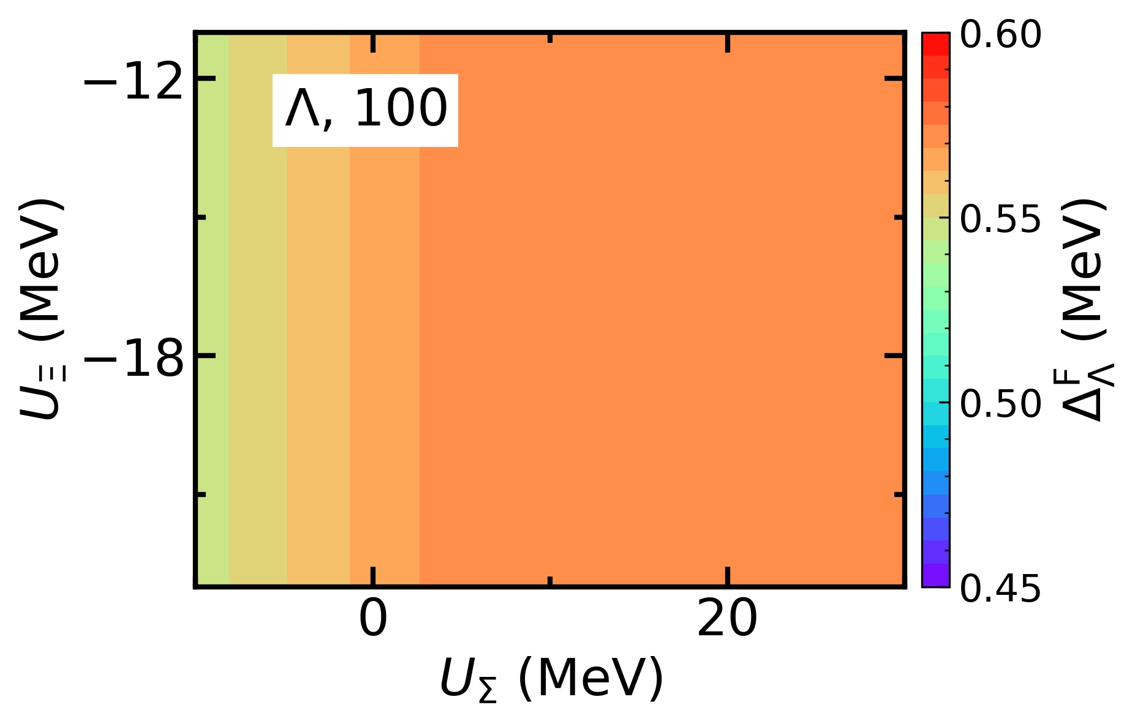
Results: hyperon potentials
$ΛΛ$ pairing: the maximum pairing gap $Δ_{Λ}^{F}$ inside NSs

Slide 26
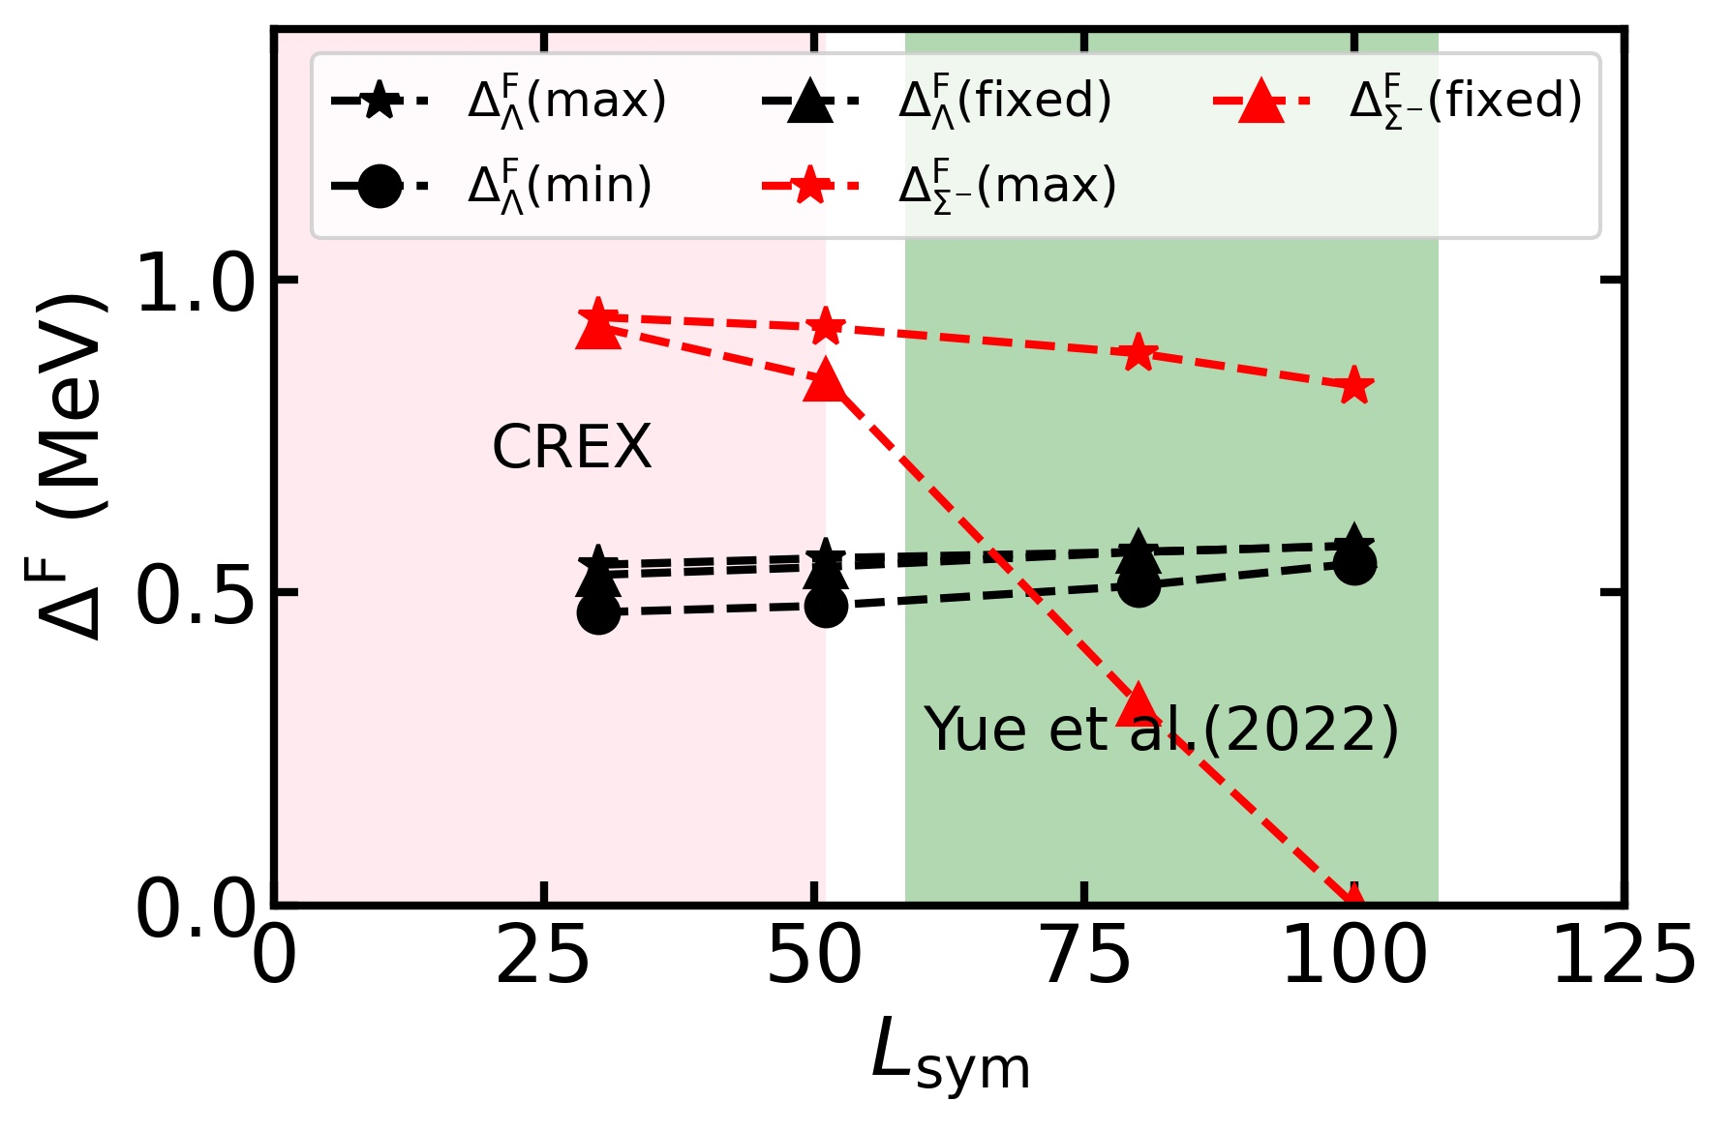
Results: hyperon potentials
For $ΛΛ$ pairing:
The maximum and minimum of the maximum pairing gap slightly increase as $L_{sym}$ increases
The variation of the maximum pairing gap decrease as $L_{sym}$ increases
Larger $L_{sym}$ suppress the effects of hyperon potentials on the $ΛΛ$ pairing
The value at ($U_{Σ}^{(N)}$, $U_{Ξ}^{(N)}$) =(20 MeV, $−$17 MeV) has similar behavior
S. Tagami et al., Results in Physics 43 (2022) 106037
T.G. Yue et al., PRR 4 (2022) L022054

Slide 27
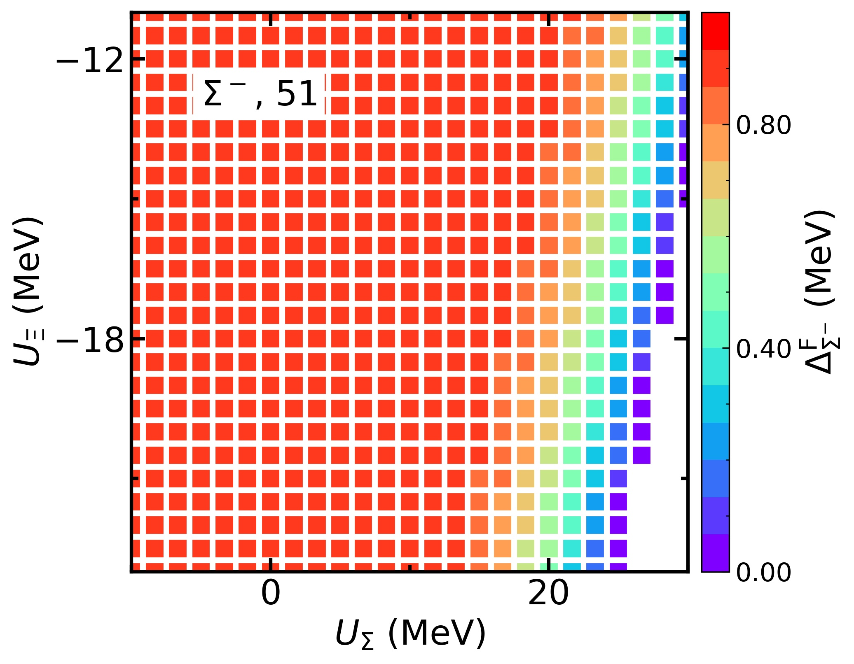
Results: hyperon potentials
$ΣΣ$ pairing: the maximum pairing gap $Δ_{Σ^{−}}^{F}$ inside NSs
Strong $Σ^{−}Σ^{−}$ pairing appear in the area with smaller $U_{Σ}^{(N)}$ ($U_{Σ}^{(N)}$ < 15 MeV)
No $Σ^{−}Σ^{−}$ pairing at larger $U_{Σ}^{(N)}$ and smaller $U_{Ξ}^{(N)}$
The effect of hyperon potentials on $Σ^{−}Σ^{−}$ pairing is more significant than $ΛΛ$ pairing

Slide 28
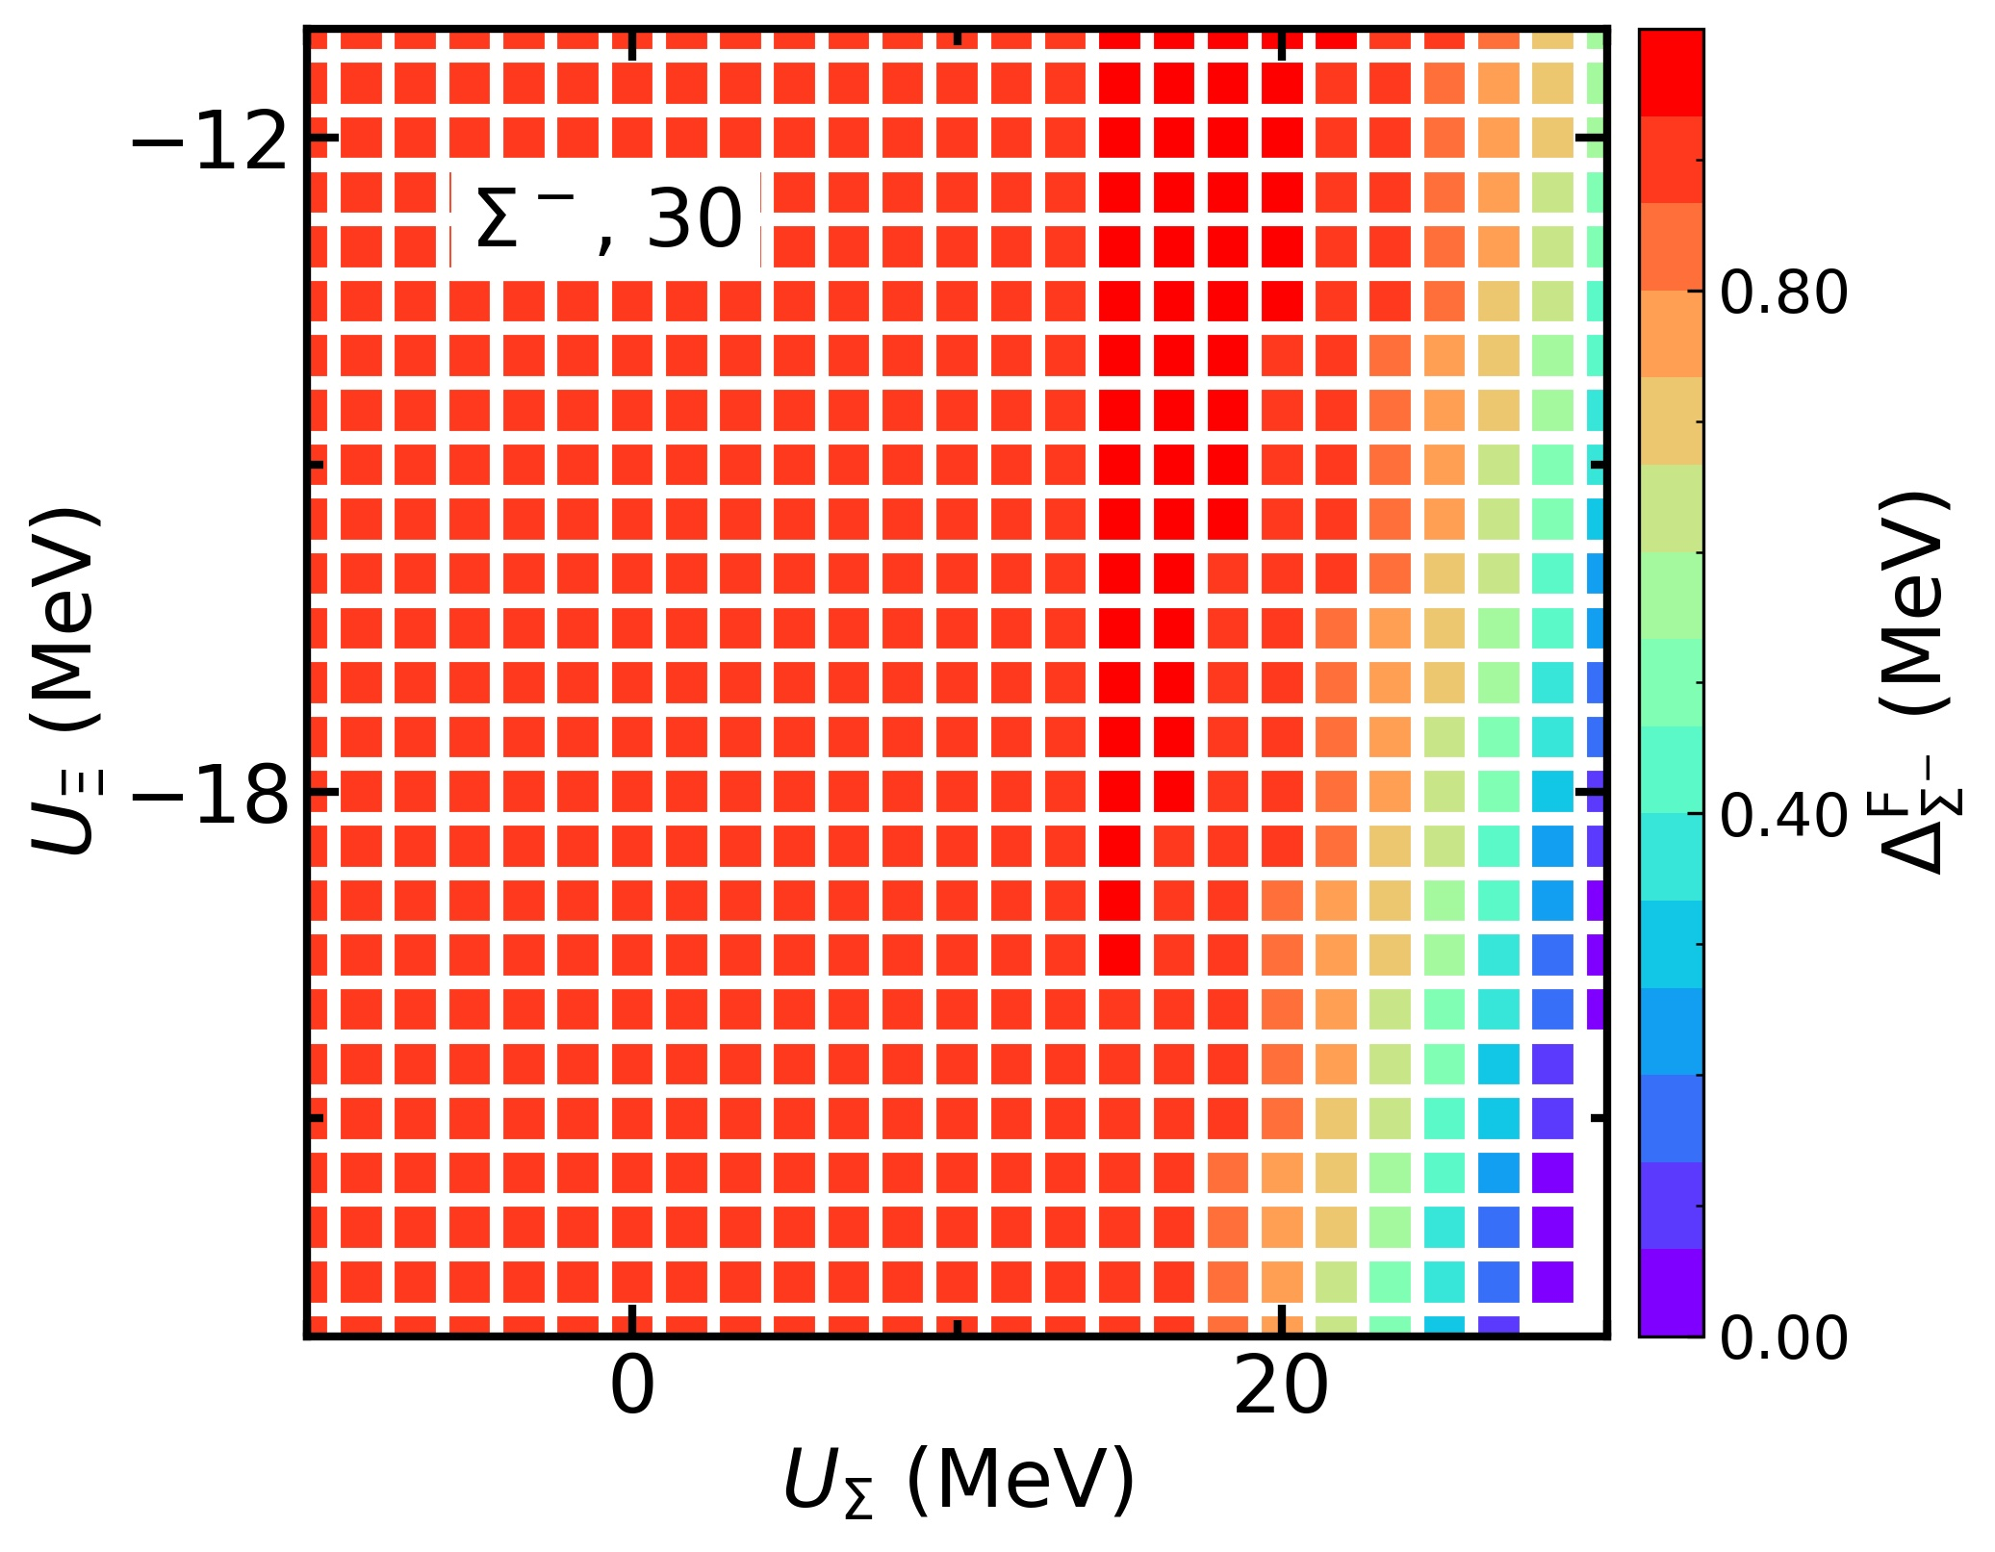
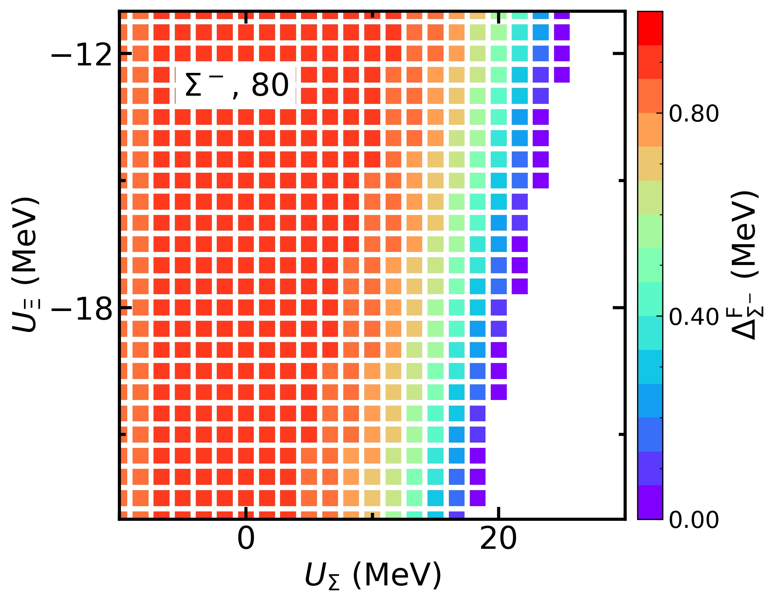
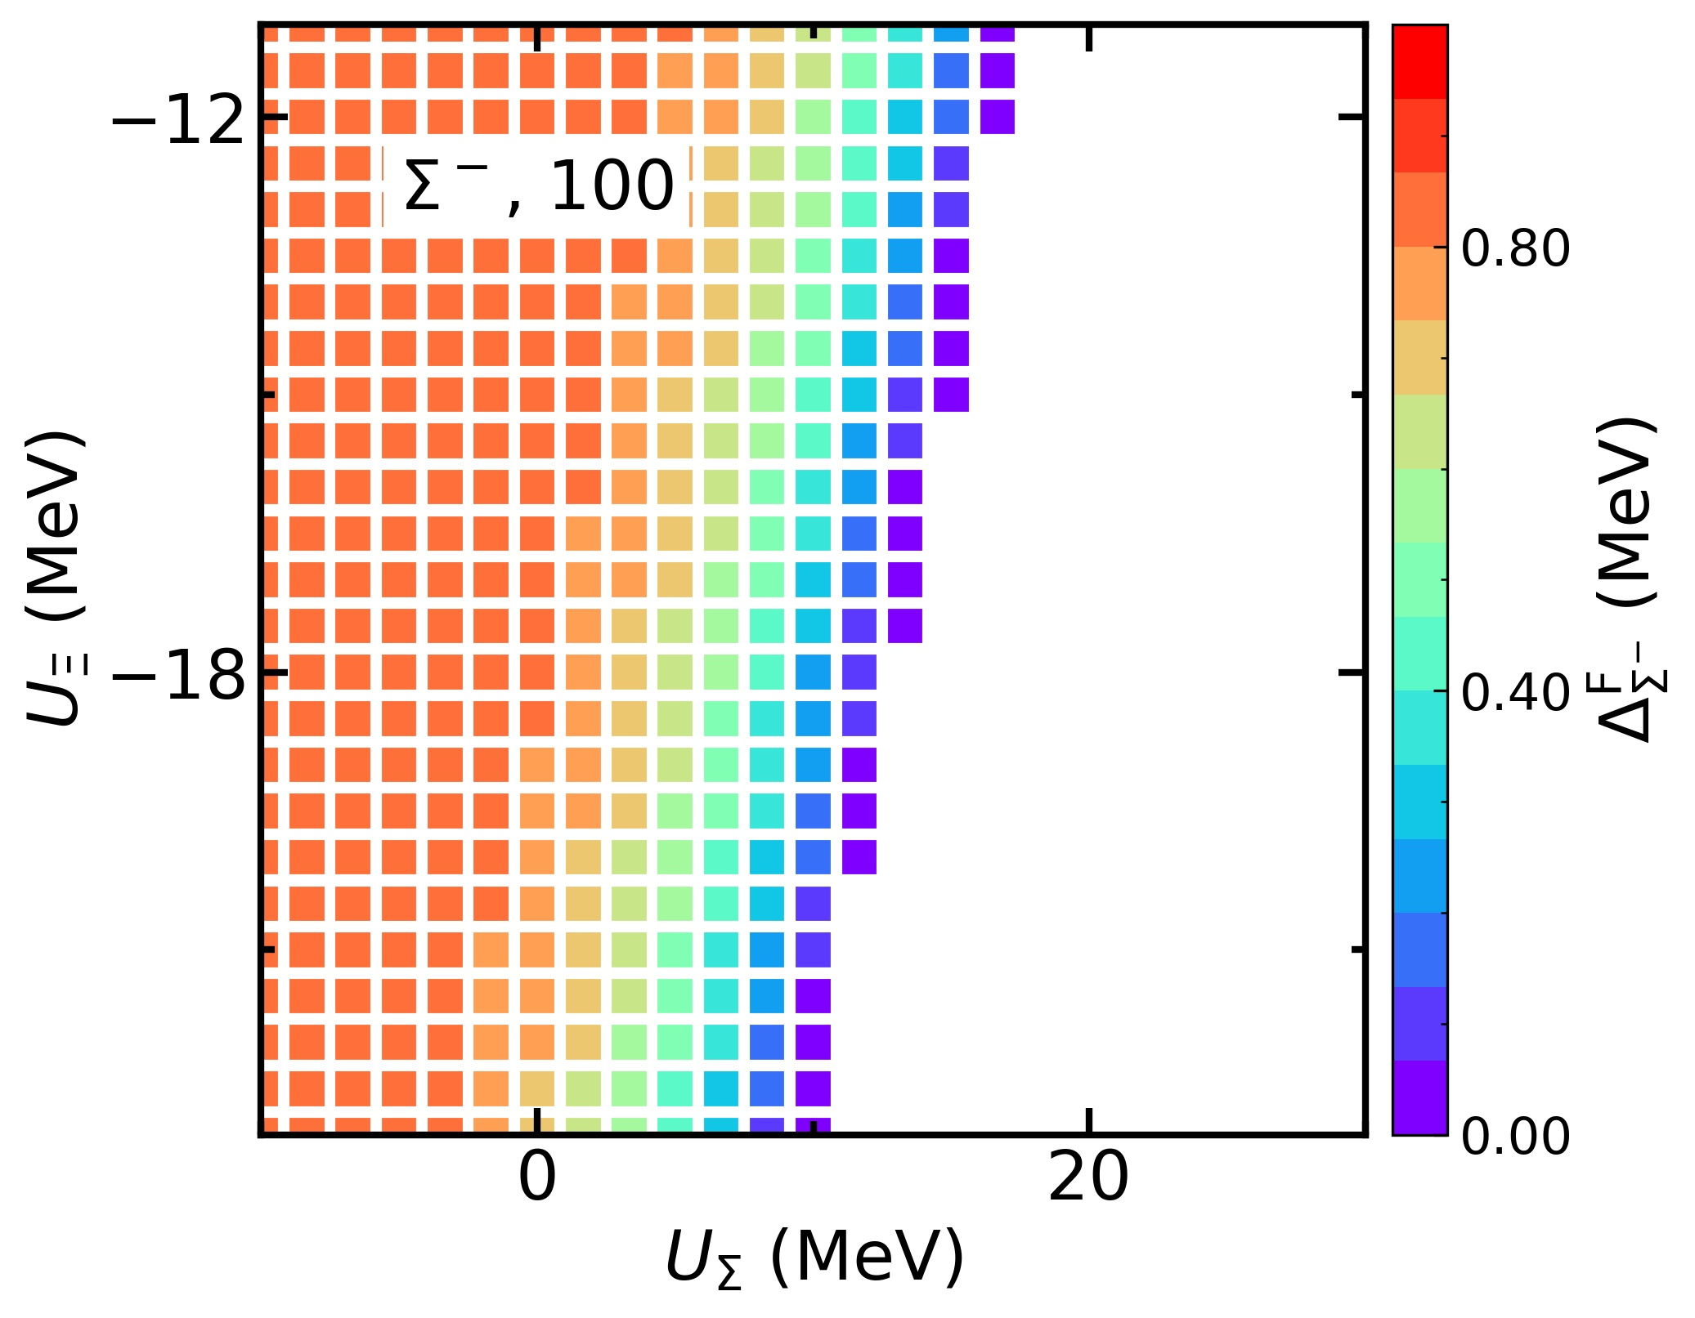
Results: hyperon potentials
$ΣΣ$ pairing: the maximum pairing gap $Δ_{Σ^{−}}^{F}$ inside NSs

Slide 29
Results: hyperon potentials
For $Σ^{−}Σ^{−}$pairing:
The maximum of the maximum pairing gap slightly decrease as $L_{sym}$ increases
The value at ($U_{Σ}^{(N)}$, $U_{Ξ}^{(N)}$) =(20 MeV, $−$15 MeV) decrease sharply
Larger $L_{sym}$ is unfavored to $Σ^{−}Σ^{−}$pairing, although strong $Σ^{−}Σ^{−}$pairing always can be found at low $U_{Σ}^{(N)}$
S. Tagami et al., Results in Physics 43 (2022) 106037
T.G. Yue et al., PRR 4 (2022) L022054

Slide 30
Contents
Background
Theoretical Framework
Results
hyperon potentials
SU(3) symmetry
Summary and Perspective

Slide 31
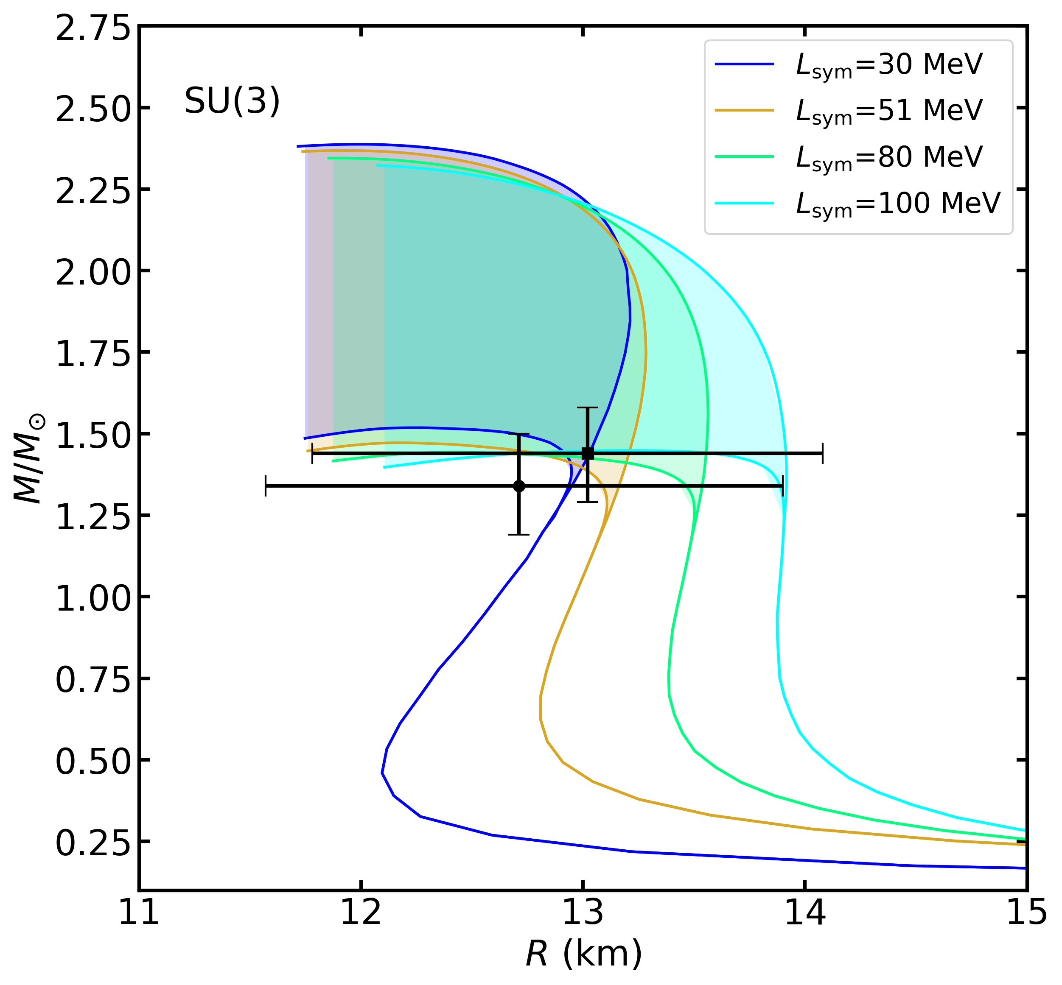
Results: SU(3) symmetry
M-R relations under the SU(3) symmetry
($U_{Σ}^{(N)}$, $U_{Ξ}^{(N)}$) is fixed at (20 MeV, $−$17 MeV)
The variations of maximum mass under the SU(3) symmetry are distinctly different (> 0.85 $M_{⨀}$)
The fraction of hyperons is related to the maximum mass
H.R. Fu et al., PLB 834 (2022) 137470
S. Weissenborn et al.,, PRC 85 (2012) 065802
How are hyperon paired inside NSs under the SU(3) symmetry?
NICER
T.E. Riley et al., ApJL 887 (2019) L21
M.C. Miller et al., ApJL 887 (2019) L24

Slide 32
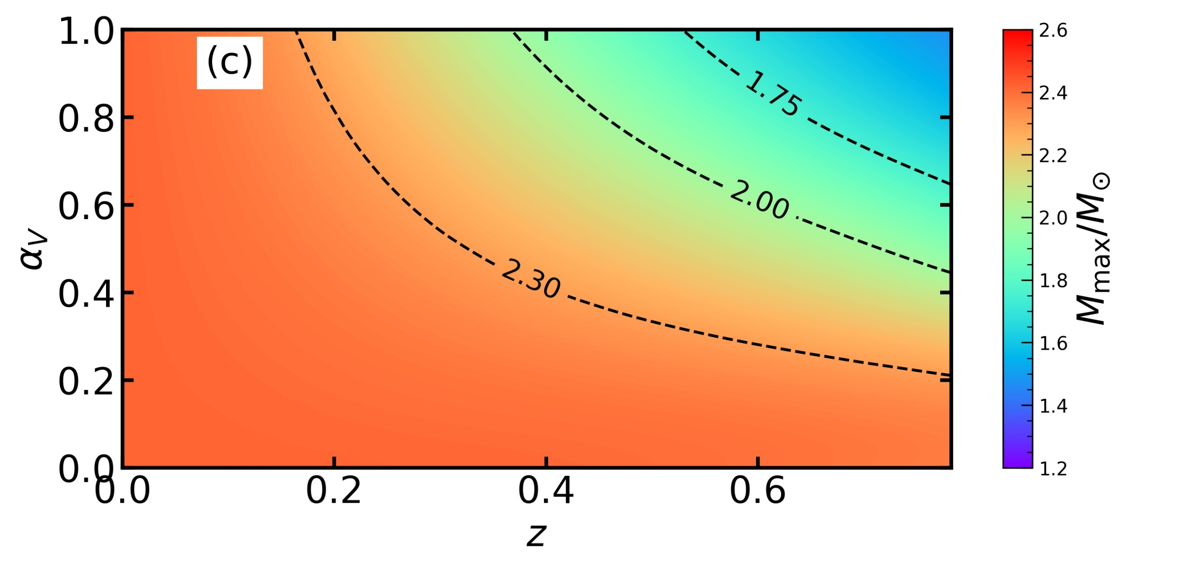
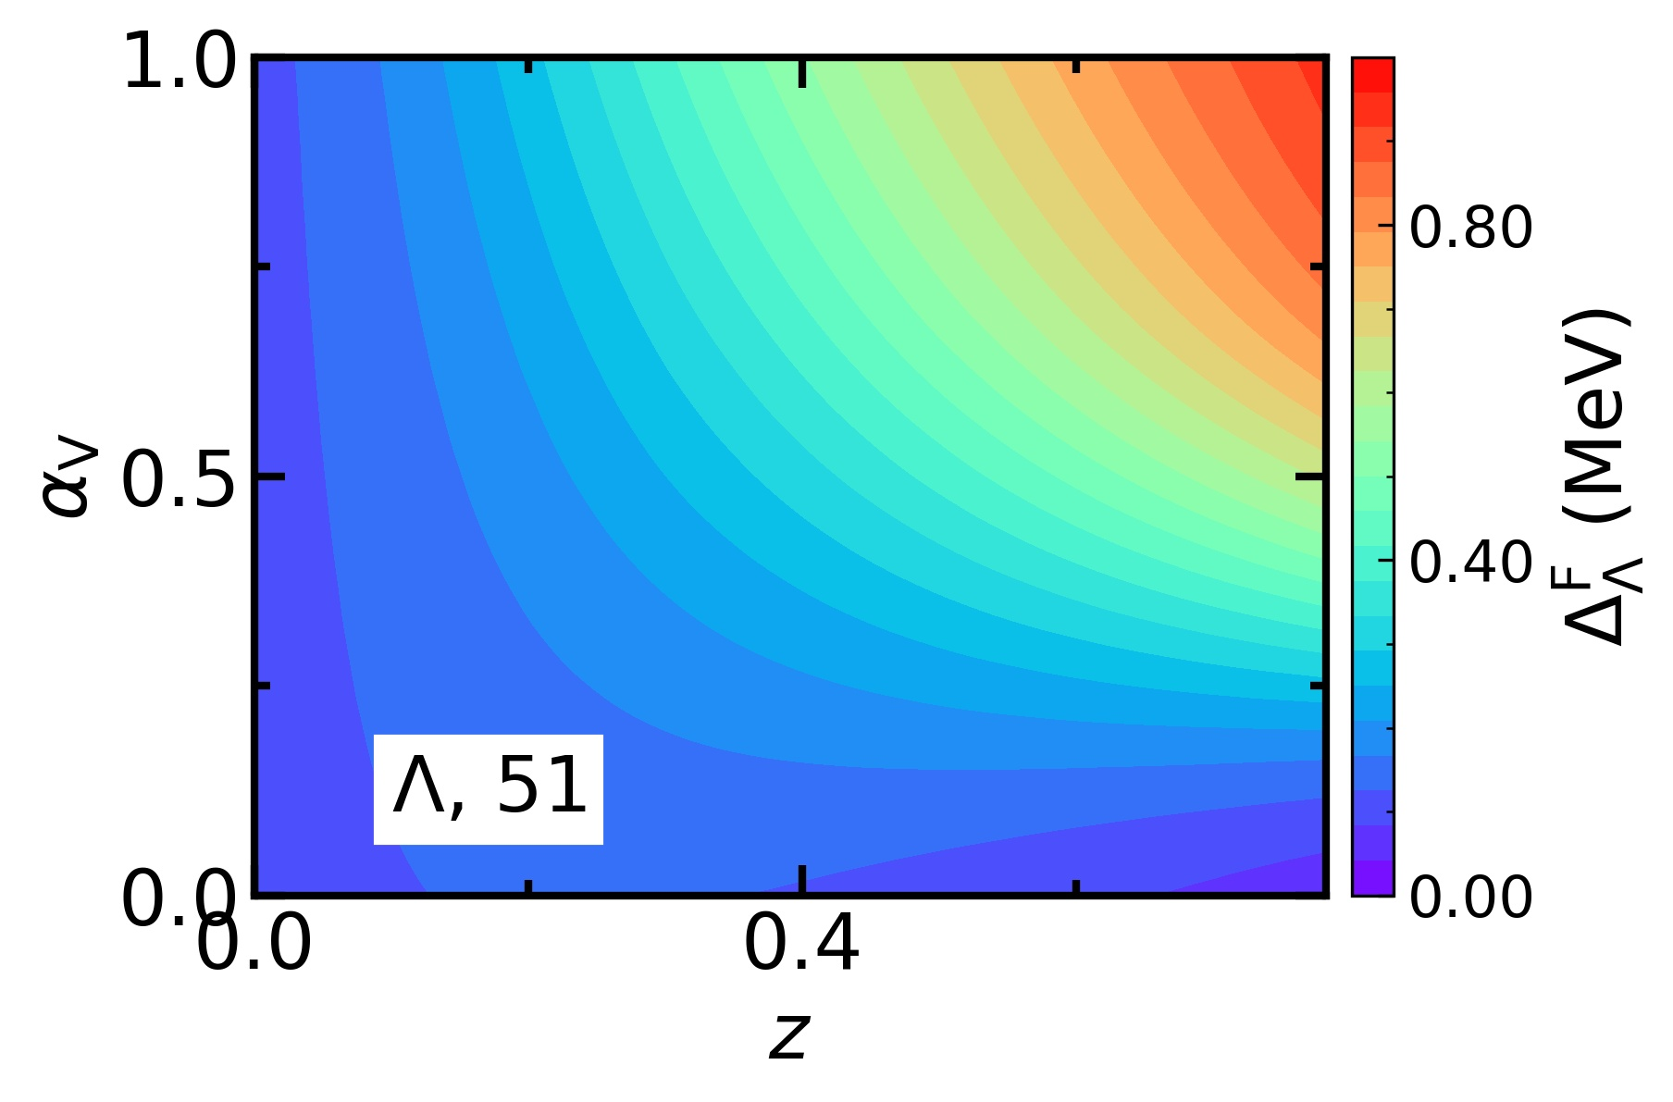
Results: SU(3) symmetry
$ΛΛ$ pairing: the maximum pairing gap $Δ_{Λ}^{F}$ inside NSs
The variation of the maximum pairing gap under SU(3) symmetry is evident (~1.0 MeV)
The maximum pairing gap decreases as $z$ and $α_{V}$ decrease, which is opposite to the behavior of maximum mass
The existence of massive NS is unfavored to $ΛΛ$ pairing

Slide 33
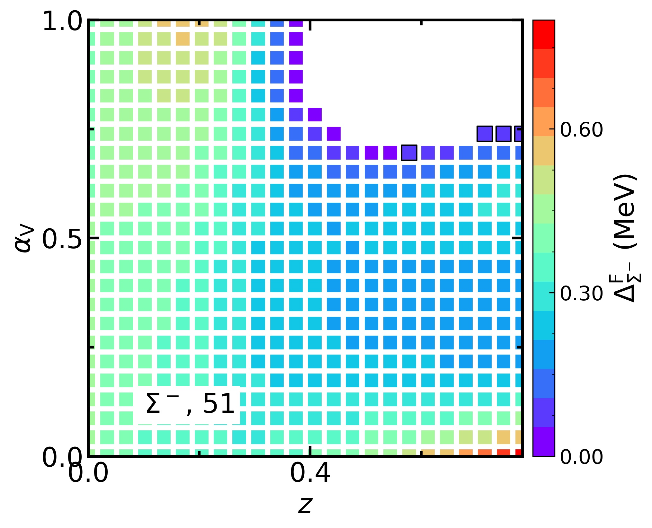
Results: SU(3) symmetry
$ΣΣ$ pairing: the maximum pairing gap $Δ_{Σ^{−}}^{F}$ inside NSs
Strong $Σ^{−}Σ^{−}$ pairing appear in the area with larger $z$ and $α_{V}$
No $Σ^{−}Σ^{−}$ pairing at the area corresponding to low maximum mass
The existence of massive NS is favored to $ΣΣ$ pairing

Slide 34
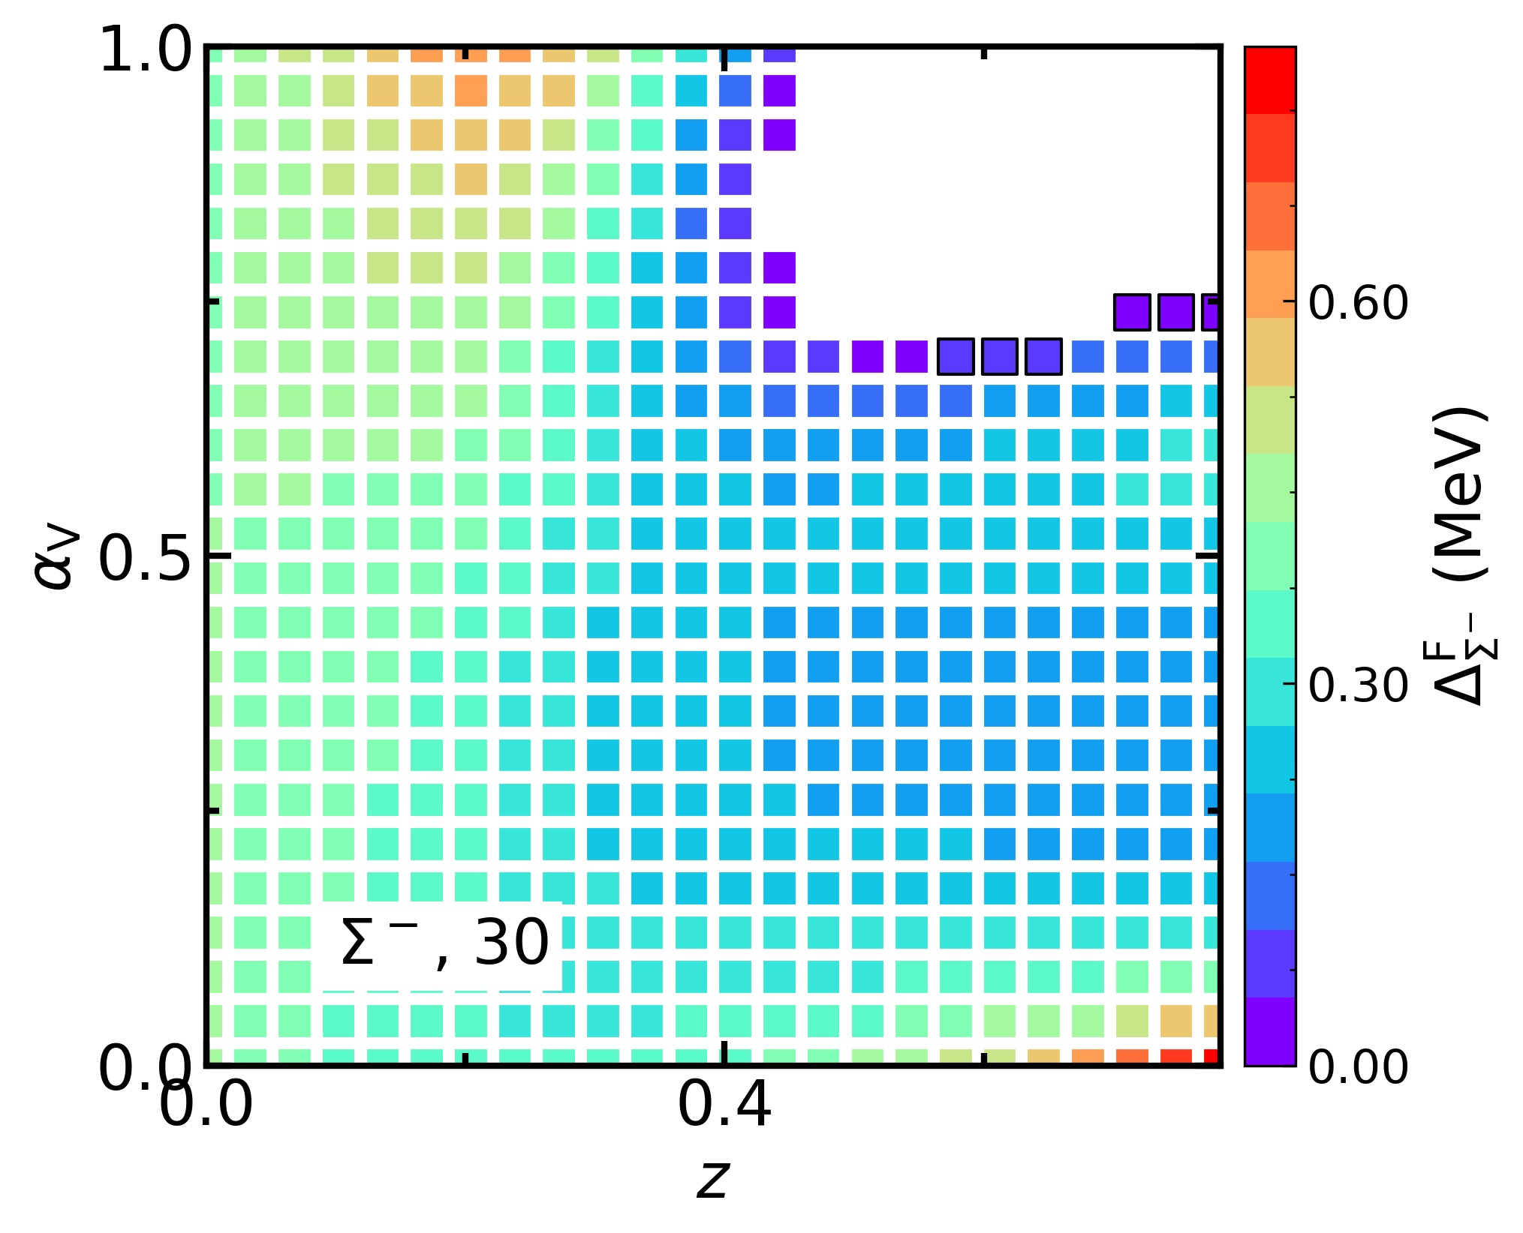
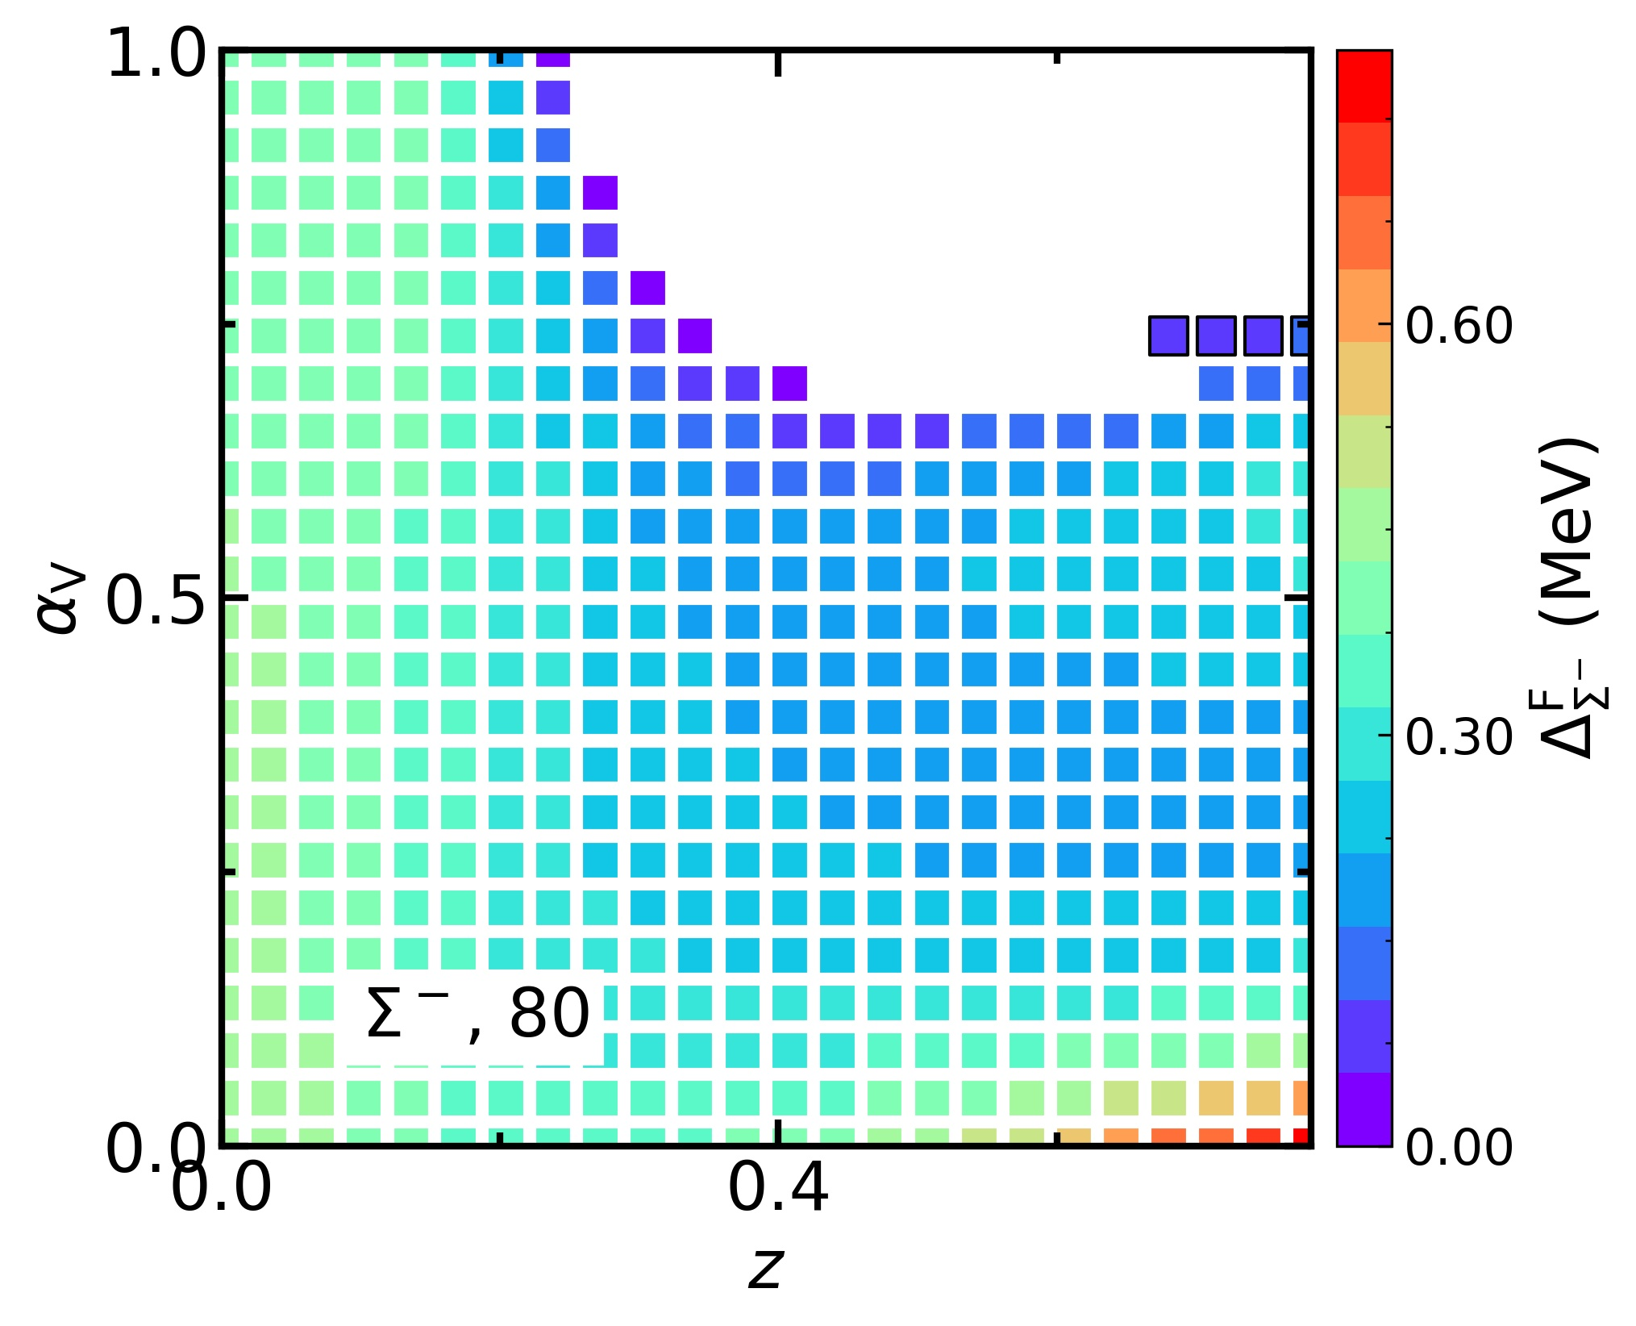
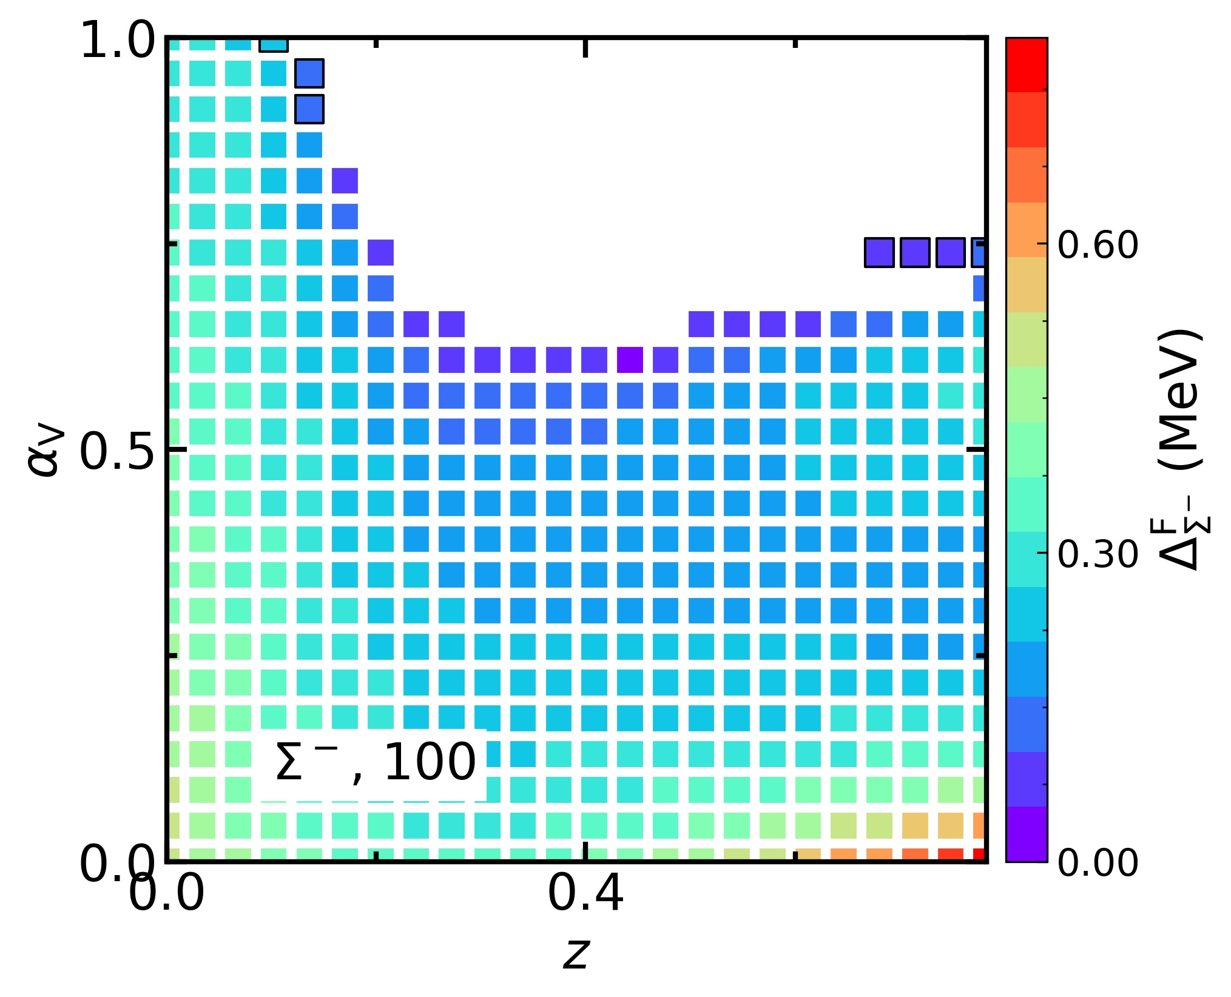
Results: SU(3) symmetry
$ΣΣ$ pairing: the maximum pairing gap $Δ_{Σ^{−}}^{F}$ inside NSs

Slide 35
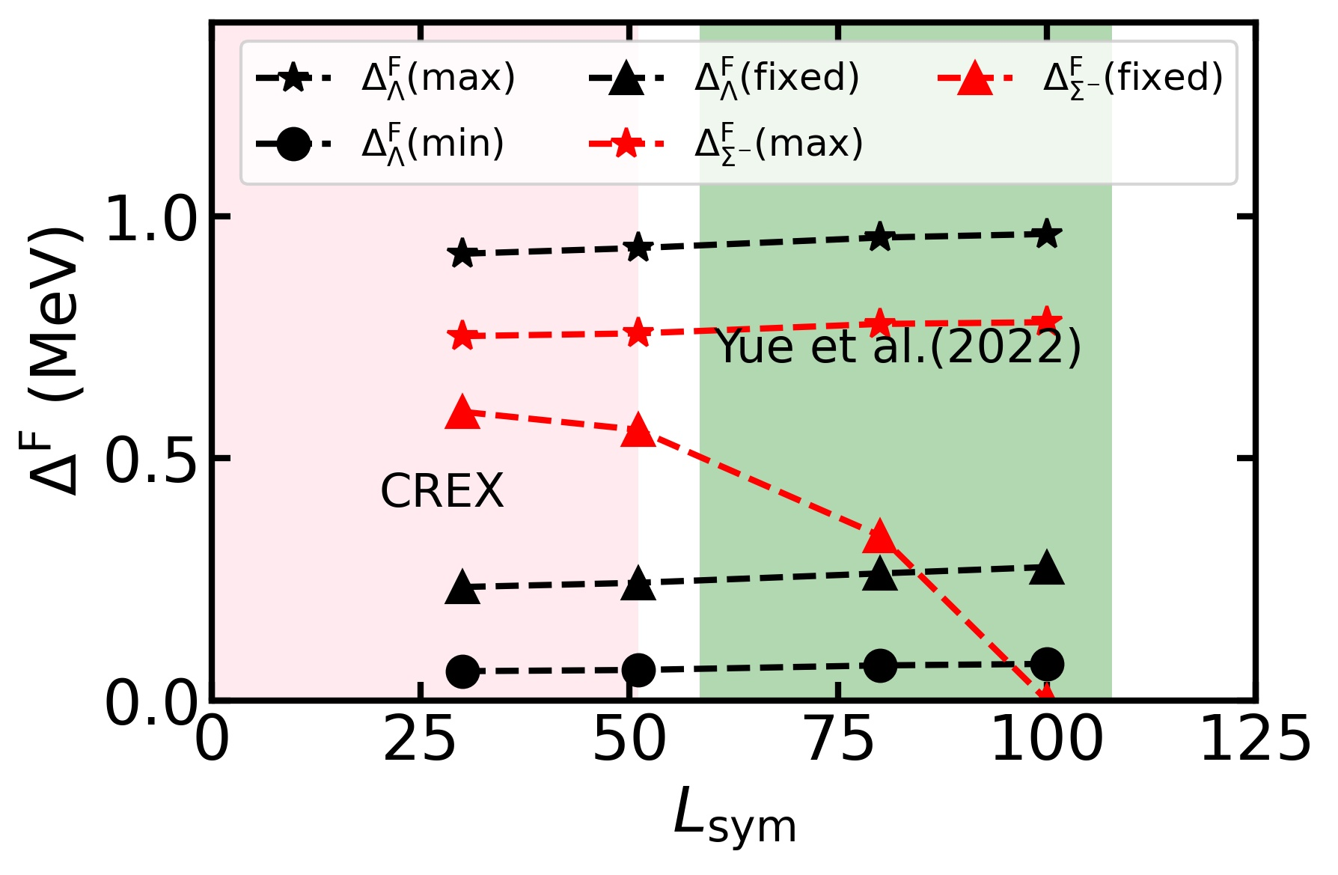
Results: SU(3) symmetry
For $Σ^{−}Σ^{−}$ pairing:
The maximum of the maximum pairing gap slightly increase as $L_{sym}$ increases
From the overall picture, $Σ^{−}Σ^{−}$pairing is suppressed by larger $L_{sym}$
S. Tagami et al., Results in Physics 43 (2022) 106037
T.G. Yue et al., PRR 4 (2022) L022054

Slide 36
Contents
Background
Theoretical Framework
Results
hyperon potentials
SU(3) symmetry
Summary and Perspective

Slide 37
Summary and Perspective
Summary:
A systematic study of the effects of hyperon couplings on hyperon superfluidity is conducted using the relativistic mean field model
Varying hyperon potentials, $ΛΛ$ pairing is strong and it magnitude shows little variation; $Σ^{−}Σ^{−}$ pairing is more sensitive to hyperon potentials and $L_{sym}$
Under the SU(3) symmetry, the existence of massive NSs is unfavored to $ΛΛ$ pairing, but is favored to $Σ^{−}Σ^{−}$ pairing
Hyperon superfluidity associated with astrophysical processes could be an essential window to probe the physics of neutron star cores
Perspective:
How the uncertainties of nuclear interactions affect the NS cooling?
Can we constrain the nuclear interactions by the observations of NS cooling?

Slide 38
Thanks for your attention!

Slide 39
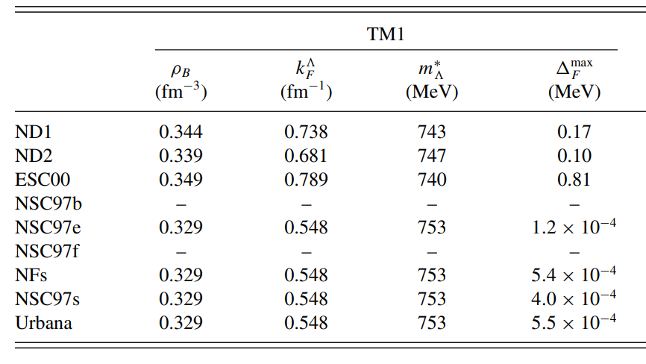
Uncertainties of Nuclear Interactions
Pairing force
Why?
No date for multi-$Λ$ hypernuclei ($−S>2$)
No $ΛΛ$pairing effect in double-$Λ$ hypernuclei
No $Σ$ hypernuclei
No date for multi-$Ξ$ hypernuclei ($−S>1$)
Y.N. Wang et al., PRC 81 (2010) 025801
The pairing gap could be significant different due to the choice of pairing force
Pairing force in this talk:
Z.H. Tu, PRC 106 (2022) 025806
Notes:
如果考虑超子配对，我们还需要考虑对力的不确定性。对力的不确定性主要来源于我们没有多超子超核以研究超子的对效应……。因此，我们只能使用超子-超子的唯象相互作用代替对力，这些相互作用通常基于不同的理论模型和假设，PRC的文章告诉我们…….

Slide 40
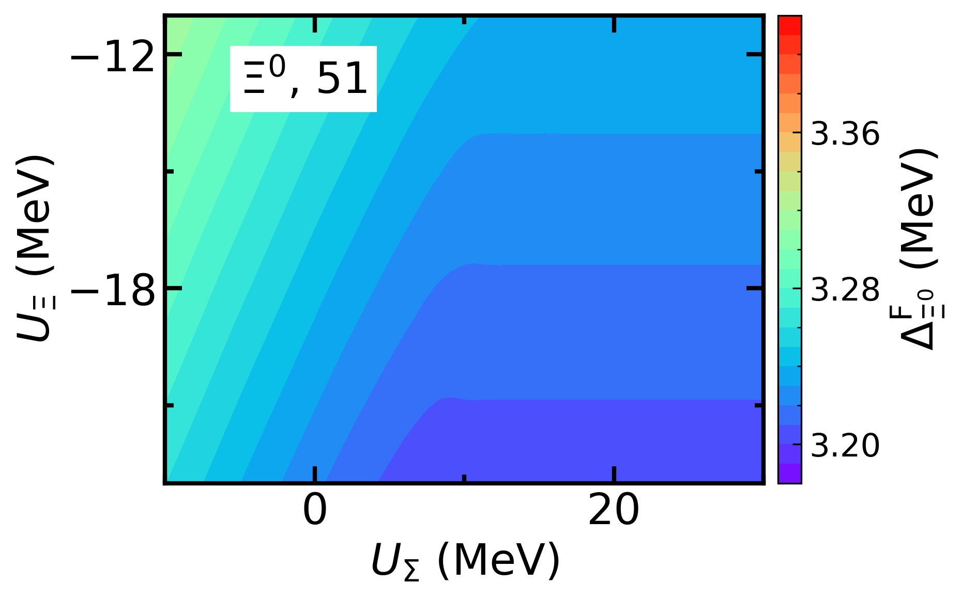
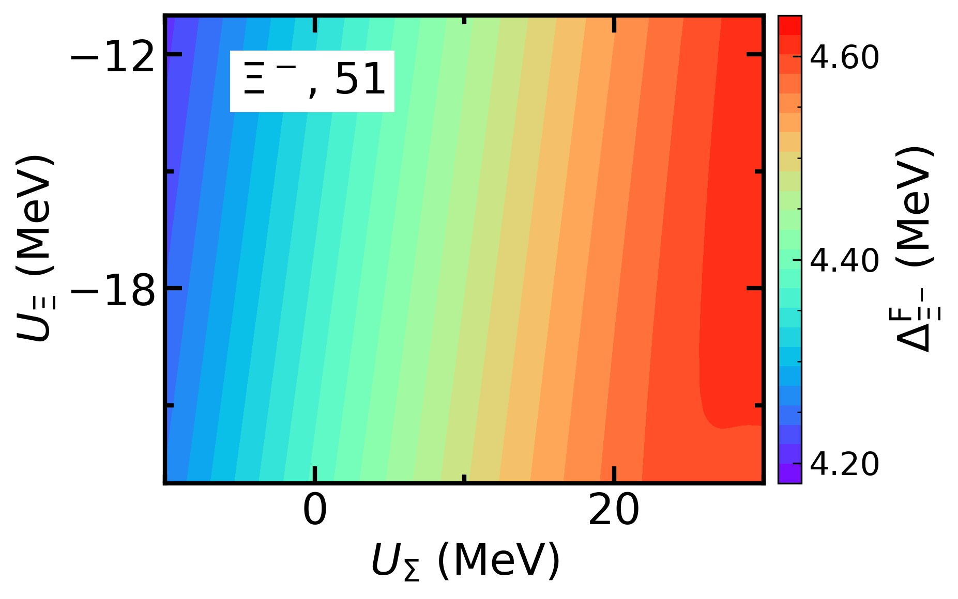
Results: hyperon potentials
$ΞΞ$ pairing: the maximum pairing gap $Δ_{Ξ^{0,−}}^{F}$ inside NSs
$Δ_{Ξ^{0}}^{F}$ depends on $U_{Ξ}^{(N)}$ at higher $U_{Σ}^{(N)}$ due to the high threshold density of $Ξ^{0}$
$Ξ^{−}Ξ^{−}$ pairing has similar behaviors as $ΛΛ$ pairing

Slide 41
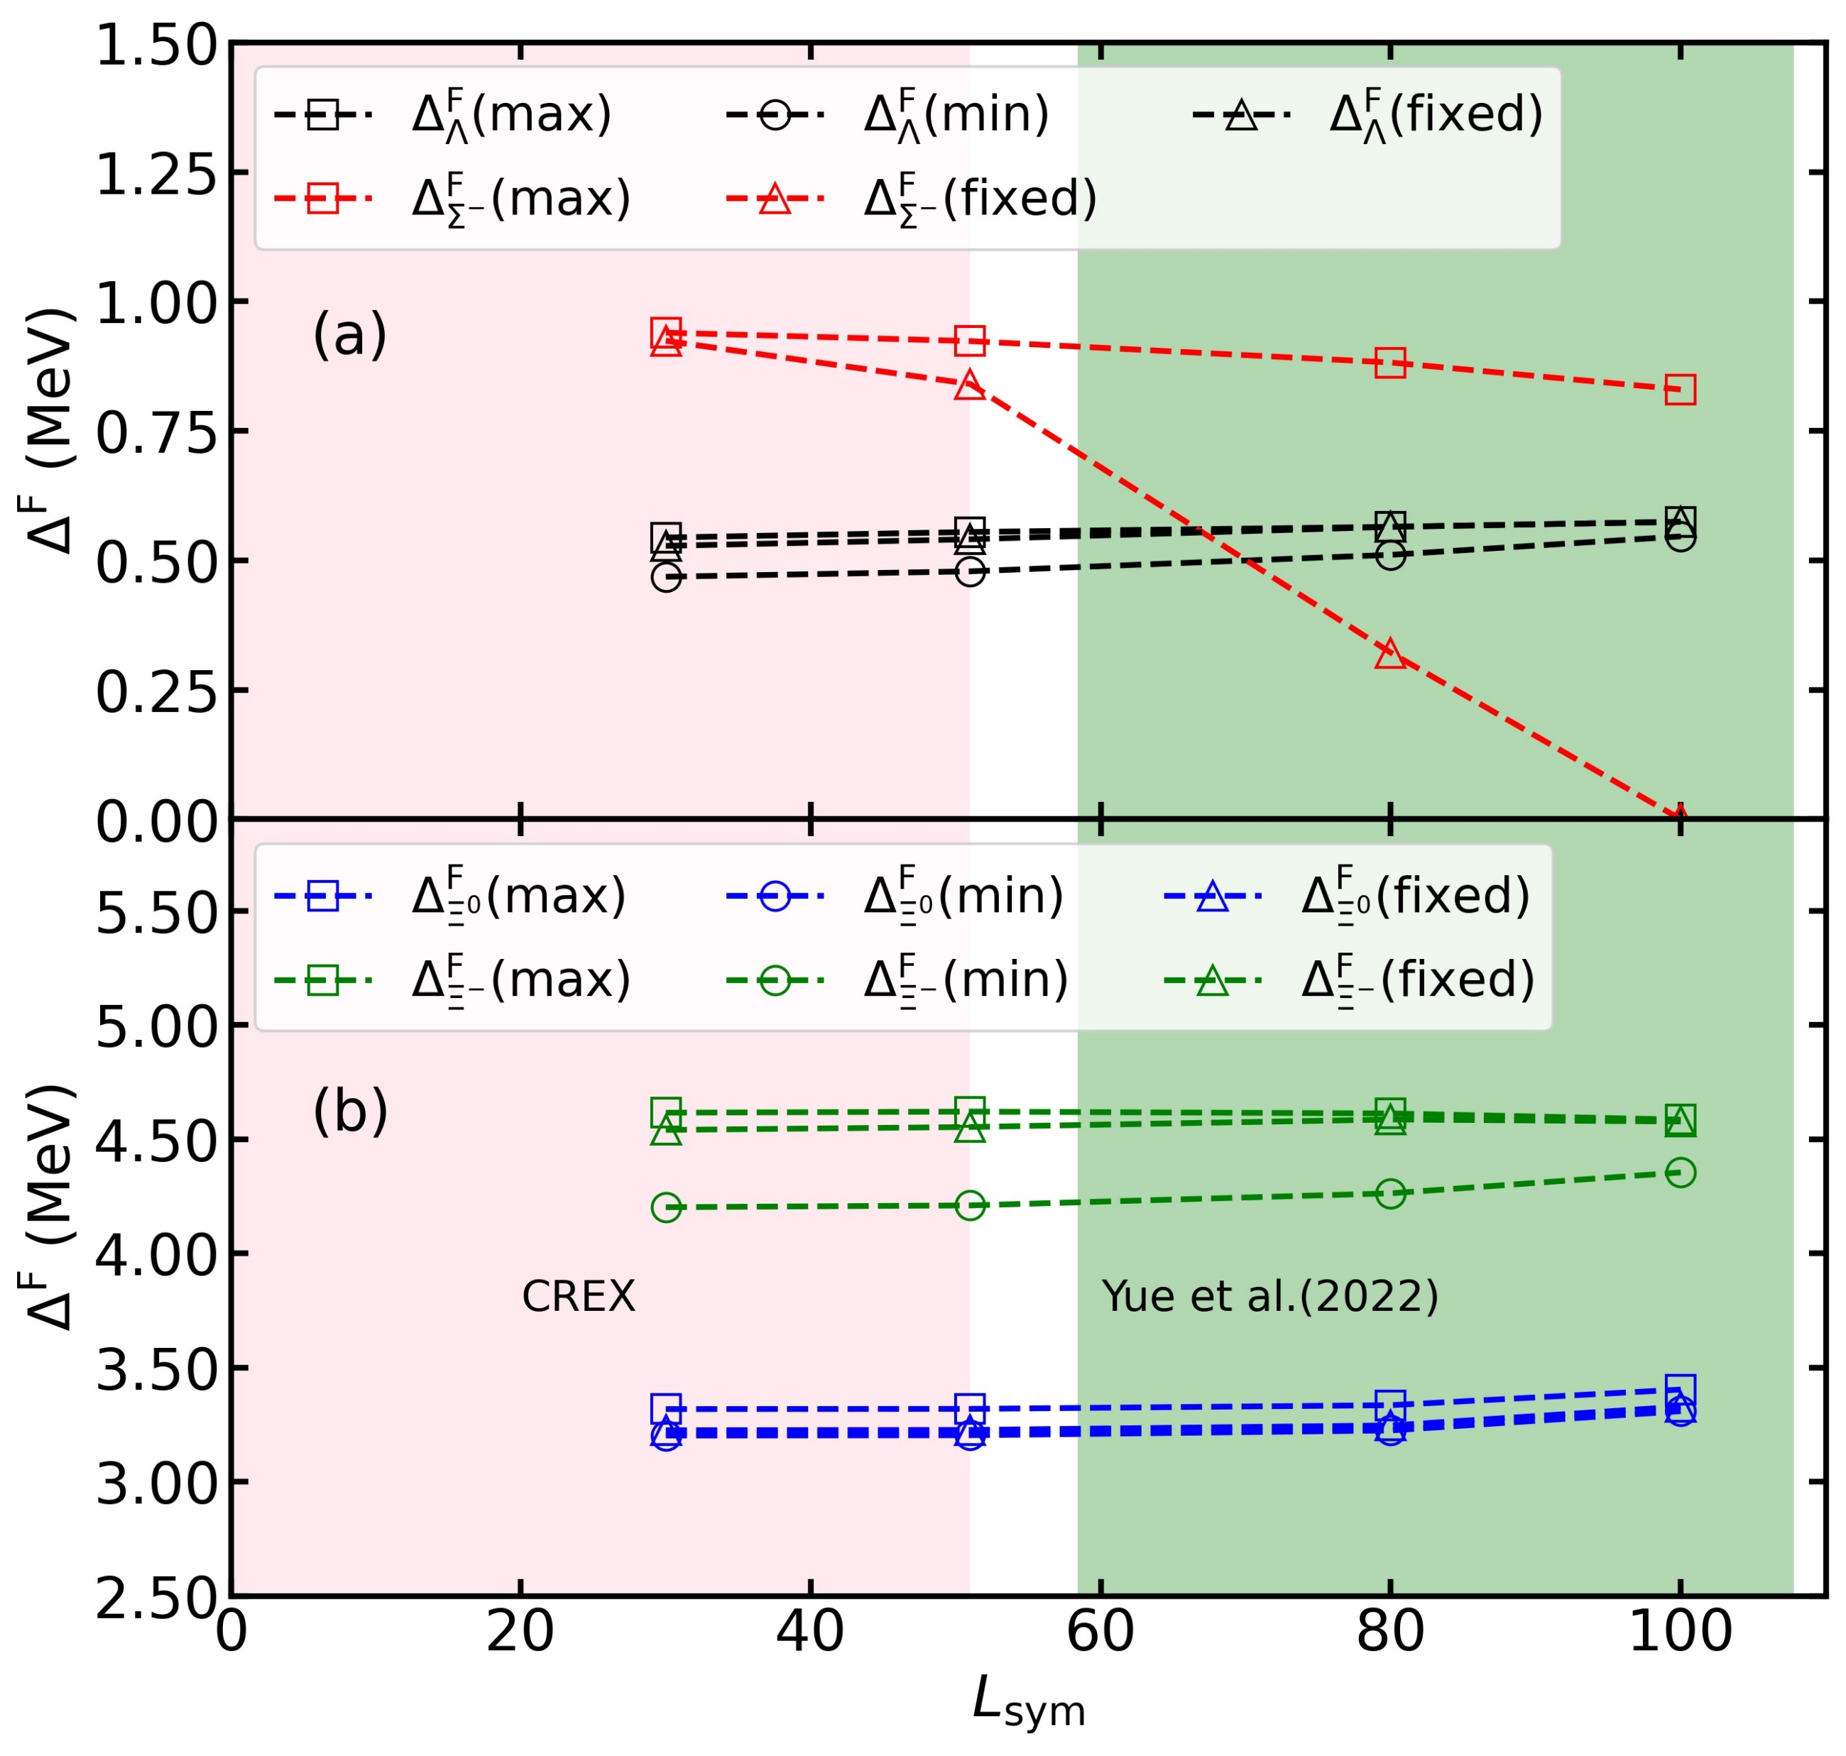
Results: hyperon potentials
For $ΞΞ$ pairing:
$Ξ^{−}Ξ^{−}$ pairing has similar behaviors as $ΛΛ$ pairing
$Ξ^{0}Ξ^{0}$ pairing is enhanced as $L_{sym}$ increases

Slide 42
Results: SU(3) symmetry
For $ΛΛ$ pairing:
The maximum and minimum of the maximum pairing gap slightly increase as $L_{sym}$ increases
S. Tagami et al., Results in Physics 43 (2022) 106037
T.G. Yue et al., PRR 4 (2022) L022054

Slide 43
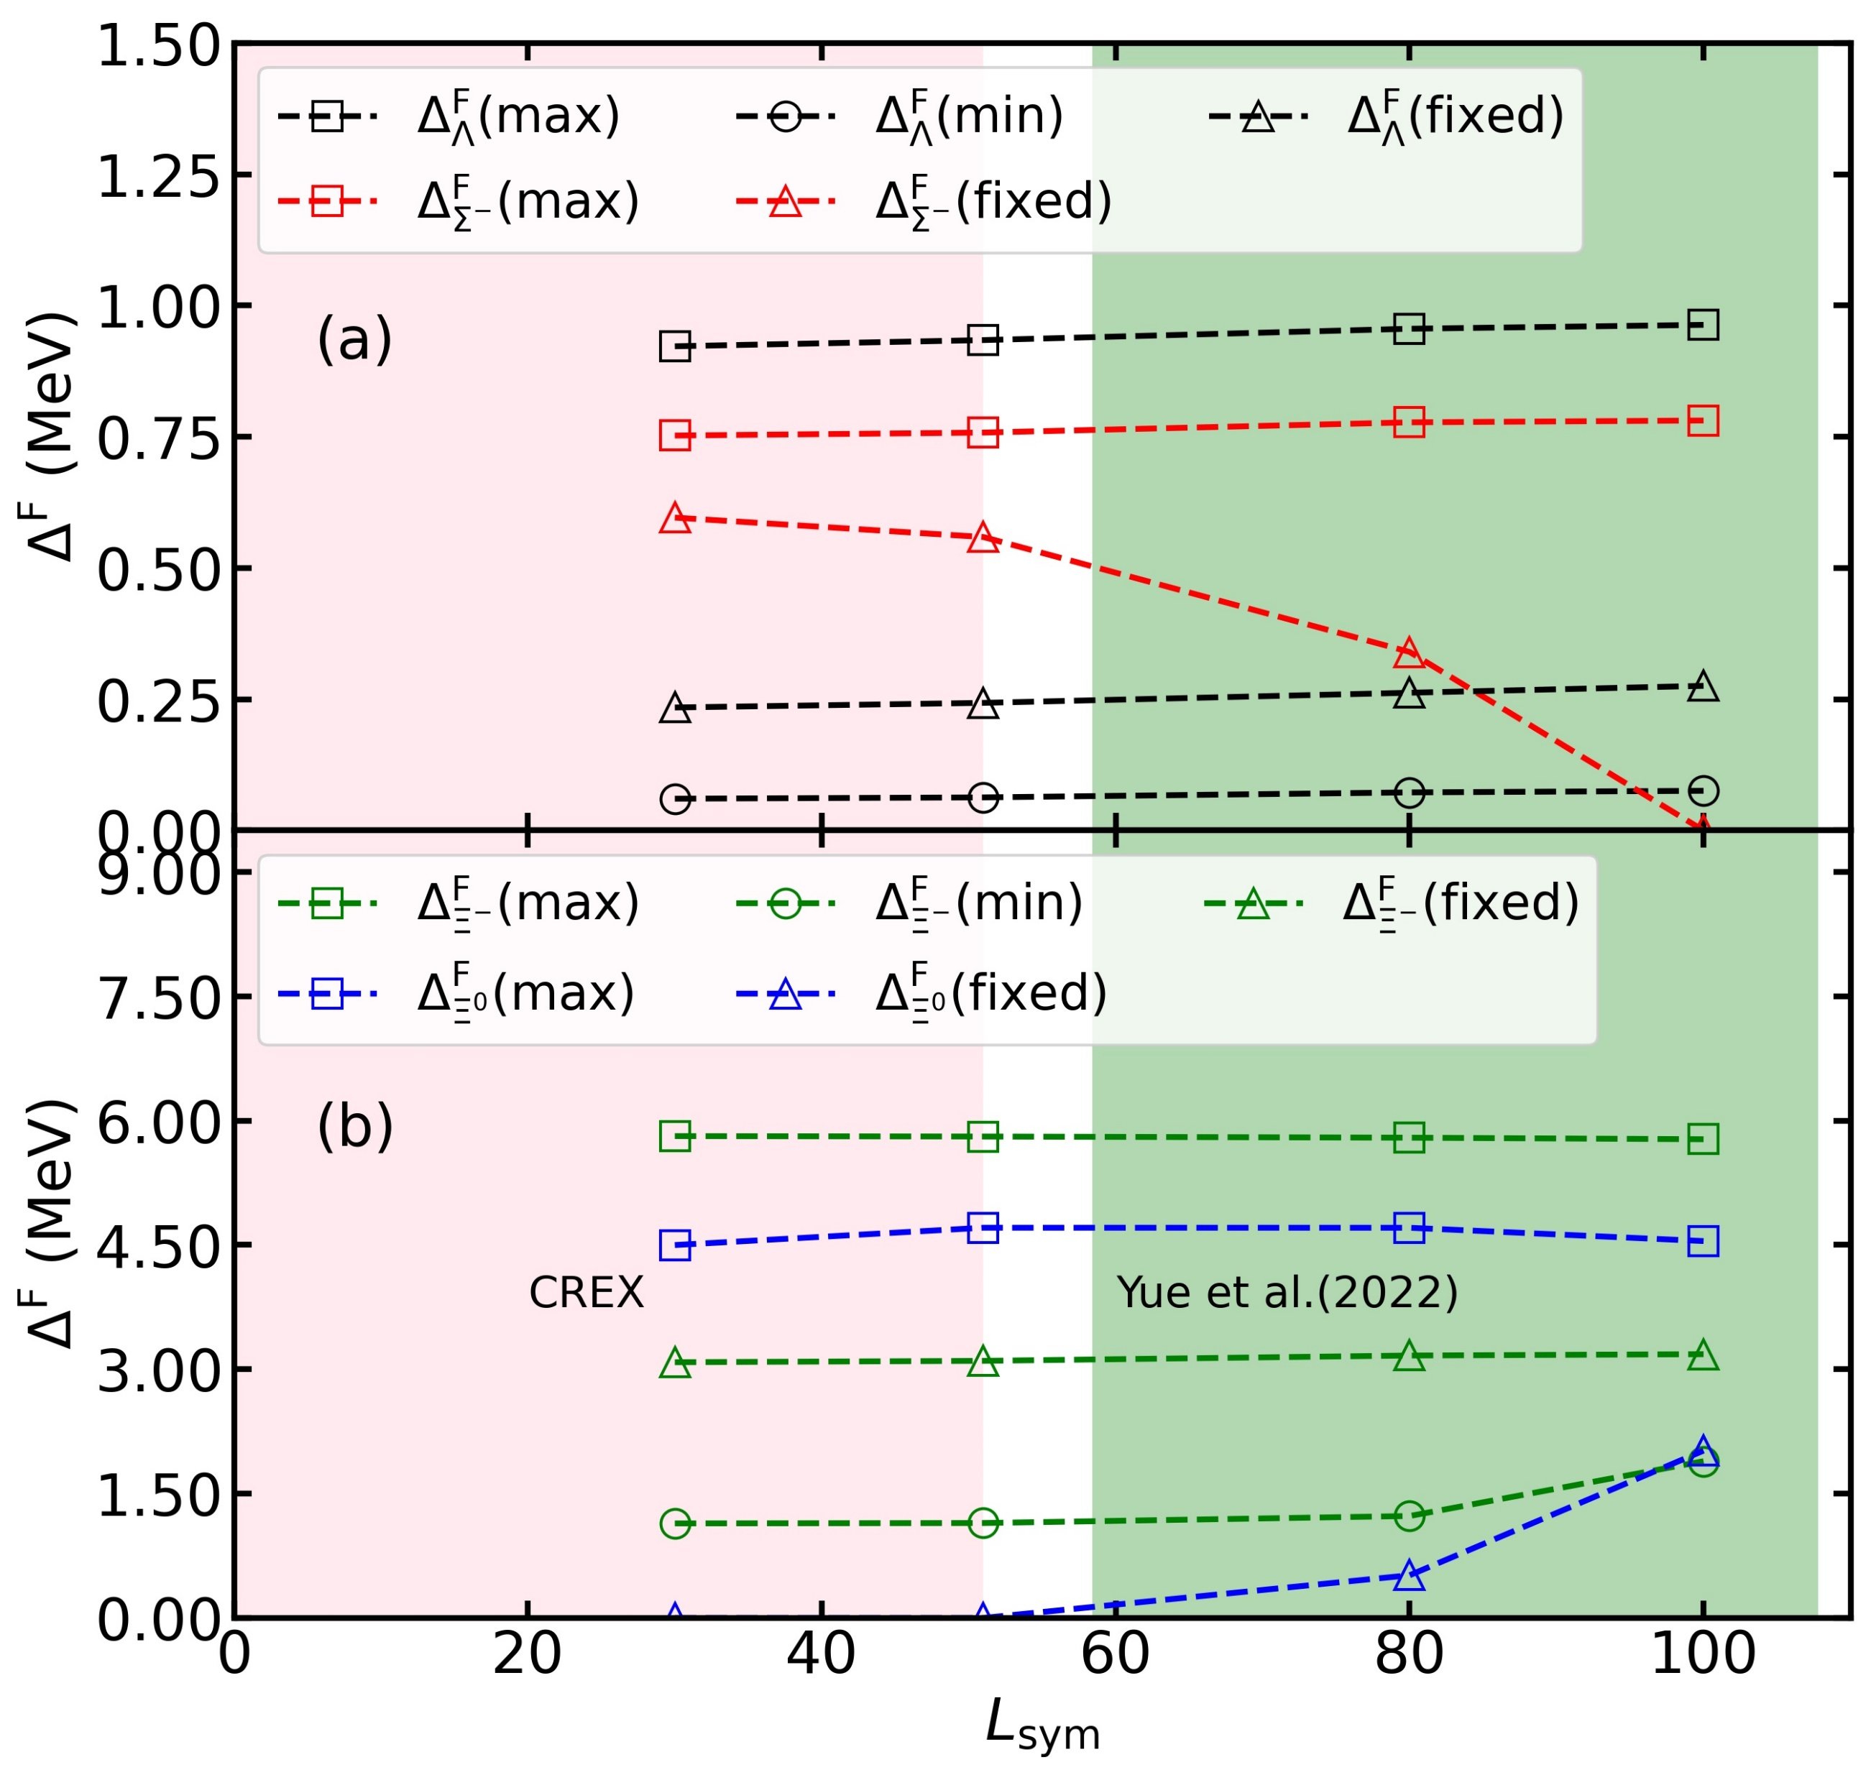
Results: SU(3) symmetry
The dependences of $ΞΞ$ pairing on the $z$ and $α_{V}$ are similar as $ΛΛ$ pairing
For $ΞΞ$ pairing:
$L_{sym}$ have no significant effect on the maximum of the maximum pairing gaps
The larger $L_{sym}$ could be favored to the $ΞΞ$ pairing for some ($z$, $α_{V}$) combinations

