Slide 1
NPR- Nuclear Physics Review
（原子核物理评论）
www.npr.ac.cn
the Special Issue on the Workshop
of Quarks and Compact Stars 2023
(QCS2023)
2023 YANGZHOU CHINA
Jinchuan Wang
LOC of QCS2023, NPR Editorial Office
QCS2023, Yangzhou University, Yangzhou, China, September 24, 2023

Slide 2
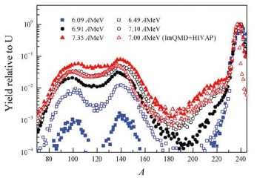
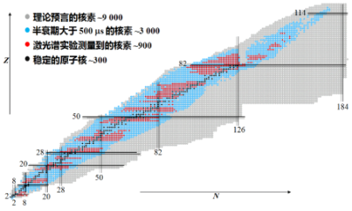
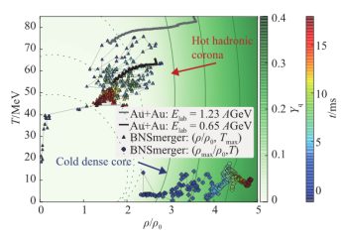
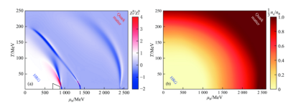
NPR- Nuclear Physics Review
（原子核物理评论）
www.npr.ac.cn
General Introduction to NPR
Nuclear Physics Review (NPR) is a comprehensive academic journal on nuclear sciences, Launched in 1984.
Sponsor: Chinese Nuclear Physics Society(CNPS) and Institute of Modern Physics,CAS(IMP-CAS).
It publishes timely, high quality original research findings, especially up-to-date achievements and advances in the nuclear sciences and related interdisciplinary studies.
Its aim is to enhance the academic exchanges and links for scientists at home and abroad, to promote the nuclear science developments and their applications in China and other countries.

Slide 3
NPR- Nuclear Physics Review
（原子核物理评论）
www.npr.ac.cn
Scope of NPR
Original research papers, and reviews covering theory and experiment in
Nuclear Physics
Nuclear Technology
Accelerator
Cross Discipline
Nuclear Energy & Nuclear Data
A comprehensive academic journal on nuclear sciences

Slide 4
NPR- Nuclear Physics Review
（原子核物理评论）
www.npr.ac.cn
Indexed
NPR has being indexed by all authorized indexing systems in China and by some international indexing systems abroad. listed as follows
P*(AJ)(Russia)
CBST, JICST(Japan)
INIS ATOM-INDEX (IAEA)
CA(USA)
CSCD
CSTPCD
CAJ(CNKI)
COJ(Wanfang Data)
A comprehensive academic journal on nuclear sciences

Slide 5
NPR- Nuclear Physics Review
（原子核物理评论）
www.npr.ac.cn
QCS2023 Special Issue
1. QCS2023 Special Issue will be published in NPR, which is the Journal of Chinese Nuclear Physics Society(中国核物理学会会刊) , the Special Issue will contain the talks in all Sessions of QCS2023 program
2. Each paper will be peer reviewed by the experts appointed by LOC. All the contributions to this issue are free of publication charge (covered by the organizer of QCS2023 workshop)

Slide 6
NPR- Nuclear Physics Review
（原子核物理评论）
www.npr.ac.cn
QCS2023 Special Issue
3. QCS2023 participant should prepare the manuscript in LATEX format with QCS2023 NPR template. Two types of LATEX templates are provided：
(1) QCS2023_NPRLatextemplate_En&Ch.rar
(Contribution in English with additional Title, author’s
name and affiliations, Abstract, etc. in Chinese)
(2) QCS2023_NPRLatextemplate_En.rar
(Contribution in English)
The QCS2023 templates can be downloaded from pan.baidu.com/s/1yRoNHUiXMpjMiAqQFr7RAw (password:1234)

Slide 7
NPR- Nuclear Physics Review
（原子核物理评论）
www.npr.ac.cn
QCS2023 Special Issue
4. The QCS2023 contribution to NPR is 5-7 journal pages for original research paper, and 7-11 journal pages for review paper.
If necessary, special request of additional pages can be put forward and consulted with the LOC team and NPR Editorial office.
5. The QCS2023 contribution should be high-quality, and with a high academic level, including the author’s recent work and new results, and not published in any acknowledged publications before.

Slide 8
NPR- Nuclear Physics Review
（原子核物理评论）
www.npr.ac.cn
QCS2023 Special Issue
6. You should submit your manuscript by email to QCS2023@126.com with the subject headings of QCS2023+Author Name.
Meanwhile, submit online at NPR website(www.npr.ac.cn) through the submission system.
7. The deadline of the submission: 31st Nov., 2023. Please prepare and submit your contribution as soon as possible after the QCS2023 workshop, to ensure the contribution would be properly and timely processed By NPR Editorial office.

Slide 9
NPR- Nuclear Physics Review
（原子核物理评论）
www.npr.ac.cn
(QCS2023)
2023 YANGZHOU CHINA
Thank you very much
for your contribution to
QCS2023 Special Issue!

Slide 10
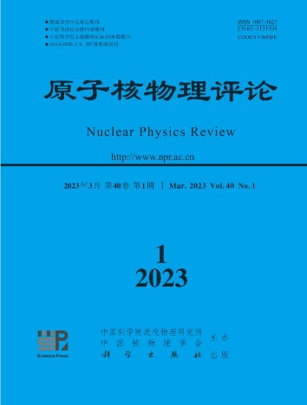
原子核物理评论
(NPR- Nuclear Physics Review)
www.npr.ac.cn
1984年创刊
—核物理、核技术及相关领域综合性核心学术期刊
—中国核物理学会会刊，中文文章为主，中英文混排
主要栏目
核物理、加速器、核技术、交叉学科、核能与核数据
国内外数据库收录
中国科学引文数据库(CSCD)、中文核心期刊要目总览、 Pж(AJ)、CBST/JICST、CA、INIS、CSTPCD等
中国科协优秀科技论文奖(2020年、2019年、2016年)
西牛奖(优秀中文科技期刊)(2022年)
甘肃省优秀期刊奖（2022年、2009年）
主办 出版

Slide 11
NPR- Nuclear Physics Review
（原子核物理评论）
www.npr.ac.cn
Introduction to the Special Issue on
the Workshop of Quarks and Compact Stars 2023
(QCS2023)
Jinchuan Wang
NPR Editorial Office, IMP-CAS

