Slide 1
Properties of strange quark matter and strange star in a new mass scaling
reporter: Wang Jingtao (UCAS)
QCS2023 2023.9 Yangzhou University, Yangzhou, China

Slide 2
why strange quark matter
thermodynamic treatment
mass scaling
properties of strange quark matter
calculation results of strange star
Outline

Slide 3
why strange quark matter
2-flavor quark matter
3-flavor quark matter
u
u
s
d
d
more degrees of freedom
E. Witten, Phys. Rev. D 30, 272 (1984).
Notes:
lower the energy of this system

Slide 4
some problem with QCD......
perturbative QCD can not be used in strong coupling situation......
lattice QCD method requires huge computational effort......
it is hard to get properties of SQM from first principle calculation......
phenomenological method

Slide 5
thermodynamic treatment (equiparticle model)
we start from free energy
we take free energy density for a even system
omega_0 is the thermodynaic potential of free particle system
this is omega_0 when temperature is 0K.

Slide 6
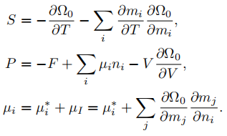
thermodynamic treatment (equiparticle model)
To introduce interaction between particles in a free system, we need to replace constant mass into effective mass and replace real chemical potential into effective potential.
by some math treatment(, we can get these thermodynamic functions.
Temperature and baryon number density
effective one

Slide 7
thermodynamic treatment (equiparticle model)
and here is particle number density and energy density
when T tends to 0K
we can calculate these thermodynamic functions when we know the effective chemical potential and particle mass.

Slide 8
mass scaling(history)
At first, people considered the infrared confinement effect, and based on the bag model
Peng G. X. derived a cubic root scaling by considering in-medium chiral condensation effect and linear confinement
In 2012, Chen S. W. further added one-gluon-exchange effect and promoted a new scaling at zero temperature
In 2014, Xia C. J. took first-order perturbation interaction into account, and got a similar scaling with a positive C

Slide 9
mass scaling
the interaction mass term will be infinitely big with nb increasing when C is positive
it is nonphysical that there exists an nb big enough to make quark mass negative with a negative C
maybe we can take asymptotic freedom effect into account to cancel this bug
strange?

Slide 10
mass scaling
we introduce a Woods-Saxon type factor to simulate asymptotic freedom
we can choose different n_a and w for calculations, but we need to make sure that there is some proper range for our parameter D and C..

Slide 11
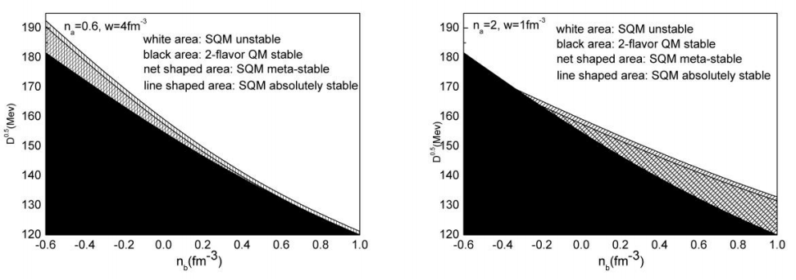
EPB
2-flavor biger or equals to 930mev(⁵⁶Fe)
mass scaling(range)
3-flavor 930mev? 939mev?
we test two parameter group （n_a, w)

Slide 12
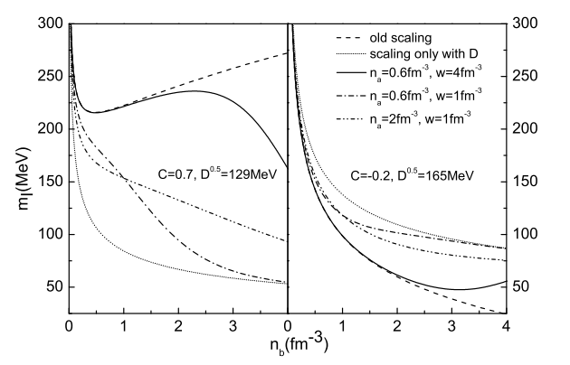

Slide 13
properties of strange quark matter
we can know m_i when n_b is set.
as long as we get the chemical potential, we can calculate all these thermodynamic quantities

Slide 14
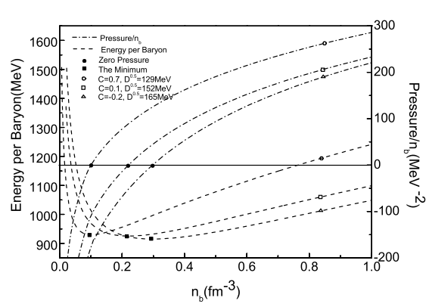
properties of strange quark matter

Slide 15
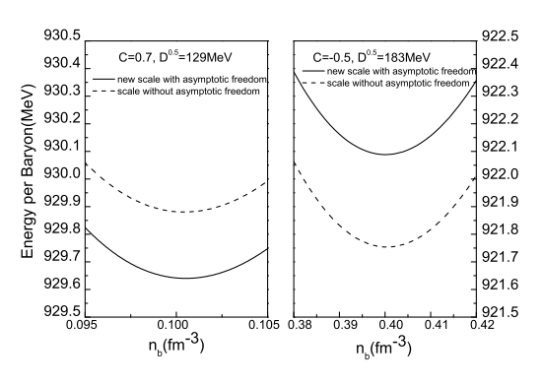
comparison between new and old scaling
repulsive
attractive

Slide 16
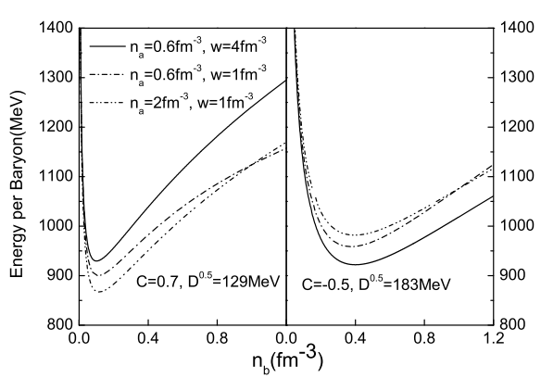
repulsive
attractive

Slide 17
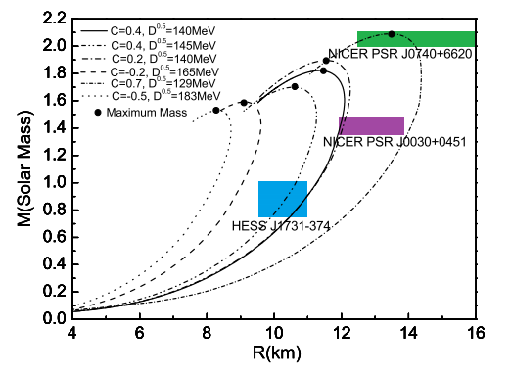
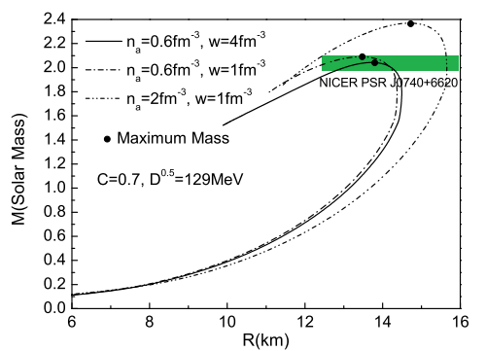
calculation results of strange star
TOV equation

Slide 18
thanks

