Slide 1
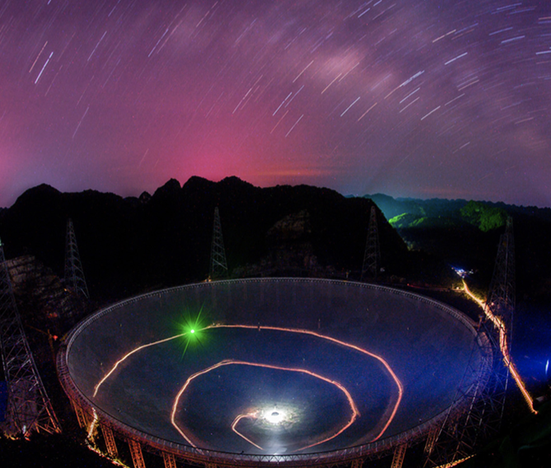
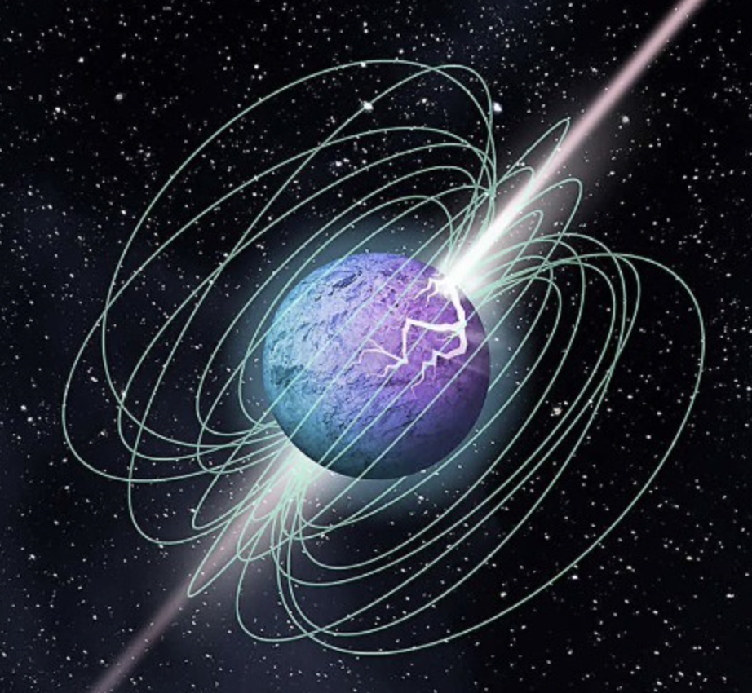
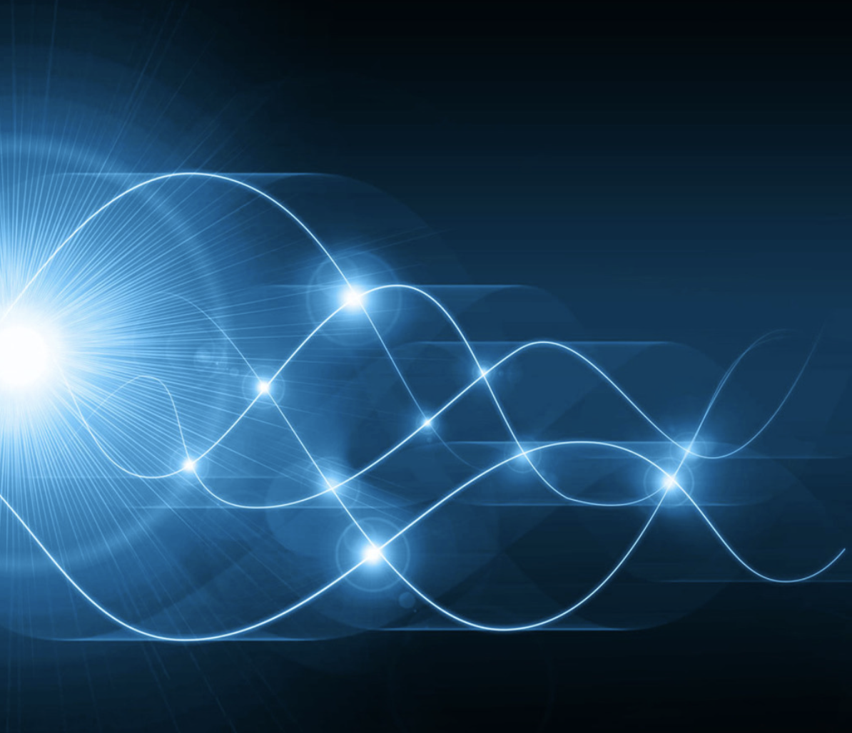
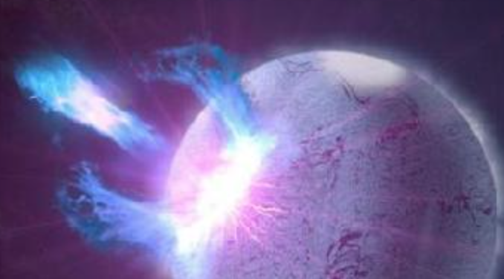


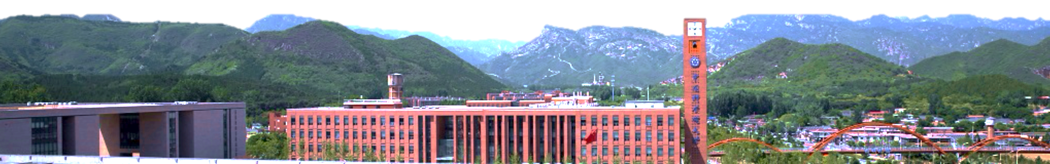
Implications of narrow band emission: Quake induced FRB?
Speaker: Weiyang Wang（王维扬）
University of CAS
School of Astronomy and Space Science
2023.9.26@Yangzhou

Slide 2

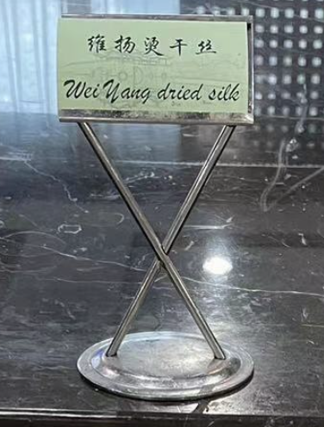

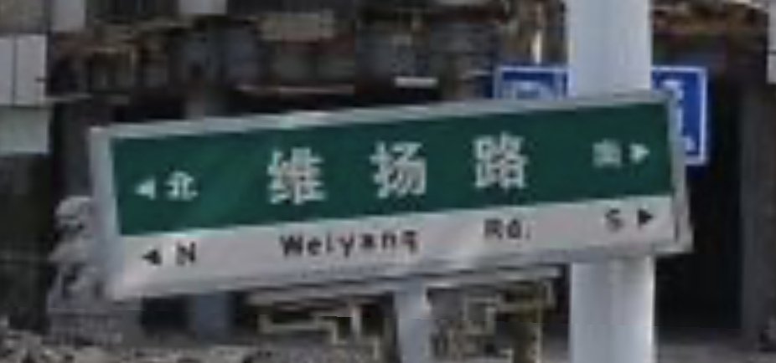
《书．禹贡》: 淮海惟扬州。惟，通'维'
Weiyang is an alternative name of Yangzhou

Slide 3
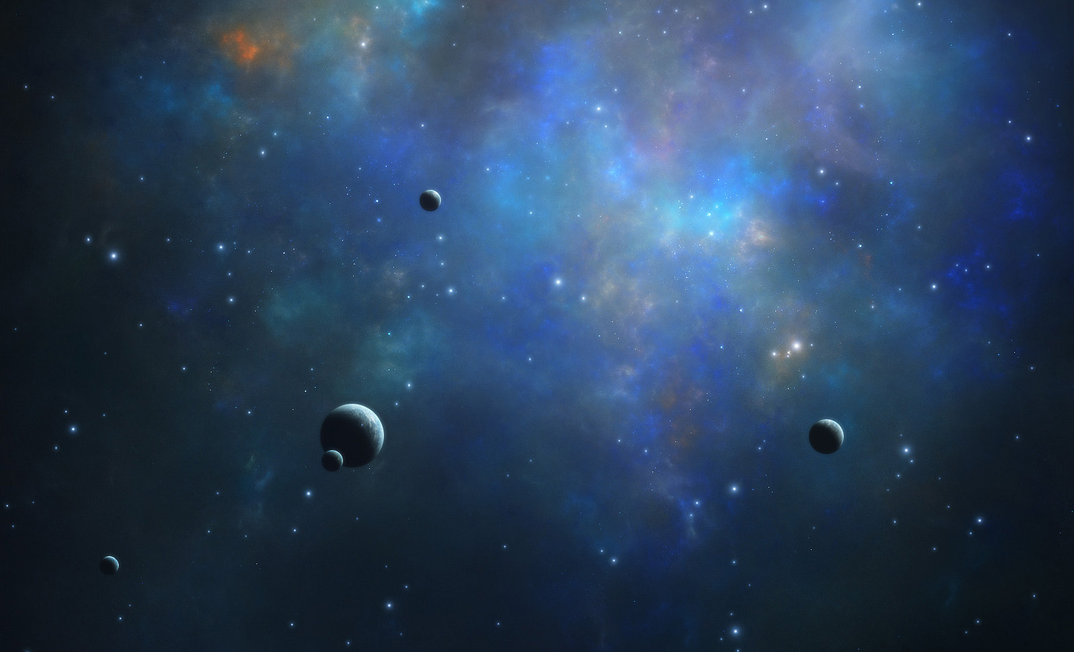


OUTLINES
Background
Compact Starquake
FRB emission
Summary

Slide 4
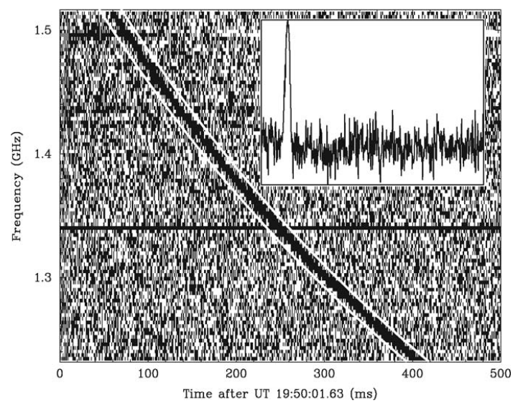
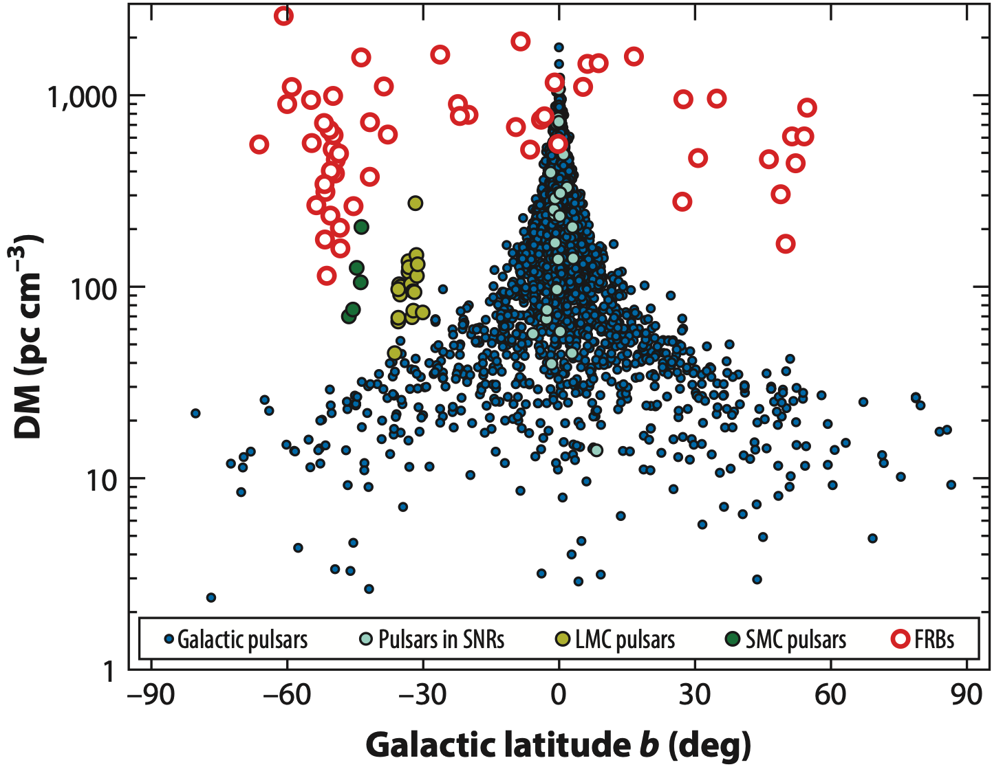

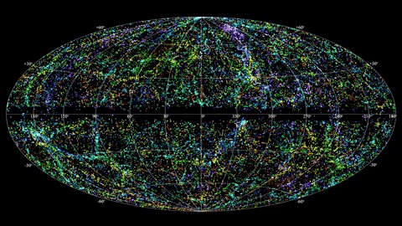
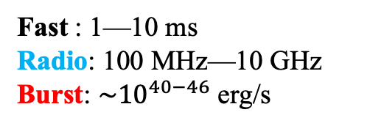
Discovery
FRB 010724
Fast : 1—10 ms
Radio: 100 MHz—10 GHz
Burst: ${\sim 10}^{40−46}$ erg/s
700+ FRB sources
60+ repeaters
Lorimer et al. 2007, Science

Slide 5
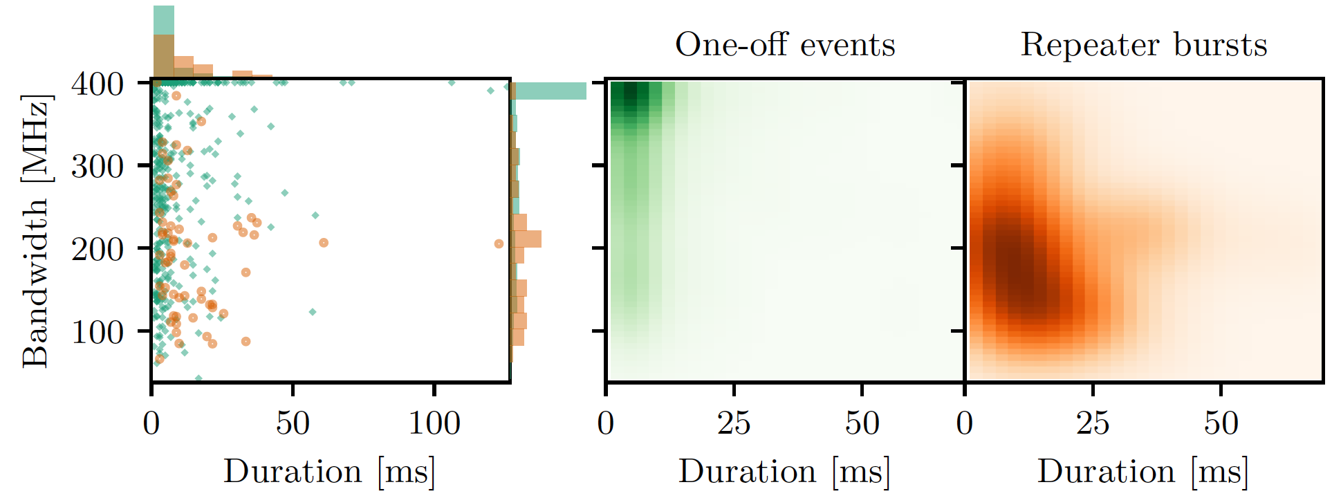
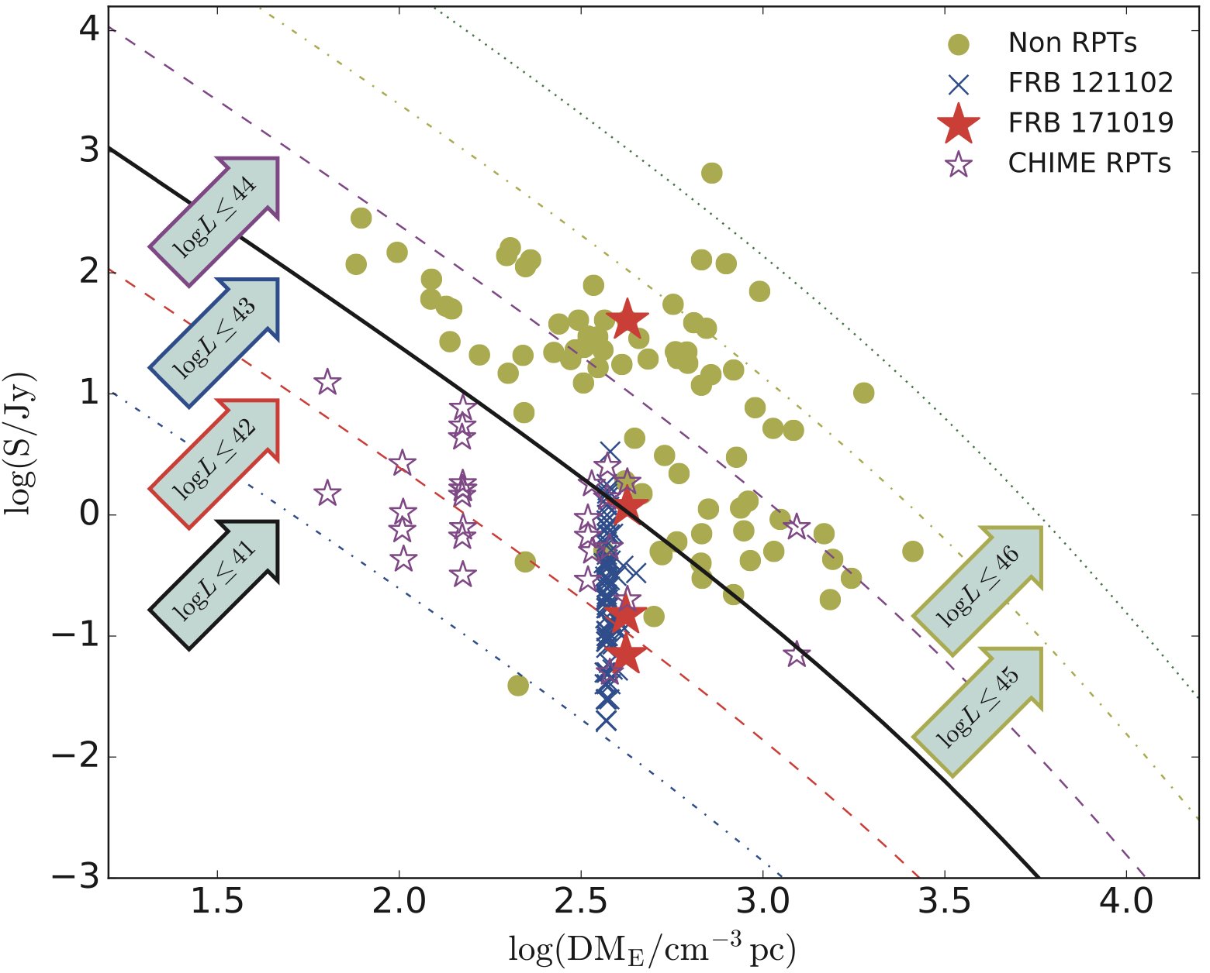

Repeating FRB
Repeaters favor narrowband and long duration
Pleunis et al. 2021, ApJ
Same
Different
Open question: whether all can repeat?
Jiang et al. 2020, RAA

Slide 6
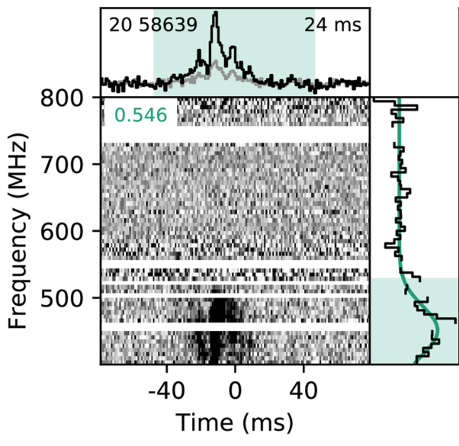
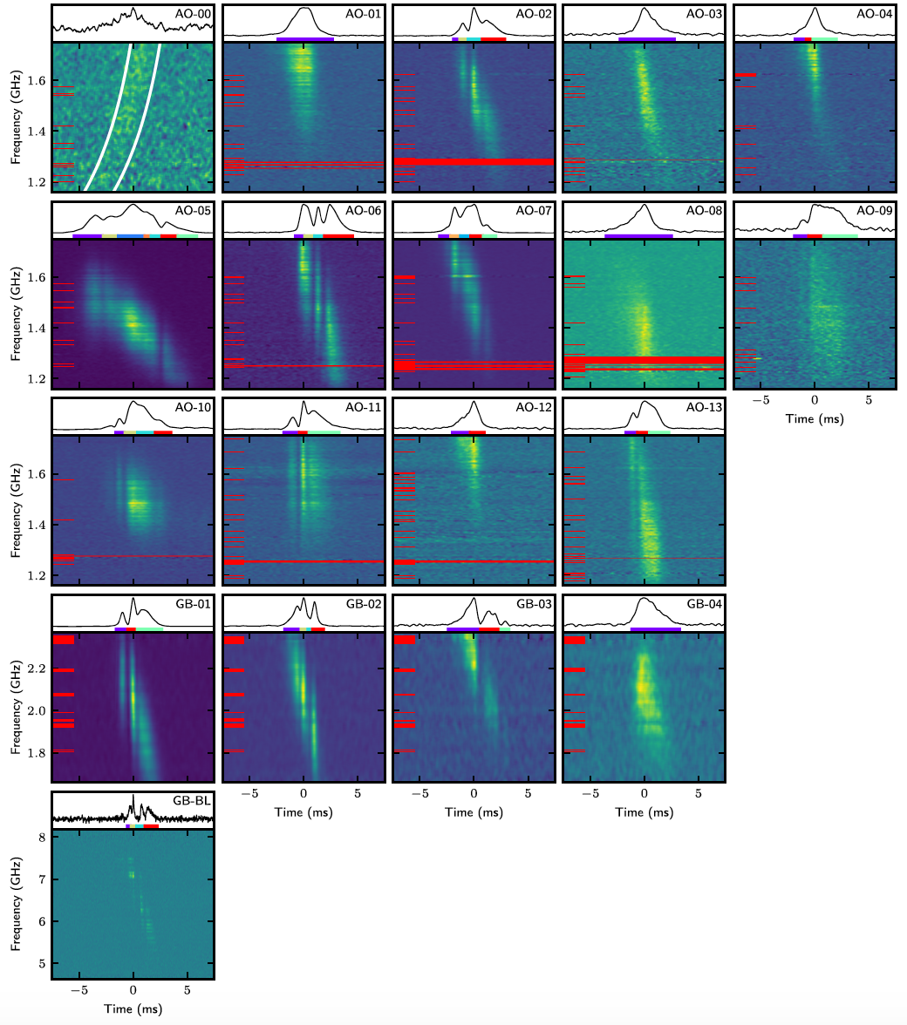
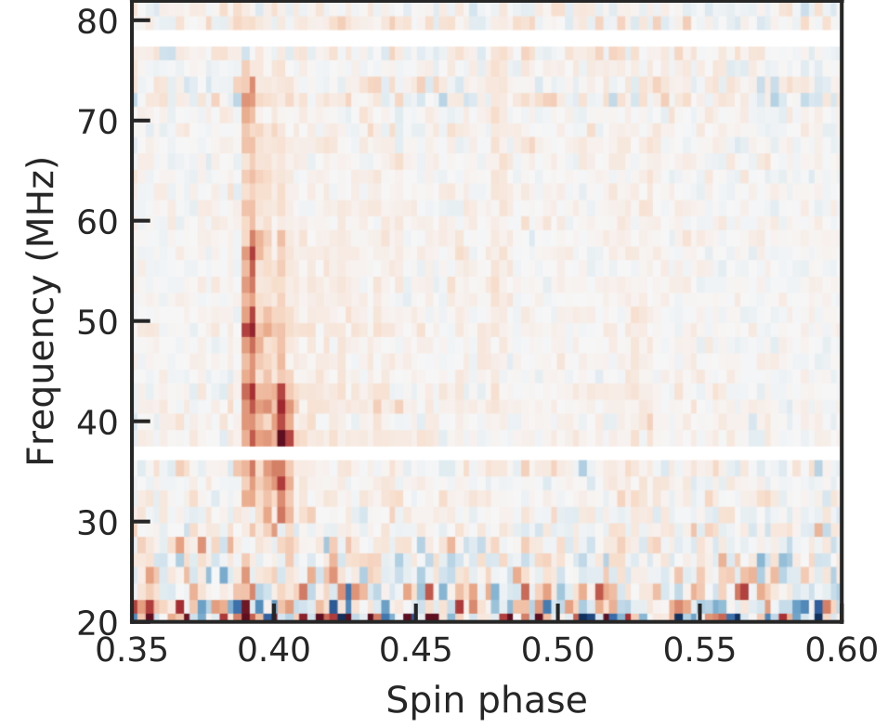
Drifting pattern of repeater
Upwards drifting pattern
Bilous et al. 2022 A&A
Downwards drifting pattern
Hessels et al. 2019, ApJ
Drifting pattern in PSR B0950+08

Slide 7
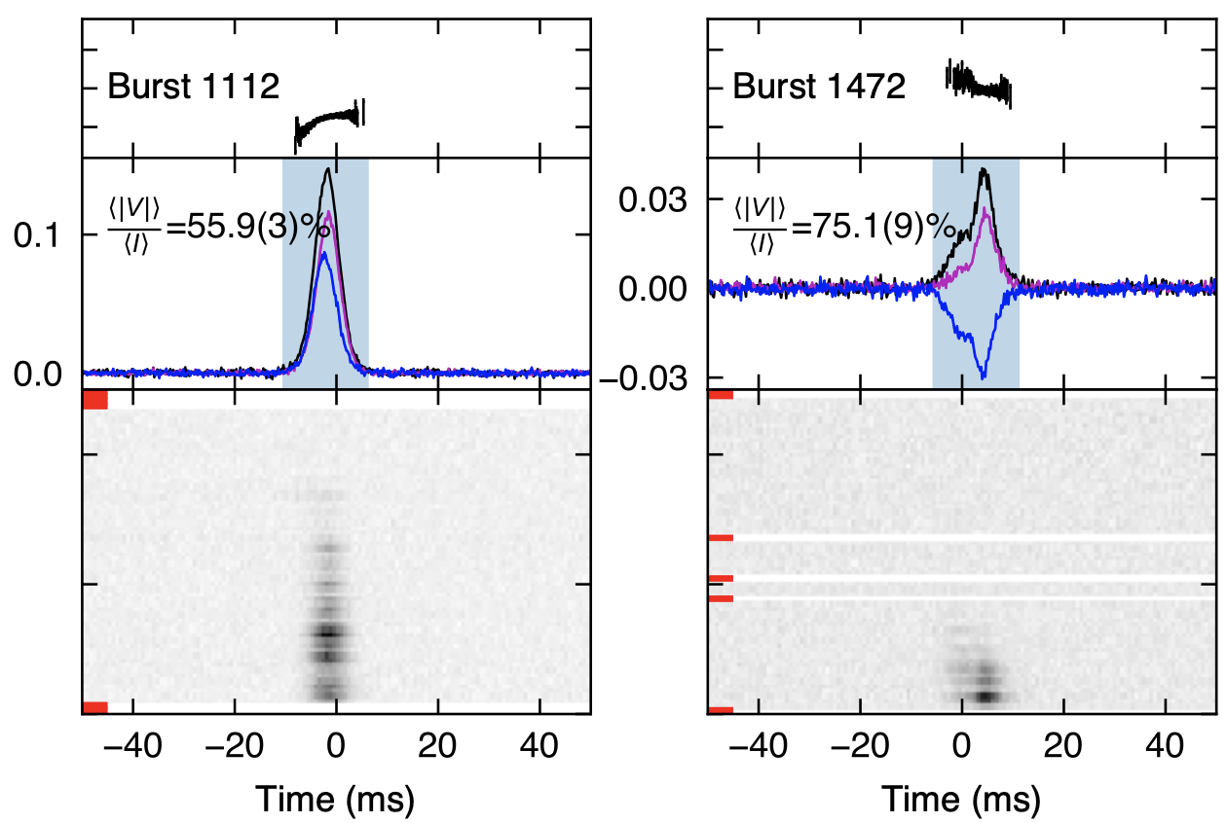
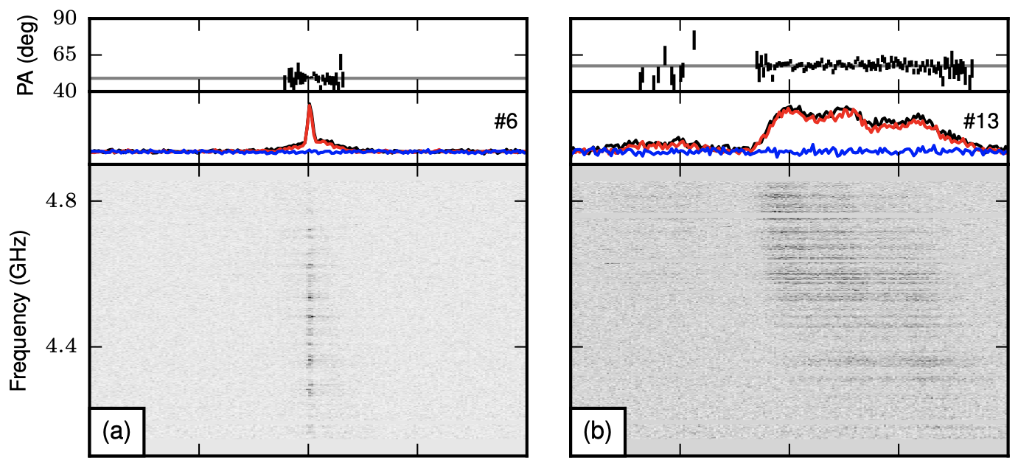
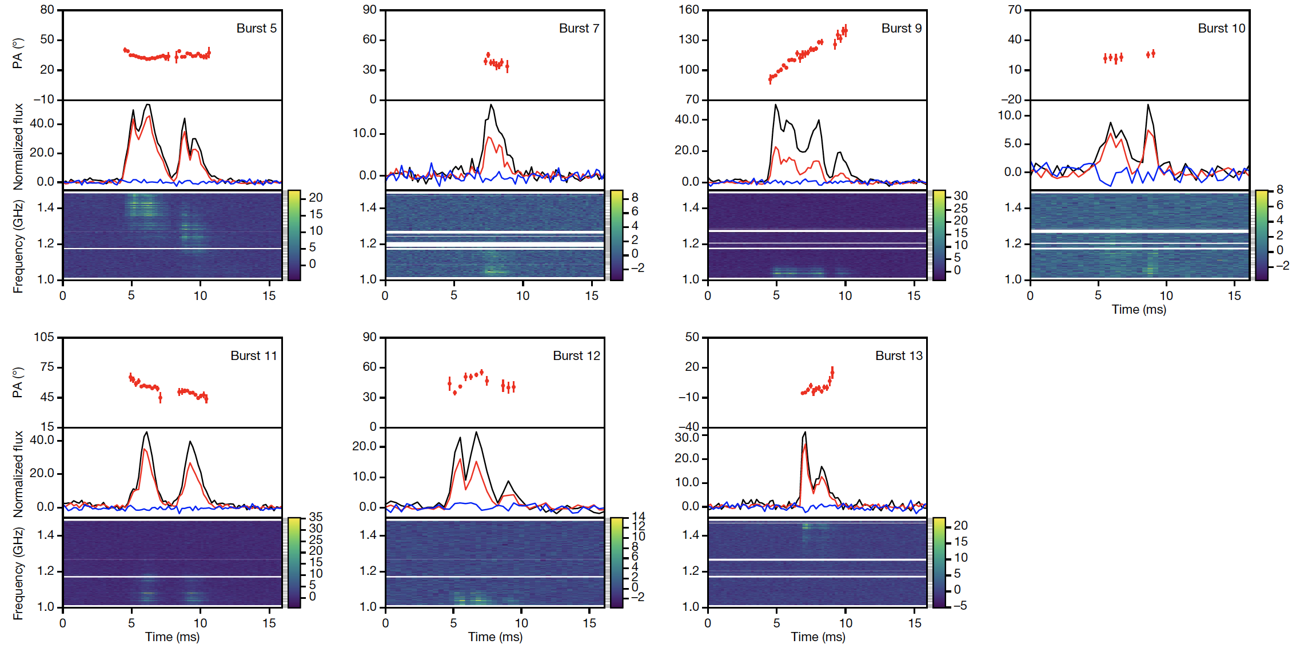
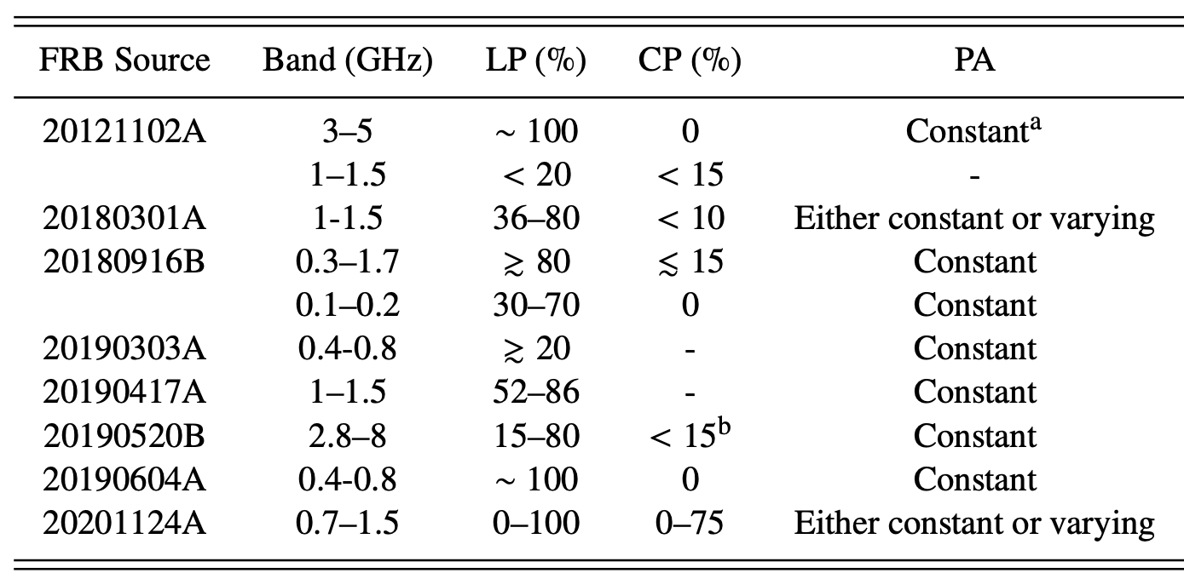
Polarization of FRB
Linear polarization (LP)
Circular polarization (CP)
FRB 20121102A
FRB 20201124A
Xu et al. 2022, Nature
Michilli et al. 2018, Nature
FRB 20180301A
Luo et al. 2020, Nature

Slide 8
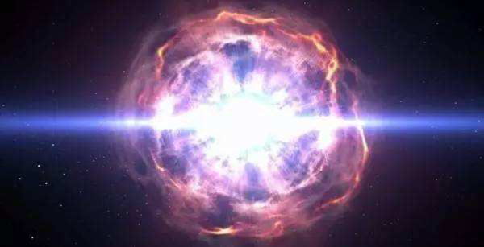
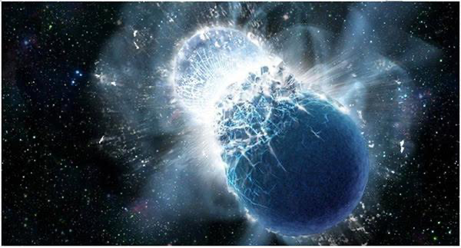
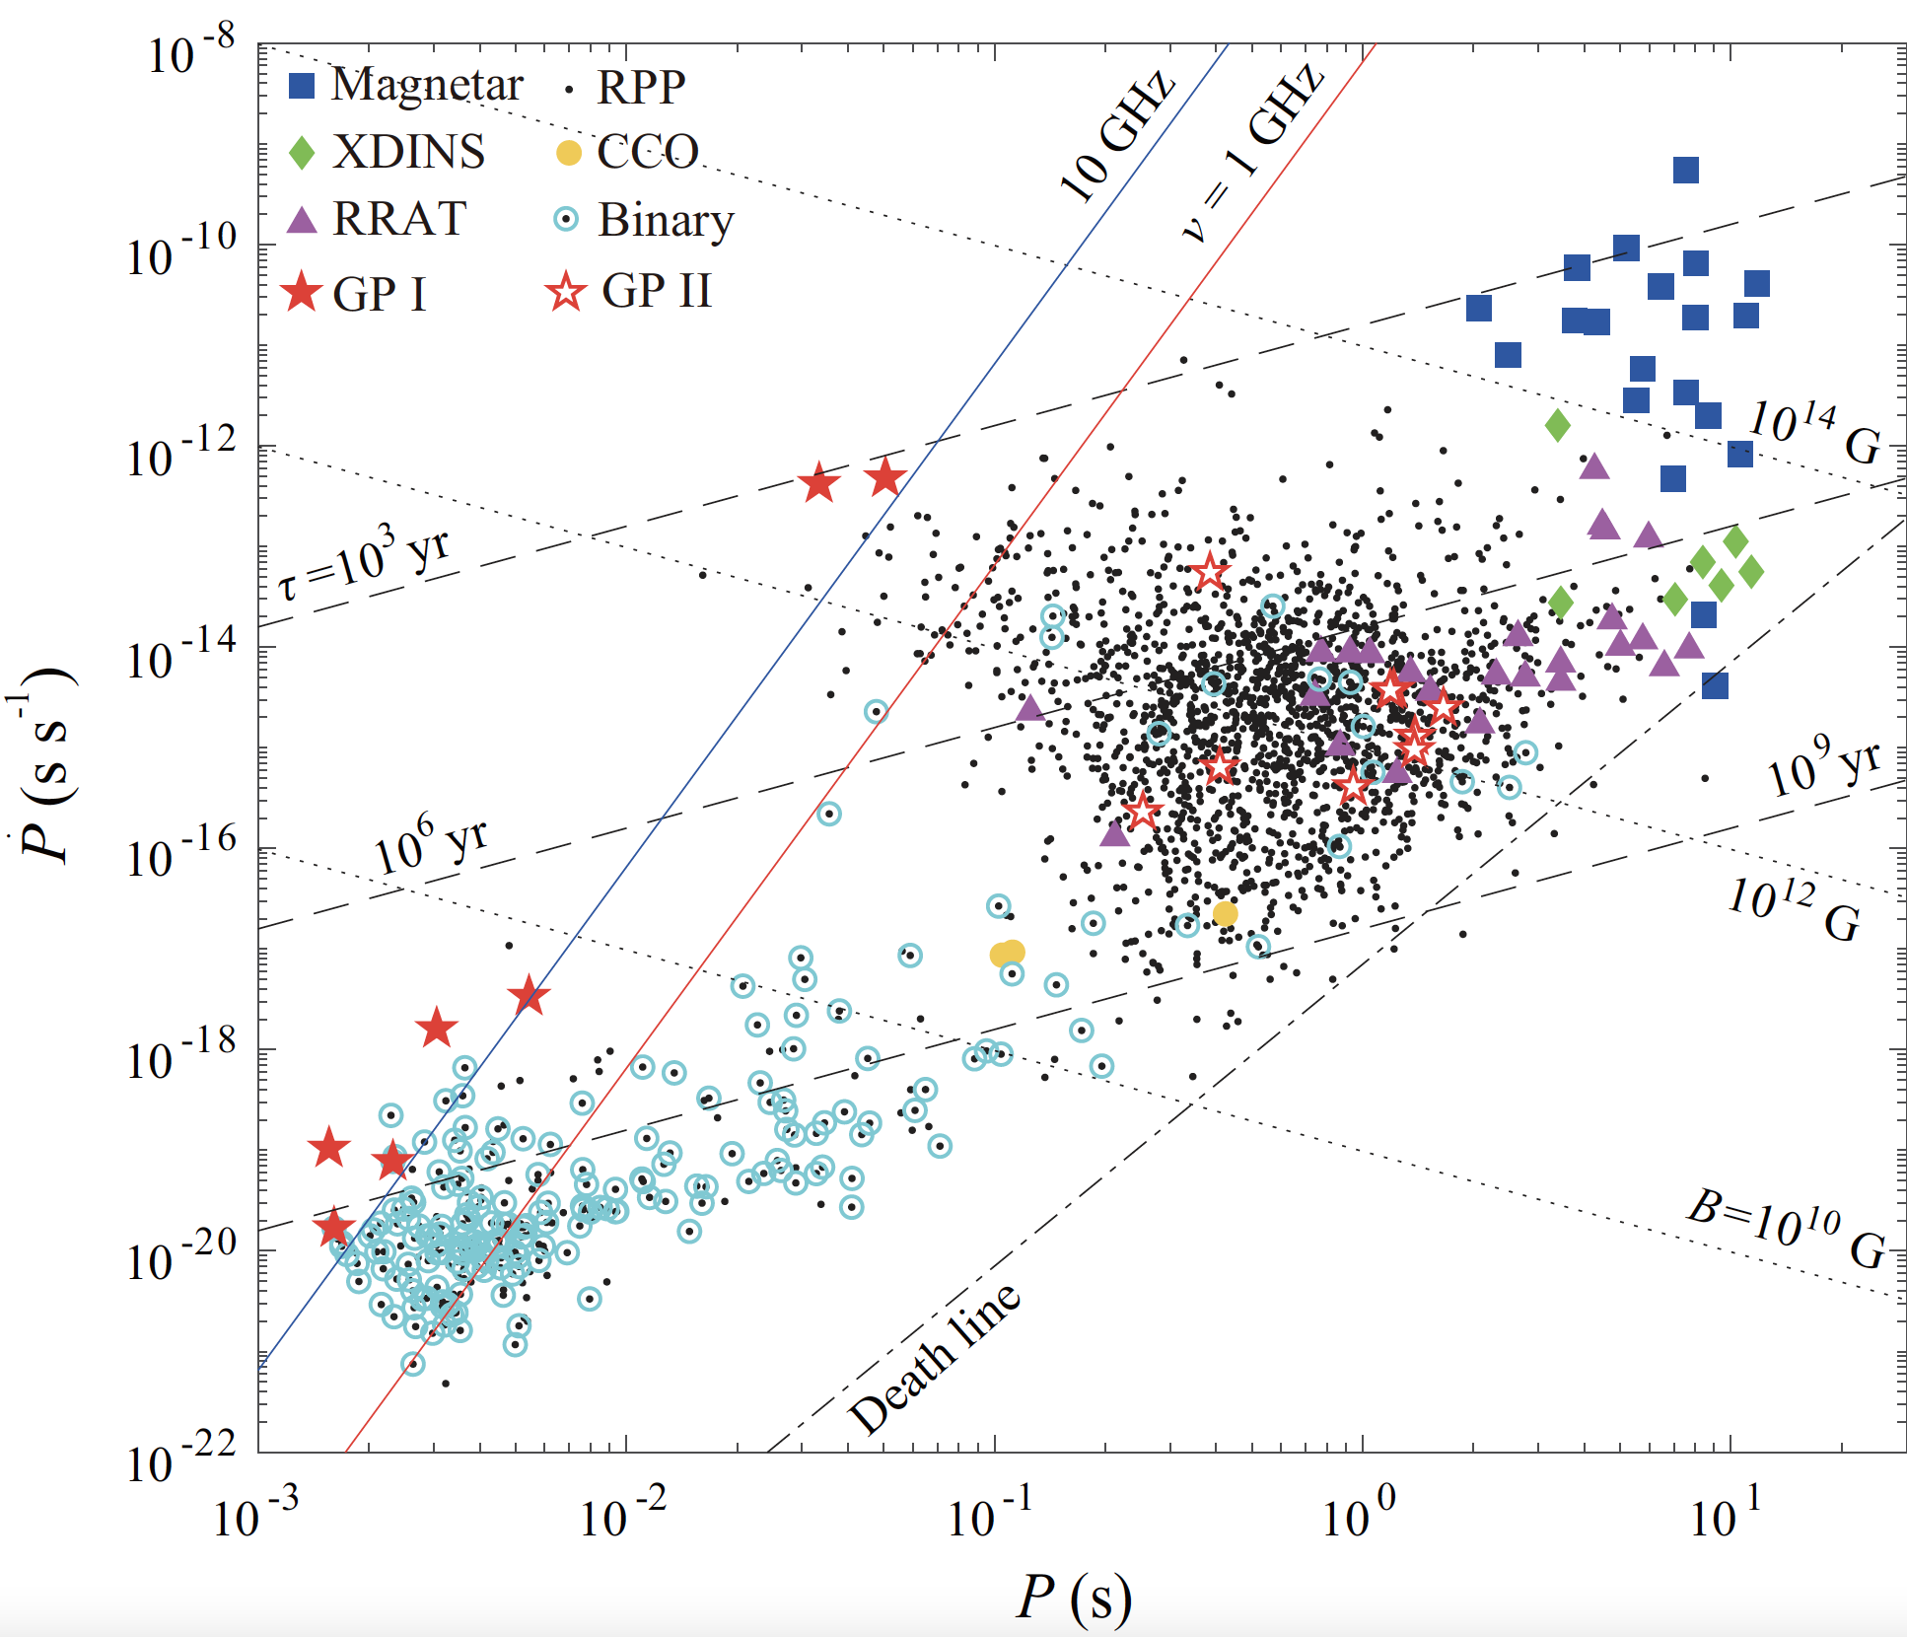
What are they?
Supernova?
Compact stars merger?
Both cases are one-off event
Key question:
How to trigger FRB?
What is the radiation mechanism?

Slide 9
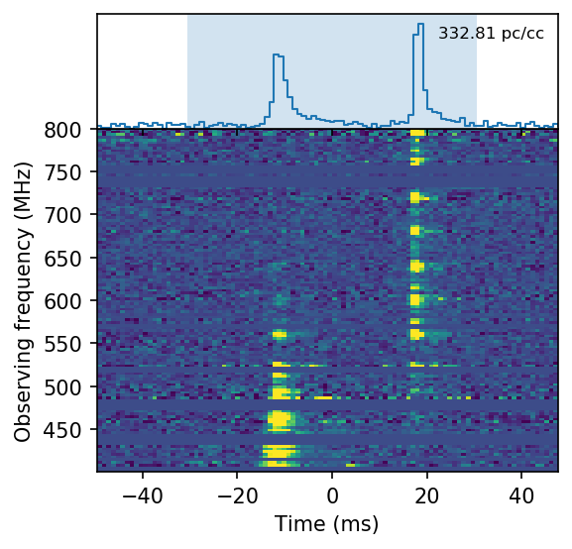
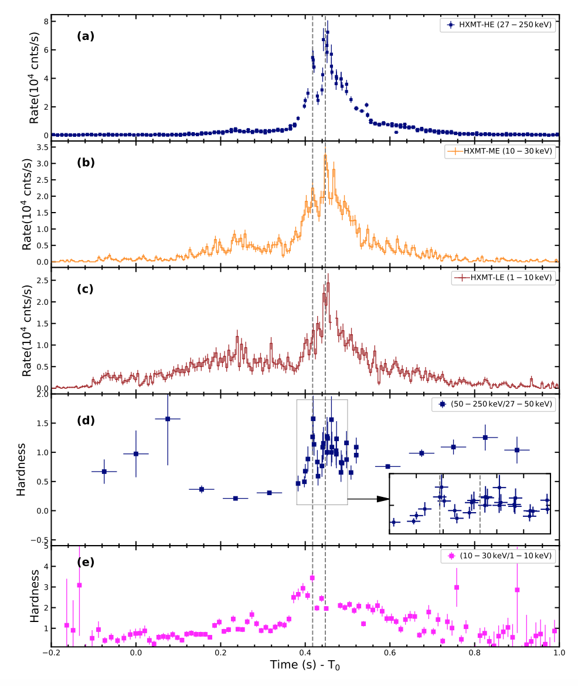
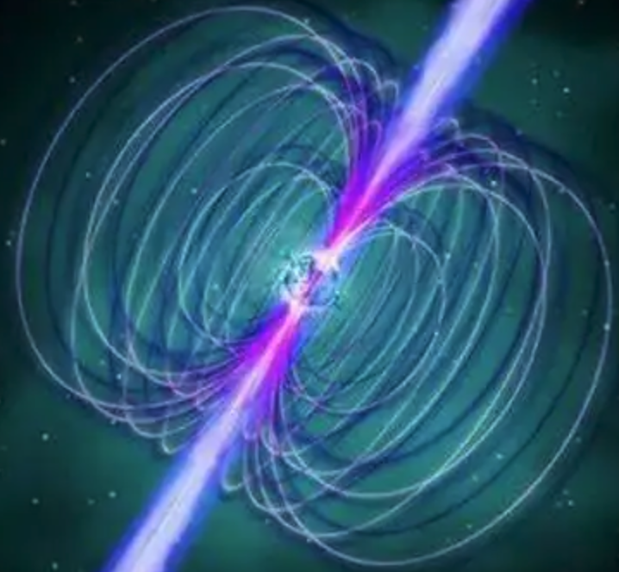
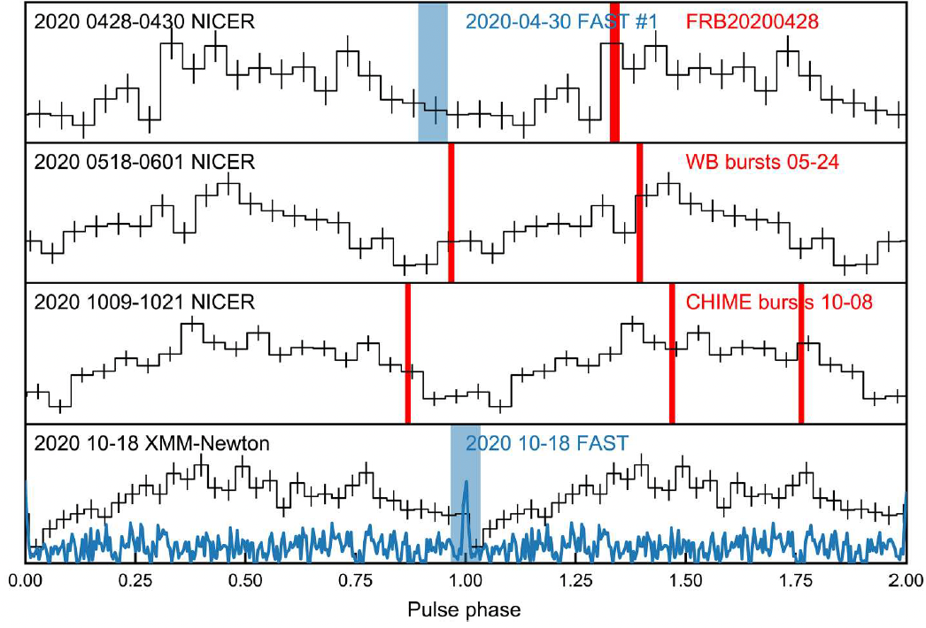
Magnetar radio burst
April 28, 2020
SGR 1935+2154
X-ray Bursts Counterpart
Becomes a radio pulsar after X-ray bursts
CHIME/FRB Collaboration, et al. 2020, Nature;
Li et al. 2021, NA; Zhu et al. 2023, SciA
Notes:
Only downward drift…
The propagation effect is challenged by why such structures are favored in repeaters.

Slide 10
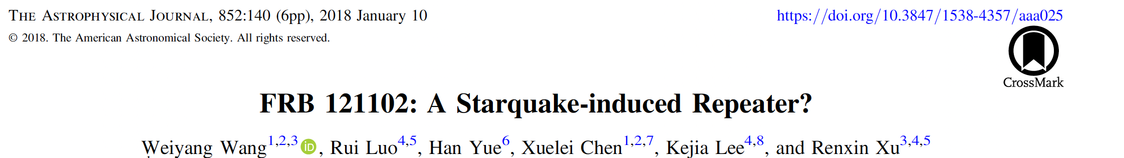
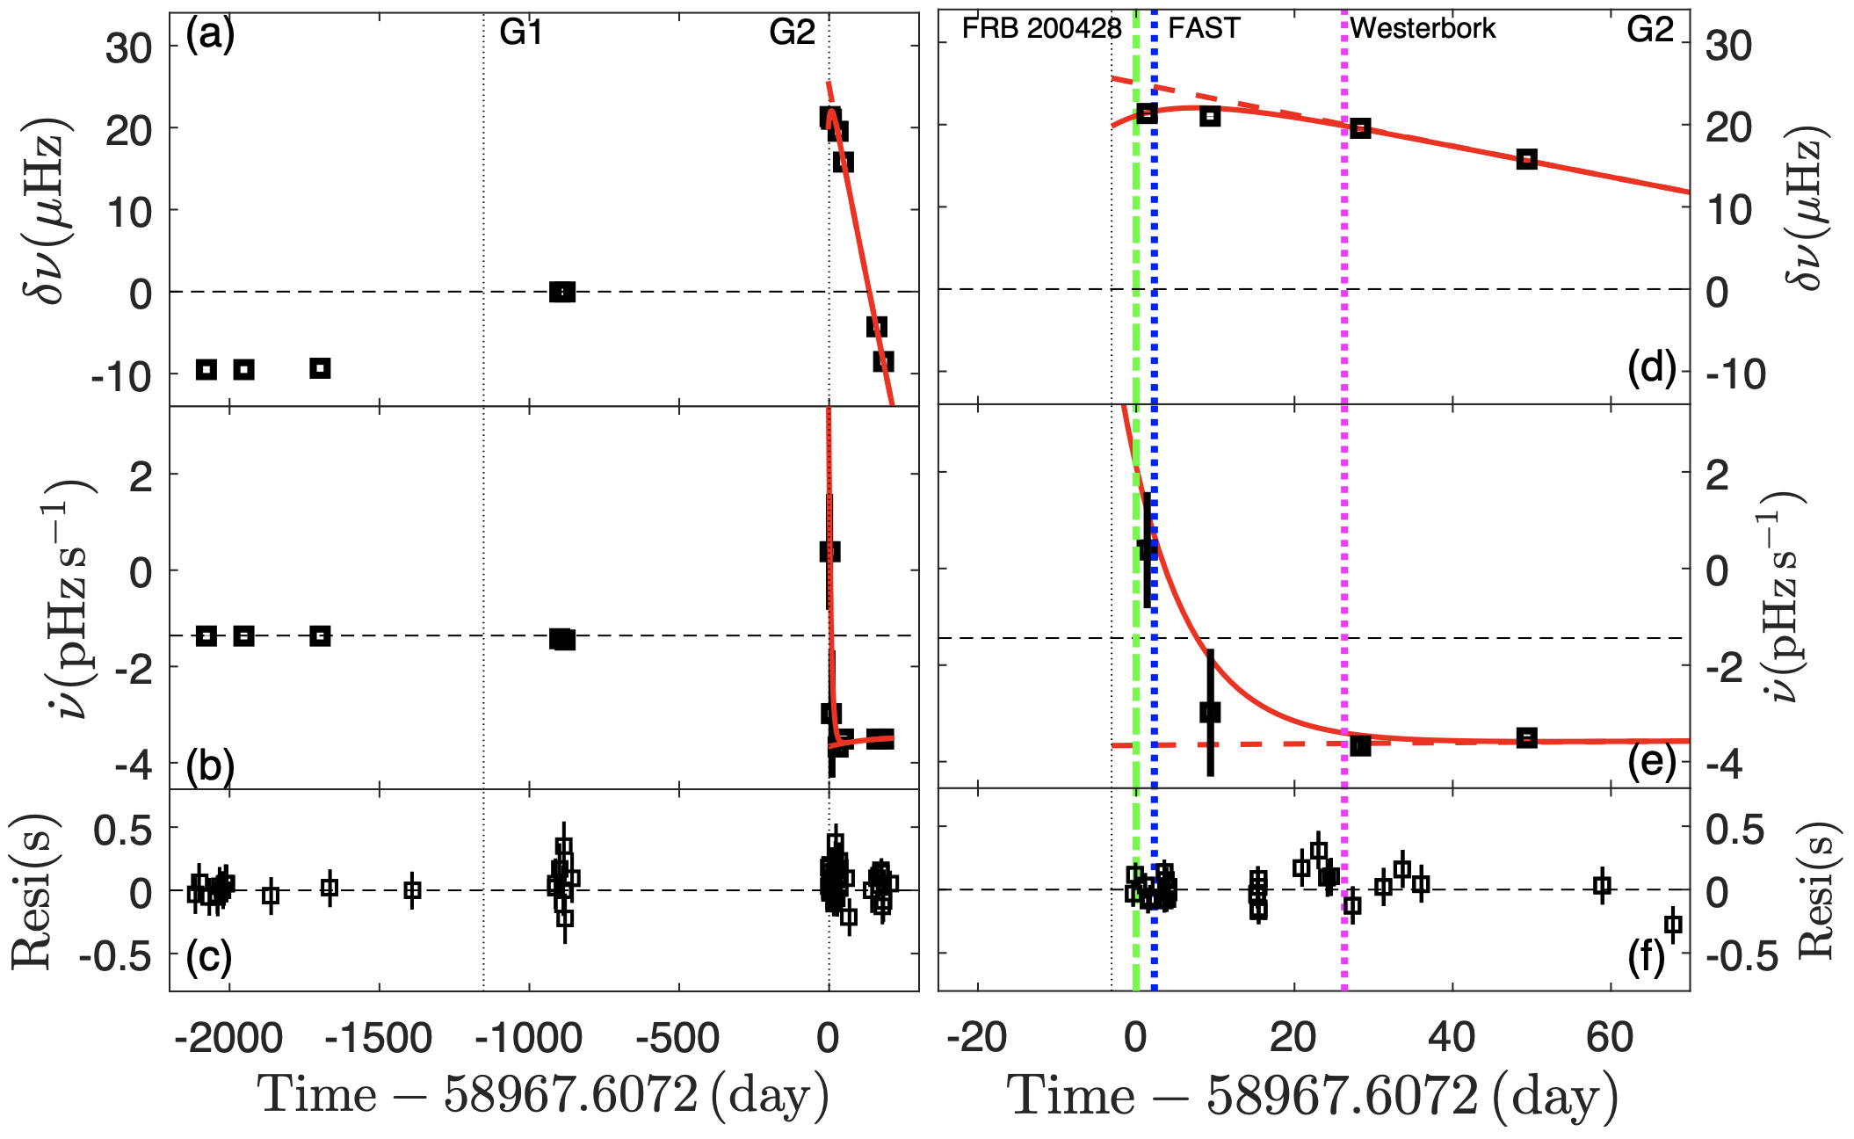
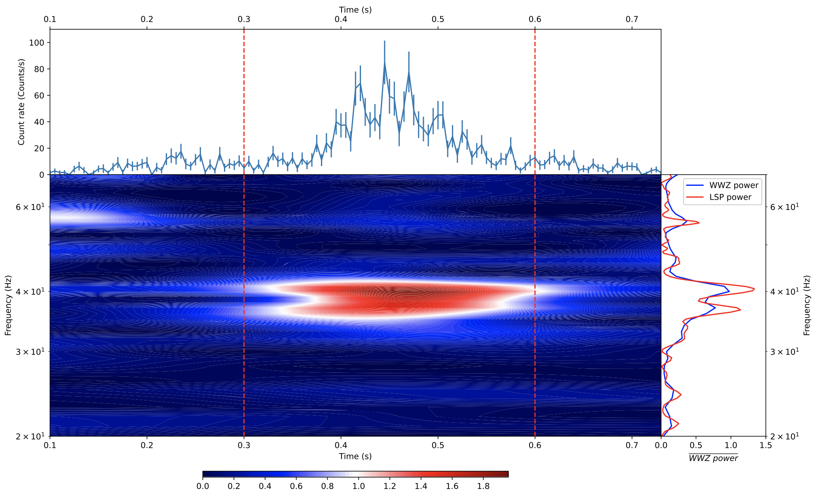
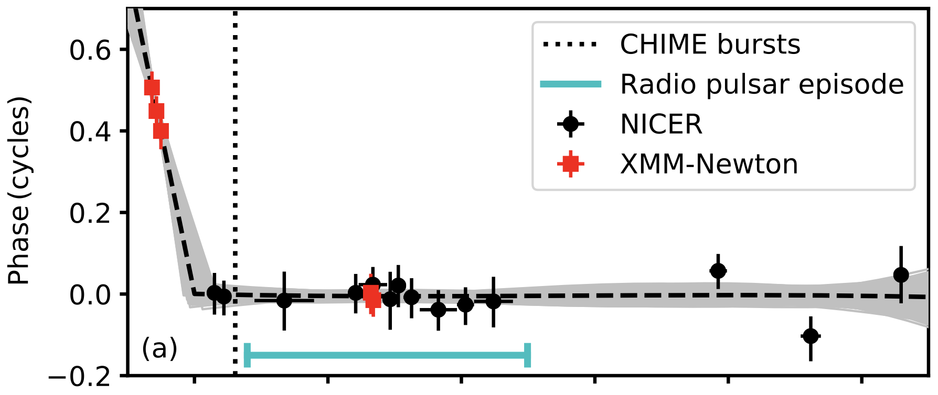
Starquake in SGR J1935+2154
Glitch and Quasi-periodic Oscillations ?
QPO of SGR J1935+2154
Li et al. 2022, ApJ
Glitches before FRBs
Ge et al. 2022, arXiv:2211.03246;
Younes et al. 2022, NA
Notes:
Only downward drift…
The propagation effect is challenged by why such structures are favored in repeaters.

Slide 11
Starquakes trigger FRB
u
d
s
u
d
s
FRB 20121102A
√ Gutenberg–Richter law: power law distribution of quake magnitude.
√ Omori law: the frequency of aftershocks decreases roughly with the reciprocal of time after the main shock.
Statistical independence,
Nonlinear coherent growth,
Random rise times.
Earthquake
Starquake
Wang et al. 2018, ApJ
Notes:
Self-organized criticality

Slide 12
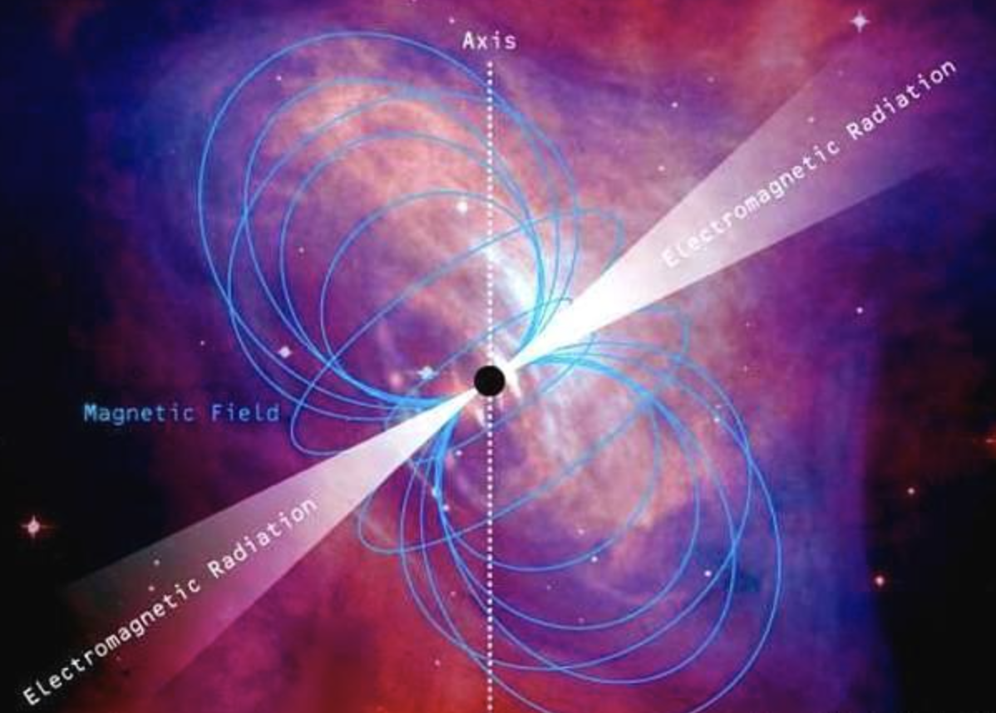
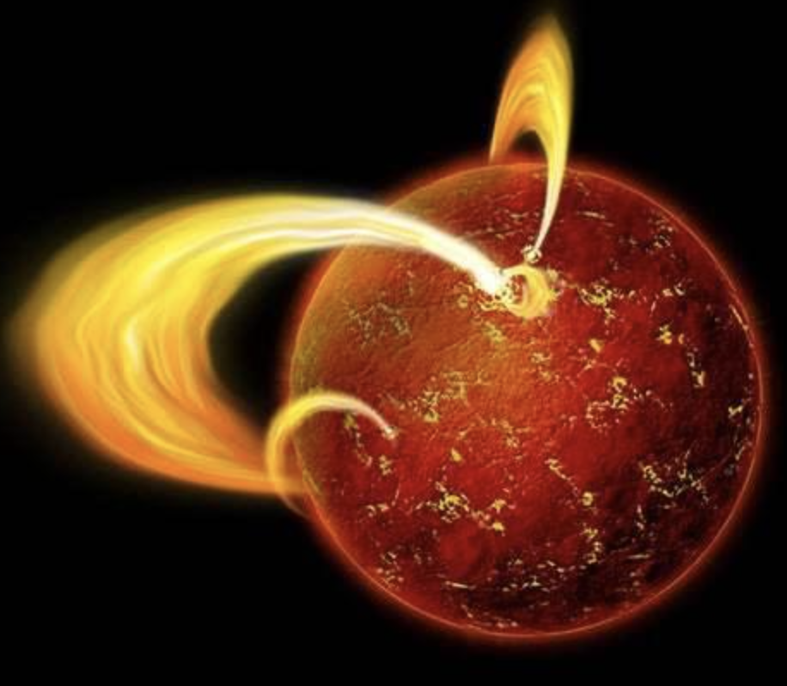
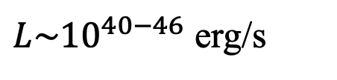
Starquakes trigger FRB
Energy budget:
${L\sim 10}^{40−46}$ erg/s
Magnetic energy, Elastic energy, or Gravitational energy
Spin-down power is not enough
Long time accumulate

Slide 13
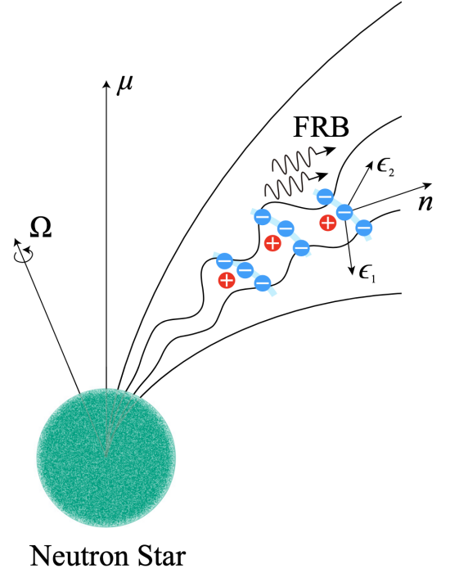
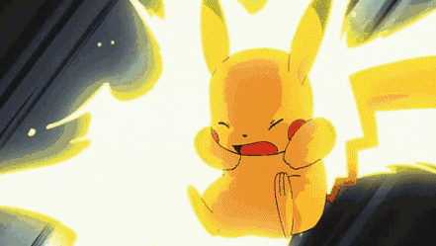
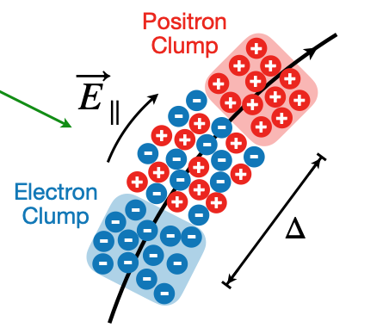
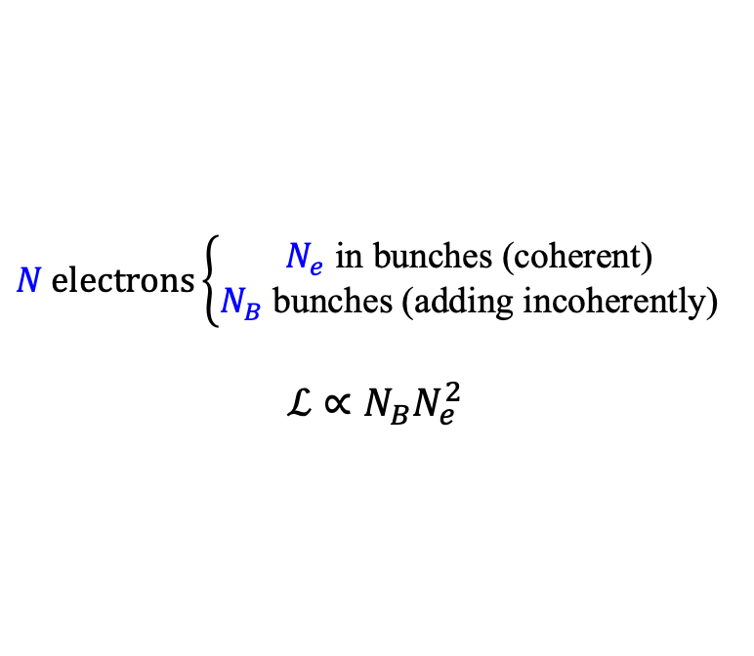
Relativistic charge radiation
$$N electrons\left\{\begin{aligned}N_{e} \text{in} \text{bunches}\text{ (}\text{coherent}\text{) } \\ N_{B} \text{bun}\text{ch}\text{es}\text{ (}\text{adding} \text{incoherently}\text{) }\end{aligned}\right.$$
$$ℒ∝N_{B}N_{e}^{2}$$
Cyclotron cooling very fast
Charges can not move across field lines
Accelerate charges
Decouple

Slide 14
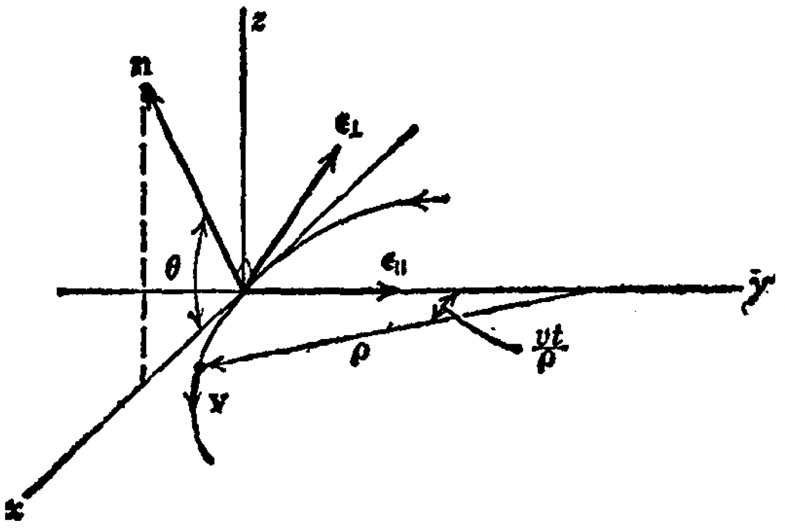
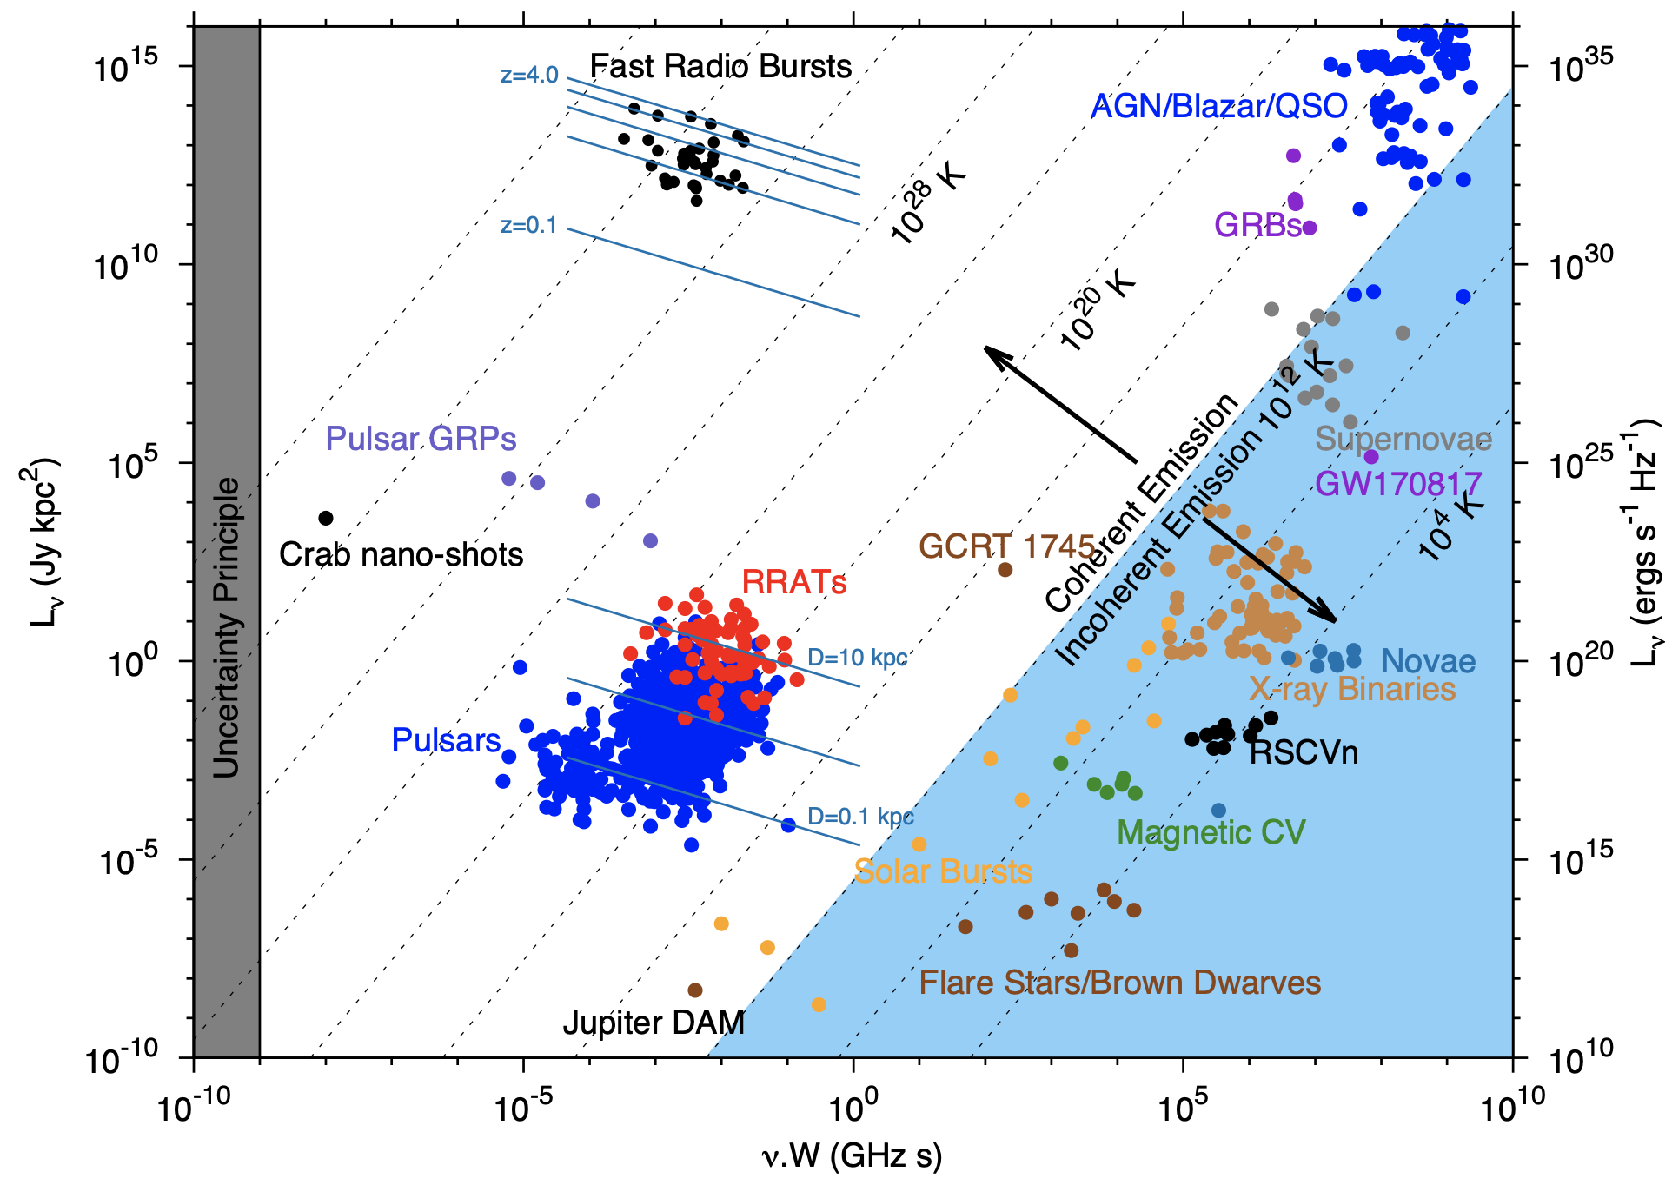
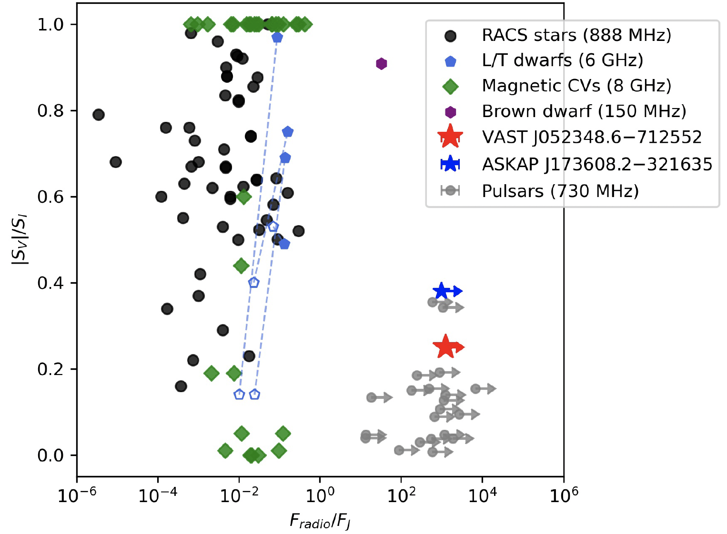
Relativistic charge radiation
Relativistic charges’ emission prefers:
High luminosities
Linear polarization
Keane 2019, arxiv

Slide 15
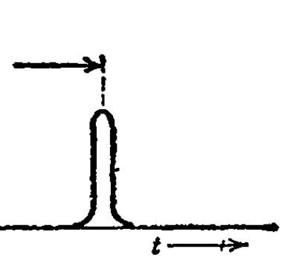
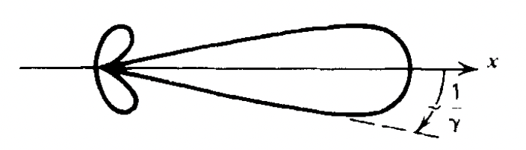
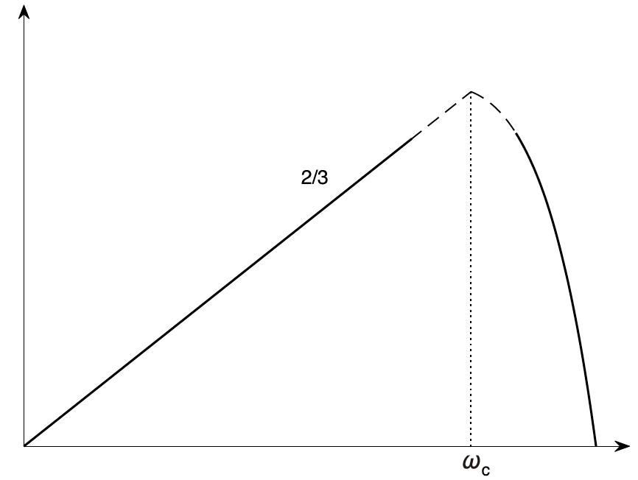
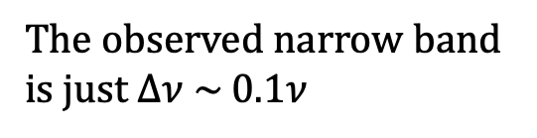
Relativistic charge radiation
Fourier transform
Beamed radiation
A wide-band emission
Wideband in log-log plot
The observed narrow band is just $Δν \sim 0.1ν$

Slide 16
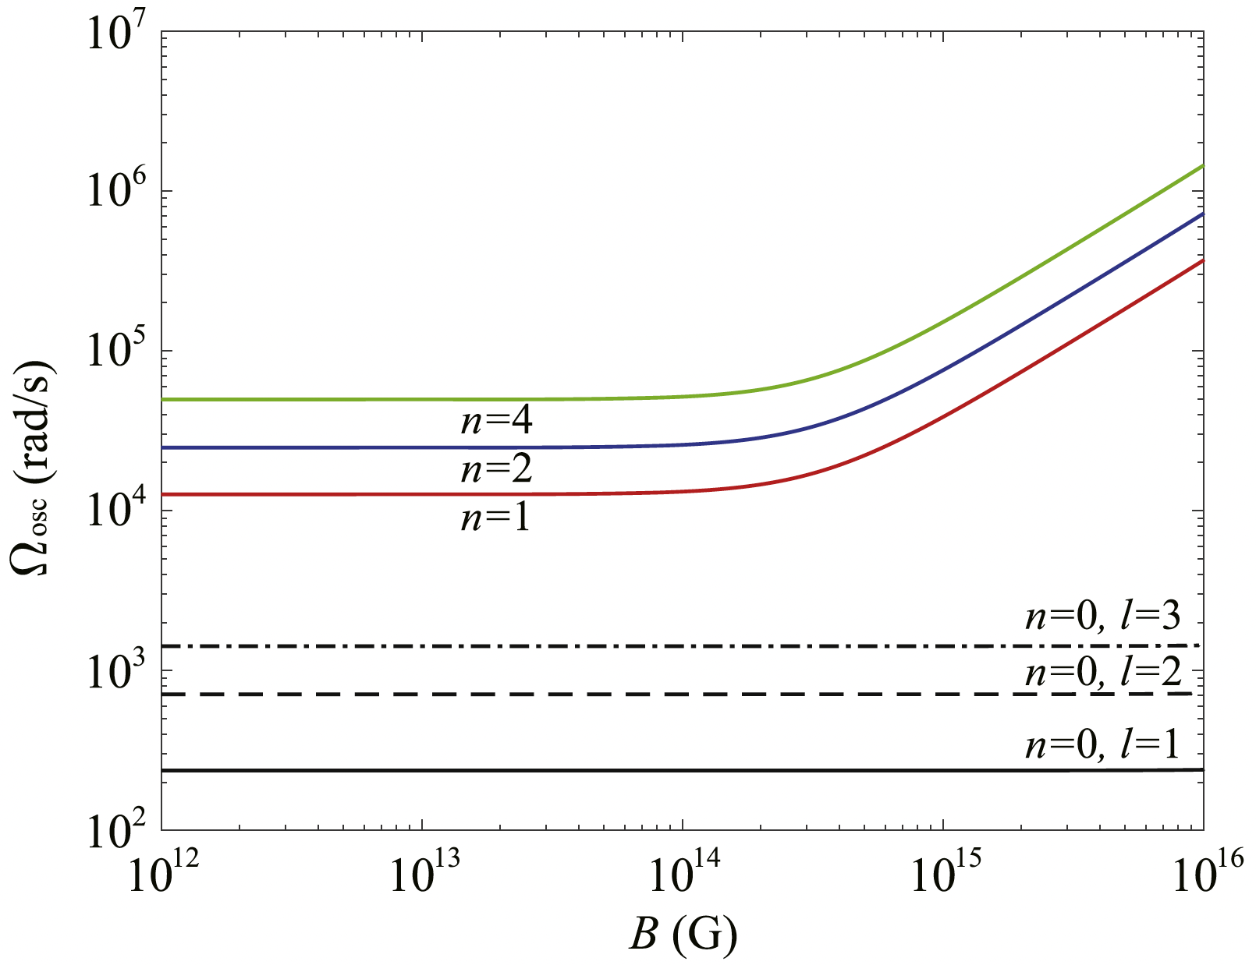
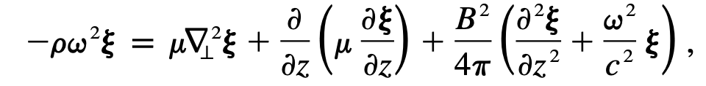
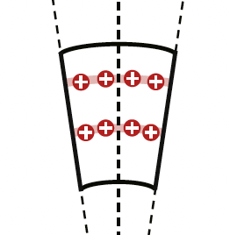
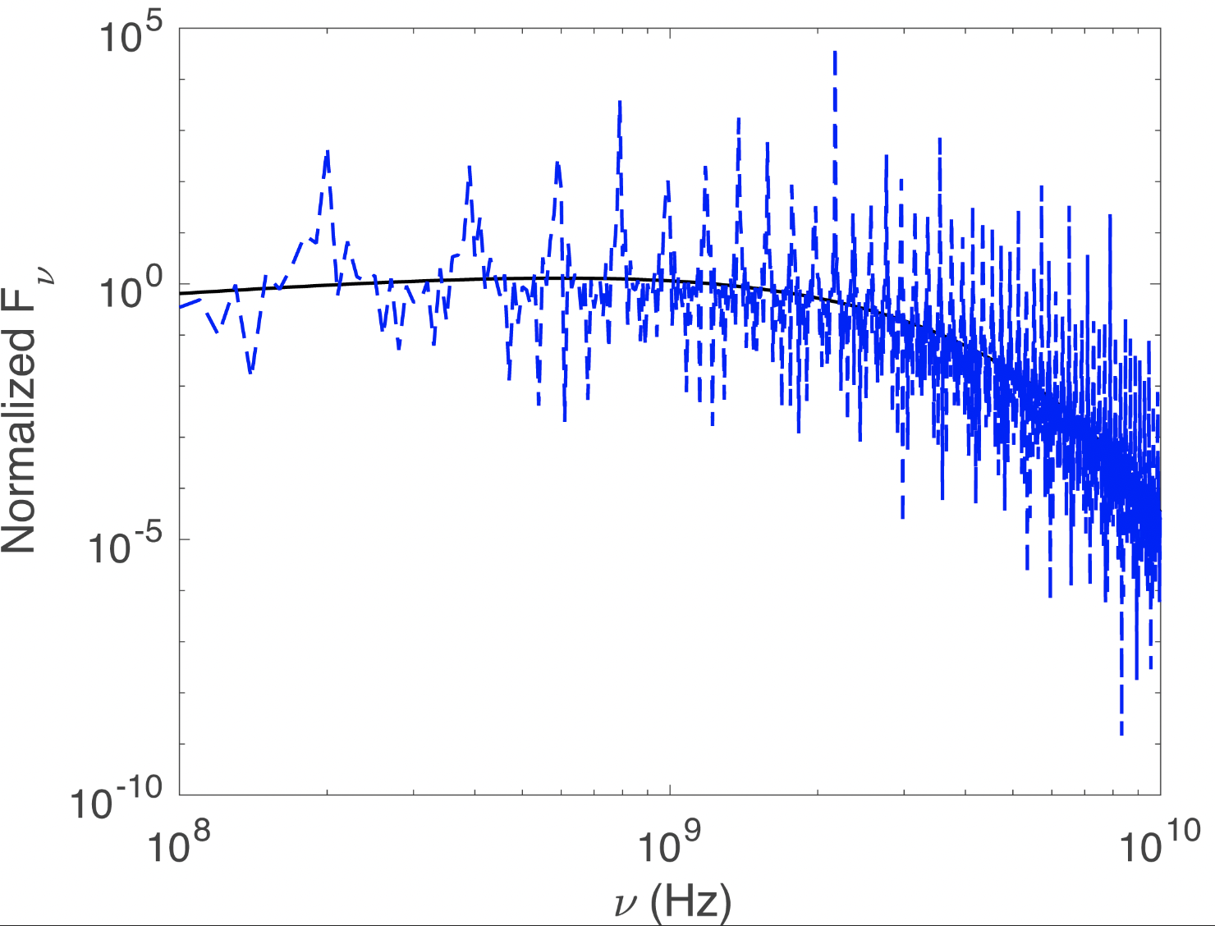


Bunches structure
Magnetic reconnection on the surface may let the bunch quasi-periodically distributed.
Curvature radiation + Bunch distribution
Wang et al. coming soon

Slide 17






Polarization for bunches
On-beam: $φ<θ_{b}$
Off-beam: $φ>θ_{b}$
“thin” bulk
Whole beam
“thick” bulk
Part beam
$$φ_{t}=0.1/γ$$
$$φ_{t}=1/γ$$
$$φ_{t}=10/γ$$
<V/I> = 54%
<V/I> = 38%
<V/I> = 0%
Off-beam:
High CP fraction
Flux are smaller
We calculated circular polarization before discovery
Wang et al. 2022, MNRAS
Notes:
No CP was detecting in repeating FRBs before our paper submitted.

Slide 18





Variety of polarization
Observation
Simulation
Kumar et al. 2022, MNRAS
Xu et al. 2022, Nature

Slide 19





Pulse to pulse drift structure
Best fitting index: 2.29
For a constant Lorentz factor
Wang et al. 2022, ApJ
Wang et al. 2019, ApJL

Slide 20

Radius-to-Frequency Mapping
Observation: ～100 MHz-10 GHz
Dipole: > 1000 R
Quadrupole : 10-100 R
Wang et al. 2020, ApJ;
Wang et al. 2022, ApJ
Dipole
Quadrupole
Notes:
The drifting pattern of FRBs reflects the radiation frequency change with the location in the magnetosphere, the so-called “radius-to-frequency mapping”

Slide 21
Summary
Thanks!
Starquake from magnetar can provide the energy budget required by FRBs. The quakes are proposed as the trigger mechanism of FRBs.
Narrow band emission may be due to the bunch distribution. A global oscillation during starquakes seems to create Alfven wave, which frequency may be reflected from the spectrum.
A variety of polarization properties can be well understood within the bunched curvature radiation.
Drifting pattern is a natural consequence of multi-bulk of bunches observed in magnetosphere.

Slide 22




Backup slides
Intrinsic mechanism: coherent CR, maser type etc.
Radiative transferring
Multi-path effect (depolarization maybe)
Notes:
but with noticeable differences.

Slide 23


Backup slides
“thin” bulk
VS
“thick” bulk
Only part radiation beam can be seen
FRBs prefer “thin” bulk because there is no significant trend between CP and width
VS
What I see in the frame of beam
Wang et al. 2022, MNRAS
Notes:
The “thickness” here is determined by radial and transverse observing time rather than the true spatial size for the two dimensions. So the“thick” and “thin” cases here are of the visual effects from an observer, not representing the intrinsic geometry of the bulk itself. If the angle \rad is almost constant, a “thick” bulk would be observed for a rapidly spinning object, while a “thin” bulk would be observed for a slowly spinning one.

Slide 24




Backup slides
Detailed calculation can be seen in
Wang et al. 2022, ApJ
Several equations easy to get

