Slide 1



Some aspects of quark matter in a strong magnetic field
Xin-Jian Wen (温新建)
Shanxi University
2023-9-25 Yangzhou

Slide 2
Outline
Chiral transition in strong magnetic fields
The role of anisotropic compressibility in chiral transition
Anisotropic surface tension of quark matter
summary

Slide 3


1 Chiral transition in strong magnetic fields
Lagrangian density of the two-flavor NJL model is given by
Without anomalous magnetic moment
Covariant derivative
With AMM
In the mean-field approximation
2023/9/25

Slide 4
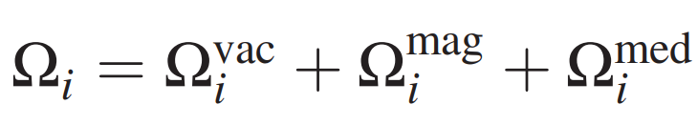

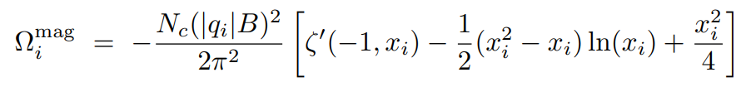


Magnetic-field-independent regurization of the divergence
The thermodynamical potential
Vacuum
$$Ω_{i}$$
Magnetic field
The separation of the divergent vacuum and finite magnetic term is realized through the Riemann-Hurwitz zeta function
Medium

Slide 5




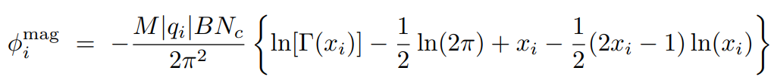



The quark energy eigenvalue
Gap equation
Quark condensate
Vacuum
$$φ_{i}$$
Magnetic field
medium

Slide 6

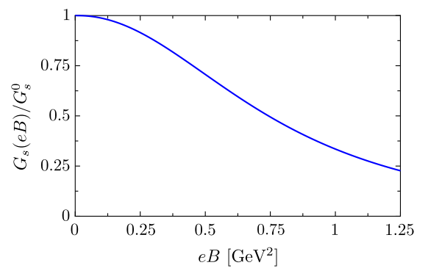






Preceding work on coupling constant depending on magnetic field
Since there is no LQCD data for $α(eB)$ available, one can fit the coupling in order to reproduce the $T_{c}^{χ}\left(eB\right)$ from the Lattice calculation.
V. A. Miransky and I. A. Shovkovy, Phys. Rev. D 66, 045006 (2002).
High temperature
R.L.S. Farias et.al Phys Rew. C 90, 025203 (2014)
Ferreira, PRD89, 116011 (2014)
M. Ferreira et.al Phys Rew. D 89, 116011 (2014)
QCD asymptotic freedom indicates that the running coupling decreases with the magnetic field strength.

Slide 7
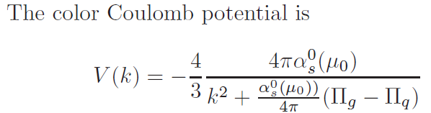
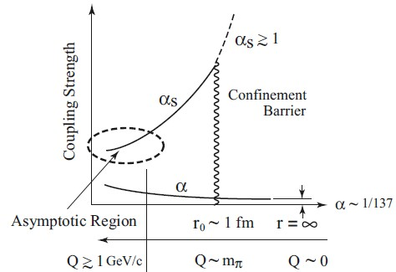
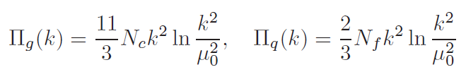
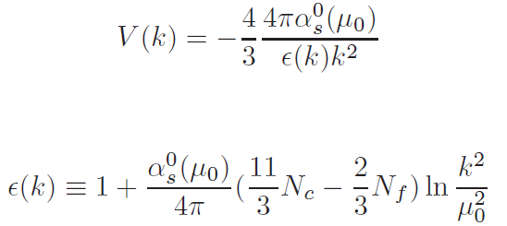
Renormalized running coupling constant
Color electric permitivity
QCD asymptotic freedom and antiscreening are dominated by the one-loop contribution in vacuum polarization tensor

Slide 8
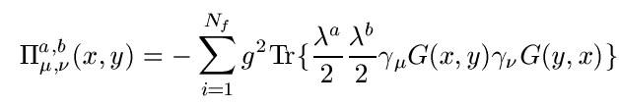
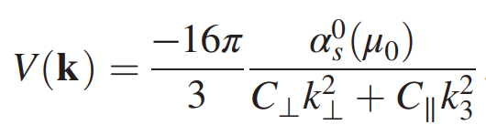
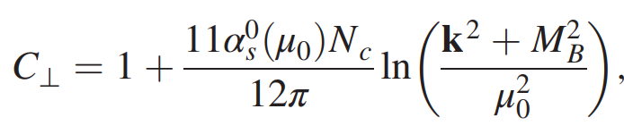
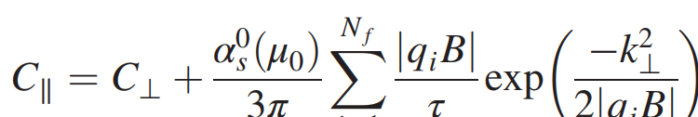
Quark-loop contribution to gluon self energy
In the low energy region, fermions in the LLL only contribute to the longitudinal components of the polarization tensor.
Transform it into momentum space with the help of Ritus eigenfunction method
Ferrer, Incera, Wen PRD,91 (2015) 054006
A magnetic field affects the color Coulomb potential through quark loops with gluon external legs.
If the field is strong enough to force the quarks to remain in the LLL. The degeneracy factor is propotional to eB. The dynamics is dimensionally reduced to D-2.

Slide 9

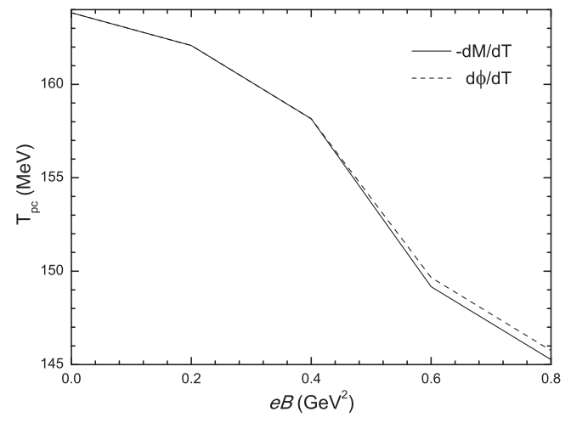
Inverse magnetic catalysis led by the running coupling
R. L. S. Farias, V. S. Timóteo, S. S. Avancini, M. B. Pinto, and G. Krein, Eur. Phys. J. A 53, 101 (2017)
In a strong magnetic field, the temperature- and magnetic-field-dependent coupling was widely introduced to account for inverse magnetic catalysis at finite temperature.
Yang & Wen PHYS. REV. D 96, 056023 (2017)

Slide 10
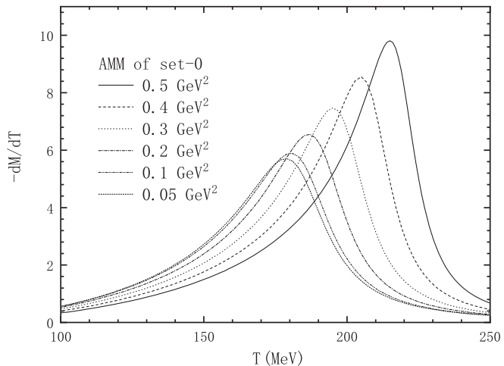
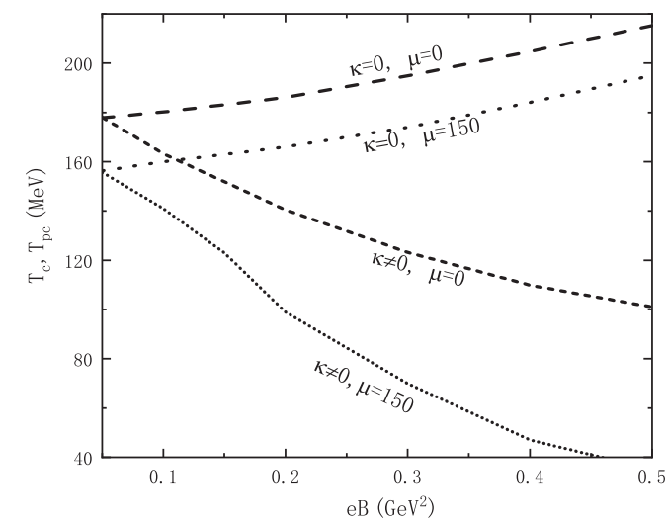
Inverse magnetic catalysis led by the Anomalous Magnetic Moment
Wen et.al. PHYS. REV. D 103, 094020 (2021)
Magnetic catalysis with zero AMM could probably develop into inverse magnetic catalysis with nonzero AMM at both zero and finite chemical potentials

Slide 11
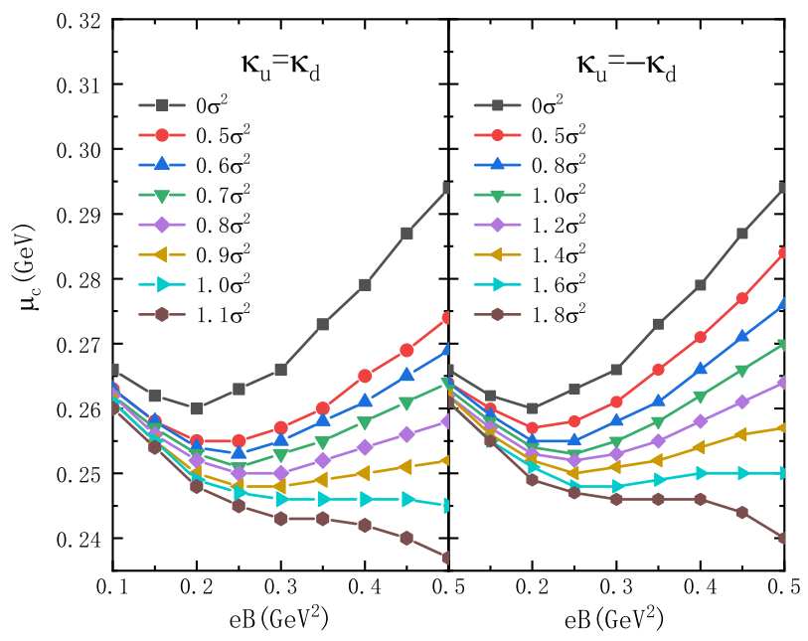
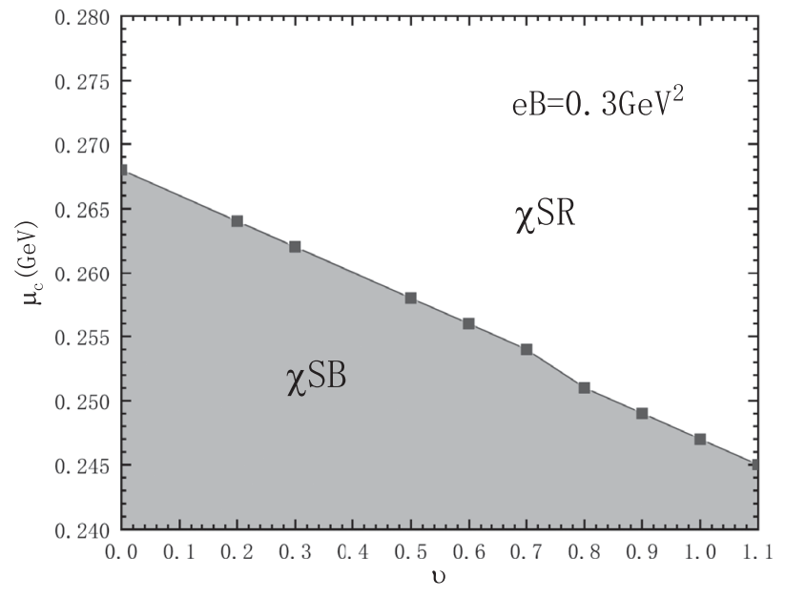

AMM proportional to the square of the chiral condensate$κ=ν σ^{2}$
He & Wen PHYS. REV. D 106, 116023 (2022)
At a smaller scale of the AMM, the critical chemical potential could go down and then grow up as the magnetic field increases. But at a larger scale, the magnetic catalysis on the critical chemical potential would not happen anymore.

Slide 12

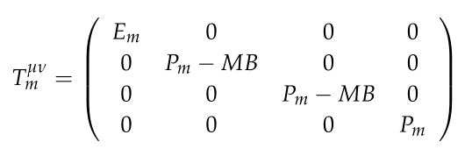
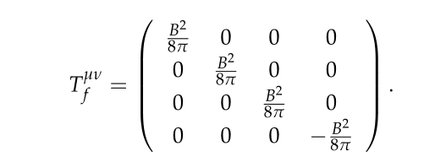
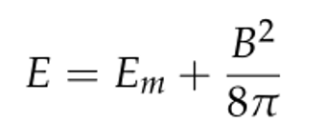
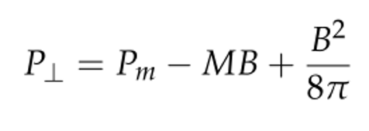
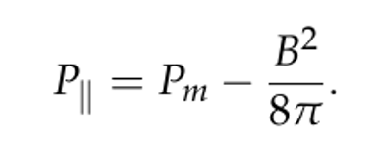
2 The role of anisotropic compressibility in chiral transition
The total energy and pressure of the system can be obtained from the energy momentum tensor
$P_{m}$is the thermodynamics pressure. M is the magnetization of the matter.

Slide 13
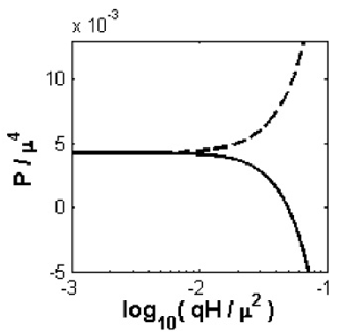
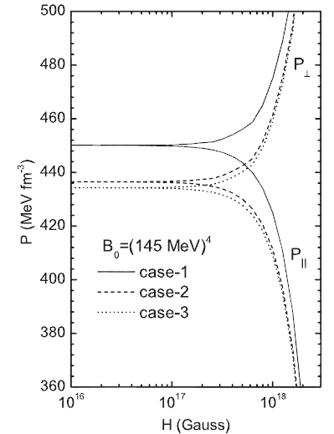
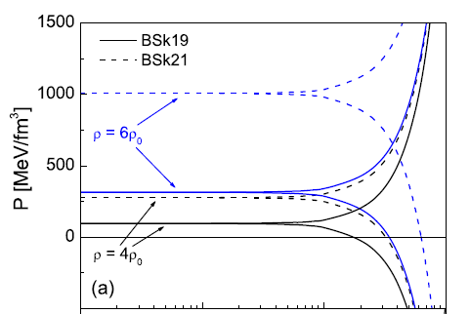
Anisotropic pressure in nuclear matter or quark matterreﬂects the breaking of the rotational symmetry by the magnetic ﬁeld.
Ferrer et.al, PRD82 (2010) 065802
Isayev & Yang PLB 707 (2012) 163
Wen PRD 88707 (2013) 034031

Slide 14



Our motivation is to explain how the magnetic field affect the anisotropic structure of QCD matter.
In the thermodynamics, the isothermal compressibility is defined as
The longitudinal compressibility can be written in a tractable form as
The transverse compressibility in the direction perpendicular to the field is

Slide 15
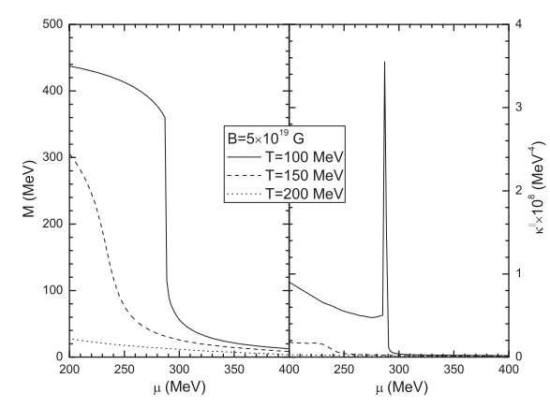
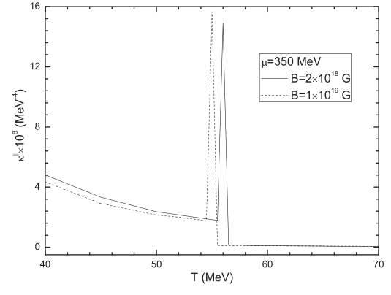
The longitudinal compressibility as a function of the chemical potential (left) or temperature (right) for the fixed magnetic fields and three different temperatures
Yang & Wen Phys.Rev.D 104 (2021) 11, 114010

Slide 16

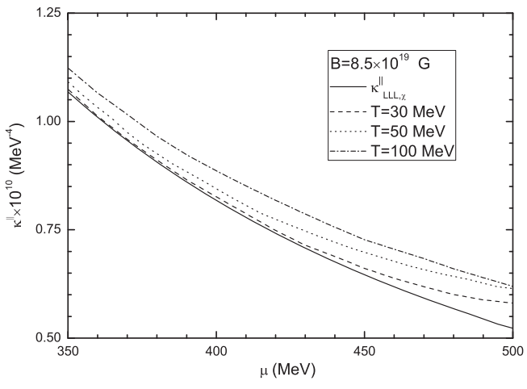



It is generally accepted that the strong magnetic field higher than the order of ${10}^{19}$ Gauss would make the quarks occupy the lowest landau level (LLL).
Longitudinal compressibility
Chiral resotration

Slide 17





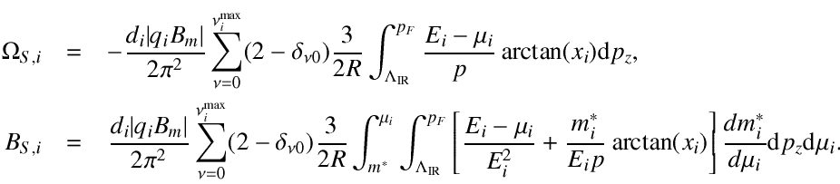
3 Anisotropic surface tension of quark matter
Anisotropic pressure in nuclear matter or quark matter reﬂects the breaking of the rotational symmetry by the magnetic ﬁeld.
Multiple Reflection Expansion (MRE) approach
The surface term proportional to the $1/R$

Slide 18

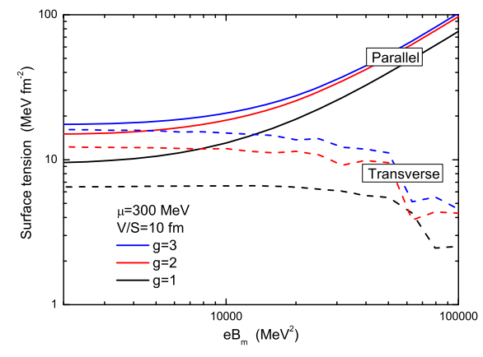


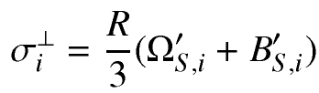
The parallel and transverse surface tensions in strong magnetic fields
2023/9/25
He & Wen Phys.Rev.D 107 (2023) 7, 074030

Slide 19
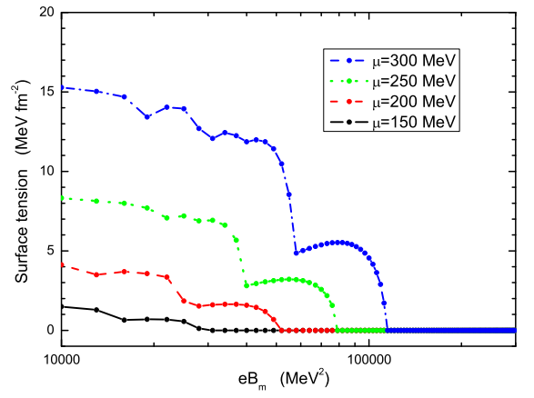
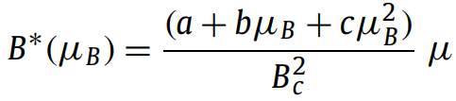
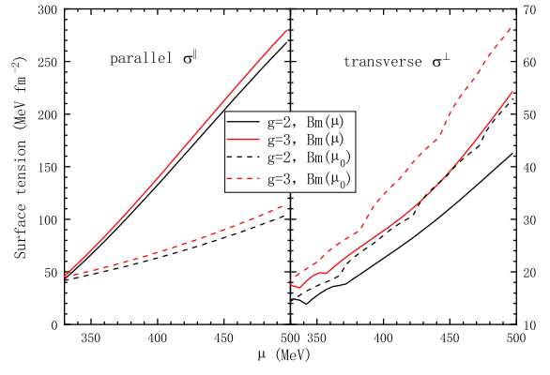
Transverse surface tension
V. Dexheimer et al. / PLB 773 (2017) 487–491
At the much stronger magnetic field, the transverse surface tension would drop down and vanish. All quarks located in the LLL have no contribution to the transverse motion
The surface tension is enlarged by the increasing chemical potential. The transverse surface tension is apparently smaller than the parallel one.
He & Wen Phys.Rev.D 107 (2023) 7, 074030

Slide 20

Summary
The magnetic field affects the chiral transition. The running coupling and/or the anomalous magnetic moment could produce the inverse magnetic catalysis.
The anisotropic compressibility can reveal the spatial asymmetry. The longitudinal component can signal the critical temperature.
The surface tension of quark matter is anisotropic in strong magnetic field. The the transverse component is vanished in sufficient strong magnetic field.
Thank you!

