Slide 1
Elastic properties of neutron star matter and crustal torsional oscillations
Quarks and Compact Stars 2023
PRC 103 (2021) 055812
PRD 106 (2022) 063020
CTP 74 (2022) 095303
PLB 839 (2023) 137769
Xia, Cheng-Jun (夏铖君)
Center for Gravitation and Cosmology,
Yangzhou University
Collaborators: T. Maruyama, N. Yasutake, T. Tatsumi, and Y.-X. Zhang
@ Yangzhou
Notes:
Thanks to the hard works of many experimentalists, we are now in the golden era of multimessengner astronomy, where detailed information on binary neutron star merger, supernova explosion, starquaks, and so on can be unveiled. In order to do that, a key factor is the EOSs and microscopic structures of dense stellar matter, which is highly uncertain. In order to reduce the uncertainties, it is thus necessary to obtain all the EOSs, transport properties, and elastic properties from one single density functional in a unified manner, which has become our main subject in recent years. Today I want to talk about one small topic of extracting elastic properties of neutron star matter from rmf model and the possible implication on crustal torsional oscillations in neutron stars. This work was done with some of my collaborators which I listed here.

Slide 2
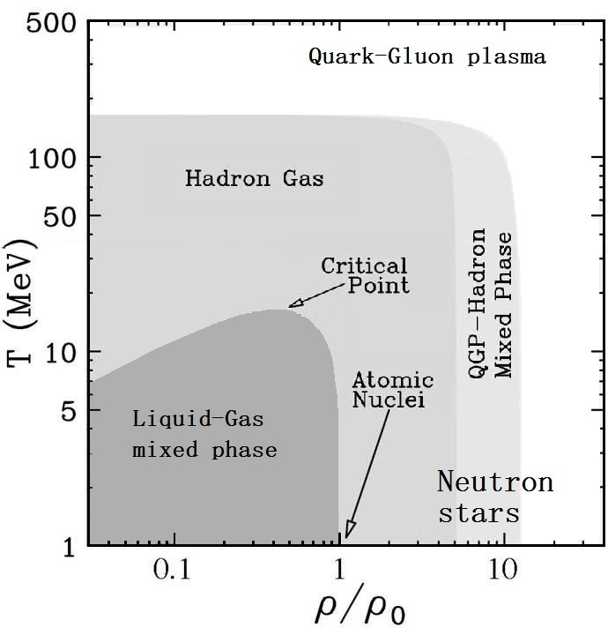
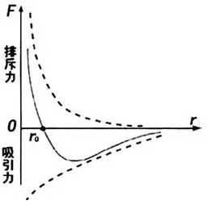
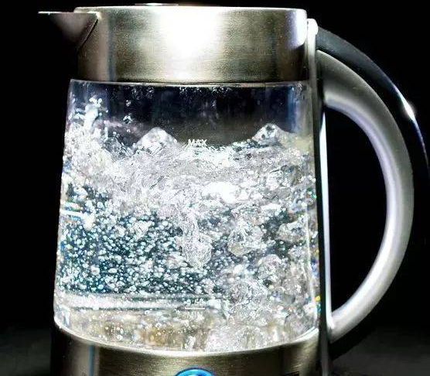
Nuclear matter phase diagram

Slide 3
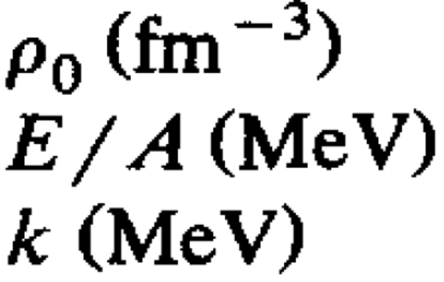
Lagrangian density
The Lagrangian density of the RMF model is
Zhang et al.2020_PRC101-034303:
K = 250.23±20.16 MeV,
S = 31.35±2.08 MeV
L = 59.57±10.06 MeV
Essick et al.2021_PRL127-192701:
S = 33.0^{+2.0}_{−1.8} MeV
L = 53⁺¹⁴₋₁₅ MeV
The adopted parameter set for RMF theory:
[Set 0: Maruyama_Tatsumi_Voskresensky_Tanigawa_Chiba2005_PRC72-015802]
Saturation density:
Binding energy:
Incompressibility:
0.153
-16.3
240
Set 0: E_{sym} = 32.46 MeV, L = 89.39 MeV
Set 1: E_{sym} = 31.85 MeV, L = 41.34 MeV

Slide 4
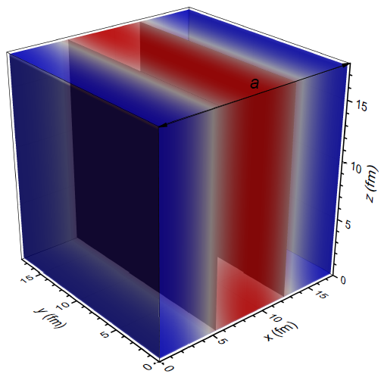

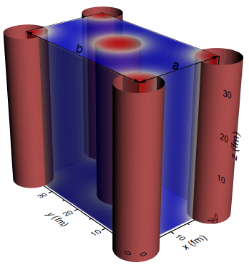
Numerical recipe
The boson
The boson
Droplet/Bubbles in BCC and FCC lattices
Slabs
n_{b}
The boson
Rods/Tubes in simple and honeycomb configurations
The boson fields and density profiles are solved iteratively inside a 3D periodic unit cell with discretized space coordinate, i.e.,
Assume initial density distributions of fermions at given total particle numbers;
Solve the boson field equations via fast cosine transformations (reflection symmetry) ;
Prepare the density distributions of fermions with the imaginary time step method [Levit1984_PLB139-147];
Go to step 2 until convergence is reached.

Slide 5
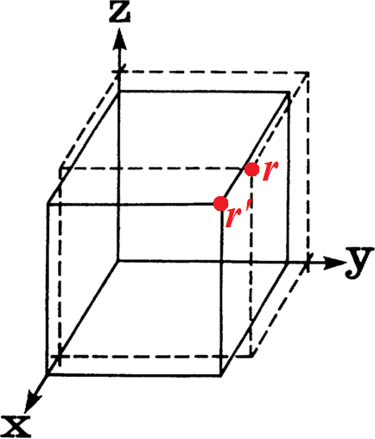
Elastic theory
The displacement gradient u_{ij} moving a droplet at position r to r'
Single crystal:
The variation of energy density due to deformation
Droplet/bubble phases with cubic symmetry (BCC and FCC lattices):
c₁₁ = c₂₂ = c₃₃, c₁₂ = c₂₁ = c₁₃ = c₃₁ = c₂₃ = c₃₂, c₄₄ = c₅₅ = c₆₆;
Rods/tubes that are aligned with the z-axis, the nonzero terms:
c₁₁ (= c₂₂), c₁₂, and c₄₄ (= c₁₁/2 - c₁₂/2 for honeycomb configuration);
Slabs perpendicular to the x-axis, only c₁₁ persists.

Slide 6

Elastic theory
Coulomb crystal:
Assuming a BCC crystal of point nuclei embedded in a uniform electron background, a Monte Carlo simulation predicts [Ogata_Ichimaru1990_PRA42-4867]
Incompressible liquid-drop model [Pethick_Potekhin1998_PLB427-7]:

Slide 7
Elastic properties
PLB 839 (2023) 137769

Slide 8
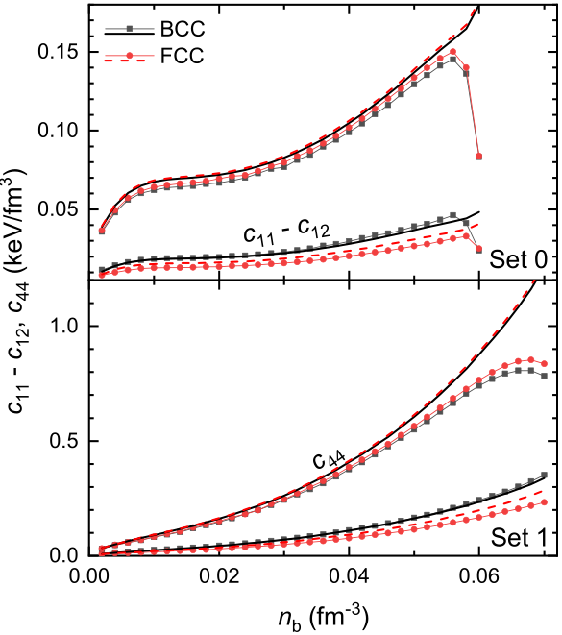
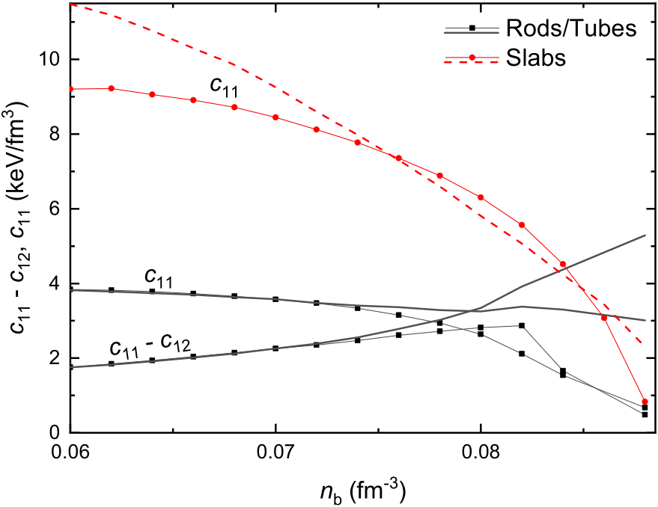
Elastic constants
PLB 839 (2023) 137769
L = 89.39 MeV
L = 41.34 MeV
Notes:
Assuming a crystal of point nuclei embedded in a uniform electron background, a Monte Carlo simulation predicts [Ogata_Ichimaru1990_PRA42-4867]
Single crystal:

Slide 9
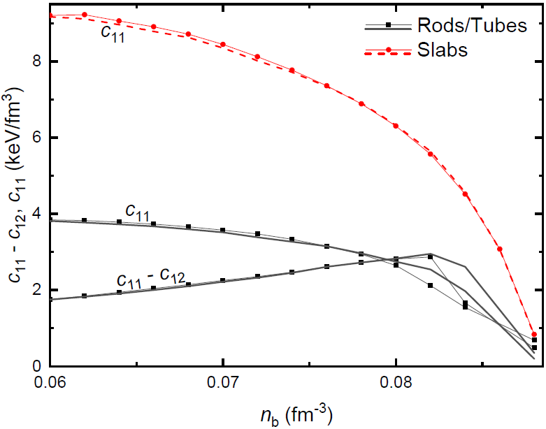
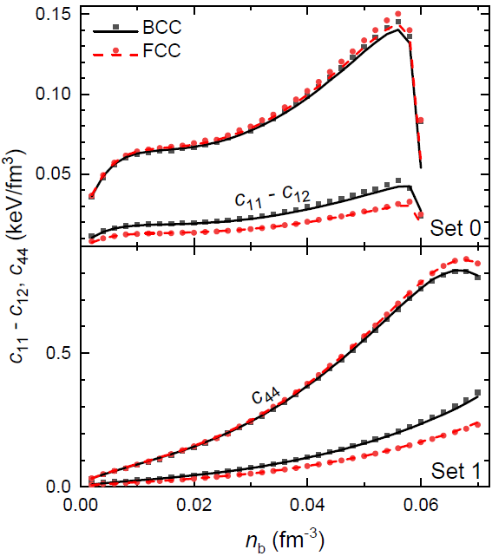
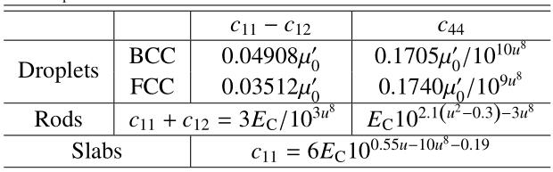
Elastic constants
L = 89.39 MeV
L = 41.34 MeV
µ₀’ ≡
Notes:
Assuming a crystal of point nuclei embedded in a uniform electron background, a Monte Carlo simulation predicts [Ogata_Ichimaru1990_PRA42-4867]
Single crystal:

Slide 10
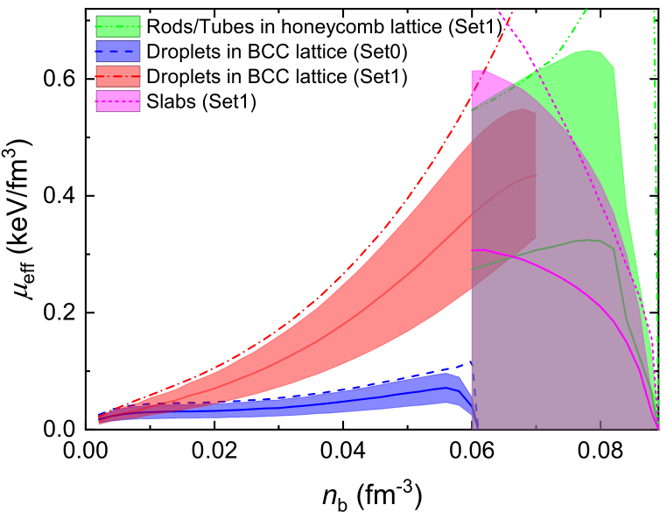
Effective shear modules
Horowitz_Kadau2009_PRL102-191102
Polycrystal:
Effective bulk module K
and shear module μ_{eff}.
Voigt theory:
Reuss theory:
for BCC and FCC lattices
Arithmetical Hill method:
Notes:
Polycrystal: Voigt theory & Reuss theory
Based on the extent of anisotropy in polycrystallines, the elastic properties vary within the bounds predicted by the Voigt and Reuss theories.
the Voigt theory estimates the effective shear module by averaging over all possible lattice orientations for the stress in a given strain.
while the Reuss theory estimates the effective shear module by averaging the strain at a given stress

Slide 11
Giant flares [arXiv1803.05716]
The 2004 December 27 giant flare of SGR 1806–20 as observed by RHESSI (from Hurley et al. 2005). Panel a shows the 20–100-keV light curve. The (saturated) spike is at ~30 s and the inset shows the profile of a bright burst the preceded the flash by ~2 minutes. The modulation at
the spin period of SGR 1806–20 (7.5 s) is apparent. Panel b shows the temporal evolution of the spectral temperature.
Quasi periodic oscillations (QPOs) at about 18, 30, 93, 150, 625 and 1840 Hz [Israel et al., 2005; Watts
and Strohmayer, 2006].
Crustal Torsional Oscillations (Starquake)
Notes:
在光变曲线图中，可以发现，在光谱初始高峰后数百秒内可观察到一个衰变，对光变曲线中的衰变尾部进行傅里叶分析后，可以得出，尾部数据中不仅提供了星体自转（由于喷射出的等离子体火球被强磁场约束在中子星表面附近）的频率，还有一个准周期振荡quasi-periodic oscillations（QPO），其范围在几十赫兹到几千赫兹之间，这被认为是中子星振荡即星震的结果。
(I) Discrete Shear modes (crust)?
(II) Alfven oscillations: coupled crust-core oscillations?
(III) Magnetospheric: oscillations?

Slide 12
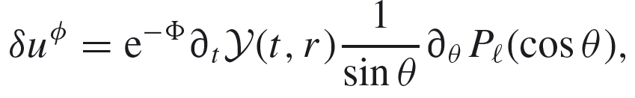

Crustal torsional oscillations
ɸ-component of the perturbed four-velocity of fluid:
The angular displacement of the stellar matter:
The perturbation equation:
$$v_{s}=\sqrt{\frac{μ}{E+P}}$$
Shear velocity:
Sotani_Nakazato_Iida_Oyamatsu2012_PRL108-201101
Notes:
考虑自由边界的分层球体
存在径向\扭向的本征振动
在震源（双力偶源）下 这些本征振动模式如何被激发

Slide 13
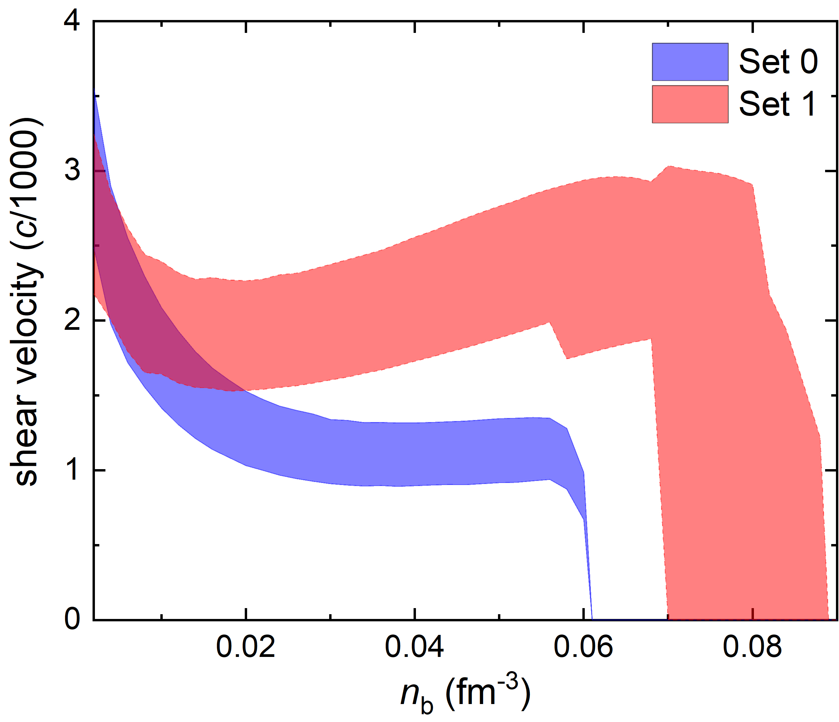
Shear velocity

Slide 14
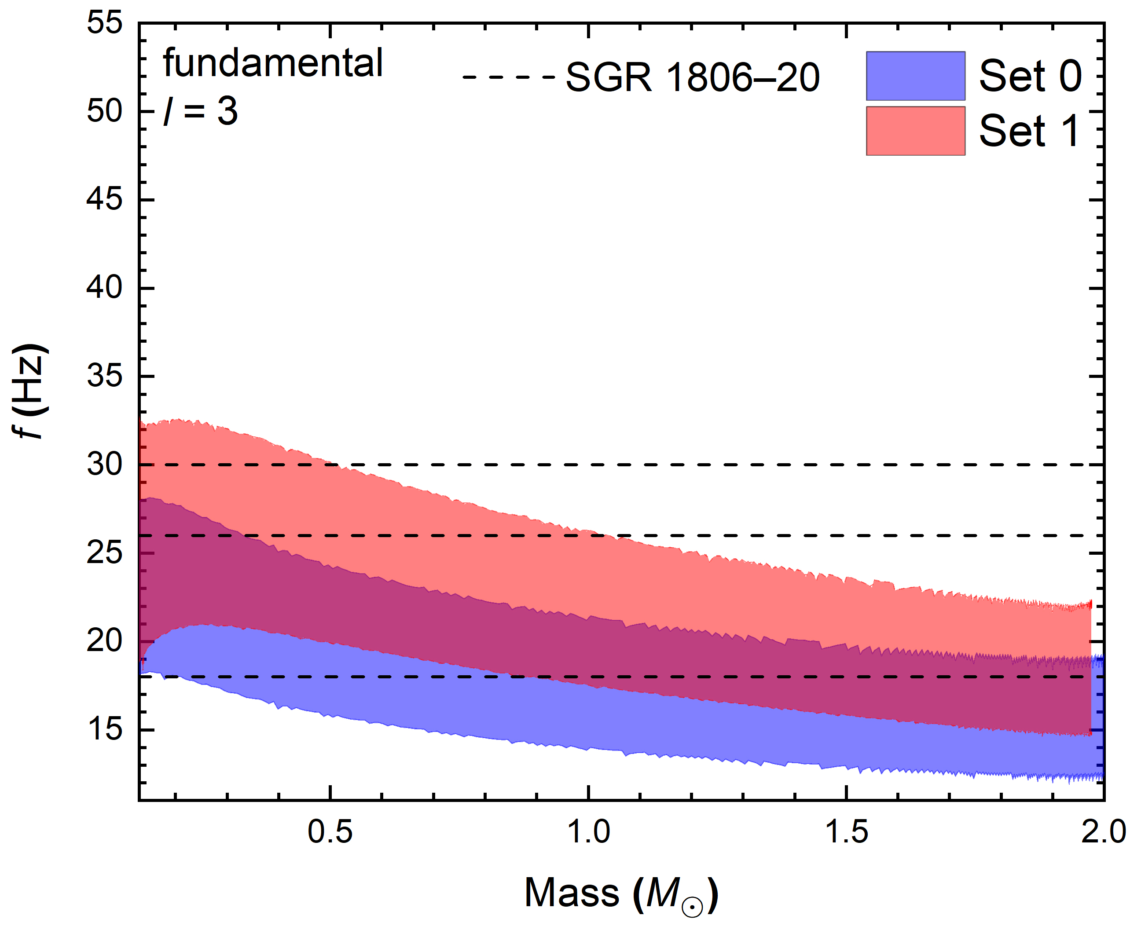
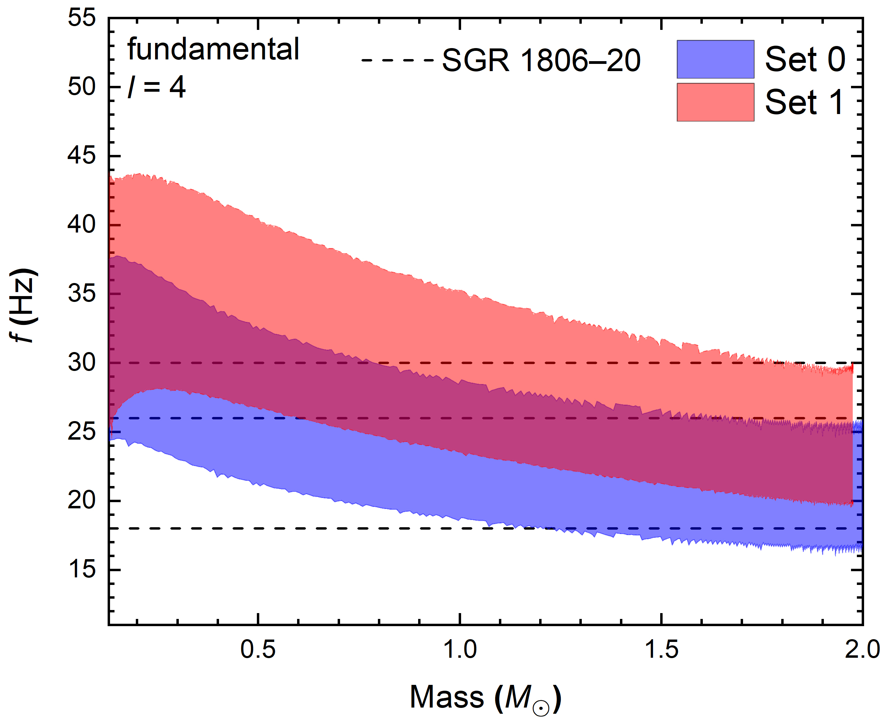
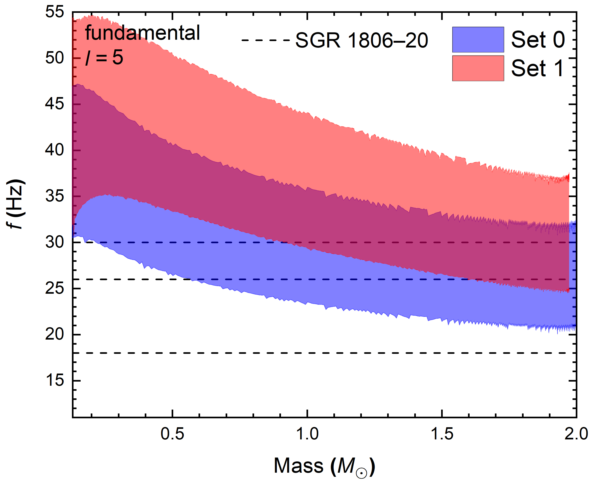
Crustal torsional oscillations
Preliminary

Slide 15
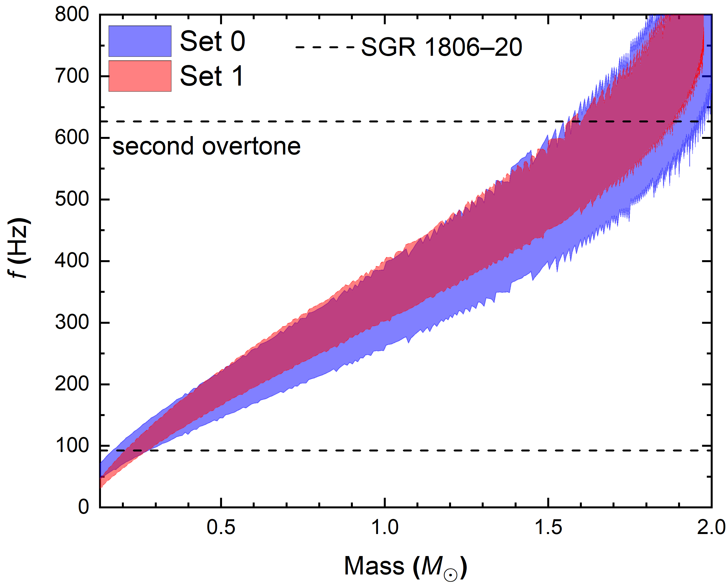
Crustal torsional oscillations
Preliminary

Slide 16
Summary
We have investigated the structures and elastic properties of low density nuclear matter in a fully three-dimensional geometry.
The effect of finite cell size is treated carefully by searching for the optimum cell size.
The EOSs of nuclear pastas are insensitive to the lattice structures (size, volume, A, and Z), where the difference of energy per baryon is small.
The elastic properties deviates from that of Coulomb crystals at large densities, while those predicted by the incompressible liquid-drop model agree with our calculation quanlitatively but not quantitatively.
A smaller slope of symmetry energy predicts larger onset densities for core-crust transition and non-spherical nuclei, elestic constants, and frequencies of fundamental torsional shear modes.
Thank you!!!

Slide 17
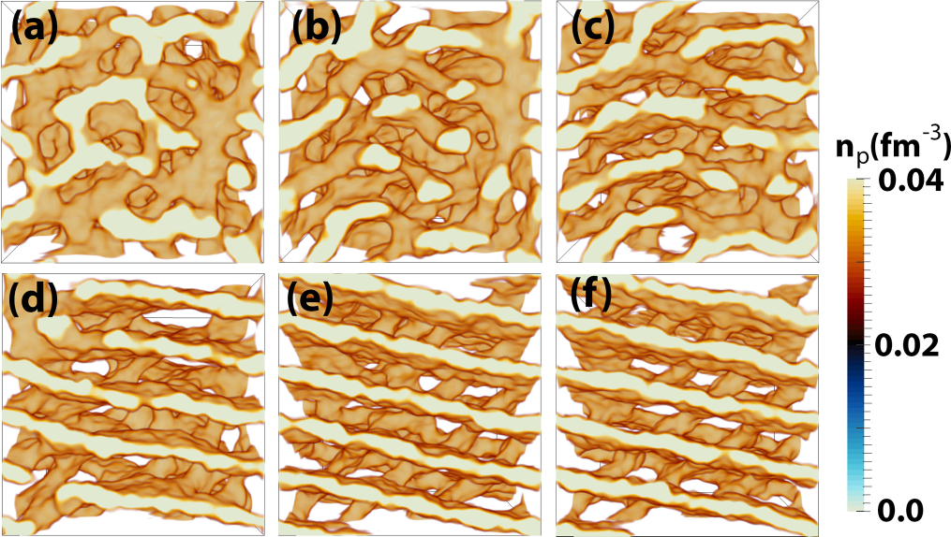
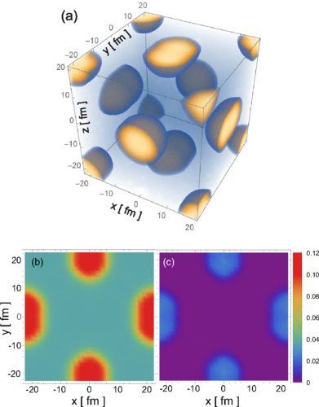
Nuclear shapes and lattice types
Okamoto_Maruyama_Yabana_Tatsumi2012_PLB713-284
Schuetrumpf_Martnez-Pinedo_Afibuzzaman_ Aktulga2019_PRC100-045806
Berry_Caplan_Horowitz_Huber_Schneider2016_PRC94-055801
Kashiwaba_Nakatsukasa2020_PRC101-045804
Oyamatsu1993_NPA561-431
Schneider_Berry_Briggs_Caplan_Horowitz2014_PRC90-055805
Notes:
the gyroid and double-diamond morphologies, P-surface configurations, nuclear waffles, Parking-garage structures
1. 中子星结构，如半径，潮汐形变等；
2. Neutrino opacity, Thermal conductivity, electric conductivity 中微子不透明度（热导率：低质量x双星系、电导率：磁星磁场演化）
3. the strength of nuclear pasta in neutron stars (such as the the breaking (yield) strain) determines Maximum degree of deformation for the crust, i.e.,
the height of Mountains which determines the gravitational wave strain from a rotating NS
4. pulsar glitch: The interplay of nuclear pasta with the superfluid vortexes was essential to explain pulsar glitches in votex creep model, starquake model
5. Quasi periodic oscillations (QPOs) observed after Giant flares of manetars are usually interpreted as
Crustal Torsional Oscillations (Starquake), where the elastic and superfluid properties of nuclear pasta play essential roles
在硬X射线和软γ射线中，探测到来自磁星的超高能巨型耀斑

Slide 18
Convergency and effect of finite cell size
∆E/A < 0.001 keV
∆E/A ≈ 1.5 keV, 0.03 keV, and 0.0006 keV
for dx = dy = dz = 0.96 fm, 0.48 fm, and 0.24 fm

Slide 19
Energy per baryon
Set 0: L = 89.39 MeV

Slide 20
Energy per baryon
Set 1: L = 41.34 MeV

Slide 21
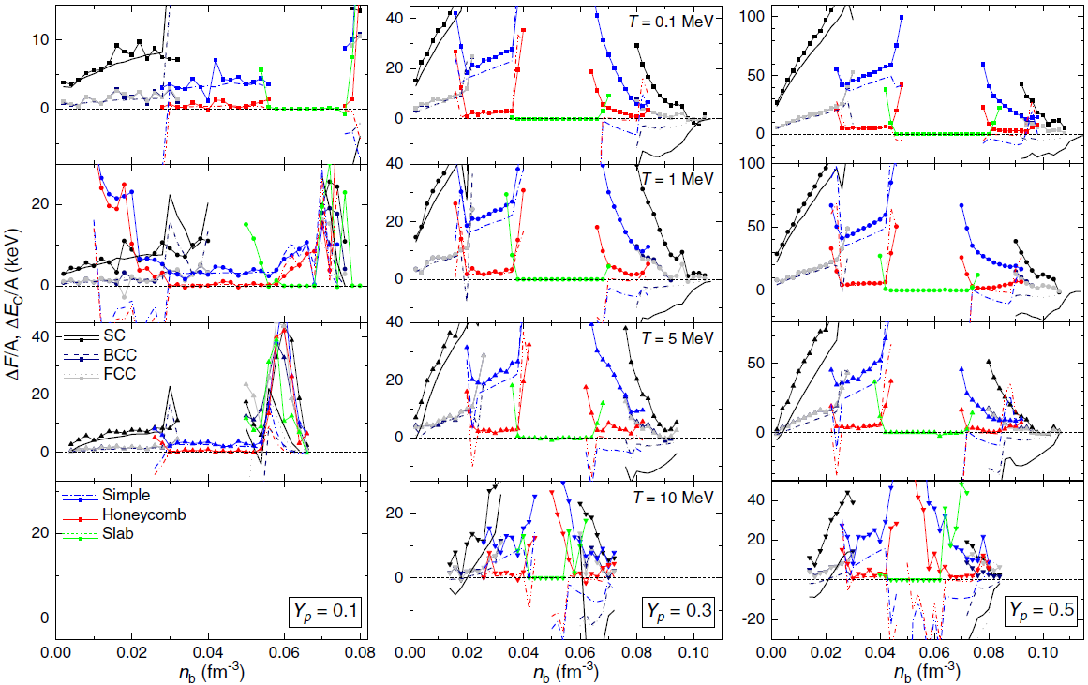
Lattice energy
PRD 106 (2022) 063020
Set 0: L = 89.39 MeV

Slide 22
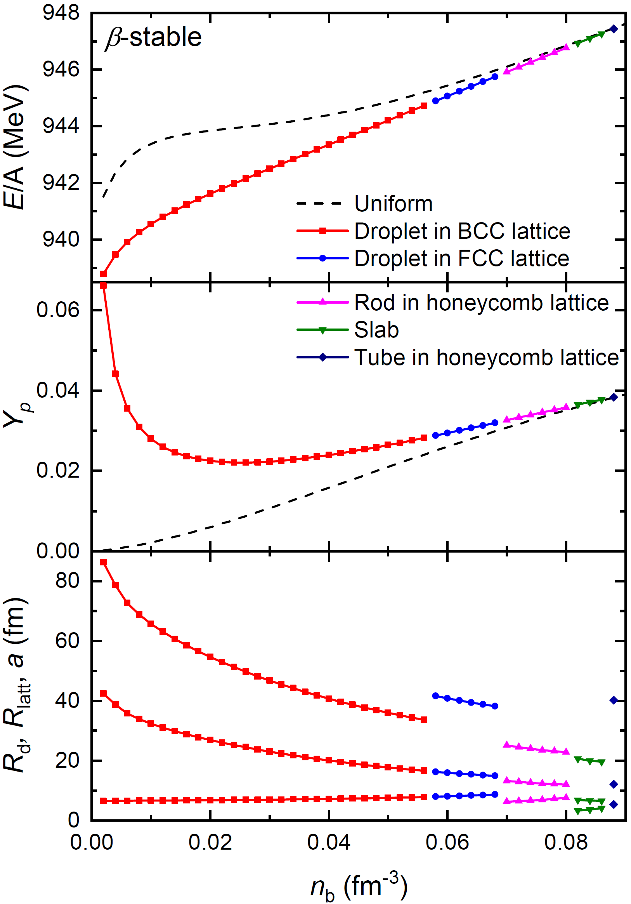
Nuclear matter in β-equilibrium
Set 0: L = 89.39 MeV
Set 1: L = 41.34 MeV

Slide 23
Neutron stars

