Slide 1
2023QCS-Yangzhou
Gravitational wave echoes from strange quark stars in the EoS with density-dependent quark masses
Jian-Feng Xu
2023.9.23-26
Suqian University
Collaborators: C.-J. Xia, G.-X. Peng, L.-Z. Yan, L. Cui
[Xu2023NST, accepted]

Slide 2
Outline
Background and Motivation
Introduction to EoS of SQM
Numerical results
Summary

Slide 3
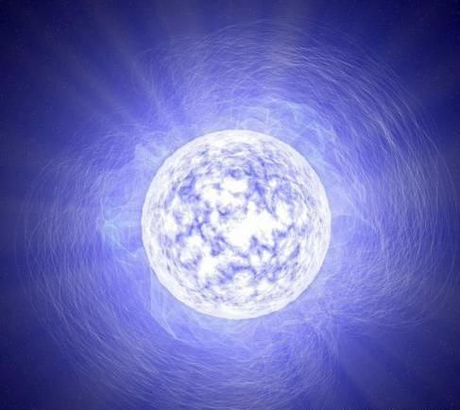
I. Background and Motivation
Observations of massive neutron stars
The mass of PSR J1614-2230:
$$1.928±0.017 M⨀$$
[Demorest2010Nature467.108]
[Fonseca2016ApJ832.167]
The mass of PSR J0740+6620:
$$2.08±0.07 M⨀$$
The mass of PSR J0952+0607:
The mass of PSR J0348+0432:
$$2.01±0.04 M⨀$$
$$2.35±0.17 M⨀$$
[Antoniadis2013Science340.1233232]

Slide 4
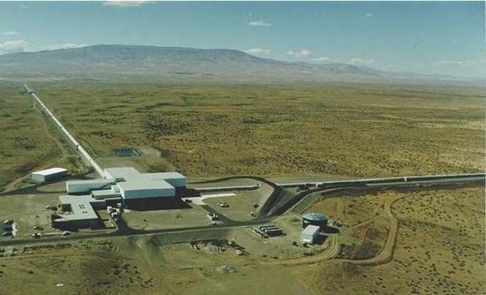
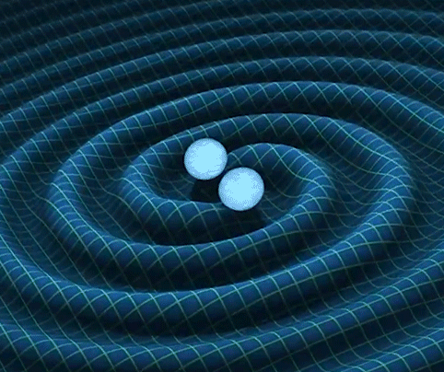
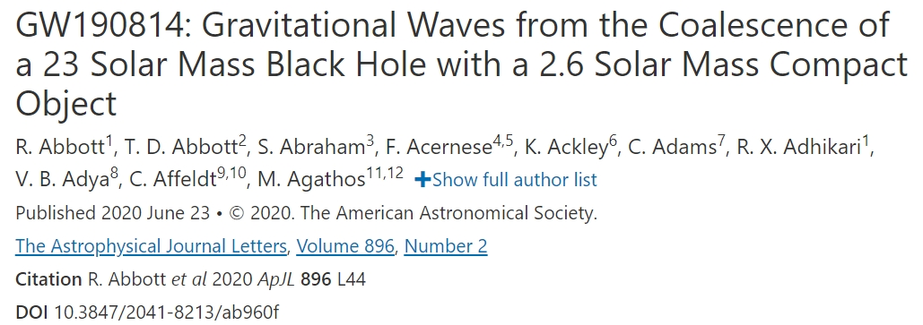
GW events
The event GW170817 opens up new avenues for research on dense stellar objects.
Tidal deformability:

Slide 5
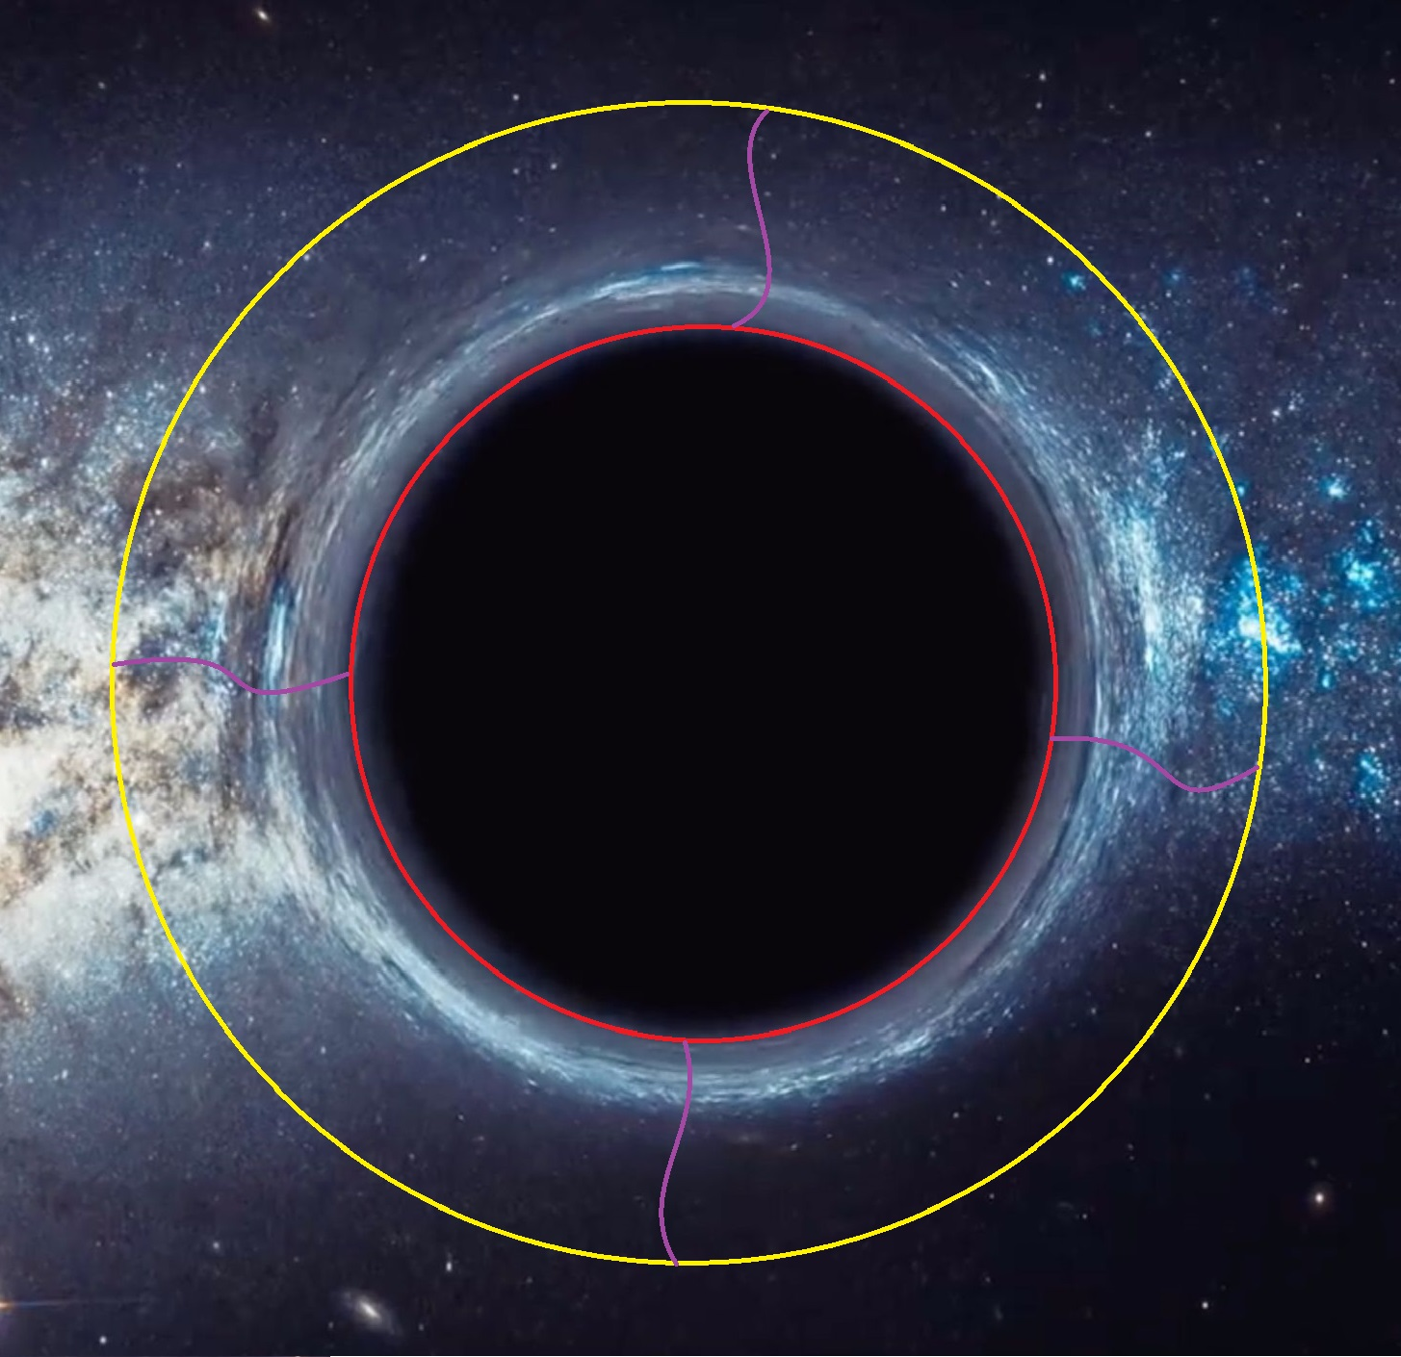
Schematic picture for production of GW echoes from BHs
GW echoes
The incoming GWs reflect back and forth between these two spheres,leaking a fraction of energy each time it hits the photon sphere.
Trapped GWs
Event horizon
GW echoes might be related to quantum effects of event horizon
Photon Sphere
[Abedi2019JCAP11.010]
[Barcelo2017JHEP05.054]
[Cardoso2016PRL116.171101]
Black holes

Slide 6
Carton for production of GW echoes from ECOs
GWs might bring information of EoS of dense matter
GW echoes
Trapped GWs
Photon Sphere
ECOs
R=3M
[Mannarelli2018PRD97]
[Xin2021PRD104.104005]
[Urban2019JCAP04.011]
Falling GWs
[Zhang2021PRD104.083032]
Exotic Compact Stars
[Zhang2023PRD108.063002]

Slide 7
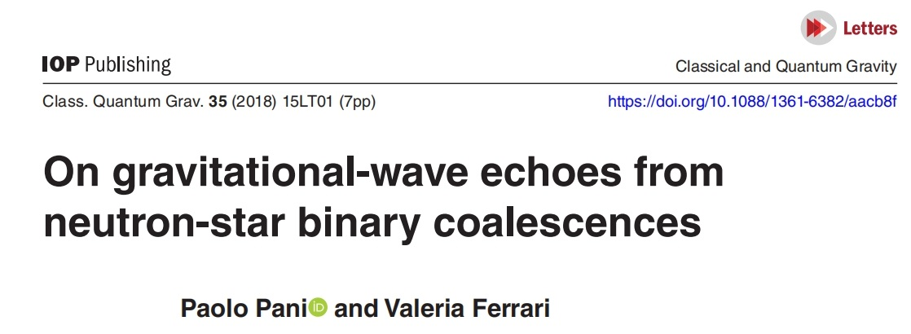
Some tentative investigations of GW echoes
Possible presence of GW echoes in the GW170817 event has been analysed.
A signal at a frequency ≈72 Hz with a 4.2σ
significance level is present.
[Abedi2018arXiv:1803.10454]
The authors interpret this signal as originating from quantum effects close to the BH horizon.
An interpretation of this echo signal as originating
from an ultracompact star was first proposed
[Pani2018CQG35.15LT01]

Slide 8
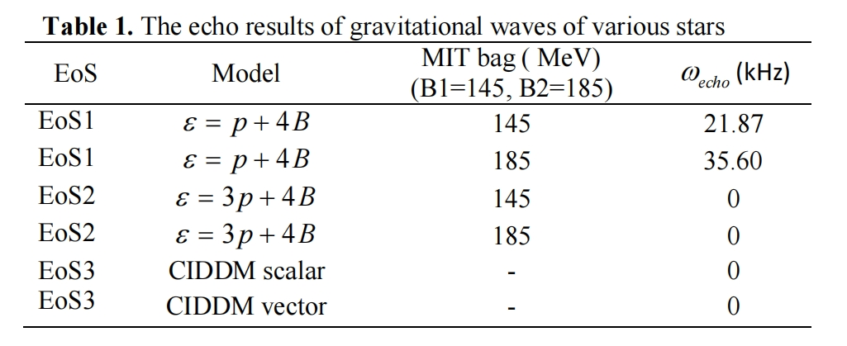
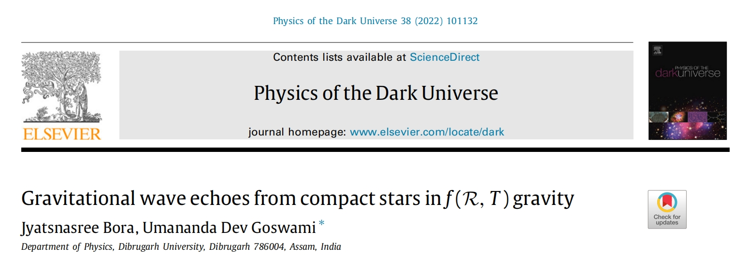
Progress made in the investigations of GWs
simple bag model with artificially assigned sound velocity
[Mannarelli2018PRD97.123010]
[Kartini2020JP:CS1572.012034]
“Realistic EOS cannot be categorized as ultra-compact objects”
Compact stars in the f(R,T) gravity with EoS given by MIT bag model and CFL interacting quark matter.
Semi-classical gravity
[Prasetyo2021PRD103.123536]

Slide 9
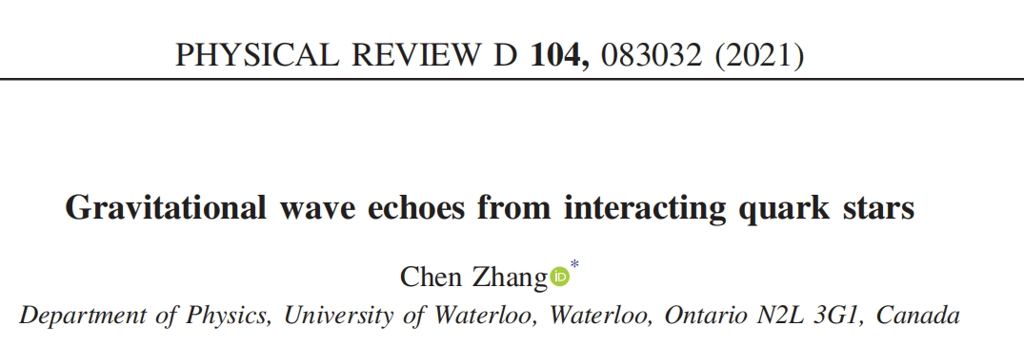
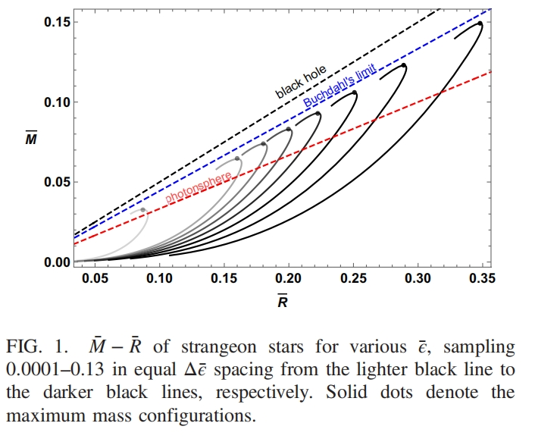
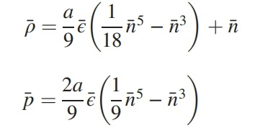
Progress made in the investigations of GWs
an IQM equation of state unifying all interacting phases by a simple reparametrization and rescaling

Slide 10
II. Introduction to the EoS of SQM
Ref. [C.-J. Xia, et. al., PRD89, 105027 (2014)]
Thermodynamical potential density in equivparticle model with color superconductivity
Same form with the free particles!!
$υ$ is the common Fermi momentum for all quark flavours.
$Δ$ is the quark pair energy gap
is the averaged quark chemical potential.
$B$ is a constant relating to the vacuum energy density.

Slide 11
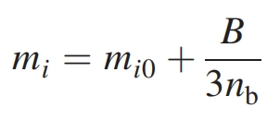
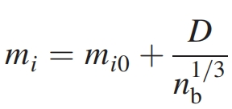
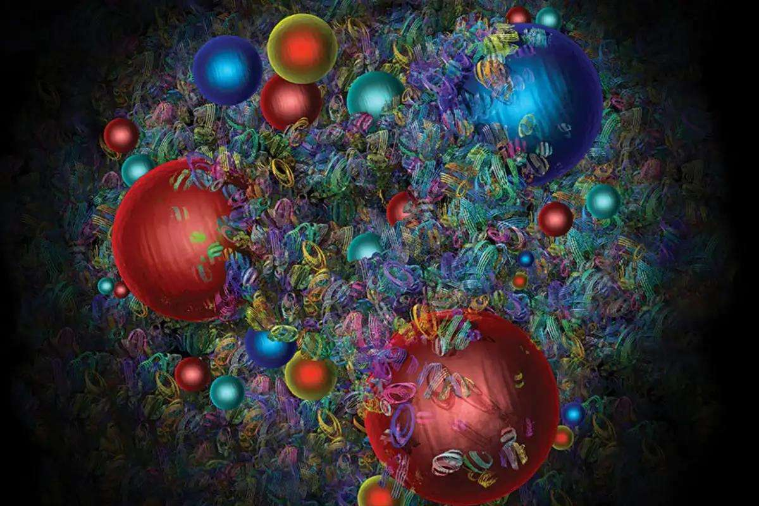
EoS of SQM with density-dependent quark masses
As to the quark mass it can be scaled in different ways:
[Flower1981ZPC9.271]
[Xia2014PRD89.105027]
[Peng1999PRC61.015201]
Model parameter reflecting the quark confinement and asymptotic freedom
[Wen2005PRC72.105204]
Particle number density

Slide 12
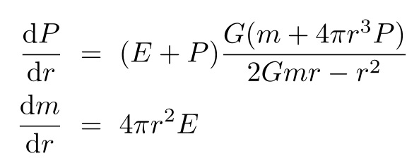
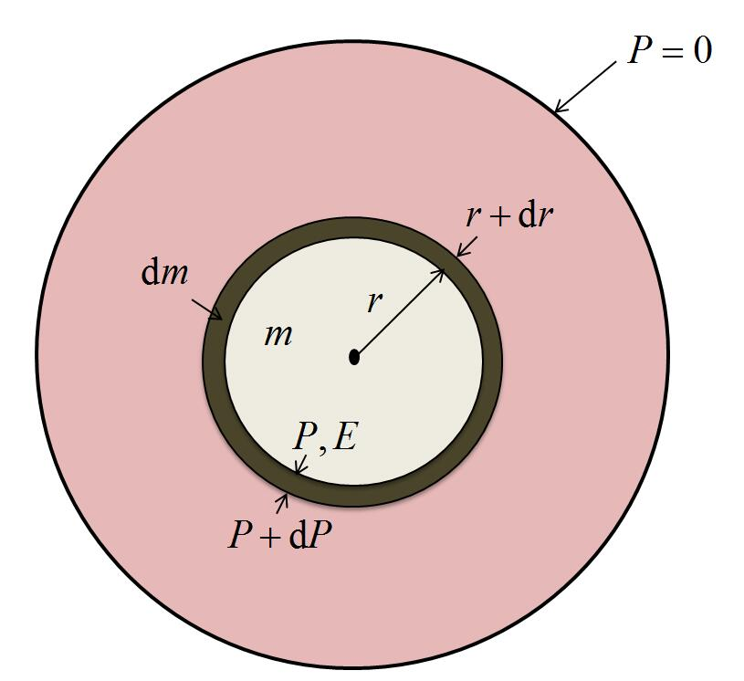
EoS of SQM & structure of SQS
TOV equation:

Slide 13
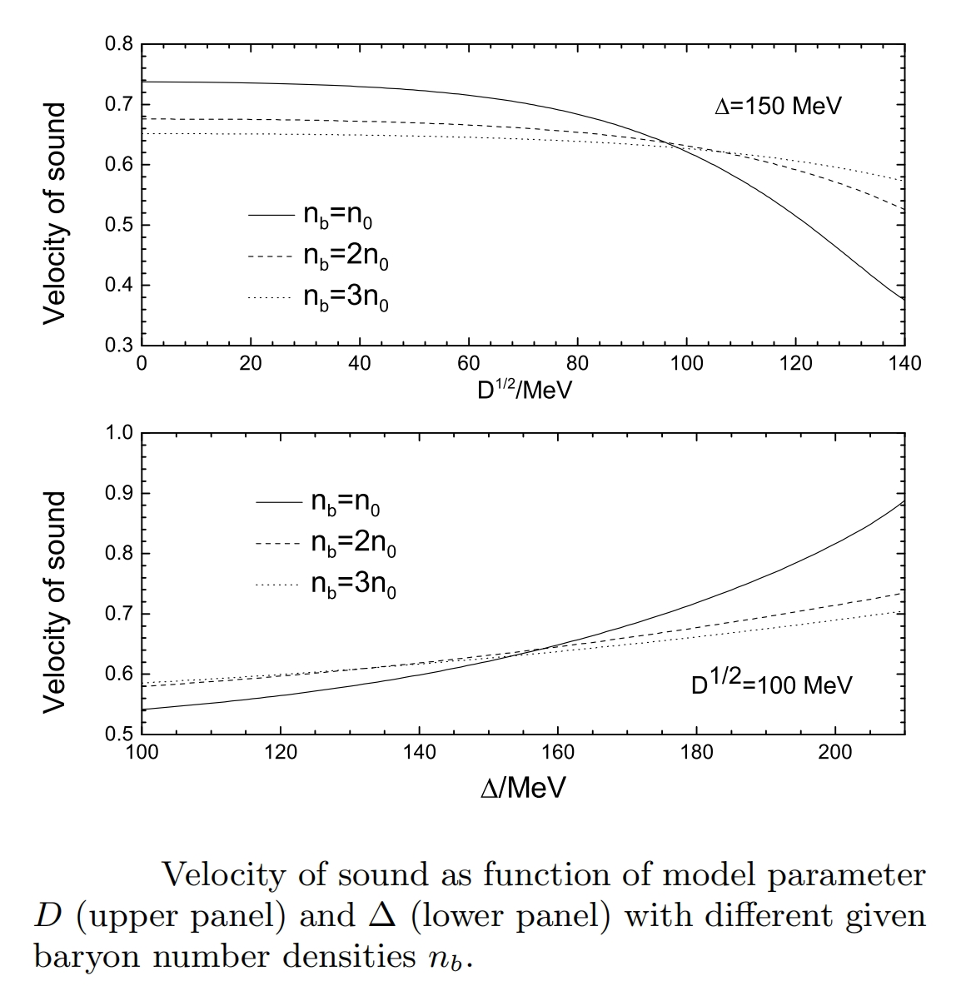
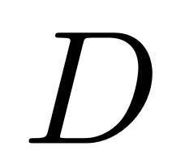
III. Discussions on the numerical results
The purpose of this figure is to determine the values of model parameters which could give stiffer EoS.
and
could stiffen the EoS.
To get a solvable EoS, the value of must be in the following range:

Slide 14
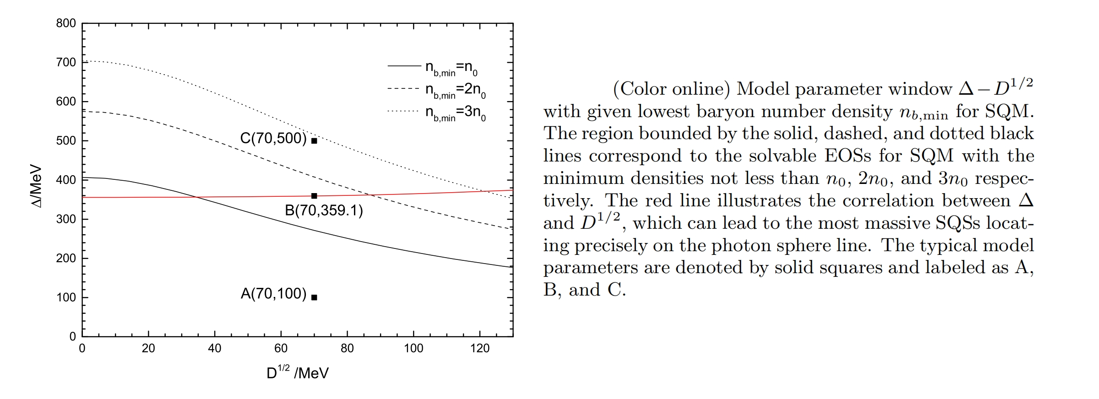
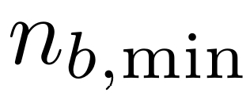
Model parameter window for SQS capable to feature a photon sphere
is the assumed minimum density for SQM
Red line:

Slide 15
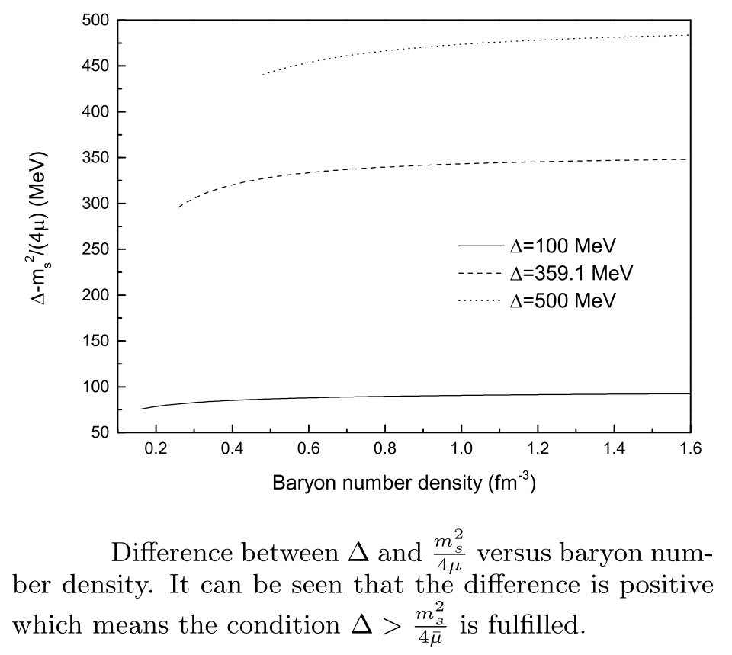
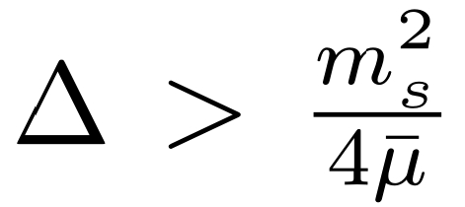
Check the condition for the stable CFL SQM
Check the condition
can be fullfilled or not.
This condition guarantees the CFL SQM is in the absolutely stable state.
[Alford2002JHEP06.031]

Slide 16
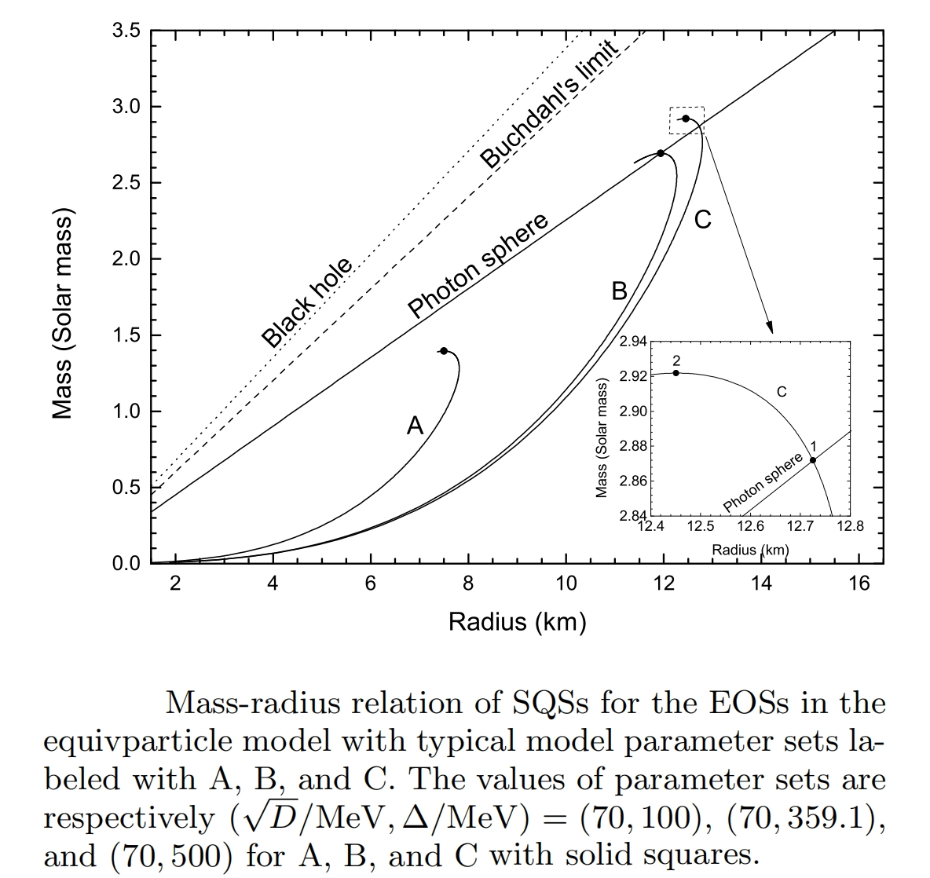
Mass-radius relation of SQSs
Maximum mass in each case is
indicated with solid dot.
In case A, the SQSs cannot possess a photon sphere, thus GW cannot be generated in this case.
In case B, the radius of photon sphere is the same as the SQS, which is the critical state.
In case C, the SQS can feature a photon sphere. Therefore, GW echoes can be produced.

Slide 17
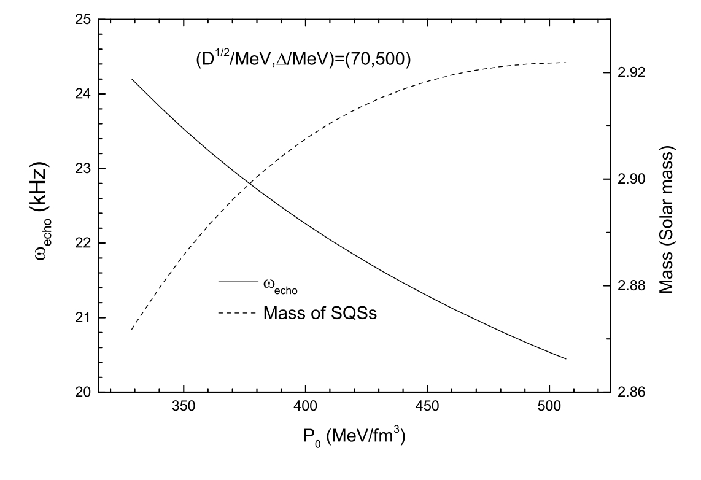
Frequency of GW echoes and SQS mass as functions of central pressure
Frequency of GW echoes increases with P₀, while the mass of SQS decreases with P₀ .

Slide 18
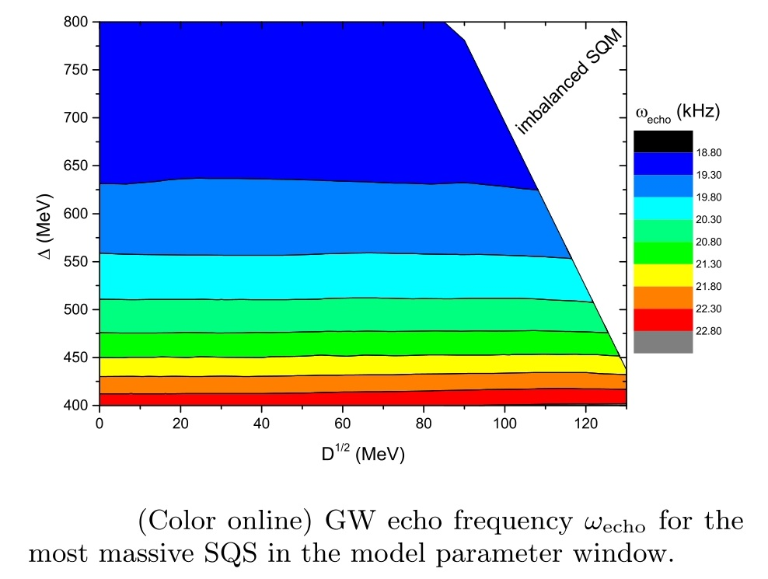
GW echoes in the parameter window
GW echoes exhits minimal variation of increasing D.
GW echoes changes significantly with Δ.
The frequencies of GW echoses are mainly about 20 kHz.

Slide 19
IV. Summary
GW echoes have been studied in EoS with density-dependent quark masses.
More realistic EoS can be stiff enough to support SQSs featuring a photon sphere to generate the GW echoes.
Large values of quark pairing energy gap are necessary to make the EoS stiff.
GW echo frequency calculated here is about 20 kHz, not compatible with the 72 Hz analysed in the event GW 170817.

Slide 20
Thanks for your attention！

