Slide 1
Quark stars in the pure pseudo-Wigner phase
Presenter：Yan Yan (Changzhou University)
Lead Author: Su Li-Qun
Supervisor: Zong Hong-Shi
Collaborators：Shi Chao，Huang Yong-Feng，Li Cheng-Ming
Discuss with Yuan Wen-Li and Li Bo-Lin
Quark and Compact Stars
22th-26th, September 2023
Yangzhou, China
arXiv:2104.01524v2[nucl-th]

Slide 2
Motivation
Quark stars : They are composed of deconfined quark matter.
Nambu-Jona-Lasinio Model: Confinement Property of QCD is not included.
Nambu-Jona-Lasinio Model:
Spontaneous breaking of chiral symmetry is manifested.

Slide 3
Main Assumption
Deconfinement happens along with Chiral symmetry restoration.
At least, they happen in the same range.
Deconfinement Phase ≈ Wigner Phase

Slide 4
Model
1 Two-flavor NJL model with a weighting parameter ɑ
2 Proper-time regularization
3 Bag constant：

Slide 5
Bag Constant
Previous work
Our B
Calculate Ω_{vac}
Gap between Nambu phase and Wigner phase
µ_{c} =µ_{de}
Zhao T, Zheng W, Wang F, et Phys Rev D 100:043018

Slide 6
Quark Condensate
Crossover?!
Where is critical chemical potential?
β equilibrium and Neutrality are not included.
Chiral Susceptibility

Slide 7
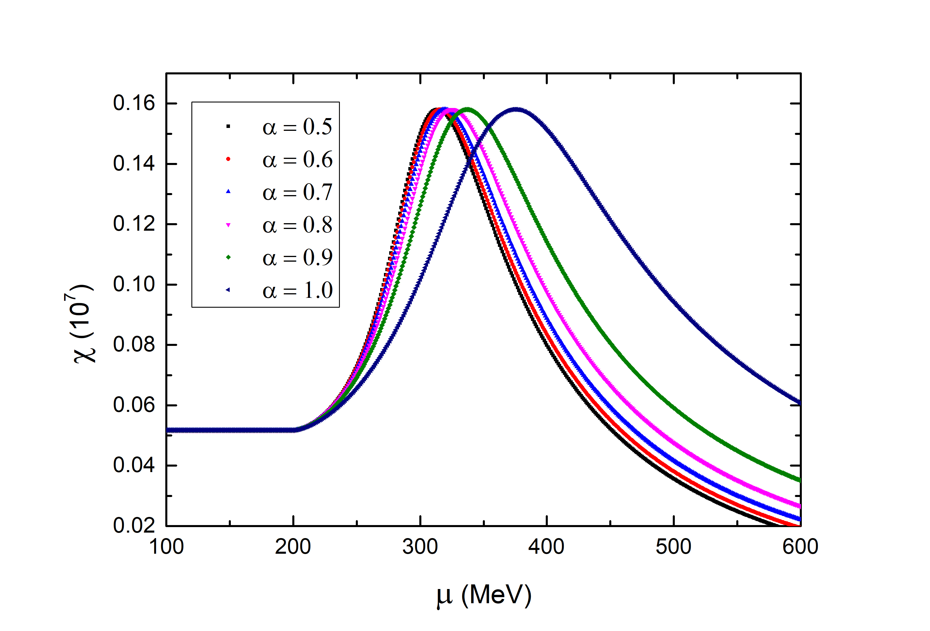
Chiral susceptibility
Critical Chemical Potential µ_{c}
β equilibrium and Neutrality are not included.
β equilibrium and Neutrality are included.

Slide 8
Bag constant for different ɑ
ɑ | 0.5 | 0.7 | 0.9 | 1.0
B^{1/4} (MeV) | 132.9 | 134.7 | 141.1 | 151.9
µ_{c} (MeV) | 286 | 293 | 312 | 354
ρ_{s} (fm⁻³) | 0.260 | 0.262 | 0.260 | 0.260
ρ_{C} (fm⁻³) | 1.04 | 1.02 | 0.974 | 0.890

Slide 9
Mass-radii relation

Slide 10
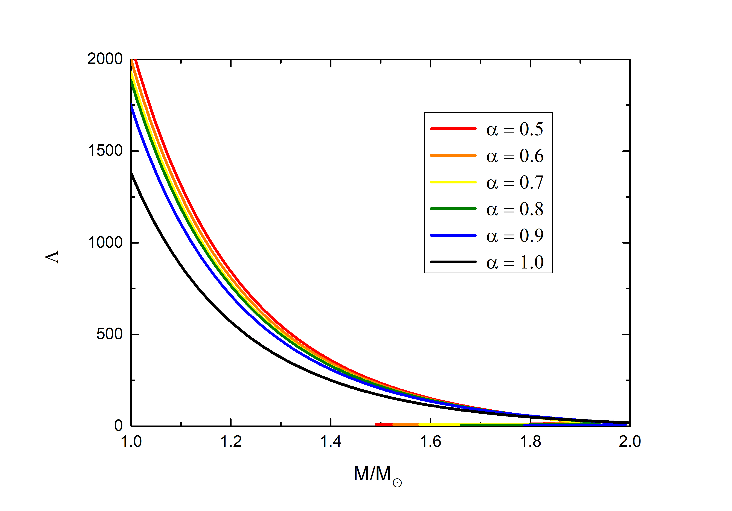
Tidal deformability

Slide 11
Conclusion
1、This work redefines the bag constant assuming deconfinement happens along with chiral restoration.
2、The maximum mass is consistent with the observation PSR J0740+6620 .Large ɑ is preferred. The radius is smaller than the observations.
3、Tidal deformability is consistent with observation.

Slide 12
Thank You！
Yan Yan​
2919ywhhxh@163.com

