Slide 1


Quarks and Compact Stars
Strangelets at finite temperature: nucleon emission rate, interface and shell effects
You, Haosong(尤浩松)
College of Physical Science and Technology, Yangzhou University
Supervisor: Xia, Cheng-Jun
2023-09-25
Notes:
Hello, everyone. My name is You Haosong from Yangzhou University. Thank you very much to the organizing committee of QCS Conference for giving me this opportunity to share my work with you. The topic of my presentation today is strangelets at finite temperature: nucleon emission rate, interface and shell effects.

Slide 2
Contents
Background
Theoretical framework
Results and Discussion
Summary
2
Notes:
My presentation will consist of the following four parts. The first part is the research background and significance of strange quark matter. Next, I will give the theoretical framework of the equivpartical model in the study. In the third part, based on the calculation results, I will discuss the influences of temperature on shell effects, surface effects, and other properties of strangelets. Finally, summarize my report.

Slide 3
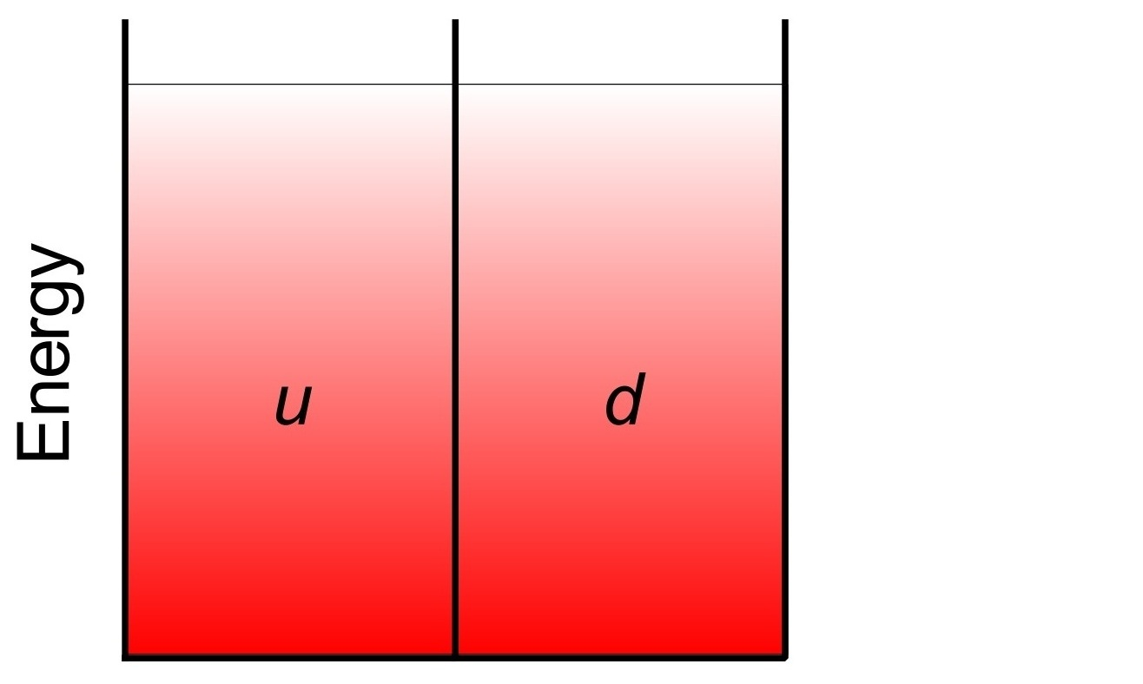
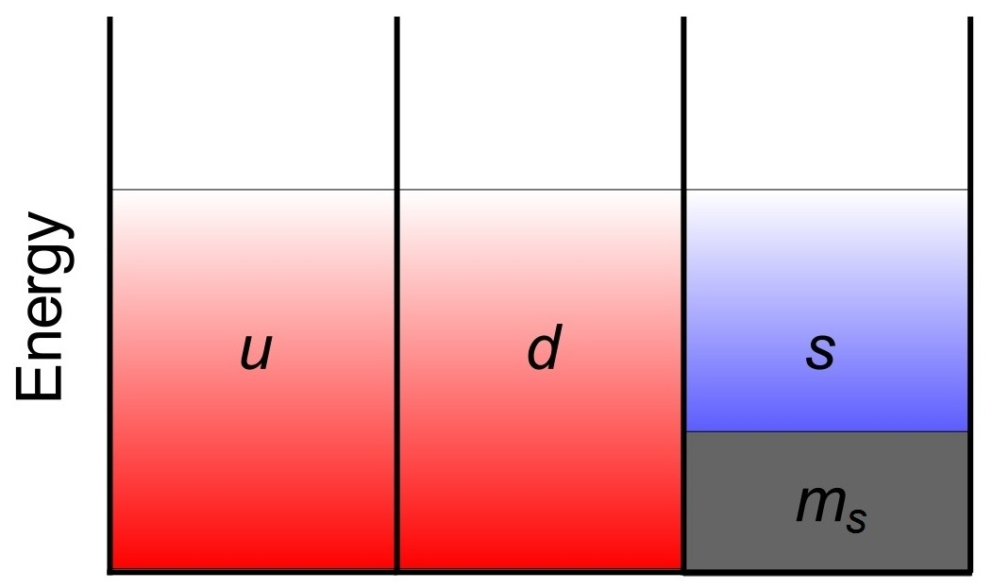
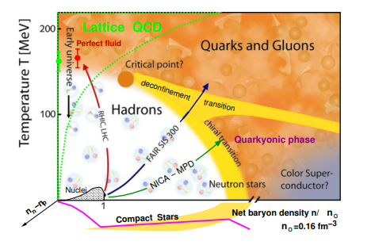
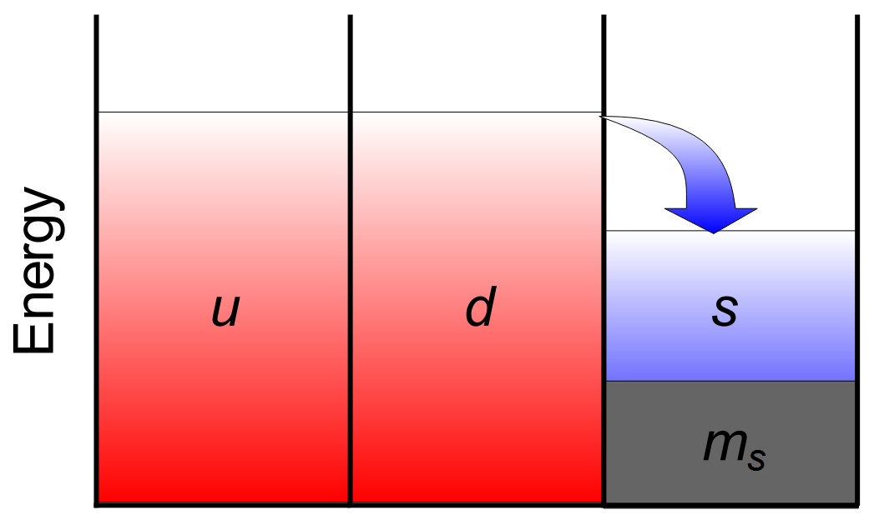
QCD Phase Diagram
Bodmer first proposed a low energy nuclear state called “collapsed nuclei”.[Bodmer1971_PRD4-1601]
Witten suggested that strange quark matter carrying roughly equal numbers of u, d, and s quarks may be the real ground state of the strongly interacting system.
[Witten1984_PRD30-272]
[McLerran2009_NPB195-275]
3
Notes:
This is a QCD phase diagram. We know that when the density of dense matter reaches more than 40 times nuclear saturation density , it can be described by perturbative QCD. However, for intermediate and low density regions, the contribution of the higher order term of perturbative expansion will exceed the leading order so that the perturbation calculation will no longer converge. In order to study strong interacting matter in the non-perturbative energy region, lattice QCD has been developed and some other satisfactory results have been obtained. However, when the chemical potential is not zero, the lattice QCD is troubled by the sign problem. As a result, many effective models have been developed. What we adopted in this study is the equivpartical model. Focus on the graph on the right, for the high density of quark matter consisting of u and d quarks, the Fermi energy of the u, d quark is greater than the mass of the s quark. In this case, u and d quarks can be transformed into s quarks through the weak interaction and reduce the energy of the system. After the weak equilibrium is reached, the energy of the system is lowest, and this is when the strange quark matter is formed. In 1971, Bodmer first discussed "collapsed nuclei." In 1984, Witten discussed that strange quark matter is absolutely stable to nuclear matter. This is the famous Witten-Bodmer Hypothesis.

Slide 4
The creation and decay of SQM
Creation:
Collision of binary compact star systems containing SQM (Madsen2002_JPG28-1737: A ≈ 10³⁸);
Phase transition during type II supernovae (Vucetich_Horvath1998_PRD57-5959);
Strangelets propagation through the atmosphere of the Earth (Banerjee_Ghosh_Raha_Syam2000_PRL85-1384);
Relics of the early universe (Witten1984_PRD30-272);
Heavy ion collisions (Weiner2006_IJMPE15-37);. . .
Temperature effect has an important influence on the survival and decay of the strange quark matter (SQM).
4
Notes:
There are several ways in which strangelets may be produced. The collision of binary compact star systems containing SQM may squirt strange quark matter outward. Type II supernova explosions driven by phase transition are also likely to generate strangelets. It is also possible that strangglets were created during the hadronic process in the early universe and persist to the present. When the strangelet reaches the Earth's atmosphere, because the larger the strangelet is, the more tightly bound it is, it is not easy for them to break into pieces after colliding with the atomic nuclei in the atmosphere, but to generate larger strangelet, so some strangelets can reach the ground. In addition, there are also attempts to generate strangelets from high energy heavy ion collision experiments. In these pathways, temperature effect has an important effect on the survival and decay of the strange quark matter (SQM).

Slide 5




Theoretical framework
The Lagrangian density of the equivparticle model can
be given as:
The quark mass scaling is given by
D is the linear confinement and C is the leading-order perturbative interactions.
The number density of quark
The baryon number density
[Xia_Peng_Chen et al2014_PRD89-105027]
[Xia_Peng_Sun et al2018_PRD98-034031]
5
Notes:
Next is the theoretical framework. The Lagrangian density of the equivparticle model can be given. Then, in the model, the strong interactions are considered with density-dependent quark masses and quarks are treated as quasi-free particles. So, The quark mass scaling is given as follows, where D is the linear confinement and C is the leading-order perturbative interactions. At the same time, quark number density and baryon number density can also be obtained.

Slide 6
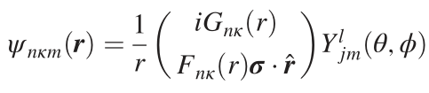
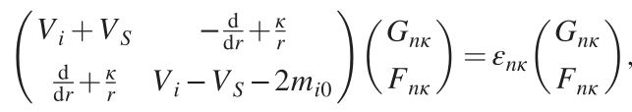


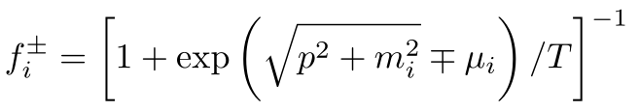
Strangelets in MFA
For spherically symmetric strangelets, the Dirac spinor
of quarks can be expanded as：
Then the Dirac equation for the radial wave functions is
obtained as：
The mean field scalar and vector potentials：
The occupation probability of each single-particle levels being fixed by the Fermi-Dirac statistics：
6
Notes:
In this study, we consider spherically symmetric strangelets, so the Dirac spinor of quarks can be expanded to spherical harmonics and radial wave functions. Based on the mean field approximation, the Dirac equation for the radial wave functions can be written in the following form. The mean field scalar and vector potentials can be given. Because of the temperature effect, the occupation probability of each single-particle levels being fixed by the Fermi-Dirac statistics.

Slide 7
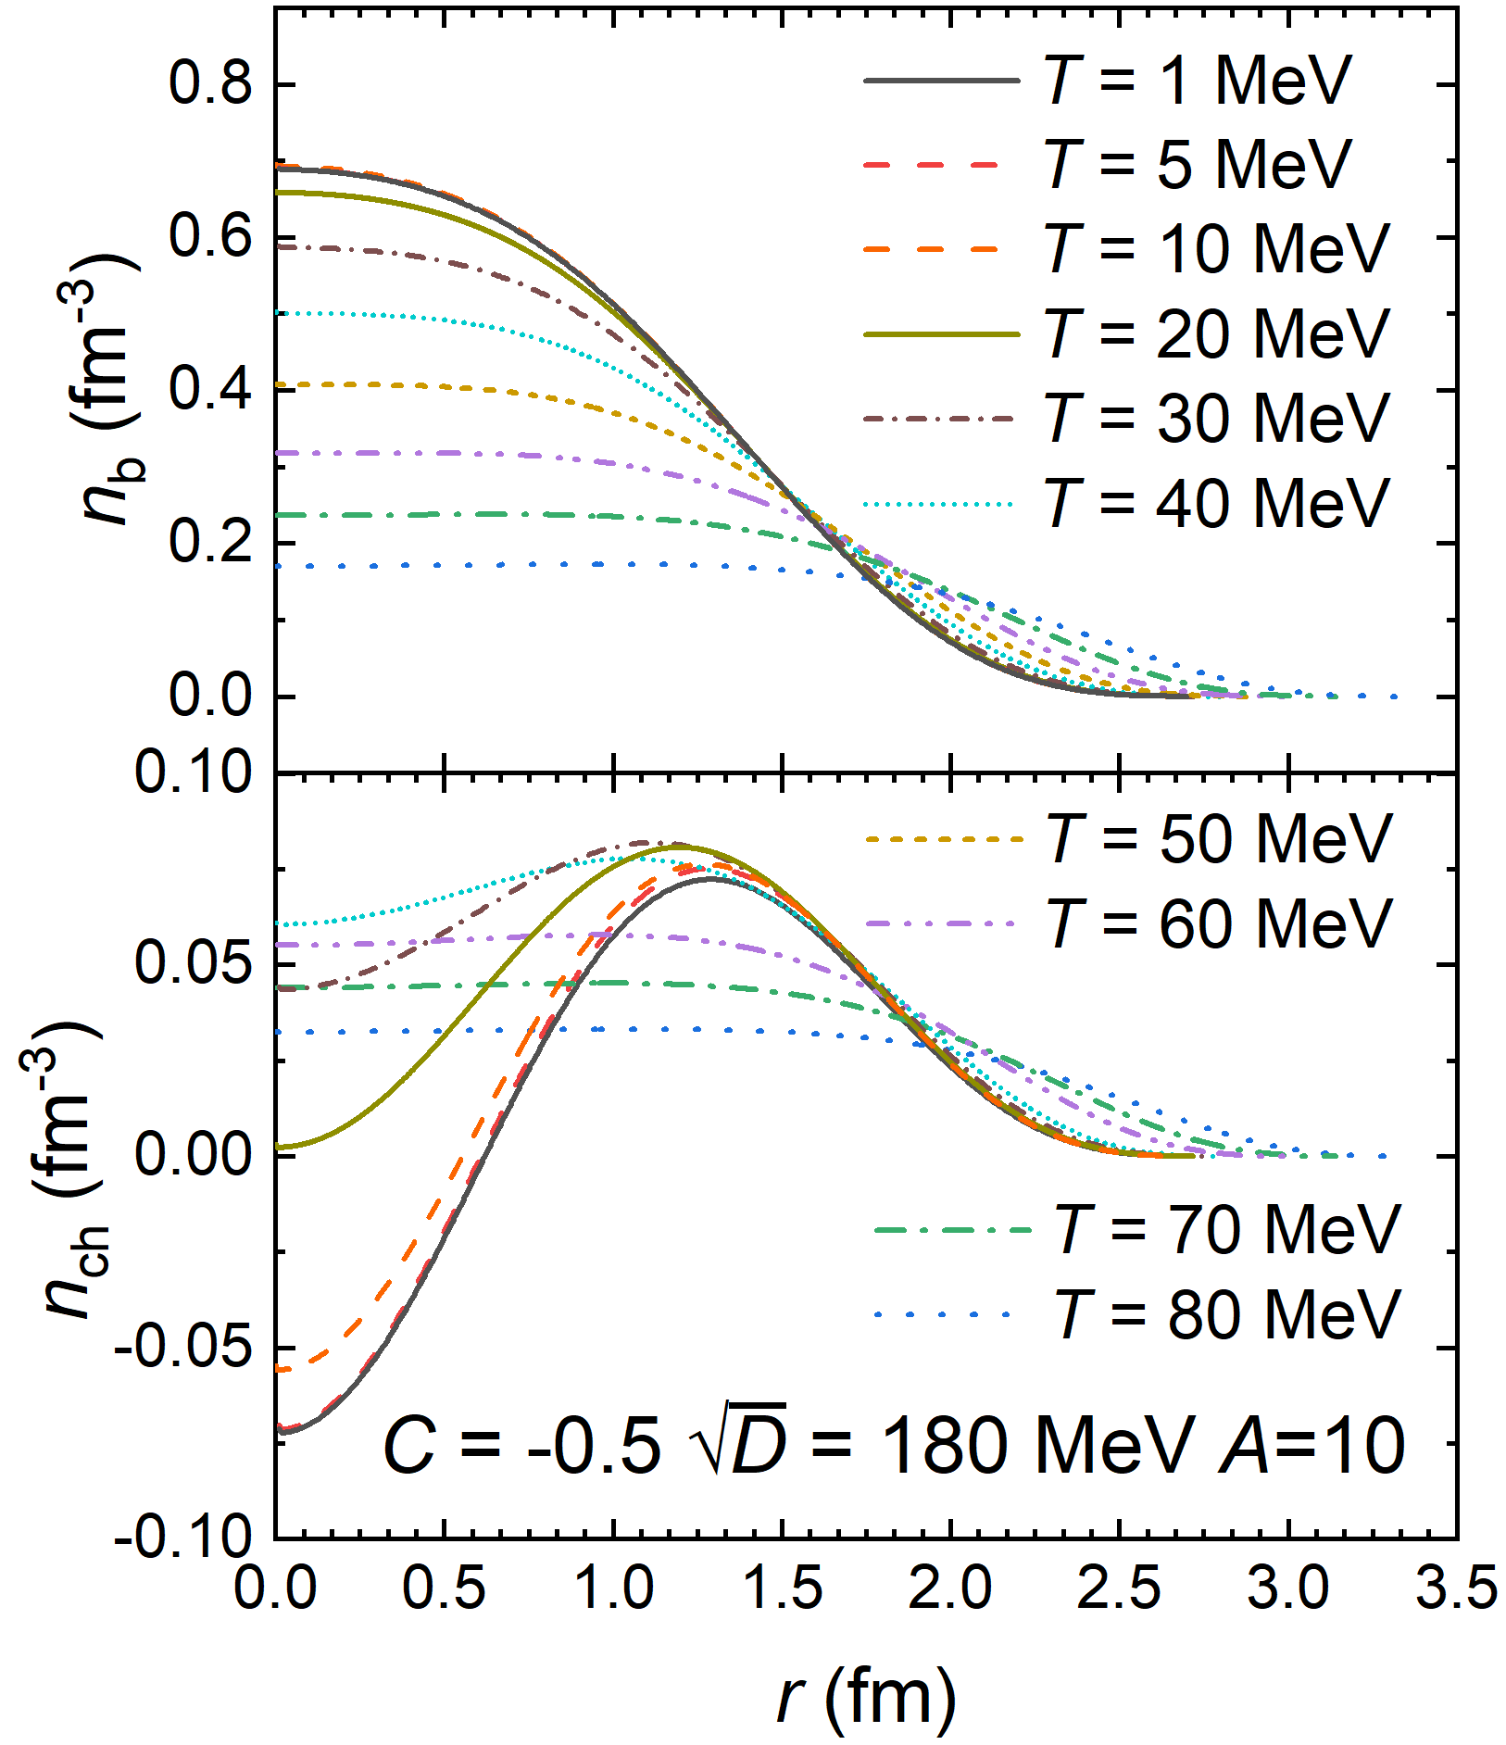
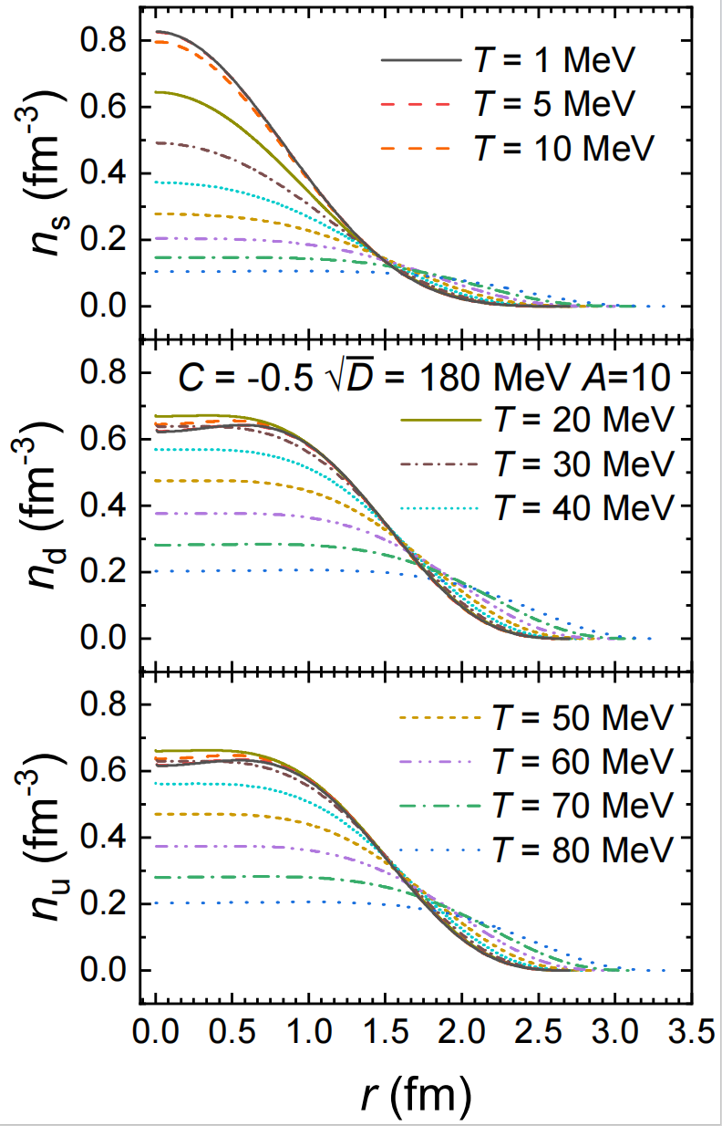
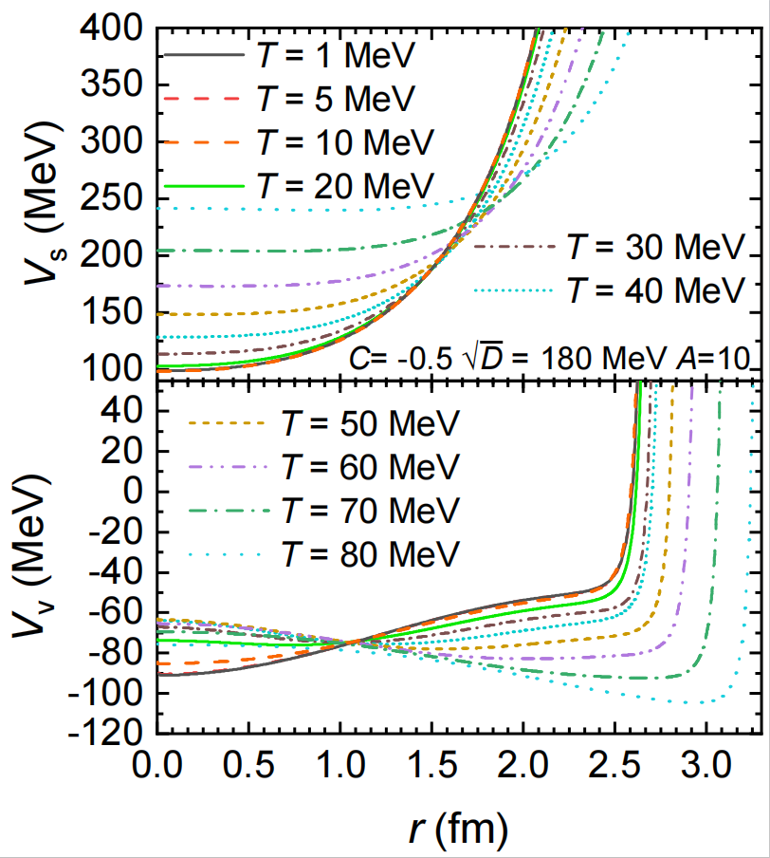
Results and discussion:Density profiles
[Oertel_Urban2008_PRD77-074015]
7
Notes:
In the third part, I will discuss the results of the calculation where the square of D is 180 MeV and C is Minus zero point five. The first given are the density profiles. On the left is the density distribution curve of the u, d and s quarks given by the bag model. On the right is our calculated quark density distribution. Among them, the density distributions of u and d quarks are very similar. Since the lattice calculation suggests that quark-quark interaction is proportional to the distance instead of a wall, so our surface density profiles are more reasonable. As the temperature increases, the density distribution of quarks becomes more diffuse. The same as the baryon number density. When the temperature is low, the charge density inside the strangelet is negative; With the increase of temperature, the central charge density increases first and then decreases. When T is equal to 20MeV, the central charge density of the strangelet is almost 0. Because of quark confinement, the mean field potentials become infinitely large at the quark-vacuum interface. Due to the temperature effect, the depth of the scalar potential increases but the vector potential is bascially unchanged.

Slide 8
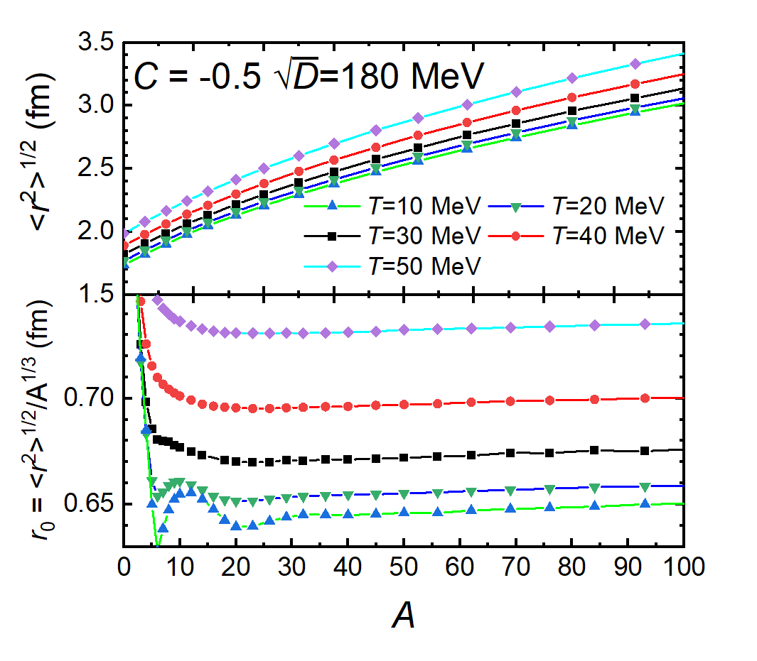
Strangelets in MFA
8
Notes:
Because the temperature effect makes SQM diffuse, the root-mean-square radius of the strangelets also increases with temperature. The ratio of root-mean-square radius to baryon number not only shows a tendency to increase with temperature, but also shows a shell effect at low temperature when the baryon number is less than 20.

Slide 9
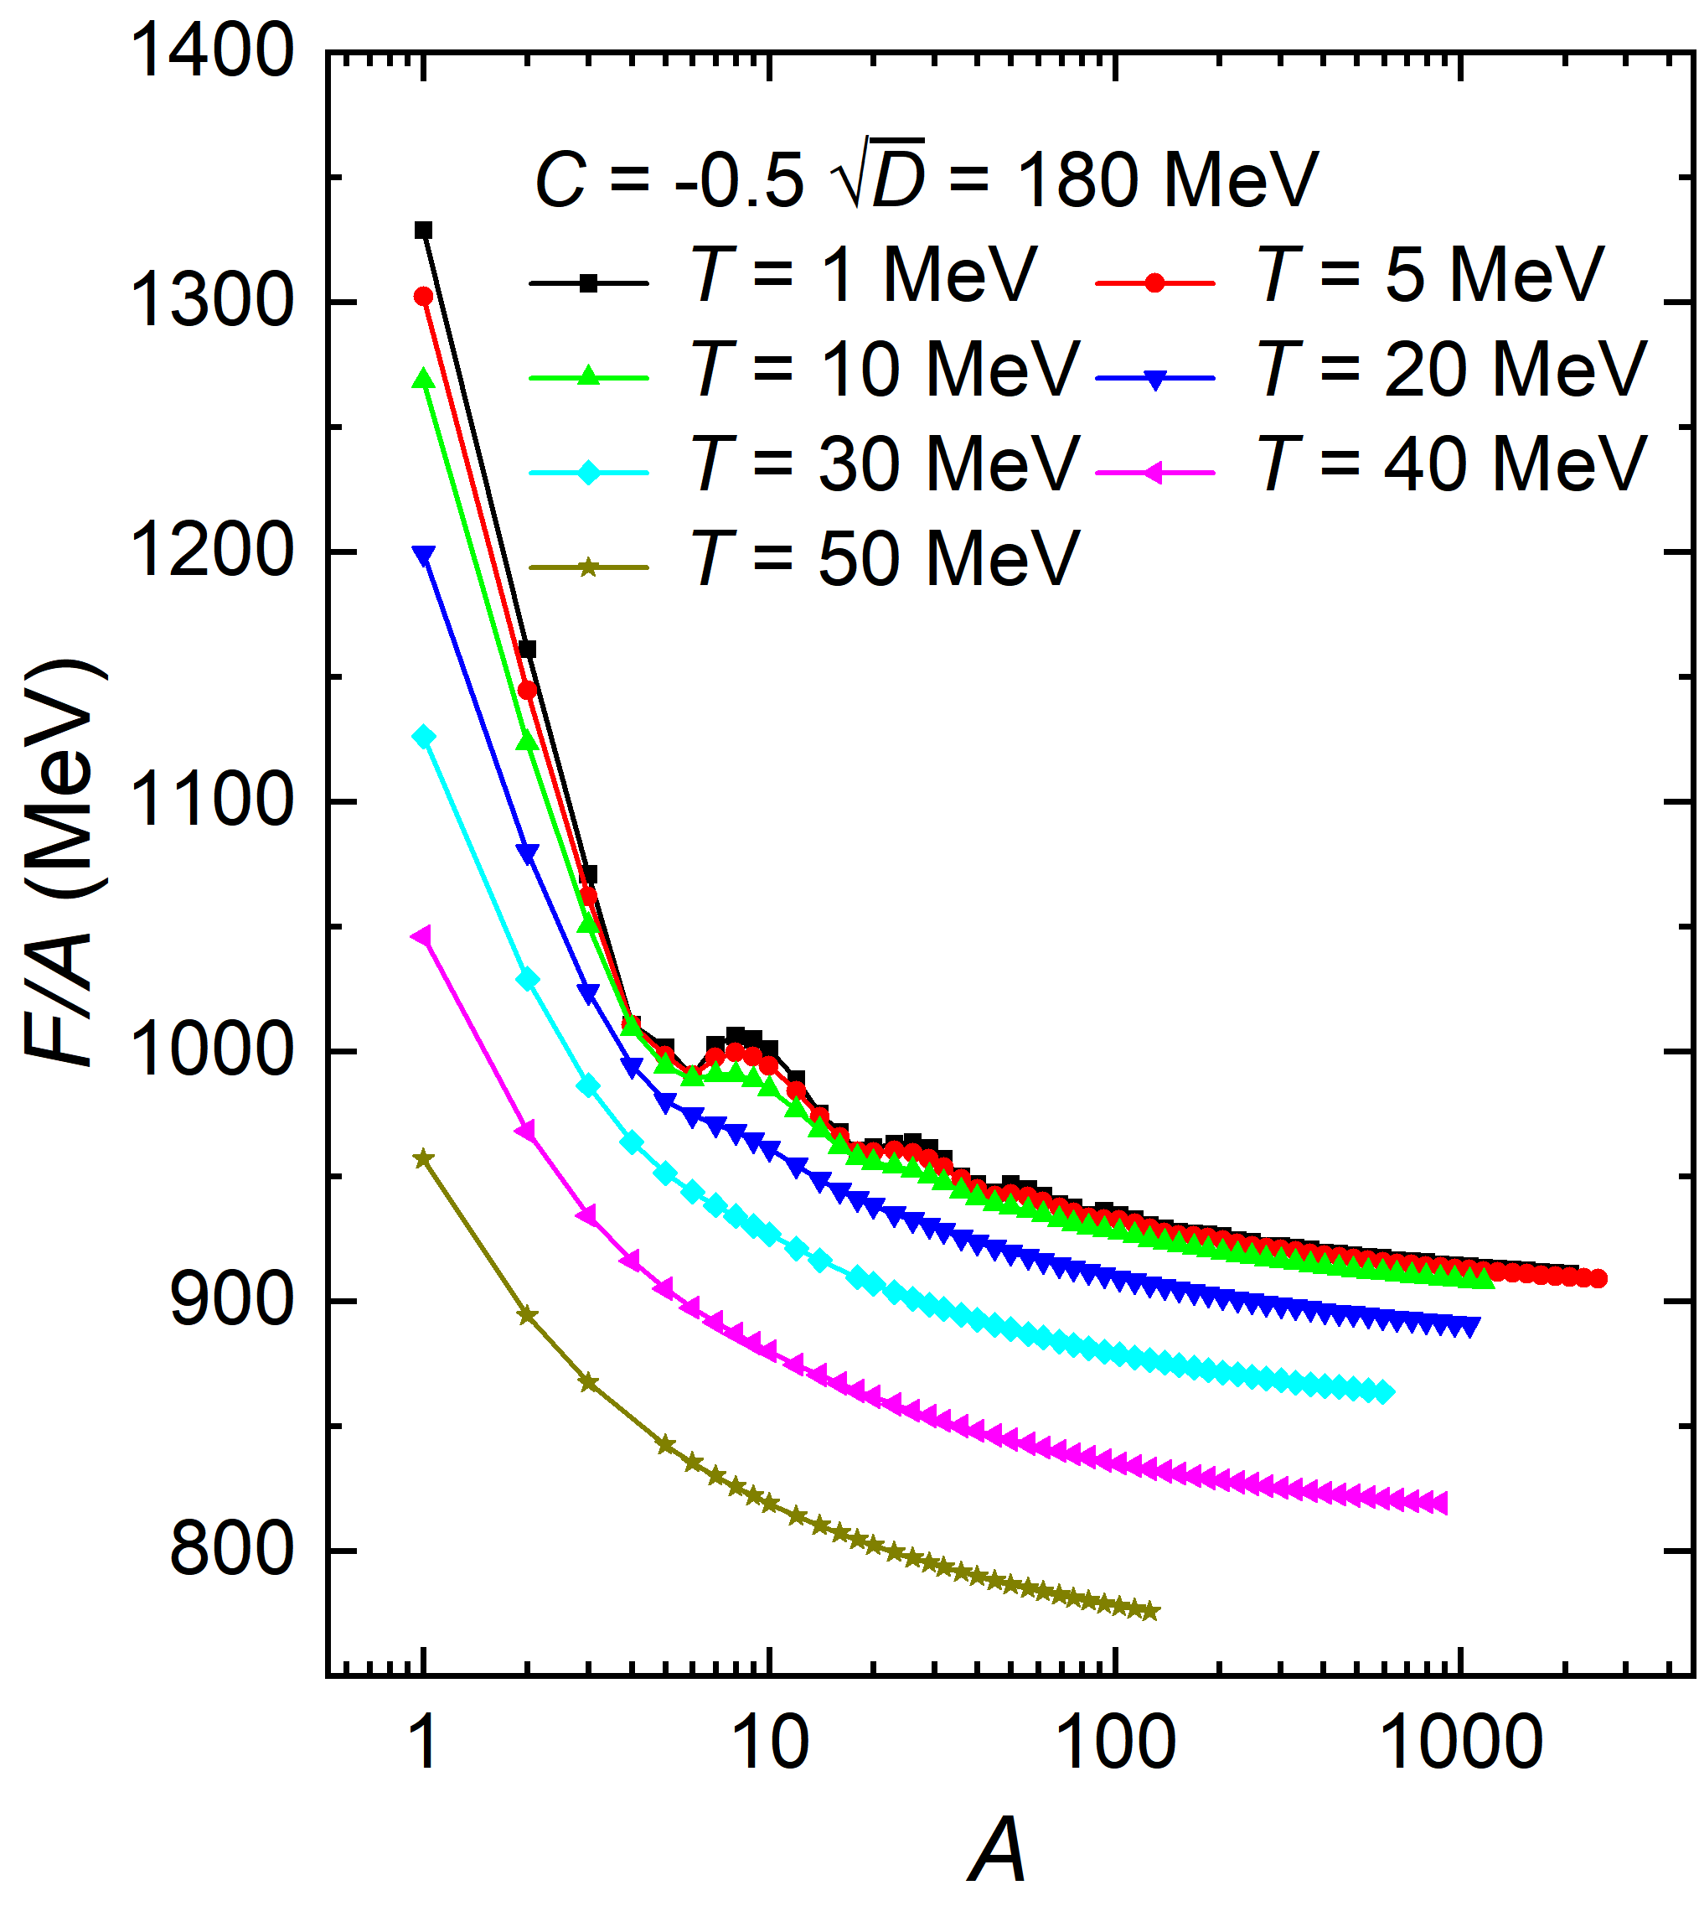
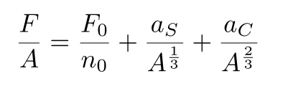



Shell dampening
We use a liquid-drop type formula to fit the free energy per baryon.
is the free energy per baryon of bulk SQM.
$$a_{S}$$
,$a_{C}$
are the fitted parameters.
[Oertel_Urban2008_PRD77-074015]
9
Notes:
This is a graph for free energy per baryon of β-stable strangelets. We also use the parameter set where C is minus 0.5 and the square root of D is 180 MeV. As the size of the strangelet becomes large, the number of baryons also increases, the free energy per baryon decreases and finally reaches the bulk value.The table in page 1. As the temperature goes up, the free energy goes down. Then, We use a liquid-drop type formula to fit the free energy per baryon. F zero over n zero is the free energy per baryon of bulk SQM. Alpha s and Alpha c are the fitted parameters.

Slide 10
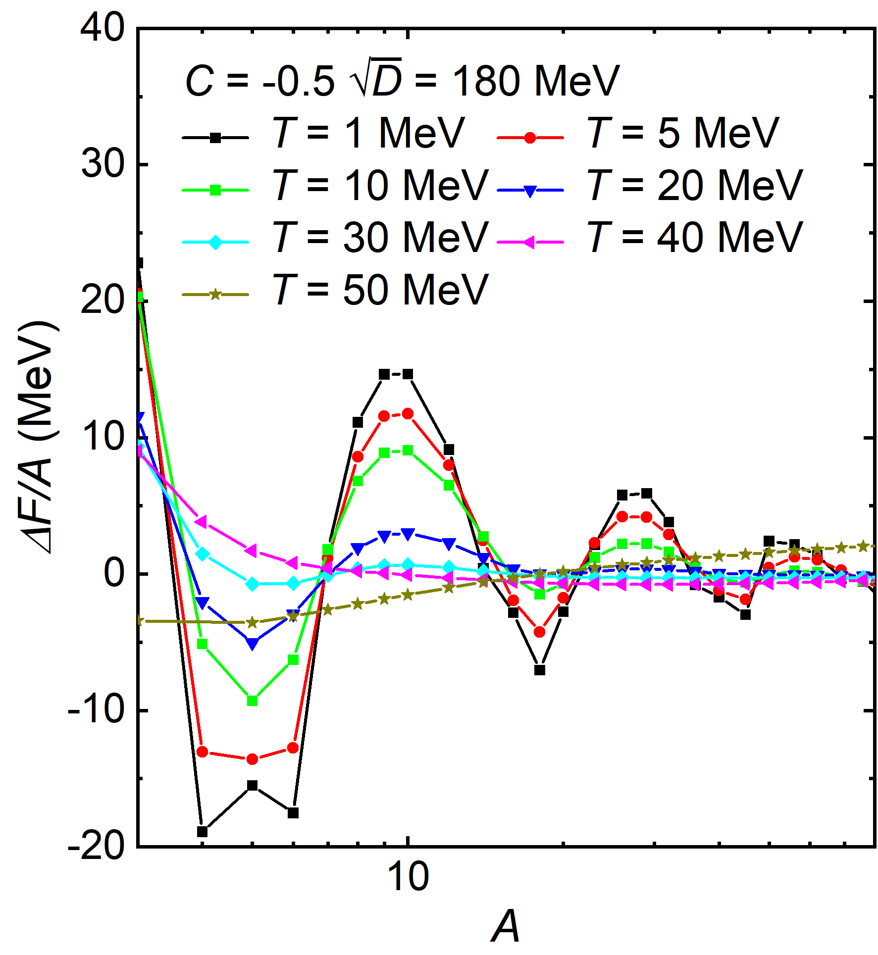
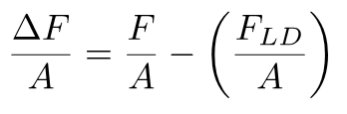
Shell dampening
Shell effects diminish with temperature!
Many properties of strangelets also exhibit shell effects.
10
Notes:
When we subtract the calculated value from the liquid-drop type fit, we can use the difference to show the shell effect. The results are clear, shell effects diminish with temperature! The difference is decreasing. Many properties of strangelets also exhibit shell effects.

Slide 11
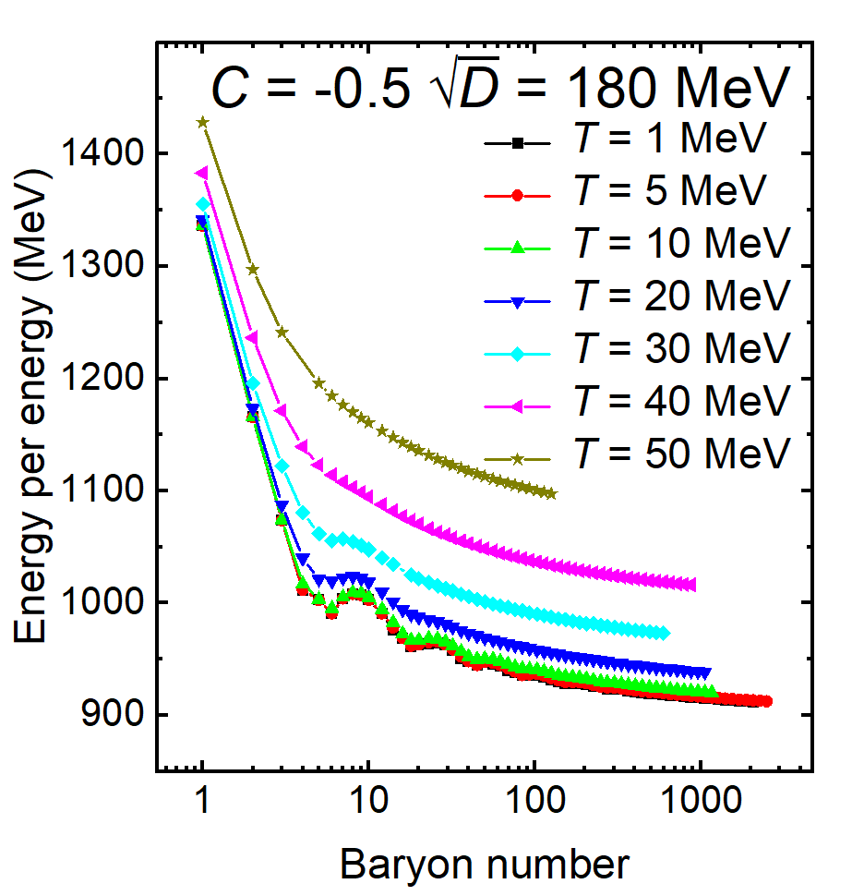
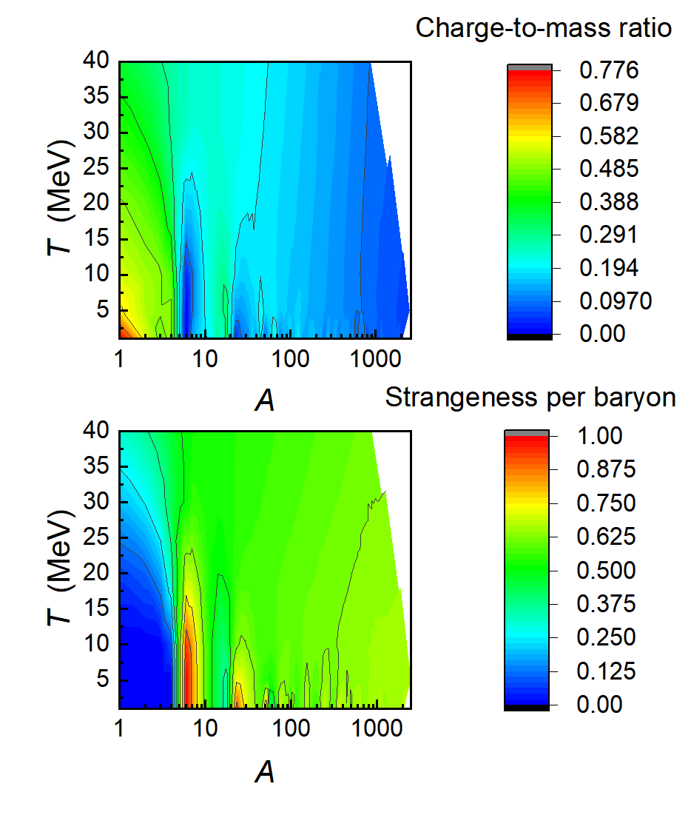
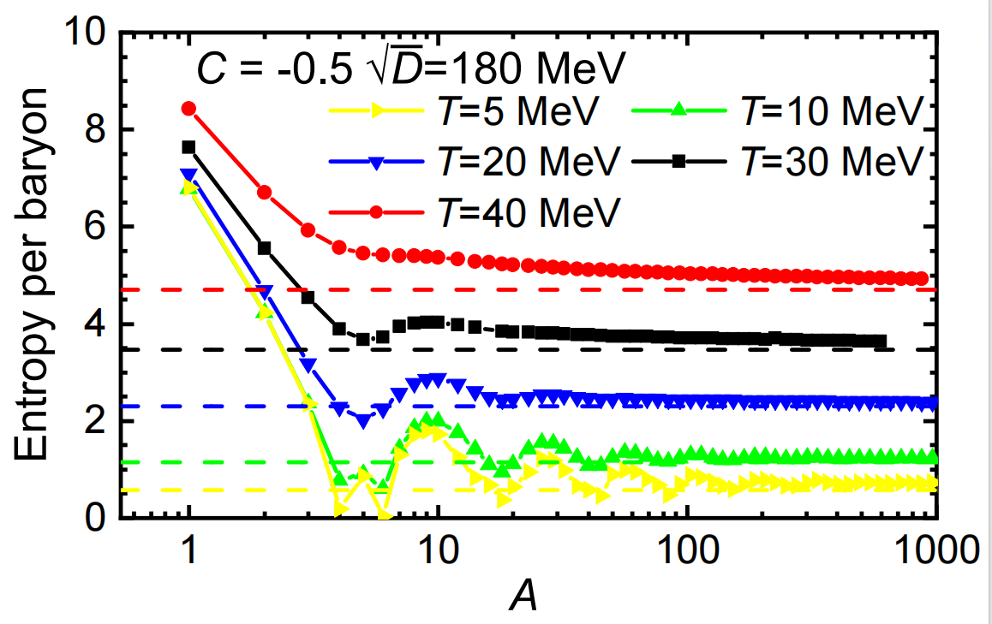
Properties of strangelets
11
Notes:
Both energy per baryon and entropy per baryon increase with increasing temperature. Different colored horizontal lines represent bulk values at different temperatures. Due to shell effects, strangelets with certain baryon numbers (A = 4, 16, …) , their charge to mass ratio is lower than the neighbor ones, while the strangeness per baryon are the opposite. All of these, shell effects diminish with temperature.

Slide 12
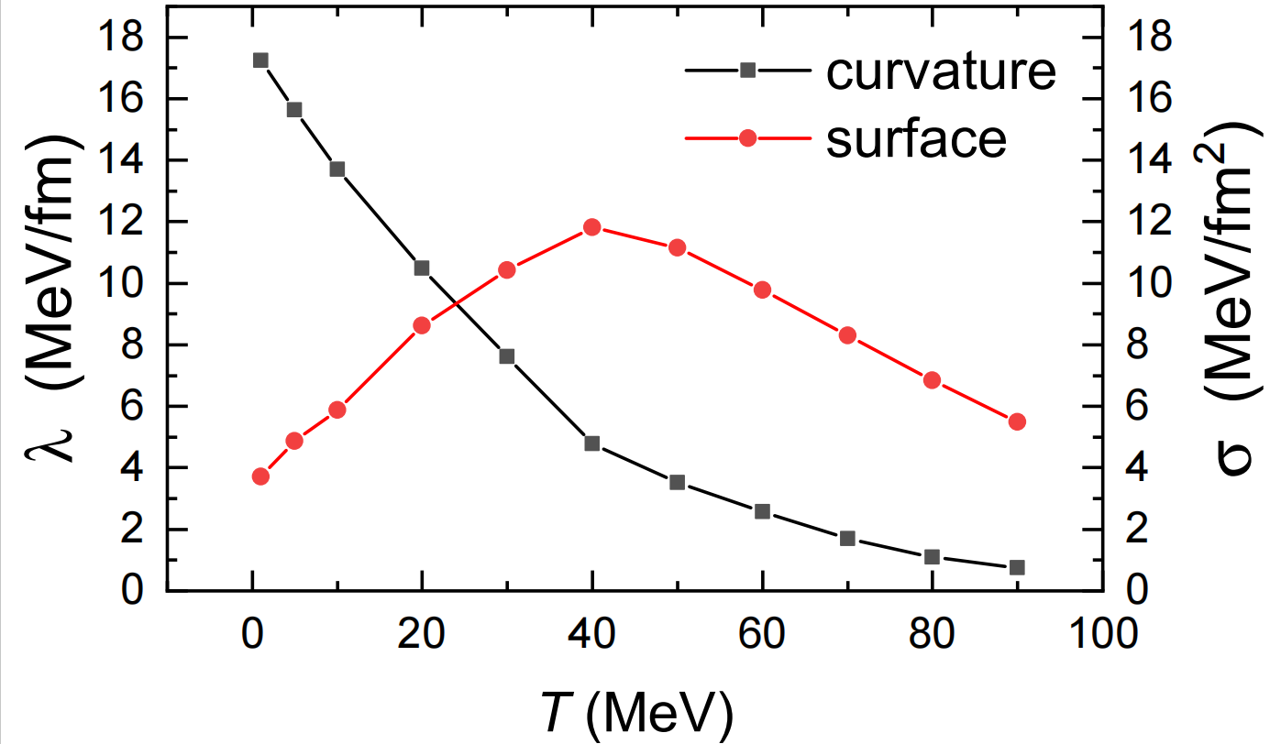
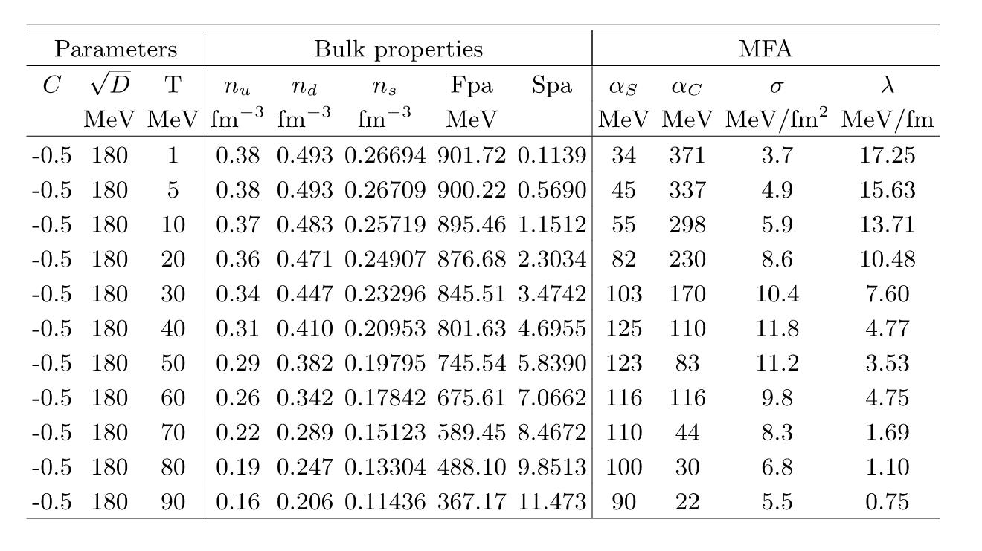
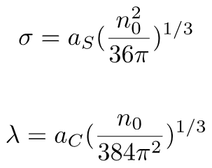
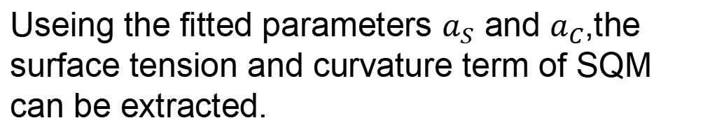
Interface effect
Useing the fitted parameters $a_{S}$ and $a_{C}$,the surface tension and curvature term of SQM can be extracted.
Peak
12
Notes:
Useing the fitted parameters a_S and a_C , the surface tension and curvature term of SQM can be extracted. The formulas are as follows. This is a table which include the bulk properties and the surface tension and curvature term of SQM for C is minus 0.5 and square root of D is 180 MeV. Then we can draw a picture like this. Consequently, instead decreasing with temperature, the surface tension increases with T until reaching its peak at T ≈ 20-40 MeV with vanishing shell corrections. The curvature term, nevertheless, decreases with T despite the presence of shell effects.

Slide 13
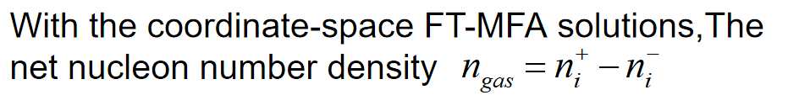
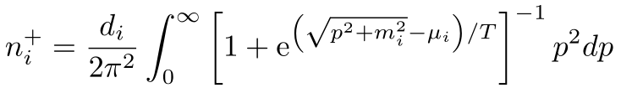

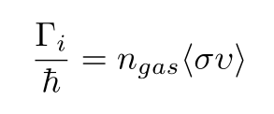

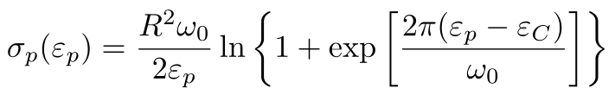
Nucleon emission rate
The formula for the emission widths of a particle can be given as:
[Zhu_Pei2014_PRC90-054316]
σ is the nucleon capture cross section. For neutrons,σ is simply treated as . For protons,coulomb interaction
is an important factor,
[Wong1973_PRL31-766]
13
Notes:
We also calculate the nucleon emission rate. With the coordinate-space solutions, the net nucleon number density can be given like this. Another important factor is the nucleon capture cross section. For neutrons, sigma is simply treated as pi R squared . For protons,coulomb barrier is an important factor. So the sigma for protons is this. Useing the formula , the neutron and proton emission rates are fixed microscopically according to the external nucleon gas densities that are in equilibrium with strangelets.

Slide 14
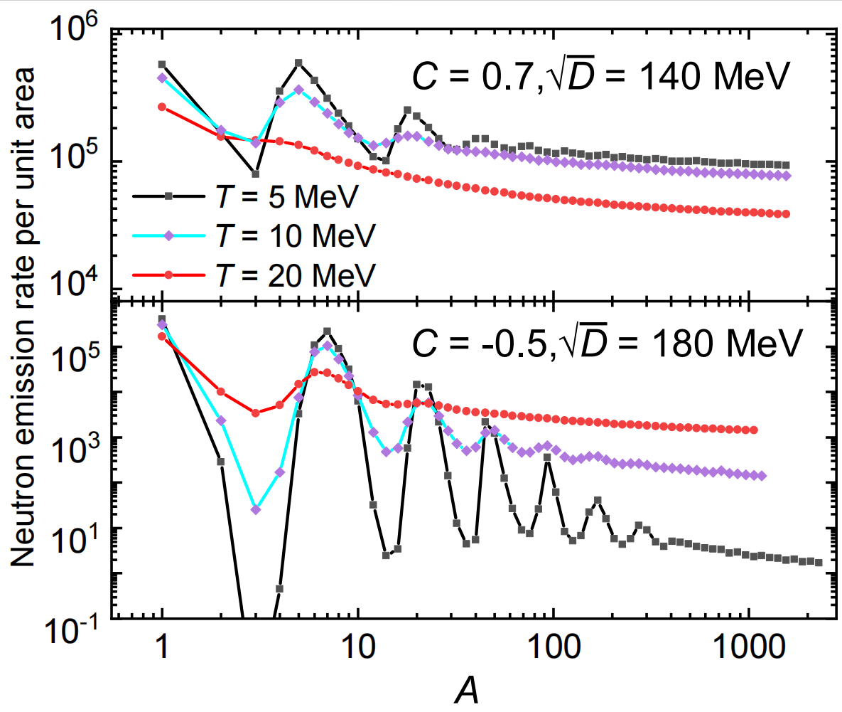
Nucleon emission rate
Strangelets are unstable
Stable strangelets
14
Notes:
Shell effect, Shell dampening caused by temperature still exists. But something is special. The nucleon emission rate generally increase with T for stable strangelets but decrease for ones that are unstable against nucleon emission at T = 0. When we choose the parameter set like this,C is 0.7 and the root square of D is 140MeV the neutron emission rate per unit area is becoming small with the temperature.

Slide 15
Summary
Based on an equivparticle model, we study the interface effects and shell effects in strangelets at finite temperture adopting mean-field approximation (MFA).
The shell effects diminish with the increase of temperature.
The surface tension increases with T until reaching its peak at T ≈ 20-40 MeV with vanishing shell corrections.
The curvature term decreases with T despite the presence of shell effects.
The neutron and proton emission rates generally increase with T for stable strangelets but decrease for unstable ones
15
Notes:
Based on an equivparticle model, we study the interface effects and shell effects in strangelets at finite temperture adopting mean-field approximation (MFA).
1.The shell effects diminish with the increase of temperature.
2.The surface tension increases with T until reaching its peak at T ≈ 20-40 MeV with vanishing shell corrections.
3.The curvature term decreases with T despite the presence of shell effects.
4.The neutron and proton emission rates generally increase with T for stable strangelets but decrease for unstable ones.s

Slide 16
Thank you
16

