Slide 1
Interacting ud and uds quark matter
at finite densities and quark stars
Wen-Li Yuan (苑文莉)
Nanjing University and Xiamen University, China
Collaborators: Ang Li, Zhi-Qiang Miao, Bing-Jun Zuo, and Zhan Bai
arXiv: 2203.04798, Phys. Rev. D 105, 123004（2022）
“Quarks and Compact Stars”
Sept. 22-26 CGC, Yangzhou University, Yangzhou, China
Notes:
Hello, everyone! I am Wen-Li Yuan from Nanjing University and Xiamen University.
Thanks for giving me this opportunity to give a presentation at this conference.
The title of my presentation today is “Interacting ud and uds quark matter at finite densities and quark stars”.

Slide 2
Outline
1
Dense matter and compact stars
Interacting quark matter at finite baryon densities within modified NJL model
2
Quark matter equation of state (EOS) and self-bound quark stars
3
4
Conclusions and outlook
Notes:
The presentation consists of the following four sections.

Slide 3
Outline
1
Dense matter and compact stars
Interacting quark matter at finite baryon densities within modified NJL model
2
Quark matter equation of state (EOS) and self-bound quark stars
3
4
Conclusions and outlook
Notes:
The first part is a brief description of dense matter and compact stars.

Slide 4
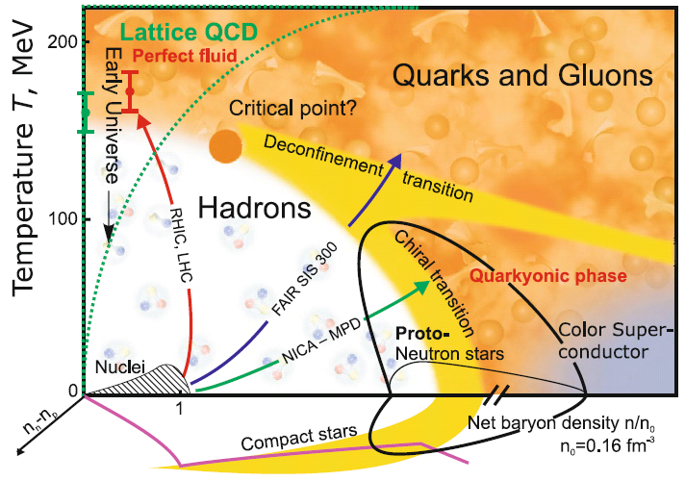
QCD phase diagram
Chiral phase transition:
Low baryon density: crossover
High baryon density: first order
Critical end point (CEP): the end of a first order phase line
NICA White paper
Notes:
We know that the theory of quantum chromodynamics (QCD) predicts that strong interaction matter exhibits very rich phase structures. This is the conjectured QCD phase diagram.
And most of the chiral effective model calculations proves that chiral phase transition is first-order at large densities, and there exists a critical-end-point (CEP). Then the phase transition becomes a crossover.
However, up to now, the specific details of the entire QCD phase diagram are not clear enough.

Slide 5
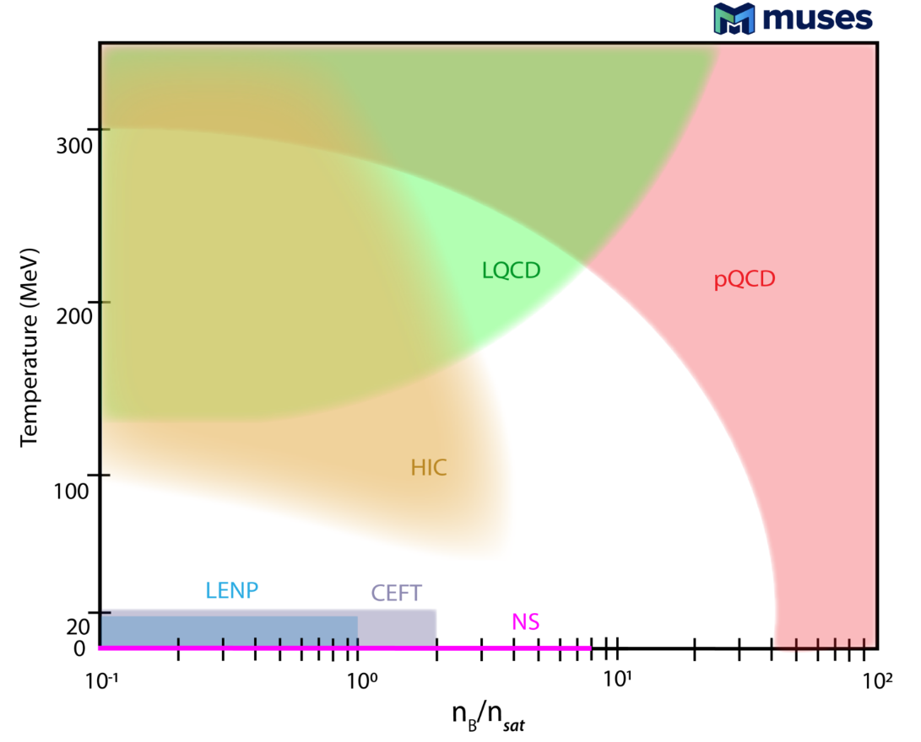
Theoretical and experimental constraints
Theoretical difficulties
High energy scale: perturbative QCD
Low energy scale: lattice QCD (T),
effective field theory etc.
Hadron degrees of freedom:
RMF, Skyrme model, quark-meson model…
Quark degree of freedom:
Nambu–Jona-Lasinio (NJL), Dyson-Schwinger Equation…
Neutron star mergers
Supernovae
What is the state of supra-nuclear matter?
Notes:
Theoretically speaking, because QCD is an asymptotically free theory for quarks and gluons, the running coupling is weak enough at high energy scale and the interaction between quarks is dominated by one-gluon exchange, this enables us to employ the perturbative method to study the quark matter.
But, in the intermediate and lower density regions, due to the non-perturbative difficulty, the calculation cannot be performed from a first-principle approach. So, in this case, we have to choose an effective field theory.

Slide 6
Compact stars: a natural laboratory
What is the state of supra-nuclear matter?
Terrestrial experiment: hard to reach
Compact stars: natural laboratory
Lai Xiaoyu and Xu Renxin 2017 J. Phys.: Conf. Ser. 861 012027
Notes:
On the one hand, what is the state of supra-nuclear matter has been the fundamental question that needs to be solved. And it is also an immense problem directly related to neutron star physics.
On the other hand, it is difficult for terrestrial experiments to reach such a low-temperature and extremely dense physical environment, and compact stars provide a natural laboratory.
Depending on the interior components, there are different compact star configurations, such as hadron star, quark star, hybrid star, and strangeon star.

Slide 7
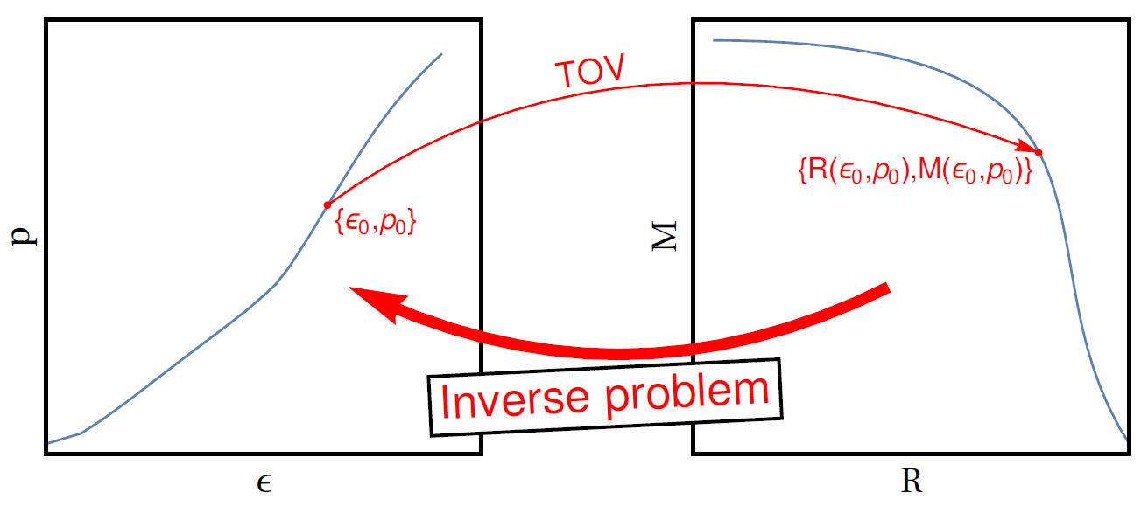
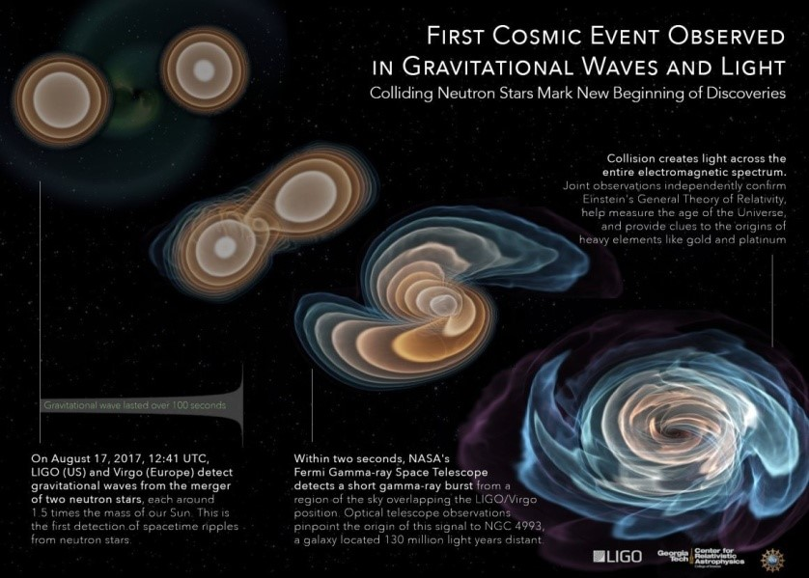
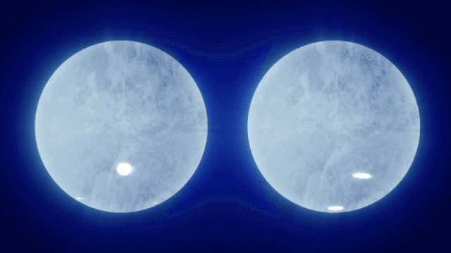
Constraints from compact stars
The unique mapping between the EOS and the M-R relation
(Abdelsalhin, T, 2019)
Astronomical observation:
GW170817 (the ‘golden’ event)
PSR J0030+0451
PSR J0740+6620
(currently most massive NS)
(Miller et al. 2019)
(Riley et al. 2019)
(Miller et al. 2021)
(Riley et al. 2021)
Notes:
We know that the equation of state establishes a unique mapping correspondence with the M-R relation through TOV equations.
Because of this, by using astronomical observations, such as the GW170817 event and the recently measured masses and radii,
we can constrain the effective field theory as well as the equation of states (EOS) of dense matter, and examine the true ground state of baryonic matter.

Slide 8
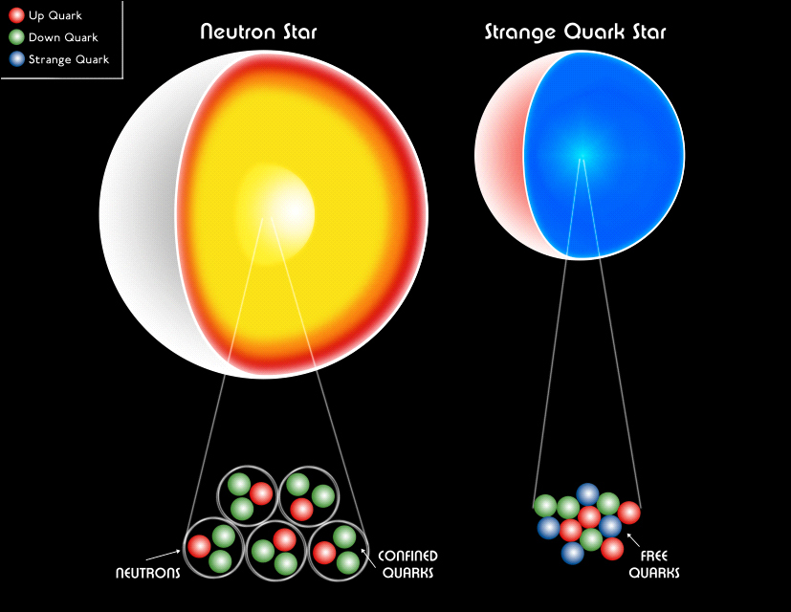
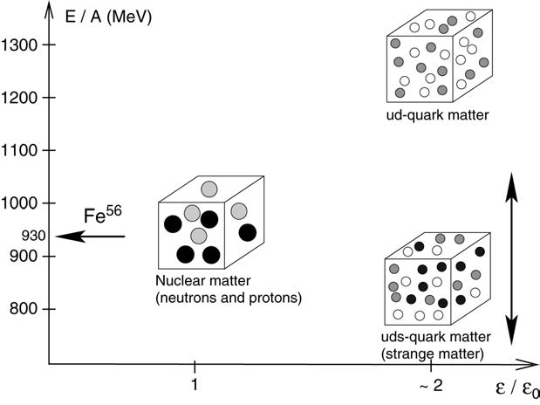
The absolutely stable strange quark matter
Bodmer-Witten
hypothesis
Phys. Rev. D 4, 1602 (1971)
Phys. Rev. D 30, 272 (1984)
Weber 2005
The strange quark matter is the true ground state of baryonic matter, which has a lower energy per baryon than iron nucleus ($E/A<930).$
Credit: NASA/CXC/M.Weiss
All compact objects would be strange quark stars!
Notes:
One interesting thing is that, in the 1970s, based on the quantitative studies within MIT bag model, Witten proposed a hypothesis that strange quark matter is the true ground state of baryonic matter, which has a lower energy per baryon than iron nucleus (Fe).
As a result, all compact objects would be strange quark stars instead of neutron stars.

Slide 9
The absolutely stable nonstrange quark matter
A recent study:
Bob Holdom, Jing Ren, and Chen Zhang
If we consider the flavor-feedback dependent of the quark gas on the QCD vacuum, ud quark matter could be in general more stable than uds quark matter.
Neutron star:
Gravity-bound
Quark star:
Self-bound by strong interactions
Whether quark matter is absolutely stable :
Phys. Rev. Lett. 120,222001 (2018)
Important for various astrophysics and cosmological problems:
Supernovae, gamma-ray bursts, pulsar glitch, cosmic rays etc.
Nonstrange quark stars could also exist.
What is the true ground state of baryonic matter?
Notes:
And, recently, it has also been proposed that, if the flavor feedback dependence of the quark gas on the QCD vacuum is considered, two flavor quark matter could be more stable than three flavor quark matter.
Then non-strange quark stars could also exist.
Therefore, there is a hot debate about what the true ground state of baryonic matter is. Unlike neutron stars that are gravity-bound, such quark stars are self-bound by strong interactions.
Whether quark matter is absolutely stable is not only a difficulty for non-perturbative strong interaction, but also could have important consequences on various astrophysics and cosmological problems.
This work expects to examine the true ground state of baryonic matter through astronomical observations and to constrain the EOS of quark matter.

Slide 10
Outline
1
Dense matter and compact stars
Interacting quark matter at finite baryon densities within modified NJL model
2
Quark matter equation of state (EOS) and self-bound quark stars
3
4
Conclusions and outlook
Notes:
For the second part, I study the interacting quark matter at finite baryon densities within the modified NJL model.

Slide 11
Nambu–Jona-Lasinio (NJL) model
An important and valid effective quark theory ( a suitable approximation to QCD
in the low-energy and long-wavelength limit)
Reproduce the basic symmetries of QCD
Dynamical chiral symmetry breaking (DCSB)
Confinement
Notes:
In this work, the effective theory I use is NJL model, which is an important and valid effective quark theory.
The NJL model can reproduce the basic symmetries of QCD, and has the feature of dynamical chiral symmetry breaking of QCD, which is responsible for about 98% of the masses of the universe.
But, this model cannot describe confinement.

Slide 12
Modified Nambu–Jona-Lasinio (NJL) model
The original two-flavor NJL model:
“Novel self-consistent mean field approximation
and its application in strong interaction phase
Transitions”
Fei Wang, Yakun Cao, Hongshi Zong
Chinese Phys. C 43 084102 (2019)
To improve the description of the strong interaction matter at large chemical potential
To resolve the huge contradictions
results drawn from the quark-gluon degrees of freedom
contradictions
results derived from the hadron degrees of freedom
Notes:
In the following, I will introduce the formalism of NJL model.
This is the original Lagrangian of two flavor NJL model, which contains the scalar and pseudoscalar interactions.
Recently, to improve the description of the strong interaction matter at large chemical potential,
and as an attempt to resolve the huge contradictions between the results drawn from the quark-gluon degrees of freedom and the expected results derived from the hadron degrees of freedom,
Prof. Zong proposed a modified NJL model containing both the original model Lagrangian and the Fierz transformation of it.

Slide 13
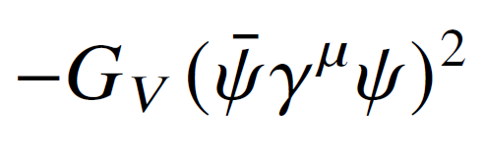
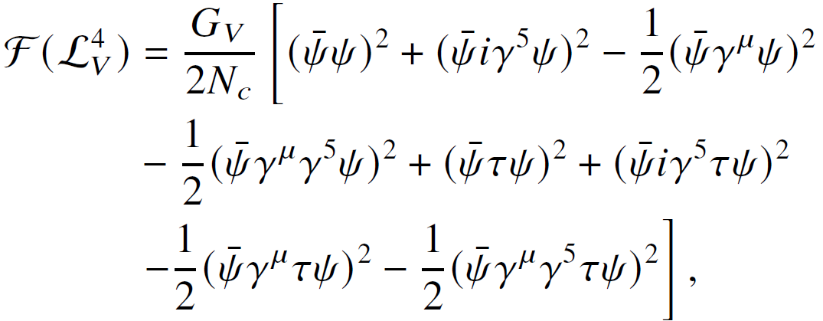
Modified Nambu–Jona-Lasinio (NJL) model
The original two-flavor NJL model:
“Novel self-consistent mean field approximation
and its application in strong interaction phase
Transitions”
Fei Wang, Yakun Cao, Hongshi Zong
Chinese Phys. C 43 084102 (2019)
The vector interaction is important for the study of compact stars.
Consider the effect of a rearrangement of fermion field operators
Notes:
Because the vector interaction is significant for the study of compact stars. Here, we consider this interaction.
And In order to make this model more complete, we use the Fierz transformation to further consider the effect of a rearrangement of fermion field operators, and examine the exchange channels influence.
The left side is the Fierz identity of scalar interactions, and the right side is the Fierz identity of vector interactions.
Because the Fierz transformation is a mathematical technique, we can combine the original interaction terms and Fierz transformed interaction terms, using a weighting factor α.
Then, changing the value of α, we can study the effect of different interaction channels.

Slide 14
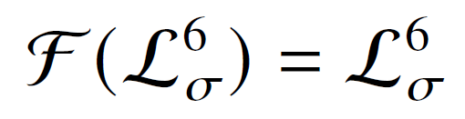
Modified Nambu–Jona-Lasinio (NJL) model
The original (2+1)-flavor NJL model:
Modified (2+1)-flavor NJL model:
Notes:
In the same way, for the three-flavor NJL model, applying the Fierz transformation to four-fermion scalar and vector interaction term, and the six-fermion interaction term. We can obtain an effective Lagrangian here.

Slide 15
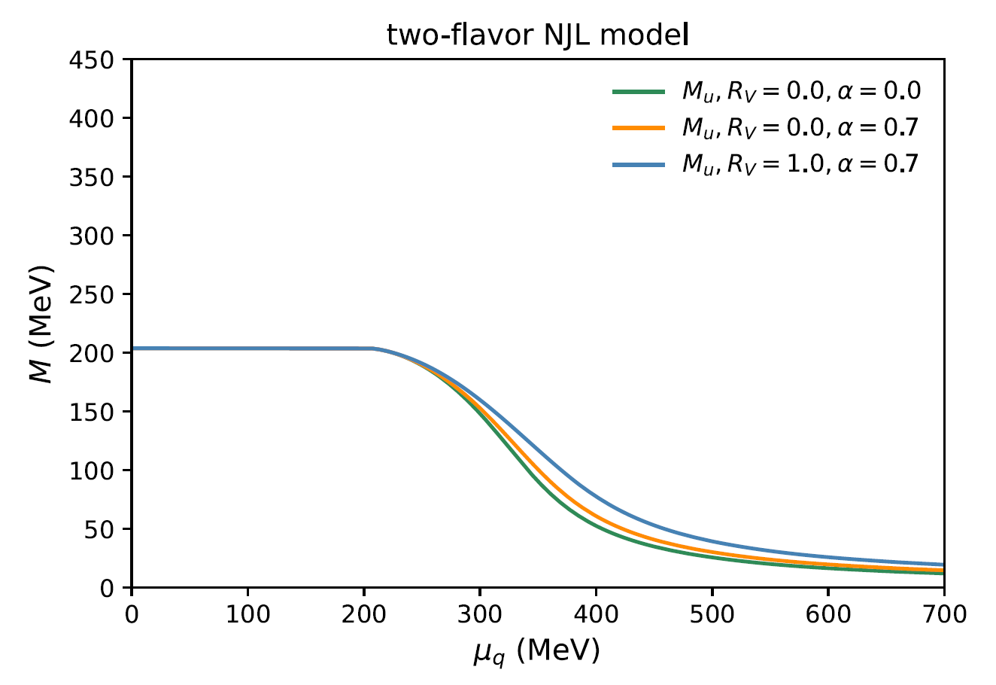
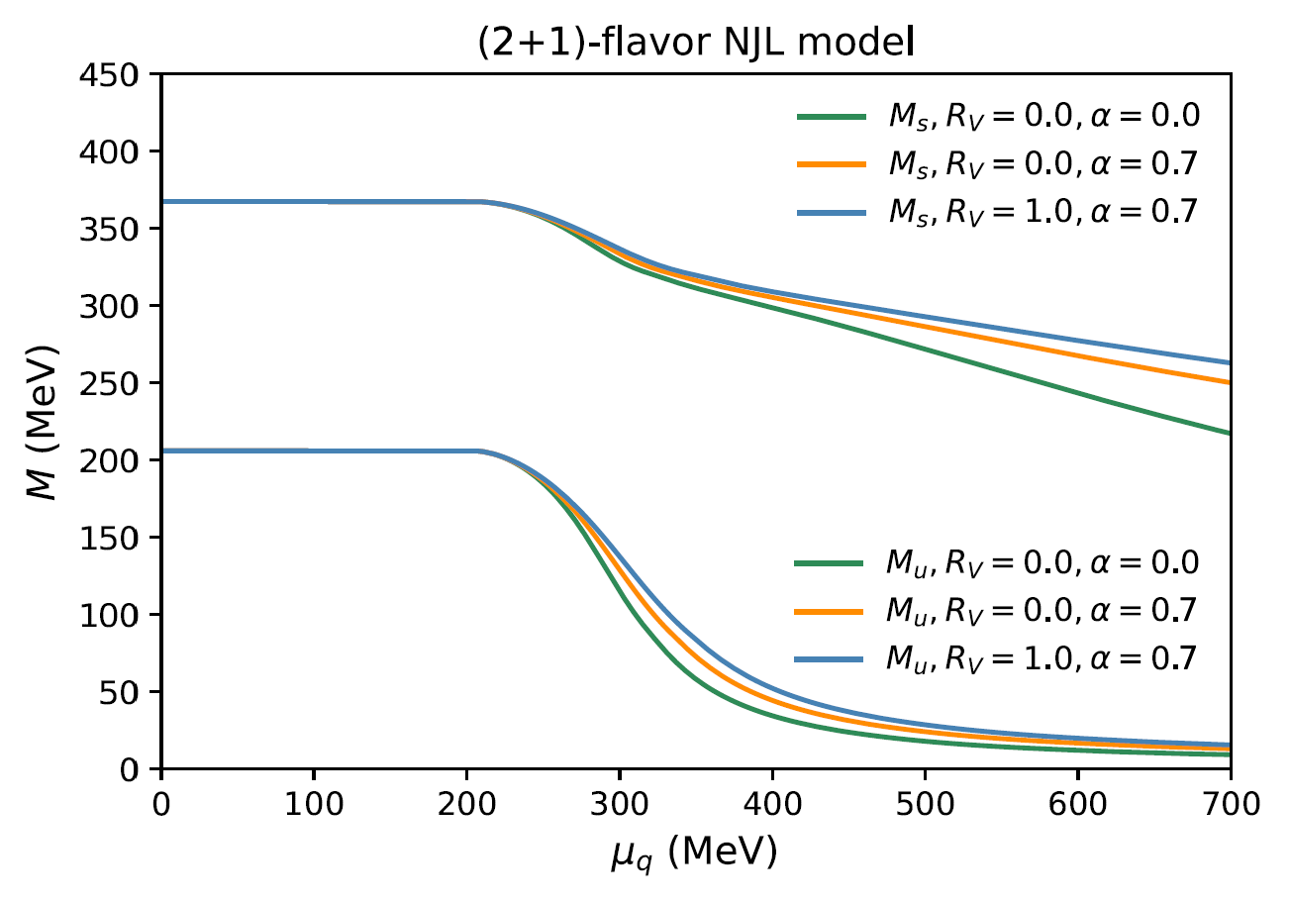
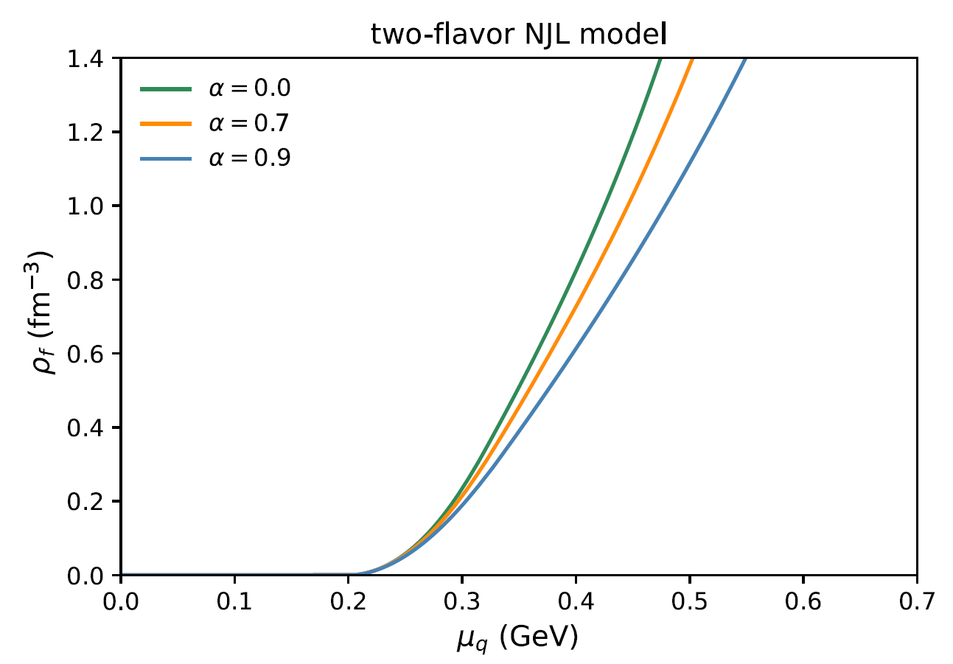
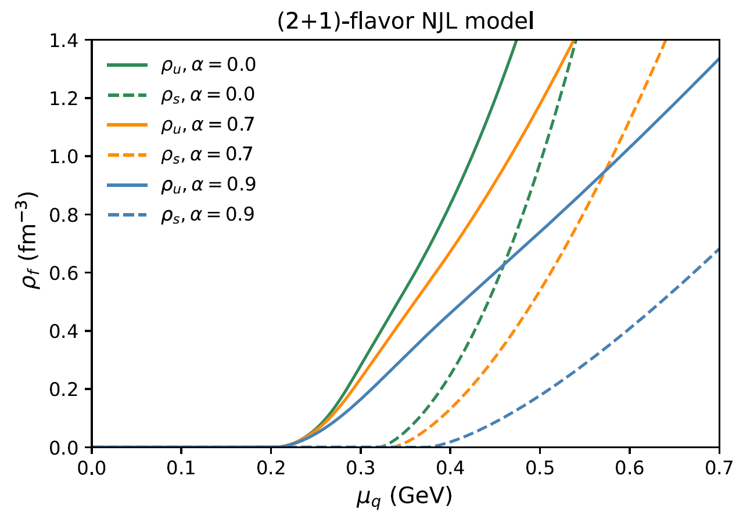
The chiral phase transition
two-flavor NJL model:
(2+1)-flavor NJL model:
a crossover
Notes:
As I mentioned earlier, the main characteristics of the NJL model is chiral symmetry and its spontaneous breakdown in vacuum, which is responsible for the dynamical mass generation from bare quarks.
In our modified NJL model, the dynamical quark masses decrease with quark chemical potential smoothly, the quark number densities have a nonzero value when the chemical potential exceeds the vacuum mass.
This indicates that the chiral phase transition is a crossover.

Slide 16
Outline
1
Dense matter and compact stars
Interacting quark matter at finite baryon densities within modified NJL model
2
Quark matter equation of state (EOS) and self-bound quark stars
3
4
Conclusions and outlook
Notes:
Next, I can further obtain the equation of states (EOSs) of quark matter, and discuss the macroscopical properties of the self-bound quark stars and compare the results with current observations.

Slide 17
Equation of state (EOS) and stability condition
Quark matter EOS:
Zong al. Int. J. Mod. Phys. A, 23, 3591(2008)
Zong al. Phys. Rev. D 78, 054001(2008)
$$−B$$
vacuum bag constant
$$B=P\left(μ=0;m\right)−P(μ=0;M)$$
trivial vacuum
nontrivial vacuum
(Nambu vacuum)
Notes:
At finite chemical potential and zero temperature, the relation of pressure and chemical potential for quark matter can be strictly proved with the functional path integrals of QCD.
The first term represents the vacuum pressure. In NJL-type models, people usually use the parameter B to describe the pressure difference between the trivial vacuum and nontrivial vacuum. Thus, the vacuum pressure can be calculated.
However, such a procedure of determining the bag constant is somewhat unsatisfying, because the results cannot be trusted within NJL-type models at vanishing density due to its lack of confinement. And the detail of this will be discussed in Yan Yan’s talk.
And, here, we take this term as a phenomenological parameter corresponding to −B (vacuum bag constant), which preserves the confinement of quarks.
The second term contains all the nontrivial dependence of quark chemical potential.
Then, using the thermodynamic relation of energy density and pressure, we can obtain the EOS of quark matter.

Slide 18
Equation of state (EOS) and stability condition
Quark matter EOS:
Zong al. Int. J. Mod. Phys. A, 23, 3591(2008)
Zong al. Phys. Rev. D 78, 054001(2008)
$$−B$$
vacuum bag constant
Stability condition for self-bound quark matter:
uds quark matter：
3-flavor quark matter is more stable than Fe nuclei.
2-flavor quark matter cannot be more stable than Fe nuclei.
ud quark matter:
Notes:
For studying the self-bound uds quark matter, according to the Witten hypothesis, the energy per baryon should be smaller than 930 MeV to ensure the strange quark matter is more stable than iron nuclei.
And nonstrange quark matter in bulk should have an energy per baryon higher than that of the confined phase.
Then, for self-bound two flavor quark matter, the conditions are opposite.

Slide 19
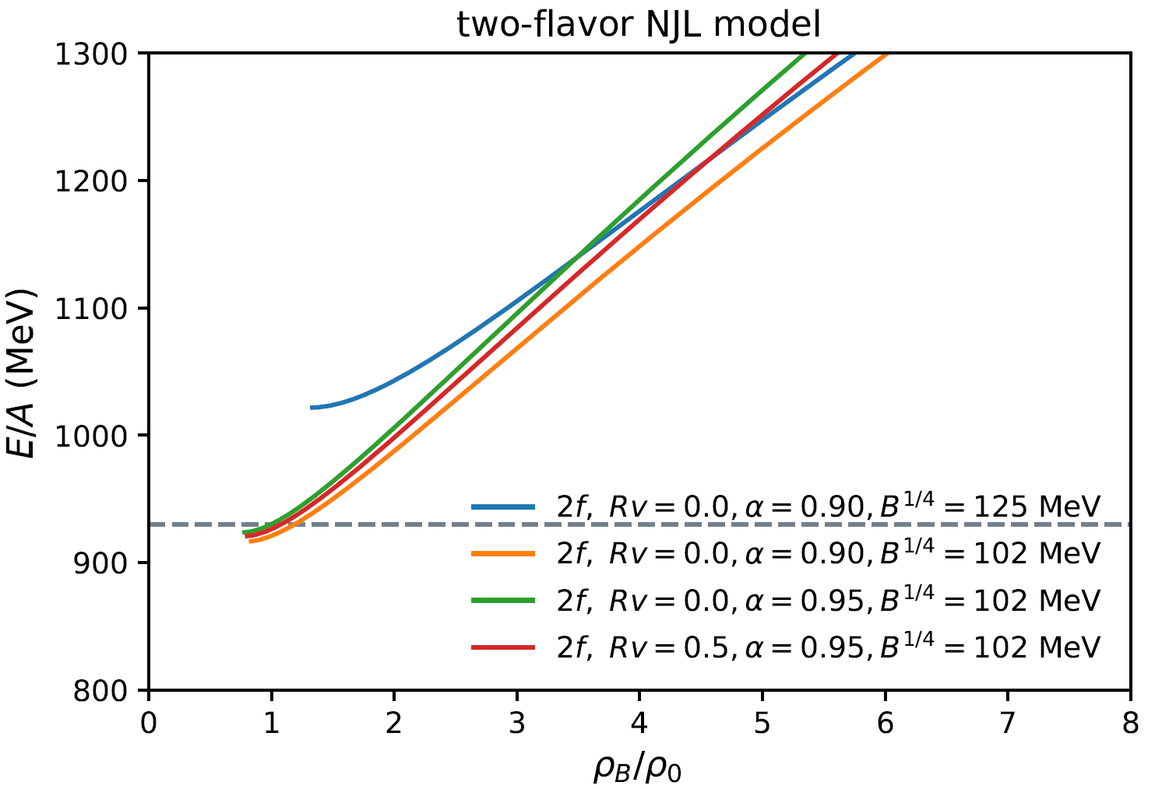
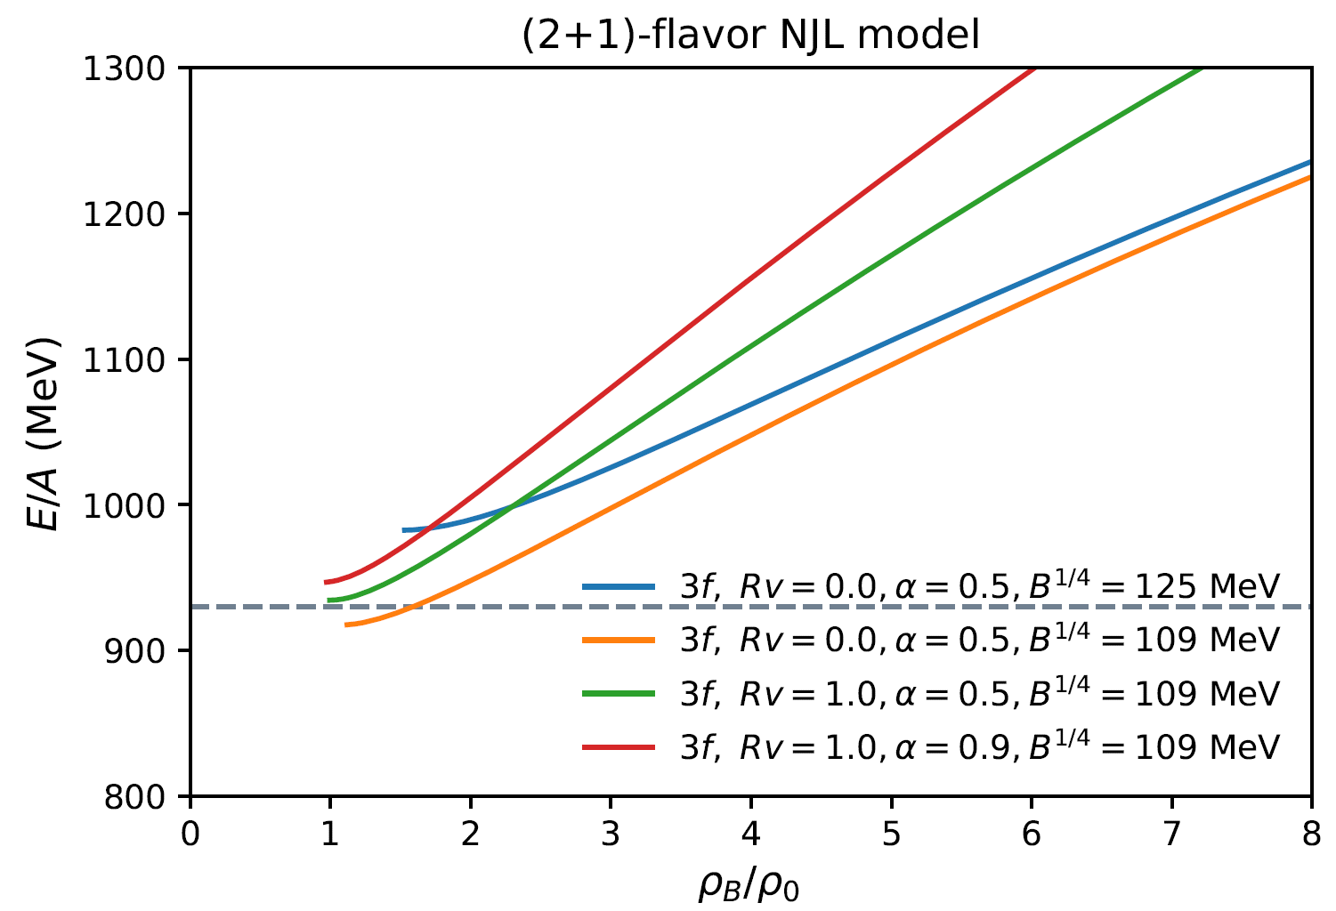
The behavior of energy per baryon for several parameter sets
In general: For larger $R_{V}, α, B^{1/4}$, E/A becomes larger.
Typical: For two-flavor quark matter, increasing the values of $R_{V}$ makes E/A smaller at large$α$ .
Notes:
This figure shows the behavior of energy per baryon for several parameter sets.
In general, for larger vector coupling constant Rv, α, and B, the energy per baryon all becomes larger. This means quark matter becomes more and more unstable.
But in two flavor case, the energy per baryon becomes smaller with increasing Rv at large values of α, which makes the two flavor quark matter more stable.

Slide 20
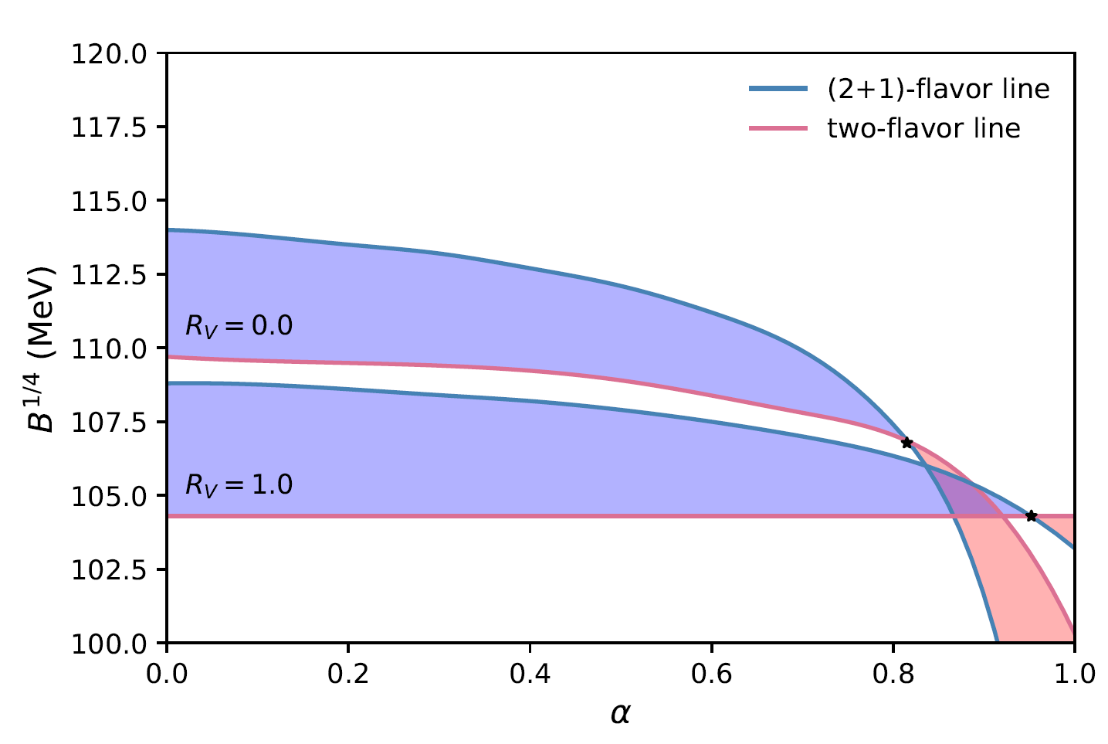
Stability window
Stable self-bound uds quark matter: ;
Stable self-bound ud quark matter:
enough parameter space to allow absolutely stable quark matter
Notes:
Here, using these self-bound conditions, this figure shows the stability windows of ud and uds quark matter.
The purple region is the stability window for the three flavor quark matter, and pink region is the window for two flavor quark matter.
We can see that, increasing the vector interaction coupling constant Rv shifts down the uds stability windows in the B − α plane, due to its repulsive contribution to the energy of the system.
And for larger α, since in the three-flavor case, the vacuum bag constant (B) decrease is faster than two flavor line, the three flavor stability windows finally disappear, and the two flavor windows grow with α.
From these results, we find that, in this theoretical framework, there is enough parameter space to allow absolutely stable quark matter.
And theoretically supports quark stars as viable alternative physical model for neutron stars.

Slide 21
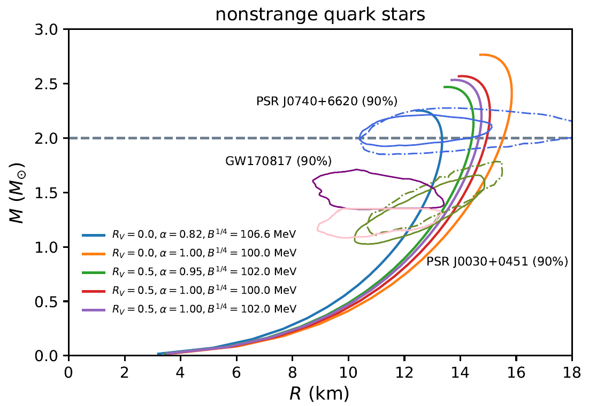
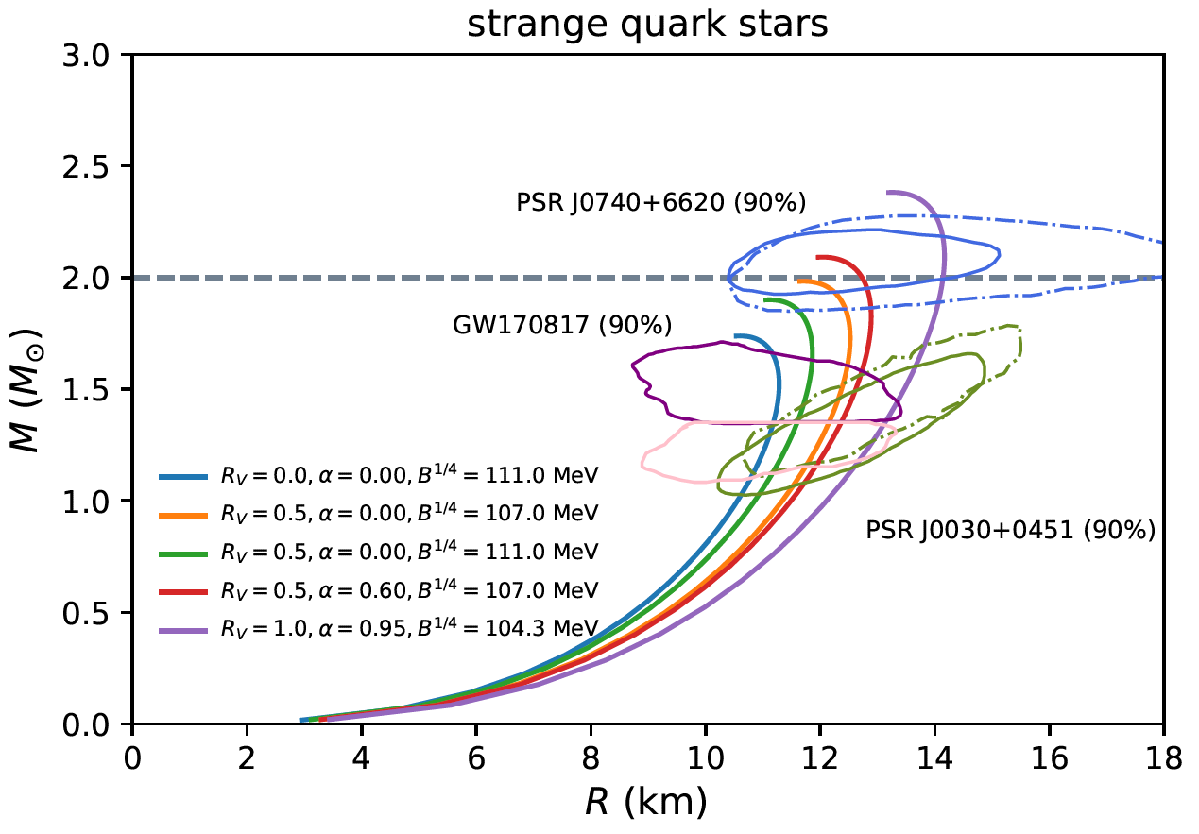
The macroscopical properties of the self-bound quark stars
$$M_{TOV}^{ud}=2.76M_{sun}$$
$$M_{TOV}^{uds}=2.1M_{sun}$$
Notes:
In the following, we employ several representative NJL parameter sets from the stability windows to perform the study of strange and nonstrange stellar quark matter and quark stars.
The maximum mass of non-strange quark stars can be 2.76 solar mass. For strange quark stars, the maximum mass is smaller and it is 2.1 solar mass.
And the constraints of astronomical observations are also shown together.
The results show that a large set of parameters could in principle explain the mass and radius constraints, and the binary tidal deformability constraint from the GW170817 event.

Slide 22
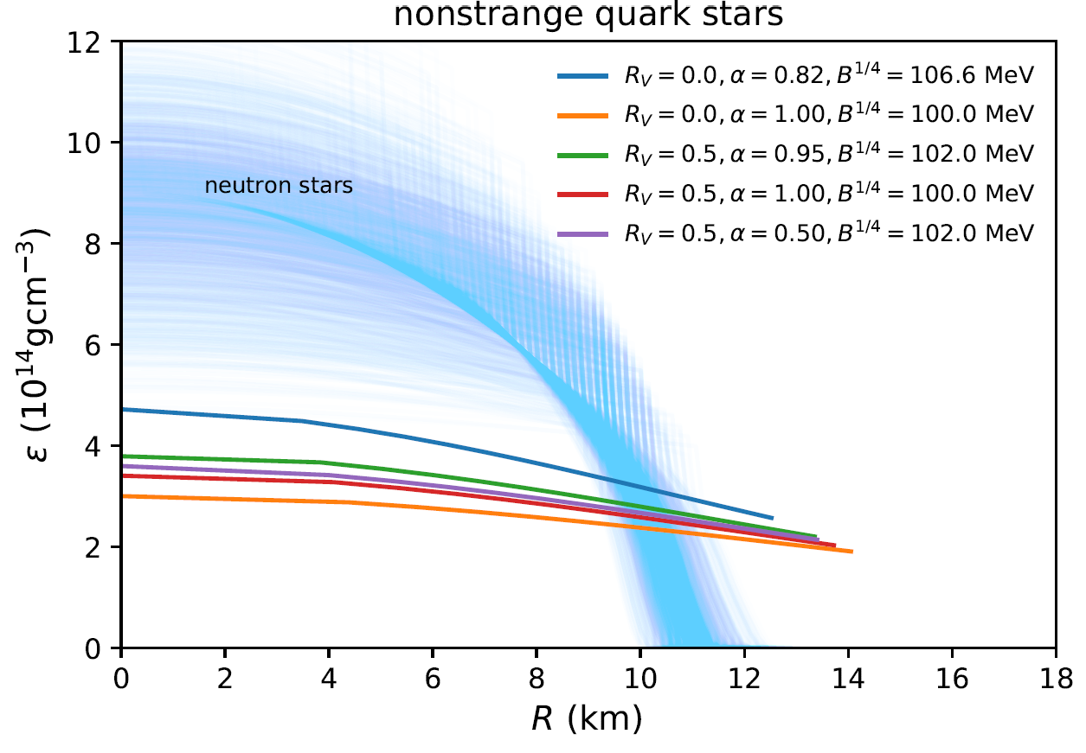
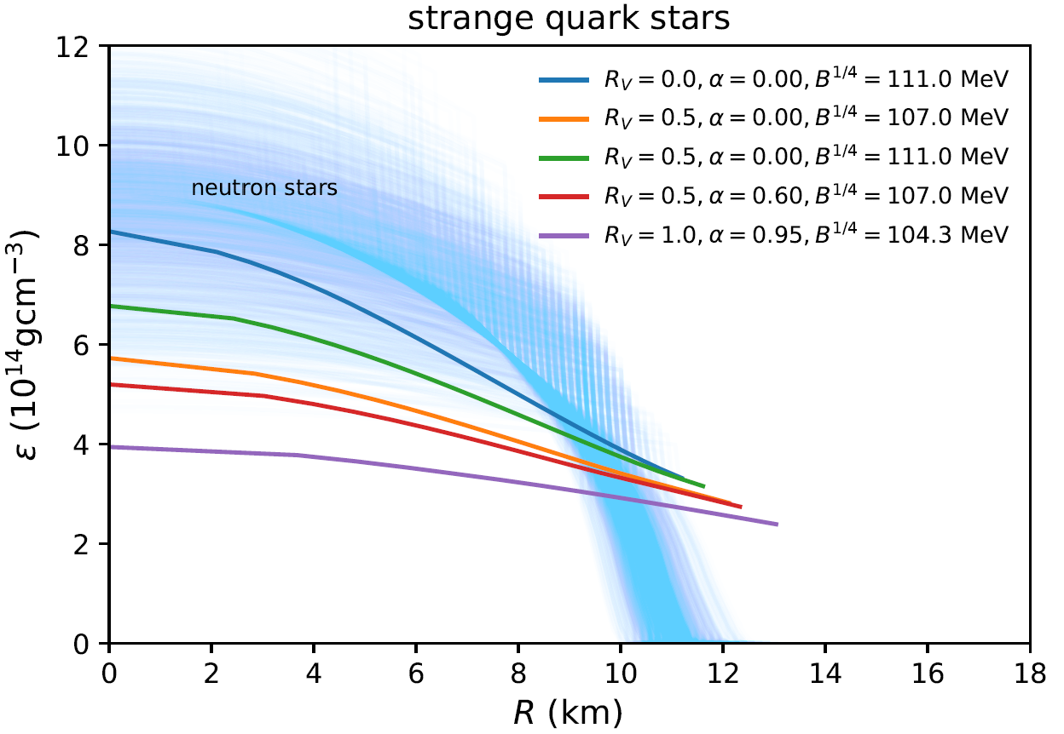
The mass density within a $1.4M_{sun}$ star as a function of radial coordinate
Nonstrange quark stars: <2.0
Strange quark stars: <2.5
Neutron Stars：~14 orders of magnitude
Notes:
For the mass density within a 1.4 solar mass as a function of radial coordinate, which is composed of entirely quark matter.
The quark stars have a huge surface density close to the nuclear saturation density, no matter nonstrange ones and strange ones.
And the central density is only a few times higher than the surface one: For the nonstrange quark stars, no more than twice; And for strange quark stars, it is less than 2.5 times.
And the internal structure of quark stars is very different from that of neutron stars. For a neutron star, it has 14 orders of magnitudes of density variation from the surface to the core.

Slide 23
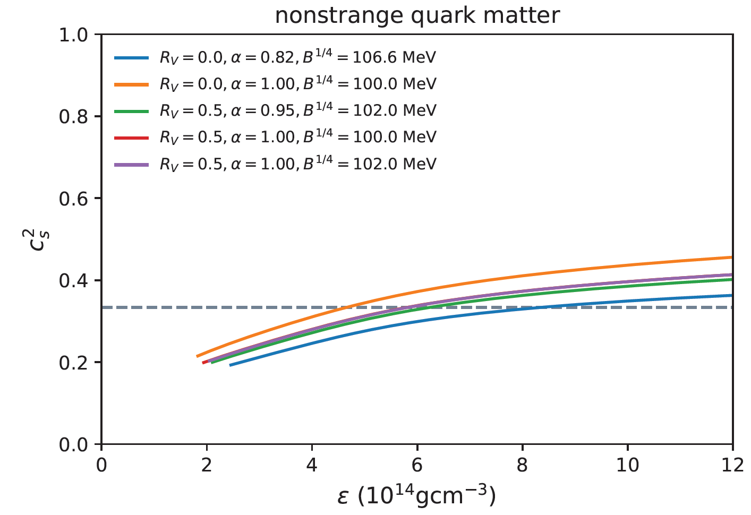
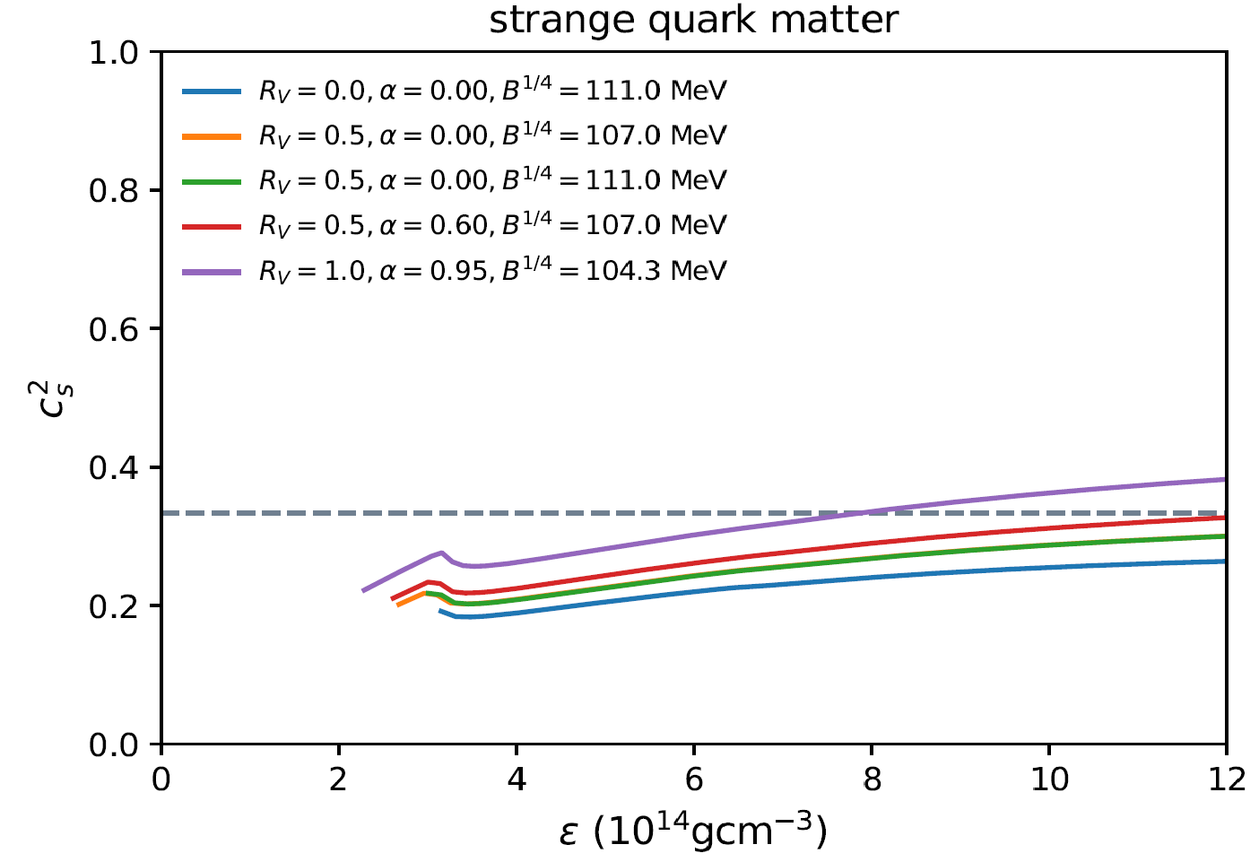
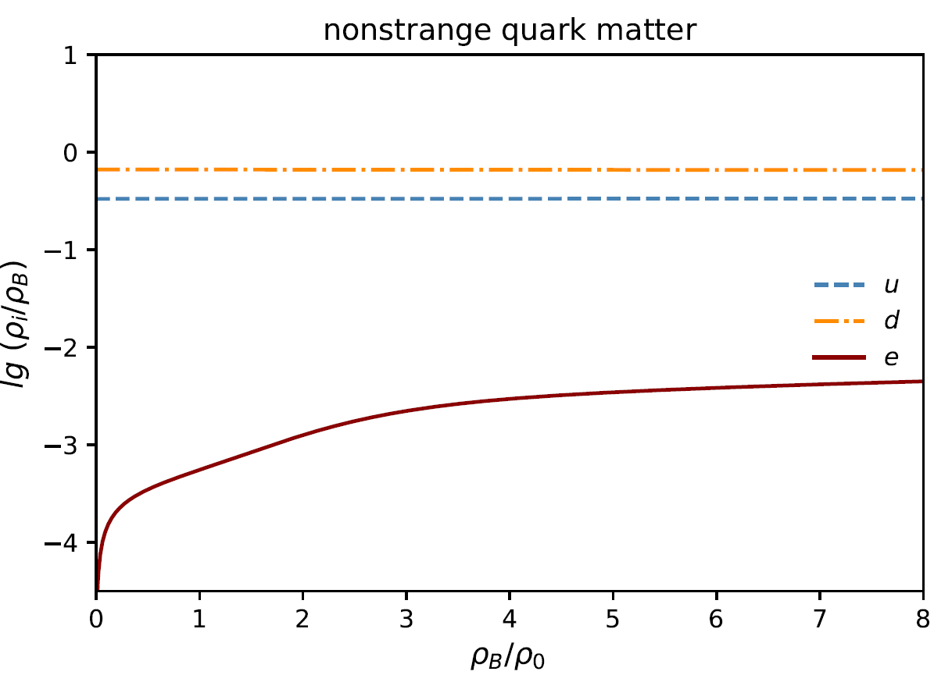
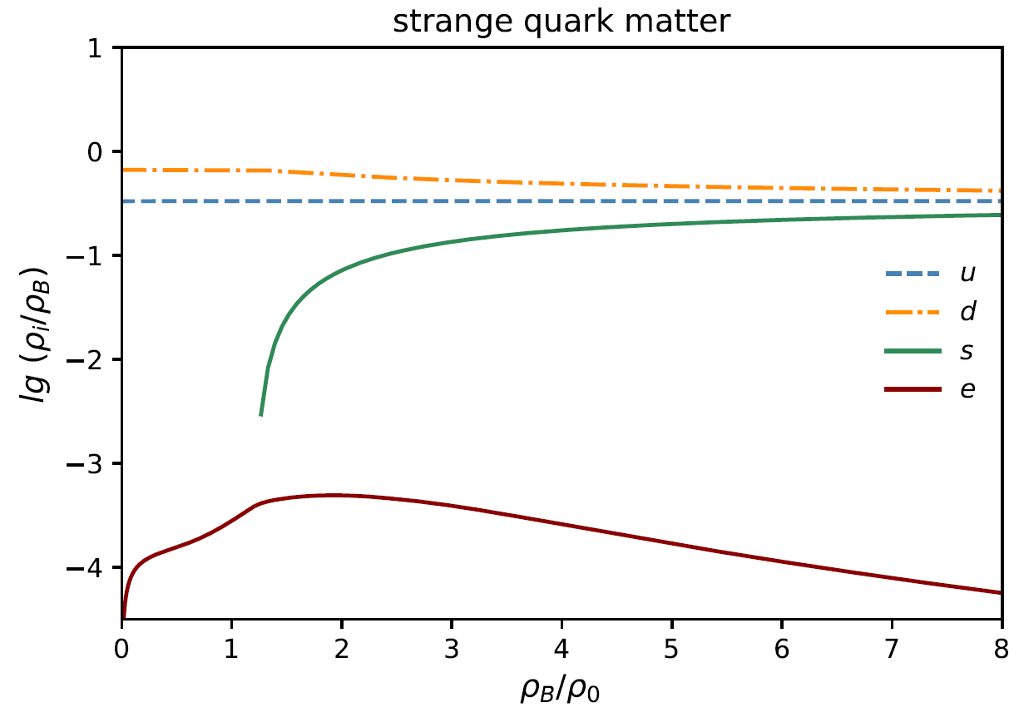
The speed of sound of quark matter
$$exceed the conformal limit$$
$around$ ${\sim 1.5−3ρ}_{0}$
Notes:
We know that the speed of sound is an important physical quantity which encodes information of the dense matter equation of state.
And it shows a monotonically increasing behavior in both nonstrange and strange cases. Then slightly exceeds the conformal limit at high densities.
For strange quark matter, there are small local maximums at the beginning of the plots, caused by the appearance of the strange quarks.

Slide 24
Outline
1
Dense matter and compact stars
Interacting quark matter at finite baryon densities within modified NJL model
2
Quark matter equation of state (EOS) and self-bound quark stars
3
4
Conclusions and outlook
Notes:
Let’s summarize my presentation.

Slide 25
Conclusions and outlook
We find that there is an ample parameter space in the NJL-type model calculations for stable quark matter. Theoretically supports quark stars as viable alternative physical model for neutron stars.
Both nonstrange and strange quark stars can, in general, reconcile with the available mass and radius constraints from observational data.
Now, we are preparing for including the diquark channels for quark superfluidity for improving the phenomenological models of strong interactions at finite density.
Notes:
We find that there is an ample parameter space in the NJL-type model calculations for stable quark matter. Theoretically supports quark stars as viable alternative physical model for neutron stars.
And both nonstrange and strange quark stars can satisfy the current observational data.
Now, we are preparing to include the diquark channels for superfluidity at finite density, and expect to share the results soon.

