Slide 1

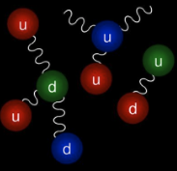
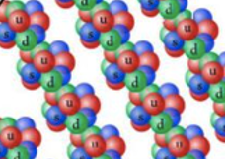
“Minimalism”of Quark Matter
And
Strangeons
Chen Zhang
Journal club, IAS HKUST
September 20, 2023
Based on
C. Z , R. B. Mann. Phys.Rev.D 103 (2021) 6, 063018
C. Z. Phys.Rev.D 104 (2021) 8, 083032
C. Z , M. Gammon, R. B. Mann Phys.Rev.D 104 (2021) 12, 123007
C.Z, Y. Gao, C.J Xia, R.X Xu Phys.Rev.D 108 (2023) 6, 063002

Slide 2
Outline
Part 1: Minimalism in (interacting) Quark matter
  Unified quark matter and quark stars
  Gravitional-wave echoes
  Charge models&Radial oscillations
Part 2: Minimalism in Strangeon Matter
  Strangeon stars
  Gravitional-wave echoes
C. Z , R. B. Mann. Phys.Rev.D 103 (2021) 6, 063018
C. Z. Phys.Rev.D 104 (2021) 8, 083032
C. Z , M. Gammon, R. B. Mann Phys.Rev.D 104 (2021) 12, 123007
C.Z, Y. Gao, C.J Xia, R.X Xu Phys.Rev.D 108 (2023) 6, 063002
Notes:
Intuition:

Slide 3


Minimalism
  Minimize the effective number of degrees of freedom without (much) loss of physics

Slide 4
Intro: Quark Matter
Hadronic Matter vs Quark Matter
Strange quark matter (SQM) hypothesis
udQM hypothesis
Witten Phys. Rev s. D 30, 272-285 (1984)
B. Holdom, J. Ren , C.Z.
Phys. Rev. Lett. 120 (2018) no.22, 222001; arXiv:1707.06610 [hep-ph]
Notes:
We know that hadronic matter like protons neutrons consist of confined quarks. However, quark matter with deconfined quarks can form at high densities or high temperatures
Quark matter can be ground state of matter even at zero temperature and pressure. Witten first proposed such possibility for strange quark matter, which composed of deconfined up,down and strange quarks.
Recently, my collaborators and I proposed such possibility for up down quark matter, which composed of only up and down quarks.
Assuming either hypothesis, this implies the existence of pure quark stars

Slide 5
Intro: Quark Stars
Neutron star vs Quark stars
Picture adapted from https://physicsworld.com/a/calculations-point-to-massive-quark-stars/
Notes:
Pure quark stars composed of purely quark matter, in contrast to neutron stars which composed mainly of neutrons and a few protons.
A quark star can be more compact than a neutron star with a larger mass but a similar or smaller radii. Introducing one-gluon exchange interaction for quark matter will make the quark stars even more compact. This motivates our study since a larger compactness means more likely to generate GW echoes, as I will show later.

Slide 6
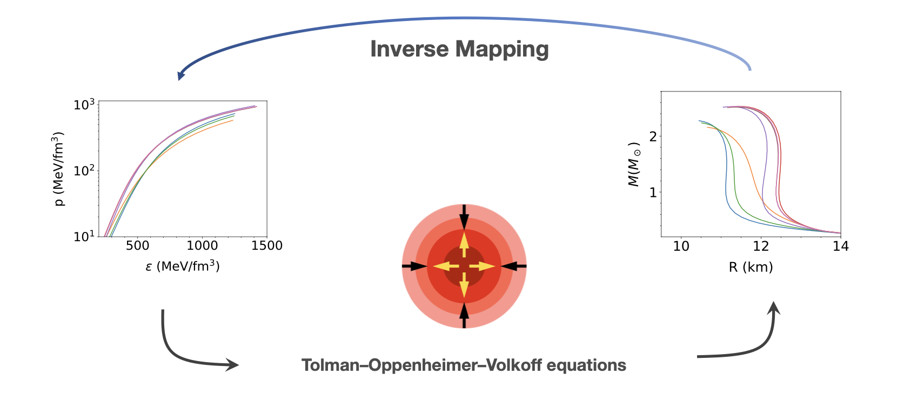

Solving Paradigm

Slide 7

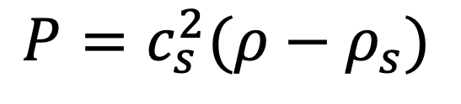

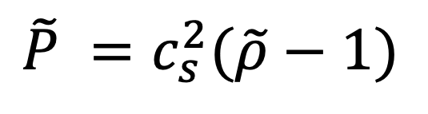
Adapted from appendix E of book
"Neutron Stars 1: Equation of State and Structure”
by P. Haensel, A.Y. Potekhin, D.G. Yakovlev
Minimalism 101:
rescaling the bag EOS of Quark matter
(In geometric units $G=c=1$, we have $[m]=[r]= \left[L\right] , \left[P\right]=\left[ρ\right]=\left[B\right]={\left[L\right]}^{−2})$
$$P=c_{s}^{2}(ρ−ρ_{s})$$
Where $ρ_{s}$ is the surface mass density (=$4B$)
Rescaling: $\tilde{P}=\frac{P}{4B}$; $\tilde{ρ}=\frac{ρ}{4B};$ (now dimensionless)
$$\tilde{P} =c_{s}^{2}(\tilde{ρ}−1)$$

Slide 8
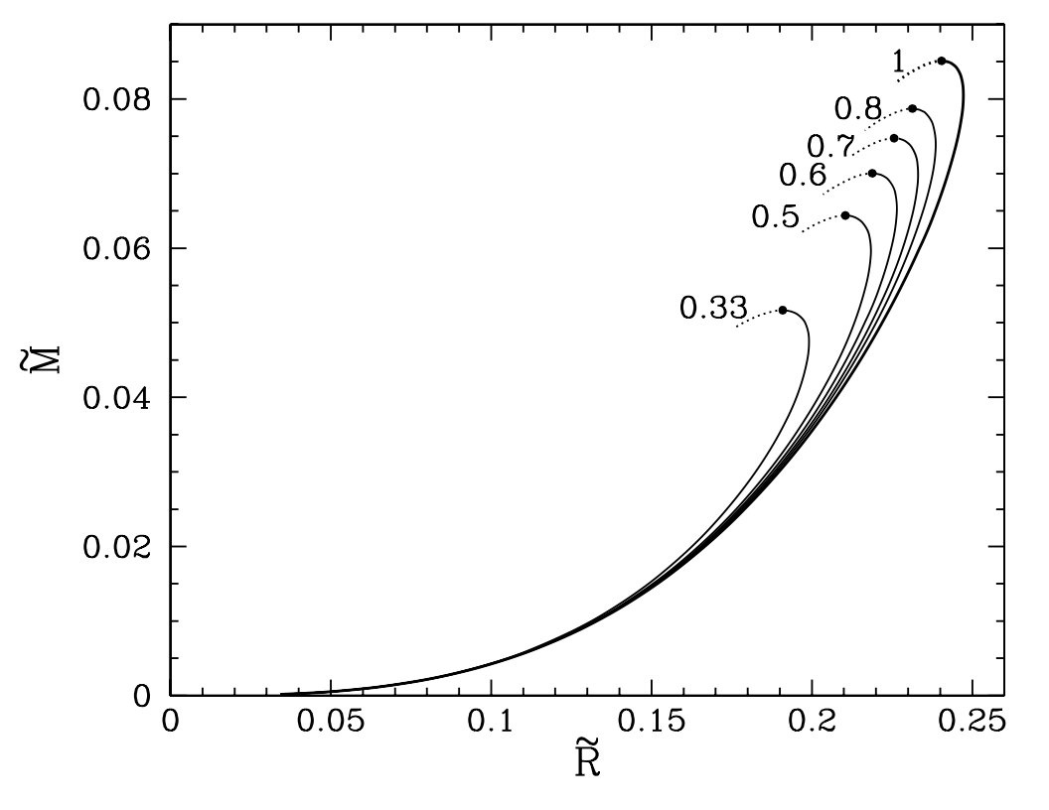
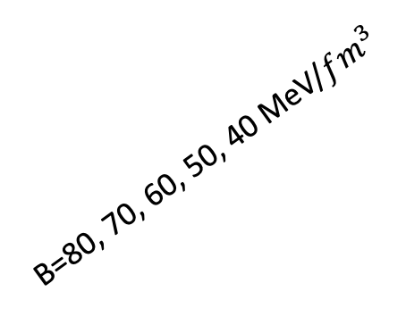

$$P=1/3(ρ−4B)$$
B=80, 70, 60, 50, 40 MeV/$fm^{3}$
$c_{s}^{2}$=1/3

Slide 9
What if the EOS is non-linear?
Interacting Quark Matter
Strangeon Matter

Slide 10
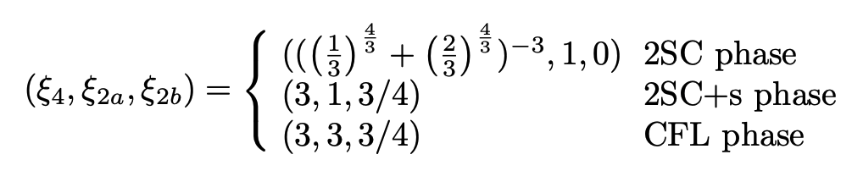
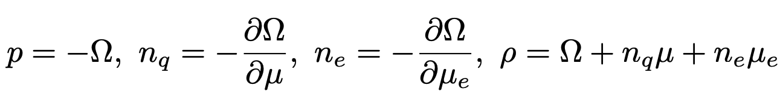
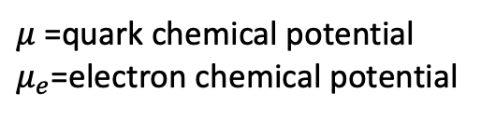
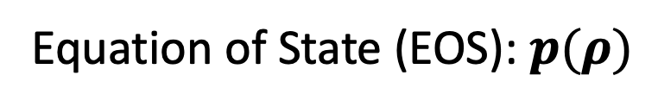
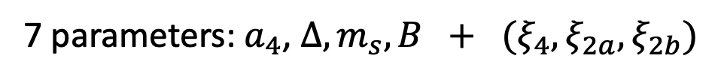
Interacting Quark matter (IQM)
Alford, M.,, Rajagopal, K. (2002) JHEP 06 (2002) 031
Alford, M., Braby, M., Paris, M., & Reddy, S. (2005). The Astrophysical Journal, 629(2), 969.
Thermodynamic potential of IQM:
$μ$ =quark chemical potential
$μ_{e}$=electron chemical potential
Effective Bag constant
pQCD correction
Color-Superconductivity
Mass correction
Cooper pair:
u, d
u, d
u, d ,s
⇒
Equation of State (EOS): $p(ρ)$
7 parameters: $a_{4}$, $Δ, m_{s}, B + {(ξ}_{4}, ξ_{2a}, ξ_{2b})$

Slide 11
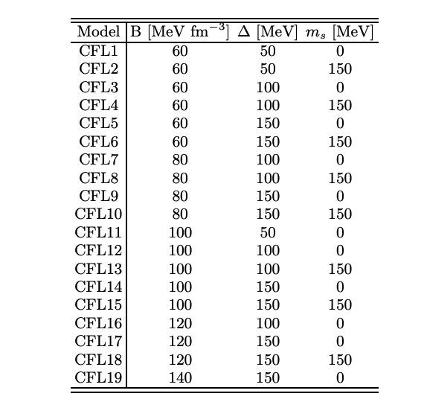
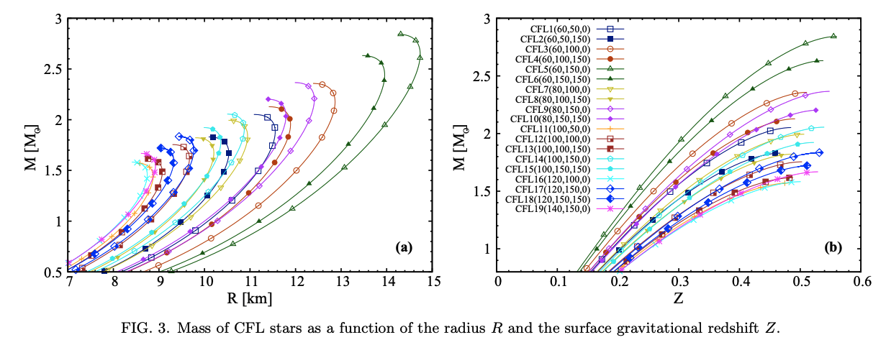
IQM: Previous studies
Scheme of Previous studies
Fix a phase (udQM or SQM, 2SC,2SC+s, or CFL), with or without a_4 (QCD) correction
Then derive results (M-R, Tidal deformability, oscillations modes, e.t.c) with some of manually selected subset parameter values. For example :
Flores, C. Vásquez, and German Lugones. "Constraining color flavor locked strange stars in the gravitational wave era." Physical Review C 95.2 (2017): 025808.

Slide 12
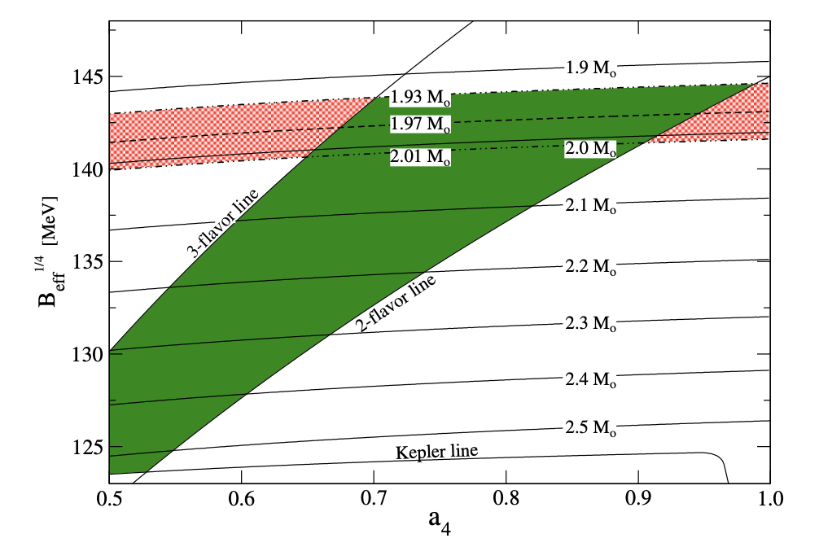
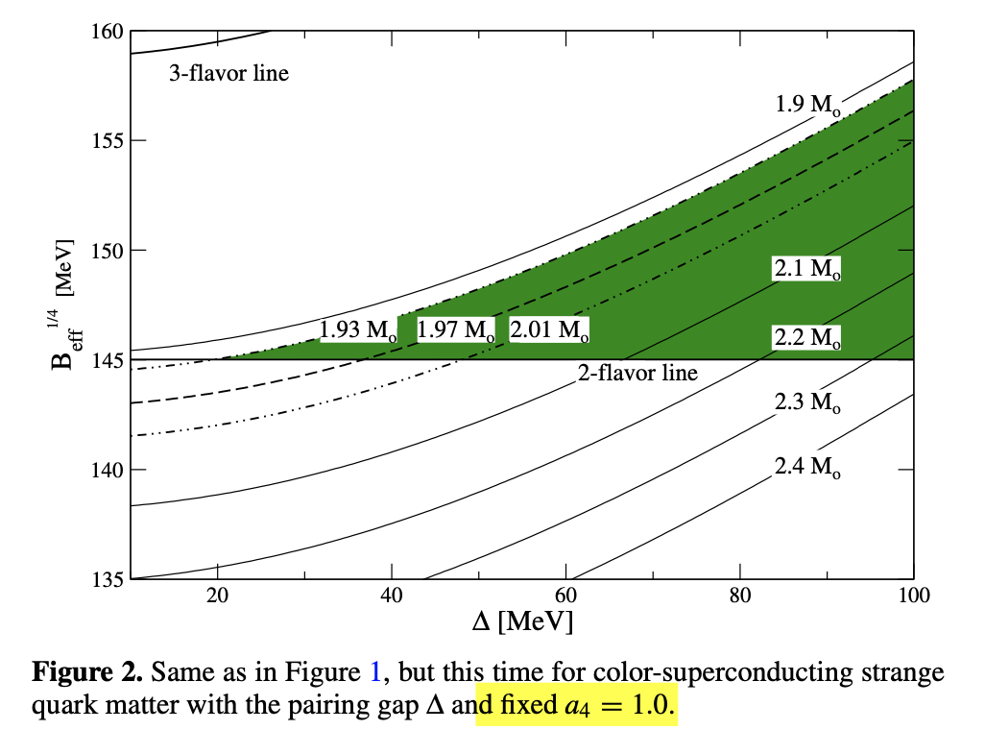


IQM: Previous studies
Only limited subset of parameter space can be explored
Weissenborn, Simon, et al. "Quark matter in massive compact stars." The Astrophysical Journal Letters 740.1 (2011): L14.
$$Δ=0$$
$$a_{4}=1$$

Slide 13
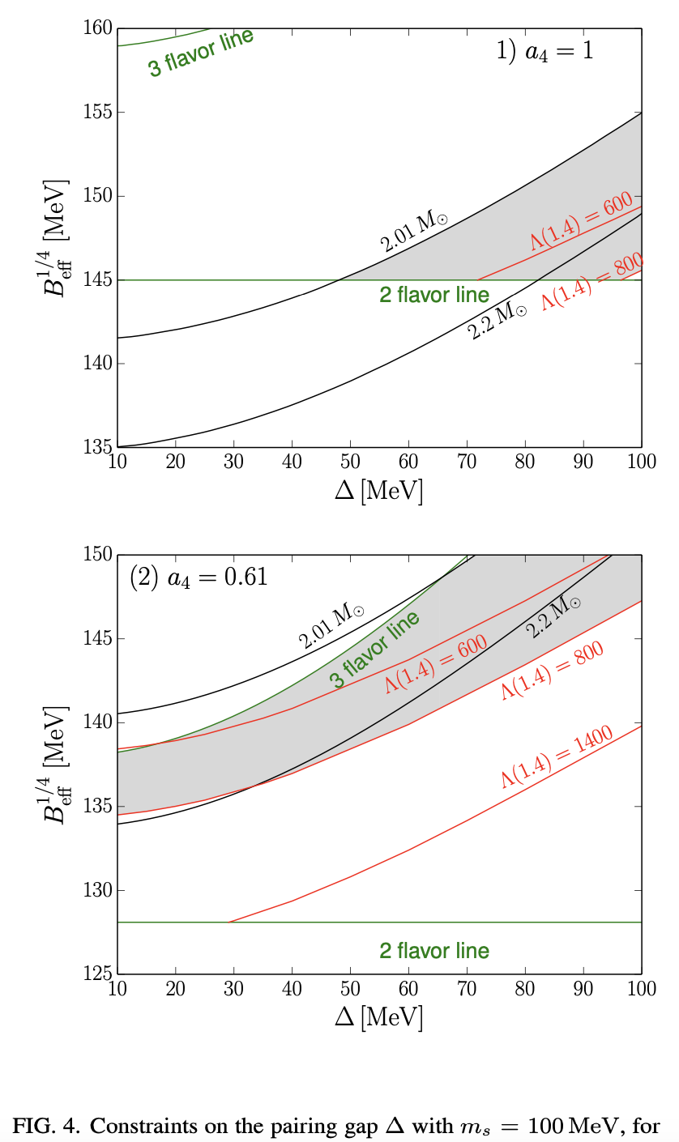
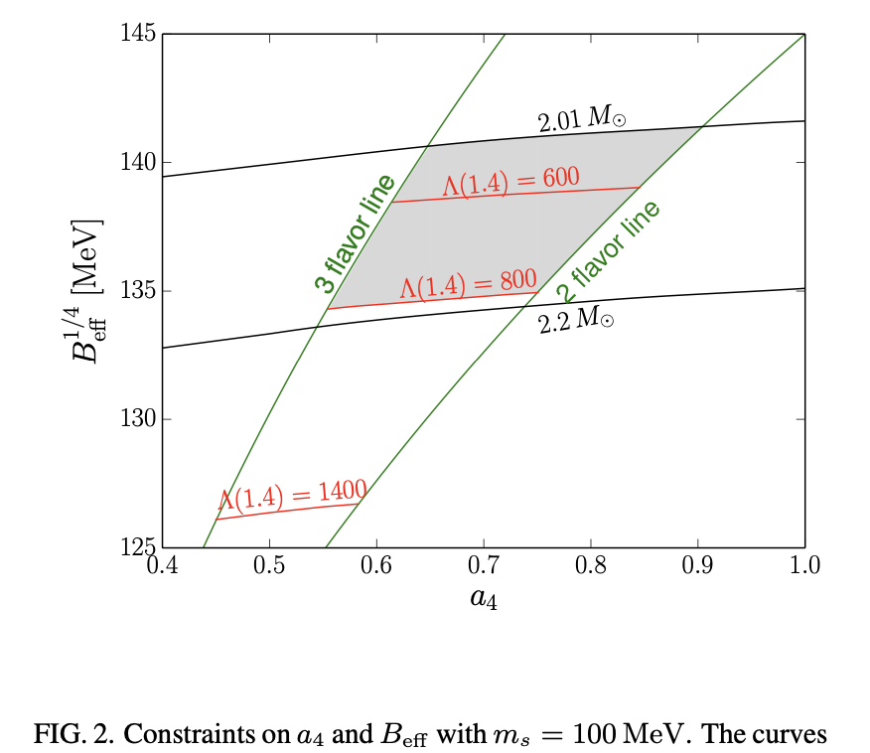

E.P.Zhou, X.Zhou and A.Li,
``Constraints on interquark interaction parameters with GW170817 in a binary strange star scenario,’’
Phys. Rev. D 97, no.8, 083015 (2018)

Slide 14
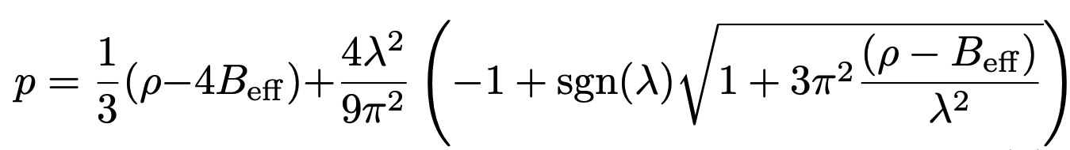
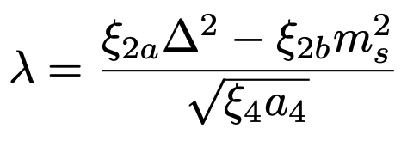
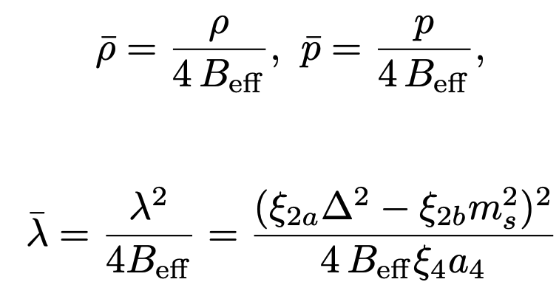
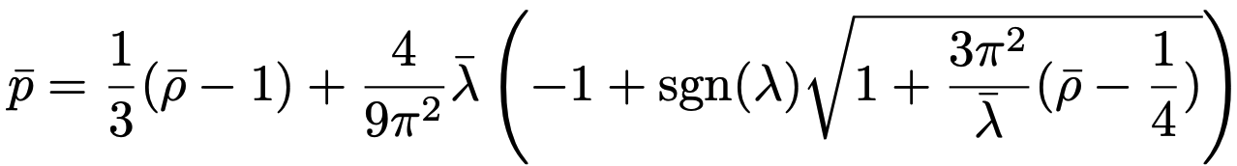
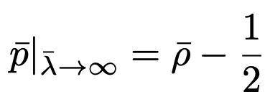
Minimalism
Of IQM
C.Zhang and R.B. Mann Phys.Rev.D 103 (2021) 6, 063018; e-Print: 2009.07182 [astro-ph.HE]
Derive EOS from the thermodynamic potential
Dimensionless rescaling:
where
In geometric units $(c=G=1)$, $[M]=[L], [ρ]=[p]={[B}_{eff}]={\left[L\right]}^{−2}$
⇒
⇒
Notes:
From the free energy we can derive the thermodynamics quantities that yield the equation of state, which relates the pressure density p to the mass density rho, the effective bag constant and the parameter lambda. Here lambda absorbs all the other parameters like the kezai, Delta, m_s, a_4, characterizing the size of correction from interquark interaction.
We can also do a dimensionless rescaling, with these dimensional parameter rescaled by the effective bag constant, so that the EOS can be cast into a dimensionless form with the dependence on Beff removed.
Taking \lambda into infinity, we see the EOS yields a simple finite form which is very stiff

Slide 15
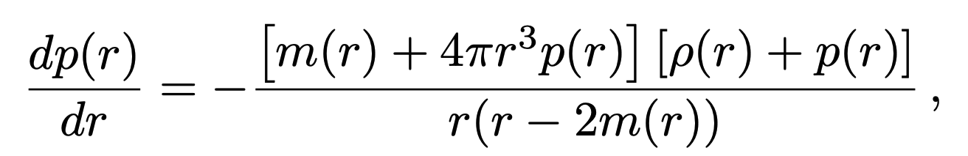
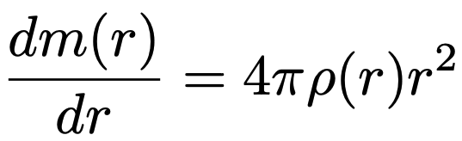
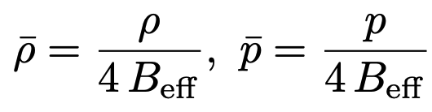

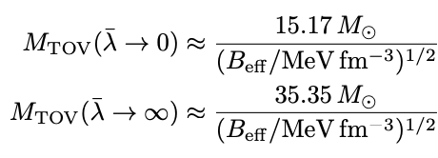
Minimalism
Of Interacting Quark Stars (IQS)
C.Zhang and R.B. Mann Phys.Rev.D 103 (2021) 6, 063018; e-Print: 2009.07182 [astro-ph.HE]
Tolman-Oppenheimer-Volkov (TOV) equation
Dimensionless Rescaling:
⇒
Notes:
With the obtained equation of state, we can solve the TOV equation to get the stellar structure such as the mass and radius as a function of center pressure.
Note that we can also cast TOV equation into a dimensionless form with these rescaling, such that we can solve for the rescaled dimensionless mass and radius, showed in this graph, where a darker colored line denotes a larger lambda^bar, with the red line for lambda^bar approaching infinity
We see a larger lambda^bar maps to a larger maximum mass and a larger maximum compactness

Slide 16
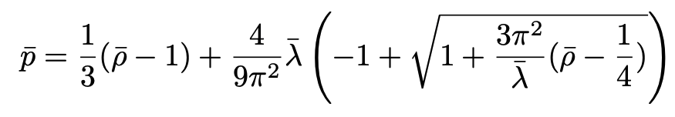
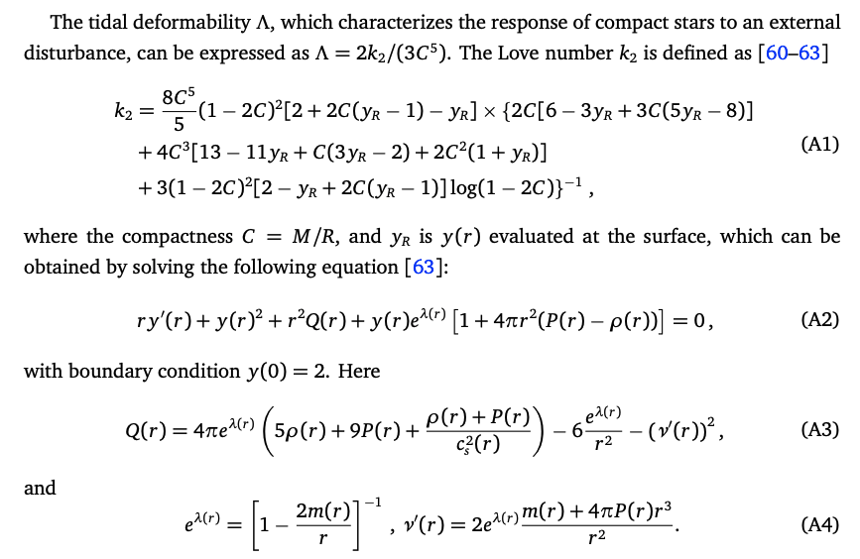
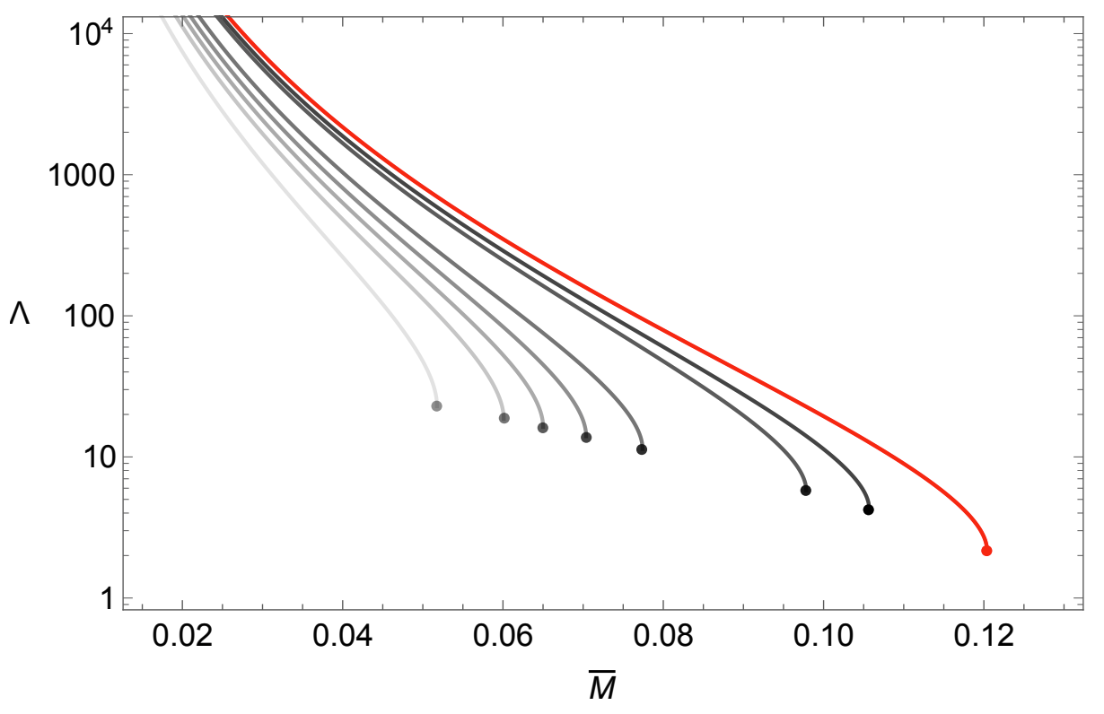
Minimalism
Of Interacting Quark Stars (IQS)
C.Zhang and R.B. Mann Phys.Rev.D 103 (2021) 6, 063018; e-Print: 2009.07182 [astro-ph.HE]
Tidal deformability
⇒
Notes:
With the obtained equation of state, we can solve the TOV equation to get the stellar structure such as the mass and radius as a function of center pressure.
Note that we can also cast TOV equation into a dimensionless form with these rescaling, such that we can solve for the rescaled dimensionless mass and radius, showed in this graph, where a darker colored line denotes a larger lambda^bar, with the red line for lambda^bar approaching infinity
We see a larger lambda^bar maps to a larger maximum mass and a larger maximum compactness

Slide 17

Astrophysical constraints
C.Zhang and R.B. Mann Phys.Rev.D 103 (2021) 6, 063018; e-Print: 2009.07182 [astro-ph.HE]
blue band for the GW170817,
Red band for GW190425,
cyan band for the recent NICER analysis of PSR J0030+0451
The 2.59 solar mass line is from GW190814
Notes:
One can easily observe that for any $\bar{\lambda}$ value, the lower bound of $B_{\rm eff}$ is determined by the LIGO constraint $\bar{\Lambda}\lesssim720$ of GW170817. The upper bound of $B_{\rm eff}$ is set by the constraint of $M_{\rm TOV}$ (the solid black curves) for small $\bar{\lambda}$, and by the NICER constraint (the right edge of the cyan band) for large $\bar{\lambda}$.
Considering the solid black curve always goes leftward for a larger mass, there is then a critical mass value $M_c\approx3.23 M_{\odot}$ beyond which the associated solid black curve no longer intersects with the blue band (GW170817) for any $\bar{\lambda}$ value. Therefore, the possibility of IQSs is only allowed for $M_{\rm TOV}\lesssim 3.23\, M_{\odot}$. (All lines go vertically straight at very large lambda bar . )

Slide 18
Part 1: Minimalism in (interacting) Quark matter
  Unified quark matter and quark stars
  Gravitional-wave echoes
  Charge models&Radial oscillations
Part 2: Minimalism in Strangeon Matter
  Gravitional-wave echoes
  Other generalizations?
C. Z , R. B. Mann. Phys.Rev.D 103 (2021) 6, 063018
C. Z. Phys.Rev.D 104 (2021) 8, 083032
C. Z , M. Gammon, R. B. Mann Phys.Rev.D 104 (2021) 12, 123007
C.Z, Y. Gao, C.J Xia, R.X Xu Phys.Rev.D 108 (2023) 6, 063002

Slide 19
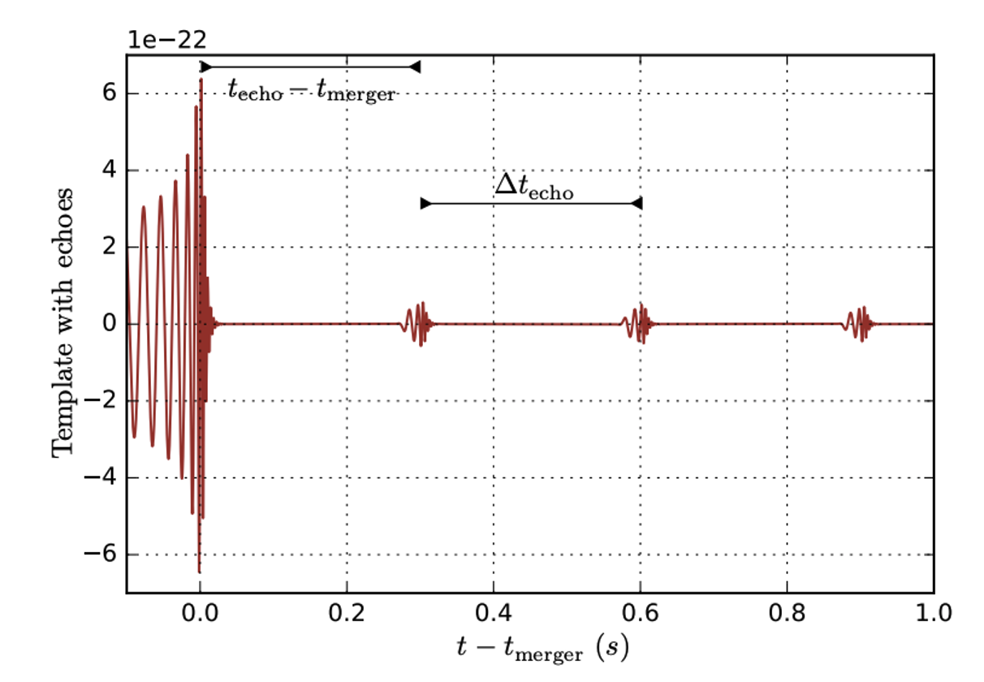

Intro: Exotic compact objects (ECO) and Gravitational-wave echoes
ECOs commonly have
a reflecting surface (membrane/firewall) inside the gravitational potential barrier, forming a cavity structure (A ECO example: BH with a reflective membrane at the stretched horizon)
A wave falling inside the cavity gets reflected and returns to the barrier after some time delay $t_{d}$
19
GW echo template. Adapted from J.Abedi, H.Dykaar and N.Afshordi,
``Echoes from the Abyss: Tentative evidence for Planck-scale structure at black hole horizons,''
Notes:
首先我简单介绍下引力波回声的有关背景。
引力波回声由引力波在超常致密体(ECO)背景下导致，其特征是引力波在其背景下会陷落到一个腔里，这个腔的两壁，一端为临近该致密体的一个反射面，另外一端具有反射作用的势垒在3倍质量附近光子球photonsphere位置。引力波会在这个腔里来回反射，导致观测的引力波波形会有周期性的信号
前期大家研究比较多的是黑洞的量子修正在黑洞视界附近造成的反射壁导致的引力波回声。

Slide 20
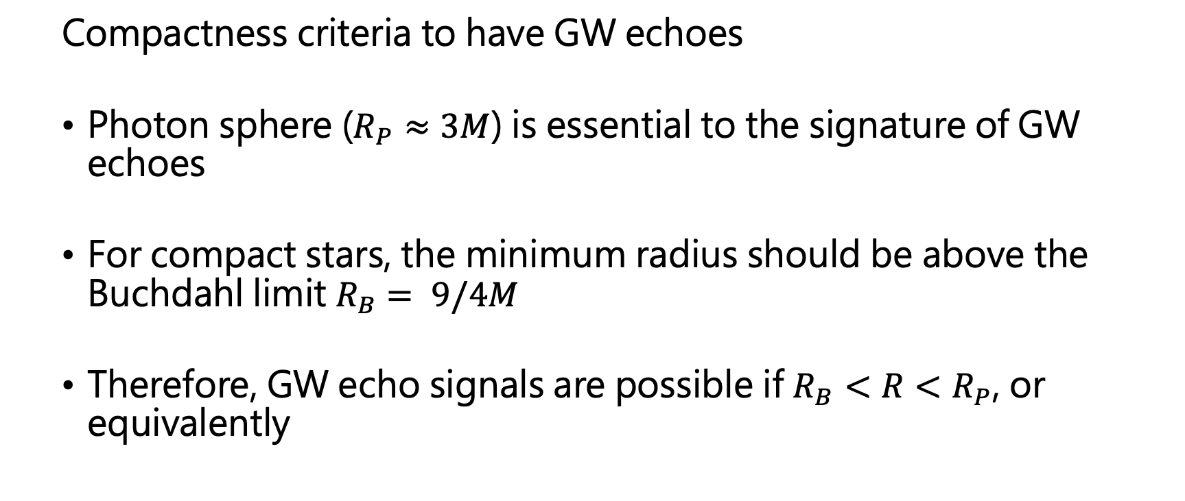
Intro: GW echoes of Ultracompact Stars
  Compactness criteria to have GW echoes
  Photon sphere ($R_{P}≈3M$) is essential to the signature of GW echoes
  For compact stars, the minimum radius should be above the Buchdahl limit $R_{B}$ $= 9/4M$
  Therefore, GW echo signals are possible if $R_{B}<R<R_{P}$, or equivalently

Slide 21
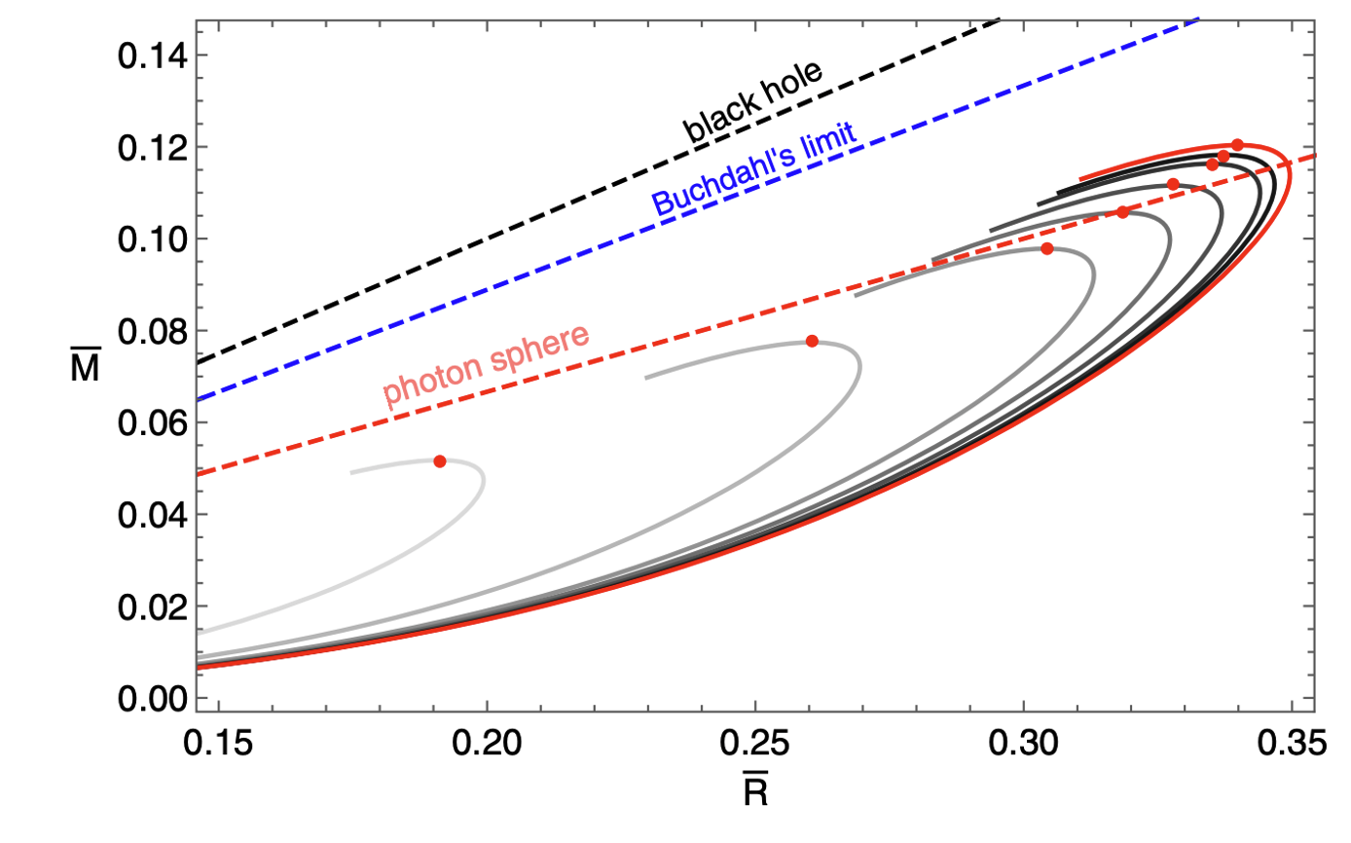




GW echoes of IQS
C. Z. PhysRevD.104.083032 [arXiv:2107.09654].
Viable $\overline{λ:}$
$$C=\frac{4}{9}$$
$$C=\frac{1}{3}$$
Notes:
Now we can translate the constraints on compactness on the rescaled mass versus radius graph of interacting quark stars.
We see that the photonsphere line crosses the maximum mass point of the lambda_bar=10 case. Therefore, stable stellar structure that is compact enough to generate GW echoes maps to the parameter space of lambda^bar larger than 10

Slide 22
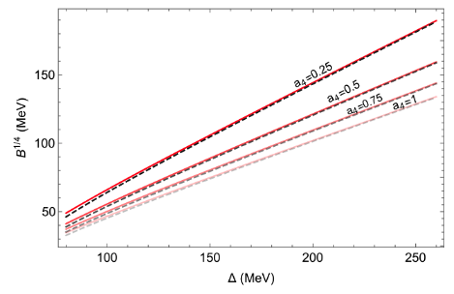
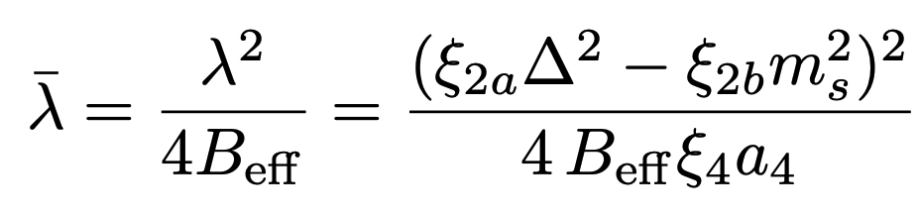
GW echoes of IQS
C. Z. PhysRevD.104.083032 [arXiv:2107.09654].
Viable Physical Parameter Space
Notes:
Recall the definition of lambda^bar, we can translate the criteria of lambda^bar back to the dimensional parameter space.
In this graph, the vertical axis denotes the bag constant, horizontal axis denotes the superconducting gap. Red solid lines are with m_s=90 MeV, while black dashed lines are with m_s=100MeV. Regions below each line of different a_4 are the viable parameter space that has IQS compact enough to generate GW echoes

Slide 23
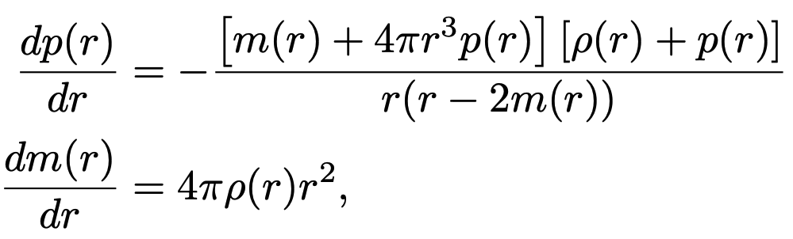
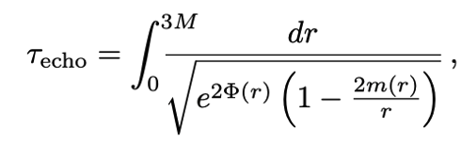
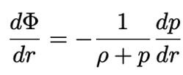
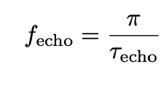

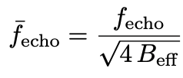
GW echoes of IQS
C. Z. PhysRevD.104.083032 [arXiv:2107.09654].
Notes:
Next we calculate the echoes frequencies. We otain this by solving the integral equation for the echo time, the differential equation for the metric factor \Phi and the TOV equations solved previously. Note that we can similarly remove the bag constant dependence by dimensionless rescaling the echo frequencies f to f^bar

Slide 24
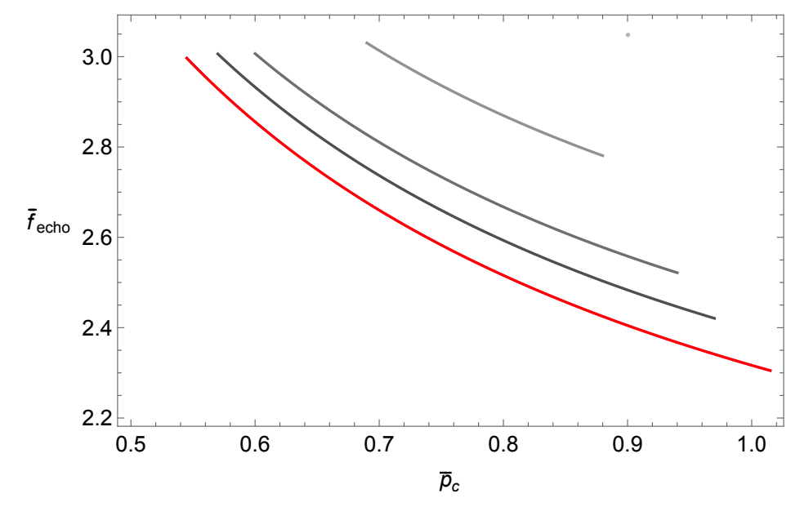

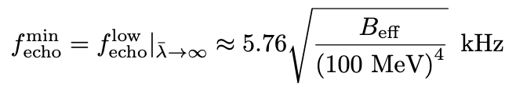





GW echoes of IQS
C. Z. PhysRevD.104.083032 [arXiv:2107.09654].
$$\overline{λ}=10$$
Fit:
$$\overline{λ}=20$$
where
$$\overline{λ}=50$$
$$\overline{λ}=100$$
$$\overline{λ}=∞$$
Notes:
We plot the result of f^bar as function of the rescaled center pressure for different lambda^bar.
We see that a smaller echo frequency is achieved for a larger center pressure and a larger $\overline{λ}$.
[click]
We can fit the lower ends of each curve into a polynomial function of inverse lambda^bar.
The zeroth order term is the minimum frequency at lambda^bar to infinity. We see that its order of magnitudes is of a few kilohertz at empirical range of bag constant.

Slide 25
Part 1: Minimalism in (interacting) Quark matter
  Unified quark matter and quark stars
  Gravitional-wave echoes
  Charged quark stars&Radial oscillations
Part 2: Minimalism in Strangeon Matter
  Gravitional-wave echoes
  Other generalizations?
C. Z , R. B. Mann. Phys.Rev.D 103 (2021) 6, 063018
C. Z. Phys.Rev.D 104 (2021) 8, 083032
C. Z , M. Gammon, R. B. Mann Phys.Rev.D 104 (2021) 12, 123007
C.Z, Y. Gao, C.J Xia, R.X Xu Phys.Rev.D 108 (2023) 6, 063002

Slide 26

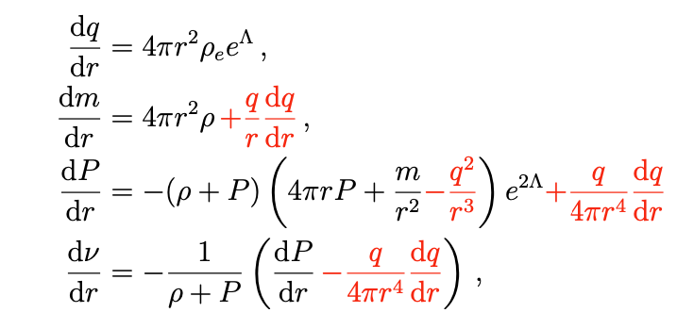


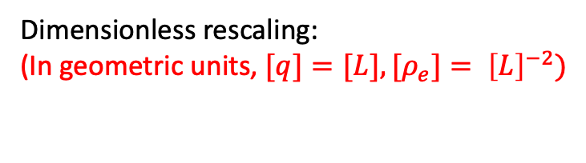
Minimalism
Of CIQS
C. Z , M. Gammon, R. B. Mann Phys.Rev.D 104 (2021) 12, 123007
Rescaling Charged TOV Equation
Dimensionless rescaling:
(In geometric units, $[q]=[L], [ρ_{e}]= {\left[L\right]}^{−2})$

Slide 27
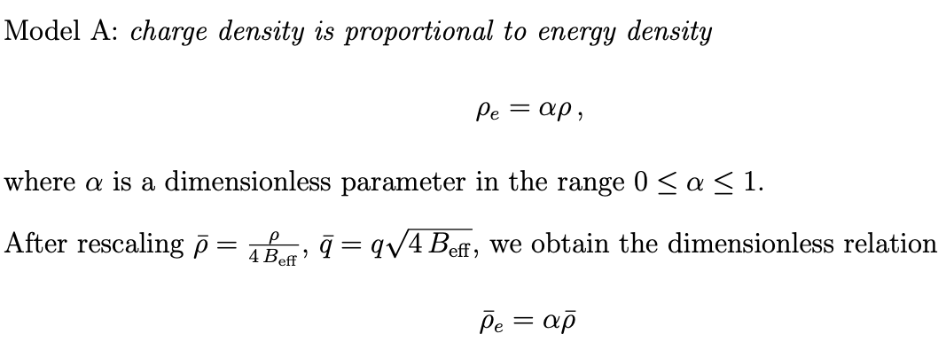
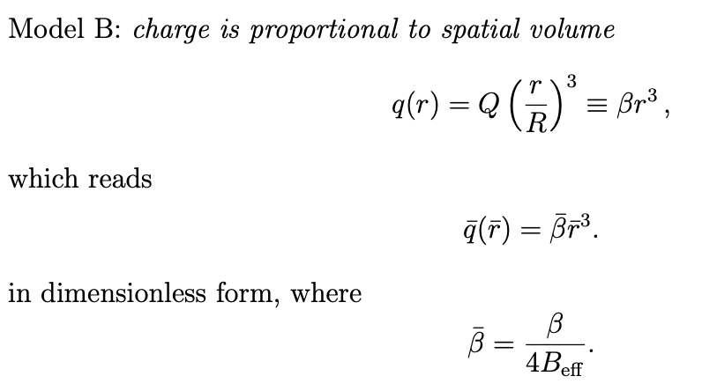
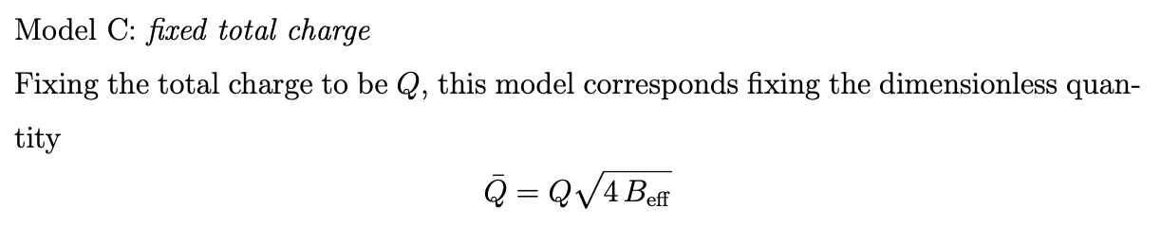
Minimalism
Of CIQS
Rescaling Charge Models

Slide 28
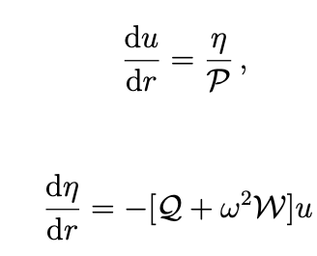



Minimalism
Of CIQS
Rescaling Radial Oscillations
The fundamental eigenfrequencies $ω_{0}$ determines the star’s stability against radial oscillations: $ω_{0}^{2}≥0$
We can also rescale it into dimensionless form: ${\overline{ω}}_{0}=ω/{(4B)}^{\frac{1}{2}}$

Slide 29



Minimalism
Of CIQS
Model C:
Model A:
Model B:

Slide 30
Part 1: Minimalism in (interacting) Quark matter
  Unified quark matter and quark stars
  Gravitional-wave echoes
  Charge models&Radial oscillations
Part 2: Minimalism in Strangeon Matter
  Gravitional-wave echoes
C. Z , R. B. Mann. Phys.Rev.D 103 (2021) 6, 063018
C. Z. Phys.Rev.D 104 (2021) 8, 083032
C. Z , M. Gammon, R. B. Mann Phys.Rev.D 104 (2021) 12, 123007
C.Z, Y. Gao, C.J Xia, R.X Xu Phys.Rev.D 108 (2023) 6, 063002

Slide 31


Strangeon (Strange-Cluster) matter
Renxin Xu 2003 ApJ 596 L59
Graph adapted from Xiaoyu Lai “Strangeon matter in kilonova”
Notes:
奇异夸克物质内部的夸克有可能非游离态，可能集结成团,类固态
A strangeon is much more massive than a nucleon. Thus the strangeon can be regarded as a traditional localized point particle rather than quantum wave.

Slide 32

Strangeon Stars
Graph adapted from X.~Lai and R.~Xu, J. Phys. Conf. Ser. 861, no.1, 012027 (2017)

Slide 33



Equation of State For Strangeons
X. Y. Lai , R. X. Xu, Monthly Notices of the Royal Astronomical Society: Letters, Volume 398, Issue 1, September 2009
Leonard-Jones Model

Slide 34


Strangeon Stars
Graph adapted from
LI, Z, QU, Z, CHEN, L, et al. Astrophys J, 2015, 798: 56

Slide 35


Strangeon Stars
Scheme of Previous studies
Li, H. B., Gao, Y., Shao, L., Xu, R. X., & Xu, R. (2022
. Monthly Notices of the Royal Astronomical Society, 516(4), 6172-6179.
Gao, Yong, Xiao-Yu Lai, Lijing Shao, and Ren-Xin Xu. "
Monthly Notices of the Royal Astronomical Society 509, no. 2 (2022): 2758-2779.

Slide 36




Minimalism
Chen Zhang, Yong Gao, Cheng-Jun Xia, Renxin Xu arXiv:2305.13323 (Accepted by PRD)
At zero pressure, $\overline{n}=3.$
Requiring $\overline{ρ}≥0$ at zero pressure thus yield $\overline{ε}≤\frac{2}{a}≈0.1757$ (${\overline{ε}}_{max}^{theo}$)
We take ${\overline{ε}}_{max}^{em}=\frac{120 MeV}{930 MeV}=0.13$

Slide 37



Stellar Properties

Slide 38


GW echoes of Strangeon Stars
Effective potentials for axial gravitational perturbations
$(l=s=2$ mode)

Slide 39








GW echoes of Strangeon Stars
Rescaled echo frequencies as functions of center pressure

Slide 40


Dimensional Parameter Space
Notes:
Physical parameter space for (a) Nq = 18 and (b)Nq = 9.
Black lines denote fecho/kHz, with red lines de- noting the maximum masses MTOV /M⊙,
green lines for the tidal deformabilities Λ at 1.4 M⊙ and blue dotted lines for the maximal compactness MTOV/RTOV.
Decreasing for given Nq or increasing Nq for given is equivalent in terms of ¯. • Dimensionless quantities like the compactness C = M/R should be independent of ns. This explains why the blue dotted lines are flat. • Dimensional quantities follows the scaling relation dictated by Eq. (6) and Eq. (10). For example, the maximum mass MTOV (and corresponding radius RTOV) scale as √ ns.

Slide 41
Summary
We have shown how we can maximally reduce the “redundant” degrees of freedom in the EOS of interacting quark matter and strangeon matter by simple reparametrizations and rescalings.
We have applied the minimalism program on quark stars, strangeon stars, and related astrophysical explorations such as stellar structure, tidal deformability, charge models, radial oscillations, and gravitational-wave echoes. We see that the minimalism program manifests the following benefits
  Greatly simplify calculations
  Generalize results of selected parameter examples to whole parameter space
  Uncover new physics

Slide 42
Backup slides

Slide 43
Charged Interacting Quark Stars (CIQS)
  Compact stars with a certain charge density profile can hold a huge net charge (of order 1020C) determined from the global force balance conditions, beyond the stability bound (100 C) set by the Newtonian approximation
  likely does not apply to quark stars since they are not composed of neutral objects but rather a gas of quarks and gluons. Considering the abundance of positively charged (up) quarks and the associated strong interaction effects, the possibility that charged quark stars exist remains an interesting open question.

Slide 44

Quark matter&Compact stars 2023
September 23-September 26, 2023
CGC，Yangzhou University, Yangzhou , China
“Minimalism”of Quark Matter
And
Strangeons
Chen Zhang
HKUST
Based on
C. Z , R. B. Mann. Phys.Rev.D 103 (2021) 6, 063018
C. Z. Phys.Rev.D 104 (2021) 8, 083032
C. Z , M. Gammon, R. B. Mann Phys.Rev.D 104 (2021) 12, 123007
C.Z, Y. Gao, C.J Xia, R.X Xu Phys.Rev.D 108 (2023) 6, 063002
Notes:
Thank you everyone for attending my talk. I will talk about my previous work on gravitational wave echoes from interacting quark stars

