Slide 1
Identifying quark aspects of compact stars in Multimessenger Era
Enping Zhou
Sep 24th @ QCS, Yangzhou
In collaboration with: Y. Ma, C. Xia, A. Li, M. Shibata, K. Kiuchi

Slide 2
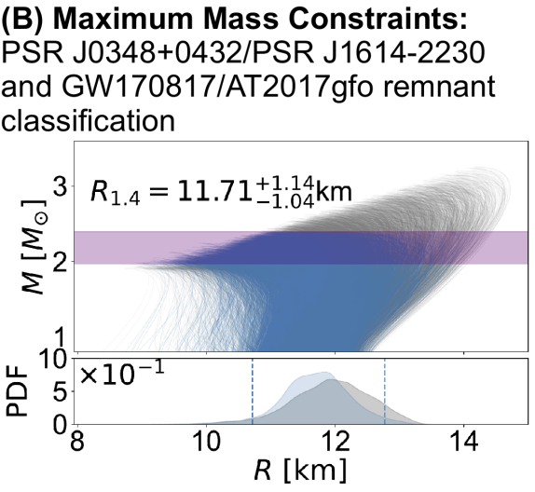
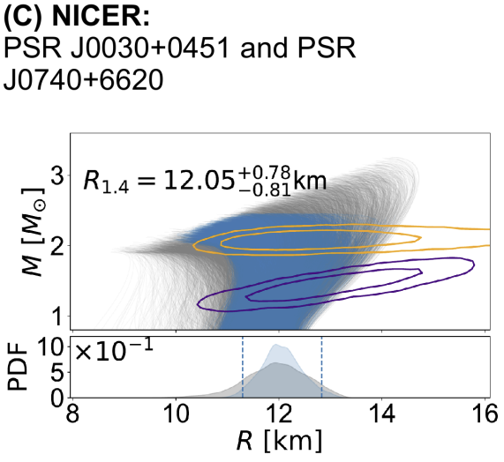
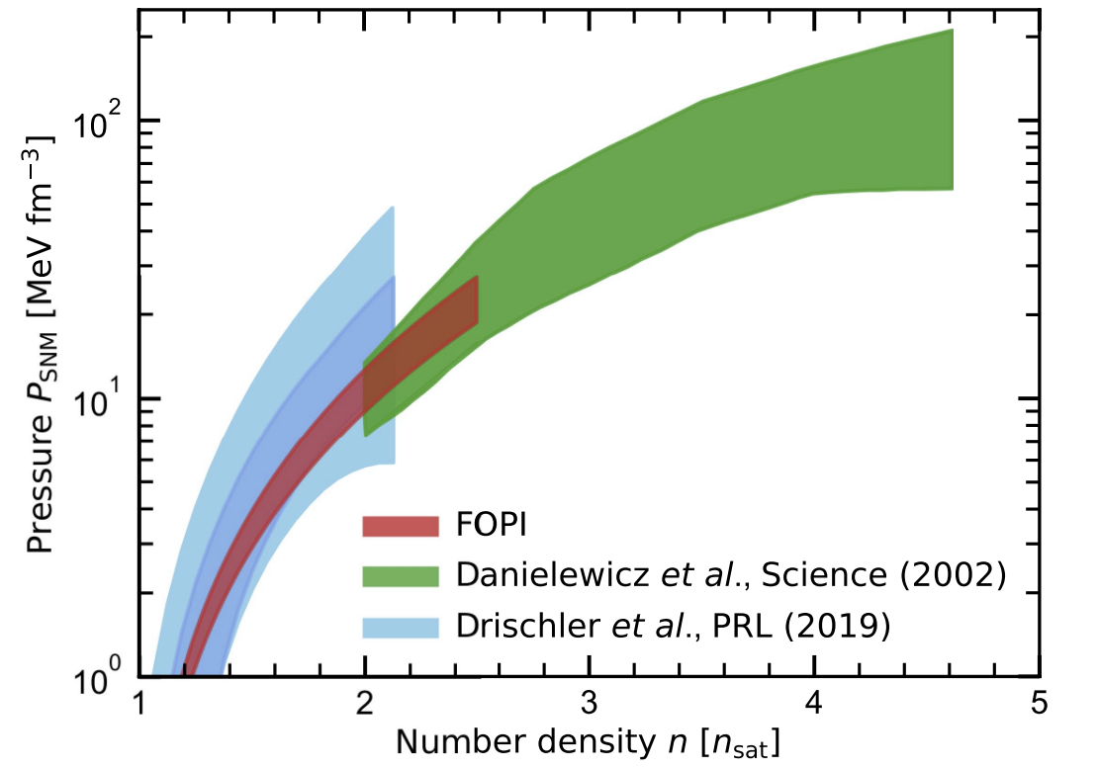
The ultimate dream
Symmetry energy slope
Energy gap of paired quarks
Why Be8 unstable?
Huth et al. 2022

Slide 3
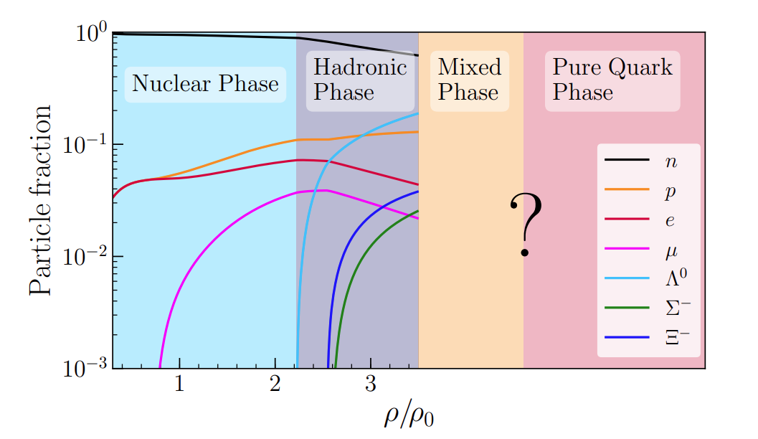
The pessimistic dream
Whether or not
PT happens inside NSs?
Huth et al. 2022

Slide 4
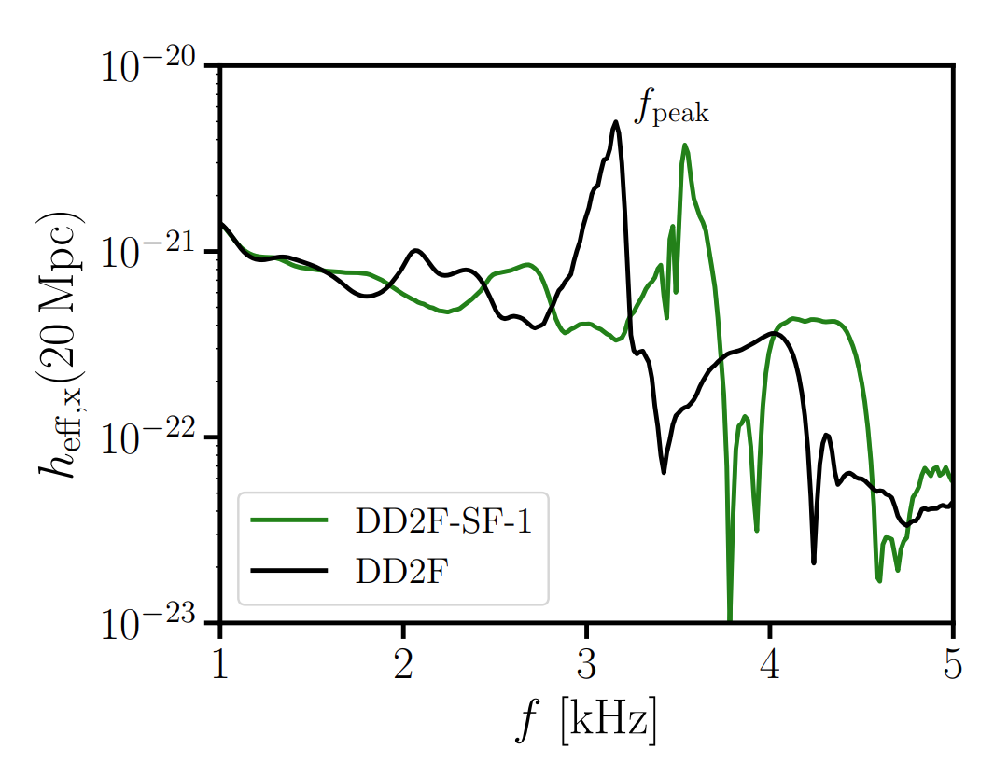
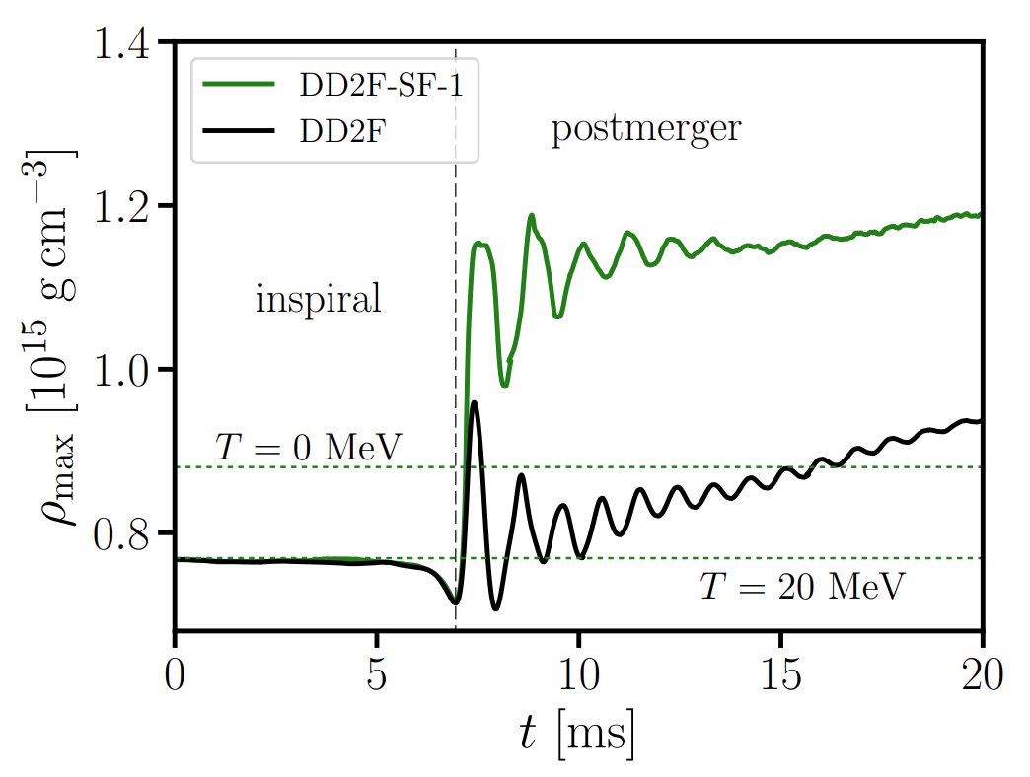
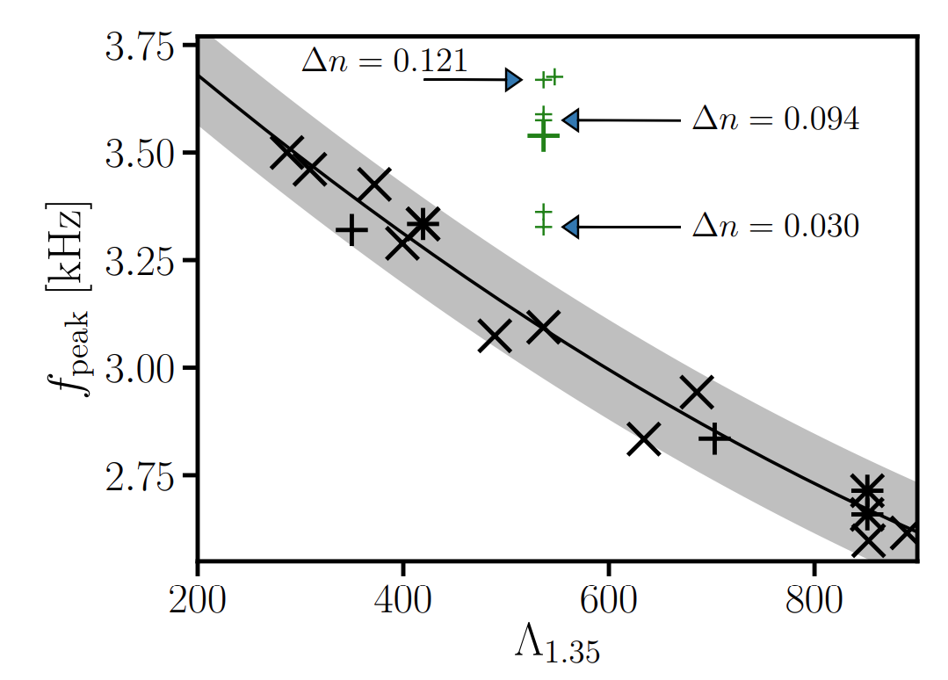
Hybrid Star and Mergers
Bauswein et al. 2018
Requires high sensitivity at very high GW frequencies (~> 3 kHz)
How do the other aspects of BNS mergers affected by a PT?

Slide 5
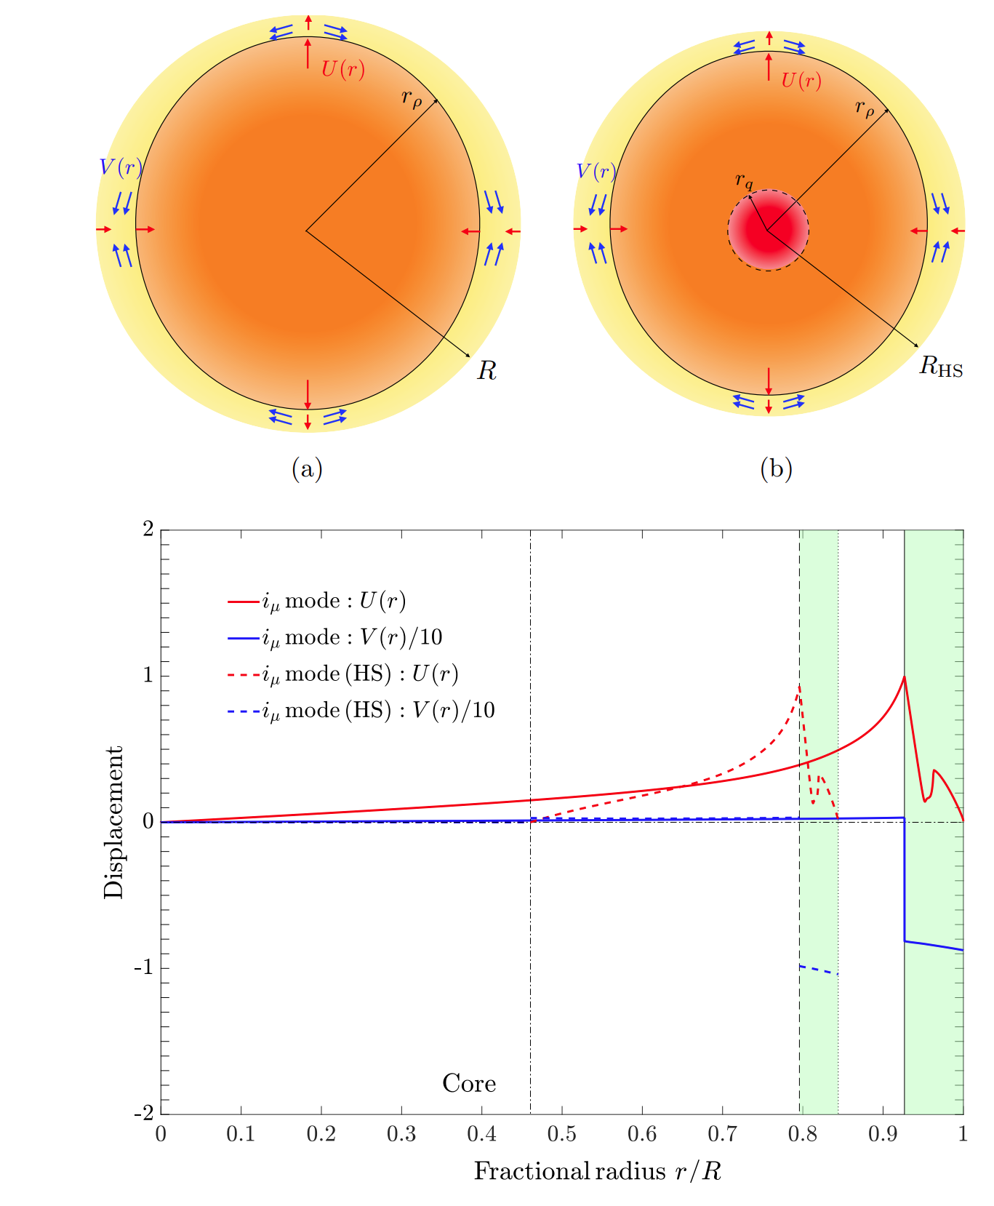
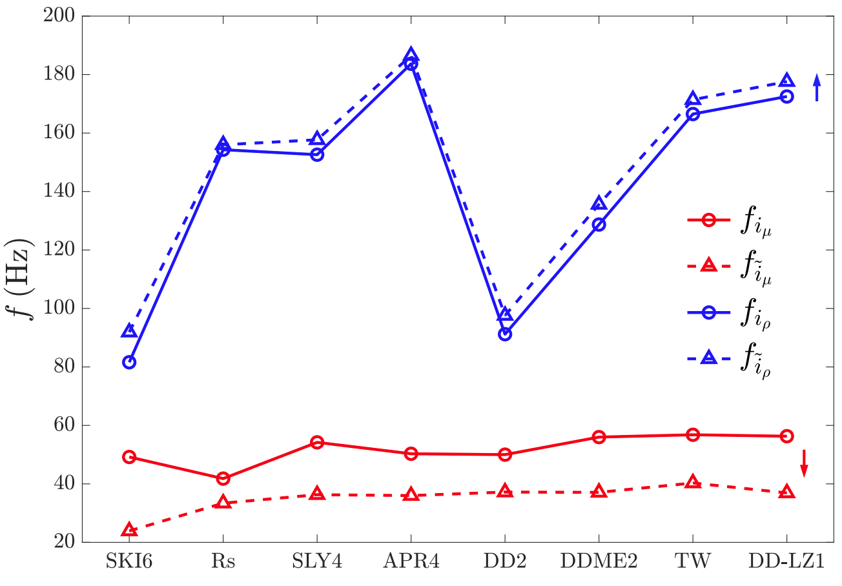
PT and Inspiral
Dynamic tides: oscillation modes of NSs (resonantly-)excited by tidal fields during inspiral.
To have significant imprint on the inspiral GW signal, modes with relatively low frequency and high tidal overlap is needed.
i-mode:
Zhu, Wang, Xia, Zhou*, Ma* 2022
c.f. Prof. Ma’s talk

Slide 6
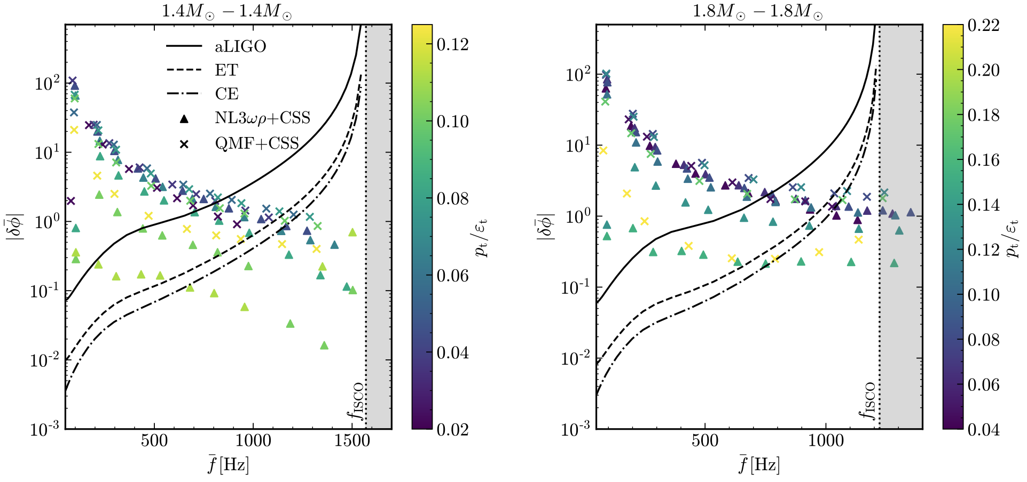
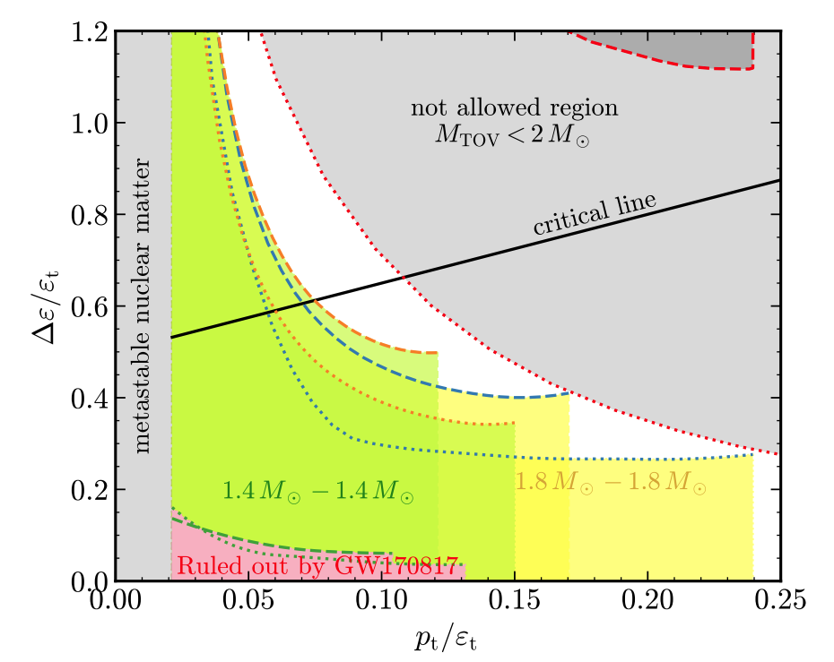
PT and Inspiral
Discontinuity g-mode:
Miao, Zhou, Li 2023
c.f. Miao’s talk
Dynamic tides with discontinuity g-mode

Slide 7
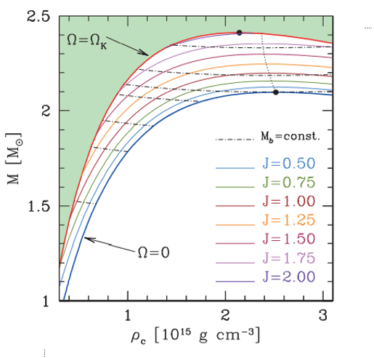
PT and Post-merger: EM aspects
$Δρ$ is larger during the spinning down of the merger remnant, than at the merger.
Any signal could be produced during a PT in the spinning down stage of the remnant?

Slide 8
PT and Post-merger: EM aspects
Phase transition in a much later time may significantly affect the X-ray features of a sGRB.

Slide 9
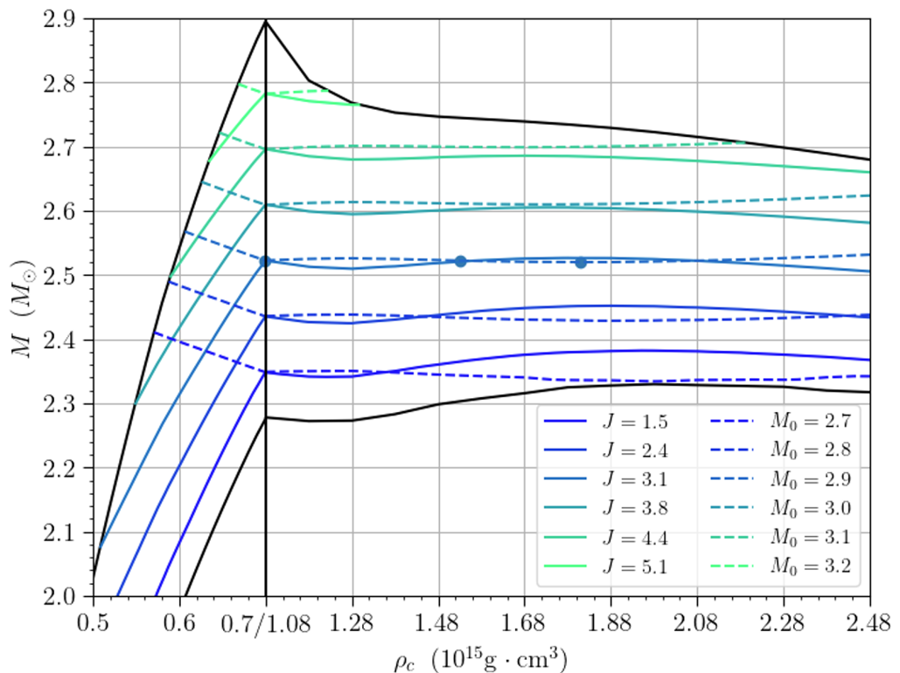
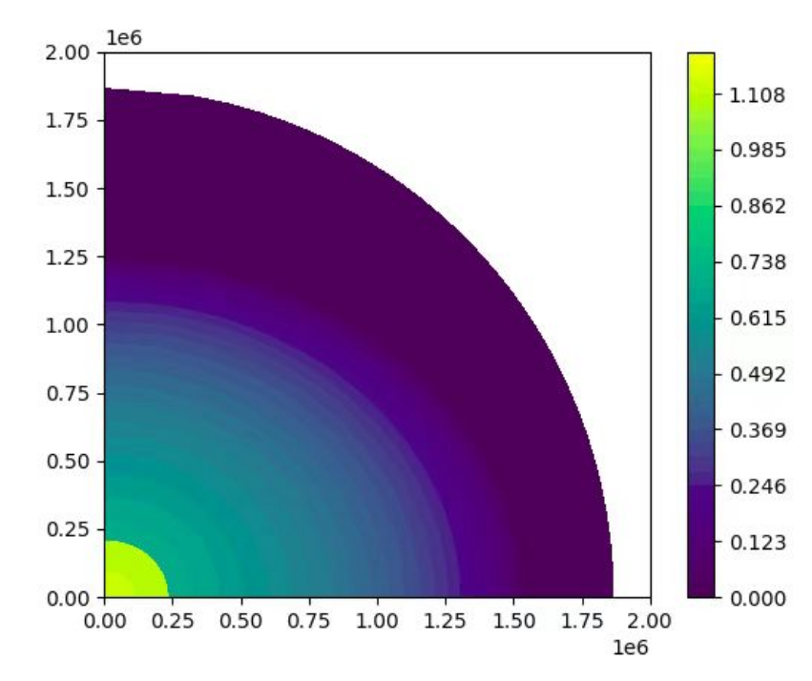
PT and Post-merger: EM aspects
Song & Zhou in prep
Left dot: onset of phase-transition
Middle dot: solution with the same baryonic mass and angular momentum
Right dot: collapse to BH

Slide 10
PT and Post-merger: EM aspects
Song & Zhou in prep
Left dot: onset of phase-transition
Middle dot: solution with the same baryonic mass and angular momentum
Right dot: collapse to BH

Slide 11
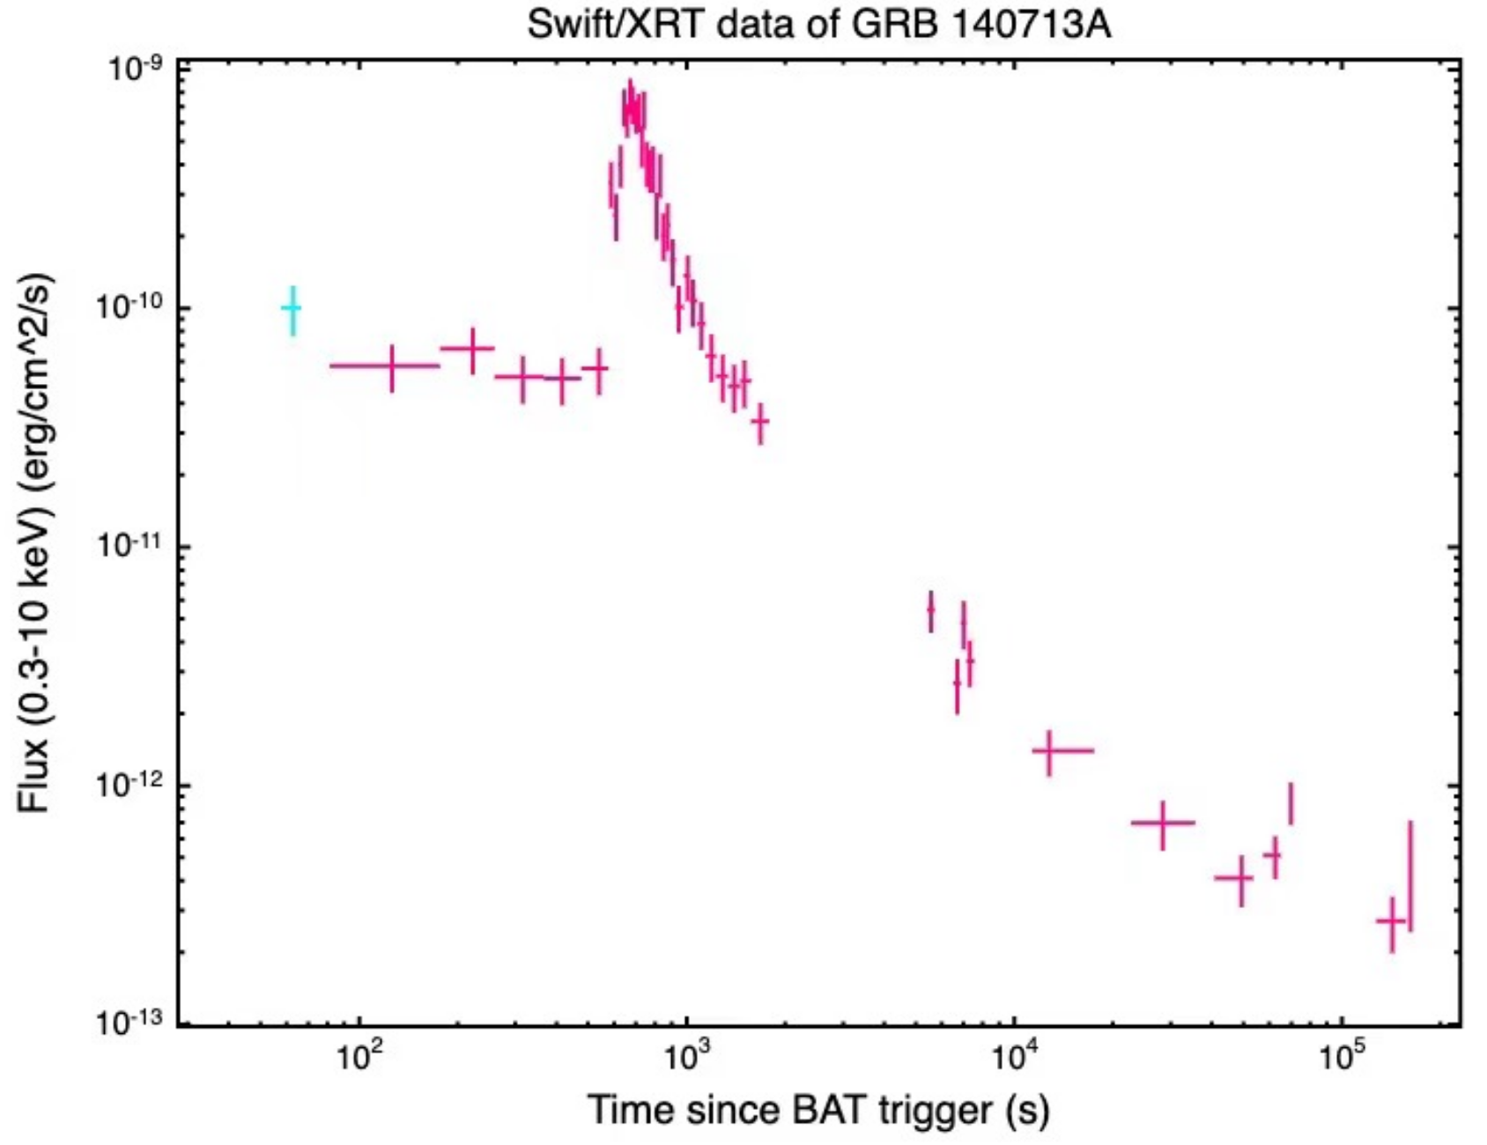
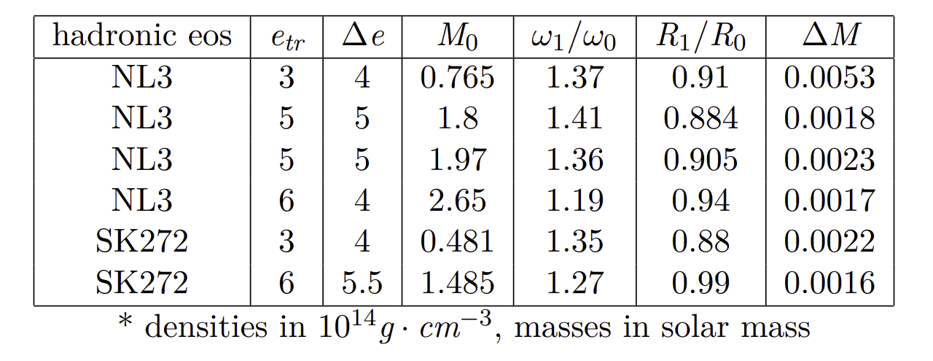
PT and Post-merger: EM aspects
Song & Zhou in prep

Slide 12
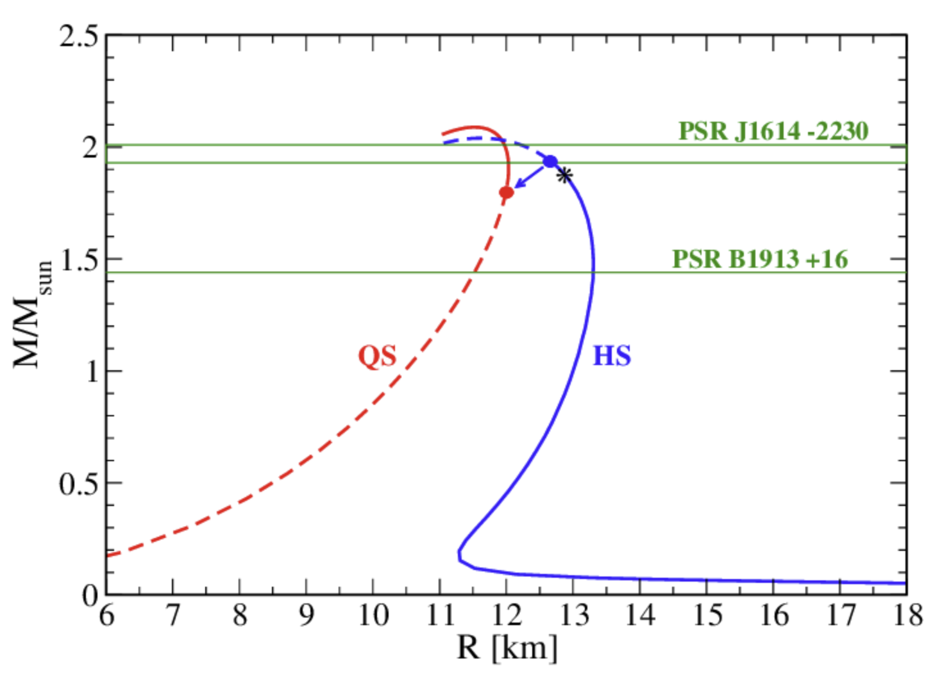
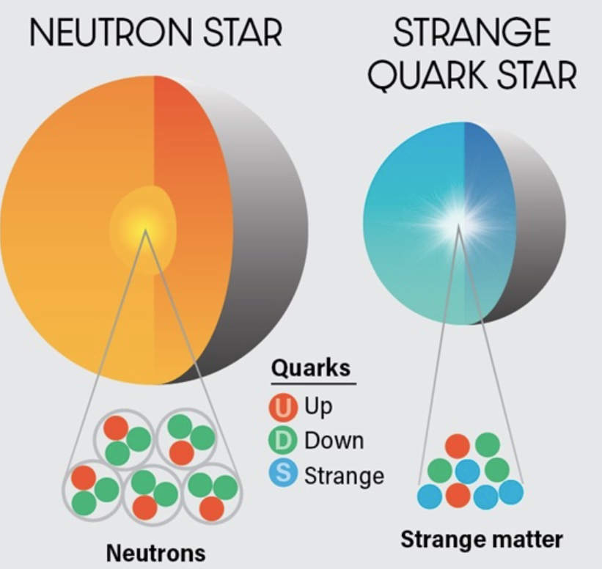
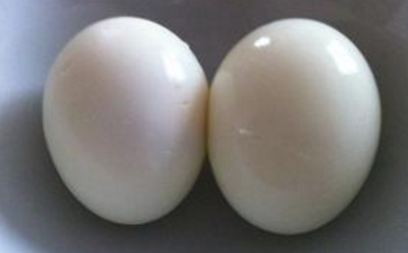
Quark stars
Bombaci 2016

Slide 13
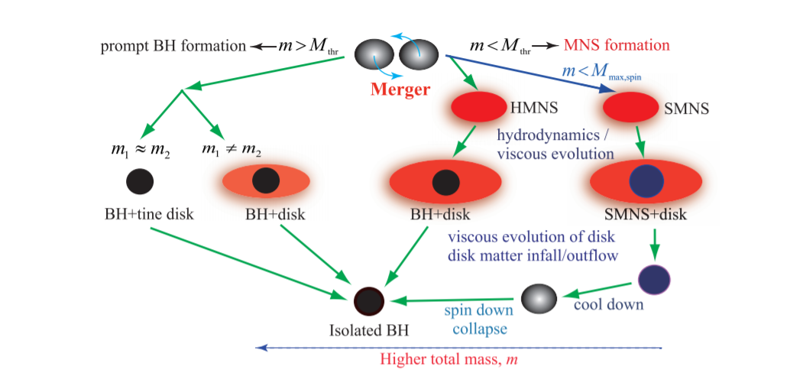
Post-merger evolution channels for QSs
The relation between total mass and several threshold masses determines the evolution channel in the post-merger.
Hotokezaka & Shibata 2019

Slide 14
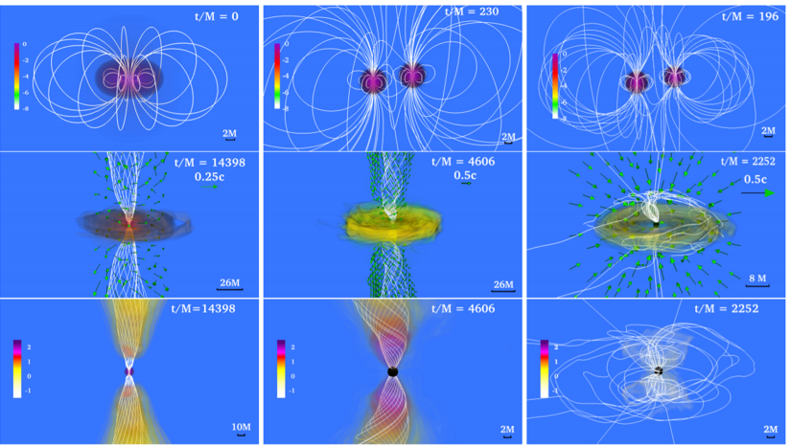
Post-merger signals for QSs
Margalit & Metzger 2017
Ruiz et al. 2018

Slide 15
Understanding collapse scenario
For GW170817, multi-messenger observation favors a short-lived merger remnant.
M_tov < 2.17 M_sun is hence derived and supported by many groups.
Rezzolla et al. 2017
Ruiz et al. 2018
Margalit & Metzger 2017
Rezzolla et al. 2017

Slide 16
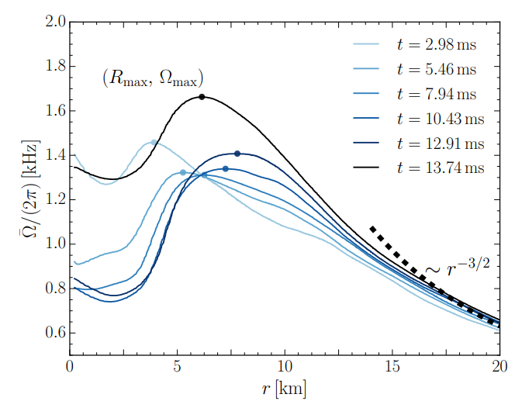
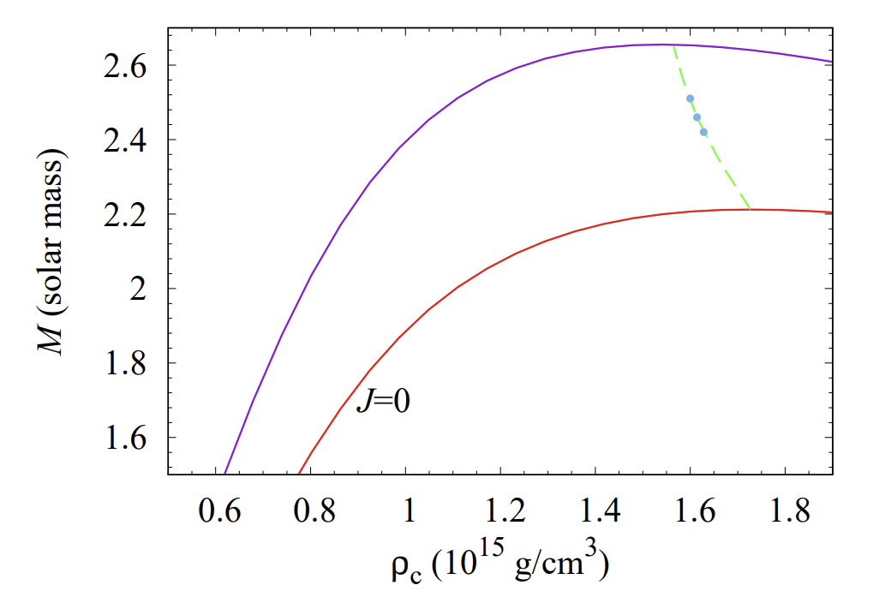
Understanding collapse scenario
Hanauske et al. 2016
Shibata et al. 2019
Considering the lack of angular momentum of the merger remnant,
we reanalyze and relax the constraint to M_max < 2.30 M_sun.
How about the situation of QSs?

Slide 17
Understanding collapse scenario
System characterized by M_b, M_g and J
Neutrino
GW
GW
Disc and ejecta
Collapse:
BH with certain M_g and J,
determined by rotational configurations of NSs/QSs.
Inspiral:
GW takes away M_g and J
Postmerger:
GW takes away M_g and J
Neutrino takes away M_g and J (more efficient in emitting M_g)
Disc and ejecta takes away M_b, M_g and J

Slide 18
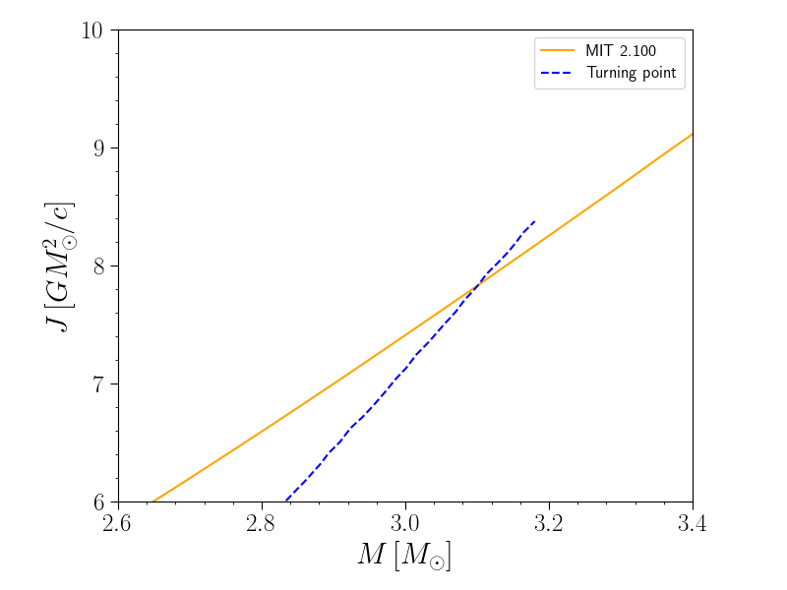
Understanding collapse scenario
System characterized by M_b, M_g and J
GW
If too much angular momentum is emitted during inspiral to support the remnant formed at merger,
a prompt collapse happens.
Collapse:
BH with certain M_g and J,
determined by rotational configurations of NSs/QSs.
Inspiral:
GW takes away M_g and J

Slide 19
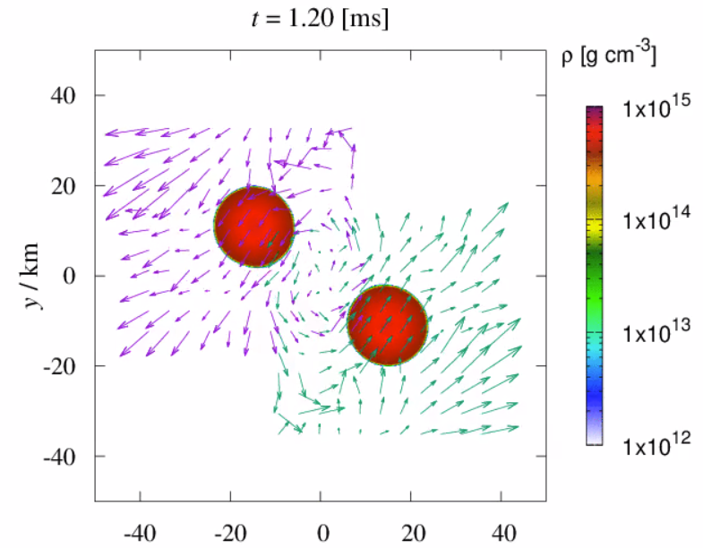
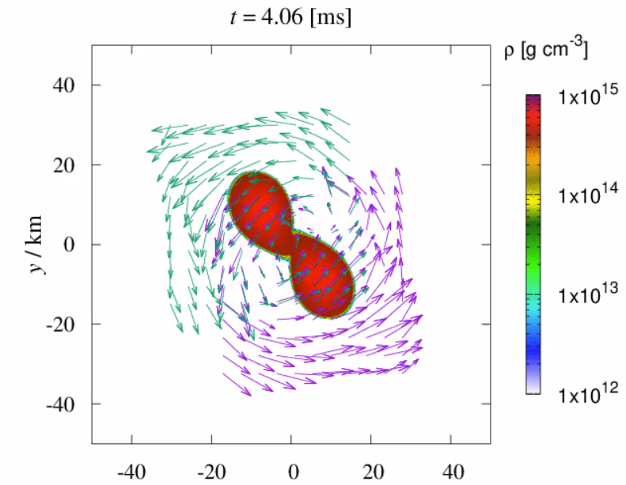
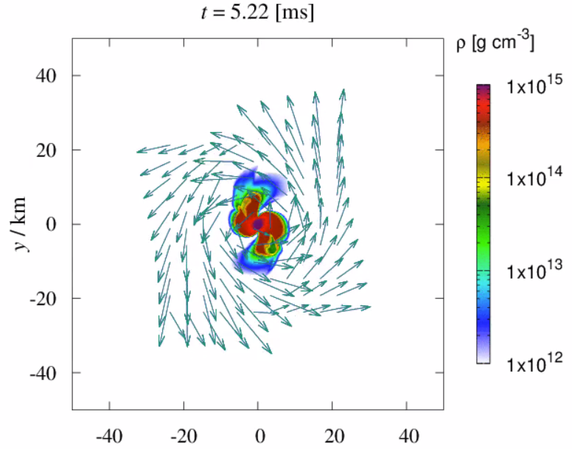
Threshold mass of BQS mergers
Collapse happens ~1 ms after merger, comparable to dynamical timescales.
MIT310 starts at ~ 40 km separation

Slide 20
New analysis: the model
Conservation of rest mass
$$M_{b,0}=M_{b,f}+M_{eje}+M_{out}$$
Conservation of energy
$$M_{g,0}=M_{g,f}+E_{gw,i}+E_{gw,p}+E_{ν}+M_{eje}+M_{out}$$
Conservation of angular momentum
$J_{0}=J_{f}+J_{gw,p}+J_{ν}+J_{eje}+J_{out}$
Blue values are from the observation
Purple values are from the EOB calculations
Red values can be determined once a value of $M_{eje}+M_{out}$ is chosen
Then, with 2nd and 3rd equation, $E_{gw,p}$ and $E_{ν}$ as well as $J_{gw,p}$ and $J_{ν}$ can be solved.
Then a consistency check can be done

Slide 21
Understanding collapse scenario
System characterized by M_b, M_g and J
Neutrino
GW
GW
Disc and ejecta
Collapse:
BH with certain M_g and J,
determined by rotational configurations of NSs/QSs.
Inspiral:
GW takes away M_g and J
Postmerger:
GW takes away M_g and J
Neutrino takes away M_g and J (more efficient in emitting M_g)
Disc and ejecta takes away M_b, M_g and J

Slide 22
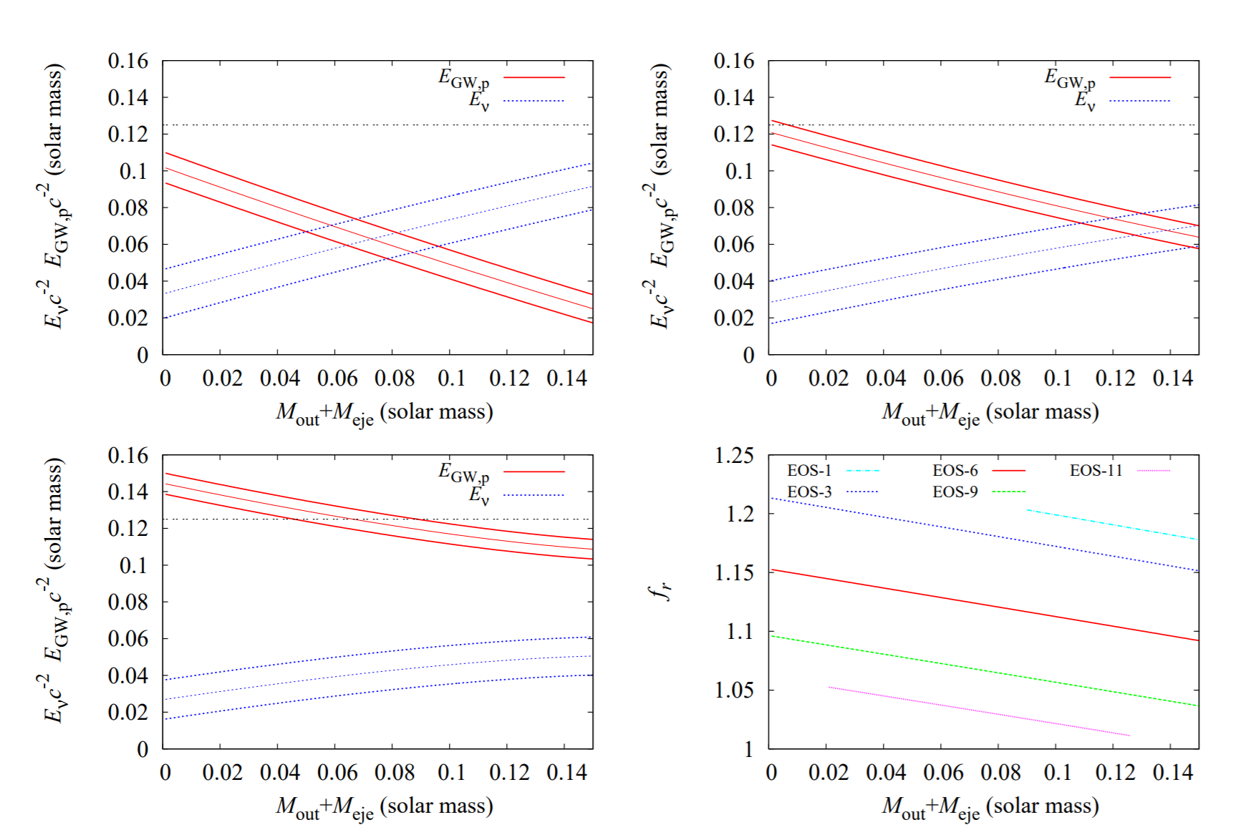
New analysis: the results
Shibata, EZ et al 2019

Slide 23
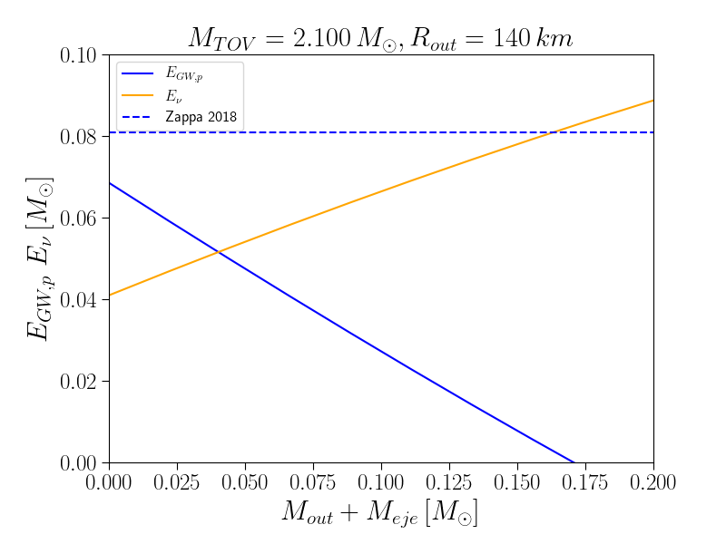
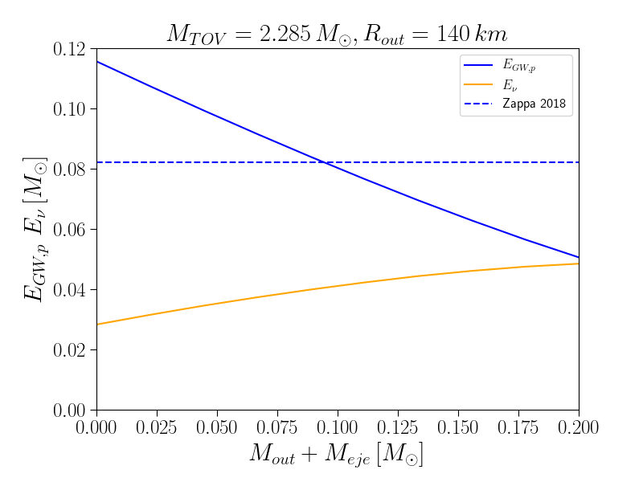
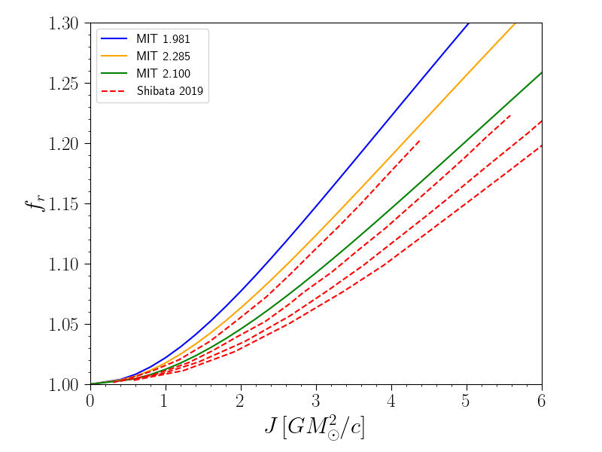
New analysis: QSs
Zhou & Zhou 2023 in prep

Slide 24
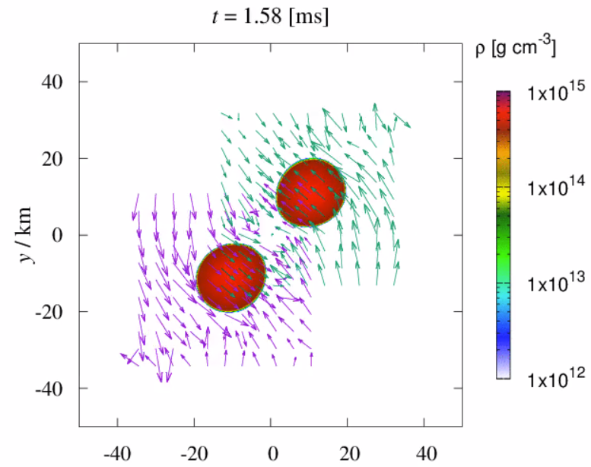
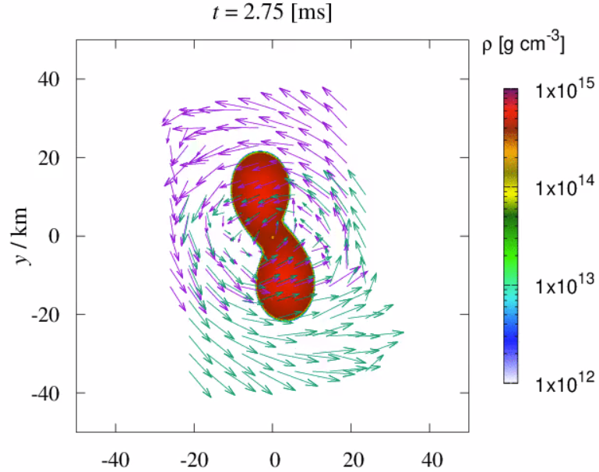
NR simulation: MIT280
Zhou et al. 2023

Slide 25
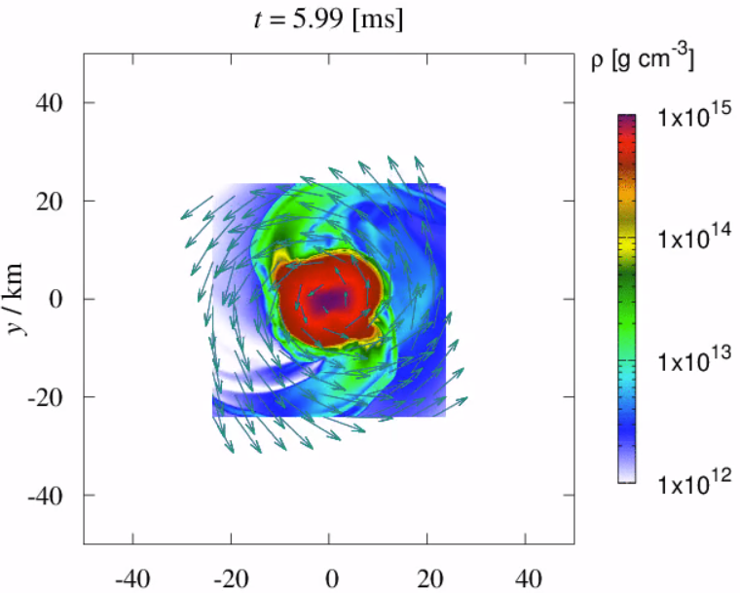
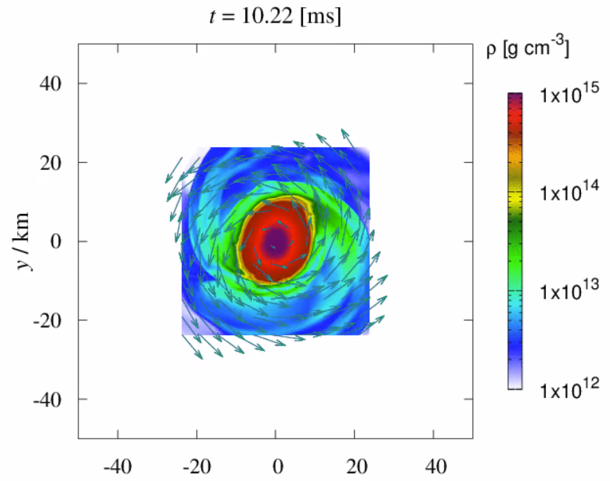
NR simulation: MIT280
GR hydro simulation of BQS reveals high density mass overflow in spiral arm structures.

Slide 26
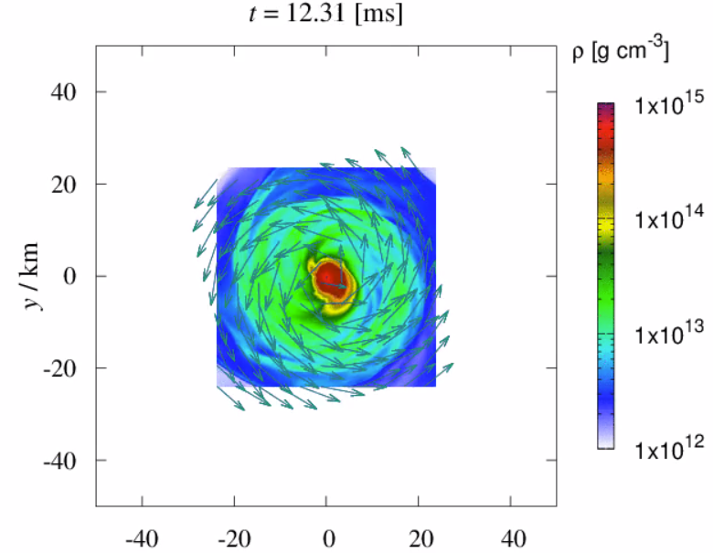
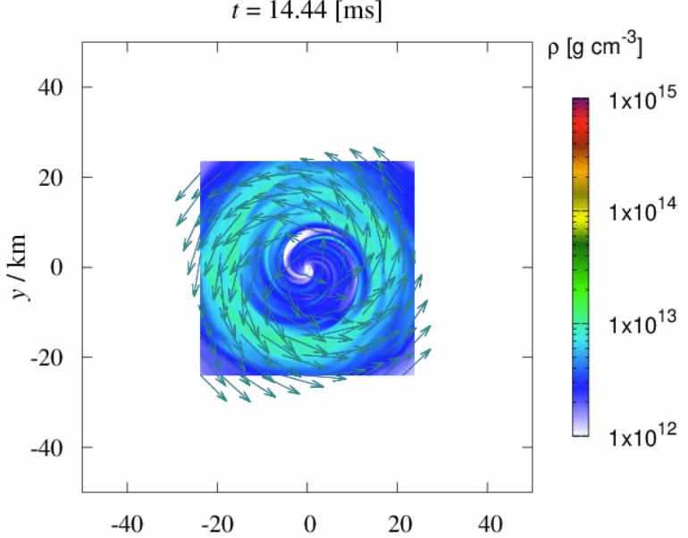
NR simulation: MIT280
Collapse happens for a BQS model with total mass much below its Keplerian limit in ~10 ms. Showing a BQS system in SMQS mass range undergoes HMQS channel.
Exceptionally heavy disc for equal mass binary (>0.2 solar mass, 0.01 solar mass unbound) is left outside the BH even ~30 ms after the collapse. But why?

Slide 27
Conclusions (for now)
PT results in significant difference in the NS structure.
PT affects asteroseismology of NSs and could be imprinted in GW signals (both inspiral and post-merger).
PT may trigger burst-like events for both EM and GW emissions.
Post-merger evolution channels for BQS are different from BNS, indicating different observational signatures.

