Slide 1
On the effect of the variation of velocity fields in pulsars
杜双（铜陵学院）
Du Shuang（Tongling University）
https://www.researchsquare.com/article/rs-2643025/v1 (简记为 Du 2023)

Slide 2
Content
Basic consideration: velocity fields & magnetic fields
The variation of pulsar magnetic fields
Indicator of the variation of the magnetic field
Possible applications

Slide 3
Basic consideration
The kinetic energy of the fluid in a pulsar can be transformed into the magnetic energy (Thompson & Duncan 1993).
Glitches and their recover stages are the consequences of unpinning and repinning of neutron superfluid vortices in pulsar crusts (e.g., Anderson & Itoh 1975).
Therefore, glitches may induce the variation of pulsar magnetic fields.

Slide 4
The variation of the magnetic field
The stable magnetic field under the variation of the velocity field should satisfy

Slide 5
Expection：
The usually invoked magnetic dipole fields cannot keep steady even in the presece of a toroidal component; The multipole component of the magnetic field should be produced/altered after a glitch.

Slide 6
Indicator of the variation
The properties of pulsar pulsed radio emissions should be closely related to the structure of pulsar magnetospheres (Ruderman & Sutherland 1975; Arons & Scharlemann 1979; Usov 1987; Qiao & Lin 1998; Beloborodov 2008; Philippov et al. 2020).
If the multipole component is altered after a glitch, the properties of the pulsed radio emission should be also changed.

Slide 7
How?--An equivalent RC circuit
The crooked magnetic field lines of the multipole component reduce the voltage needed to tragger a spark and increase the spark frequency.
Ruderman & Sutherland 1975

Slide 8
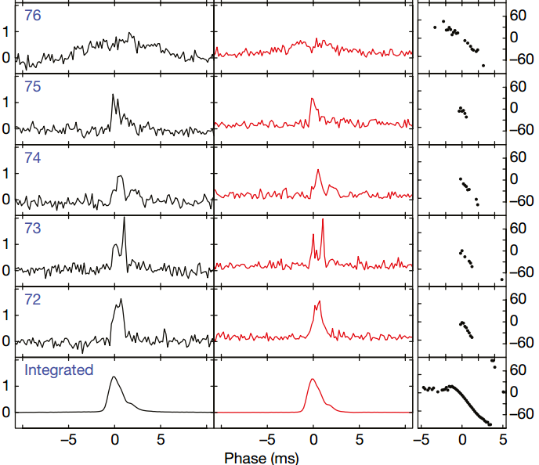
Verification?
sudden change of the pulse shape coincident with a glitch
event of Vela pulsar (Palfreyman et al. 2018)

Slide 9
Application (1): pulse nulling
U
U_{sp}<U_{max}, τ<P, normal radio pulsar
U_{max}
U’_{max}
U_{sp}
τ
τ’
t
U_{sp}~U’_{max}, τ’>P, nulling

Slide 10
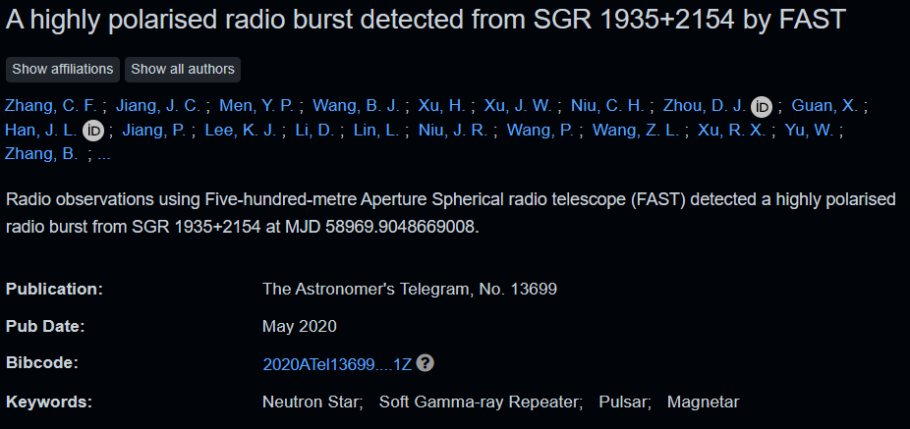
Application (2): resurgences of magnetars
see more details later
Say sorry to the authors of the paper--Camilo et al. 2006 (∩_∩).

Slide 11
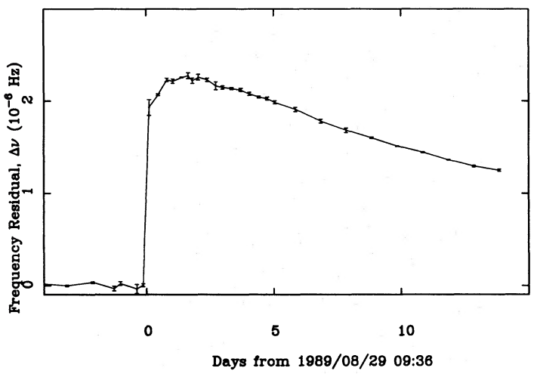
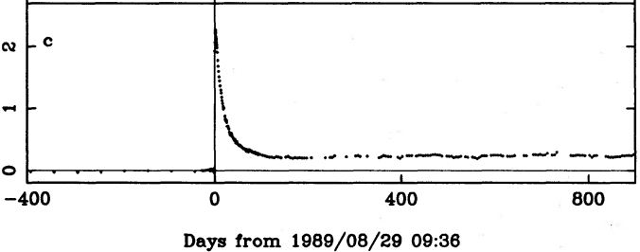
Application (3): Crab pulsar and Vela pulsar
The younger Crab pulsar should have a stronger toroidal magnetic field and more magnetic free energy.
23 years of Crab pulsar rotational history (Lyne et al. 1993)；Thank WHW。
Du 2023
smaller
Du 2023

Slide 12
Application (4): FRB-like events from a magnetar
A bright millisecond-duration radio burst from a Galactic magnetar (CHIME/FRB Collaboration et al. 2020); A fast radio burst associated with a Galactic magnetar (Bochenek et al. 2020).
A giant glitch from the magnetar SGR J1935+2154 before FRB 200428 (Ge et al. 2022).
Magnetar spin-down glitch clearing the way for FRB-like bursts and a pulsed radio episode (Younes et al. 2023).

Slide 13
Ruderman & Sutherland 1975
？
Energy; Charges; Electric field; coherent emission.

Slide 14
Summary
Glitches may induce the variation of velocity fields in pulsars, as well as pulsars magnetic fields.
The increase of the spark freqency is the indicator of the variation of the magnetic field after a certain glitch.
Pulse nulling, rebrigtenning of radio-quiet magentars, differences between Crab pulsar and Vela pulsar after glitches and extragalactic-FRB-like events from SGR 1935+2154 are explained based on the variation of pulsar magnetic fields induced by glitches.
替副院长带个话(∩_∩)：欢迎找工作的同学考虑铜陵学院。
Thanks!

