Slide 1
Research progresses of young pulsars
SPSS2023 & FPS 12
葛明玉
合作者：闫林丽、庹攸隶、叶文韬、卢方军、张双南、郑世界、李小波、郑金涛、袁建平、周世奇、仝号
中科院高能物理研究所
南阳，2023-07-04

Slide 2
Outline
Pulsars
Crab pulsar: glitches, spectra
PSR B0540-69： state transition and evolution
PSR J1124-5906：state transition
PSR J0205+6449：short variation triggered by glitch
PSR J1811-1925： Phase resolved spectra
Vela pulsar：Gamma-ray pulse profile
SGR J1935+2154: glitch and X-ray burst property
Summary

Slide 3

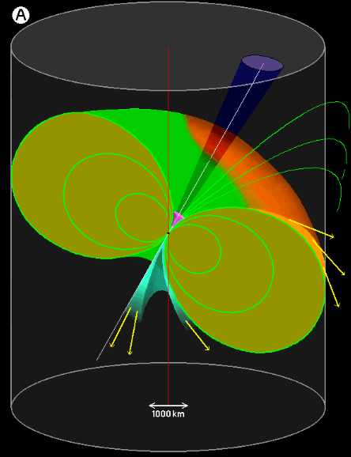
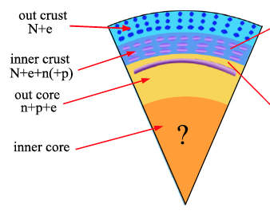
Pulsars
Pulsars are highly magnetized fast rotating neutron stars
Emission model
  Outer gap
  Slot gap
  Annular gap
  …
Structure

Slide 4
Pulsars
Magnetar
Young pulsar

Slide 5
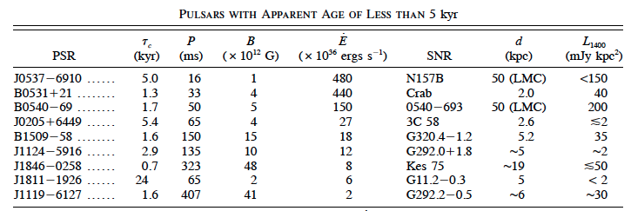
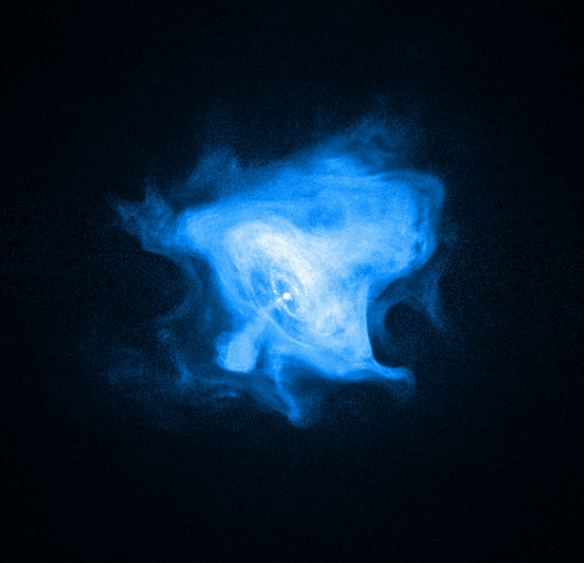
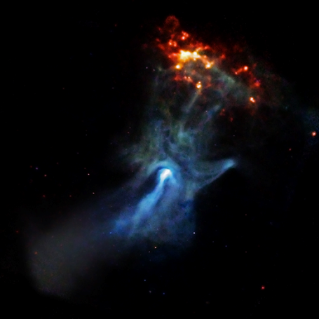
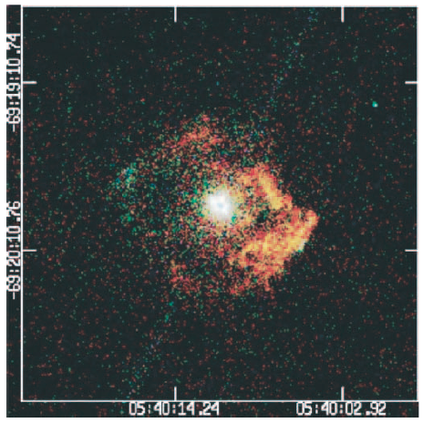
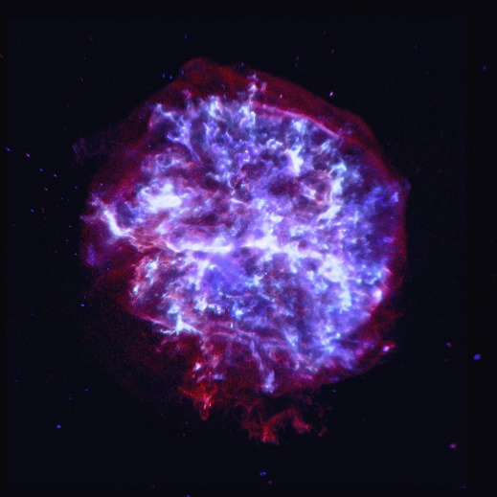
Young pulsars
Crab
B1509-58
B0540-69
J1124-5916

Slide 6
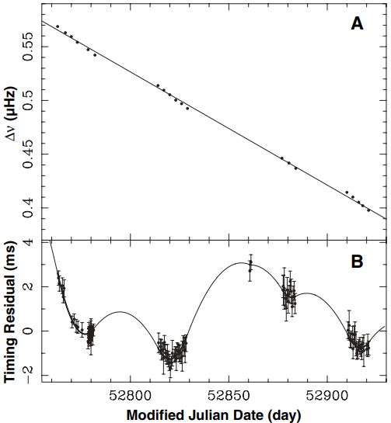
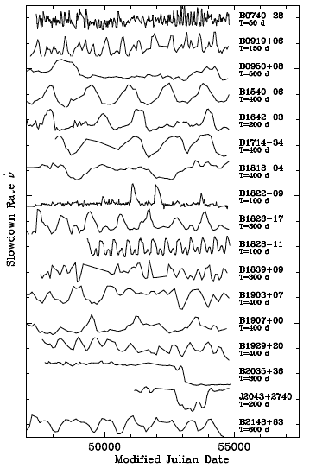
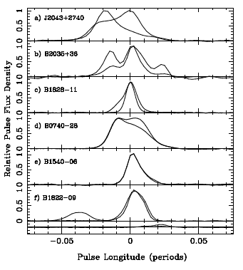
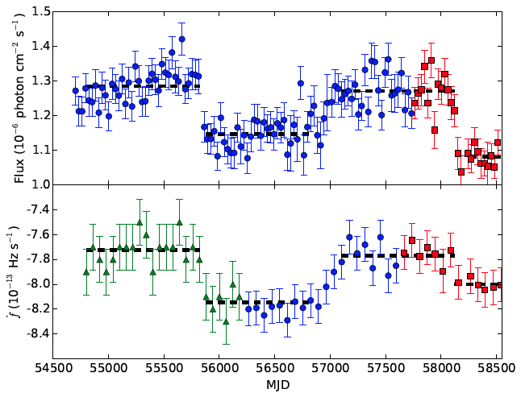
State transition
Change of magnetosphere
B1931+24
Kramer et al. 2006
PSR J2021+4026
Lyne et al. 2010. tau_c~10^5-10^6 yrs
Takata et al. 2020

Slide 7
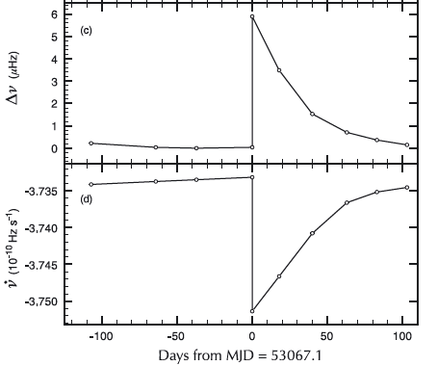
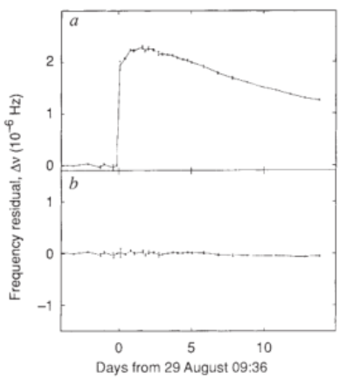

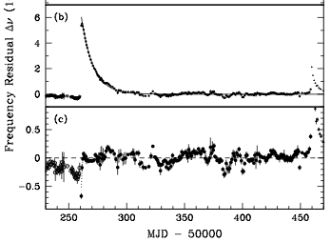
Glitch
Typical glitches
Crab pulsar
G1
The first glitch event with spin-up
Lyne et al. 1992
G2
Vela pulsar: 4 components
None of them are spin-up processes
Dodson et al. 2002,564,85
Slow glitch/Anti-glitch
Wong et al. 2003

Slide 8
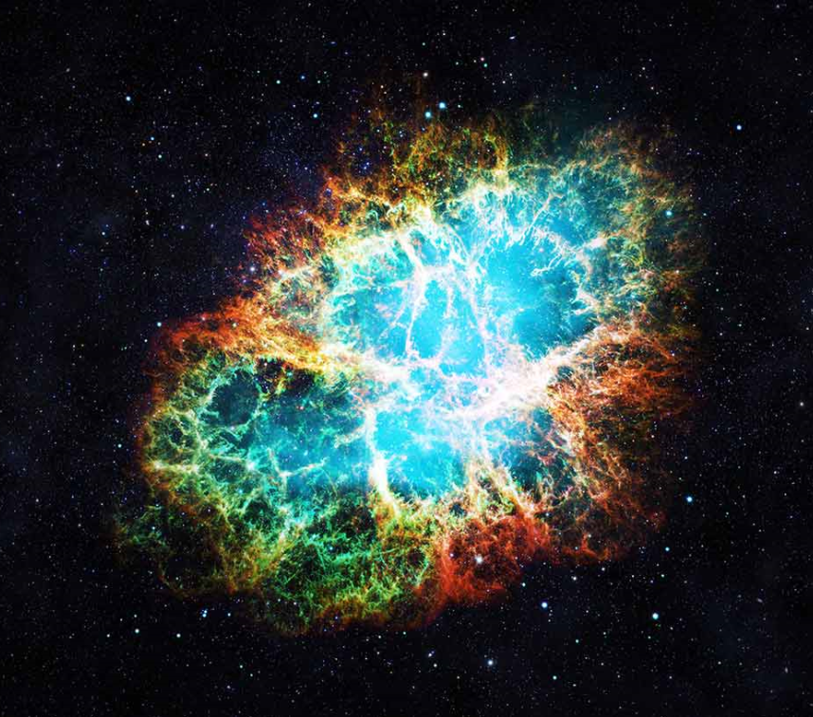
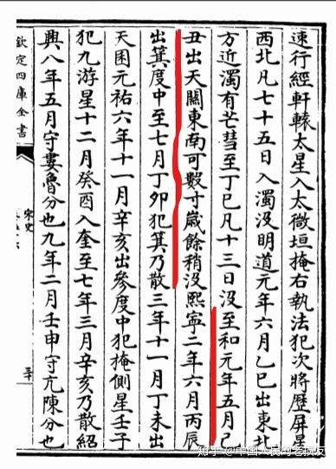
Crab pulsar
曾经担任过美国原子能委员会主席的麻省理工学院教授韦斯科夫(V·F·Weisskopf)说:“在人类历史上有两个7月4日,值得永远纪念。一个是1776年7月4日美利坚合众国的成立;一个是1054年7月4日,中国天文学家纪录了金牛座超新星的爆发,这次爆发产生了蟹状星云。”1054年7月4日相当于宋仁宗至和元年五月二十六日,中国古时用干支纪日,这一天的日名为“已丑”。（摘自席泽宗《蟹状星云与中国客星》）

Slide 9
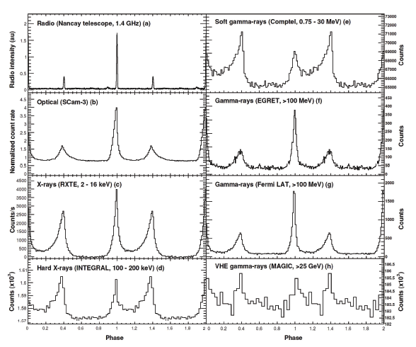
Crab pulsar
  Pulse profile: from radio to gamma
Abdo et al. 2010

Slide 10
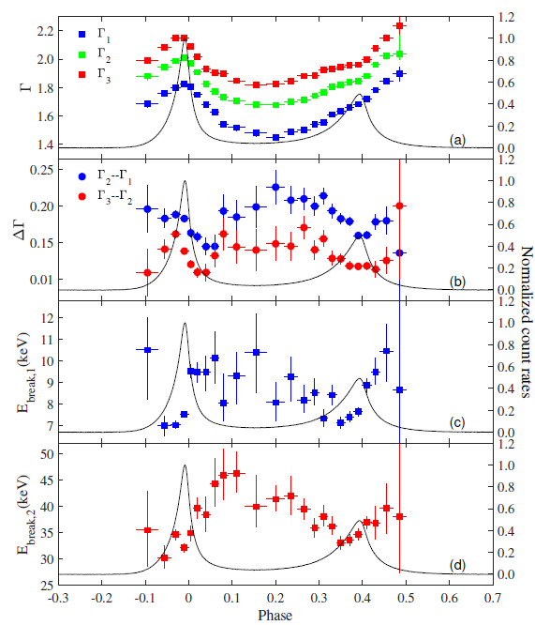
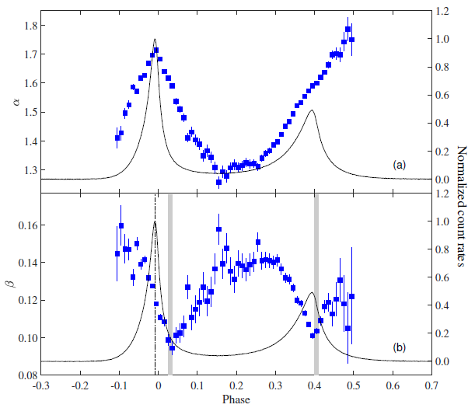
Crab pulsar
Yan et al. 2022
Two broken PL

Slide 11
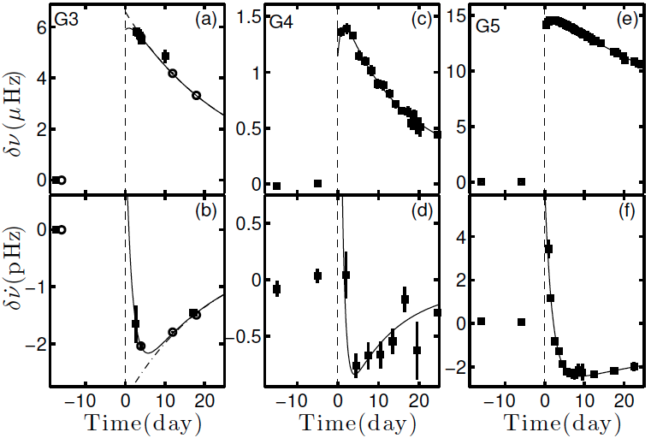
Crab pulsar
G3(2011): 2nd
G4(2014): 5th
G5(2017): 1st
Only large glitches show spin-up process
Shaw et al. 2018
Zhang et al. 2018
Ge et al. 2020
The observations for part-timing results are obtained from Radio telescopes in China, RXTE, INTEGRAL, Fermi LAT/GBM, Insight-HXMT. Some results are from the ephemeris of Jordell Bank.

Slide 12
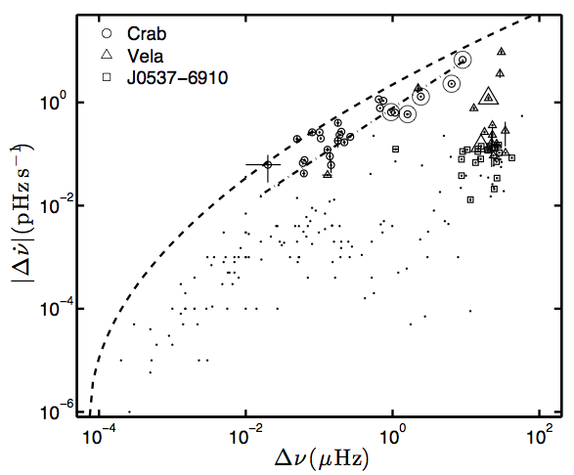
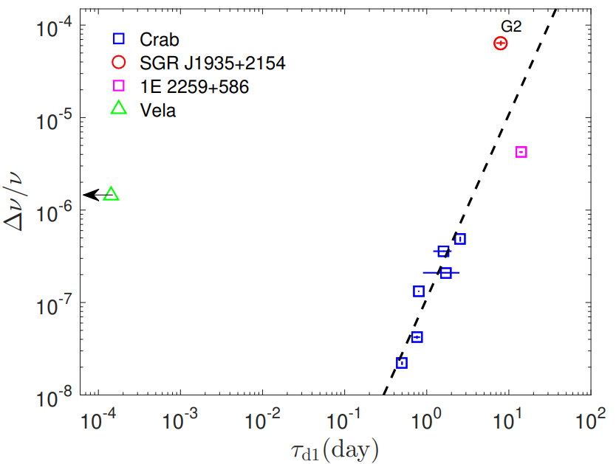

Crab pulsar
The distribution of the five events; follow the same correlation between Δν and Δν and suggests that the glitches with spin-up processes are actually normal
The correlations between different parameters of the five events
$˙$
Ge et al. 2020

Slide 13
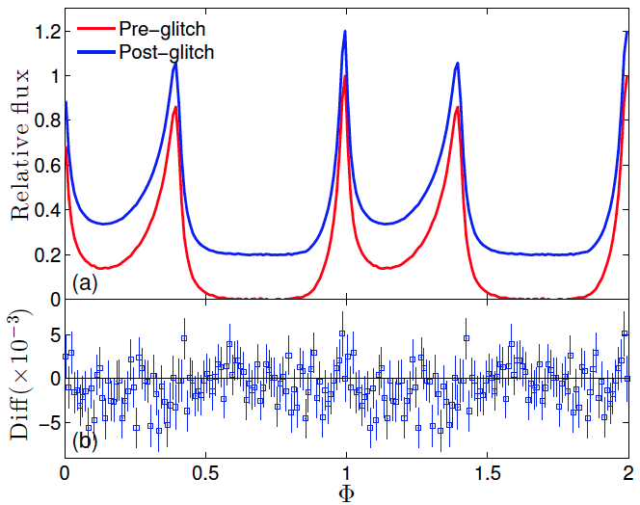
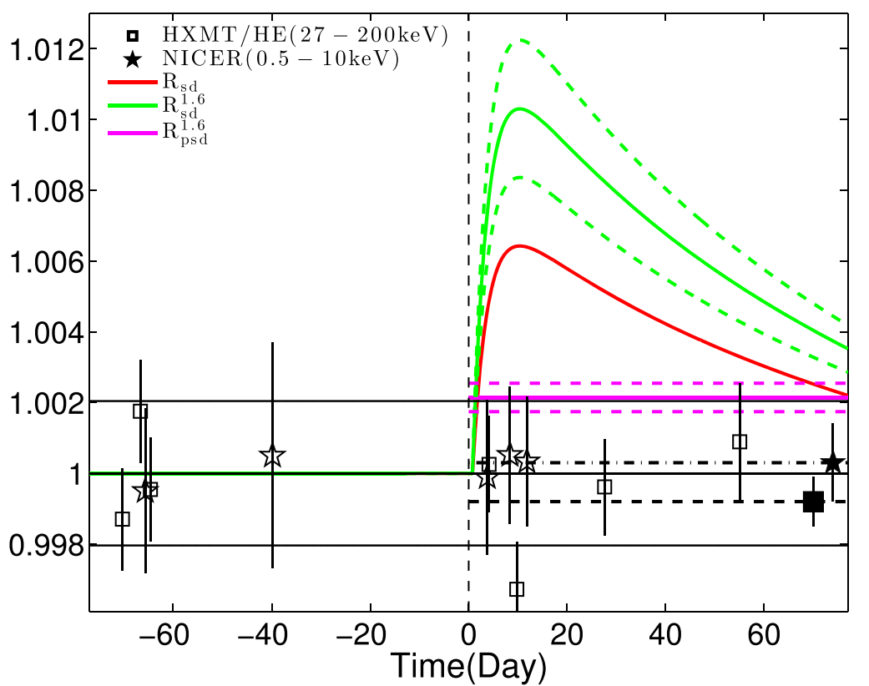
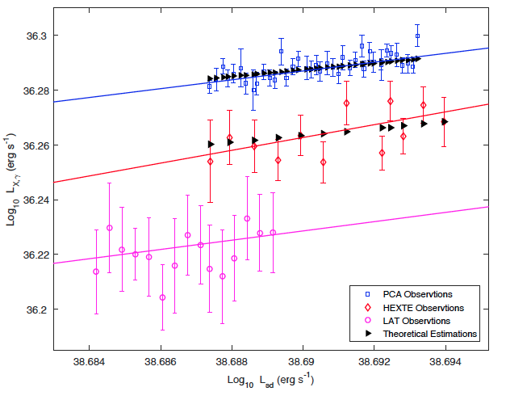


Crab pulsar
Zhang, Y.H. et al. 2022
During the glitch, only the rotation of the crust (instead of the whole pulsar body) becomes faster;
The spin-down luminosity of the pulsar during the glitch (including the recovery) process can not be represented by the usually used equation;
The main force slowing down the rotation of the crust in the glitch recovery phase is not the magnetic dipolar emission.
Yan et al. 2018

Slide 14
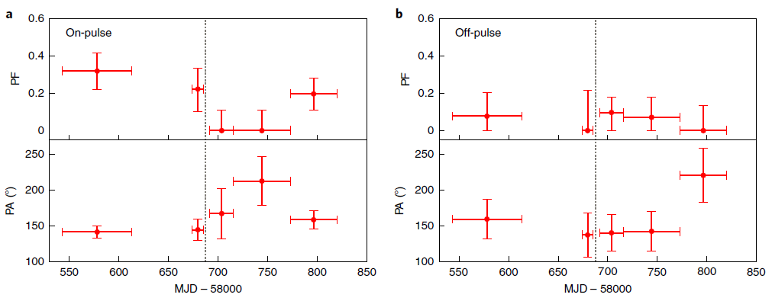
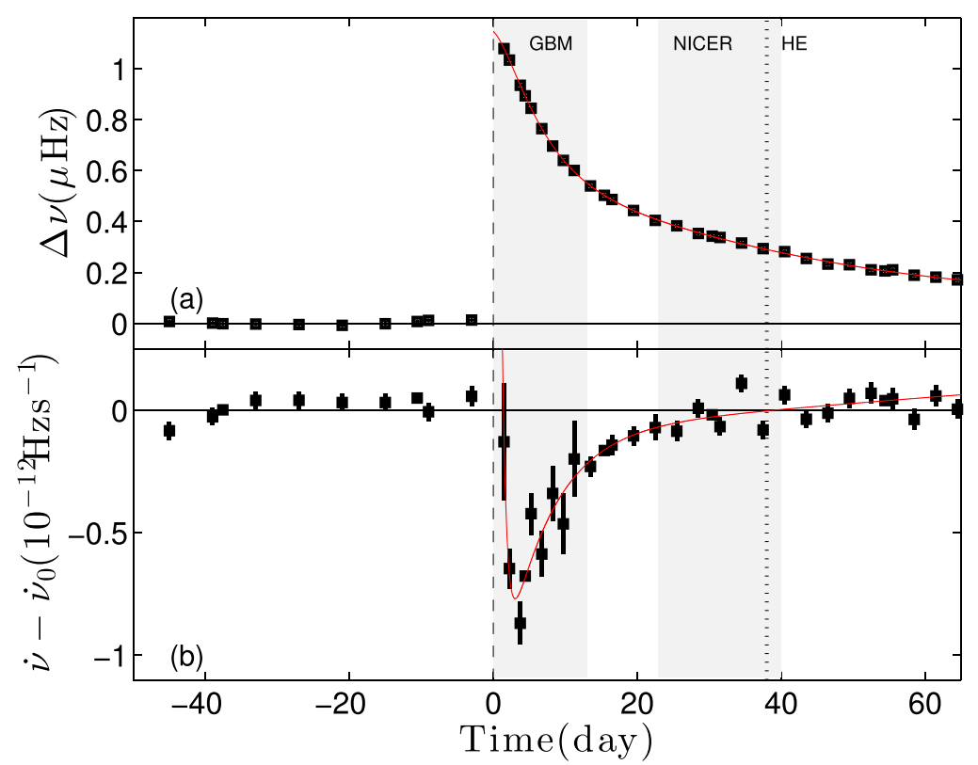
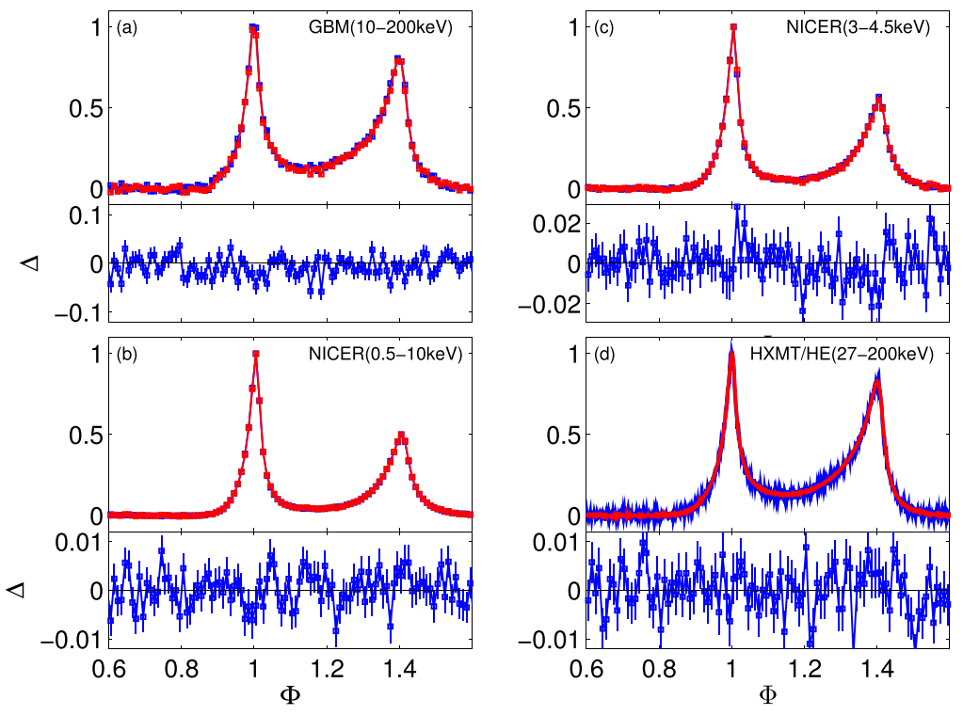
Crab pulsar
Polarization Variation post glitch?
Feng et al. 2020
X-ray pulse profile
No variations!
Zhang, Y.H. et al. 2022

Slide 15
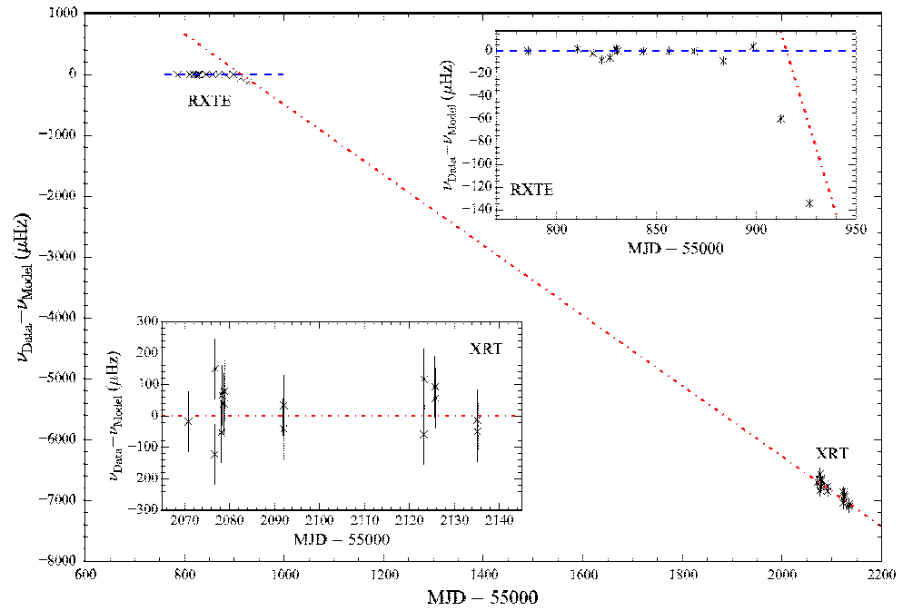
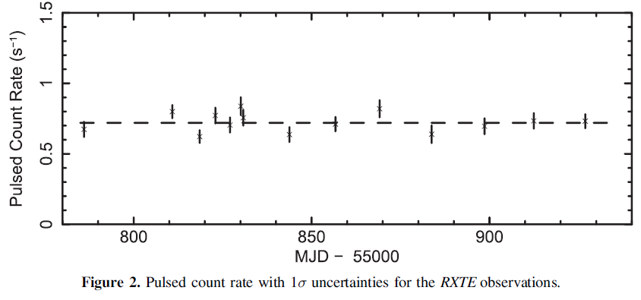
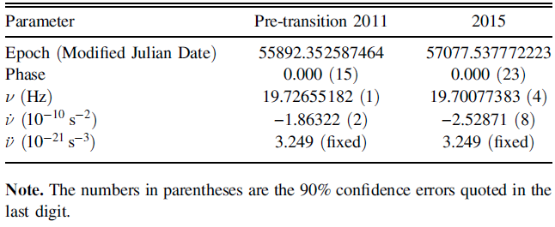
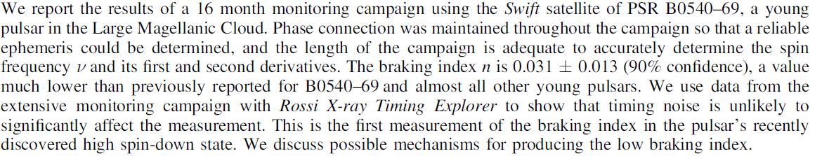
PSR B0540-69
n = 2.5
Marshall et al. 2015
Spin-down rate transition（SRT）~36%

Slide 16
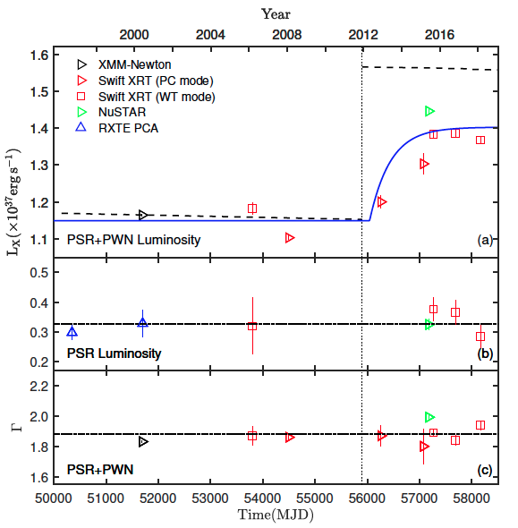
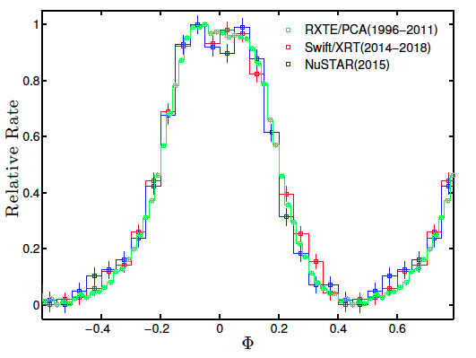
PSR B0540-69
The luminosity of pulsar and pulse shape do not change
PWN 32(8)%
Tau=400 day

Slide 17
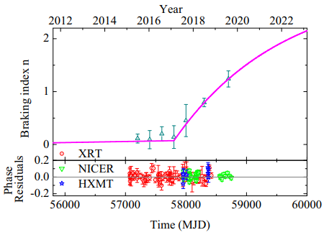
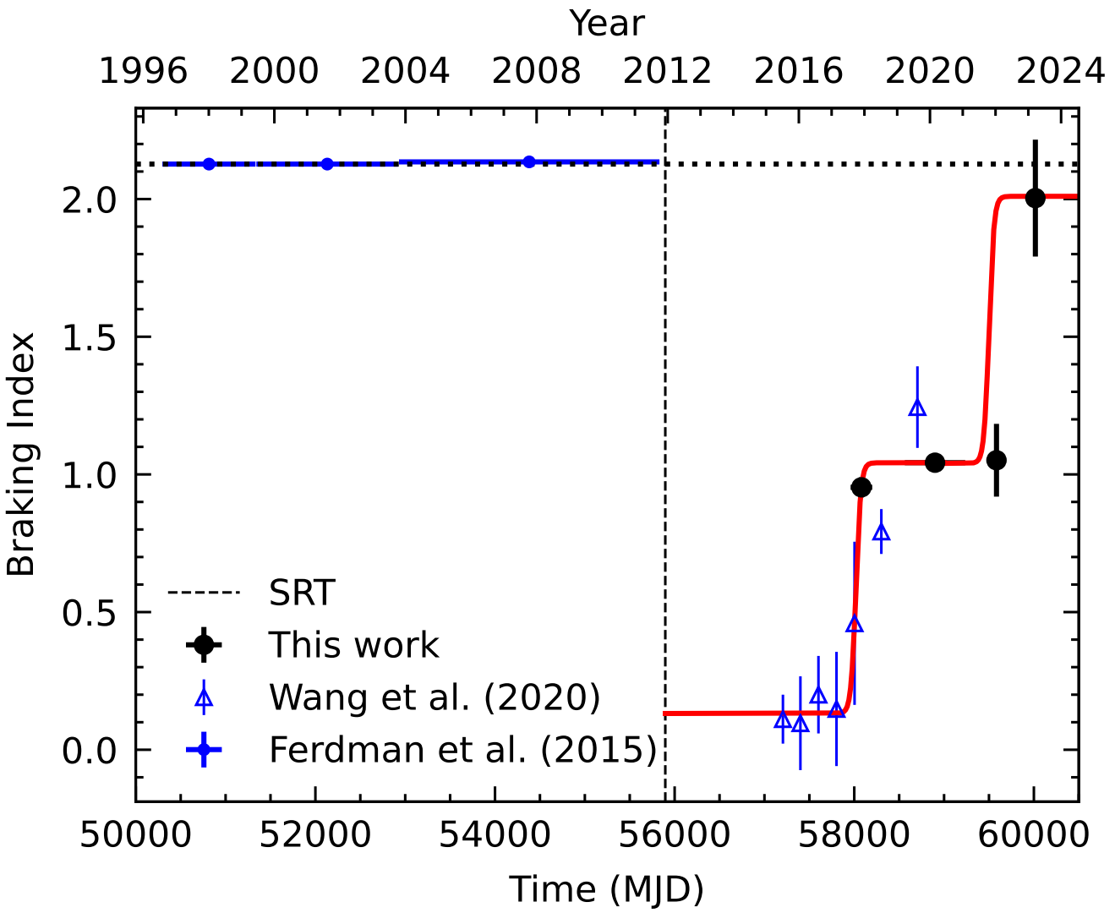
PSR B0540-69
Braking index recovering
From ~0 to 1., then stable~1.?
HXMT+NICER + IXPE(2022-2023)
Wang et al. 2020
By Y.L.Tuo and M.Y. Ge
In preparation

Slide 18
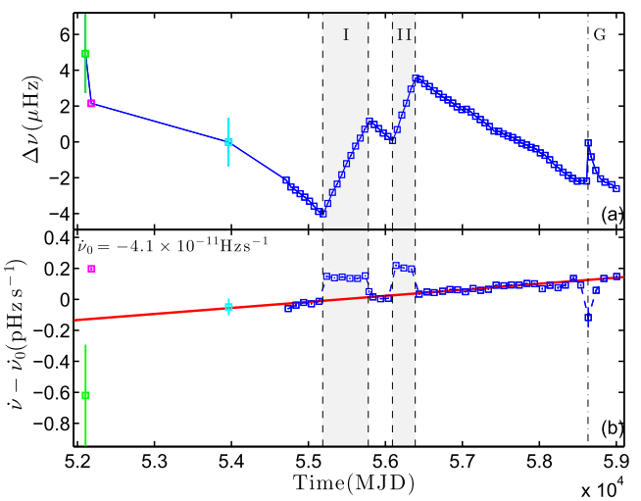

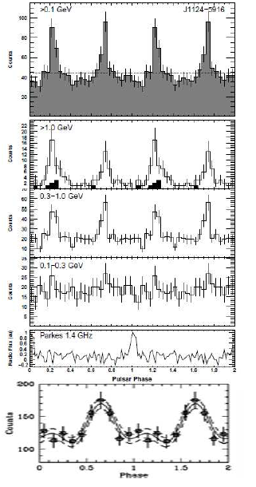
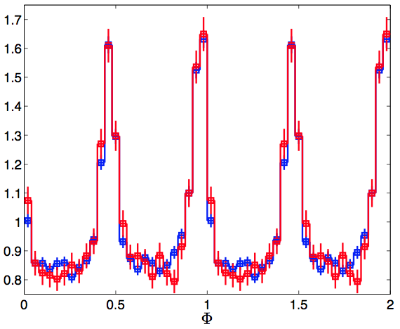
PSR J1124-5916
Low
High
G292.0+1.8
2.9kyr,
F0=7.37Hz,
F1=-4.1E-11 Hzs⁻¹
State transition：0.4%
Braking index：~ 1.98
Like PSR B0540-69
Ge et al. 2020
Gamma-ray pulse profile

Slide 19
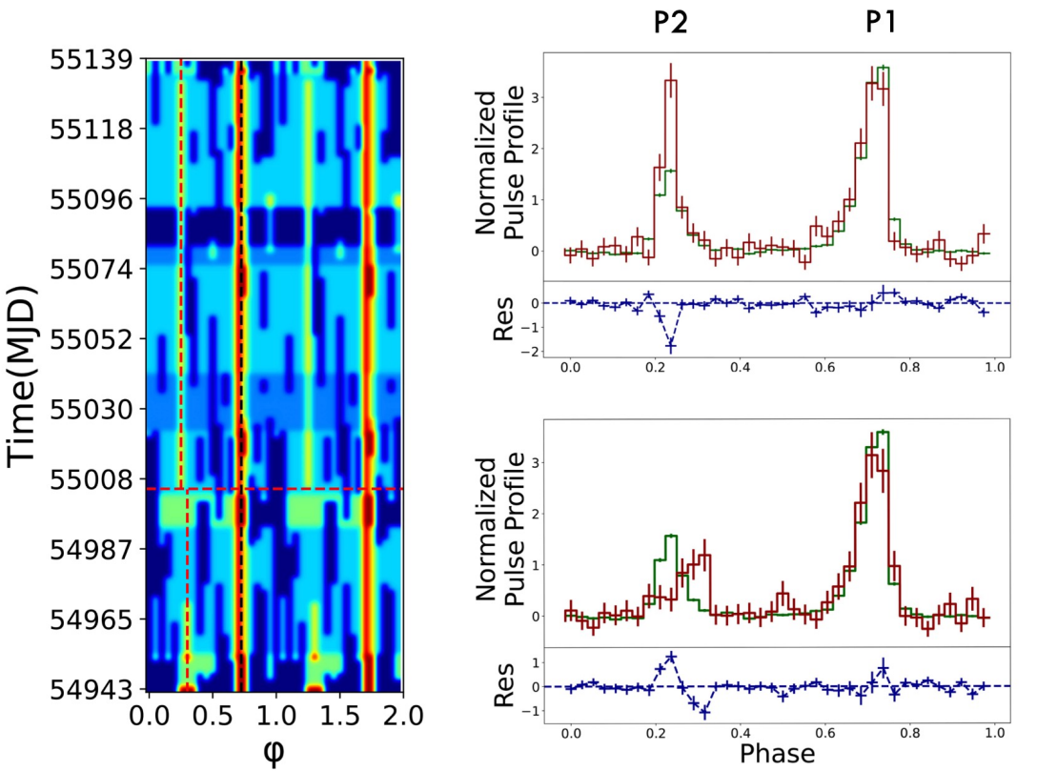
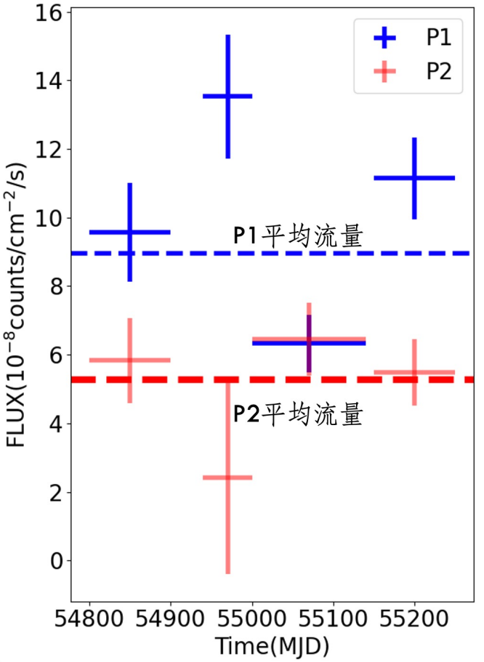
PSR J0205+6449
Gamma-ray pulse profile:
Peak separation: -0.050(6)
Peak ratio: 1.2(2)
Possible flux variation
From Ye Wento

Slide 20
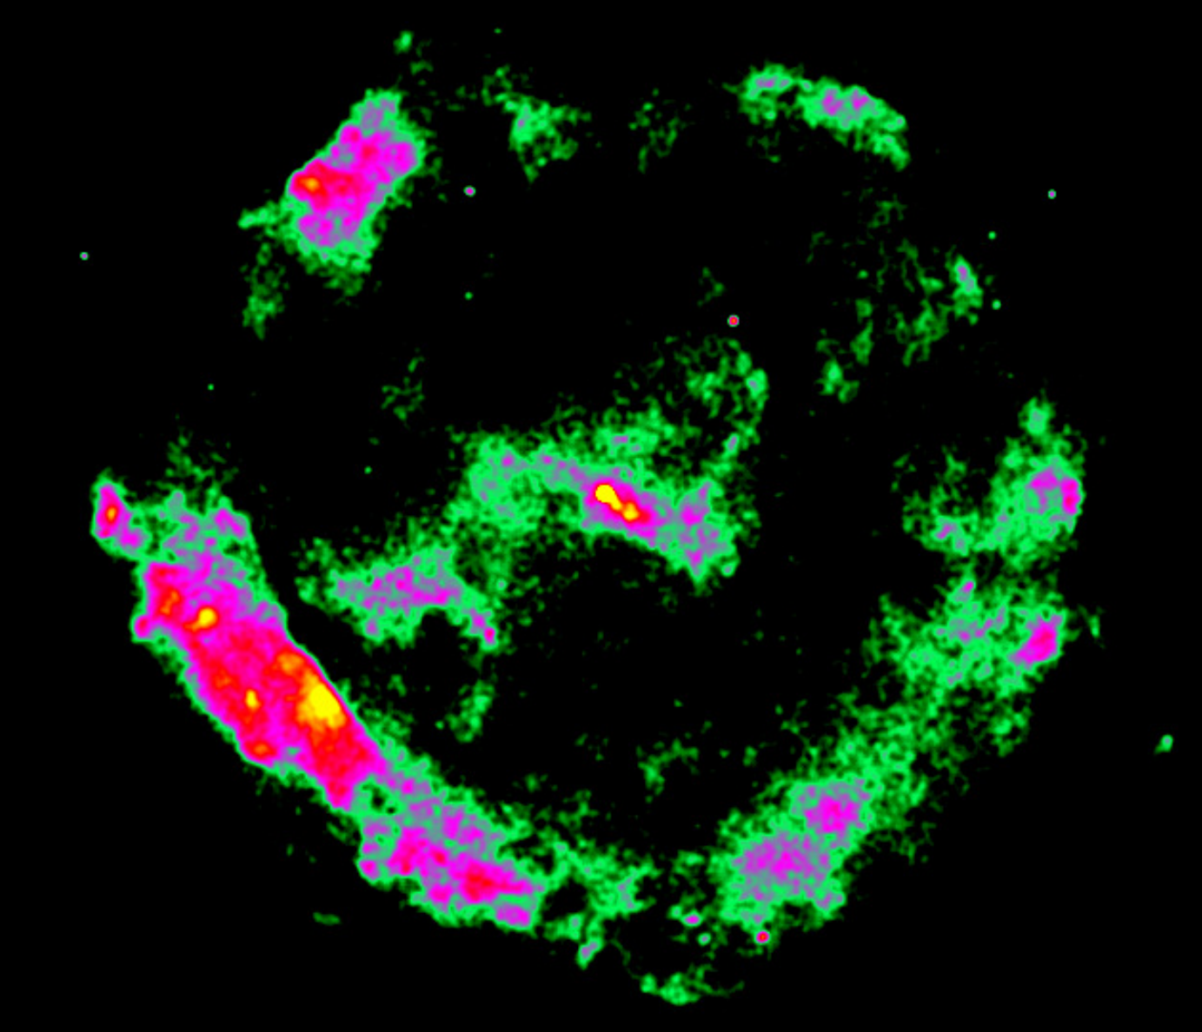
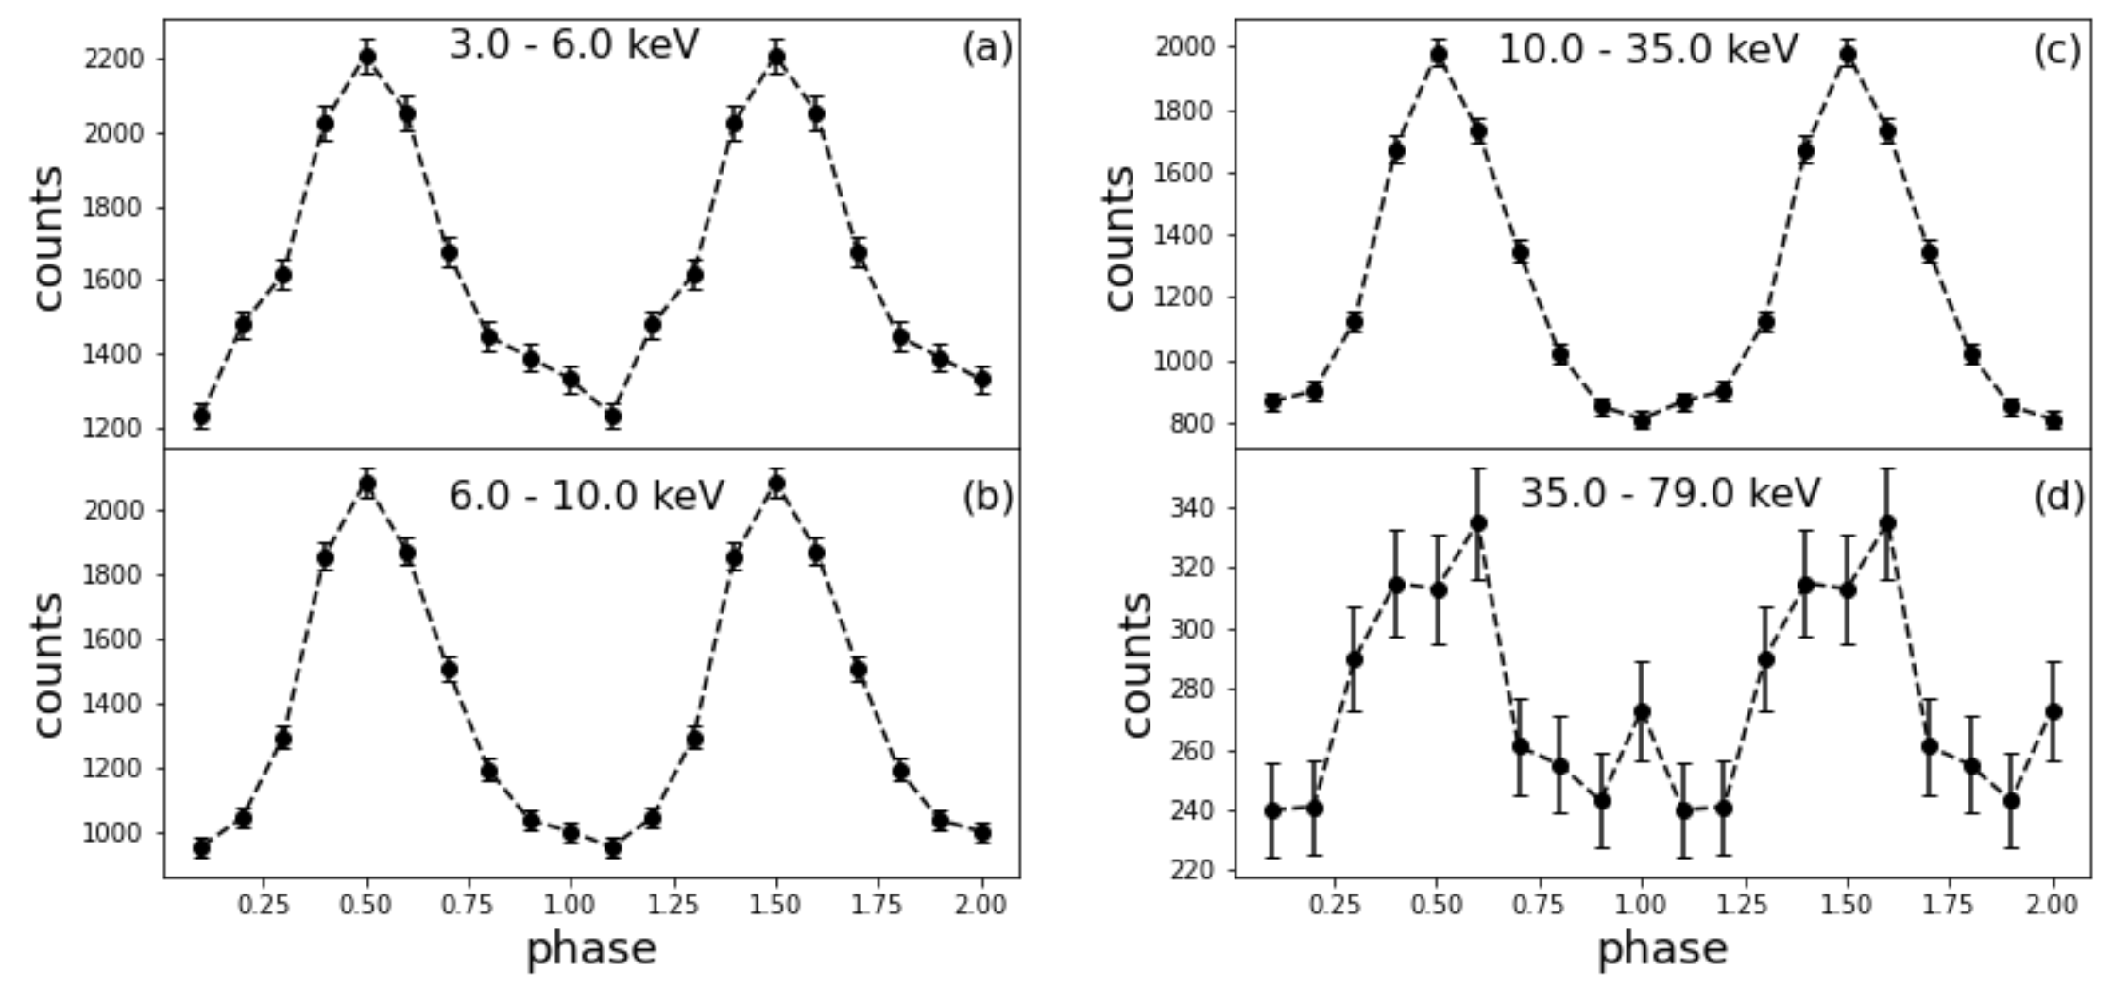
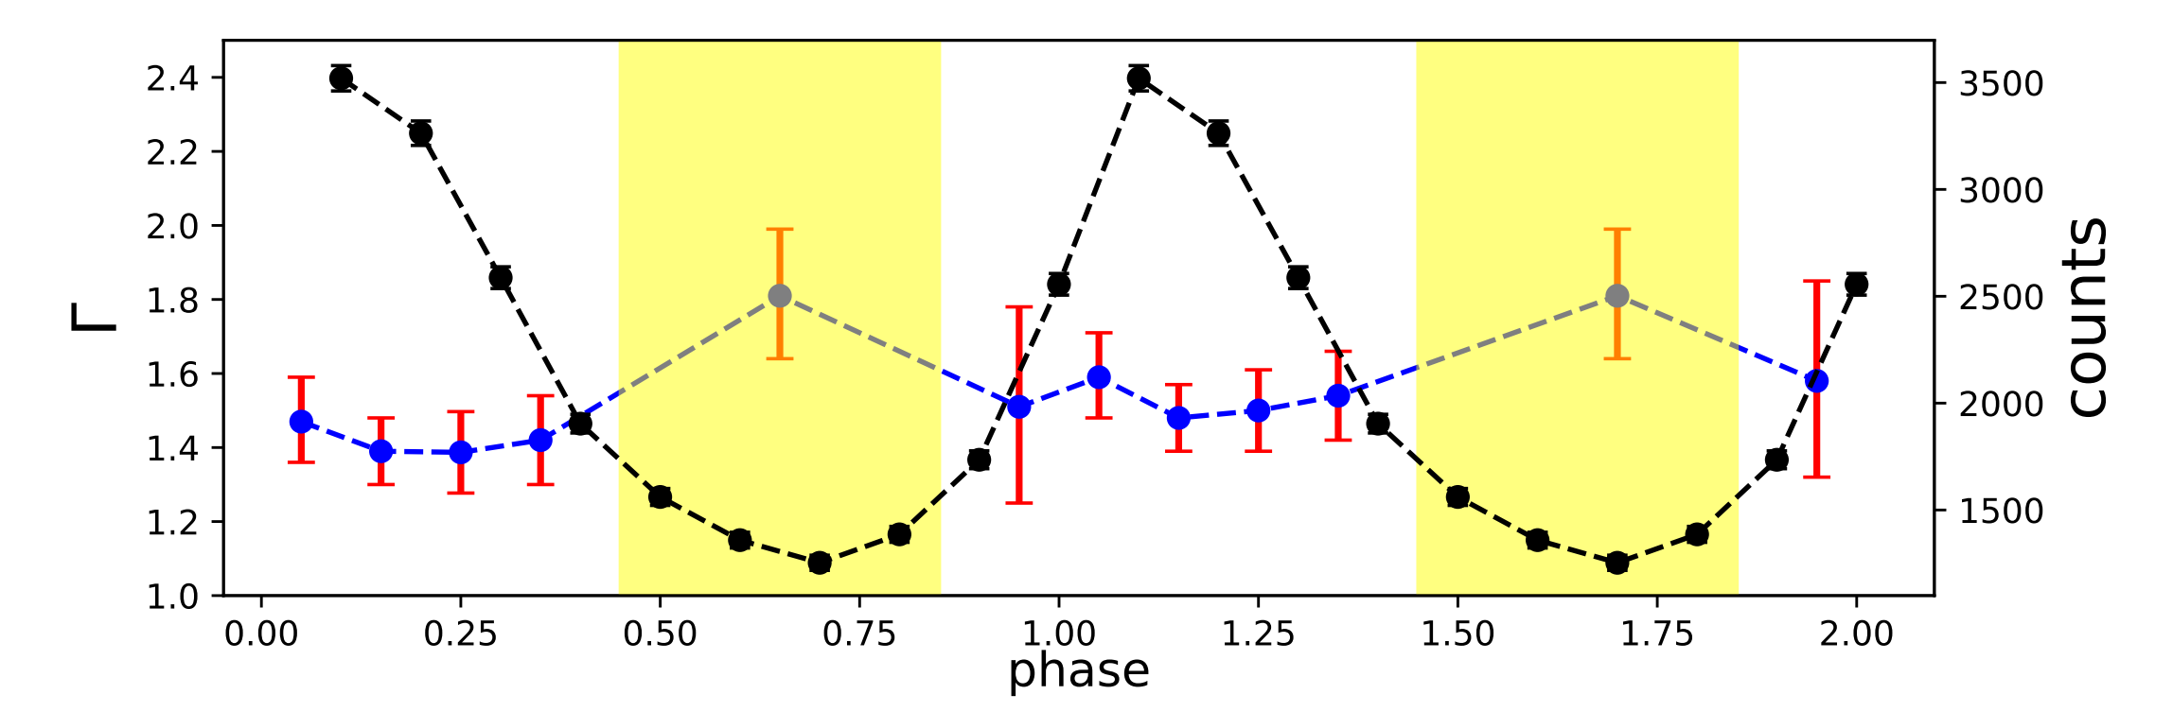
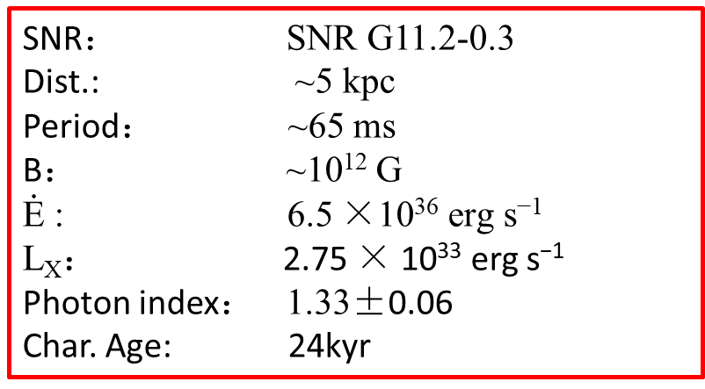
PSR J1811-1925
SNR： SNR G11.2-0.3
Dist.: ~5 kpc
Period： ~65 ms
B： ~10¹² G
$\dot{\text{E}}$ : 6.5 ×10³⁶ erg s⁻¹
L_{X}： 2.75 × 10³³ erg s⁻¹
Photon index： 1.33±0.06
Char. Age: 24kyr
Zheng, J.T. et al. 2023

Slide 21
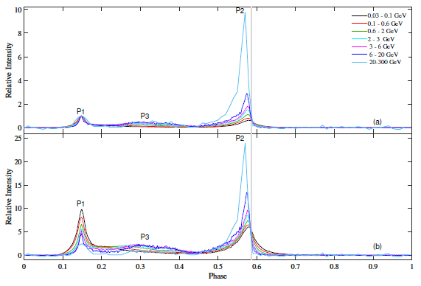
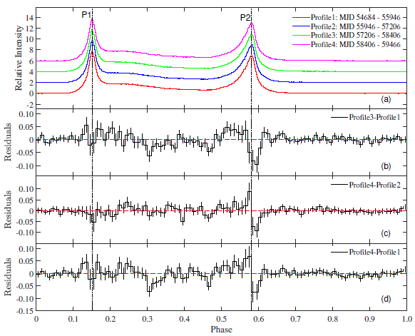
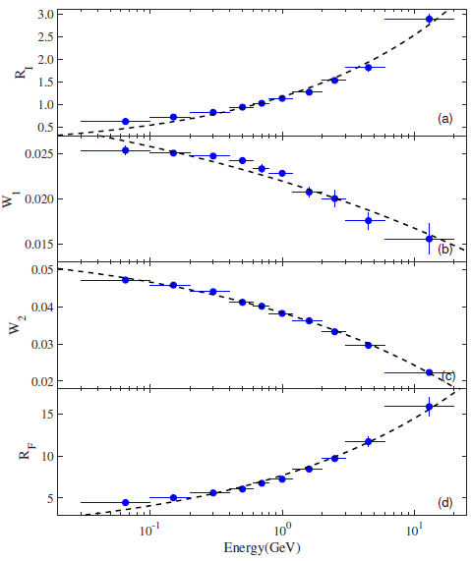
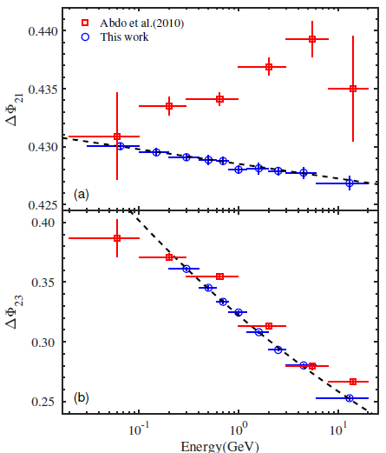
Vela pulsar
Fermi-LAT
Yan et al. 2022，RAA

Slide 22
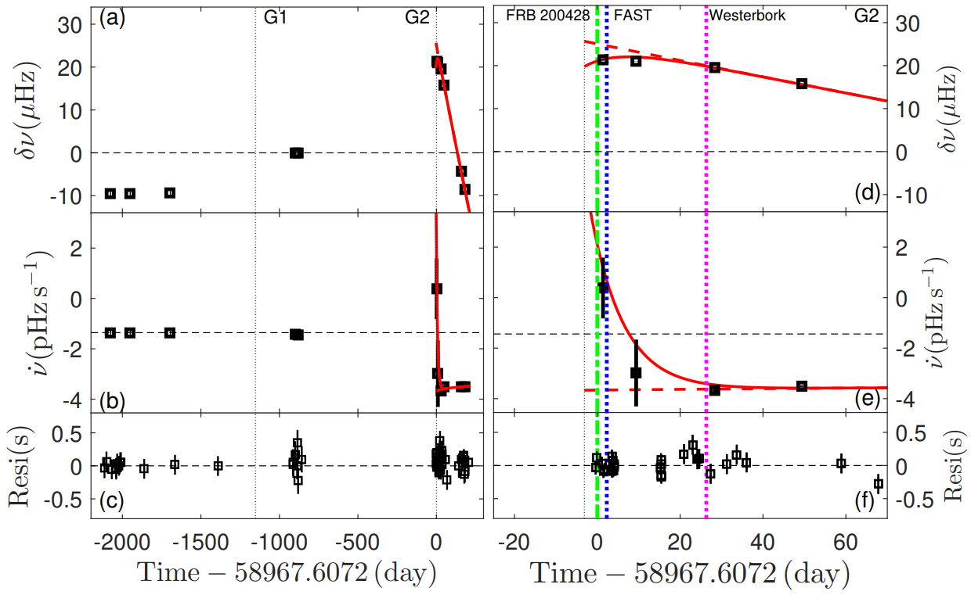

SGR J1935+2154
Possible large glitch in Magnetar
Delayed spin-up component?
Ge M.Y. et al. 2022 submitted to ApJ

Slide 23




SGR J1935+2154
Li X.B., Ge M.Y. et al. 2022 ApJ
FRB200428
Ge M.Y. et al. 2023 ApJ

Slide 24
Summary
Crab pulsar:
  Insight-HXMT detected the spin-up processes in the largest glitch; statistical studies show that the large glitches have detectable spin-up processes, and the spin-up processes of the smaller glitches are too short to be detected.
  Flux does not change (0.1-0.2% ) during the largest glitch, which is inconsistent with ; the pulsar profile does not show any significant change either
  Phase resolved spectra in higher energy bands from HXMT
PSRs B0540-69 & J1124-5916 & J0205+6449: state transition, variation in short time scale
PSR J1811-1925: Photon index does not evolve with phase
Vela pulsar：Parameters of gamma-ray profile updated
SGR J1935+2154: oscillation in X-ray burst associated to FRB 200428, time delay with radio peaks.
Thank you

Slide 25
SGR J1935+2154
Possible large glitch in Magnetar
Delayed spin-up component?
Ge M.Y. et al. 2022 submitted to ApJ

Slide 26
SGR J1935+2154
2020
2022
SGR J1935+2154 （FRB）：
（1）2020年暴发，周期跃变存在延迟加速成分（投稿ApJ）
（2）2022年暴发，直接探测到延迟加速成分
进一步验证延迟加速时标与周期跃变幅度正相关
Ge et al. 2022 (投稿)

Slide 27



The Crab pulsar changes
Profile varies with time (Lyne et al. 2013, Ge et al. 2016)
  Inclination angle 0 .6°per century (Lyne et al. 2013)
X-ray pulse profile
Radio Phase separation
Radio flux ratio
Ge et al.(2016)
Lyne et al. (2013)

Slide 28

Crab pulsar
The evolution of phase resolved spectra from Insight-HXMT is consistent with RXTE, NuSTAR and other X –ray telescopes.
Tuo et al. 2019

Slide 29



Crab pulsar
L_{x}
L_{sd}
Yan et al. 2018
Statistical Results of young pulsars
Possenti et al. 2002

Slide 30
PSR J1124-5916状态转换
第二颗年轻脉冲星存在状态改变
状态改变：0.4%
制动指数：~ 1.98
与B0540-69类似
Fermi-LAT数据
伽玛射线脉冲轮廓没有变化
Ge et al. 2020

Slide 31

B0540-69
Observations from XMM－Newton、Swift／XRT、NuSTAR
The luminosity of PSR+PWN enhances by 22%
Ge et al. 2020

Slide 32



PSR B1509-58
By Wentao, Ye

Slide 33




PSR B0540-69
The faintest pulsar detected by Insight-HXMT
NICER
XRT
HXMT/LE
Pulse profiles for LE and HE
Pink：LE

Slide 34


Crab pulsar
HXMT + NICER
Yan et al. 2022

