Slide 1
LAconic Program Units for pulsar Data Analysis (LAPUDA)
Jiguang Lu
20230704

Slide 2
LAPUDA
LAPUDA (拉普达，LAconic Program Units for pulsar Data Analysis)
Function
Predicting the pulse phase based on the pulsar ephemeris and observation epoch
Folding, dedispersing and calibrating the search-mode PSRFITS data
Reading and updating the parameters of the fold-mode data visually
Generating ToAs and fitting timing-parameters
Simulating search-mode or fold-mode pulsar data

Slide 3
LAPUDA
Program characteristics
Coding in Python, laconic, flexible and extensible
Adopting new data structure, including high-precision class on time, coordinates and pulsar parameters
New data format LD（Laconic Data）:
Head (file size and data shape) + Data + File information
Head: 24 bytes; file size as uint64 + 4 * data shape size as uint32
Data：4-D data as float64
File information：text in JSON format

Slide 4
JSON format
{
"name": “China",
"province": [{
"name": “Heilongjiang",
"cities": {
"city": [“Harbin", “Daqing"]
}
}, {
"name": “Guangdong",
"cities": {
"city": [“Guangzhou", “Shenzhen", “Zhuhai"]
}
}, {
"name": “Taiwan",
"cities": {
"city": [“Taibei", “Gaoxiong"]
}
}, {
"name": “Xinjiang",
"cities": {
"city": [“Urumqi"]
}
}]
}

Slide 5
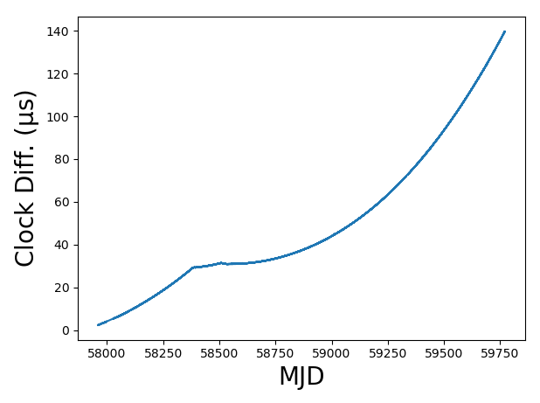
Pulse phase prediction
Time standard transformation
Converting UTC(local) to UTC(GPS)
Converting UTC(GPS) to standard UTC
Converting UTC to TT(TAI)
Converting TT(TAI) to TT(BIPM)
Considering the effect of relativity and converting TT(BIPM) to TCB and TDB

Slide 6
Pulse phase prediction
Genering pulsar class instance with parameters
Parameters: pulsar location, rotation, orbiting and others
Transforming parameters between different time-standard and space-coordinates
Creating, reading, updating and deleting parameters
Computing time delays
Delay in solar system: Roemer delay, Shapiro delay, troposphere delay, solar wind dispersion delay
Interstellar dispersion delay: dispersion, chromatic noise
Binary model: BT, DD, ELL1, MSS
Shklovskill effect
Intrinsic rotation braking and glitch

Slide 7
Pulsar data preprocess
Preprocessing
For search-mode PSRFITS data, the data are saved as sub-integrations in the file, and each sub-integration is composed by several spectra in time order. The program would calculate the pulse phase of each data with Chebyshev fitting, and interpolate the data into the correct phase bins.
The program can calibrate the data while folding and dedispersing.
The output data are saved as LD format.

Slide 8
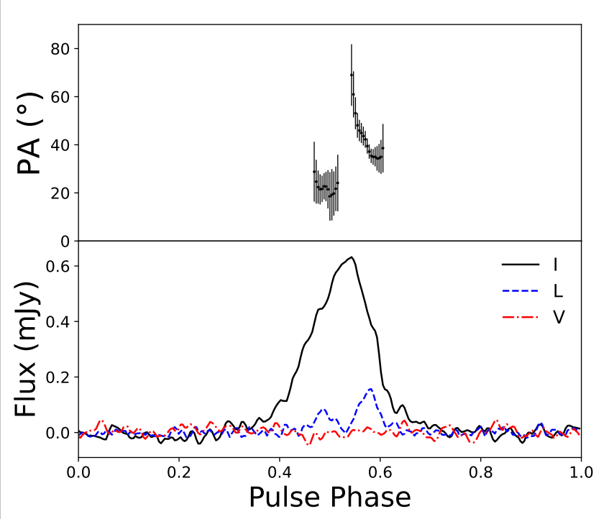
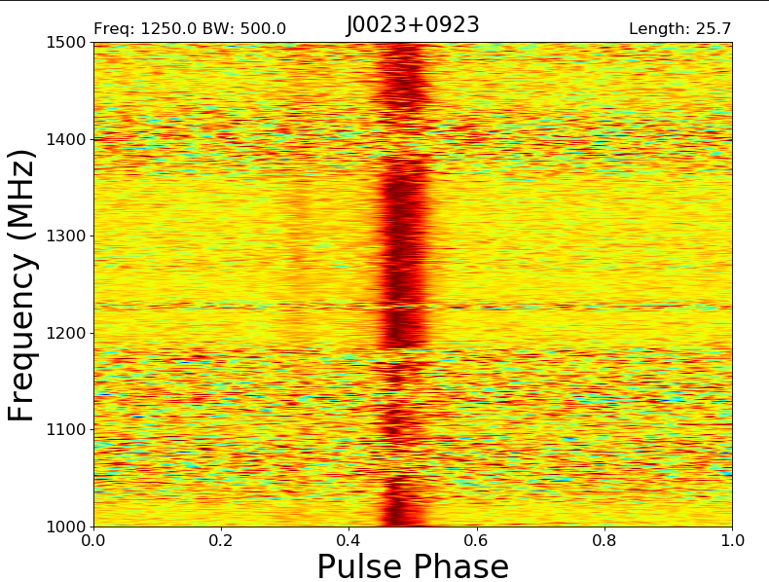
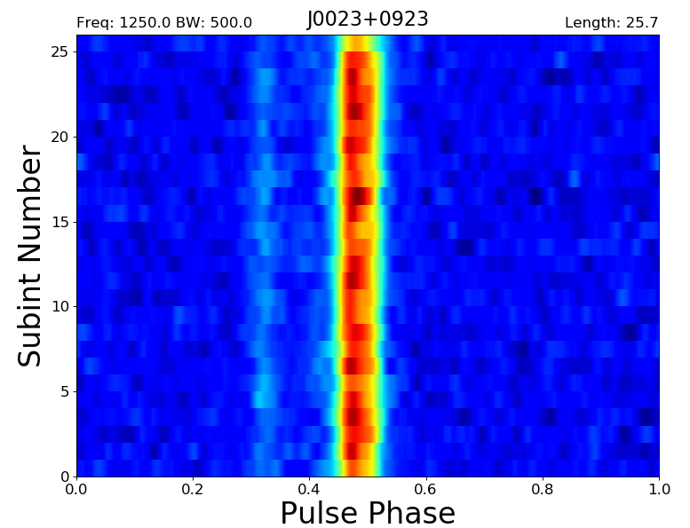
Data visualization
Data visualization
The time-domain, frequency-domain and pulse profile of the pulsar data can be plotted.

Slide 9
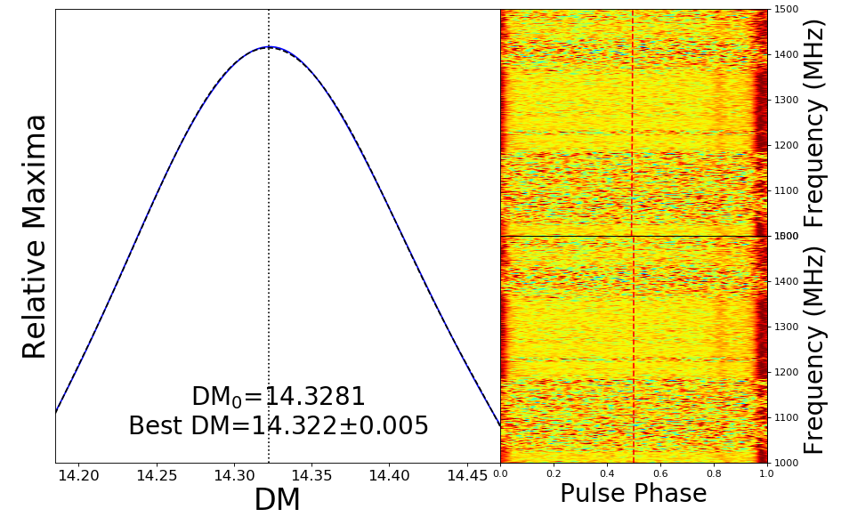
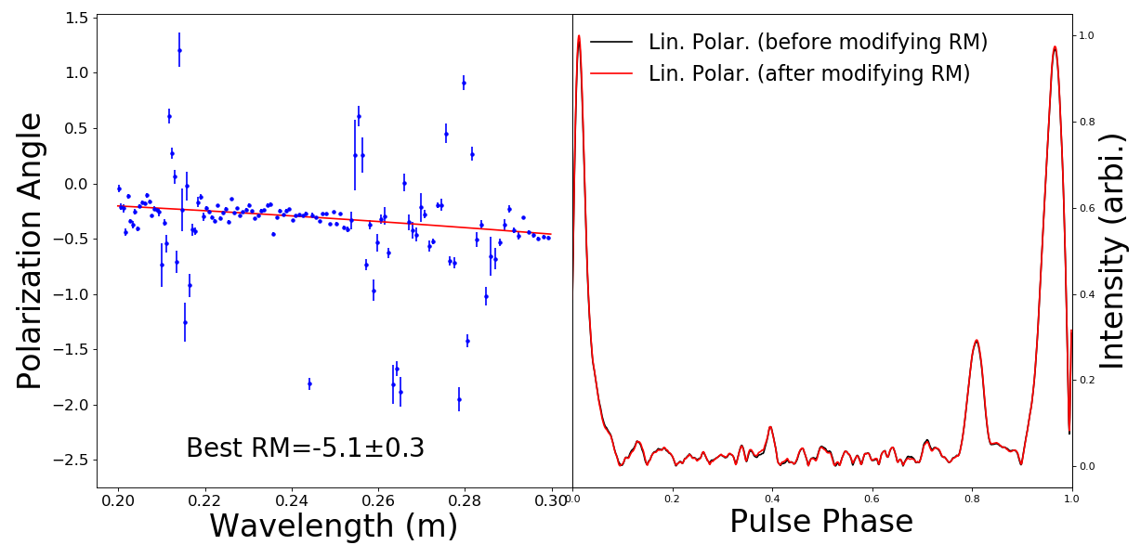
Data correction
Fitting the DM and RM of the data
Fitting the variation of pulse phase or polarization angle along frequency with inverse-square law and aligning the pulse profile at different frequency

Slide 10
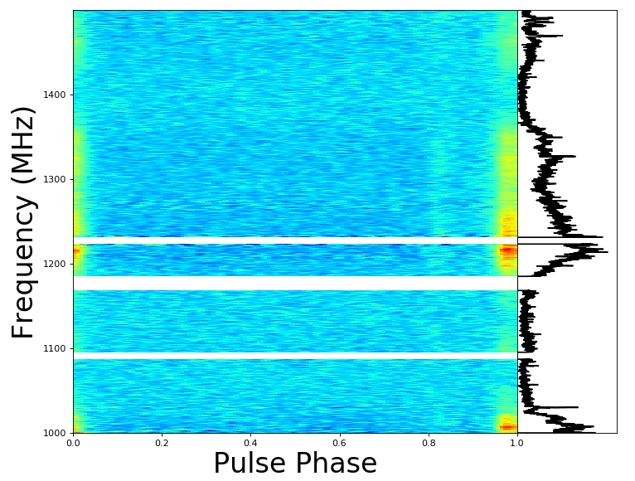
Data correction
Eliminating frequency-domain RFI
Zapping abnormal channel
Other functions
Compressing the data to less channels, sub-integrations and phase bins
Converting data format

Slide 11
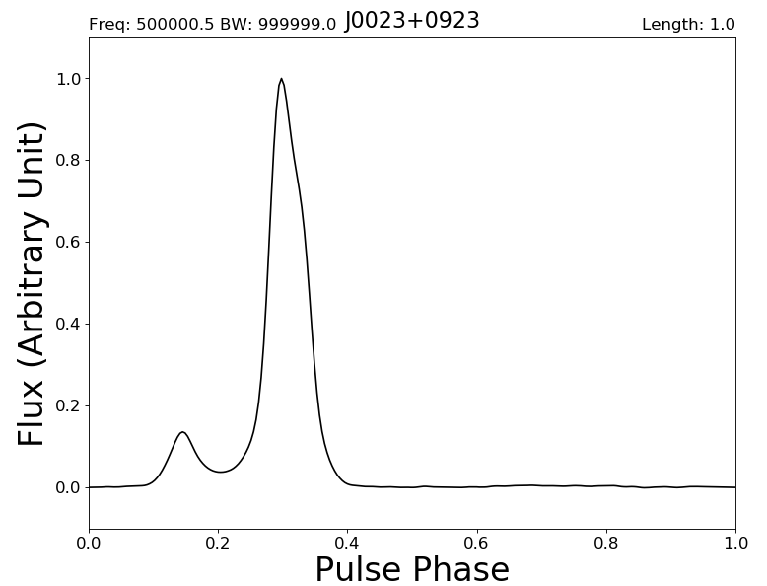
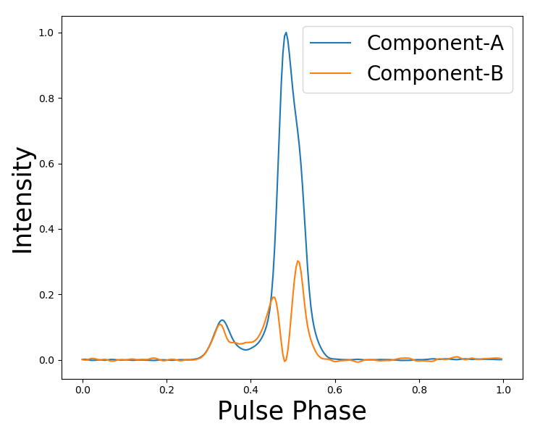
Pulsar timing
Generating standard pulse profile
The program can synthesize many profiles and extract the characteristics from them to generate pulse profile template.
Analyzing different components in pulse profiles.

Slide 12
Pulsar timing
ToA measurement
Measuring the phase differences between observed profiles and template to obtain time of arrival
Method：Fourier phase gradient, sinc interpolation of cross-correlation function, least-square method
Multi-frequency template and data in ToA calculation
Multi-component template to obtain ToA

Slide 13
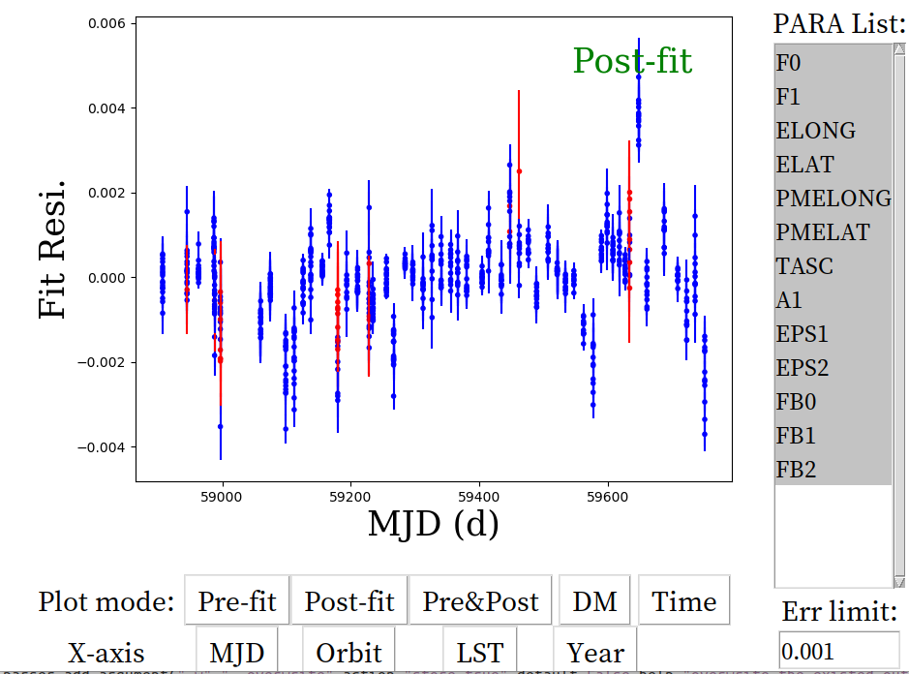
Pulsar timing
Pulsar parameter fitting
Fitting the pulsar parameters interactively or non-interactively

Slide 14
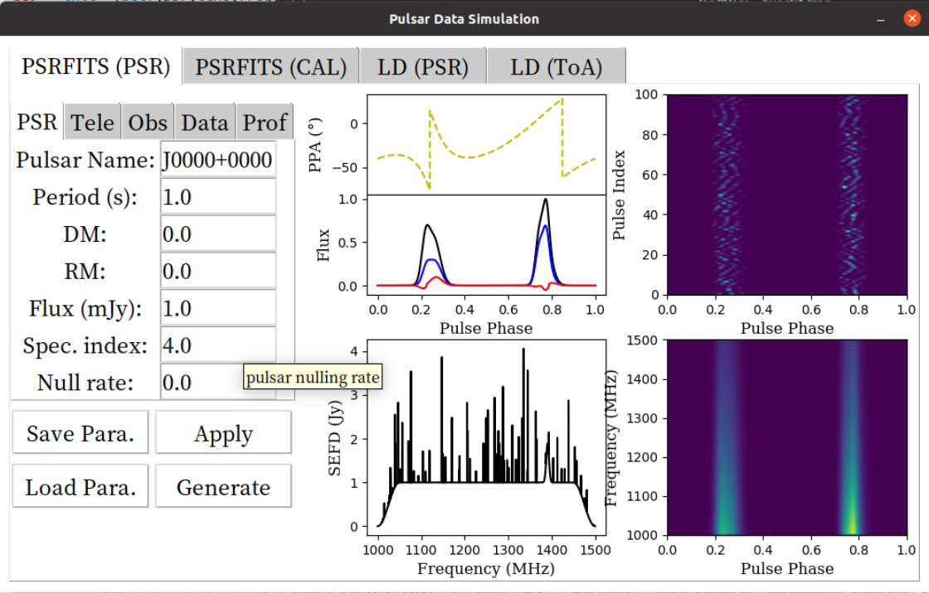
Data Simulation

Slide 15
Thanks!

