Slide 1
FAST Globular Cluster Pulsar Survey III.
潘之辰 钱磊 闫振 罗近涛 Kuo Liu，等等等等
2023.7
Notes:
Wang et al. M13?
M3A?

Slide 2
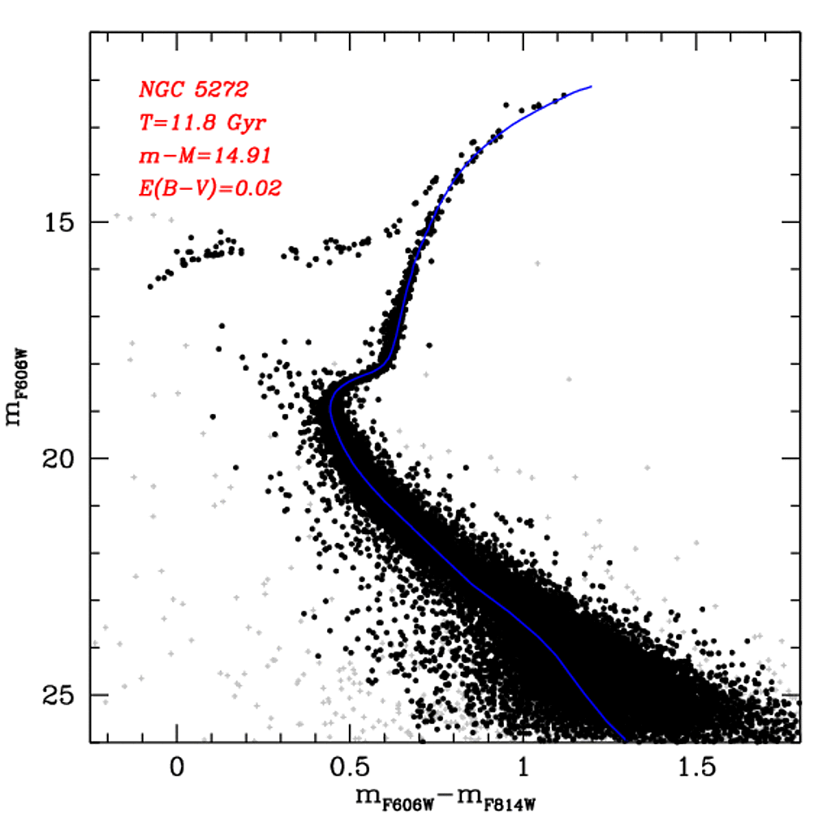
What are GCs
M3 – 4+2 psr Li et al. in prep
M4 – 1 psr
M5 – 5+2 psr Zhang et al. in prep
M3 11.8 Gyr
https://people.smp.uq.edu.au/HolgerBaumgardt/globular/fits/phot/ngc5272_cmd.gif
M13 – 6+1 psr
Wang et al. 2020
M80 – 0 psr
M107 – 0 psr
FAST Site, 20200515 Credit: Zhichen Pan

Slide 3
GCs in FAST Sky and Previous GC Pulsars
45/160+ GCs in FAST sky, 10 GCs have 33/157+ PSRs (2019)
~20/45 GCs out of Arecibo sky, 2 have 5 PSRs
Closest:
NGC6366, 3.5 kpc, no PSR
M71, 4.0 kpc, 1+4 PSR (Pan et al. 2021, 2023)
Farthest:
Palomar 4, 108.7 kpc, no PSR
M53, 17.9 kpc, 1+4 PSR (Lian et al. 2023)
M71 20230621
Credit: Xinming Obs & Mr. Xing Gao
Left to Right: M92A (Pan et al. 2020), NGC6517N (Yin et al. in prep.), Glimpse C01 A (from Paulo’s catalog)

Slide 4
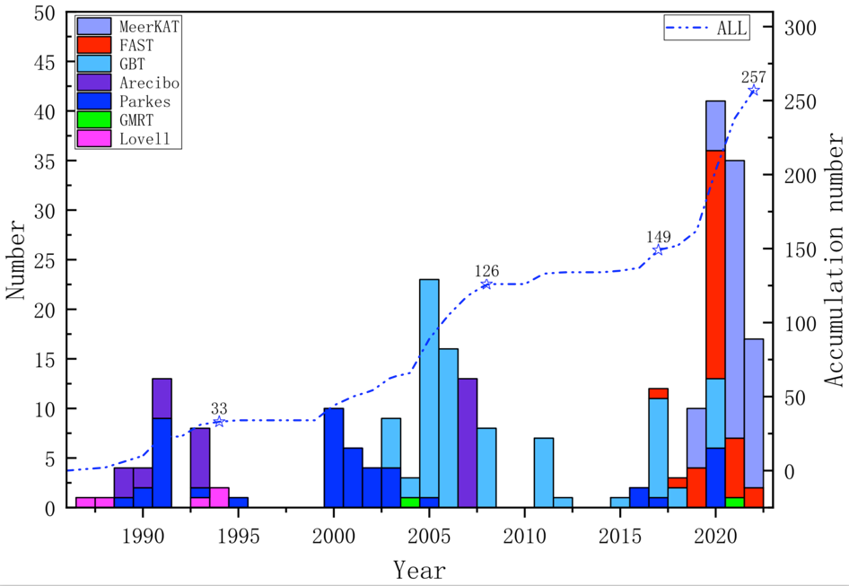
GC Pulsar Discoveries
Parkes: 48 (47 Tuc: 25)
Arecibo: 28
GBT: 81 (Terzan 5: 38)
FAST: 39
MeerKAT: 43
Others (GMRT + Lovell): 7
FAST:
Pan et al. 2020
Wang et al. 2020
Pan et al. ApJL, 2021
Yan et al. 2021
Pan et al. RAA, 2021
Qian & Pan, 2021
etc………….
Yin et al. in prep
Till 2022.7, 257 pulsars in 36 GCs
Notes:
A plot for all GC discoveries

Slide 5
GC Pulsar Discoveries
Parkes: 50 (47 Tuc: 25)
Arecibo: 28
GBT: 83 (Terzan 5: 38)
FAST: 43
MeerKAT: 79
Others (GMRT + Lovell): 7
FAST:
Pan et al. 2020
Wang et al. 2020
Pan et al. ApJL, 2021
Yan et al. 2021
Pan et al. RAA, 2021
Qian & Pan, 2021
Yin et al. 2023
Pan et al. 2023
etc………….
FPS1 2012.8
Modified from Yin et al. 2022
Till 2022.7.1, 290 pulsars in 38 GCs
Notes:
A plot for all GC discoveries

Slide 6
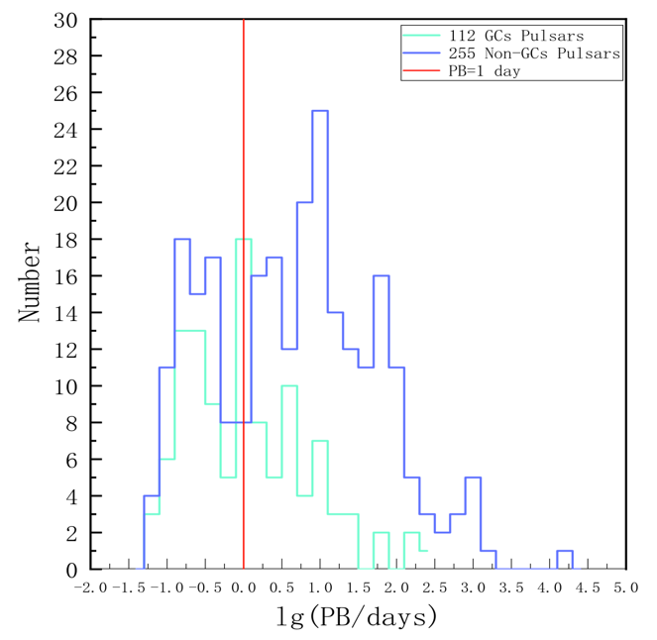
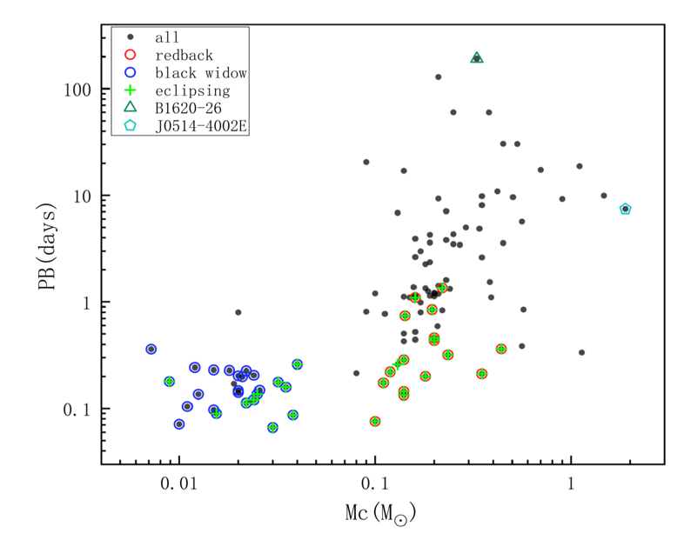
M71 – A GC Contains Many Interests
M71B/C
M71D
M71E
Yin et al. in prep
Notes:
M71D

Slide 7
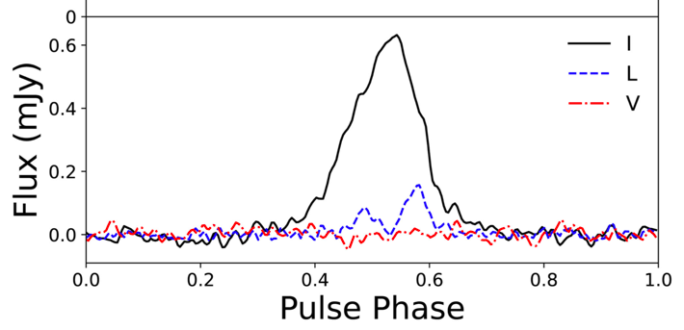
53 minutes!
PSR J1953+1844/M71E
Near M71, 2.5’
P0 = 4.44 ms (Han et al. 2021)
Seen with M71A to D simultaneously by FAST, orbital parameters are from archival FAST GC pulsar survey data.
Background Credit: Xingming Observatory, Mr. Xing Gao

Slide 8
Its Companion
PB = 0.037 days, A1 = 0.006668 lt-s
White dwarf or low mass star?

Slide 9
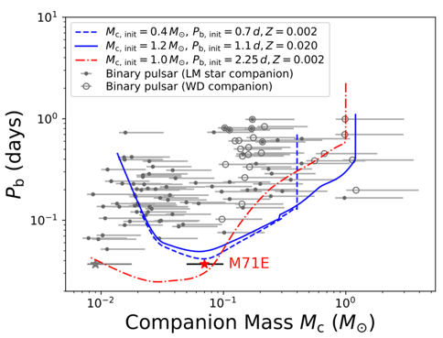
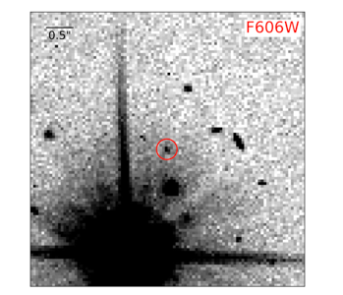
The Evolution Routine for Redbacks and Black Widows
No inter-state found in previous observations
Black Widows: circular orbit, several hours, Mcomp ~<0.03 Ms, some eclispe
Redbacks: accretion, circular orbit, eclipsing normally, Mcomp 0.1-0.4 Ms
Should be a new type of spider pulsars, more should be found in the future!
BW
RB
M71E: can be an He-rich companion and possibly evolved from a triple system?
OR, CO white dwarf core?
53 min.
Dong et al. submitted to ApJL
Pan et al. 2023

Slide 10
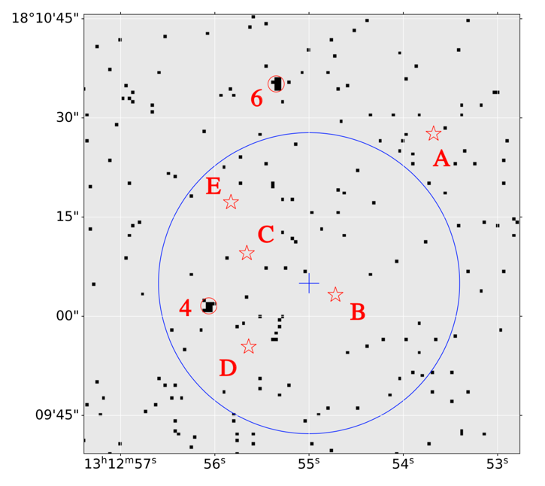
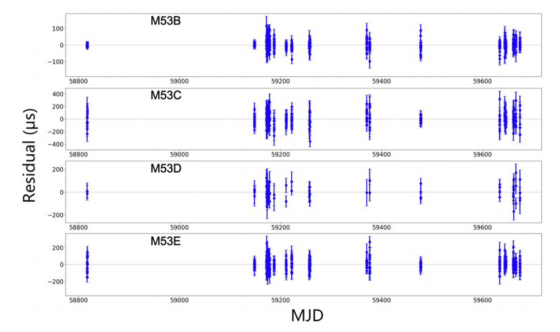
The Four New Pulsars at 17.9 kpc – M53B/C/D/E
B: 6.24 ms, PB=47.7 days
C: 12.53 ms
D: 6.07 ms, PB=5.75 days
E: 3.97 ms, PB=2.43 days Lian et al. 2023

Slide 11
NGC6517 & M3
Much higher detection rates for pulsars in M3. And scintillation of M3A/B/D
While much more faint MSPs discovered, is there a ring? (Yin et al. in prep)

Slide 12
Conclusion
1, M71E, 53-minute binary, Pan et al. 2023;
Multiband counterpart? Optical – Dong et al. submitted to ApJL, others?
Relation to M71?
2, M53B to E, 4 new pulsars is 17.9 kpc, Lian et al. 2023;
Post-Keplerian parameters for M53B? More pulsars?
3, NGC6517, M3, etc……
Next year!
4, we are preparing the initial project description paper.
Most of the data are public.
FAST GC Discovery Page
Notes:
M71D

Slide 13
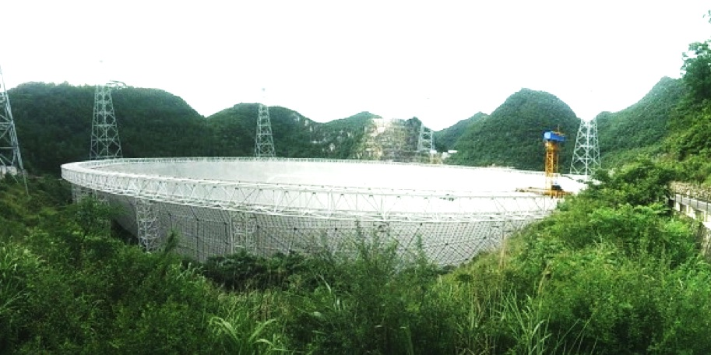
FAST Globular Cluster Pulsar Survey III.
Thank You!
潘之辰 钱磊 闫振 罗近涛 Kuo Liu，等等等等
2023.7
Photo Credit: Zach and Shana

