Slide 1
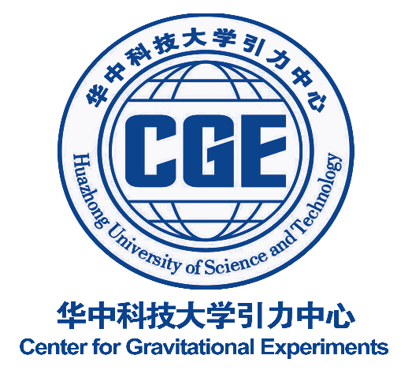
Detecting gravitational waves beyond Nyquist frequency with the PTA in SKA era
SPSS, Nanyang, July 3, 2023
Yan Wang (王炎)
Huazhong University of Science and Technology
ywang12@hust.edu.cn
in collaboration with
Soumya D. Mohanty (UTRGV),
Zhoujian Cao (曹周键, BNU), Xuan Tao(陶轩, HUST), etc

Slide 2
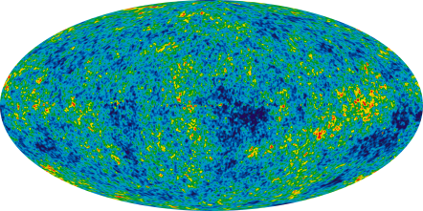
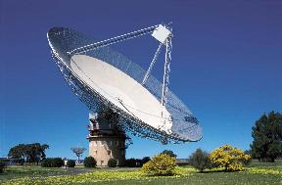
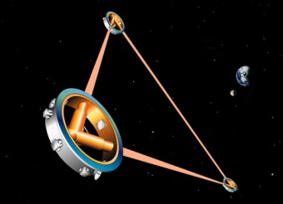
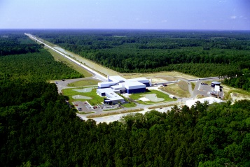
Gravitational-Wave Spectrum
Quantum fluctuations in early universe
Supermassive black holes binary mergers
Compact objects captured by supermassive black holes
Compact binary mergers
Supernovae, neutron star
Wave period
Age of universe
years
hours
sec
ms
Log(frequency)
-16
-14
-12
-10
-8
-6
-4
-2
0
2
Cosmic Microwave Background polarization
Pulsar timing array
Space-based interferometers
Ground-based interferometers

Slide 3
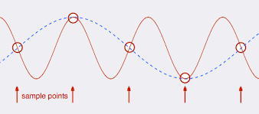
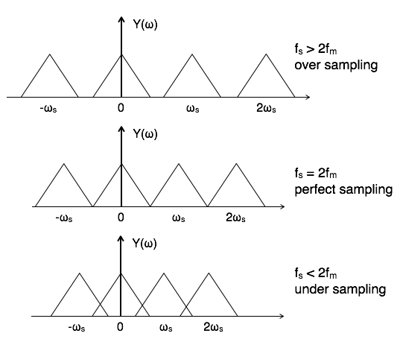
Sampling and Nyquist frequency

Slide 4
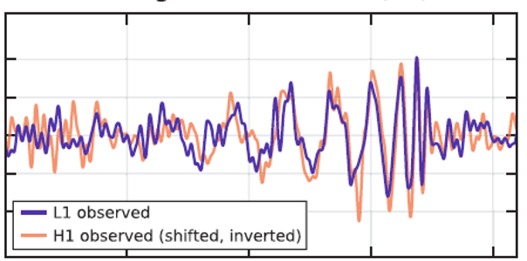
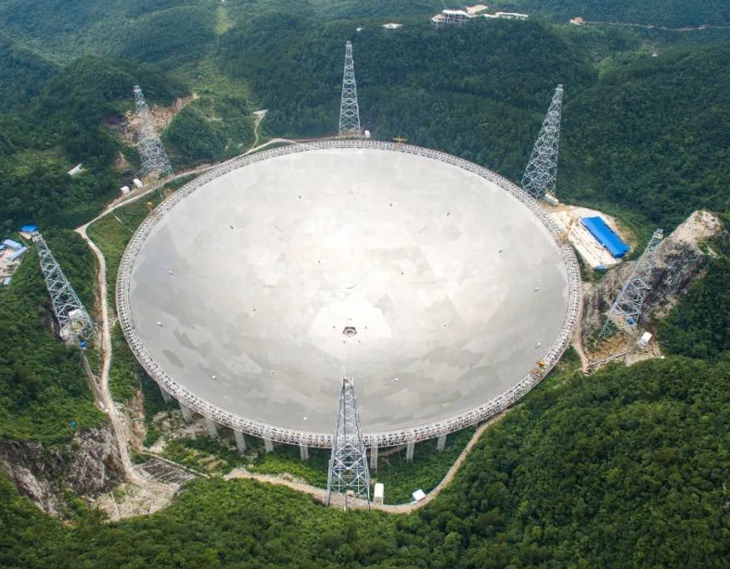
Analog vs. digital signals
2¹⁴ = 16384 Hz
~3 Hz
~10⁻⁷ Hz

Slide 5
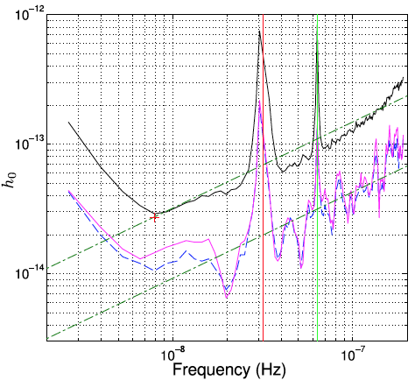
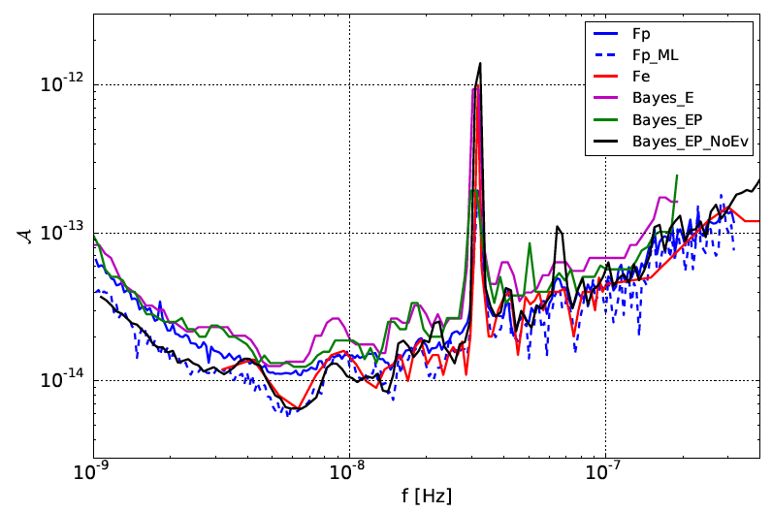
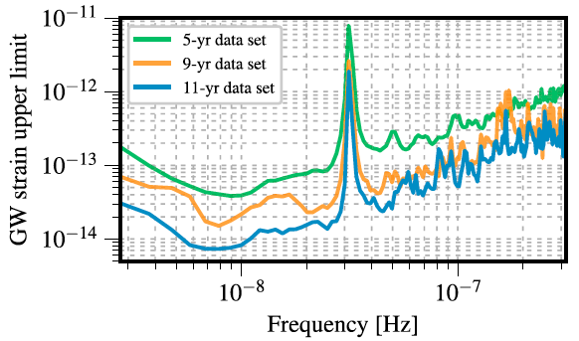
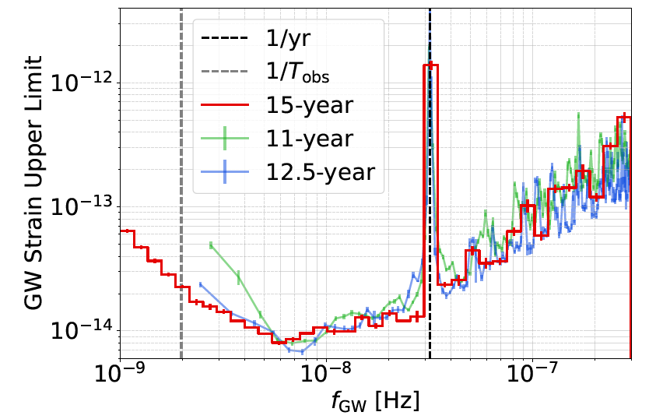
PTA individual SMBHB searches
PPTA, MNRAS (2014)
EPTA, MNRAS (2016)
NANOGrav, ApJ (2019)
NANOGrav, arXiv: 2306.16222
Notes:
NANOGrav: ApJ, 880:116 (11pp), 2019 https://doi.org/10.3847/1538-4357/ab2236 arXiv: 2306.16222
EPTA: MNRAS (2016) arXiv:1509.02165v1 DOI: 10.1093/mnras/stv2092
PPTA: MNRAS, 444, Issue 4 (2014) DOI: 10.1093/mnras/stu1717

Slide 6
Uniform
staggered sampling
Pulsar 1
Pulsar 2
Pulsar 3
Pulsar 4
…
Pulsar N
h_{+,x}(t)
time

Slide 7
Randomized
staggered sampling
Pulsar 1
Pulsar 2
Pulsar 3
Pulsar 4
…
Pulsar N
h_{+,x}(t)
time

Slide 8
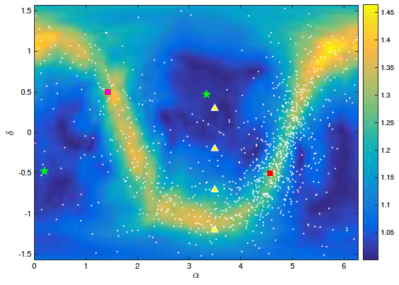
Data model for SKA-era PTA
Galactic North Pole
Galactic Center
Smits et al. A&A (2009)
Wang & Mohanty, PRL (2017)

Slide 9
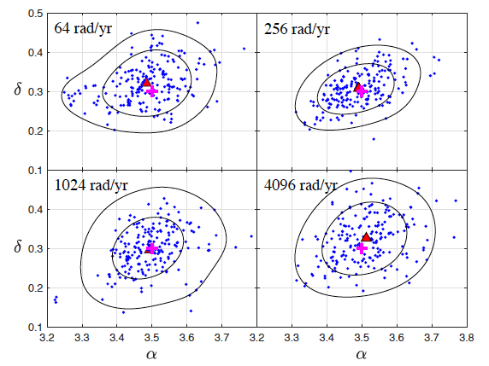
Sky localization with staggered sampling
$$ρ=20$$
Wang, Mohanty, and Cao, ApJL (2021)

Slide 10
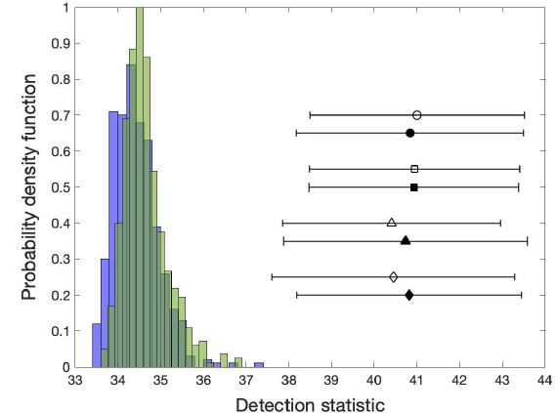
Distributions of detection statistic
64 rad/yr
256 rad/yr
1024 rad/yr
4096 rad/yr
Wang, Mohanty, and Cao, ApJL (2021)

Slide 11
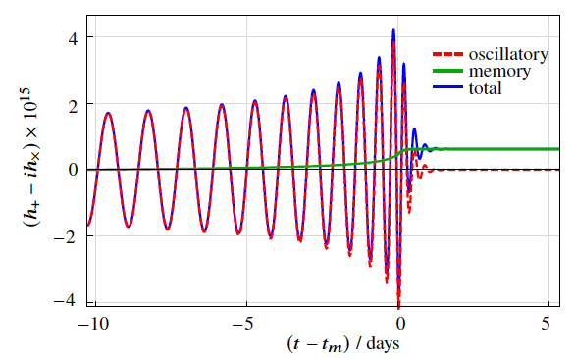
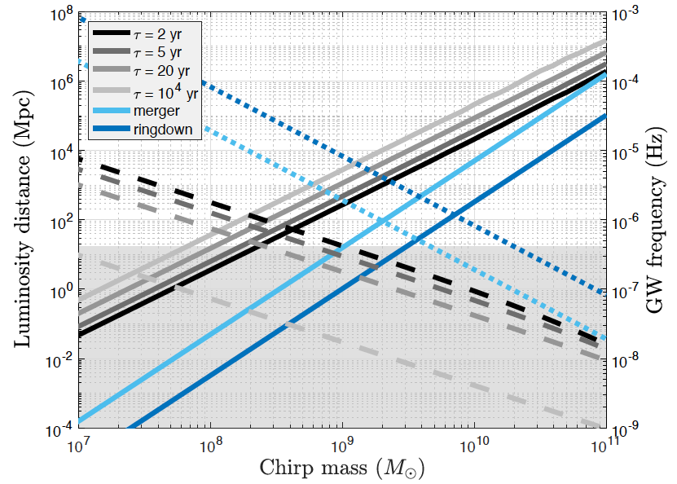
Distance reach
Wang, Mohanty, and Cao, ApJL (2021)

Slide 12
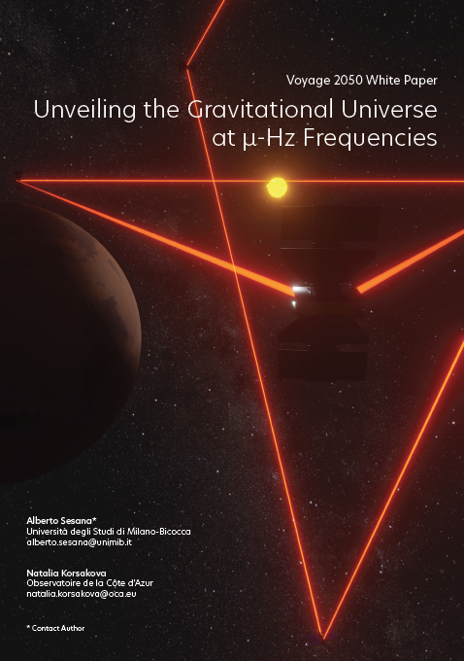
GW Upper limits in uHz
Dolch (2016)
J0437
B1937
NANOGrav 14’
EPTA 16’
This work
PPTA 14’
uAres
arXiv: 1908.11391
Notes:
GW limits from the J1713 24-hr global campaign (red) from individual GW sources in random sky directions. The dashed curve shows the GW limit in the direction of the pulsar. The other CW limits shown are: pulsar J0437 [14] (blue), pulsar B1937 [15] (magenta), NANOGrav [13] (black), the EPTA [16] (green), and the PPTA [17] (cyan).
https://arxiv.org/abs/1509.05446

Slide 13
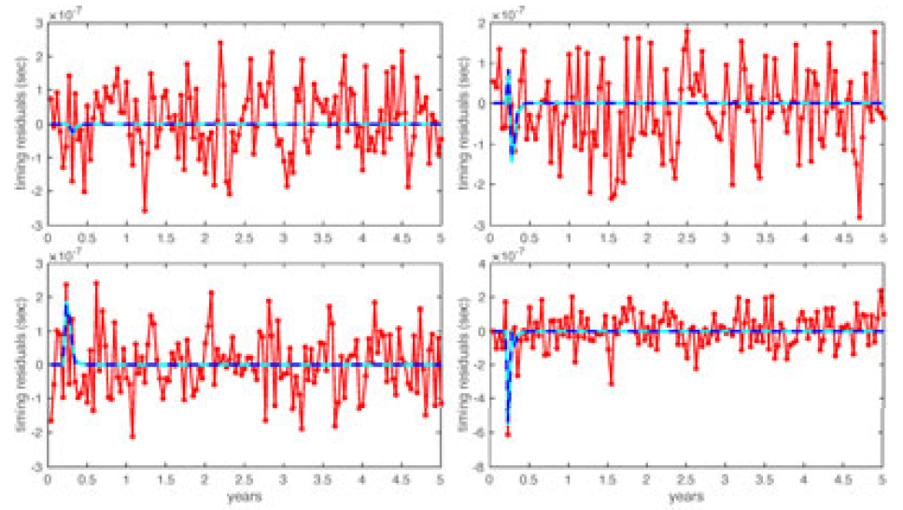
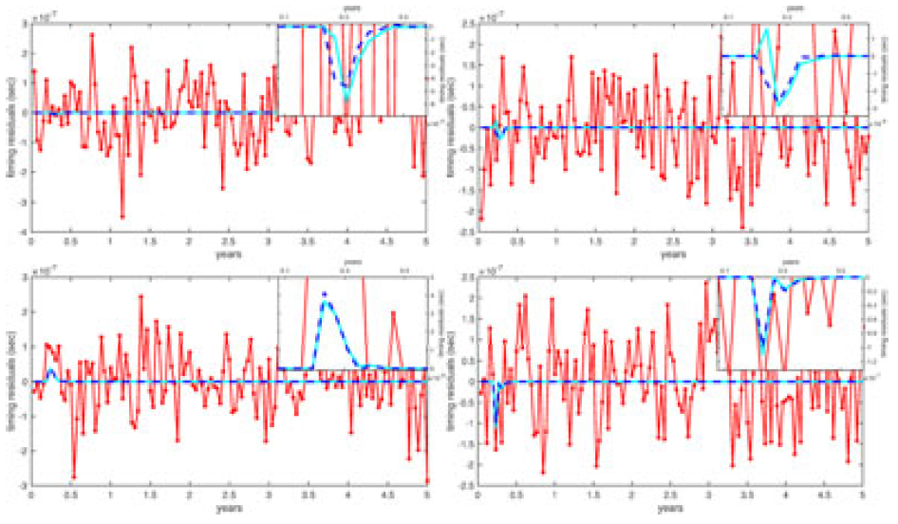
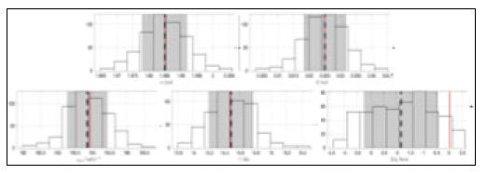
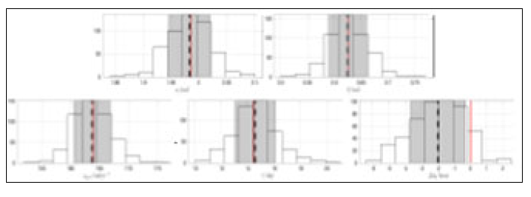
Reconstructed ringdown waveforms
Tao et al., in prep.
Notes:
The reconstructed signals are shown as blue dotted lines. The two sets of figures from left to right represent the case where SNR is 100 and 20.

Slide 14
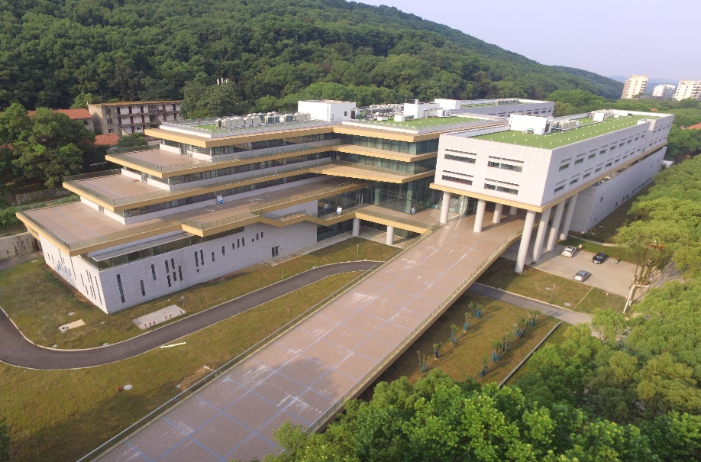
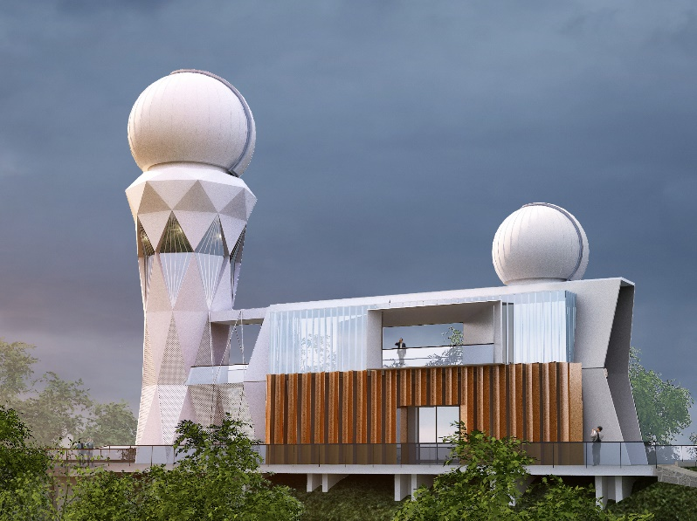
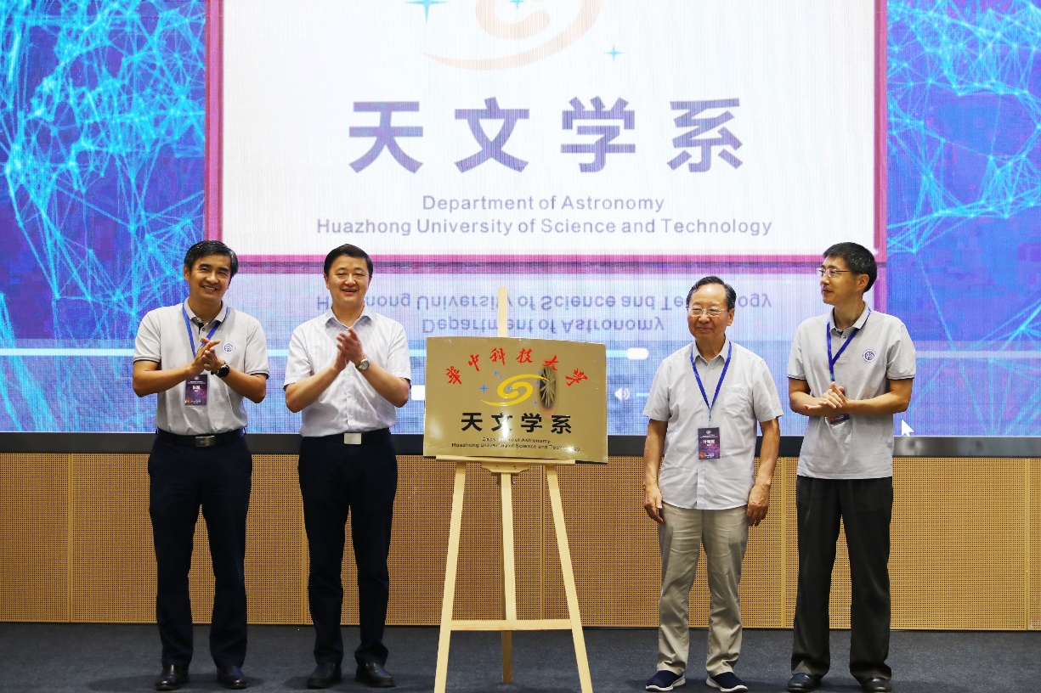
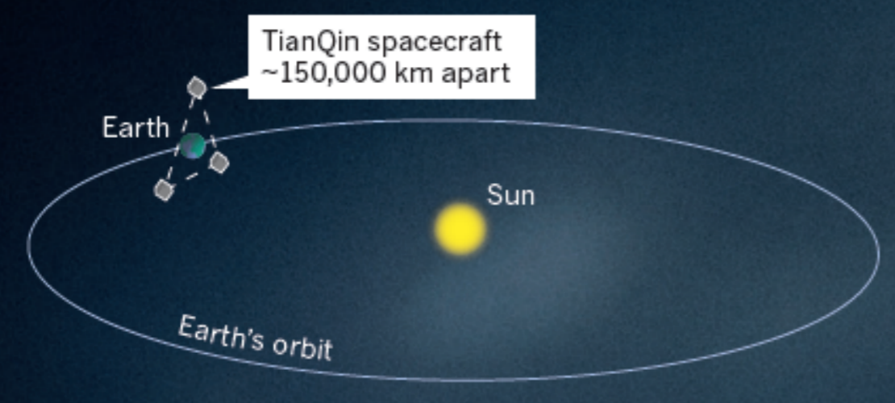
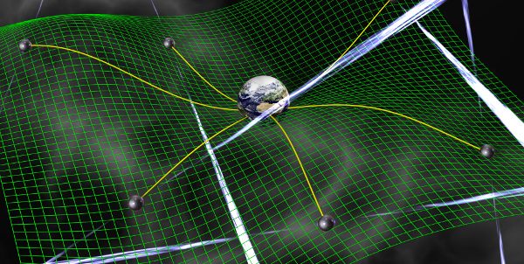
精密重力测量国家重大科技基础设施
天文学系
谢谢大家！Thank you!
王炎（ywang12@hust.edu.cn）
天琴计划
PTA

Slide 15
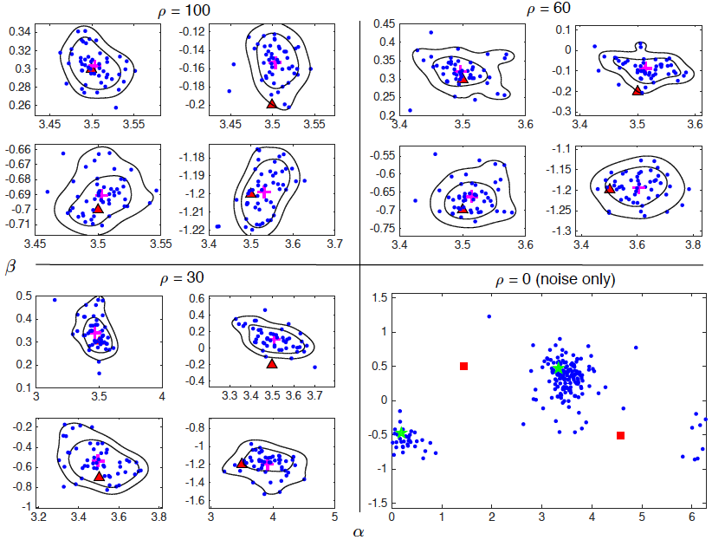
Sky localization
Conservative error area:
Localization to within ~70 to 180 deg² at
Search for PSO J334 (Liu et al. ApJL 2015): 80 deg² field from Pan-STARRS1 Medium survey
Optical counterpart searches possible for even the most distant sources (SKA+LSST)
Wang & Mohanty, PRL (2017)

Slide 16
Measure Hubble parameter
D’Orazio & Loeb, arXiv: 2009.06084
$$f_{gw}={10}^{−6} Hz$$
$$M_{c}={2×10}^{9}M_{s}$$
$$D_{L}=2 Gpc (4 Gpc)$$
$$τ=5 yr (20 yr)$$
$$γ=0.21 (0.125)$$
Notes:
Schematics for visualizing the geometrical (panel a), and mathematical (panel b), description of the co-moving distance measurement. In panel a), we assume \theta=90 deg to simplify the geometrical argument.
Using GravitationalWave Parallax to Measure the Hubble Parameter with Pulsar Timing Arrays
The governing condition for the measurability of this effect is gamma.

Slide 17
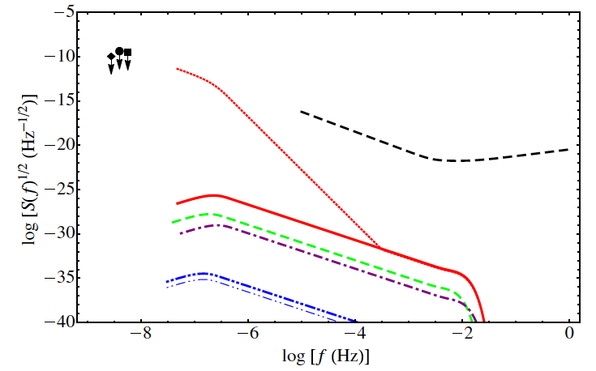
Gravitational helioseismology
Bennett & Melatos, ApJ (2014)
Thank you!
Cutler & Lindblom, PRD (1996)
Finn, CGQ (1985)
Notes:
https://iopscience.iop.org/article/10.1088/0004-637X/792/1/55
uHz GW from stellar convection

