Slide 1
A tide-induced starquake model for GRB211211A
Enping Zhou
July 3rd 2023 SPSS & FPS12 @ 南阳
Arxiv:2305.10682
Also majorly contributed by: Yong Gao, Yurui Zhou, Garvin Yim ..

Slide 2
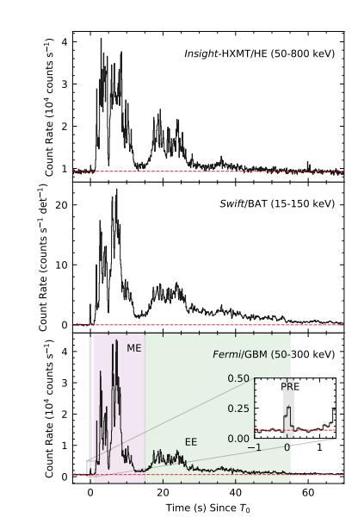
The observation: GRB211211A
Relatively long main burst ~8s
Precursor 1s prior to the main burst
Precursor lasts ~ 0.2 s
Precursor energy 7.7E+48 erg
QPO in precursor ~ 22 Hz
Xiao et al., 2022

Slide 3
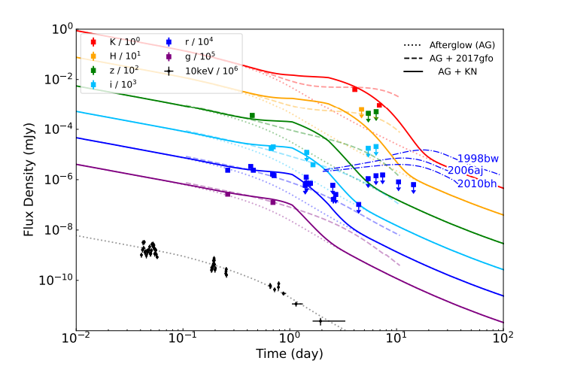
The observation
Late optical excludes Type Ic SN
Optical excess consistent with KN
Indication:
Merger (involving NS) origin event
with precursor
Xiao et al., 2022

Slide 4
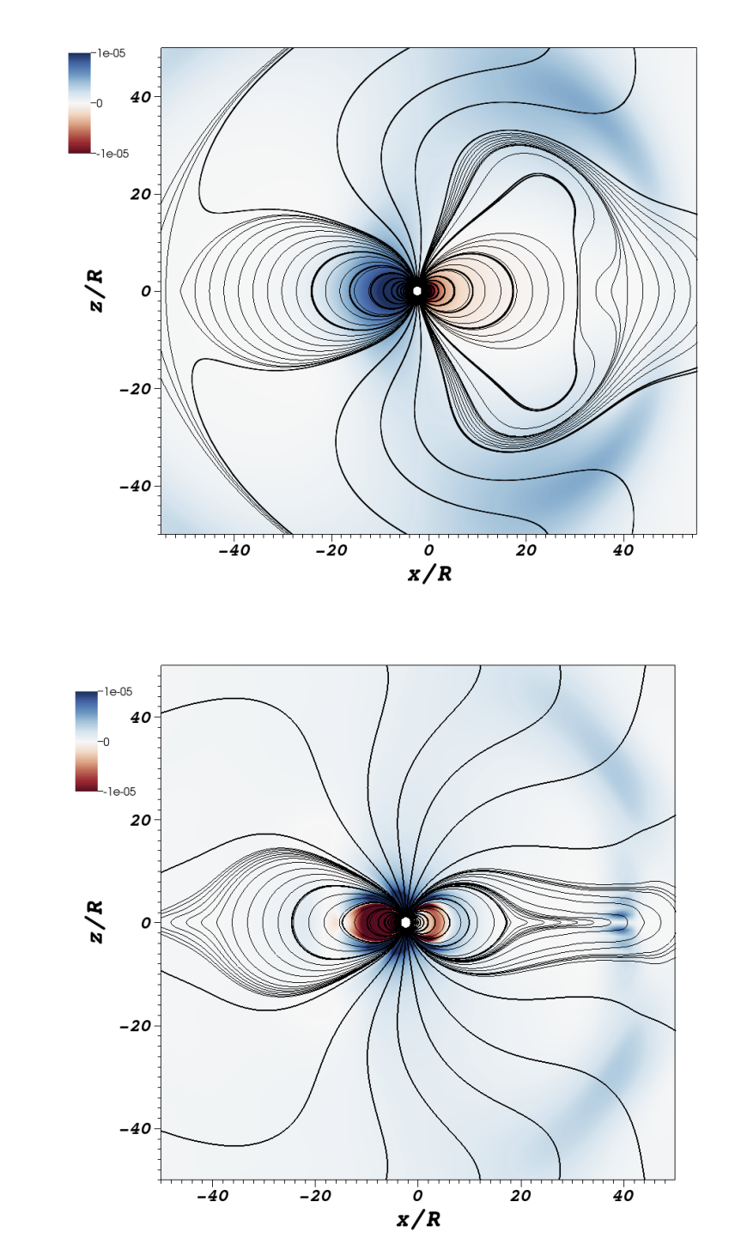
Previous models for the precursor
Poynting flux of an orbiting
magnetized NS
Flares of magnetars before merger
Resonant shattering of a spinning
NS crust during inspiral
Carrasco & Shibata 2019

Slide 5
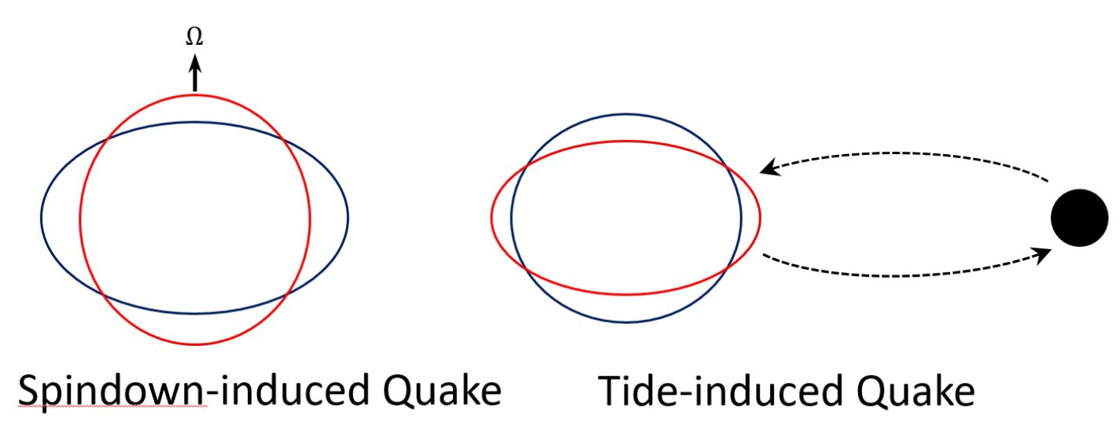
Our model
Change in spin (B dipole)
Ellipticity decreases
Elastic energy accumulated
Starquake
Glitch
Baym & Pines 1971
Change in tidal field (GW quad)
Ellipticity increases
Elastic energy accumulated
Starquake
Precursor
Zhou et al., 2023

Slide 6
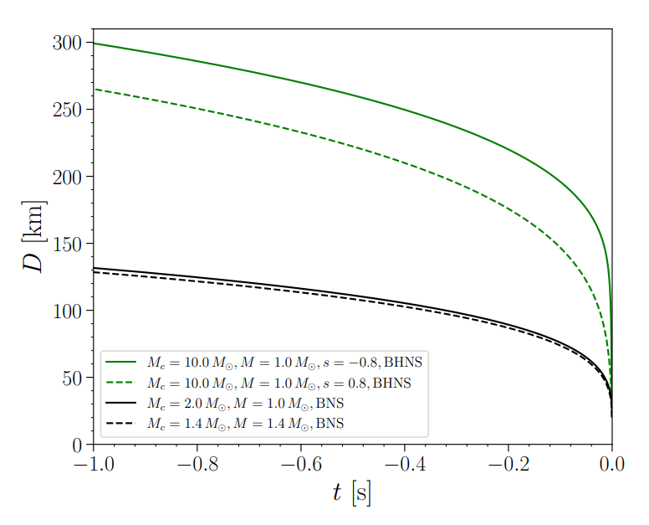
Our model
Orbital separation
D < ~100 km for
t-t_merger < -1 s
Results of EOB calculation

Slide 7
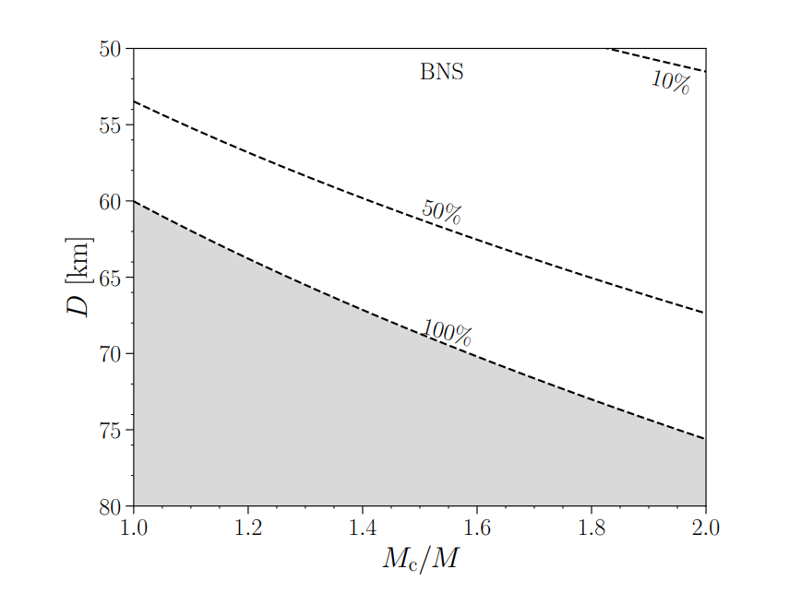
Our model
BNS
Tense parameter space
Requires major elastic energy release & conversion

Slide 8
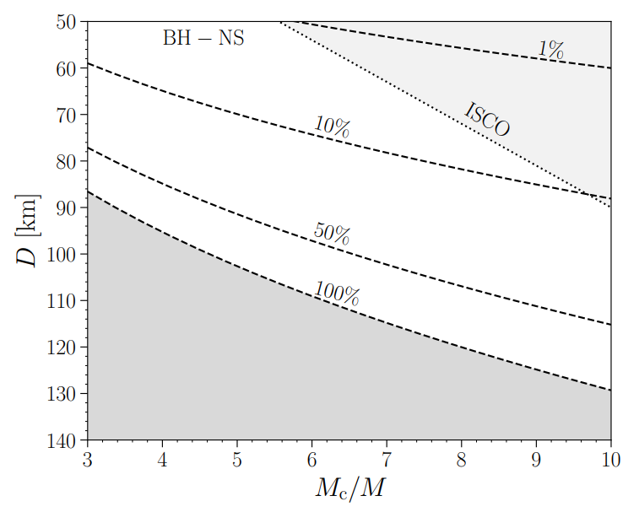
Our model
BH-NS
Larger parameter space
Allow for 10% (even 1%) energy release
More consistent with event rates (future study)
Consistent with KN observation as well

Slide 9
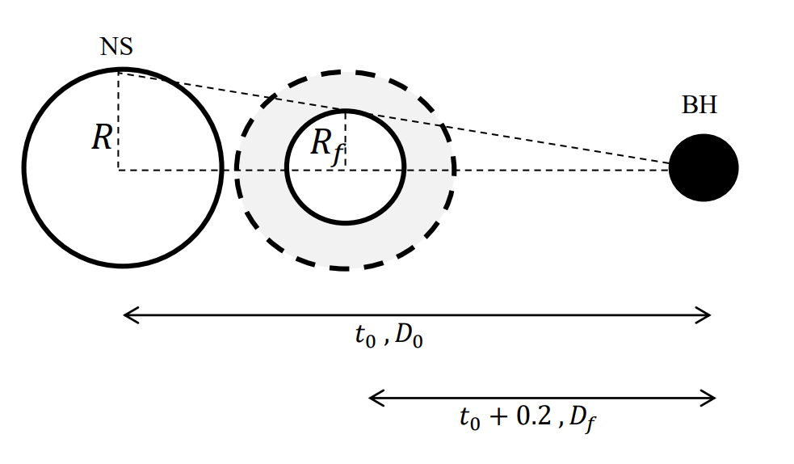
Our model
In reality, the elastic energy could be released in a sequence of starquakes.

Slide 10
Hints of a sequential starquake model
Hints:
Time-sequential components with declining amplitudes
Tidal force is stronger on the surface and weaker in the center, at a given binary separation.

Slide 11
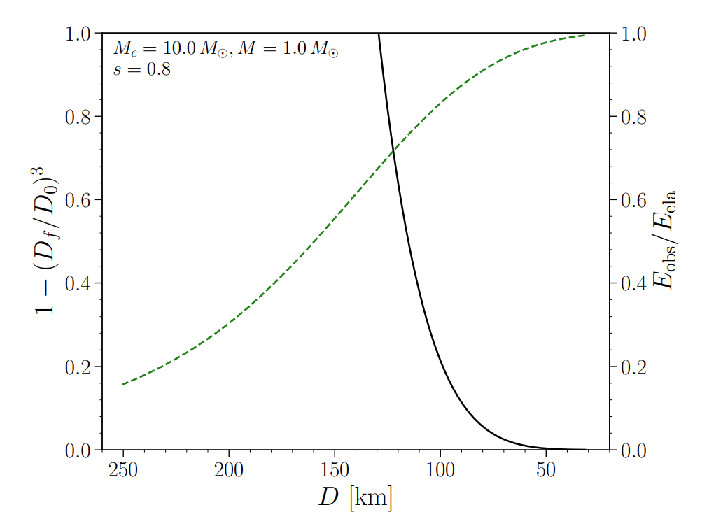
Our model
Black: Fraction of elastic energy released according to observation
Green: Fraction of elastic energy released during the sequential quakes.

Slide 12
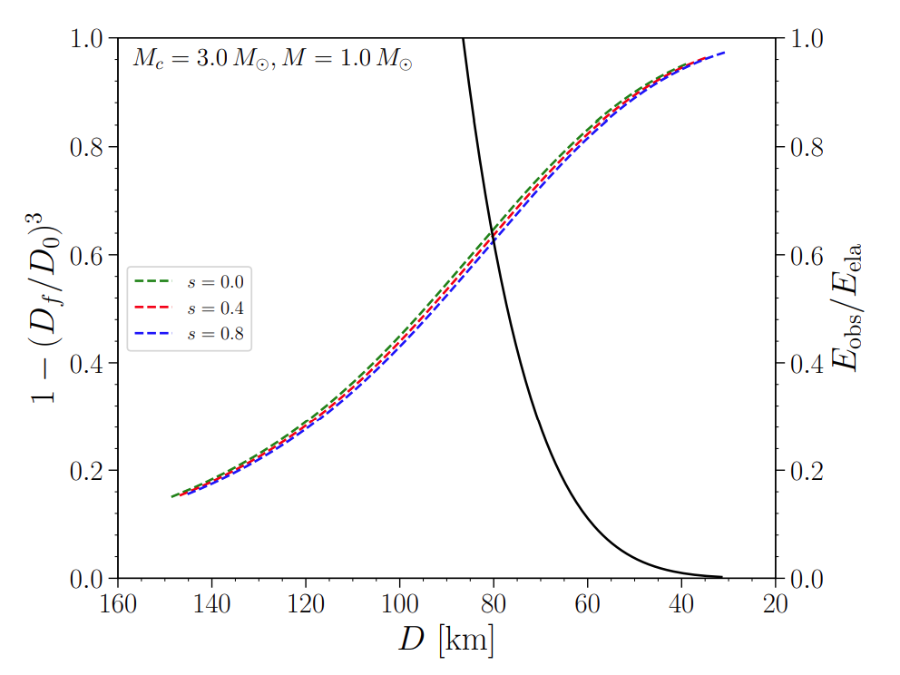
Our model
Black: Fraction of elastic energy released according to observation
Colored: Fraction of elastic energy released during the sequential quakes by assuming different BH spin.

Slide 13
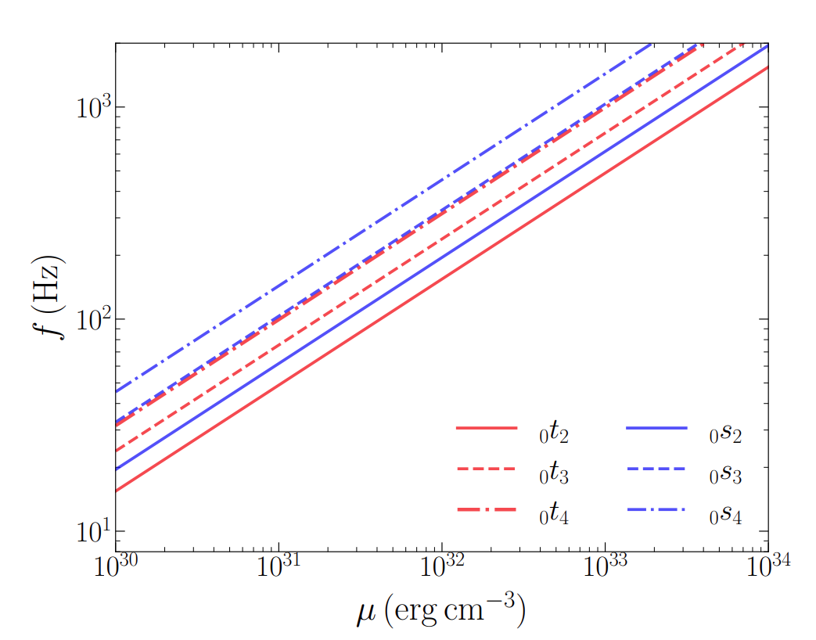
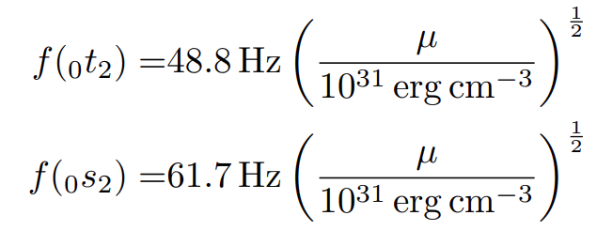
Our model
Other origin of QPOs?

Slide 14
Future prospects
Event rates
Number of quakes in a sequence?
Energy conversion mechanism

