Slide 1

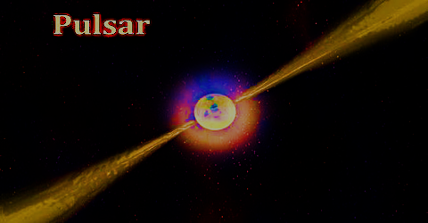
Detailed emission analysis of three slow-period pulsars using FAST
Presenter: Habtamu Menberu Tedila (Postdoc)
Collaborators: Di Li, Pei Wang, Rai Yuen, Na Wang, Jianping Yuan, et al.
July 14, 2024
SPSS2024 symposium
Kunming, China

Slide 2

Outline
Introduction
Motivations
Result
Summary

Slide 3
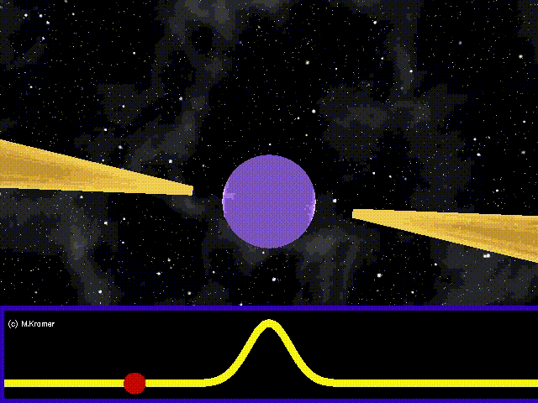
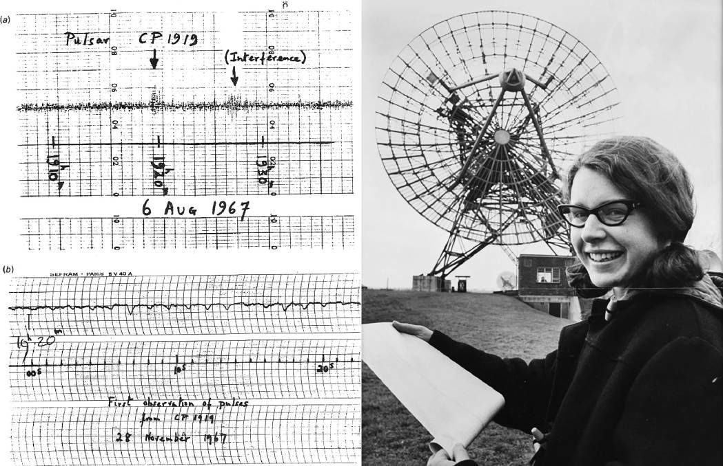
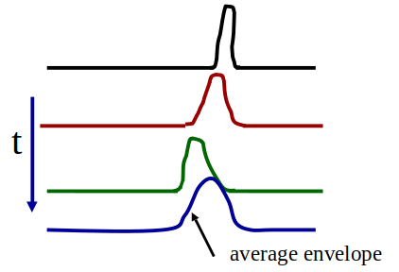
Pulsars
Introduction
Credit: Michael Kramer (JBCA, University of Manchester)
Credit: Cambridge University

Slide 4
Motivations …
Key problems for pulsar radio emission include:
  Causes of temporal modulation in emission switching between different states.
  Radiation conditions in the emission region and factors causing changes.
  Determinants of the timescale for emission stability or instability in radio pulsars.
An in-depth examination of the overall emission properties and address these questions using observational data, modeling, simulation, and theoretical analysis.

Slide 5
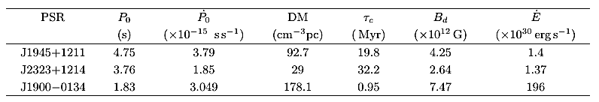
Information on three slow-period pulsars
Cameron et al. 2020

Slide 6
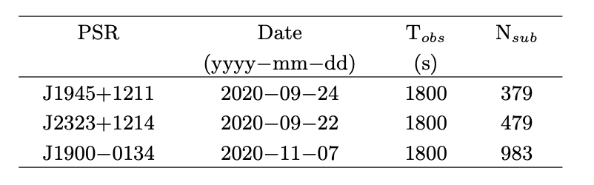
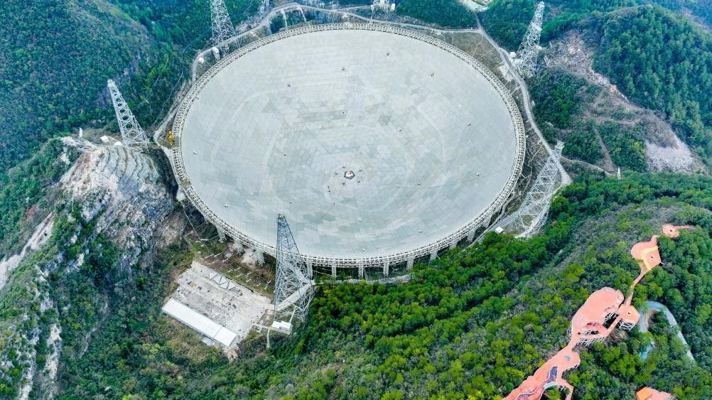
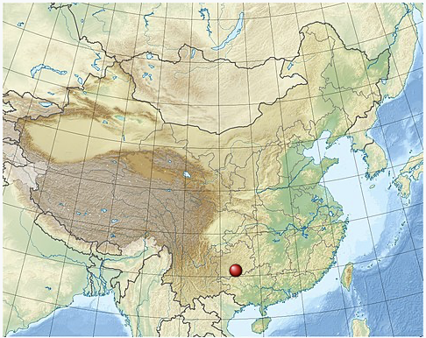
Data and Methods
The pulsars were discovered in 2017 during CRAFTS survey.
The single-pulse observation also was performed using the FAST telescope:
  Receiver: 19-beam,
  Signal processor: Reconfigurable Open Architecture Computing Hardwar-version2 (ROACH2),
  Centre frequency: 1.25 GHz,
  Bandwidth: 500 MHz,
  Time and Frequency resolutions: 49.152 µs, and 0.488 MHz,
  Frequency channels: 1024,
  Recorded file format: PSRFITS.
Data analysis → single pulse techniques

Slide 7
Results
PSR J1945+1211
PSR J2323+1214
PSR J1900−0134
PSR J1945+1211
PSR J2323+1214
PSR J1900−0134

Slide 8
The pulse energy distributions
PSR J1945+1211
NF = 52.46 ± 2.89%
PSR J2323+1214
NF = 48.48 ± 2.51%
PSR J1900-0134
NF = 27.51 ± 1.37%

Slide 9
The pulse profiles
PSR J1945+1211
PSR J2323+1214
PSR J1900-0134

Slide 10
Durations of nulls and bursts pulses
PSR J1945+1211
PSR J2323+1214
PSR J1900−0134
Null and burst state durations suggesting a power law distribution.

Slide 11
Active pulses around nulls
PSR J1945+1211
PSR J2323+1214
PSR J1900−0134
The LAP displays a higher peak intensity than the FAP and average profile, this suggests an increase in emission just before the pulsar transitions into a null state, potentially indicative of heightened magnetospheric activity as the pulsar depletes its charged particles.
In contrast, the FAP shows a significant reduction in intensity, which may signify a weakened emission mechanism immediately after a null period.

Slide 12
Quasi-periodic nulling
Transitions from null to burst or vice versa can be gradual or abrupt.
Fluctuations in pulsar emissions are common.
Backer (1970) initially proposed periodic behavior, later seen as stochastic.
Recent observations by Wen et al. (2016), Rejep et al. (2022), and Chen et al. (2023) indicate periodic nulling patterns in certain pulsars.
PSR J1945+1211

Slide 13
PSR J1900-0134

Slide 14
Bright pulses
PSR J2323+1214
Pulses with peak intensity above ten times of the average are detected.
PSR J1945+1211
PSR J1900-0134

Slide 15
As P increases, the electric potential in the gap decreases, implying that the production of plasma pairs for emission also reduces.
Since the plasma density decreases, the frequency of detecting bright pulses would also decrease.

Slide 16
Microstructure Pulses
Quasi-periodic microstructure
PSR J1900-0134

Slide 17
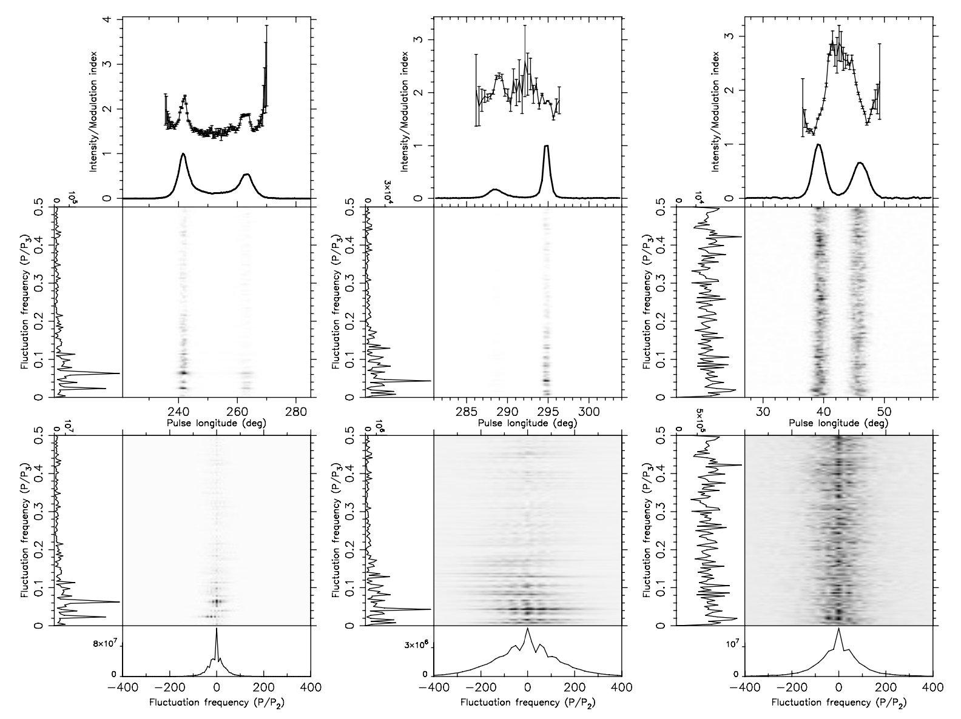
Drifting subpulse
PSR J1945+1211
PSR J2323+1214
PSR J1900−0134

Slide 18
Evolution of pulsars

Slide 19
Summary
Nulling fractions (NF)
  PSR J1945+1211: 52.46±2.89%
  PSR J2323+1214: 48.48±2.51%
  PSR J1900−0134: 27.51±1.37%
Emission features
  PSR J1900−0134: Complex emissions with microstructure pulses down to 1.57 microseconds.
  Asymmetric emissions with bright pulses predominantly in the leading component for PSR J1945+1211 and PSR J1900−0134.
  Quasi-periodic microstructures in PSR J1900−0134 suggest a periodic emission process in the pulsar magnetosphere.
  Various microstructure pulses indicate diverse emission characteristics.

Slide 20
Cont …
State transitions
  Periodic transitions between null and burst states.
  Abrupt transitions in PSR J1945+1211 and J2323+1214.
  Mixed transitions in PSR J1900−0134.
Quasi-periodic nulling phenomenon: Duration 57 to 71.44 seconds.
Duration distributions: Null and burst state durations suggest a power law distribution.
Bright pulses: Occur at different rates in all three pulsars.
Pulse profile intensity: Burst state profiles exhibit higher peak intensities and wider widths.

Slide 21
Thank you!
谢 谢！
አመሰግናለሁ፡፡

