Slide 1
Rotating pulsars in slow rotation approximation
Xiaoyu Lai 来小禹
Hubei University of Education 湖北第二师范学院
@SPSS2024 in Kunming

Slide 2
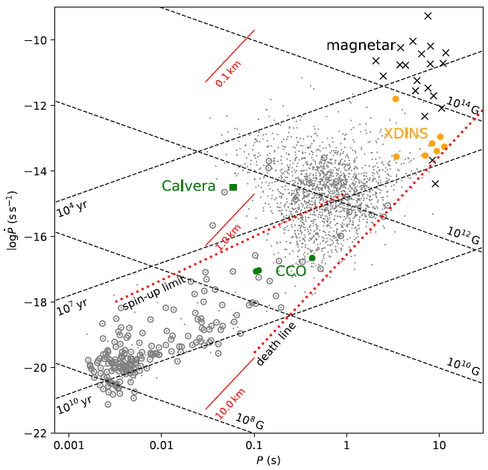
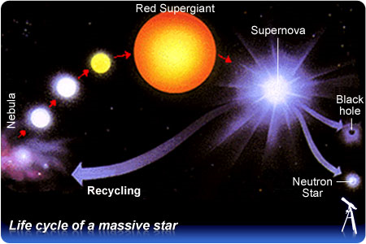
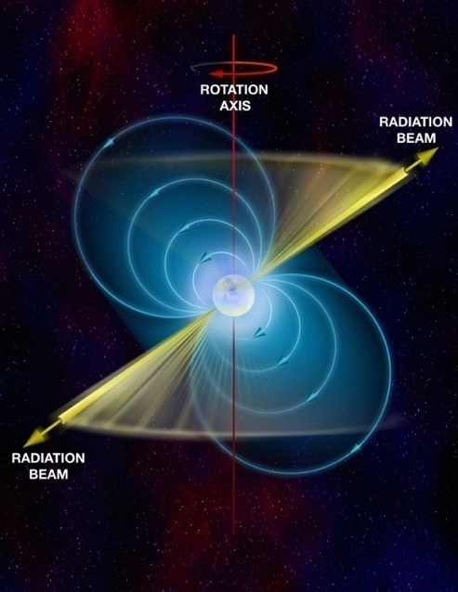
The nature of pulsar-like compact stars ?
M ~ 1.4 M⊙ , R~10 km
（ ρ₀ ≈ 2.8×10¹⁴ g/cm³：saturated nuclear matter density）
(Li et al. 2018)

Slide 3
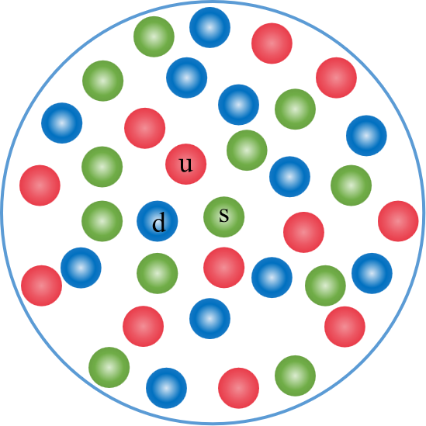
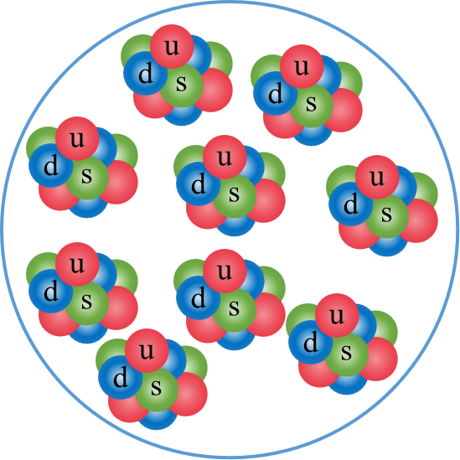
Two ways to
eliminate electrons
p + e－ → n + ν_{e}
Neutronization → Neutron Stars
Energy scale E ~ 400 MeV:
Strange quarks? ( Δm_{u/d-s} ≈ 90 MeV )
Strongly coupled (α_{s} ≈ 1)
(u, d) → (u, d, s)
“Strangenization”
→
Strange Quark Stars
Strangeon Stars
N_{q} = 3, 6, 18, ... ?

Slide 4
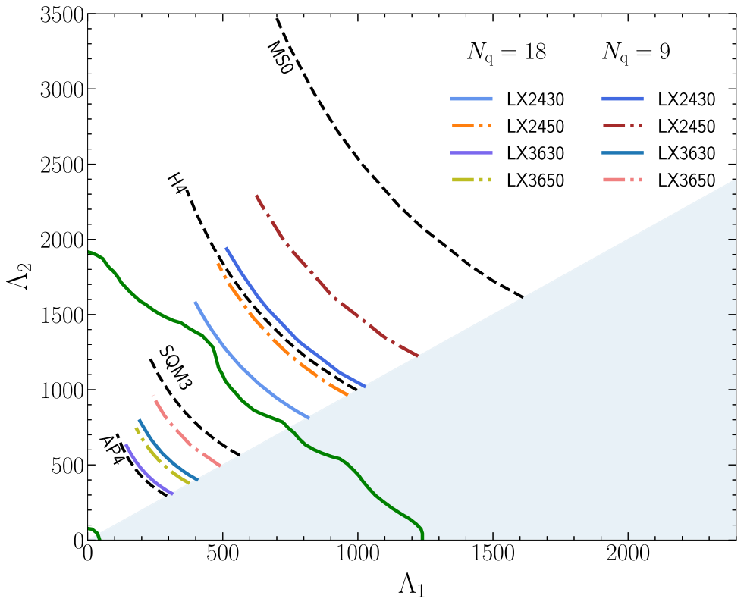
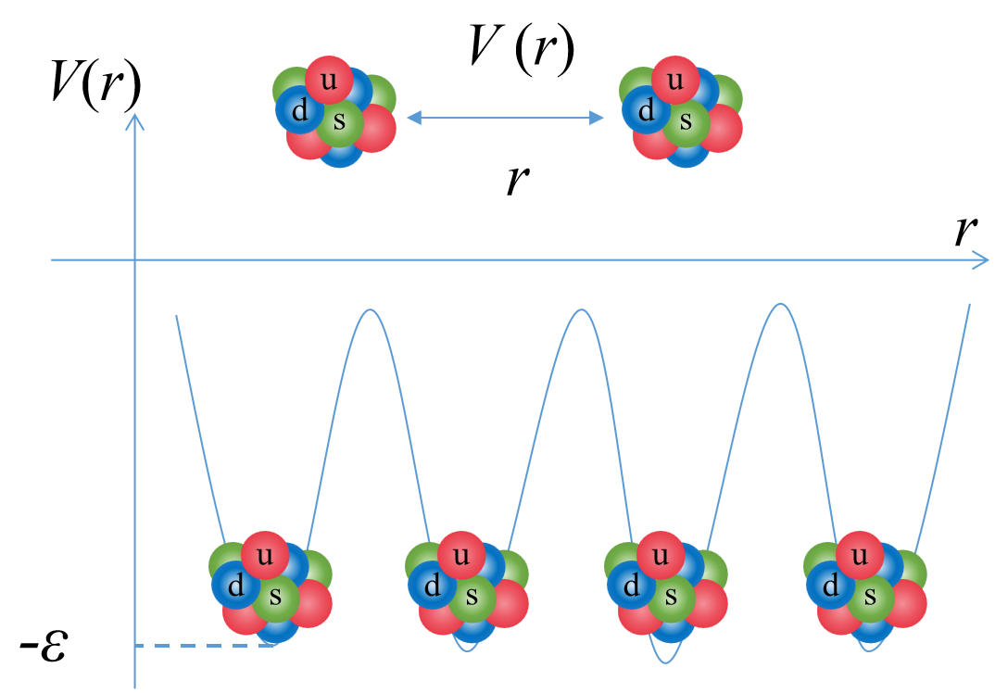
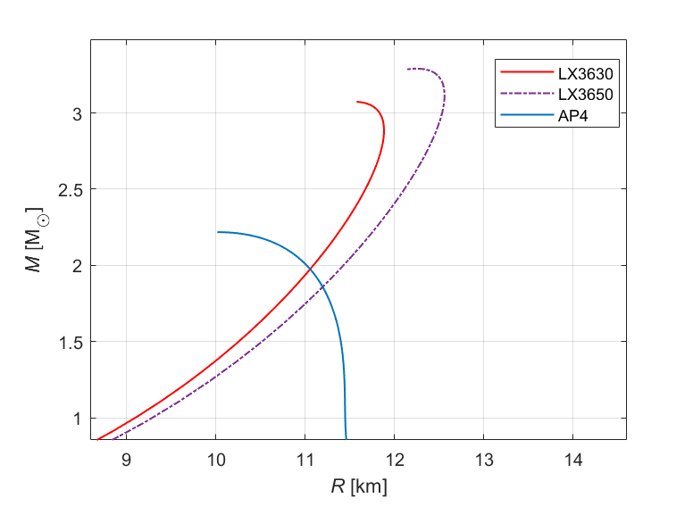
NSs: AP4 - {npeμ} (Akmal, Pandharipande & Ravenhall, 1998)
SSs: LX n_{s} ε (Lai & Xu 2009)
n_{s} : surface density, ε is the potential depth
LX3630: n_{s} = 0.36 fm⁻³ , ε = 30 MeV
LX3650: n_{s} = 0.36 fm⁻³ , ε = 50 MeV
(Gao et al. 2022)
N_{q} = 18

Slide 5
Slow rotation approximation
Hartle-Thorne formalism （$Ω≪Ω_{c}=\sqrt{\frac{GM}{R^{3}}}）$
$$ds^{2}=−e^{v\left(r\right)}\left[1+2h\left(r,θ\right)\right]dt^{2}+e^{λ\left(r\right)}\left[1+\frac{2m^{∗}\left(r,θ\right)}{r−2m\left(r\right)}\right]dr^{2}$$
$$+r^{2}\left[1+2k_{2}\left(r,θ\right)\right]\left\{dθ^{2}+\sin^{2}{θ}{\left[dϕ−(ω\left(r\right)+w\left(r,θ\right))dt\right]}^{2}\right\}+O(Ω^{4})$$
(Hartle J. B., ApJ, 1967; Hartle and Thorne, ApJ, 1968)
First order
$$Frame−dragging effect，转动惯量$$
Second order
引力质量、半径、重子质量等
Third order
转动惯量的二阶修正

Slide 6
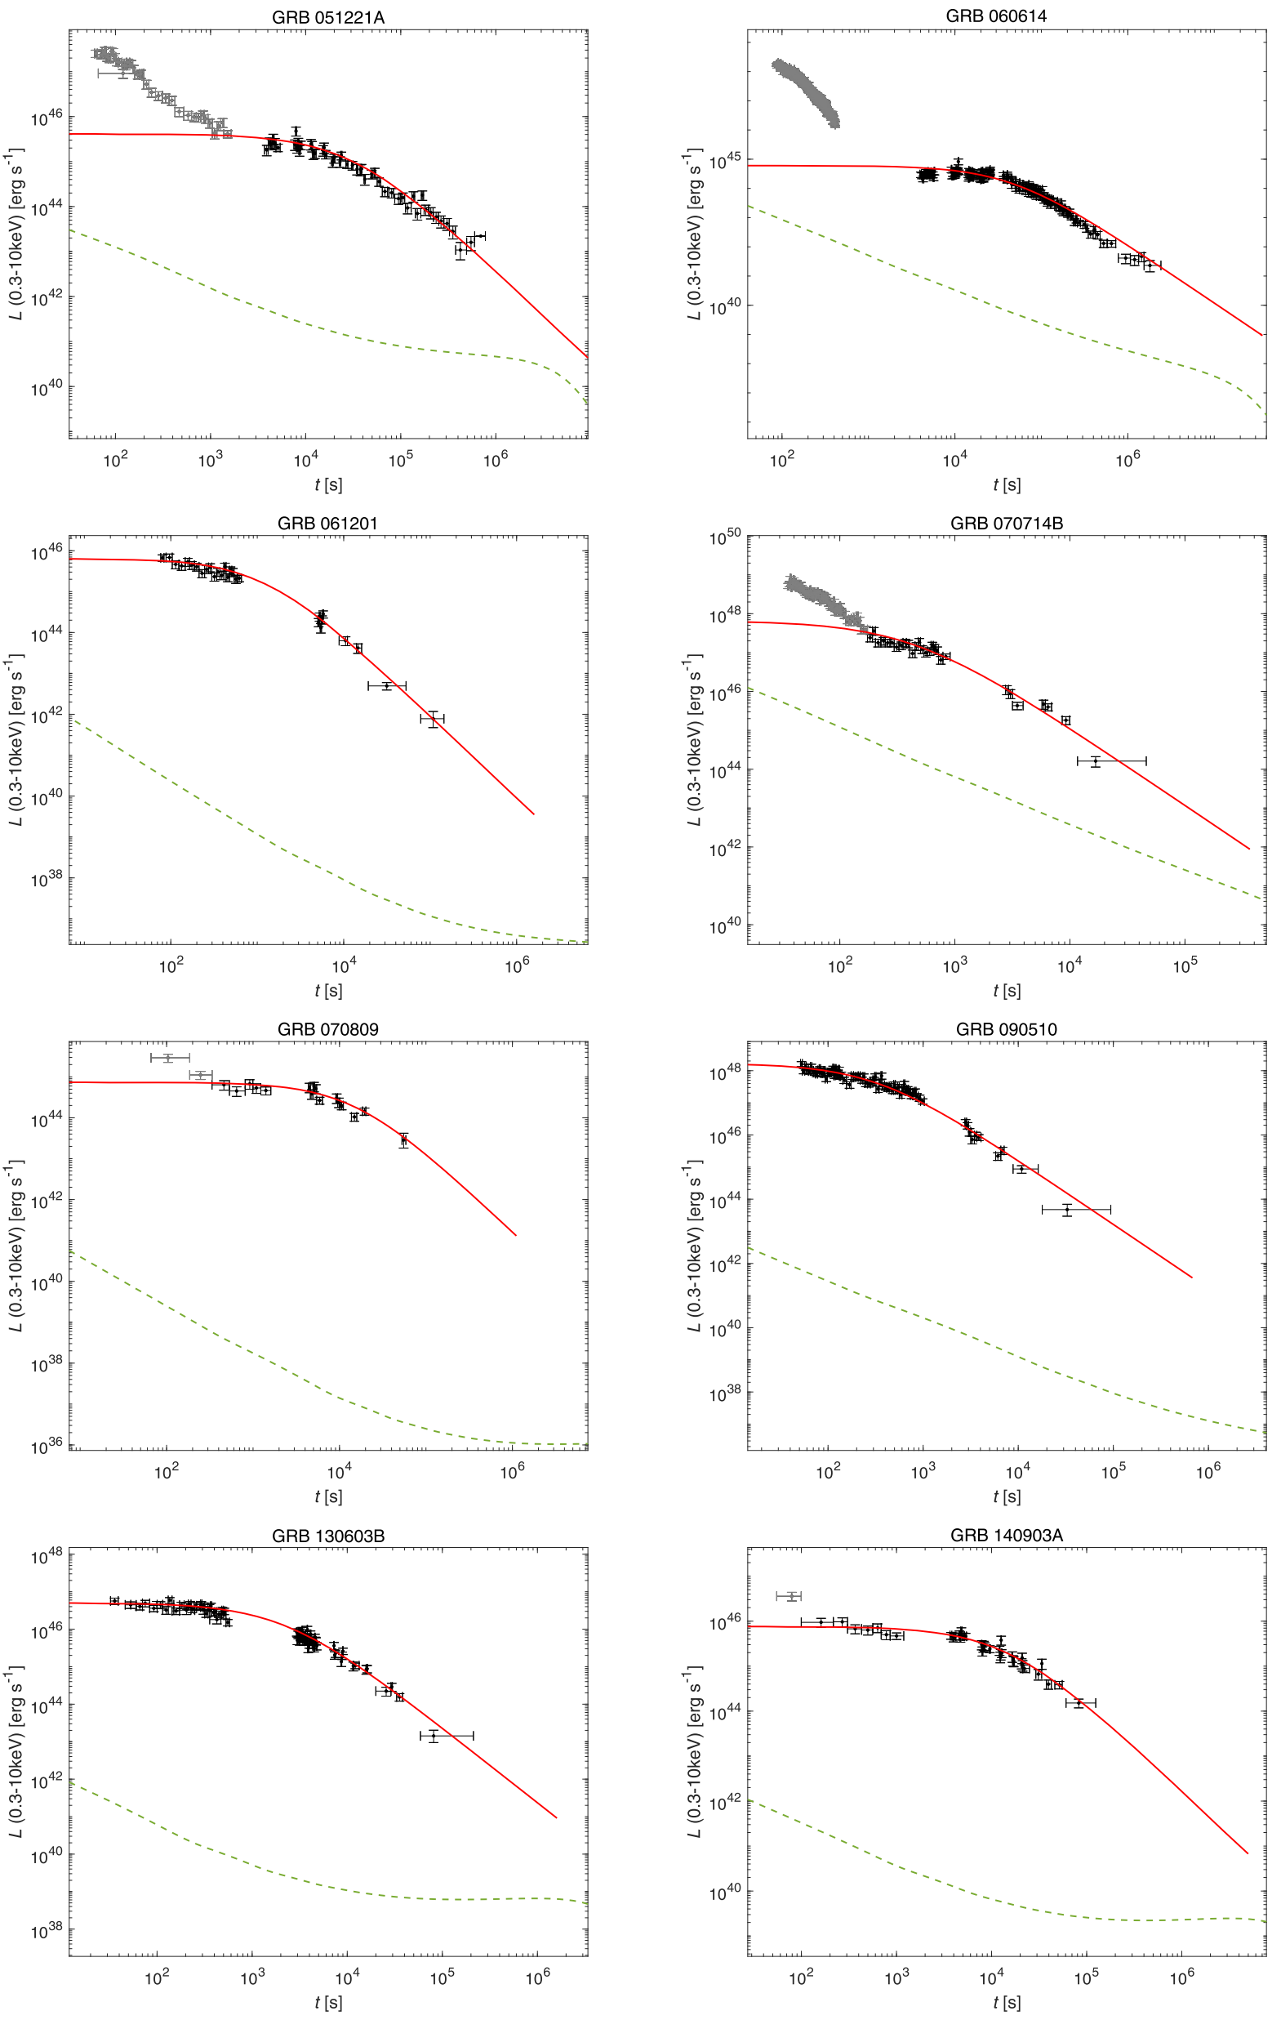
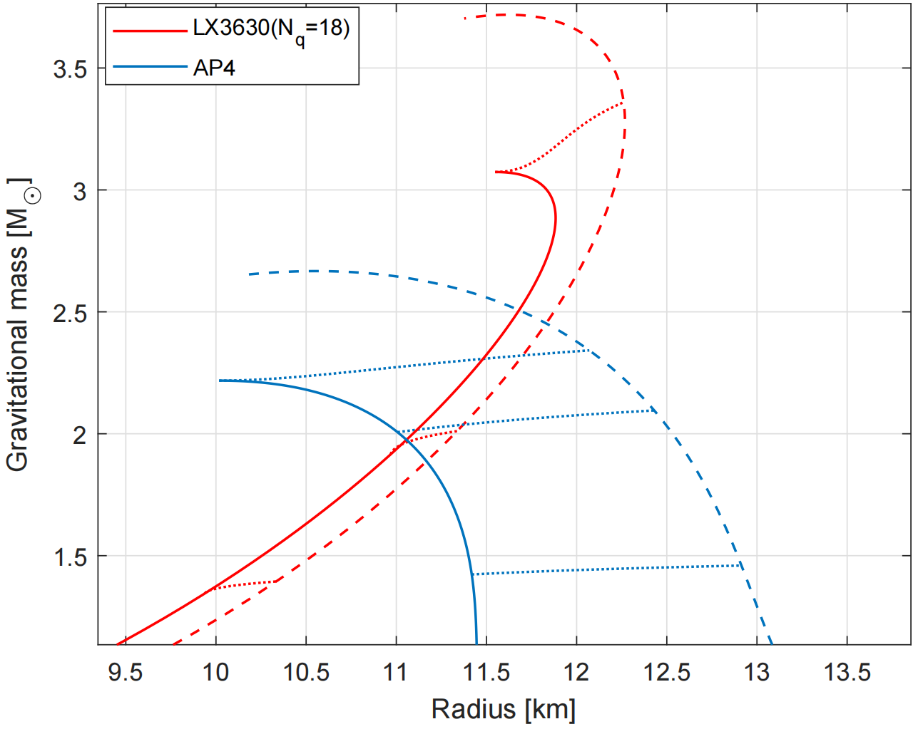
双致密星并合后形成大质量奇子星 (M ~ 2.36 M⊙)
由于磁偶极辐射导致转动减慢时，将引力能作为能量注入源，可以解释 SGRB 的 X-ray 余辉平台.
所需的磁场强度不超过磁星模型所需磁场强度 (甚至可以小一个量级).
(Yang et al. 2024)

Slide 7
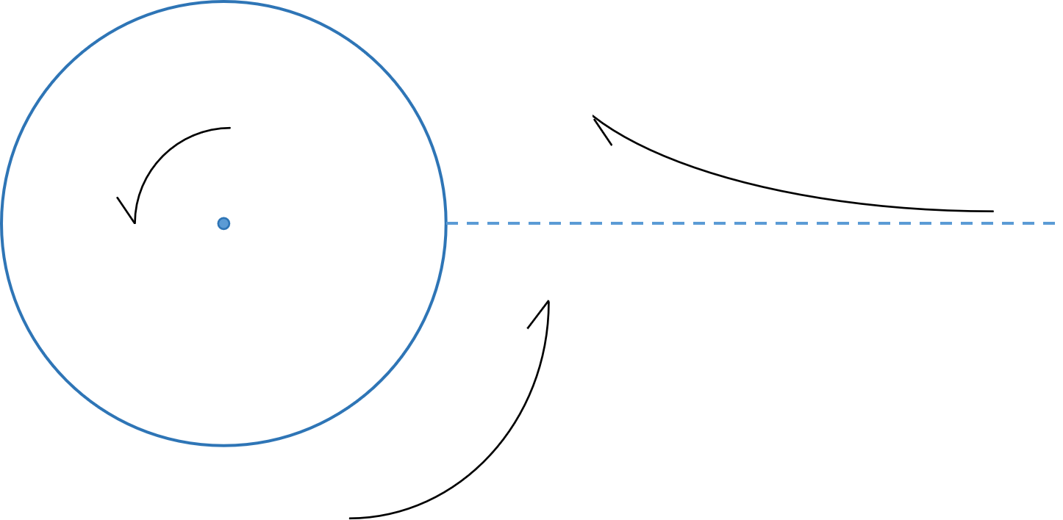
Dragging of local inertial frames 局域惯性系的拖曳
$$ds^{2}=−e^{v\left(r\right)}\left[1+2h\left(r,θ\right)\right]dt^{2}+e^{λ\left(r\right)}\left[1+\frac{2m^{∗}\left(r,θ\right)}{r−2m\left(r\right)}\right]dr^{2}$$
$$+r^{2}\left[1+2k_{2}\left(r,θ\right)\right]\left\{dθ^{2}+\sin^{2}{θ}{\left[dϕ−(ω\left(r\right)+w\left(r,θ\right))dt\right]}^{2}\right\}+O(Ω^{4})$$
$$Ω$$

Slide 8
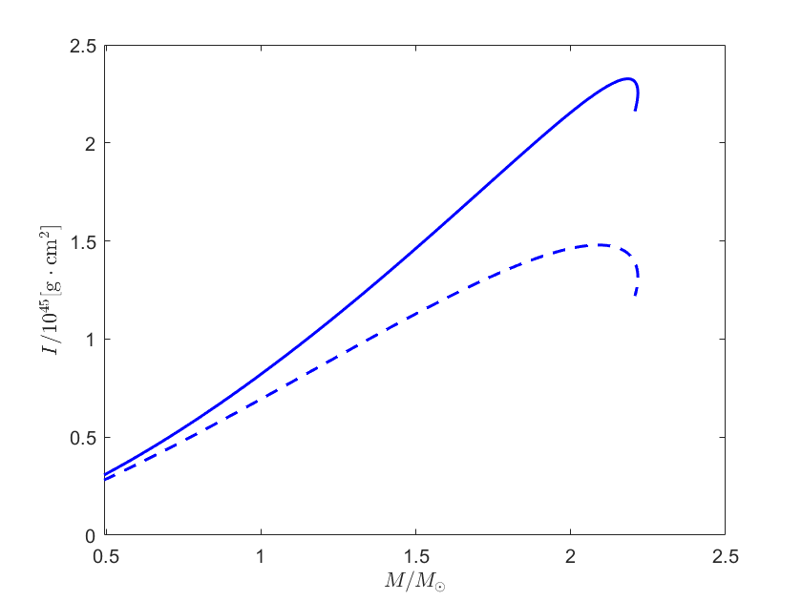
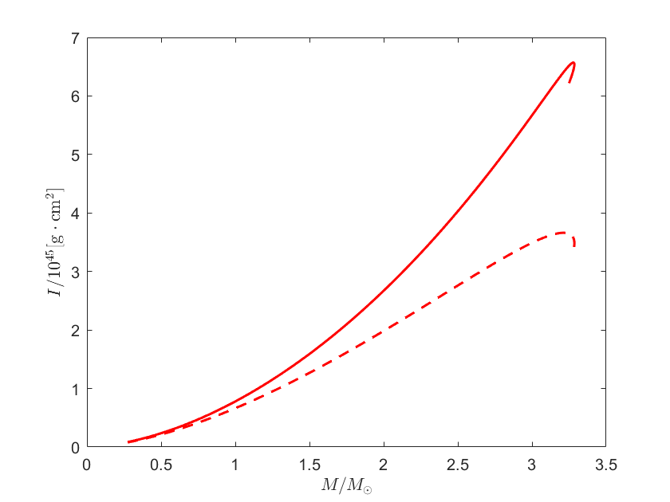
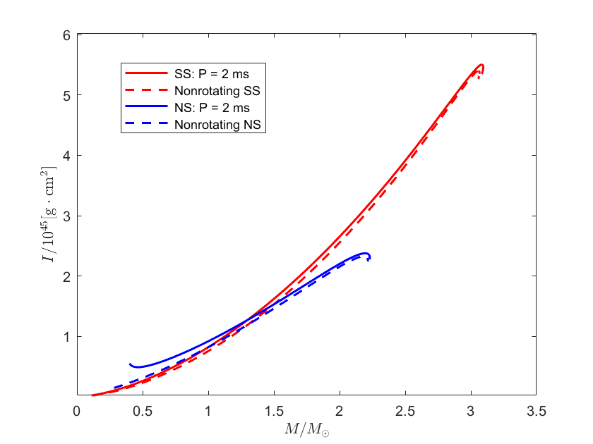
Moment of inertia
NS: AP4
SS: LX3630

Slide 9
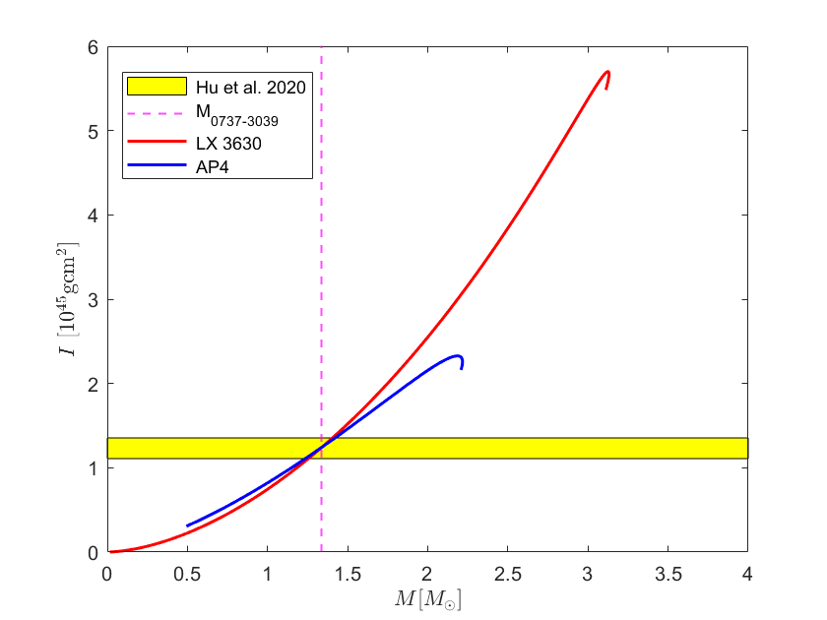
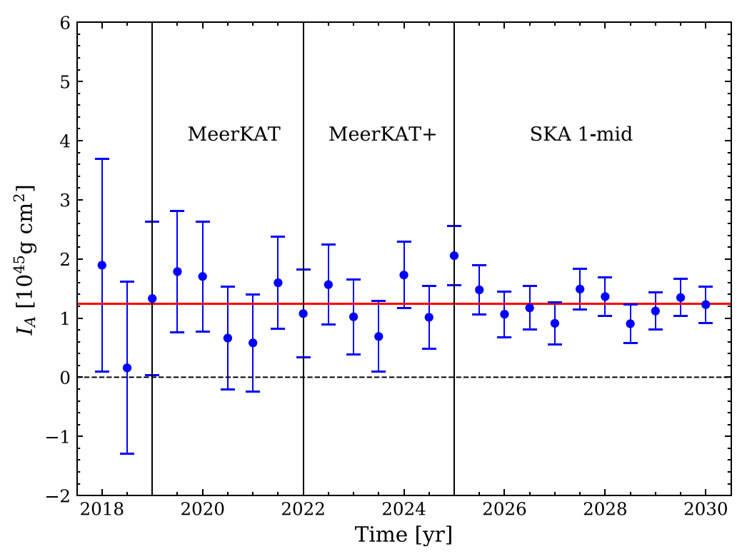
Compare with observations
PSR J0737-3039
m_{A} = 1.3381 M⊙, m_{B} = 1.2489 M⊙
P_{A} = 23 ms , P_{B} = 2.8 s
a_{R} = 1.26 R⊙
(Hu et al. 2020)

Slide 10
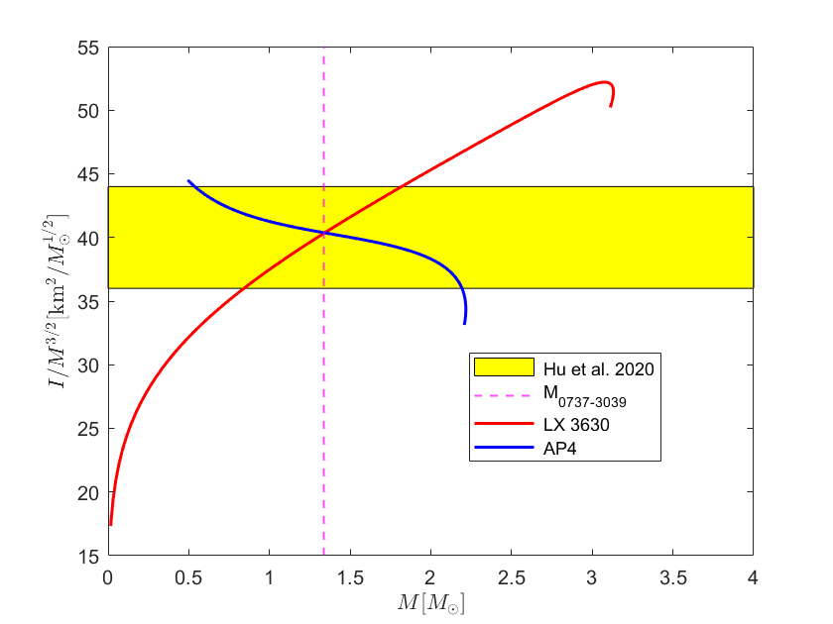
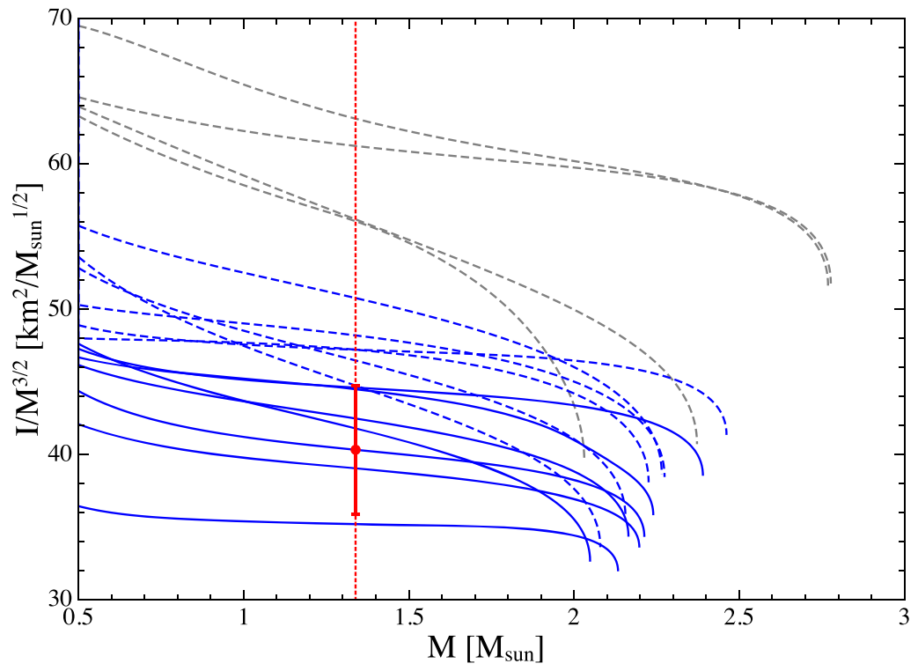
Compare with observations
(Hu et al. 2020)

Slide 11
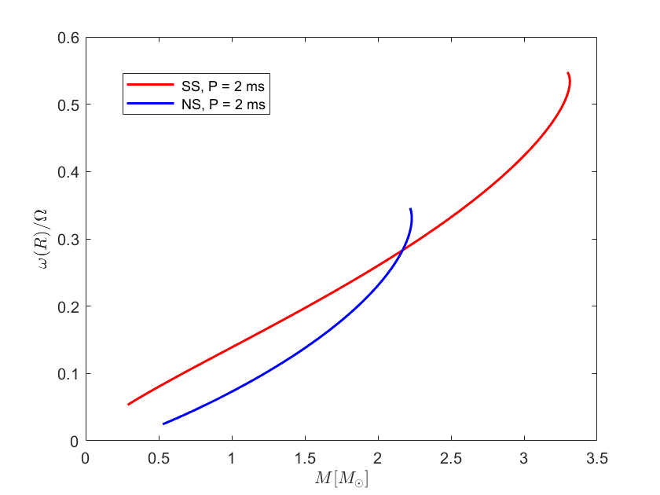
Dragging of local inertial frames
$$Ω$$
Effect on the accretion process ?
Effect on the formation process of MSPs ？

Slide 12
Summary
Pulsar-like compact stars could be strangeon stars.
The calculations in slow rotation rotation approximation show that:
Strangeon stars as the remnants of BNS mergers could explain the X-ray plateau in the afterglow of short GRBs.
Are there some other effects which could test different models of EOS?
Thank you !

