Slide 1
FAST Globular Cluster Pulsar Survey IV.
潘之辰 钱磊
闫振 罗近涛 张仲莉 Kuo Liu
张立云 潘宇 李祎丰 彭波
Scott Ransom Duncan Lorimer
尹德江 李保达 戴印丰 李耀威 吴宇枭
刘通 李文泽 姜东岳 陈语杰 彭泽辉 。。。。。。
2024.7 昆明
Notes:
Wang et al. M13?
M3A?

Slide 2
GCs in FAST Sky and Previous GC Pulsars
45/160+ GCs in FAST sky, 10 GCs have 33/157+ PSRs (2019)
~20/45 GCs out of Arecibo sky, 2 have 5 PSRs
Closest:
NGC6366, 3.5 kpc, no PSR
M71, 4.0 kpc, 1+4 PSR (Pan et al. 2021, 2023)
Farthest:
Palomar 4, 108.7 kpc, no PSR
M53, 17.9 kpc, 1+4 PSR (Lian et al. 2023)
M71 20230621
Credit: Xinming Obs & Mr. Xing Gao
Left to Right: M92A (Pan et al. 2020), NGC6517N (Yin et al. 2024), Glimpse C01 A (McCarver et al. 2024)

Slide 3
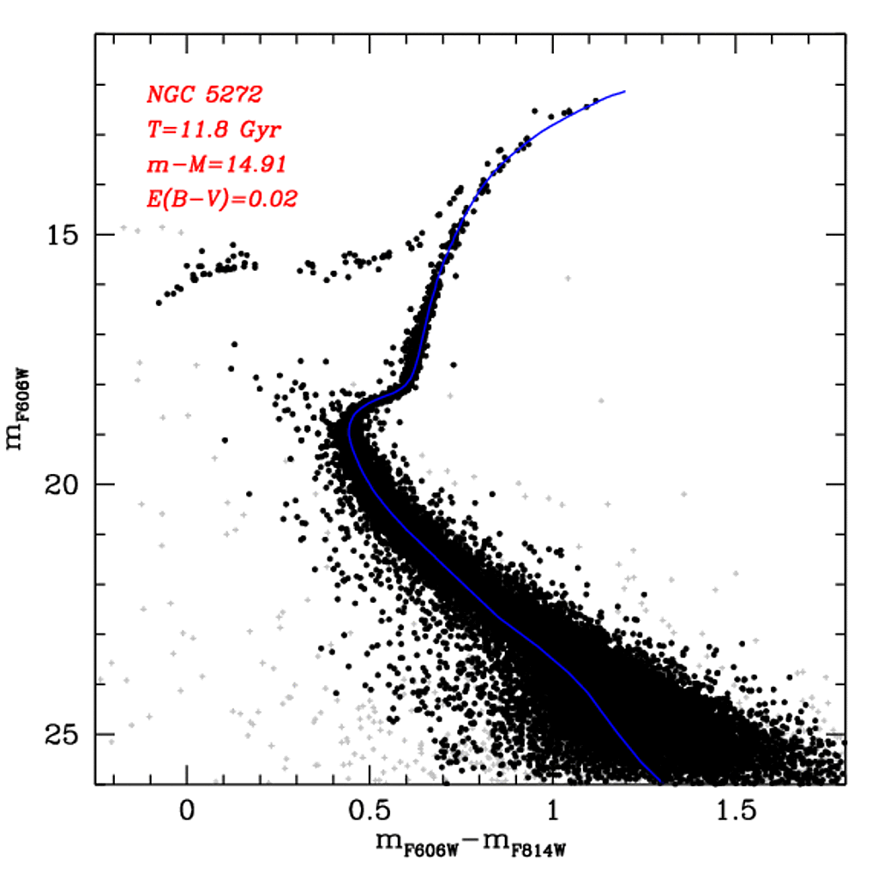
What a GC looks like?
M3 – 4+2 psr Li+
M4 – 1 psr
M5 – 5+2 psr Zhang+
M3 11.8 Gyr
https://people.smp.uq.edu.au/HolgerBaumgardt/globular/fits/phot/ngc5272_cmd.gif
M13 – 6+4 psr
Wang+, …
M80 – 0 psr
GMRT: +1
M107 – 0 psr
FAST Site, 20200515 Credit: Zhichen Pan

Slide 4
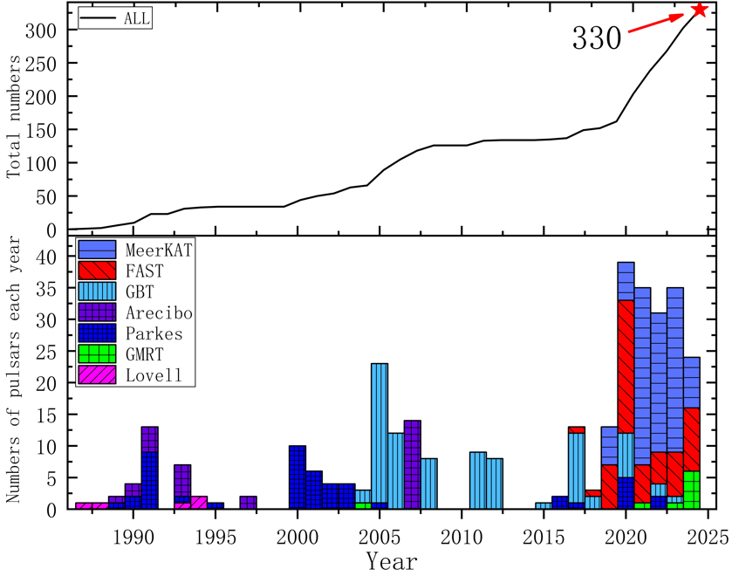
GC Pulsar Discoveries
Parkes: 50 (47 Tuc: 25)
Arecibo: 26 (-2 than 2023)
GBT: 85 (Terzan 5: 38)
FAST: 61 + determining orbits
MeerKAT: 94
Others (GMRT + Lovell): 9+5
FAST GC Pulsar Survey, 2023.7-2024.6:
Yin et al. 2024, ApJL
Li et al. 2024, ApJ
Wu et al. under review, ApJL
Li et al. in prep. (M2 puslars)
Li et al. in prep. (FFA and GC MSPs)
Dai et al. in prep. (Stacking search)
Liu et al. in prep. (Pulse profiles)
Lian et al. in prep. (Survey description)
Lian et al. in prep. (NGC 6517 psr ring)
FPS8 2019.7
FPS1 2012.8
Modified by Yin, Dejiang
Till 2024.7.8, 330 pulsars in 44 GCs
Notes:
A plot for all GC discoveries

Slide 5
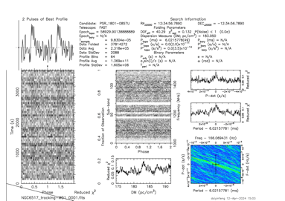
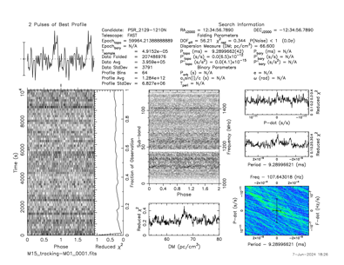
GC Pulsar Discoveries: FAST, 2023-2024
Pulsar Discoveries: from 42 to 58
Discovered: M15J/K/L/M/N, Glimpse C01 B, M2G/H/I/J, M13G/H/I, NGC 6517 S/T/U, M92B
Mistakes: NGC 6517J, previously M15M, M3C?, NGC6749B?
Timing solutions for:
M92B: (Dejiang Yin, GZU)
M71B/C/D: (Yujie Lian, BNU&MPIfR)
M2E/F/G: (Baoda Li, GZU)
M13I: (Yaowei Li, GZU)
M15I/J/K/L/M/N: (Yuxiao Wu, CQUPT; Yinfeng Dai, GZU)
M10A/B: (Yujie Wang, SHAO)
M12A/B:(Yujie Wang, SHAO)
53-min. shortest PSR binary orbital period record is still there!
NGC 6517U & M15N
Notes:
A plot for all GC discoveries

Slide 6
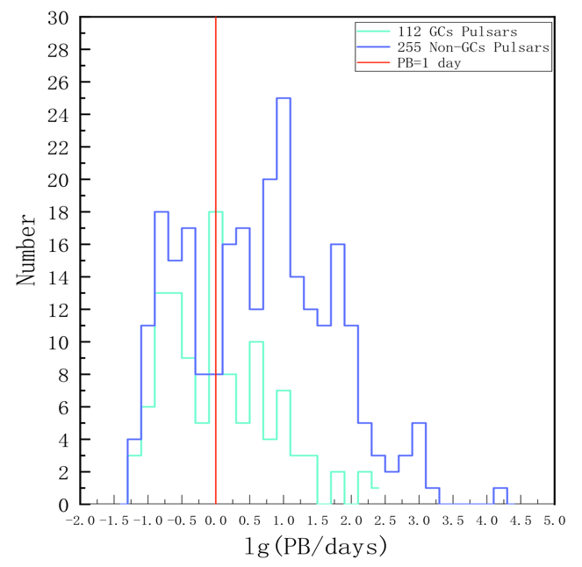
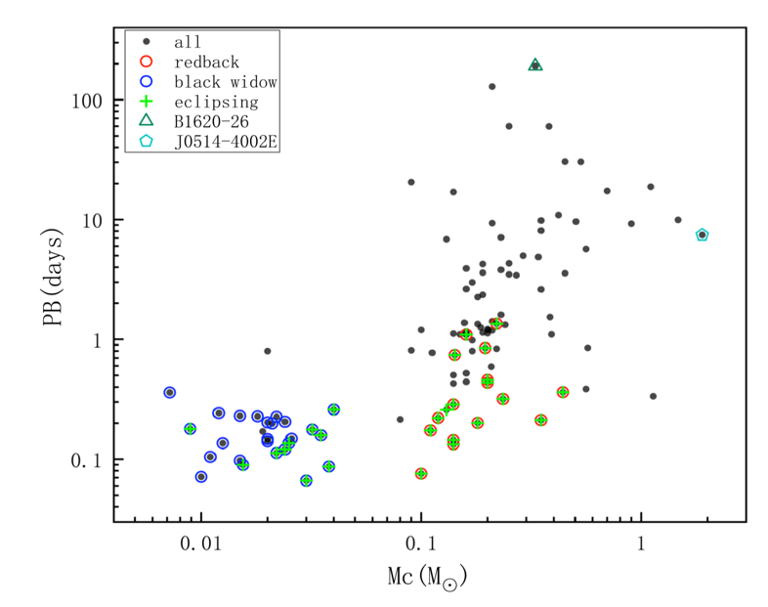
M71 – A GC Contains Many Interests
M71B/C
M71D
M71A
M71E
Lian et al. in prep
Notes:
M71D

Slide 7
Timing of M71B/C/D
M71B: PB=466 days (longest GC PSR)
Mcomp=0.49
EPS1=0.0015165(6)
EPS2=-0.0012559(5)
M71B
M71C: PB=378 days
Mcomp=0.41
EPS1=0.0002698(4)
EPS2=-0.0002642(4)
M71C
M71D: PB=10.938 days
Mcomp=1.63
E=0.6289 OMDOT=0.0116(2)
Mtot = 2.8 ??? DNS system?
M71D
Lian et al. in prep
Notes:
M71D

Slide 8
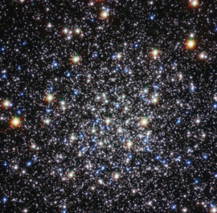
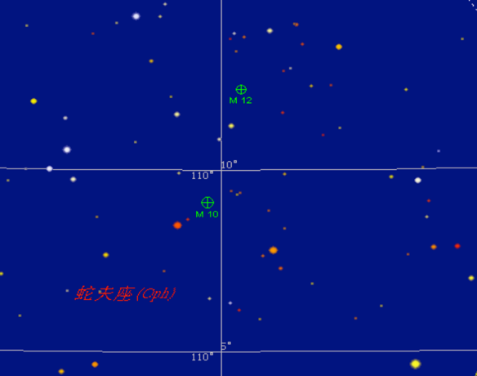
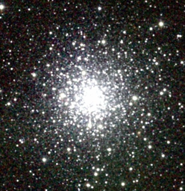
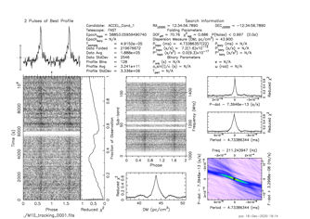
M10&M12: the DM Estimation
M12_{YMW16}: 63.4 pc cm⁻³
M10_{YMW16}: 107.5 pc cm⁻³
Sky Map 10 PRO
M12
B, 42.586 pc cm⁻³
M12: A, 42.5 pc cm⁻³
M10: A, 43.9 pc cm⁻³; B, 43.3 pc cm⁻³
M10
M12: 4.67 +/- 0.21 kpc
M10: 4.96 +/- 0.13 kpc
GC distances and images are from: https://people.smp.uq.edu.au/HolgerBaumgardt/globular/

Slide 9
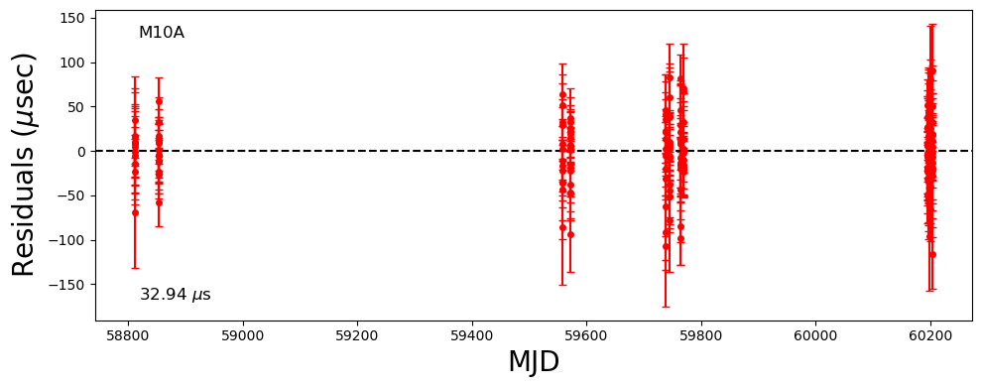
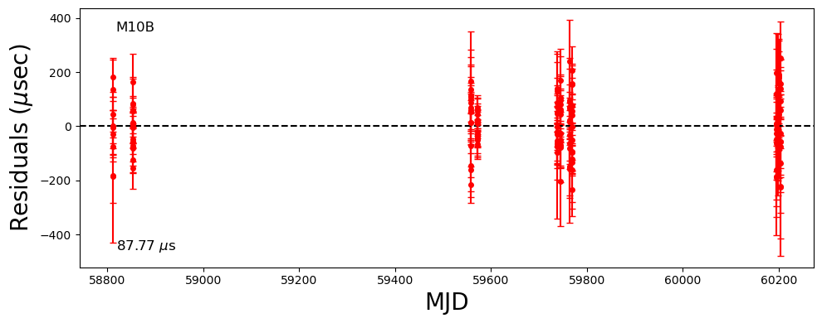
M10 and M12, Yujie Wang et al. in prep.
M10A: PB = 37.4 days; A1 = 14.2 lts
e = 0.12
M10B: PB = 27.7 days; A1 = 5.9(2) lts
e = 0.75 ???
M10 is a GC that all known pulsars in it are in eccentric orbits.
M12A is with very narrow pulse profile.
TOA error < 1 us.
M12A and B are in circular orbits.

Slide 10
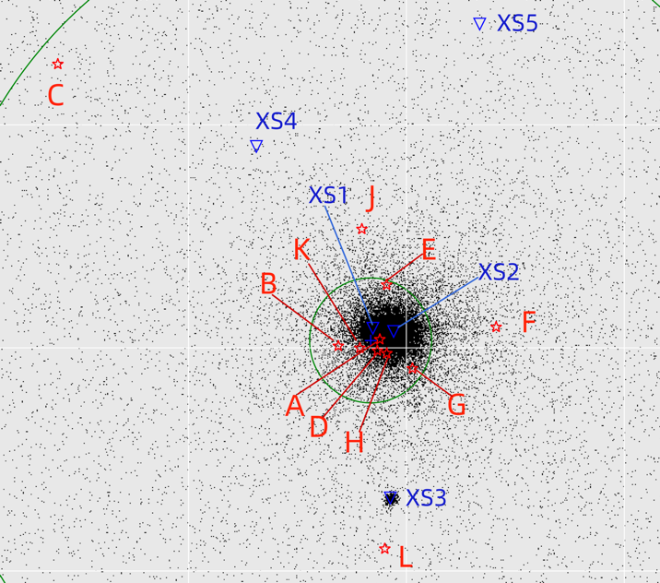
Exotic Pulsars in M15, Wu et al. submitted to ApJL
Pulsar M15G is with many peaks;
FFA helps a lot in filtering harmonics;
M15J is quite bright, should be found earlier:
Long period pulsars M15K and L (4 s, longest);
The pulsar in a massive core-collapse GC center.
M15I, with quite larger F1 and detectable F2.
然而种种原因使得我们被迫突然投稿。
各种工作还在继续，希望带来更多惊喜。
M15I can be here!
Notes:
两篇内容接近的文章出现在arxiv上，不希望再次发生。
我们是相互独立的工作，自始自终，无论是文章准备阶段，投稿阶段，还是审稿阶段，尤其是审稿阶段，我们没有任何关于研究工作的讨论和协商，没有就任何事项达成一致。
你们不引用我们的文章没关系，我们引用了你们的文章；你们发新闻对于我们绝口不提没关系，等我们发新闻，我们会提你们的。
我们欢迎大家使用我们的无论是公开的还是非公开的数据，欢迎大家使用我们的发现，更期待和大家合作，这是我们一贯的不变的态度。

Slide 11
Faintest Pulsars in Human History???
3 hours FAST L-band observation;
ZA < 26.5 degree;
SNR <= 5;
No frequency domain detection from single observational data;
Stacking search results;
S₁₄₀₀ ~= 1 uJy;
M15N, Dai et al. in prep.
Notes:
How to time such pulsars?

Slide 12
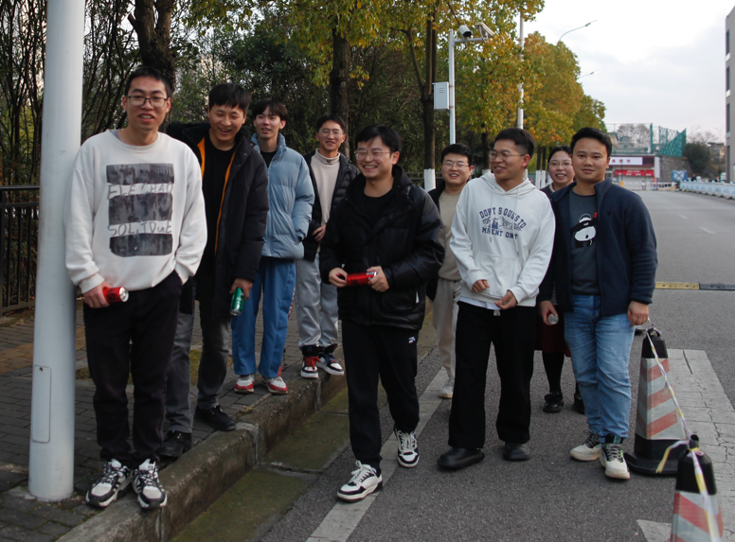
People
Part of People in GZU, 2024.1

Slide 13
Conclusion
1, FAST GC Pulsar Survey (GC-FANs) from 42 to 58;
With two more discovered by others,
M13F, Wang et al. 2020; M5G, Zhang et al. 2023;
M71E, Han et al. 2021 and Pan et al. 2023;
61 GC pulsars in total by FAST!
Killed two: M3C and NGC 6749B.
Mistakes: NGC 6517J, previous M15M.
2, records:
Longest orbital period: M71B, 466 days (Lian et al. in prep.);
Longest spinning period: M15L, ~4 seconds (Wu et al. submitted);
Shortest orbital period: M71E, 53 min. (Pan et al. 2023);
3, Science:
GC pulsar number simulation (Yin et al. 2024);
Searching methods (Dai et al. in prep; Li et al. in prep);
FAST GC Discovery Page
Notes:
球状星团只是解决科学问题而决定的研究目标，我们的前方是星辰大海！

Slide 14
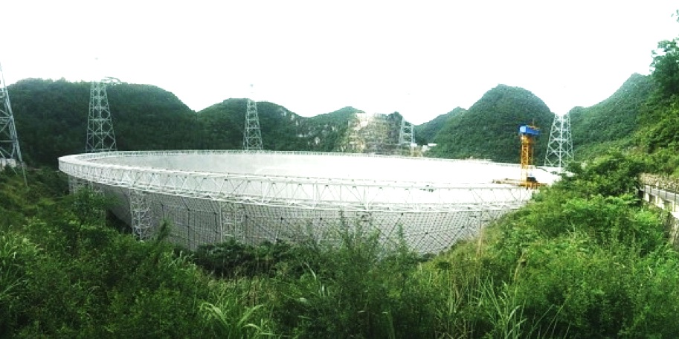
FAST Globular Cluster Pulsar Survey IV.
Thank You!
潘之辰 钱磊
闫振 罗近涛 张仲莉 Kuo Liu
张立云 潘宇 李祎丰 彭波
Scott Ransom Duncan Lorimer
尹德江 李保达 戴印丰 李耀威 吴宇枭
刘通 李文泽 姜东岳 陈语杰 彭泽辉 。。。。。。
2024.7 昆明
Photo Credit: Zach and Shana

