Slide 1
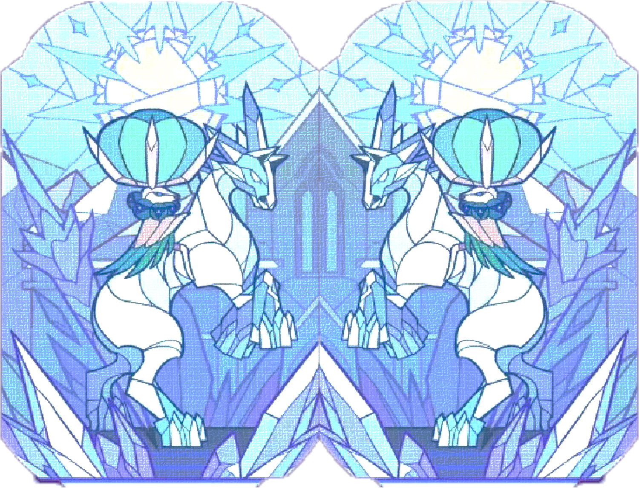
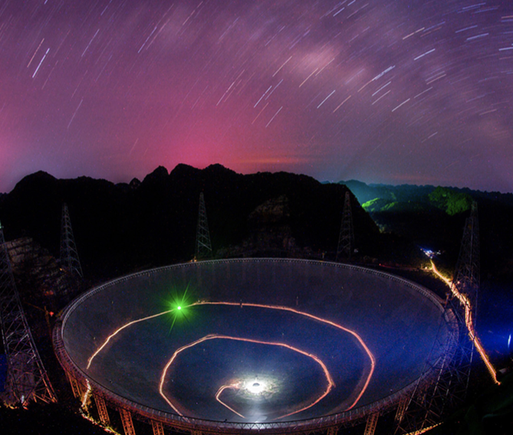
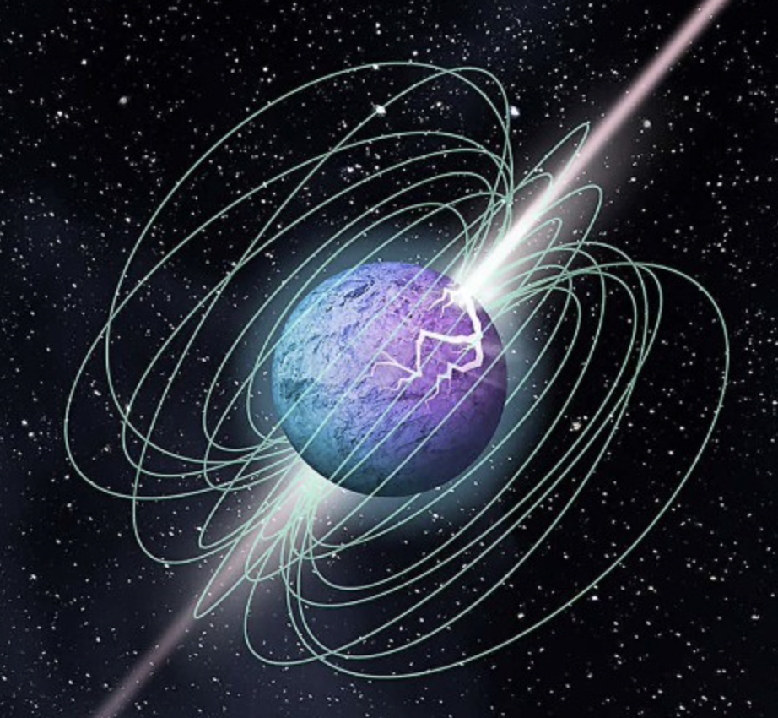
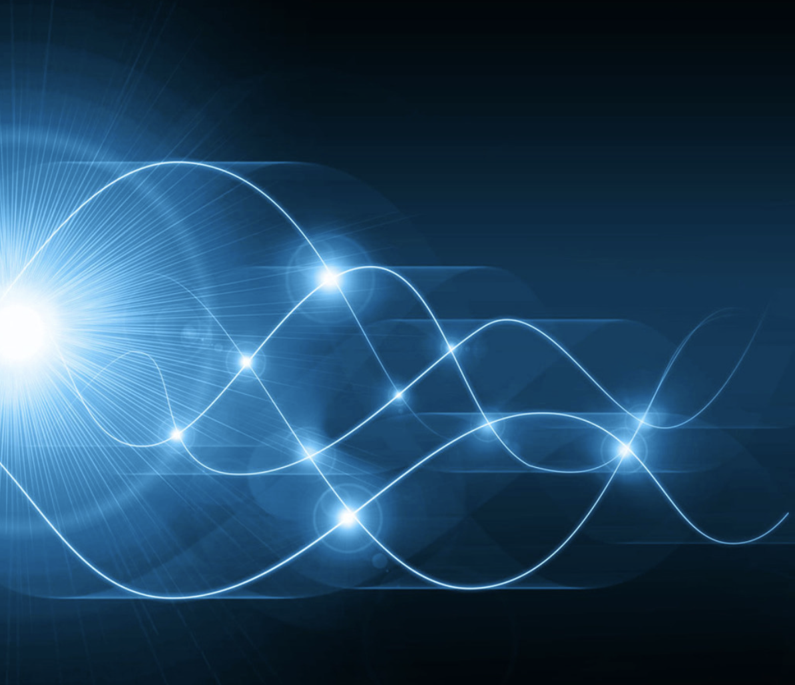
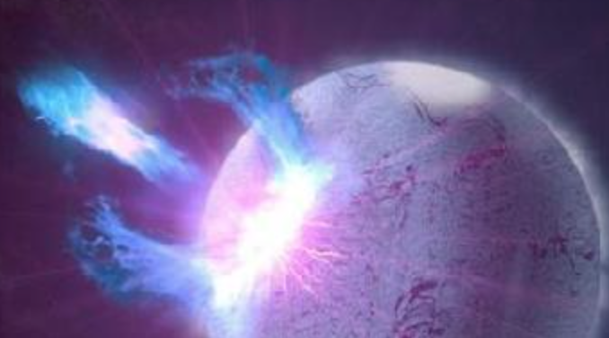




Spectra of FRBs: Magnetopheric emission and propagation
Weiyang Wang（王维扬）
University of Chinese Academy of Sciences
School of Astronomy and Space Science
2024.7 @Kunming

Slide 2
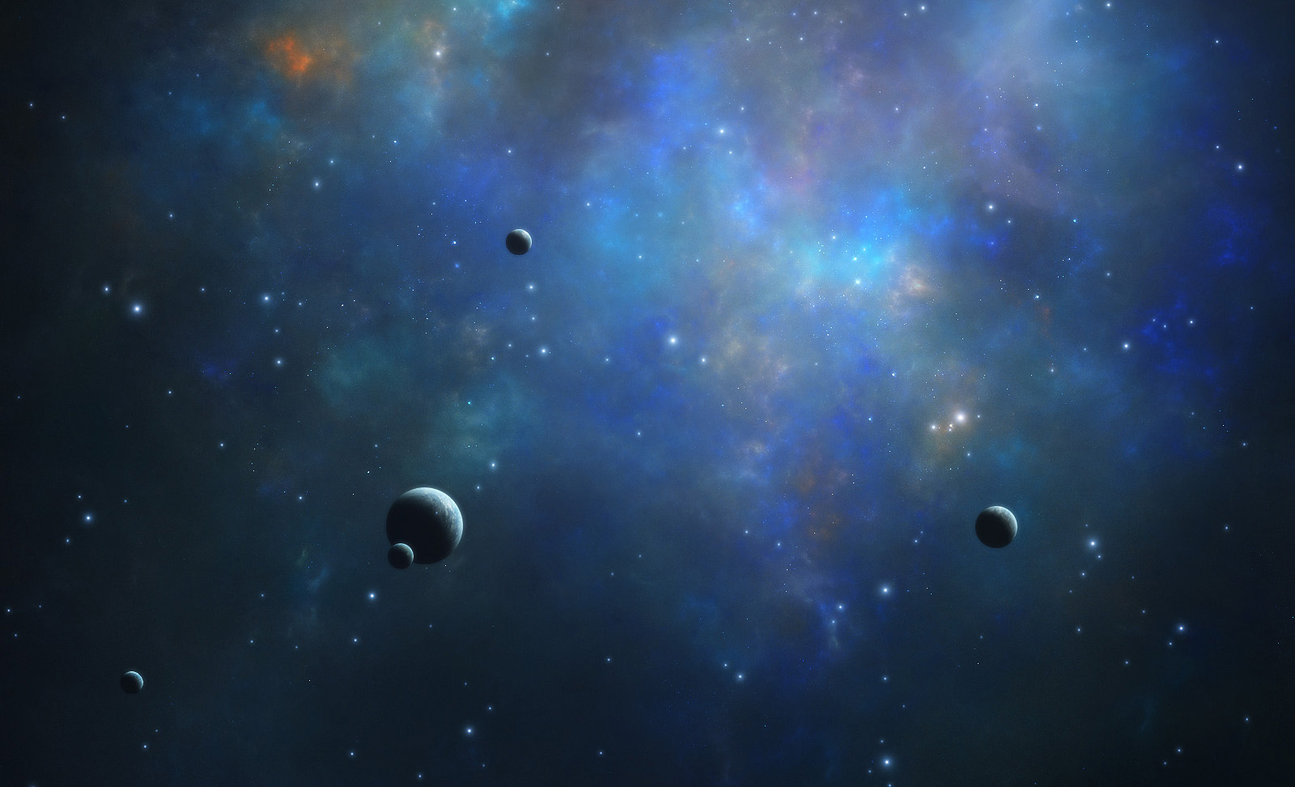


OUTLINES
Background
Intrinsic mechanism
Propagation effect
Summary

Slide 3
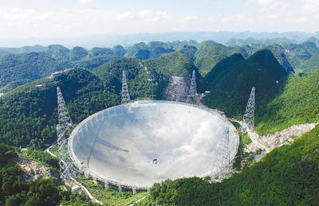
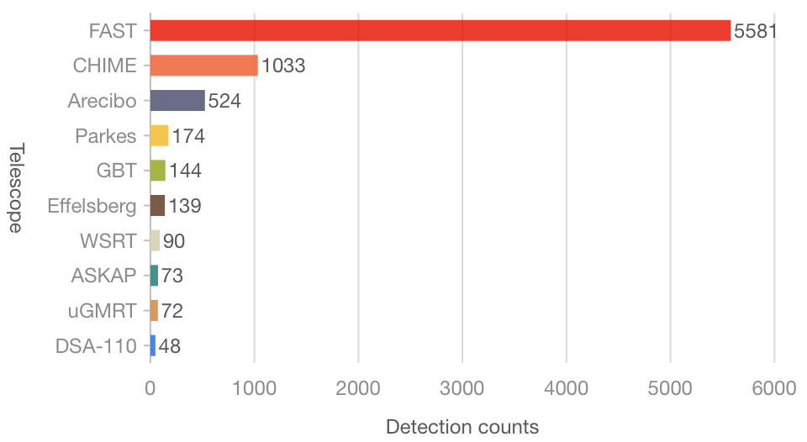
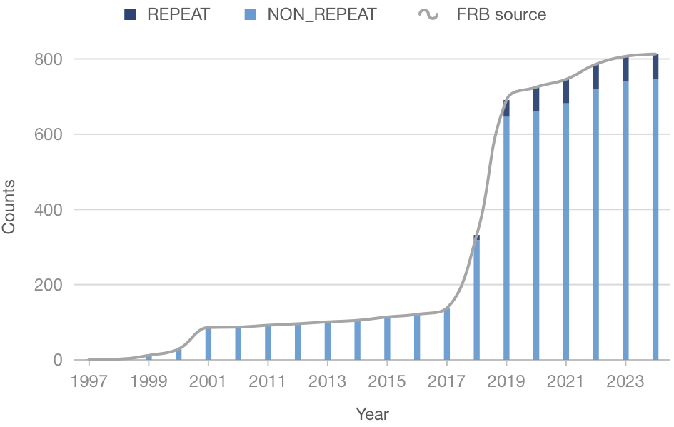
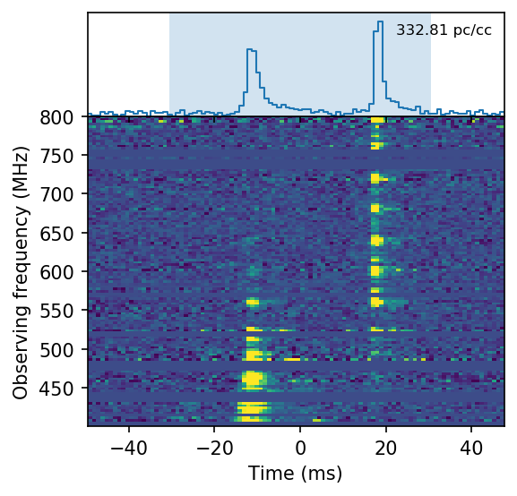
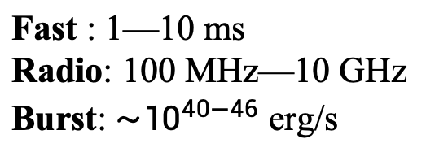
Discovery
Fast : 1—10 ms
Radio: 100 MHz—10 GHz
Burst: ${\sim 10}^{40−46}$ erg/s
800+ FRB sources
60+ repeaters
One is Galactic magnetar
CHIME et al. 2020, Nature
Key questions:
How to trigger FRB?
What is the radiation mechanism?
FRB-like Burst from SGR J1935+2154

Slide 4
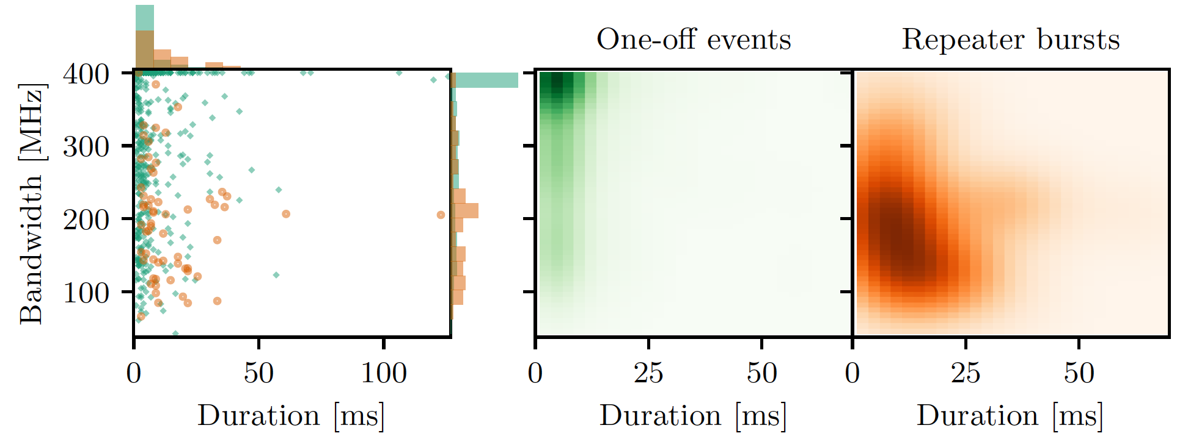
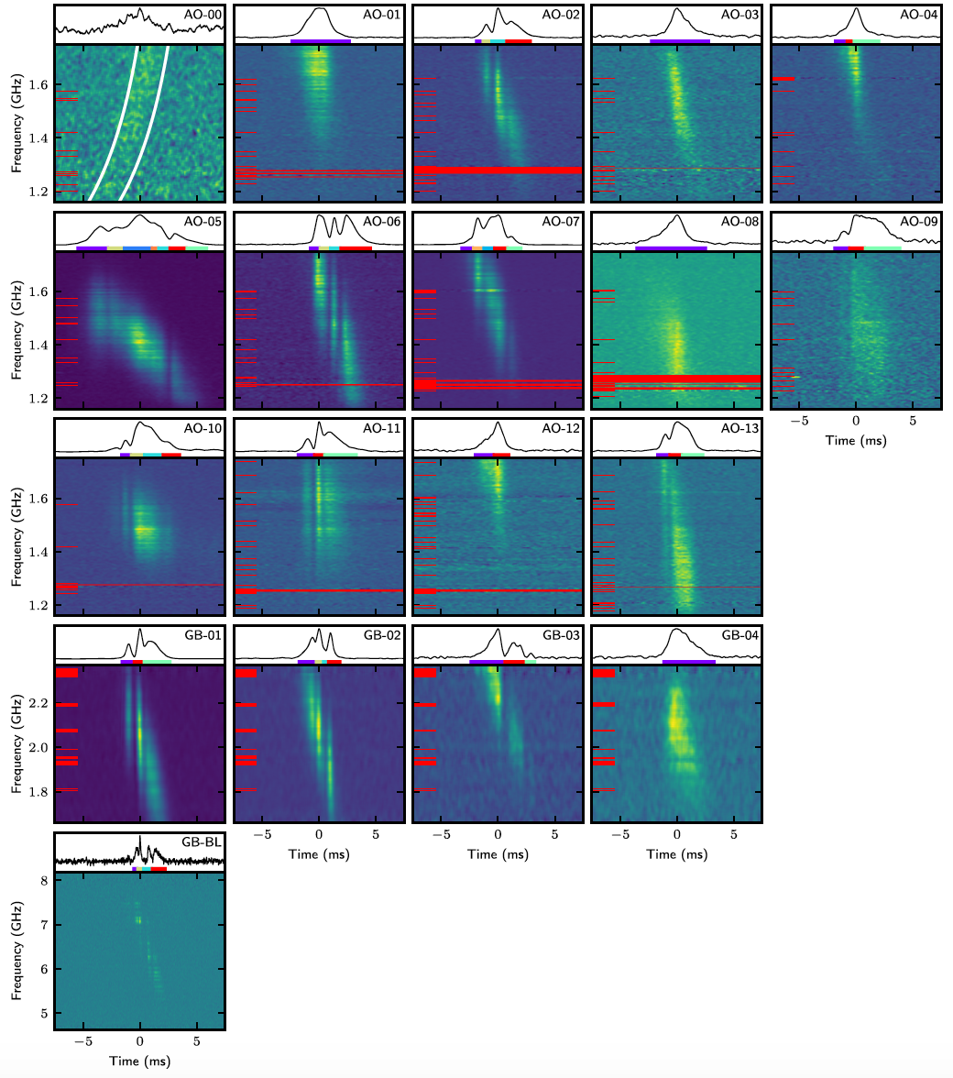
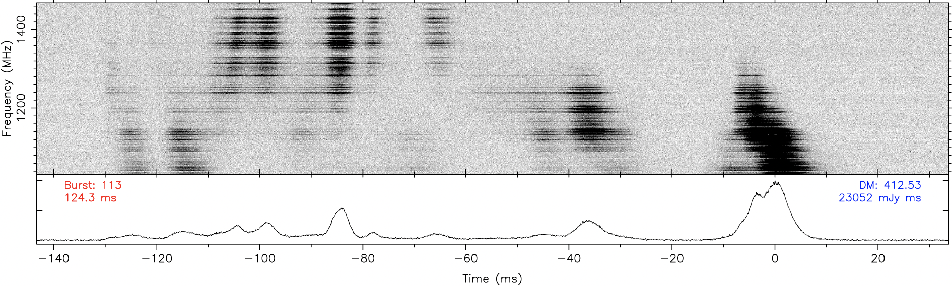
Narrow band drift
Repeaters prefer to narrow spectra
Plenuis et al. 2021, ApJ
Zhou et al. 2022, RAA
Structures: Downward/upward drifting, complex structure, and no drifting pattern
Hessels et al. 2019, ApJ

Slide 5
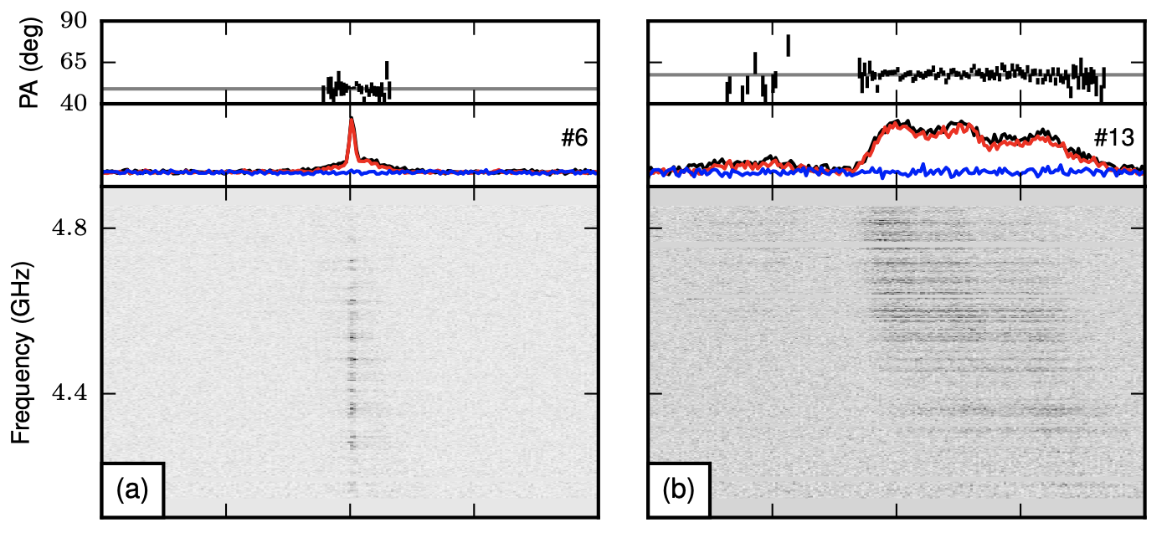
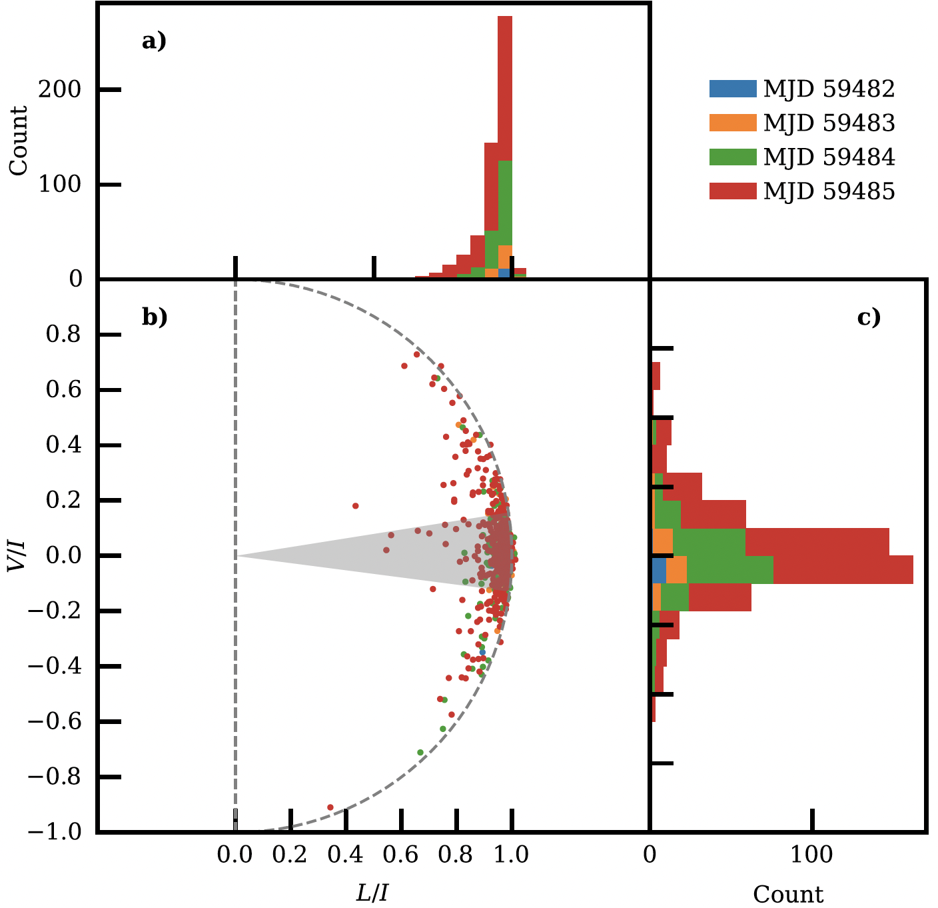
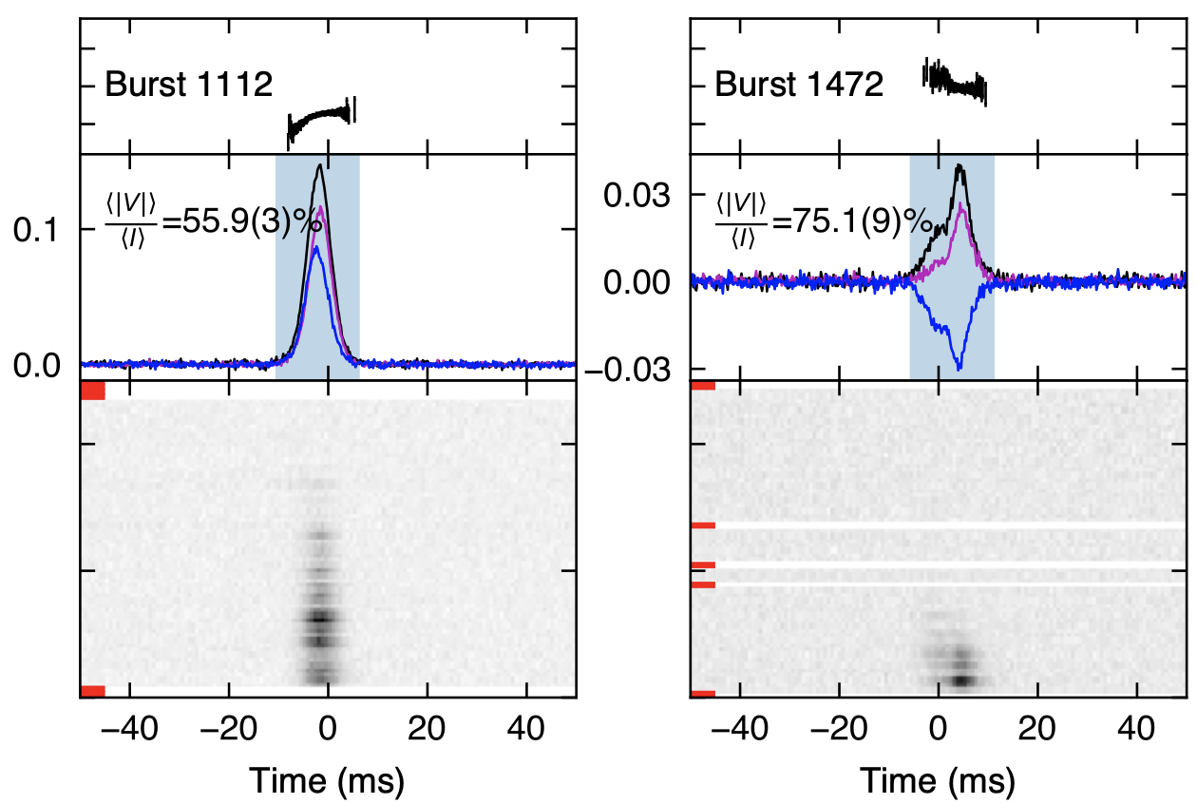
Polarization of FRB
Linear polarization (LP)
Circular polarization (CP)
Most FRBs are dominated by LP, but there are some of them dominated by CP.
Jiang et al. 2022, RAA
FRB 20121102A
Michilli et al. 2018, Nature
FRB 20201124A
Xu et al. 2022, Nature

Slide 6
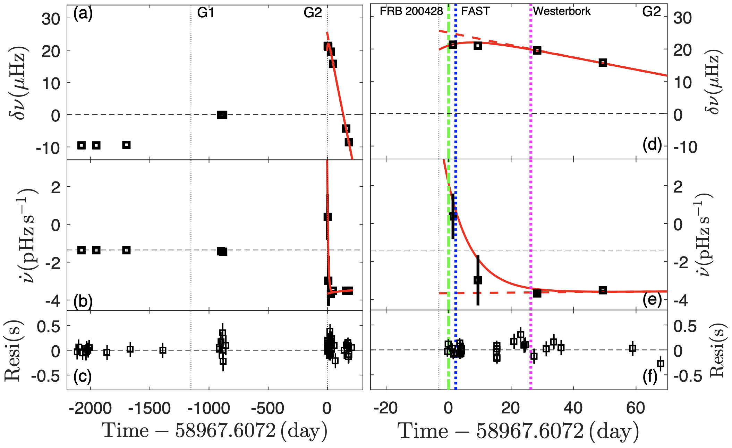
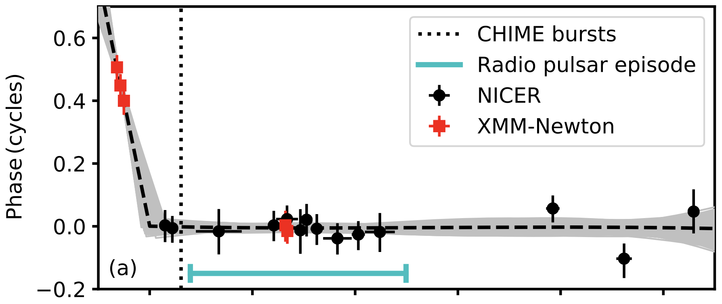
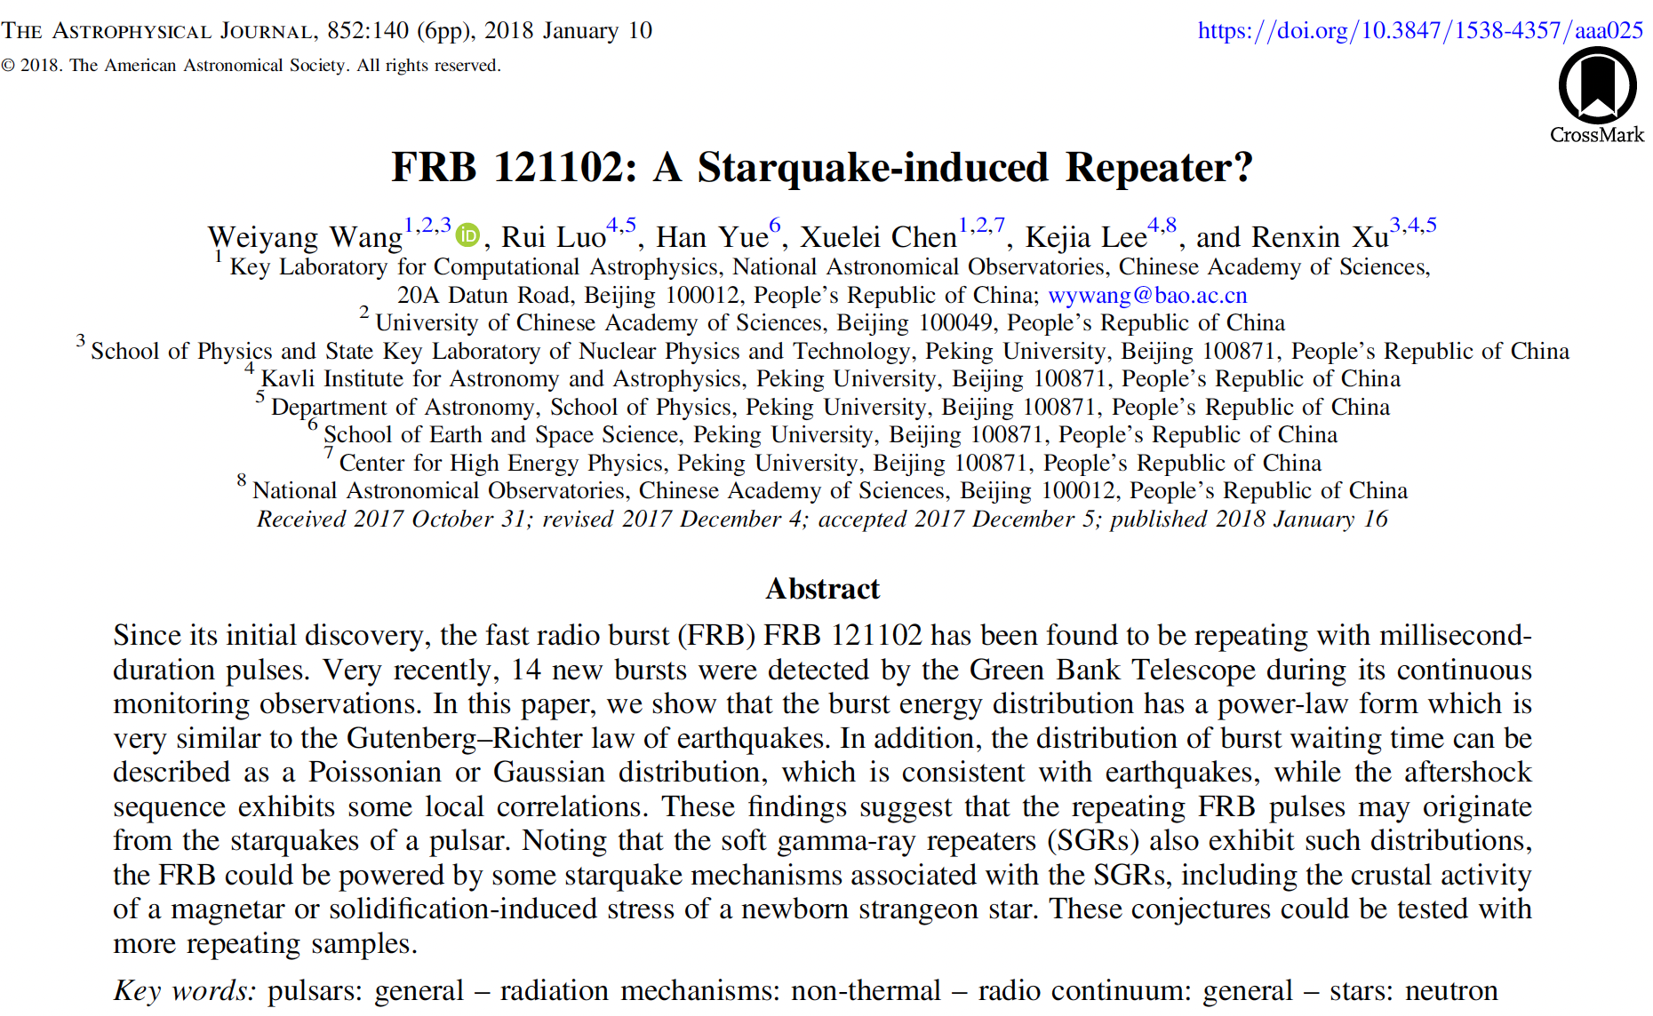
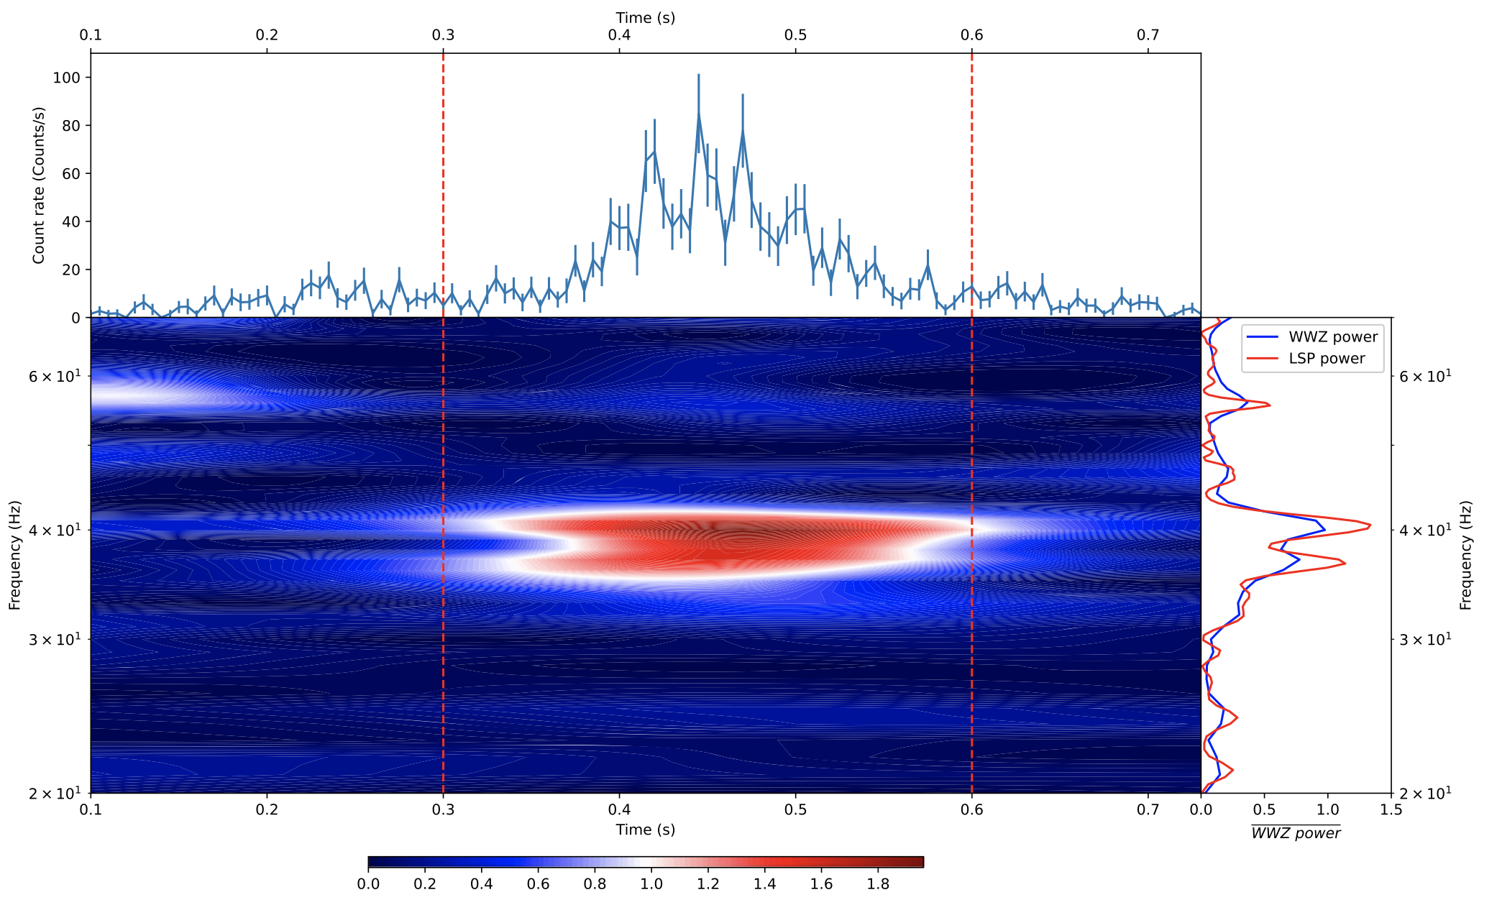
Starquake in SGR J1935+2154
Glitches before FRBs
Younes et al. 2022, NA
Ge et al. 2022, arXiv:2211.03246
QPO of SGR J1935+2154
Li et al. 2022, ApJ
Wang et al. 2018, ApJ
Notes:
Only downward drift…
The propagation effect is challenged by why such structures are favored in repeaters.

Slide 7
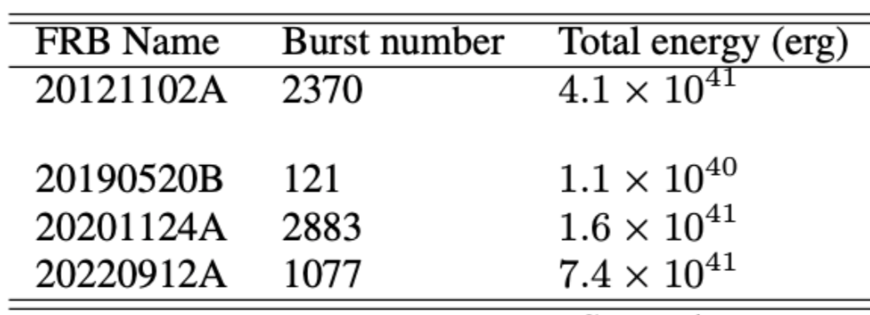

Energy budget and conversion
Rotational energy
Needs a long waiting time
Spindown power
Bulk variable before glitch
A massive star with stiff EOS
Magnetic energy
Strain energy
Gravitational energy
Magnetic reconnection
Alfvén wave ejecta
$B>{10}^{16}$ G toroidal field is required
Kinetic energy of oscillation
Internal energy
Kinetic energy of charges
Considering the beam factor, duty cycle, and efficiency, the total energy budget is at least 10⁴⁶ erg.
FRB Radiation
Wang et al. arXiv: 2405.07152

Slide 8
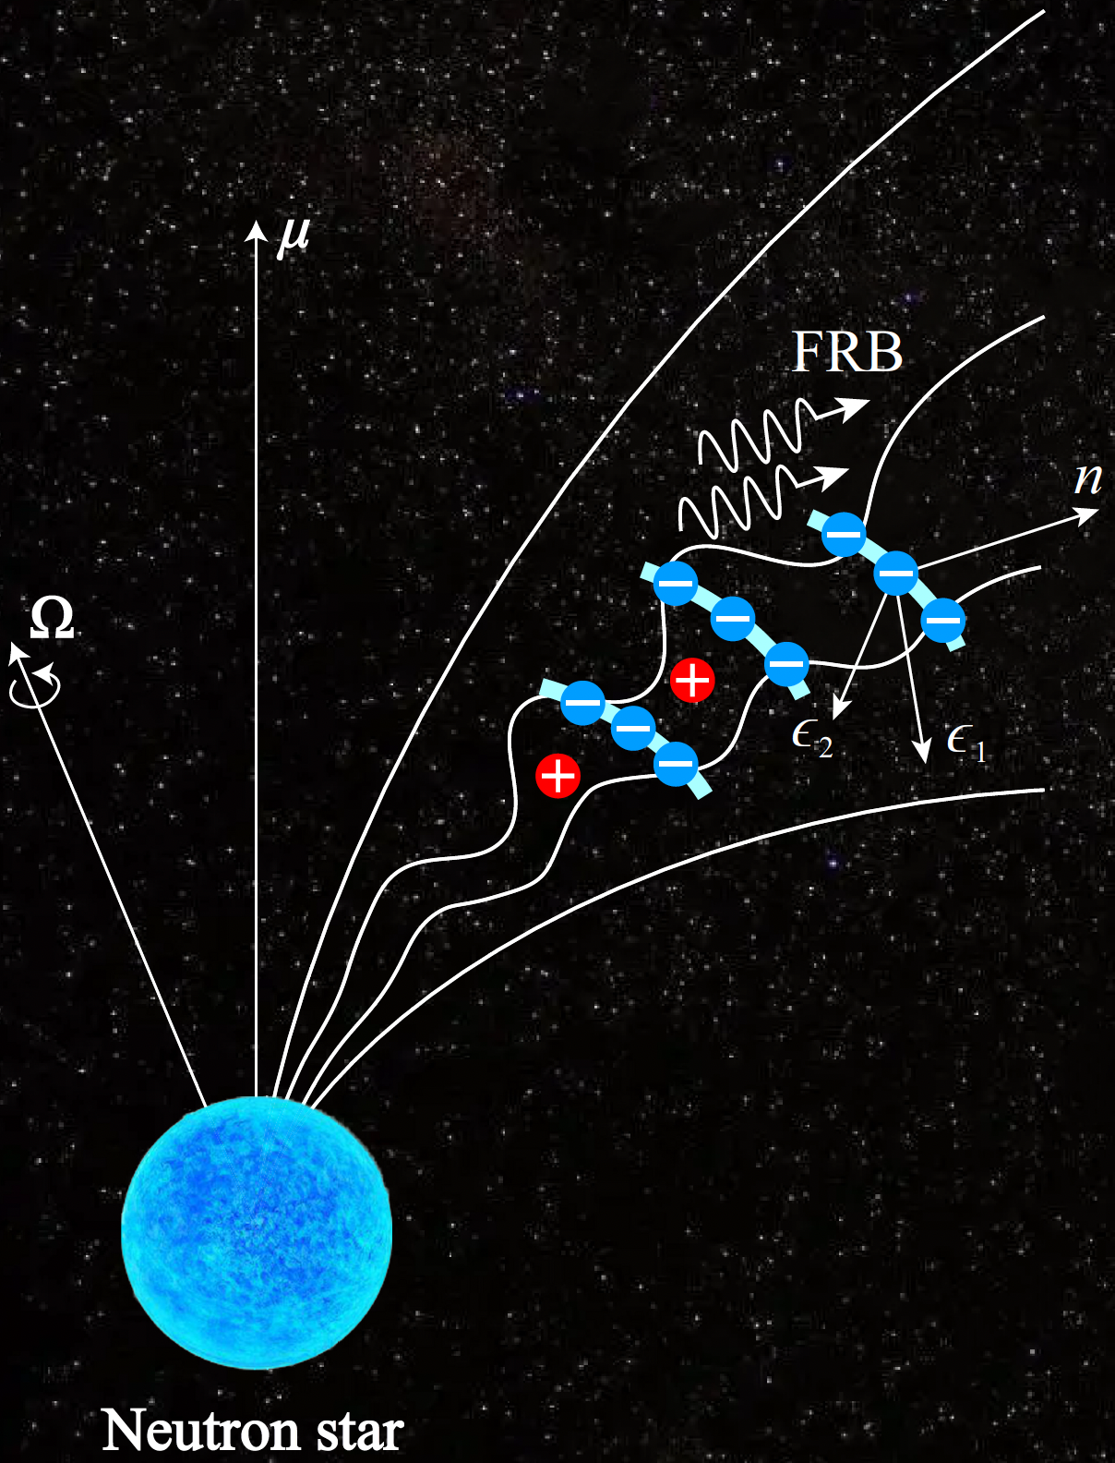

Relativistic charge radiation
Relativistic charges’ emission prefers:
High luminosities
2. Polarization
$$N electrons\left\{\begin{aligned}N_{e} \text{in} \text{bunches}\text{ (}\text{coherent}\text{) } \\ N_{B} \text{bun}\text{ch}\text{es}\text{ (}\text{adding} \text{incoherently}\text{) }\end{aligned}\right.$$
$$ℒ_{iso}≈γ^{4}N_{B}N_{e}^{2}\frac{2e^{2}γ^{4}c}{3ρ^{2}}$$
An $E_{||}$ is required to sustain the radiation
Charged Bunches
Wang et al. 2022, MNRAS
Off-beam
On-beam
Off-beam

Slide 9
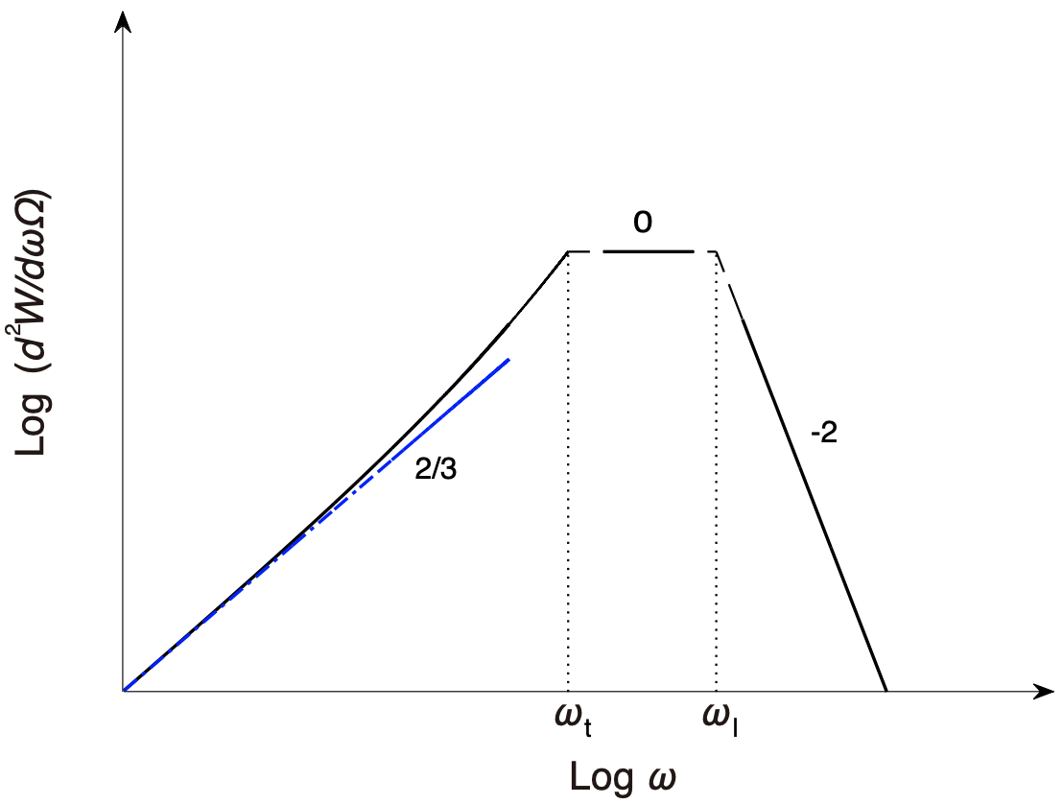
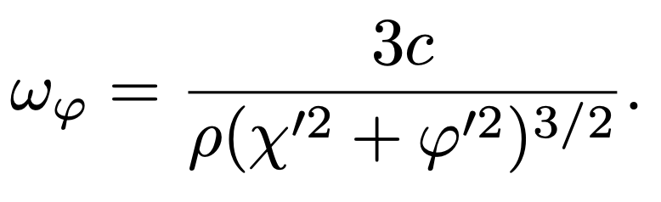
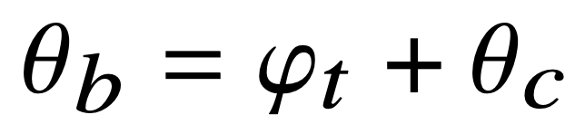
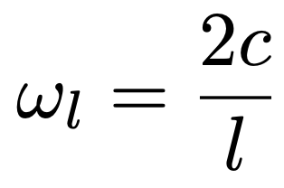
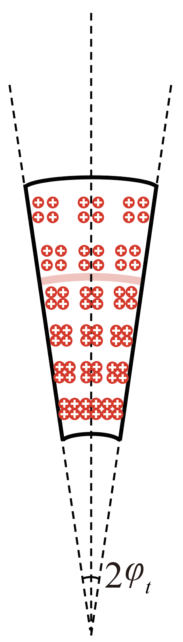
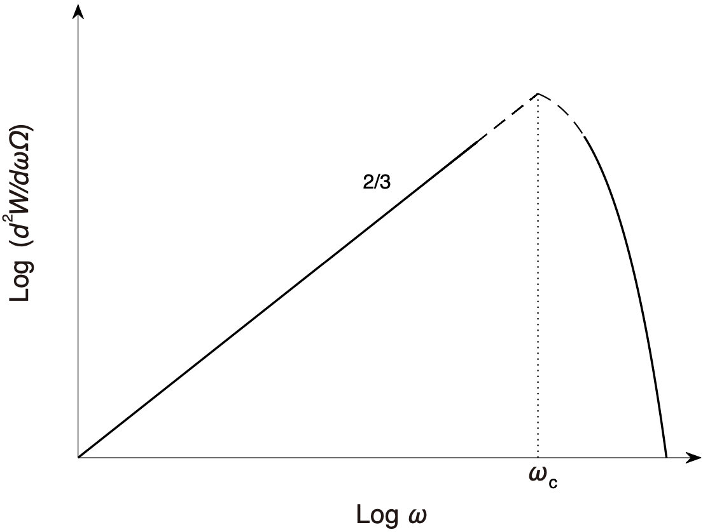

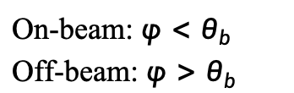


Spectral evolution
Off-beam: $φ>θ_{b}$
On-beam: $φ<θ_{b}$
Off-beam: $φ>θ_{b}$
$$ω_{c}=3cγ^{3}/2ρ$$
On-beam: $φ<θ_{b}$
Off-beam: $φ>θ_{b}$
Wang et al. 2022, ApJ
Notes:
Characteristic
Critical frequency for curvature radiation

Slide 10
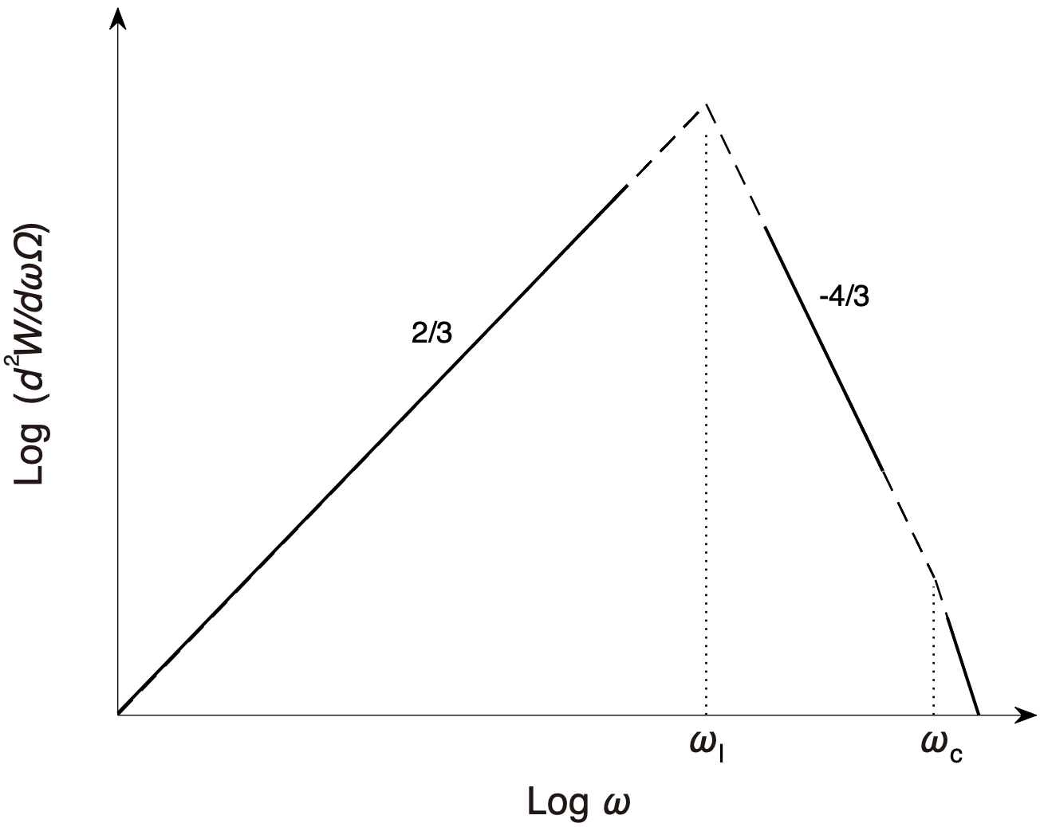
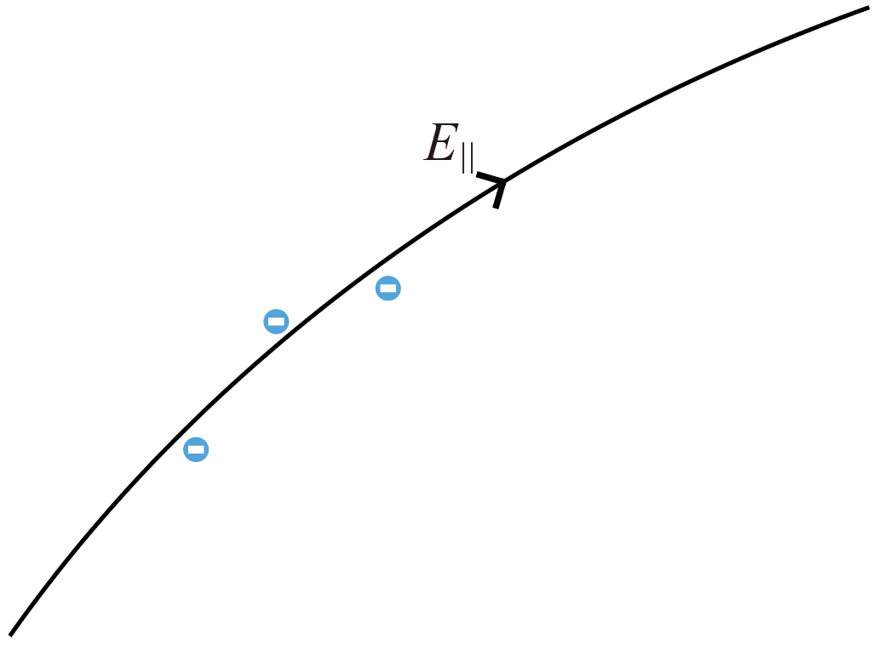

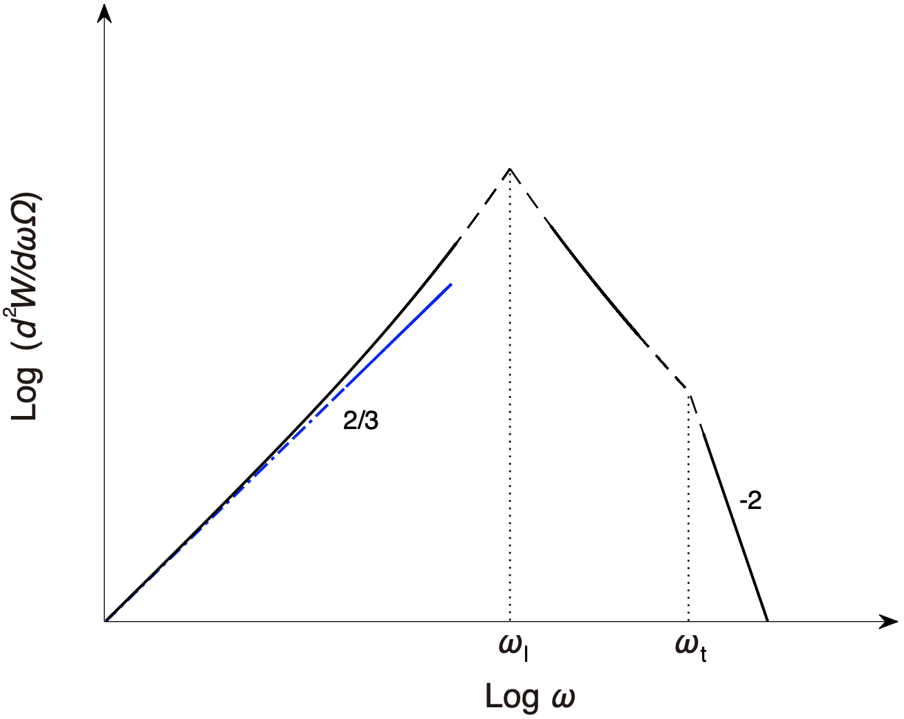
Spectral evolution
On-beam
Off-beam
Wang et al. 2022, ApJ

Slide 11
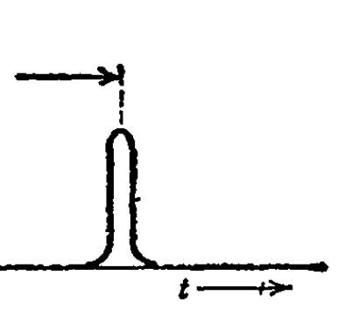
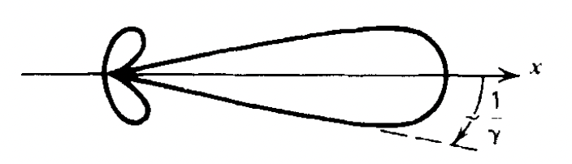
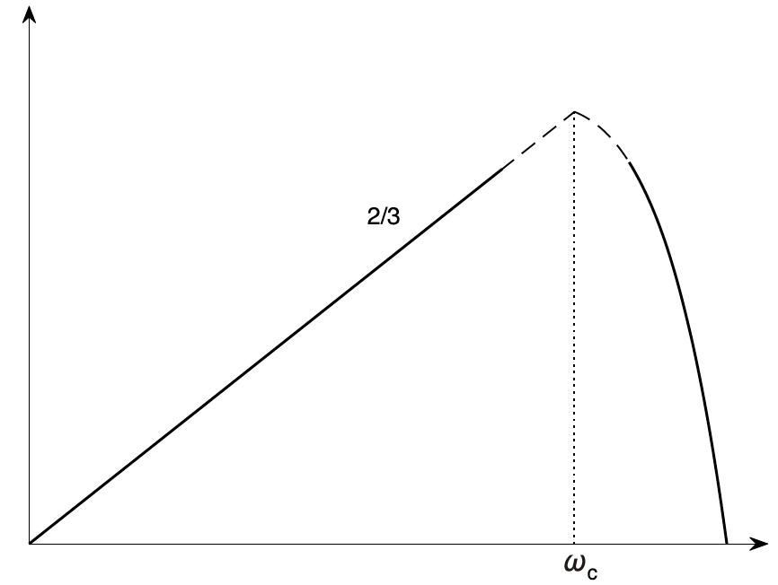
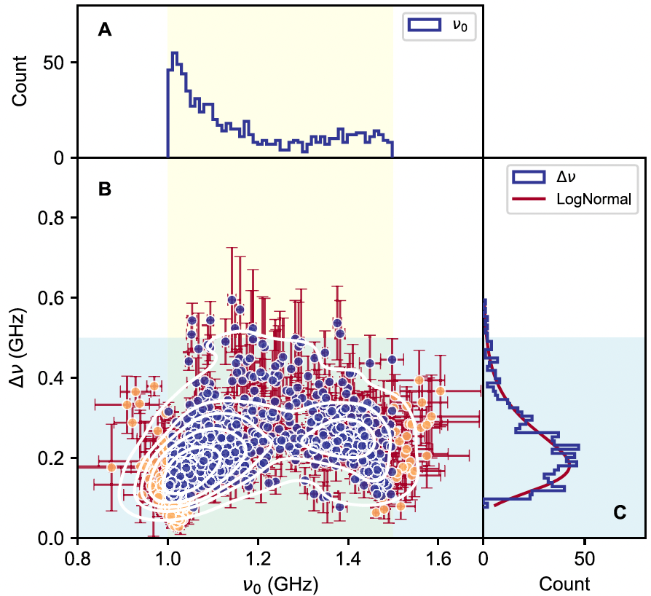
Temporal and spectral properties
Fourier transform
Beamed radiation
A wide-band emission
Wideband in log-log plot
The observed narrow band is 181 MHz for 1—1.5 GHz bands.
Bandwidth is independent with circular polarization
Zhang et al. 2023, ApJ

Slide 12
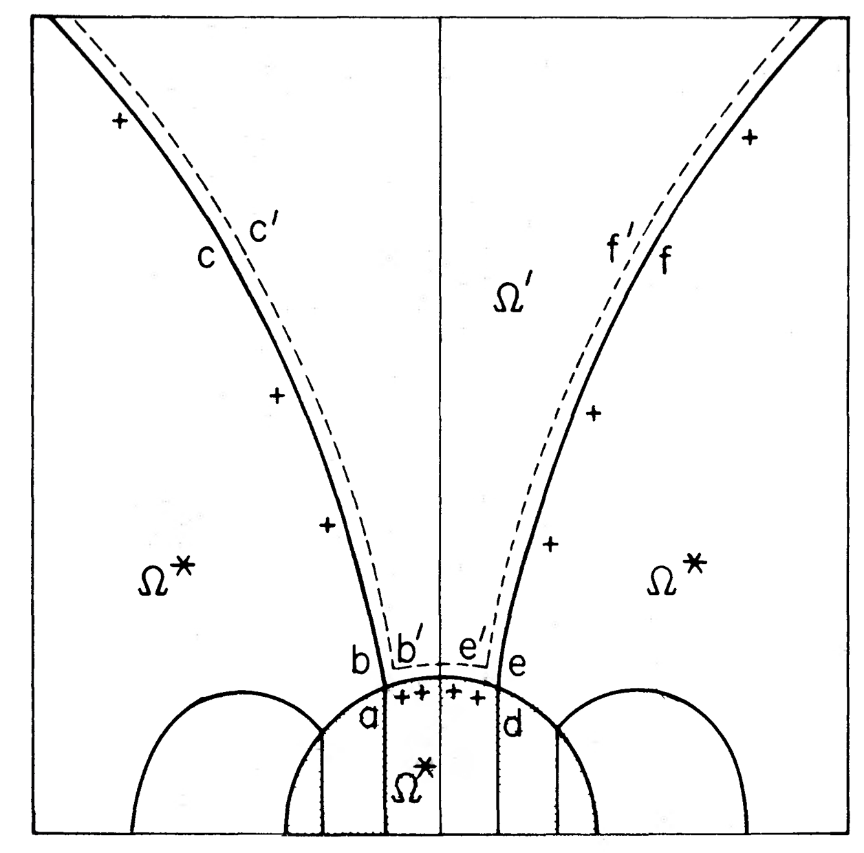
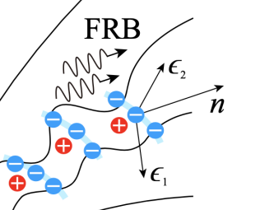
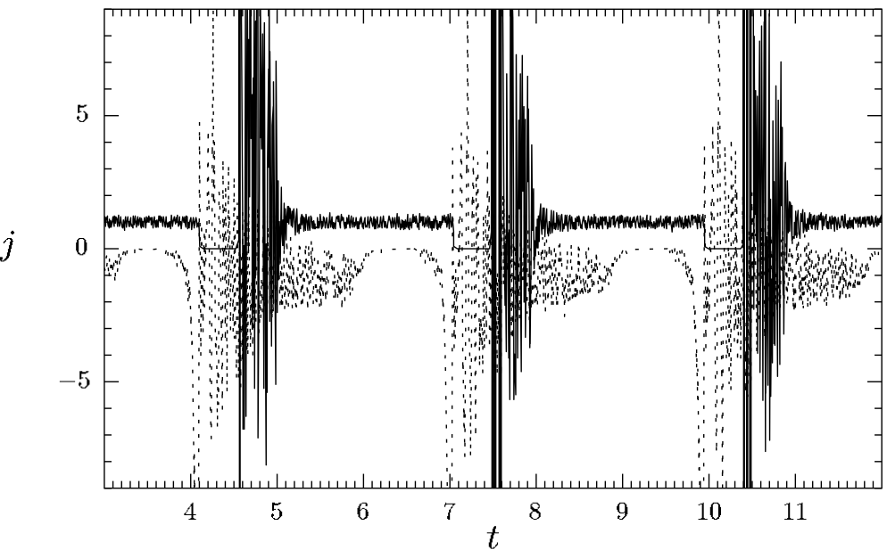
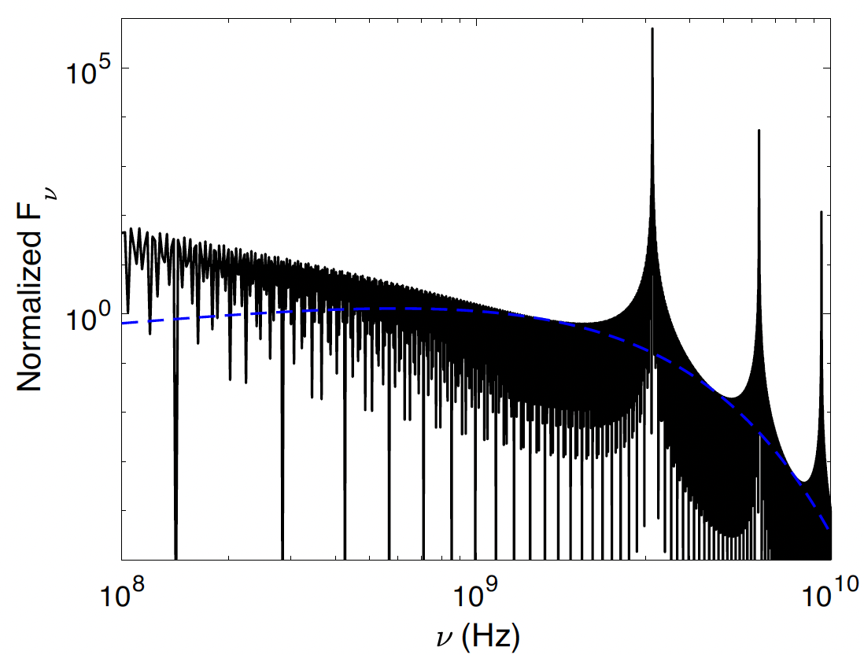
Bunch structure
Amount charges (screen E-field)
Stream outflow (sparking)
Amount charges (screen E-field)
If is is quasi-periodically distributed
Timokhin 2010, MNRAS
Quasi-periodically discharge in gap?
Wang et al. 2024, A&A

Slide 13
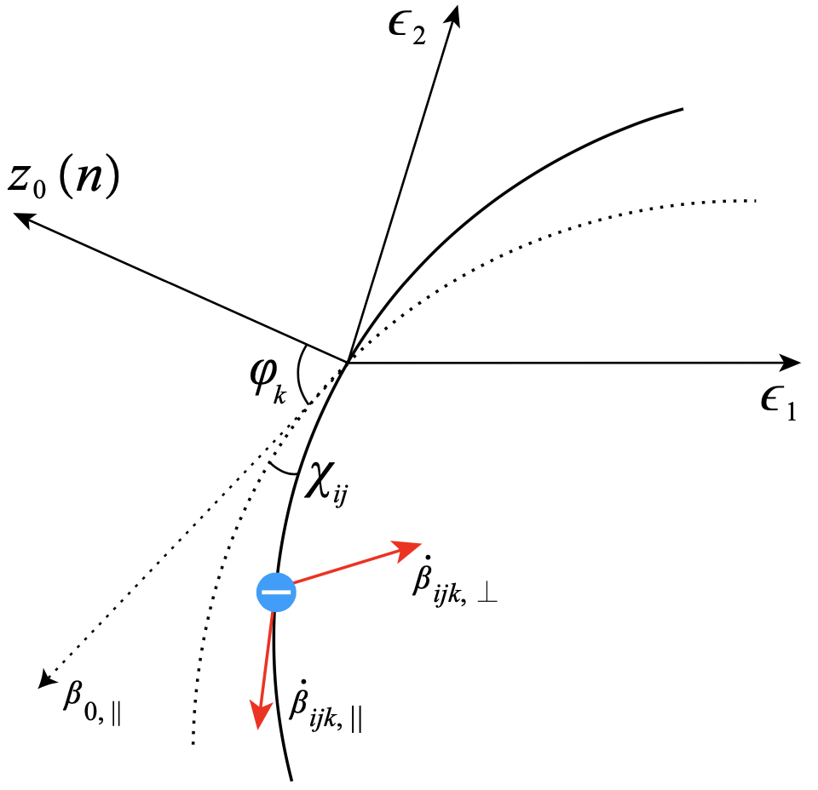
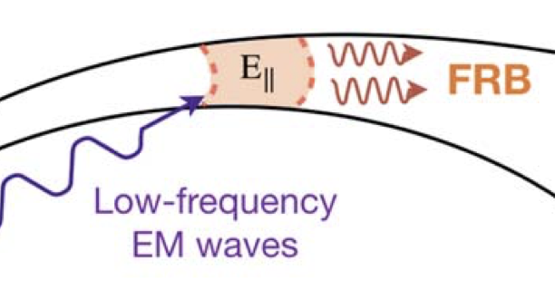
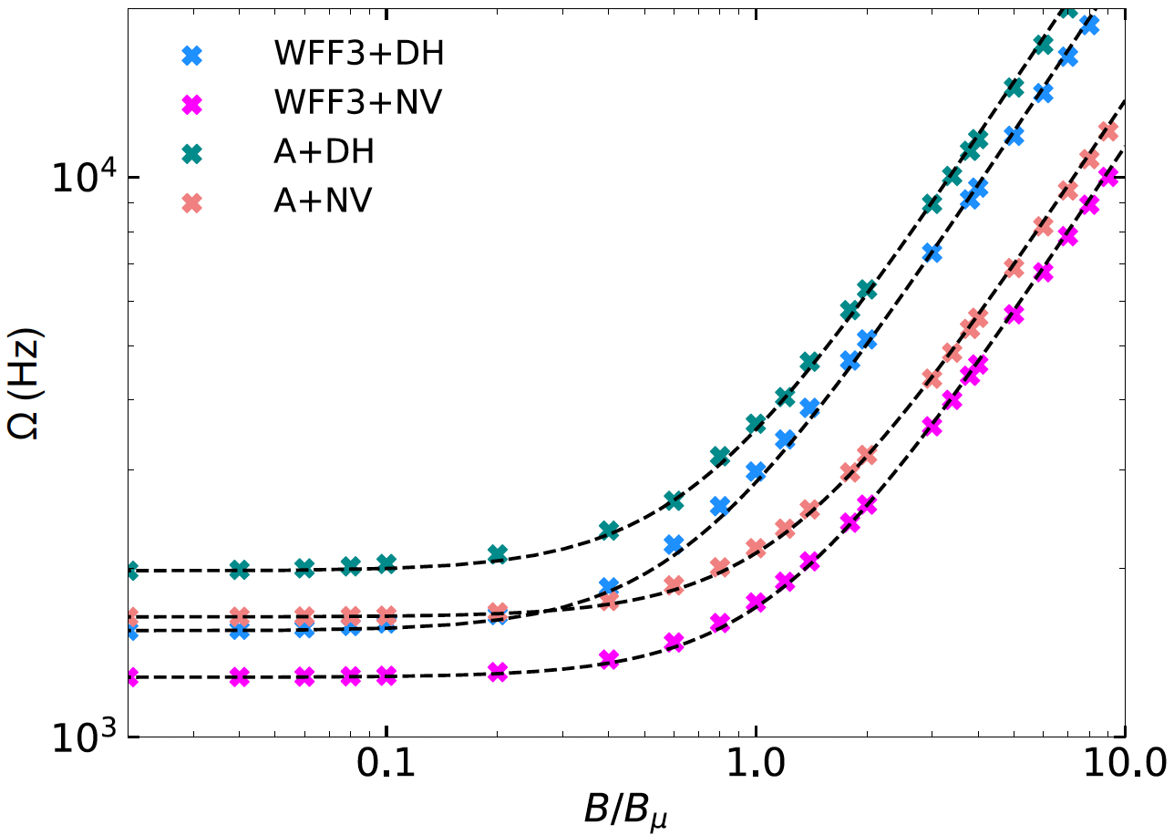
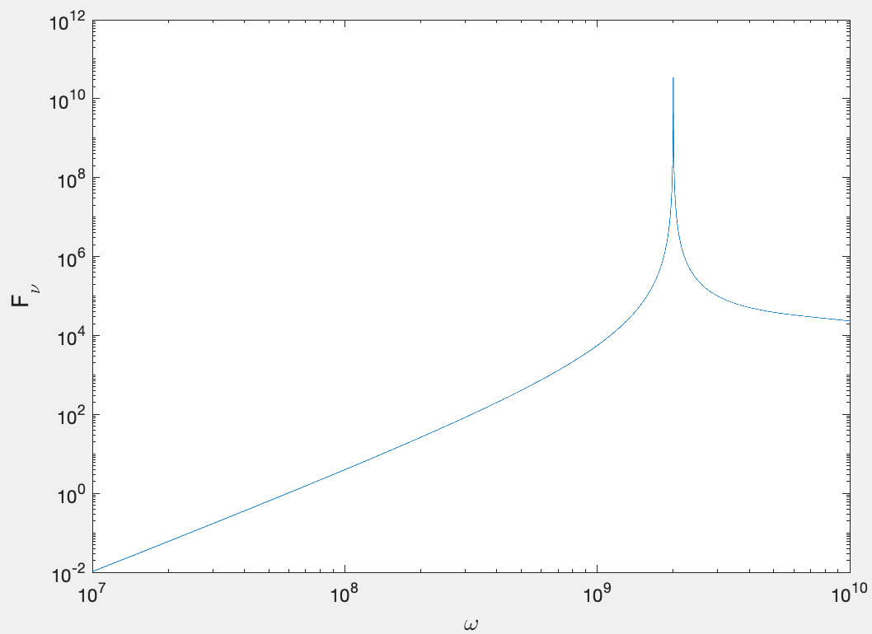
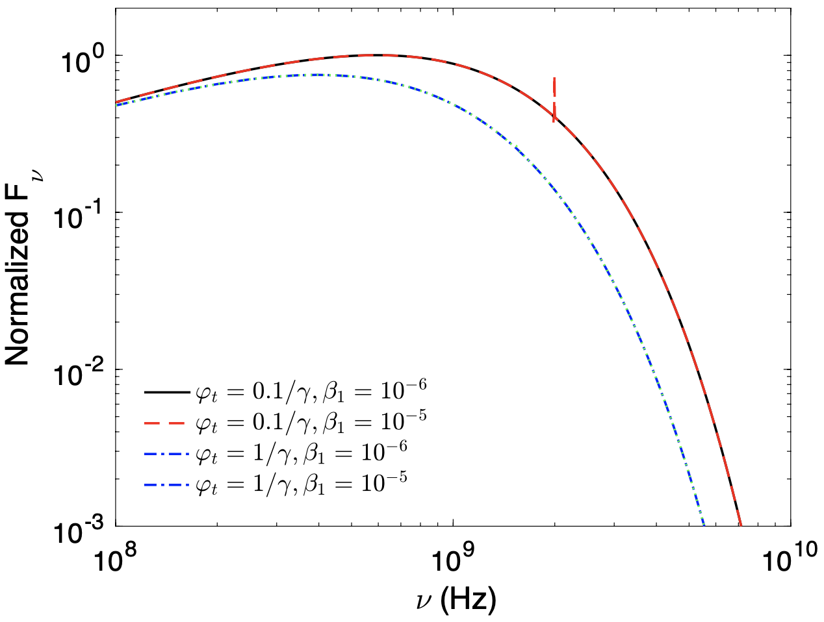
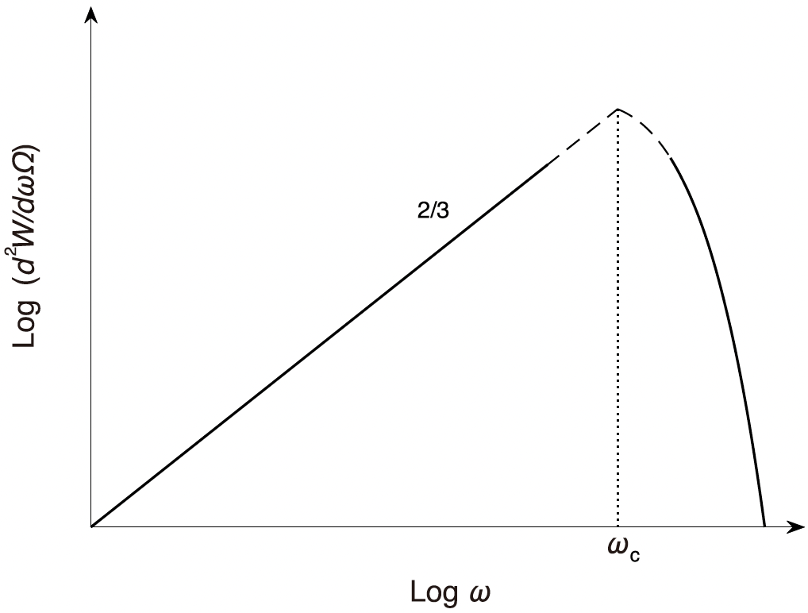
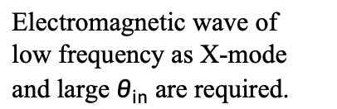
Perturbation on curved trajectory
ICS?
B Zhang’s talk
Electromagnetic wave of low frequency as X-mode and large $θ_{in}$ are required.
Alfvén wave can not generate a narrow spectrum at 100 MHz-10 GHz.
+
=

Slide 14
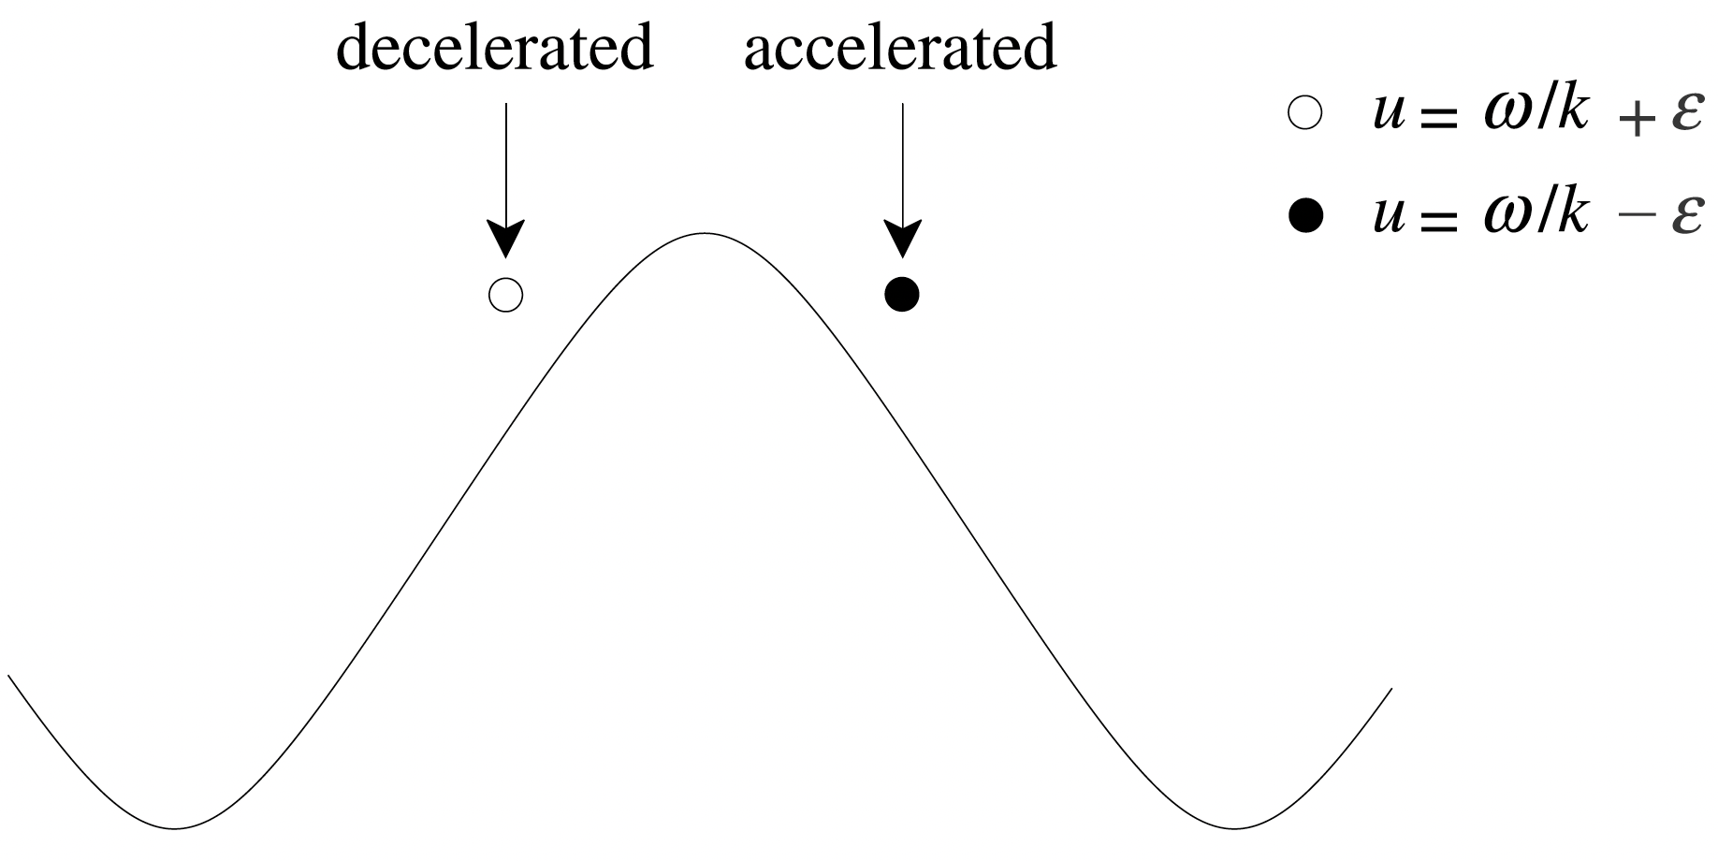




Landau Damping
Low frequency waves are absorbed significantly.
Spectra can become narrower.
O-mode: E in k-B plane
X-mode: E ⊥ k-B plane
Wave is faster
Particle accelerated
Wave damp
Landau damping only for subluminous O-mode
Superluminous O-mode has a low frequency cut-off
Wang et al. 2024, A&A

Slide 15

Self-absorption of CR
Spectral index is 5/3 at lower band
But can not as narrow as the observations
Wang et al. 2024, A&A

Slide 16

Summary
Thanks!
Narrow spectrum
Intrinsic: quasi-periodic bunch distribution and perturbation
Propagation: Landau damping and self-absorption
Starquake is the trigger
Variety polarization and drifting pattern
Magnetic and gravitational energy can match the required budget
Wang et al. 2019, ApJL; 2022, ApJ; 2022, MNRAS

