Slide 1
Quark-hadron mixed phase and the corresponding surface tension
SPSS2024&FPS13
2024年7月12-16日
arXiv: 2405.02946
Xia, Cheng-Jun (夏铖君)
Center for Gravitation and Cosmology,
Yangzhou University
Collaborators:
H.-M. Jin, T. Maruyama, G.-X. Peng, H. Shen, T.-T. Sun, H. Togashi, T. Tatsumi, and N. Yasutake
@ Yunnan University

Slide 2
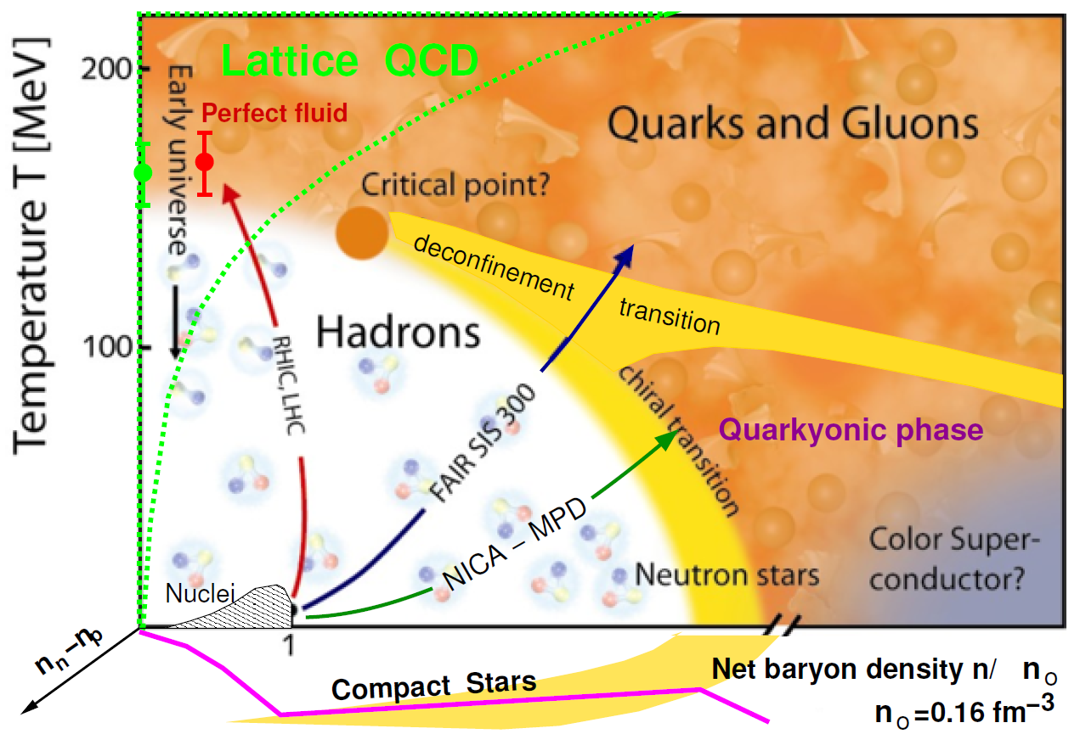
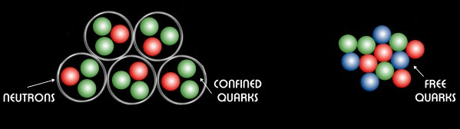
QCD Phase Diagram [McLerran2009_NPB195-275]
First-order/
Crossover?
Quark matter
First-order: Important interface effects (surface tension, curvature, quark depletion, ...)
background

Slide 3
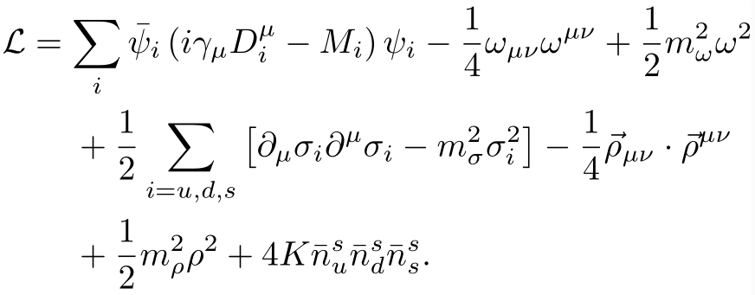
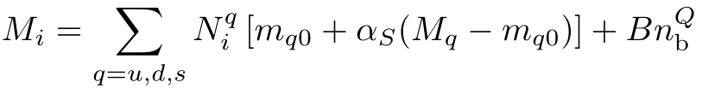
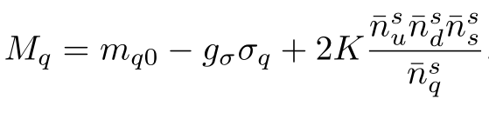
Extended NJL model
The Lagrangian density of an extended SU(3) NJL model:
Baryons:
Quarks:
Parameters RKH [Rehberg_Klevansky_Hüfner1996_PRC53-410]:
Λ = 602.3 MeV, m_{u0} = m_{d0} = 5.5 MeV, m_{s0} = 140.7 MeV, G_{S} = g_{σ}²/4m_{σ}² = 1.835/Λ² , K = 12.36/Λ⁵
unified Description

Slide 4

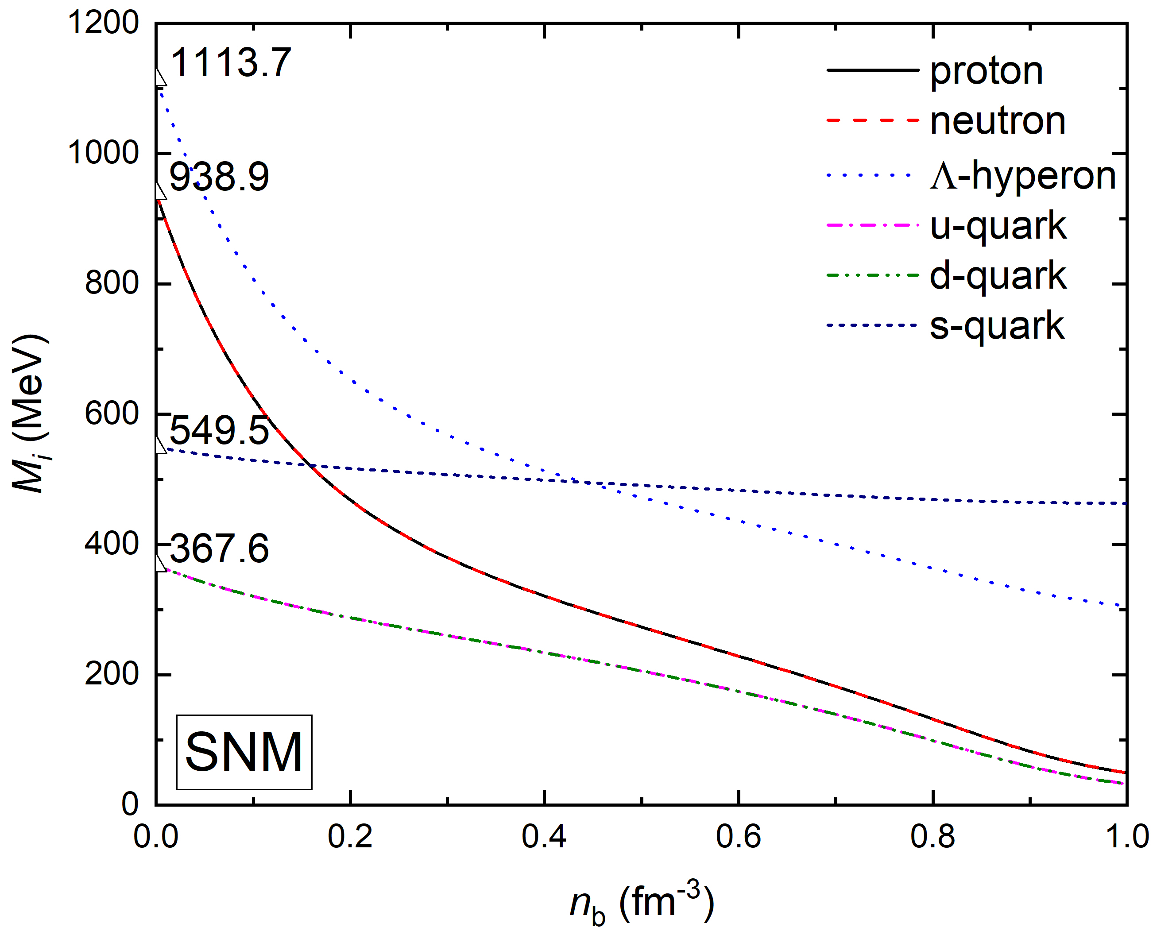
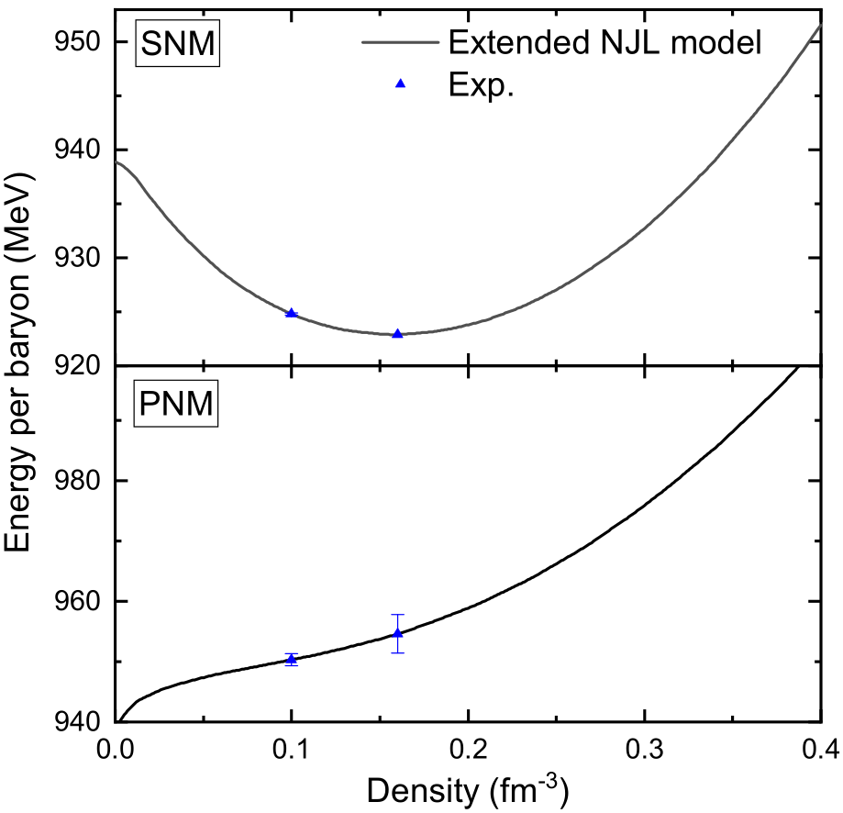
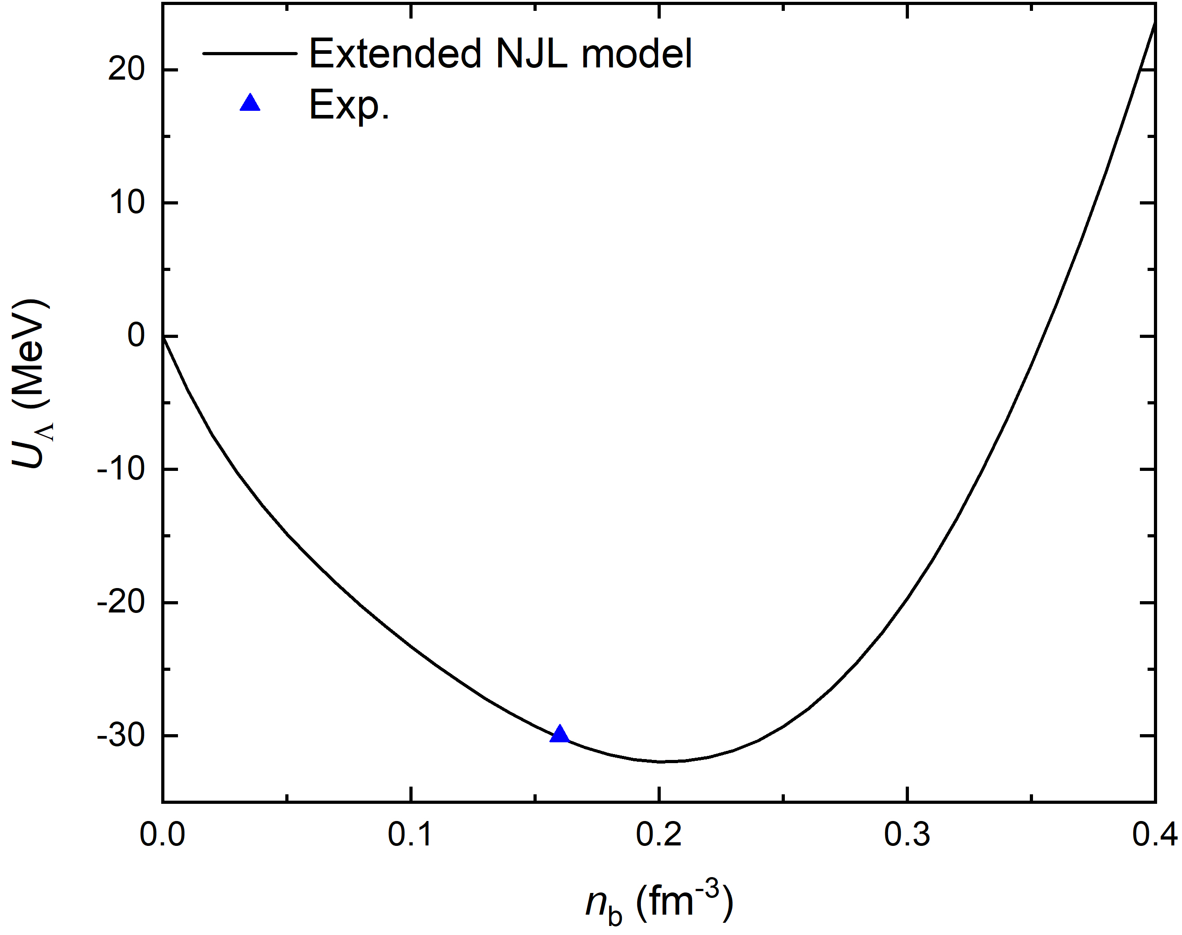
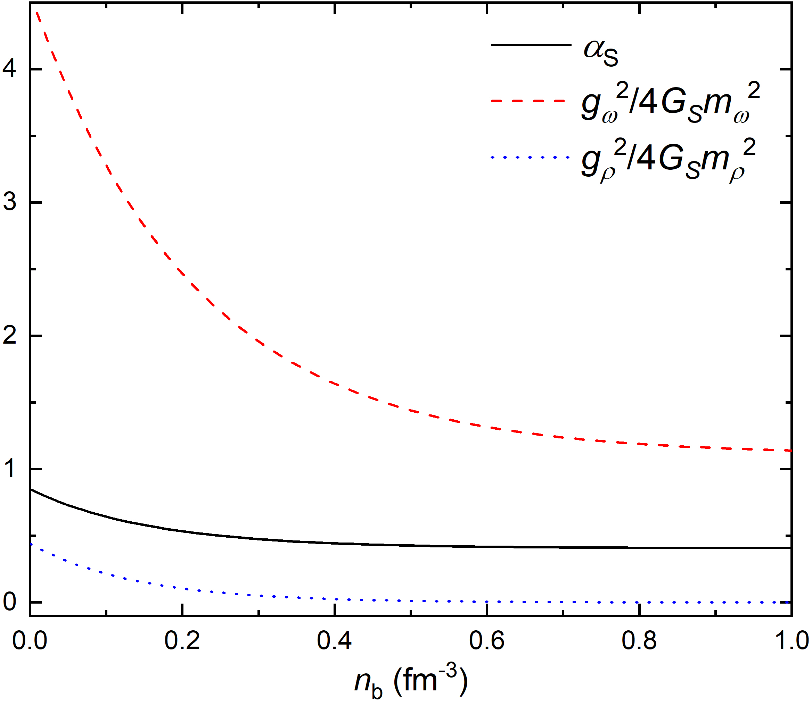



Coupling constants
unified Description

Slide 5
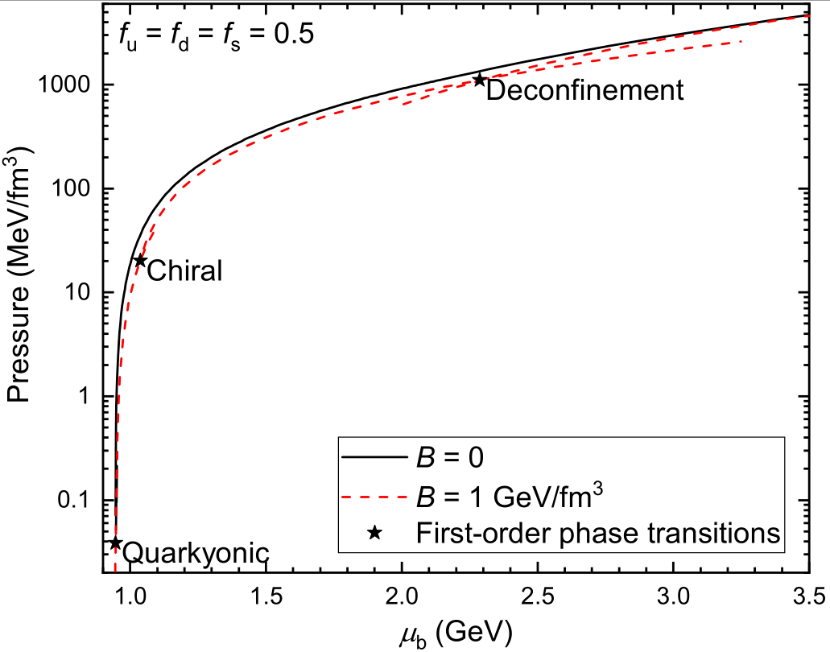
Phase transitions of NS matter
unified Description

Slide 6
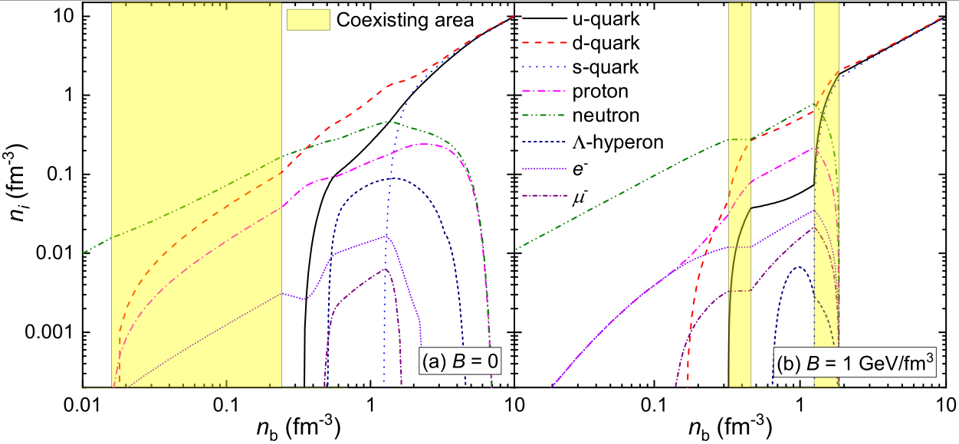
Particle fractions
first-order
third-order
Quarkyonic transition
unified Description

Slide 7
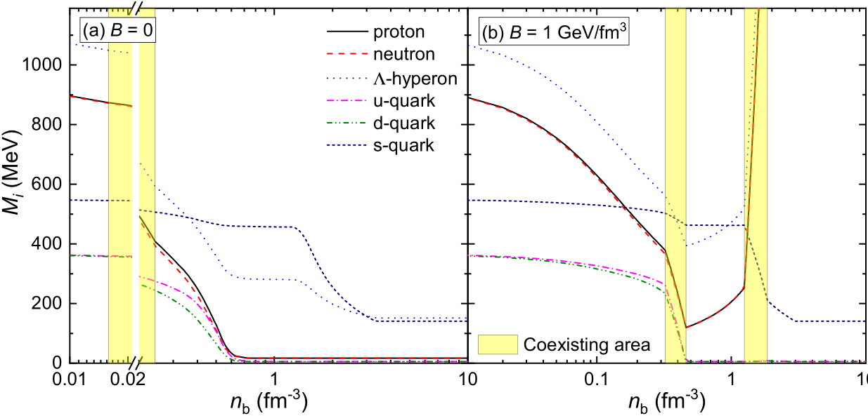
Masses
unified Description

Slide 8
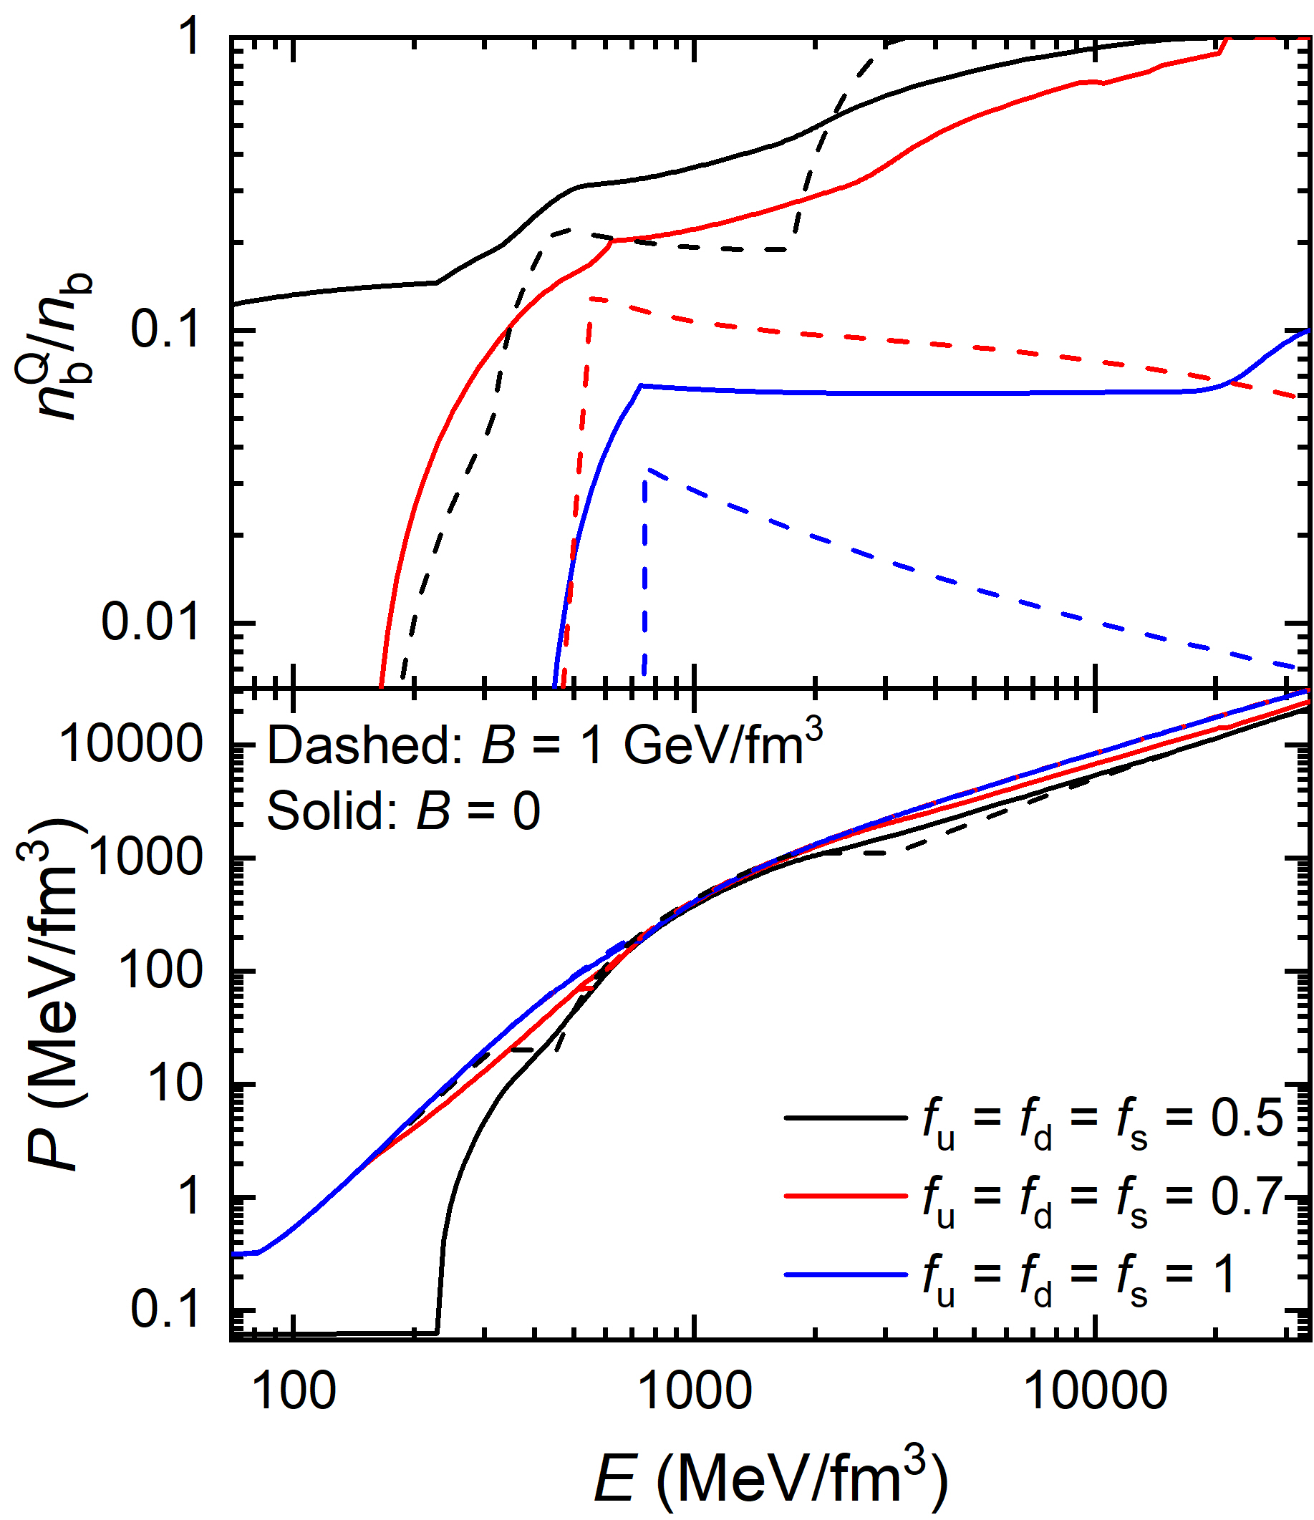
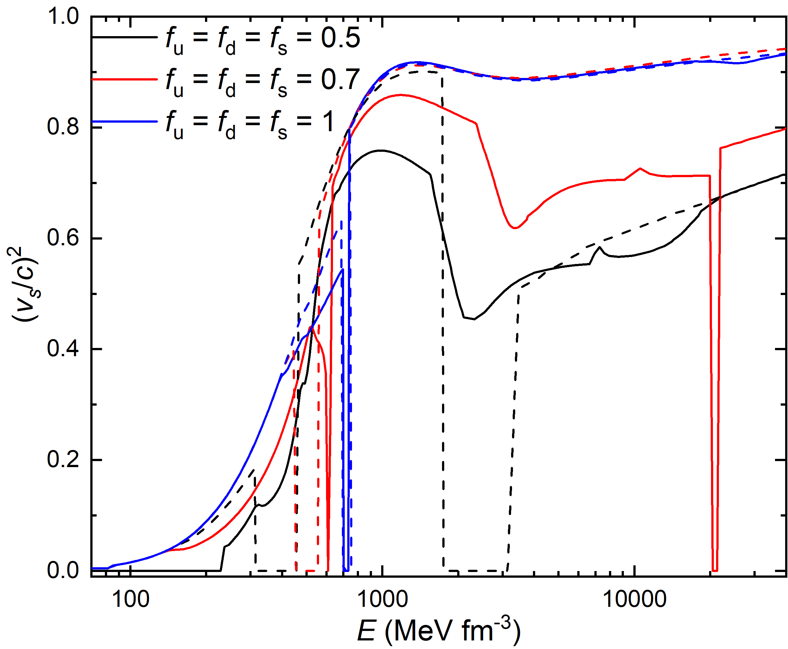
Equation of state
unified Description

Slide 9
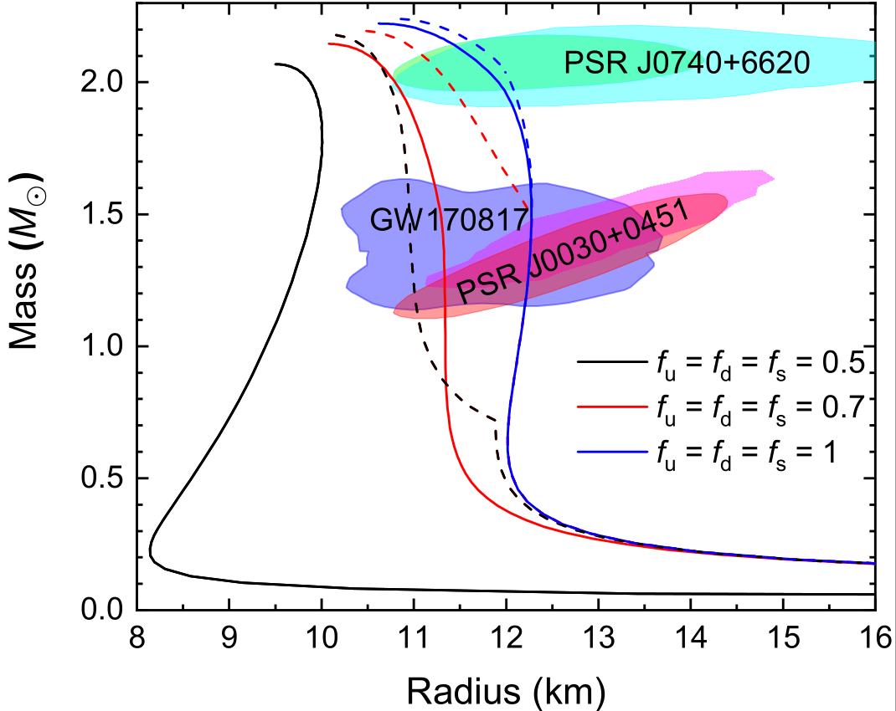
Mass-radius relations
unified Description

Slide 10
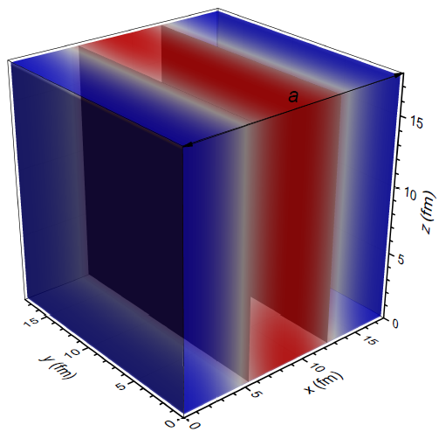
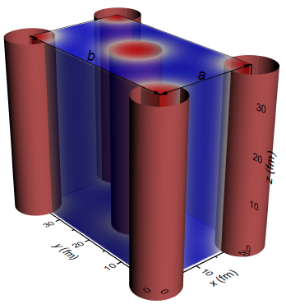
Nonuniform structure
The boson
Droplet/Bubbles in BCC and FCC lattices (D=3)
The boson
Slabs (D=1)
The boson
Rods/Tubes in simple and honeycomb configurations
(D=2)
(D=2)
Single nucleus
approximation：assume spherical and cylindrical shapes for Wigner-Seitz (WS) cells
unified Description
Notes:
To minimize the uncertainties on the nuclear matter structures, we estimate the EOSs and microscopic structures of nuclear matter by searching for the most stable configuration at fixed density, where nucleons and electrons move freely in a periodic unit cell.
SNA

Slide 11
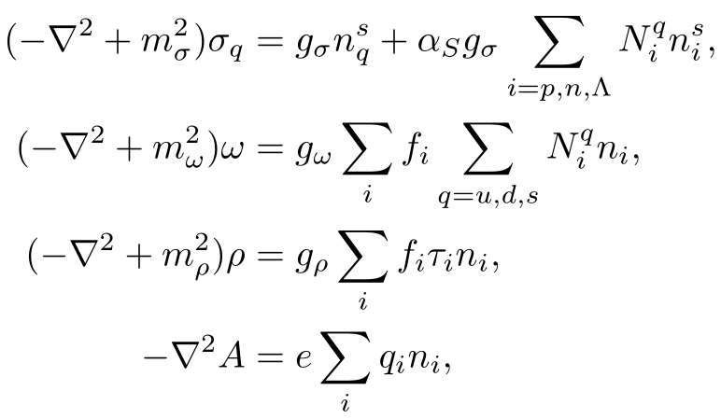
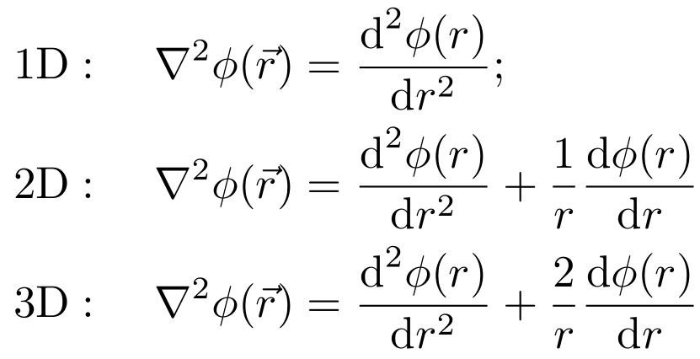
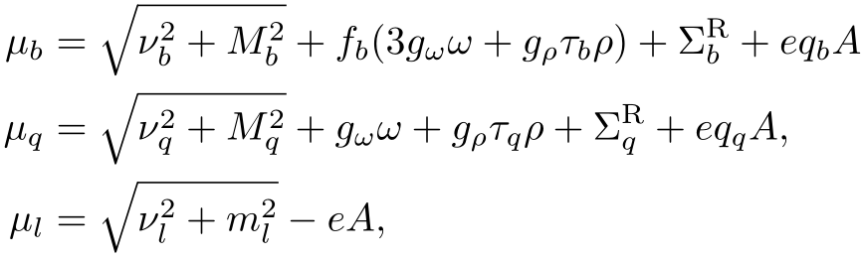

Numerical recipe
n_{b}
The boson fields and density profiles are solved iteratively inside a WS cell with discretized space coordinate, i.e.,
Assume initial density distributions of fermions at given total particle numbers;
Solve the boson field equations via fast cosine transformations (satisfy reflective boundary conditions) ;
Prepare the density distributions of fermions with the imaginary time step method [Levit1984_PLB139-147];
Go to step 2 until convergence is reached.
unified Description
Notes:
reflective boundary conditions at r = 0 and r = R W

Slide 12
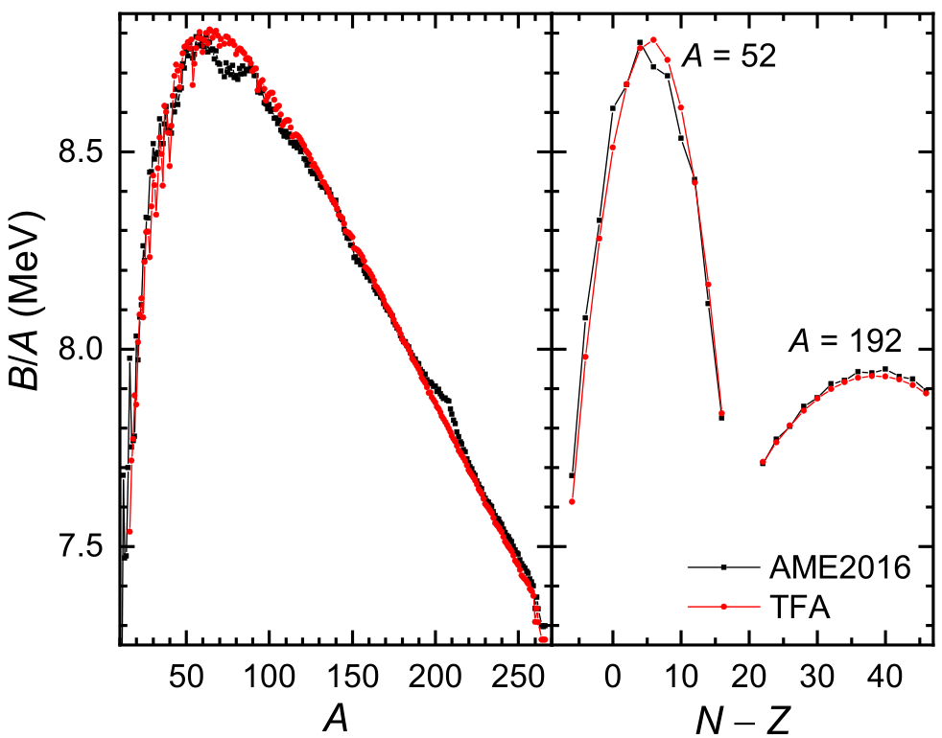
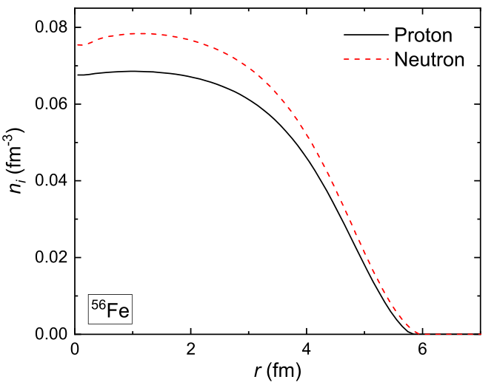
Finite nuclei
unified Description

Slide 13
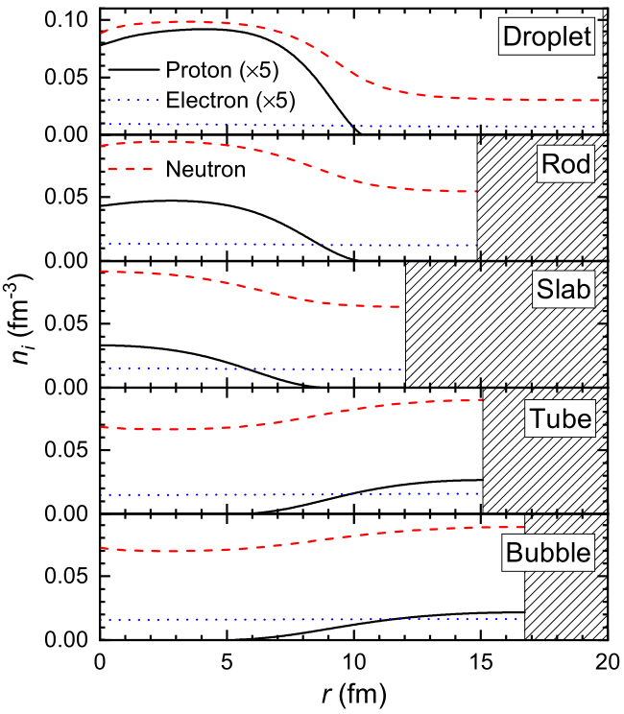

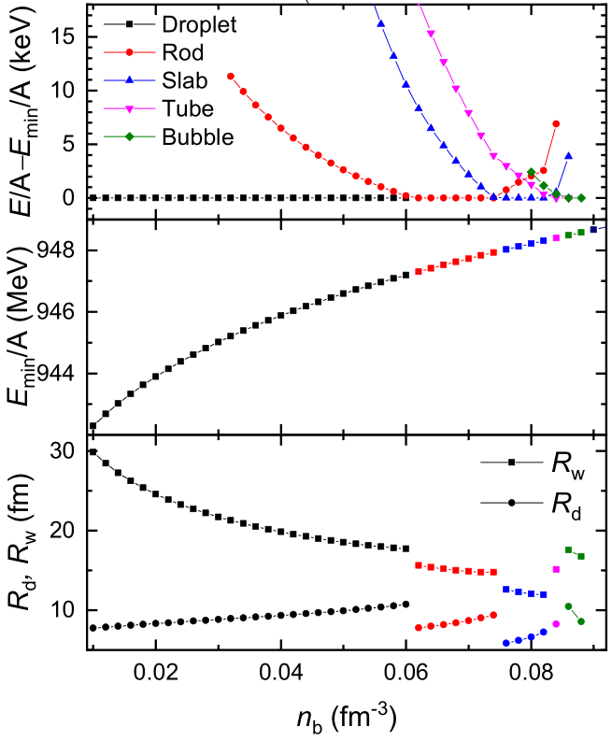




Nuclear pasta
unified Description
Notes:
电荷屏蔽效应
reflective boundary conditions at r = 0 and r = R W

Slide 14
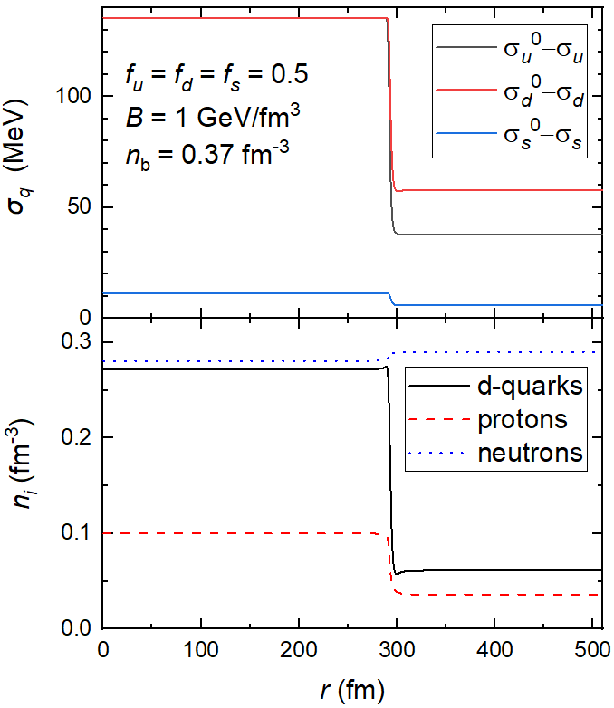
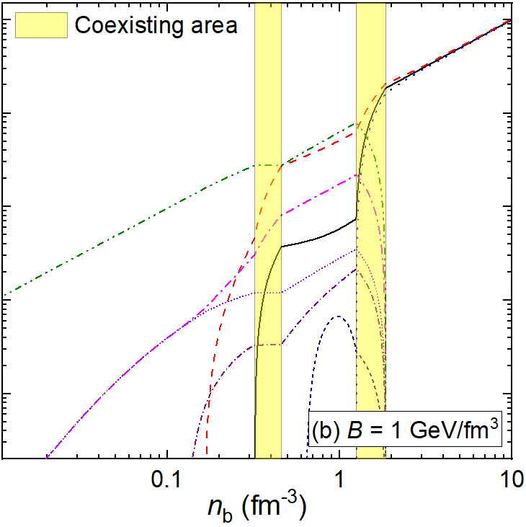
Chiral phase transition
unified Description

Slide 15
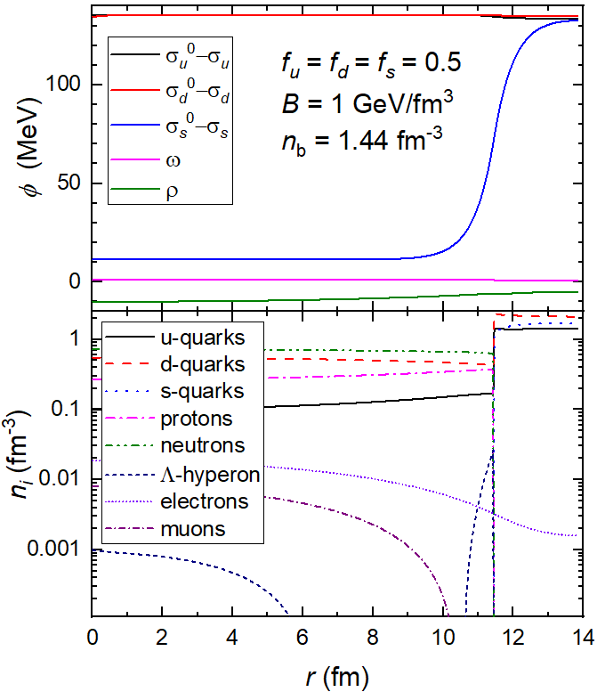
Deconfinement
unified Description

Slide 16
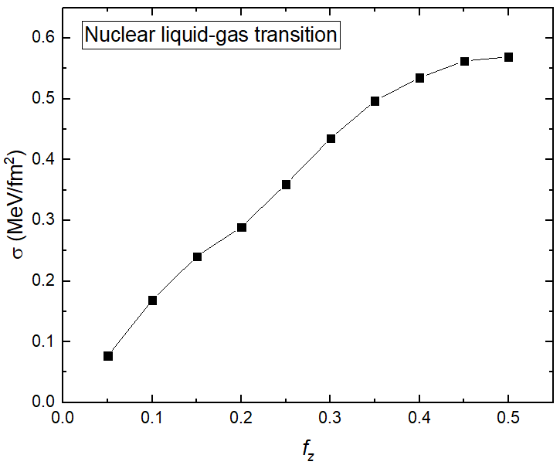
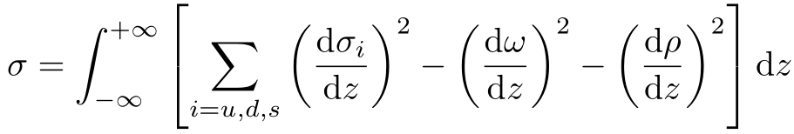
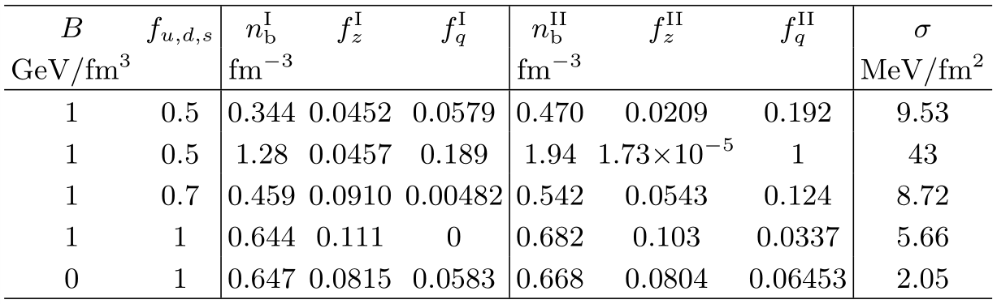
Surface tension
Thin-wall approximation:
[Avancini et al.2010_PRC82-055807]
unified Description

Slide 17
Summary
By considering baryons as clusters of quarks, we investigate the properties of dense matter by extending NJL model
Both first-order and continues phase transitions are observed for quarkyonic, chiral, and deconfinement phase transitions;
The nonuniform structures of mixed phases for various first-order phase transitions are investigated, i.e., nuclear matter liquid-gas transition, chiral and deconfinement phase transitions；
The correspond surface tension are then estimated, which approximately increases with the density differences between two phases.
Thank you!!!

Slide 18
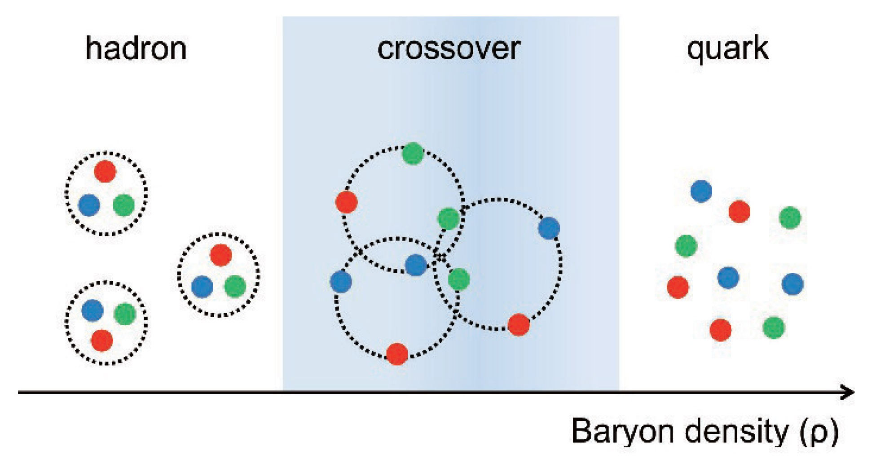
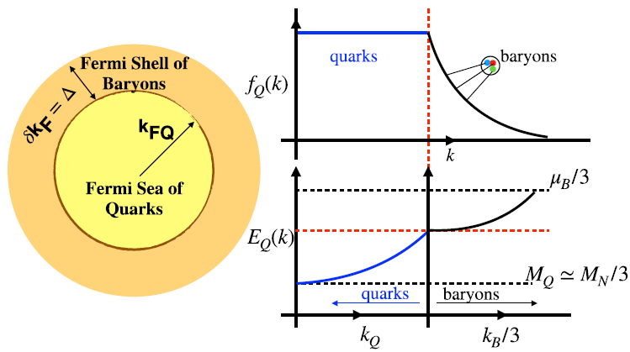
Hadron-quark transition (Crossover)
Masuda_Hatsuda_Takatsuka2016_EPJA52-1
Hadron-quark crossover can be bridged by the quarkyonic matter; The growing contributions of many-body correlations can be attributed to the increasing numbers of exchanged quarks [Fukushima_Kojo2016_ApJ817-180]
Quarkyonic matter: quark Fermi sea + baryonic Fermi surface [McLerran_Pisarski2007_NPA796-83, in lage N_{C} limit]; a quark does not know which baryon it belongs to and can be viewed as quasi-free particles [McLerran2009_NPA830-709c].
[McLerran_Reddy2019_PRL122-122701]
Hadron-quark Crossover

Slide 19
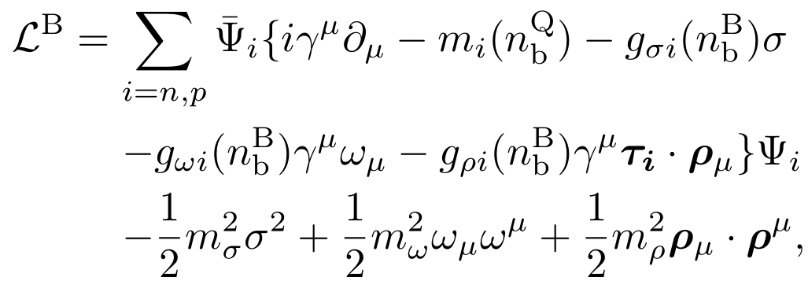
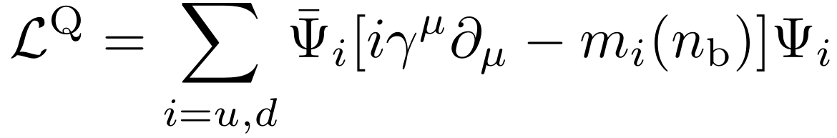
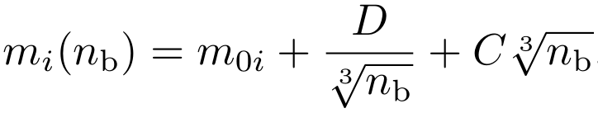
Extended RMF model
Nuclear matter (RMF model):
Energy
Quark-baryon interaction (Pauli blocking effects, ...)
Baryon mass: m_{i}(n_{b}^{Q}) = m_{b0} + B n_{b}^{Q}
n_{b} = n_{b}^{B} + n_{b}^{Q}
Baryon number densities of nuclear matter (n_{b}^{B}) and quark matter (n_{b}^{Q}).
Quark matter (Equivparticle model):
Quarkyonic transition: emergence of quasi-free quarks;
Deconfinement: baryon melting (Mott transition)
[Xia_Peng_Chen_Lu_Xu2014_PRD89-105027]
Hadron-quark Crossover

Slide 20
Neutron stars
Annala et al.2020_NatPhys2101-03193
background

Slide 21
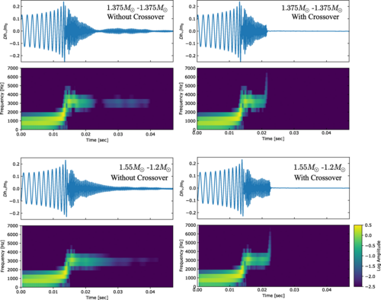
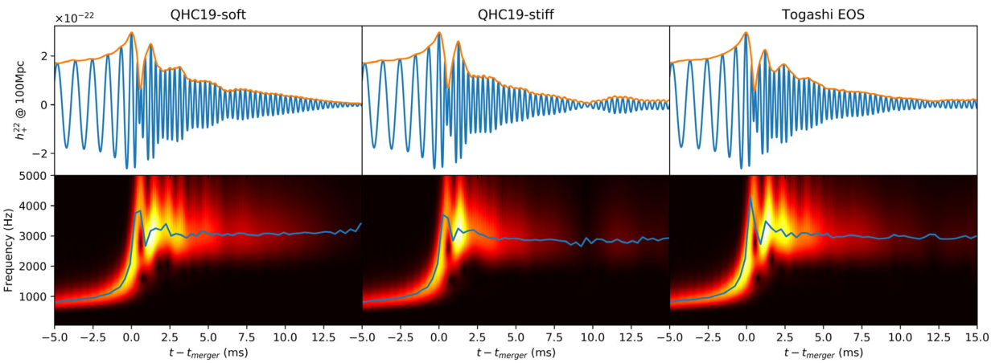
Binary neutron star merger
Fujimoto et al.2023_PRL130-91404
Bauswein et al. 2019_PRL122-061102
Huang et al.2022_PRL129-181101
background

Slide 22
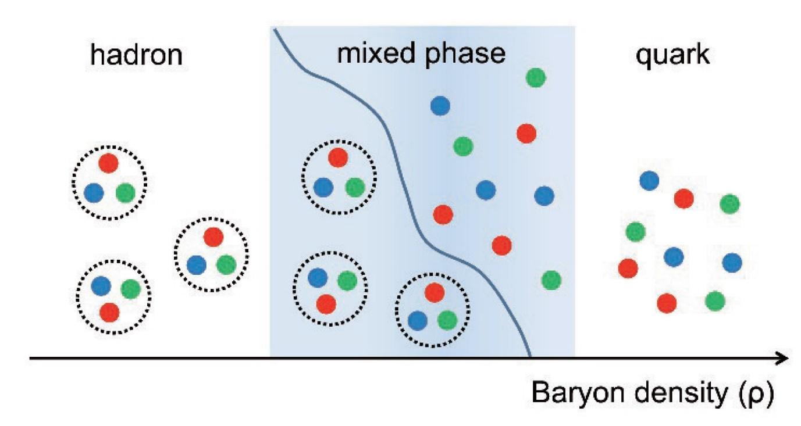
Hadron-quark first-order phase transition
Hadron-quark mixed phase inside compact stars
σ
Crust
Crust
NM
NM
MP
QM
QM
σ_{c}
σ
Taken from [Masuda_Hatsuda_Takatsuka2016_EPJA52-65]
σ = 0: point-like hadronic matter (HM) and quark matter (QM), i.e., Gibbs construction.
Moderate σ : geometrical structures [Chiba, Endo, Heiselberg, Maruyama, Tatsumi, Voskresensky, Yasuhira, Yasutake, ...]
σ>σ_{c}: bulk separation of HM and QM, i.e., Maxwell construction.
First-order phase transition

