Slide 1
Searching for Pulsar with the Murchison Widefield Array
MWA SMART pulsar survey collaboration (PI: Ramesh Bhat);
Kaichao Wu, Zihan Zhang, Xiaoning Tang, Xiaoli Zhang (Computer Network Information Center, CAS);
Qiuyang Fu (NAOC); Yukai Zhou (PKU)
Mengyao Xue
2024-07-14 SPSS, Kunming

Slide 2
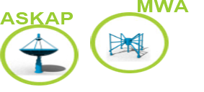
Murchison Widefield Array (MWA)
Precursor for the SKA-low at the same site
MRO (Murchison Radio-astronomy Observatory)
41,000 km² = The Netherlands
Population density = 0.002 people / km²
Geraldton
~200 km
Perth

Slide 3
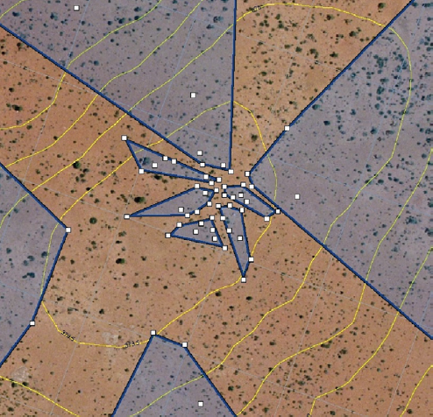
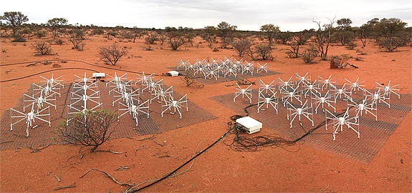
Murchison Widefield Array (MWA)
Phase I (2012 -- 2016)
128 tiles, distributed in ~ 3 km diameter region
- each tile contains 16 dipoles, 4×4 dual polarisation array
Low-frequency phased array
Working frequency: 80-300 MHz
Bandwidth: 30.72 MHz (24*1.28 MHz)
Tingay et al. (2013)

Slide 4
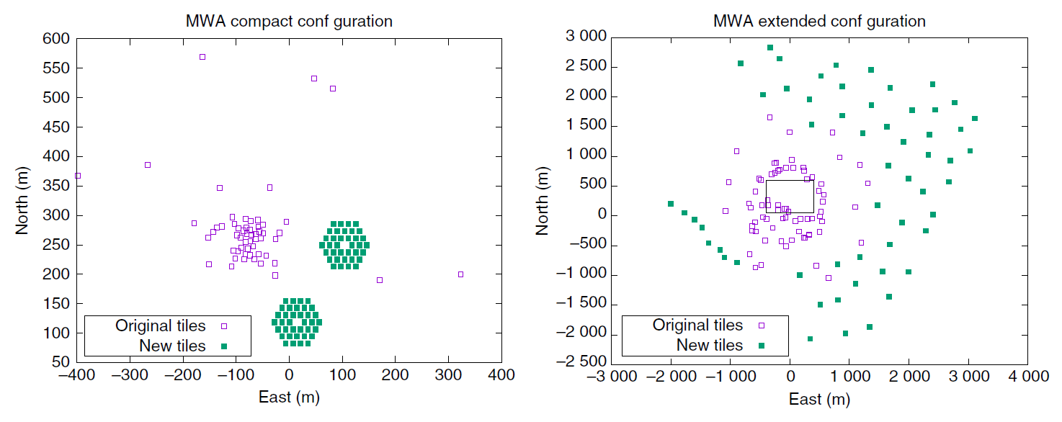
Murchison Widefield Array (MWA)
Phase II (2016 -- )
256 tiles in total, but can only use 128 tiles at a time
(because of the maximum signal throughput of the MWA hardware)
Two type of configuration:
compact and extended for different science goal
Wayth et al. (2018)

Slide 5
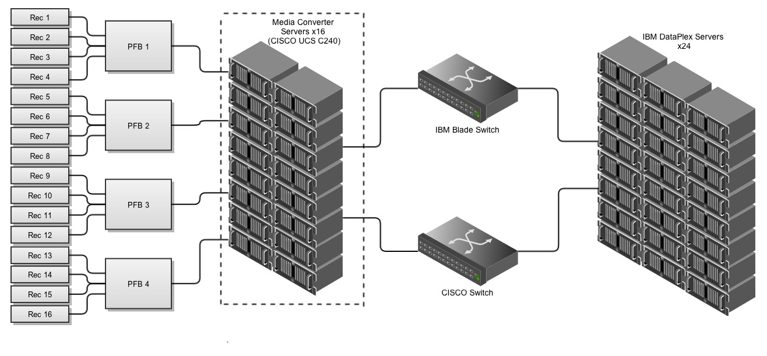
Observing pulsars with the MWA the “voltage capture” (VCS) way
Record all channelised voltage streams from each tile
Bandwidth: 30.72 MHz (24 coarse channels, 1.28 MHz each)
Time resolution: 100 μs Frequency resolution: 10 kHz
Data rate: 28 TB per hour Maximum recording: 1.5 hour
MWA correlator
Voltage capture (VCS)
Tremblay et al. (2015)

Slide 6
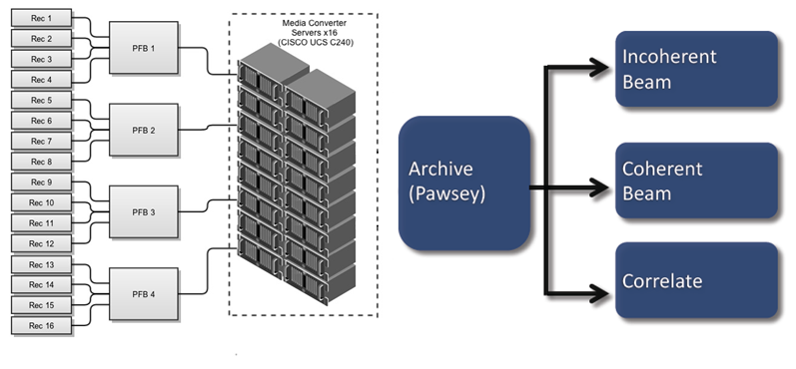
Observing pulsars with the MWA the “voltage capture” (VCS) way
Record all channelised voltage streams from each tile
Bandwidth: 30.72 MHz (24 coarse channels, 1.28 MHz each)
Time resolution: 100 μs Frequency resolution: 10 kHz
Data rate: 28 TB per hour Maximum recording: 1.5 hour
Voltage capture (VCS)
Tremblay et al. (2015)

Slide 7
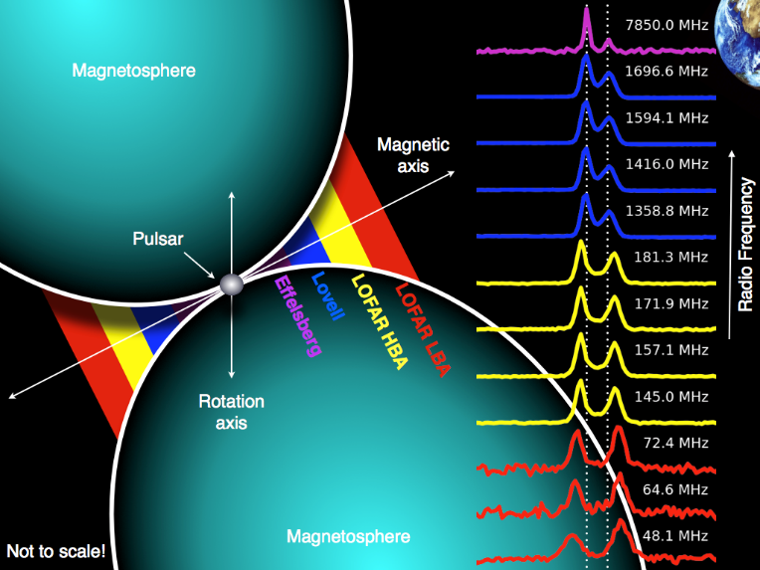
Pulsar studies at low radio frequencies
The first pulsar was discovered at 81.5 MHz
Majority of currently known pulsars were discovered and studied at higher frequency (e.g. 1.4 GHz) because:
- Less ISM propagation effects
- Less Galactic continuum emission background
- Less earth ionosphere effects
However, pulsar studies at low radio frequencies can
Credit: Tom hassall
Provide insights into the emission mechanism of pulsars
Profile evolution with frequency
Spectral index (low frequency turn over; break; flattening)
Provide valuable information about the interstellar medium

Slide 8
Some low-frequency pulsar surveys
Bhat et al. (2023)

Slide 9
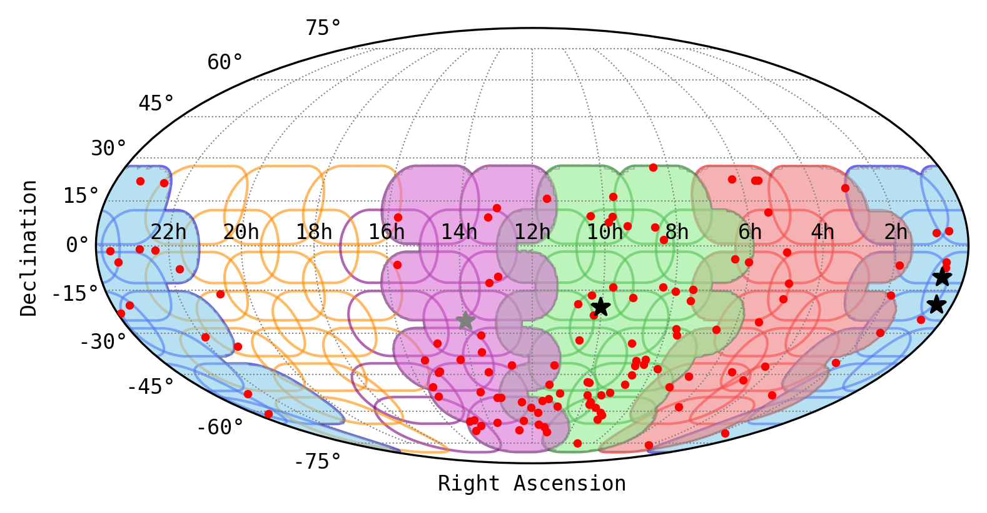
Southern-sky MWA Rapid Two-metre (SMART) pulsar survey
2022: receiver update to MWAX
128 tiles → 144 tiles
Legacy data:
35 TB per observation
Bhat et al. (2023)
Notes:
文章中写错了（推测是因为用 28TB/hr*1.5hr得到的）

Slide 10
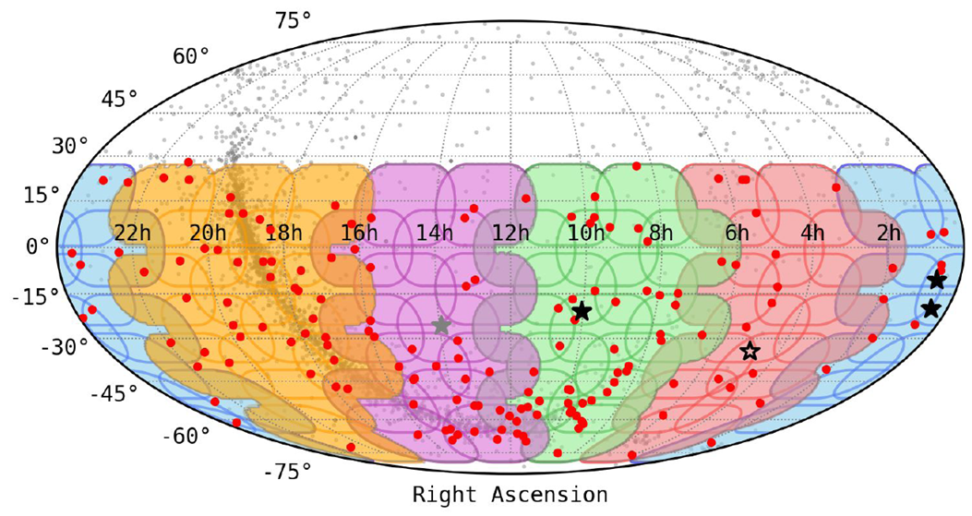
Southern-sky MWA Rapid Two-metre (SMART) pulsar survey
70 observations in total（B:13，R: 13，G: 15，P: 14，O: 15），
Each observation is 4800s long，covers ~ 600 deg²，need 5000~8000 tied-array beam
Legacy data: 35 TB x 51 = 1.78 PB; MWAX data: 79 TB x 19 = 1.5 PB; In total: 3.28 PB
May – August 2023
2022: receiver update to MWAX
128 tiles → 144 tiles
MWAX data:
79 TB per observation
Credit: Chris Lee
Notes:
文章中写错了（推测是因为用 28TB/hr*1.5hr得到的）

Slide 11
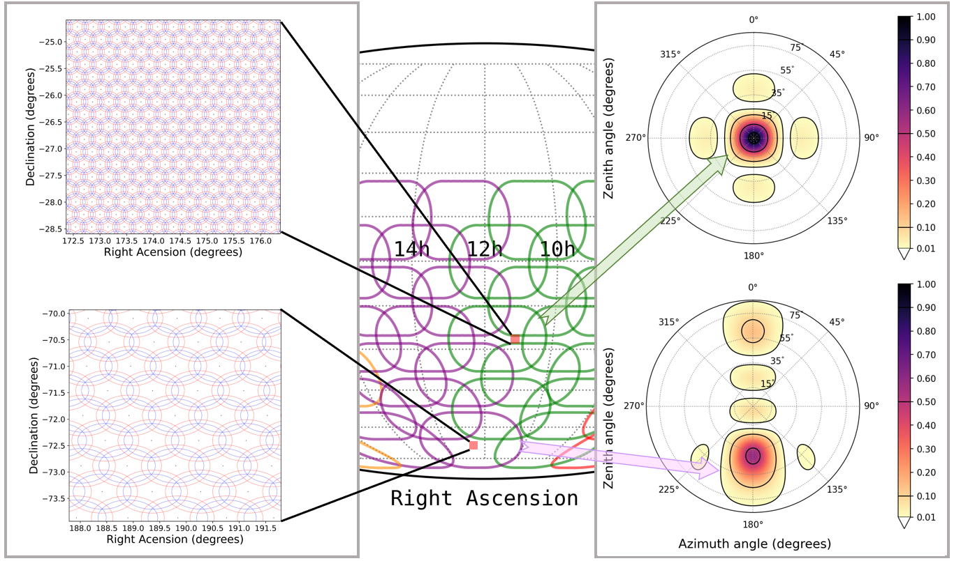
Coherent beamformed data: tied-array beam
Each observation is 4800s long，covers ~ 600 deg²，need 5000~8000 tied-array beam
For each tied-array beam, the full polarization data is 175 GB; therefore, 5000 beams account for 875 TB
Bhat et al. (2023)
Notes:
main lobes overlap by 20%
155MHz ~23’; 140MHz ~25.3’; 170MHz ~20.7’

Slide 12
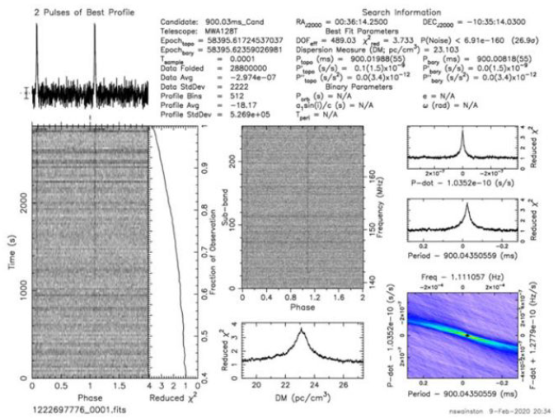
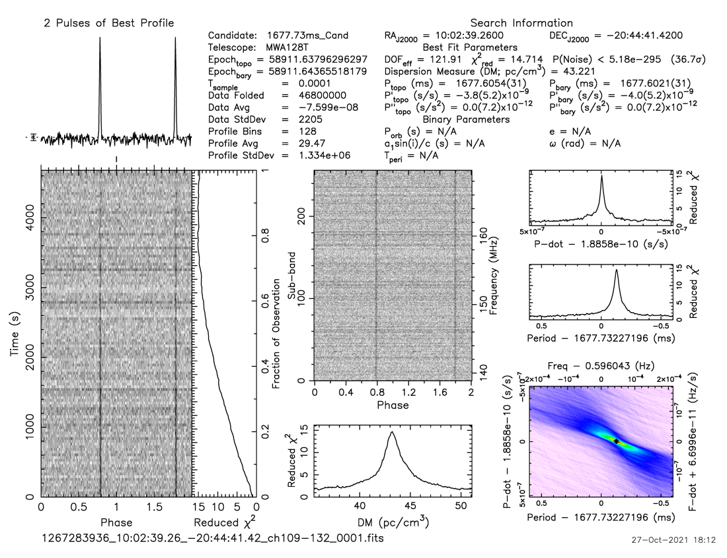
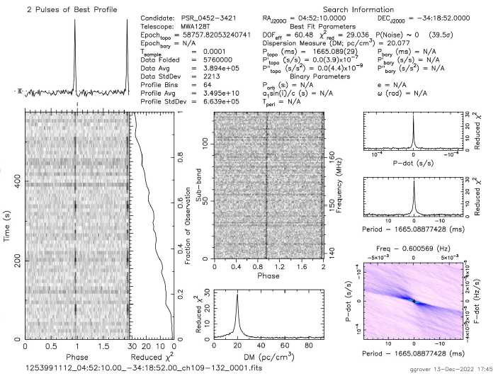
New pulsar discoveries made by MWA-SMART survey
J0036-1033
J1002-2044
J0452-3418
Bhat et al. (2023), Grover et al. (2024)

Slide 13
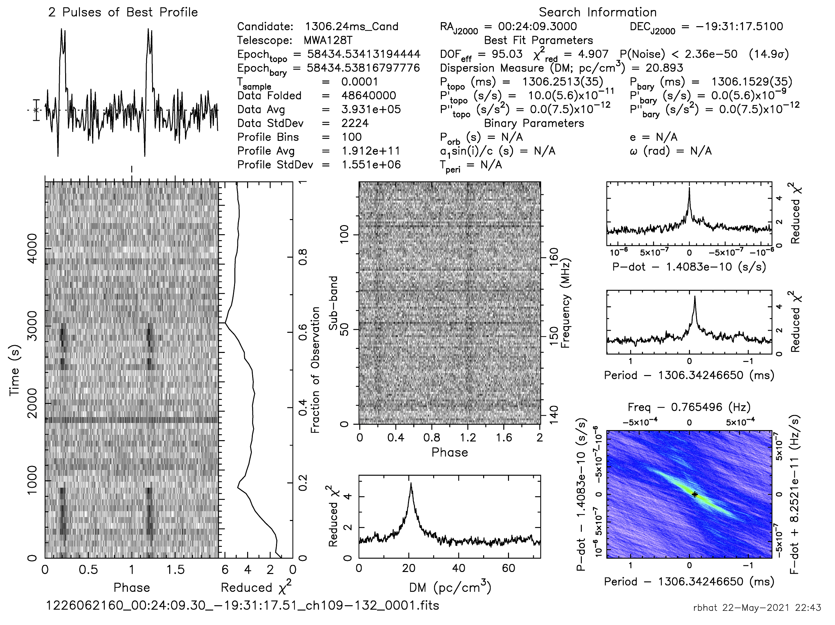
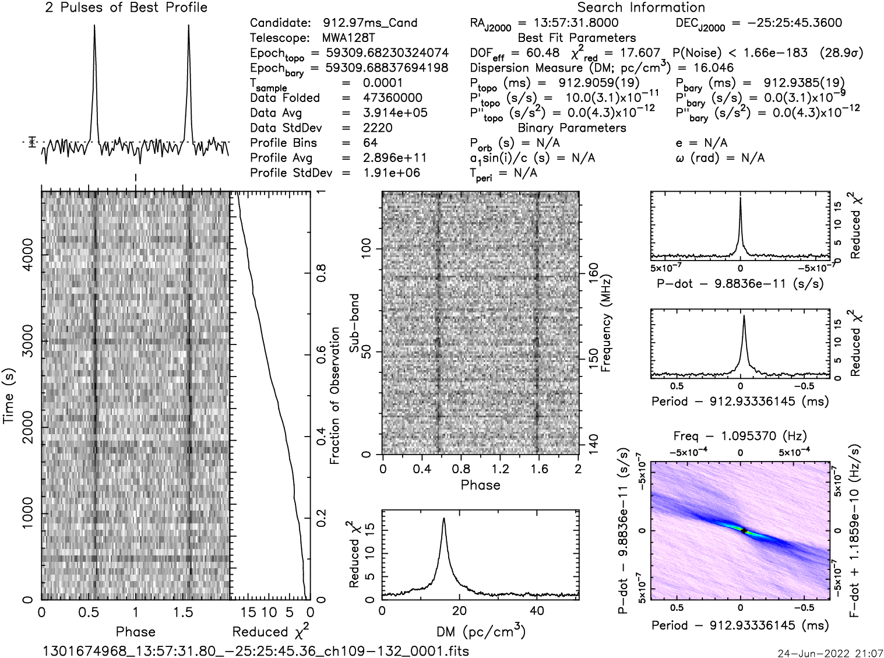
Independent pulsar discoveries by MWA-SMART survey
J0026-1955
J1357-2530
Qiuyang Fu
Also detected in GBT pulsar survey GBNCC
Parkes discovery, but mislabeled as J1358-2533
Position: 13:58:42_-25:33 → 13:57:24_25:30:39
DM: 31.27 → 16.05

Slide 14
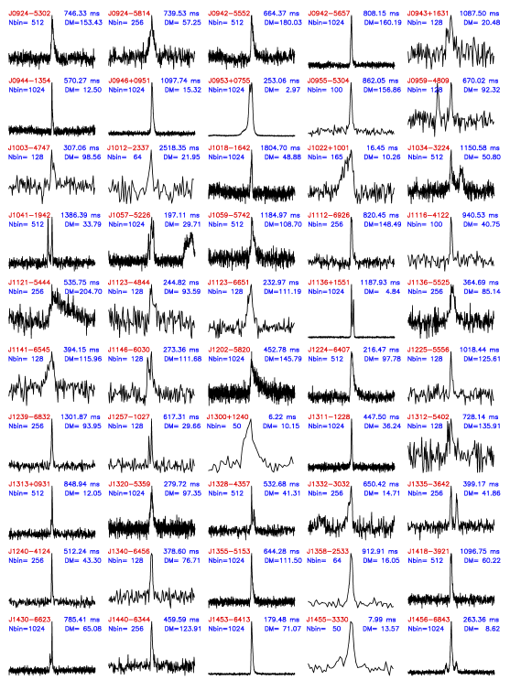
Known-pulsar detections
Pulsars: 217
Millisecond pulsars: 15
Binary pulsars: 15
First detections below 300 MHz: 34
Bhat et al. (2023), Lee in prep.

Slide 15
The ‘first pass’ shallow search of the SMART survey
Only analyzed the first 10 minutes of 80% legacy observations
No RFI mitigation
Coarse de-dispersion plan (2358 trials)
Next step
A more thorough search on 4800s data (e.g. finer DM step)
But the computing resources limitation ……

Slide 16
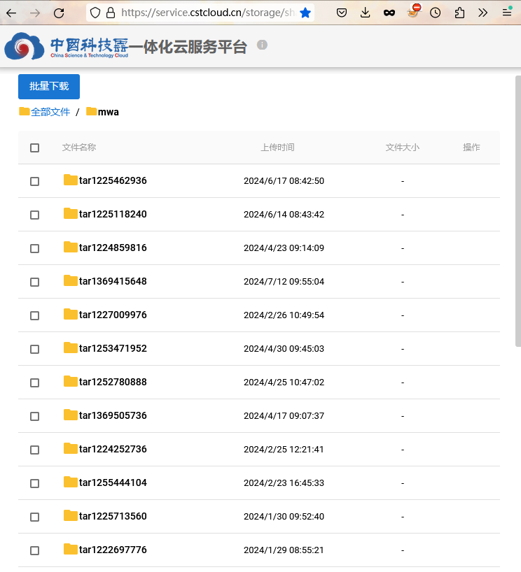
Data transfer & store
Object storage
So far have transferred 47(/51) legacy observations (1.64 PB) & 3(/19) MWAX observations (0.24 PB)
Stored on cstcloud
With the help from Xiaoning Tang

Slide 17
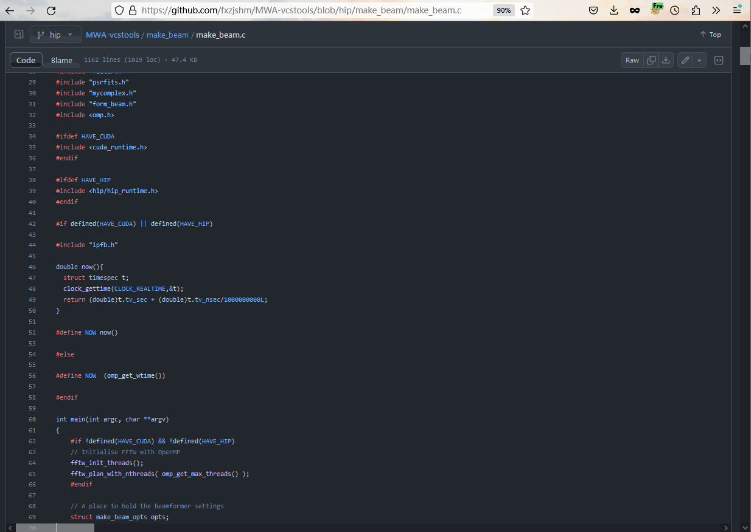
Yukai Zhou
Original coherent beam-forming code (CUDA)
Hip version beam-forming code
(https://github.com/fxzjshm/MWA-vcstools)

Slide 18
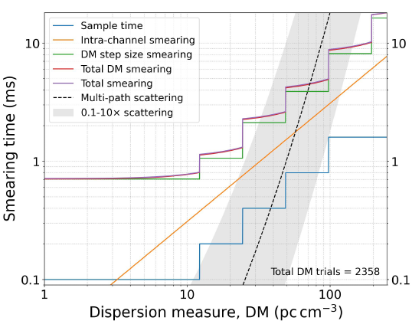
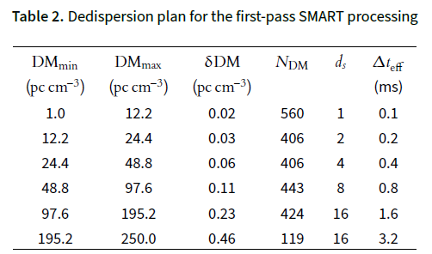
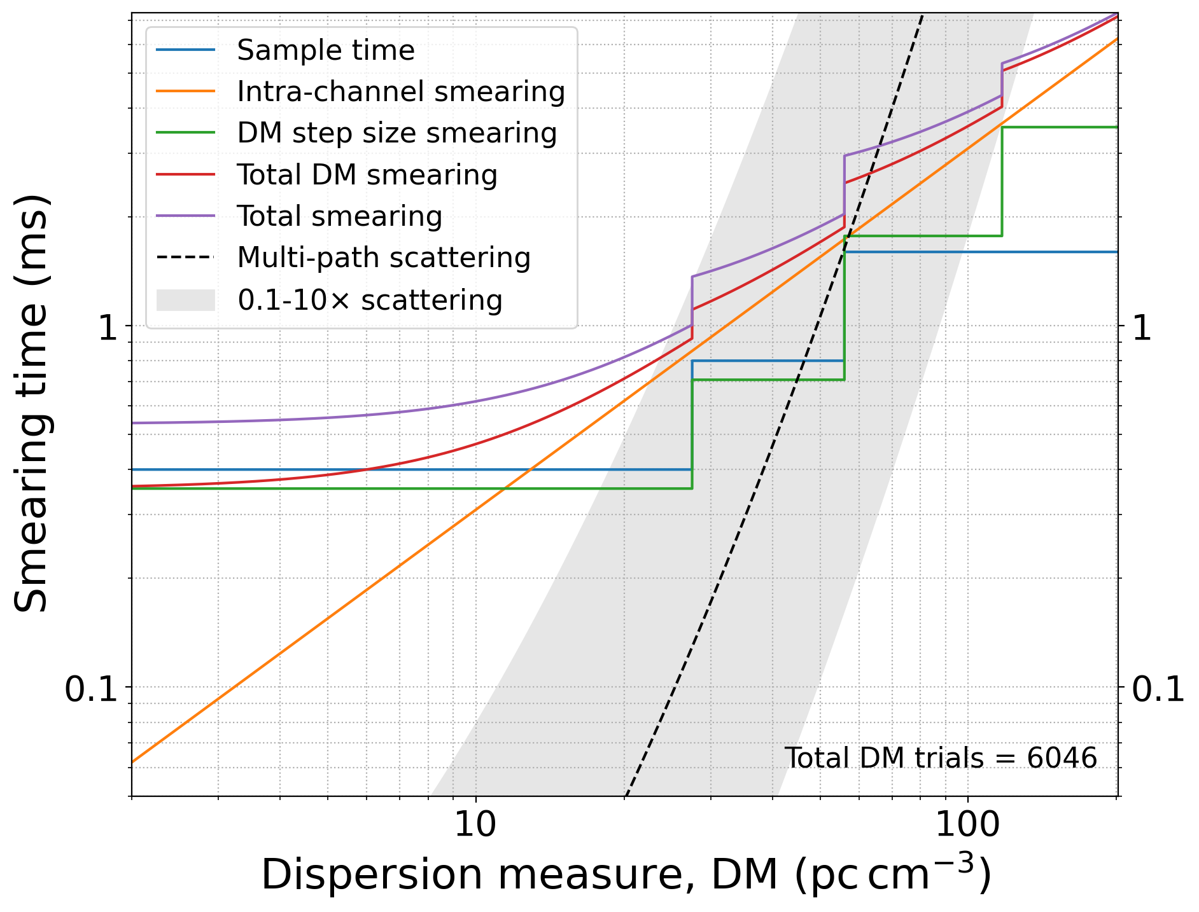
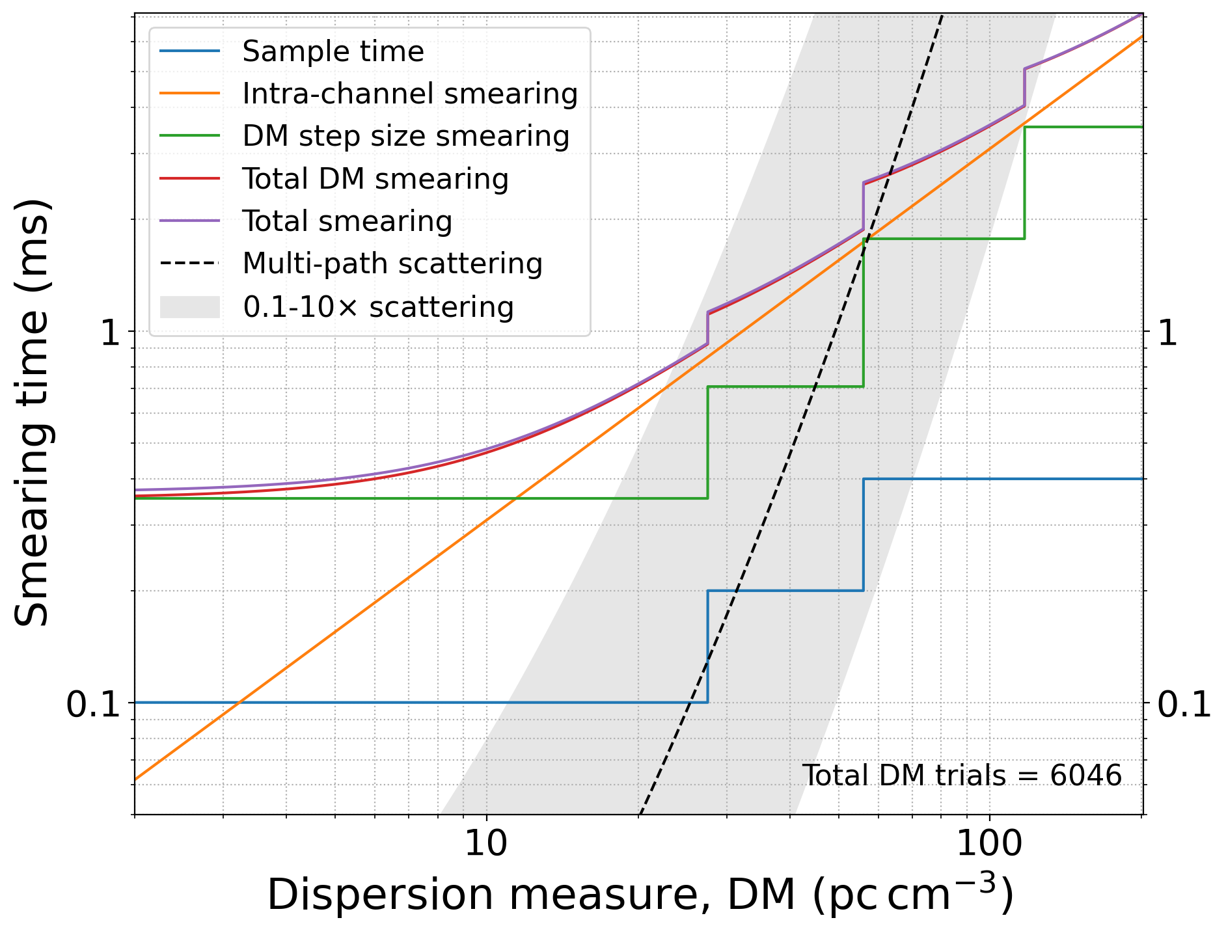
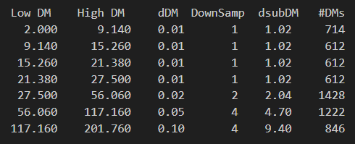
De-dispersion Plan update and introduce down-sampling in time
Total DM trials = 2358
Down-sampling by a factor of 4 in time
Total DM trials = 6046

Slide 19
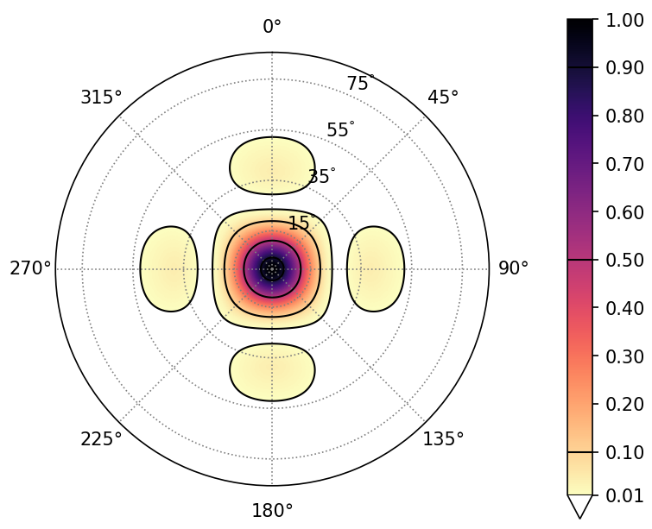
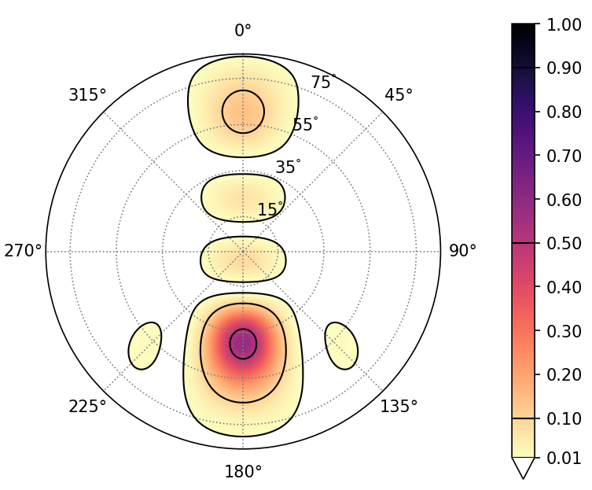
MWA SMART full observation searching test at CNIC
Data set: two 4800s observations
For 144 point beamforming
Beamforming takes 90 hr in total
Pulsar search takes 75 hr in total
Kaichao Wu, Zihan Zhang
Computing resources:
3 nodes
Each contains one 32-core CPU & 4 DCU cards
Beamforming
Shared storage
For one point beamforming
(90+75) hour✖️12DCU➗144 pointings =13.75 DCU hour/pointing
Assume each observation can be covered with 6000 pointings
13.75 DCU hour/pointing✖️6000 pointings = 82500 DCU hours
With 100 four-DCU-card nodes, processing one observation will take
82500 DCU hours ➗ 400 DCU ➗ 24 hours = 8.6 days
Pulsar search

Slide 20
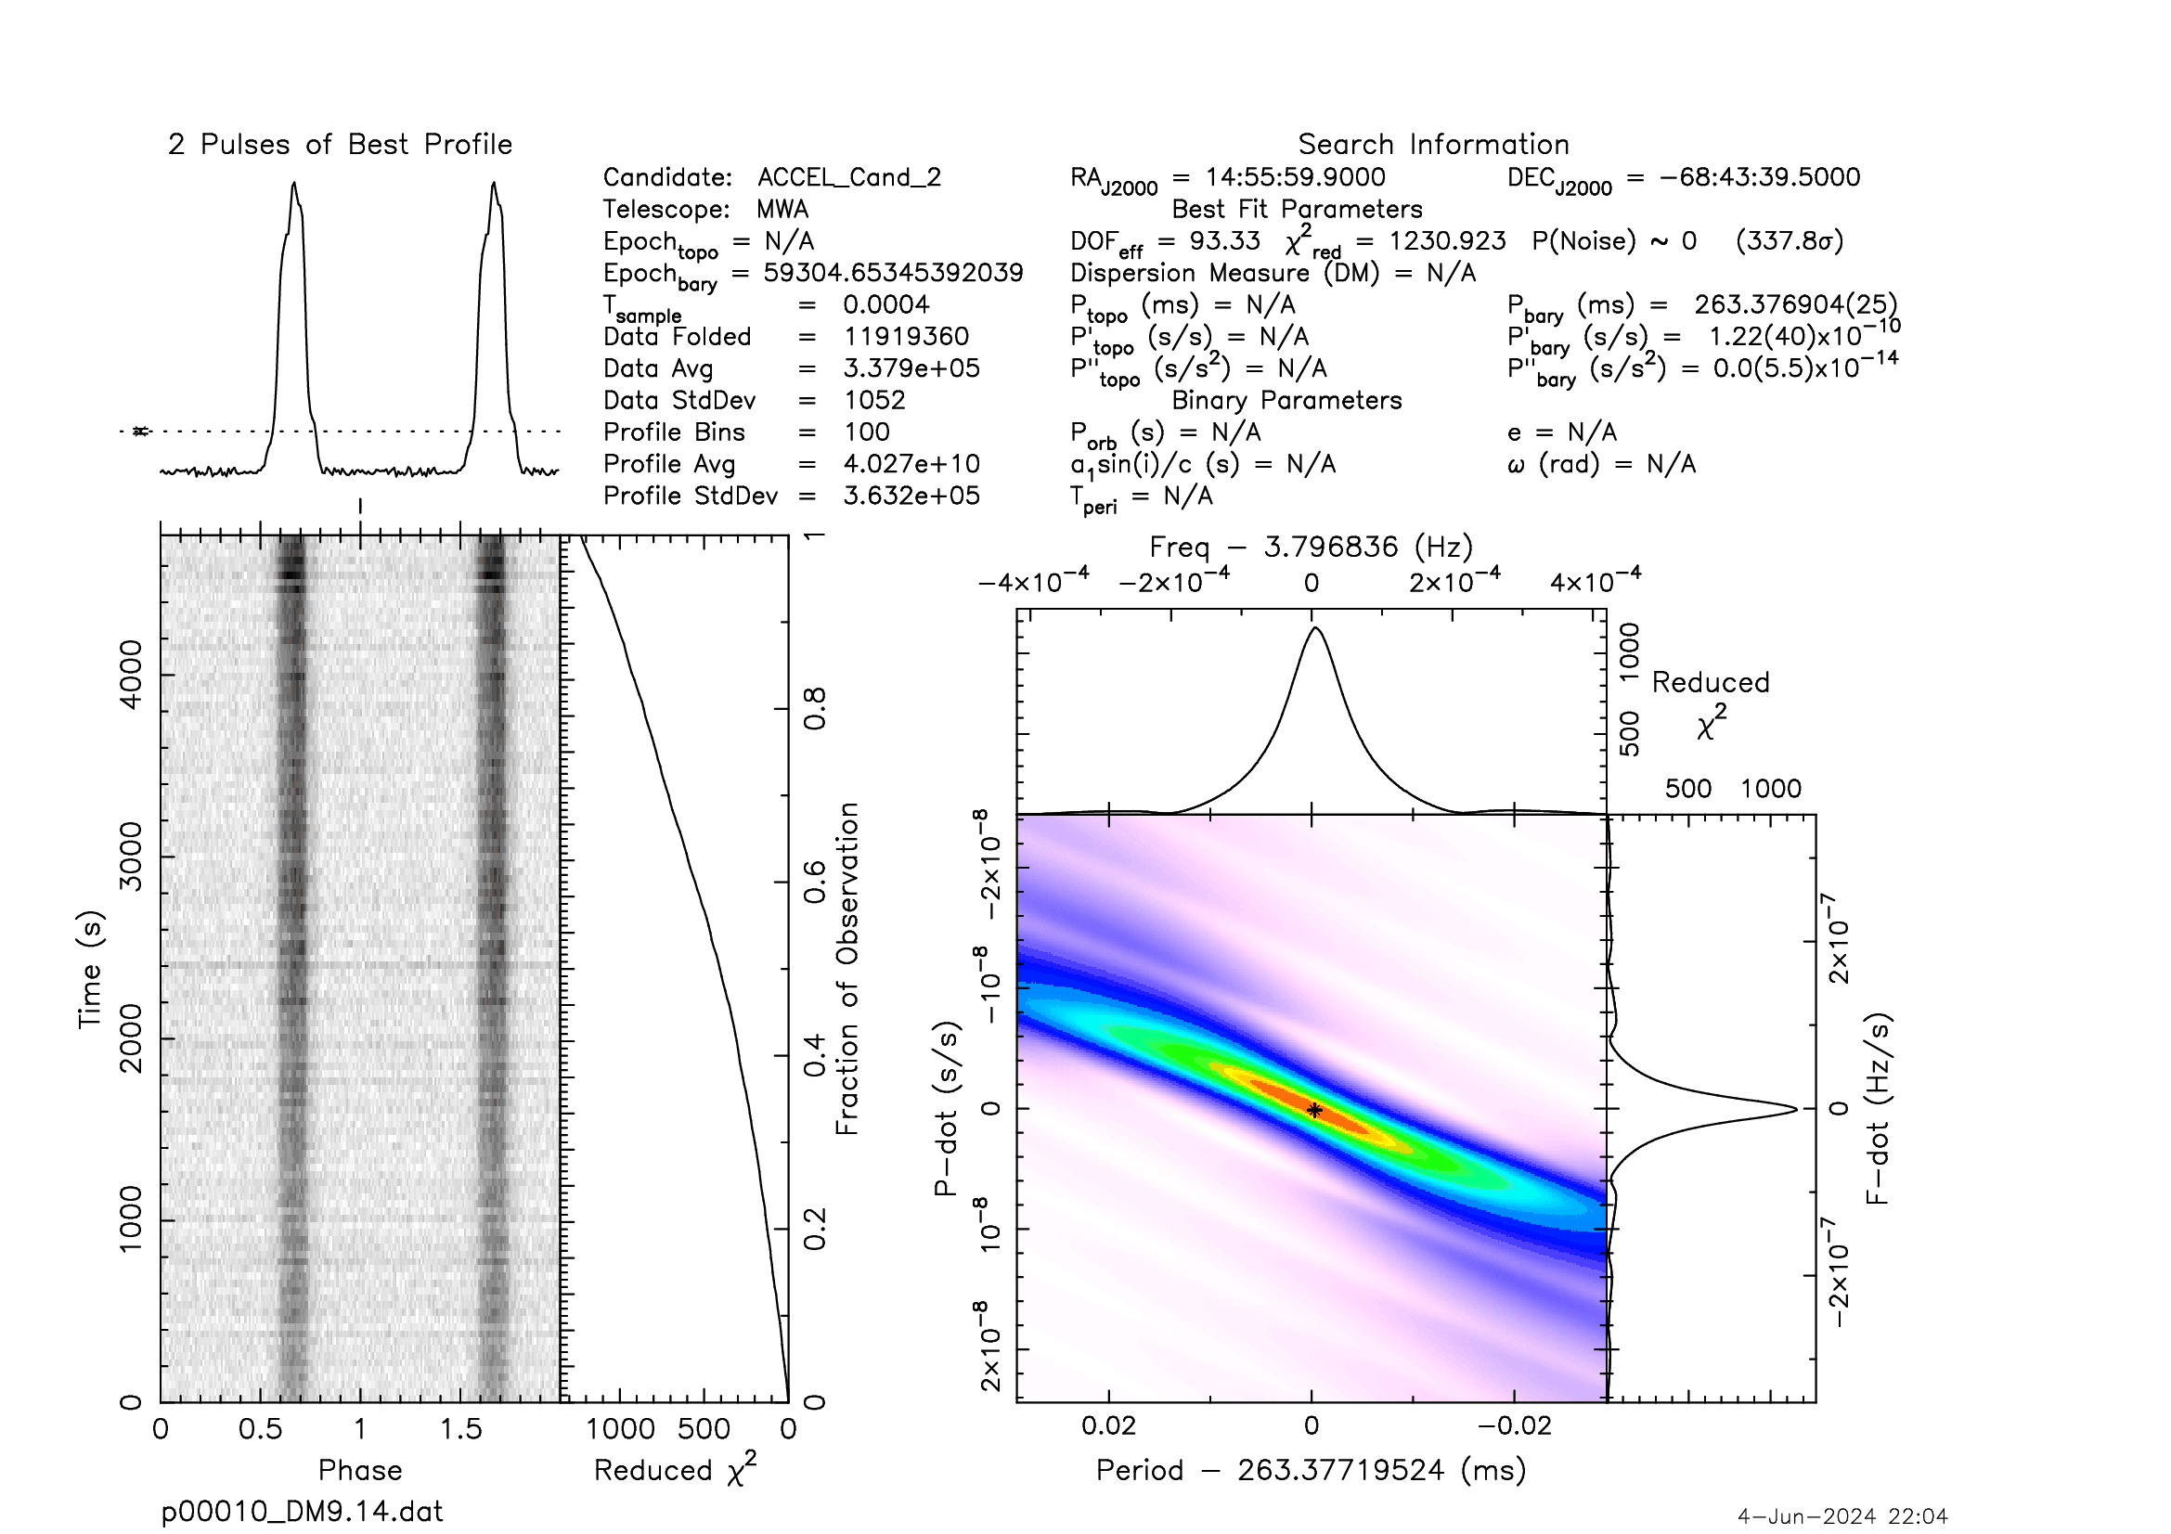
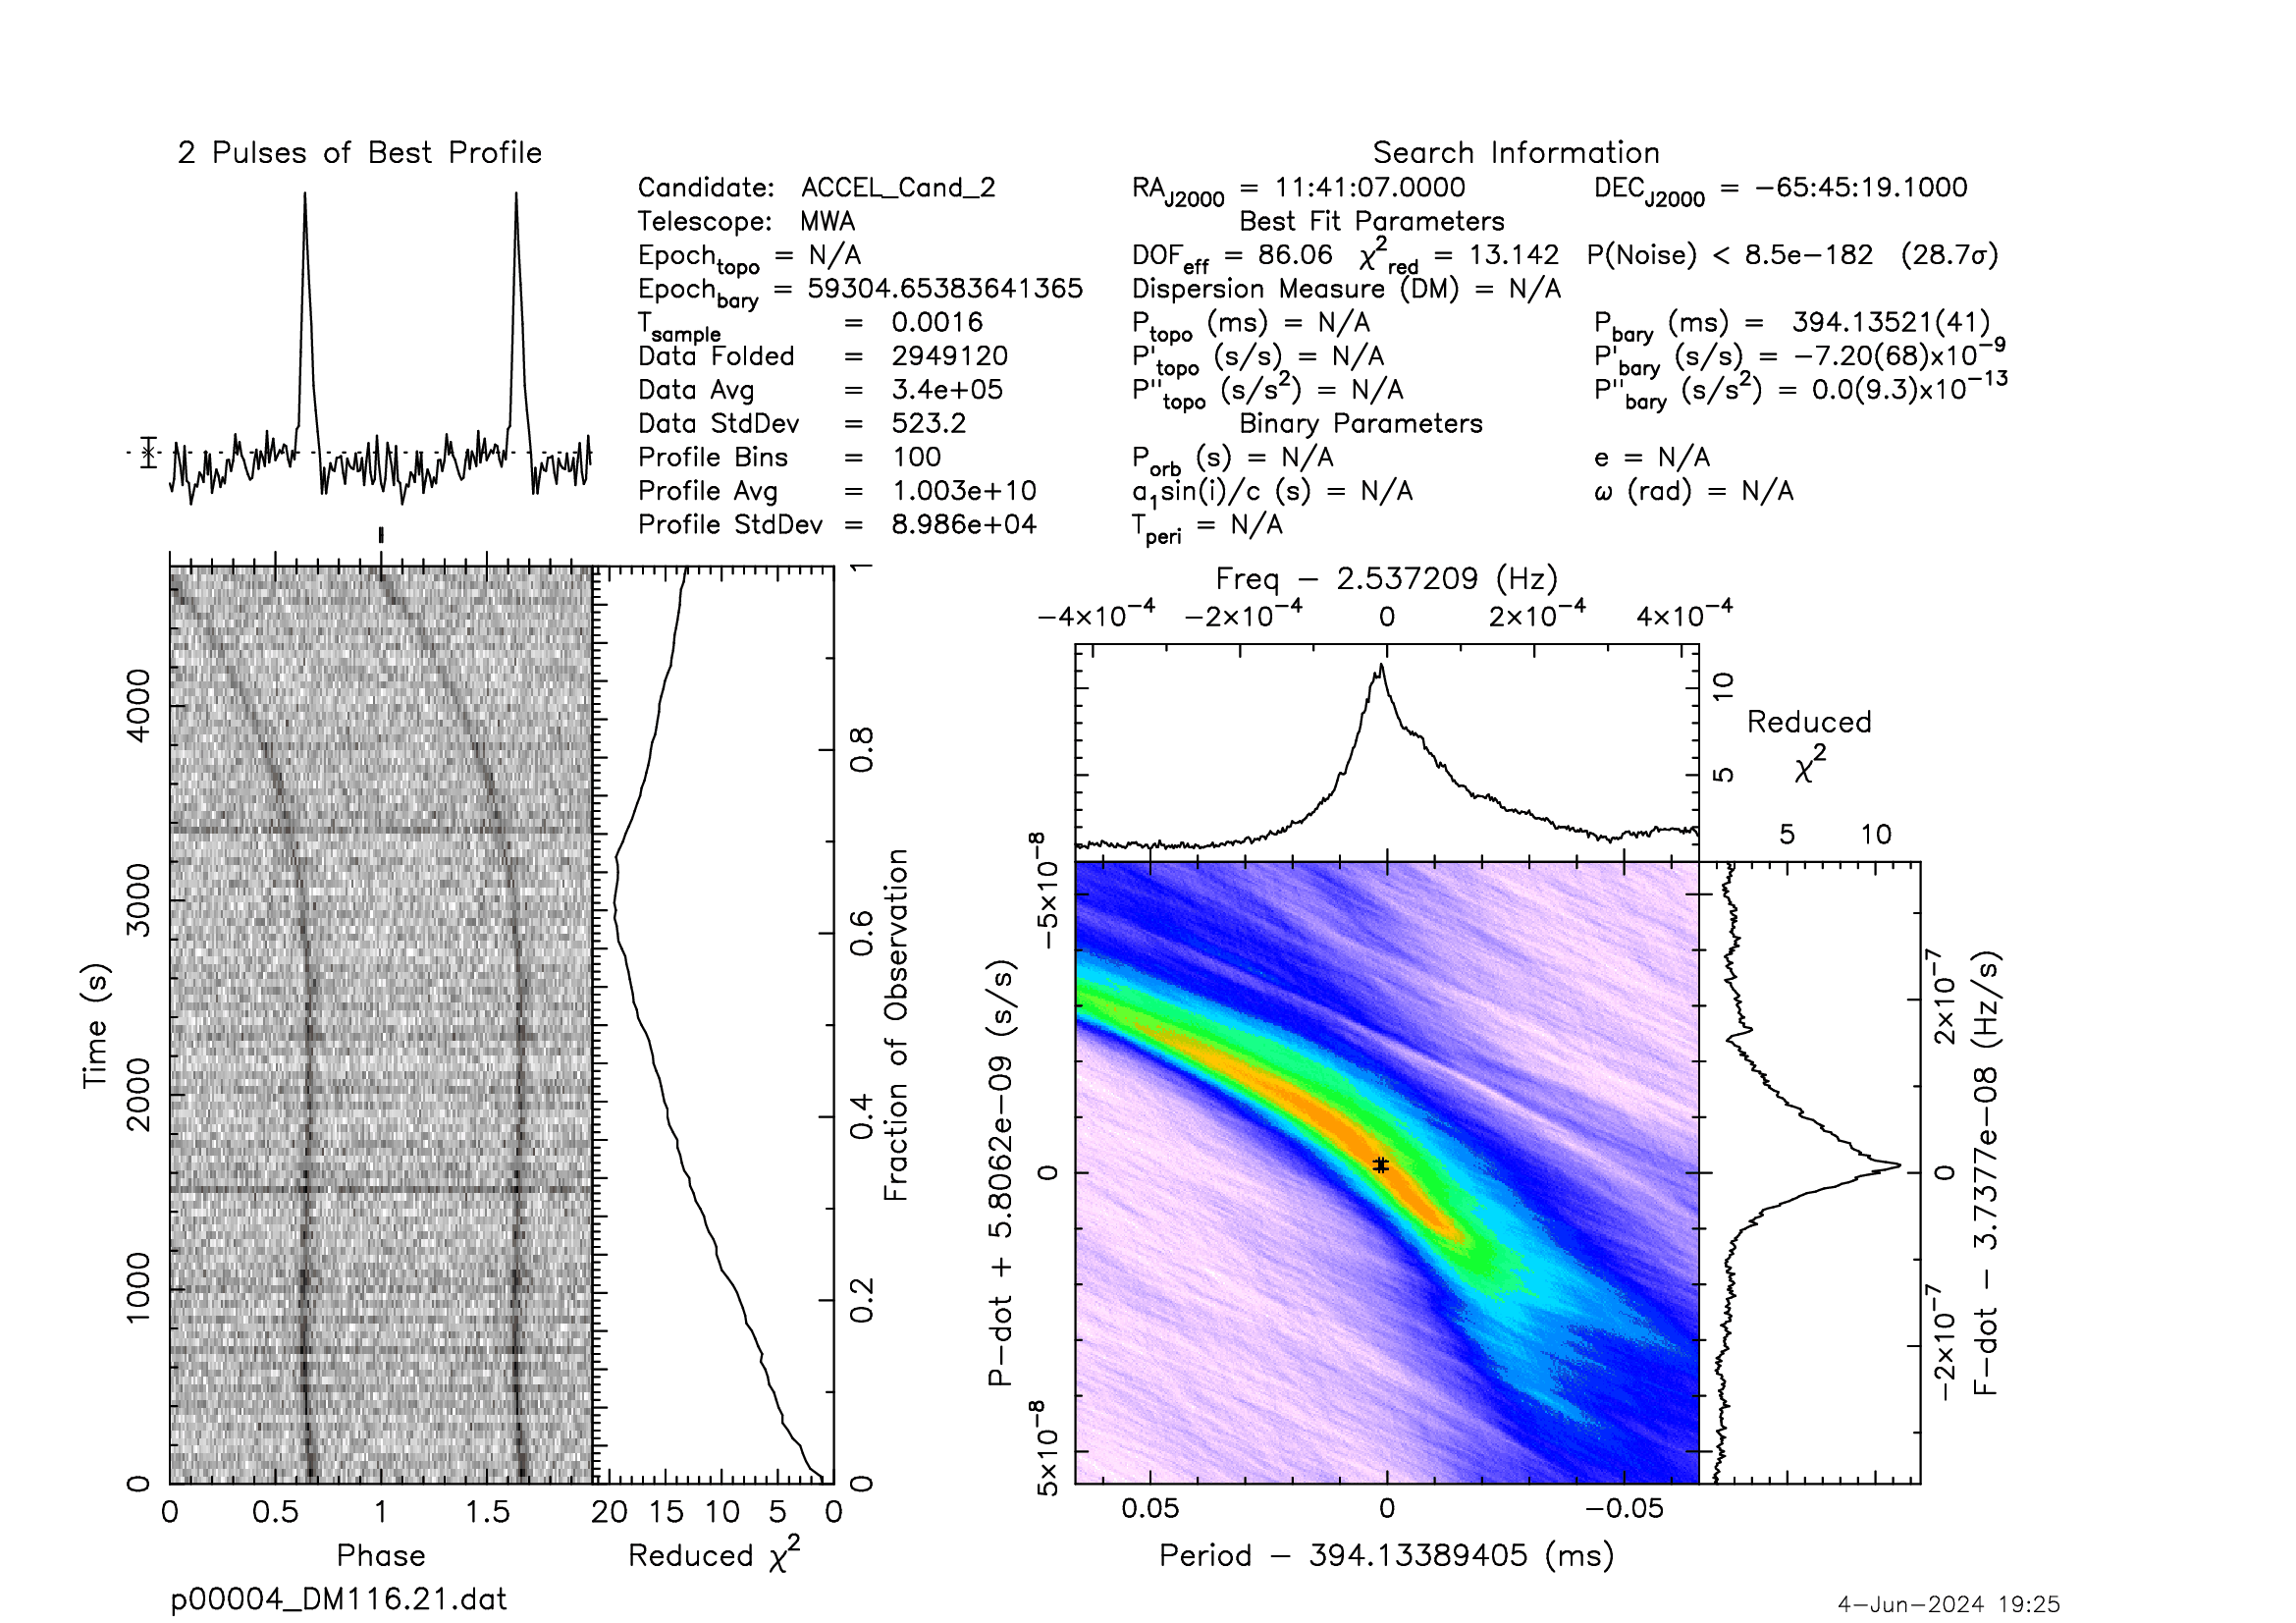
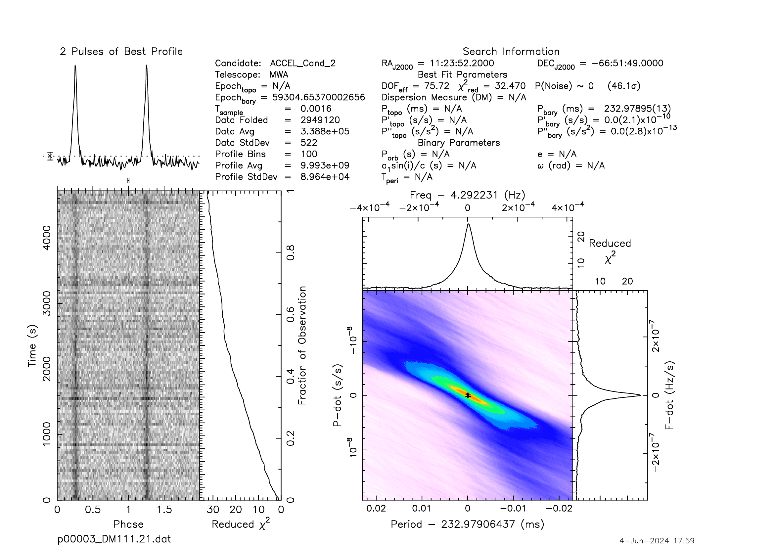
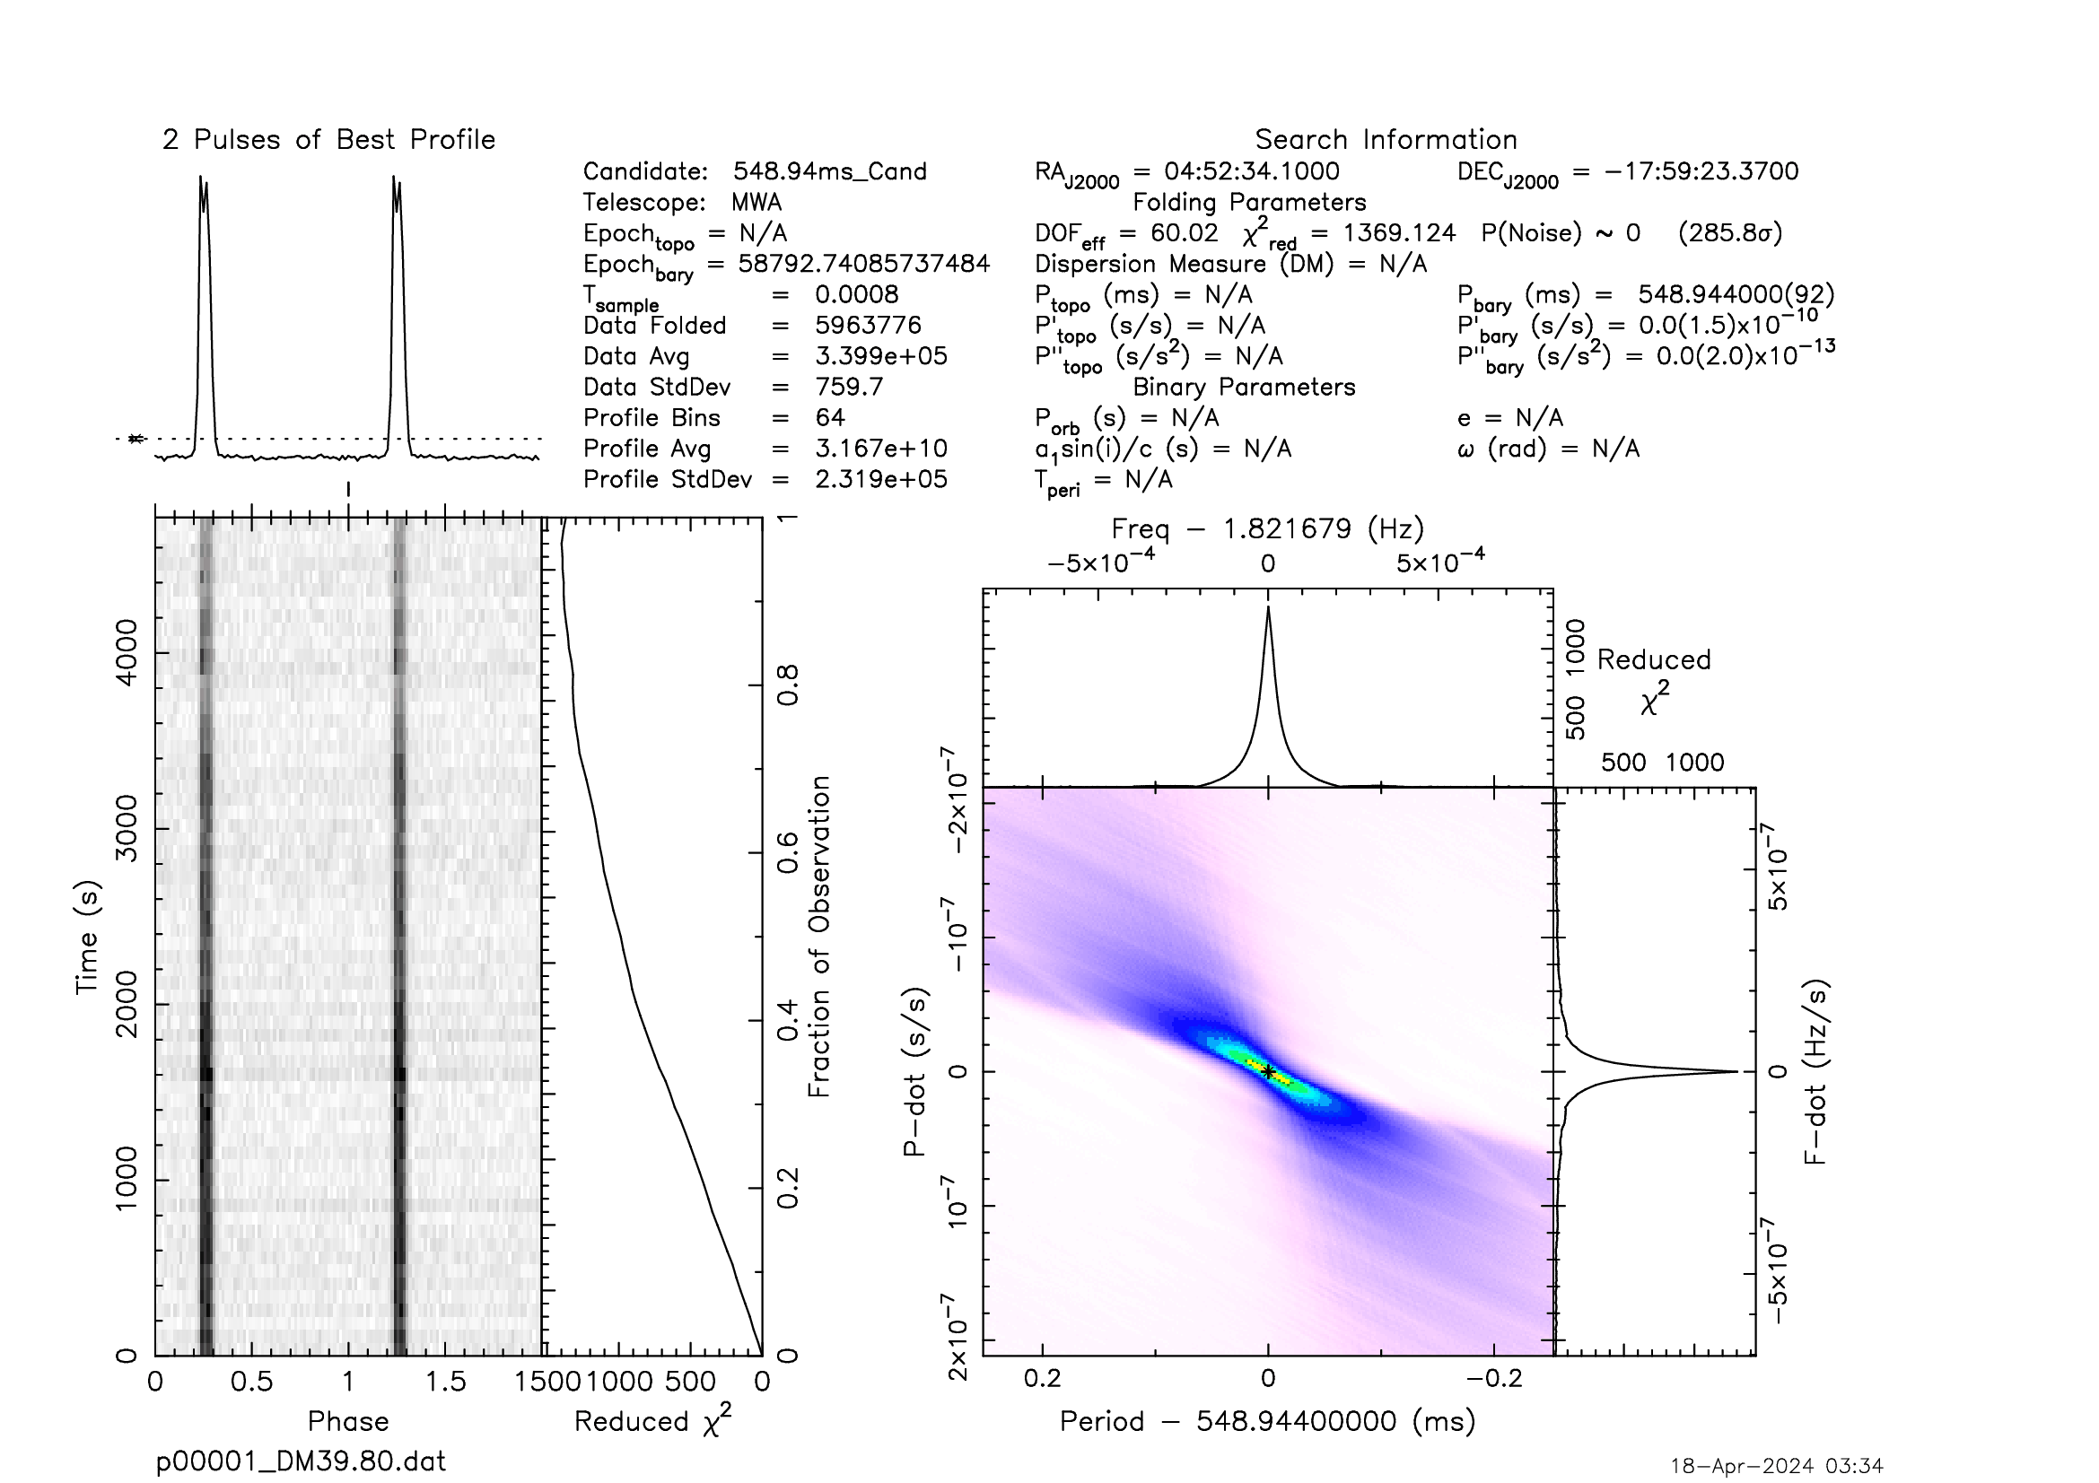
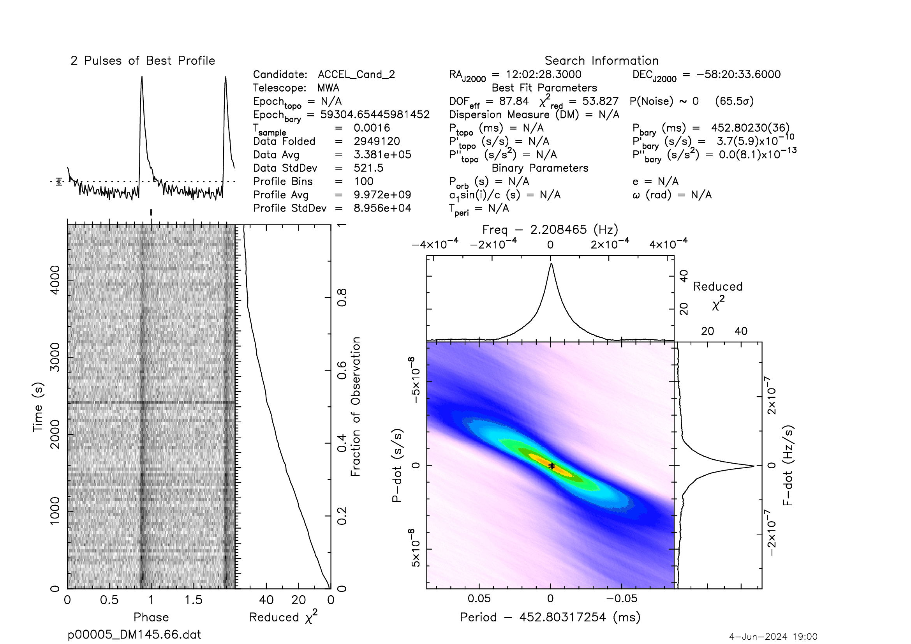
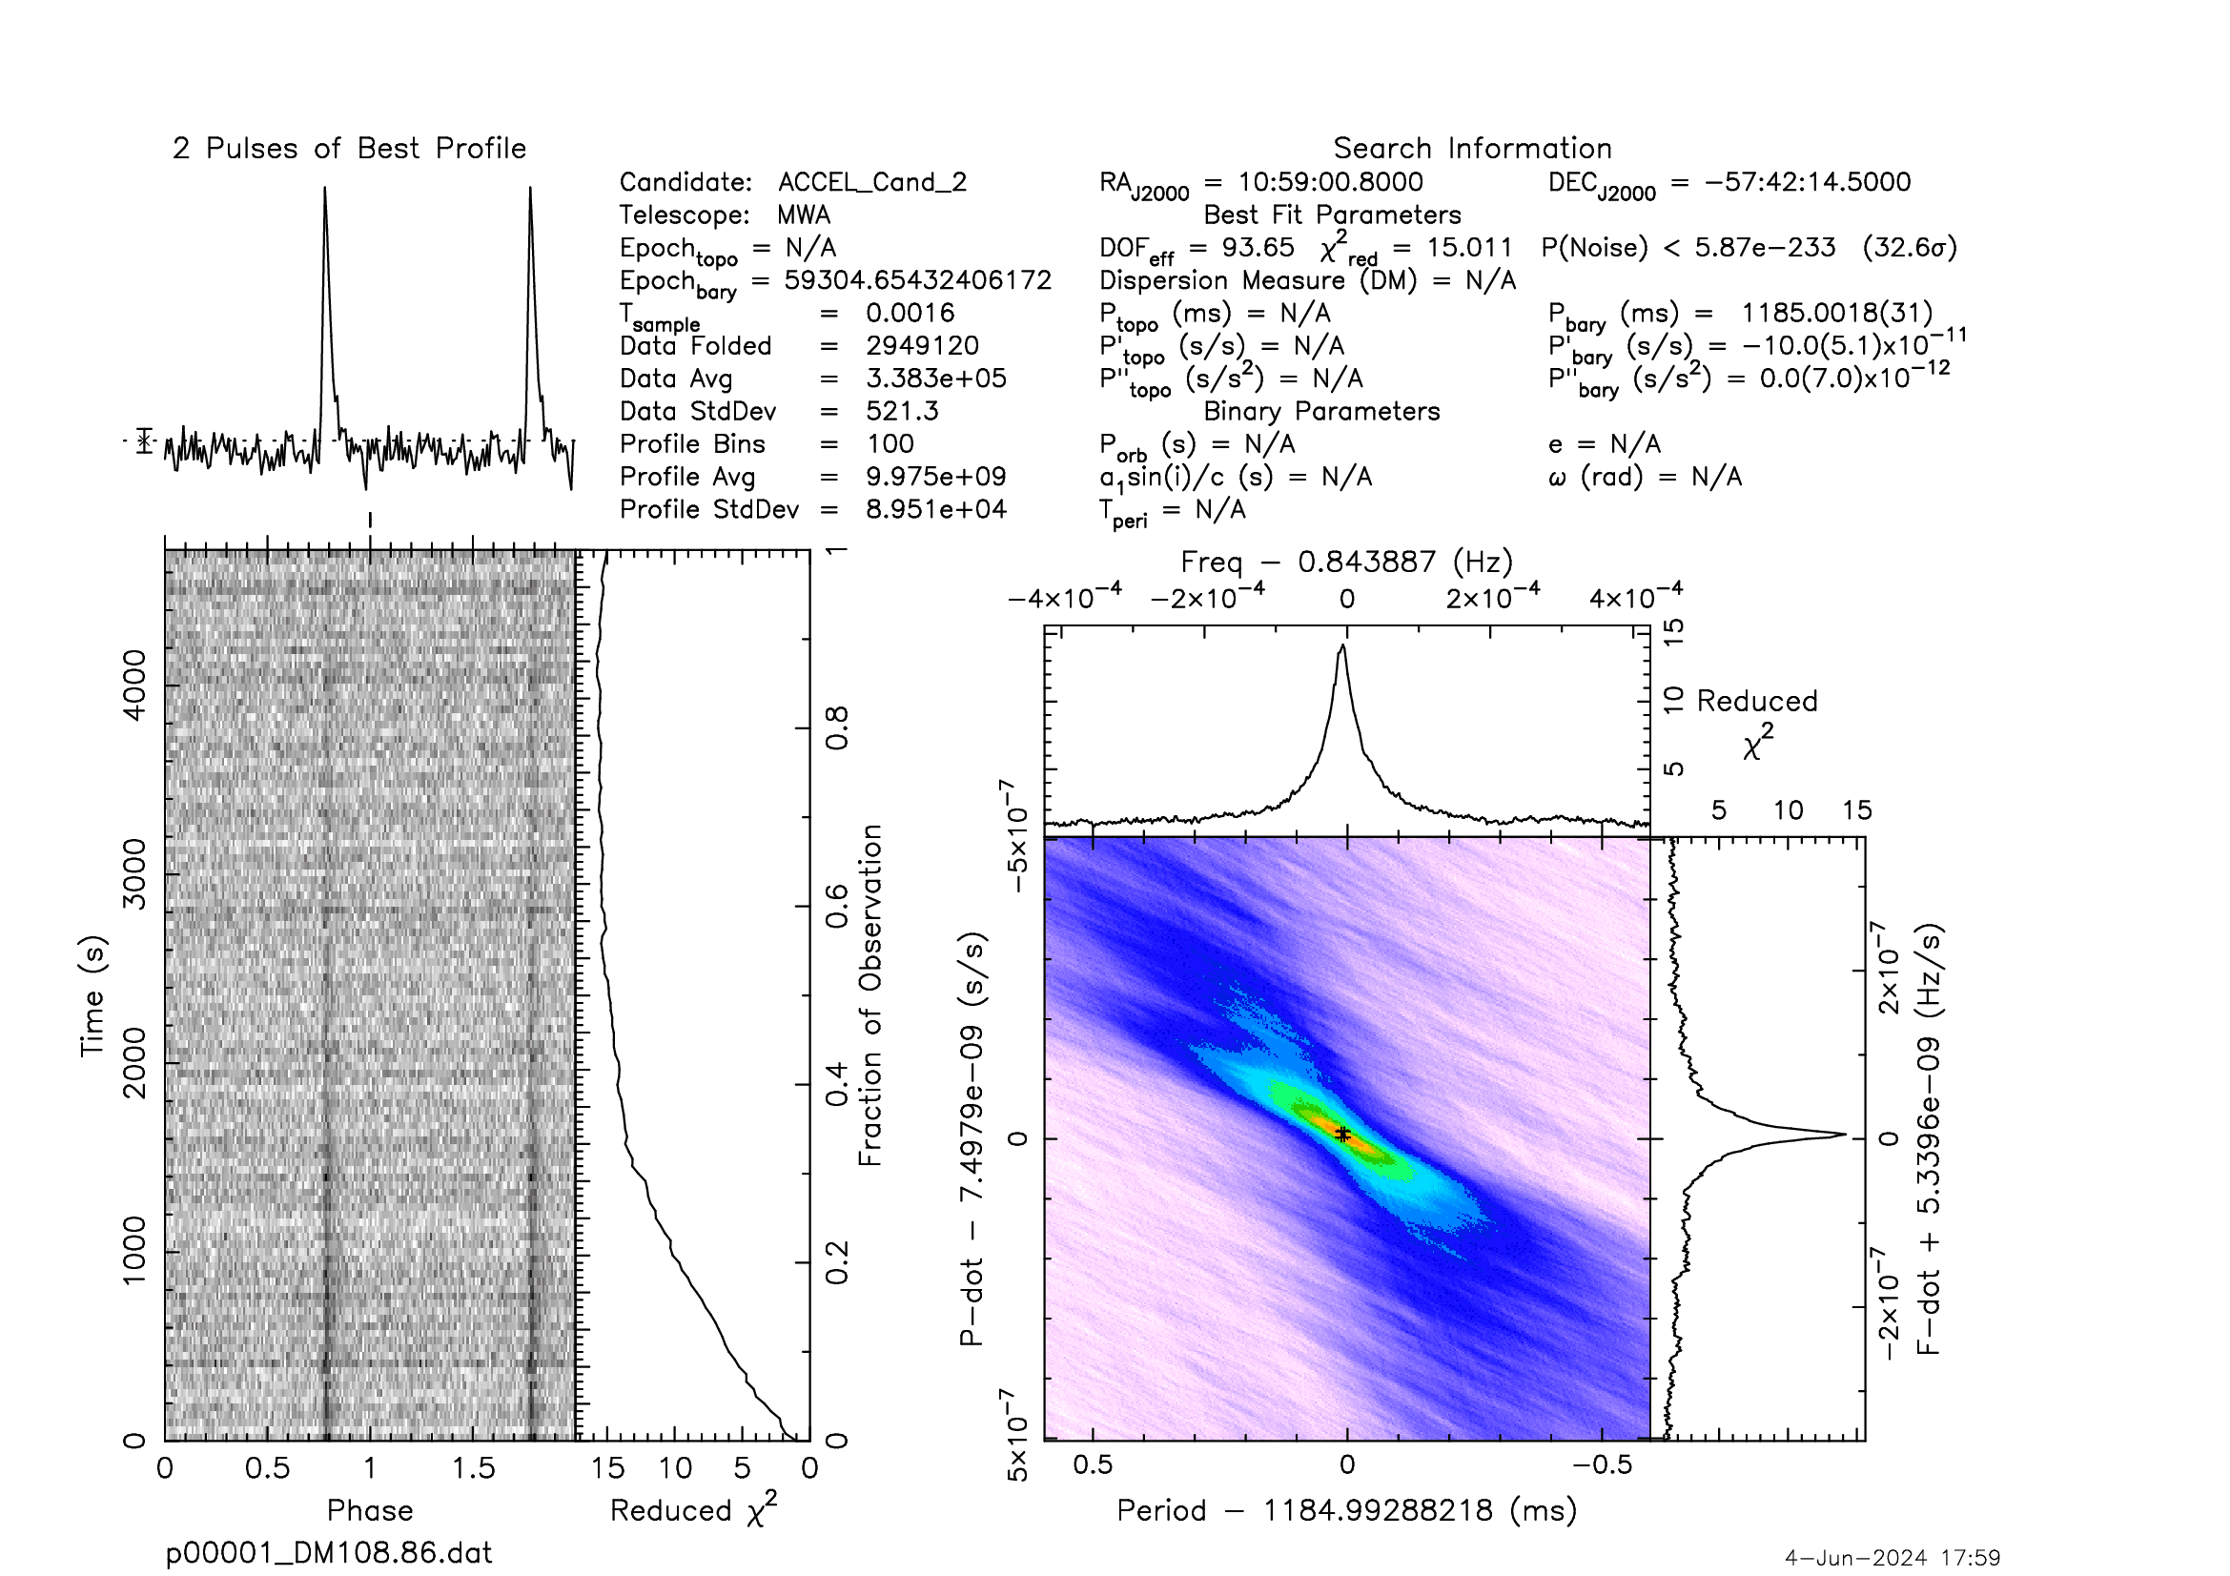
Some known pulsar detections from the test

Slide 21
Future works
Data transfer:
Aim for transfer rest of the legacy (4/51) & MWAX (16/19) data to CNIC
Beamforming and searching on a regular basis:
With a more efficient searching pipeline
Be more selective in choosing the beamforming positions
Hope to make new pulsar detections

