Slide 1


SKA Pulsar Science Symposium 2025 @ Qingdao, July 2025
Constraining the EoS of QCD with lattice results and neutron star observations
Cheng-Ming Li
Institute for Astrophysics, School of Physics, Zhengzhou University
Collaborators：Yong-Feng Huang, Hui-Jun Mu, Fei Wang, Ya-Peng Zhao......
Astrophys. J. 980, 231 (2025), Phys. Rev. D 106, 116009 (2022)

Slide 2
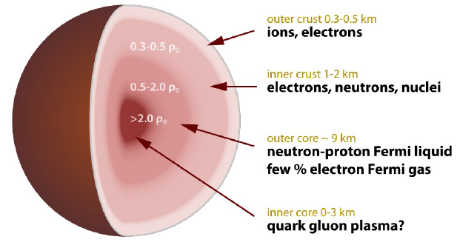

SKA Pulsar Science Symposium 2025 @ Qingdao, July 2025
Backgrounds
Neutron stars:
At present, there are roughly four theoretical models portraying the wreckage left after a supernova explosion:
Hadron star (HS)
Hybrid neutron star (HNS, a neutron star with an extremely dense core containing quark matter that looks like an egg with a yolk)
Quark star (QS)
Strangeon star (SS, formerly known as the star of strange quark-cluster, where quarks are not completely free, but instead there are six quarks or more that form a small collective, which in turn form a large strangeon star)
[X.-Y. Lai and R.-X. Xu, J. Phys.: Conf. Series 861, 012027 (2017)]
2

Slide 3
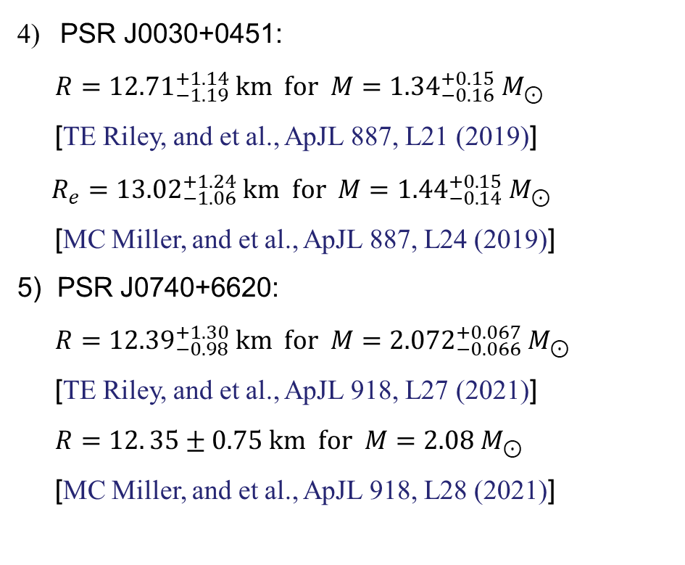
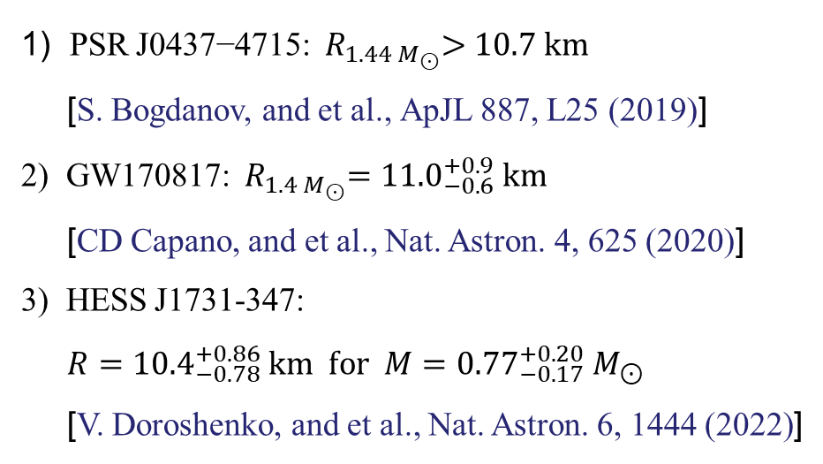
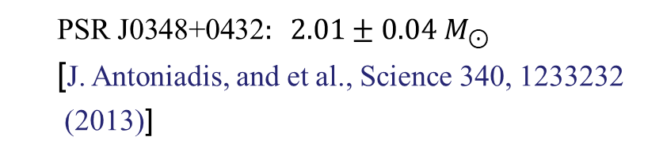
SKA Pulsar Science Symposium 2025 @ Qingdao, July 2025
M-R relations
Recent compact star observations
Mass
$$\text{PSR} \text{J}\text{0348+0432}: 2.01±0.04 M_{⊙}$$
[J. Antoniadis, and et al., Science 340, 1233232
(2013)]
4) PSR J0030+0451:
$R={12.71}_{−1.19}^{+1.14} km for M={1.34}_{−0.16}^{+0.15}{ M}_{⊙}$
[TE Riley, and et al., ApJL 887, L21 (2019)]
$R_{e}={13.02}_{−1.06}^{+1.24} km for M={1.44}_{−0.14}^{+0.15}{ M}_{⊙}$
[MC Miller, and et al., ApJL 887, L24 (2019)]
5) PSR J0740+6620:
$R={12.39}_{−0.98}^{+1.30} km for M={2.072}_{−0.066}^{+0.067}{ M}_{⊙}$
[TE Riley, and et al., ApJL 918, L27 (2021)]
$R=12. 35±0.75 km for M=2.08{ M}_{⊙}$
[MC Miller, and et al., ApJL 918, L28 (2021)]
Radius & Mass
1) PSR J0437−4715:${ R}_{1.44 M_{⊙}}>10.7 km$
[S. Bogdanov, and et al., ApJL 887, L25 (2019)]
2) GW170817:${ R}_{1.4 M_{⊙}}={11.0}_{−0.6}^{+0.9} km$
[CD Capano, and et al., Nat. Astron. 4, 625 (2020)]
3) HESS J1731-347:
$R={10.4}_{−0.78}^{+0.86} km for M={0.77}_{−0.17}^{+0.20}{ M}_{⊙}$
[V. Doroshenko, and et al., Nat. Astron. 6, 1444 (2022)]
3

Slide 4
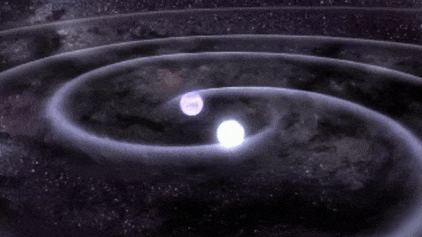
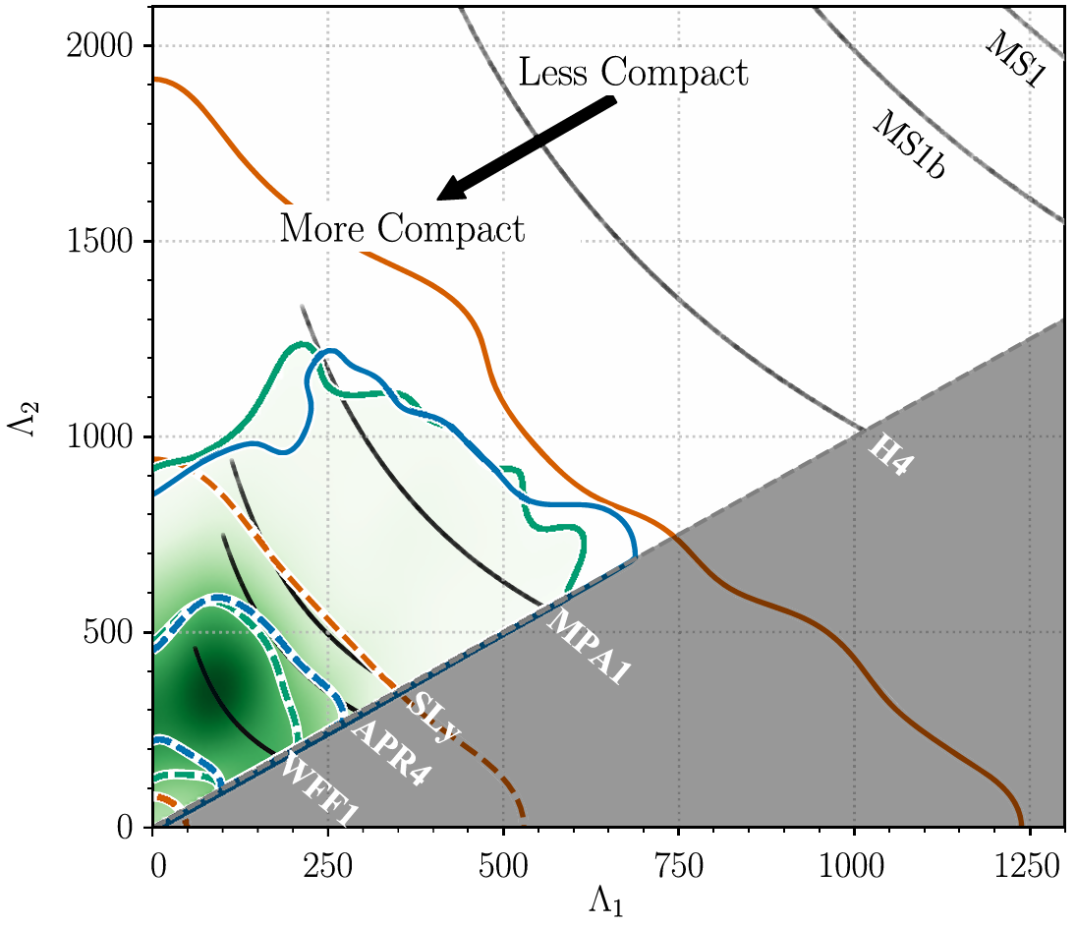
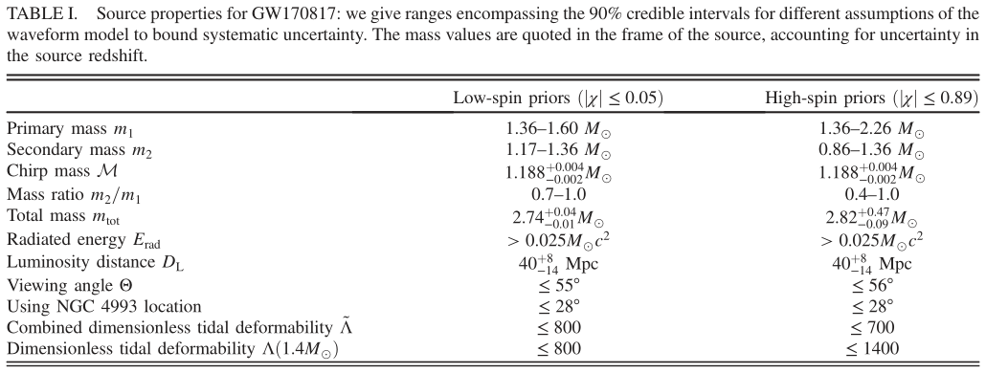
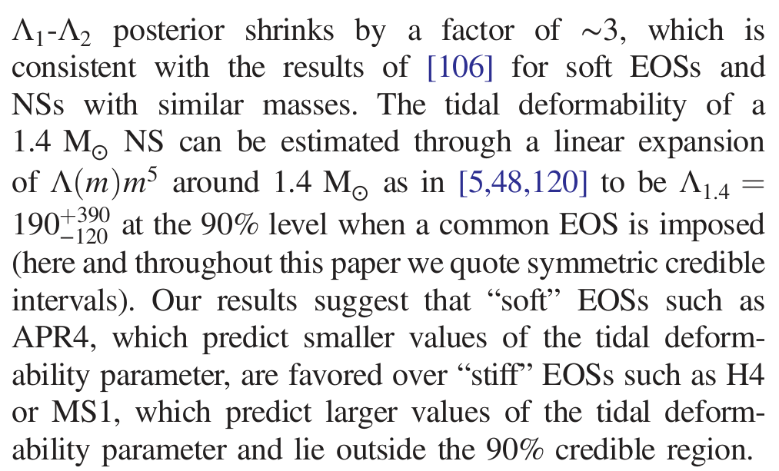
SKA Pulsar Science Symposium 2025 @ Qingdao, July 2025
Tidal deformability
00
[BP Abbott, and et al., PRL 119, 161101 (2017)]
[BP Abbott, and et al., PRL 121, 161101 (2018)]
4

Slide 5
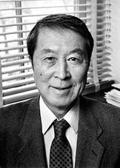
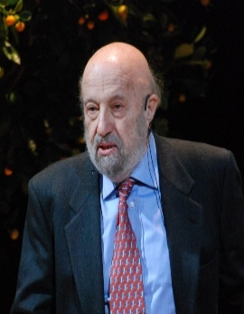
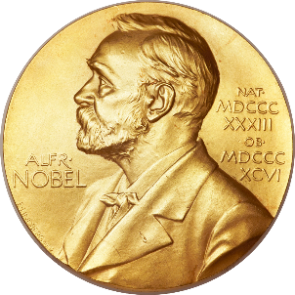
SKA Pulsar Science Symposium 2025 @ Qingdao, July 2025
NJL model
The Nambu–Jona-Lasinio (NJL) Model:
invented by Yoichiro Nambu and Giovanni Jona-Lasinio in 1961 at The University of Chicago
inspired by the BCS theory of superconductivity, is originally a theory of elementary nucleons, and rediscovered as an effective quark theory in the 1980s
“for the discovery of the mechanism of spontaneous broken symmetry in subatomic physics” —— Nobel Committee (2008)
It is a relativistic quantum field theory, and is relatively easy to work with. Furthermore, it is very successful in the description of hadrons, nuclear matter, etc
[Rev. Mod. Phys. 64, 649 (1992), Phys. Rep. 407, 205 (2005), Phys. Rev. 122, 345 (1961), Phys. Rev. 124, 246 (1961)]
5

Slide 6
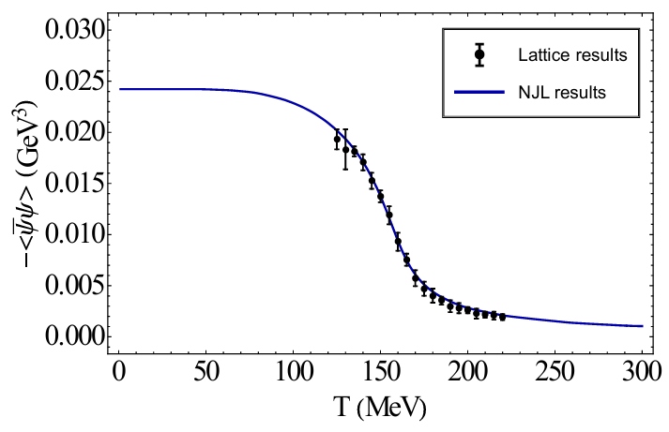
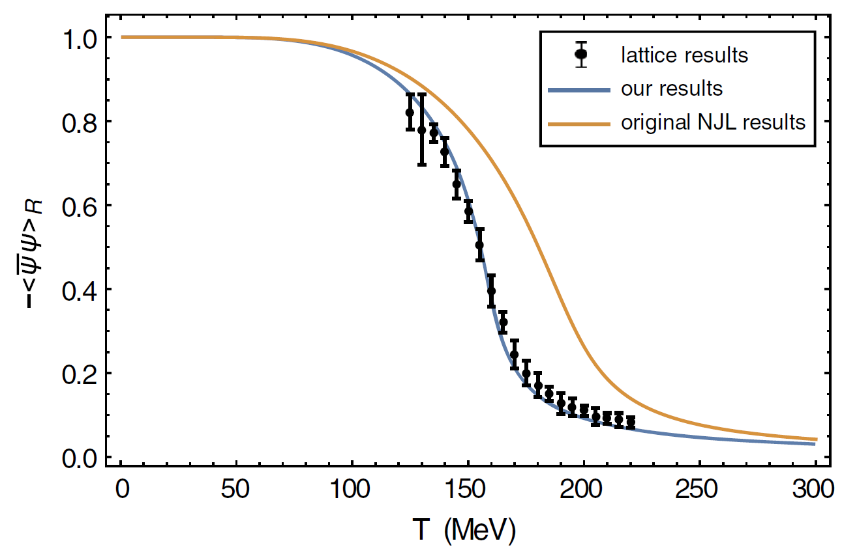
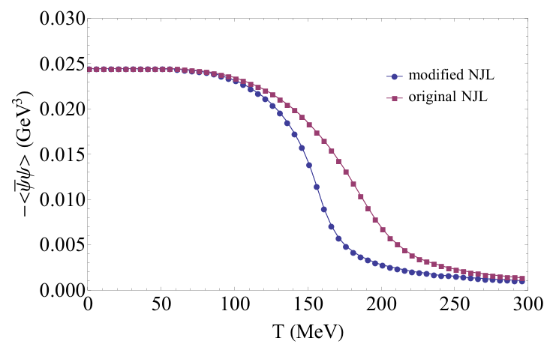
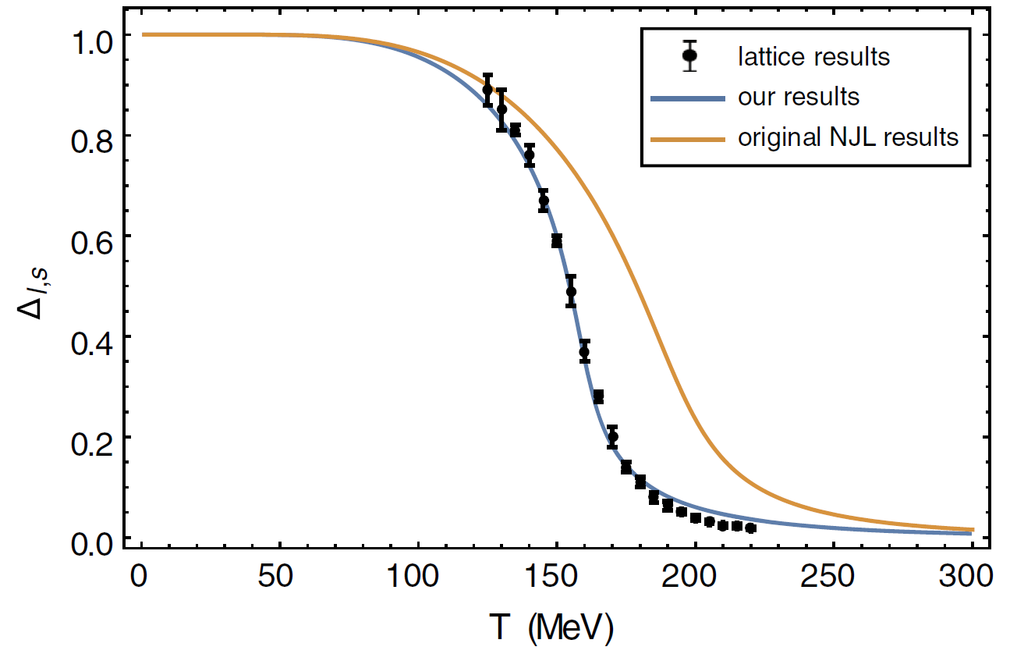
NJL model
SKA Pulsar Science Symposium 2025 @ Qingdao, July 2025
Z.-Y. Fan et al., MPLA, 32, 1750107 (2017)
C.-M. Li et al., PhRvD, 97, 103013 (2018)
6

Slide 7
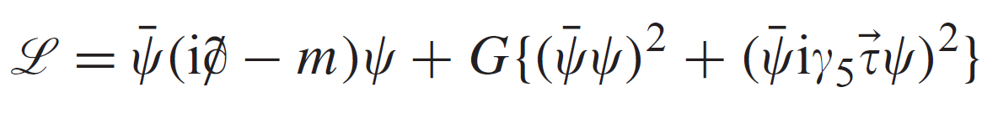
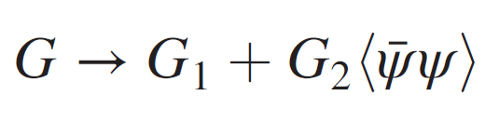

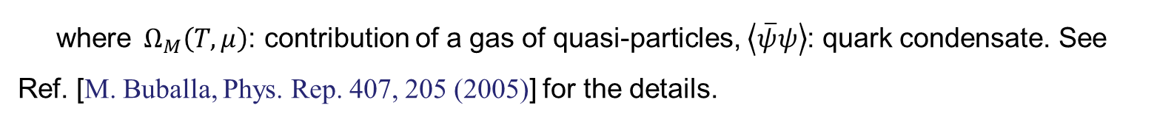
SKA Pulsar Science Symposium 2025 @ Qingdao, July 2025
NJL model
[B. Holdom, and et al., PRL.120.222001 (2018)]: quark matter may not be strange
Nambu-Jona-Lasinio (NJL) model Lagrangian:
Two flavor:
Incorporating the quark condensate into the gluon propagator, thus making it naturally
change with the temperature and chemical potential
2) Making the effective gluon propagator different in Nambu and Wigner phase
Thermodynamic potential
(with Mean Field approximation):
$$Ω\left(T,μ, \left\langle \overline{ψ}ψ\right\rangle \right)=\sum{Ω_{M}}\left(T,μ\right)+G_{1}{\left\langle \overline{ψ}ψ\right\rangle }^{2}+\frac{4}{3}G_{2}{\left\langle \overline{ψ}ψ\right\rangle }^{3}+const.$$
$$G{\left\langle \overline{ψ}ψ\right\rangle }^{2}$$
where${ Ω}_{M}\left(T,μ\right)$: contribution of a gas of quasi-particles, $\left\langle \overline{ψ}ψ\right\rangle$: quark condensate. See Ref. [M. Buballa, Phys. Rep. 407, 205 (2005)] for the details.
7

Slide 8
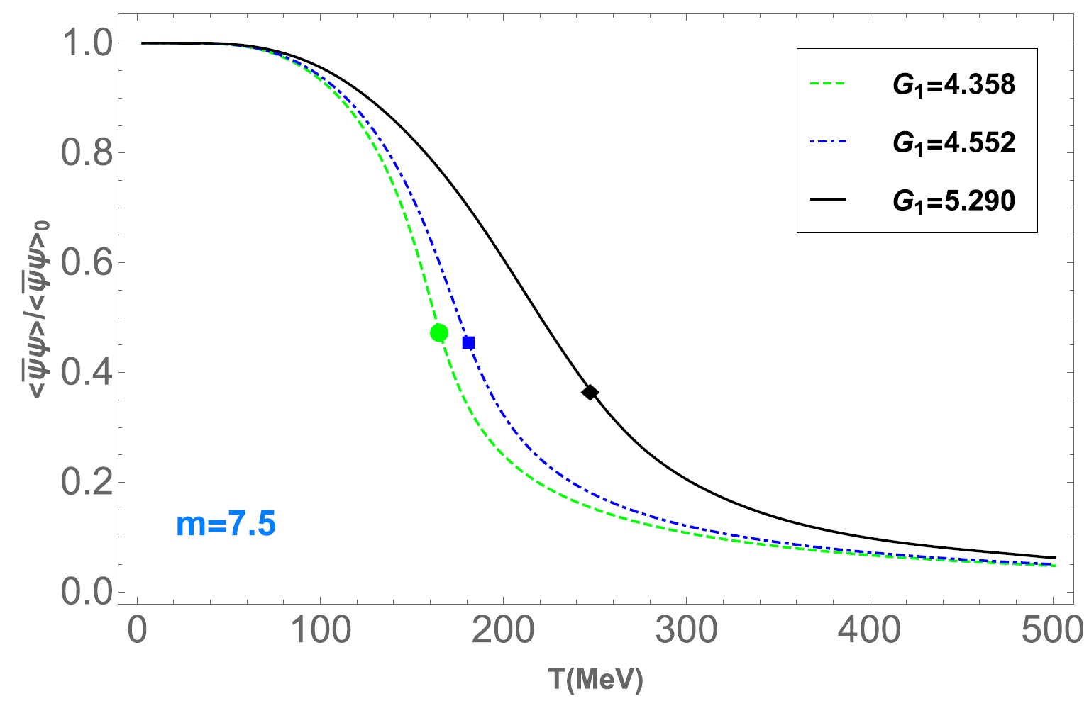
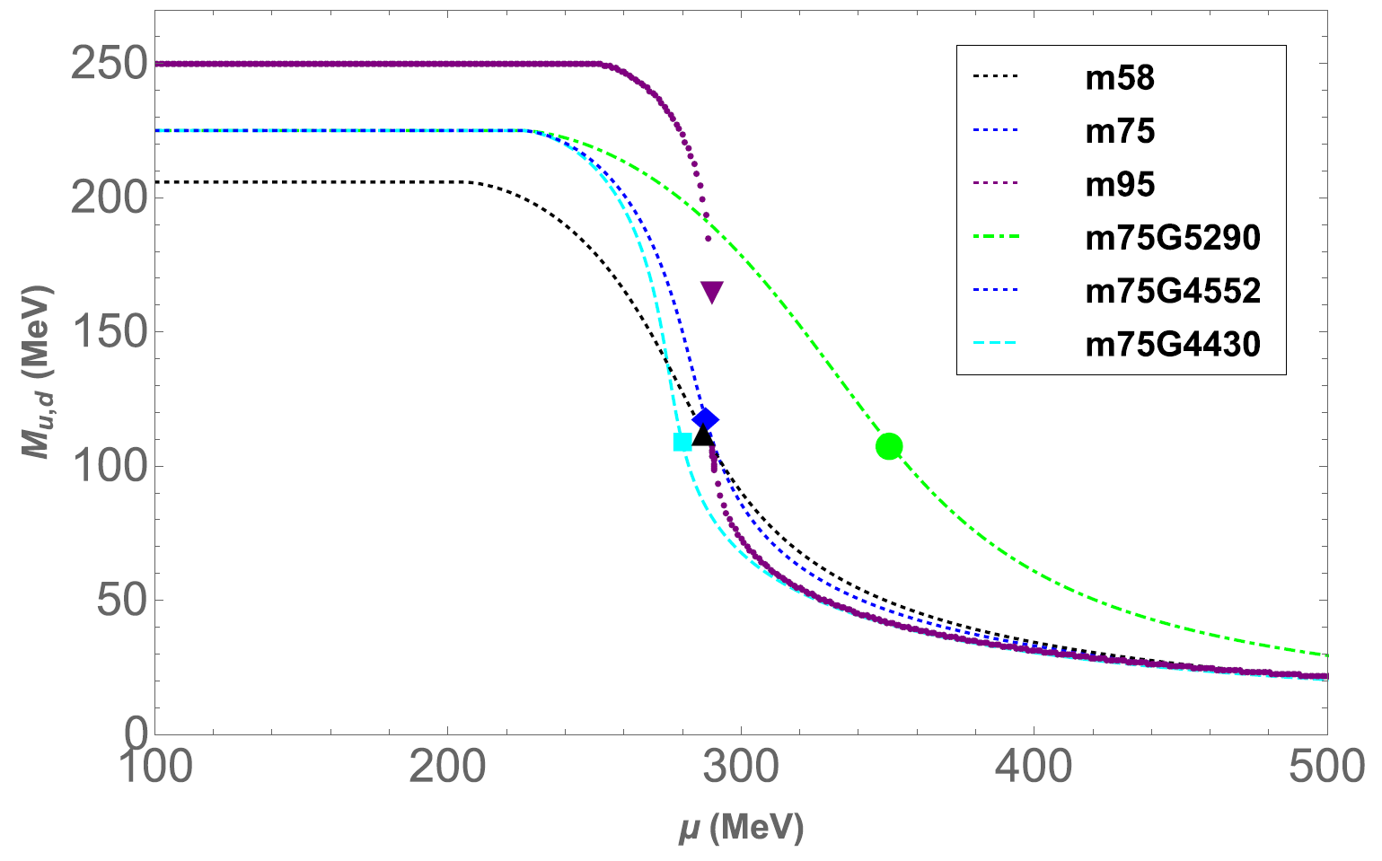
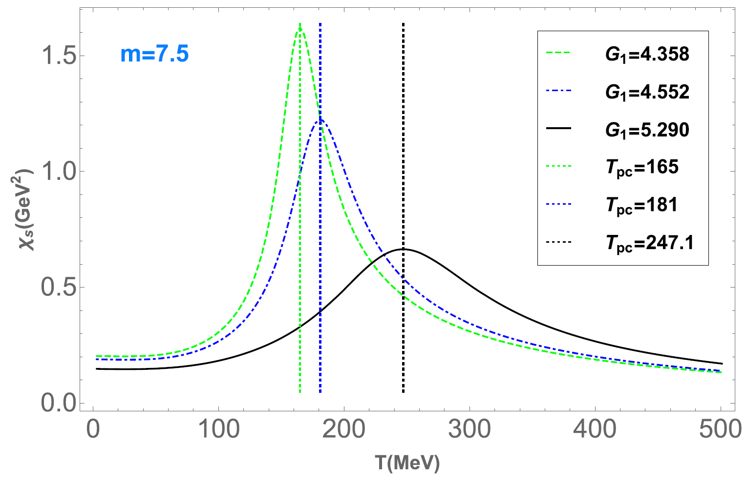
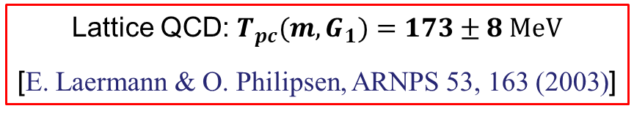
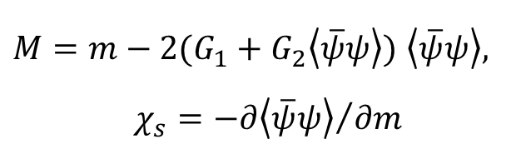
NJL model
SKA Pulsar Science Symposium 2025 @ Qingdao, July 2025
ApJ, 980, 231 (2025)
Gap equations & chiral susceptibility
(with Mean Field approximation)
$M=m−2(G_{1}+G_{2}\left\langle \overline{ψ}ψ\right\rangle )$ $\left\langle \overline{ψ}ψ\right\rangle ,$
$$χ_{s}={−∂\left\langle \overline{ψ}ψ\right\rangle }/{∂m}$$
Lattice QCD: $T_{pc}(m,G_{1})=173±8$ MeV
[E. Laermann & O. Philipsen, ARNPS 53, 163 (2003)]
8

Slide 9
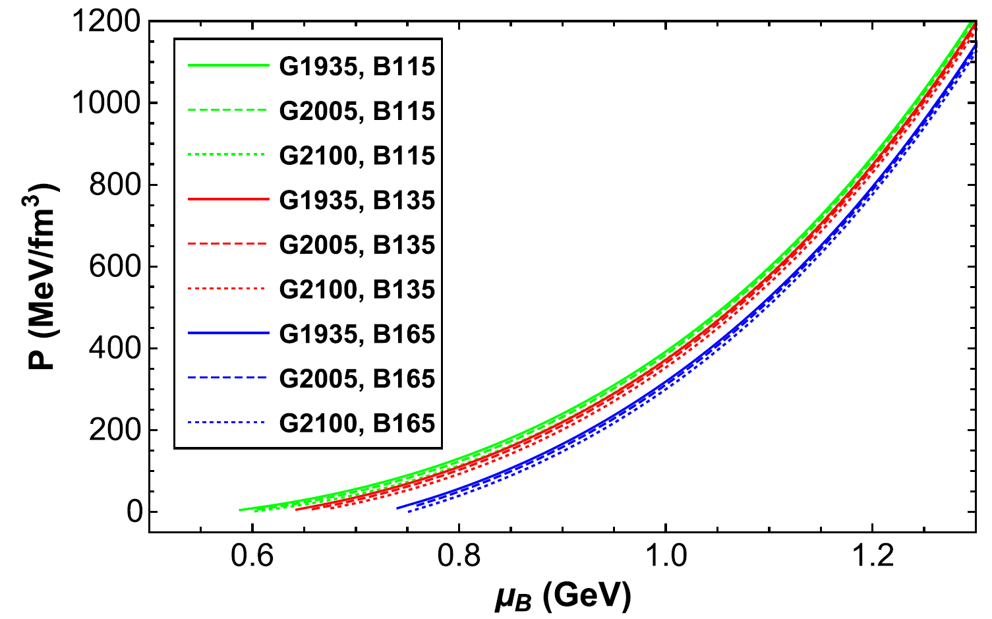
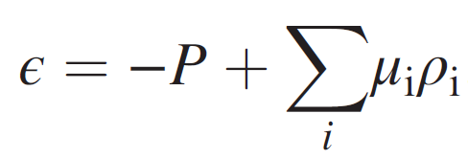
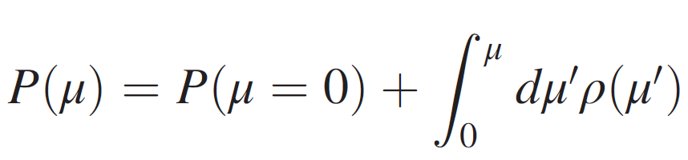
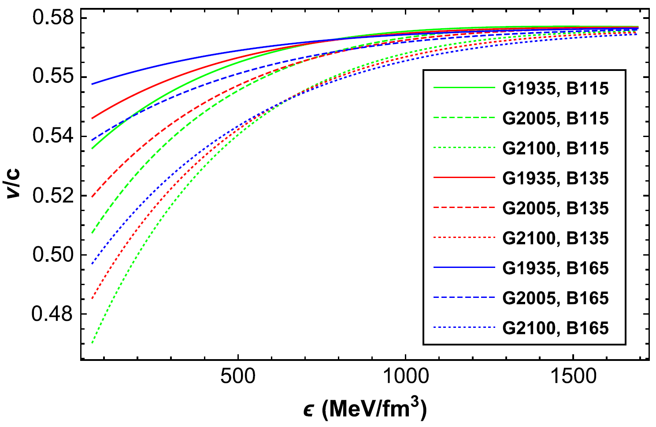
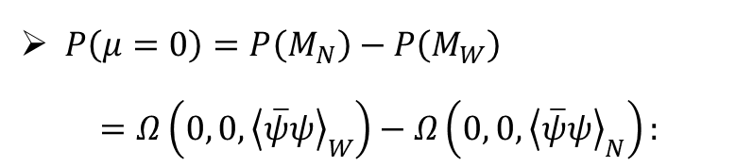

Equation of state
SKA Pulsar Science Symposium 2025 @ Qingdao, July 2025
PhRvD, 106, 116009 (2022)
Equation of state
vacuum pressure
bag constant, $−B$：
[C.-M. Li et al., PhRvD, 95, 056018 (2017)]
$P\left(μ=0\right)=P\left(M_{N}\right)−P\left(M_{W}\right)$
$=Ω\left(0, 0,{\left\langle \overline{ψ}ψ\right\rangle }_{W}\right)−Ω\left(0, 0,{\left\langle \overline{ψ}ψ\right\rangle }_{N}\right):$
[Q.-W. Wang et al., PhRvD, 100, 123003 (2019)]
9

Slide 10
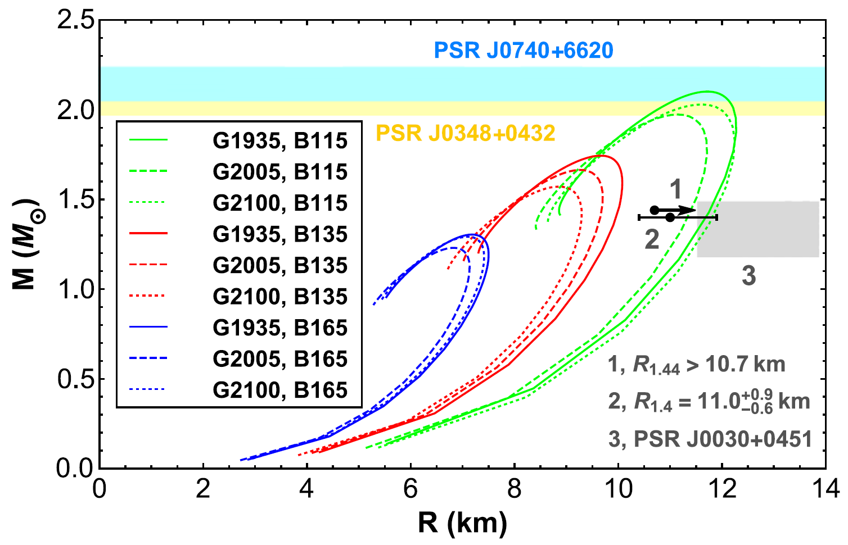

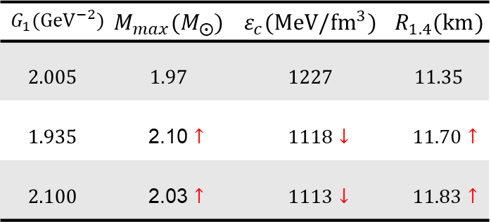
SKA Pulsar Science Symposium 2025 @ Qingdao, July 2025
M-R relations
QS: PhRvD, 106, 116009 (2022)
$m=3.5 MeV$, $B^{1/4}=115 MeV$
$$G_{1}({GeV}^{−2})$$ | $$M_{max}(M_{⨀})$$ | $$ε_{c}(MeV/{fm}^{3})$$ | $$R_{1.4}(km)$$
$$2.005$$ | $$1.97$$ | $$1227$$ | $$11.35$$
$$1.935$$ | 2.10 $↑$ | $1118$ $↓$ | $11.70$ $↑$
$$2.100$$ | 2.03 $↑$ | $1113$ $↓$ | $11.83$ $↑$
10

Slide 11
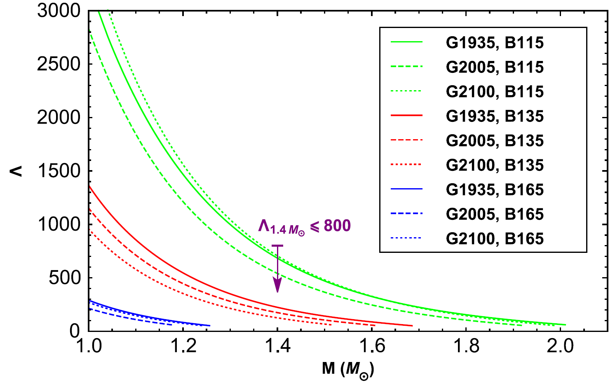
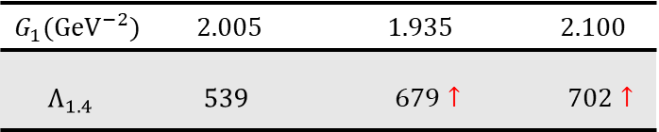

SKA Pulsar Science Symposium 2025 @ Qingdao, July 2025
Tidal deformability
QS: PhRvD, 106, 116009 (2022)
$m=3.5 MeV$, $B^{1/4}=115 MeV$
$$G_{1}({GeV}^{−2})$$ | 2.005 | 1.935 | 2.100
$$Λ_{1.4}$$ | $$539$$ | $679$ $↑$ | $702$ $↑$
11

Slide 12
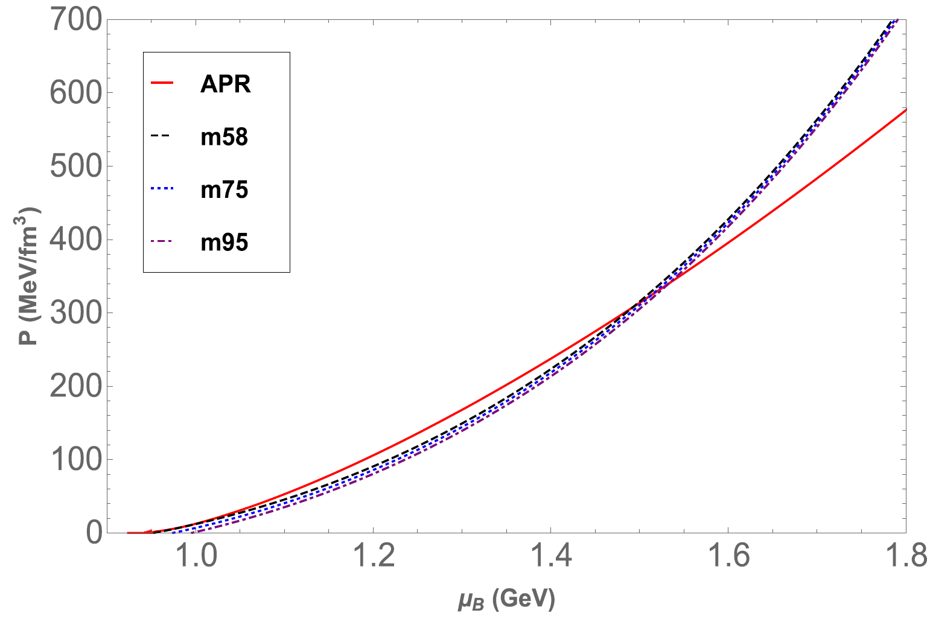
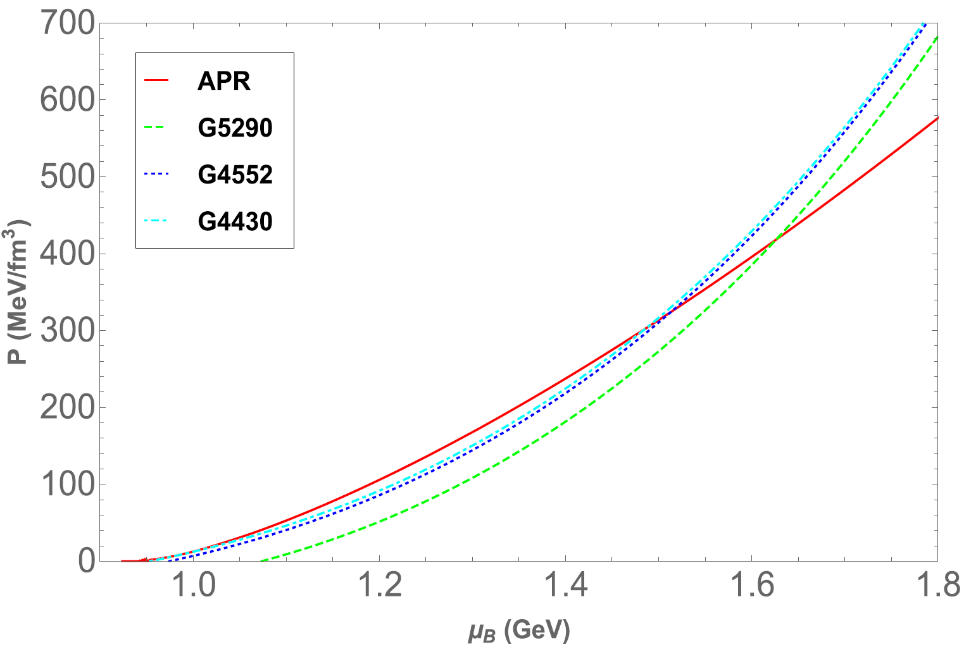
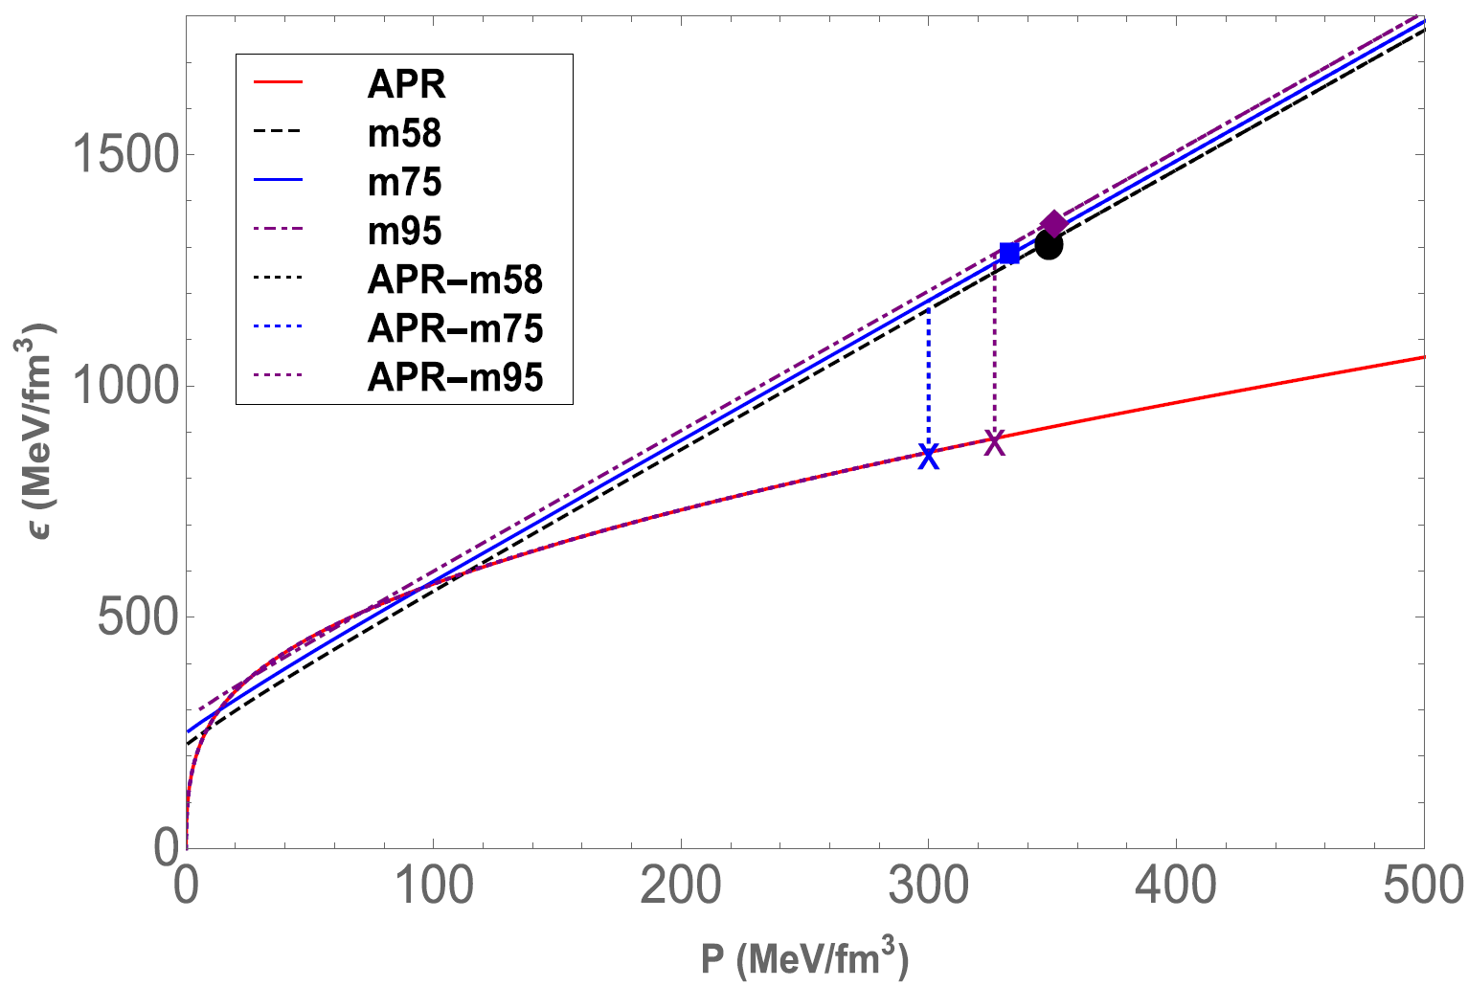
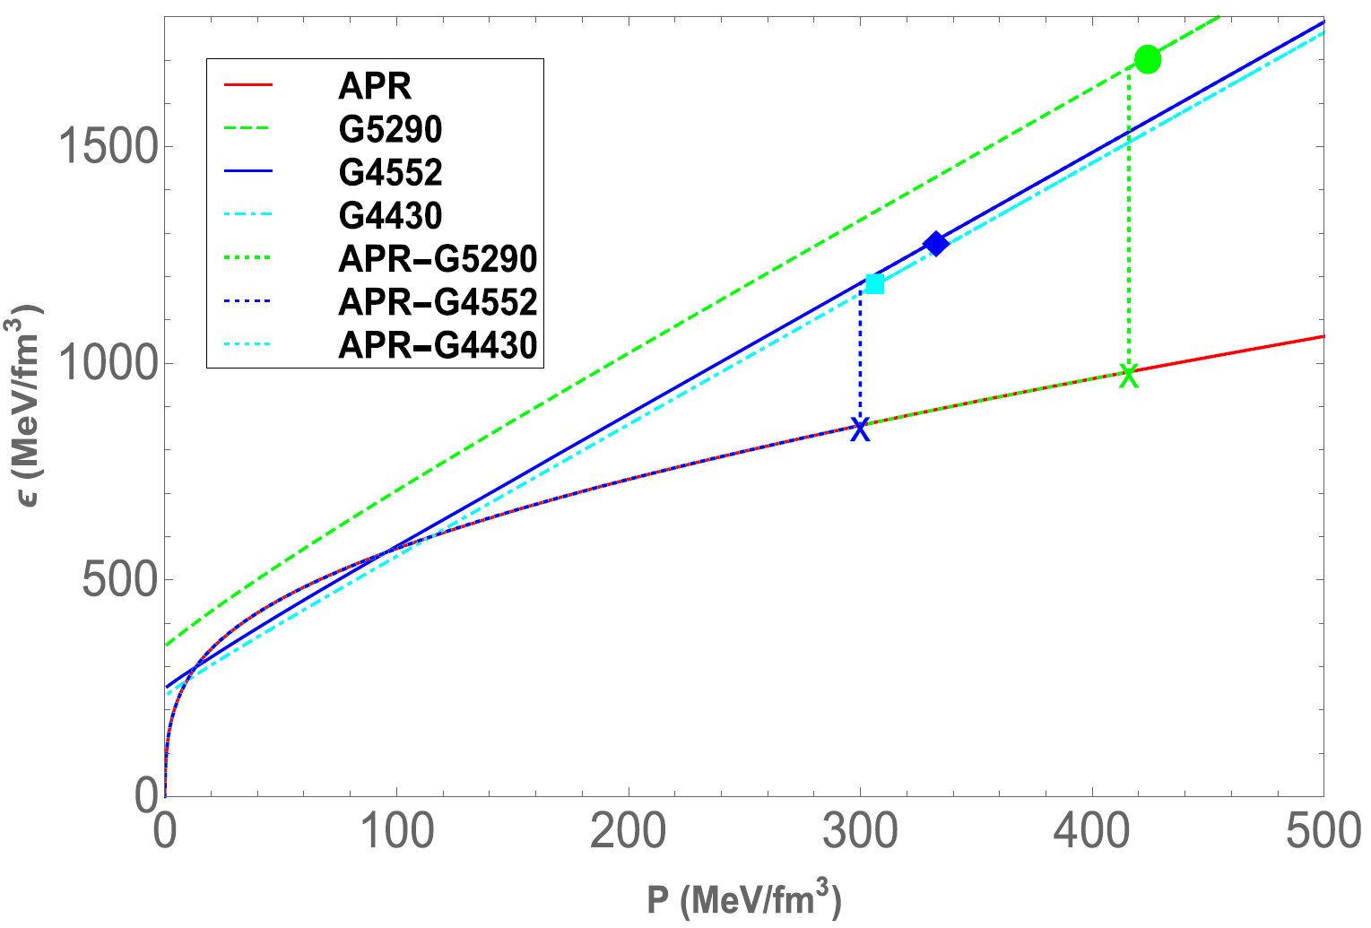
Equation of state
SKA Pulsar Science Symposium 2025 @ Qingdao, July 2025
ApJ, 980, 231 (2025)
12

Slide 13
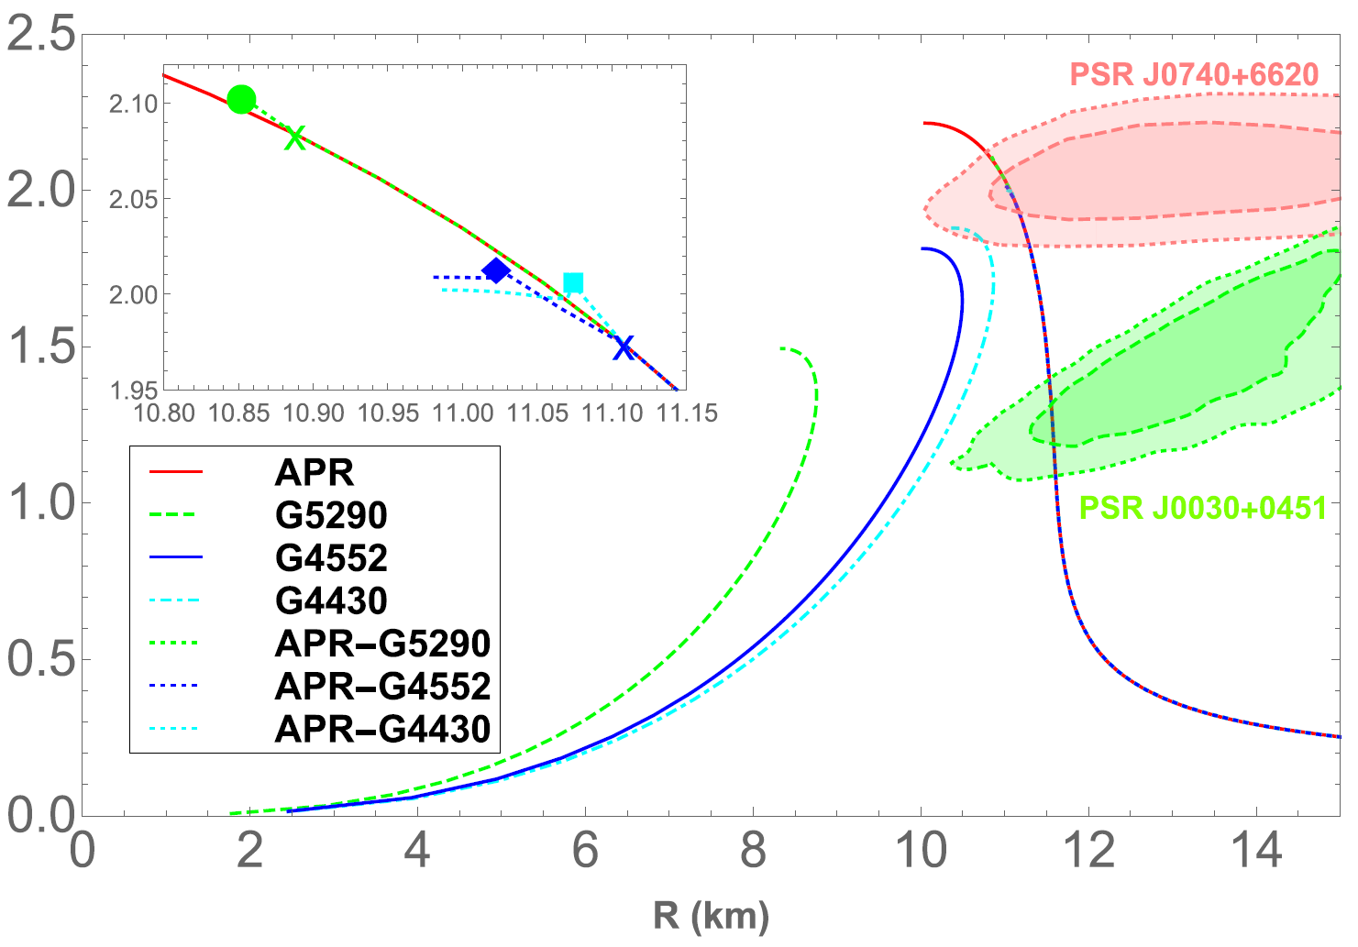
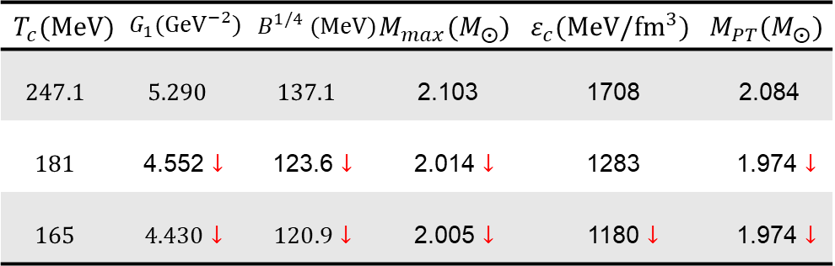

SKA Pulsar Science Symposium 2025 @ Qingdao, July 2025
M-R relations
HNS: ApJ, 980, 231 (2025)
$$m=7.5 MeV$$
$$T_{c}(MeV)$$ | $$G_{1}({GeV}^{−2})$$ | $$B^{1/4} (MeV)$$ | $$M_{max}(M_{⨀})$$ | $$ε_{c}(MeV/{fm}^{3})$$ | $$M_{PT}(M_{⨀})$$
$$247.1$$ | $$5.290$$ | $$137.1$$ | 2.103 | 1708 | 2.084
$$181$$ | 4.552 $↓$ | 123.6 $↓$ | 2.014 $↓$ | 1283 | 1.974 $↓$
$$165$$ | $4.430$ $↓$ | $120.9$ $↓$ | 2.005 $↓$ | 1180 $↓$ | 1.974 $↓$
13

Slide 14
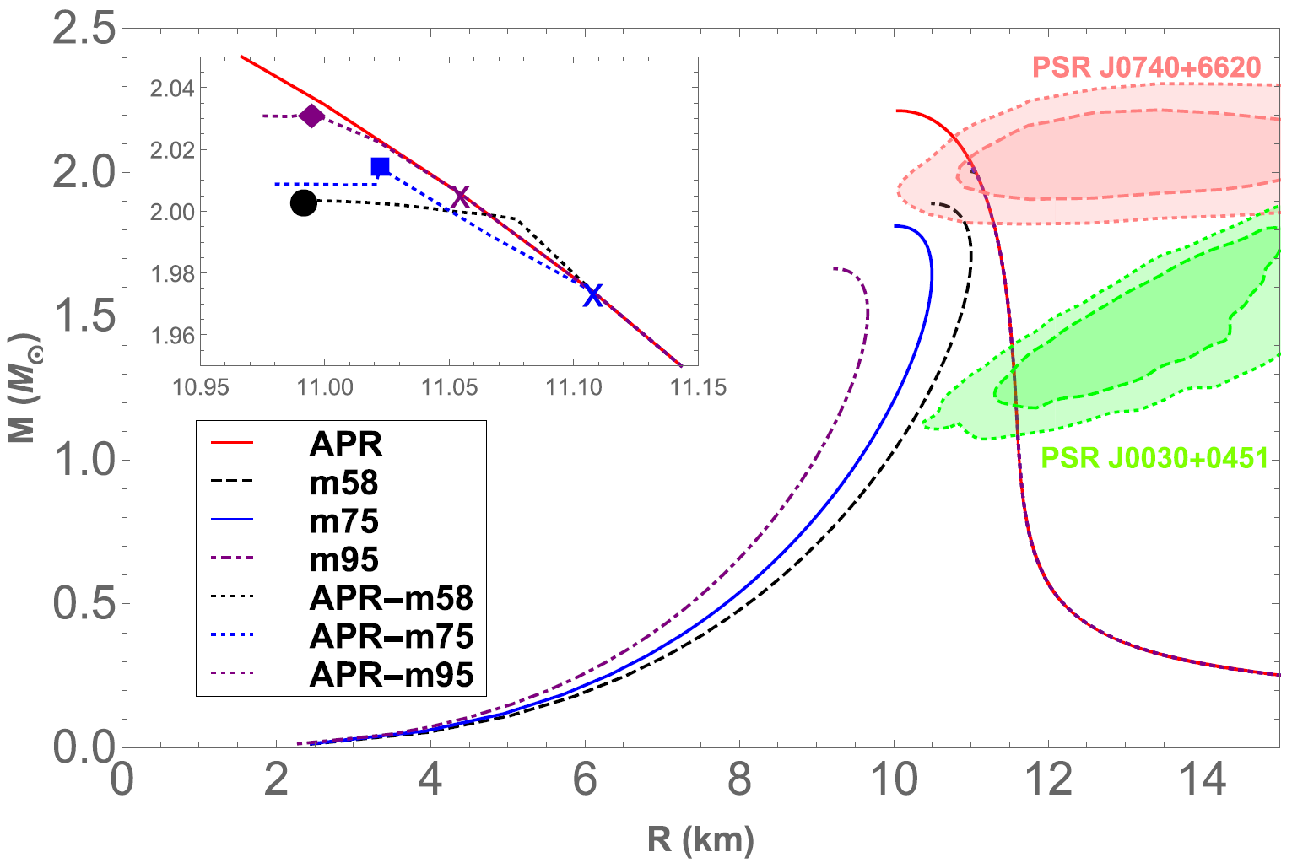

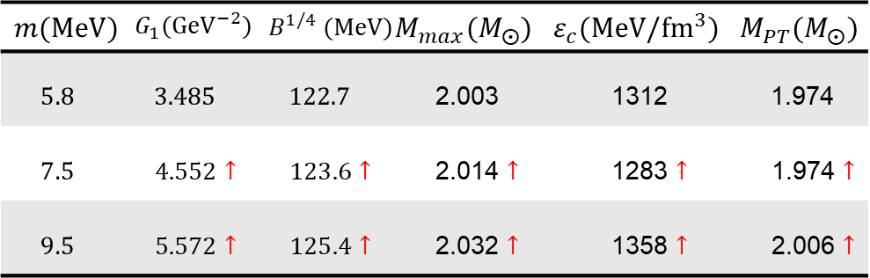
SKA Pulsar Science Symposium 2025 @ Qingdao, July 2025
M-R relations
HNS: ApJ, 980, 231 (2025)
$$T_{c}=181 MeV$$
$$m(MeV)$$ | $$G_{1}({GeV}^{−2})$$ | $$B^{1/4} (MeV)$$ | $$M_{max}(M_{⨀})$$ | $$ε_{c}(MeV/{fm}^{3})$$ | $$M_{PT}(M_{⨀})$$
$$5.8$$ | $$3.485$$ | $$122.7$$ | 2.003 | 1312 | 1.974
$$7.5$$ | $4.552↑$ | $123.6↑$ | 2.014 $↑$ | 1283 $↑$ | 1.974 $↑$
$$9.5$$ | $5.572↑$ | $125.4↑$ | 2.032 $↑$ | 1358 $↑$ | 2.006 $↑$
14

Slide 15
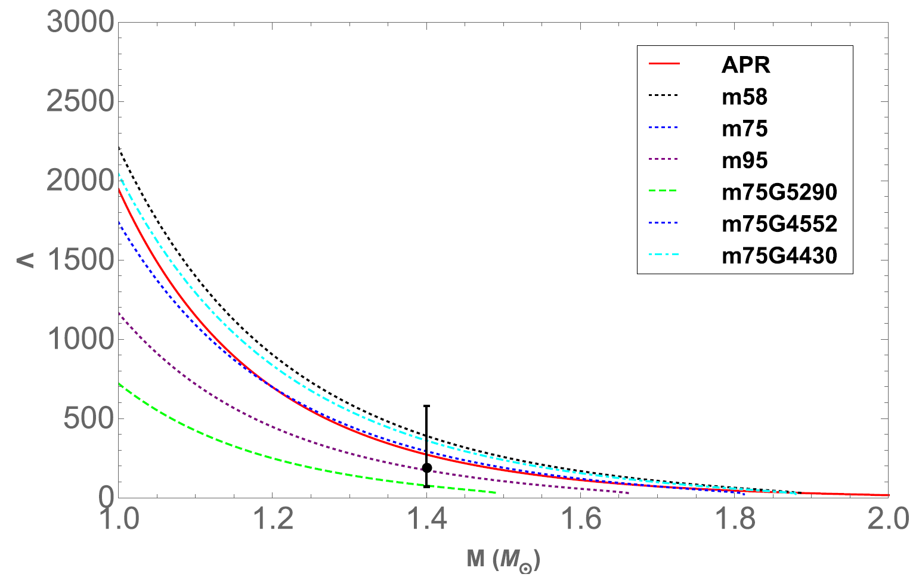

SKA Pulsar Science Symposium 2025 @ Qingdao, July 2025
Tidal deformability
HNS: ApJ, 980, 231 (2025)
$m=5.8, 7.5, 9.5 MeV$, $Λ_{1.4}=272$
15

Slide 16



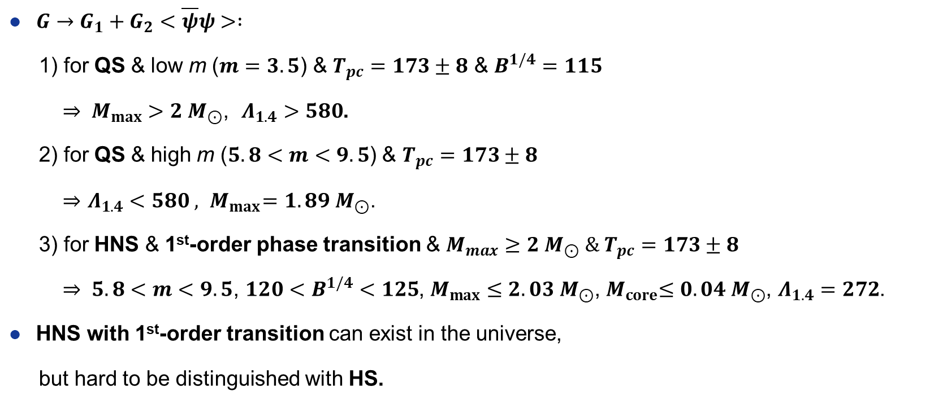
Summary
SKA Pulsar Science Symposium 2025 @ Qingdao, July 2025
Constraining the EoS of QCD with lattice results and neutron star observations
$G→G_{1}+G_{2}<\overline{ψ}ψ> :$
1) for QS & low m ($m=3.5$) & $T_{pc}=173±8$ & $B^{1/4}=115$
$⇒ M_{max}>2 M_{⊙}$, $Λ_{1.4}>580$.
2) for QS & high m ($5.8<m<9.5$) & $T_{pc}=173±8$
$⇒$ $Λ_{1.4}<580 , { M}_{max}=1.89 M_{⊙}$.
3) for HNS & 1st-order phase transition & $M_{max}≥2 M_{⊙} \& T_{pc}=173±8$
$⇒ 5.8<m<9.5$, ${120<B}^{1/4}<125$, $M_{max}≤2. 03 M_{⊙}$,${ M}_{core}≤{0.04 M}_{⊙}$, $Λ_{1.4}=272$.
HNS with 1st-order transition can exist in the universe,
but hard to be distinguished with HS.
16

Slide 17

SKA Pulsar Science Symposium 2025 @ Qingdao, July 2025
17

Slide 18
Backup

Slide 19
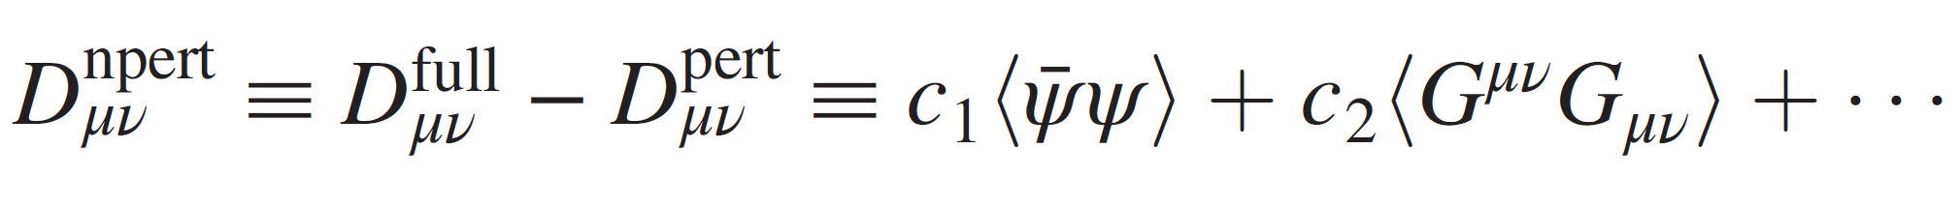
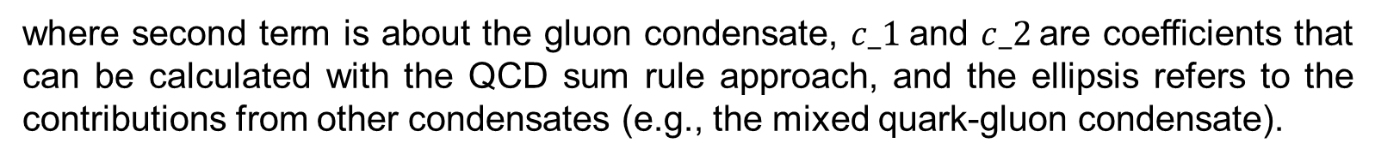
Modification of coupling constant G
PhRvD, 106, 116009 (2022)
According to the plane wave method in QCD sum rule approach [L. Reinders, and et al., Phys. Rep. 127, 1 (1985)], the full Green’s function (which is unknown) can be divided into two parts: the nonperturbative part and the perturbative part. the most general form of the “nonperturbative” gluon propagator is:
where second term is about the gluon condensate, $c_1$and $c_2$are coefficients that can be calculated with the QCD sum rule approach, and the ellipsis refers to the contributions from other condensates (e.g., the mixed quark-gluon condensate).
Among all the condensates, the quark condensate has the lowest dimension, and a nonzero value of this quantity, in the chiral limit, just signals the dynamical chiral symmetry breaking. Thus we will treat its contribution separately, while the contribution of other condensates is included in the perturbative part of the gluon propagator, which is
B.1

Slide 20
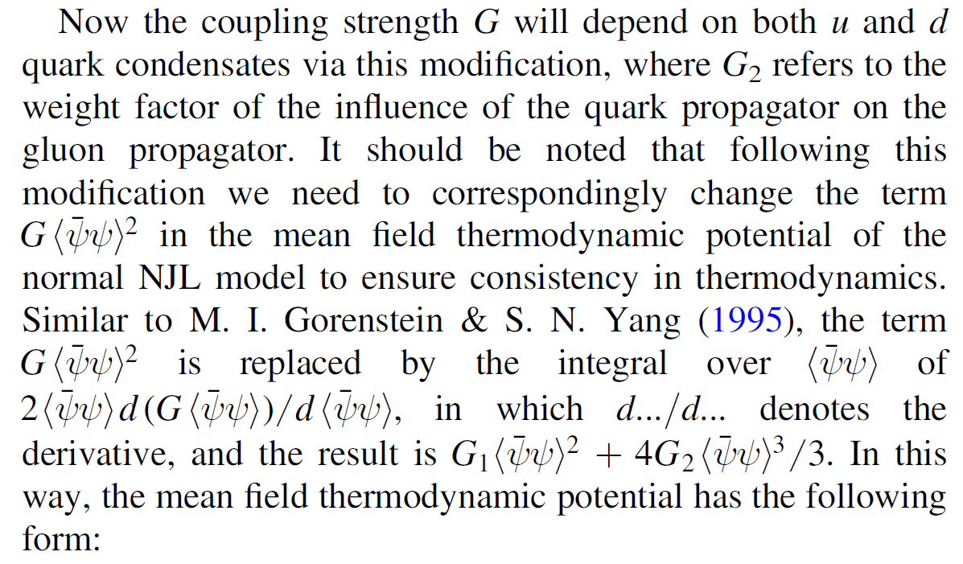
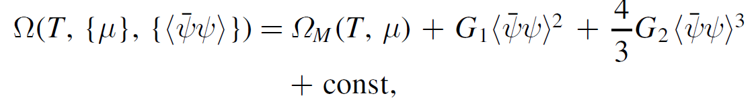
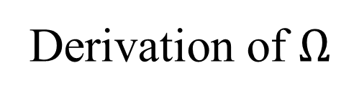
Derivation of $Ω$
ApJ, 980, 231 (2025)
B.2

Slide 21
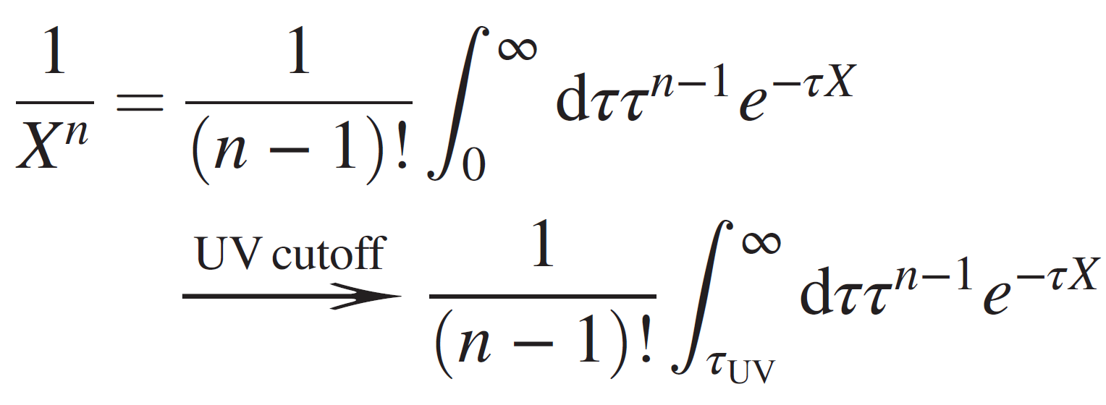
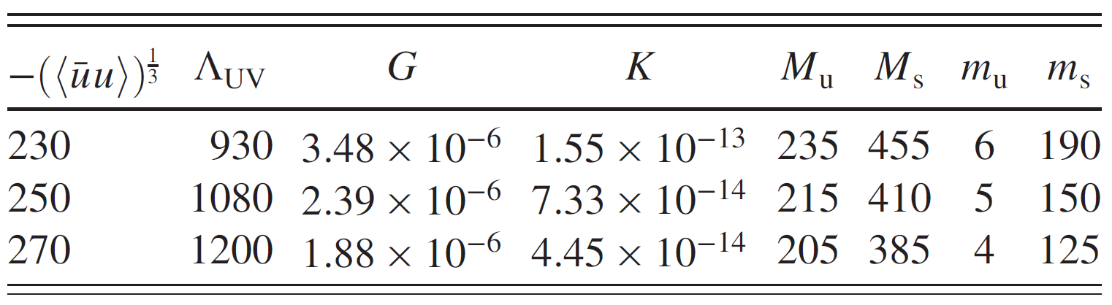
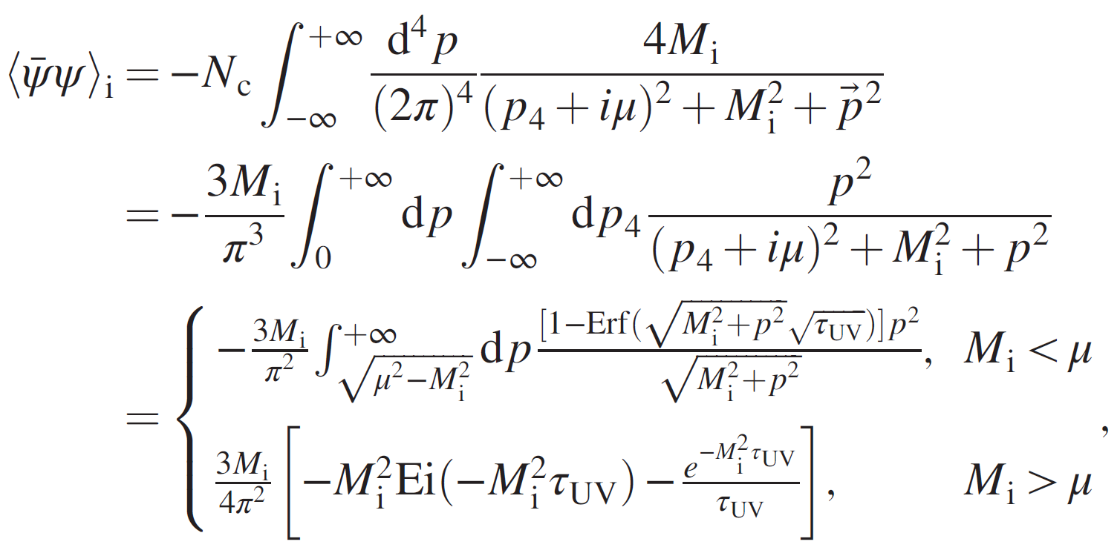

Proper-time regularization
PhRvD, 95, 056018 (2017)
Parameters fixed with PTR
B.3

Slide 22



CPT vs DPT
[Z.-F Cui, and et al., Eur. Phys. J. C 74, 2782 (2014)]
Parameters sets with modification of $G→G_{1}+G_{2}<\overline{ψ}ψ>$
Case (I)
Case (II)
B.4

Slide 23






Tidal deformability
$H\left(r\right):$the metric function
$p$: pressure
$y$:
See Ref. [T. Hinderer, and et al., Phys. Rev. D 81, 123016 (2010)] for the details.
Dimensionless tidal Love number for $l=2:$
Dimensionless tidal deformability for $l=2:$
Dimensionless combined tidal deformability$:$
B.5

Slide 24


Parameter Sets & QS properties
PhRvD, 106, 116009 (2022)
B.6

Slide 25



Parameter Sets & HNS properties
ApJ, 980, 231 (2025)
B.7

