Slide 1



  What can we learn from radio emission of FBOTs
报告人: 刘良端
华中师范大学 天体物理研究所

Slide 2

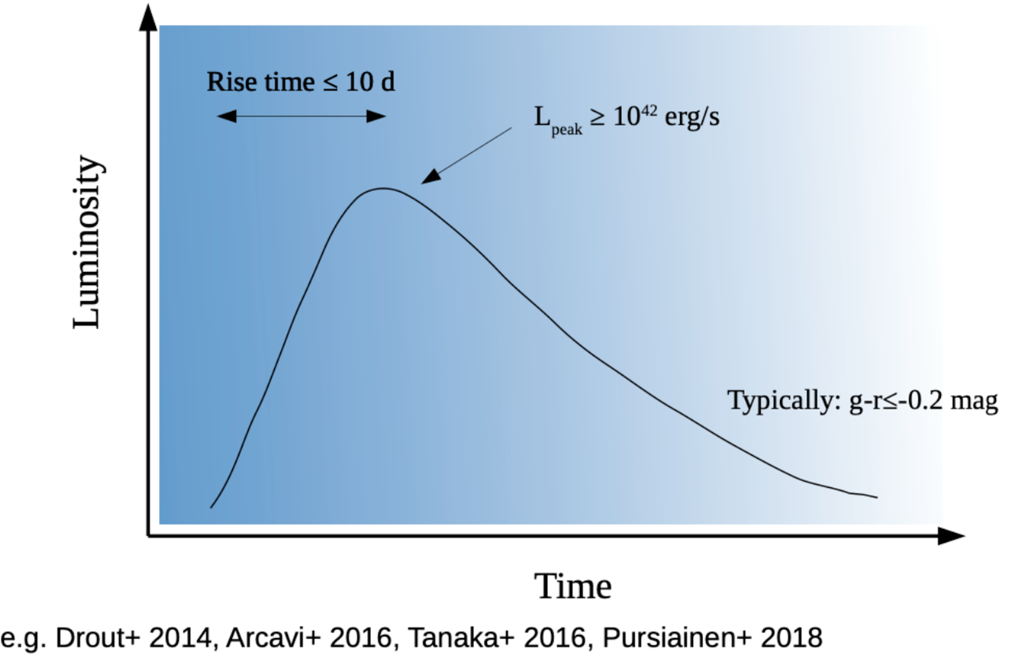
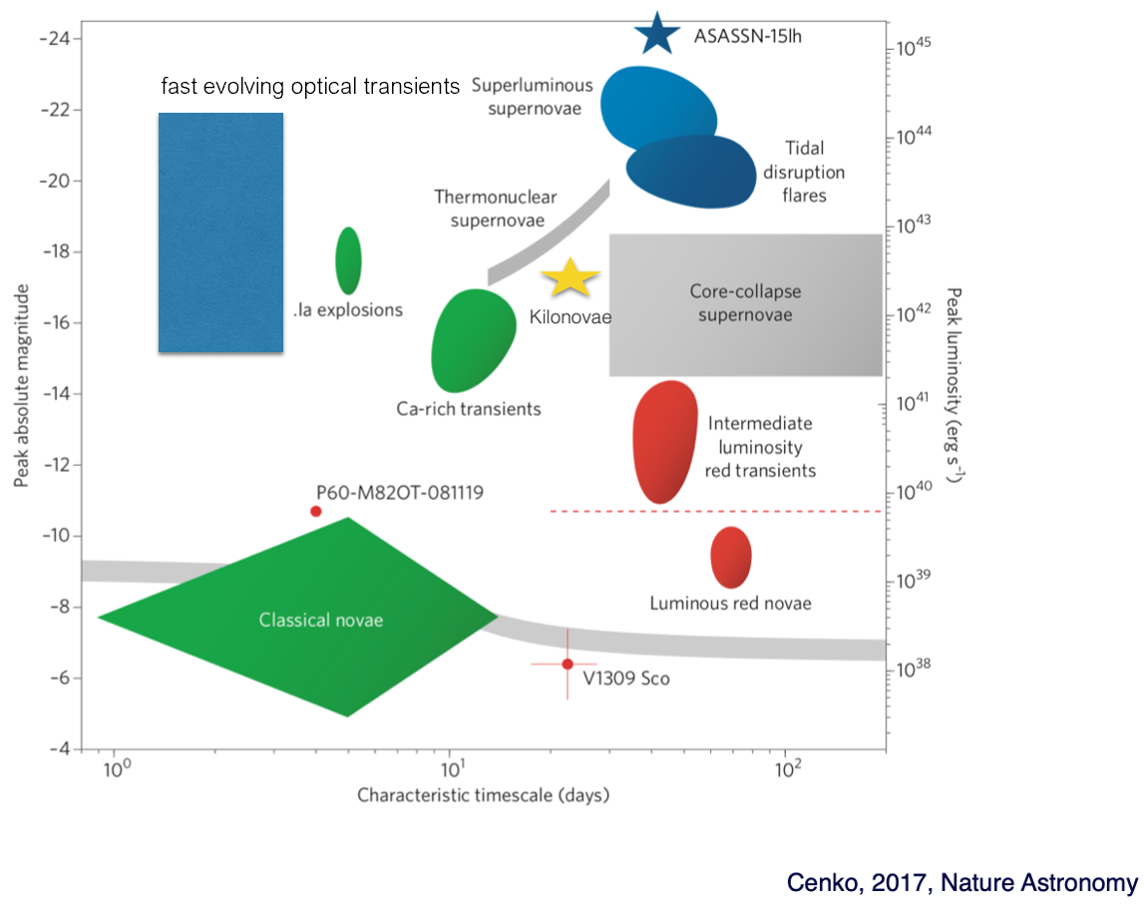
Fast blue optical transients

Slide 3
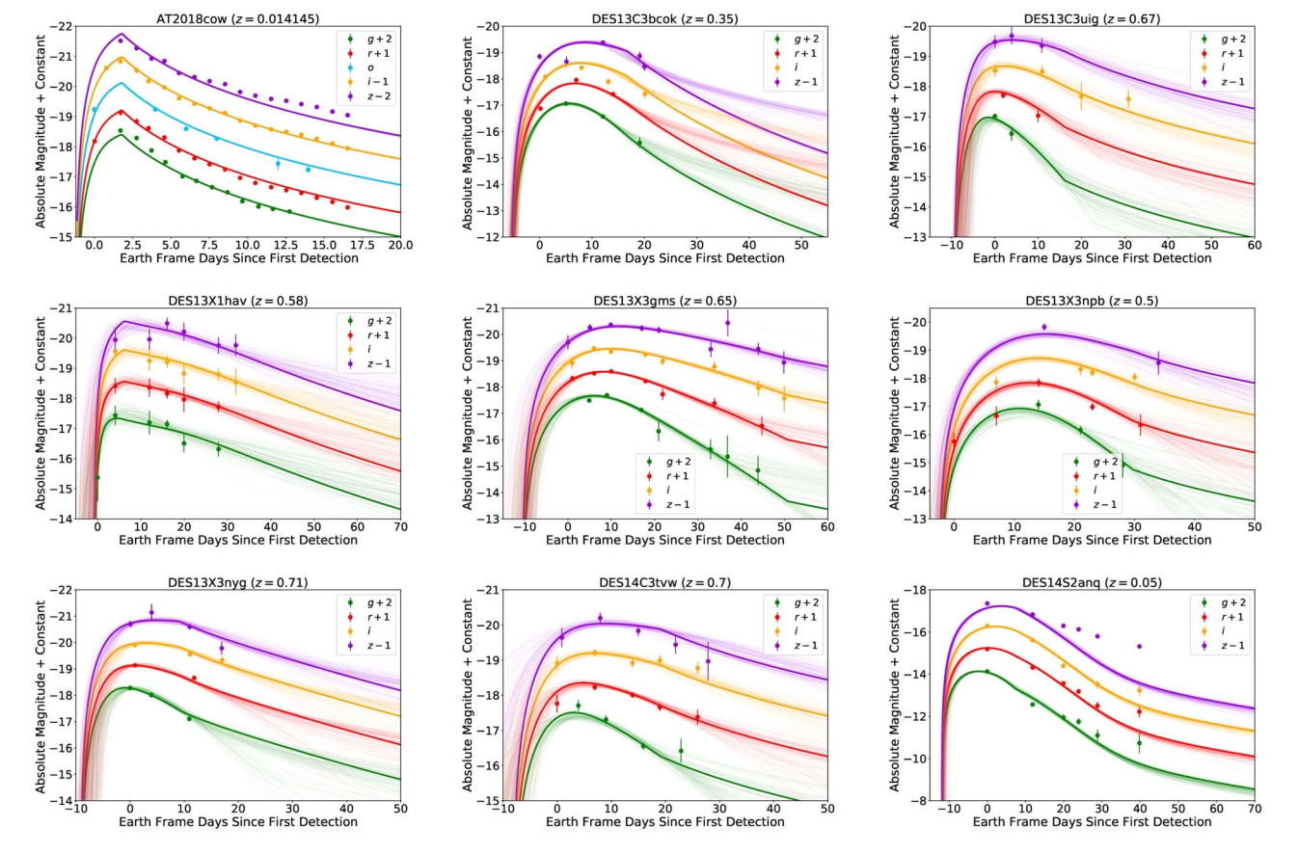
Magnetar powered model for fast blue optical transients
Liu et al. 2022, ApJL,935,34

Slide 4
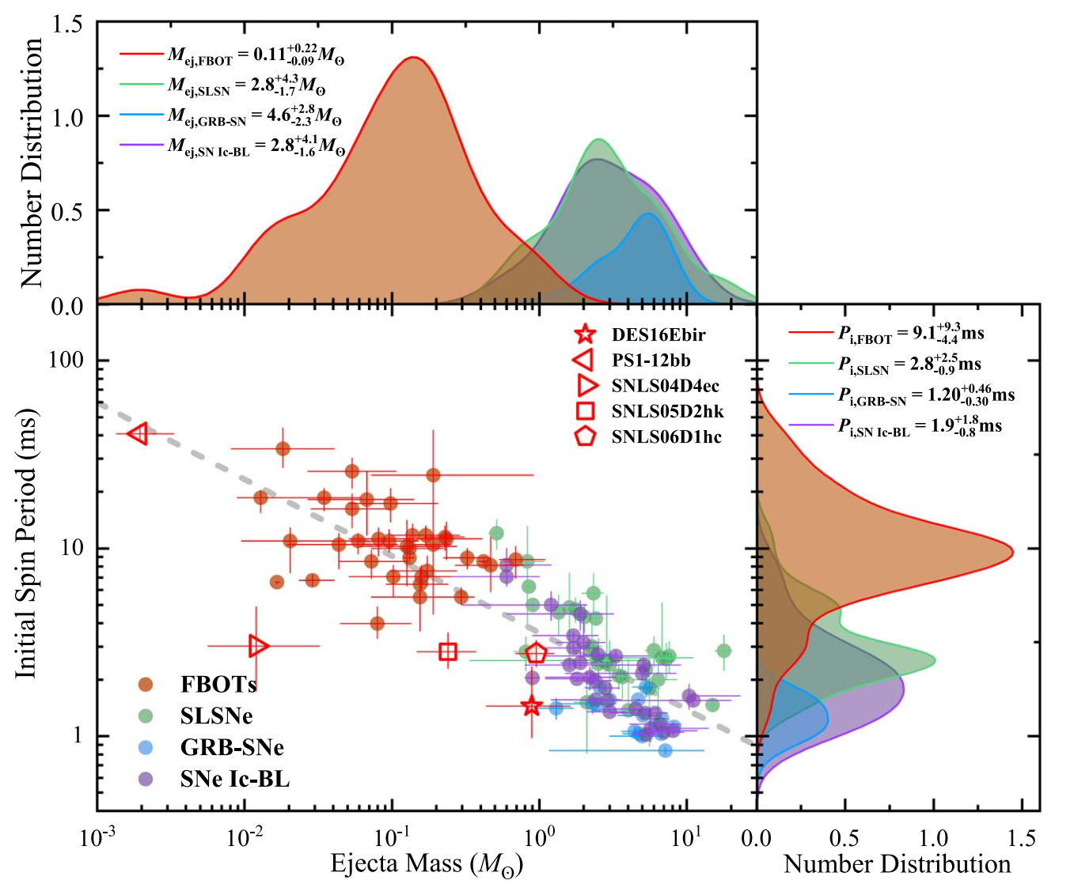
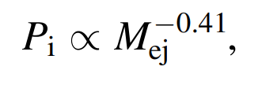
Relationship between initial period of magnetar and ejecta mass
Liu et al. 2022, ApJL,935,34

Slide 5
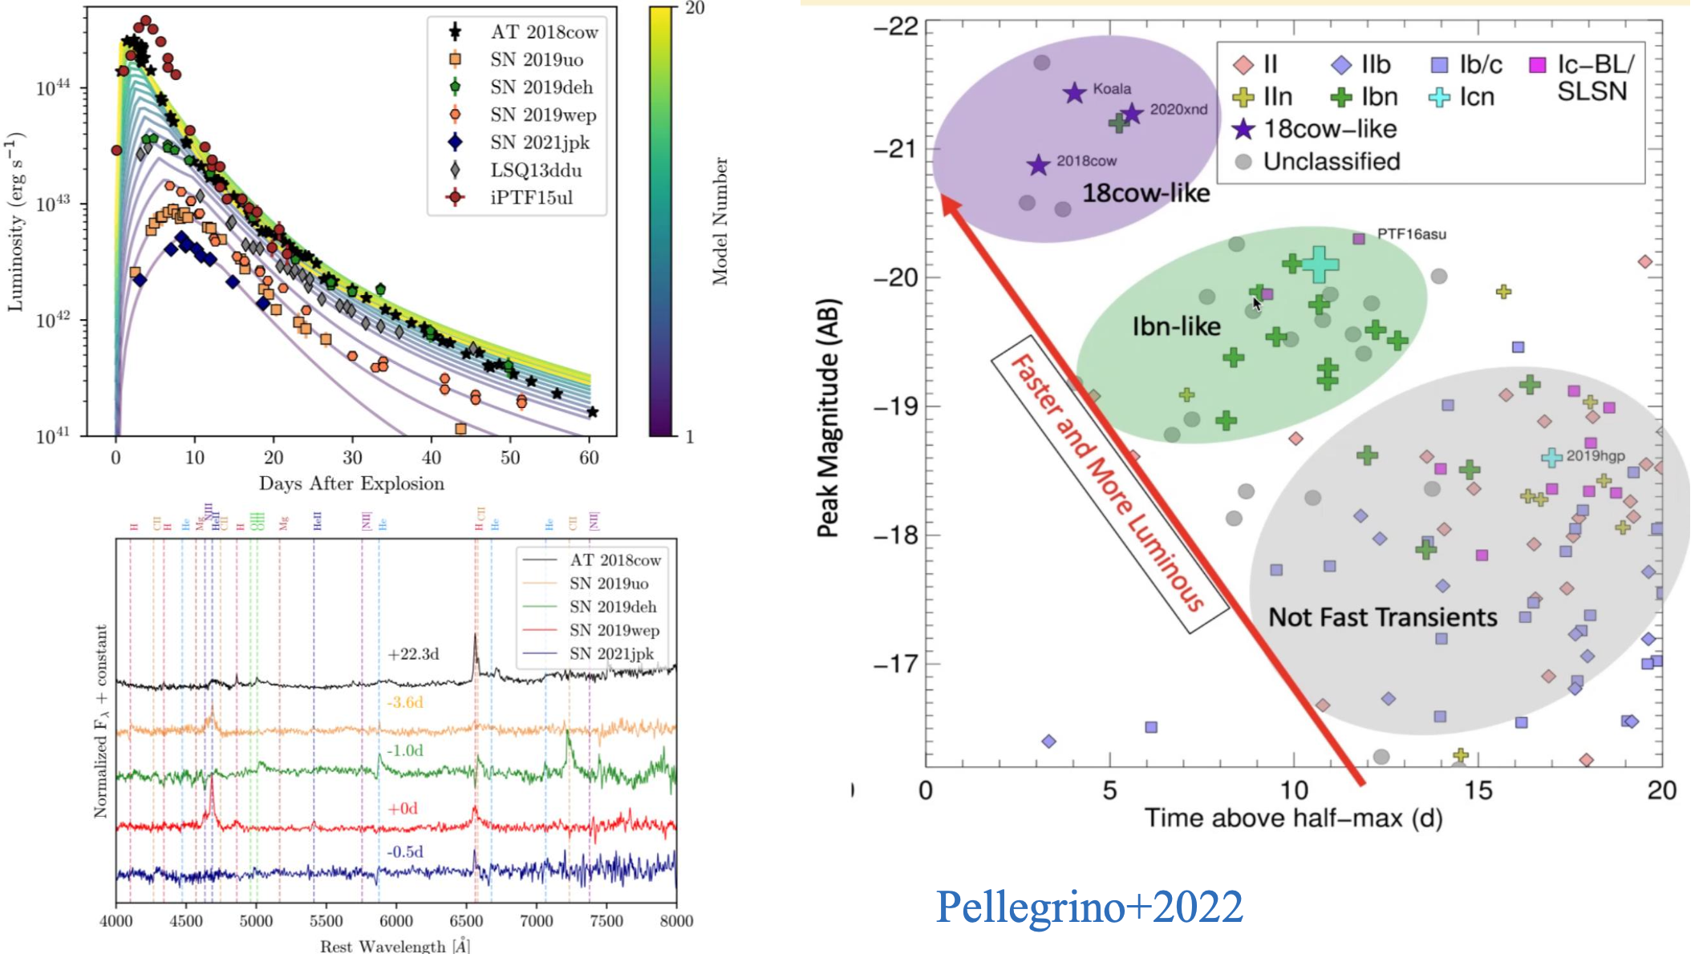
Are FBOT and SN Ibn of the same origin?
Xiang+ 2021

Slide 6
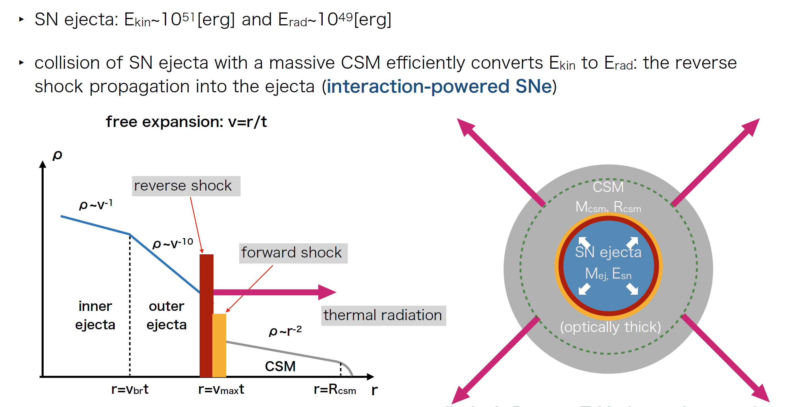
The physical picture of CSM interaction model

Slide 7
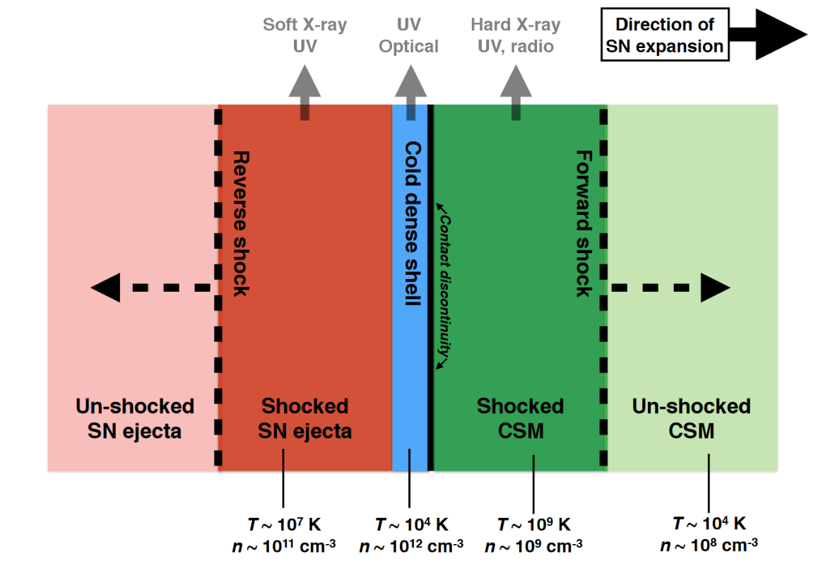
The physical picture of CSM interaction model

Slide 8
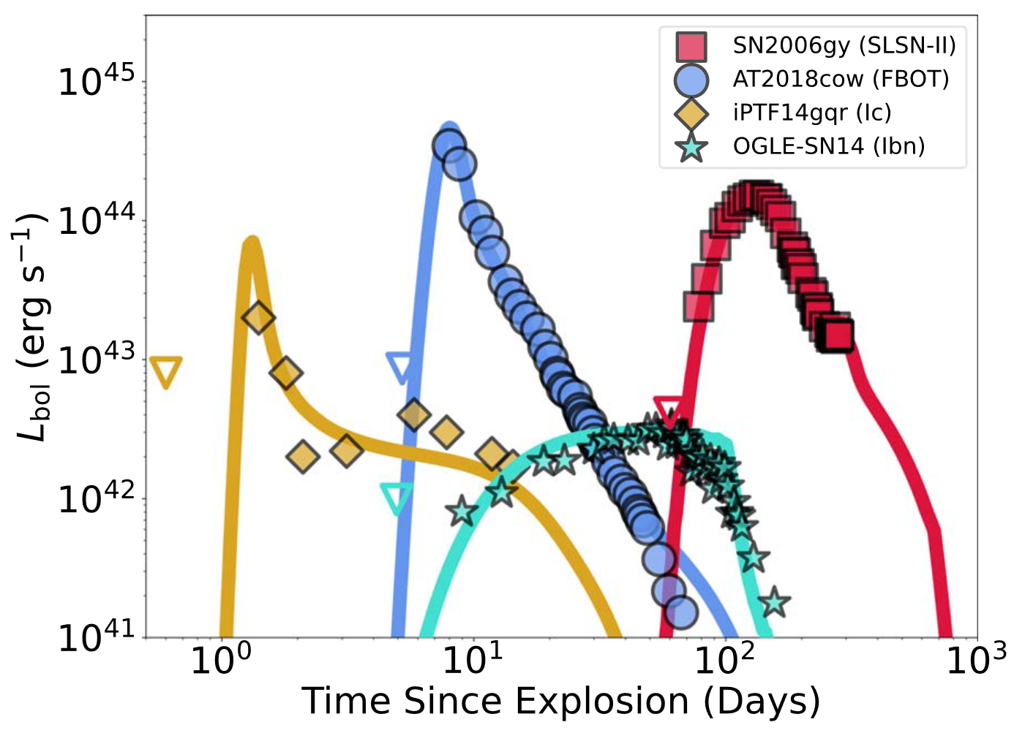
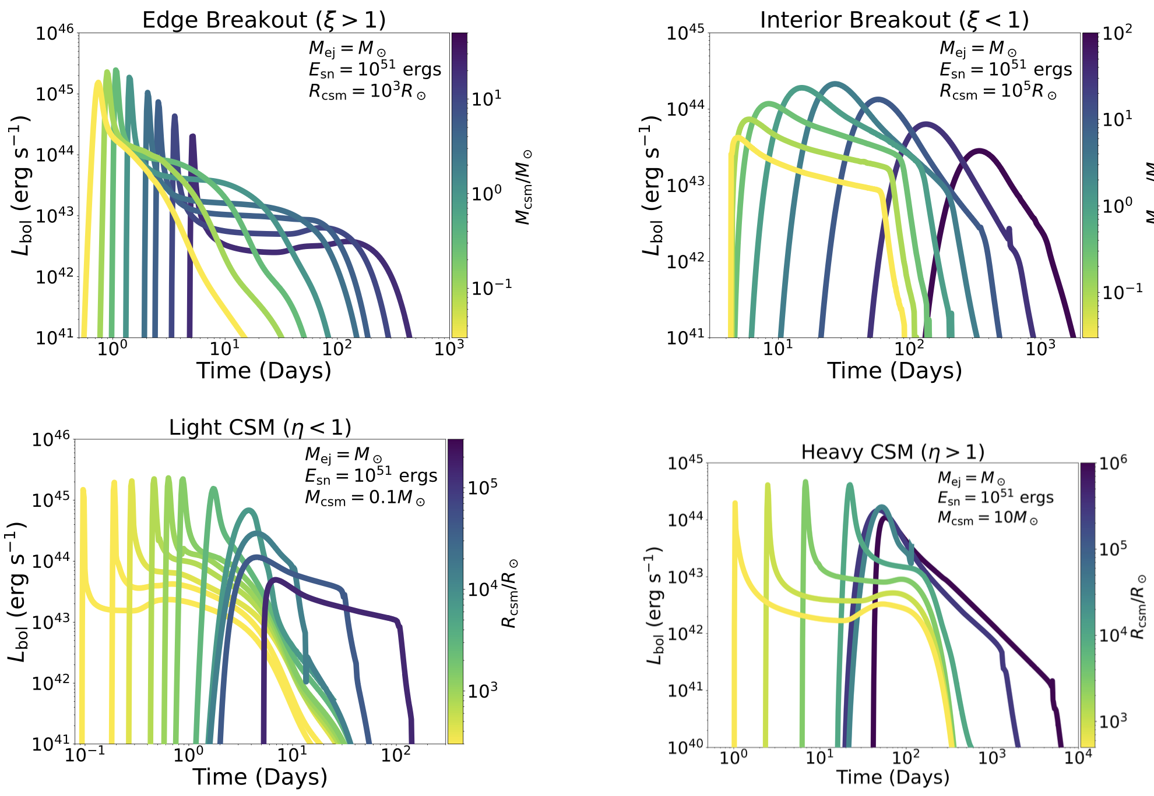
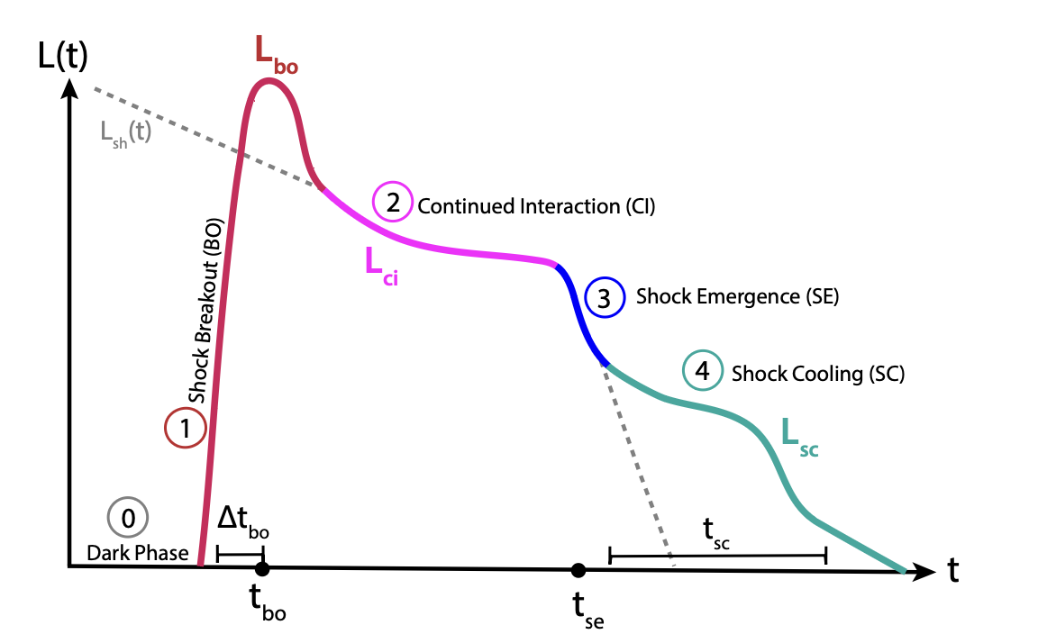
Light Curves of CSM interaction model
Khatami & Kasen 2024

Slide 9
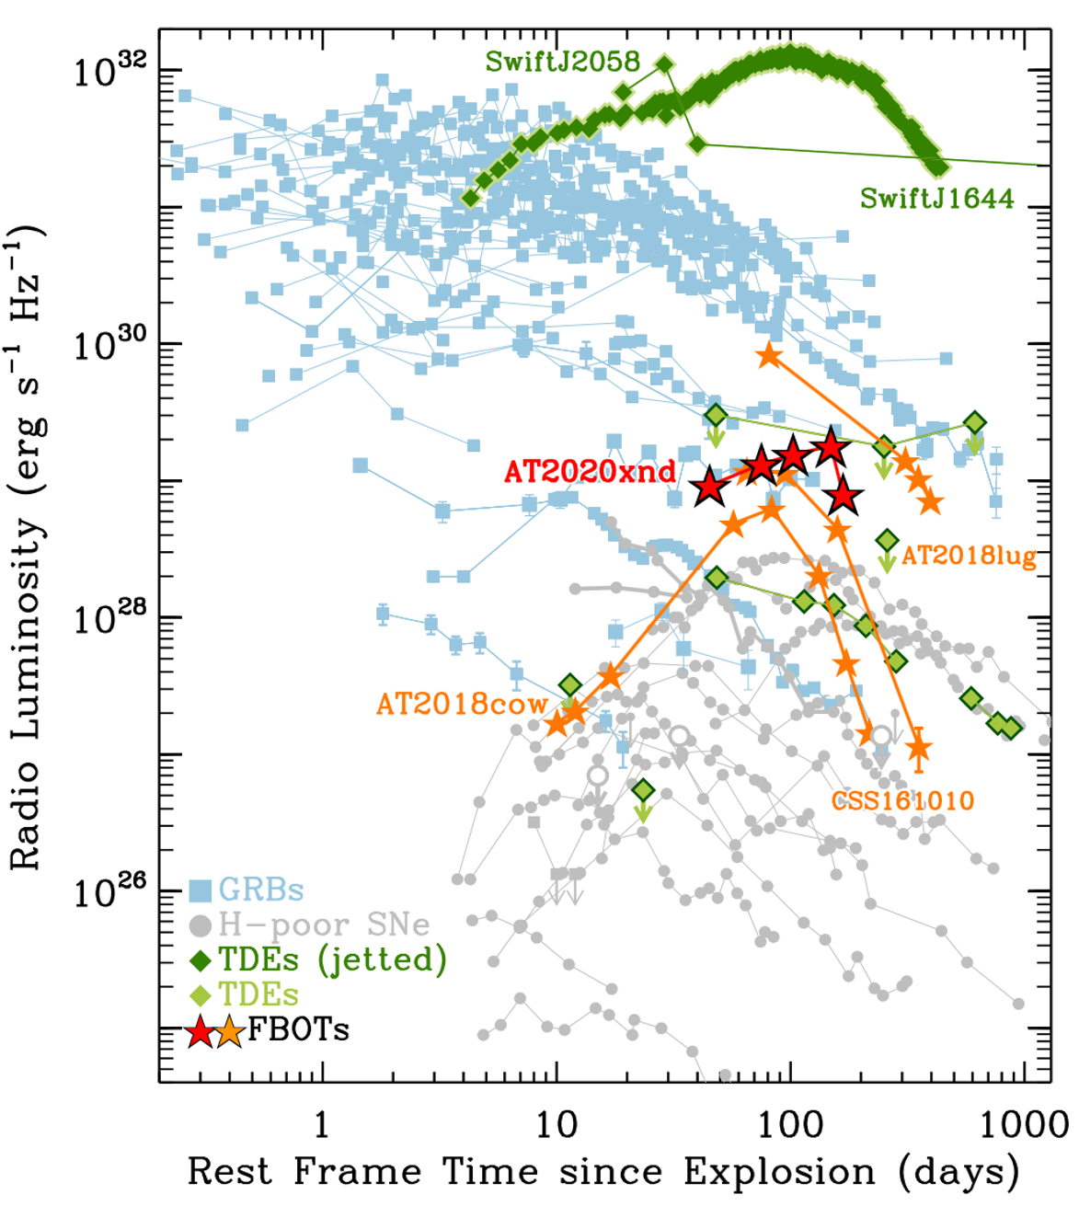
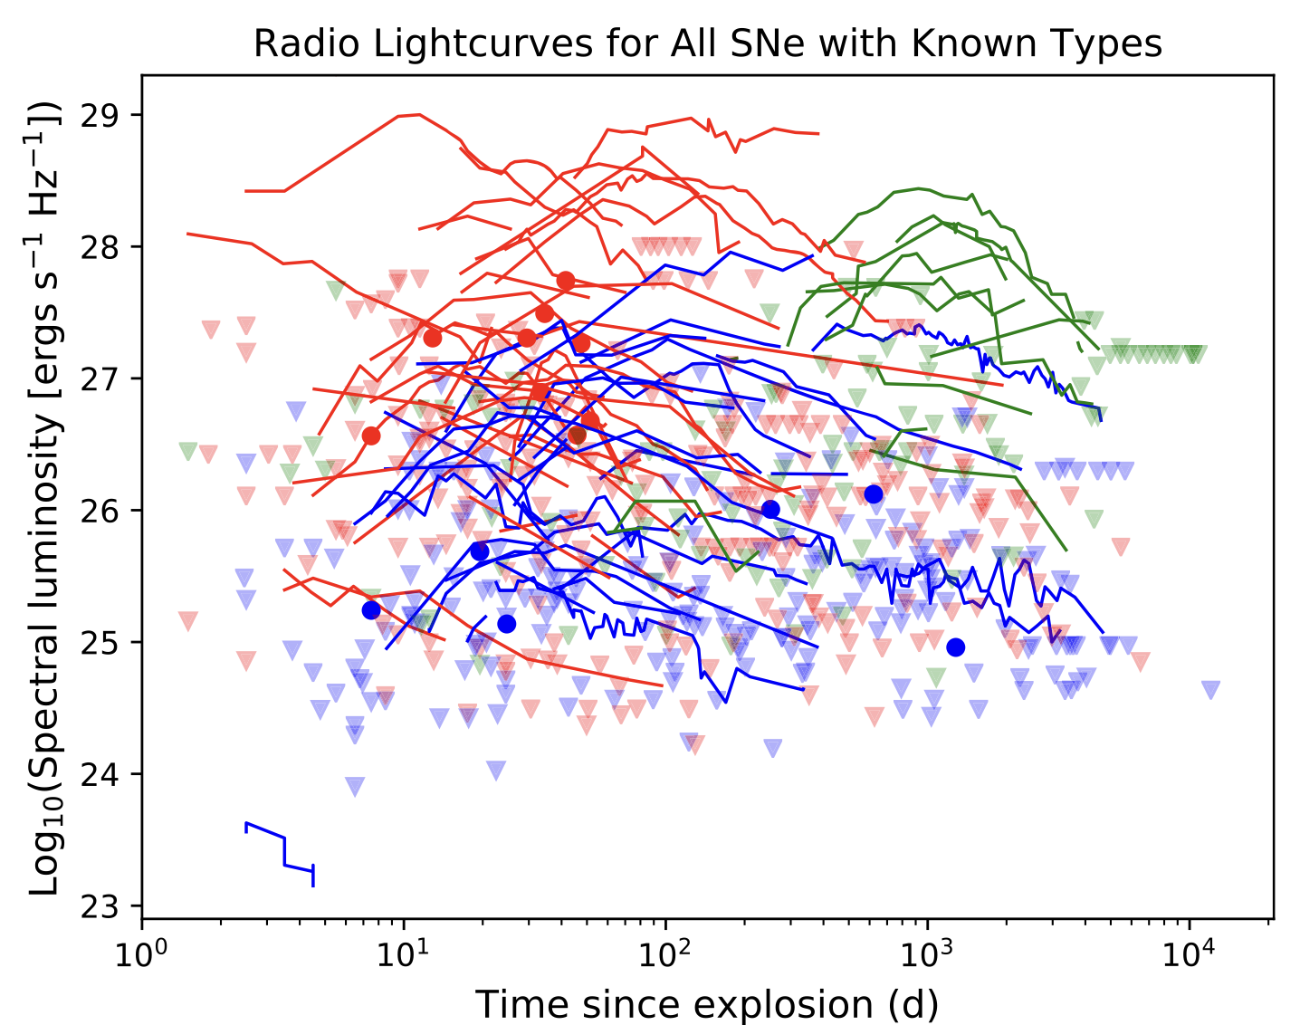
Radio observation of stellar explosions
Bietenholz+ 2021
Bright+ 2022

Slide 10
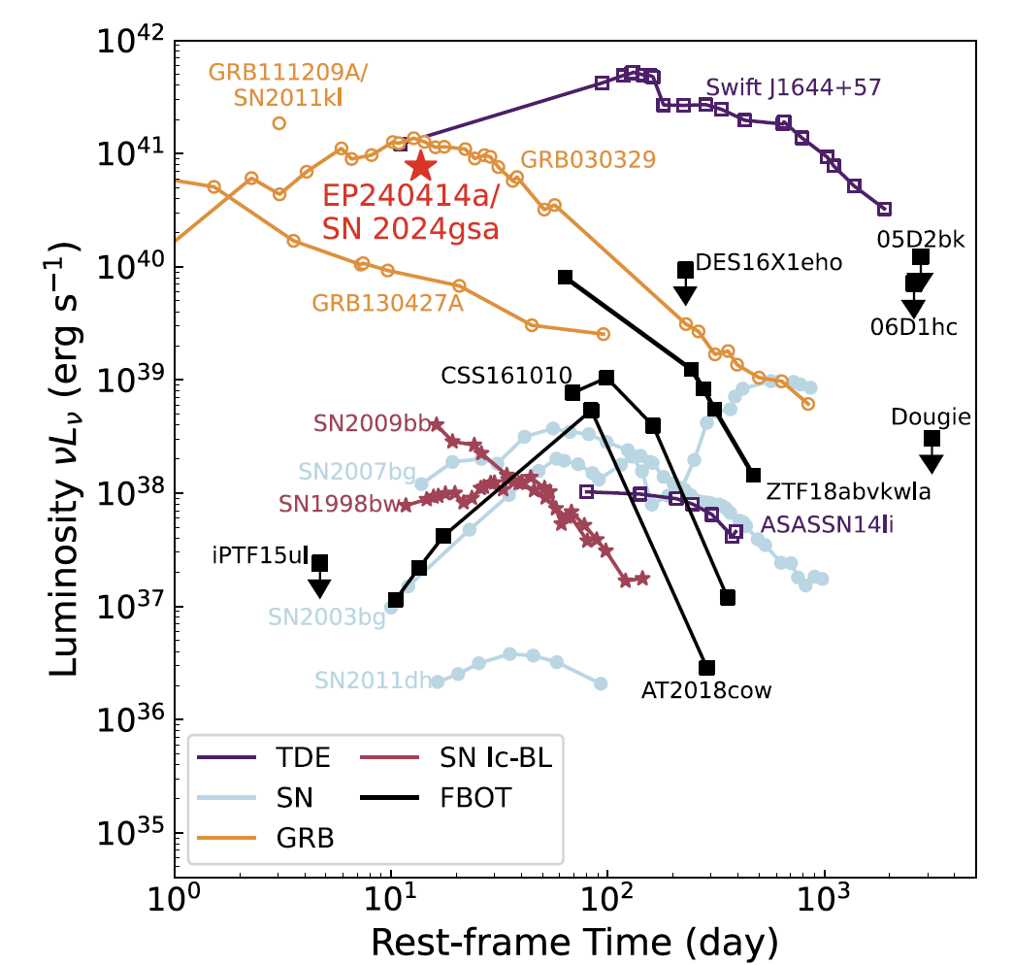
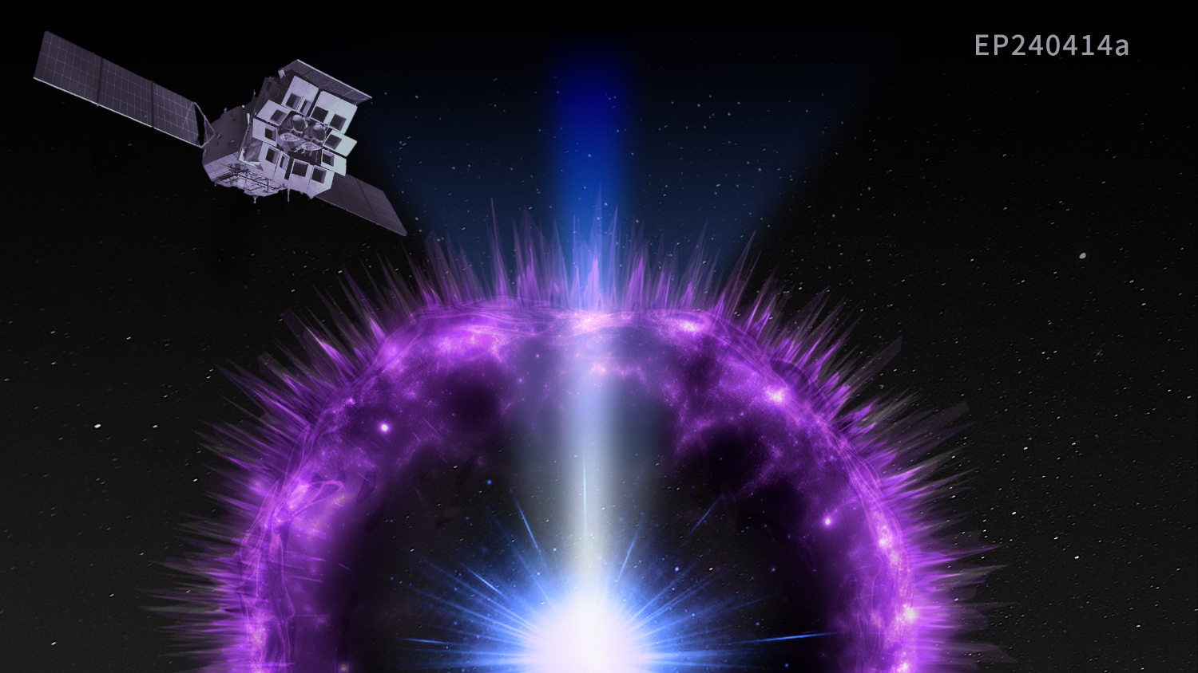
Radio observation of stellar explosions
Sun, Li, LiuLD+ 2025 Nature Astronomy

Slide 11
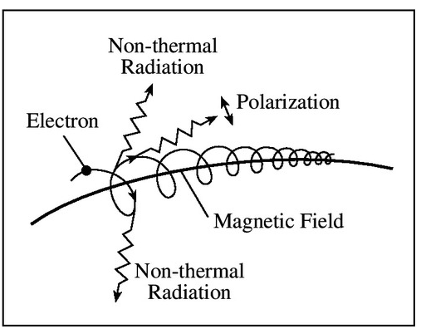
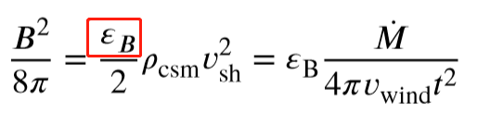
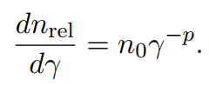
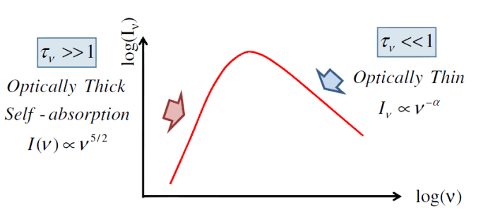
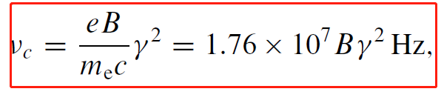
Radio emission from ejecta and CSM interaction
Synchrotron radiation from shock-accelerated electrons

Slide 12
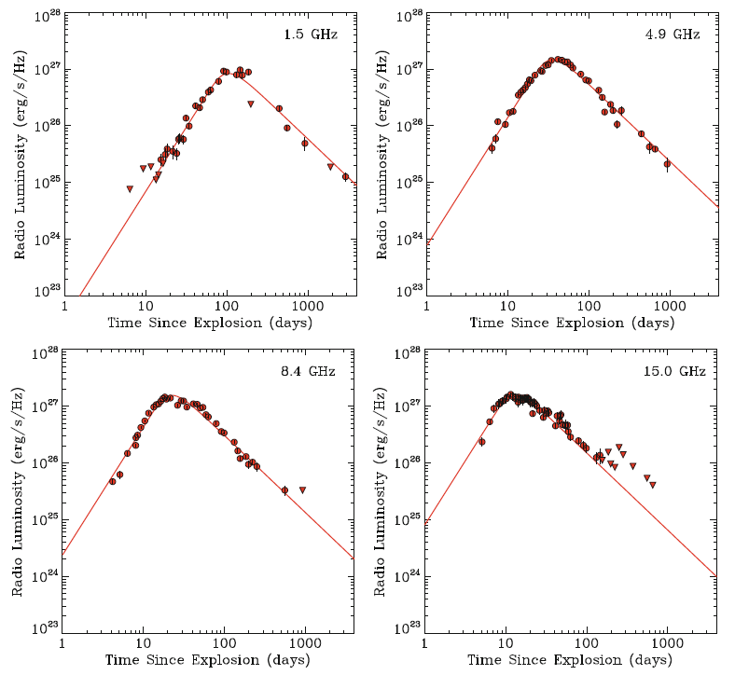
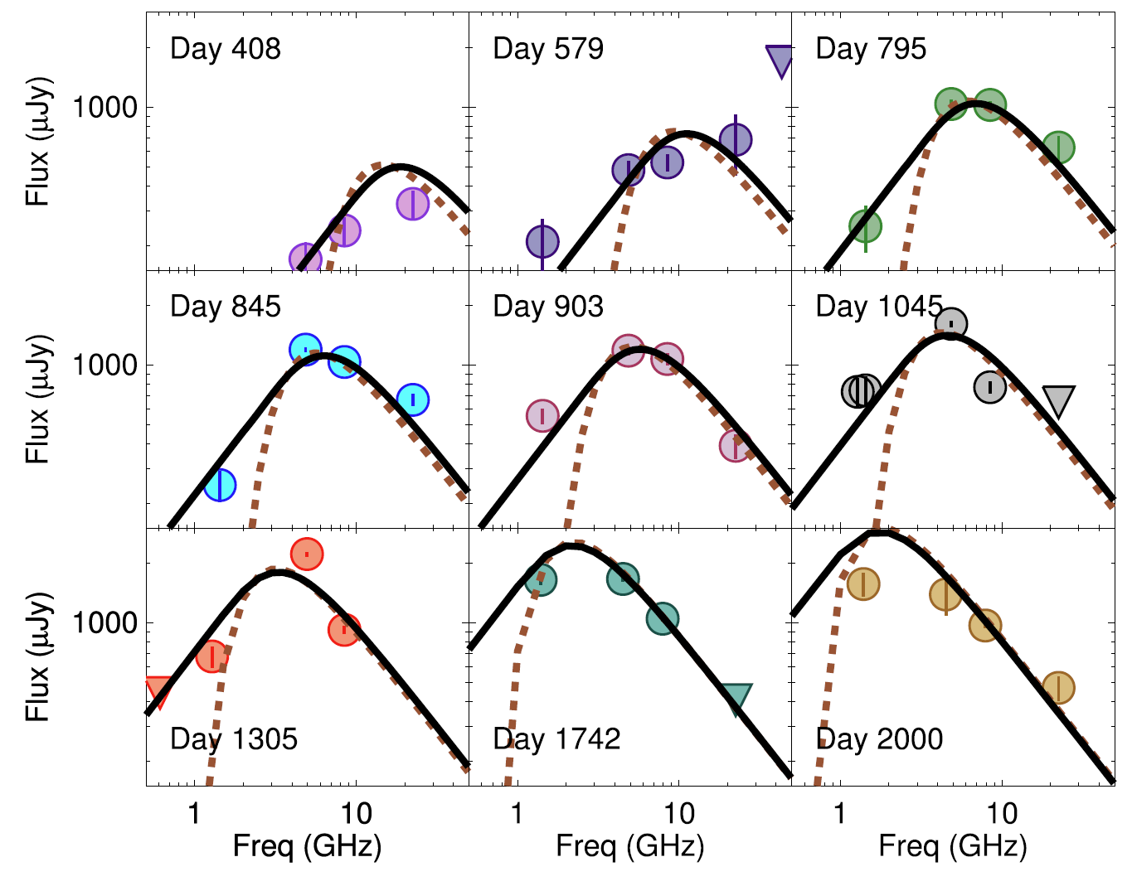
Radio emission from ejecta and CSM interaction
SN 1994J
SN 2006jd
Chandra+ 2022
Alexander+ 2015

Slide 13
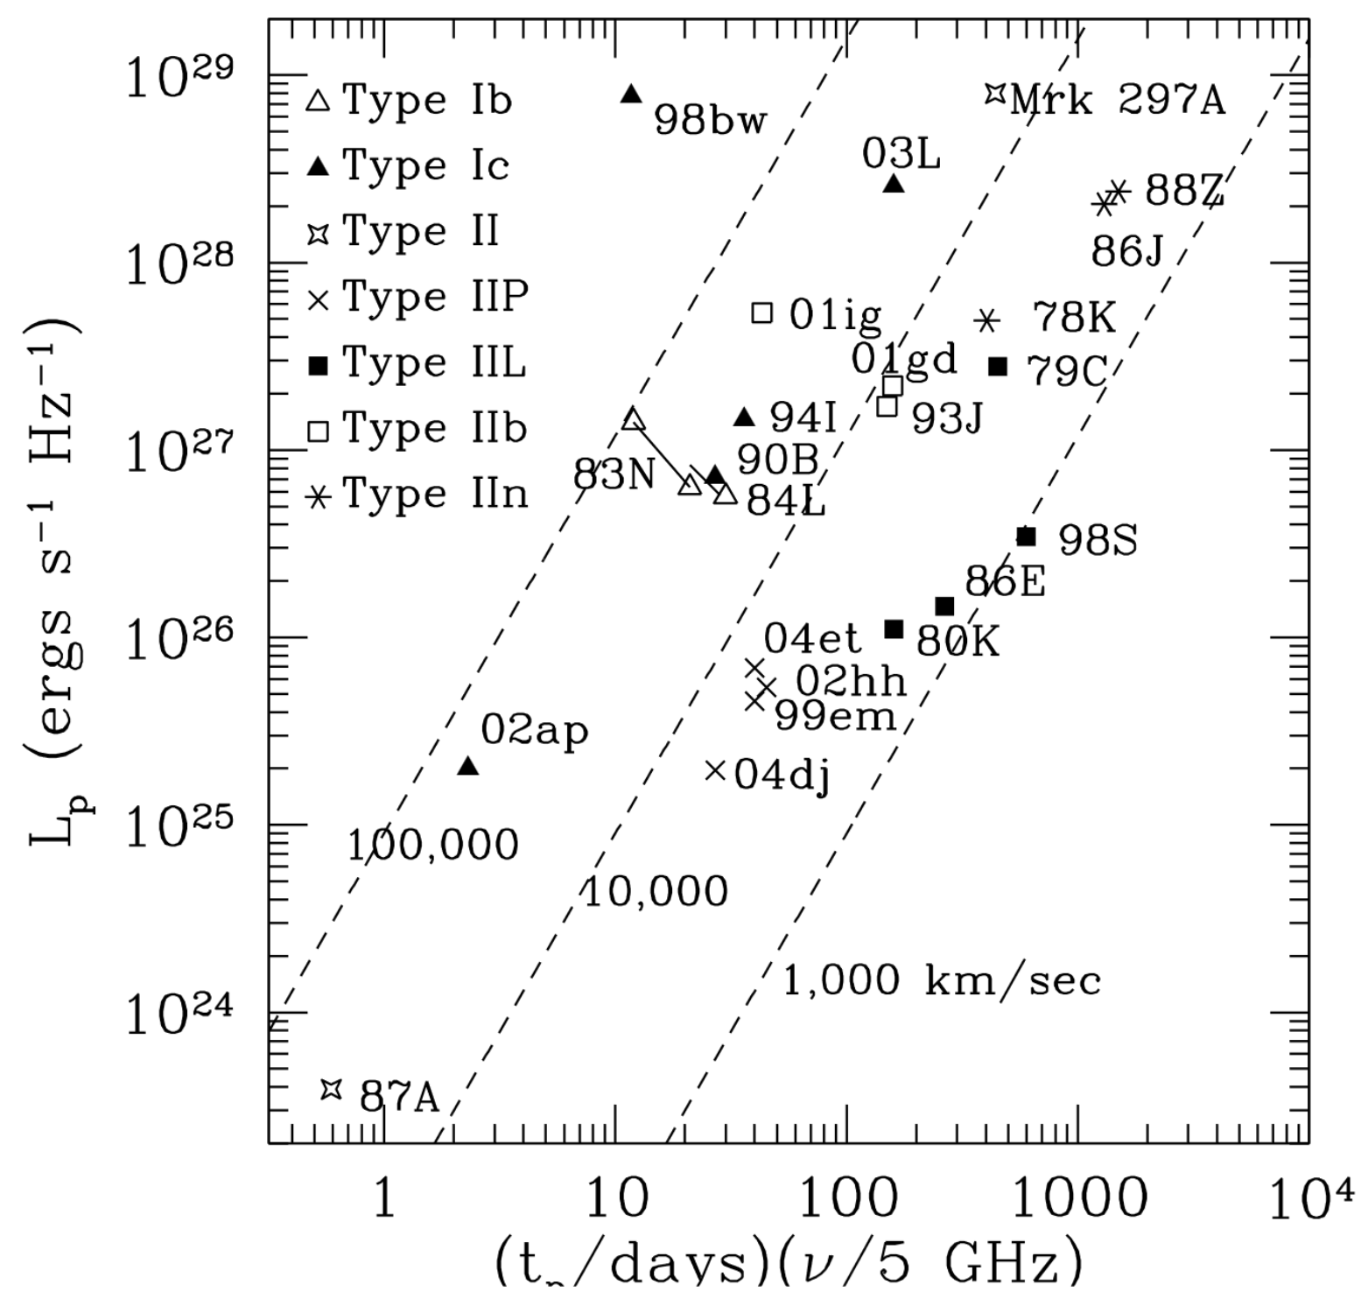
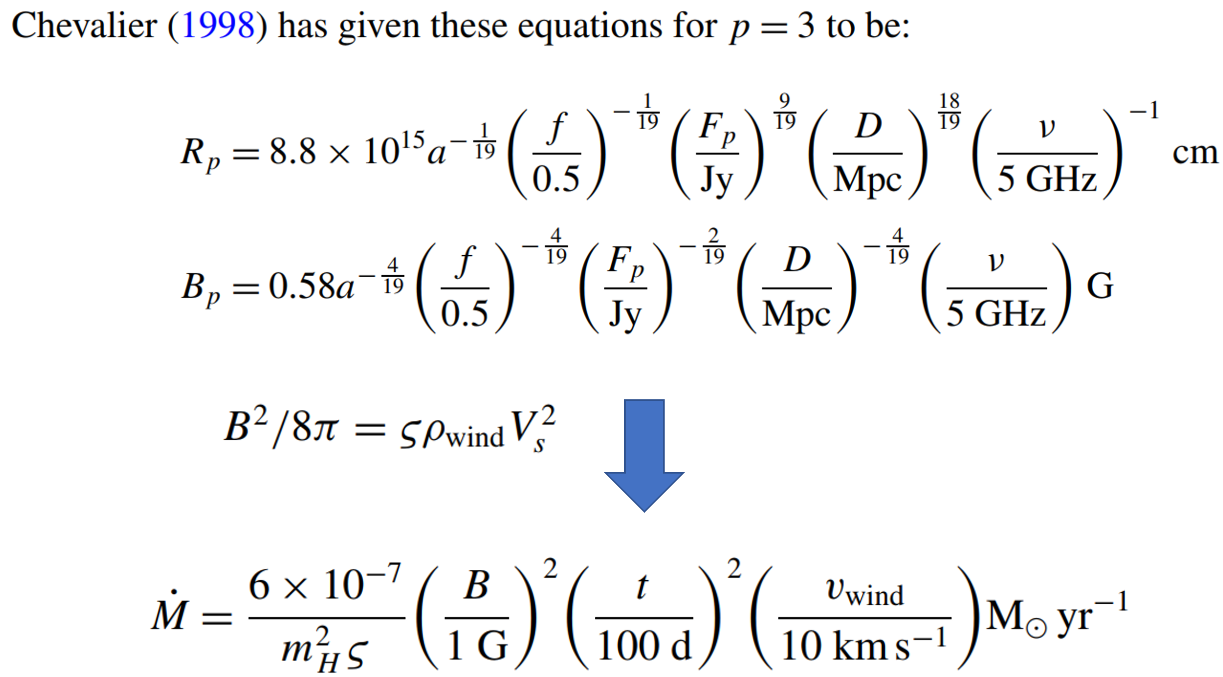
Synchrotron Self-Absorption model for radio emission
Chevalier+ 2016

Slide 14
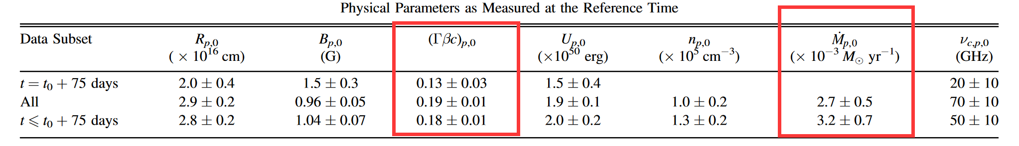
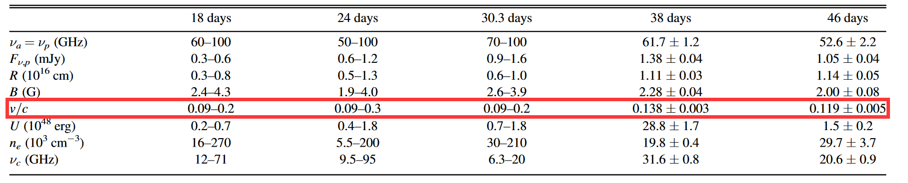
Synchrotron Self-Absorption model for radio emission

Slide 15
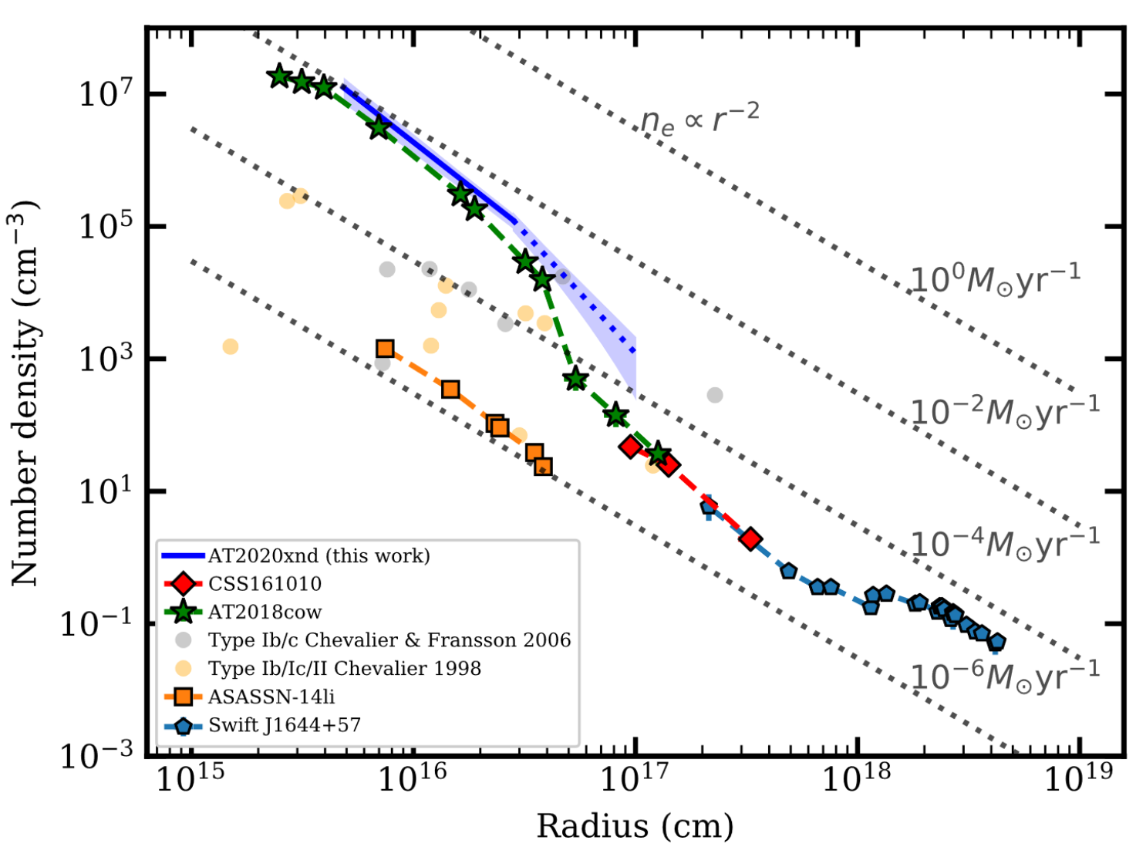
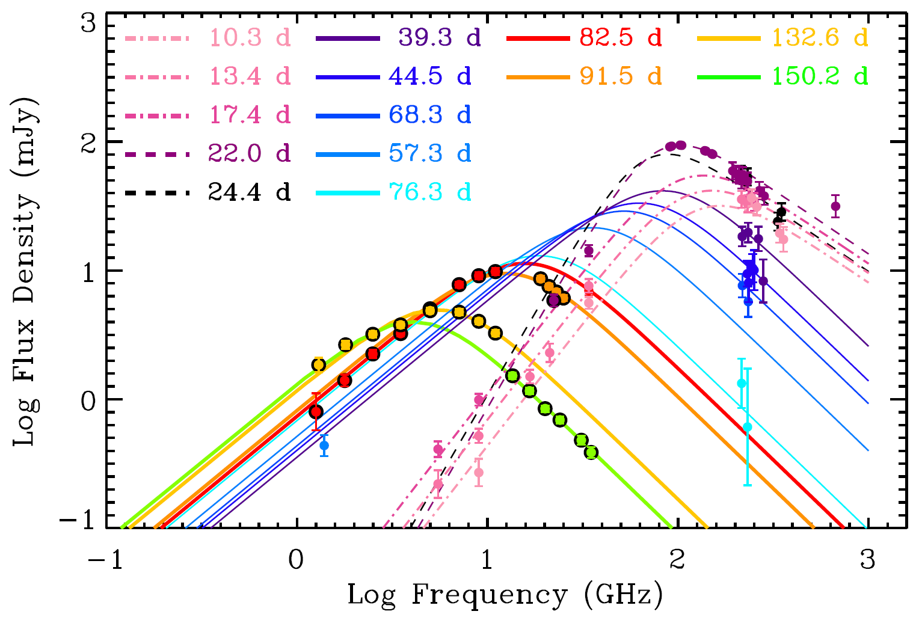
CSM properties can be inferred using radio emissions
Margutti+ 2019
Bright+ 2022

Slide 16
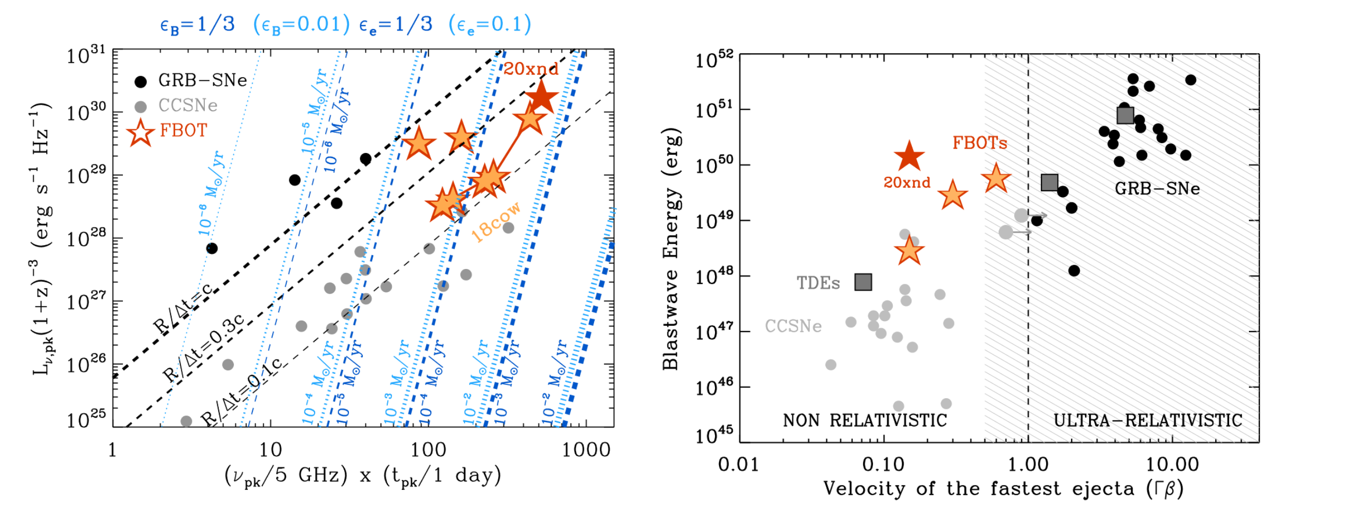
Radio phase space of stellar explosions
Bright+ 2022

Slide 17
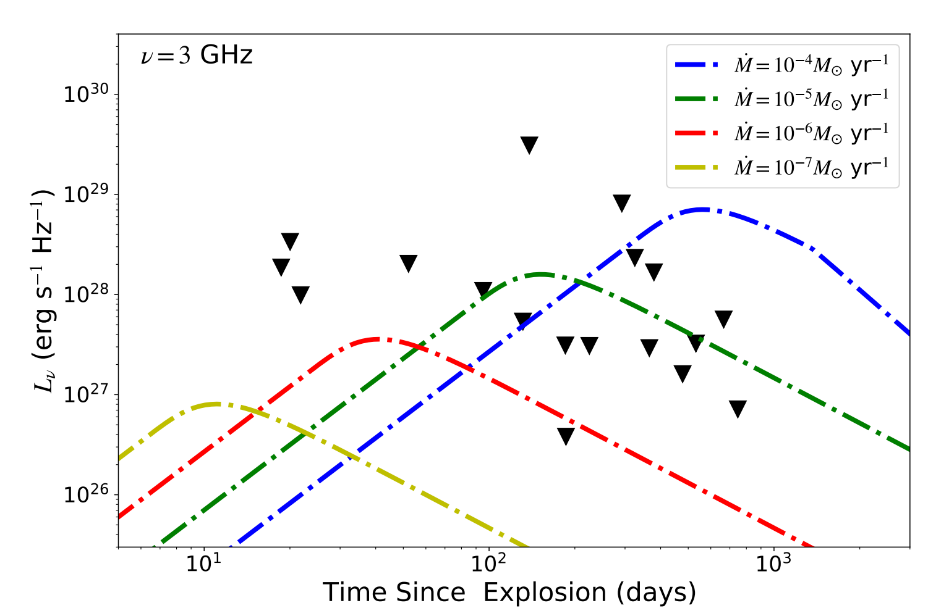
Radio upper limits of FBOTs
Liu，LiuLD, Yu, Zhu 2023, ApJ, 946(2023)35

Slide 18
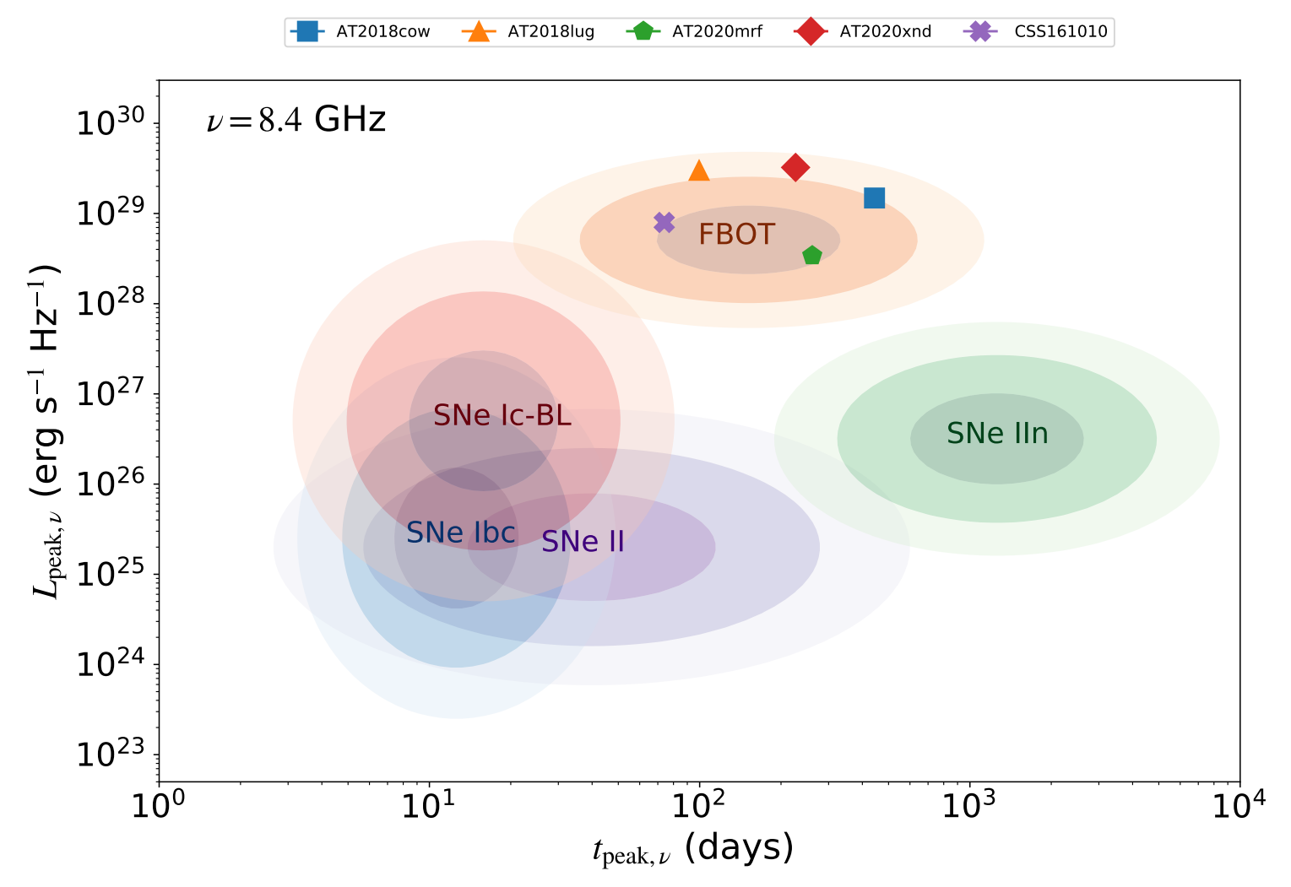
The peak luminosity and peak time of radio emission of FBOTs
Liu，LiuLD, Yu, Zhu 2023, ApJ, 946(2023)35

Slide 19
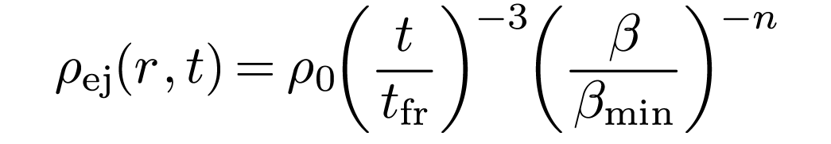
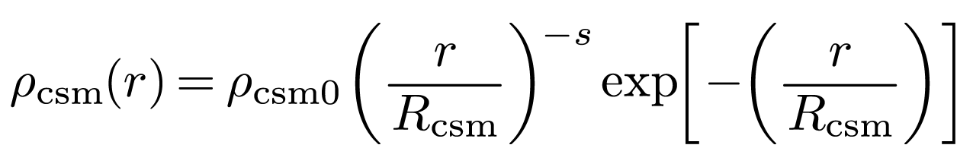
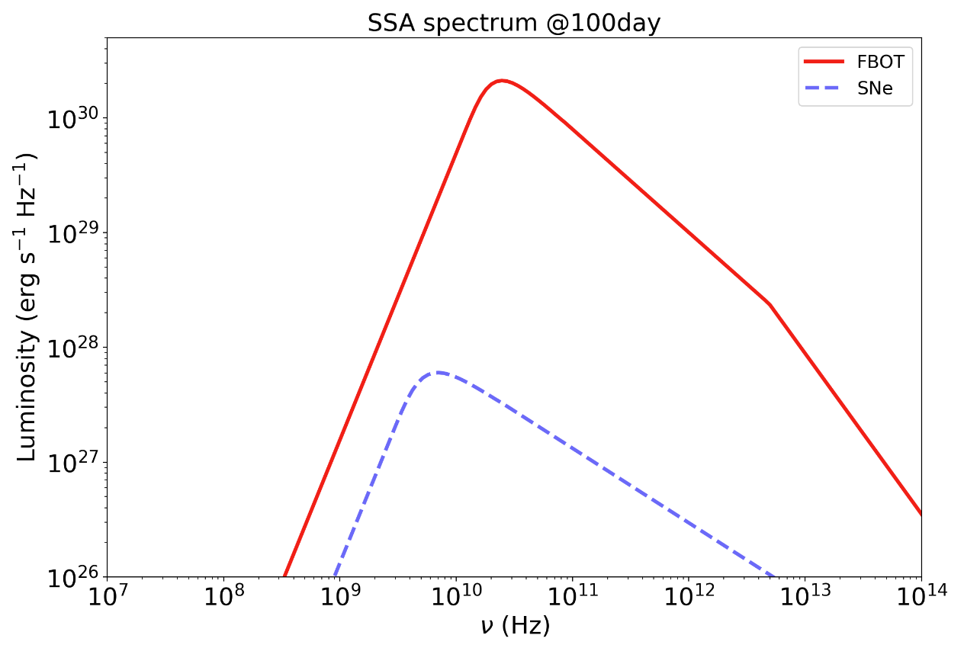
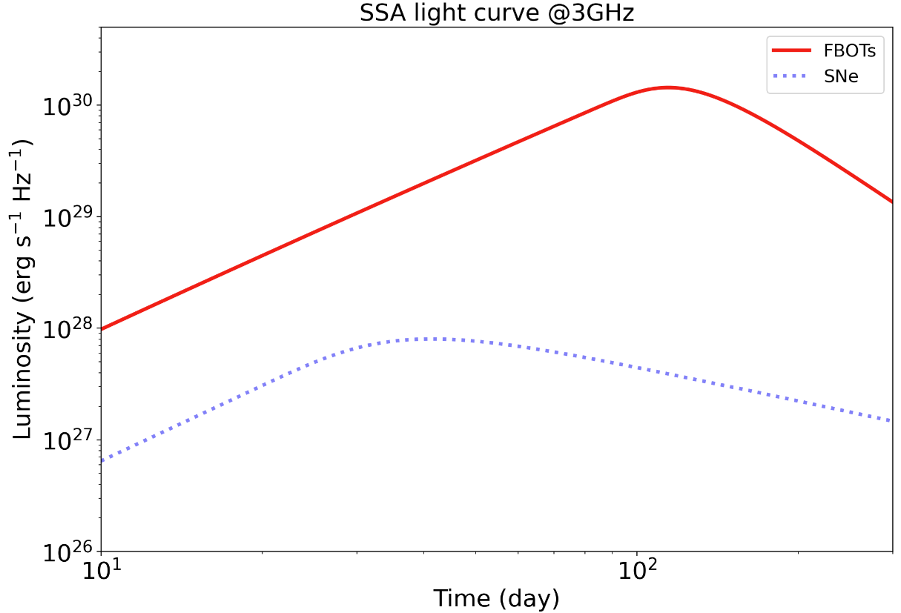
Radio emission from sub-relativistic ejecta and CSM interaction
Liu+ 2025 in preparation

Slide 20
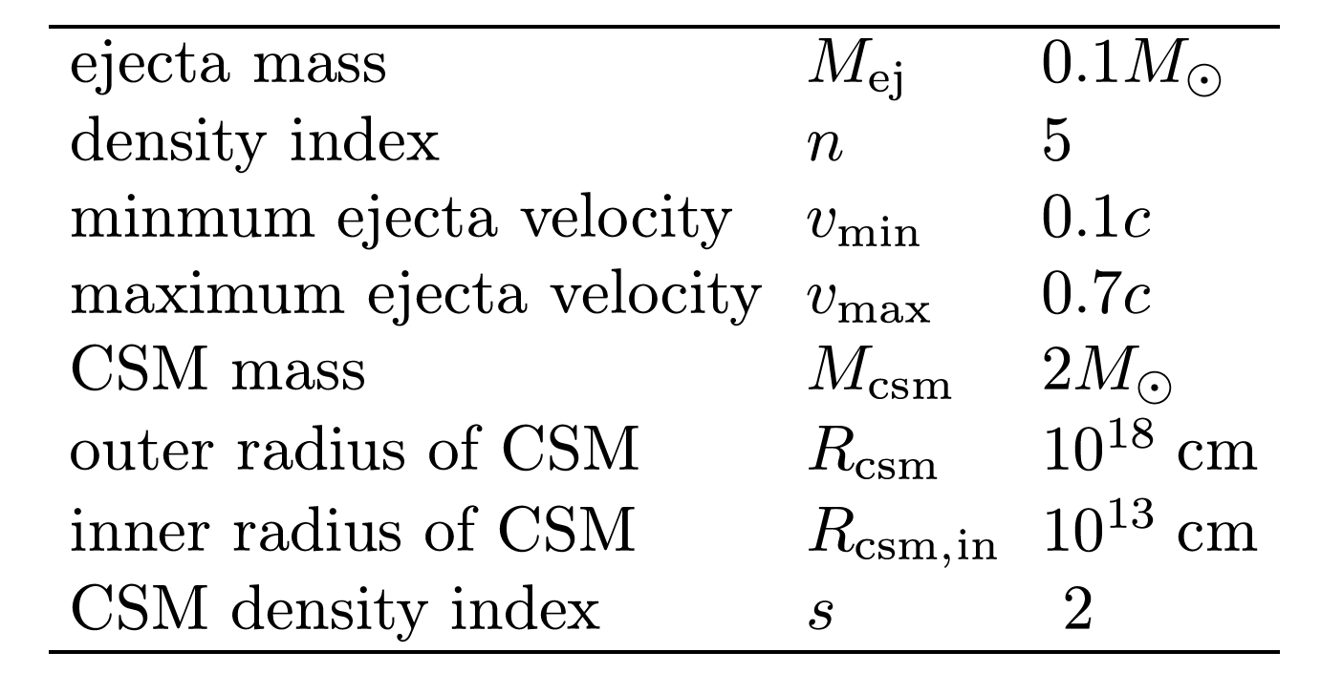
Model parameters

Slide 21
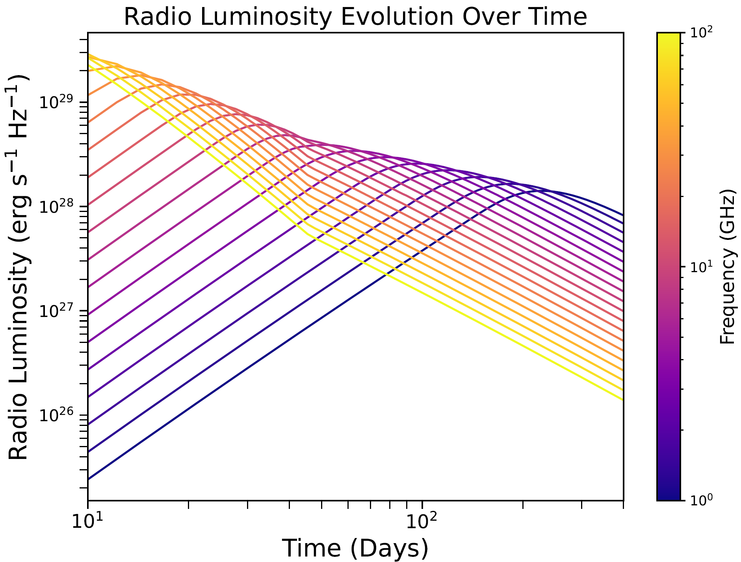
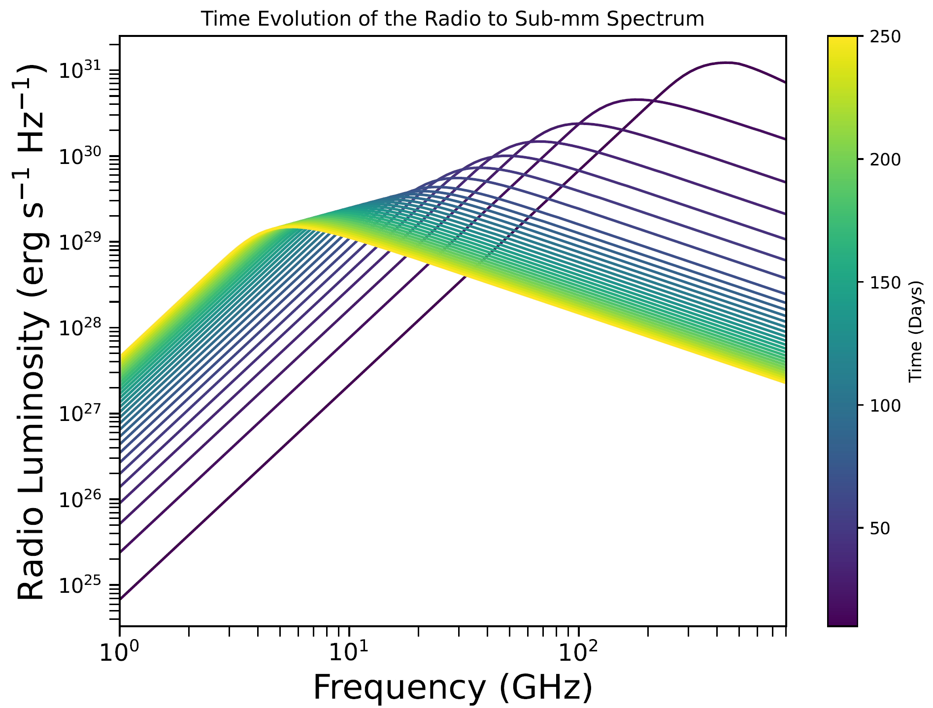
Light curve & SED of our model
LiuLD+ 2025 in preparation

Slide 22
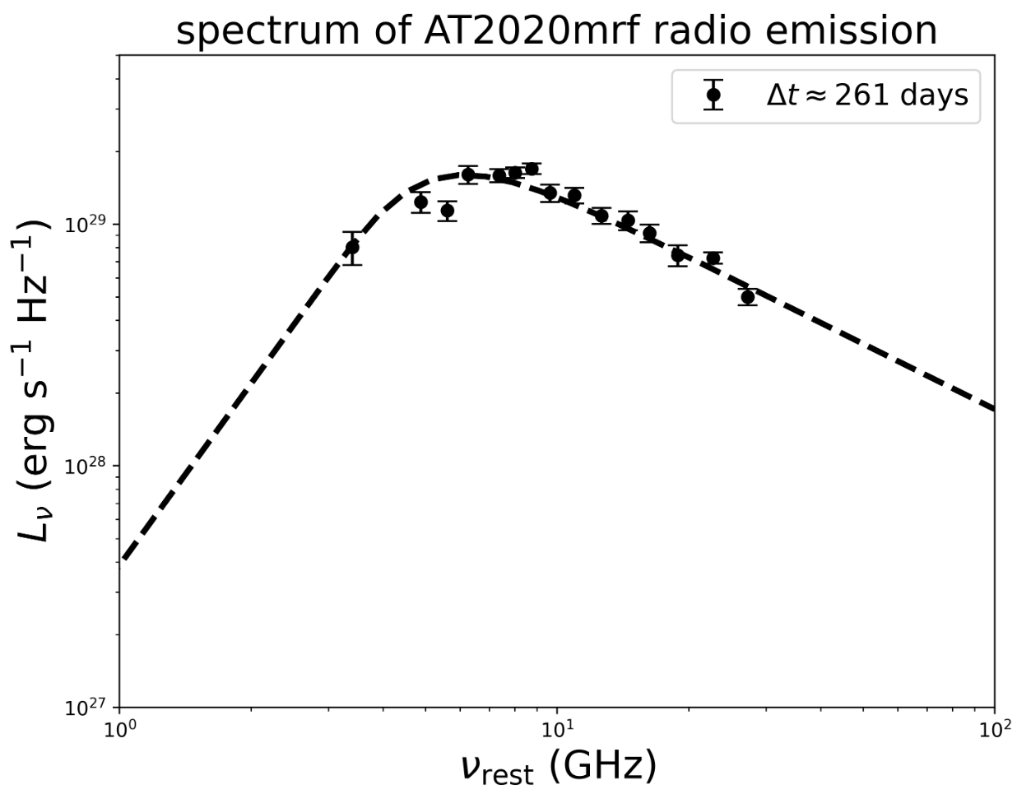
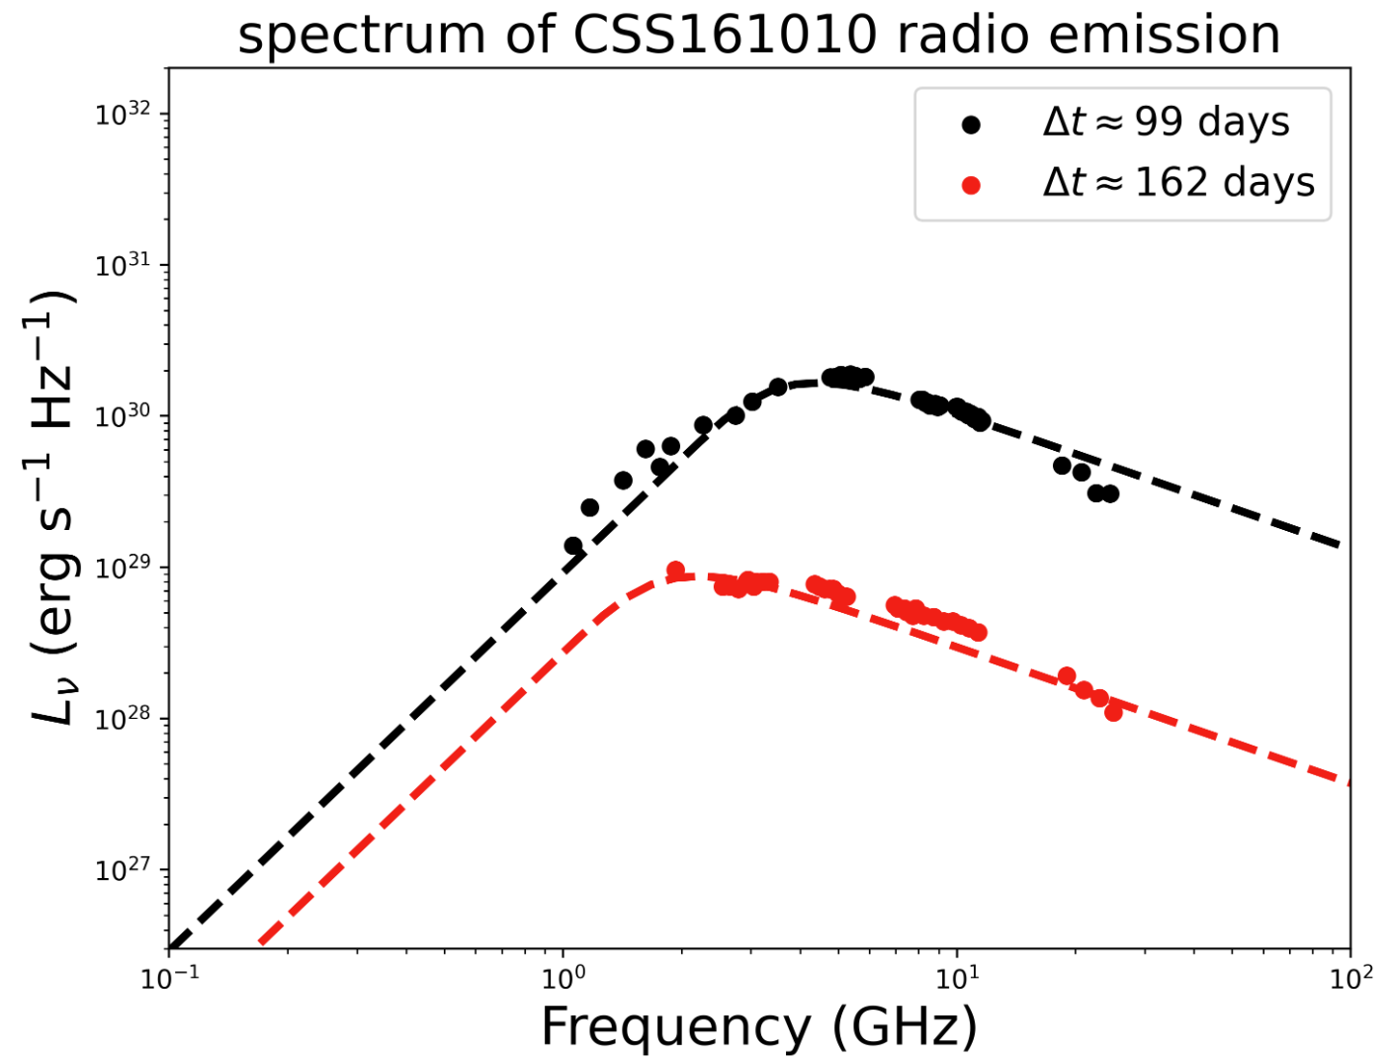
Apply our model into fitting radio emission of FBOTs
LiuLD+ 2025 in preparation

Slide 23
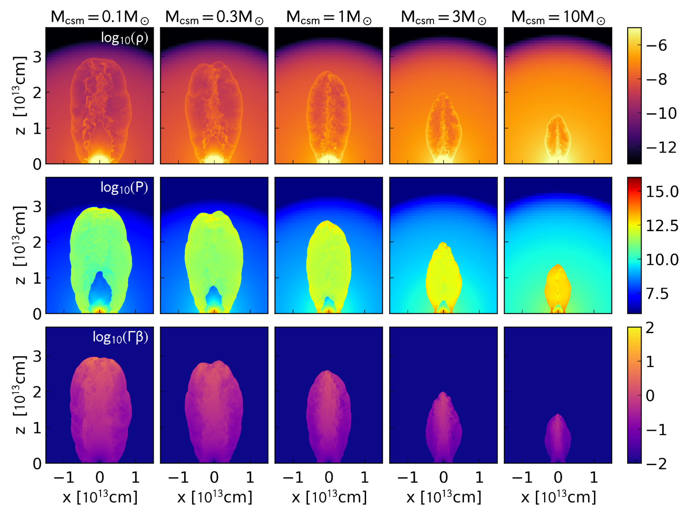
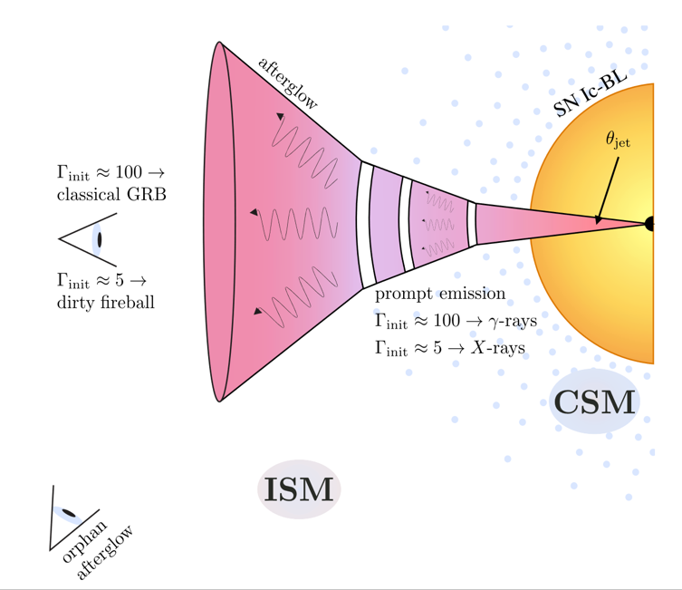
Possible origins of sub-relativistic ejecta/outflow
Suzuki+ 2024

Slide 24
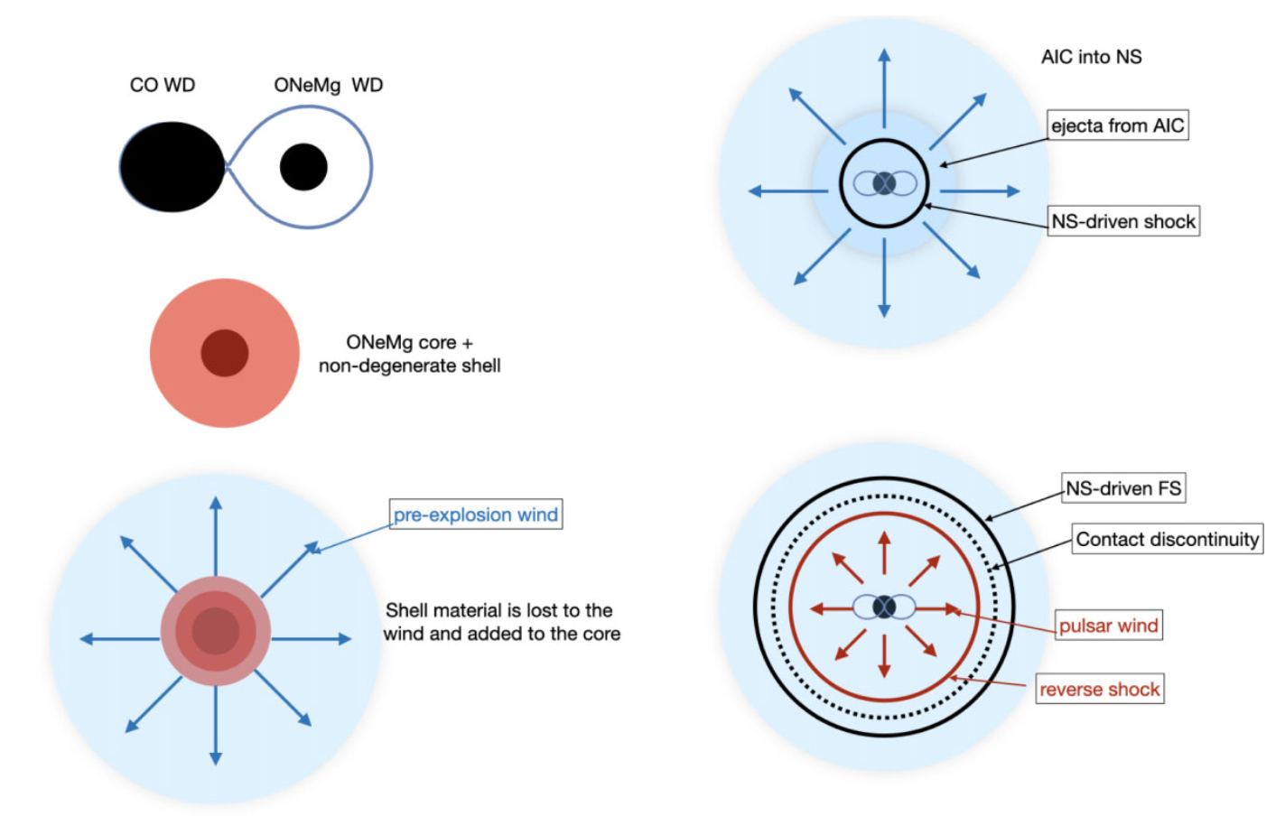
Possible origins of sub-relativistic ejecta/outflow
Lyutikov 2022

Slide 25
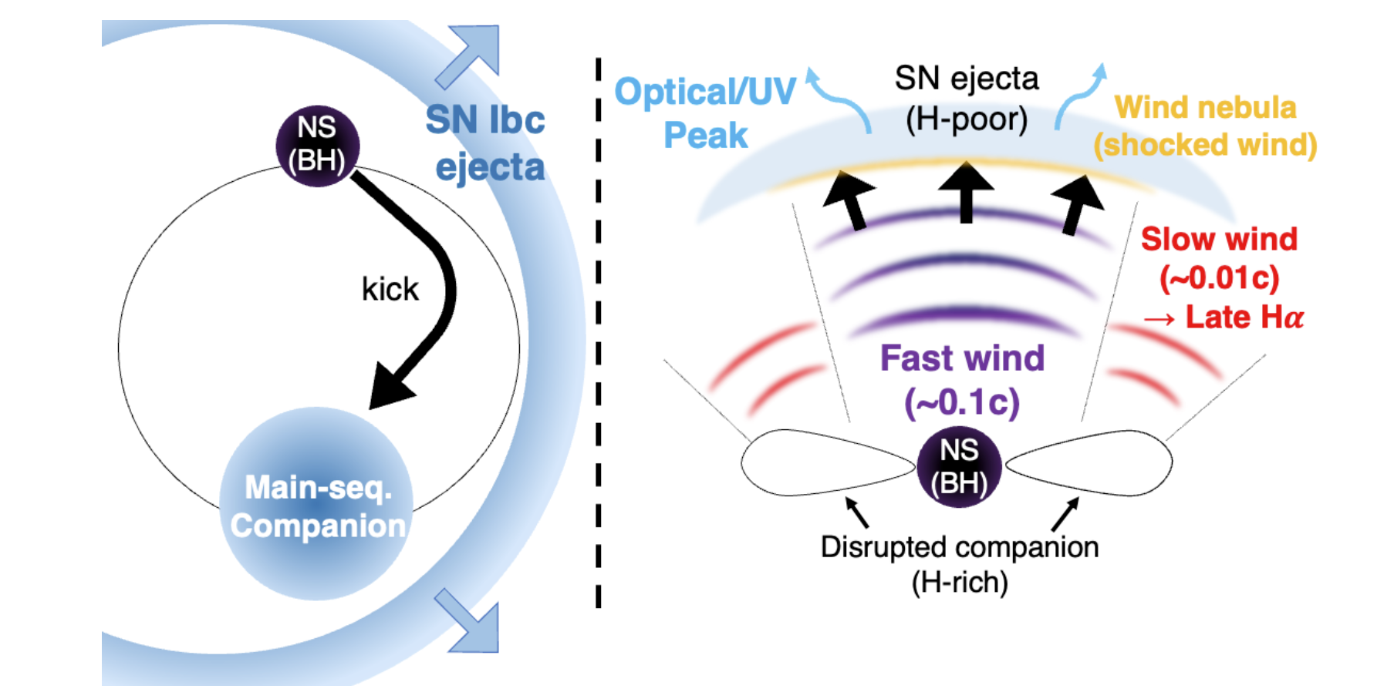
Possible origins of sub-relativistic ejecta/outflow
Tsuna & Lu 2025

Slide 26
Conclusion
By studying the radio emission from FBOTs, we can gain insights into the CSM density and structure, the speed of the explosion ejecta, and potentially identify the central engine powering the FBOT.
FBOTs radio emission require high outflow rates and fast velocities (∼0.2–0.3c), with the typical ejecta mass ∼ 0.1Msun.
To determine the physical origin of FBOTs, multi-wavelength observations are required.

Slide 27
Thank you

